Slide 1
A Mixed-Flux-Based Nodal Discontinuous Galerkin Method for 3D Dynamic Rupture Modeling
Wenqiang Zhang✉, Yajing Liu, Xiaofei Chen
Published on JGR: https://doi.org/10.1029/2022JB025817
Open source: https://github.com/wqseis/drdg3d
Contact: wqseis@gmail.com

Slide 2
Table of Contents
Discontinuous Galerkin (DG) methods and dynamic rupture modeling
Method Improvement: mixed-flux-based DG
Convergence test and parallelization
Benchmarks
Branching faults/roughness/step-overs/bimaterial/plasticity/thermal press …
Application to the 2008 Wenchuan earthquake
Summary

Slide 3
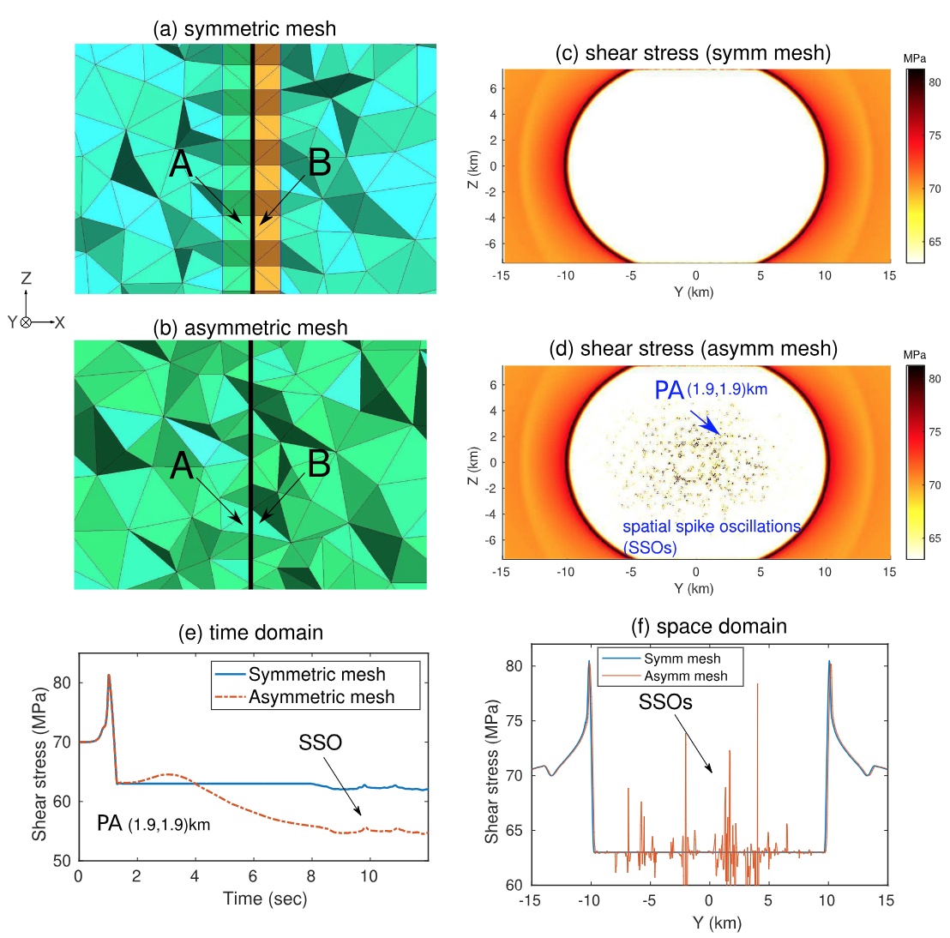
Upwind flux: Mesh dependency of simulation results
Bug?
The grids on both sides of the fault must be nearly symmetrical, which places high demands on the mesh software.

Slide 4
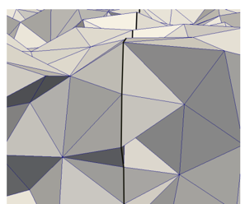
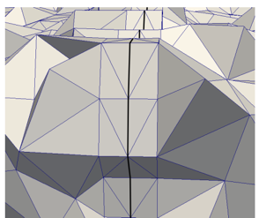
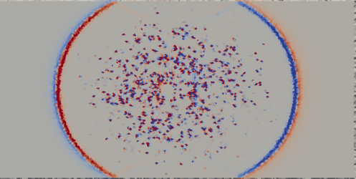
The same problem on previous work
2016 SCEC Proposal: Breuer & Cui (ADER-DG method)
Spatial spike oscillations occur when the fault mesh is arbitrary
The result is correct when the grids on both sides of the fault are symmetrical

Slide 5
Solutions
Posterior limiters ✗
Prakash-Clifton regularizations ✗
Kevin-Voigt viscosity ✗
Neighboring cell smoothing ✗
Spatial viscosity ✓
Modal filtering ✓
…
Mixed flux ✓✓✓
Notes:
Some of our attempts: Some methods can work to a certain extent, but have side effects (order reduction, etc.); the mixed flux method has no side effects and completely solves the problem.

Slide 6
Method Improvement: mixed flux
Fault surface
Old scheme: All boundary conditions use upwind flux
New scheme: Mixed upwind/central flux (central flux is only used on continuous boundaries attached to faults)

Slide 7
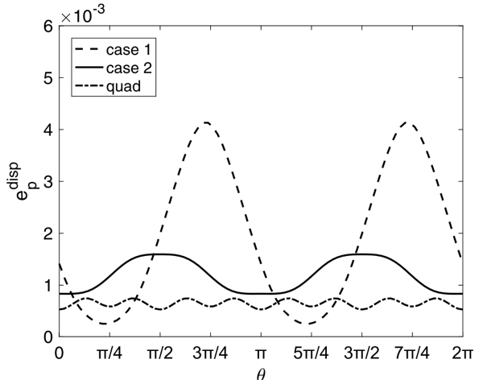
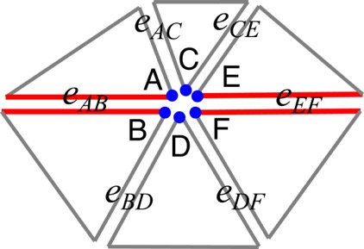
Numerical flux and dispersion/dissipation
He et al., 2020, JCP
Unbalanced numerical dissipation error?
Not fully understood yet

Slide 8
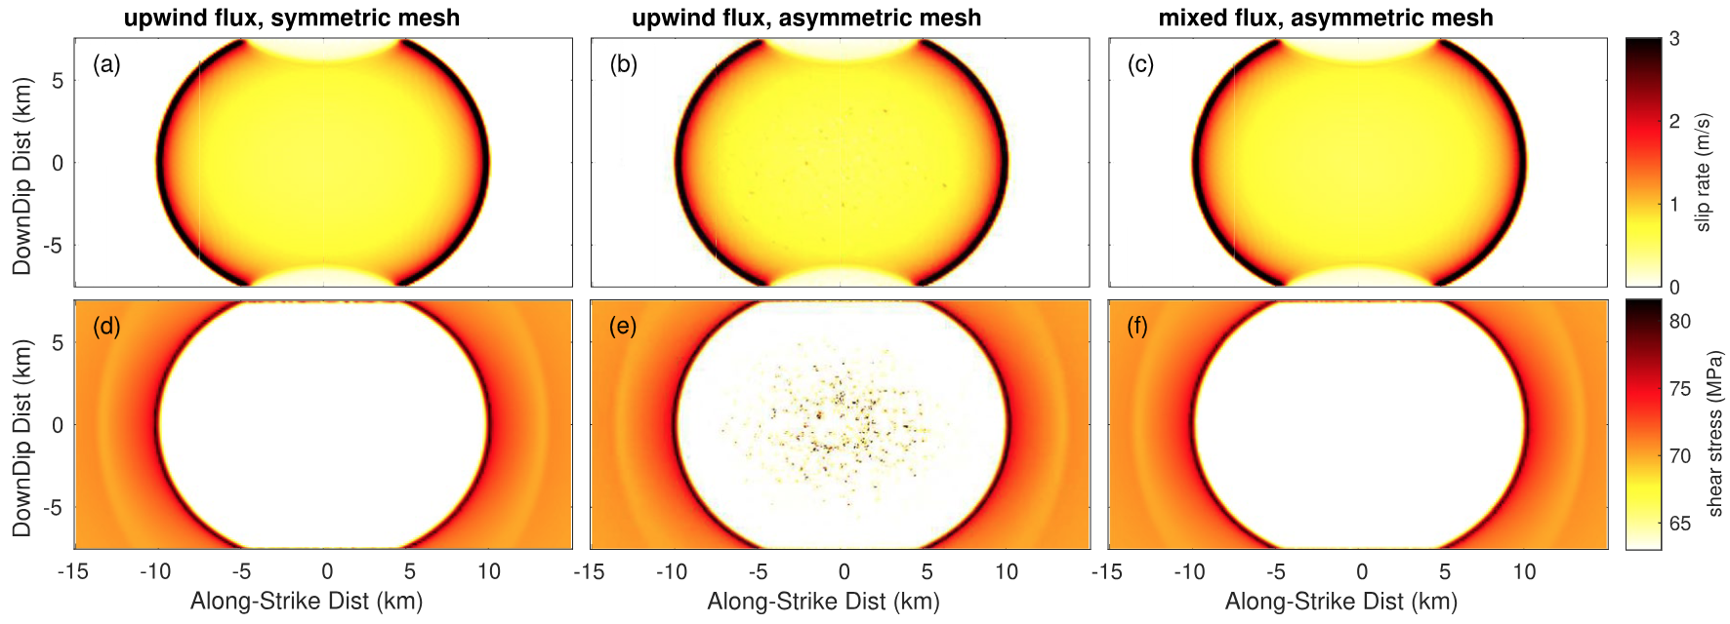
Method Improvement: reduce mesh dependency
symmetric mesh
upwind flux
asymmetric mesh
upwind flux
asymmetric mesh
mixed flux
After using mixed flux, the grids on two sides of the fault do not need to be nearly symmetrical, which reduces the difficulty of meshing

Slide 9
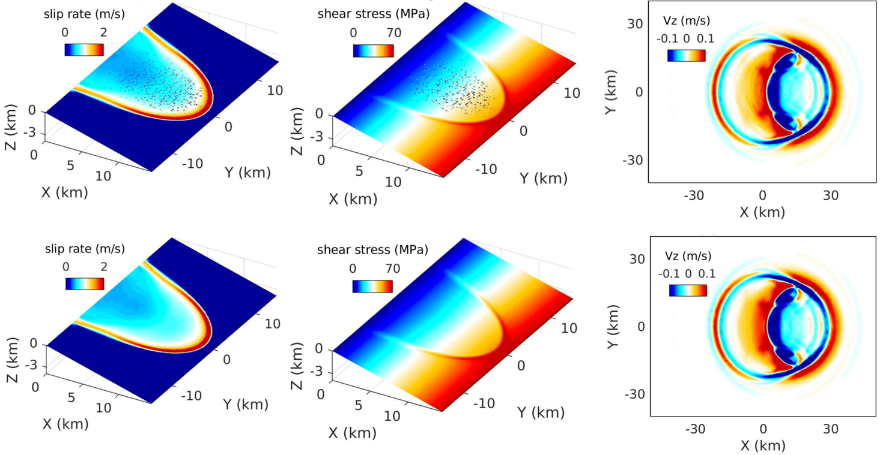
Method Improvement: reduce mesh dependency
Low-dip-angle (15°) trust fault
Upwind
Flux
Mixed
Flux

Slide 10
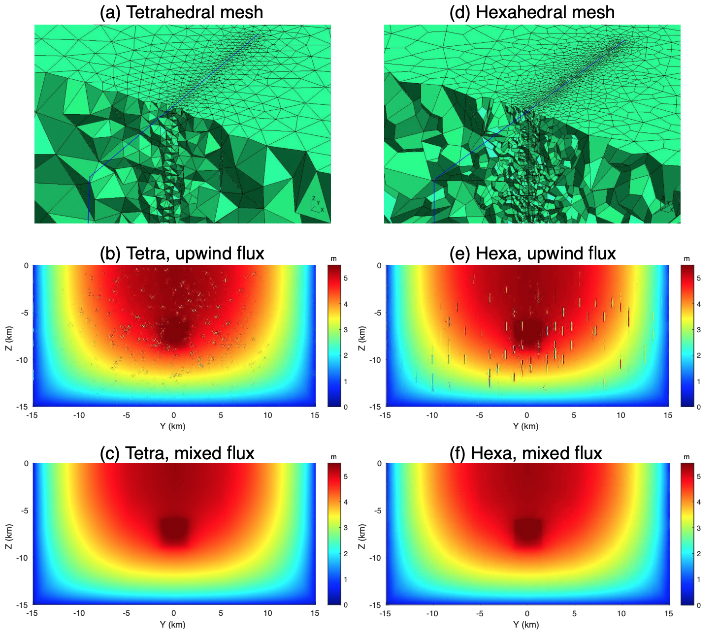
The hexahedral cases
Mixed-flux can be applied to both tetrahedral and hexahedral cases

Slide 11
Summary
Upwind flux has advantages in simulating dynamic rupture processes, but modelers need to pay more attention to construct appropriate meshes using certain constraints, which is not easy for both meshing software and geophysical modelers
We propose a mixed flux method that reduces the mesh dependency and thus simplifies the meshing process, especially for geometrically complex faults

Slide 12
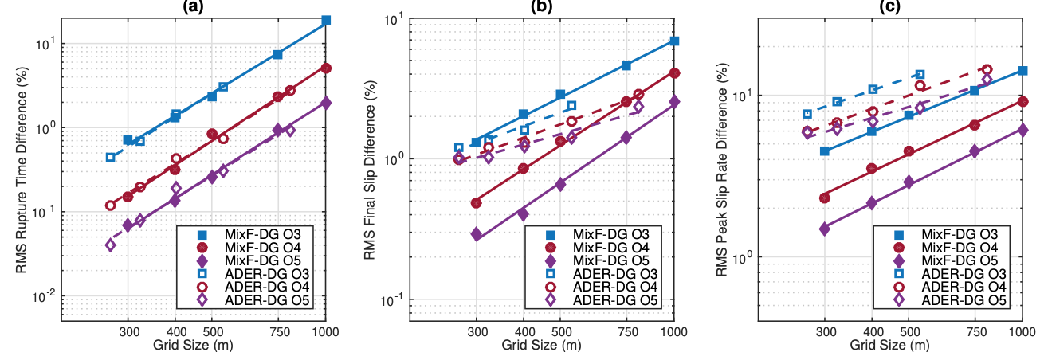
Convergence Test
The convergence of our method is generally comparable to that of previous methods (Pelties et al., 2012; Tago et al, 2012), and some indicators are even better!
Notes:
The convergence test shows that there is no side effect of order reduction!

Slide 13
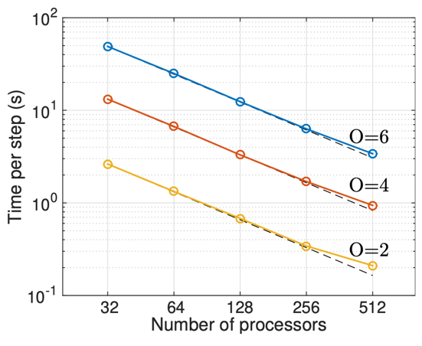
CPU/GPU parallelization
CPU scaling test
GPU/CPU scaling test
Notes:
h = 200 m~2 km, O3,
Nelem = 2443949
CPU: Intel Xeon W-2223 @ 3.6 GHz
GPU: Nvidia A100 40G

Slide 14
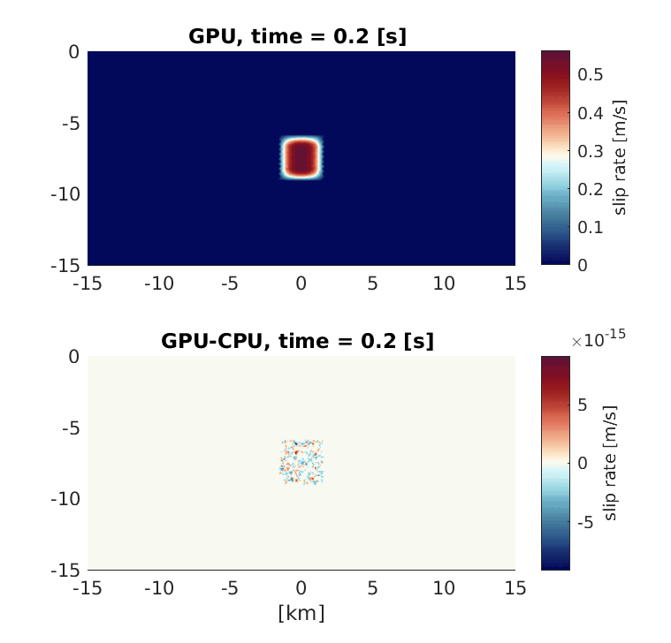
Accuracy test for the GPU code
error
Fault mesh size: 300 m
Spatial order: 3
Notes:
h = 300 m~20 km, O3

Slide 15
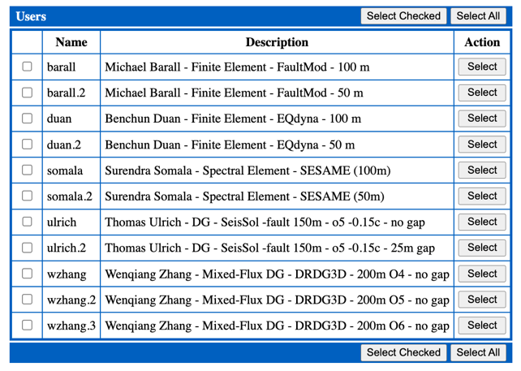
Benchmark
The SCEC/USGS Spontaneous Rupture Code Verification Project (Harris et al., 2009,2018)
TPV5: Non-uniform stress
TPV24: Branch fault
TPV29: Rough fault
TPV6: bimaterial fault
TPV26/27: off-fault plasticity
TPV22/23: Step-over fault
TPV101-104: Rate state friction
TPV105: Thermal pressurization
……
https://strike.scec.org/cvws/

Slide 16
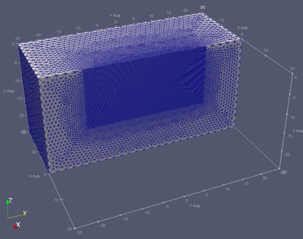
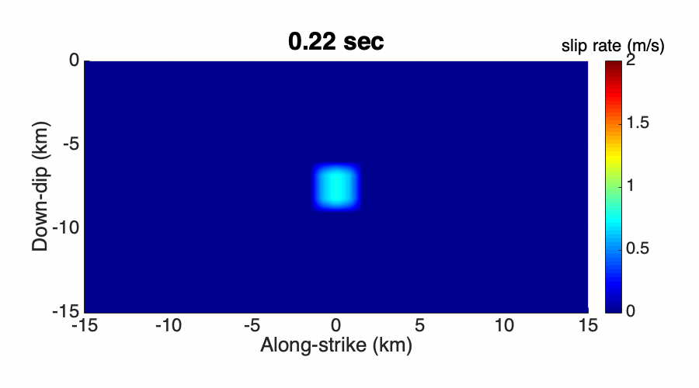
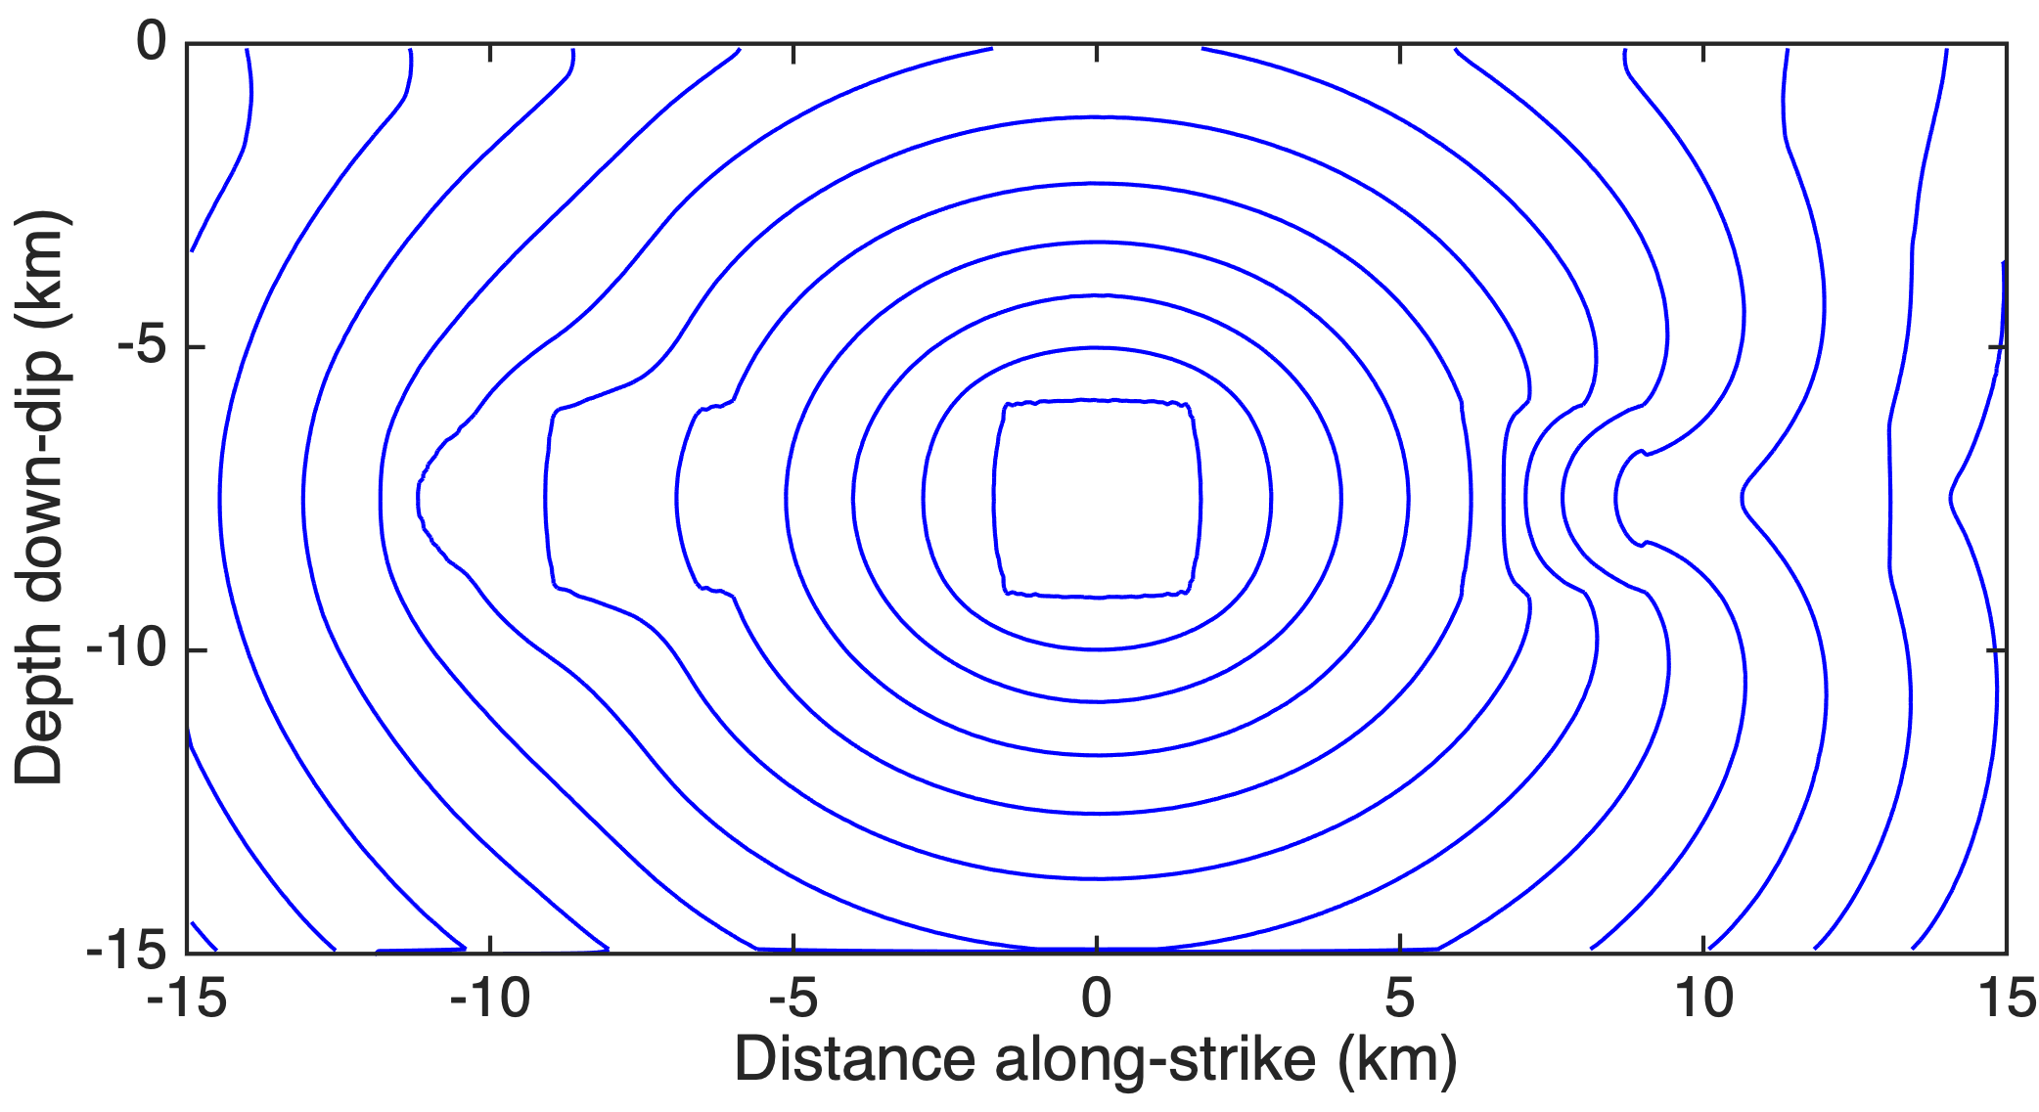
TPV5: non-uniform stress
Background stress
70 MPa
High stress asperity
78 MPa
Low stress asperity
62 MPa
supershear
delay

Slide 17
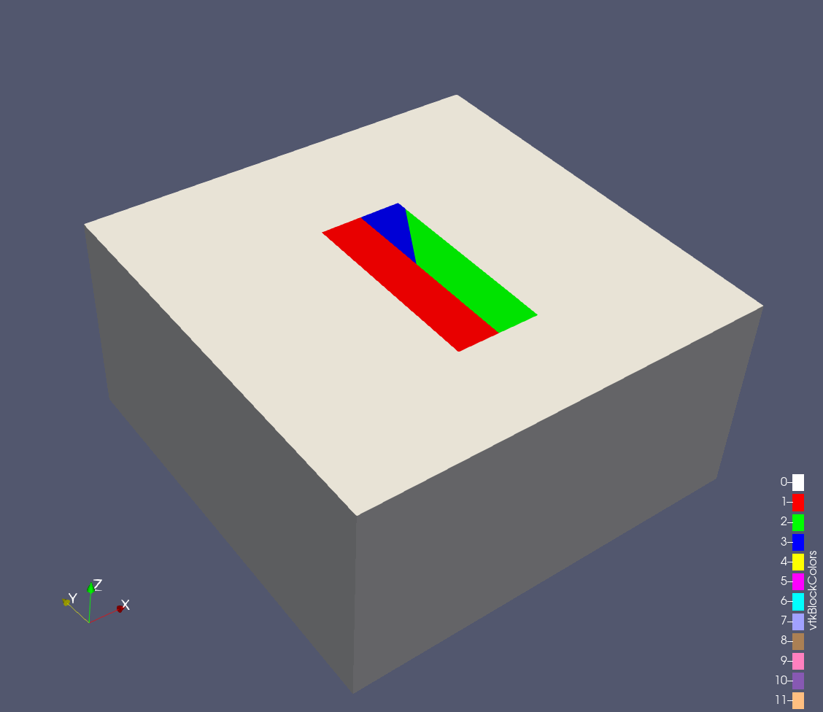
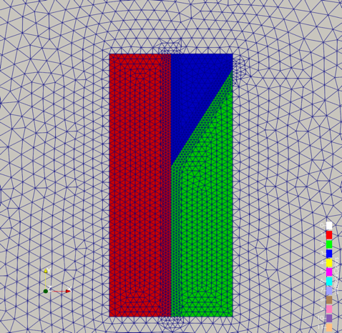
TPV24: branch fault

Slide 18
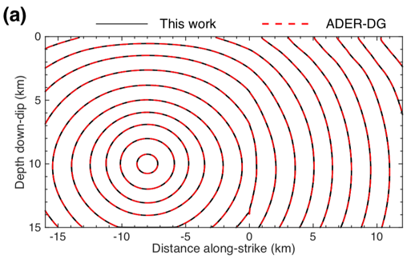
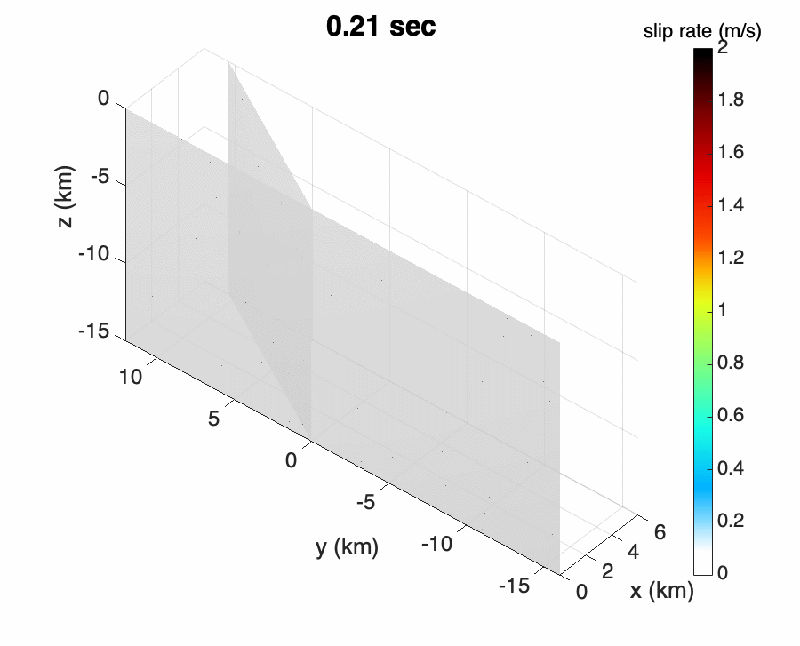
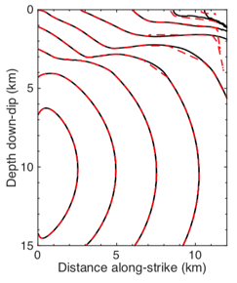
branch fault
main fault
main fault
branch fault
Rupture front contours: the initial time when fault rupture first occurs

Slide 19
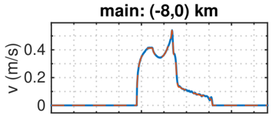
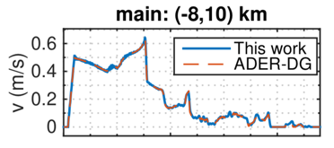
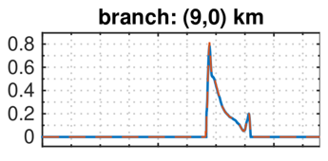
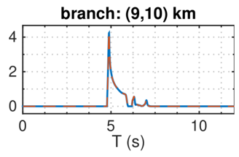
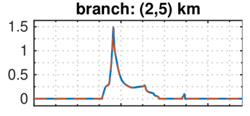
main fault
branch fault

Slide 20
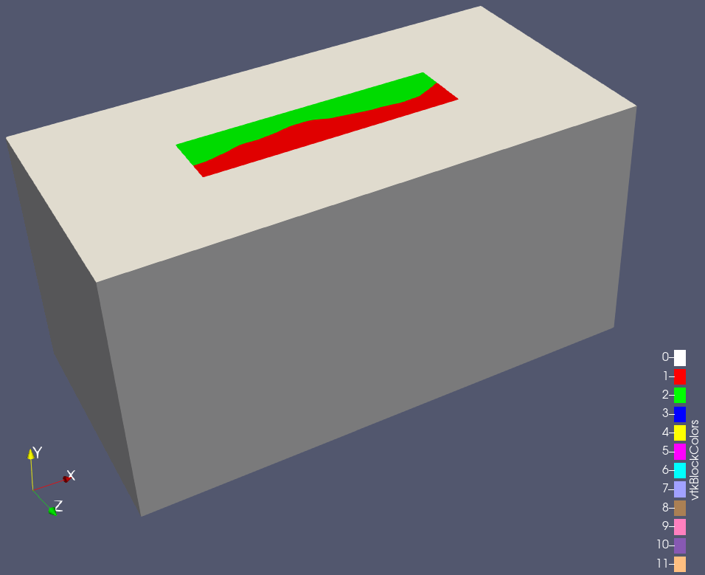
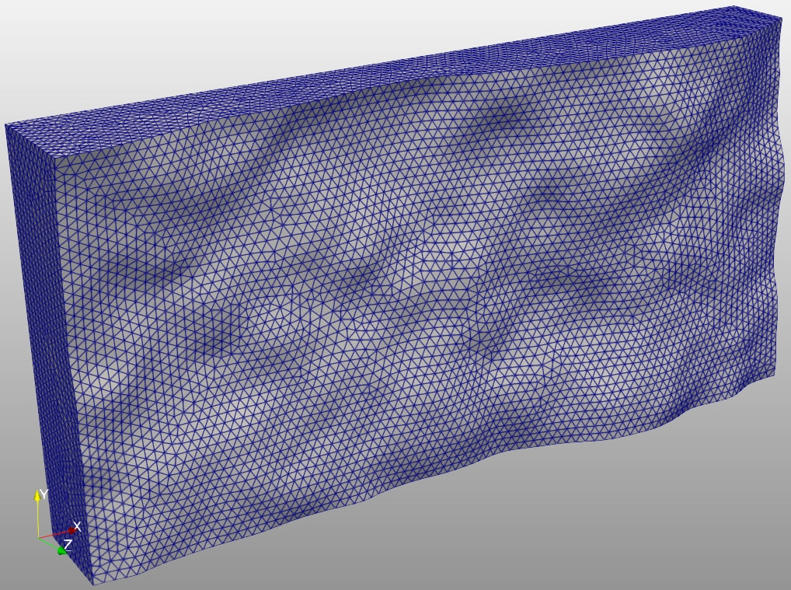
TPV29: rough fault

Slide 21
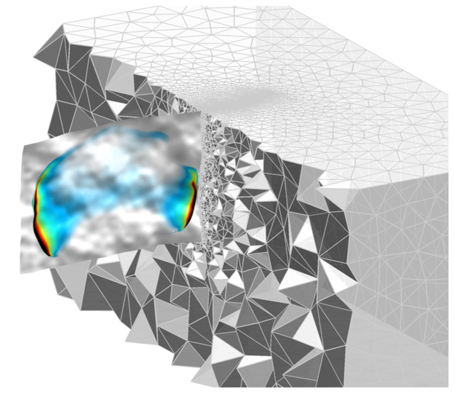
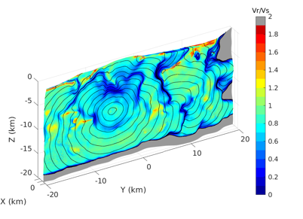

Slide 22
TPV22: Step-overs

Slide 23
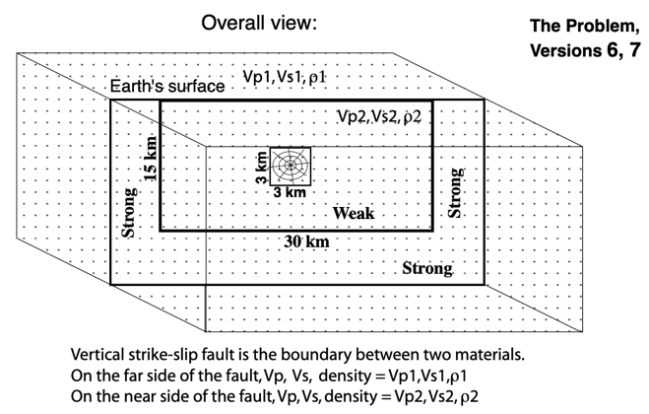
TPV6: bimaterial fault
vp1 = 3750 m/s vs1 = 2165 m/s density1 = 2225 kg/m3
vp2 = 6000 m/s vs2 = 3464 m/s density2 = 2670 kg/m3

Slide 24
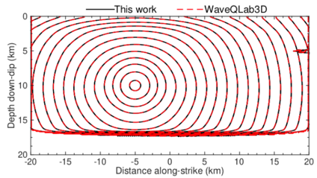
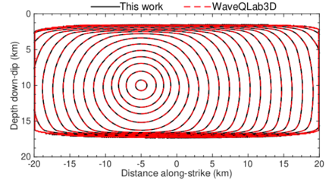
TPV26/27: off-fault plasticity

Slide 25
TPV105: thermal pressurization

Slide 26
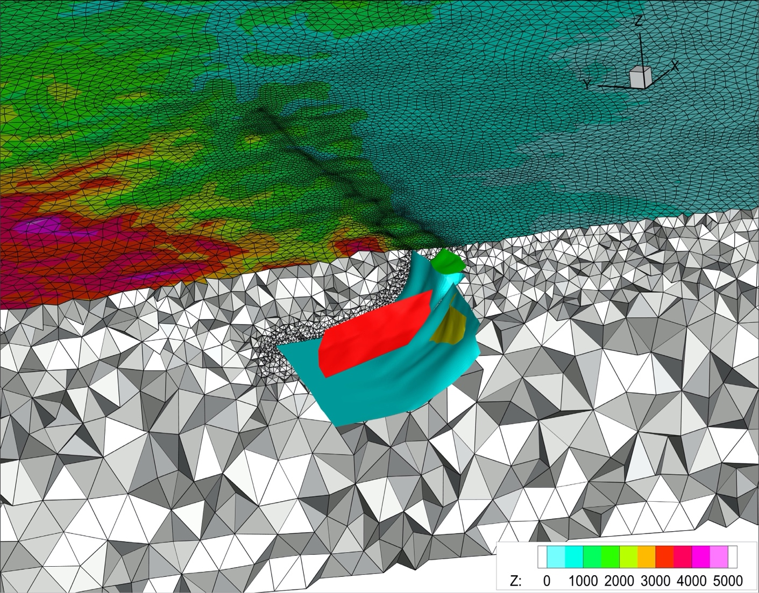
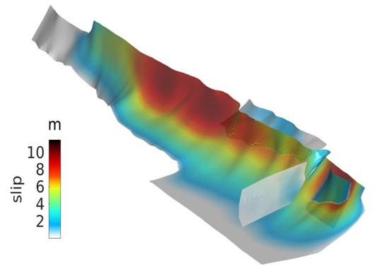
Application to the 2008 Wenchuan earthquake
Zhang et al, in progress
Notes:
未对几何做任何简化！包括所有几何细节！并考虑起伏地表

Slide 27
Summary
We developed a discontinuous Galerkin method for 3D dynamic rupture modeling
Upwind flux has numerical issues (spatial spike oscillations) when the mesh near the fault is highly asymmetric
We proposed a mixed flux method to solve the numerical issue of oscillations, reduce the dependence on the mesh and simplify the meshing process
Our code is verified by many benchmark cases
Open source: https://github.com/wqseis/drdg3d

Slide 28
Supporting Information
Technical details can be found in the supporting information:
https://agupubs.onlinelibrary.wiley.com/action/downloadSupplement?doi=10.1029%2F2022JB025817&file=2022JB025817-sup-0001-Supporting+Information+SI-S01.pdf

