Slide 1

CyberShake Physics-Based Seismic Hazard Models for Northern California
Scott Callaghan and the CyberShake Collaboration
SC19
Denver, CO
November 17-22

Slide 2
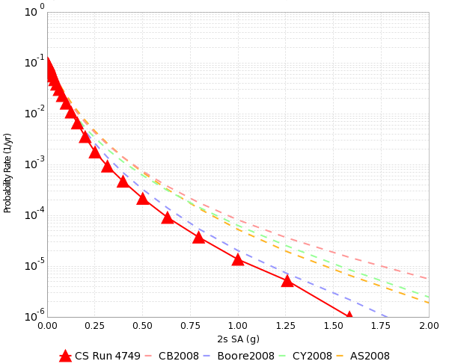
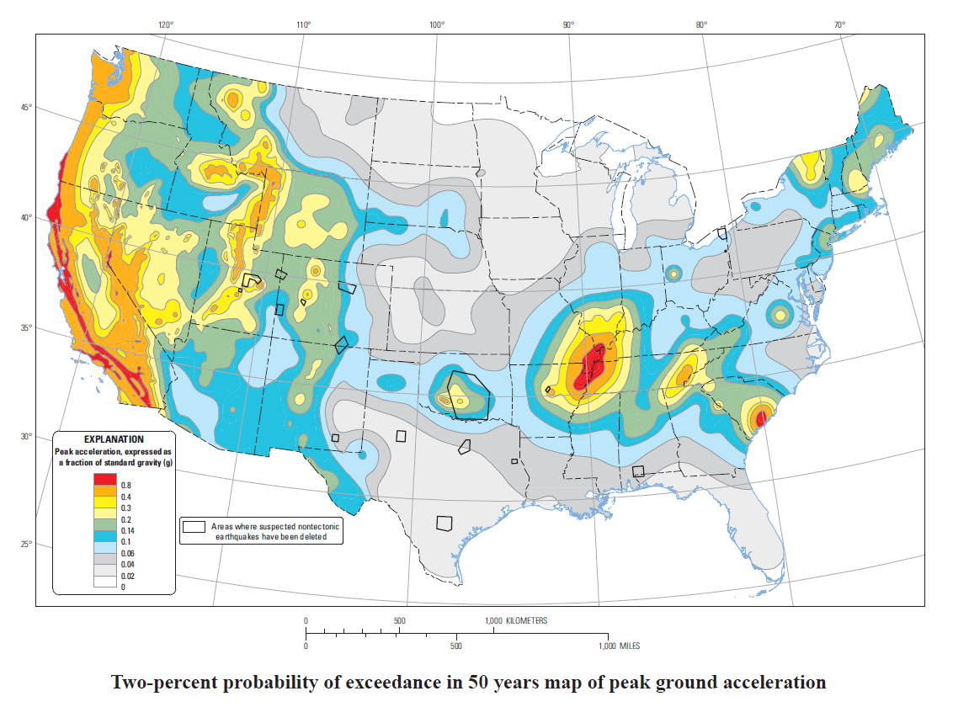
Probabilistic Seismic Hazard Analysis (PSHA)
What will peak earthquake shaking be over the next 50 years?
Useful information for:
  Building engineers
  Disaster planners
  Insurance agencies
PSHA performed by
  Assembling a list of earthquakes
  Determining how much shaking each event causes
  Combining the shaking levels with probabilities
2% in 50 yrs
0.4 g

Slide 3
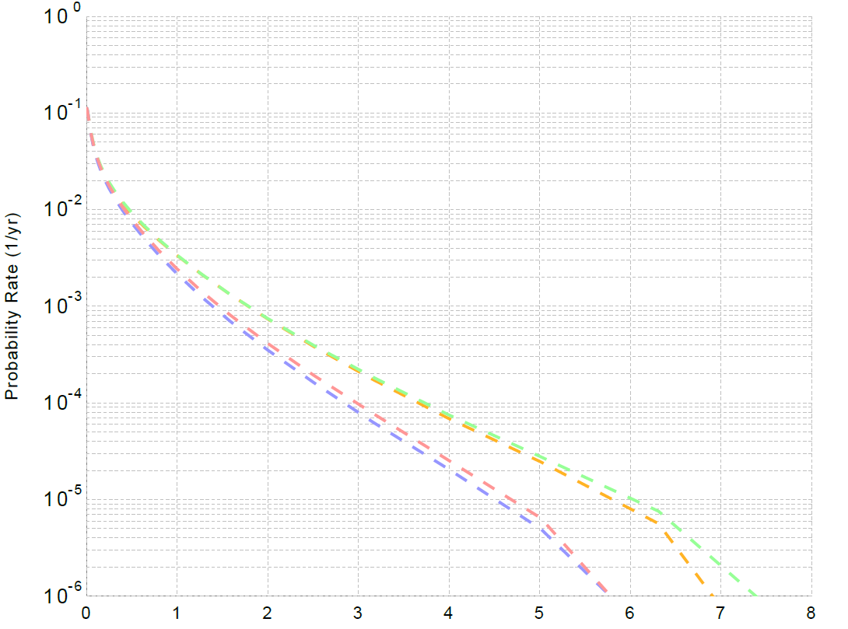
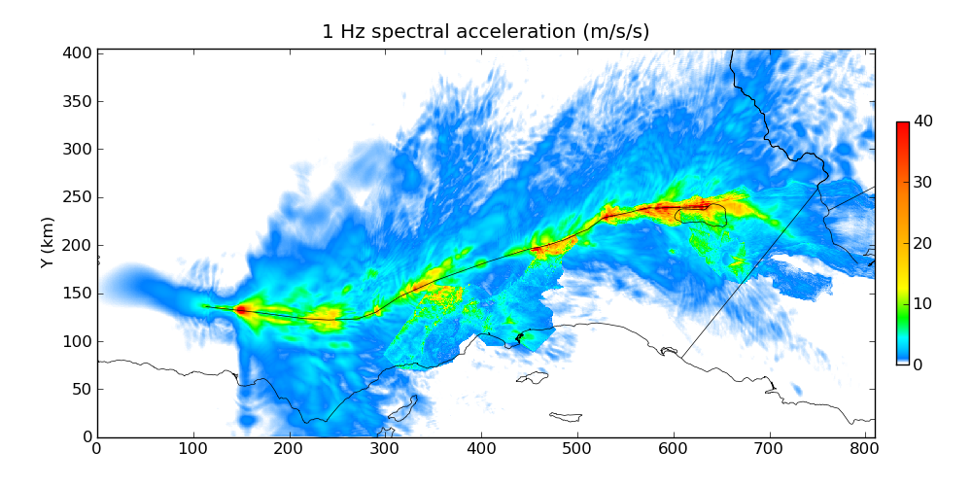
PSHA Approaches
Ground Motion Prediction Equations (GMPEs)
  Equations derived from observed data
  Mean and standard deviation of ground
  motion produced from each earthquake
  Computationally cheap
  Statistical approach can yield unphysical results
Simulation-based approach
  Each earthquake is simulated
  using wave propagation
  Can reduce uncertainty by capturing
  complex physics
  Computationally expensive
6-7g

Slide 4

SCEC CyberShake Project
3D physics-based platform for PSHA
For each site of interest:
  Determine nearby (<200 km) earthquakes
  Add variability to earthquakes
  Simulate each of 500,000 earthquakes
  Determine maximum shaking from each
  Combine with probabilities to produce curve
Repeat process for multiple locations
Continual improvement since 2007

Slide 5
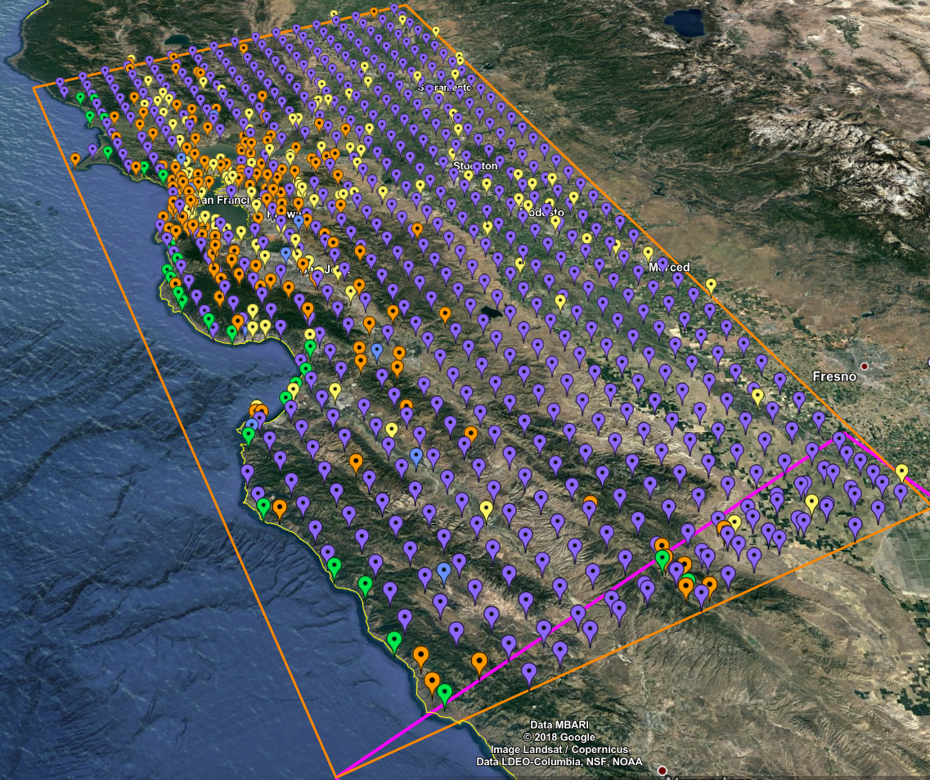
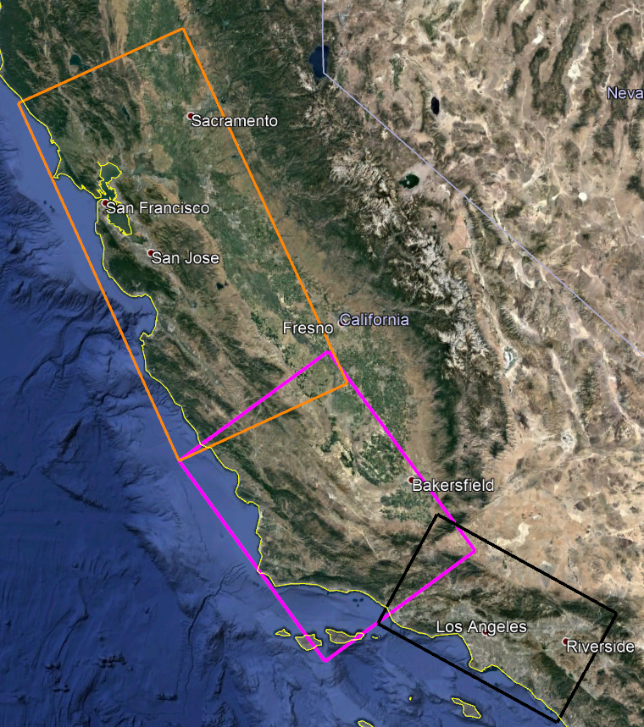
Northern California CyberShake: Study 18.8
Build upon previous CyberShake results
800+ new locations
New velocity model of earth’s crust
Statewide simulation volumes
Largest suite of CyberShake simulations to date
Southern CA region in black
Central CA region in magenta
Bay Area region in orange
869 sites, densest near San Francisco Bay

Slide 6
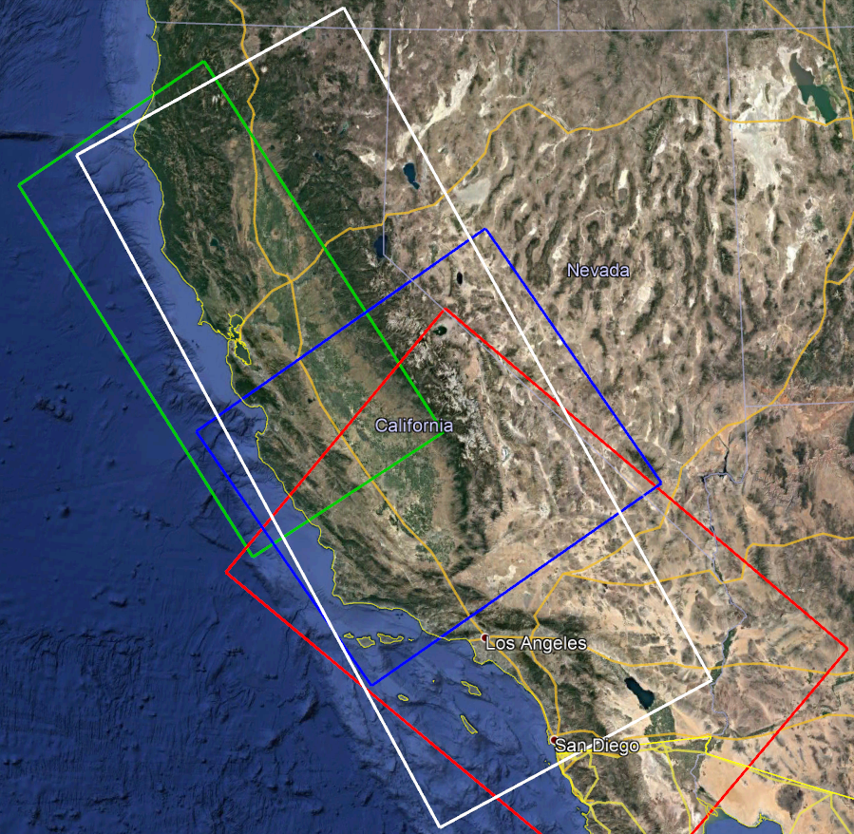
Combined Velocity Model
No single 3D model large enough
for large volumes
Stitch together multiple models
  Central California (blue)
  USGS Bay Area (green)
  Southern California (red)
  1D background model (white)
Apply smoothing along
model interfaces
  Average of neighbor values

Slide 7
Study 18.8 Computational Requirements
CyberShake stage | Compute-hours | Output data
Velocity mesh creation | 3,700 CPU | 177 GB
Wave propagation (“SGT”) simulations | 2,500 GPU | 345 GB
Seismogram synthesis | 61,000 CPU | 17 GB
Total, 1 site | 64,700 CPU; 2,500 GPU | 539 GB
Total, Northern California Study | 56 million CPU, 2.1 million GPU | 457 TB
Very large computational requirements
Targeted NCSA Blue Waters and OLCF Titan supercomputers
High degree of automation required for around-the-clock execution
  Rely heavily on scientific workflow tools
  Workflows orchestrated from USC

Slide 8
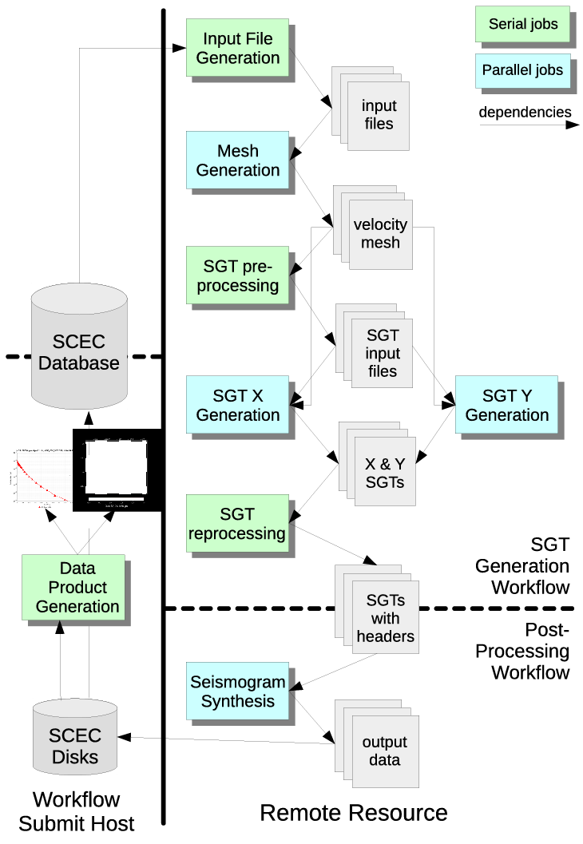
Scientific Workflow Tools
Pegasus-WMS
  Use API to create description of workflow
    Tasks with dependencies
    Input/output files
  Plans workflow for execution on specified systems
  Adds jobs to manage data
  Wraps executables to track metadata
HTCondor
  Manages real-time execution of jobs
  Submits jobs to remote systems, checks on success
  Monitors dependencies
  Checkpoints workflow
GridFTP used to transfer data
Schematic of CyberShake workflow

Slide 9
Automated Remote Job Submission
Push-based
  When jobs are ready to run, send them over the network to wait in queue
  SSH: keys must be accepted on remote system
  Globus GRAM: protocol for job submission, requires support on remote system
  rvGAHP: daemon on remote system connects to workflow submit host
    Can be used on systems with two-factor authentication
Pull-based (“pilot jobs”)
  Submit job on remote system first
  After job starts up, advertises to workflow submit host
  Results in additional overhead
  Can take advantage of scheduling policies
Bin | Node Range | Aging Boost
1 | 11250+ | 15 days
2 | 3750 – 11249 | 5 days
3 | 313 – 3749 | 0
4 | 126 – 312 | 0
5 | 1 – 125 | 0
OLCF Titan Scheduling Policy

Slide 10
Dynamic Workflow Assignment
To accomplish CyberShake study efficiently, must be able to use resources when available
Job throughput on large clusters varies widely
Designed workflow metascheduler to
submit workflows
  Split workflows into SGT and post-processing
  Ability to run each part on separate systems
Are the clusters available for workflows?
Yes
No
Are MAX_WORKFLOWS running?
No
Yes
Select new workflows from workflow queue to submit
Determine number of available workflow slots on clusters
 | BW SGTs | Titan SGTs | Total
BW PP | 444 | 290 | 734
Titan PP | 0 | 135 | 135
Total | 444 | 425 | 869
Create, plan, and run the workflows
Wait 10 minutes
Systems used for SGT and post-processing workflows

Slide 11
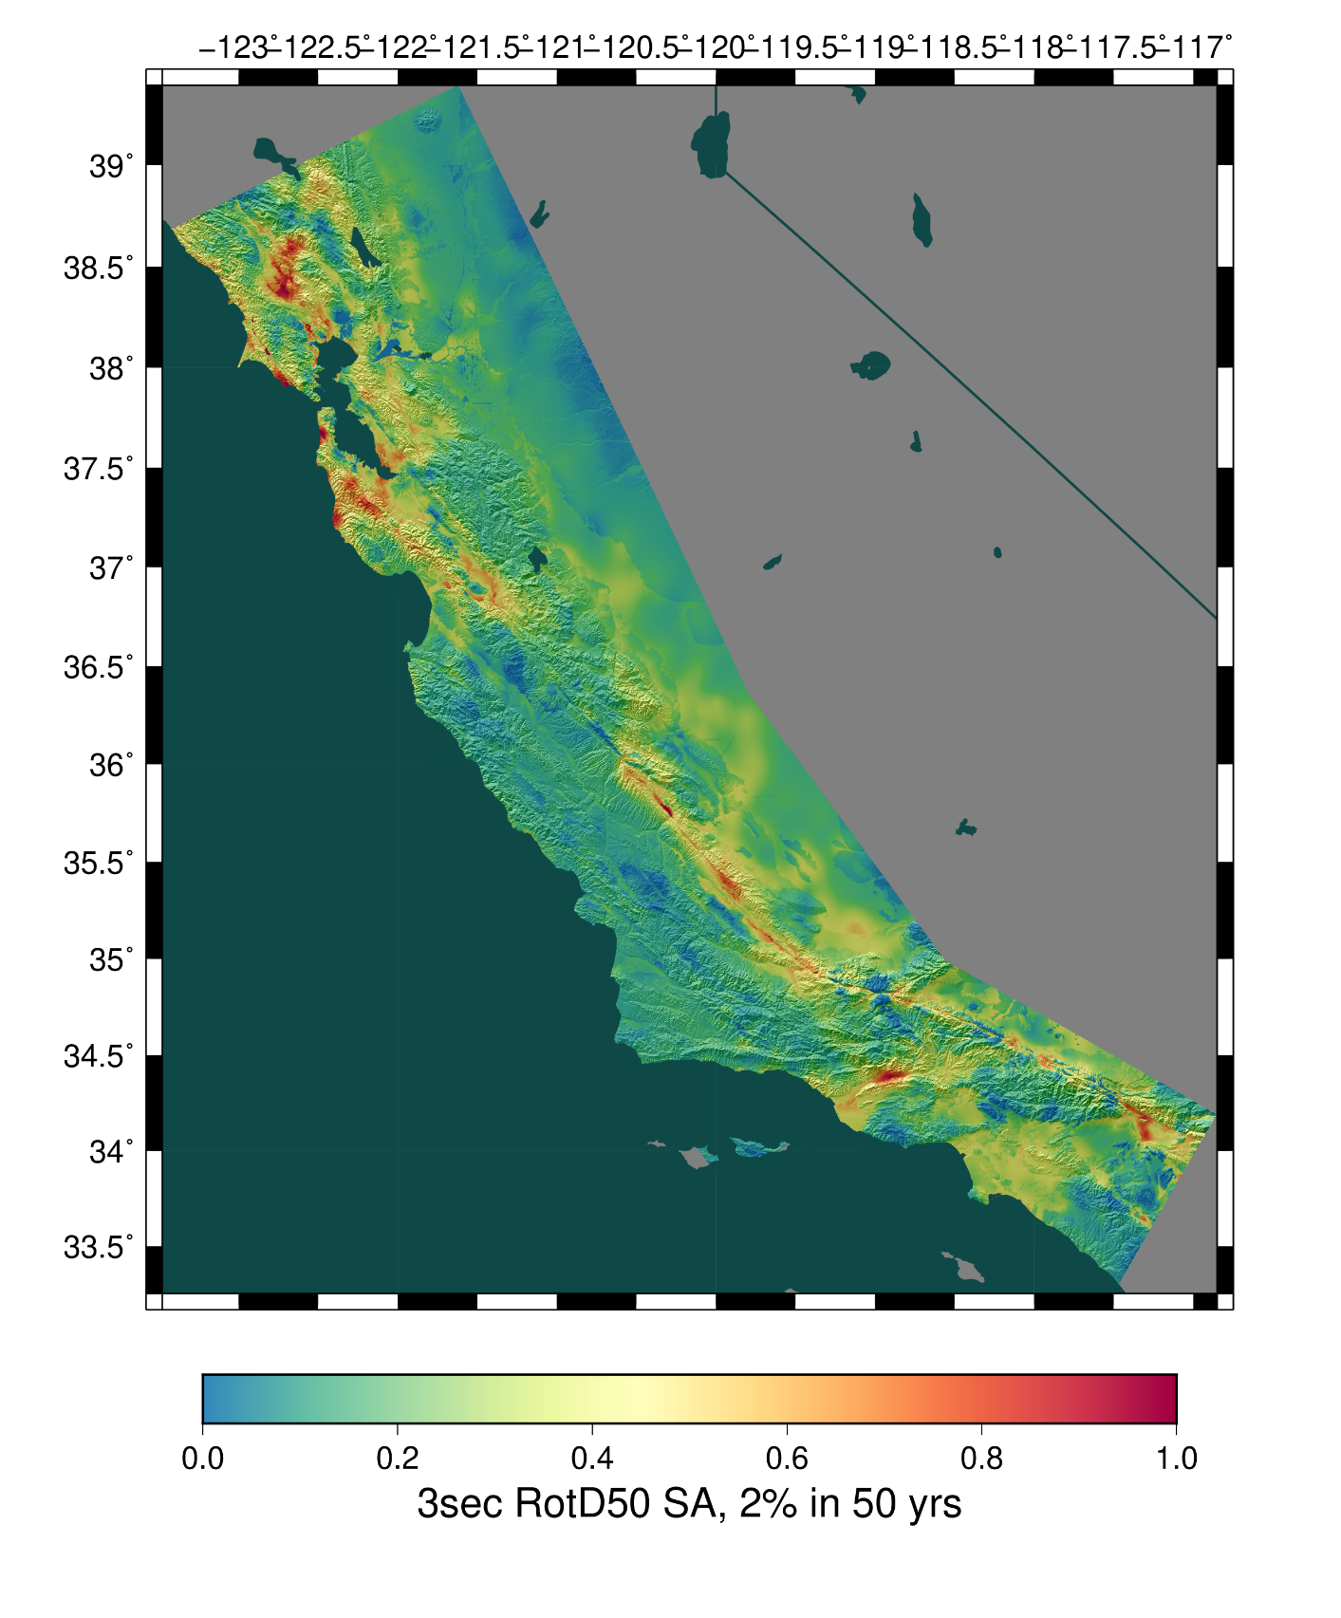
CyberShake Study 18.8 Metrics
Study conducted over 128 days
Consumed 6.2 million node-hours
(120M core-hours/13,650 core-years)
  Averaged 2,018 nodes / 38,850 cores
  Max of 16,219 nodes / 279,984 cores
Ran 21,220 jobs at USC, 10,308 at Blue Waters, and 7,757 jobs at Titan
1.2 PB of data generated
  157 TB of data automatically transferred
  14.4 TB of final data products staged to USC HPC
Simulated 203 million seismograms
  30.4 billion shaking values
Study 18.8
Study 17.3
Study 15.4

Slide 12
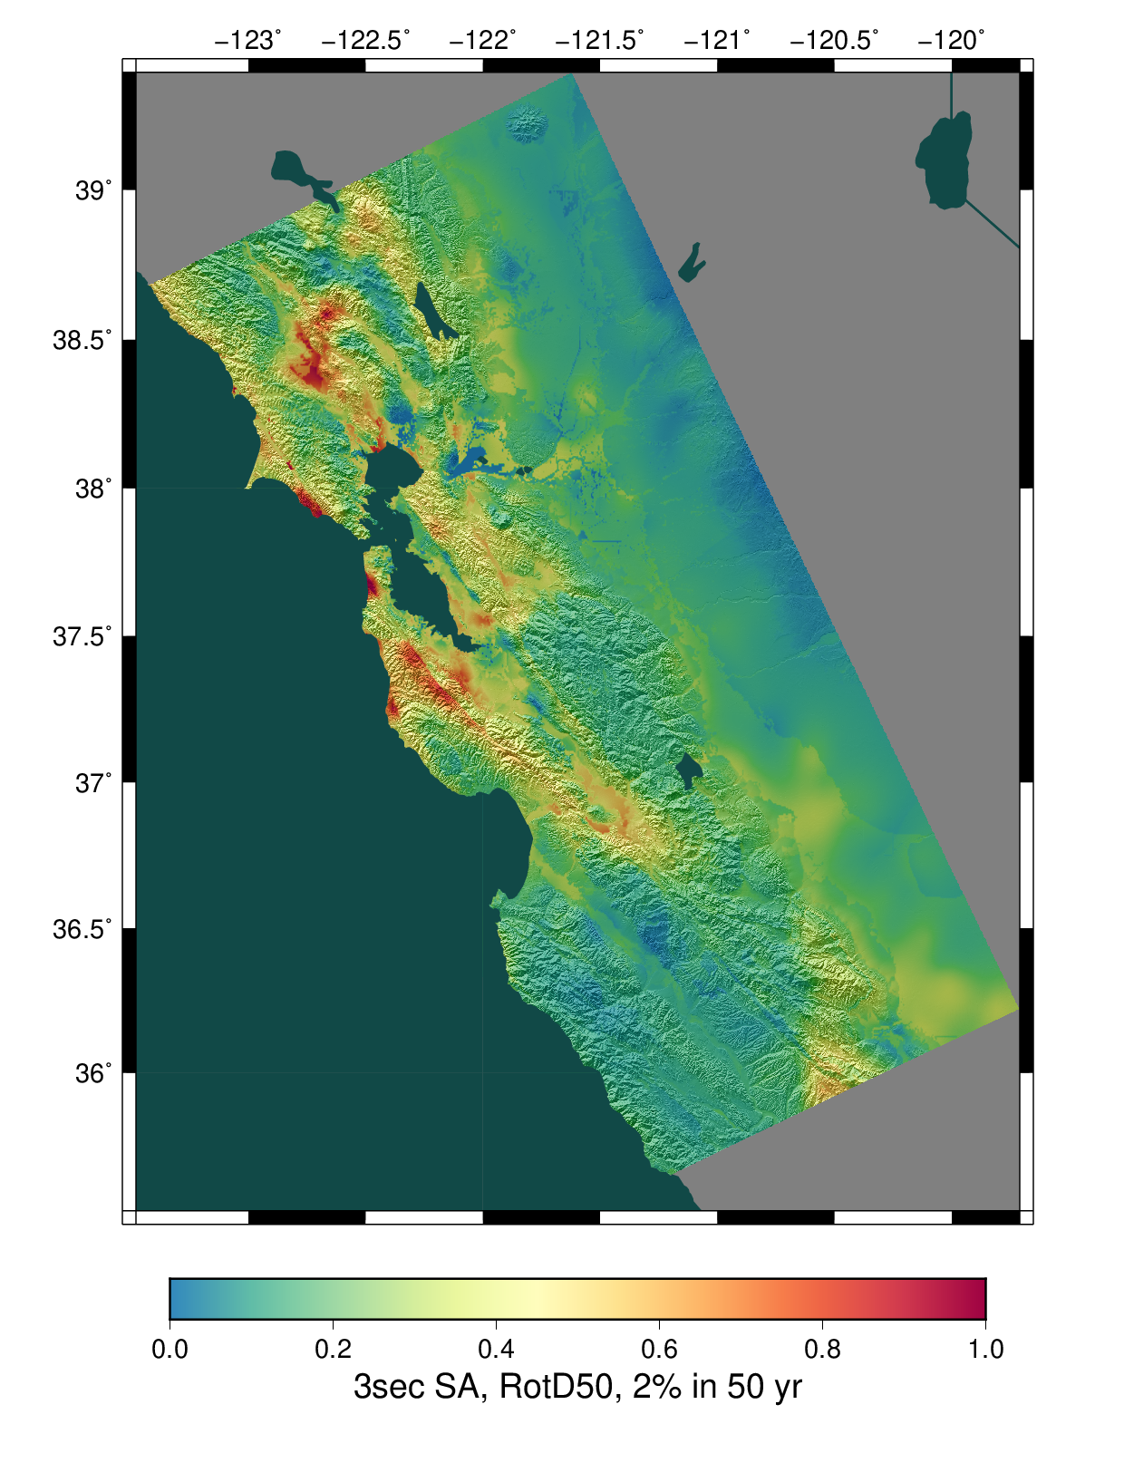
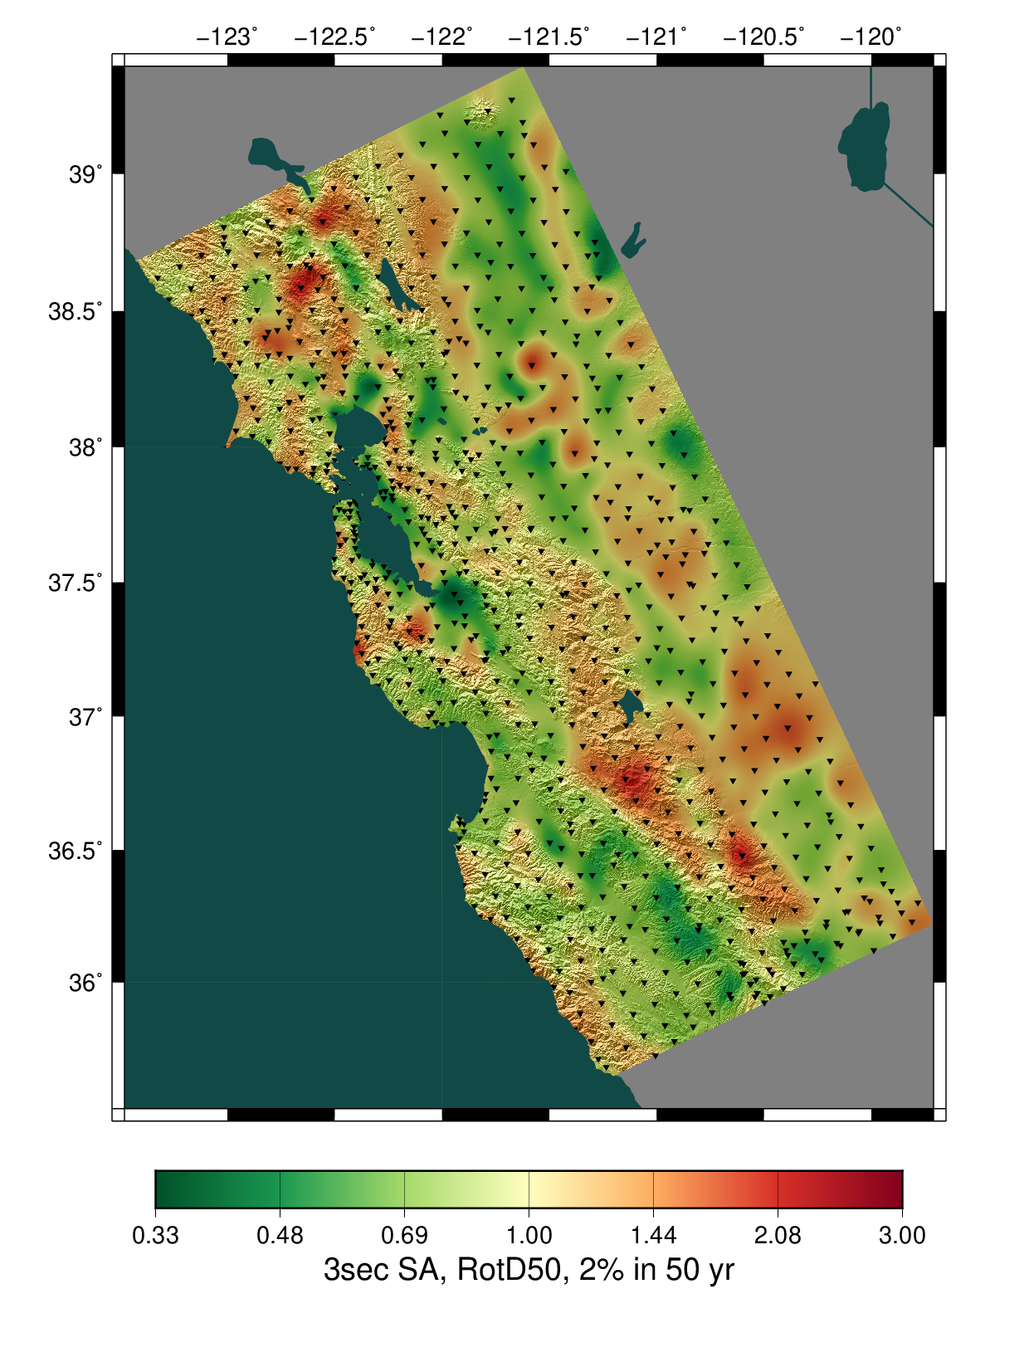
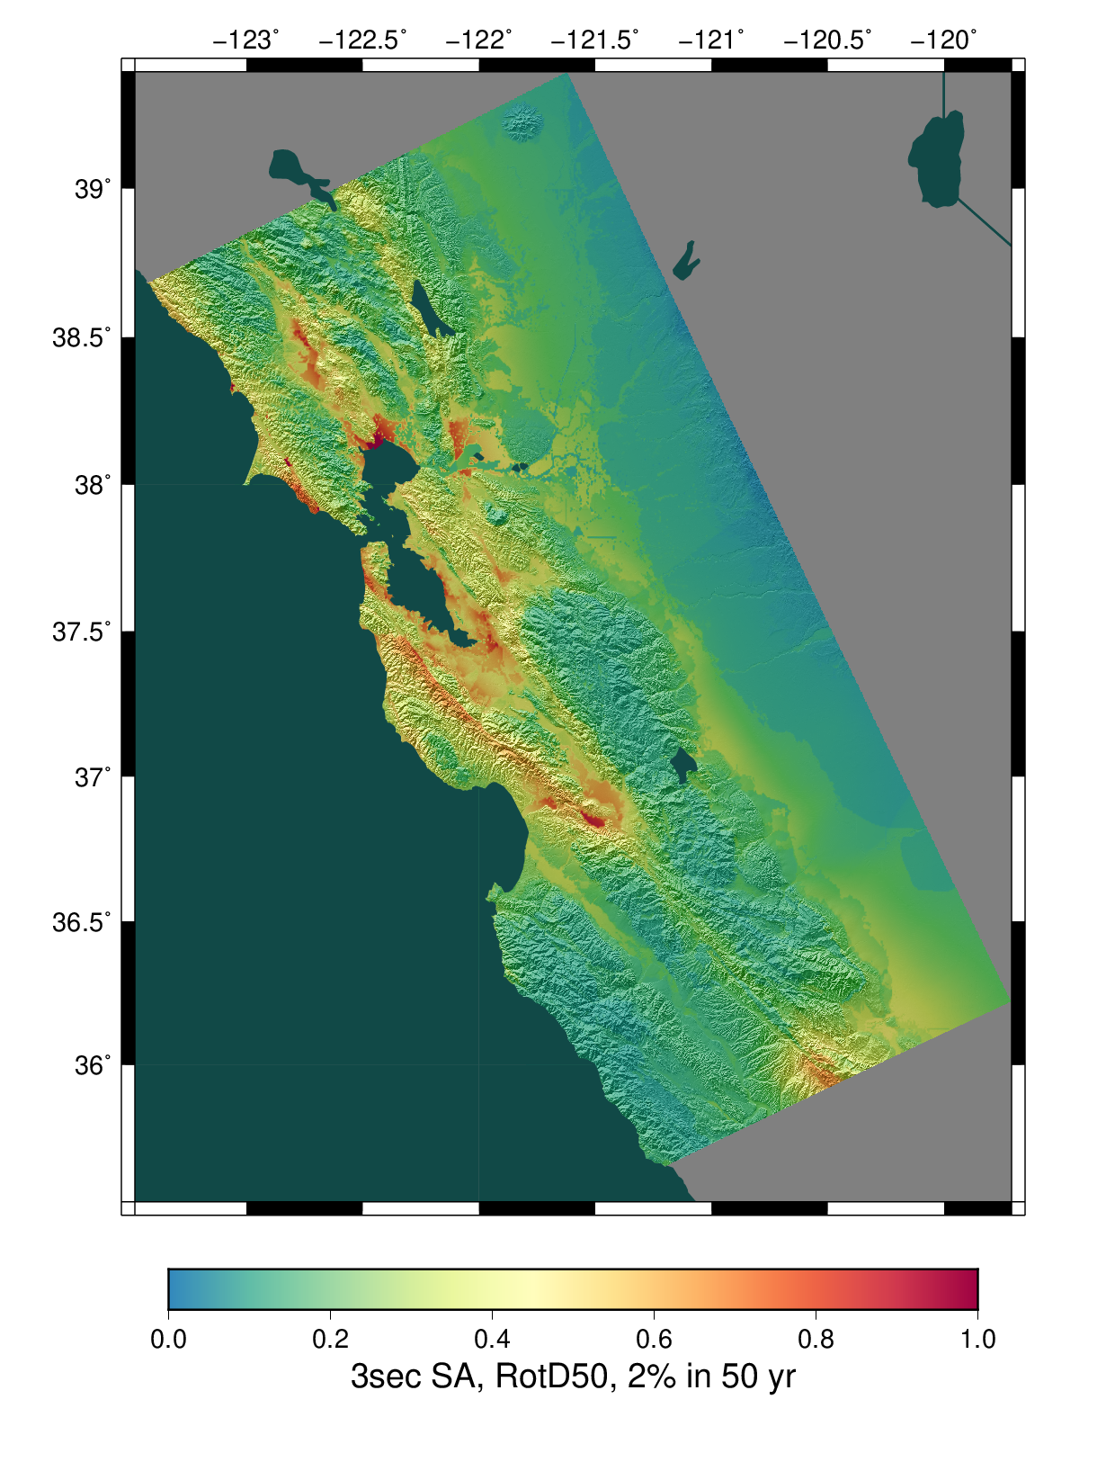
Study 18.8 Results
CyberShake
Ratio of CyberShake/GMPEs
Average of 4 GMPEs
Notes:
New systems
DM code
Containerized version

Slide 13
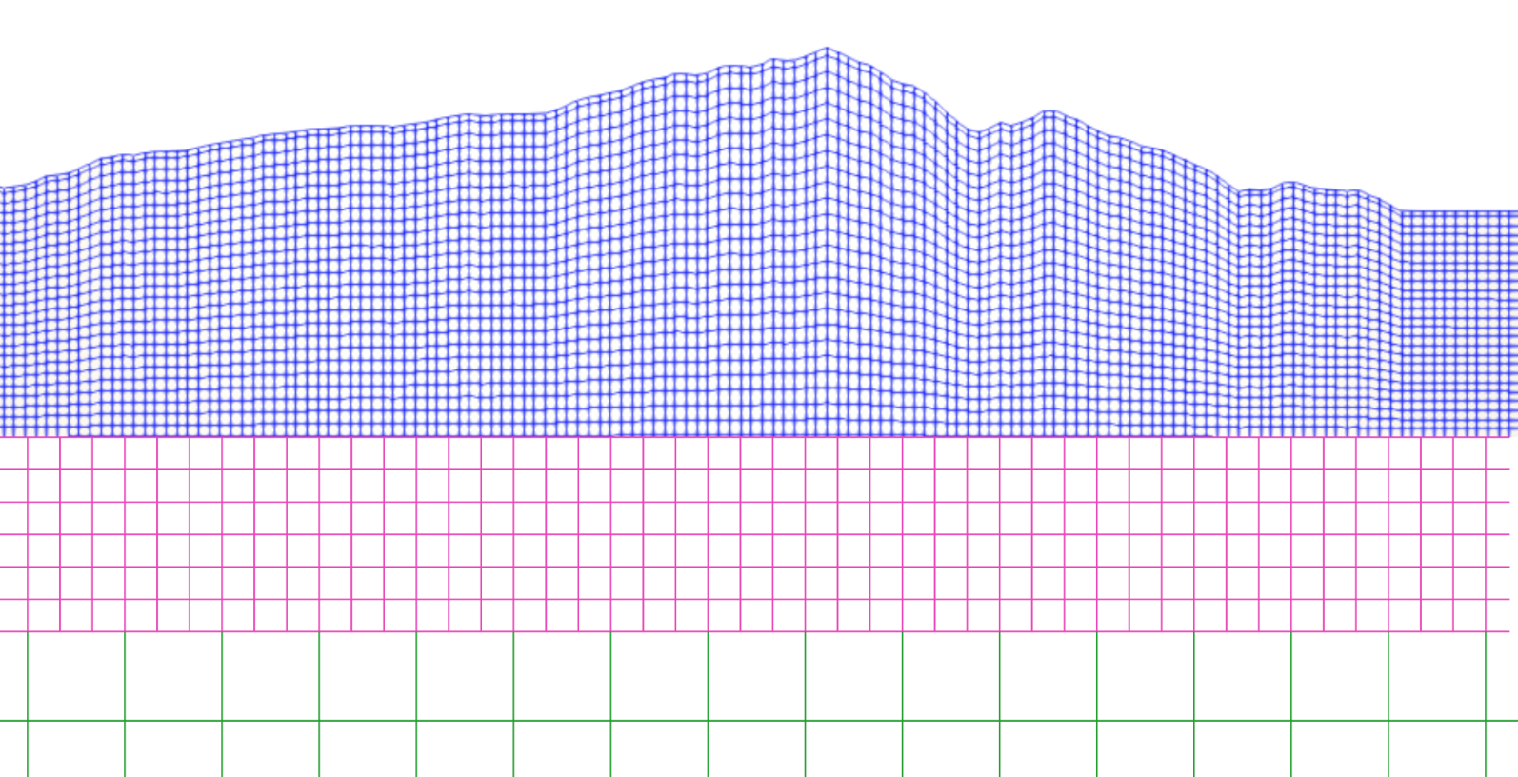
Future Directions
Moving to next-generation systems
  OLCF Summit: CyberShake fully verified
  TACC Frontera: Verification underway
Enhancing and improving physics in CyberShake simulations
  Updated rupture generation code with better observational agreement
  Discontinuous mesh version of wave propagation code
  Topography
  Higher frequencies
Performance optimizations
  Machine learning to eliminate some events

Slide 14












Questions?

