Slide 1
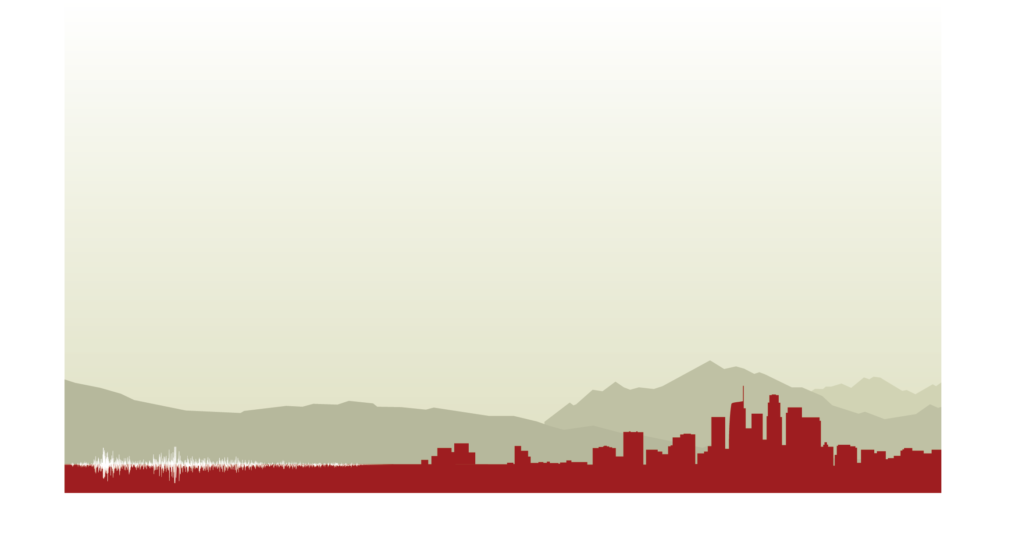
S11A-05: Verification and Validation of the Broadband CyberShake Platform
Scott Callaghan, Christine A. Goulet, Fabio Silva, Philip J. Maechling, Robert W. Graves, Ossian O’Reilly, Te-Yang Yeh, Kim B. Olsen, Albert Kottke, and Yehuda Ben-Zion
2021 AGU Fall Meeting

Slide 2
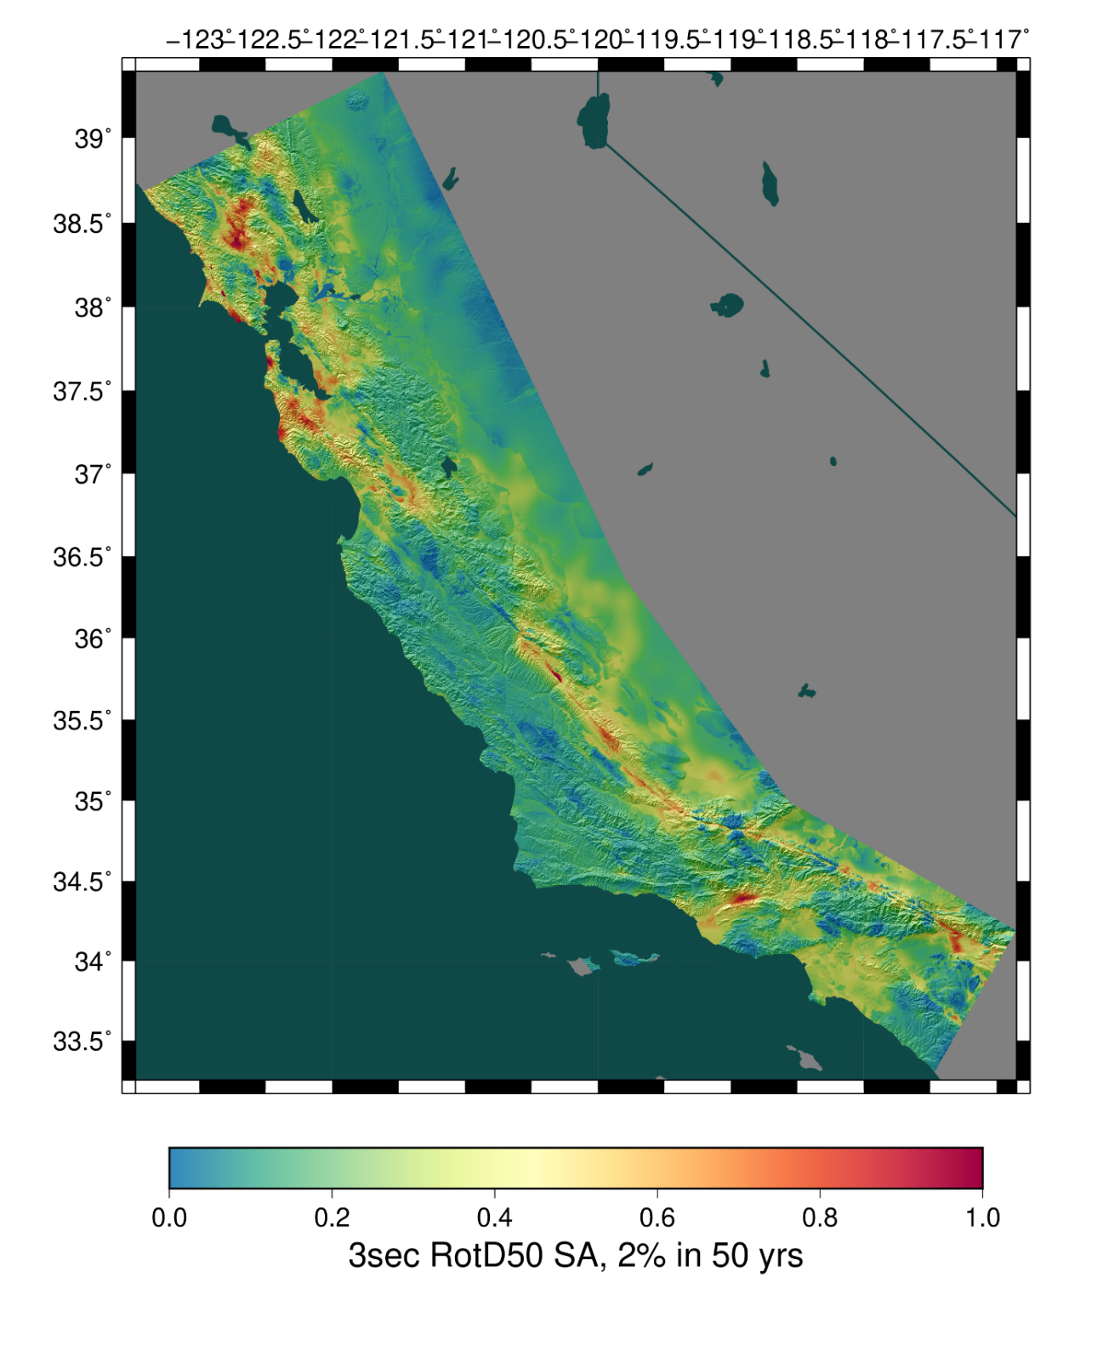
CyberShake Platform
Southern California Earthquake Center’s 3D physics-based probabilistic seismic hazard analysis (PSHA) platform
UCERF2 or RSQSim earthquake simulator ERF
  75,000-500,000 events per site
Reciprocity-based approach to simulate seismograms
Intensity measures derived from seismograms
Hazard results from individual sites interpolated with GMPE basemap
Deterministic simulations to 1 Hz

Slide 3
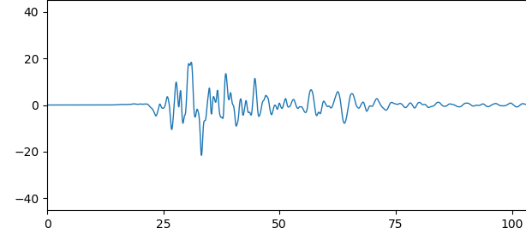
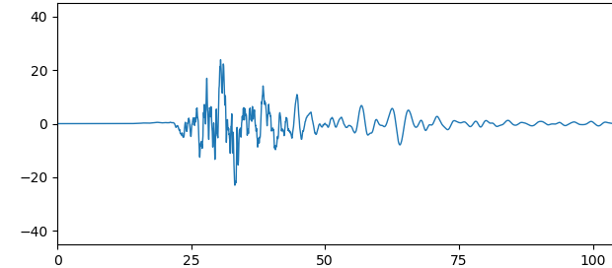
Broadband CyberShake
Higher frequencies are desirable for engineering applications
Computational cost scales as (frequency)⁴
Alternatively, perform deterministic low-frequency simulations and combine with stochastic high-frequency
Use modules from the SCEC Broadband Platform for high-frequency

Slide 4
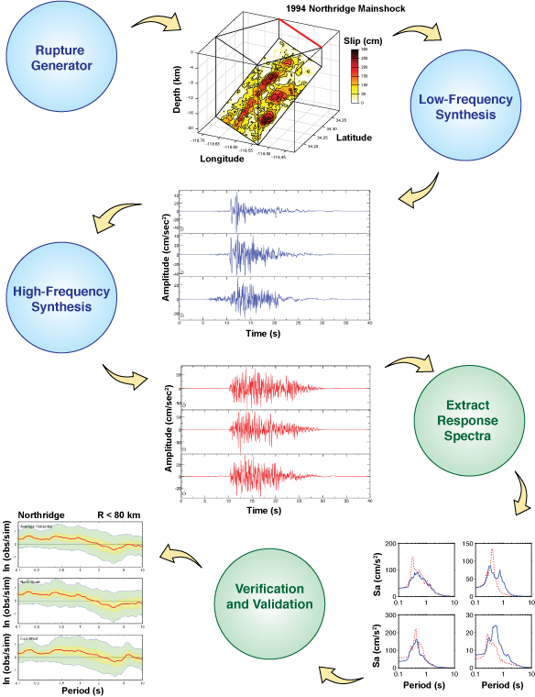
SCEC Broadband Platform (BBP)
Simulates broadband (0-100 Hz) seismograms
Combines two simulation approaches
  Pre-computed 1D Green’s Functions for low frequencies
  Stochastic representation for high frequencies
  Applies site response
  Filters and combines
Multiple implementations of each stage
User-described and historic events
User-specified list of stations
Suite of V&V tools

Slide 5
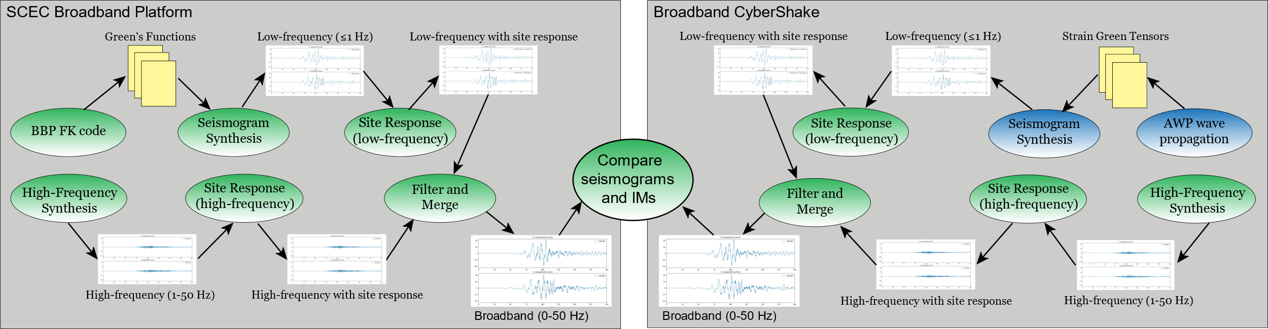
Verification Process
To verify Broadband CyberShake results, compare to BBP
Different methods for calculating low-frequency
  Results should be similar but not identical

Slide 6
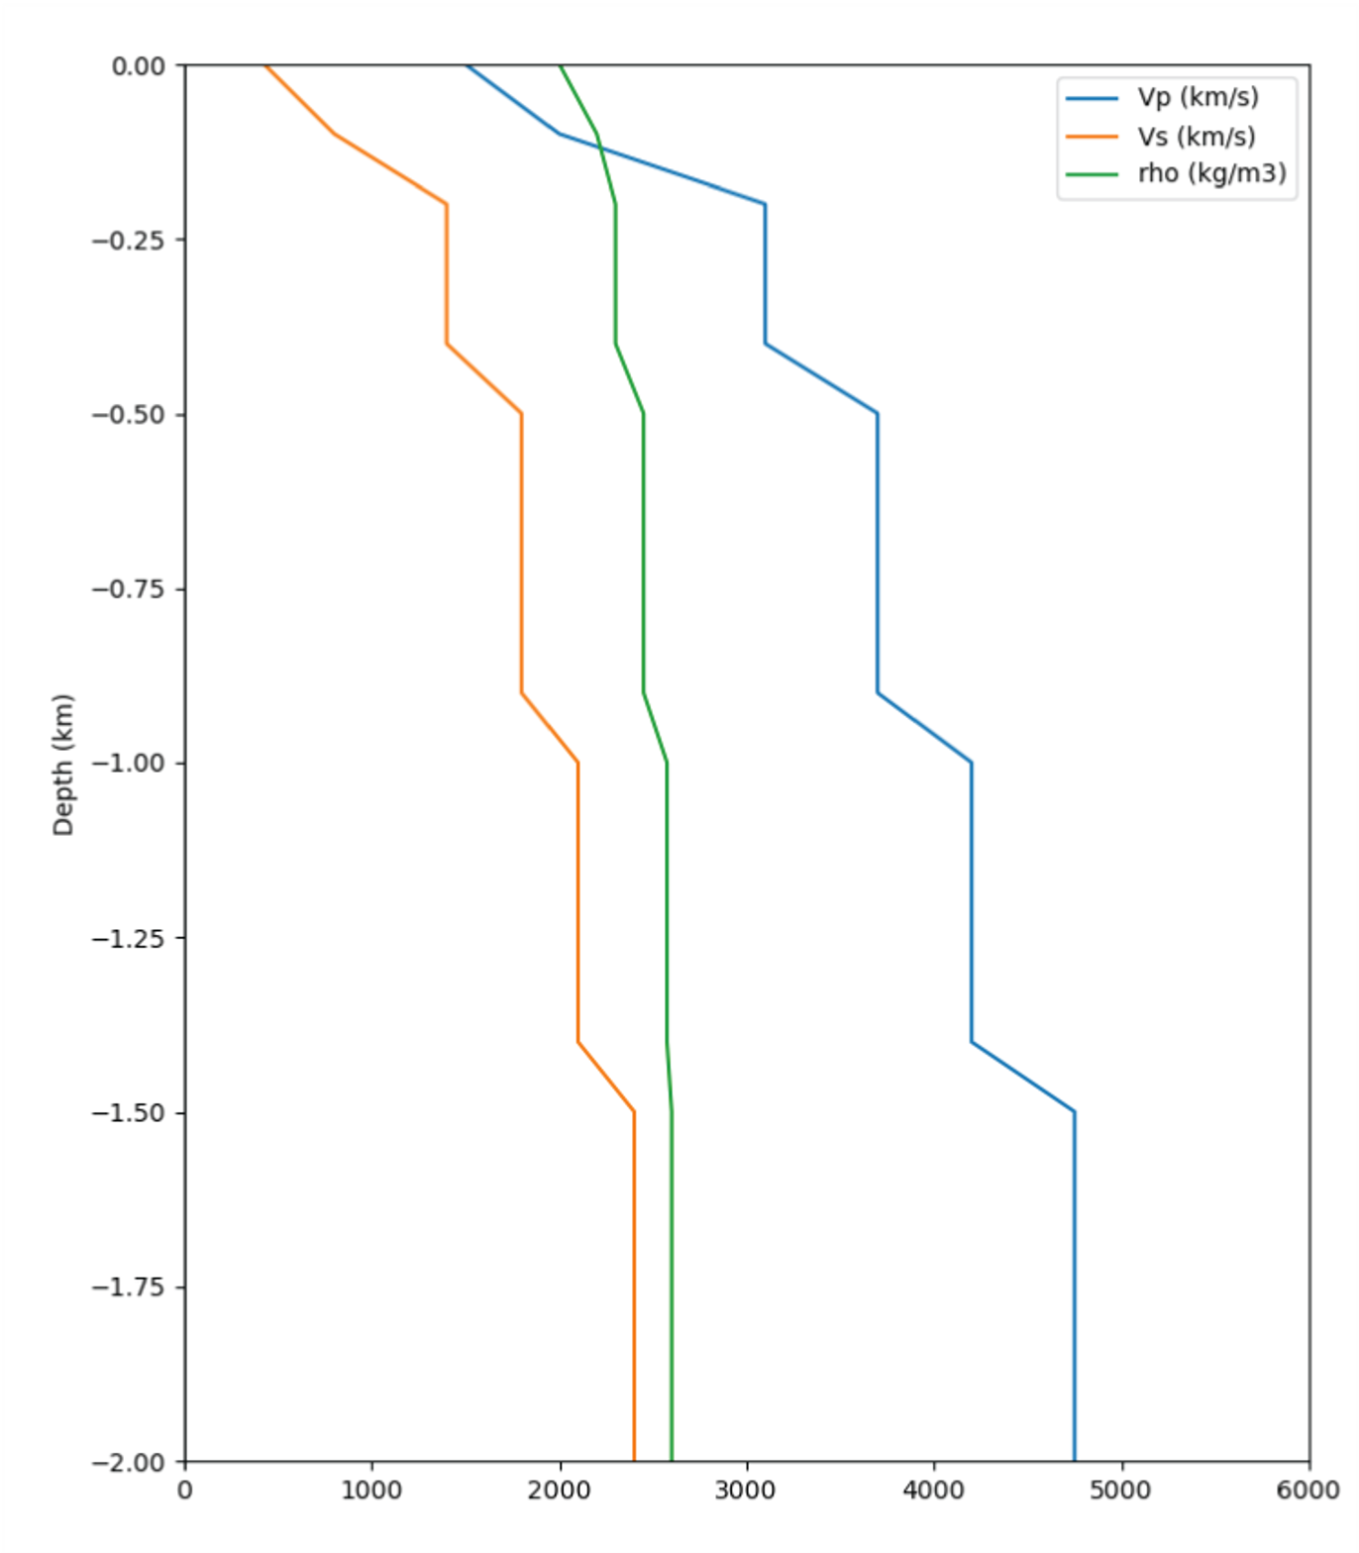
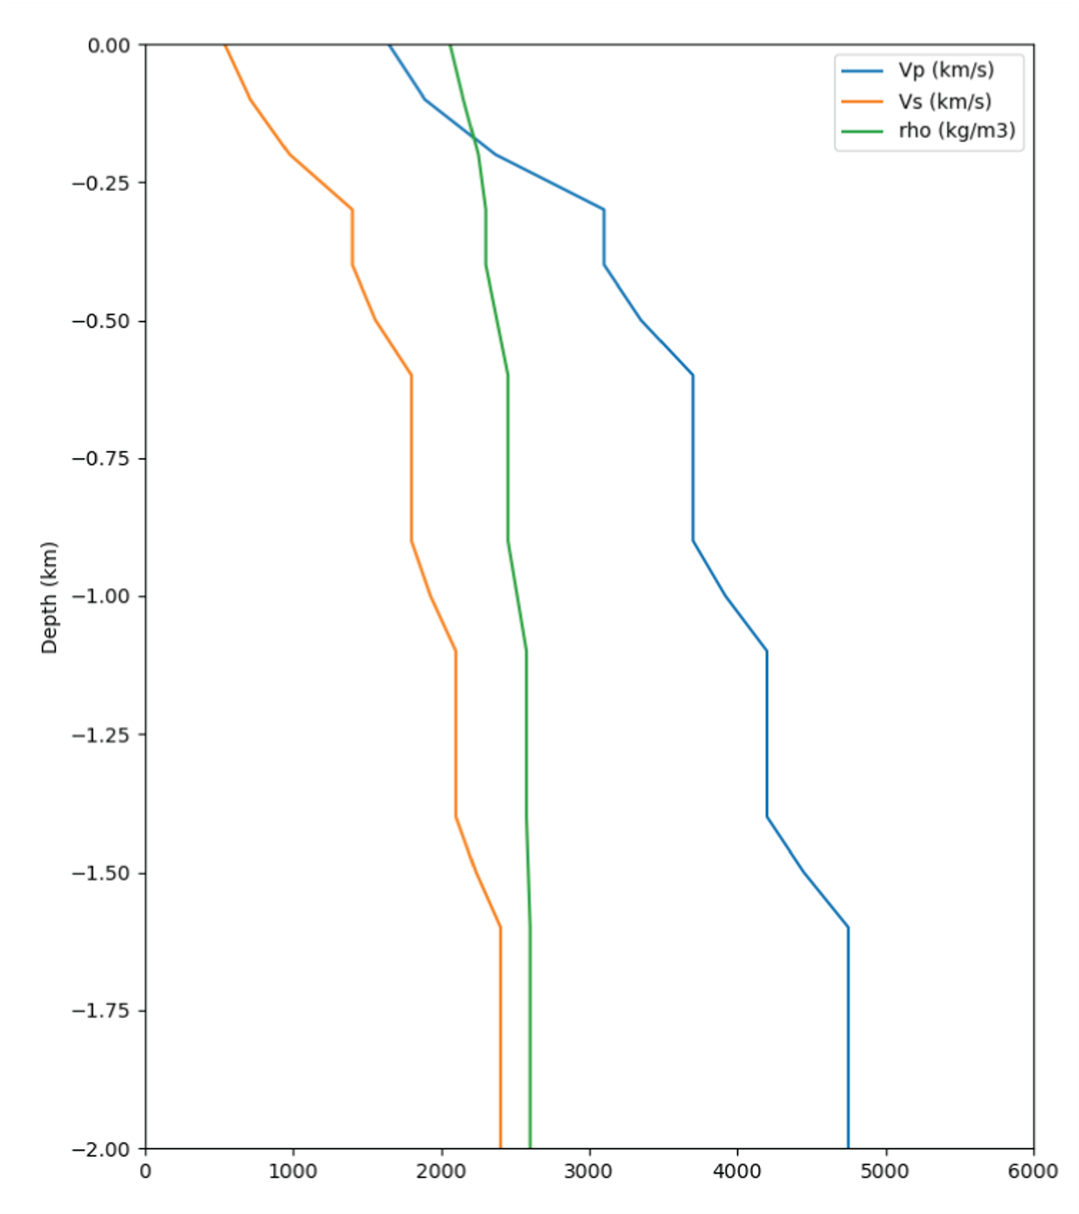
Initial Testing
Began with simple configurations (point source in a halfspace)
Challenge to define the problem identically
Transitional layers added for equivalent model
14-layer BBP 1D model
24-layer CyberShake 1D model

Slide 7
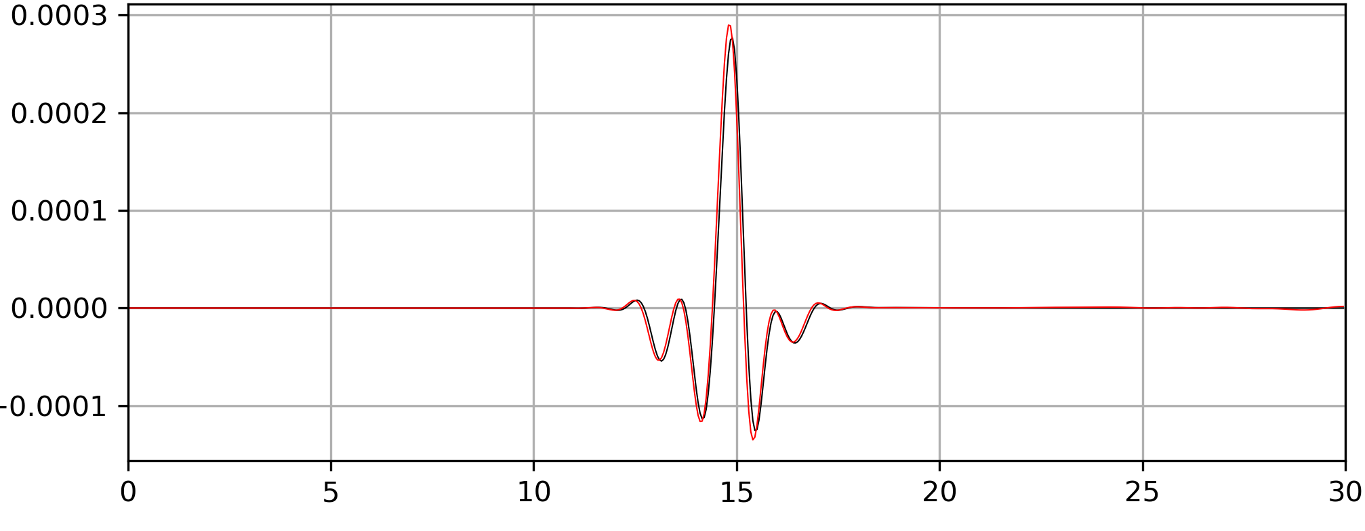
Initial Testing
Offset due to relative locations of stress and velocity in finite grids

Slide 8
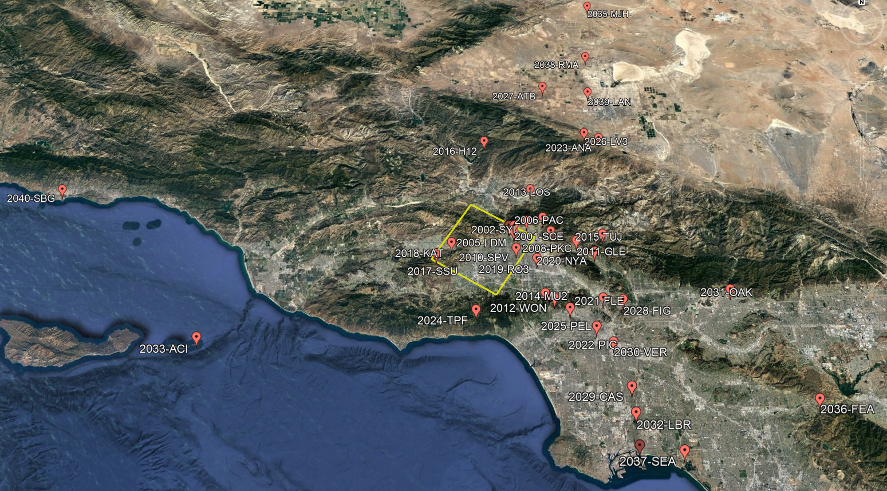
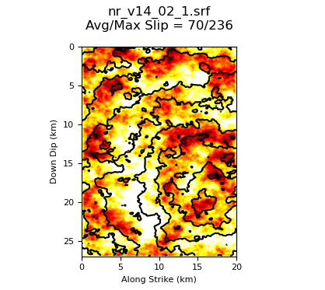
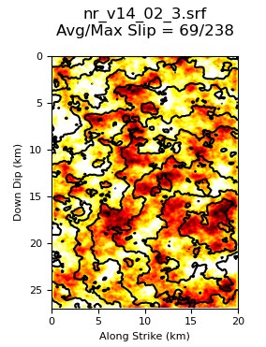
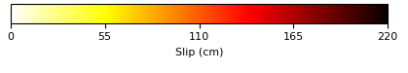
Northridge Testing
Comparisons for 10 realizations of 1994 Northridge
  Observed magnitude and hypocenter, multiple slip distributions
  Selected 38 stations around Southern California

Slide 9
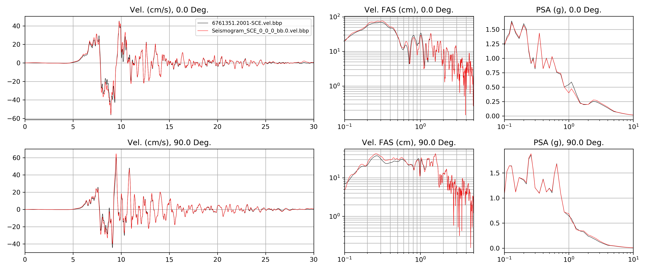
Results for Individual Stations
SCE (above fault)
Red=CyberShake, Black=BBP

Slide 10
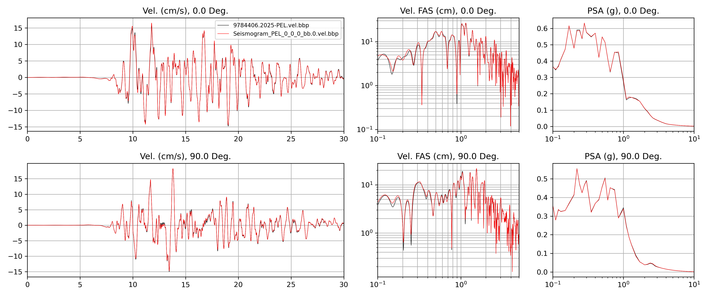
PEL (20 km)
Red=CyberShake, Black=BBP

Slide 11
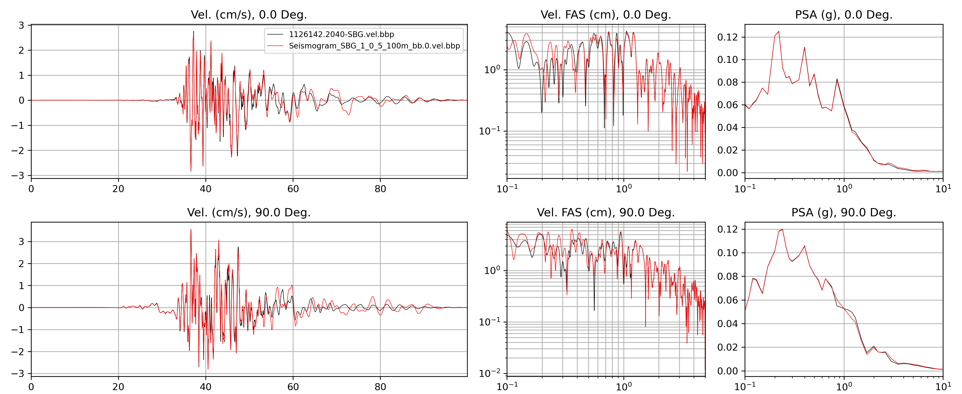
SBG (105 km)
Red=CyberShake, Black=BBP

Slide 12
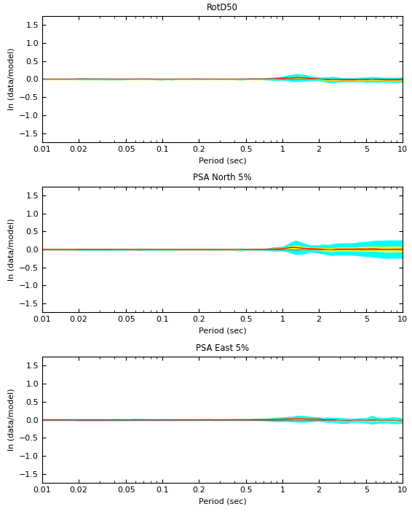
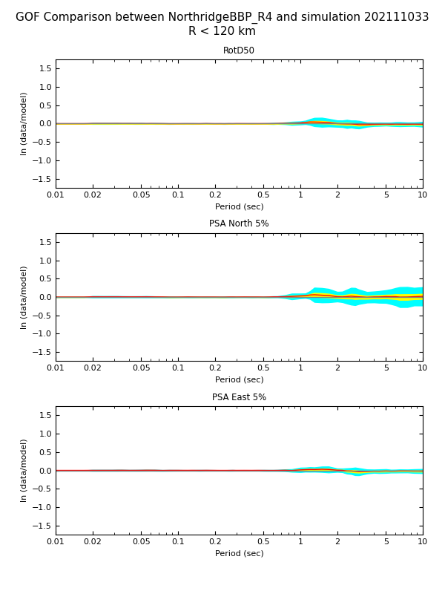
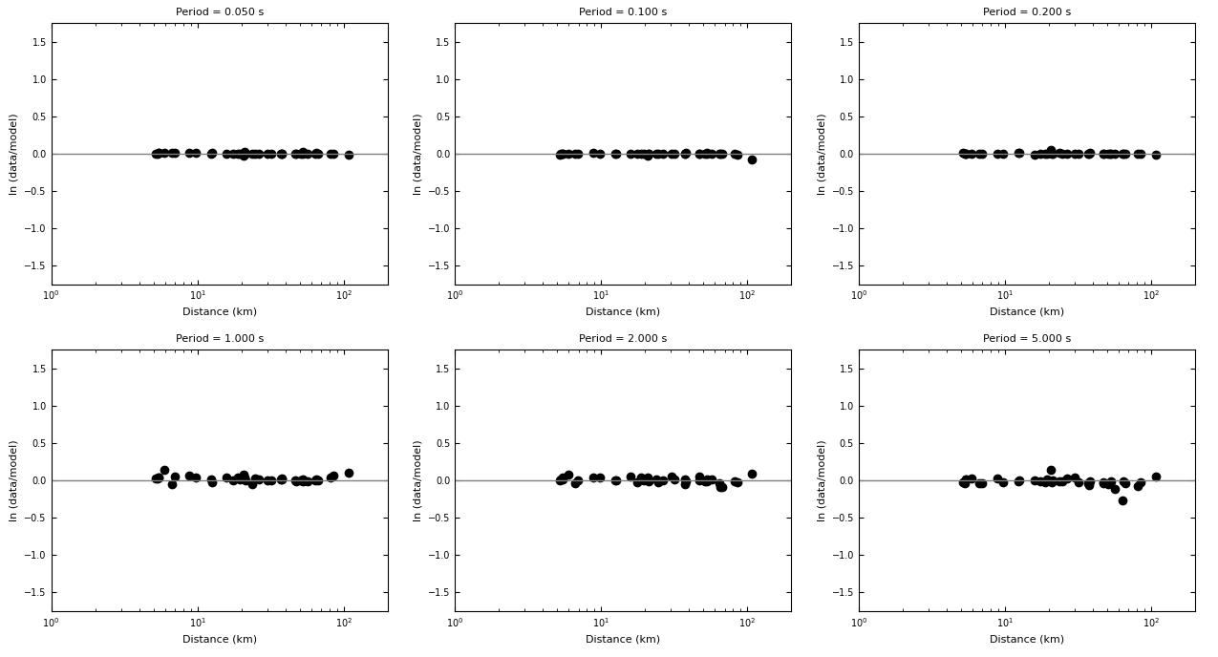
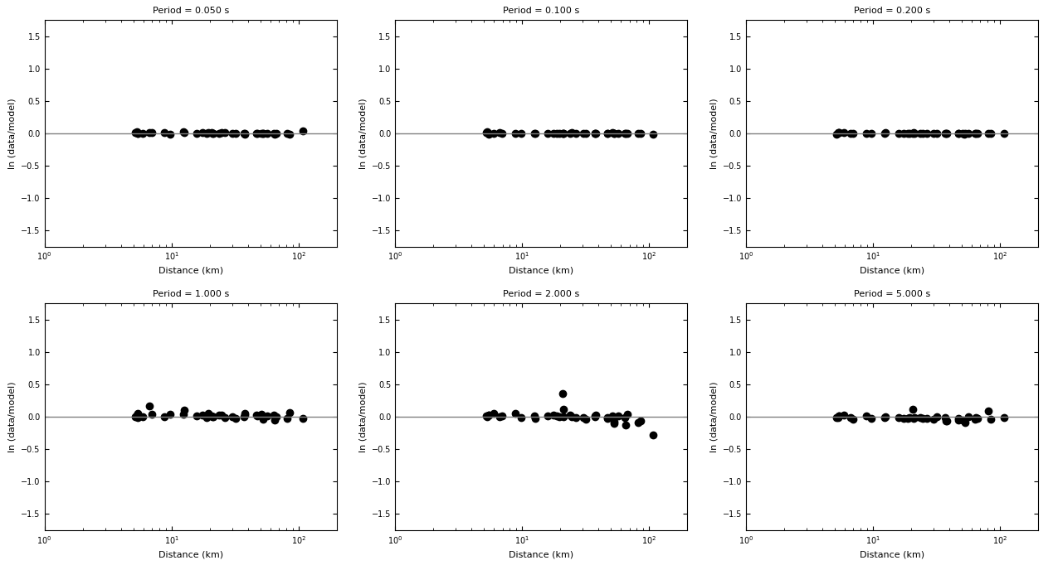
Goodness-of-fit Results
Aggregates results for all 38 stations, for each realization
Realization 3 of 10
Realization 4 of 10
Realization 3 of 10
Realization 4 of 10

Slide 13
Future Directions
Run Broadband CyberShake using 3D velocity model to compare to historical Northridge observations
Look at additional historic events (Landers, North Palm Springs, Whittier, Chino Hills)
Produce Broadband CyberShake hazard map for Southern California

Slide 14










Thanks!

