Slide 1
Utilization of Ground-Motion Simulations to Develop MCE_{R} Spectral Acceleration Maps for
Los Angeles Region
SCEC UGMS Committee Meeting No. 6
May 16, 2016

Slide 2
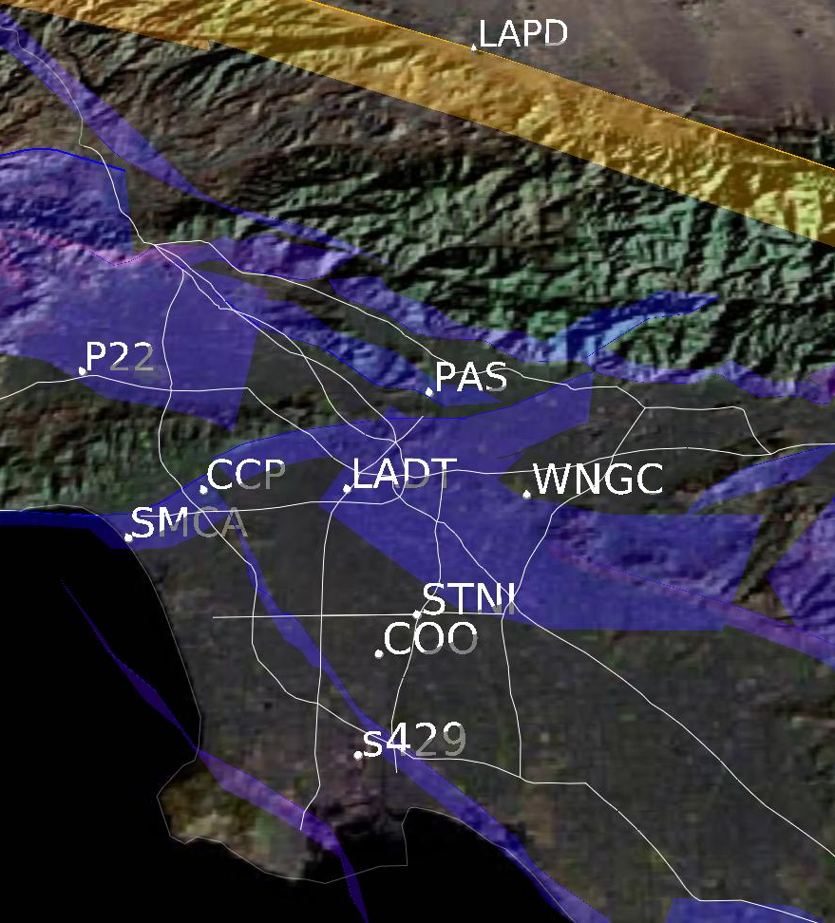
MCE_{R} S_{a} for 14 Sites (2015)

Slide 3
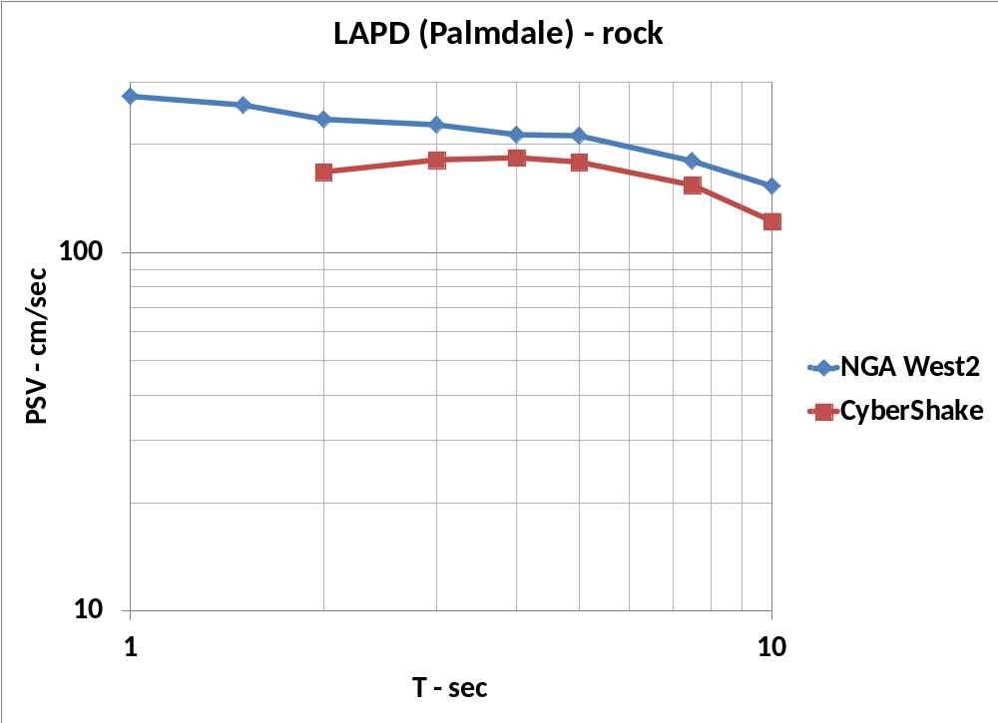
LAPD MCE_{R}

Slide 4
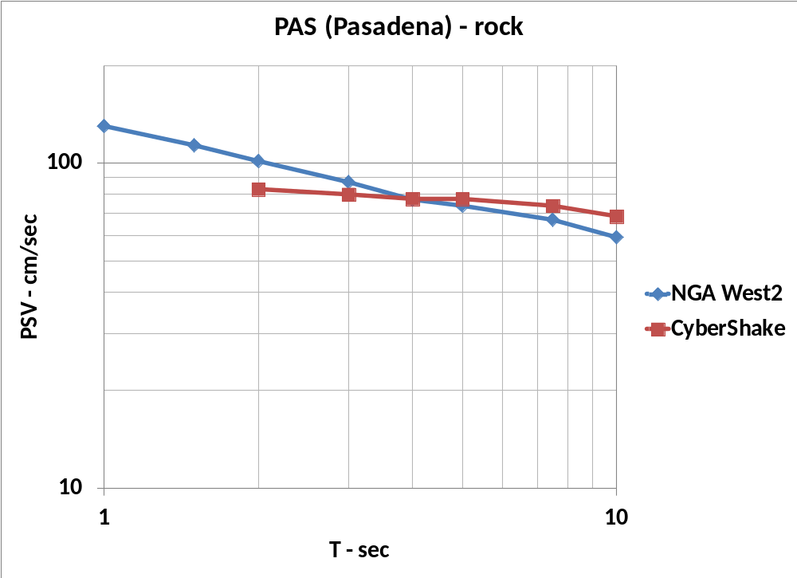
PAS MCE_{R}

Slide 5
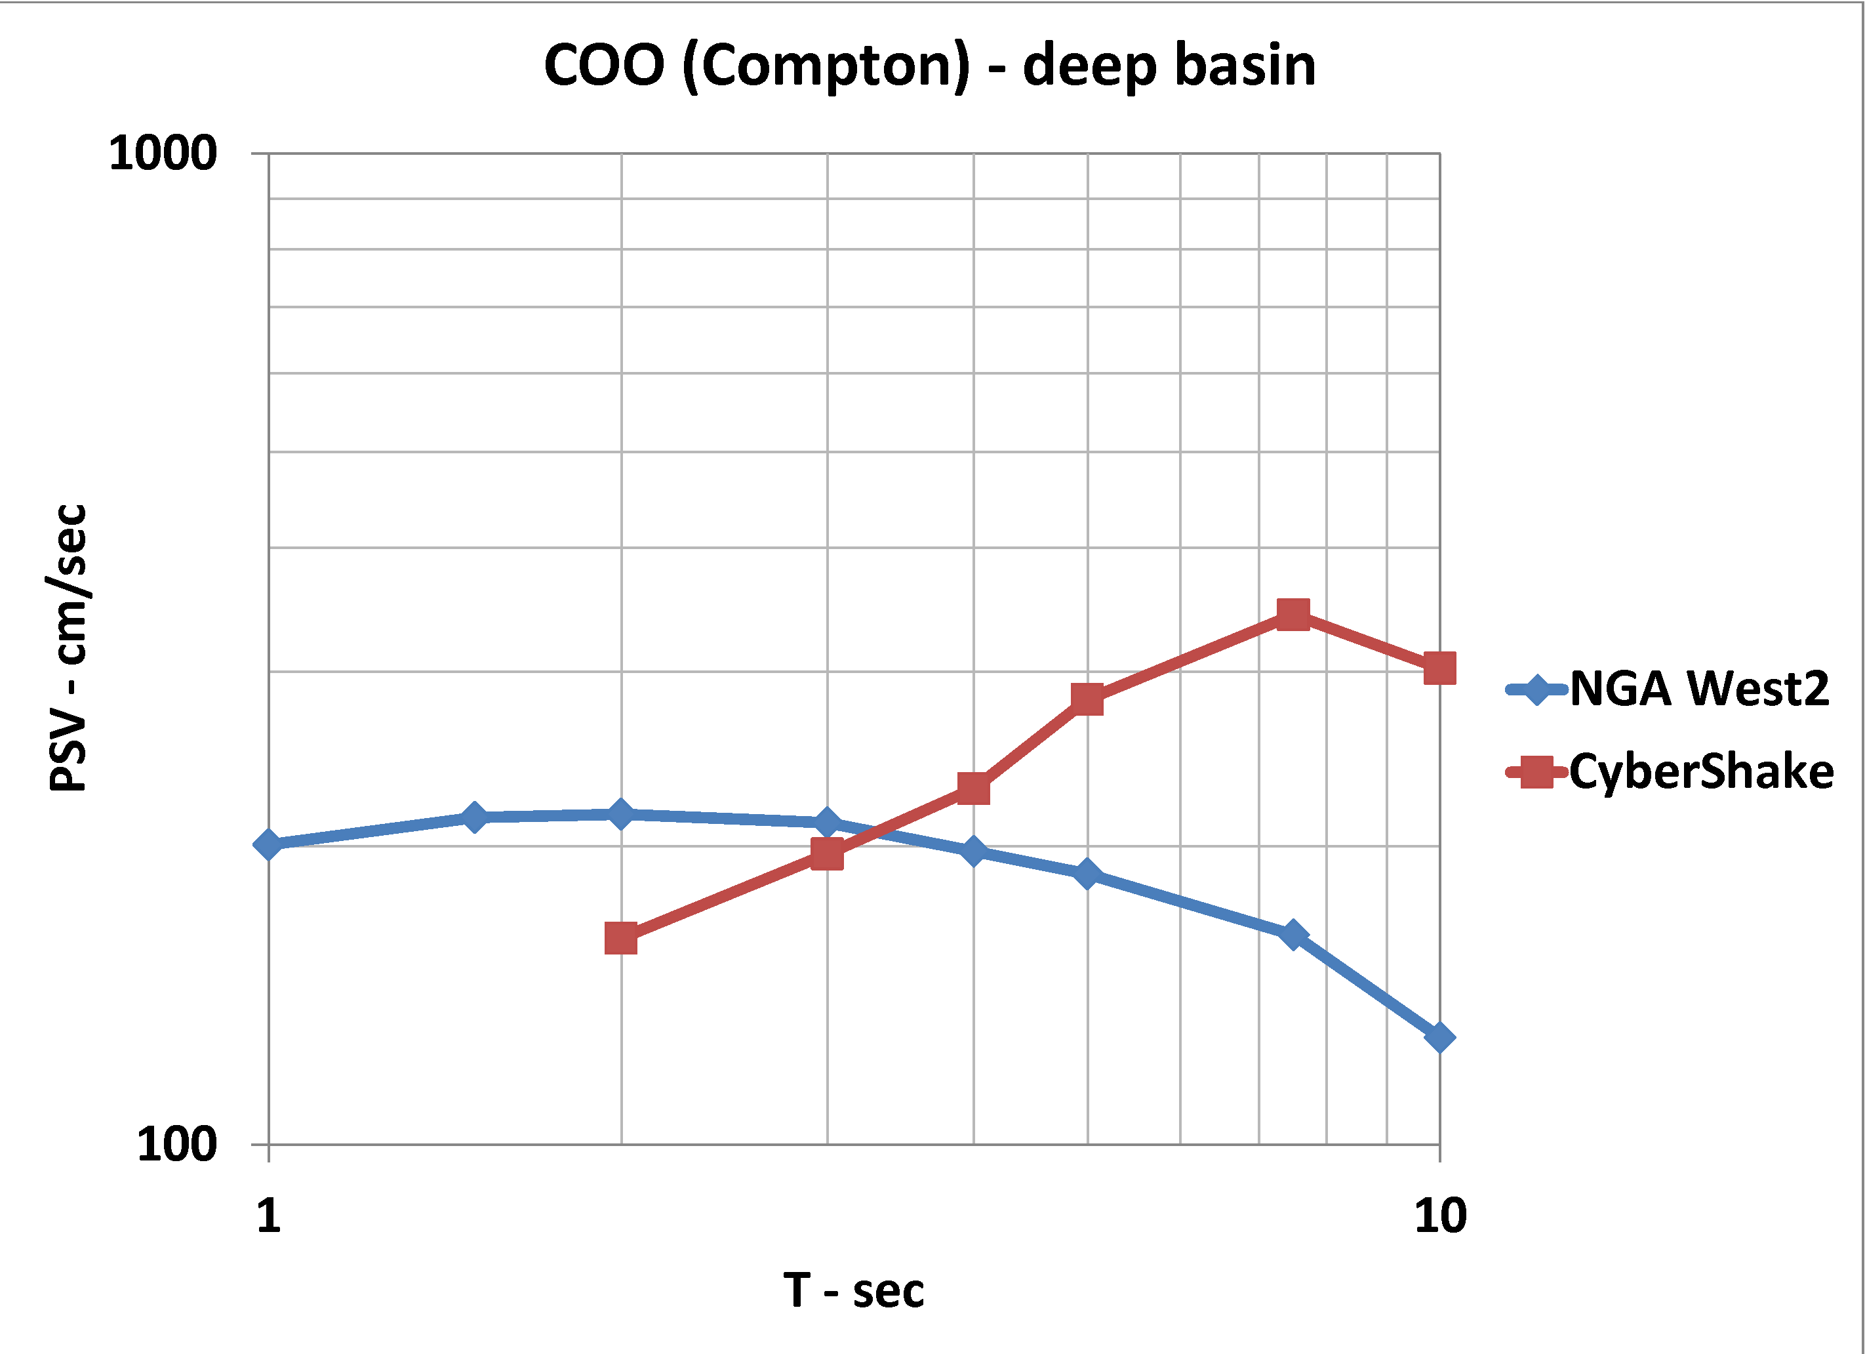
COO MCE_{R}

Slide 6
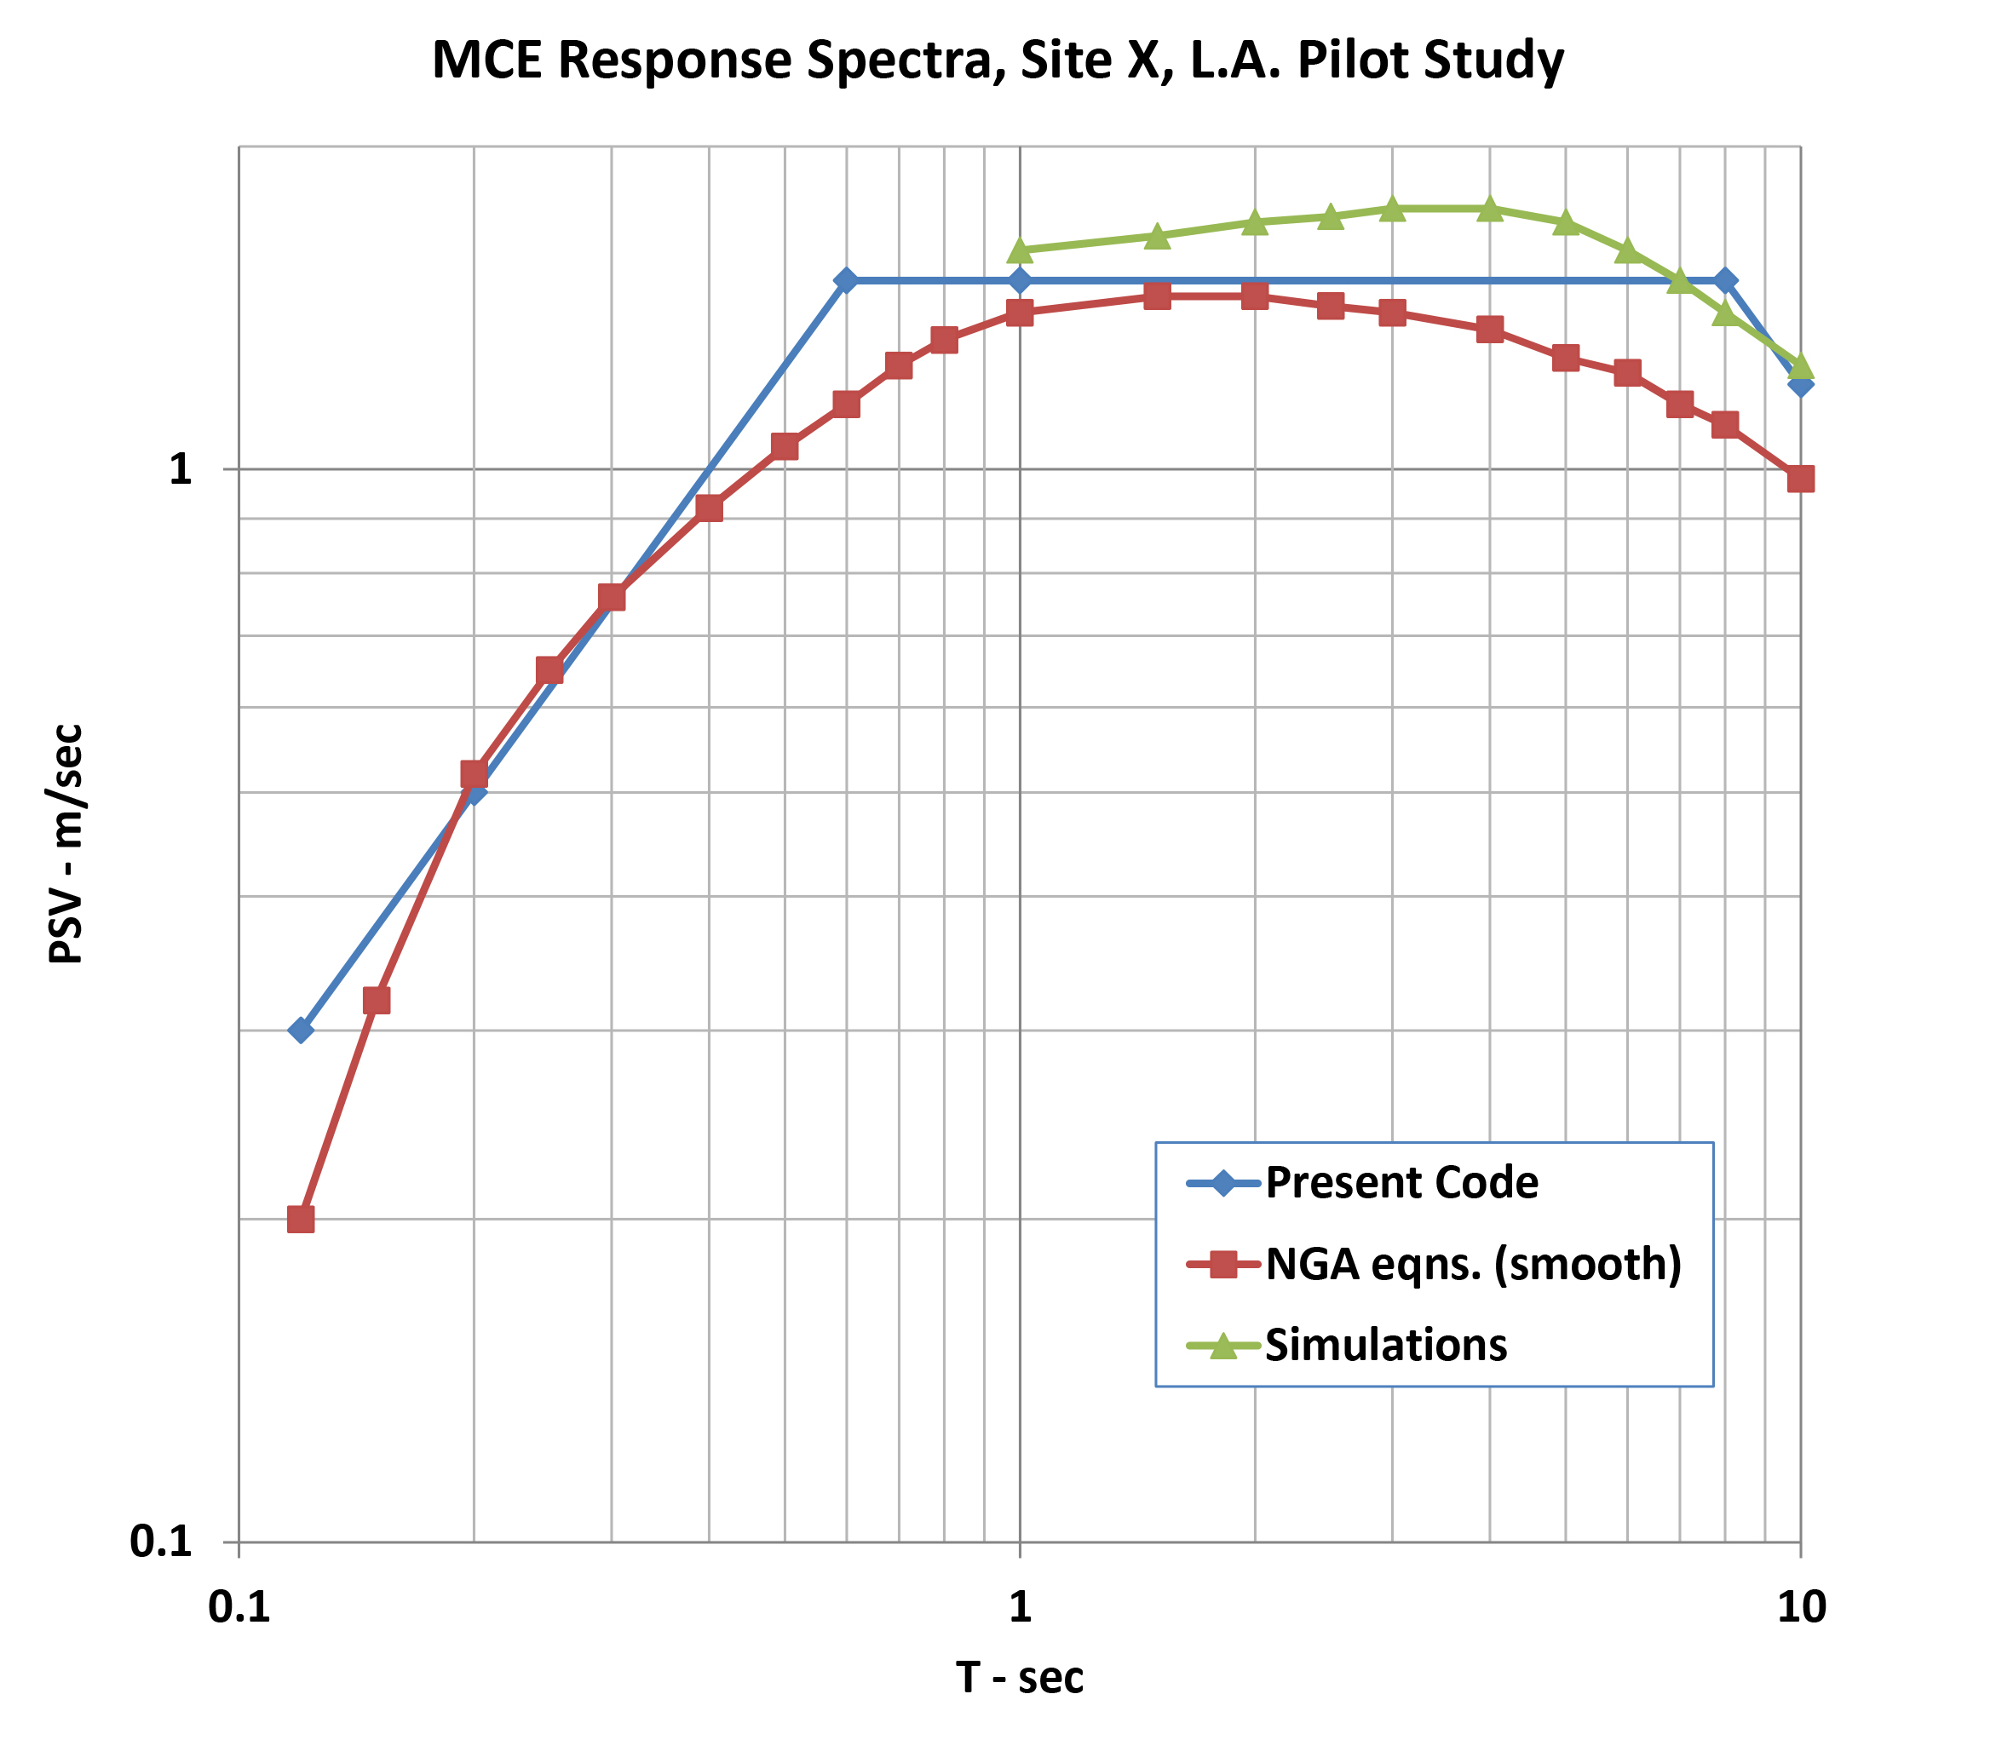
MCE_{R} Response Spectra, Multiple Sites, L.A. Region

Slide 7
Logic Tree for PSHA/DSHA for MCER
Source Model |  |  |  |  | G-M Models |  |  | Weights
 |  |  |  |  | GMPE |  |  | Collective Weights for Periods, T - sec
 |  |  |  |  |  | Individual |  | ≤ 1.0 | 2 | 3 | 4 | ≥ 5
 |  |  |  |  | NGA West2 | weight
 |  |  |  |  | AKS | 0.25
 |  |  |  |  | BASS | 0.25 |  | 1 | 0.8 | 0.7 | 0.6 | 0.5
 |  |  |  |  | CB | 0.25
 |  |  |  |  | CY | 0.25
 | UCERF
 |  |  |  |  | CyberShake |  |  | 0 | 0.2 | 0.3 | 0.4 | 0.5

Slide 8
May 16, 2016 UGMS Meeting
Present MCE_{R} S_{a} for 50 Additional Sites
Deaggregation Data

Slide 9
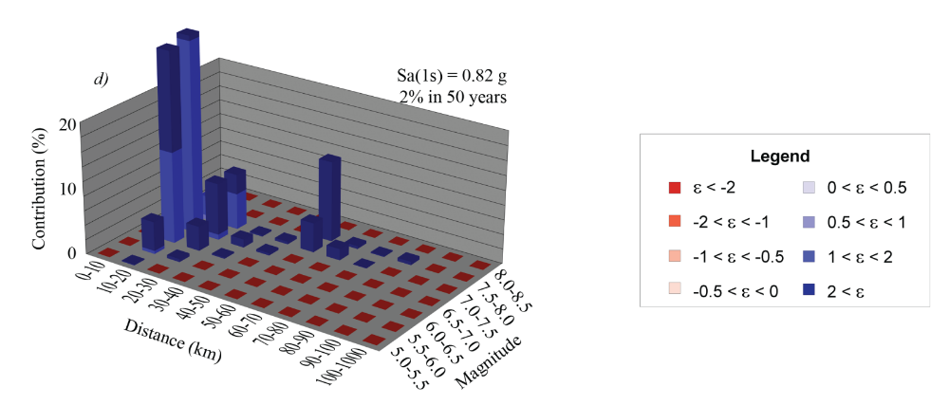
Deaggregation Plot for L.A.

Slide 11
Site-Response Analysis
Purpose: Check Effect on long period response spectra to realistic soil properties in upper 200m

Slide 12
Los Angeles Sites

Slide 16
Proposal for MCE_{R} S_{a} Construction
Original 14 sites
Additional 50 sites

Slide 17
Logic Tree for PSHA/DSHA for MCER
Source Model |  |  |  |  | G-M Models |  |  | Weights
 |  |  |  |  | GMPE |  |  | Collective Weights for Periods, T - sec
 |  |  |  |  |  | Individual |  | ≤ 1.0 | 2 | 3 | 4 | ≥ 5
 |  |  |  |  | NGA West2 | weight
 |  |  |  |  | AKS | 0.25
 |  |  |  |  | BASS | 0.25 |  | 1 | 0.8 | 0.7 | 0.6 | 0.5
 |  |  |  |  | CB | 0.25
 |  |  |  |  | CY | 0.25
 | UCERF
 |  |  |  |  | CyberShake |  |  | 0 | 0.2 | 0.3 | 0.4 | 0.5

Slide 18
Validations
1994 Northridge Earthquake
  CyberShake Simulations of M~6.7 on Northridge fault
  Ground motions recorded at stations close to CyberShake grid pts.
  Ground motions computed from NGA West2 GMPEs

Slide 19
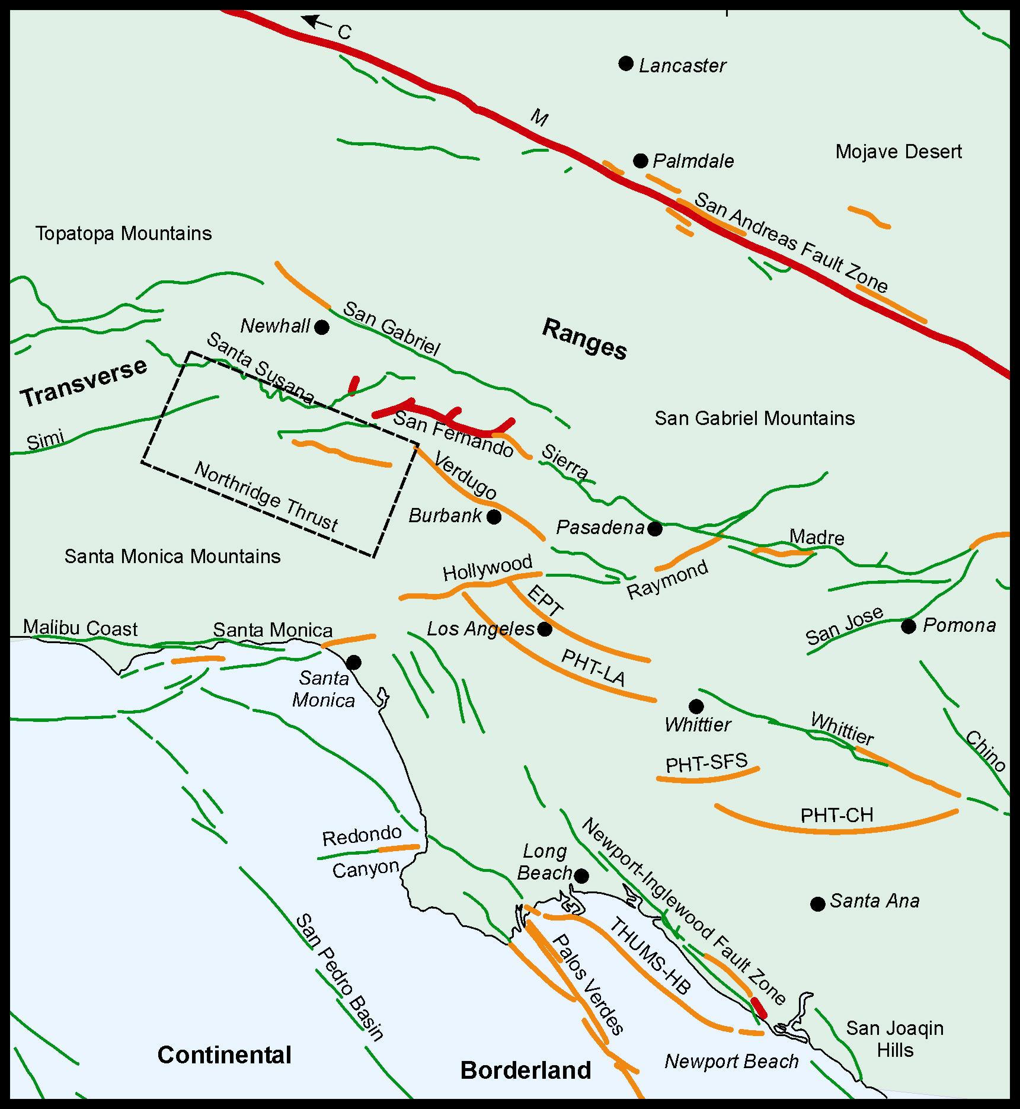
Limitation of Empirical Approach – Los Angeles
Lack of Local Strong Motion Records
(Only 1994 M6.7 Northridge & 1971 M6.6 San Fernando EQ)

Slide 22
Goal of UGMS for 2016
MCE_{R} S_{a} maps for L. A. City
  Amendment to ASCE 7-16 maps for City
  Resource to City and consultants
Look-up tool ~ USGS web app tool

Slide 23
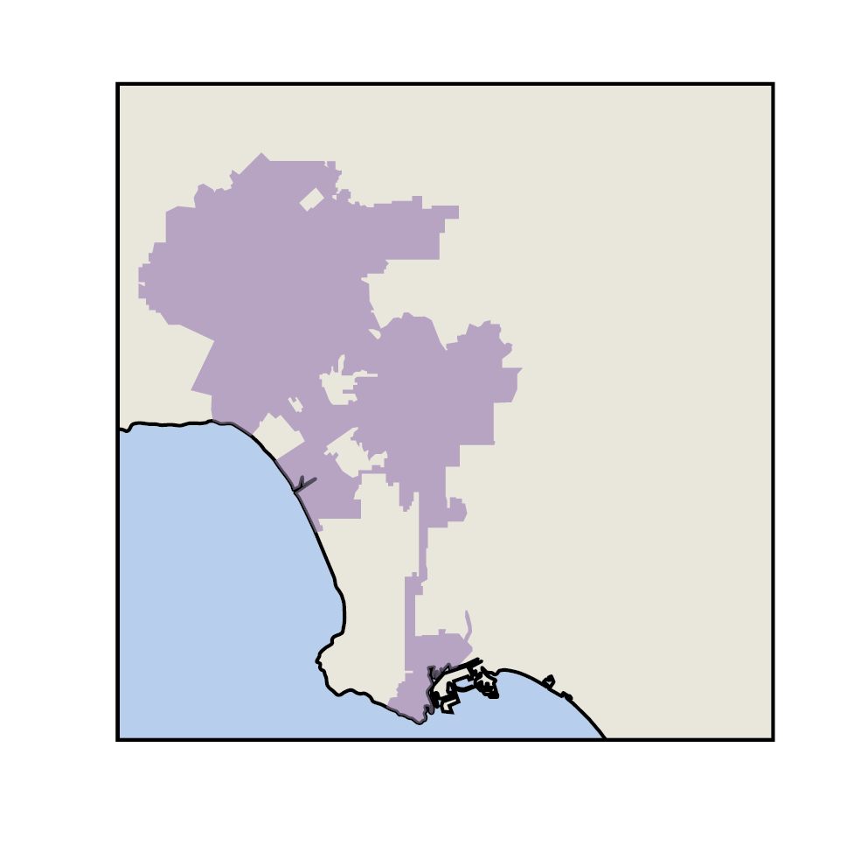
MCE_{R} Look-up Tool for L. A. City
Enter Site lat./long.
  Lat. 34.05204
  Long. -118.25713
L. A. City Map

Slide 24
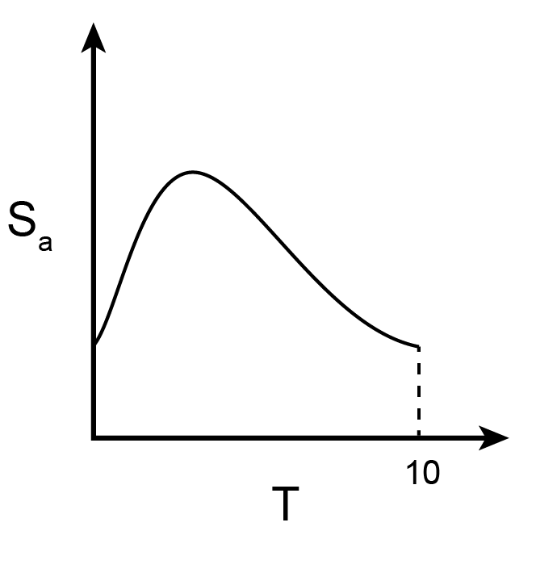
MCE_{R} Look-up Tool for L. A. City
Output
  Site Class = C
  V_{S30} = 390 km/sec
  Z_{1.0} = 0.31 km
  Z_{2.5} = 2.08 km
  Table : MCE_{R} S_{a} vs T
  S_{DS} & S_{D1}
  per new rules in
  Ch. 21 of ASCE 7-16
MCE_{R}

Slide 25
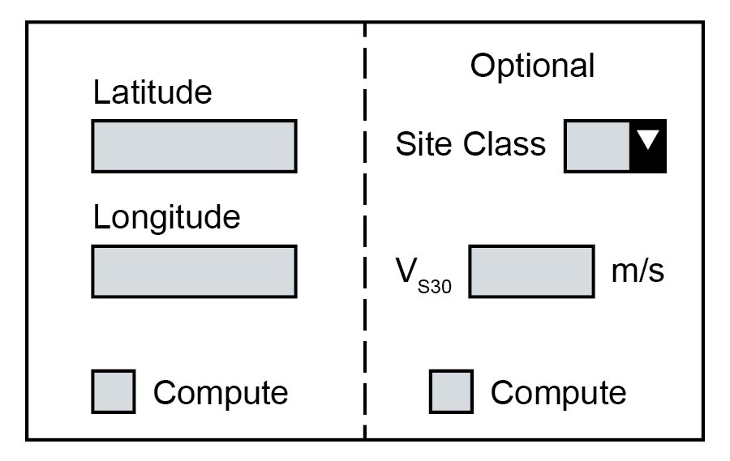
UGMS 2016 Schedule for Look-up Tool
Finalize calcs in summer/fall
Develop tool – start summer; Beta version in fall/winter

Slide 26
Promotion of “Maps”
What is best approach to accomplish this task?

