Slide 1








The CyberShake Platform
Scott Callaghan (SCEC)
October 1, 2026
2026 DEFORM workshop
scottcal@usc.edu

Slide 2
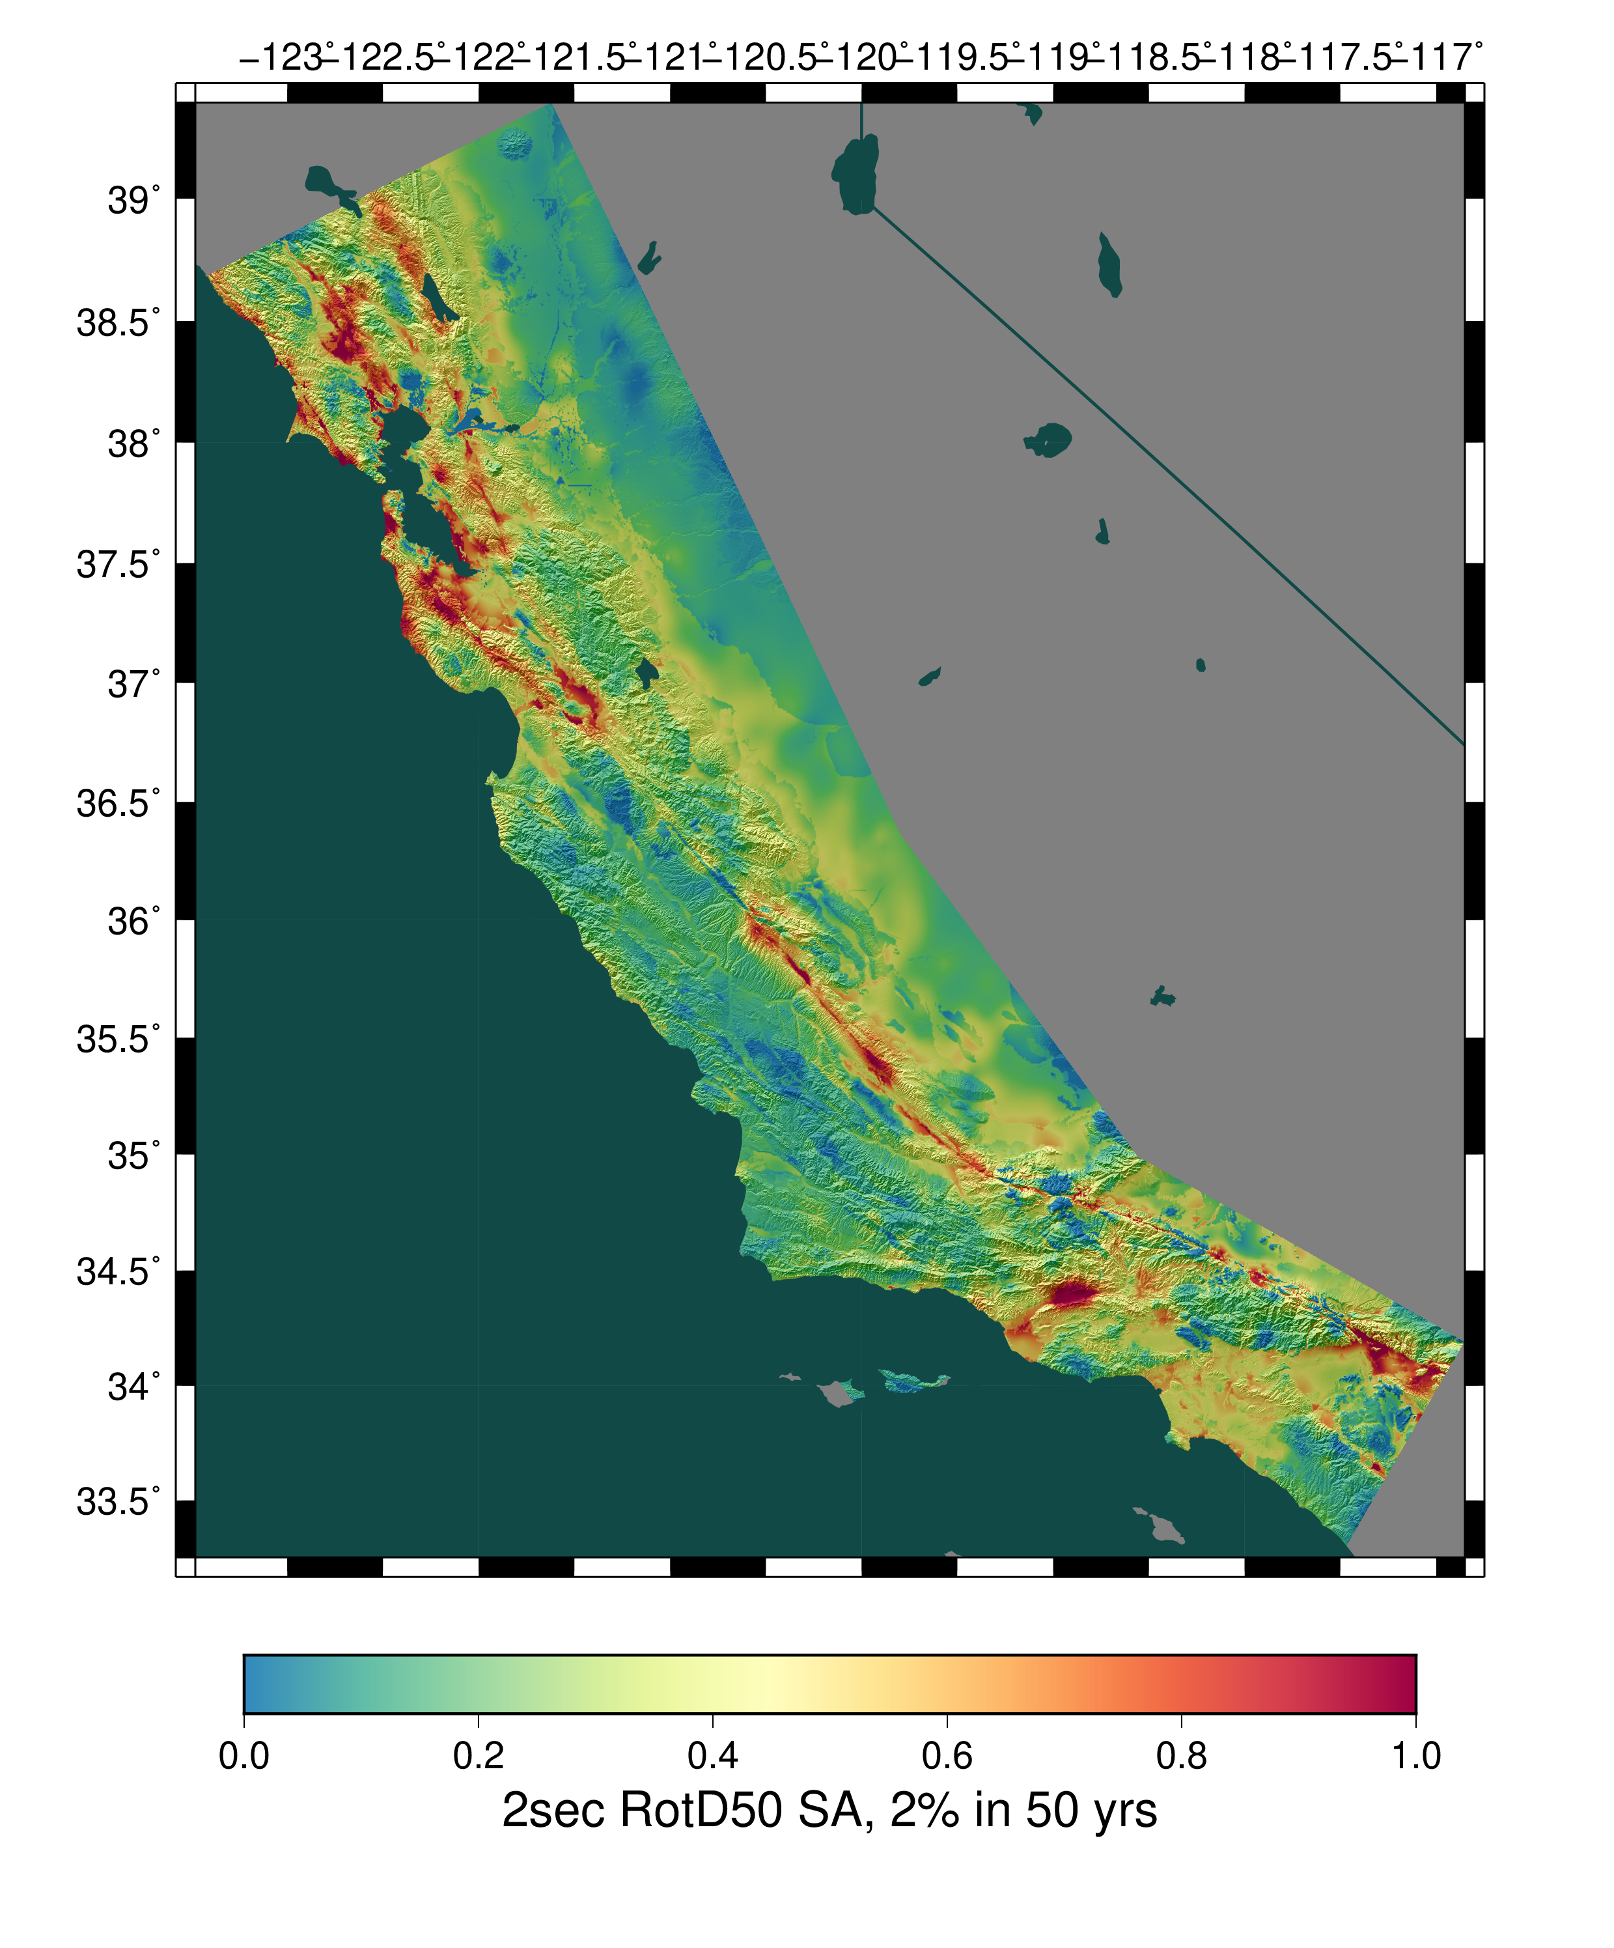
PSHA Overview
CyberShake platform
Key elements
Computational requirements
Hazard data products
Results in California
Statewide California Earthquake Center | www.scec.org

Slide 3
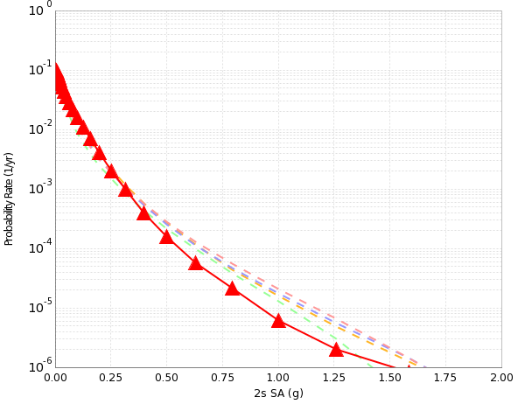
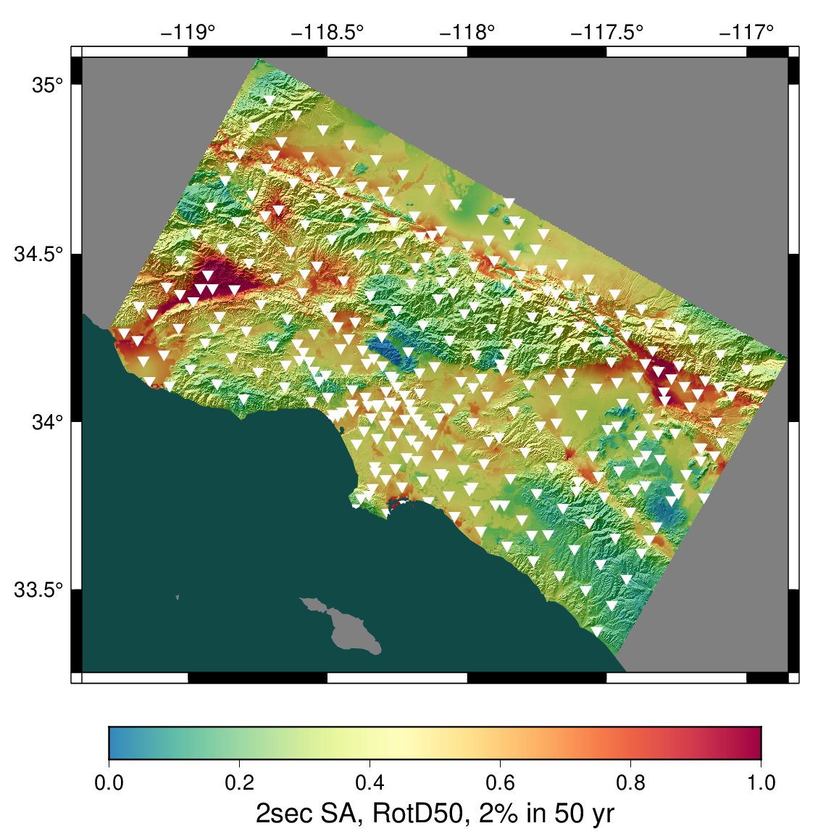
Probabilistic Seismic Hazard Analysis
What ground motions can I expect at a location over the next N years?
  Building codes
  Insurance rates
  Disaster planning
The PSHA process:
Obtain a list of all earthquakes
of interest (ERF)
Determine the shaking
each earthquake causes
Combine shaking with probabilities
to produce hazard products
Step 2 often performed using empirical GMMs
CyberShake uses physics-based simulation
2% in 50 years
0.4 g
Statewide California Earthquake Center | www.scec.org
3

Slide 4
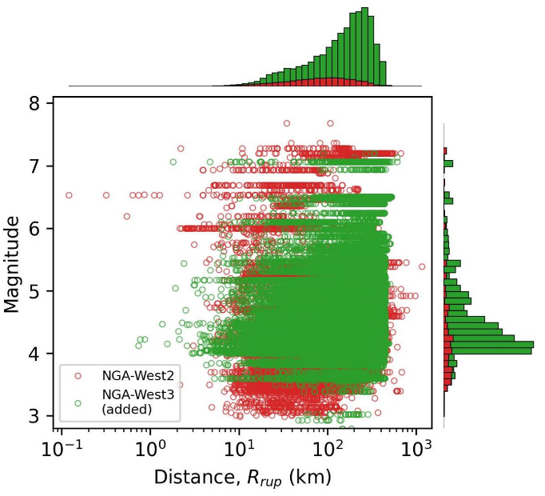
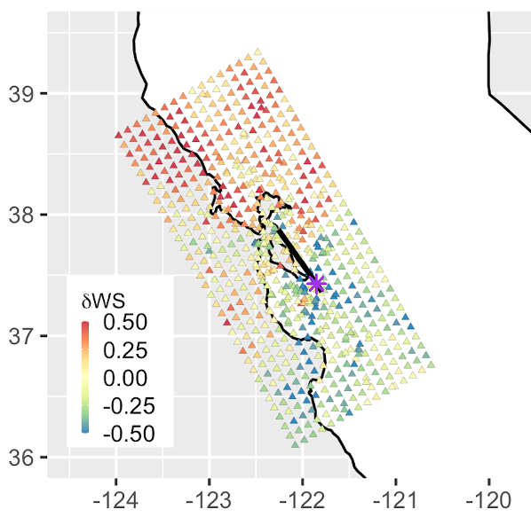
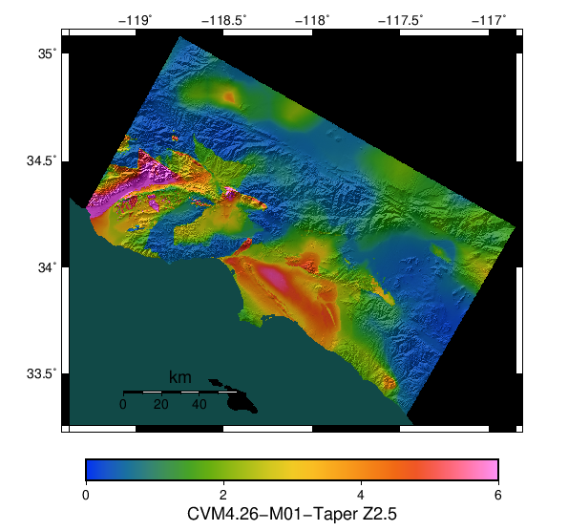
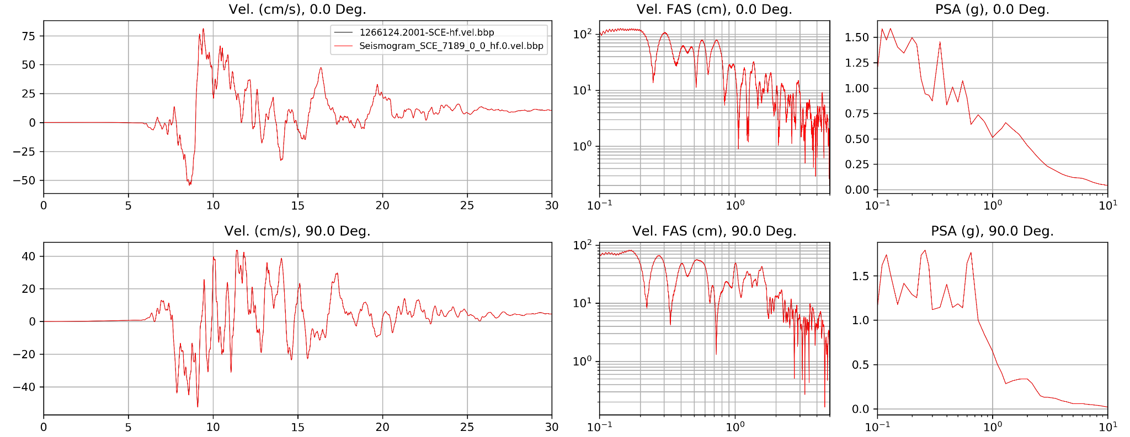
What does physics-based simulation offer?
Fills data gaps
Captures complex effects
Produces synthetic seismograms
Stewart et al., 2024
Statewide California Earthquake Center | www.scec.org
3

Slide 5
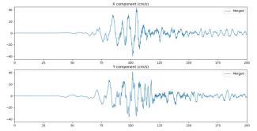
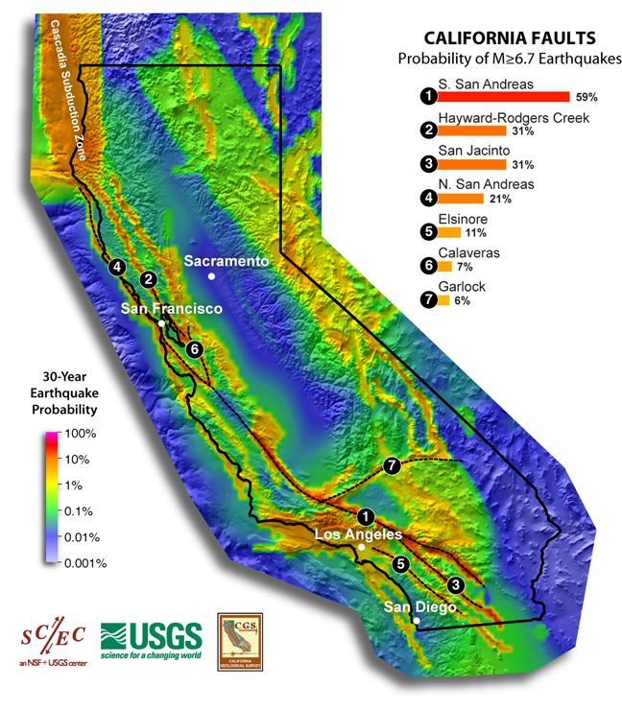
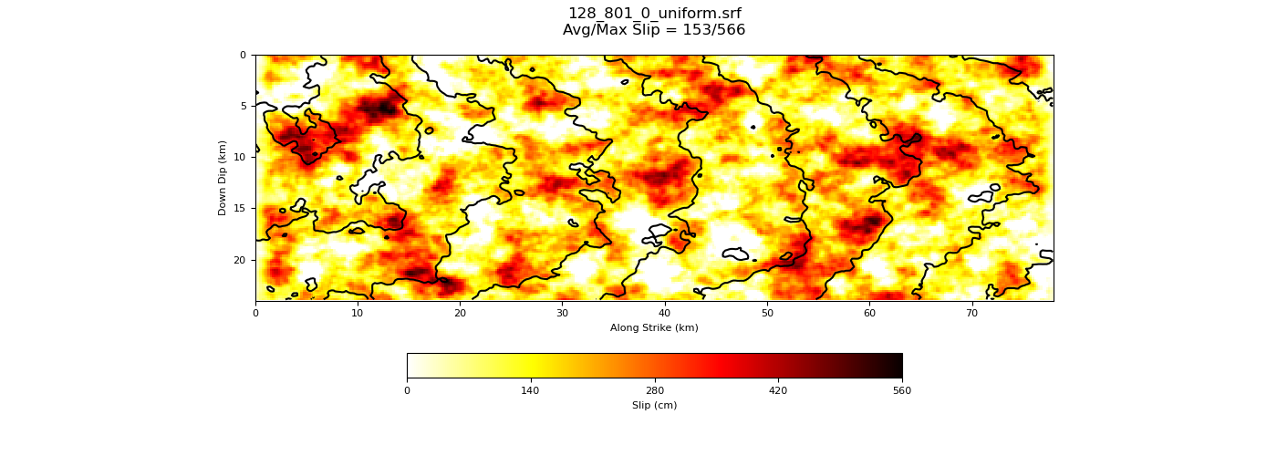
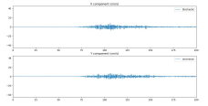
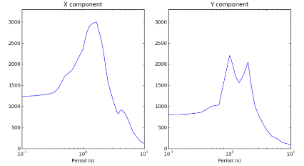
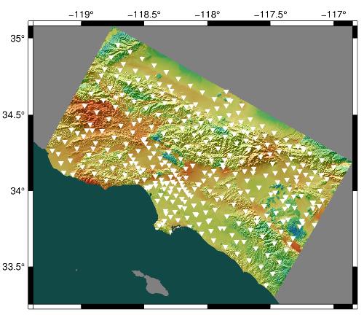
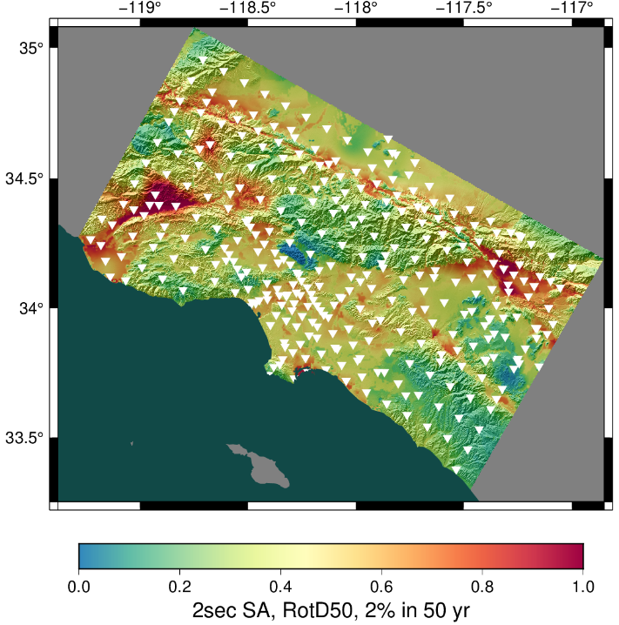
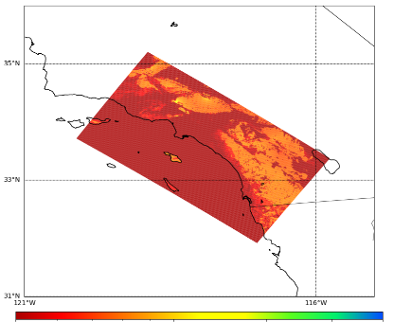
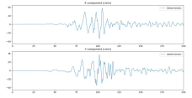
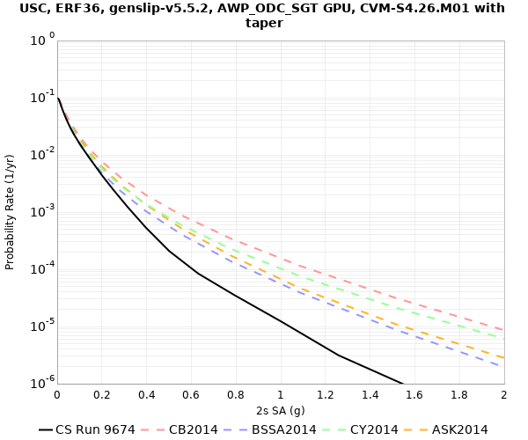
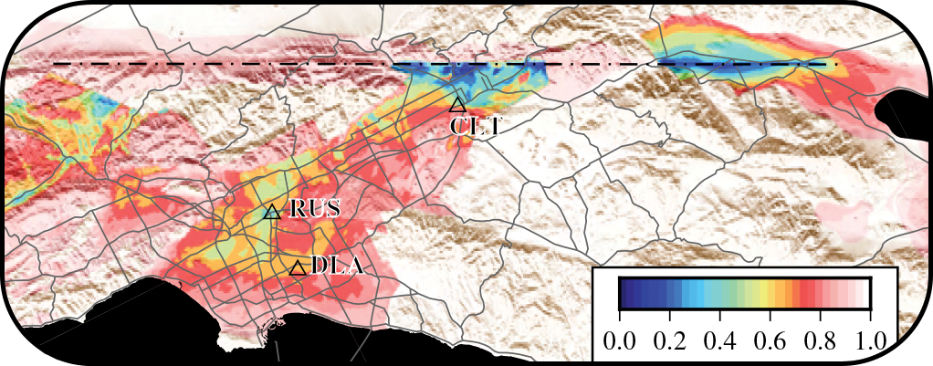
CyberShake Workflow Steps
Broadband CyberShake workflow
Low-frequency CyberShake workflow
Graves-Pitarka kinematic rupture generator
High-frequency seismogram synthesis (BBP)
Merge and combine
0-50 Hz broadband data products
600,000+ events
Uniform California Earthquake Rupture Forecast
1-50 Hz seismograms
RotD50, PGA, PGV, durations
AWP-ODC-SGT
wave propagation
Low-frequency seismogram synthesis
Intensity measures
Aggregate
data products
UCVM
Strain Green Tensors
0-1 Hz low-frequency seismograms
RotD50, PGA, PGV, durations
Velocity Mesh
Hazard Curve
Hazard Map
Statewide California Earthquake Center | www.scec.org
3

Slide 6
Earthquake Rupture Forecast (ERF)
Derived from the UCERF2 model for California
Prescribes fault surfaces with associated probabilities and magnitudes to be consistent with data
Magnitudes permitted to vary +/- 2 sigma to capture aleatory variability in potential magnitude
  Median magnitudes range from 6.55 to 8.15
  Full range is 5.95 to 8.45
Events with median magnitude > 6.5 and with some part of the fault is within 200 km of the site are included in the simulation
Statewide California Earthquake Center | www.scec.org
6

Slide 7
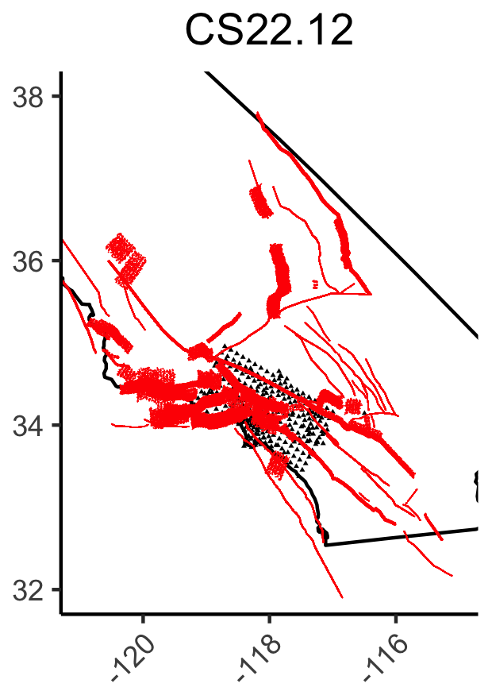
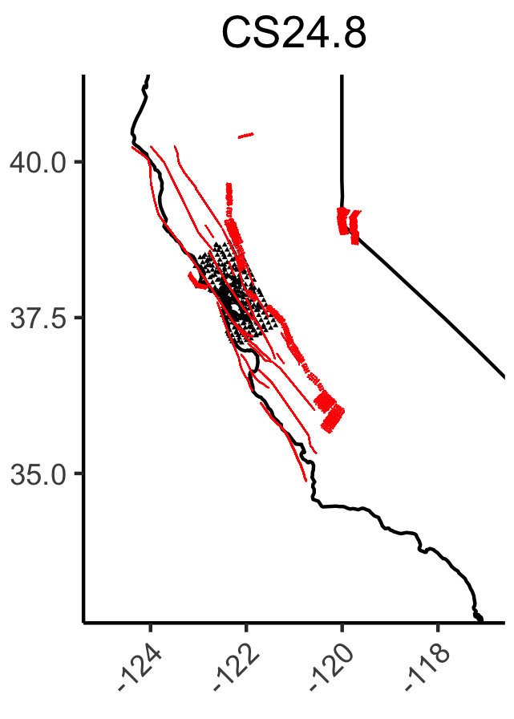
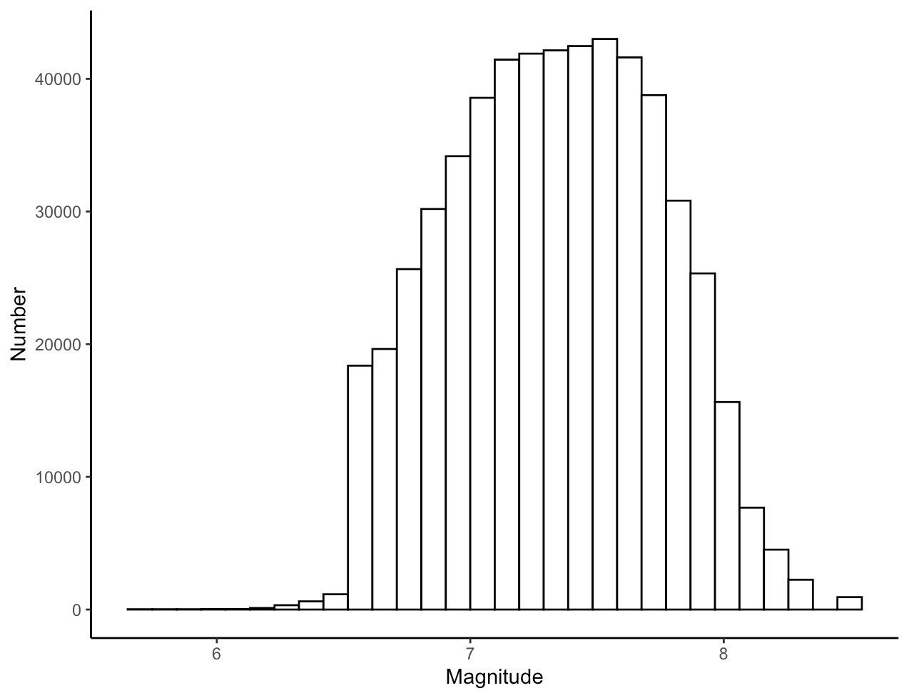
CyberShake ERF
Magnitude distribution
from UCERF2
Statewide California Earthquake Center | www.scec.org
6

Slide 8
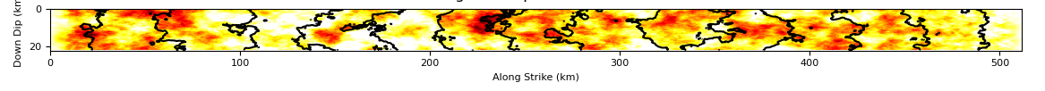
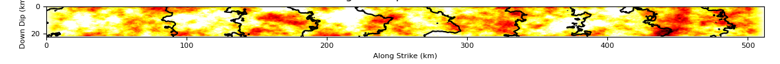
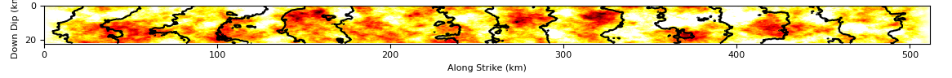
Rupture Generator
CyberShake uses the Graves-Pitarka kinematic rupture generator
Takes in a fault geometry, hypocenter location, rupture velocity (67.5%-87.5% of shear wave velocity), random seed
Hypocenters are placed every 4 km along the fault surface
Each realization or “rupture variation” has a unique rupture velocity, hypocenter, and slip distribution
Statewide California Earthquake Center | www.scec.org
6

Slide 9
Velocity Model Development
Begin with “best available” 3D velocity model for a region
  May depend on the key metric
  May require tiling together multiple models
Consider near-surface for modification if Vs is too high
  In California, frequently apply a Vs30-based taper
Apply minimum Vs floor
Check Vp/Vs ratio
Perform verification simulations to check for unusual features
Statewide California Earthquake Center | www.scec.org
6

Slide 10
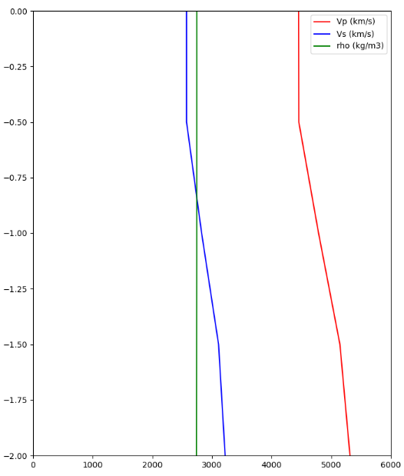
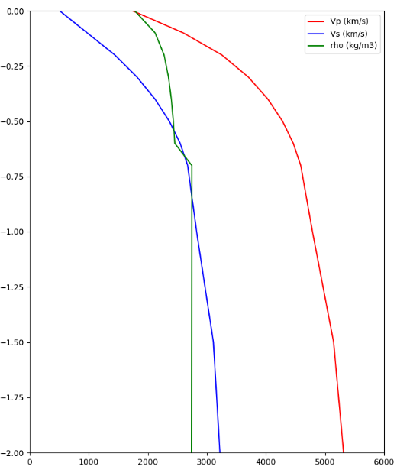
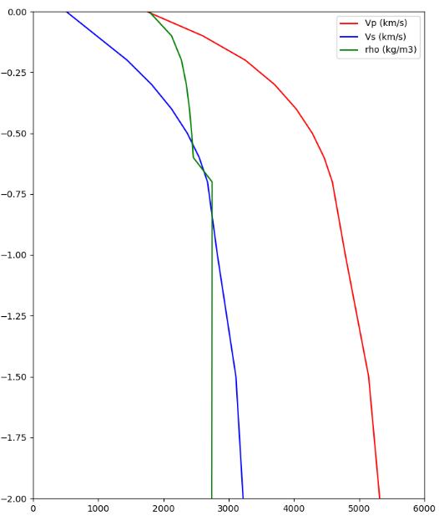
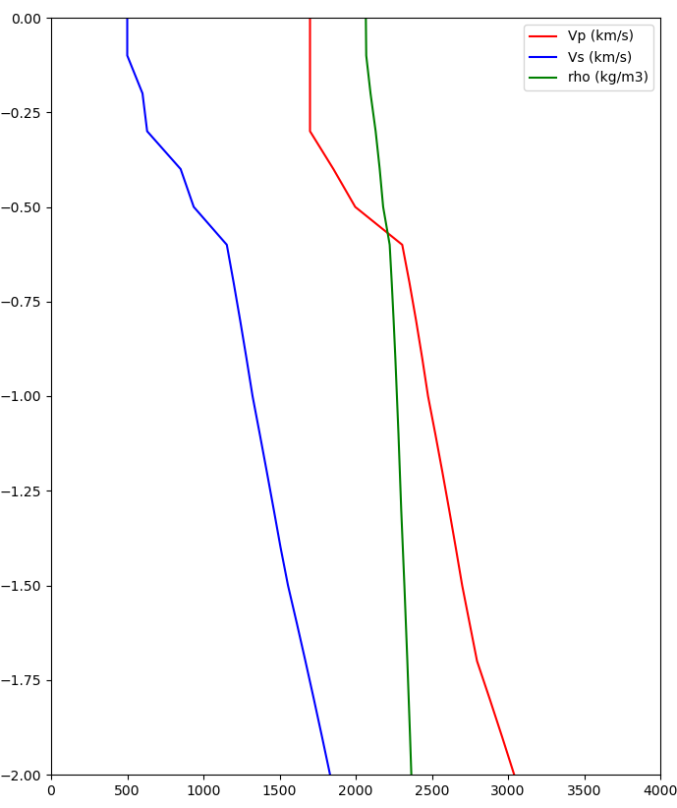
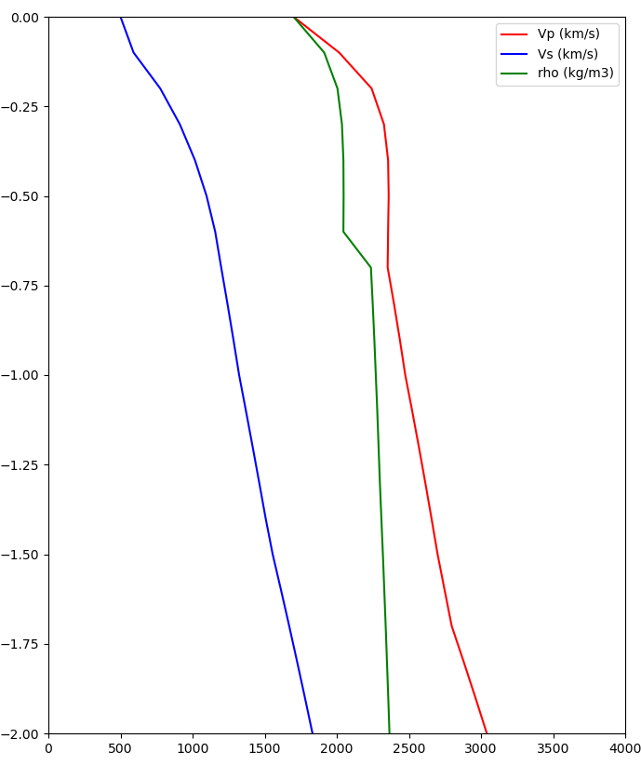
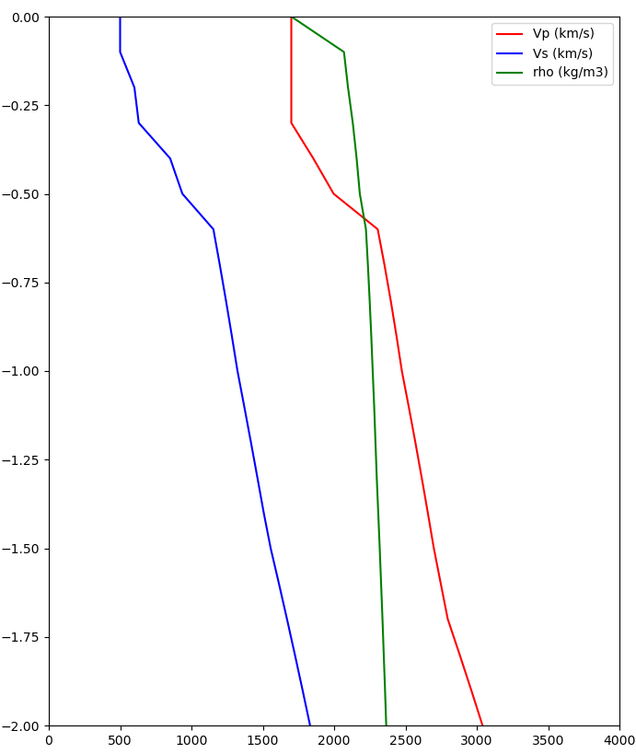
Merged Taper Near-Surface Modification
Original Model
700m taper
Merged taper
Taper is selected at all depths to 700m
Vs30: 2573 m/s -> 400 m/s
Z1.0: 0m -> 110m
LAPD
(outside basin)
~2500 m/s
~400 m/s
Taper is only selected at surface point
Vs30: 500 m/s -> 500 m/s
Z1.0: 580m -> 580m
USC
(in basin)
500 m/s
500 m/s
Statewide California Earthquake Center | www.scec.org
6

Slide 11
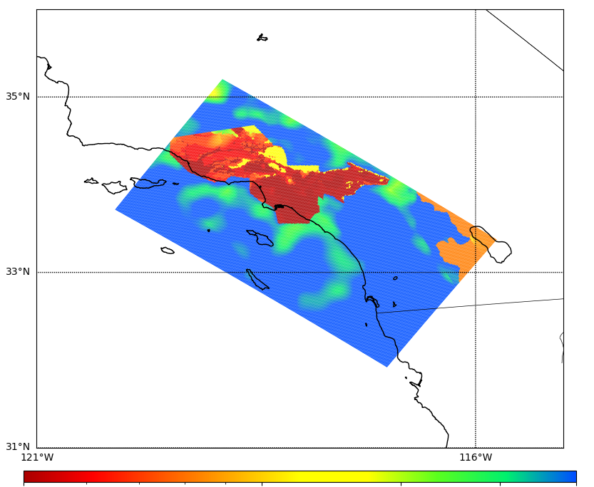

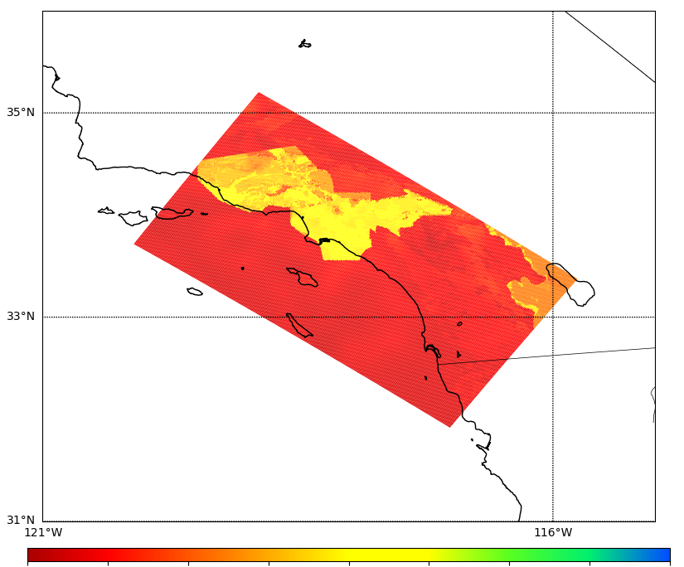
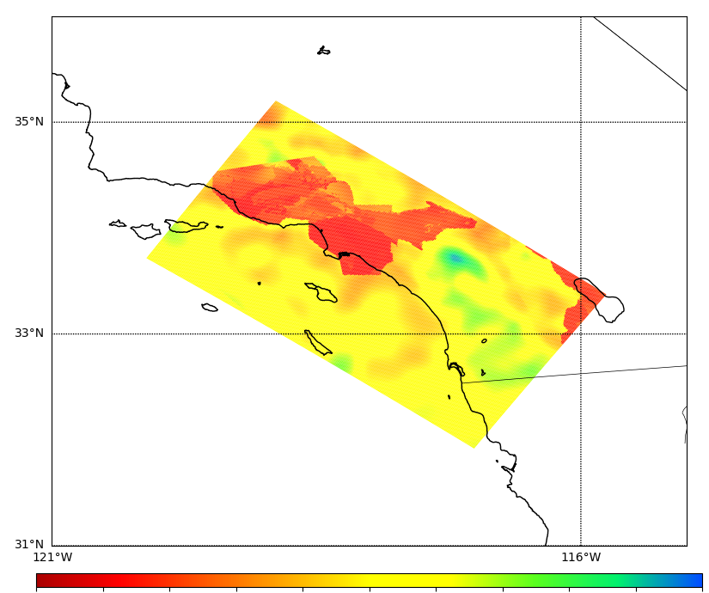
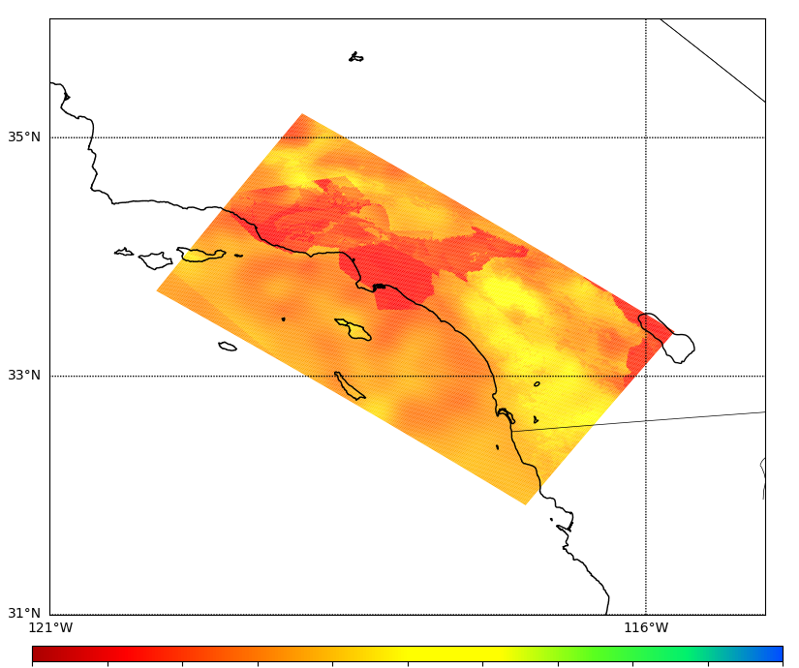
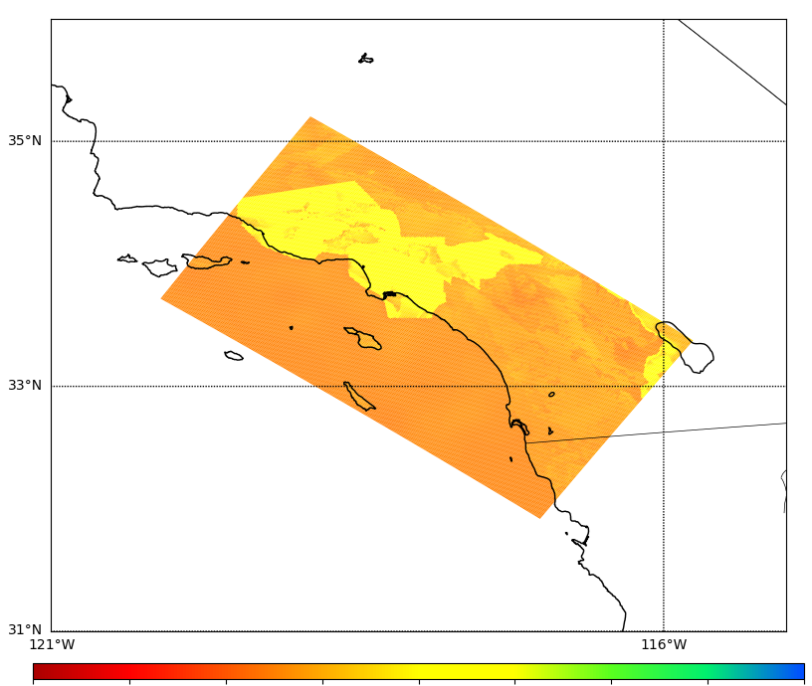
Southern California Velocity Model
Original Model
Final Model with Taper
% difference
Surface
500
1000
2500
500
1000
2500
-100%
0%
100%
300m
depth
500
1000
2500
500
1000
2500
-100%
0%
100%
Statewide California Earthquake Center | www.scec.org
6

Slide 12
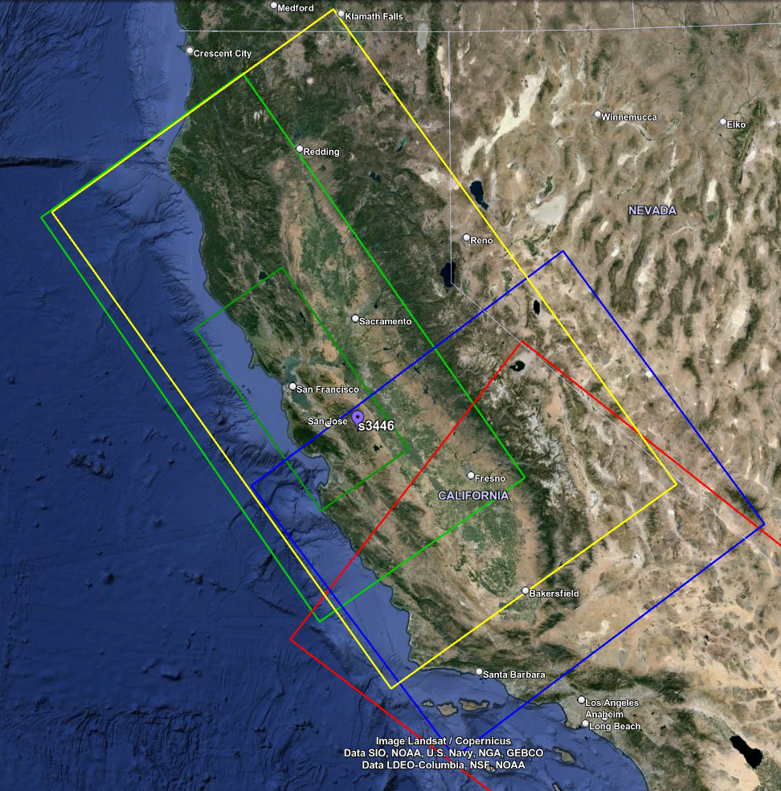
Northern California Velocity Model
Model consists of 3 tiled models
  USGS SFCVM, v21.1
  CCA-06 (tomographic model)
  1D background model, based on Sierra geologic region in SFCVM
Smoothing applied 20km from all interfaces
Merged taper applied throughout model
Vp/Vs ratio capped at 4
Minimum Vs of 400 m/s
Sample simulation volume with tiling
Statewide California Earthquake Center | www.scec.org

Slide 13
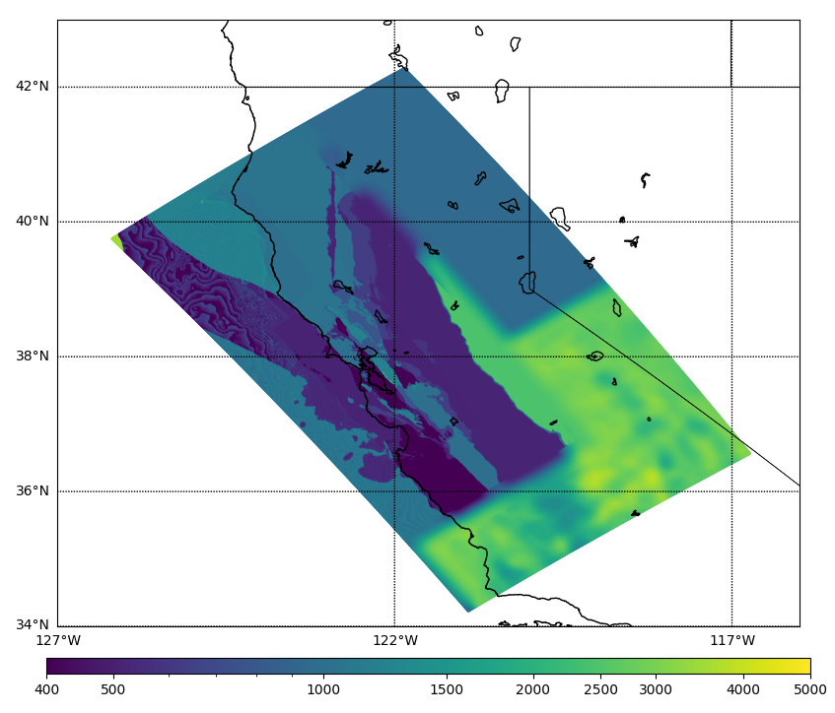
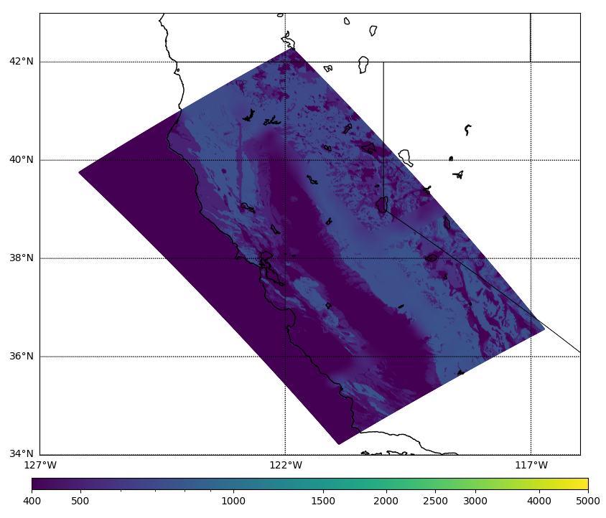
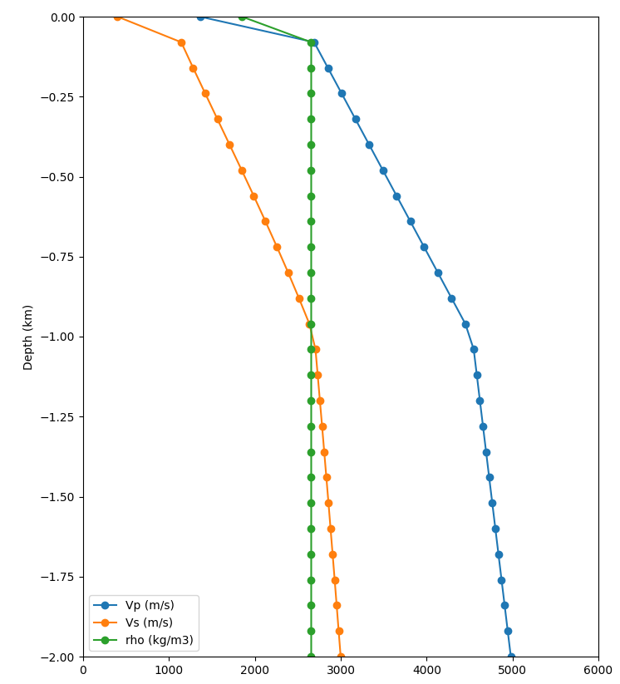
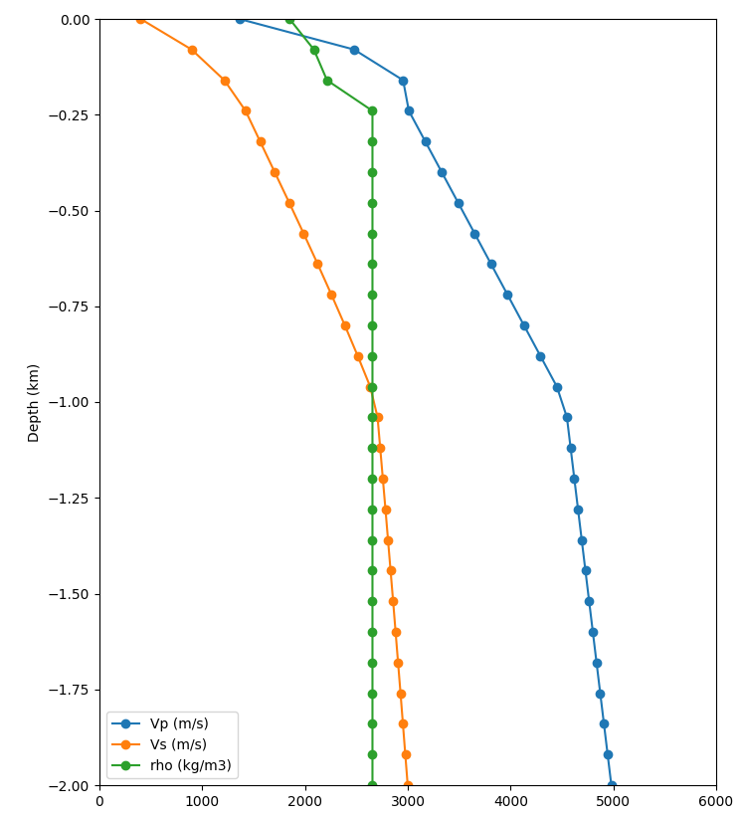
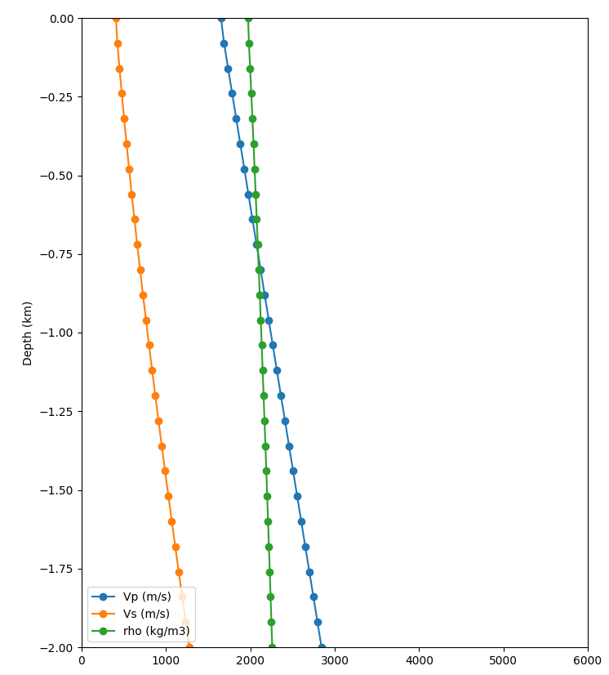

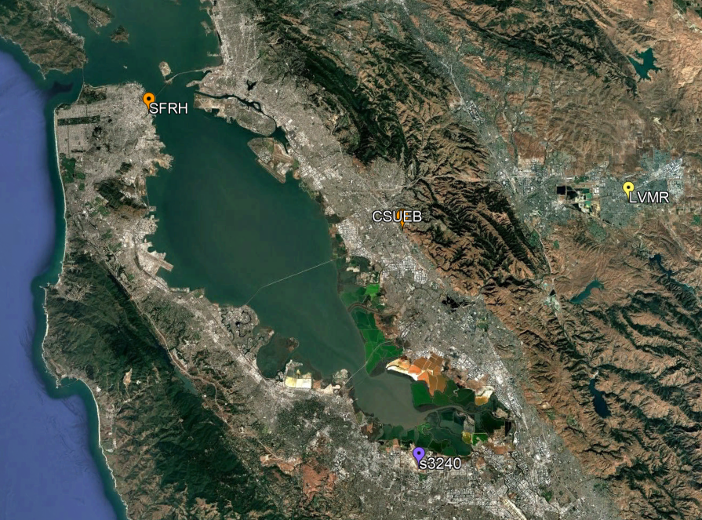
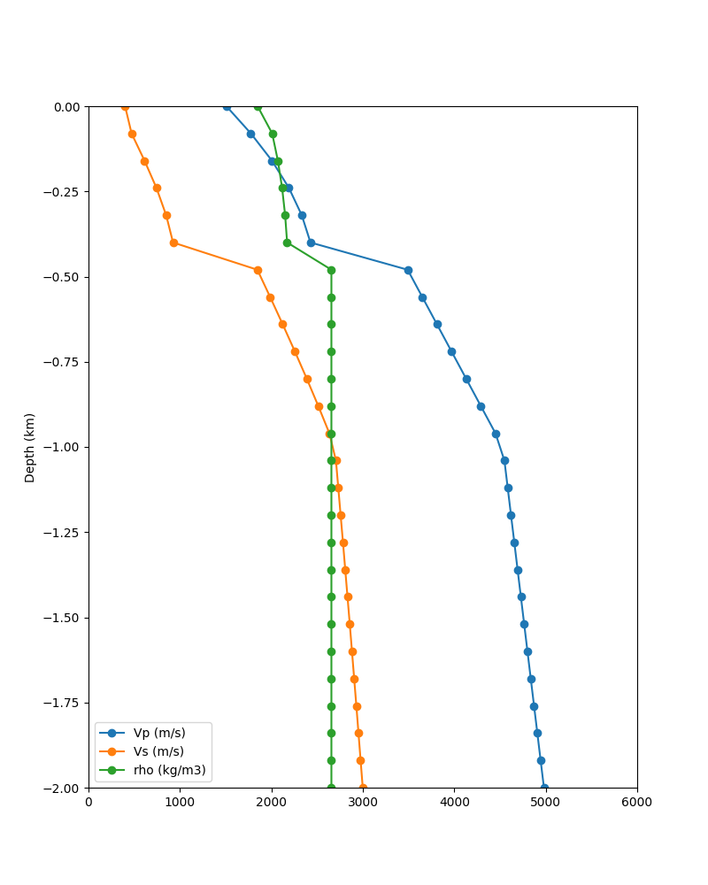
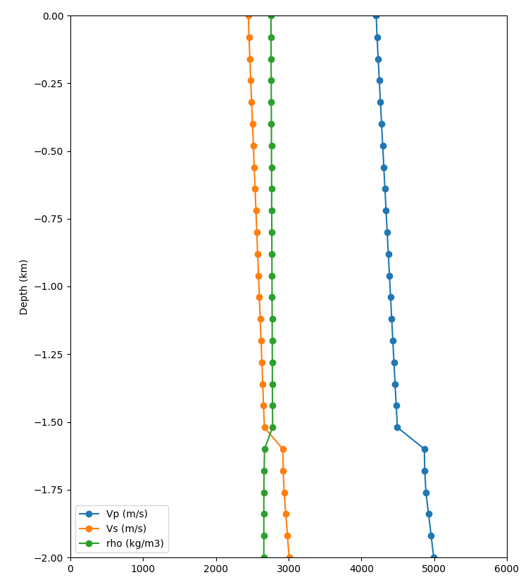
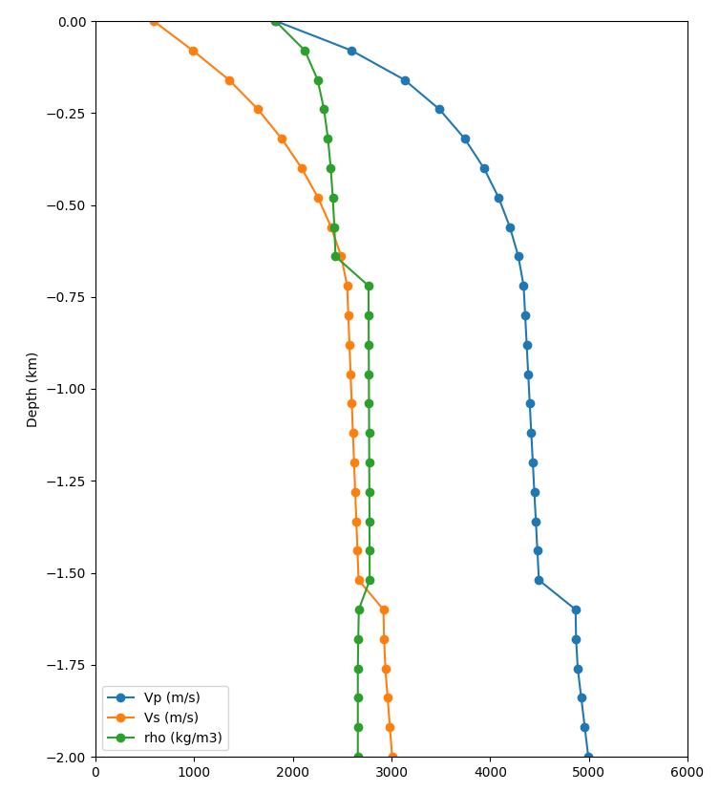
Merged Taper Impact
Apply Thompson Vs30-based taper to grid points in top 700m if resulting Vs is lower
Before taper
After taper
Before taper
After taper
Surface slice, no taper
Surface slice, merged taper
Statewide California Earthquake Center | www.scec.org

Slide 14
CyberShake Model Development
Performs integrative science: advances in source descriptions, velocity models, and physics codes are integrated into the platform to improve hazard models
Integrate and test
Identify new features
Perform study
CyberShake Development Process
Distribute
data products
Analyze results
Statewide California Earthquake Center | www.scec.org
14

Slide 15
Computational Requirements
CyberShake Stage | Number of Tasks | Node-Hours | Output Data
Velocity mesh creation (parallel) | 1 | 10 CPU | 300 GB
AWP-ODC wave propagation (parallel) | 3 | 200 GPU | 1500 GB
Low-frequency seismogram synthesis (parallel) | 1 | 230 CPU | 38 GB
High-frequency seismogram synthesis (serial) | 20,000 | 90 CPU | 187 GB
Total, 1 site (including small jobs) | 20,020 | 530 | 2025 GB
Total, full region | 6.3 million | 167,000 | 620 TB
CyberShake runs require scientific workflows utilizing high performance computing resources
Statewide California Earthquake Center | www.scec.org
14

Slide 16
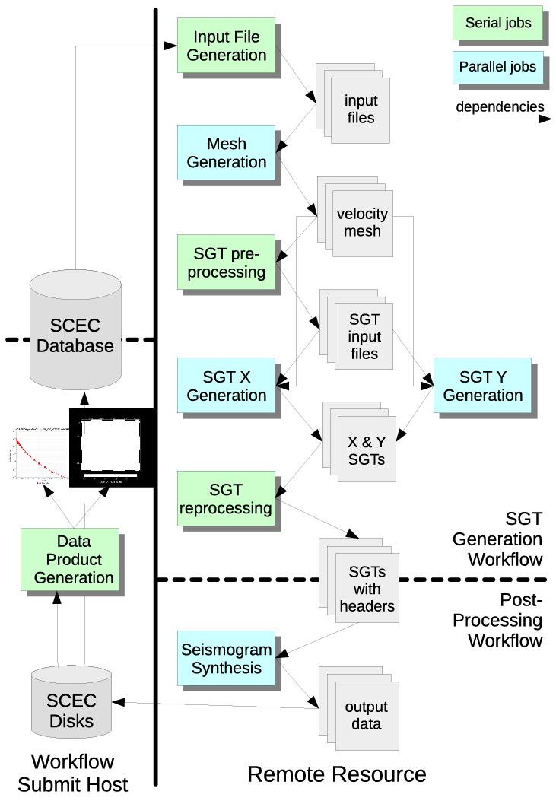
Scientific Workflow Stack
Pegasus-WMS: describes workflow as directed graph of jobs with dependencies that make and use files
HTCondor: manages queue of jobs and executes them on remote systems
No changes to application codes
Scientific workflows provide:
  Automation
  Data management
  Job execution
  Error recovery
Statewide California Earthquake Center | www.scec.org

Slide 17
Study 24.8 (Northern California) Statistics
September 24 – November 8 (45 days)
Ran wave propagation calculations on OLCF Frontier and low-frequency synthesis and stochastic simulations on TACC Frontera
Used about 180,000 node-hours, including up to 44% of Frontier
Ran 27,800 jobs using Pegasus-WMS and HTCondor workflow tools
Managed 1 PB of data
Produced 36 TB / 9 million files of output data products
Generated 126.8 million three-component seismograms and 34.3 billion IMs
Statewide California Earthquake Center | www.scec.org

Slide 18

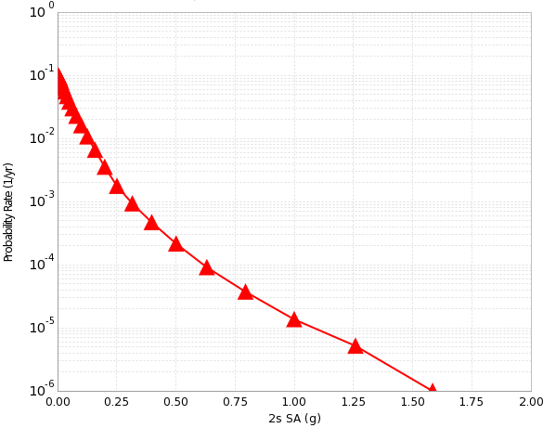
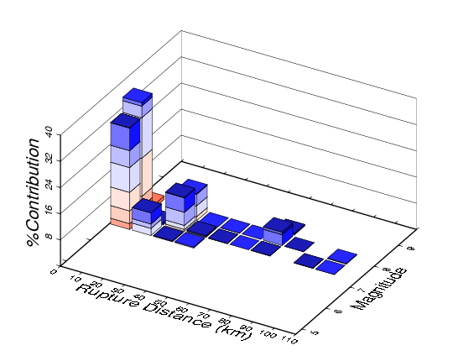
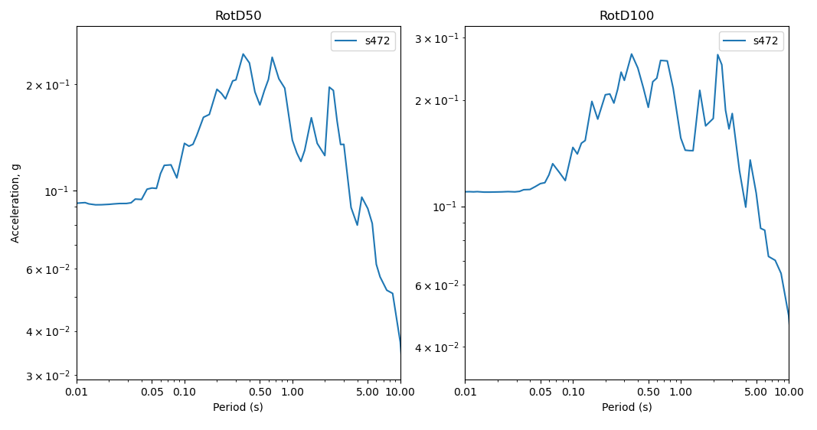
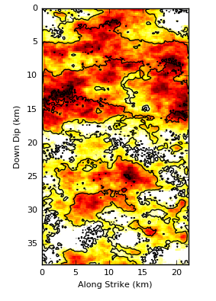

Layered Dataset of Hazard Products
Hazard Maps (multiple periods)
Hazard Curves
(100s of sites)
Disaggregation (arbitrary level)
Seismograms
(~500,000 per site,
2- or 3-component)
Intensity Measures
(100s per seismogram)
Earthquake Realizations
(~1M events per hazard model)
Statewide California Earthquake Center | www.scec.org
17

Slide 19
Data Products
Seismograms for each event for each site
  Base raw data product
Peak shaking measures
  RotD50 and RotD100 at dozens of periods, PGA, PGV
  Vertical response spectra for 3-component seismograms
  Subset (~25%) stored in relational database for quick access with the CyberShake Data Access Tool
Durations
  5-75%, 5-95%, others
  Period-dependent durations
  ~25% stored in relational database
Smoothed EAS (Effective Amplitude Spectra)
Aggregate products: disaggregations, hazard curves, hazard maps
You’ll get to try data retrieval later in the workshop!
Statewide California Earthquake Center | www.scec.org

Slide 20



Example California Results
2 sec
10 sec
2 sec
San Francisco
San Francisco
San Francisco
50 km
50 km
100 km
Los Angeles
Statewide California Earthquake Center | www.scec.org

Slide 21














Low-frequency Hazard Map Comparisons
2s
2s
2s
CS18.8 velocity profile
CS24.8 velocity profile
3s
3s
3s
CS24.8
CS24.8
GMMs
CS24.8
CS18.8
CS24.8
CS24.8
GMMs
CS24.8
CS18.8
5s
5s
5s
10s
10s
10s
CS24.8
CS24.8
GMMs
CS24.8
CS18.8
CS24.8
GMMs
CS24.8
CS18.8
CS24.8
Statewide California Earthquake Center | www.scec.org

Slide 22



Validation of CyberShake
CyberShake-based Ergodic GMM
Slide from Xiaofeng Meng
Statewide California Earthquake Center | www.scec.org
Notes:
Instead of looking just a handful of historical events, I use the entire CyberShake dataset to develop a cybershake-based ergodic ground motion model. The equation here is the functional form we used for regression, which includes magnitude scaling, geometrical spreading, linear site response, basin response term, anelastic attenuation. Delta Be is the between event residual, or the event term, which represents the systematic differences between one event’s ground motions and the median from the model. Delta Wes is the within event residual, which represents the variances of ground motions from the same event at different sites. It is a combination of site effects, path effects, some source effects, such as radiation pattern and directivity, and random fluctuations. The figure to the right shows total residuals versus magnitude, VS30 and rupture distance. There is no trend, which confirms that the ergodic model is properly constrained.

Slide 23




Low-frequency Aggregate Analyses
2 sec
5 sec
10 sec
Comparison of distance and magnitude scaling between CyberShake-derived GMM and other GMMs
Z-score distribution
Statewide California Earthquake Center | www.scec.org

Slide 24



Broadband Data Products
1s
1s
CS24.8
GMMs
CS24.8
Z-score distribution
Statewide California Earthquake Center | www.scec.org

Slide 25





Next Steps
Updated velocity models
Nonlinearity
Surrogate models
Rekoske et al., 2025
Roten et al., 2023
New ERFs with multi-fault ruptures
…as well as technical improvements to support all this!
Statewide California Earthquake Center | www.scec.org
24

Slide 26


CyberShake Applications
Seismic hazard analysis
Earthquake early warning
Examining spatial correlations
Performance of distributed infrastructure
Basin amplifications for the
US national seismic hazard model
Response history analysis
Any application needing a large dataset
of ground motions
Moschetti et al. 2024
Baker et al. 2021
Statewide California Earthquake Center | www.scec.org

Slide 27








Questions?
<number>

