Slide 1

How’s It Shakin’?
Simulating Earthquakes with HPC
International HPC Summer School
June 3, 2014
Scott Callaghan
Southern California Earthquake Center
University of Southern California
scottcal@usc.edu

Slide 2
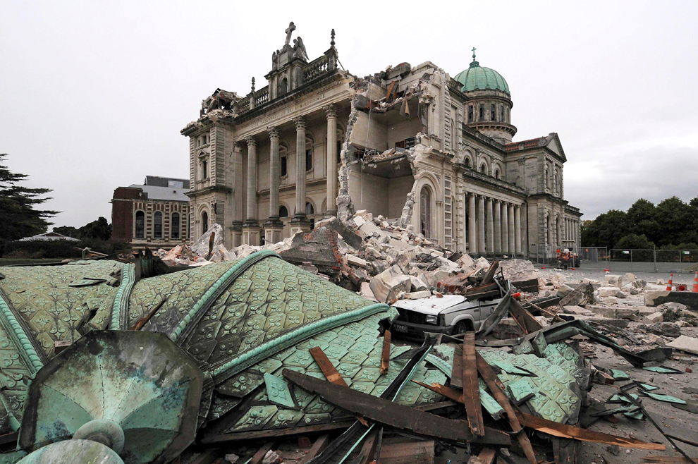
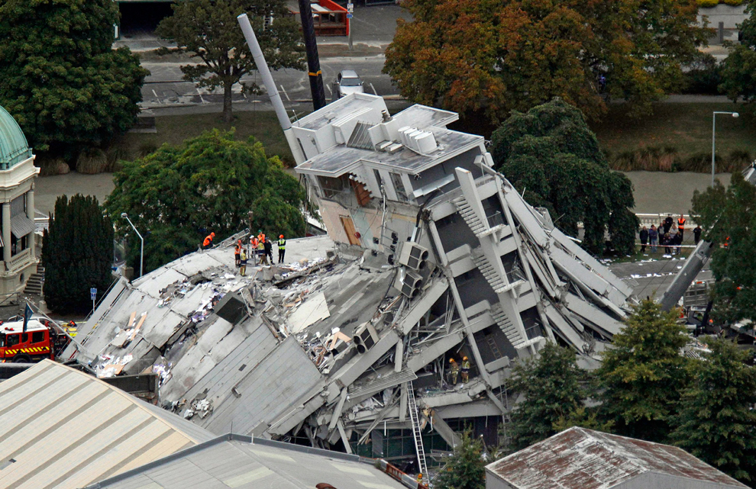
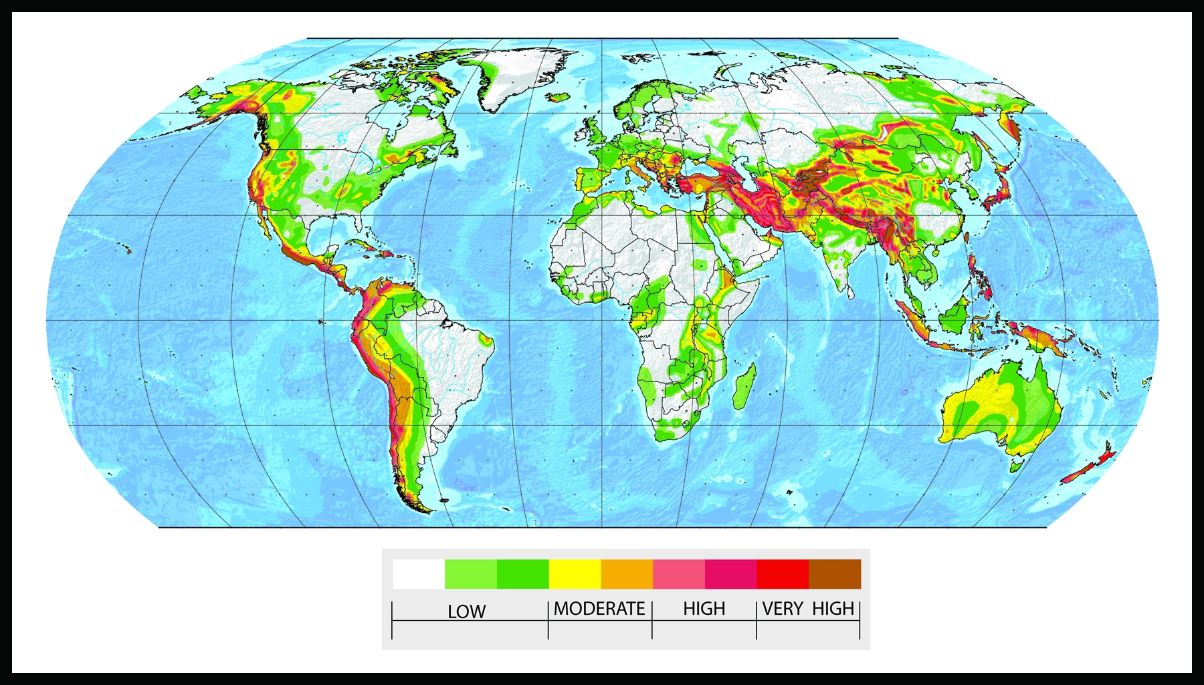
Earthquakes are worldwide
Christchurch, NZ
February 21, 2011
M6.1
185 deaths
29% GDP
Notes:
Last week: 245 eq M2.5+, 105 eq M4.5+
About 15 M7+, 1 M8+ per year
1 magnitude point = 10x displacement, 32x energy

Slide 3
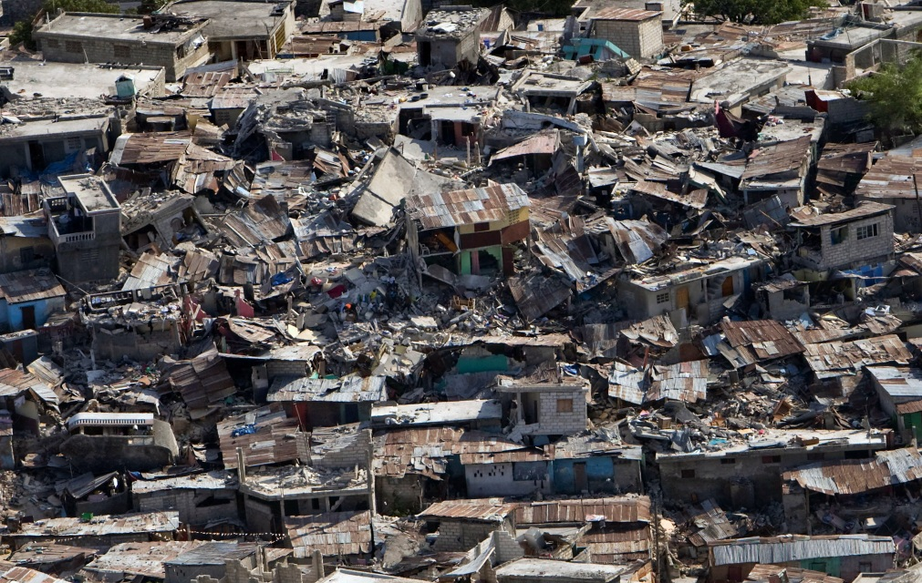
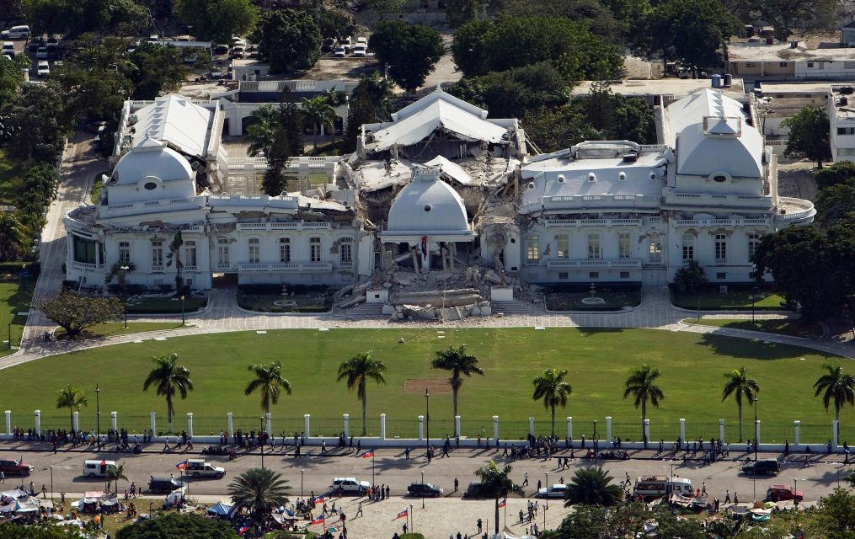
Earthquakes are worldwide
Port-au-Prince, Haiti
January 12, 2010
M7.0
220,000+ deaths
120% GDP
Notes:
Last week: 245 eq M2.5+, 105 eq M4.5+
About 15 M7+, 1 M8+ per year
1 magnitude point = 10x displacement, 32x energy

Slide 4
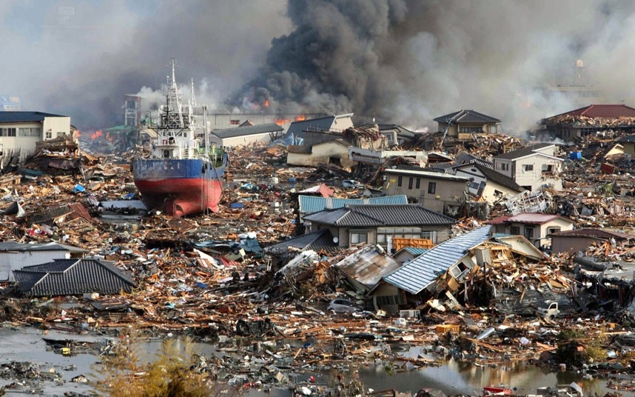
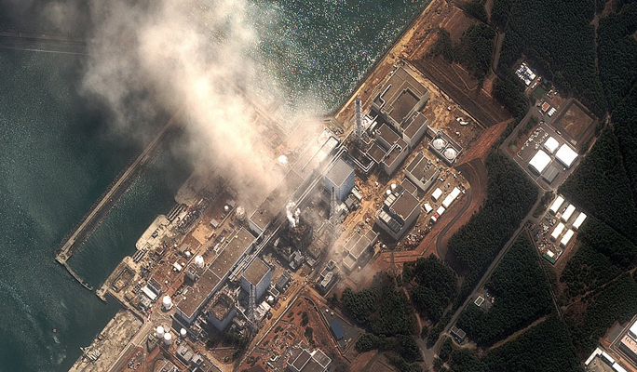
Earthquakes are worldwide
Tohoku, Japan
January 12, 2010
M9.0
19,000 deaths
4% GDP
Notes:
Last week: 245 eq M2.5+, 105 eq M4.5+
About 15 M7+, 1 M8+ per year
1 magnitude point = 10x displacement, 32x energy

Slide 5
Why such variable impact?
Earthquakes span a huge range of scales
  Each magnitude point is 10x displacement, 32x energy
  M9.0 (Tohoku, Japan) has 790x motion, 23000x energy compared to M6.1 (Christchurch, New Zealand)
Earth structure strongly affects ground motion
  Maximum Tohoku ground motion: 2.7g
  Maximum Christchurch ground motion: 2.2g
  Christchurch earthquake shallow, in basin
Building types and infrastructure affect human impact

Slide 6
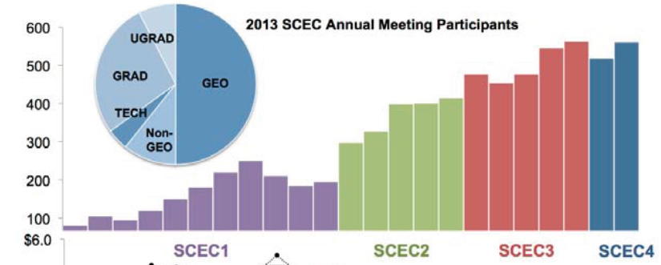
Southern California Earthquake Center
Collaboration of 600+ scientists at 60+ institutions
Major missions:
  Gather field and experimental data
  Integrate “ground truth” with simulation results
  Communicate understanding to society
Registrants at the SCEC annual collaboration meetings
1991-2013

Slide 7
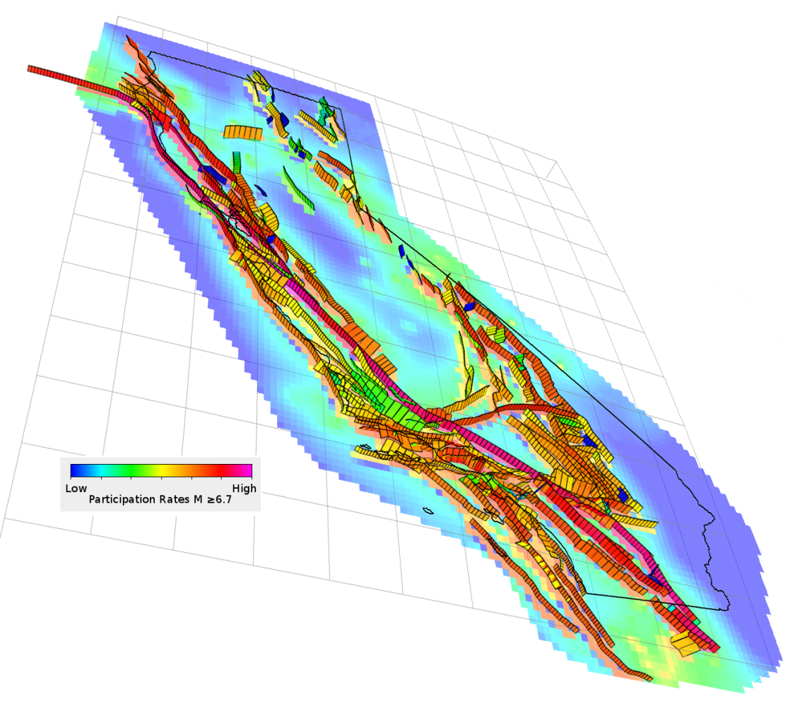
SCEC Simulations
Focus on Southern California
Two main types of
SCEC HPC projects
  Scenario earthquakes: What kind of shaking will
  this one earthquake cause?
  Seismic hazard:
  What kind of shaking
  will this one location experience?
Southern California, next 30 years:
95% chance of M6.6+
70% chance of M7+
29% chance of M7.5+

Slide 8
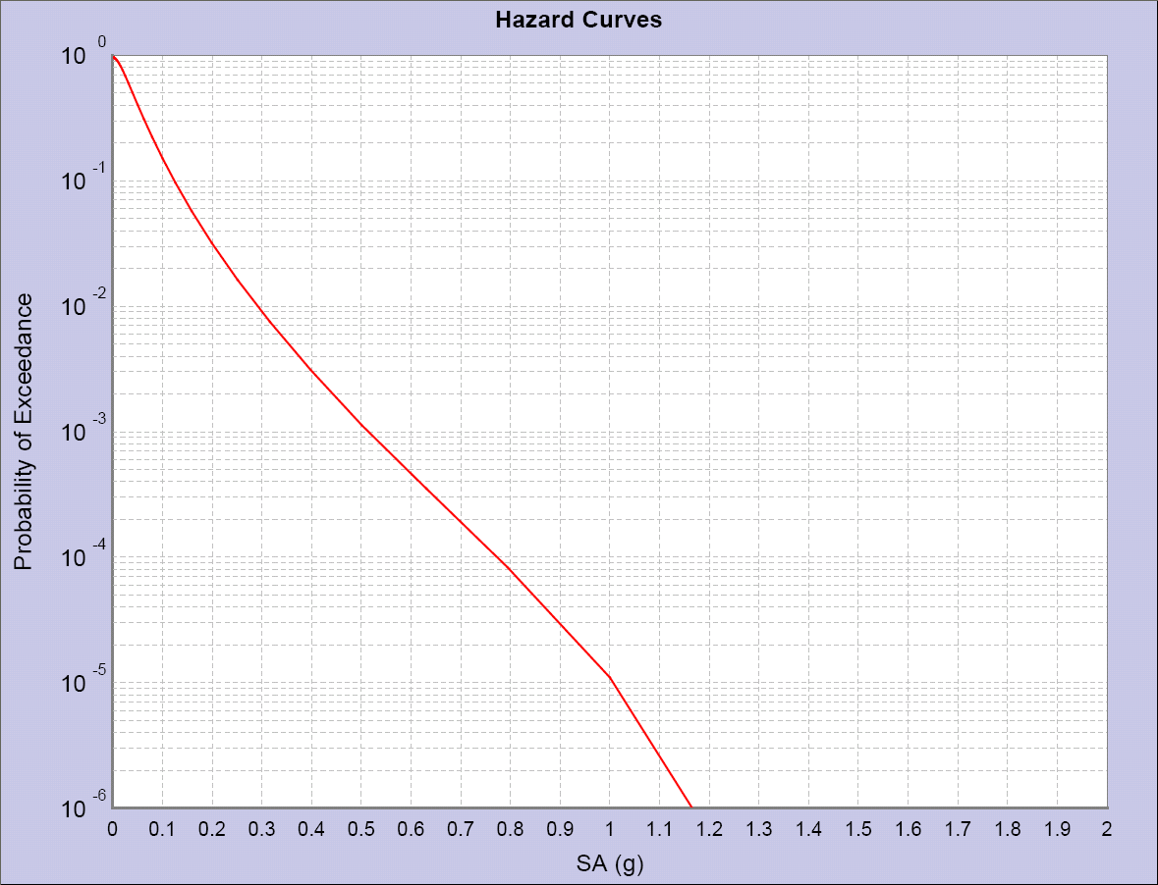
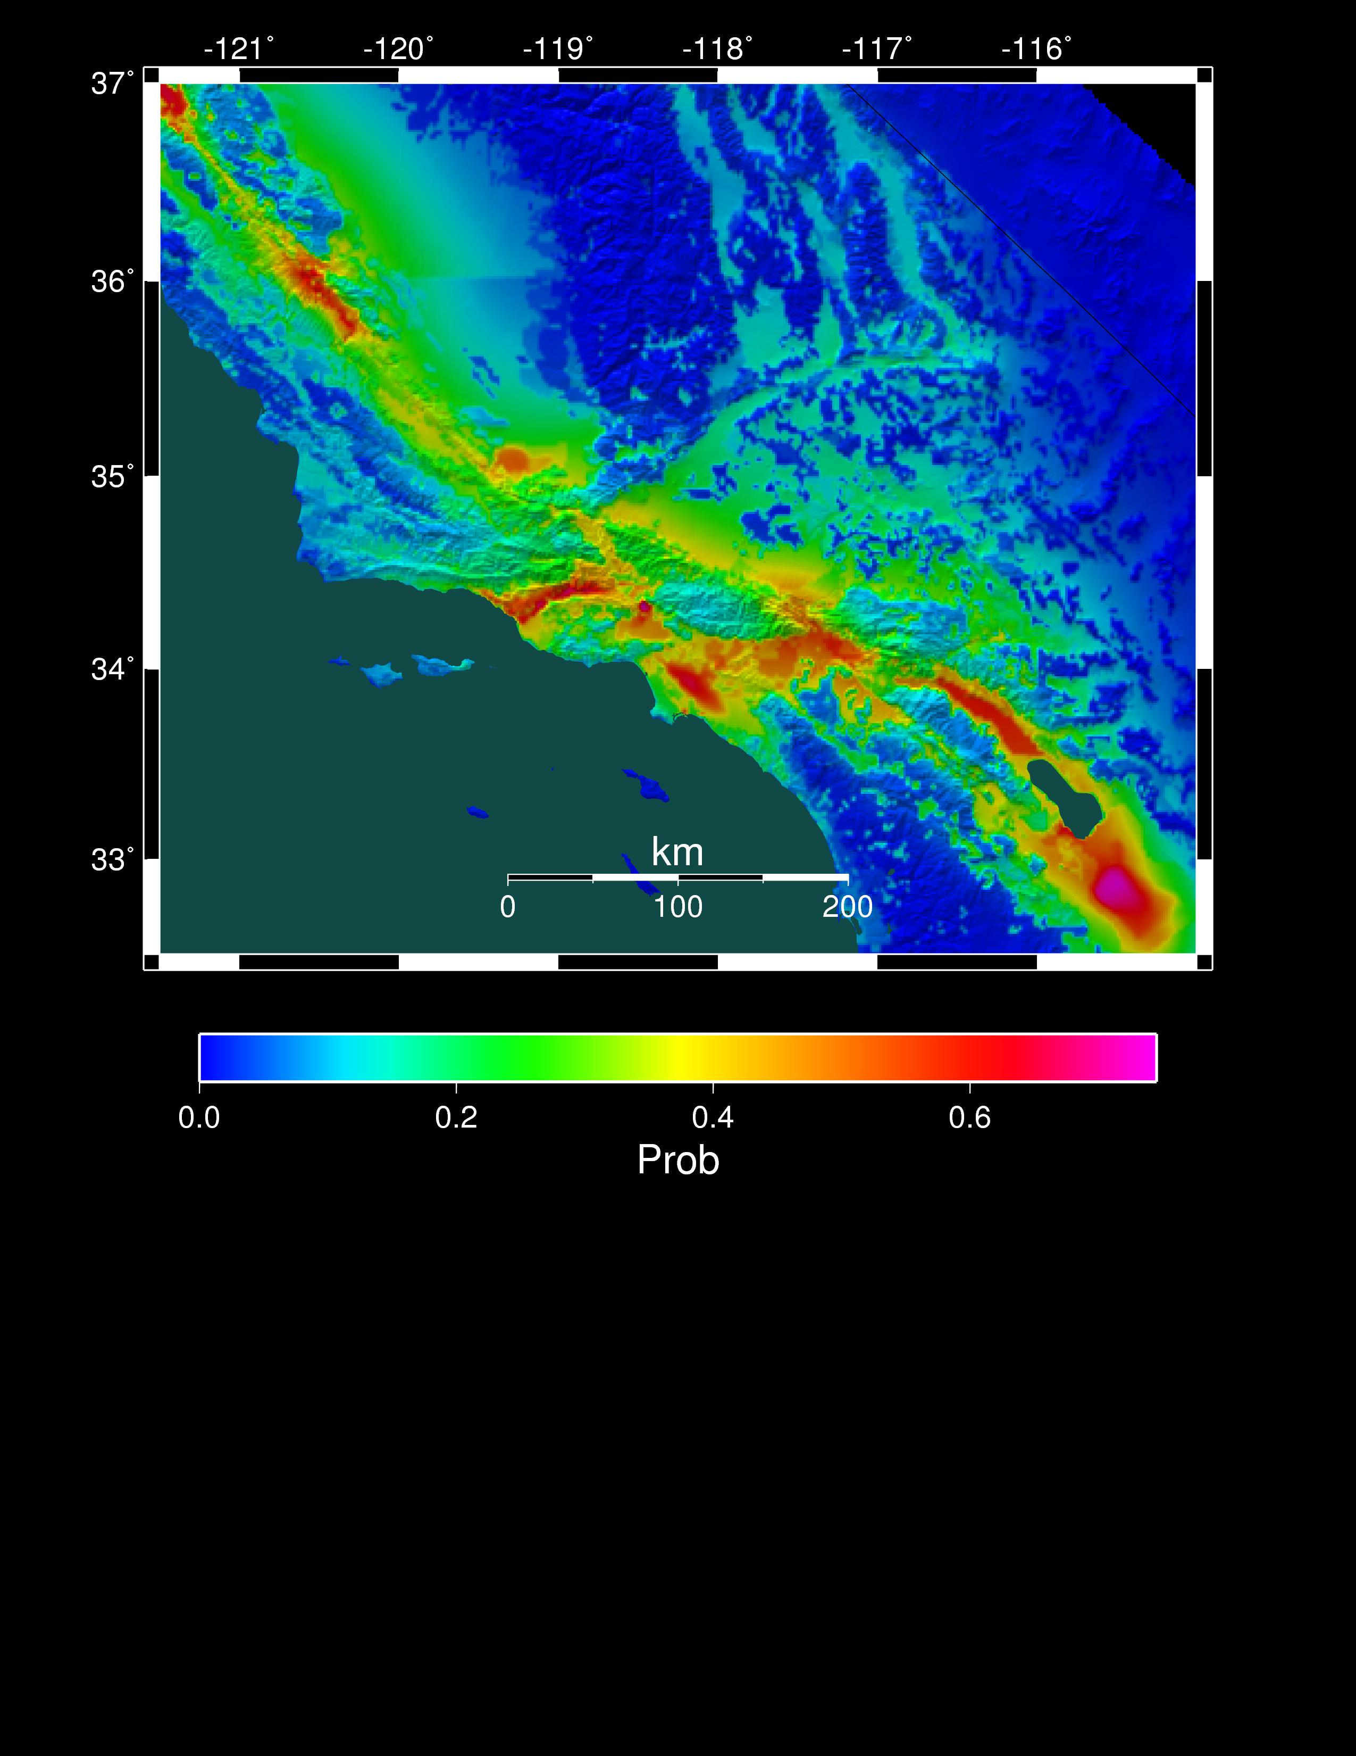
Seismic Hazard Analysis
What will peak ground motion be over the next 50 years?
  Used in building codes, insurance, planning
  Answered via Probabilistic Seismic Hazard Analysis (PSHA)
  Communicated with hazard curves and maps
2% in 50 years
0.6 g
Hazard curve for downtown LA
Probability of exceeding 0.1g in 50 yrs

Slide 9
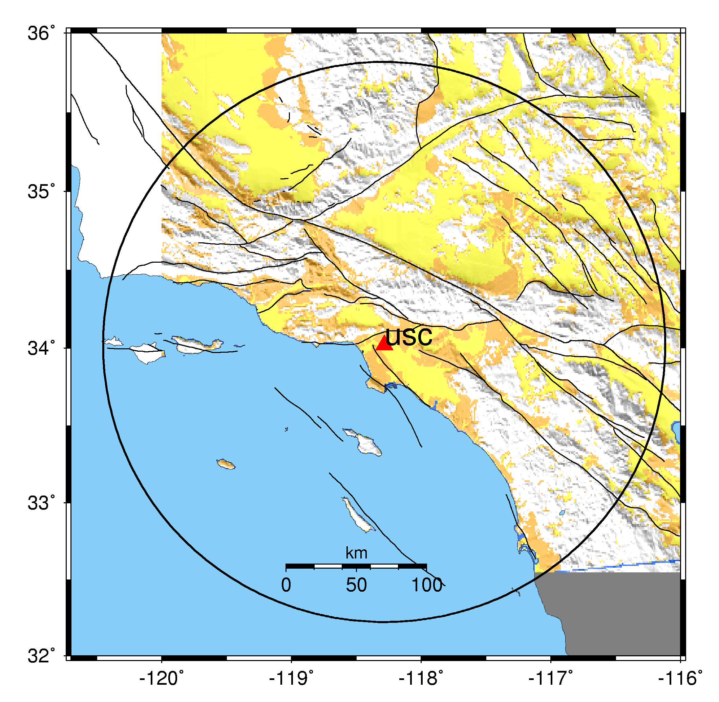
How to Calculate Seismic Hazard
Pick a location of interest.
Determine what future earthquakes might happen which could affect that location.
Estimate the magnitude and probability for each earthquake using “earthquake rupture forecast”

Slide 10
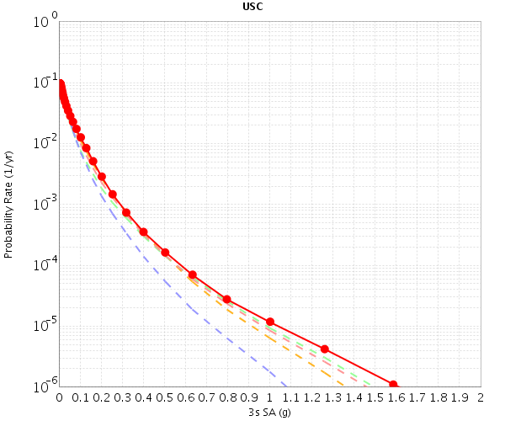
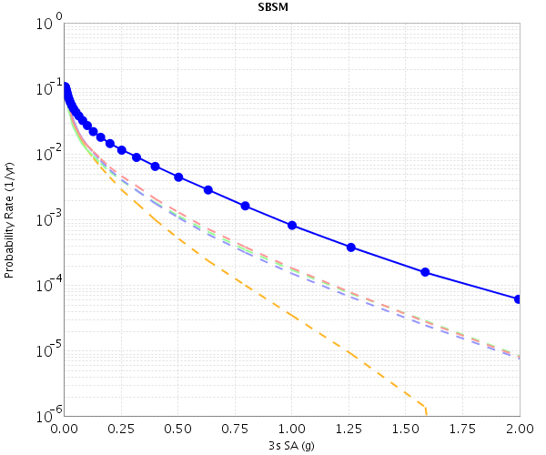
4. Determine the shaking caused by each earthquake at the site of interest.
Two different strategies, each with pros and cons
5. Combine the levels of shaking with probabilities to produce a hazard curve.
Repeat for many locations for a hazard map.

Slide 11
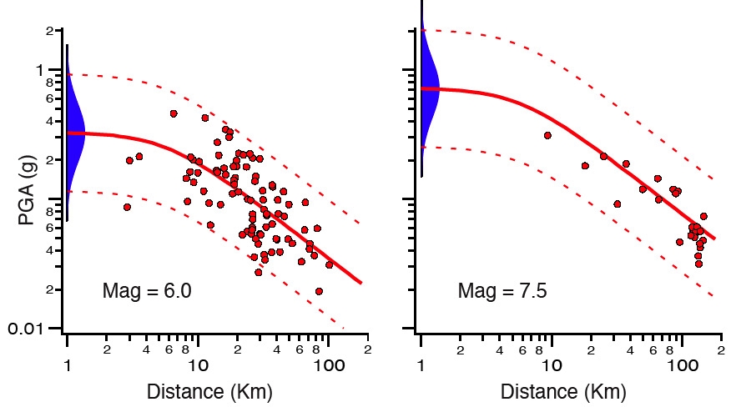
Option 1: Attenuation Relationships
Extrapolate from historical data
Based on what magnitude, how far
Very quick, but (too?) simple.

Slide 12
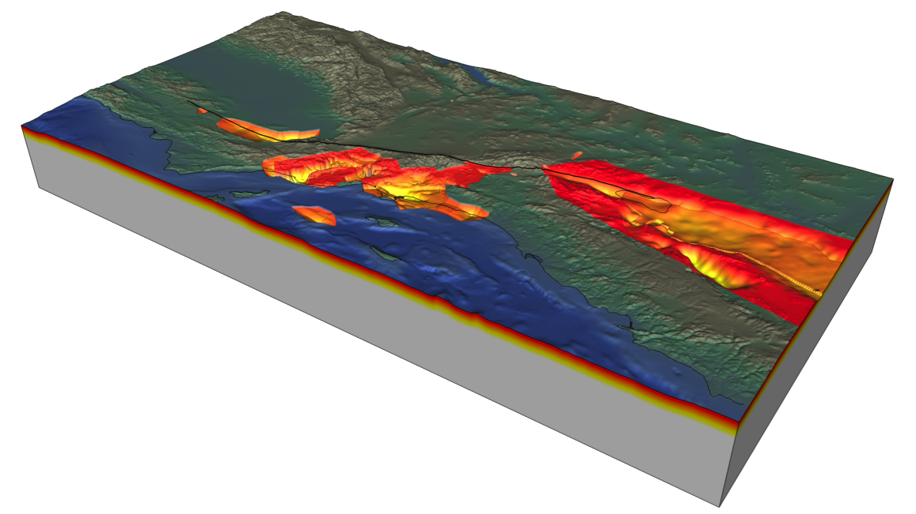
Option 2: Physics-Based Approach
Alternatively, we can use a physical approach to simulate each earthquake
SCEC does this in the “CyberShake” project
Requires HPC: more expensive than attenuation approach
(Image by Geoff Ely)

Slide 13
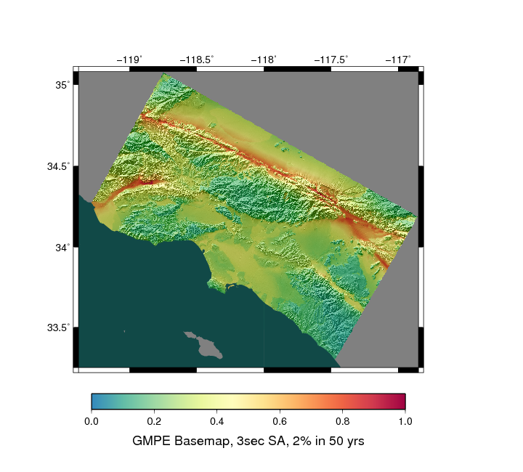
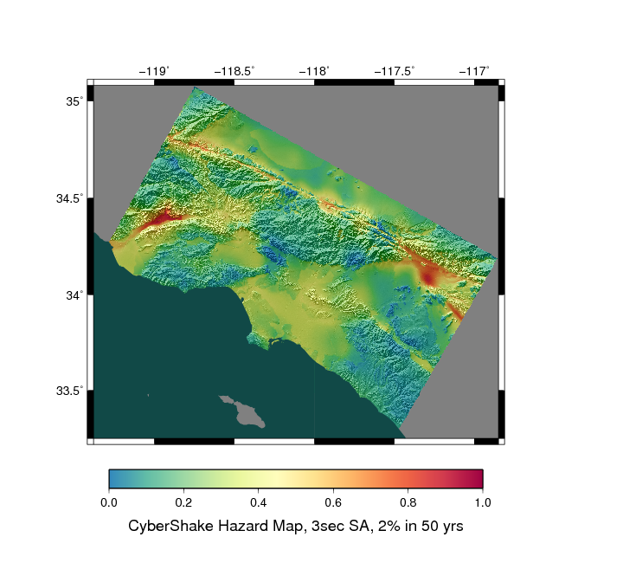
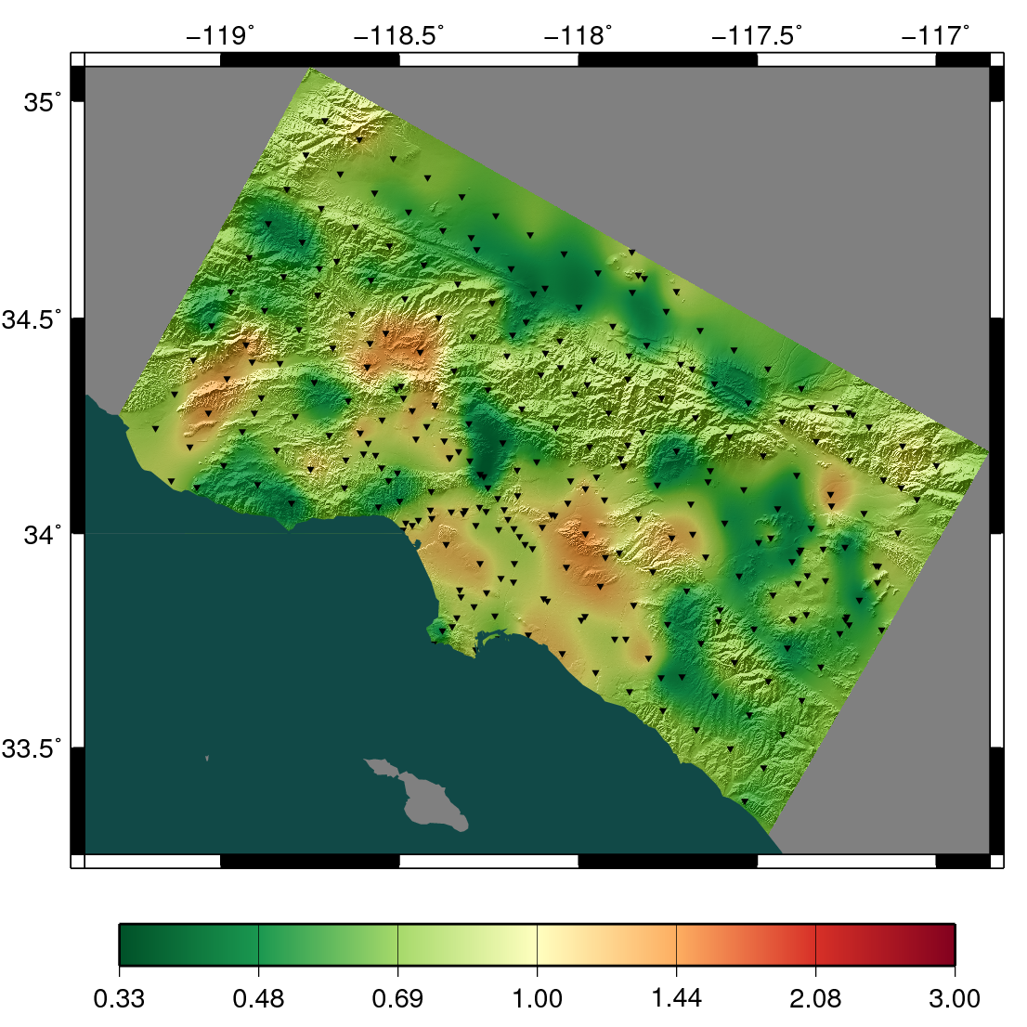
Does the approach make a difference?
Attenuation Hazard Map
CyberShake Hazard Map
Higher Attenuation
Higher CyberShake

Slide 14

Simulation Results (N->S)
W2W (S-N)

Slide 15
Simulation Results (S->N)

Slide 16
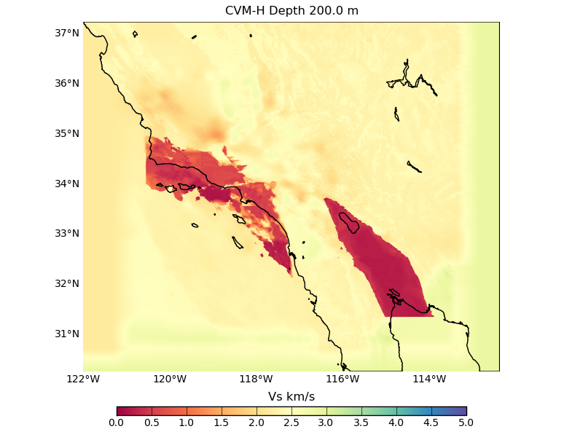
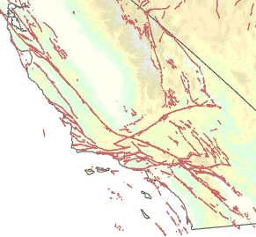
Physics-based CyberShake approach
Wave propagation simulation
  Create 1.5 billion point mesh with material properties
  Generate Strain Green Tensors across volume
  Parallel, ~8,000 CPU-hrs

Slide 17
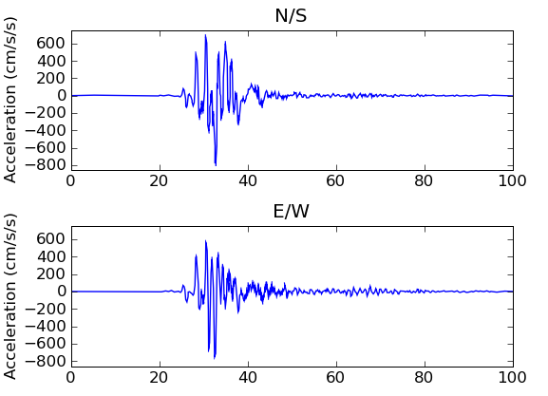
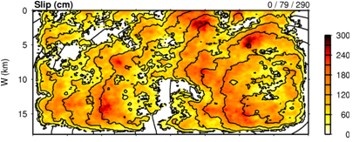
Post-Processing
Individual earthquake contributions
  Use “seismic reciprocity” to simulate seismograms
  for each of ~415,000 earthquakes
  Loosely-coupled, short-running serial jobs
  From each seismogram determine peak shaking (“peak spectral acceleration”)
Combine the levels of shaking with probabilities from earthquake rupture forecast to produce hazard curve

Slide 18
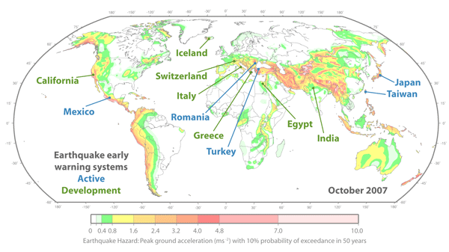
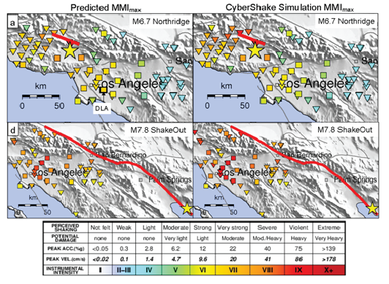
Earthquake Early Warning
Detect earthquake at
distance from populated area
Send signal ahead
Up to 60 sec warning
CyberShake seismograms used for training and testing machine learning algorithm
Influenced EEW system for California

Slide 19
CyberShake workflows
Tensor Workflow
Post-Processing Workflow
Data Products Workflow
Seismogram synthesis
PSA
Tensor extraction
Seismogram synthesis
DB
Insert
PSA
Mesh generation
Tensor simulation
.
.
.
.
.
.
Hazard
Curve
Tensor extraction
Seismogram synthesis
PSA
1 job
7,000 jobs
2 jobs
415,000 jobs
415,000 jobs

Slide 20
Challenge 1: Strain Green Tensor Code
4th order, staggered-grid, finite difference code
85% of CyberShake CPU-hours
Used same SGT code since 2007
  Readable, easy to use, interfaces with other software
  Scaling limitations
    Writes file-per-core, merged in post-processing
    Synchronous MPI communication
    Little single-core optimization
Moved to alternative SCEC community code, AWP-ODC
  Optimized starting in 2004

Slide 21
AWP-ODC enhancements
Runtime per timestep of CPU version reduced 98%
Two enhancements responsible for 82% of improvement
  Asynchronous communication
  Single-core optimization (no division, vectorization, loop unrolling, cache blocking, etc.)
Leads to 100% weak scaling in CyberShake regime

Slide 22
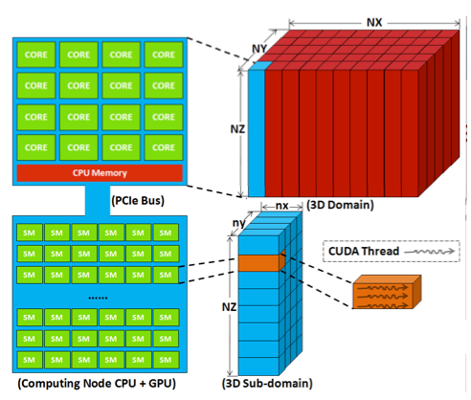
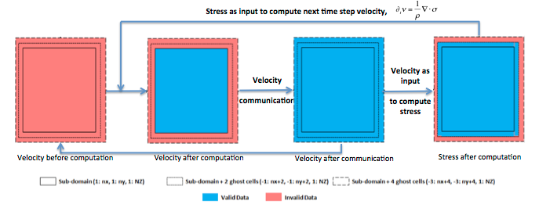
AWP-ODC ported to GPU
3D domain decomposition
  Z-striping good for cache
  Reduces # of neighbors
Single-GPU optimizations
Multi-GPU optimizations
  Eliminate stress communication
(Zhou et al., ICCS’12)
(Cui et al., SC’13)
Notes:
Only decomposed in X and Y because arrays are fast Z, so it reduces cache misses
Aligned memory access: do zero-padding if necessary
Pipeline register usage: need to keep data from 4 gridpoints which are X-neighbors in registers at a time. Pipeline copy data between them.
Exchange velocity (3 variables), no stress (6 variables): trade 5% more memory for 33% less data only half as often

Slide 23
CyberShake workflows
Tensor Workflow
Post-Processing Workflow
Data Products Workflow
Seismogram synthesis
PSA
Tensor extraction
Seismogram synthesis
DB
Insert
PSA
Mesh generation
Tensor simulation
.
.
.
.
.
.
Hazard
Curve
Tensor extraction
Seismogram synthesis
PSA
1 job
7,000 jobs
2 jobs
415,000 jobs
415,000 jobs

Slide 24
Challenge 2: High Throughput Jobs
~837,000 serial jobs per run
  0.1 to 60 sec
  Mostly independent
Combined seismogram and PSA jobs into one using C wrapper
  “SeisPSA”
  Half as many jobs
  Also eliminates PSA job reading in seismogram file

Slide 25
High Throughput Scheduling
Workflow tools required to manage the jobs
Can’t put them directly into the queue
  Schedule can’t handle millions of short jobs
  Scheduler cycle is too slow (5+ minutes)
Pegasus-mpi-cluster workflow tool (PMC)
Workflow tools request chunk of cores, PMC manages task scheduling
MPI wrapper around serial or thread-parallel jobs
  Master-worker paradigm
  MPI messaging has low latency

Slide 26
CyberShake workflows
Tensor Workflow
Post-Processing Workflow
Data Products Workflow
PMC
PMC
Tensor extraction
SeisPSA
DB
Insert
.
.
.
.
.
.
Mesh generation
Tensor simulation
Tensor extraction
SeisPSA
Hazard
Curve
7,000 jobs
415,000 jobs
1 job
6 PMC jobs
6 PMC jobs
2 jobs

Slide 27
Challenge 3: I/O
I/O load influenced by:
  Amount of data
  Number of reads and writes
  Number of opens and closes
Tensor extraction jobs
  Read 40 GB, then write a subset
    40 GB x 7000 jobs = 273 TB of data read
  Instead, restructure as MPI job
    Read in 40 GB distributed among processors
    Write many subsets
    40 GB x 6 jobs = 240 GB read = 99.9% improvement

Slide 28
I/O-memory-CPU tradeoff
SeisPSA jobs
  Read earthquake description and tensors
  Write two files (350 bytes, 24 KB)
  Groups of 2 to 1568 SeisPSA jobs share input files
Reduce reads
  Generate earthquake description on the fly from geometry
    Exchange I/O for memory and CPU time
    Use memcached library to explicitly cache rupture geometry
  Batch jobs together to reuse tensors
    Read tensors once, calculate multiple seismograms
Reduce writes
  Pegasus-mpi-cluster supports “pipe forwarding”
  Workers write to pipes, master writes to 60x fewer files

Slide 29
CyberShake workflows
Tensor Workflow
Post-Processing Workflow
Data Products Workflow
PMC
SeisPSA
.
.
.
Tensor extraction
SeisPSA
DB
Insert
.
.
.
Mesh generation
Tensor simulation
PMC
SeisPSA
Tensor extraction
.
.
.
Hazard
Curve
SeisPSA
1 job
6 jobs
6 PMC jobs
85,000 jobs
2 jobs

Slide 30
Challenge 4: Lengthy Runs
Run 1100+ hazard curves (2+ weeks wallclock time)
High degree of automation required
  Workflow tools
    No manual job submission
    Automatic retries
  Easy monitoring
    Database tracks run states
    Email notifications
  Data products generated automatically

Slide 31
CyberShake Study 14.2 Metrics
1144 hazard curves (4 maps) on NCSA Blue Waters
342 hours wallclock time (14.25 days)
46,720 CPUs + 225 GPUs used on average
  Peak of 295,040 CPUs, 1100 GPUs
GPU SGT code 6.5x more efficient than CPU
99.8 million jobs executed (81 jobs/second)
  31,463 jobs automatically run in the Blue Waters queue
On average, 26.2 workflows (curves) concurrently
Notes:
Job failure rate: 1.3%

Slide 32
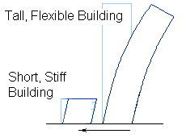
Future (Science) Directions
Higher frequencies
  Buildings are most affected by
  frequency = 10 / (height in floors)
  Currently at 0.5 Hz, moving to 1 Hz
  2x frequency -> 16x computational work
Notes:
Could be cut

Slide 33
Future (Technical) Directions
Improve post-processing
  Currently extraction reads 40 GB of data, writes 690 GB
  At 1 Hz, would read 1 TB, write 17 TB
  Make extraction more clever?
  Remove extraction entirely?
Coscheduling
  GPU XK nodes have 1 GPU, 16 CPUs
  While running SGTs on GPUs, schedule post-processing to CPUs
  Difficult to explain to workflow tools (2 workflows, 1 job)

Slide 34
Things we wish we knew: Workflow Tools
Help to:
  Automate processes
  Manage data
  Gather metadata
  Do more than 1 person can do manually
CyberShake not possible without them

Slide 35
Verification
Verification
  Does this code behave as I expect it to? Was it programmed correctly?
Construct verification test problem
  Identify small test problem (ideally, automated)
  Generate reference solution
  Run after all code modifications, compare to reference
  If discrepancy is “too much”, dive in deeper
  Can also use to quantify impact of change

Slide 36
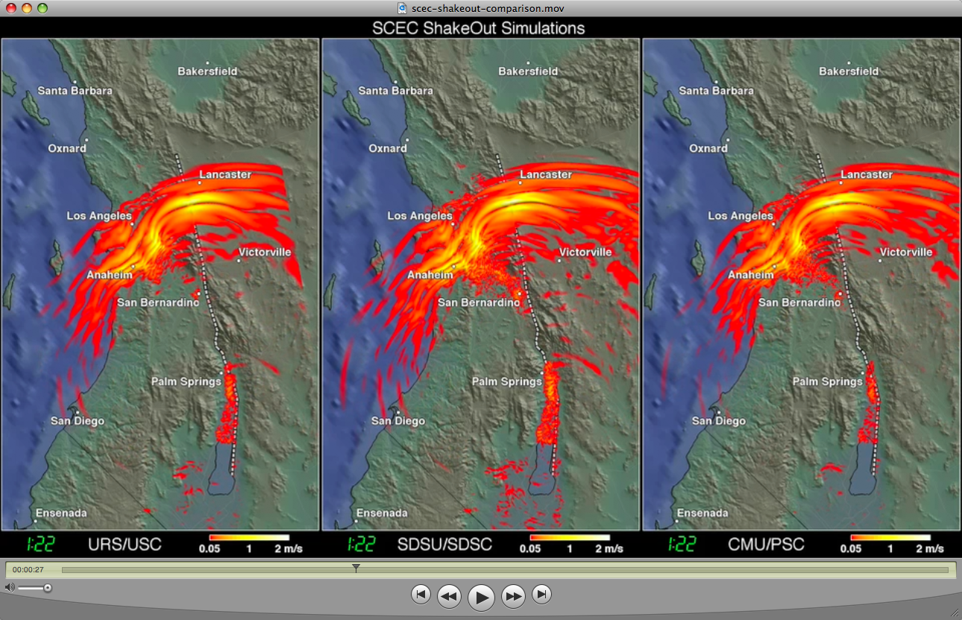
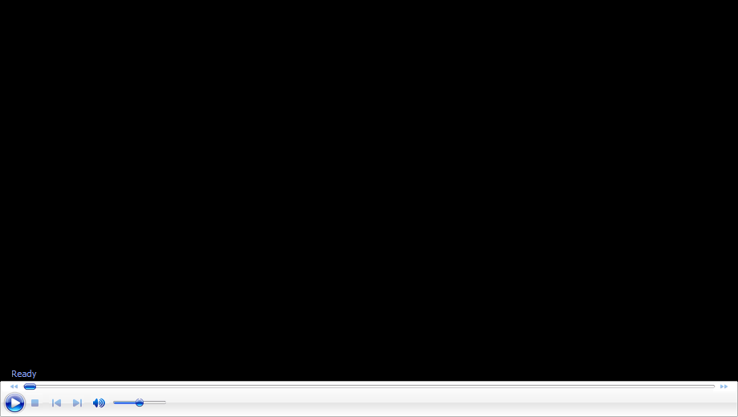
Codes Comparison

Slide 37
Software Engineering Best Practices
Version control
  Can always go back
  Track what code was used with which simulation
Alternate production and development cycles
  Gives time for both optimization and science results
Incremental improvement
  “Premature optimization is the root of all evil.”
  Donald Knuth
  Wait until you have identified a limiting factor
  Cost/benefit analysis: how much development time for how much performance gain?

Slide 38
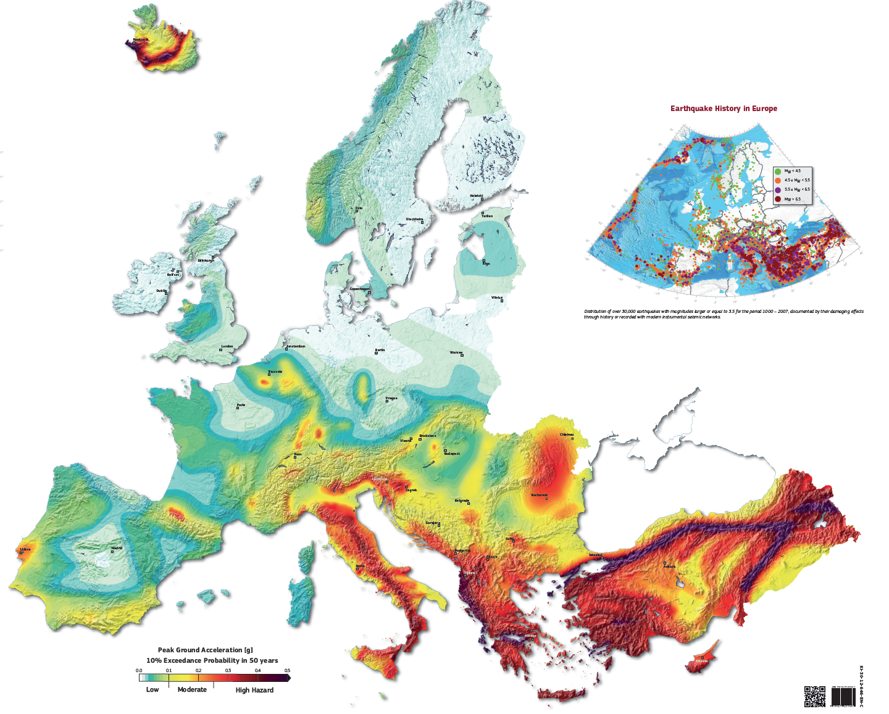
(SHARE Consortium)

Slide 39










Questions?

Slide 40
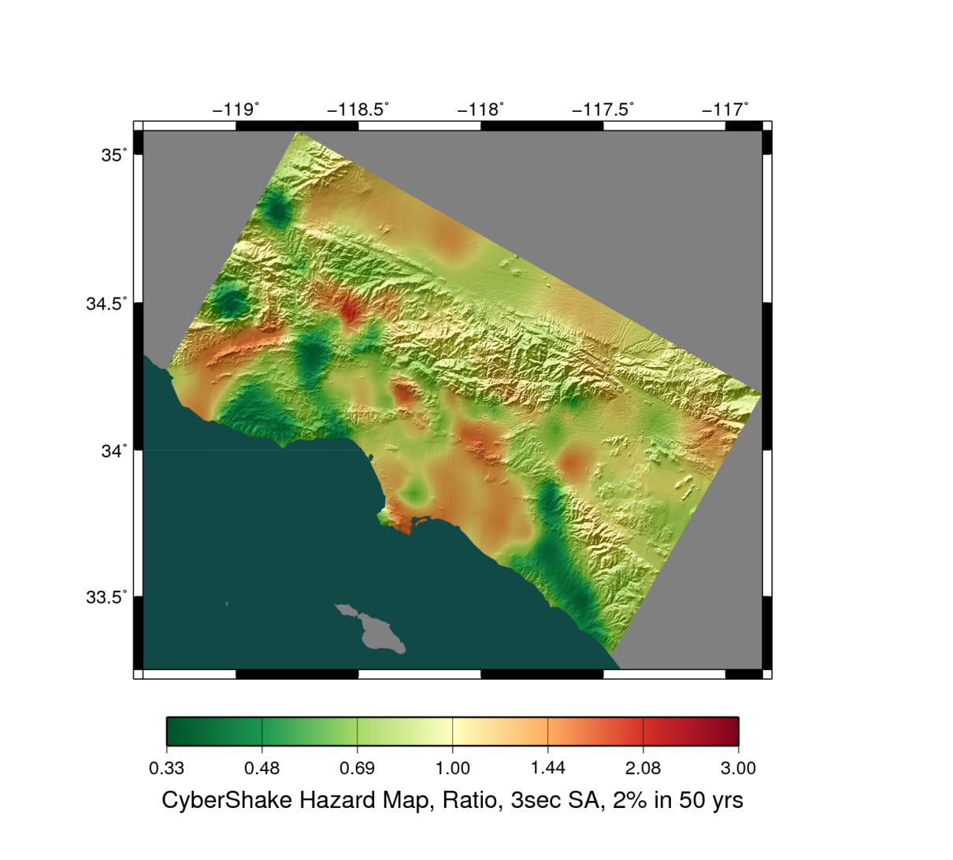
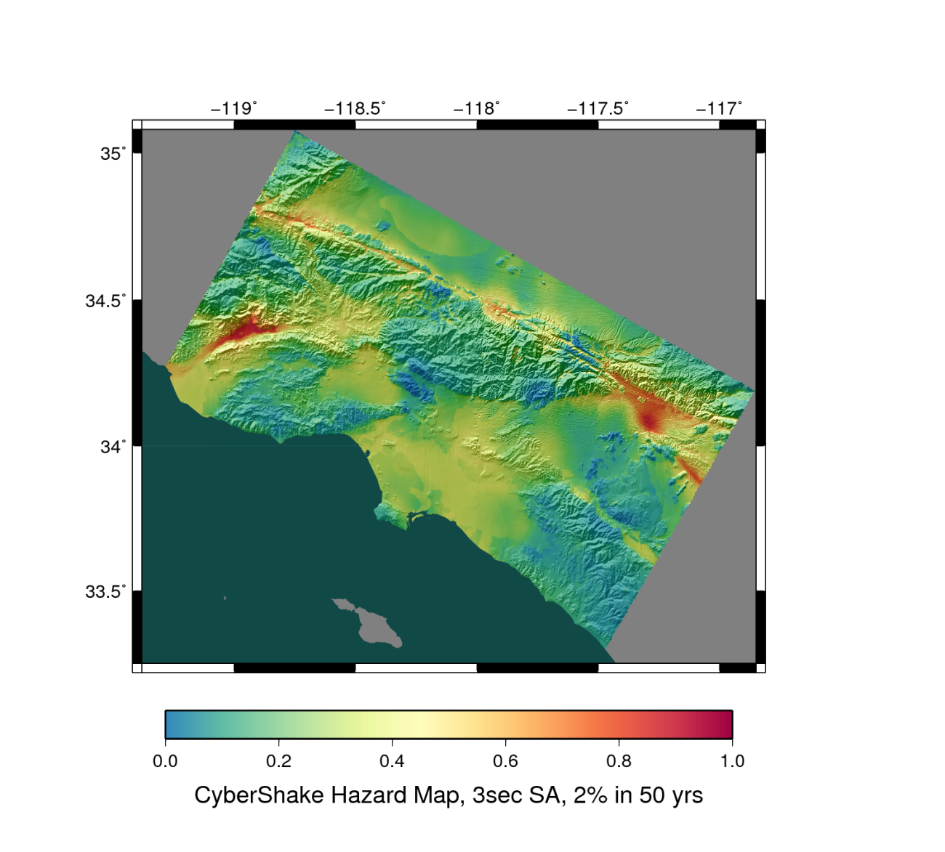
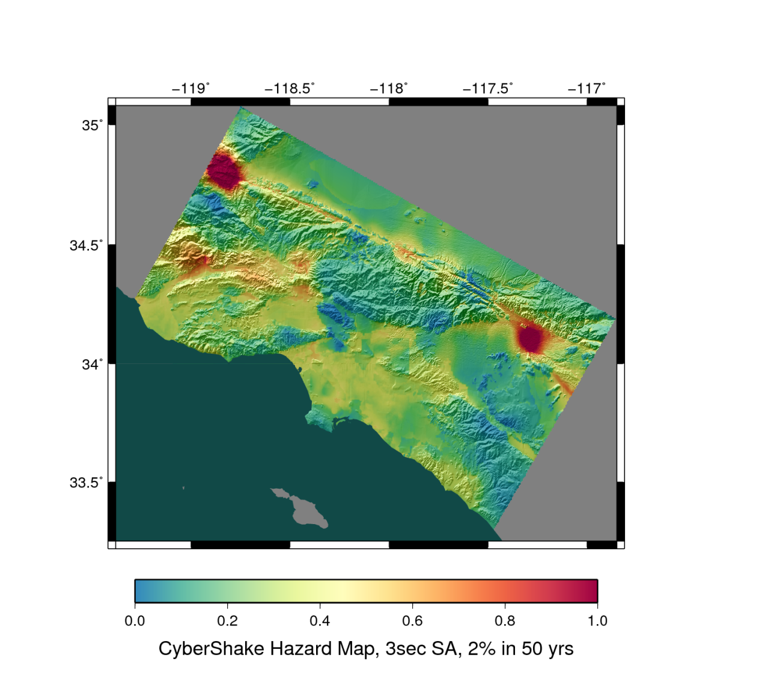
Different Velocity Models

Slide 41
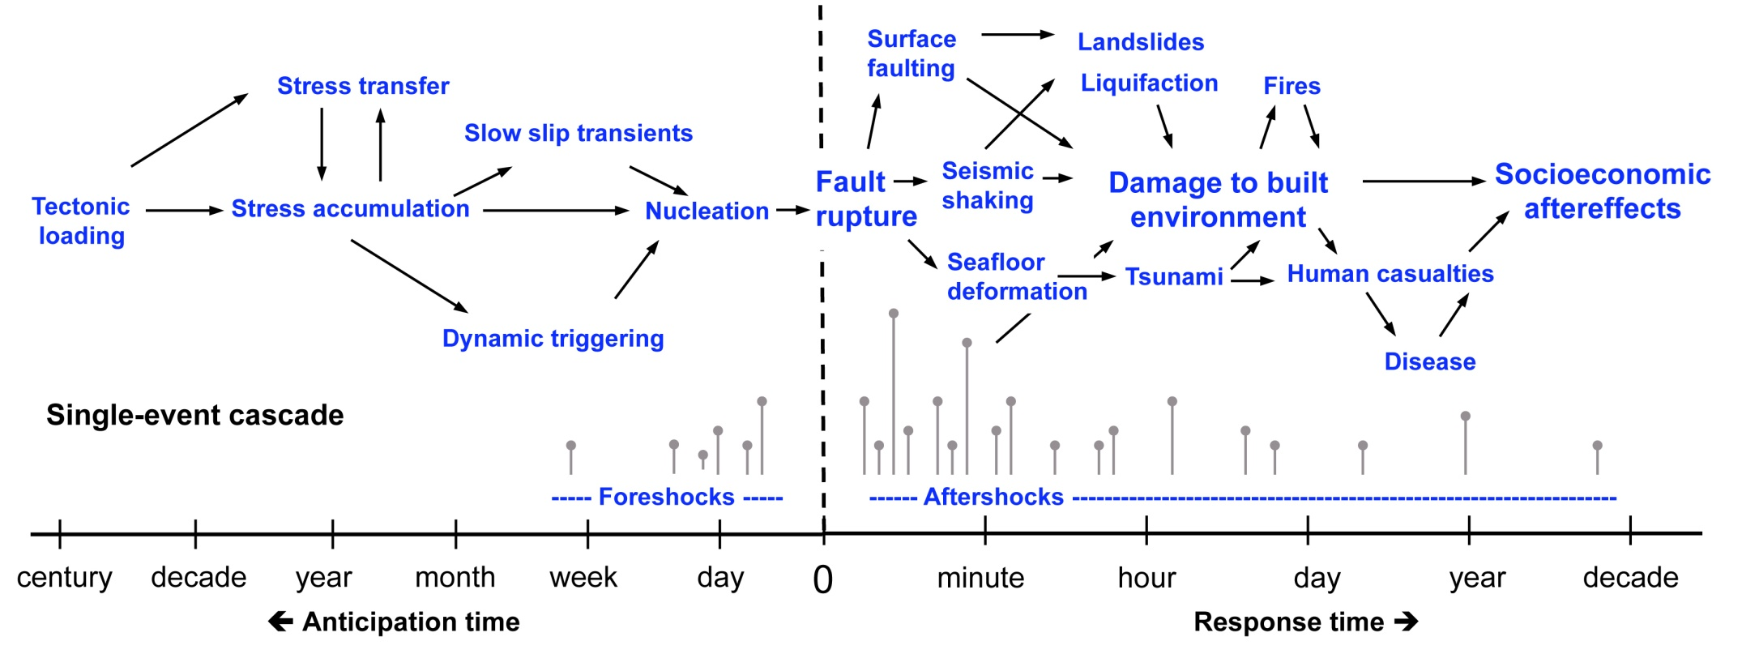
Earthquake System Science
Many physical elements contribute to impact
Most are difficult to explore experimentally
Notes:
Could be cut

Slide 42
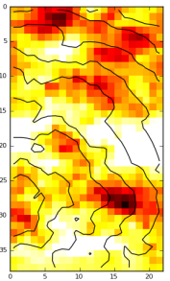
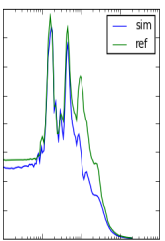
SeisPSA
Site
Source 1
Source 2
Source 3

Slide 43
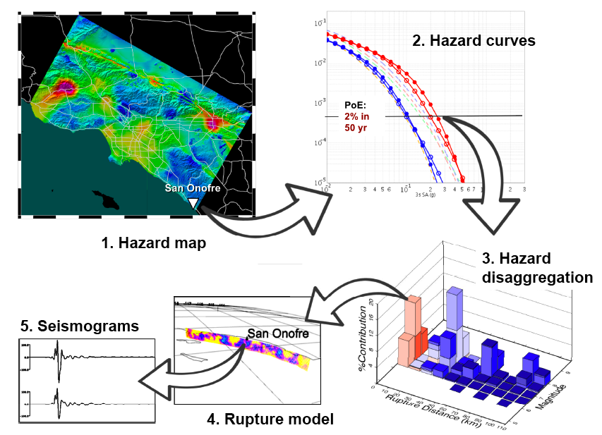
CyberShake data products

Slide 44
Computational Requirements
Component | Data | Executions | Cores/exec | CPU hours
Mesh generation | 15 GB | 1 | 320 | 50
Tensor simulation | 40 GB | 2 | 10,000 | 16,000
Tensor extraction | 690 GB | 6 | 256 | 275
Seismogram synthesis | 12 GB | 415,000 | 1 | 2,300
Curve generation | 1 MB | 1 | 1 | < 1
Total | 757 GB | 415,000 |  | 18,625
Tensor Creation
Post Processing
This is for one location of interest; we wanted to run ~1000

Slide 45
Intro 3
Asfd
  asdfsd

Slide 46
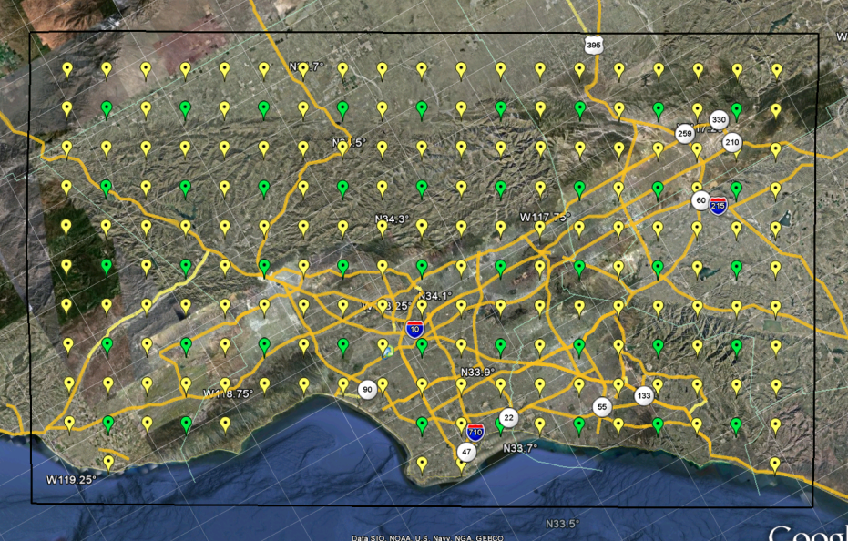
Scientific Workflows
Large-scale, heterogeneous, high throughput
  Parallel and many (~415,000) serial tasks
  Task duration 100 ms – 2 hours
Automation
Data management
Error recovery
Scalable
More on workflows tomorrow

Slide 47
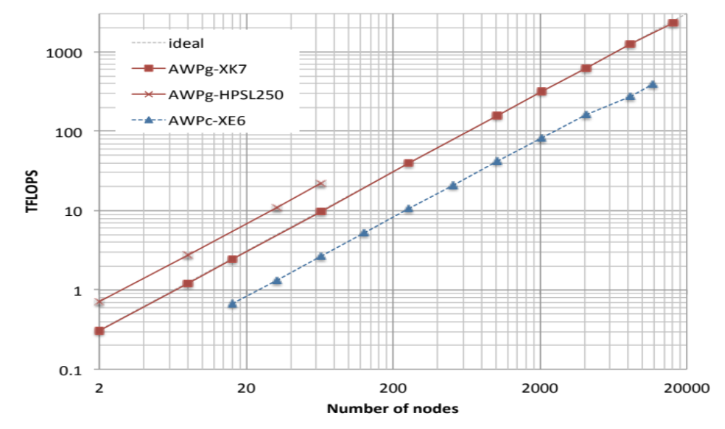
AWP-ODC Weak Scaling
93% efficiency
2.3 Pflop/s
100% efficiency
Scenario Earthquakes
1-10 simulations
CyberShake regime
1000+ simulations
(Cui et al., 2013)
Notes:
Could be cut

Slide 48
Recent CyberShake Study
4 maps of 286 sites each
  Half CPU SGTs, half GPU SGTs
  2 different velocity models
Run entirely on NCSA Blue Waters
342 hours wallclock time (14.25 days)
46,720 CPUs + 225 GPUs used on average
  Peak of 295,040 CPUs, 1100 GPUs
Compared GPU and CPU SGT implementations
  CPU: 2792 sec x 313.8 nodes = 243.4 node-hrs
  GPU: 1338 sec x 100 nodes = 37.2 node-hrs
  GPU code 6.5x more efficient

Slide 49
High Throughput Performance
99.8 million jobs executed (81 jobs/second)
  31,463 jobs automatically run in the Blue Waters queue
860 TB of data managed
  57 TB output files
  12 TB staged back to SCEC storage
Inserted 1.4 billion rows into relational DB
  Peak shaking values used in hazard curve
On average, 26.2 workflows (sites) concurrently
Job failure rate: 1.3%
Notes:
Could be cut

Slide 50
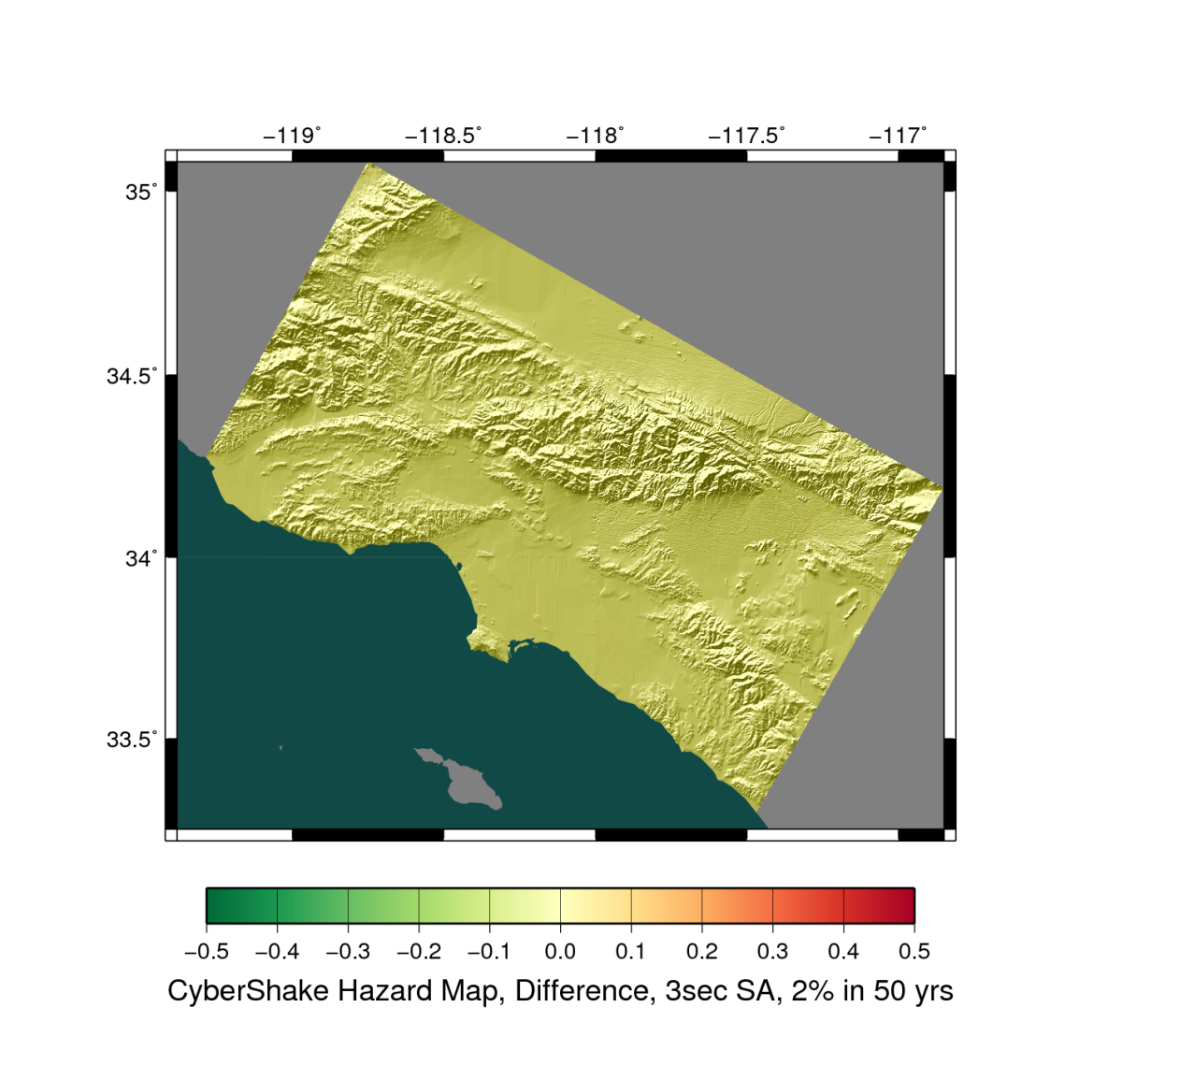
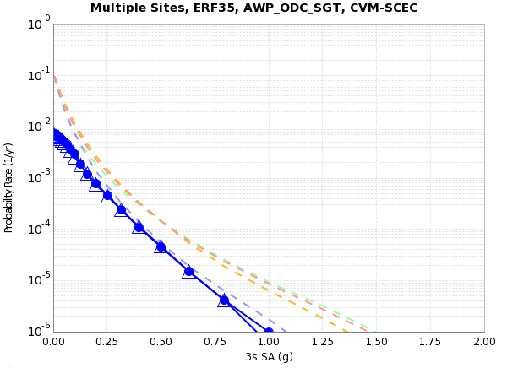

Slide 51
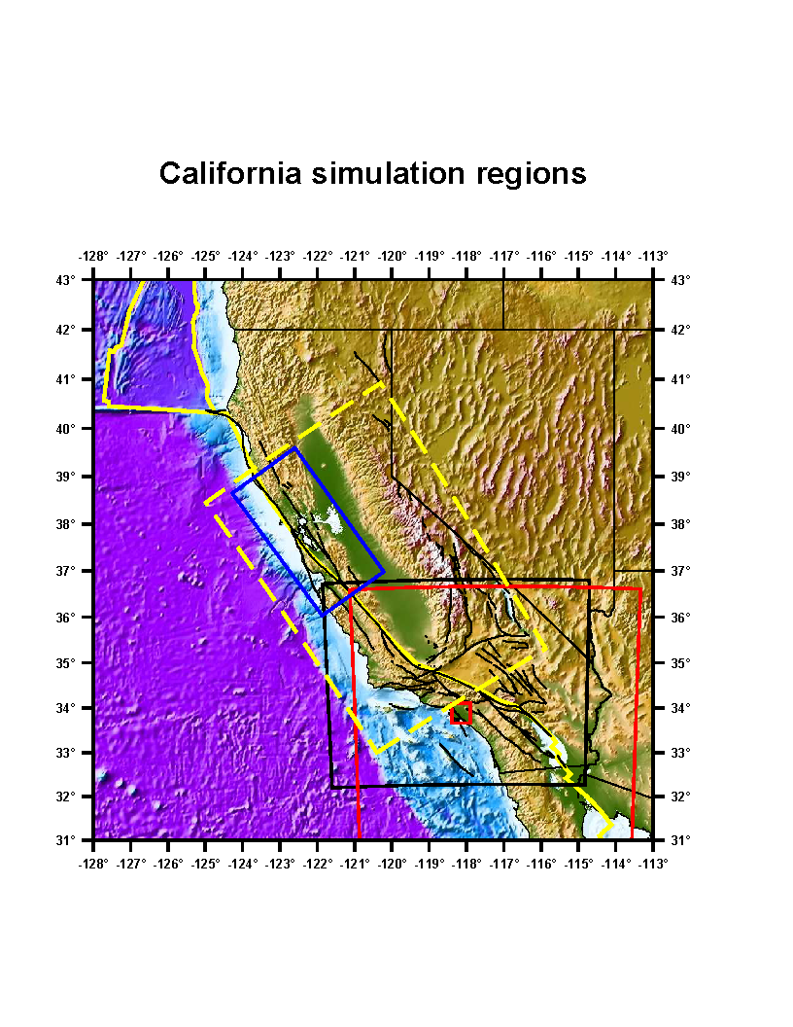
Common Interfaces
SCEC has multiple velocity models
Each had a different interface
Developed UCVM
  Common interface to models
  Open-source
  C API
  New models easily added to UCVM
  All SCEC modelers can use for simulations
If you have multiple models, consider developing unified access

Slide 52
Challenge 4: Data Management
Millions of input and output files to manage
  Workflow tools automatically add staging jobs
  Files transferred and symlinked appropriately
Directory hierarchy to reduce files per directory
Added automated checks to check file integrity
  Correct number of files
  NaNs, zero-value checks
  Checksums

