Slide 1

Updated Broadband CyberShake
PSHA Model for Southern California
Scott Callaghan, Philip J. Maechling, Fabio Silva, Kevin R. Milner, Mei-Hui Su, Christine A. Goulet, Kim B. Olsen, Te-Yang Yeh, Robert W. Graves, Karan Vahi, Ewa Deelman, Albert Kottke, Thomas H. Jordan, and Yehuda Ben-Zion
2023 SSA Annual Meeting
Tuesday, April 18, 2023

Slide 2
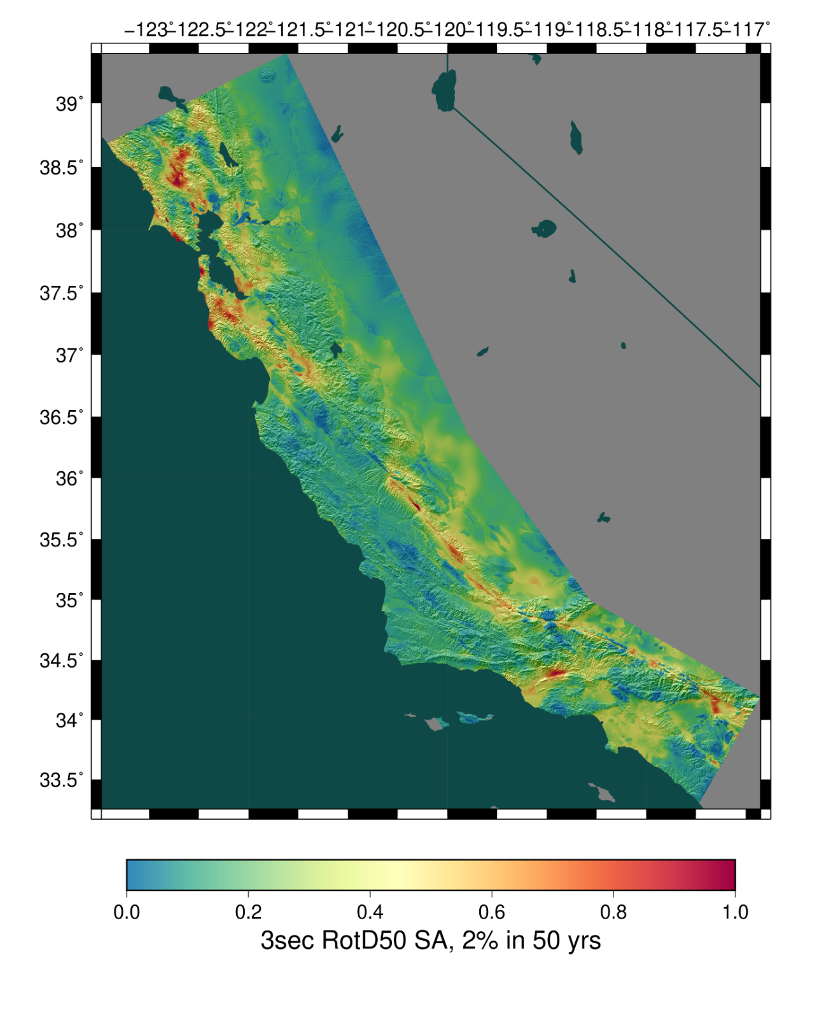
CyberShake Overview
SCEC’s 3D physics-based probabilistic seismic hazard analysis (PSHA) platform
Earthquake Rupture Forecast (ERF) provides list of relevant events with probabilities
  625,000 events per site
Reciprocity-based approach to simulate low-frequency seismograms
Intensity measures derived from seismograms
Hazard results from individual sites interpolated with GMM basemap

Slide 3
New Features in CyberShake Study 22.12
Update to Study 15.4 and 15.12
Broadband simulations
  Deterministic (wave propagation + reciprocity) to 1 Hz
  Stochastic (Graves & Pitarka module from SCEC Broadband Platform) to 50 Hz
  Site corrections applied
  Validated against historic events (Northridge, Whittier, Landers)
Modifications to 3D velocity model
  Goal is to resolve issues with high velocities at the surface
Updates to rupture generation for individual events
  Migrate to more recent kinematic rupture code
  Sample additional variability

Slide 4
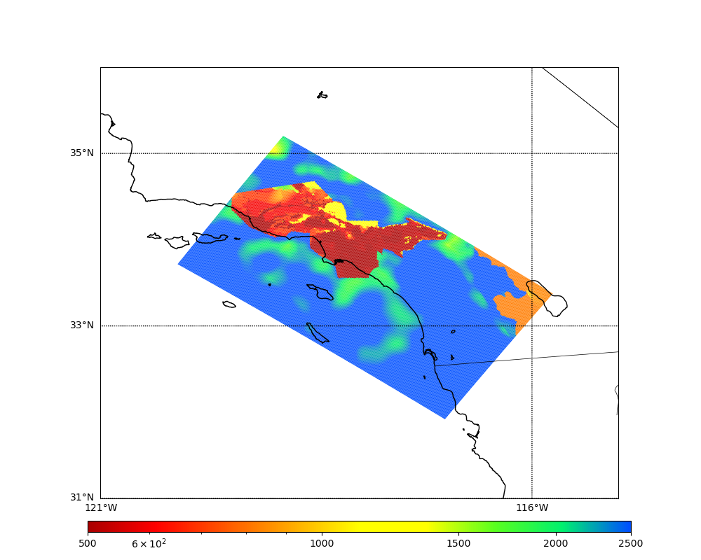
Velocity Model Merged Taper
Previous studies used CVM-S4.26.M01
  Tomography model + near-surface layer
  High Vs values outside of basins
Used Ely-Jordan approach to apply Vs30-
based taper down to 700m (Hu et al., 2022)
  Using taper, determine Vp, Vs, rho values at
  each grid point in the mesh
  Compare taper and non-taper Vs value
  Select smaller Vs value (and corresponding Vp
  and rho) to preserve basins
CVM-S4.26.M01, surface Vs
500
1000
2500

Slide 5
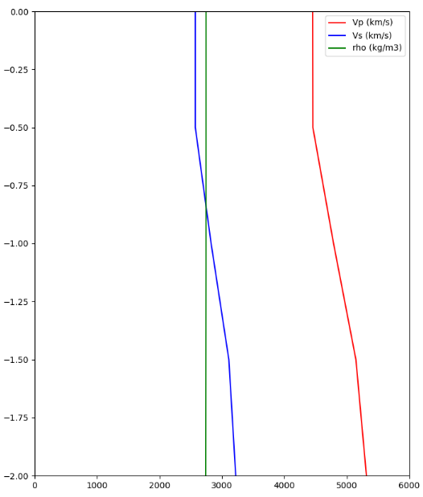
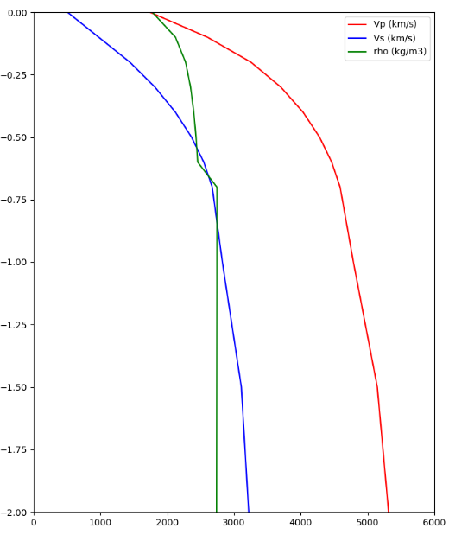
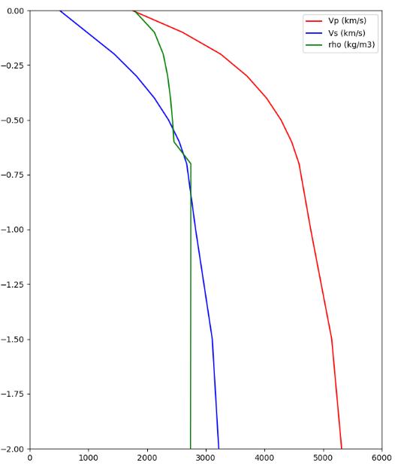
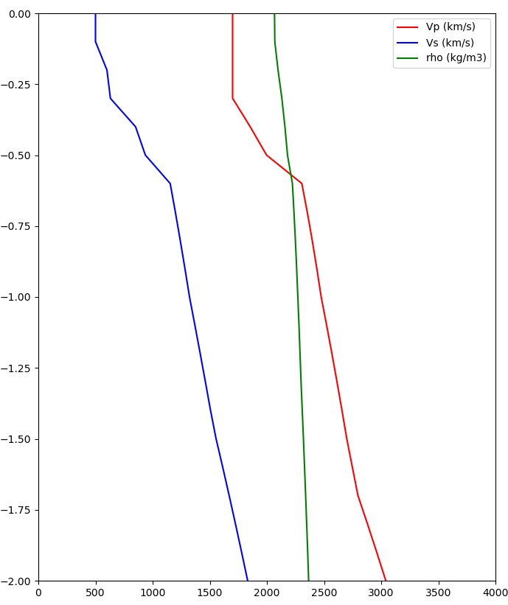
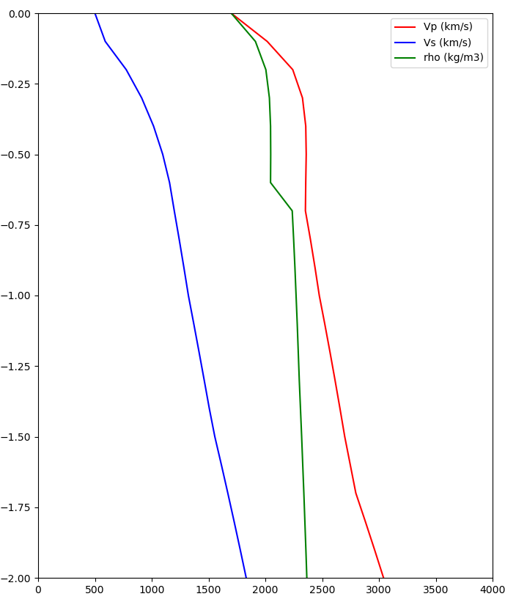
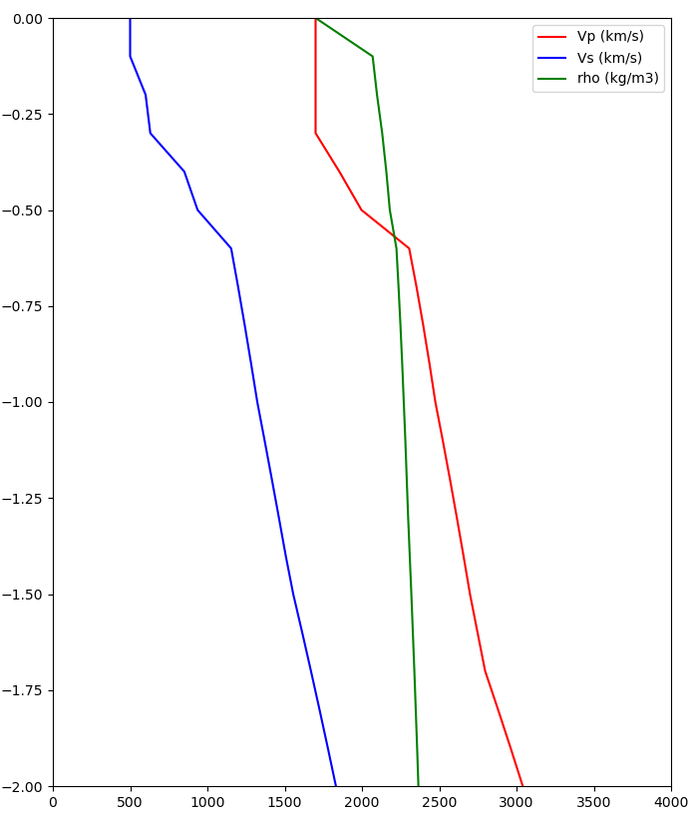
Site Velocity Profiles
CVM-S4.26.M01
700m taper
Merged taper
Taper is selected at all depths to 700m
Vs30: 2573 m/s -> 400 m/s
Z1.0: 0m -> 110m
LAPD
(outside basin)
~2500 m/s
~400 m/s
Taper is only selected at surface point
Vs30: 500 m/s -> 500 m/s
Z1.0: 580m -> 580m
USC
(in basin)
500 m/s
500 m/s

Slide 6
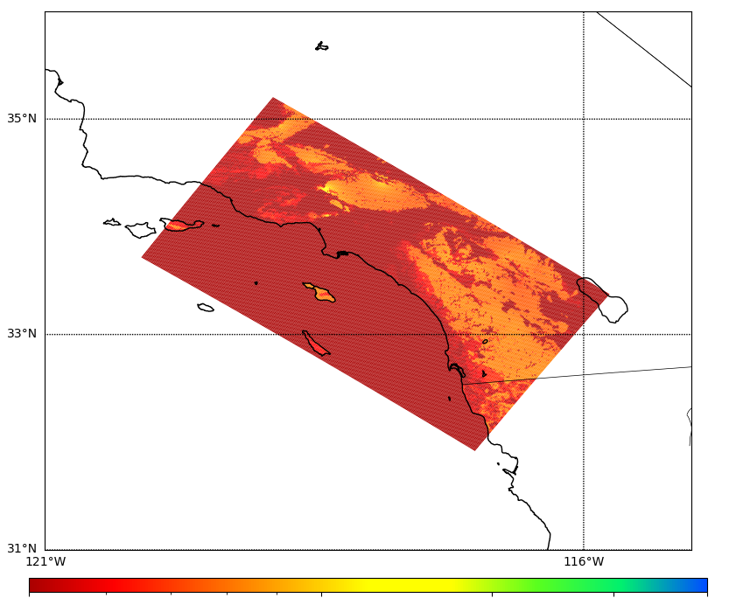
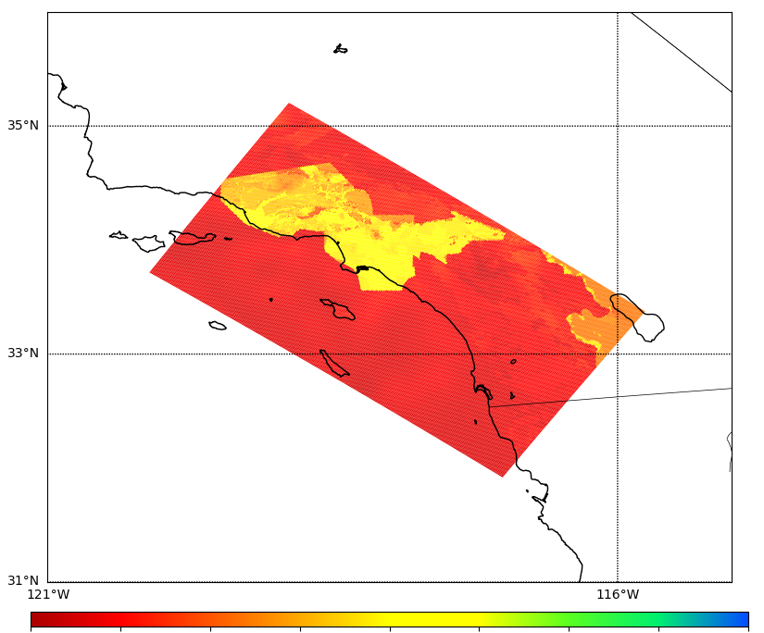
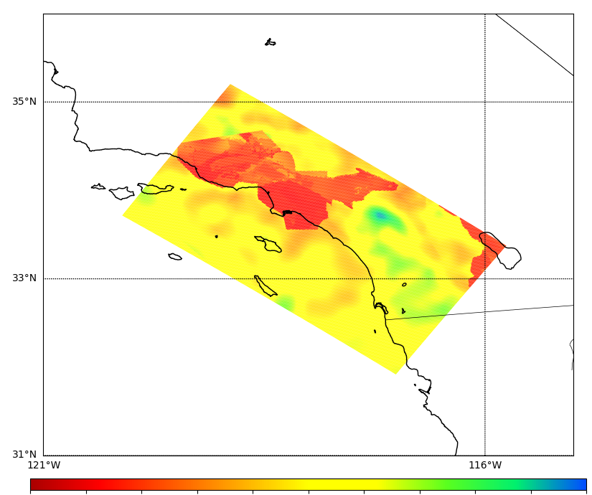
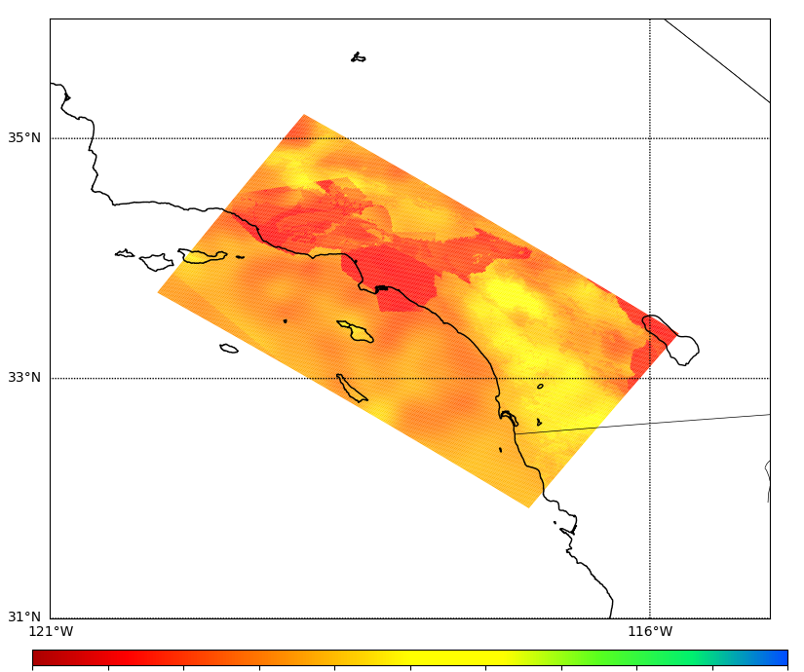
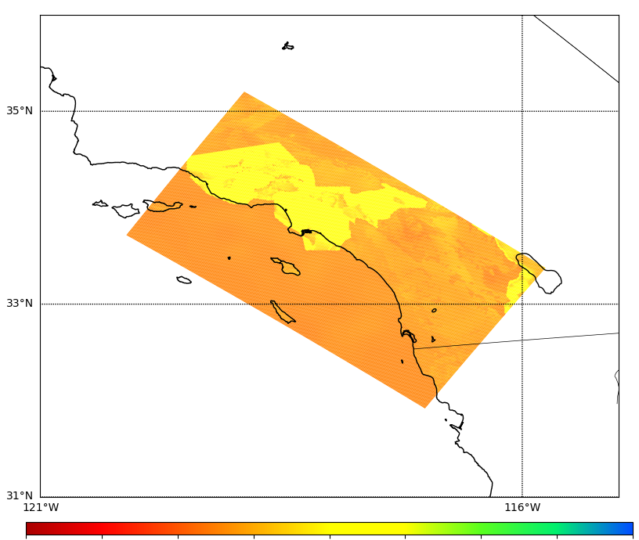
Merged Taper Cross-sections
CVM-S4.26.M01
Merged Taper
% difference
Surface
500
1000
2500
500
1000
2500
-100%
0%
100%
300m
depth
500
1000
2500
500
1000
2500
-100%
0%
100%

Slide 7
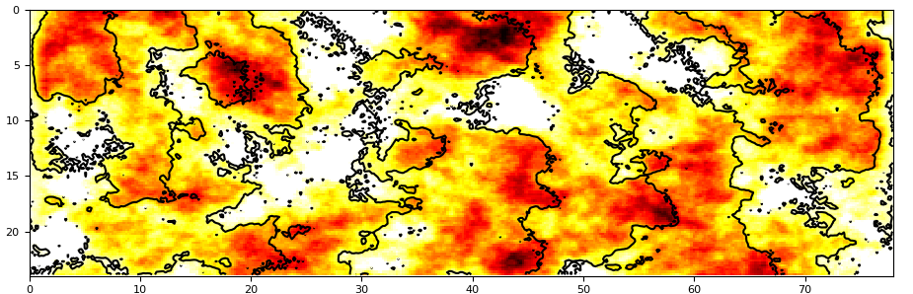
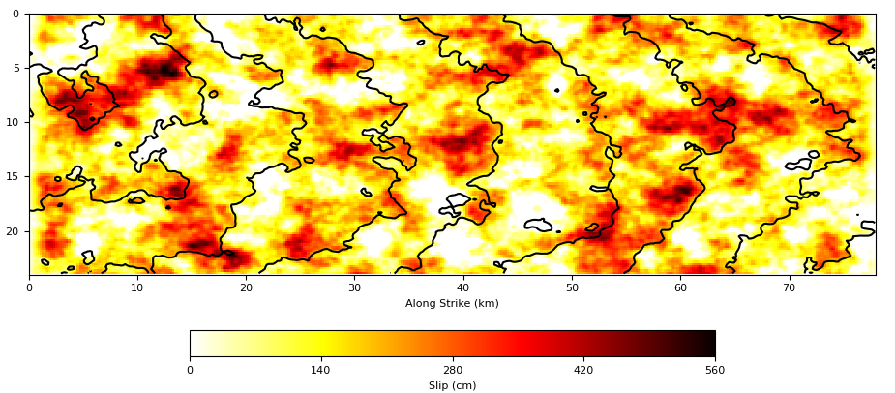
Updates to Rupture Generation
New version of GP generator (v5.5.2, same as in latest BBP release)
  Reduced correlation between slip and
  risetime
  Reduced shallow fault rupture speed
  Slightly weaker directivity
  Variable strike & dip
Rupture velocity is no longer fixed
  67.5%-87.5% of shear wave velocity
Denser hypocentral spacing
  4.5 km -> 4 km
  ~31% increase in rupture variations
Slip plot, v3.3.1 from Study 15.4 (top); v5.5.2 from Study 22.12 (bottom)

Slide 8
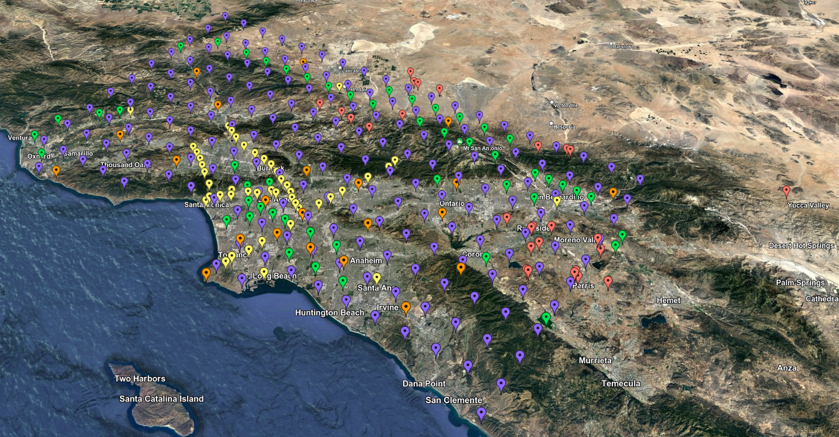
Study 22.12 Statistics
Standard 335 SoCal sites
Study performed over 76 days
772,000 node-hours on Summit
  Averaged 422 nodes
  Max of 3382 (73% of Summit)
Managed ~2.5 PB of data
74 TB of data staged back to archival storage
  420 million two-component low-frequency and broadband seismograms
  83 billion intensity measures and durations
Study 22.12 site map

Slide 9
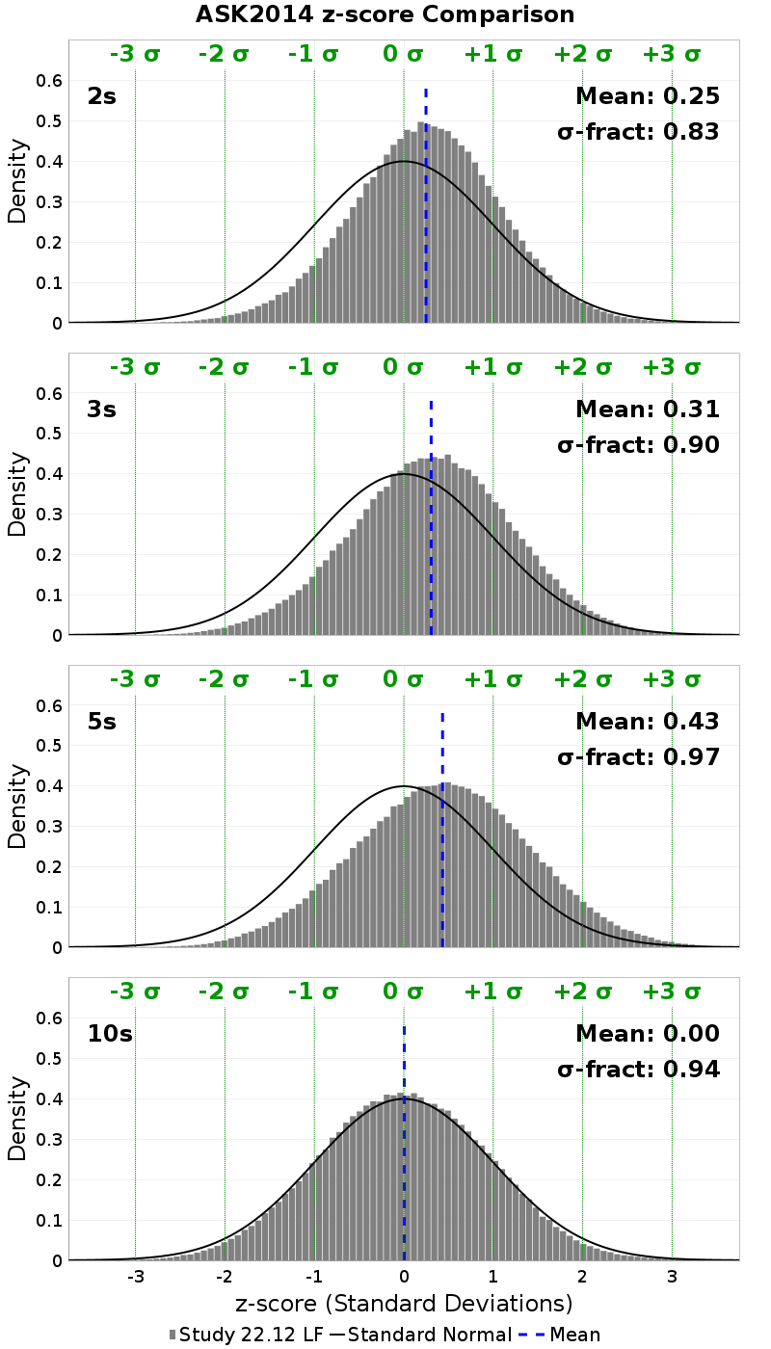
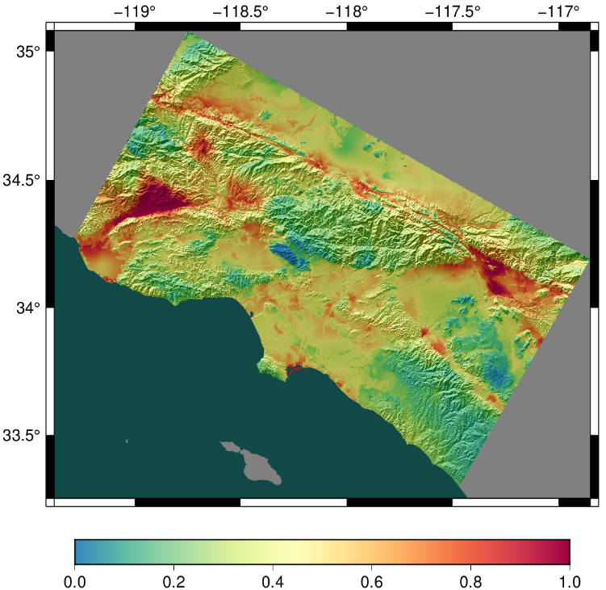
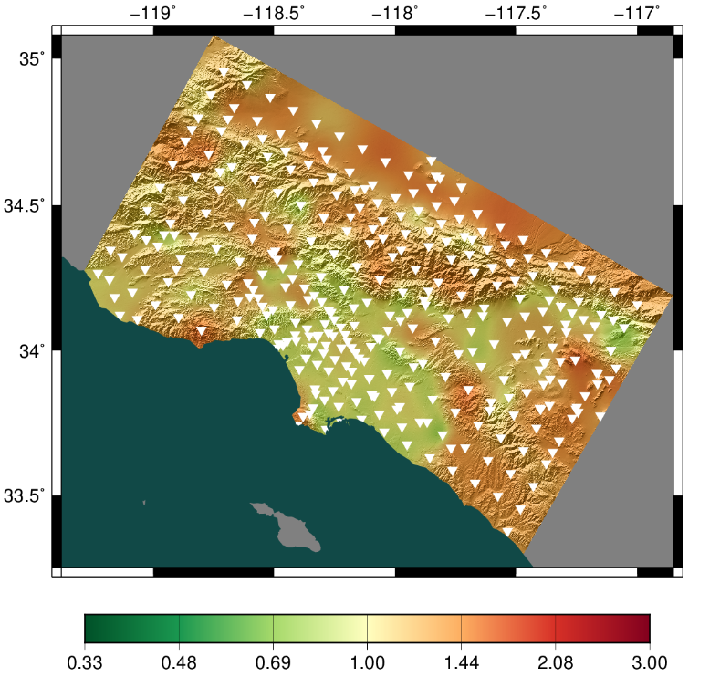
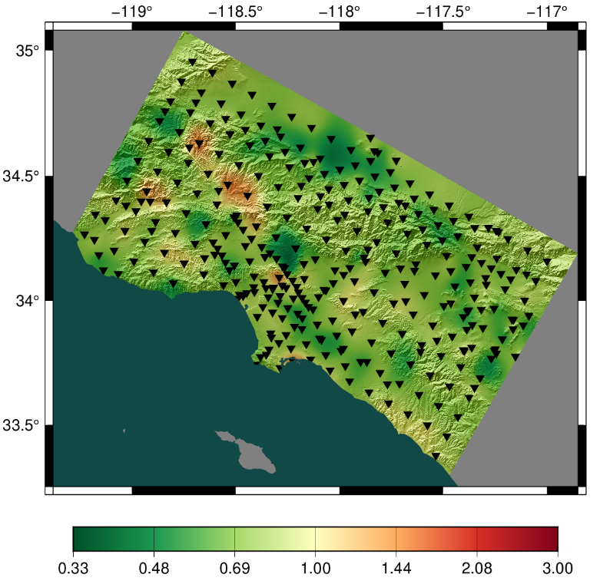
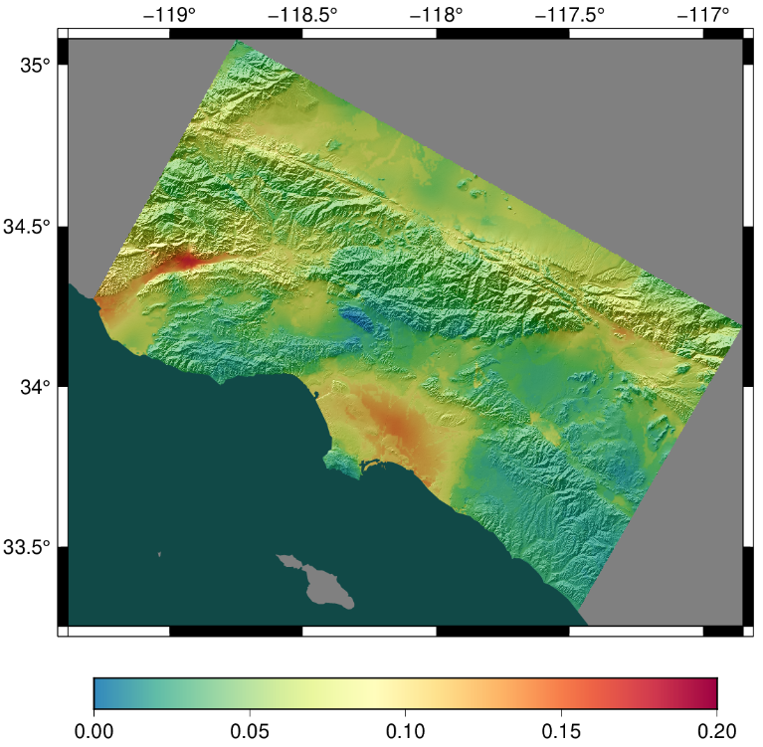
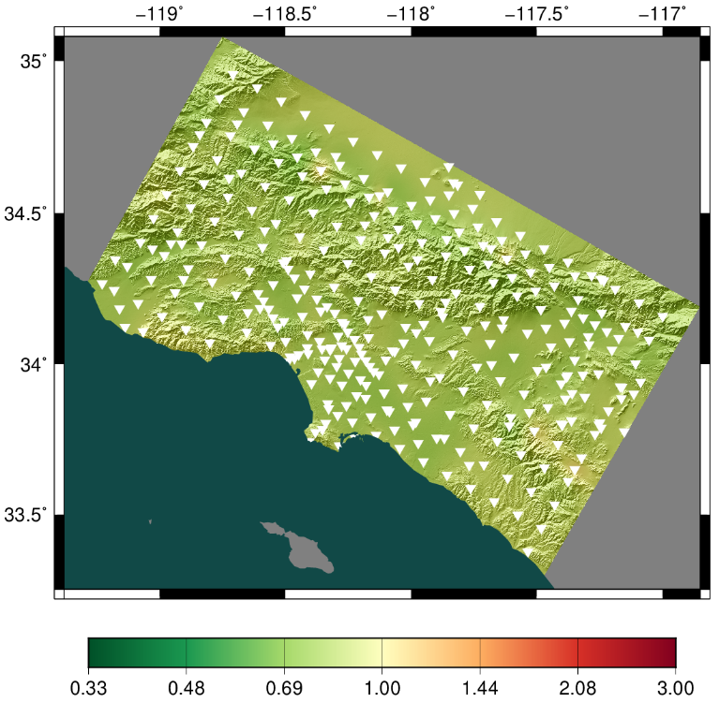
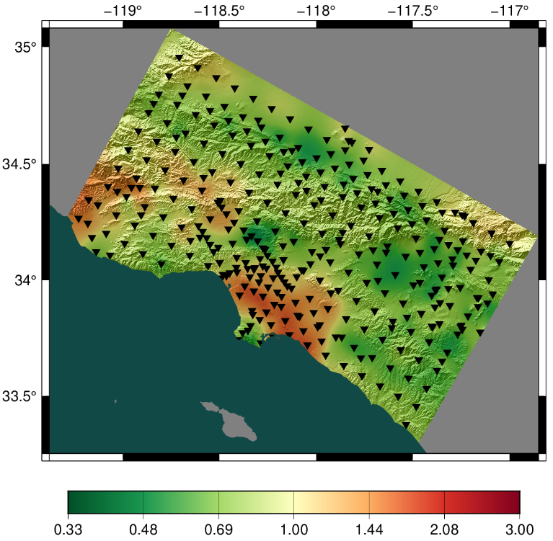
Low-Frequency Results
Study 22.12
Ratio, 22.12/15.4
Ratio, 22.12/GMMs
2 sec,
RotD50
10 sec,
RotD50
Distribution of z-scores between 22.12 and ASK2014

Slide 10
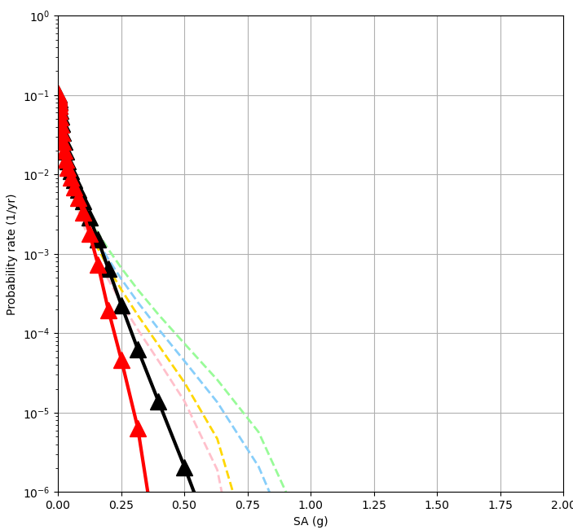
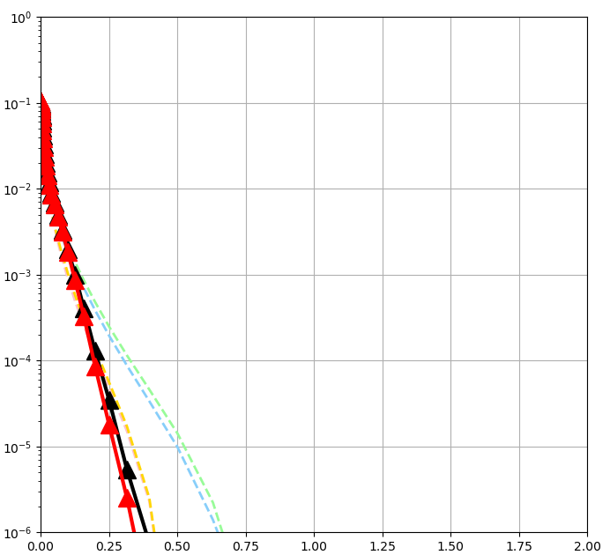
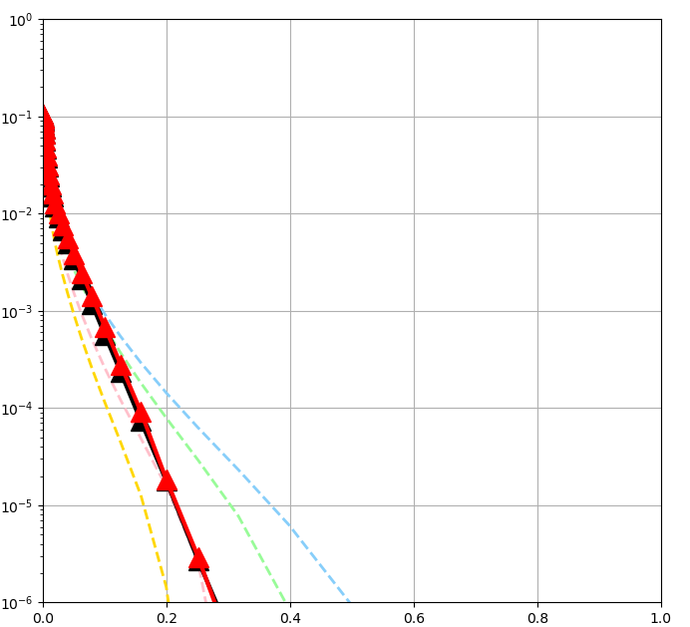
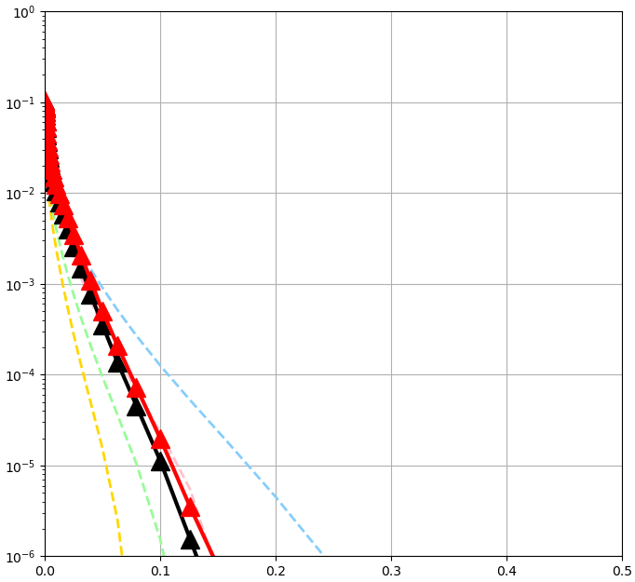
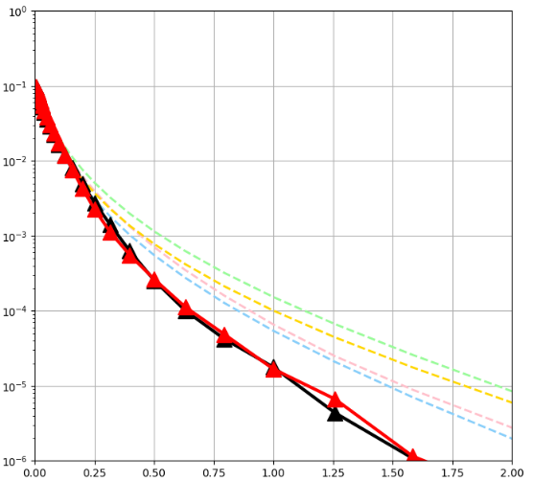
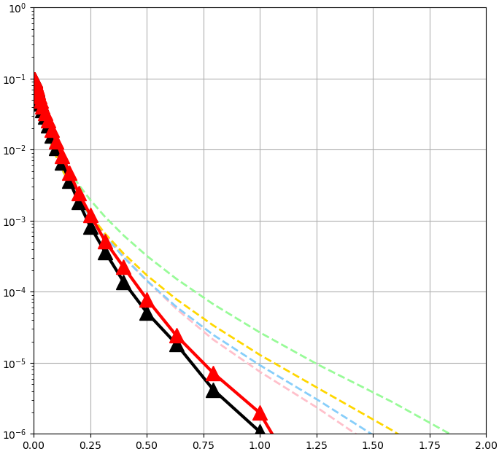
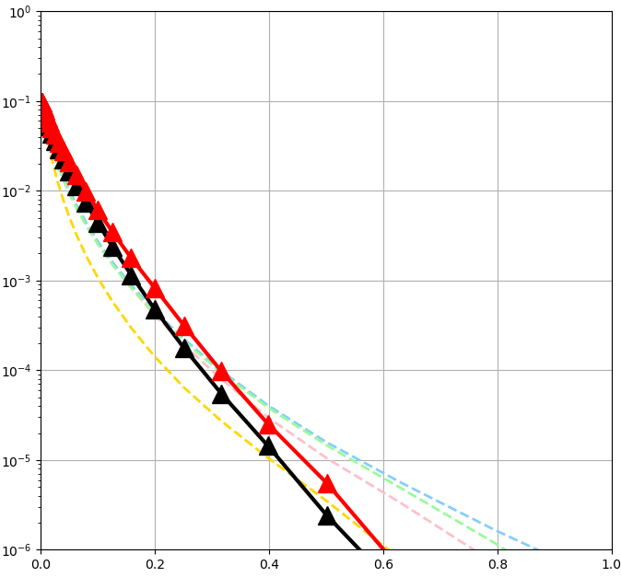
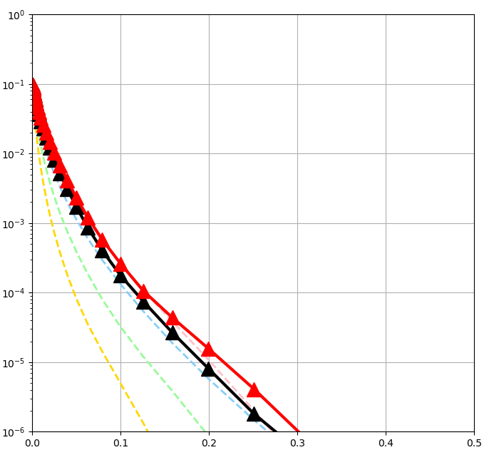
Study 22.12: Low-Frequency Curves
2 sec RotD50
3 sec RotD50
5 sec RotD50
10 sec RotD50
LBUT
(outside basin)
USC
(inside basin)
Red: Study 15.4
Black: Study 22.12

Slide 11
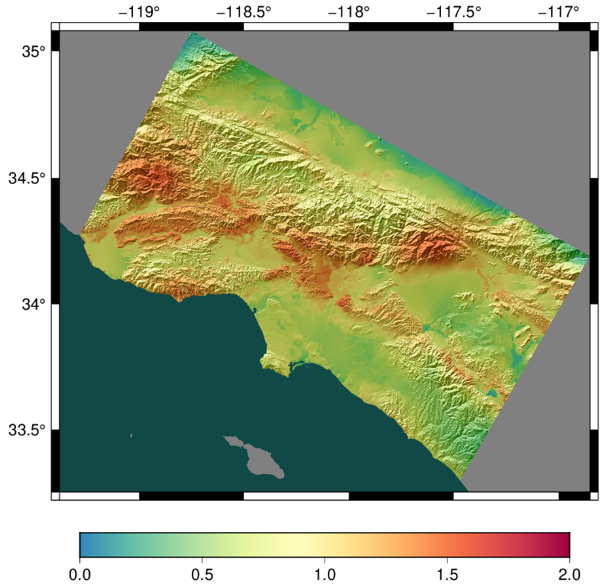
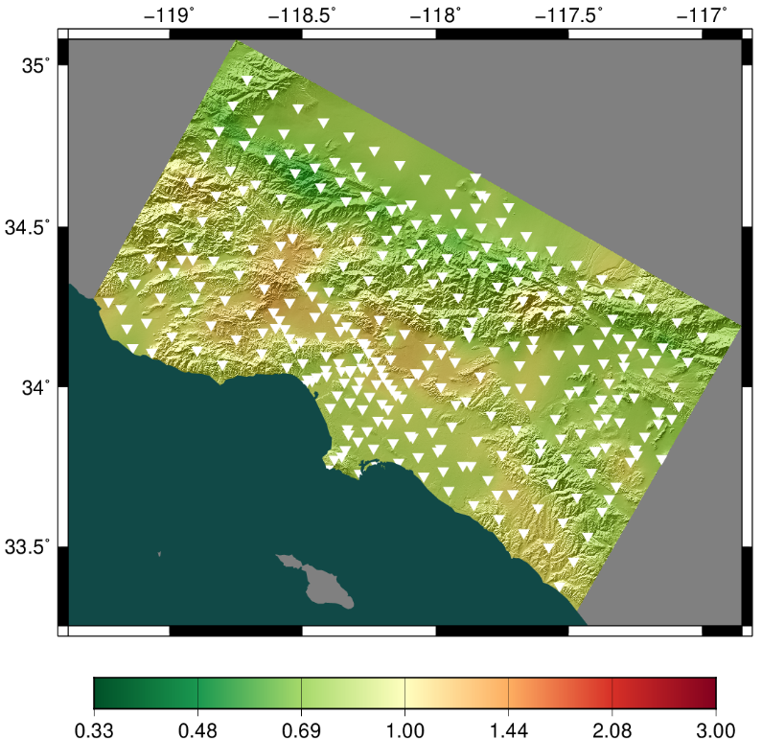
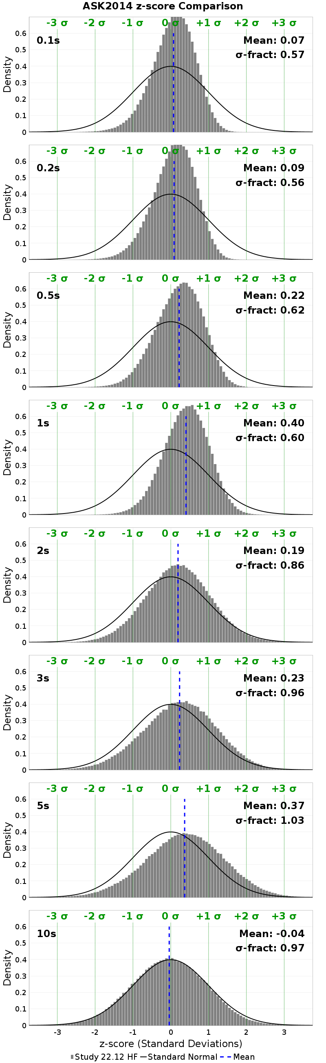
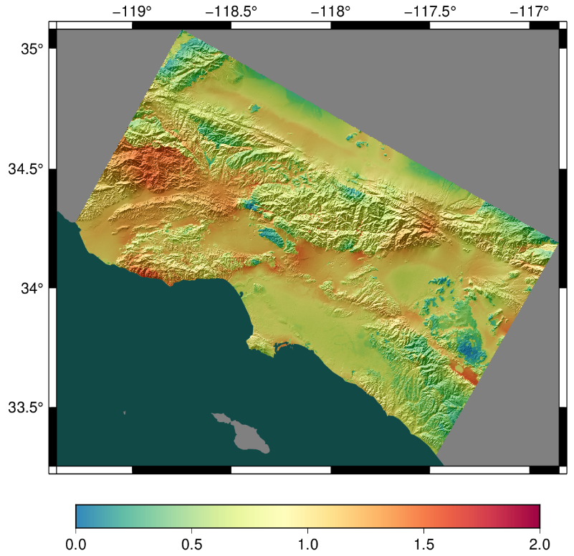
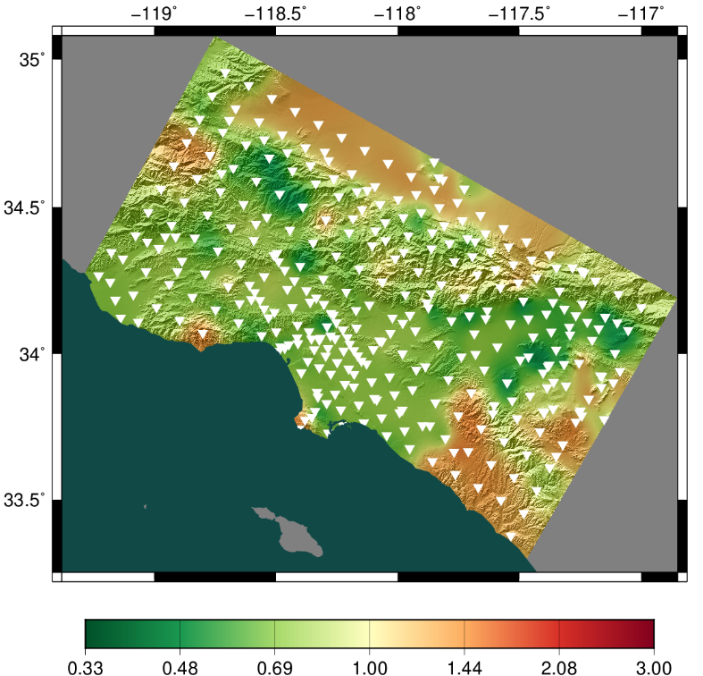
Study 22.12: Broadband Results
Study 22.12
Ratio, 22.12/15.12
0.1 sec,
RotD50
0.5 sec,
RotD50
Distribution of z-scores between 22.12 BB and ASK2014

Slide 12
Study 22.12: Data Access
CyberShake data access tool is under development
  Will streamline access to metadata, intensity measures, seismograms
  On pace for completion in May
In the meantime, data is available thru DB as with previous studies
Email me (scottcal@usc.edu) if you’re interested!

Slide 13









Thanks!

