Slide 1
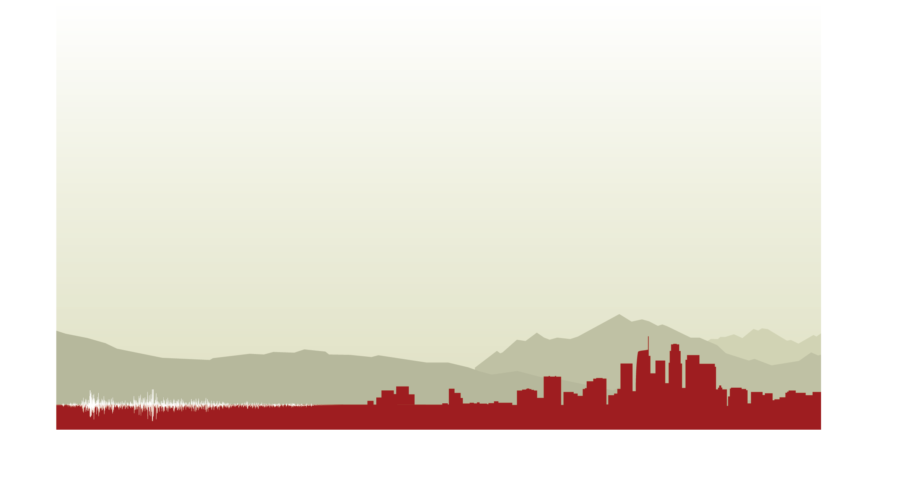
A CyberShake PSHA Model for Northern California
Scott Callaghan, Philip J. Maechling, Christine A. Goulet,
Kevin R. Milner, Mei-Hui Su, Robert W. Graves, Kim B. Olsen, Yifeng Cui, Brad Aagaard, Kathryn E. Wooddell, Albert R. Kottke and Thomas H. Jordan
2019 SSA Annual Meeting
April 25, 2019

Slide 2
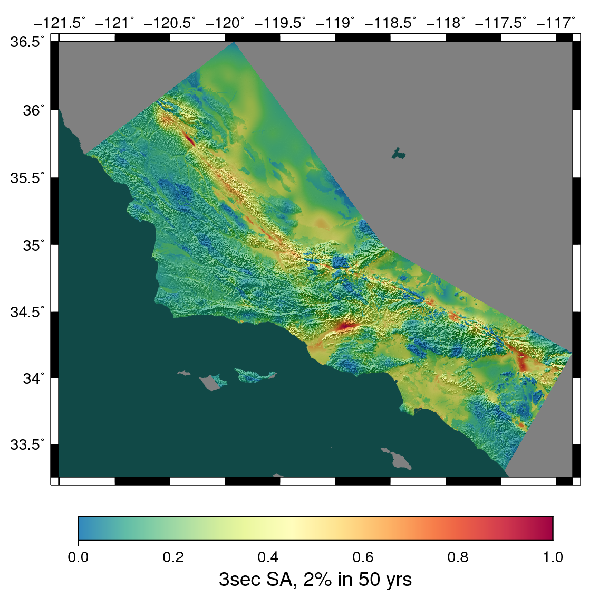
CyberShake Overview
Southern California Earthquake Center’s 3D physics-based probabilistic seismic hazard analysis (PSHA) platform
UCERF2 ERF (M≥6.5, ≤200 km) with Graves & Pitarka rupture generator (~500,000 events per site)
Reciprocity-based approach to simulate seismograms
Intensity measures derived from seismograms
Hazard results from individual sites interpolated with GMPEs to make map
Structural models: CVM-S4.26, CCA-06
Earthquake forecast: UCERF2

Slide 3
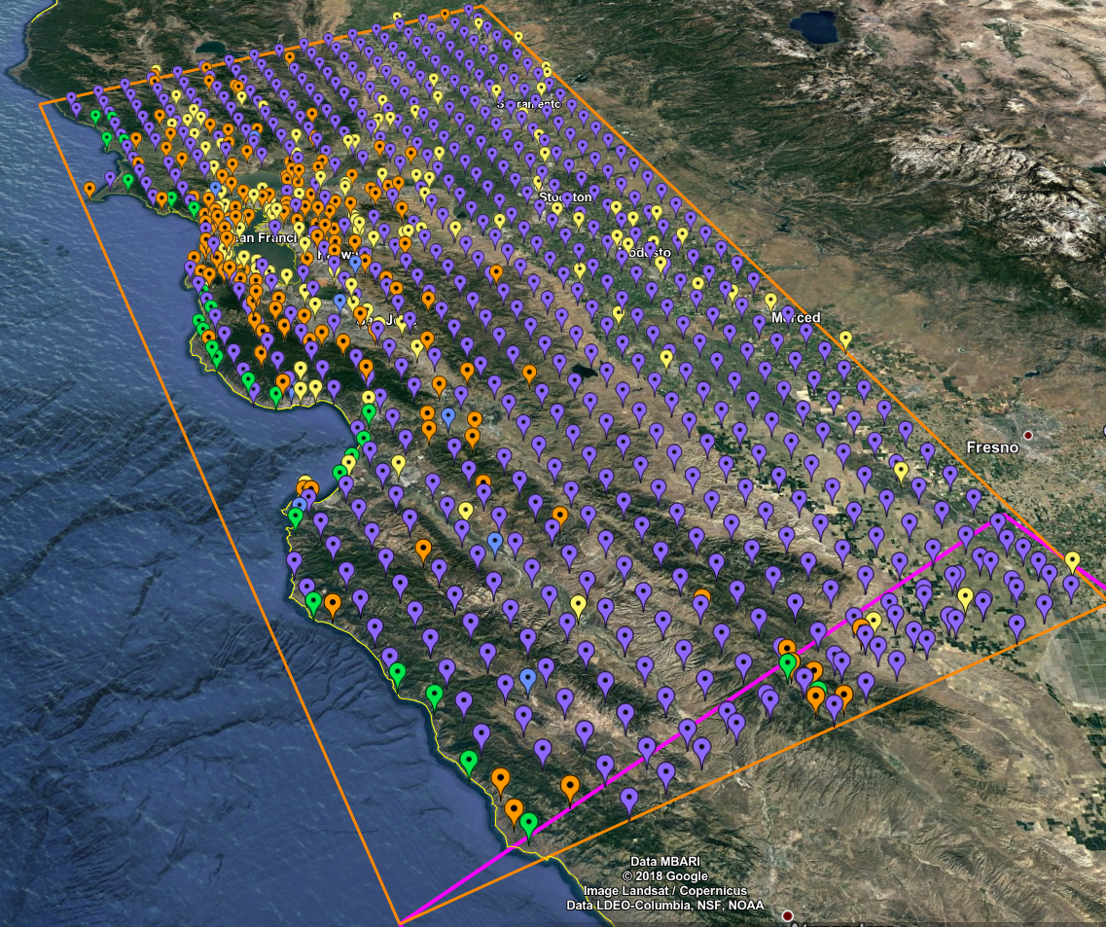
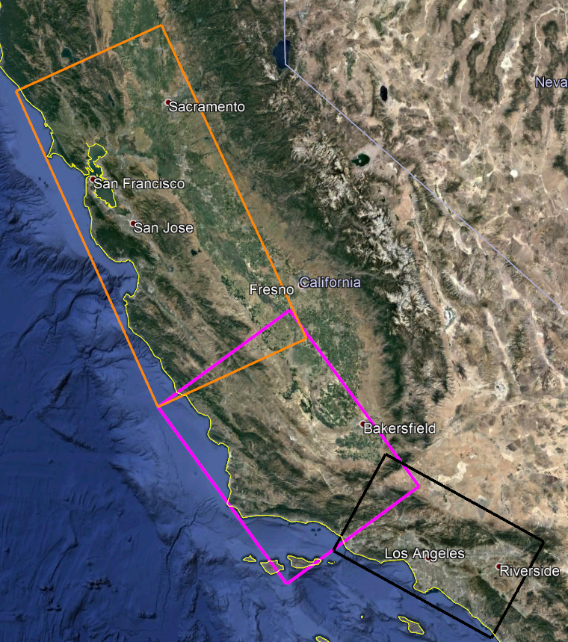
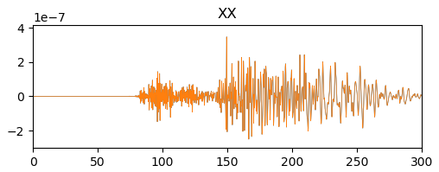
Northern California: Study 18.8
After success of Central California CyberShake, move further north
869 locations
1 Hz
Vs min = 500 m/s
Longer SGTs for some sites
Southern CA (Study 15.4) region in black
Central CA (Study 17.3) region in magenta
Bay Area (Study 18.8) region in orange
200s
300s
869 sites, densest near San Francisco Bay

Slide 4
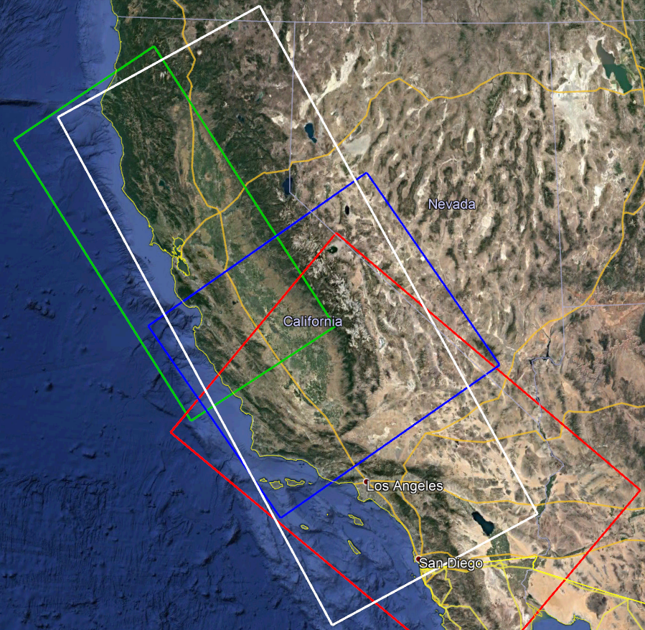
Combined Velocity Model
No single model large enough
for large volumes
Stitch together models
  CCA-06 + Ely GTL (blue)
  USGS Bay Area (green)
  CVM-S4.26.M01 (red)
  1D background model (white)
Apply smoothing along
model interfaces
  Average of neighbor values

Slide 5
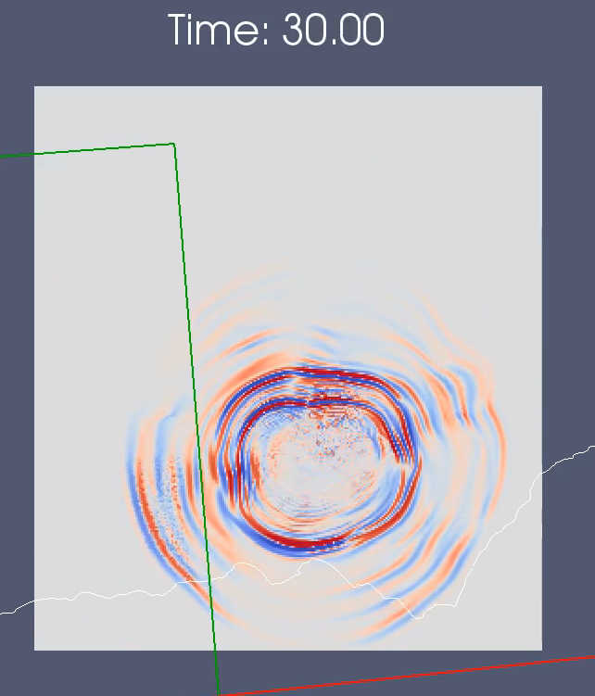
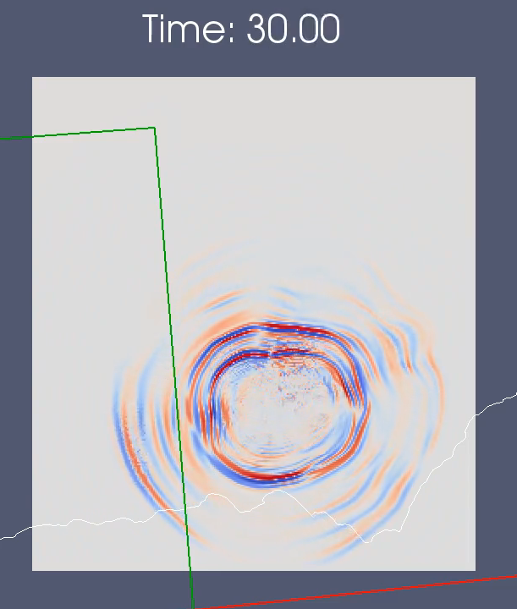
Smoothing Zone
Performed forward simulations near model interface to test smoothing
10 km smoothing
Wavefront encounters smoothed region
20 km smoothing
20 km smoothing shows reduced refraction effects

Slide 6
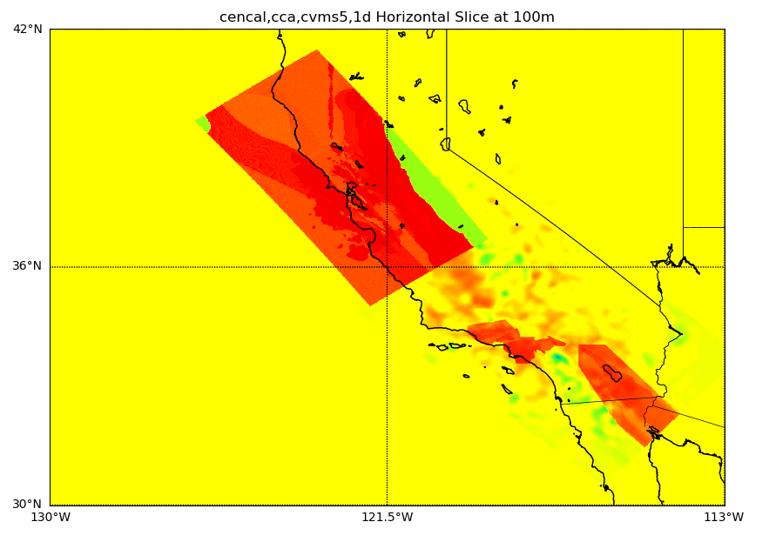
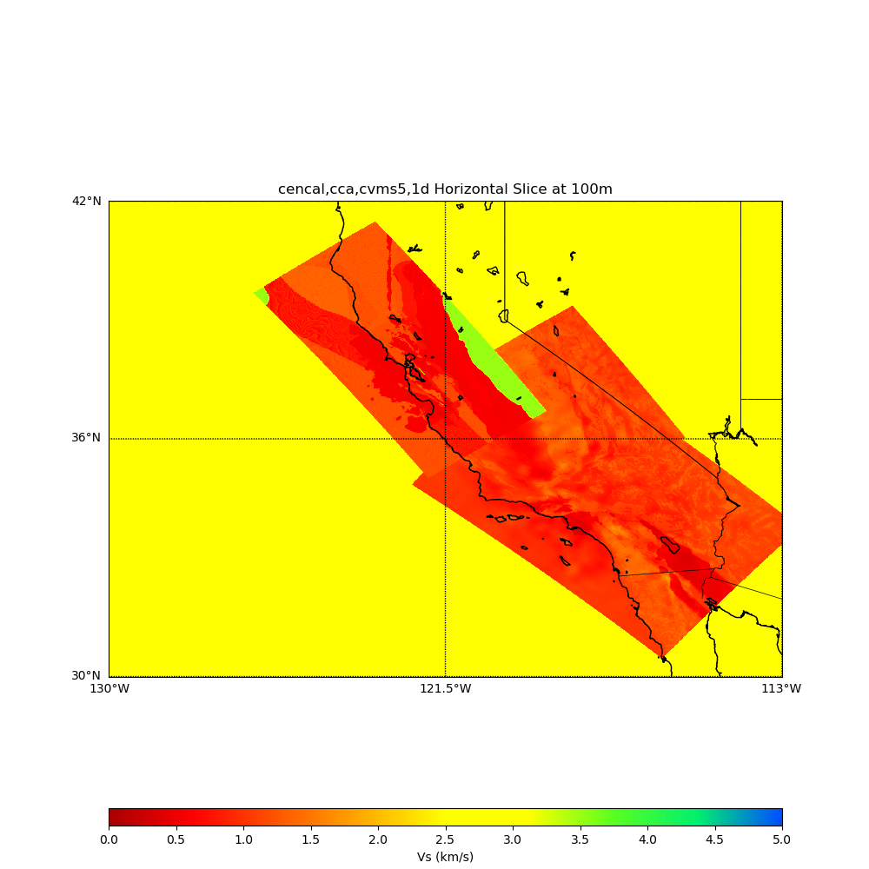
Geotechnical Layer
When using CCA-06 for Study 17.3, used Vs min=900 m/s due to tomography
Wanted to include lower-velocity information with Study 18.8
Added Vs30-derived GTL to top 500m using Ely (2010)
  Wills (2015) as source for Vs30
No GTL applied
Ely GTL applied

Slide 7
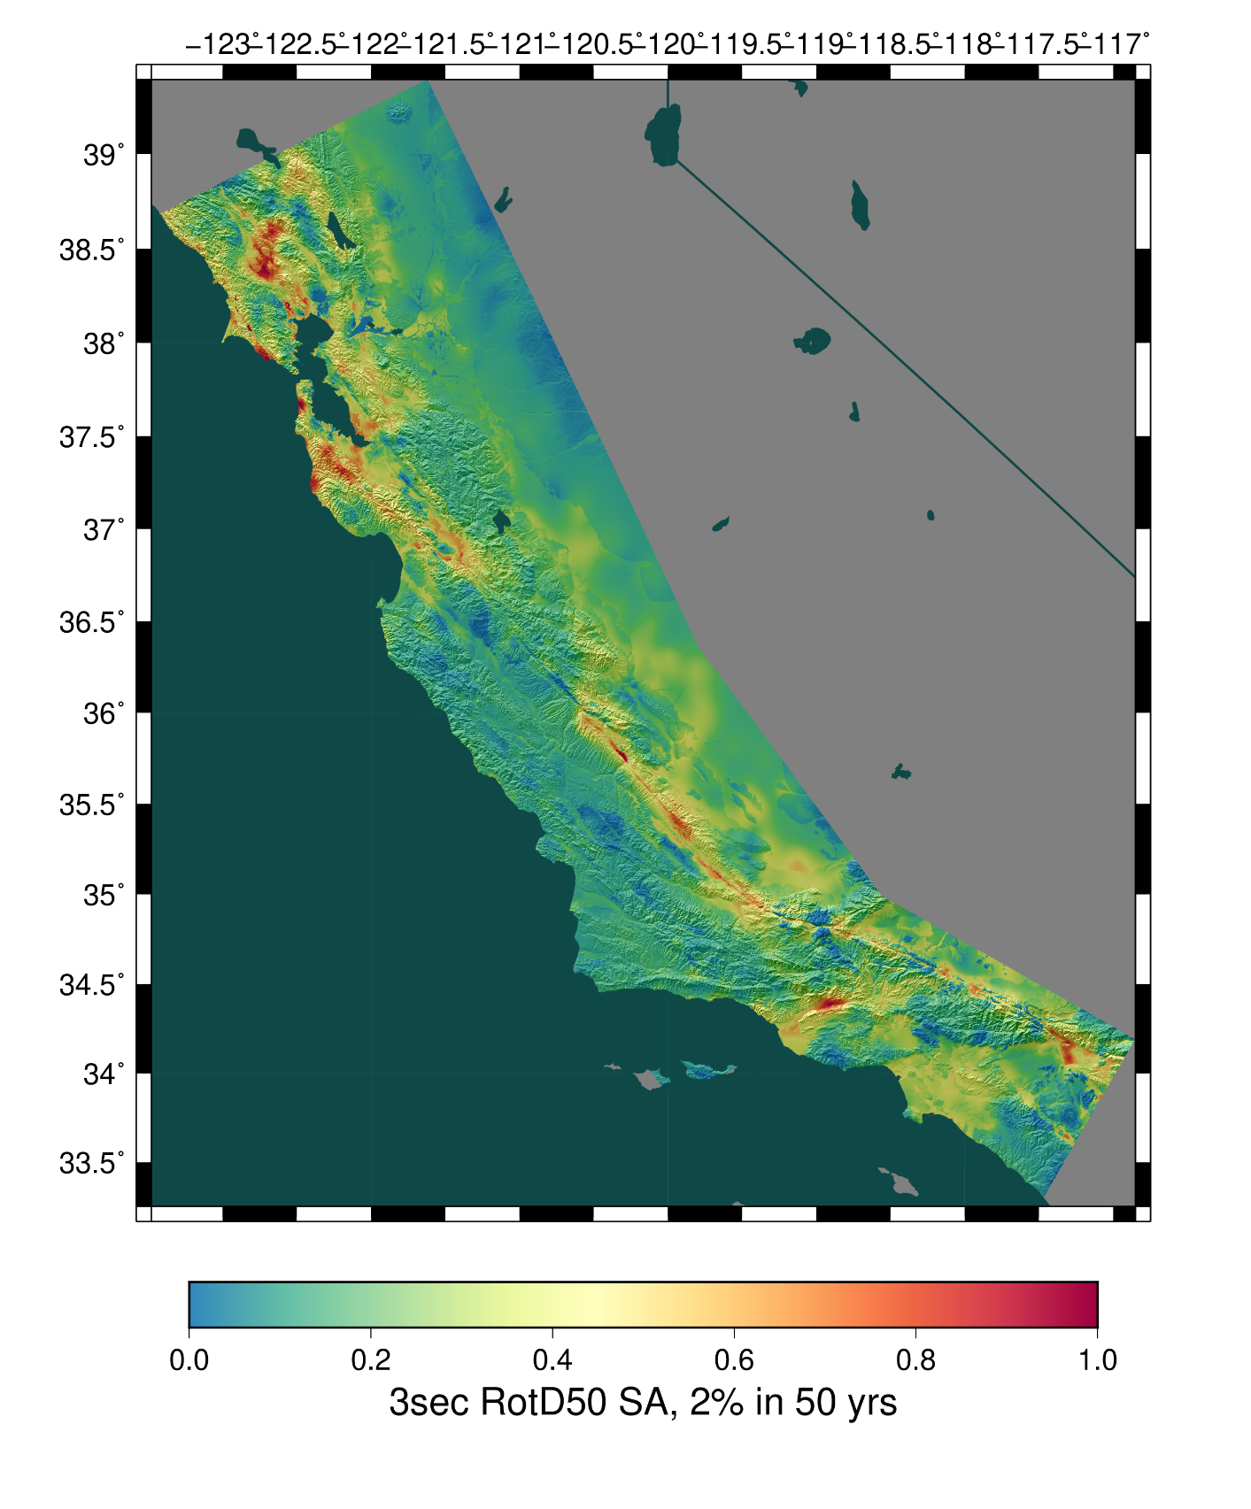
Study 18.8 Metrics
Study conducted over 128 days
  NCSA Blue Waters, OLCF Titan
Consumed 6.2 million node-hours (120 million core-hours/13,650 core-years)
  Averaged 2,018 nodes / 38,850 cores
1.2 PB of data generated
  14.4 TB of final data products
Synthesized 203 million two-component seismograms
  30.4 billion intensity measures
Study 18.8
Study 17.3
Study 15.4

Slide 8
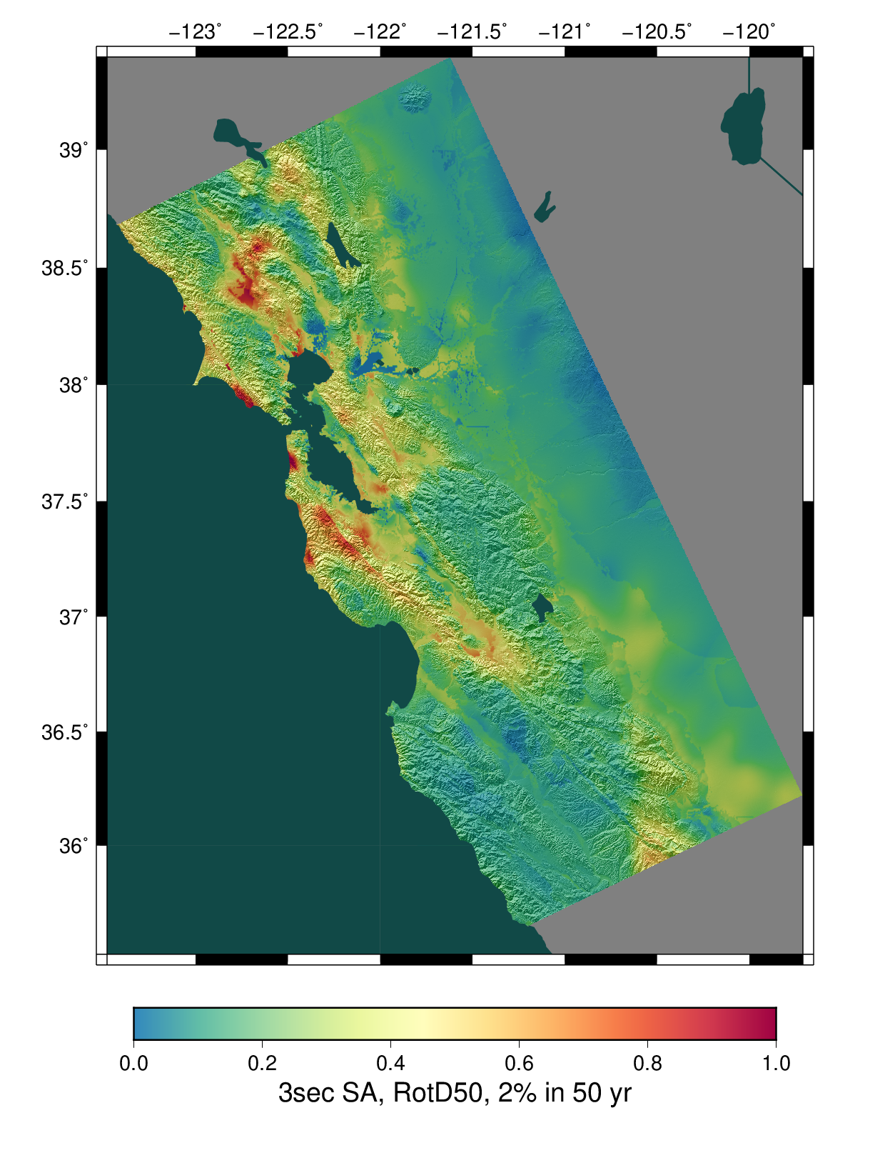
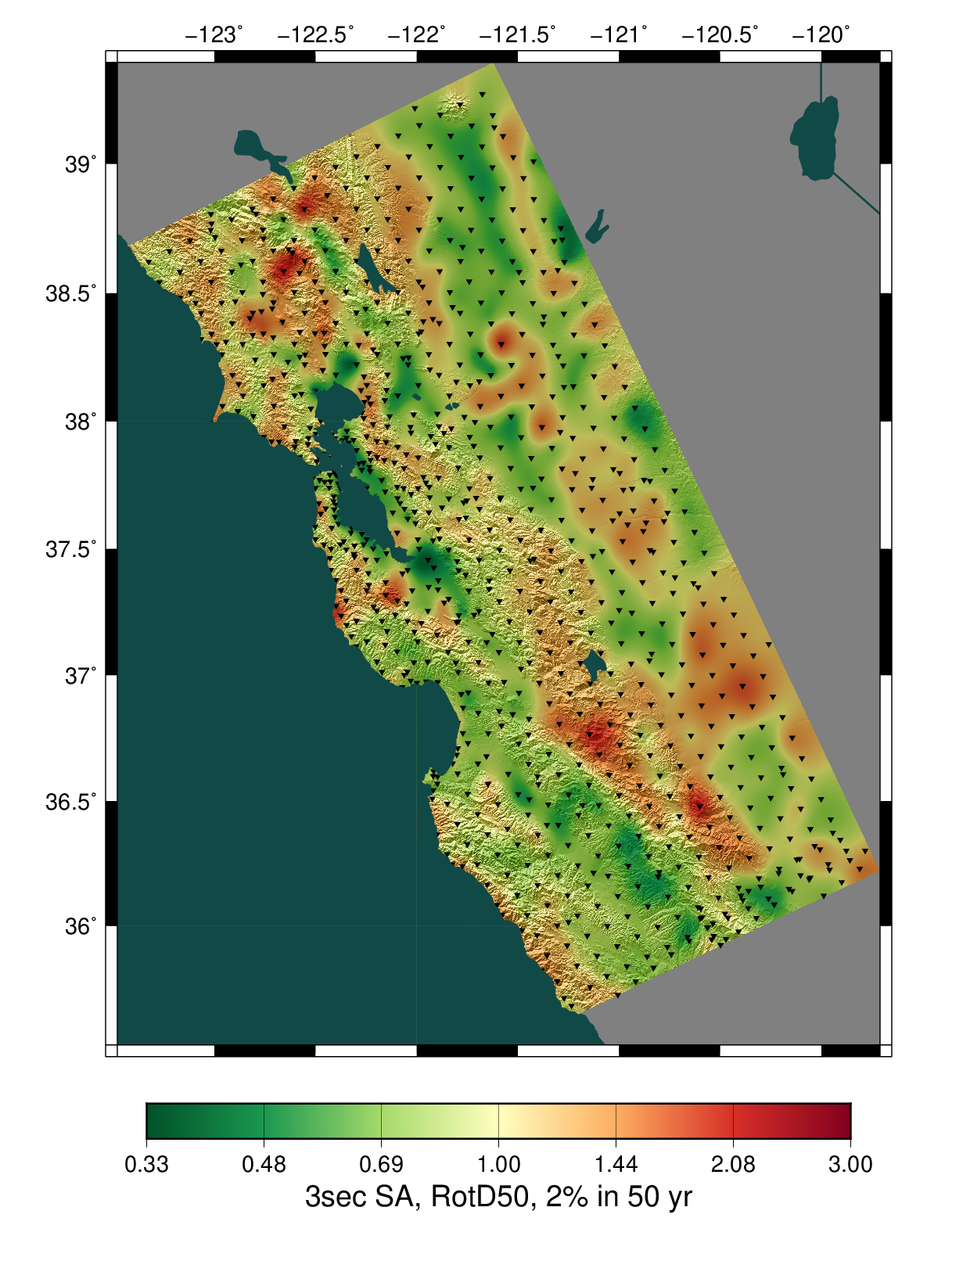
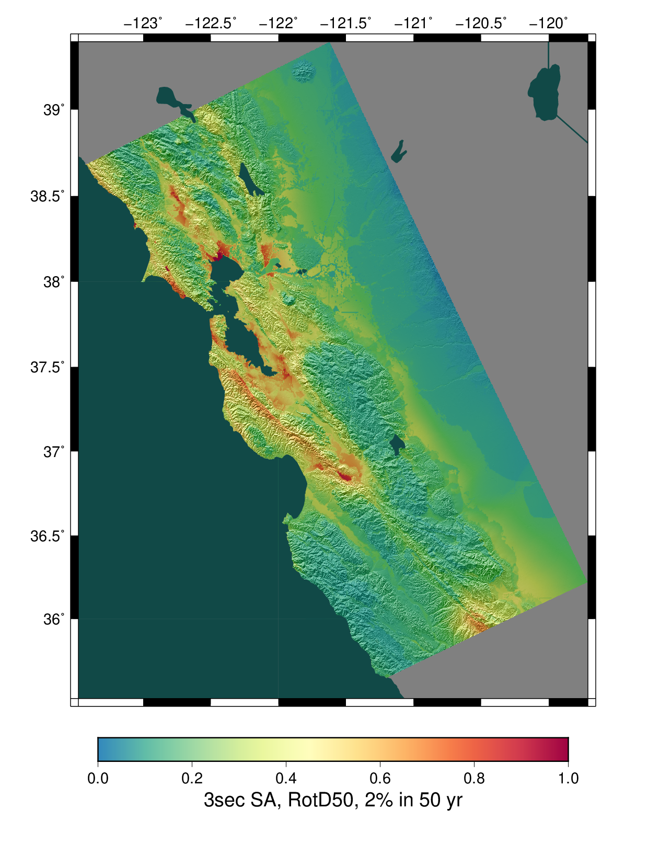
Study 18.8 Results
CyberShake
Ratio of CyberShake/GMPEs
Avg of 4 NGAWest2 GMPEs

Slide 9
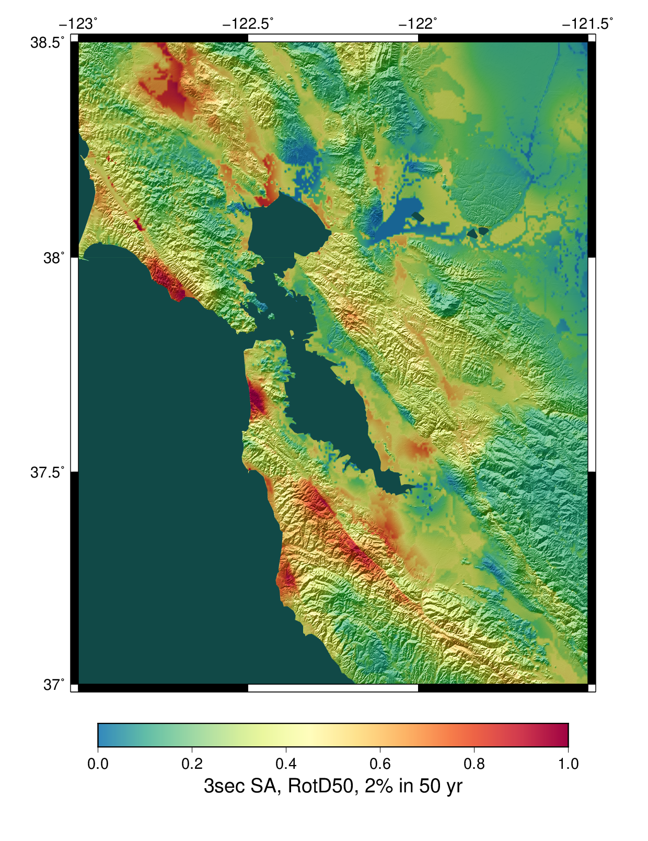
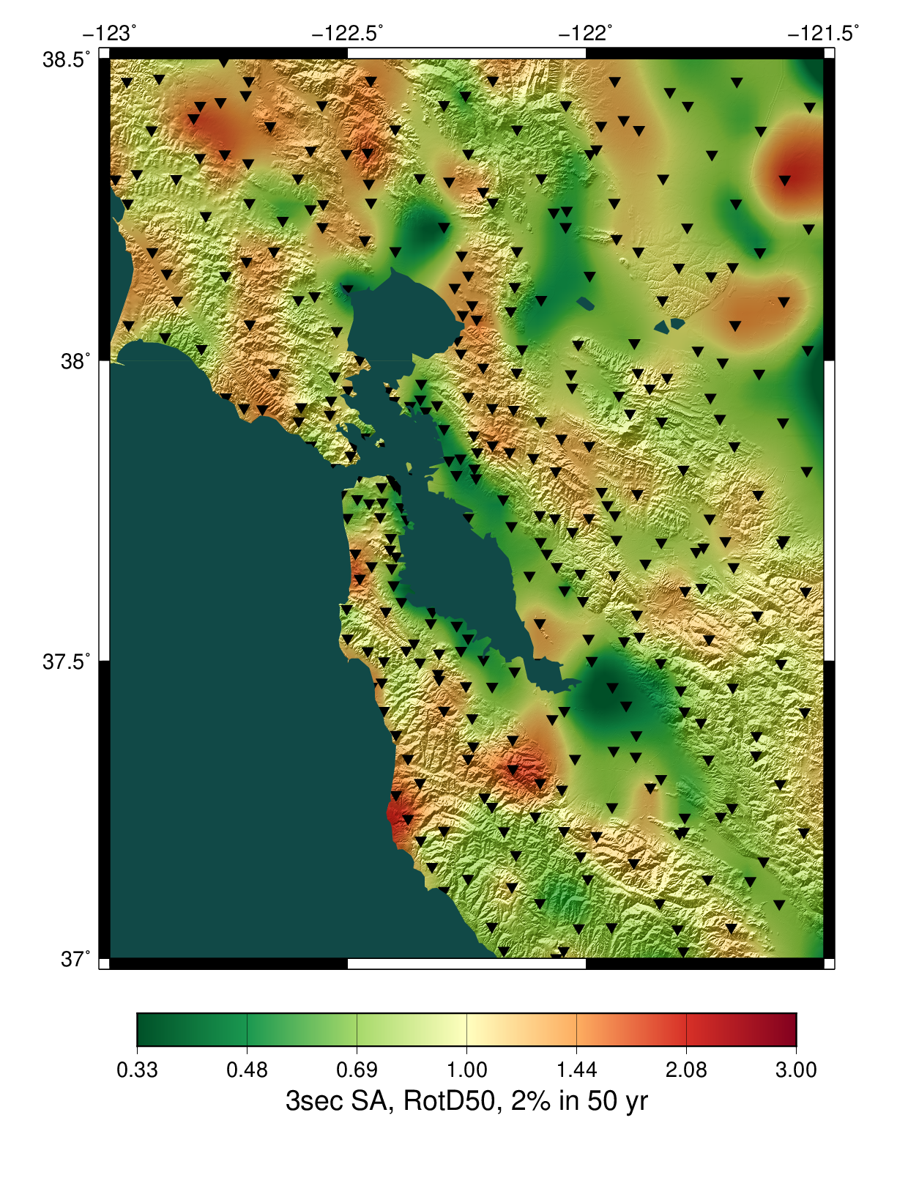
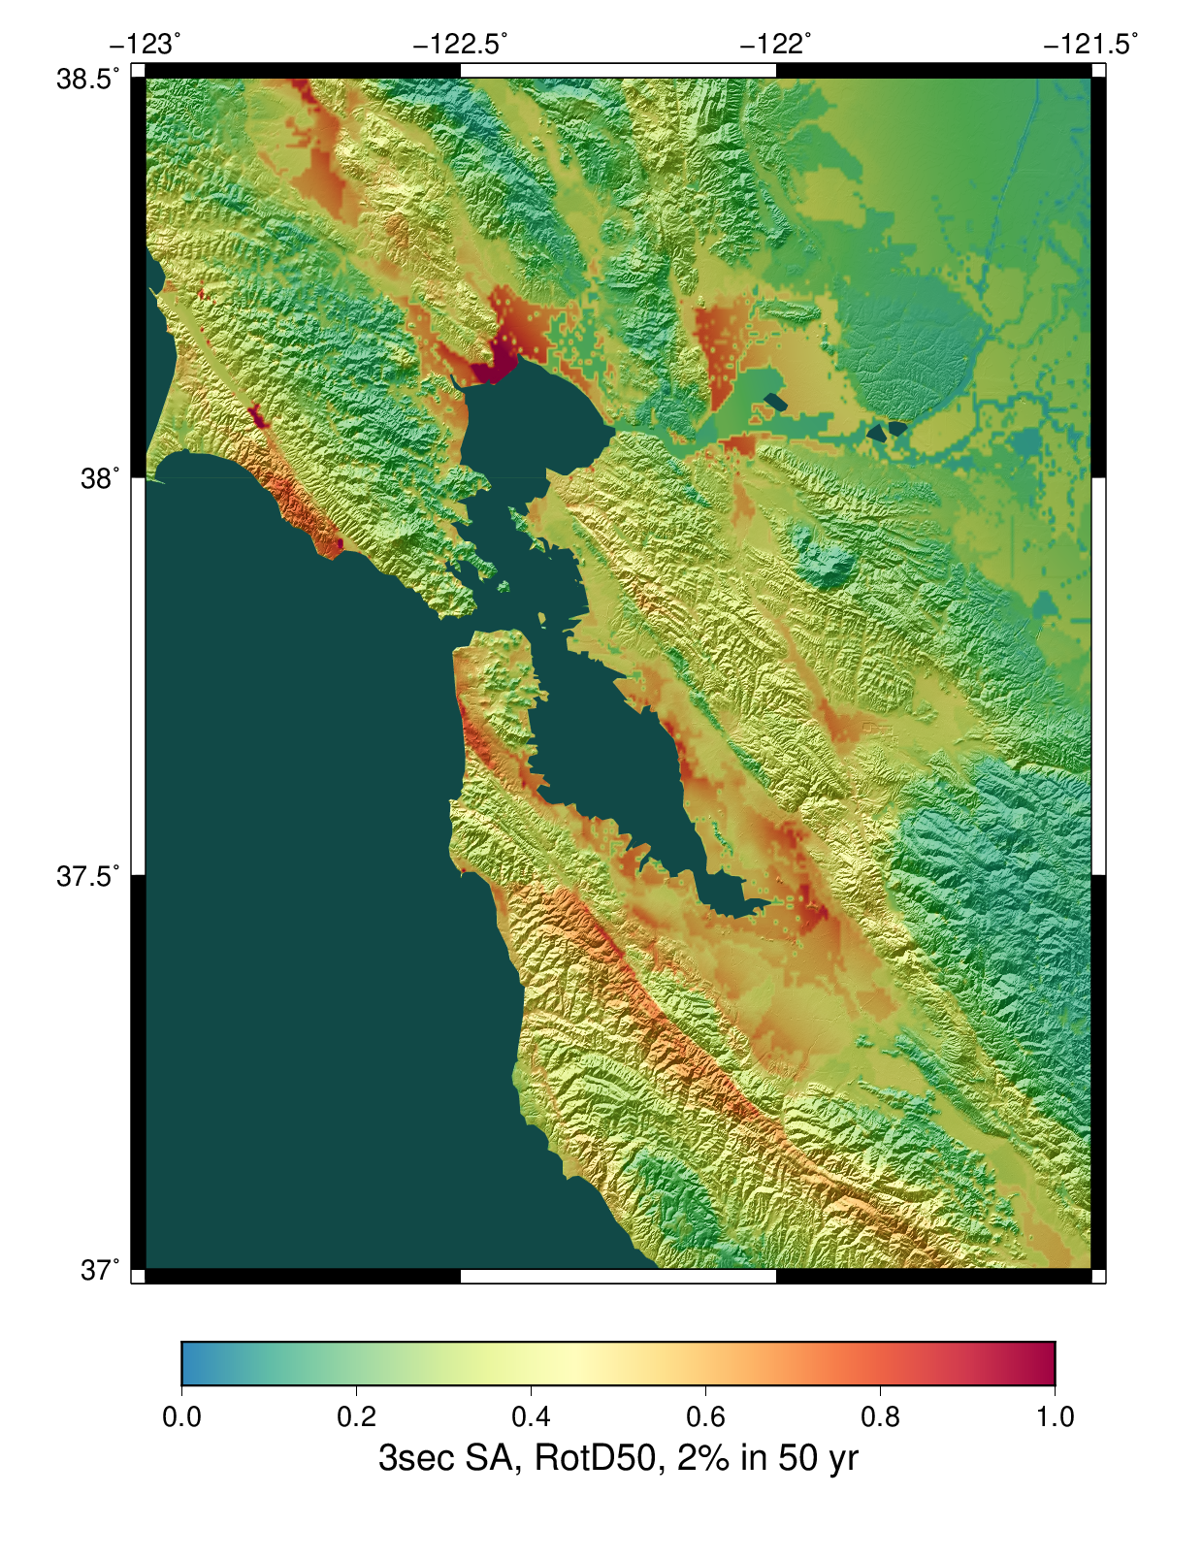
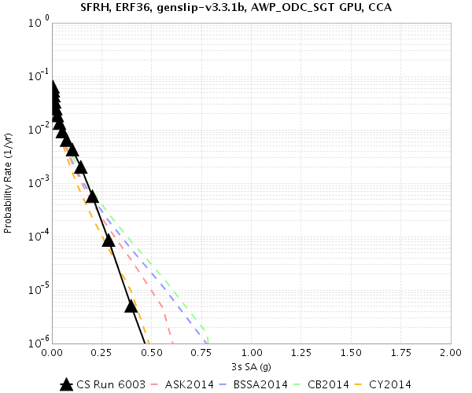
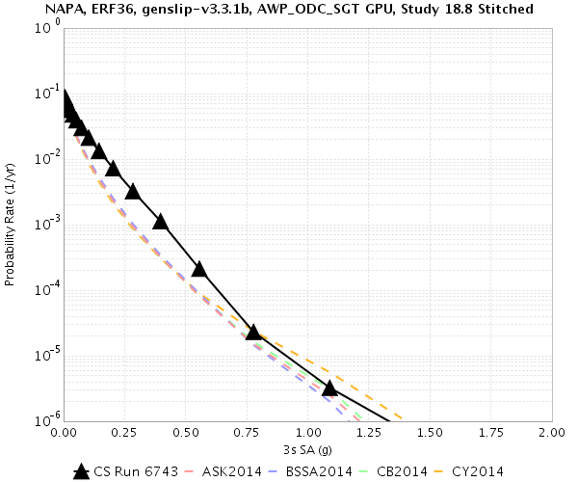
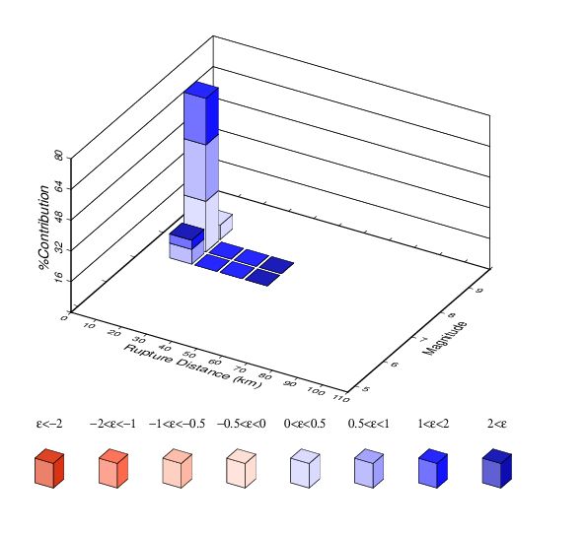
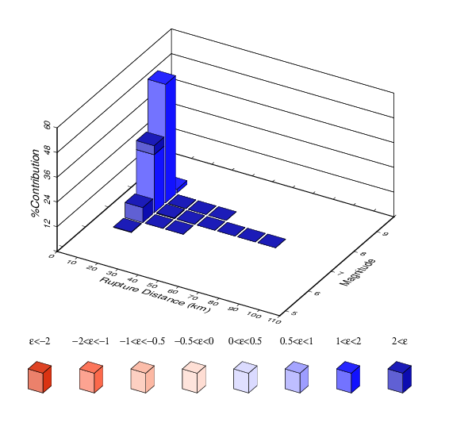
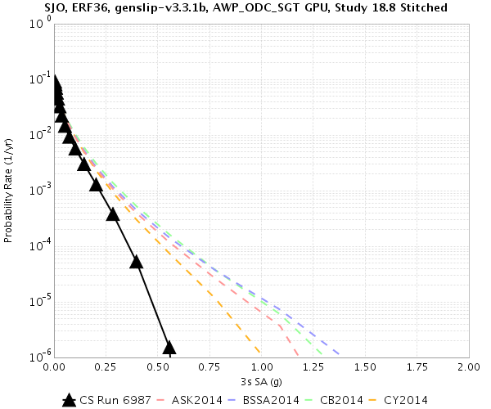
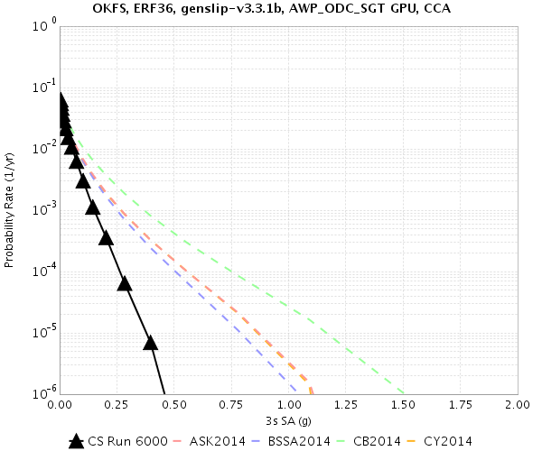
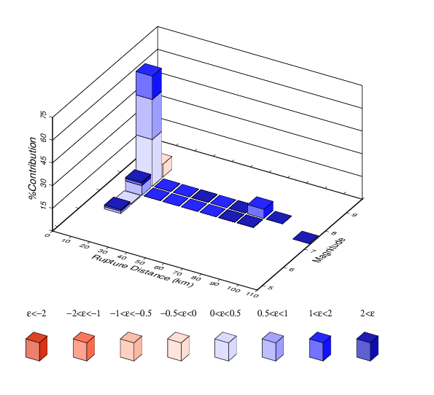
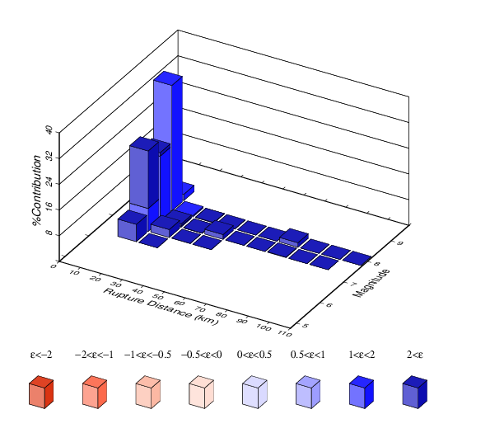
Study 18.8 Results, Bay Area
SFRH, CyberShake 3sec RotD50 disaggregation
SFRH, ASK 2014 3sec RotD50 disaggregation
SJO, CyberShake 3sec RotD50 disaggregation
SJO, ASK 2014 3sec RotD50 disaggregation
CyberShake
Ratio of CyberShake/GMPEs
Avg of 4 NGAWest2 GMPEs

Slide 10
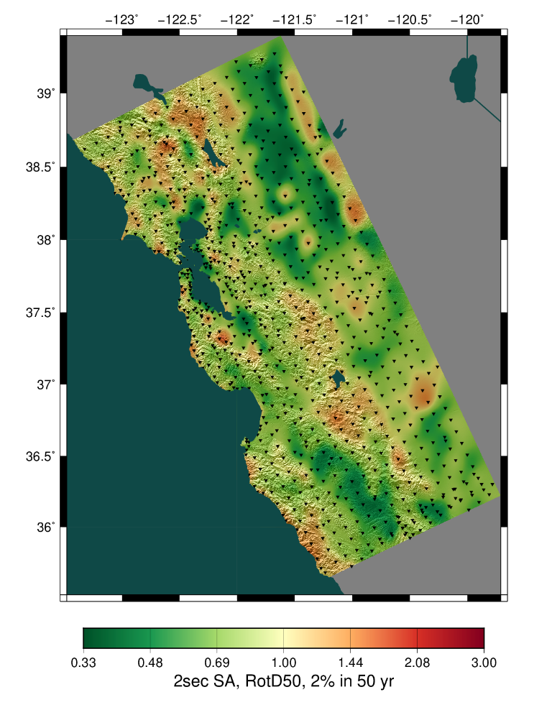
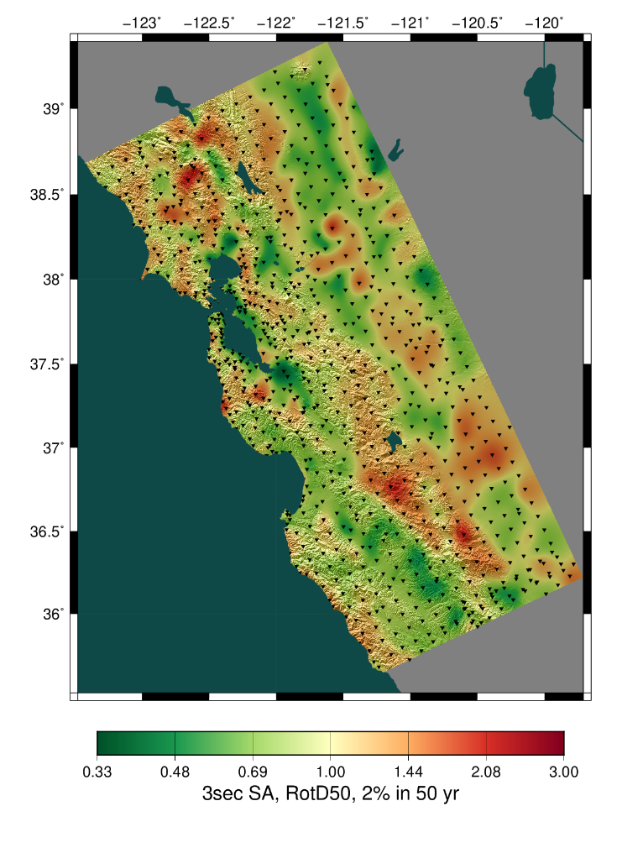
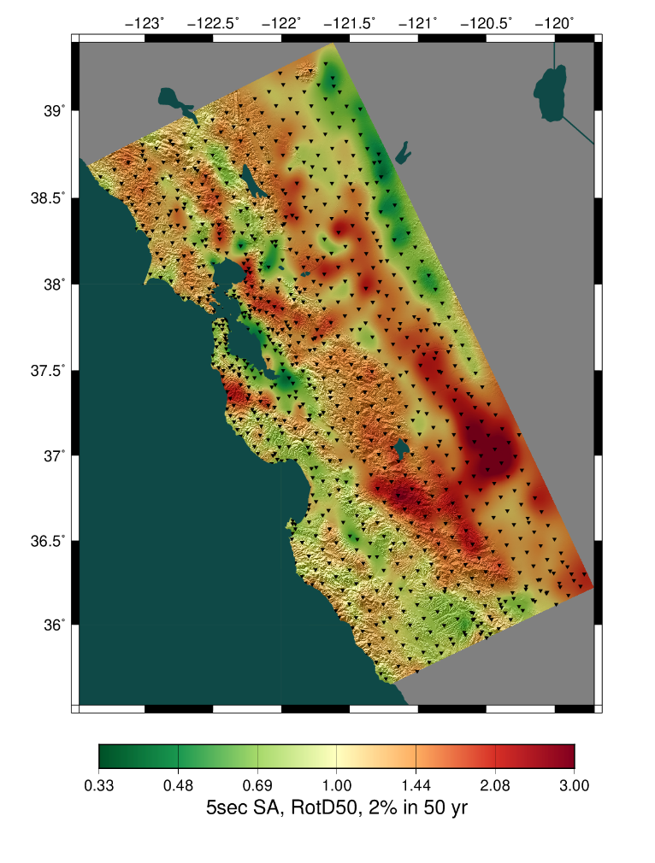
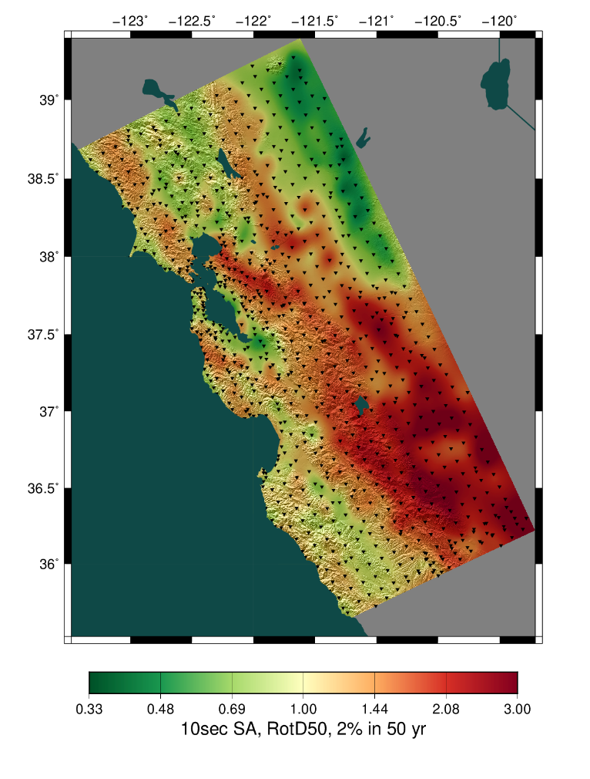
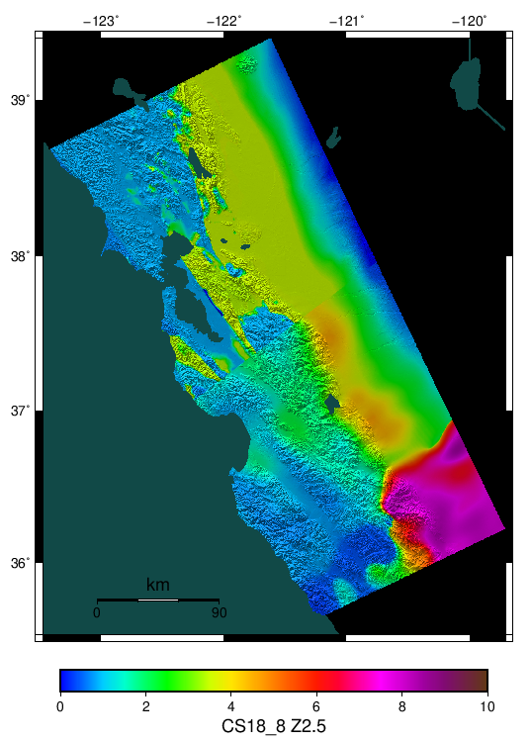
San Joaquin Valley
CyberShake shows increased hazard in San Joaquin Valley, especially at longer periods
Likely due to basins in tomographic CCA-06 model
Ratio, 2 sec
Ratio, 3 sec
Ratio, 5 sec
Ratio, 10 sec
Z2.5 map

Slide 11
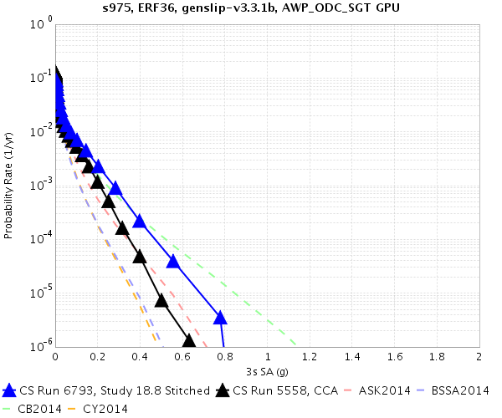
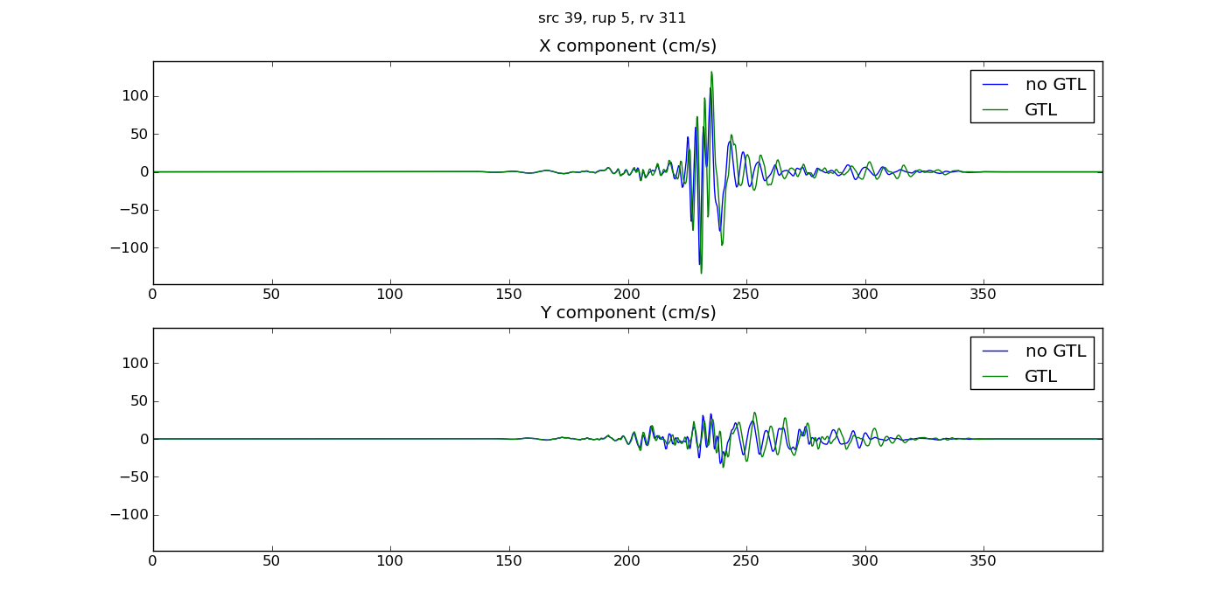
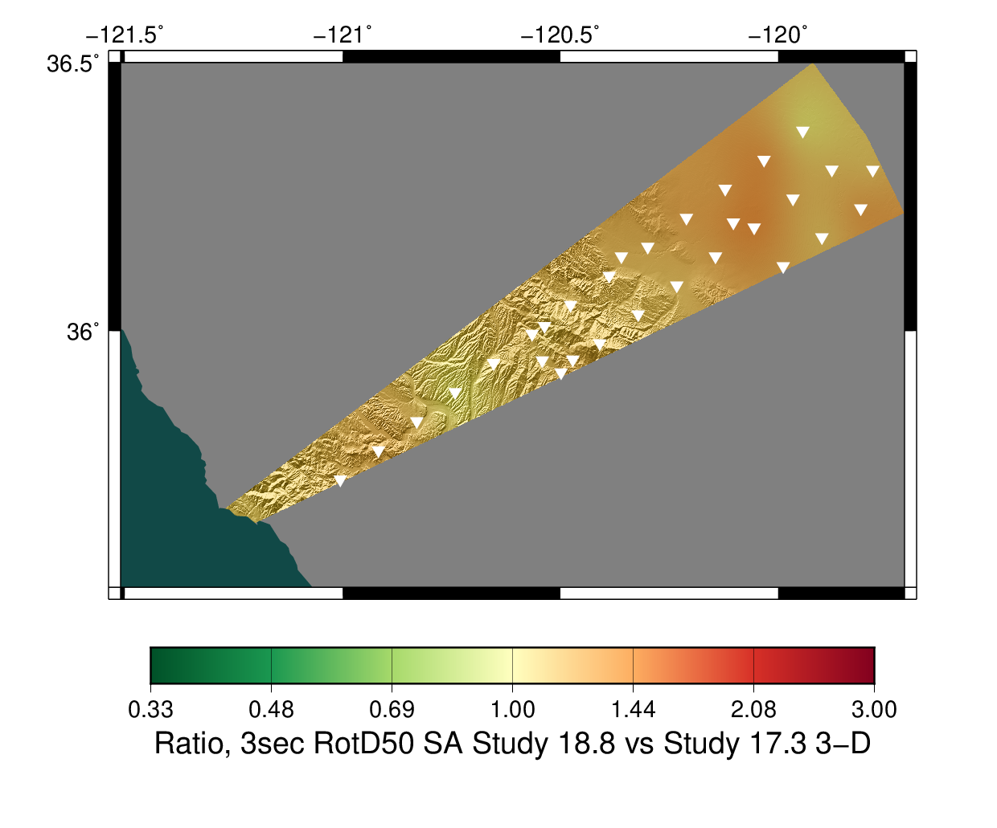
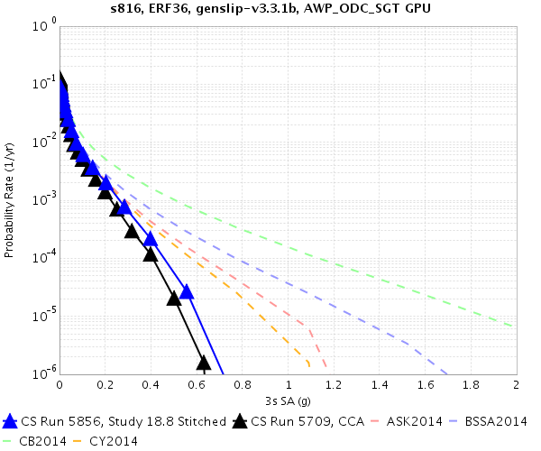
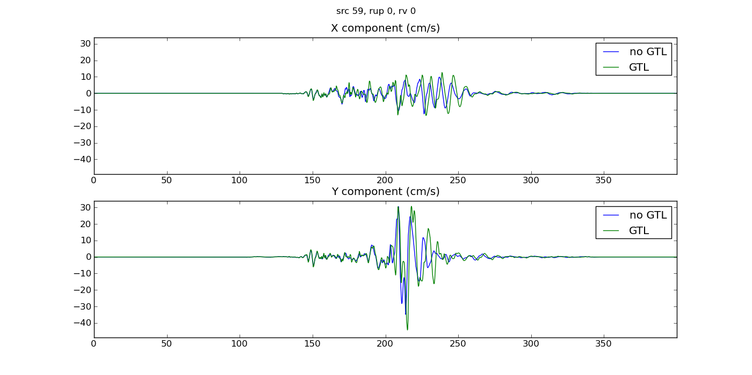
Study 18.8 vs 17.3

Slide 12
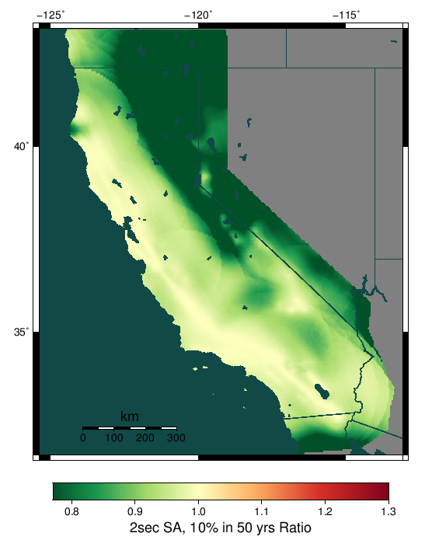
Future Directions
Background seismicity contributes 5-10% to hazard in region using GMPEs
  Will add to Study 18.8 results
Update to latest Graves and Pitarka rupture generator
Nonlinearity
  Breaks reciprocity, which gives CyberShake a 500x advantage over forward simulations
  Develop nonlinear approximations which preserve reciprocity
  Mix of reciprocal and forward nonlinear simulations
Ratio of hazard with background seismicity to hazard without, with GMPEs

Slide 13












Questions?

