Slide 1

High Performance Computing at SCEC
Scott Callaghan
Southern California Earthquake Center
University of Southern California

Slide 2
Outline
Who am I?
What is High Performance Computing?
How is it useful to SCEC?
How does high performance computing work?
How does it work at SCEC?
How do we know if we’re doing it right?
What kind of simulations has SCEC run?

Slide 3

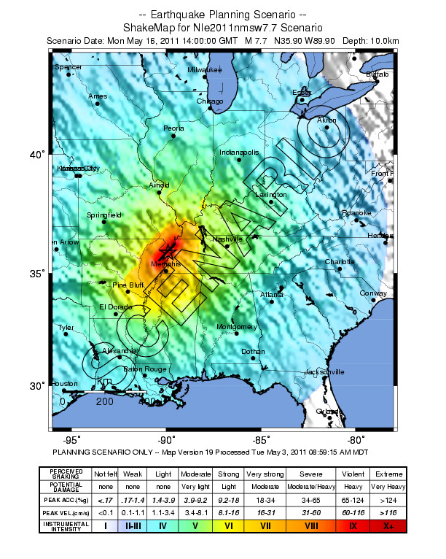


Slide 4
Why did I choose to do this?
I like math, science, programming
  A little programming experience in high school, not a lot
Computer science for a research group brings together my interests
  Work with smart people in many fields
  Work on real problems with useful applications
  Advance science research
I get to ‘dabble’ in science

Slide 5
What is High Performance Computing?
Using large computers with many processors to do simulations quickly
Used by many fields, such as:
  Chemistry
  Aerospace
  Genomics
  Climate
  Cosmology
Serves as the (controversial)
“third pillar” of science
Theory
Simulation
Experiment

Slide 6
  How is HPC useful to SCEC?
Earthquakes are really, really complicated
Many of these pieces can be simulated
  Don’t have to wait for a real earthquake
  Can perform “experiments” to test theories
  Can try to look into future
Surface
faulting
Landslides
Stress transfer
Liquifaction
Fires
Slow slip transients
Seismic
shaking
Socioeconomic
aftereffects
Fault
rupture
Structural & nonstructural
damage to built environment
Tectonic loading
Stress accumulation
Nucleation
Seafloor
deformation
Tsunami
Human casualties
Dynamic triggering
Disease
----- Foreshocks -----
------ Aftershocks -------------------------------------------------------------------
century
decade
year
month
week
day
0
minute
hour
day
year
decade
Anticipation time
Origin time
Response time ➔
6

Slide 7
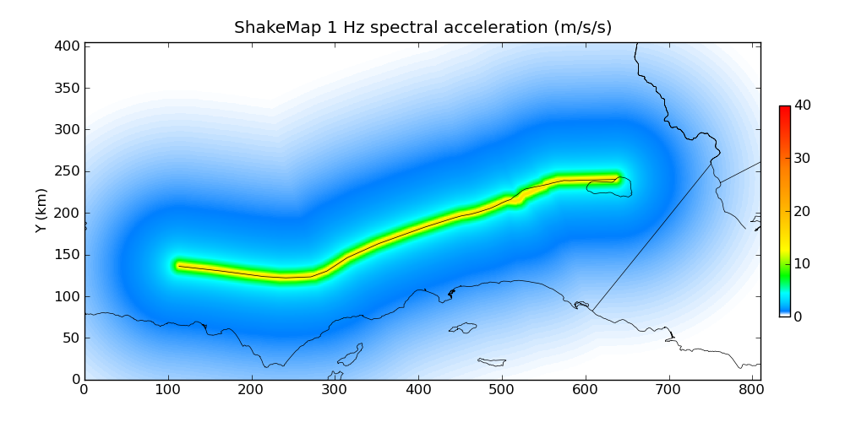
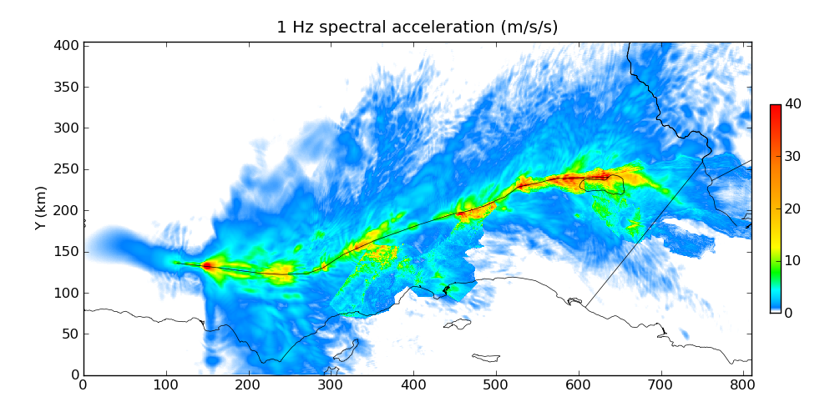
HPC provides “best estimate”
Magnitude 8, San Andreas
Produced without simulation
Produced with HPC simulation

Slide 8
Simulating has its own challenges
Large range of scales
  Faults rupture over 100s of kilometers
  Friction acts over millimeters
  Want to understand shaking over large regions
Need access to large, powerful computers
Need efficient software
Must make sure you’re getting the right answer
Like all good science, must be reproducible

Slide 9
How does it work?
Start with a physical phenomenon
Write down the physics equations that govern it
Discretize it, since computers only work in discrete increments
Create an algorithm based on these equations
Break the algorithm into pieces for each processor
Run it
Analyze the results
Add additional complexity to be more accurate

Slide 10
Wait, what?
Let’s simulate the velocity v(t) of a falling object over time, with air resistance
Introductory physics time!
kv(t)
mg
Notes:
Gravity: F = mg
Air resistance: F = kv(t)
F = ma = mg – kv(t)
mv’(t) = mg – kv(t)
Need to discretize. Could do this many ways, but will take the simplest:
(v(t+d) – v(t))/d = g – k/m*v(t)
v(t+d) – v(t) = dg – dk/m*v(t)
v(t+d) = dg + (1 – dk/m)v(t)
Could have replaced v’(t) with (v(t) – v(t-d))/d, (v(t+d/2)-v(t-d/2))/d, etc.
Pull up spreadsheet and try different values of d.

Slide 11
Now that we’ve got the equation
v(t+∆) = ∆g + (1-∆k/m)*v(t)
We can write an algorithm:
  v = 0, delta=0.1, g=10, k=0.1, m=1
  for timestep=1 to timestep=100:
  v = delta*g + (1-delta*k/m)*v
Now you could use this to run a simulation
Later we could add more complexity to be more accurate
  Non-zero initial velocity, g and k vary with altitude, determine k from cross-section, other forces, etc.
Notes:
Spreadsheet

Slide 12
But wait! We forgot a step
Break the algorithm into pieces, right?
In HPC, speedup comes from doing work in parallel
  Each processor works on small subset of job
  Results are combined
  Usually, calculations are repeated some number of times
  Final results are saved
Most commonly, divide work up into subsets based on data
Let’s look at matrix multiplication as example

Slide 13
Matrix Multiplication
1
2
-4
7
0
1
1
0
3
-5
4
9
1
2
0
1
X
=
0
-7
-6
6
0
0
1
2
-2
5
-1
8
2
1
0
0
1
2
-4
7
X
0
=
(1x0)+(2x1)+
(-4x0)+(7x2)=
16 | 12 | 4 | -6
13 | 2 | 7 | 3
5 | -8 | -6 | -19
21 | 16 | -3 | 3
1
0
2
Can give each row/column pair to a different processor

Slide 14
3 phases in simulation
Calculation - actually doing the numerical calculation
Input/output (I/O) - reading and writing numbers from/to the paper
Communication
  Passing out sheets (send out pieces of the problem)
  Telling me what your results were (send results back)
As in this example, calculation is usually the fastest of the phases
To speed up performance, must optimize all phases

Slide 15
What do we at SCEC need?
Wave propagation code
  Simulates the movement of seismic energy through the volume, like ripples in a pond
  Constructed from first principles wave physics
Velocity model
  Speed of the earthquake waves at all points in the earth that you’re simulating – relates to rock density
  Calculated from boreholes, analyzing past earthquakes
Earthquake description
  The forces experienced as an earthquake starts at a hypocenter and moves along a fault surface – initial condition
  Constructed from historic earthquakes, physics

Slide 16
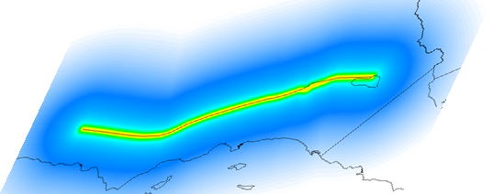
Simulating Large Earthquakes
Run wave propagation simulation
Material properties, wave moves through volume
Break up the work into pieces by geography
  Give work to each processor
  Run a timestep
  Communicate with neighbors
  Repeat
As number of processors rises, harder to get good performance

Slide 17
How do we know if we’re doing it right?
Must be able to trust science results
  Just because it runs doesn’t mean it’s right…
Verification
  Does this code behave as I expect it to? Was it programmed correctly?
Validation
  Does this code accurately model a physical phenomenon in the real world?
Can compare results against real earthquakes
Can run multiple codes on same problem and compare results

Slide 18
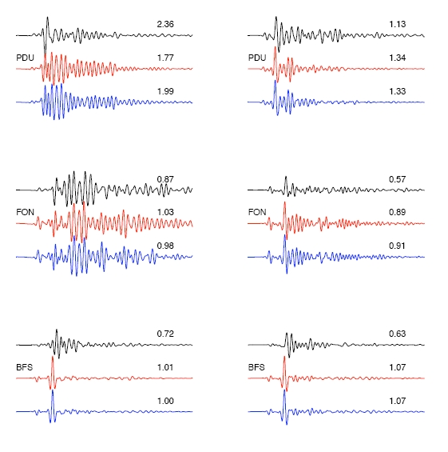
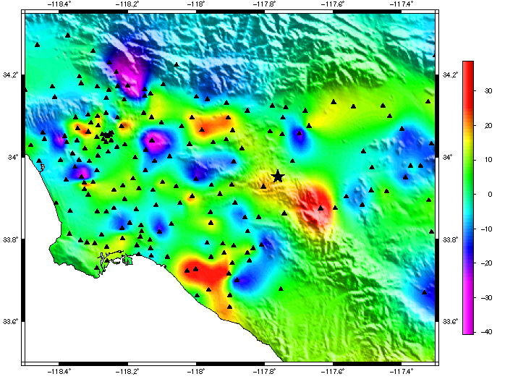
Comparison against real events
Comparison of data (black) to two simulations (red, blue) using alternative earth structural models for the 2008 Mw5.4 Chino Hills earthquake.
0.1-0.5Hz goodness-of-fit for simulated earthquakes relative to data from same earthquake. Colors indicate which structural model is a better fit.

Slide 19
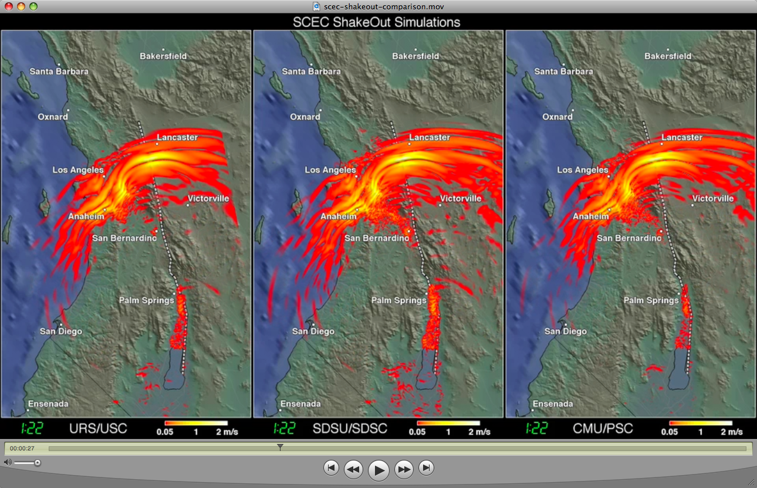

Comparison between codes

Slide 20

Comparison with past good code

Slide 21
What kind of simulations does SCEC run?
Two main types of SCEC HPC projects
  What kind of shaking will this one earthquake cause?
  What kind of shaking will this one location experience?
The first: “Scenario simulations”
The second: “Seismic hazard analysis”
Complimentary – answering different key questions

Slide 22
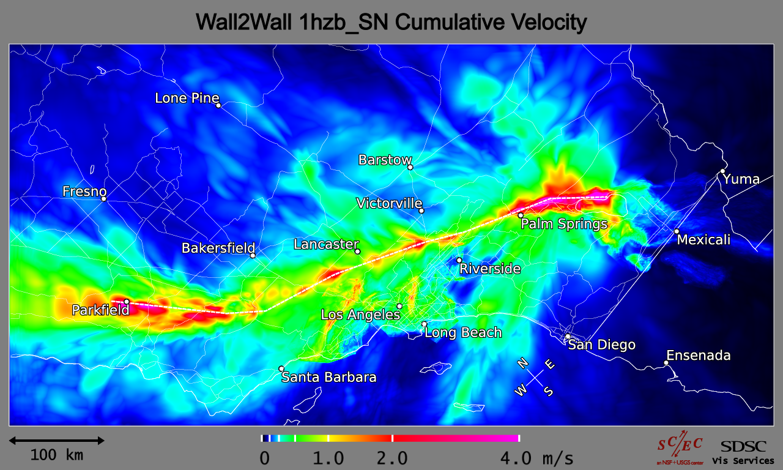
SCEC Scenario Simulations
Simulations of individual earthquakes
  Determine shaking over a region caused by a single event (usually M > 7)
Peak ground velocities for a Mw8.0 Wall-to-Wall Scenario on the San Andreas Fault (1Hz) calculated using AWP-ODC on NICS Kraken.

Slide 23
Simulation Results (N->S)
W2W (S-N)

Slide 24
Simulation Results (S->N)

Slide 25
SCEC Simulation Growth
Year | Number of points in mesh (simulation size) | Number of timesteps | Peak speed | Number of processors
2004 | 1.8 billion | 22,768 | 0.04 Tflops | 240
2007 | 14 billion | 50,000 | 7.3 Tflops | 32,000
2009 | 31 billion | 60,346 | 50.0 Tflops | 96,000
2010 | 440 billion | 160,000 | 220.0 Tflops | 223,074
2013 | 859 billion | 2,000 (benchmark) | 2330.0 Tflops | 16,384 GPUs
Since it’s harder to write fast software for lots of processors, looking at new exotic solutions (GPUs, coprocessors, etc.)

Slide 26
Seismic Hazard Analysis
The second kind of simulation
Builders ask seismologists: “What will the peak ground motion be at my new building in the next 50 years?”
Different question – don’t care which earthquake, care about this one location
Seismologists answer this question using Probabilistic Seismic Hazard Analysis (PSHA)
  PSHA results used in building codes, insurance
  California building codes impact billions of dollars of construction yearly

Slide 27
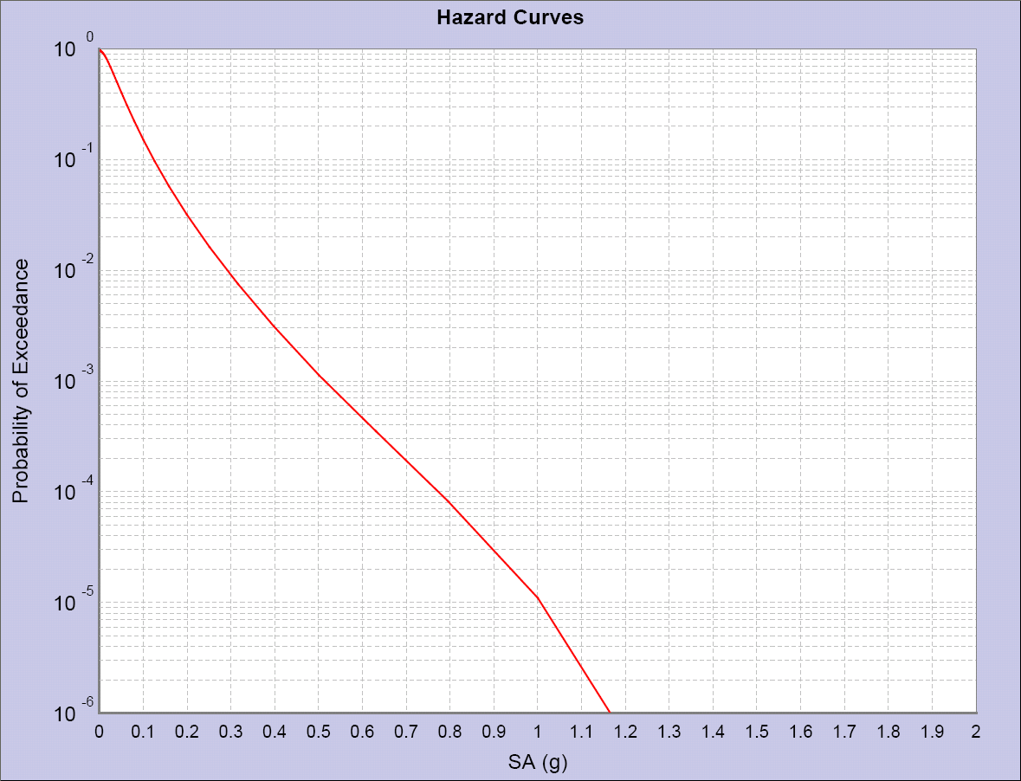
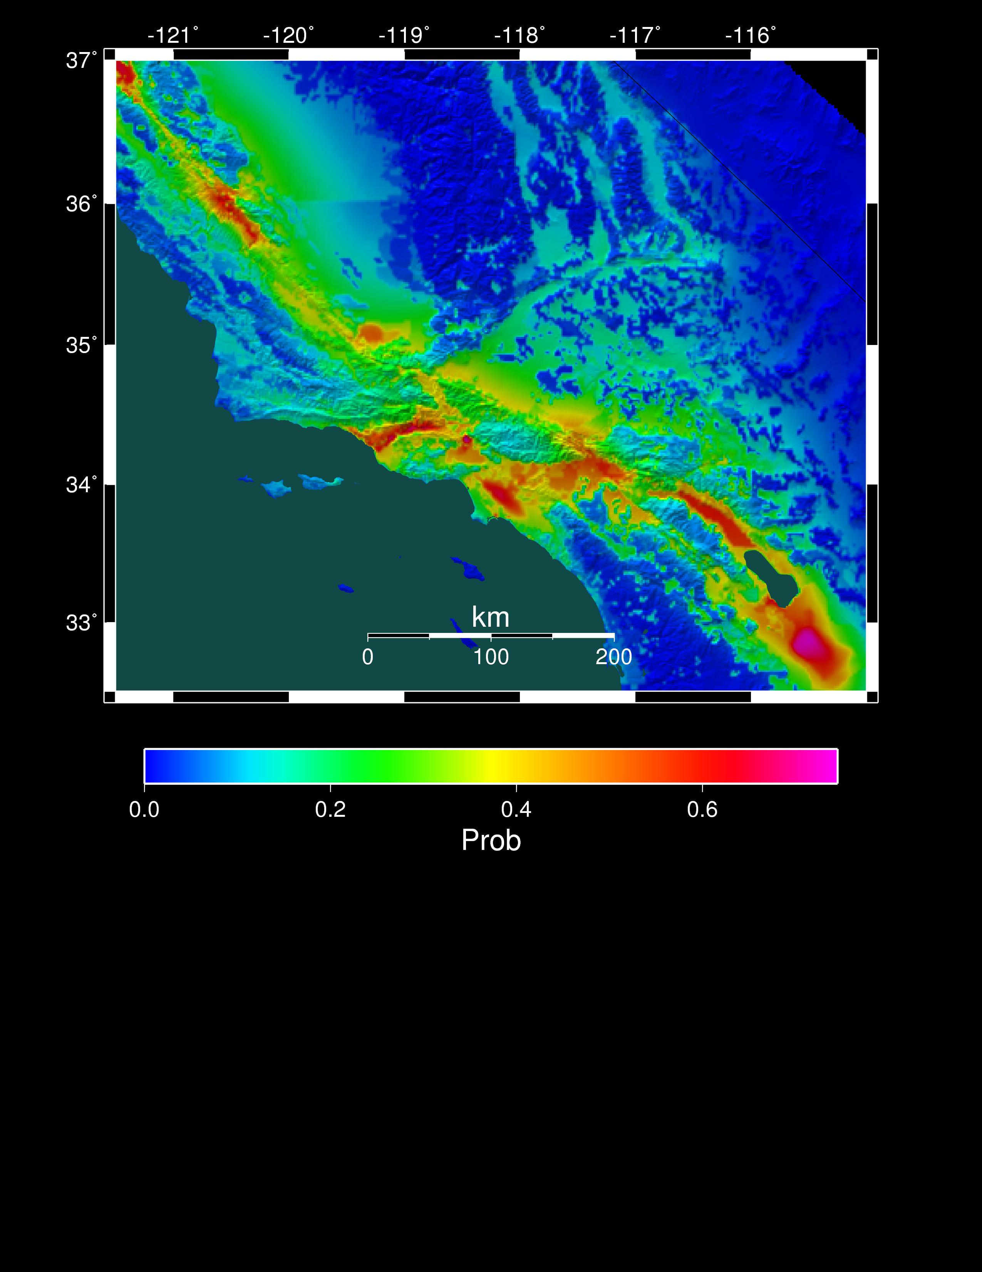
PSHA Reporting
PSHA information is relayed through
  Hazard curves (for 1 location)
  Hazard maps (for a region)
2% in 50 years
0.6 g
Curve for downtown LA
Probability of exceeding 0.1g in 50 yrs

Slide 28
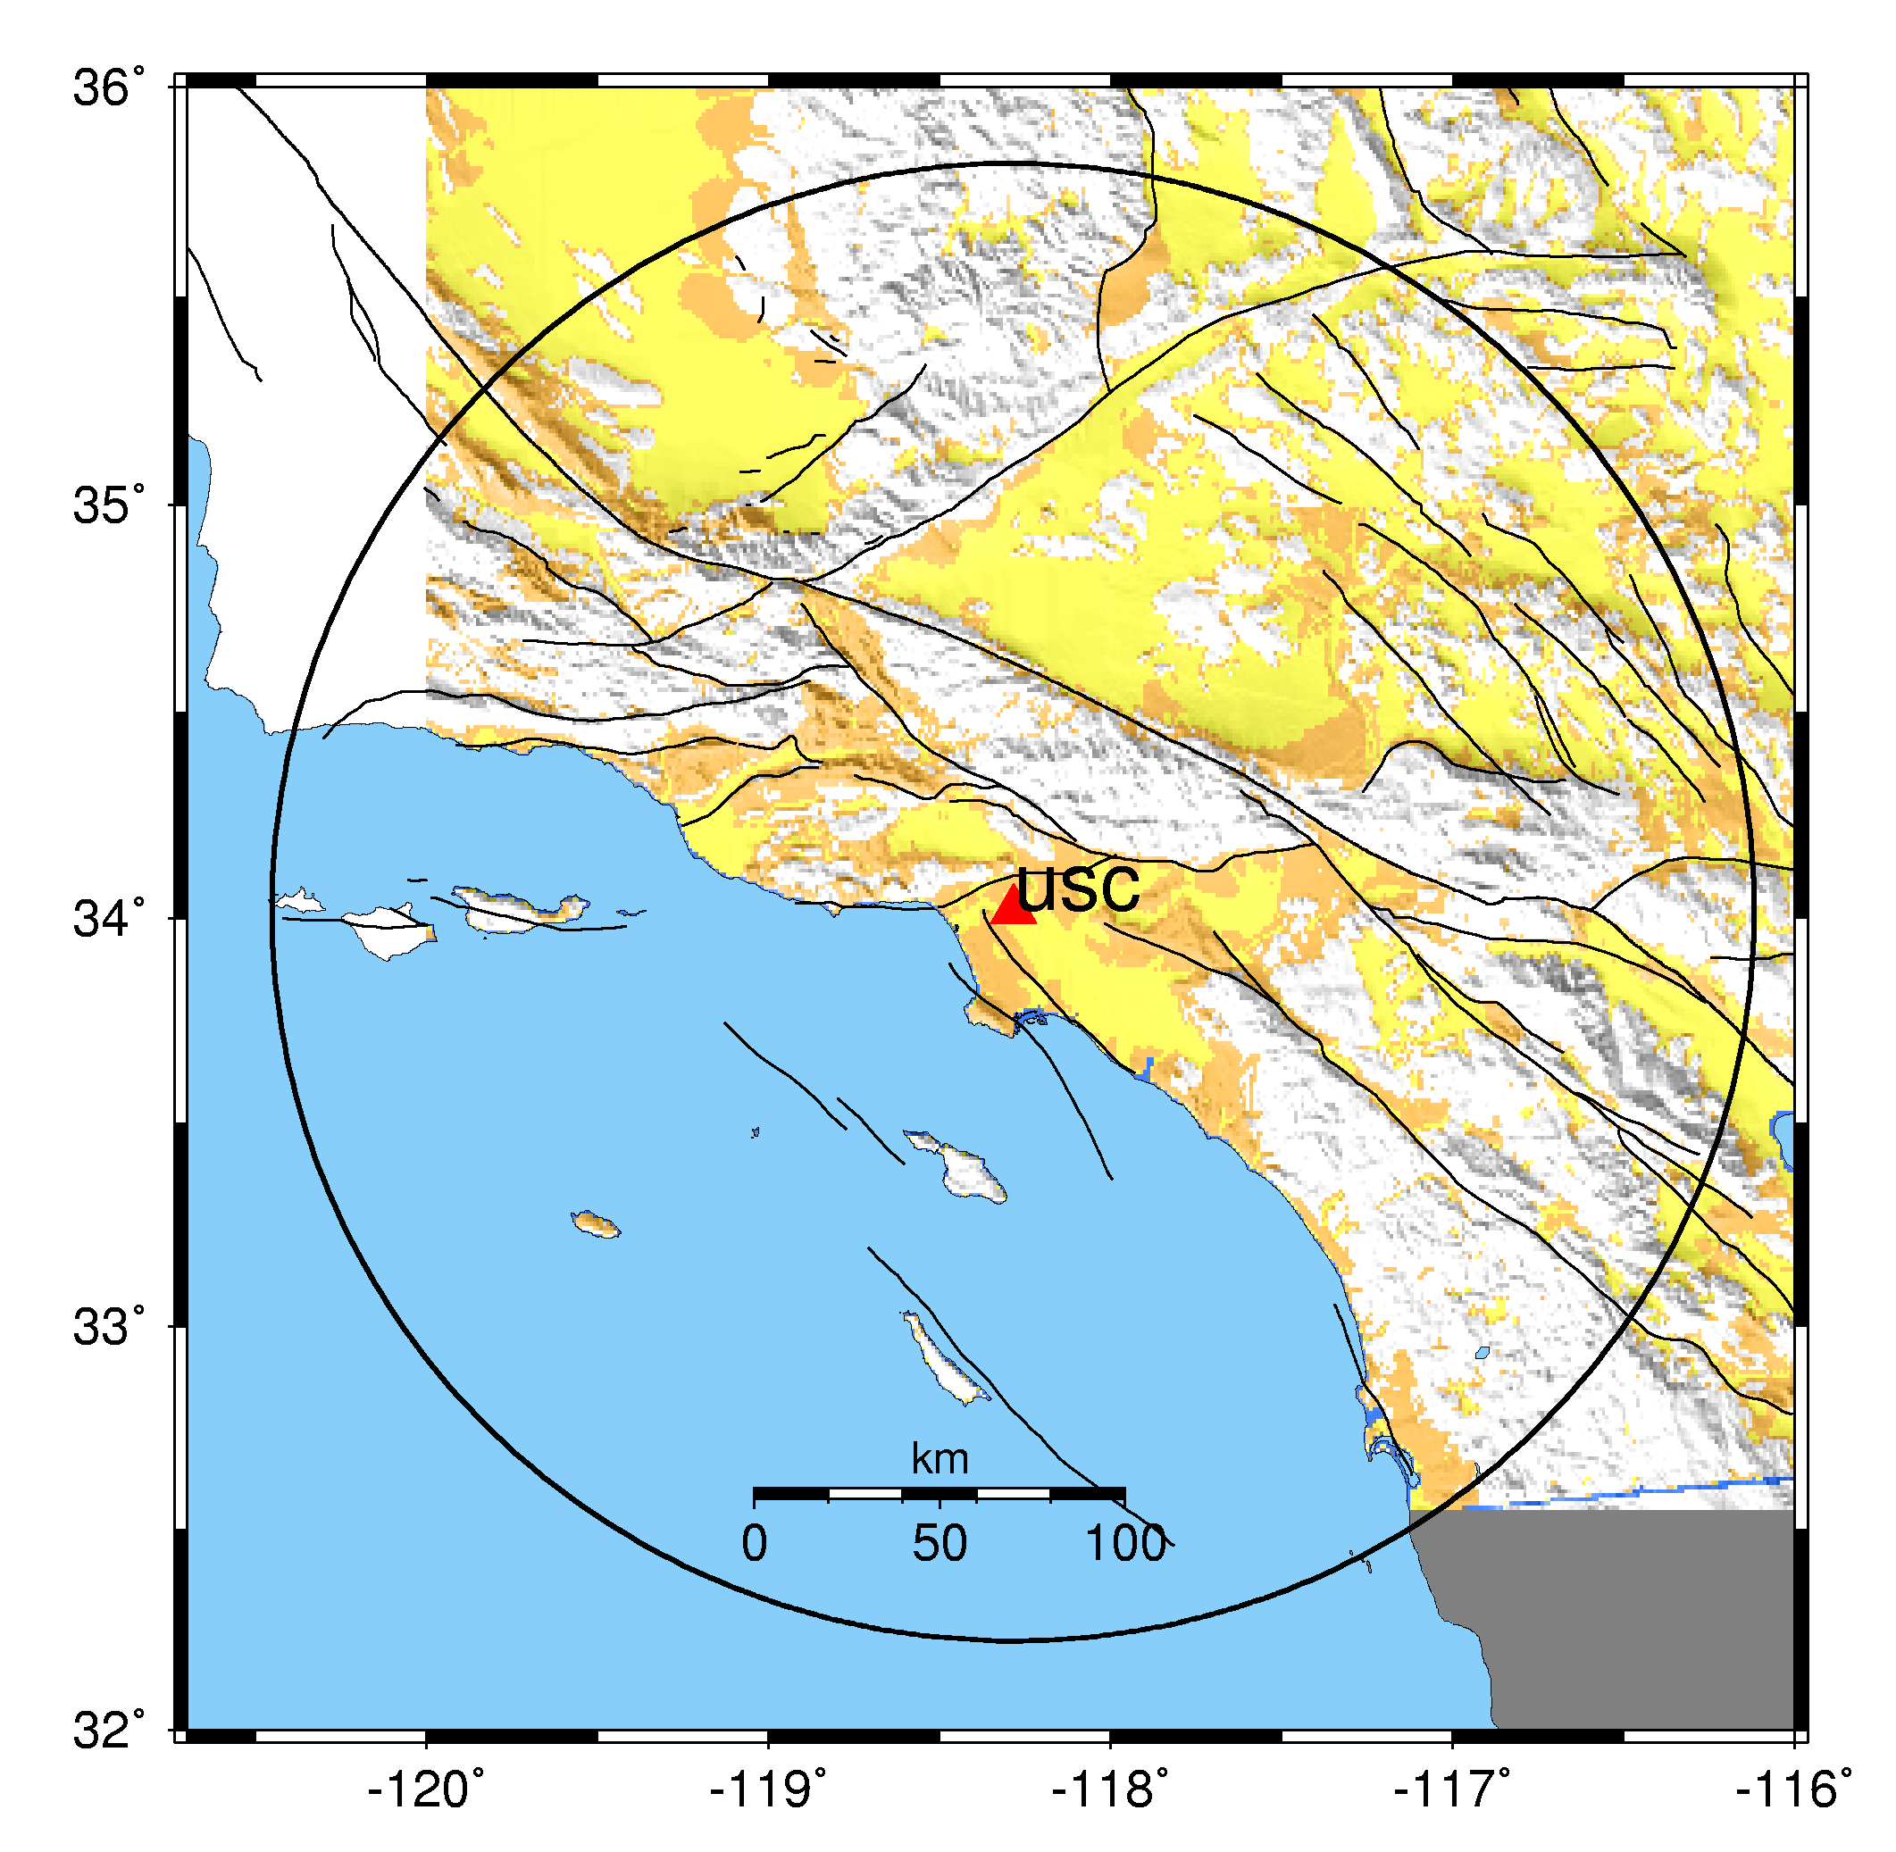
How do you do PSHA?
Pick a location of interest.
Determine what future earthquakes might happen which could affect that location.
Estimate the magnitude and probability for each (using UCERF!)

Slide 29
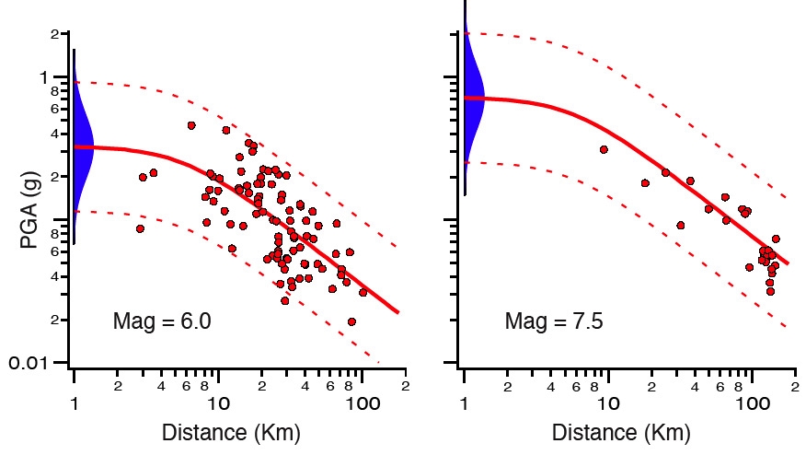
And now the interesting part…
4. Determine the shaking caused by each earthquake at the site of interest.
Can calculate with ‘attenuation relationships’ – extrapolate from historical data.
Roughly, based
on how far, what
magnitude.
Very quick, but
(too?) simple.

Slide 30
Alternatively
We can use a physical approach to simulate each earthquake
SCEC does this in the “CyberShake” project
For each site (like USC)
  Run 2 wave propagation simulations, like the scenarios
  Determine shaking from ~415,000 earthquakes
Since it is a 3D simulation, includes more complexity
  Earth structure
  Rupture direction
Different kind of HPC – many earthquakes, each one cheap to run

Slide 31
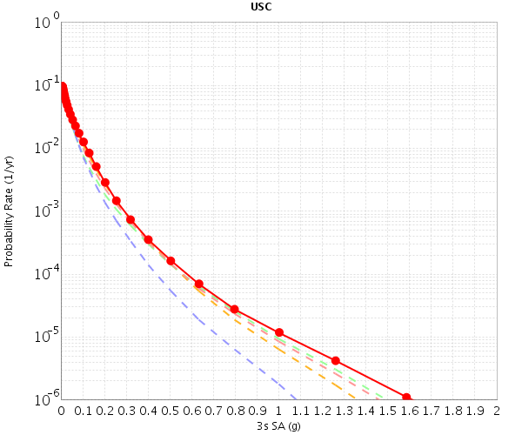
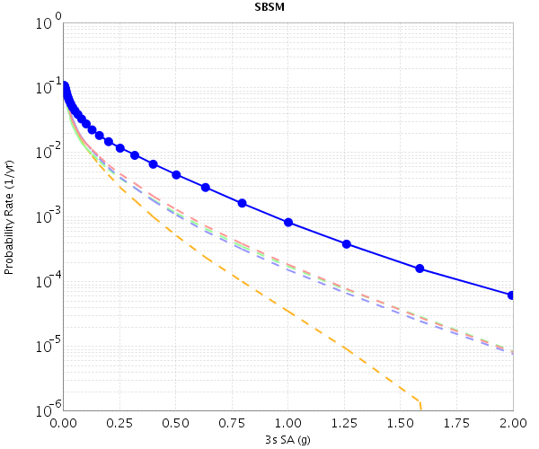
To complete PSHA
5. Combine the levels of shaking with probabilities to produce a hazard curve.
Repeat for multiple locations for a hazard map. For the Los Angeles area, we need about 200 locations for a good map.

Slide 32
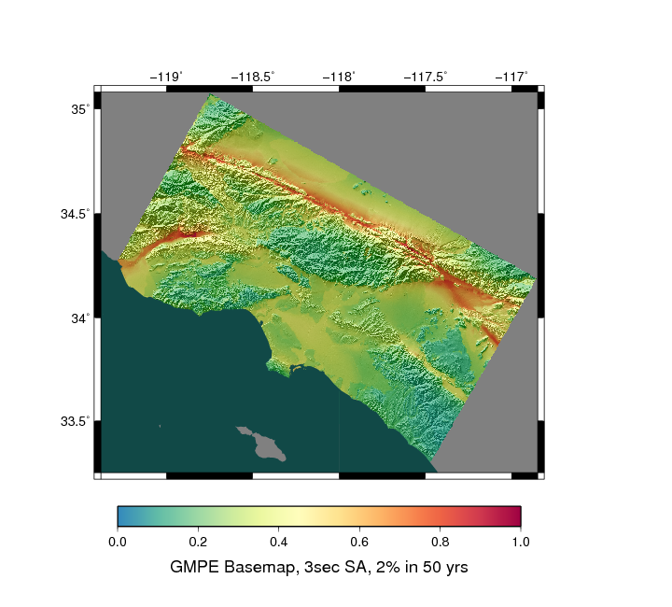
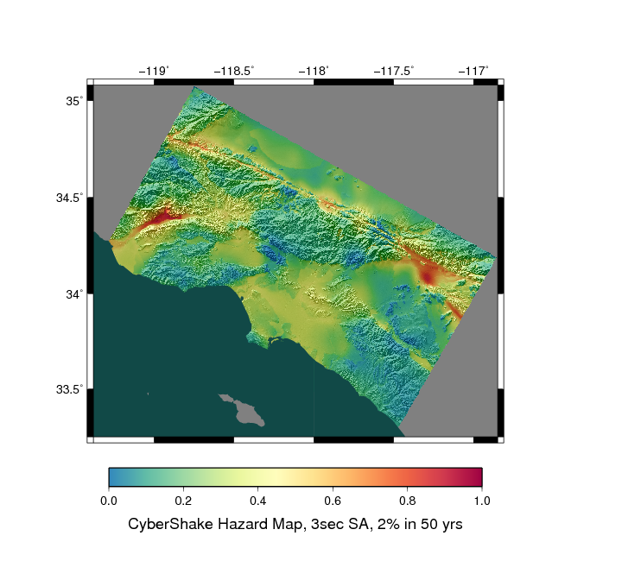
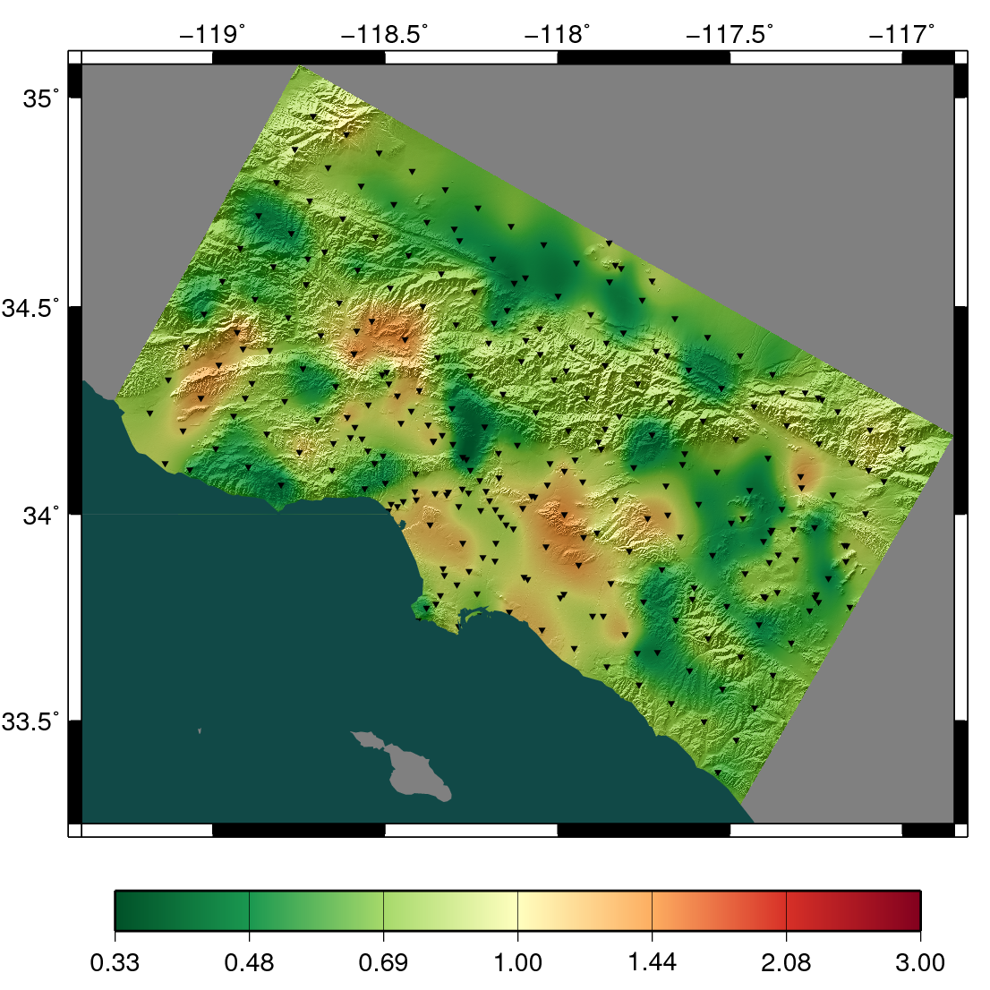
Does the approach make a difference?
Attenuation Hazard Map
CyberShake Hazard Map
Higher Attenuation
Higher CyberShake

Slide 33
Some numbers
M8 simulation
  600 TB output
  436 billion mesh points
  223,074 processors for 24 hours
CyberShake (Feb-March 2014)
  1144 sites
  57 TB output files
  100 million tasks executed
  46,700 CPUs + 225 GPUs for 14 days
Onward and upward!

Slide 34
In summary
High performance computing
  Is hard
  But interesting!
  Provides a technique for solving big problems in many fields
  Opportunities to problem-solve and expand horizons
SCEC uses HPC
  To determine the shaking from one big earthquake
  To determine the hazard at one location
  To support experiments and theory

