Slide 1
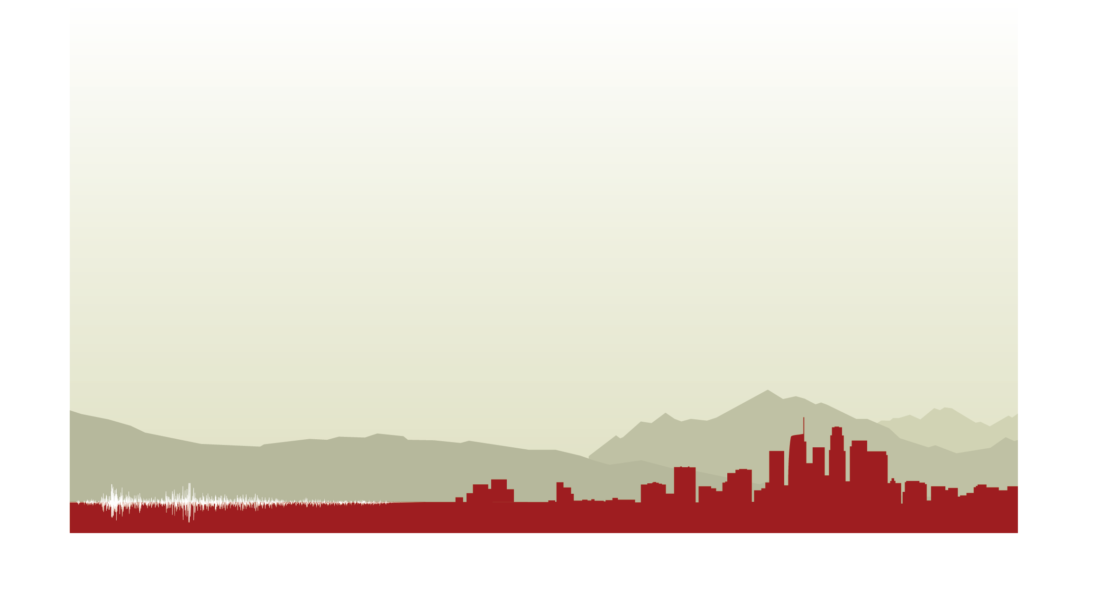
CyberShake Study 18.8
Science Readiness Review
Scott Callaghan

Slide 2
Study 18.8 Scientific Goals
Expand CyberShake to the extended Bay Area.
  1 Hz
  UCERF 2
  Graves & Pitarka (2014) rupture generator
Calculate CyberShake results with a new combination of velocity models.
  USGS Bay Area, CCA-06 + Ely-Jordan GTL, CVM-S4.26.M01
Compare Central and Bay Area results at overlapping sites.
Include background seismicity contributions in final hazard estimates

Slide 3
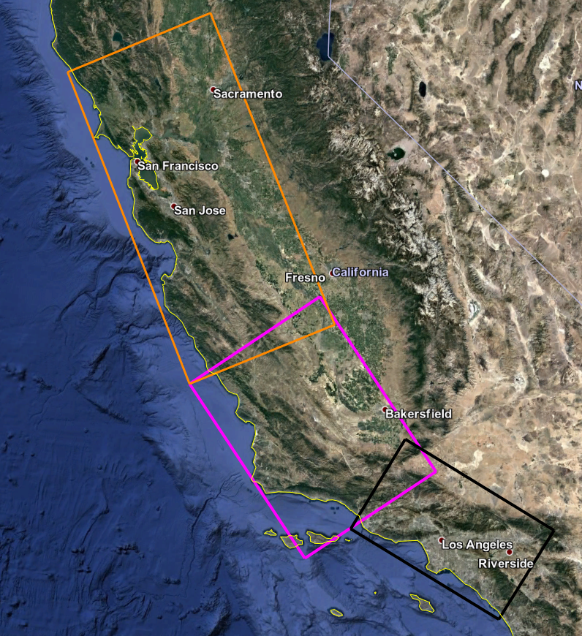
Study Region
Region (orange) selected to continue CyberShake up the coast
180 x 390 km, 27 degrees
Largest region so far
Overlap with Study 17.3 region for comparisons
Sites fall within both CCA-06 and USGS Bay Area velocity models (detailed velocity model discussion to follow)

Slide 4
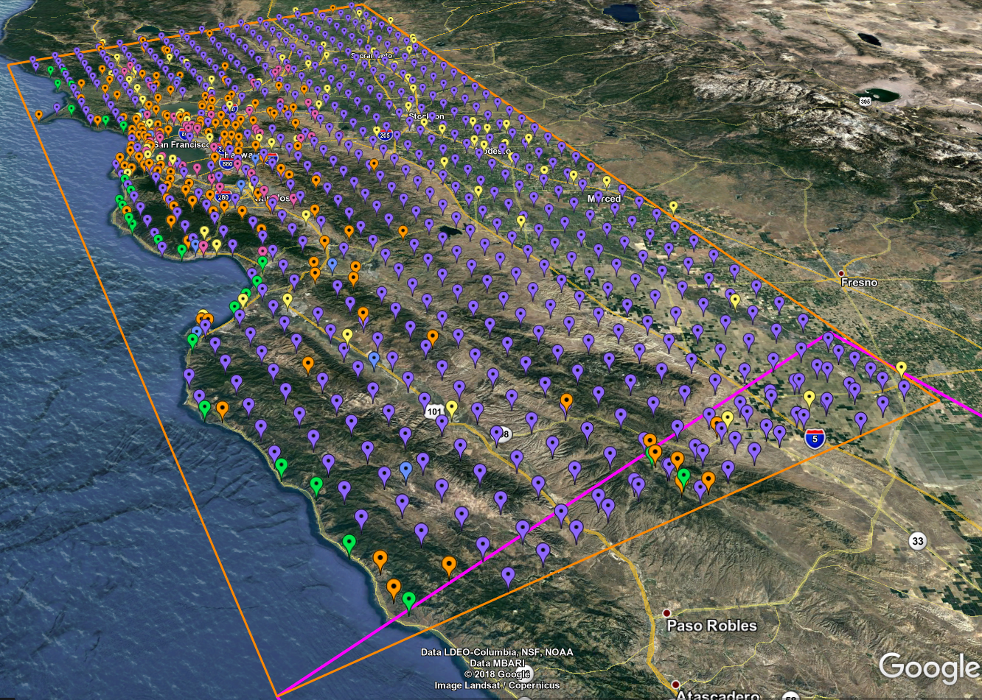
869 Proposed Study sites
10 km spacing (purple)
5 km spacing for greater shore density (green)
CISN stations (orange)
PG&E sites (pink)
Cities (yellow)
Decimation applied to reduce overall number
32 overlapping sites
44% have southern San Andreas events within 200 km

Slide 5
Study 18.8 Data Products
SRF-format rupture descriptions
Two-component seismograms (~195 million)
Intensity measures
  Geometric mean at 44 periods (0.1 – 10 sec): 2, 3, 5, 10 sec stored in DB
  RotD50 and RotD100 at 22 periods (1 – 10 sec): 2, 3, 4, 5, 7.5, 10 sec stored in DB
Duration metrics
  Energy integral, Arias intensity, cumulative absolute velocity
  Significant durations (5-75%, 5-95%, 20-80%) for velocity and acceleration
  Significant durations (5-75%, 5-95%) for acceleration for X and Y stored in DB
Hazard curves for 869 sites
  RotD100 at 2, 3, 4, 5, 7.5, 10 sec
  RotD50 at 2, 3, 4, 5, 7.5, 10 sec
  Geometric mean at 2, 3, 5, 10 sec
RotD50 hazard maps at 2, 3, 5, 7.5, and 10 sec

Slide 6
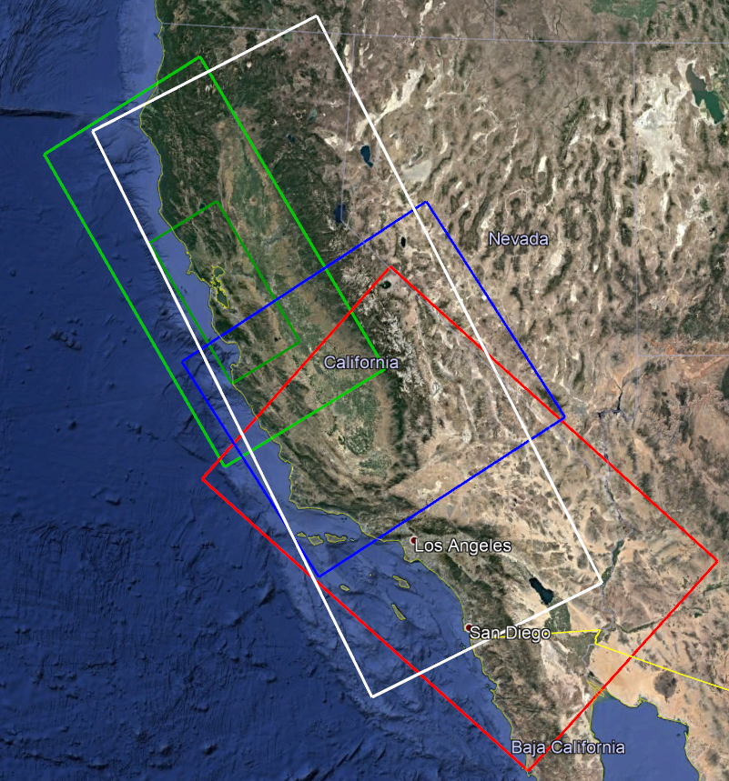
Velocity Models
Simulation region for some sites extends beyond any one model
  Angle adjusted from 55 to 30 degrees
Tiling required: order is
  CCA-06 model + Ely GTL
  USGS Bay Area (includes high-res)
  CVM-S4.26.M01
Great Valley basins better represented in CCA-06
Minimum Vs = 500 m/s
White: simulation region
Green: USGS Bay Area Dark Green: USGS Bay Area, high-res
Blue: CCA-06 Red: CVM-S4.26

Slide 7
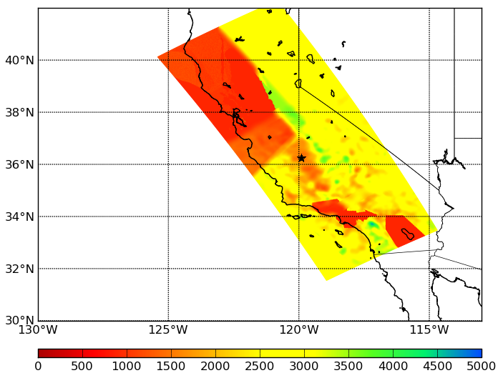
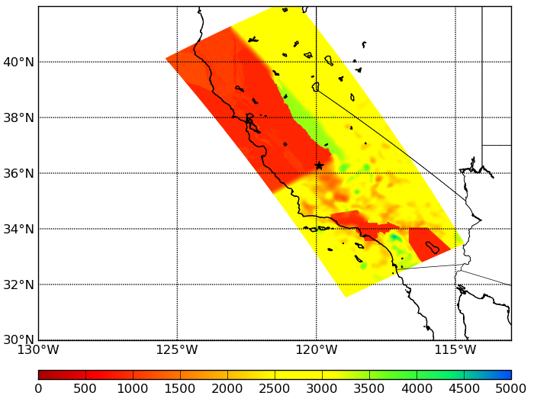
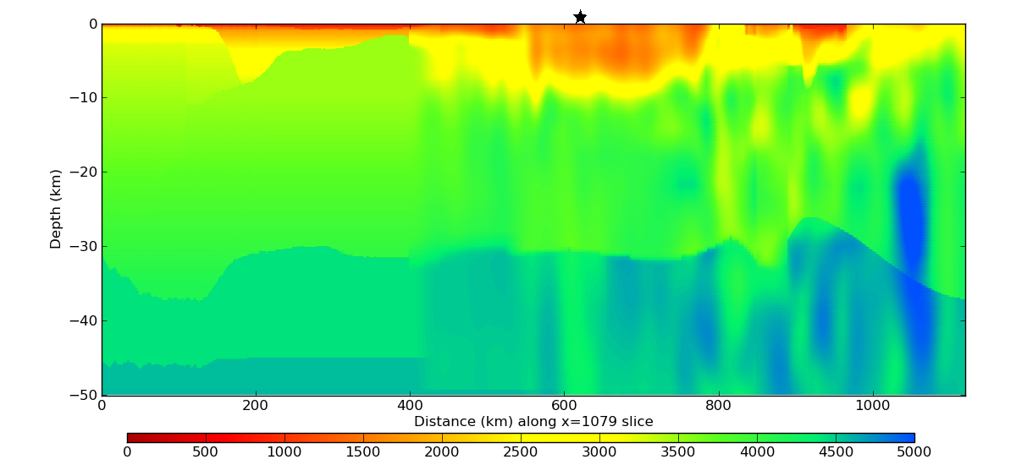
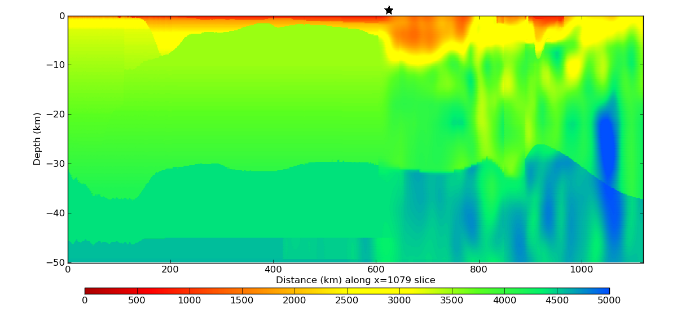
Velocity cross-sections
Proposed tiling
USGS Bay Area first
Surface plot
Cross-section through star

Slide 8
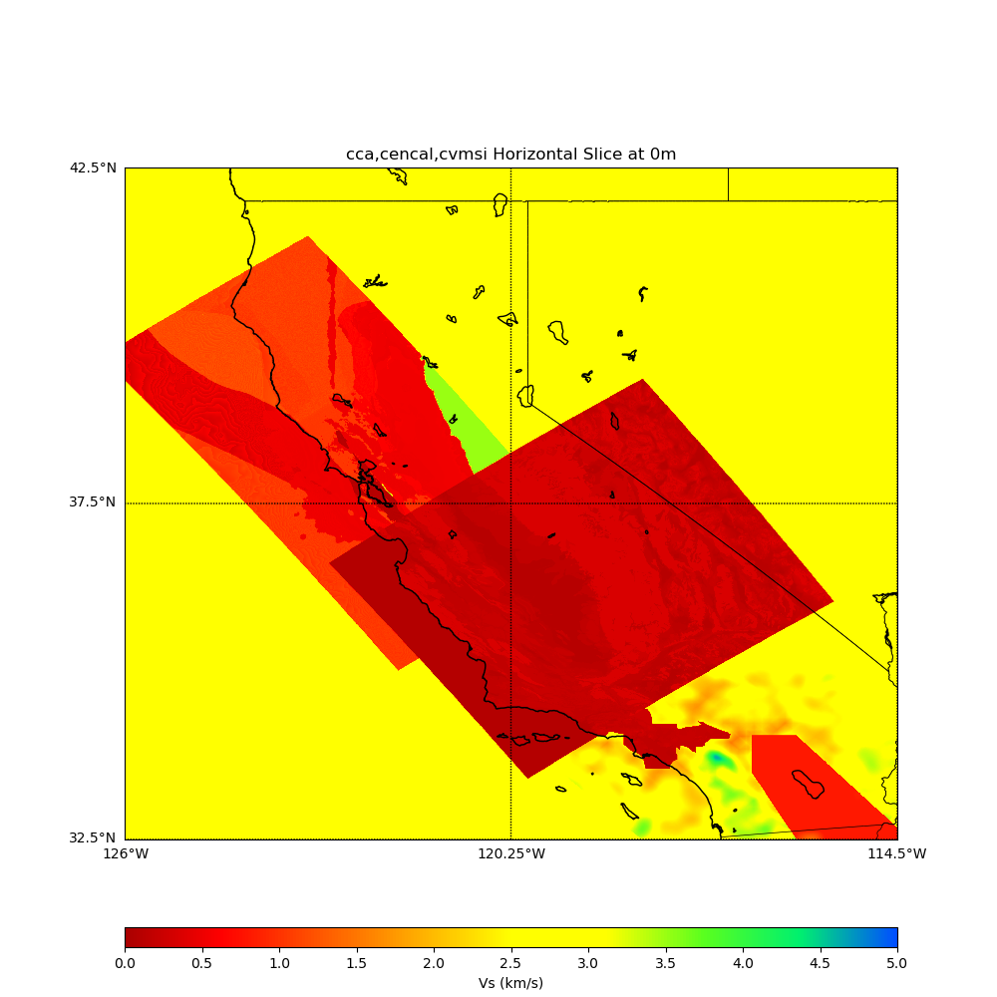
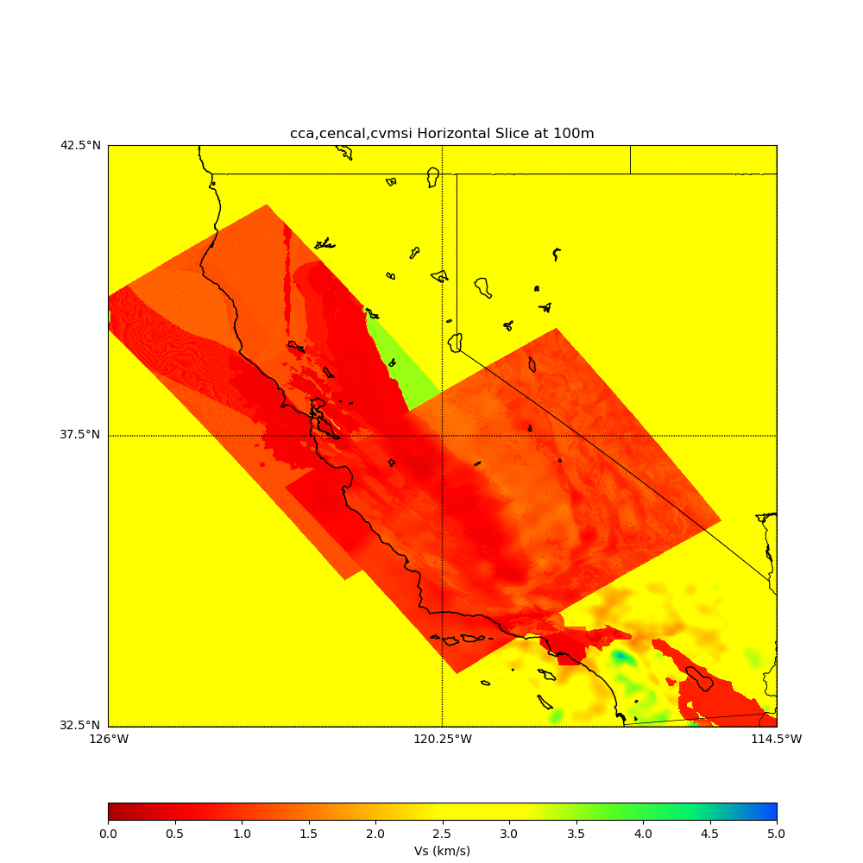
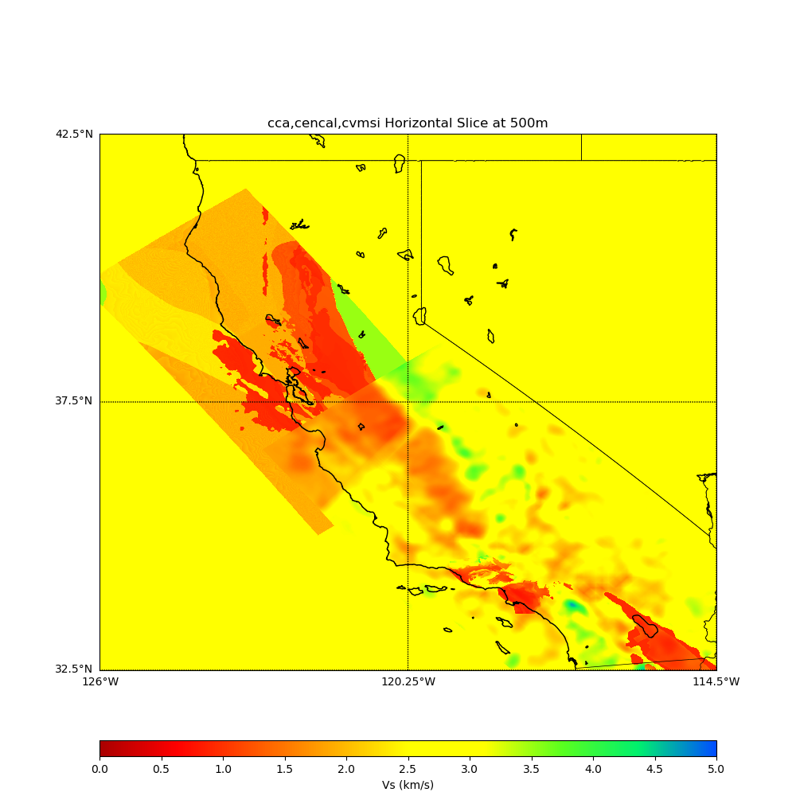
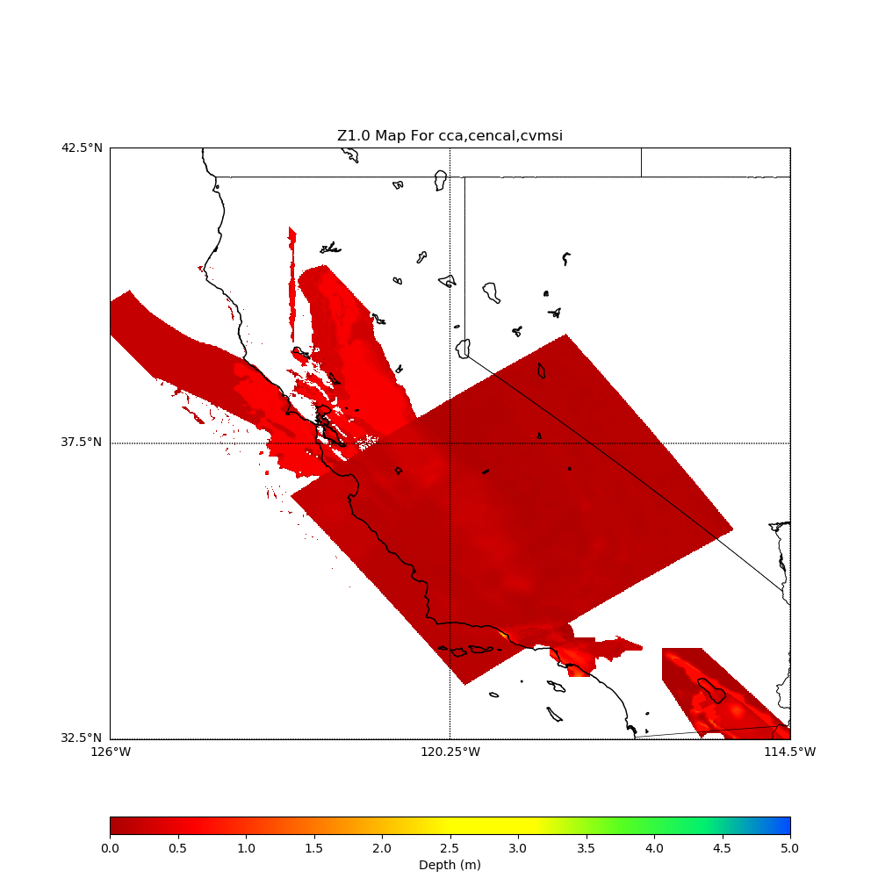
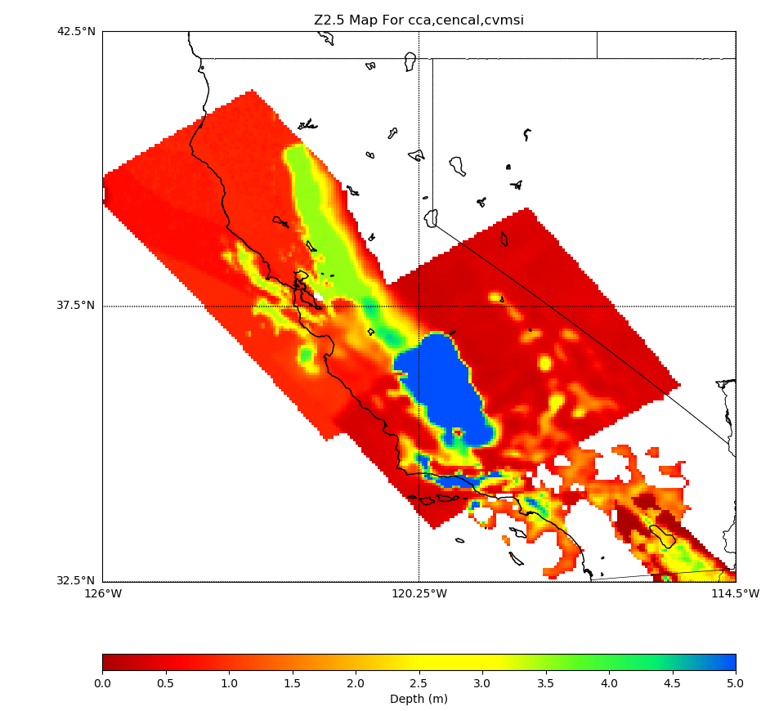
Vs at depth=0m
Vs at depth=100m
Vs at depth=500m
Z1.0
Z2.5

Slide 9
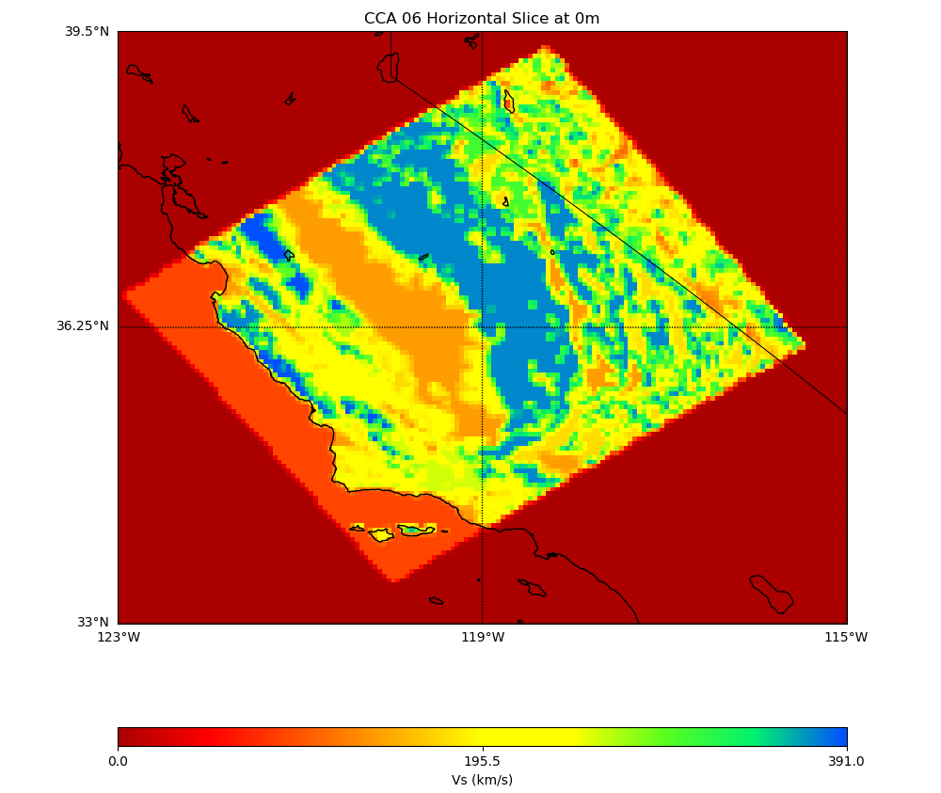
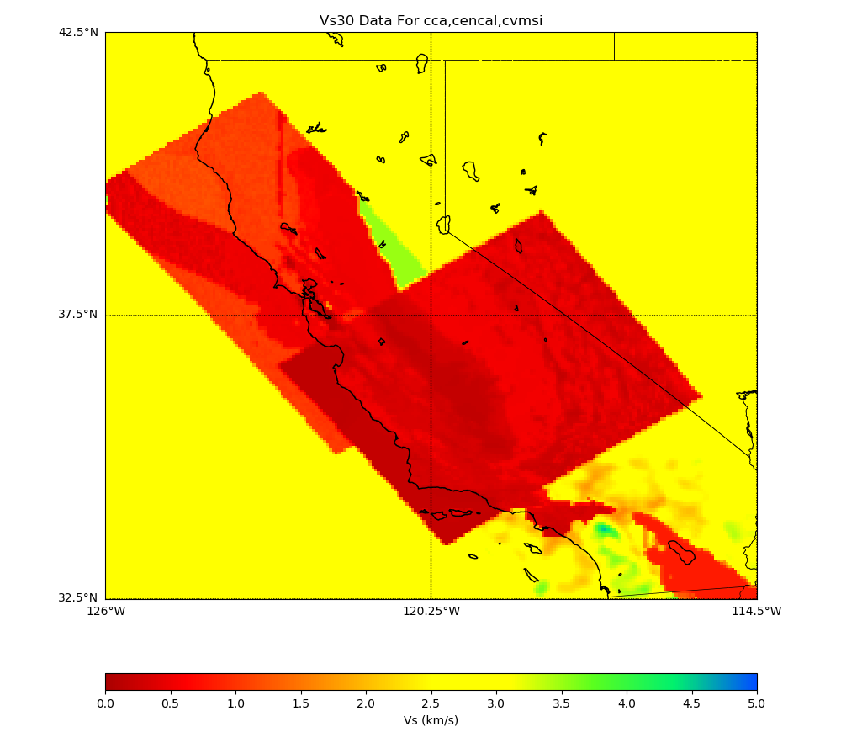
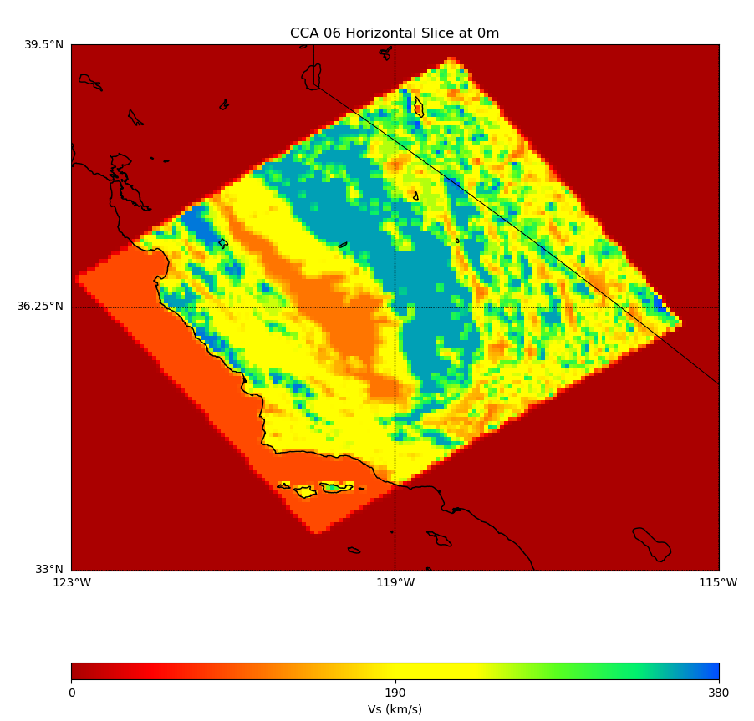
Wills (2015) Vs30
Vs30, using Ely-Jordan GTL and Wills (2015) in CCA-06
Surface Vs using Ely-Jordan GTL and Wills (2006)
Surface Vs using Ely-Jordan GTL and Wills (2015)

Slide 10
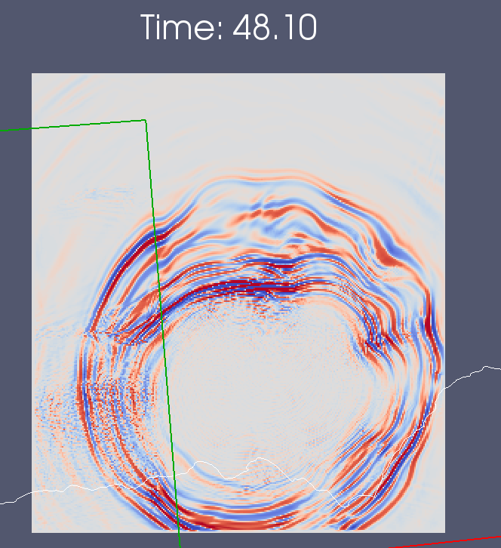
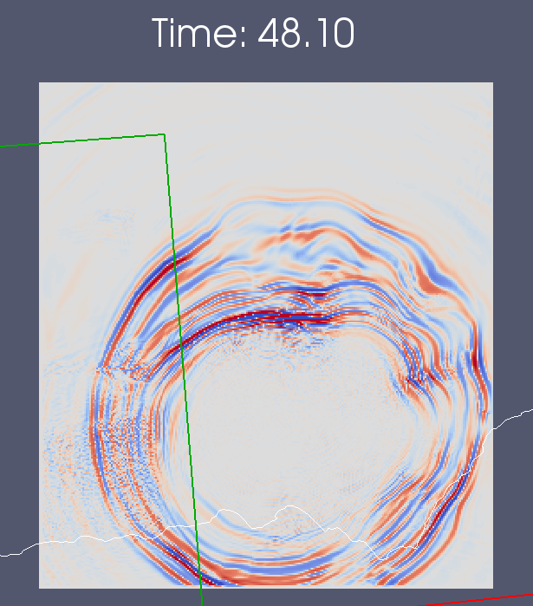
Smoothing
Performed forward sims across model interface: decided on 20 km
Wavefront encounters smoothed region
10 km smoothing
20 km smoothing
20 km smoothing shows reduced refraction effects

Slide 11
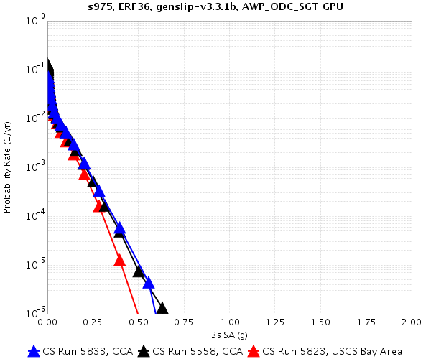
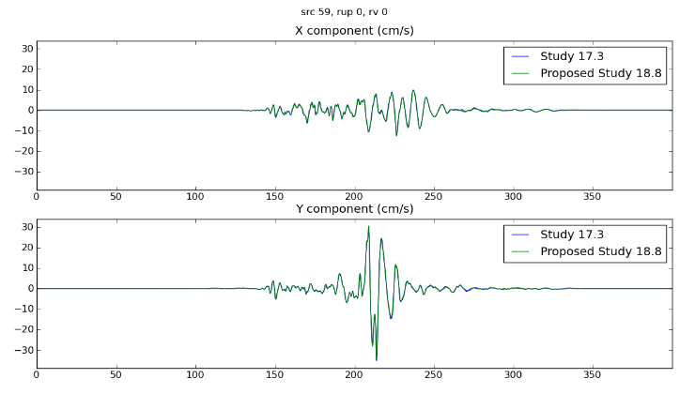
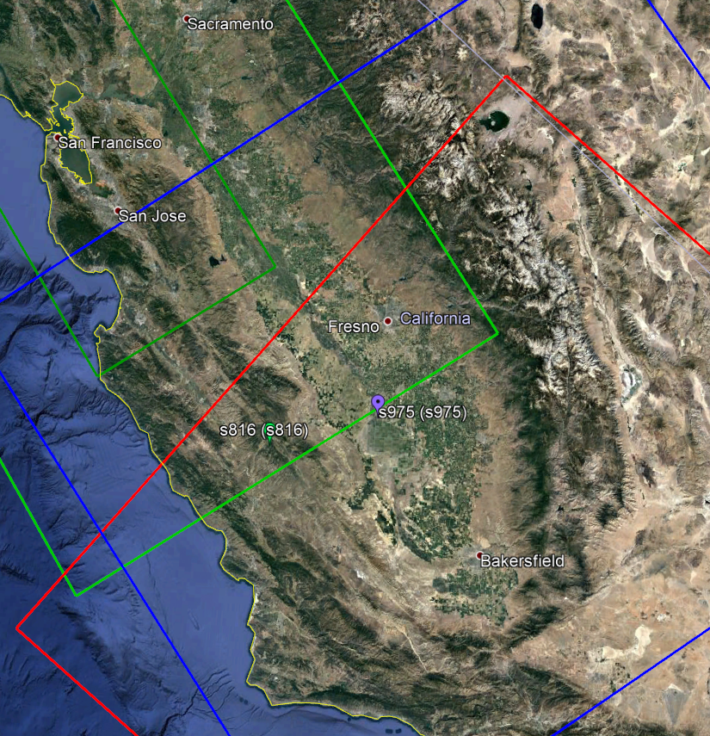
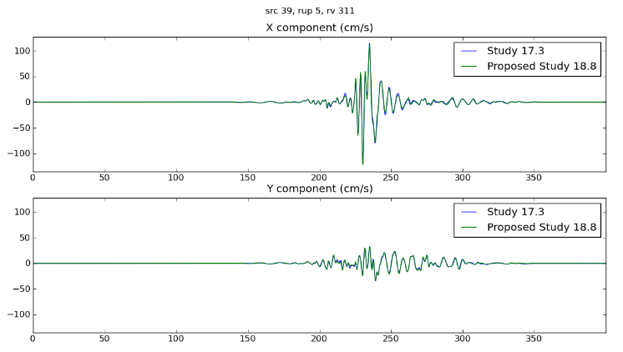
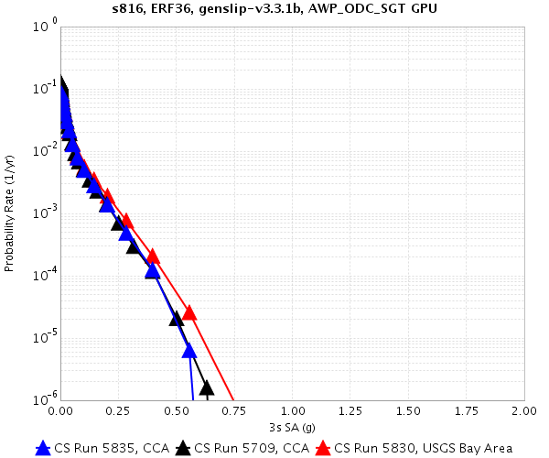
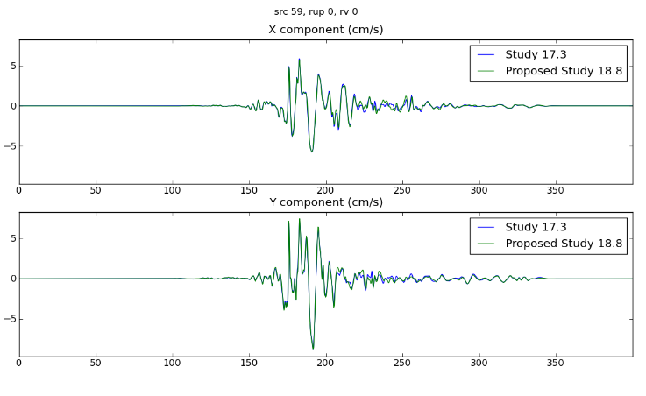
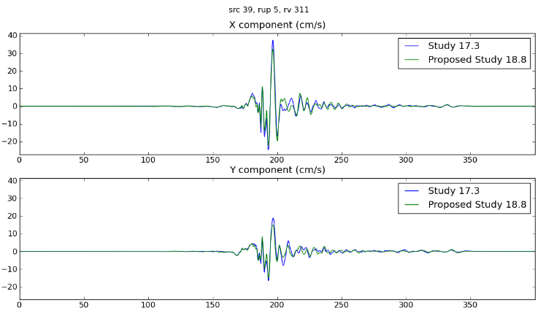
Comparisons with Study 17.3 (Central CA)
Green: USGS Bay Area Dark Green: USGS Bay Area, high-res
Blue: CCA-06 Red: CVM-S4.26

Slide 12
Study 18.8 Parameters
1.0 Hz deterministic
  100 m grid spacing
  50 km depth (no difference with 80 km depth)
  Volumes range from 6 – 25 billion points (210 x 550 km to 450 x 1120 km)
  dt = 0.005 sec
  SGT nt = 40000 timesteps (200 sec)
  Seismogram nt = 8000 timesteps (400 sec)
Source filtered at 2.0 Hz
UCERF 2 ERF
  200 m rupture grid point spacing
Graves and Pitarka (2014) rupture variations
  2100 – 4600 UCERF2 ruptures become 130K – 350K rupture variations per site

Slide 13
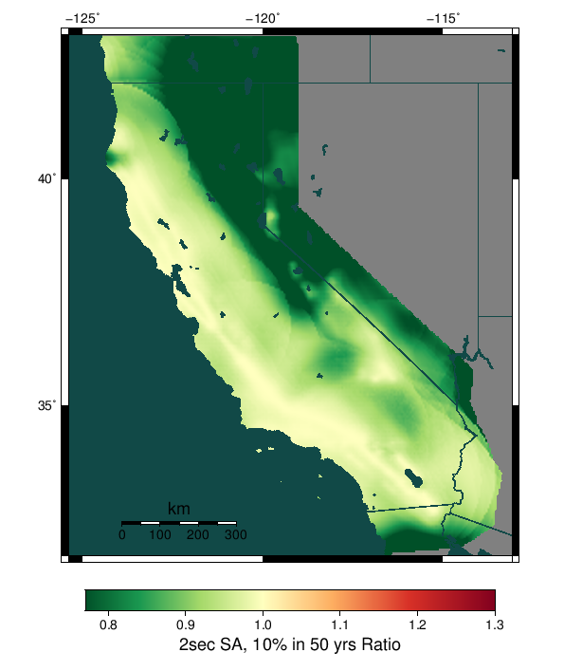
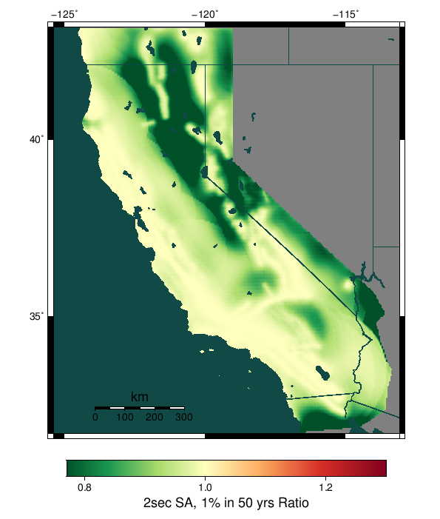
Background Seismicity
Contributions of
up to ~10%
We will add
background
seismicity after
the study is
complete
exclude / include for UCERF 2

Slide 14
Site order
Full study is 869 sites. Proposed execution order is:
32 Overlapping sites
46 PG&E sites
136 CISN stations
571 grid sites
74 Cities
10 Missions

Slide 15
Computational Plan
Goals are to minimize makespan and human involvement
SGTs: 75% Blue Waters, 25% Titan
  1.2M node-hrs on Blue Waters
  12.5M SUs on Titan
Post-processing: 75% Blue Waters, 25% Titan
  600K node-hrs on Blue Waters
  12.6M SUs on Titan
Total of 1.8M node-hrs on BW, 25.1M SUs on Titan
  BW has 6.98M node-hrs
  Titan has 48.5M Sus
May adjust percentages depending on throughput

Slide 16
Storage Requirements
Titan
  Purged: 148 TB temp files + 3 TB output files = 151 TB
Blue Waters
  Purged: 589 TB temp files + 9 TB output files = 598 TB
SCEC
  12 TB archived (28 TB free on shared SCEC disks)
  1 TB workflow logs
  360 GB database entries (2.0 TB free on moment.usc.edu disks)

Slide 17
Estimated Duration
Dependent on BW GPU throughput
To complete in 4 weeks before BW allocation expires, must achieve 80% higher usage than during Study 15.4
Planning to request XE and XK reservations and quota increase on Blue Waters
Planning to request queue changes on Titan for higher throughput

Slide 18
Staff
SCEC Staff
  Scott Callaghan
  Phil Maechling
  Christine Goulet
  Mei-Hui Su
  Kevin Milner
  John Yu
Science review
  John Vidale
  Tom Jordan
  Rob Graves
  Kim Olsen
  Brad Aagaard
Pegasus Staff
  Karan Vahi
  Mats Rynge
NCSA Staff
  Tim Bouvet
  Greg Bauer
  Galen Arnold
OLCF Staff
  Judy HIll

Slide 19
Possible study extensions
Sites using Vs min = 250 m/s
Selected sites with 1D model
Selected sites with finer simulation grids

Slide 20
Study 18.8 Notables
First Bay Area CyberShake calculation
First study with Ely-Jordan GTL applied
Computationally largest study to date
Largest number of sites per map
First study with Wills (2015) Vs30 data

Slide 21
Science to-dos Pending
Calculate a few sites on Blue Waters and compare with Titan results

Slide 22
Risks
GPU throughput on Blue Waters
Blue Waters allocation expiration
  Can request extension of the smaller of 5% or 300K node hours

Slide 23
Action Items
Calculate comparison curves on Blue Waters for verification
Have calls with OLCF and NCSA

Slide 24
Thanks for your time!

