Slide 1

High Performance Computing at SCEC
Scott Callaghan
Southern California Earthquake Center
University of Southern California

Slide 2
Outline
Who am I?
What is High Performance Computing?
How does high performance computing work?
How is it useful to SCEC?
How does it work at SCEC?
How do we know if we’re doing it right?
What kind of simulations has SCEC run?

Slide 3

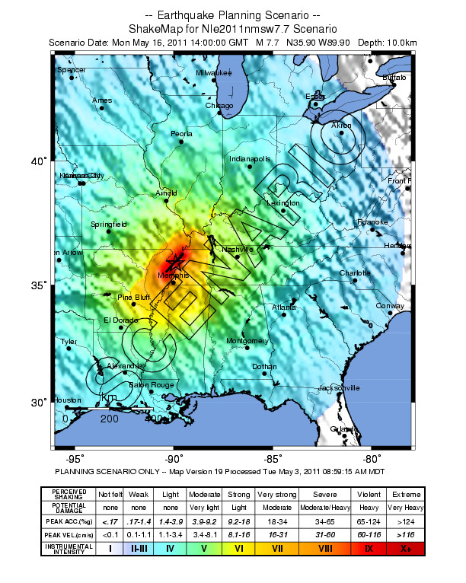

X

Slide 4
Why did I choose to do this?
I like math, science, programming
  Only a little programming experience in high school
Computer science for a research group brings together my interests
  Work with smart people in many fields
  Work on real problems with useful applications
  Advance science research
I get to ‘dabble’ in science

Slide 5
What is High Performance Computing?
Using large computers with many processors to do simulations quickly
Used by many fields, such as:
  Chemistry
  Aerospace
  Genomics
  Climate
  Cosmology
Serves as the (controversial)
“third pillar” of science
Theory
Simulation
Experiment

Slide 6
How does HPC work?
Start with a physical phenomenon
Write down the physical equations that govern it
Discretize it, since computers only work in discrete increments
Create an algorithm based on these equations
Break the algorithm into pieces for each processor
Run it
Analyze the results
Add additional complexity to be more accurate

Slide 7
Wait, what?
Let’s simulate the velocity v(t) of a falling object over time, with air resistance
Introductory physics time!
kv(t)
mg
Notes:
Gravity: F = mg
Air resistance: F = kv(t)
F = ma = mg – kv(t)
mv’(t) = mg – kv(t)
Need to discretize. Could do this many ways, but will take the simplest:
(v(t+d) – v(t))/d = g – k/m*v(t)
v(t+d) – v(t) = dg – dk/m*v(t)
v(t+d) = dg + (1 – dk/m)v(t)
Could have replaced v’(t) with (v(t) – v(t-d))/d, (v(t+d/2)-v(t-d/2))/d, etc.
Pull up spreadsheet and try different values of d.

Slide 8
Now that we’ve got the equation
v(t+∆) = ∆g + (1-∆k/m)*v(t)
We can write an algorithm:
  v(0) = 0, delta=0.1, g=10, k=0.1, m=1
  for timestep=1 to timestep=100:
  v = delta*g + (1-delta*k/m)*v
Now you could use this to run a simulation
Let’s look at the impact of changing delta
Later we could add more complexity to be more accurate
  Non-zero initial velocity, g and k vary with altitude, determine k from cross-section, other forces, etc.
Notes:
Spreadsheet

Slide 9
But wait! We forgot a step
Break the algorithm into pieces, right?
In HPC, speedup comes from doing work in parallel
  Each processor works on small subset of job
  Results are combined
  Usually, calculations are repeated some number of times
  Final results are saved
Most commonly, divide work up into subsets based on data
Let’s look at matrix multiplication as example

Slide 10
Matrix Multiplication
1 | 2 | -4 | 7
3 | -5 | 4 | 9
0 | -7 | -6 | 6
-2 | 5 | -1 | 8
4 | 0 | 8 | -1
0 | 1 | 1 | 0 | -1
1 | 2 | 0 | 1 | 3
0 | 0 | 1 | 2 | 0
2 | 1 | 0 | 0 | 1
X
=
1 | 2 | -4 | 7
X
0
1
0
2
=
(1x0)+
(2x1)+
(-4x0)+
(7x2) =
16 | 12 | -3 | -6 | 12
13 | 2 | 7 | 3 | -9
5 | -8 | -6 | -19 | -15
21 | 16 | -3 | 3 | 25
-2 | 3 | 12 | 16 | -5
Can give each row/column pair to a different processor

Slide 11
3 phases in simulation
Calculation - actually doing the numerical calculation
Input/output (I/O) - reading and writing numbers from/to the paper
Communication
  Passing out sheets (send out pieces of the problem)
  Telling me what your results were (send results back)
As in this example, calculation is usually the fastest of the phases
To speed up performance, must optimize all phases

Slide 12
  How is HPC useful to SCEC?
Earthquakes are really, really complicated
Many of these pieces can be simulated
  Don’t have to wait for a real earthquake
  Can perform “experiments” to test theories
  Can try to look into future
Surface
faulting
Landslides
Stress transfer
Liquifaction
Fires
Slow slip transients
Seismic
shaking
Socioeconomic
aftereffects
Fault
rupture
Structural & nonstructural
damage to built environment
Tectonic loading
Stress accumulation
Nucleation
Seafloor
deformation
Tsunami
Human casualties
Dynamic triggering
Disease
----- Foreshocks -----
------ Aftershocks -------------------------------------------------------------------
century
decade
year
month
week
day
0
minute
hour
day
year
decade
Anticipation time
Origin time
Response time ➔
12

Slide 13
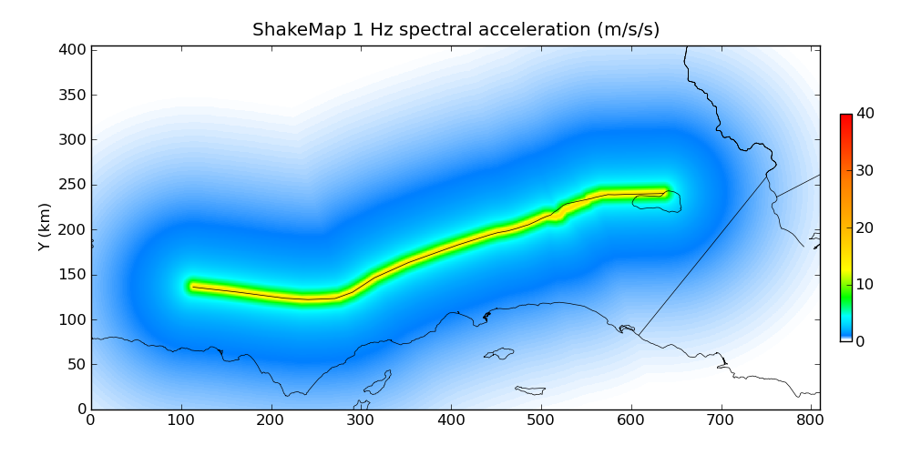
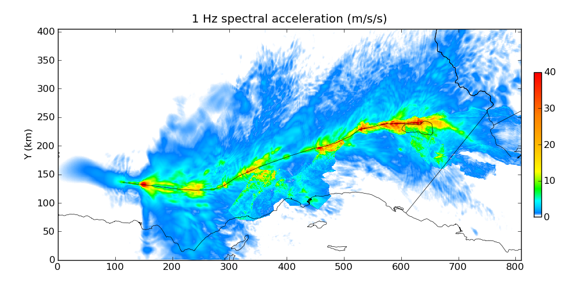
HPC provides “best estimate”
Magnitude 8, San Andreas
Produced without simulation
Produced with HPC simulation

Slide 14
Simulating has its own challenges
Large range of scales
  Faults rupture over 100s of kilometers
  Friction acts over millimeters
  Want to understand shaking over large regions
Need access to large, powerful computers
Need efficient software
Must make sure you’re getting the right answer
Like all good science, must be reproducible

Slide 15
What codes & inputs do we at SCEC need?
Wave propagation code
  Simulates the movement of seismic energy through the volume, like ripples in a pond
  Constructed from first principles wave physics
Velocity model
  Speed of the earthquake waves at all points in the earth that you’re simulating – related to rock density
  Calculated from boreholes, analyzing past earthquakes
Earthquake description
  The forces experienced as an earthquake starts at a hypocenter and moves along a fault surface – initial condition
  Constructed from historic earthquakes, physics

Slide 16
Simulating Large Earthquakes
Run wave propagation simulation
Material properties, wave moves through volume
Break up the work into pieces by geography
  Give work to each processor
  Run a timestep
  Communicate with neighbors
  Repeat
As number of processors rises, harder to get good performance – why?

Slide 17
How do we know if we’re doing it right?
Must be able to trust science results
  Just because it runs doesn’t mean it’s right…
Verification
  Does this code behave as I expect it to? Was it programmed correctly?
Validation
  Does this code accurately model a physical phenomenon in the real world?
Can compare results against real earthquakes
Can run multiple codes on same problem and compare results

Slide 18
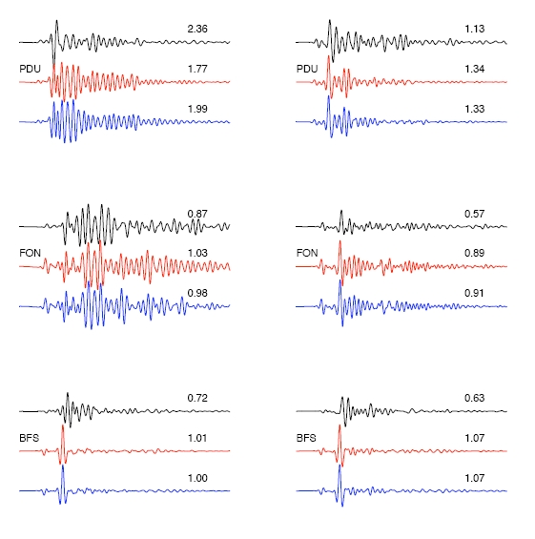
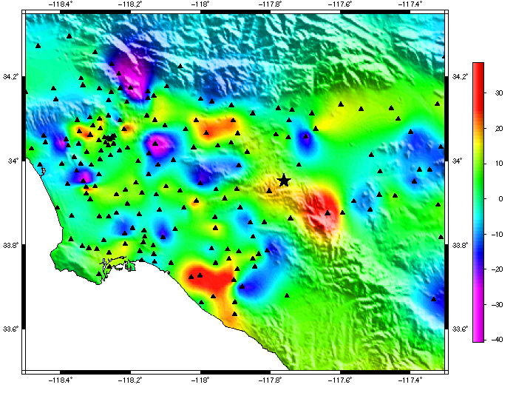
Comparison against real events
Comparison of data (black) to two simulations (red, blue) using alternative earth structural models for the 2008 Mw5.4 Chino Hills earthquake.
0.1-0.5Hz goodness-of-fit for simulated earthquakes relative to data from same earthquake. Colors indicate which structural model is a better fit.

Slide 19
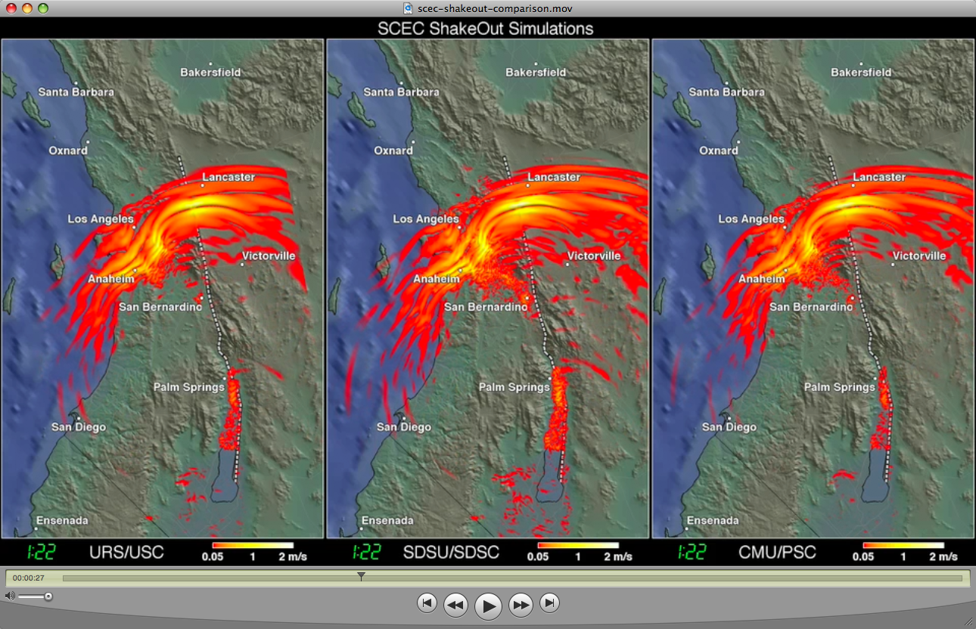

Comparison between codes

Slide 20

Comparison with past good code

Slide 21
What kind of simulations does SCEC run?
Two main types of SCEC HPC projects
  What kind of shaking will this one earthquake cause?
  What kind of shaking will this one location experience?
The first: “Scenario simulations”
The second: “Seismic hazard analysis”
Complimentary – answering different key questions

Slide 22
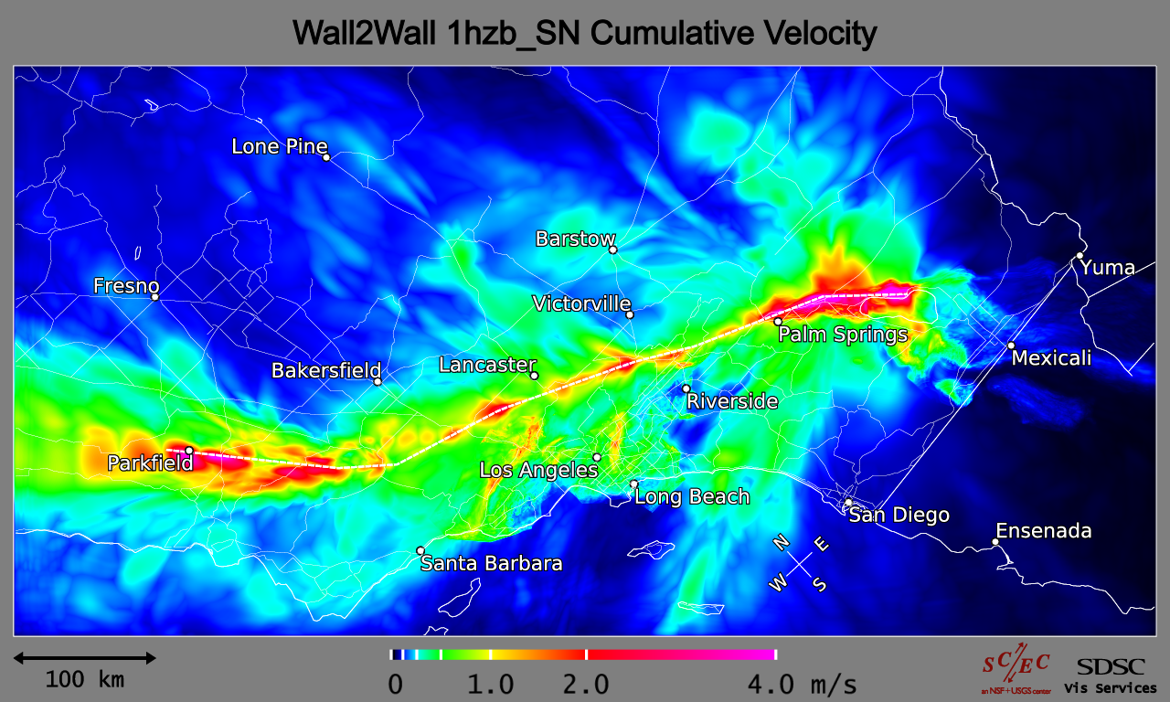
SCEC Scenario Simulations
Simulations of individual earthquakes
  Determine shaking over a region caused by a single event (usually M > 7)
Peak ground velocities for a Mw8.0 Wall-to-Wall Scenario on the San Andreas Fault (1Hz) calculated using AWP-ODC on NICS Kraken.

Slide 23
Simulation Results (N->S)
W2W (S-N)

Slide 24
Simulation Results (S->N)

Slide 25
SCEC Simulation Growth
Year | Number of points in mesh (simulation size) | Number of timesteps | Peak speed | Number of processors
2004 | 1.8 billion | 22,768 | 0.04 Tflops | 240
2007 | 14 billion | 50,000 | 7.3 Tflops | 32,000
2009 | 31 billion | 60,346 | 50.0 Tflops | 96,000
2010 | 440 billion | 160,000 | 220.0 Tflops | 223,074
2013 | 859 billion | 2,000 (benchmark) | 2330.0 Tflops | 16,384 GPUs
Since it’s harder to write fast software for lots of processors, looking at new exotic solutions (GPUs, coprocessors, etc.)
Need next-gen machines to improve on 2013

Slide 26
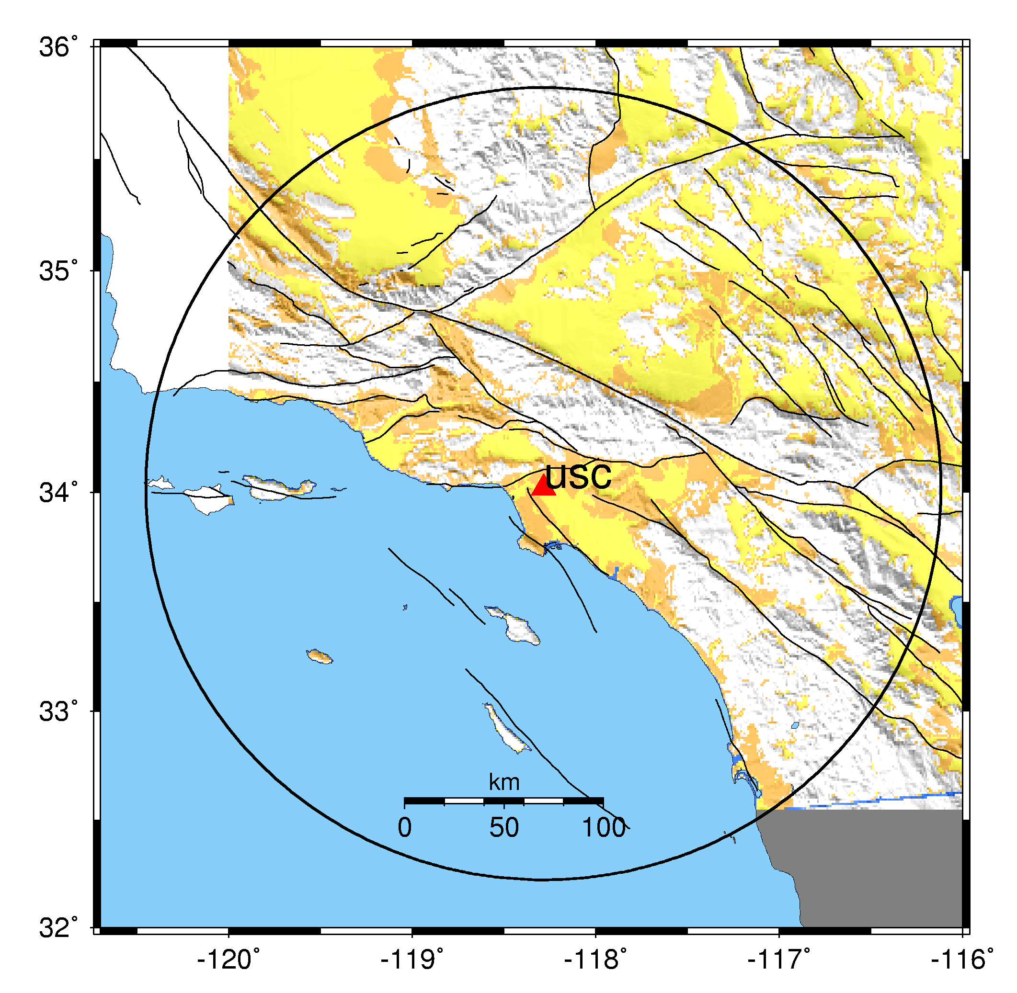
Seismic Hazard Analysis
The second kind of simulation
Builders ask seismologists: “What will the peak ground motion be at my new building in the next 50 years?”
Different question – don’t care which earthquake, care about this one location

Slide 27

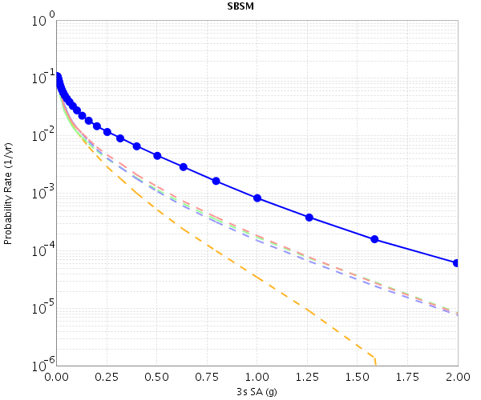
CyberShake Project
Consider all earthquakes, >M6.5, within 200 km of site of interest (~500,000)
Physically simulate every earthquake using HPC
Combine amount of shaking with probability

Slide 28
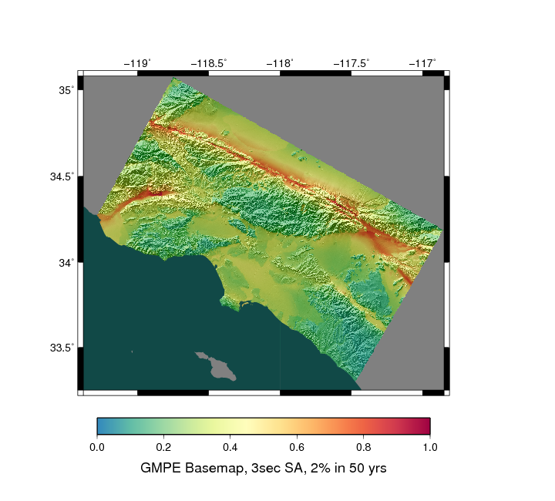
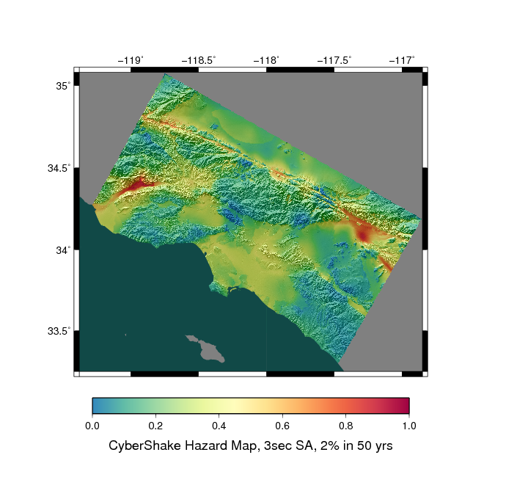
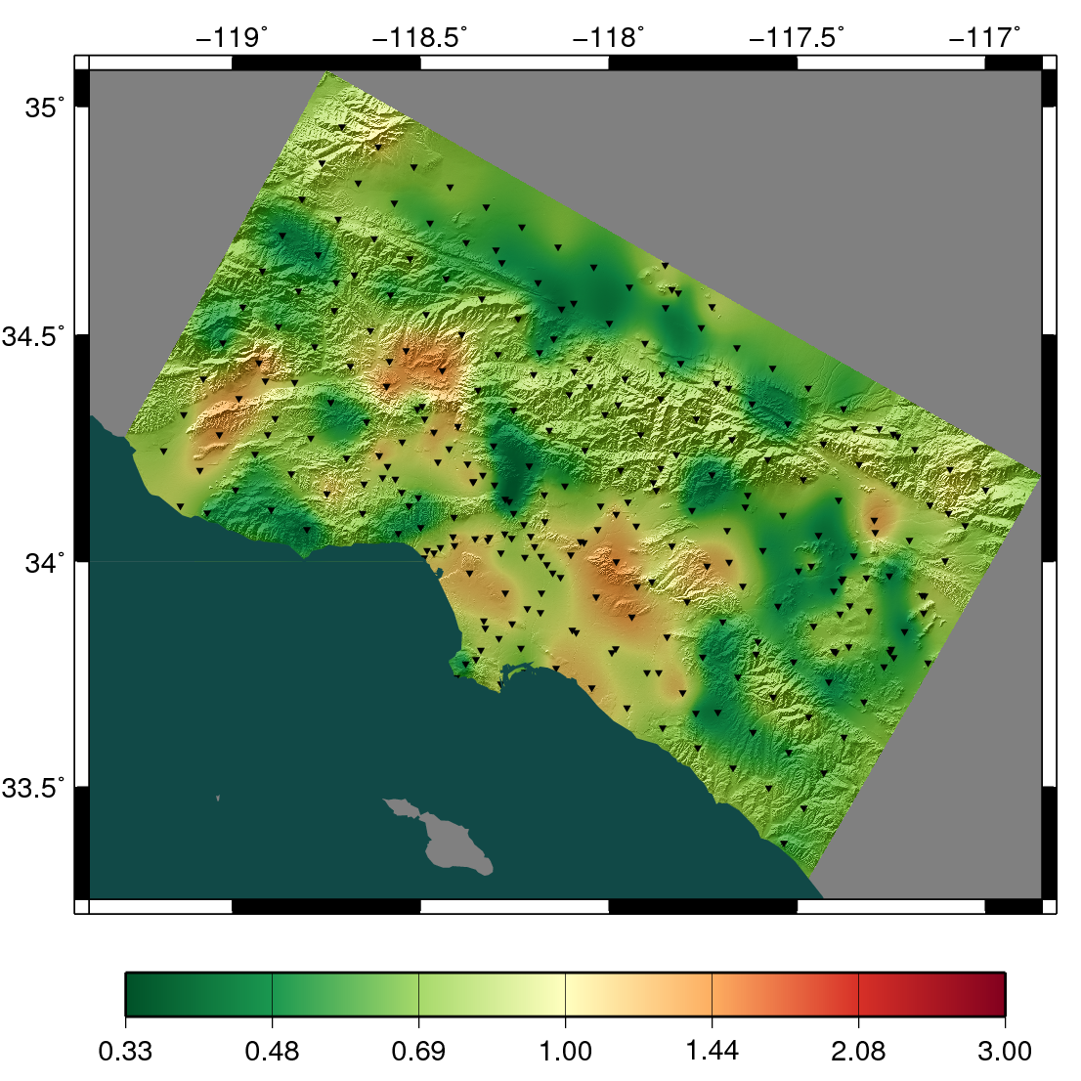
Does the approach make a difference?
Attenuation Hazard Map
CyberShake Hazard Map
Higher Attenuation
Higher CyberShake

Slide 29
Some numbers
M8 simulation
  600 TB output
  436 billion mesh points
  223,074 processors for 24 hours
CyberShake (April-May 2015)
  Seismic hazard analysis performed for 336 sites
  510 TB data generated
  170 million seismograms
  Average of 55,328 cores, max of 238,000 for 5 weeks
  37.6 million CPU+GPU hours (~4300 years)
Onward and upward!

Slide 30
In summary
High performance computing
  Is hard
  But interesting!
  Provides a technique for solving big problems in many fields
  Opportunities to problem-solve and expand horizons
SCEC uses HPC
  To determine the shaking from one big earthquake
  To determine the hazard at one location
  To support experiments and theory

Slide 31
2016 UseIT and HPC
Everyone will have the opportunity to use a supercomputer
  NCSA Blue Waters
  Top 3 non-proprietary supercomputers in the world
Friday, Tom will explain why HPC is needed
Tutorial Monday to get you started
Linux experience?
Scripting experience?
HPC experience?

