Slide 1

CyberShake Study 21.12:
Say, what is that, anyway?
Scott Callaghan
February 2022 SCEC Staff Meeting

Slide 2
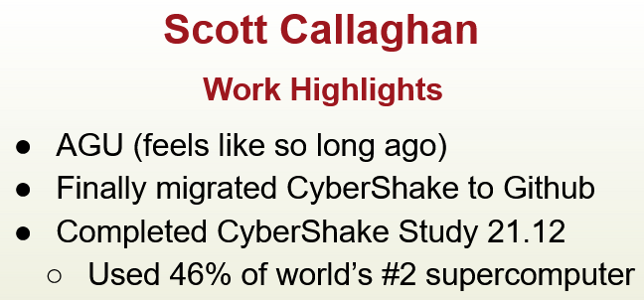
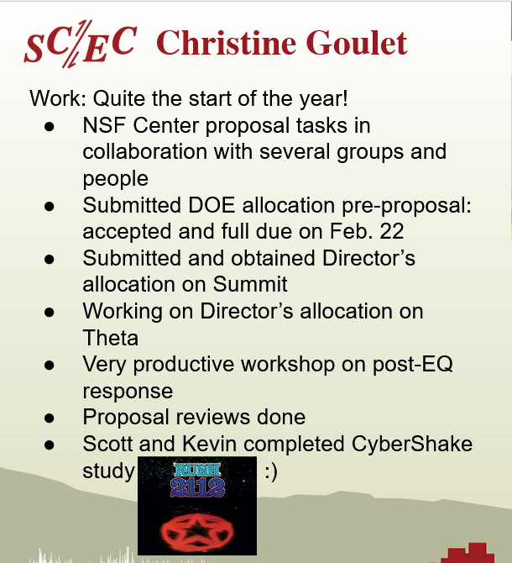

From January 2022 staff slides…

Slide 3
CyberShake Study 21.12
What is CyberShake?
What’s unique about Study 21.12?
What is CyberShake?

Slide 4
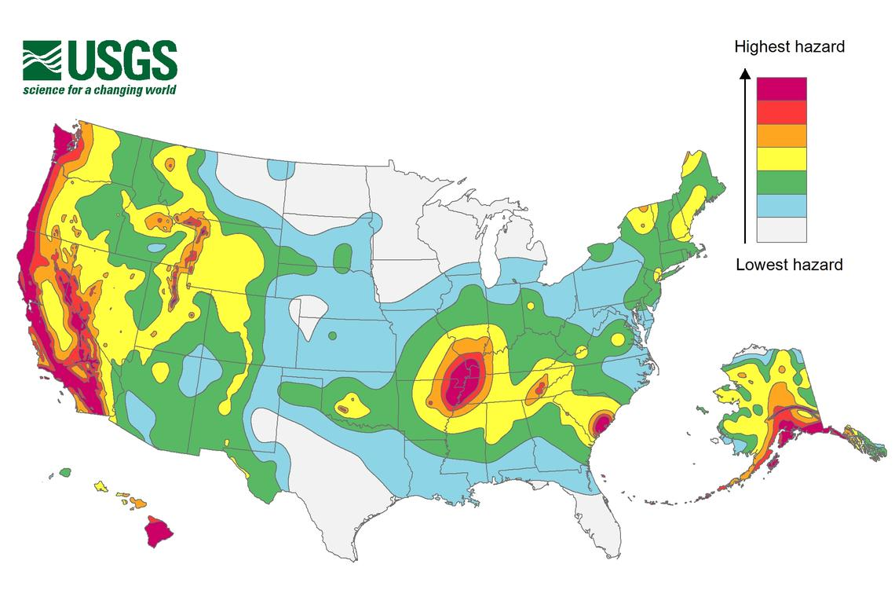
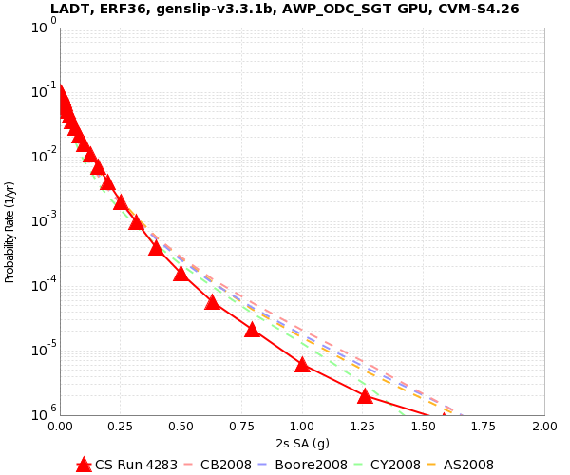
Probabilistic Seismic Hazard Analysis (PSHA)
Quantifying hazard based on probabilities.
Pick a location.
Get a list of all possible earthquakes
that might affect the site, along
with their probabilities.
Calculate the amount of shaking each
earthquake would cause at the site.
Combine the shaking values with the
probabilities to produce a hazard curve.
2% in 50 yrs
0.45g

Slide 5
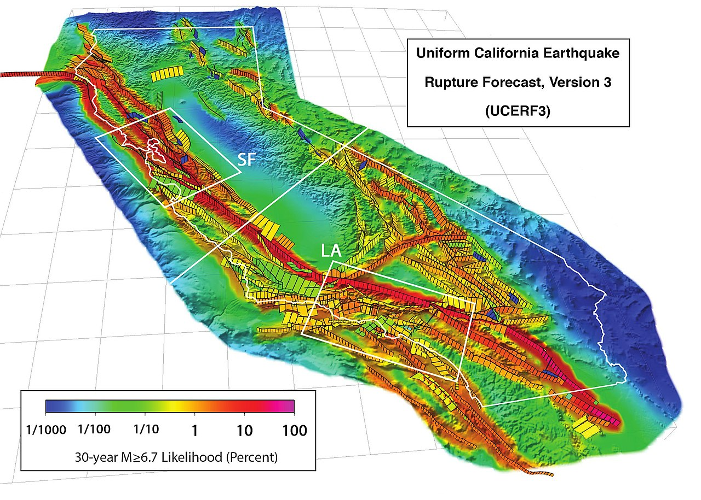
Where do we get this list?
Called an ‘earthquake rupture forecast’, or ERF
Working Group on California Earthquake Probabilities produces ERFs
  UCERF2 (2008), UCERF3 (2015), ask Kevin about UCERF4 ☺
  Derived from slip rates, event rates, deformation, other observables
Alternatively, can run a physics-based
earthquake simulator, like RSQSim
  Simulates hundreds of thousands of years
  of California fault system
  Use the generated earthquakes as an ERF
Usually 50-600k earthquakes per site

Slide 6
Probabilistic Seismic Hazard Analysis (PSHA)
Quantifying hazard based on probabilities.
Pick a location.
Get a list of all possible earthquakes
that might affect this location, along
with their probabilities.
Calculate the amount of shaking each
earthquake would cause at your site.
Combine the shaking values with the
probabilities to produce a hazard curve.

Slide 7
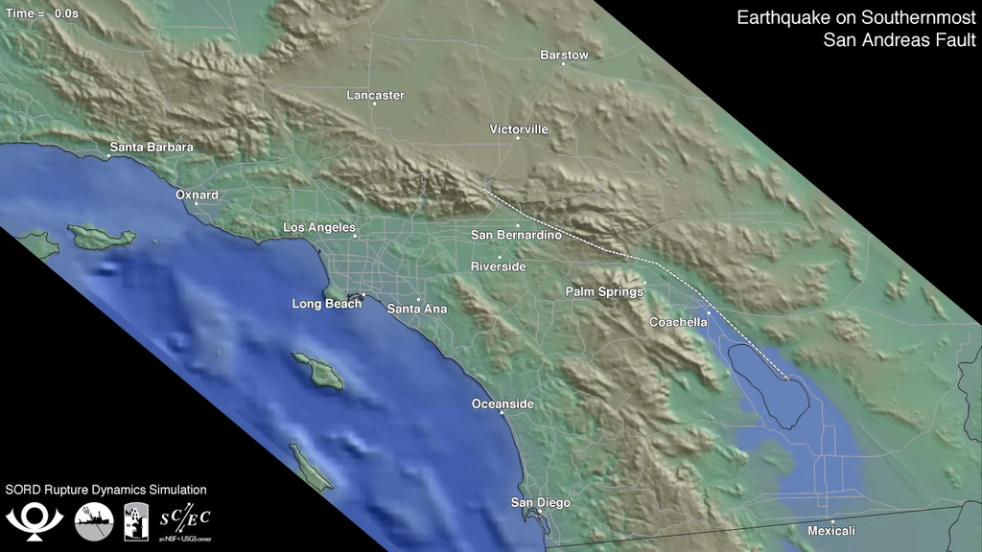
Calculating Intensities
M6.5
One way is to use ground motion prediction
equations (GMPEs).
  Regressions on historic earthquake data
  Very quick to calculate
  Only able to capture simpler effects
CyberShake uses a “physics-based” approach
  Performs wave propagation simulations
  Captures complex physics
  Requires supercomputers
Ground Motion
Distance

Slide 8
Is CyberShake worth it?
Overall goal is to reduce hazard uncertainty
GMPEs deliver a mean + standard deviation. Larger deviations translate into higher hazard curves, requiring stronger buildings.
With CyberShake, we hope to be able to model additional physics to reduce uncertainty.
  For example, perhaps differences in ground structure which are rolled into ‘uncertainty’ in GMPEs can be modeled in CyberShake.
σ
σ
∑
Single-event intensity distribution
Hazard Curve

Slide 9

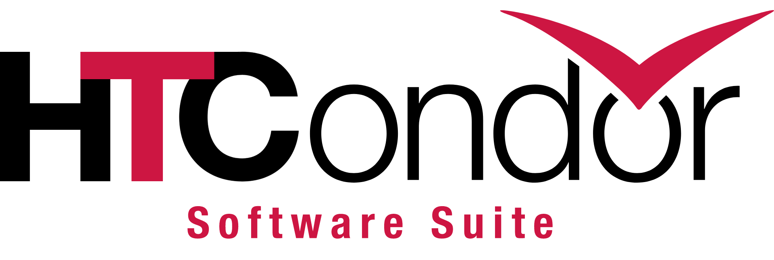
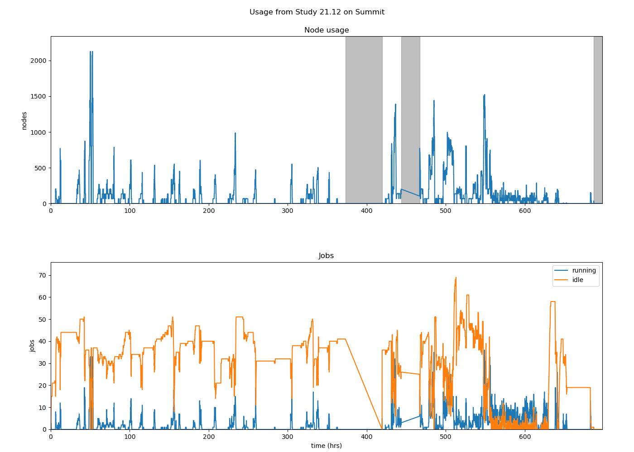
Workflow Tools
CyberShake manages many jobs and files
  16,000 software executions
  103 million files
We use workflow tools (Pegasus, HTCondor) to help with all this
  Describes the software steps, their inputs, and their outputs
  Transfers files between workflow server, USC storage, and supercomputer
  Execute jobs automatically
  Restarts jobs if they fail
One workflow per site

Slide 10
CyberShake Study 21.12
What is CyberShake?
What’s unique about Study 21.12?

Slide 11
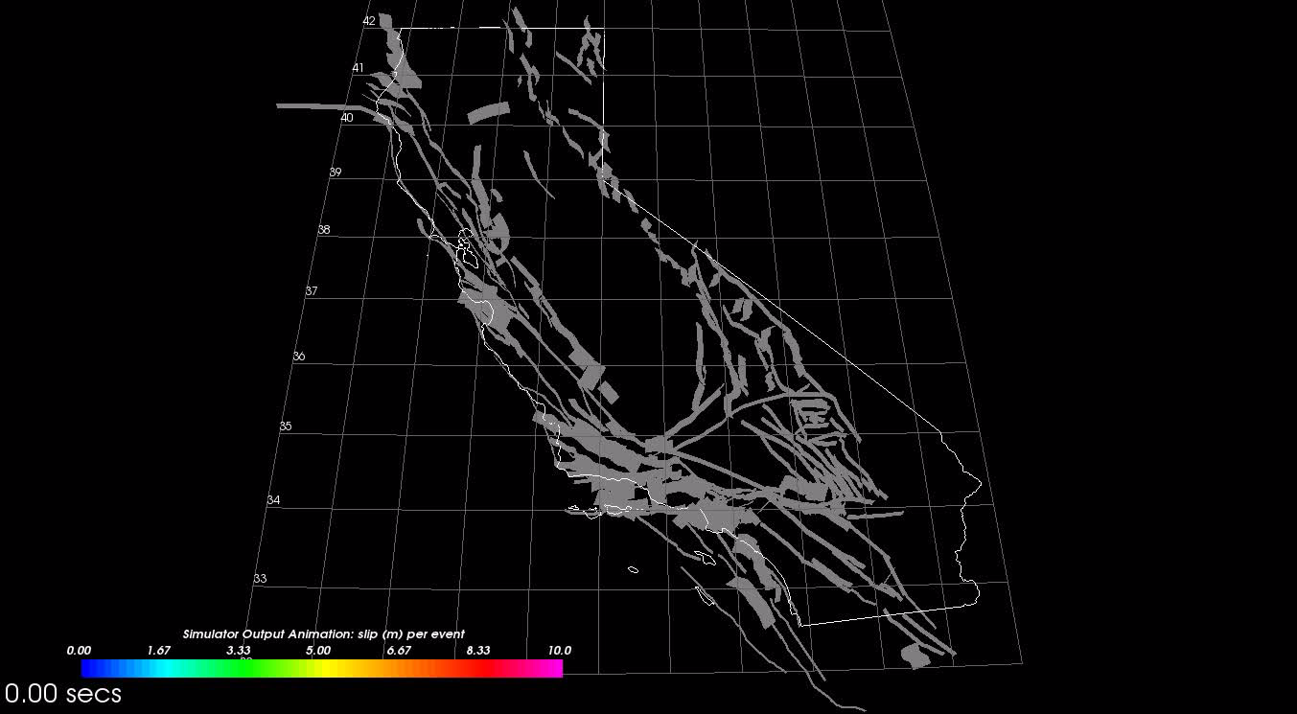
What’s special about this study, scientifically?
RSQSim earthquake simulator as source of ERF
Kevin and Bruce Shaw
generated 715,000 years of
California earthquakes
Builds on Kevin’s paper
(presented at 10/20
staff meeting)
Entire Southern California
hazard map (335 sites)
First fully physics-based PSHA model

Slide 12
What’s special about this study, technically?
In summer 2021, moved our workflow server to USC CARC
  Many issues to resolve (storage, firewall, permissions, etc.)
  First CyberShake study with new server
First study to use the Summit supercomputer at Oak Ridge
  #2 on Top500 list
  70,000 node-hrs
Peak of 46% of Summit

Slide 13
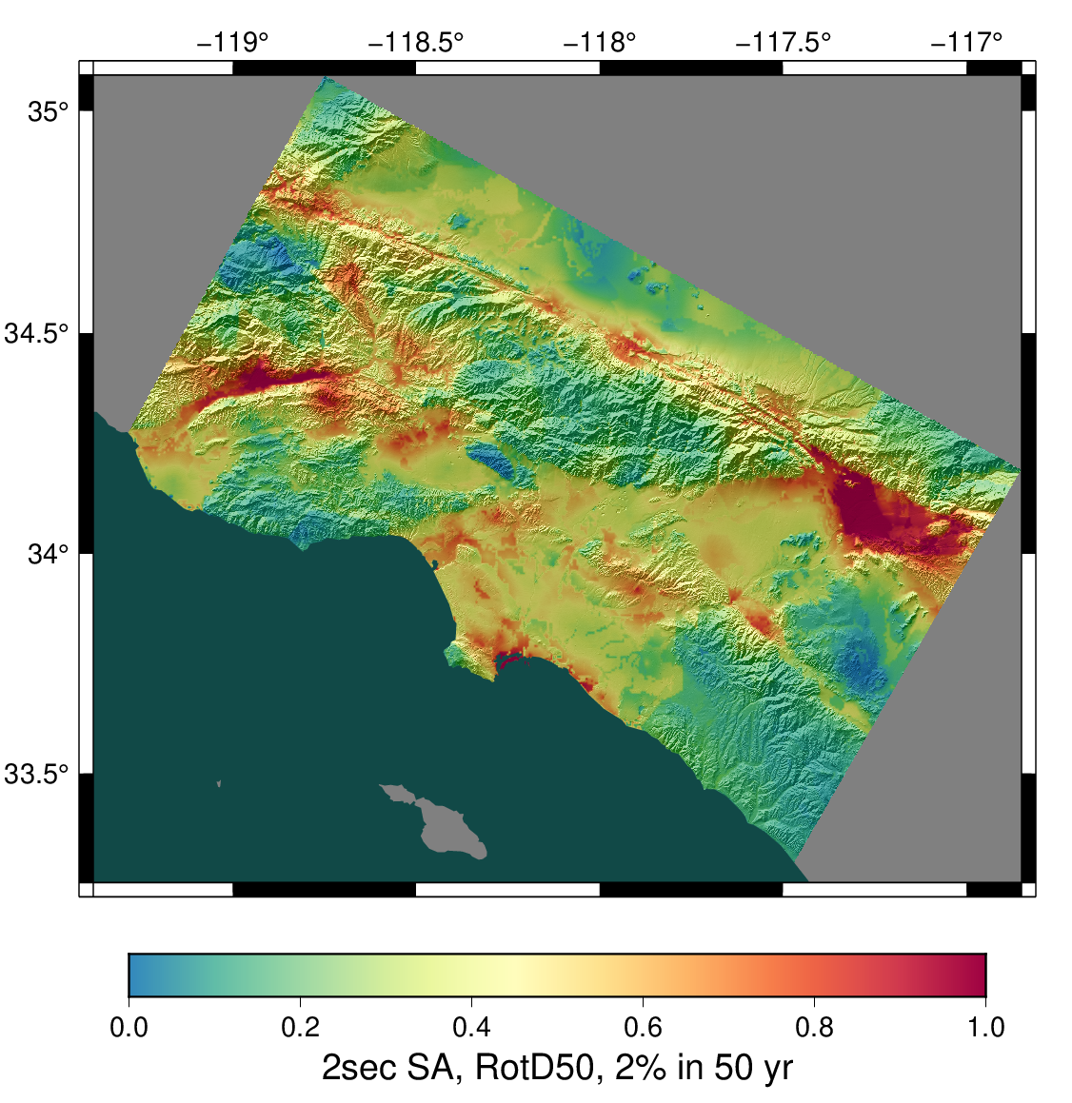
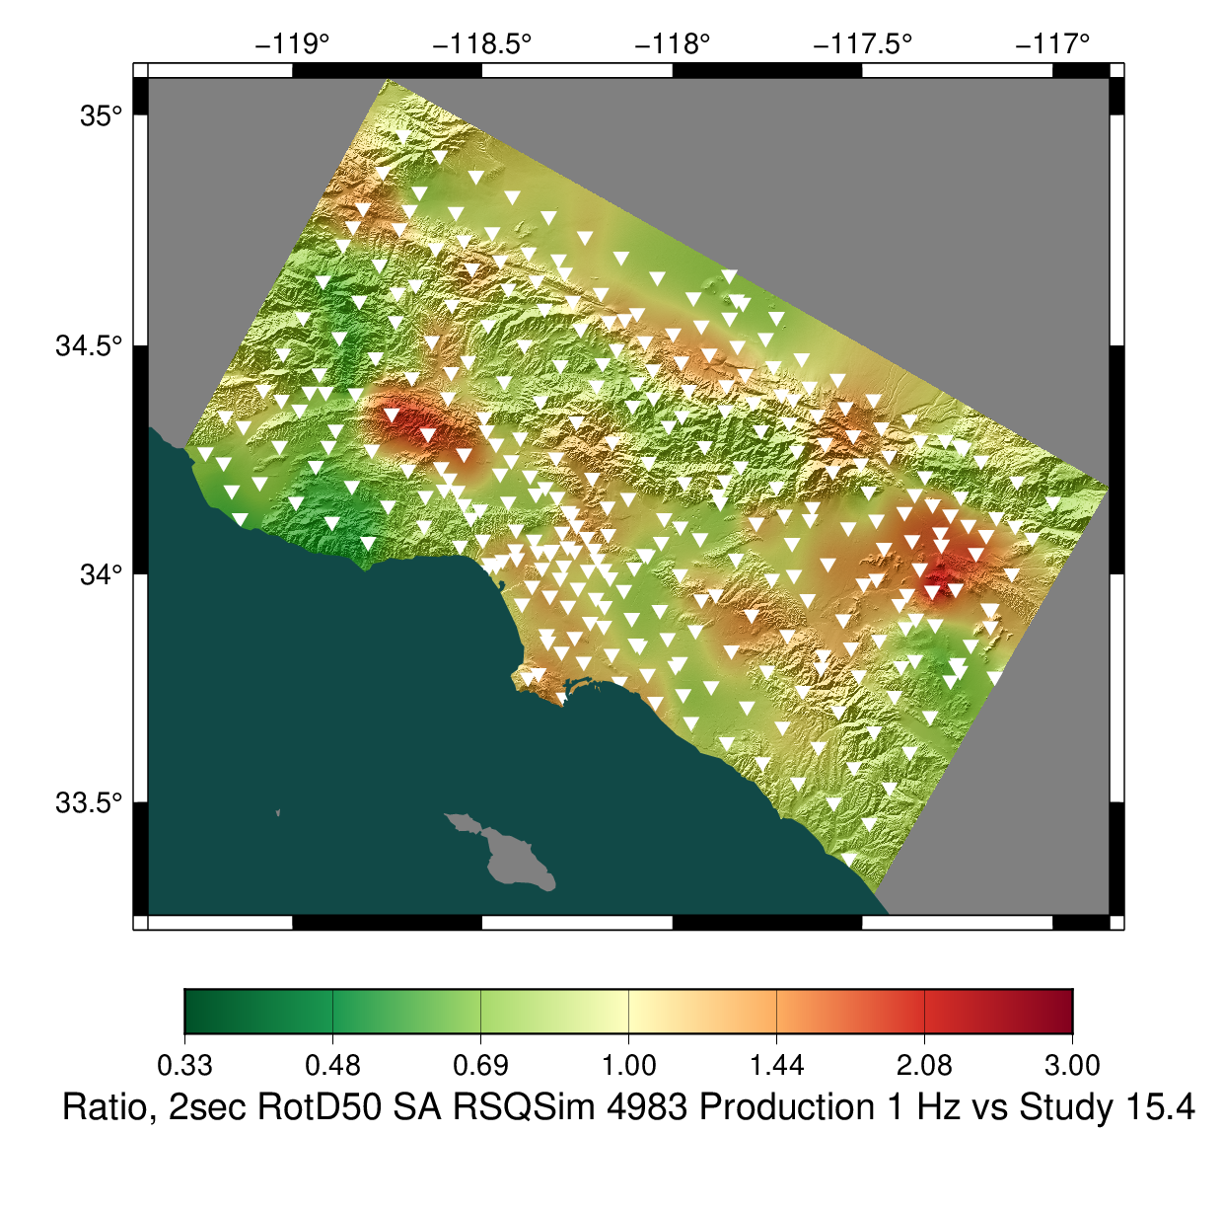
Results, 2 sec
Ratio of Study 21.12 to UCERF2 CyberShake
Study 21.12

Slide 14
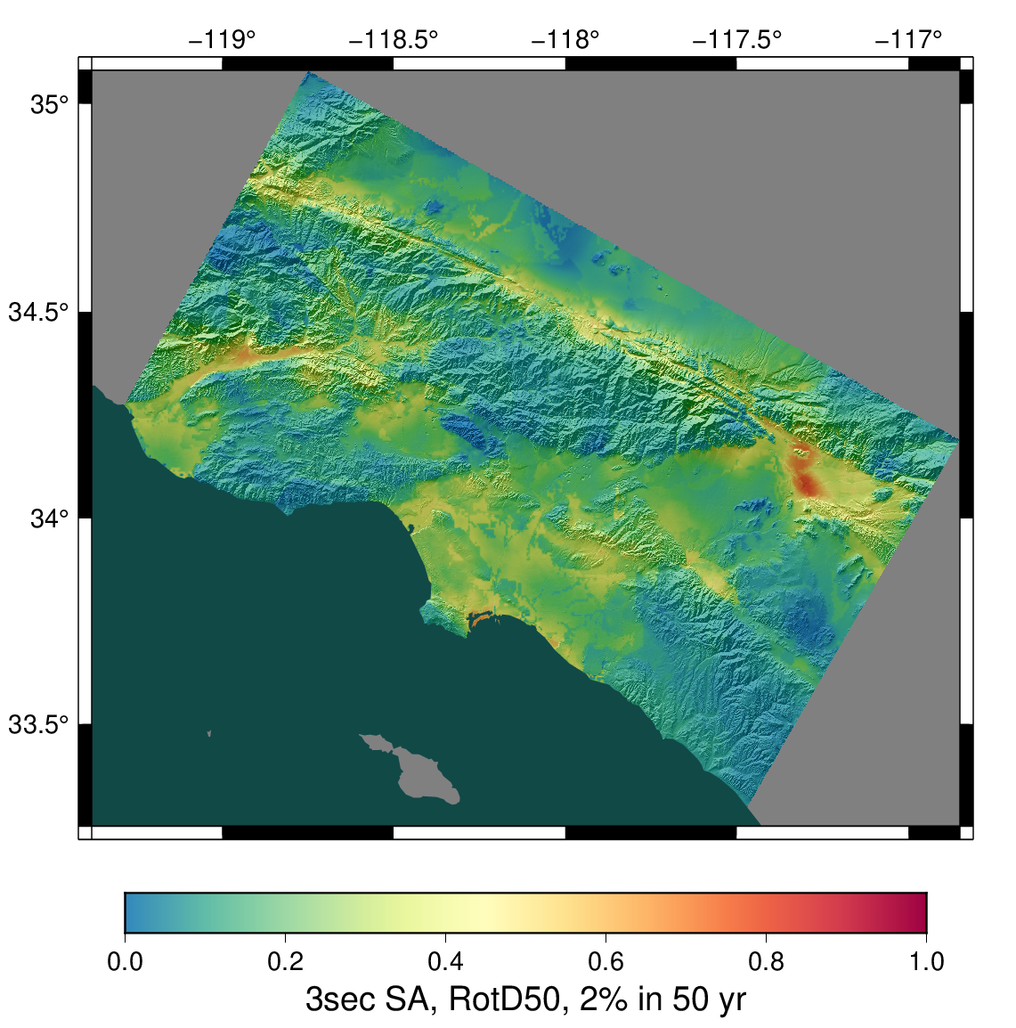
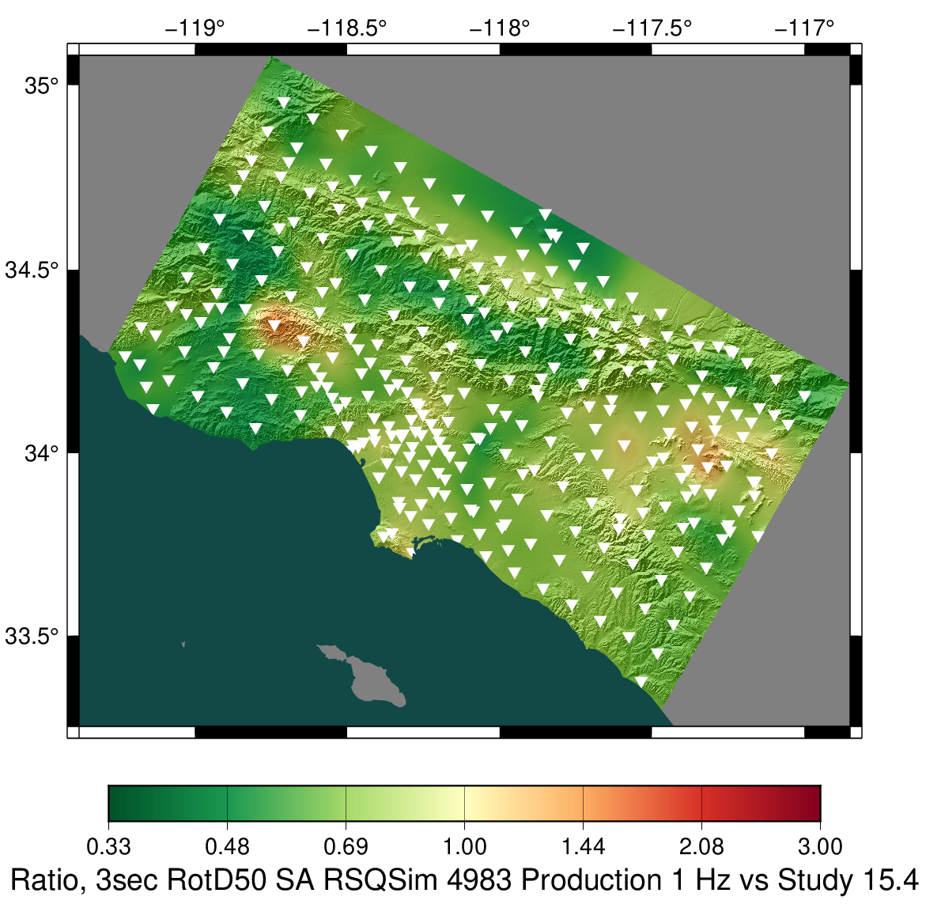
Results, 3 sec
Ratio of Study 21.12 to UCERF2 CyberShake
Study 21.12

Slide 15
Now you know!

