Slide 1

Non-ergodic PSHA Using Fully-Deterministic Physics-based Models for Southern California
Scott Callaghan, Kevin R. Milner, Christine A. Goulet, Bruce E. Shaw, Philip J. Maechling, Kim B. Olsen, Robert W. Graves, Karan Vahi, Ewa Deelman, Thomas H. Jordan, and Yehuda Ben-Zion
2022 SSA Annual Meeting
Thursday, April 21, 2022

Slide 2
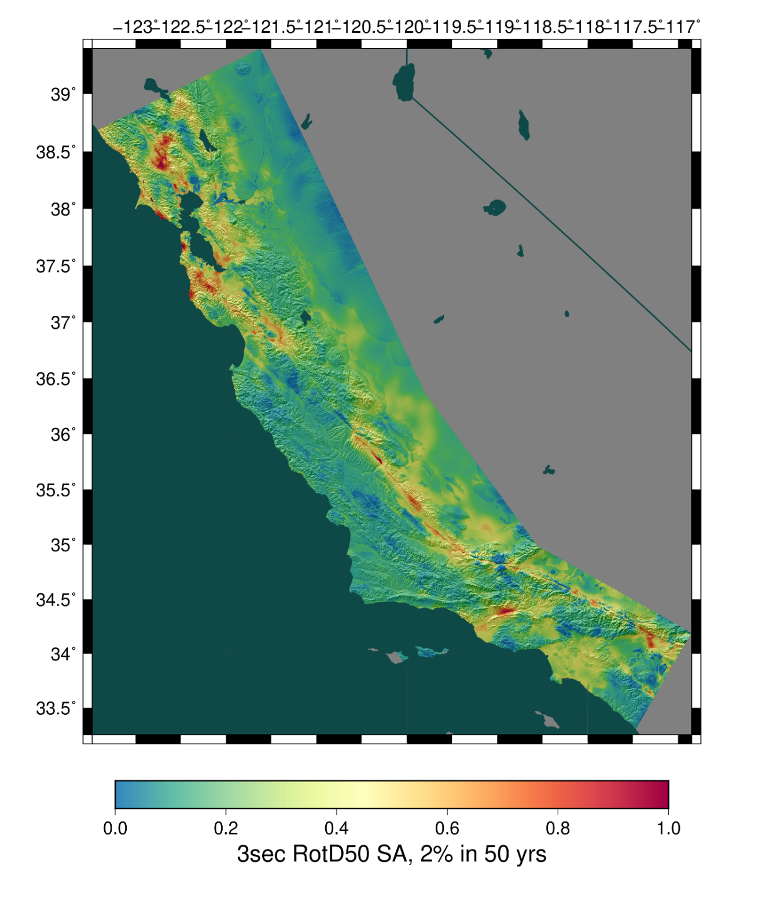
CyberShake Platform
SCEC’s 3D physics-based probabilistic seismic hazard analysis (PSHA) platform
Earthquake Rupture Forecast (ERF) provides list of relevant events with probabilities
  70,000-500,000 events per site
Reciprocity-based approach to simulate seismograms
Intensity measures derived from seismograms
Hazard results from individual sites interpolated with GMPE basemap
Deterministic simulations to 1 Hz

Slide 3
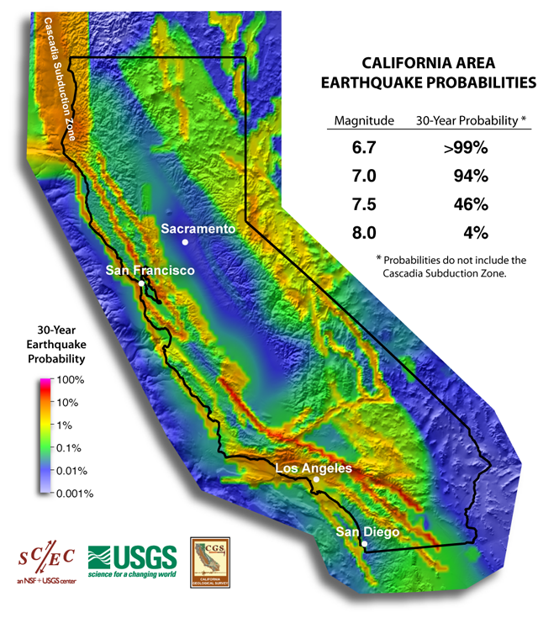
Earthquake Rupture Forecast
List of events to simulate + probabilities
To date, all CyberShake studies use
UCERF2 ERF
  Derived from empirical data
  Average of logic tree branches
  Includes aleatory magnitude uncertainty
Investigated impact of using deterministic
ERF generated with earthquake simulator

Slide 4
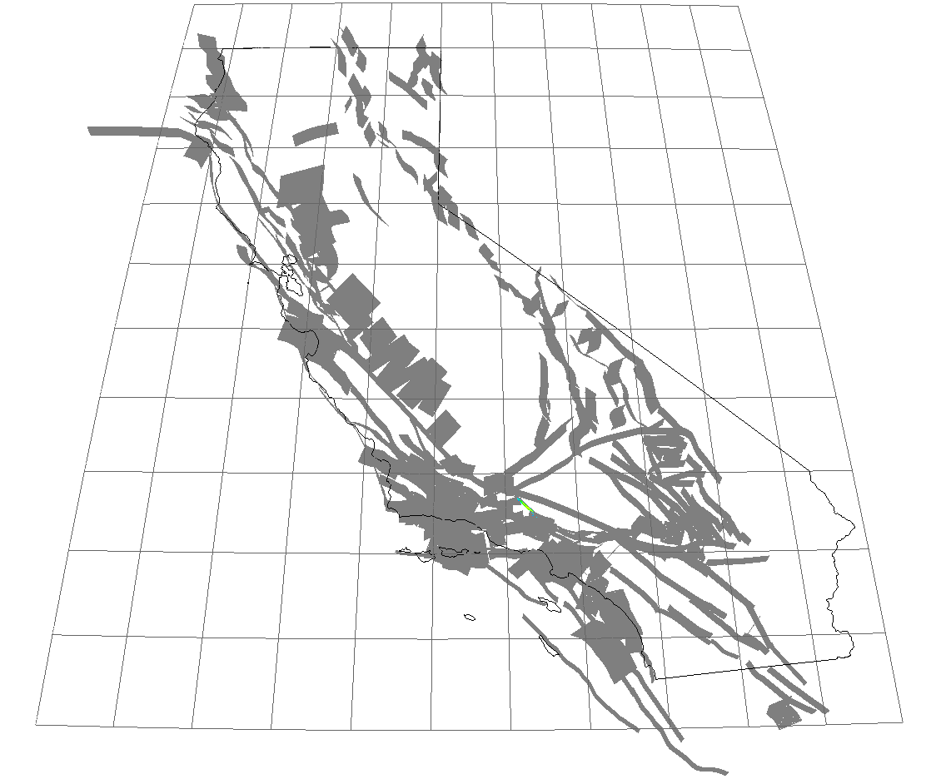
RSQSim
Rate-State Earthquake Simulator
Physics-loaded multi-cycle simulator
Simulates hundreds of thousands of
years of earthquakes on CA fault system
Generates full slip-time histories for
all events
Can use as an ERF for CyberShake
  Catalog provides list of events
  Uniform probability, 1/(catalog length)
Visualization of 3,000 year RSQSim catalog

Slide 5
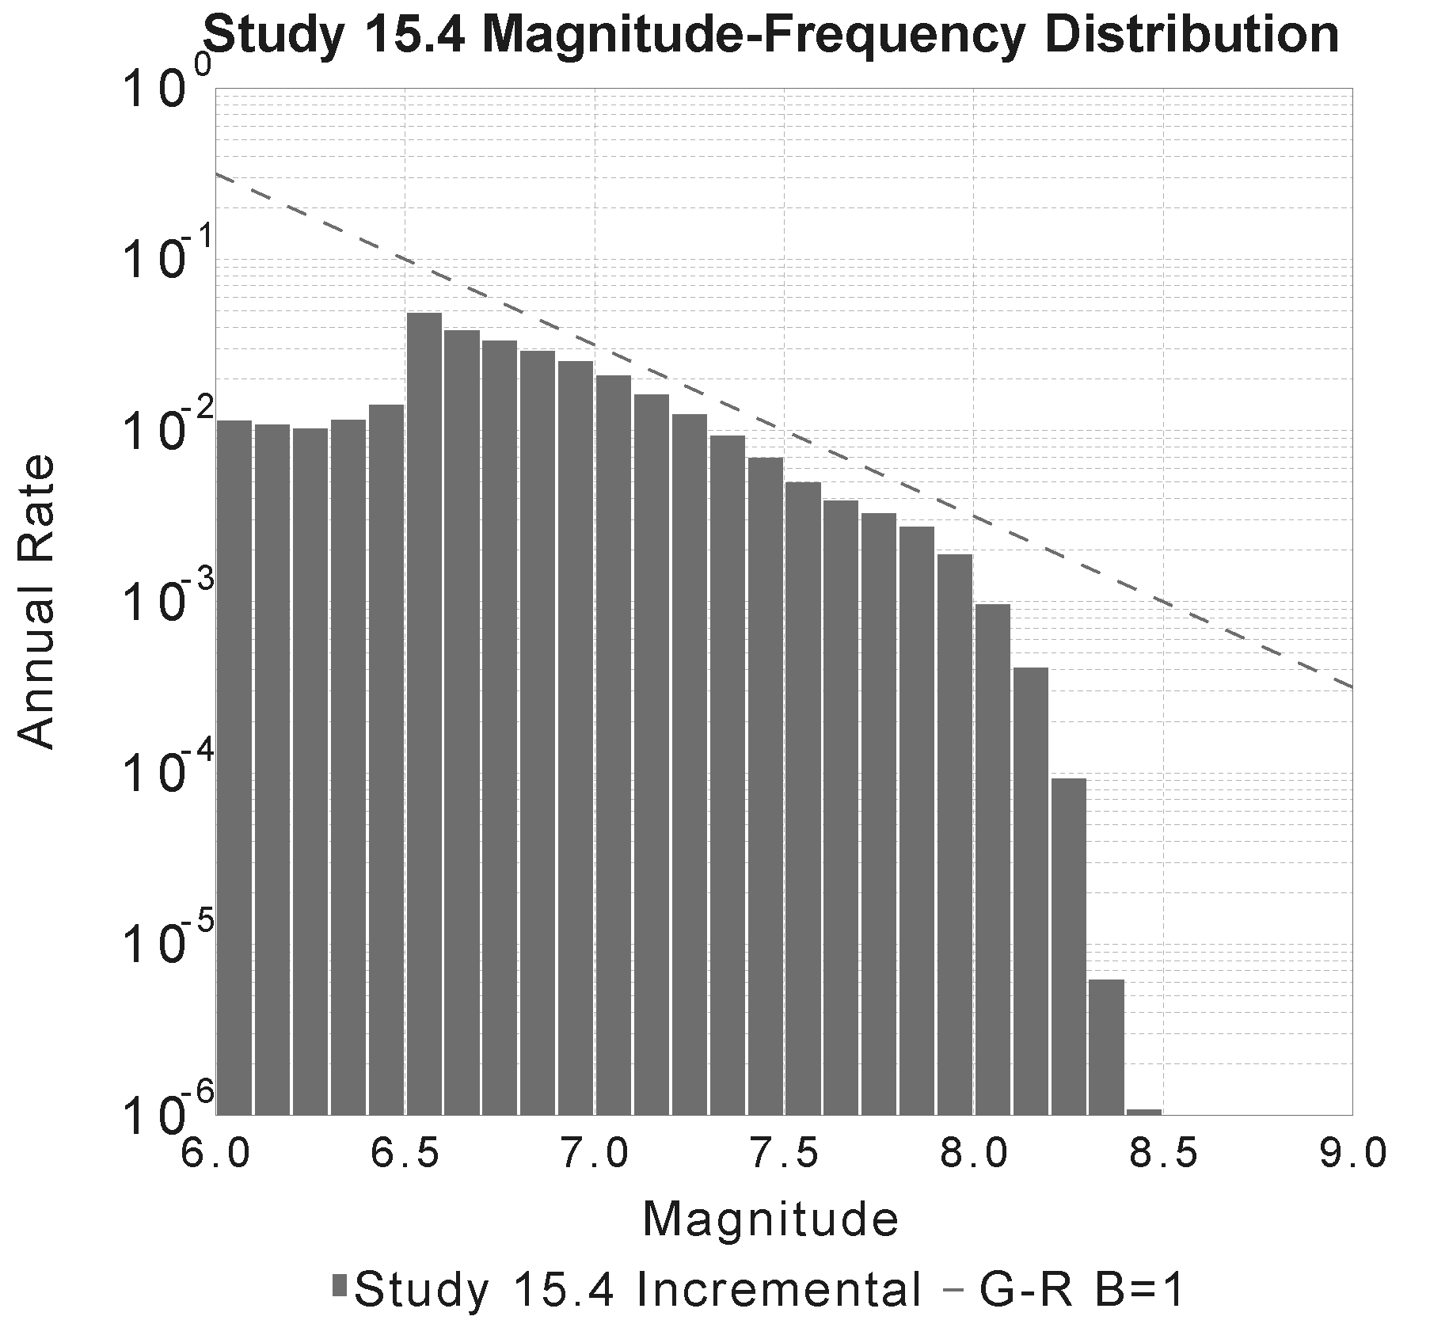
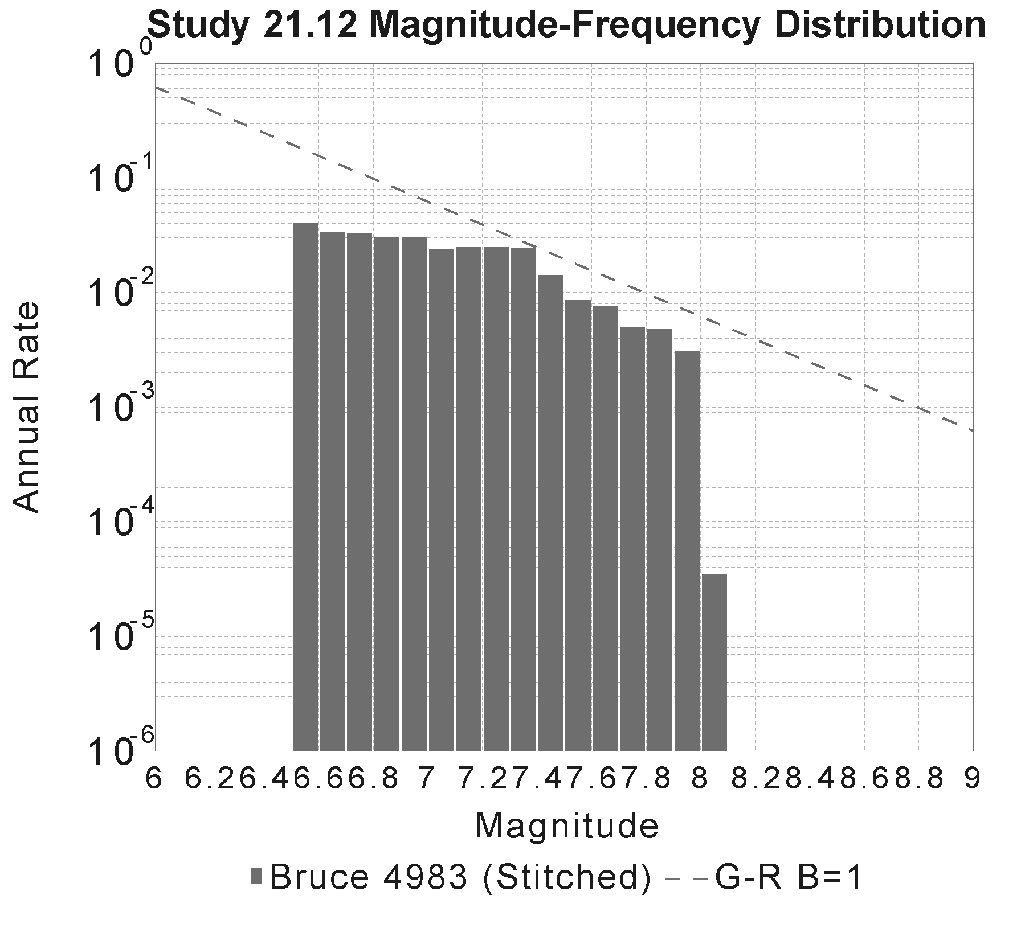
RSQSim CyberShake ERF
Generated 779,523 year catalog, 13.5 million events
  Discarded first 65kyrs as spinup
  Selected events M≥6.5 (220,927 events)
  Same cutoff rule (200 km from site)
UCERF3 fault surfaces
Triangular discretization
of ruptures, 1 km/side
Non-uniform hypocenter
distribution
UCERF2 ERF
RSQSim ERF

Slide 6
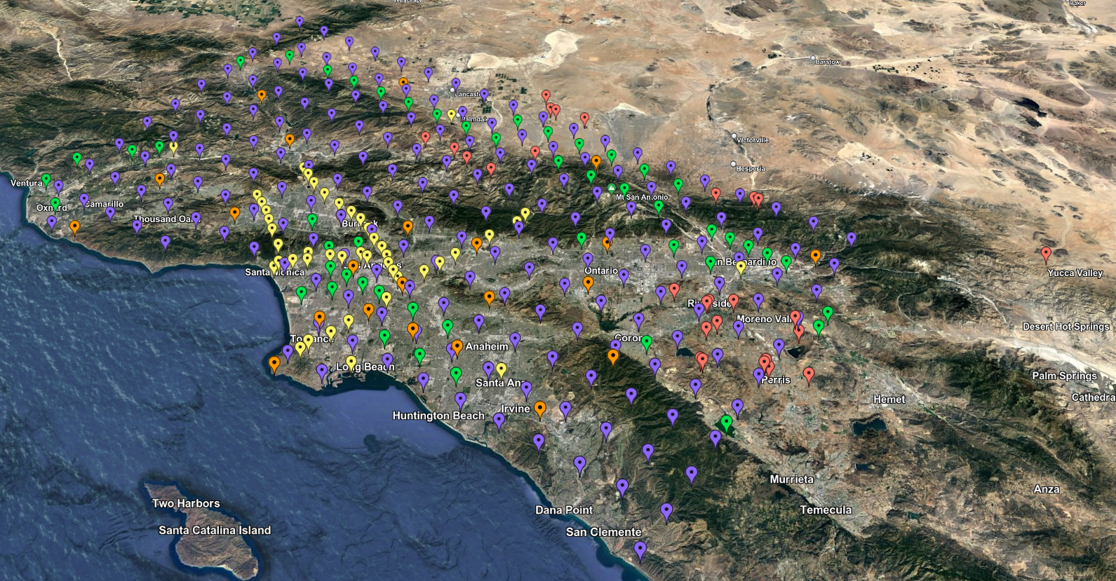
CyberShake Study 21.12
RSQSim ERF
335 sites in Southern California
  About 75,000 events per site
Study performed over 29 days
  Used OLCF Summit supercomputer
65,500 node-hours used
  At peak, 46% of Summit
Synthesized 25.7 million
two-component seismograms
Study 21.12 site map

Slide 7
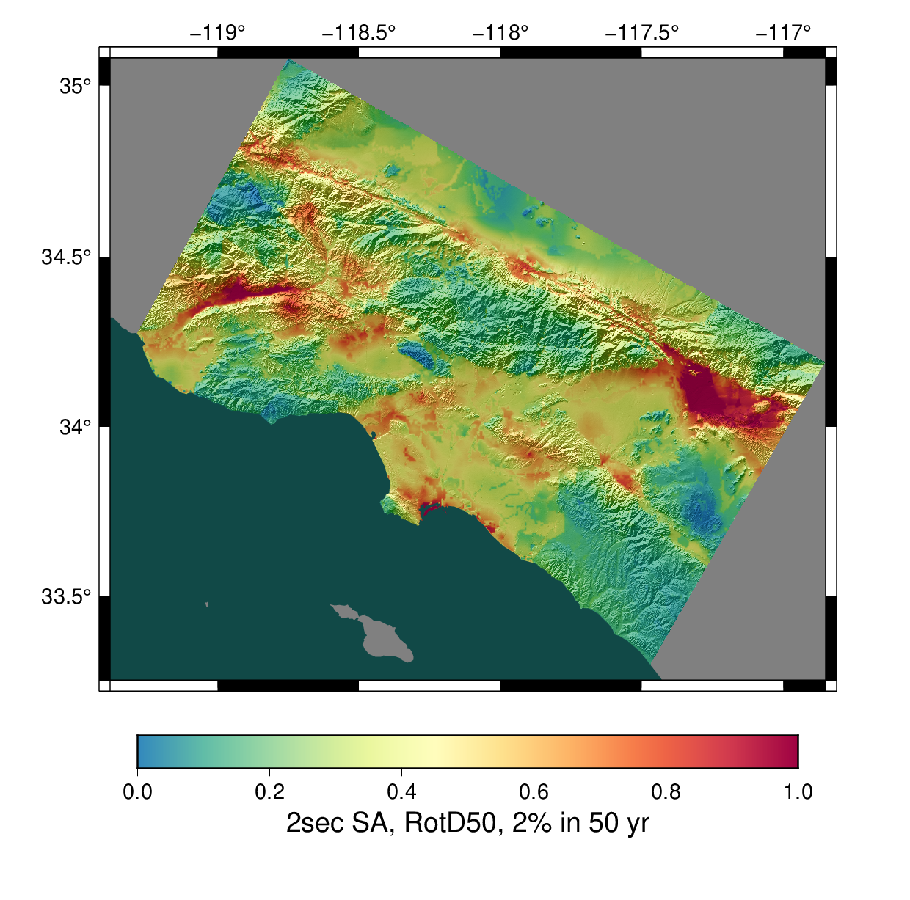
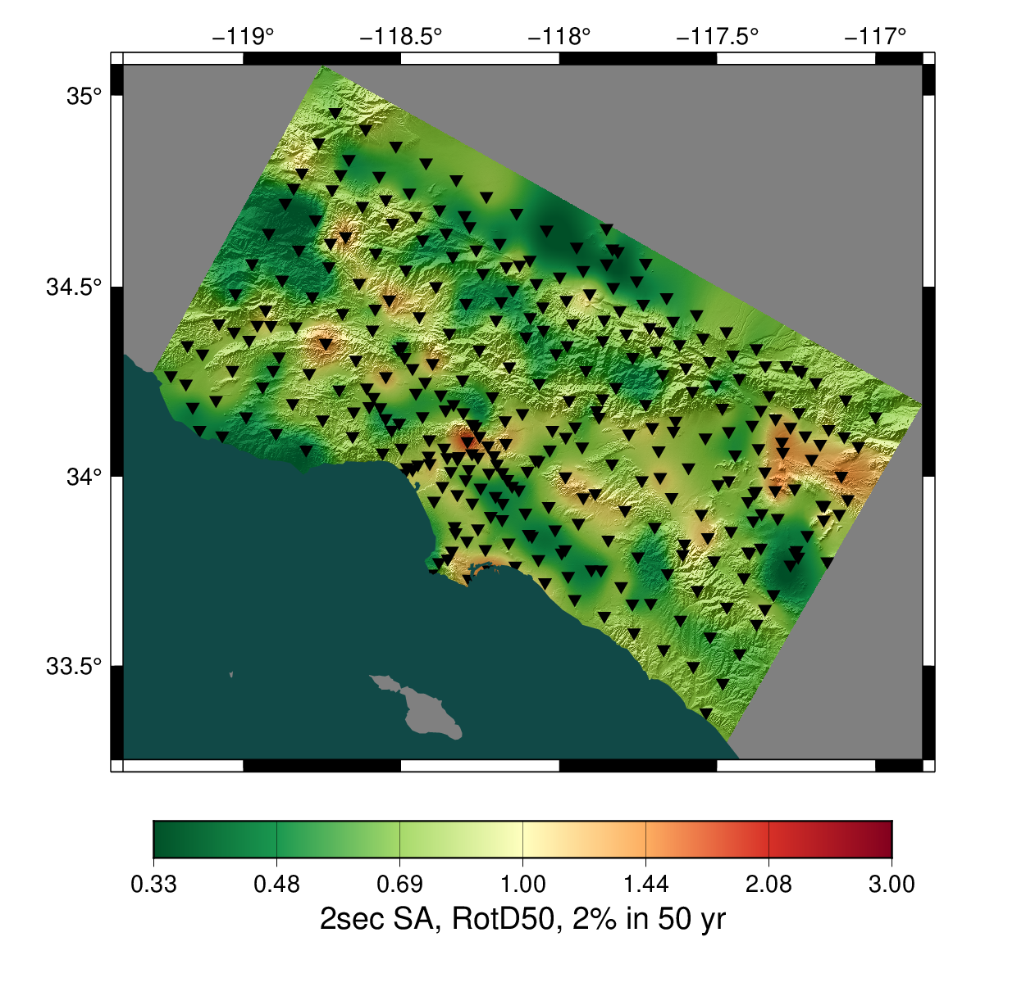
Study 21.12 Results
Study 21.12
Ratio, Study 21.12/GMPEs
2 sec RotD50, 2% in 50 years
2 sec RotD50, 2% in 50 years

Slide 8
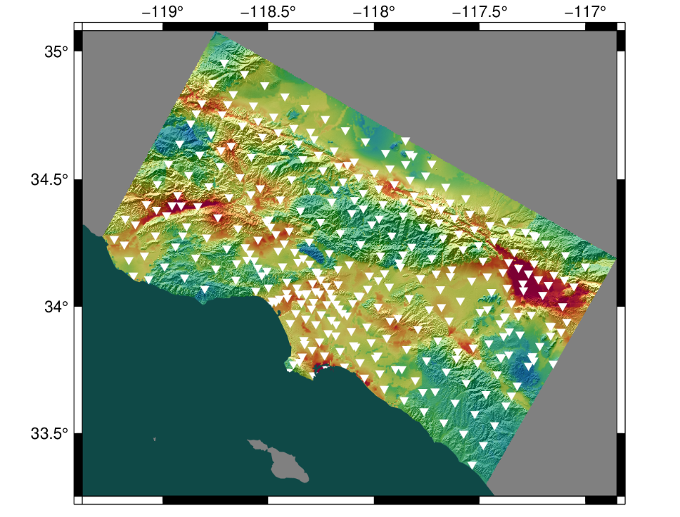
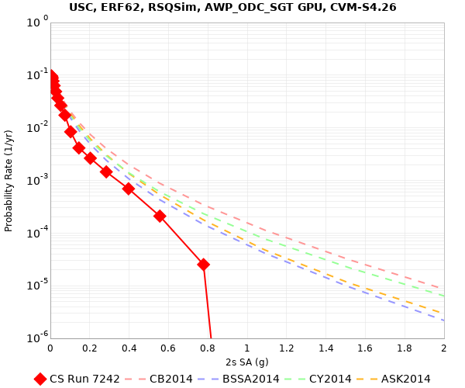
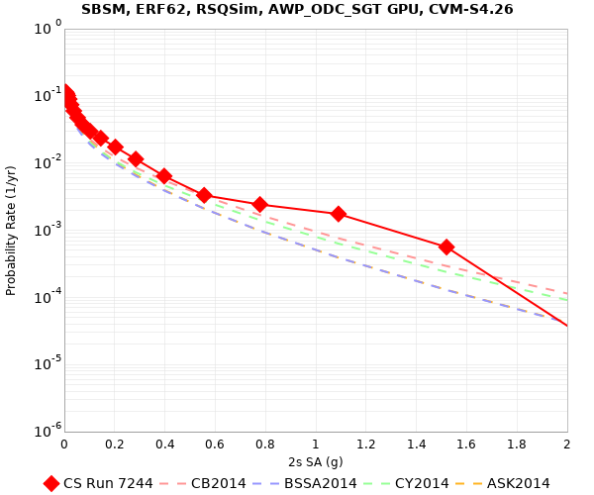
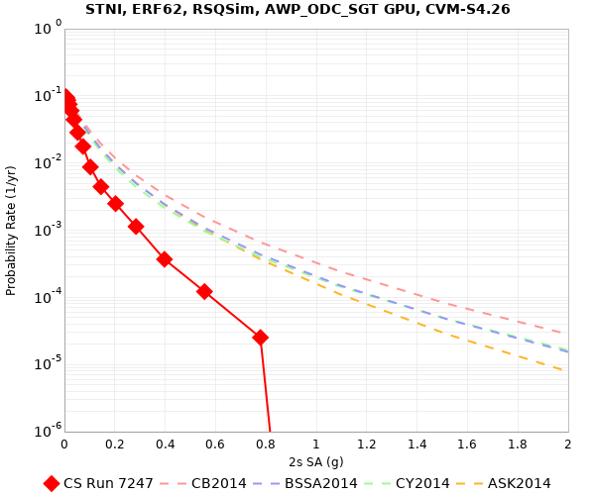
Study 21.12 Hazard Curves
USC
SBSM
STNI

Slide 9
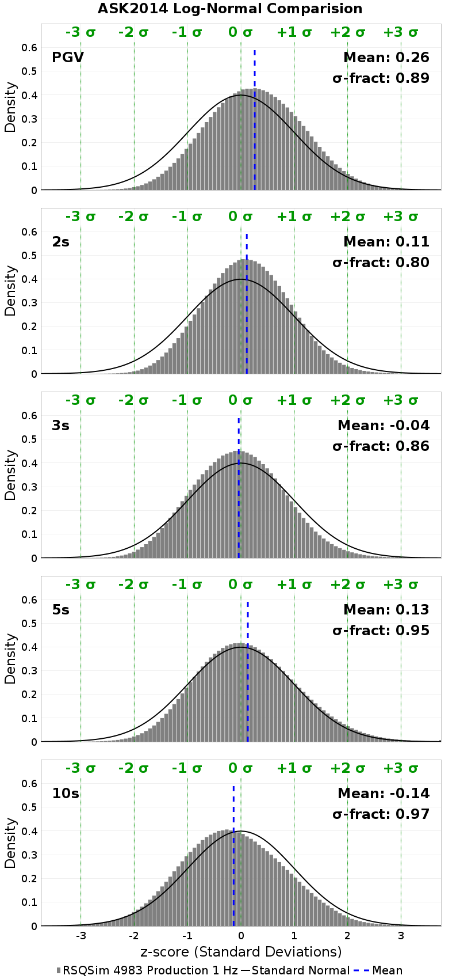
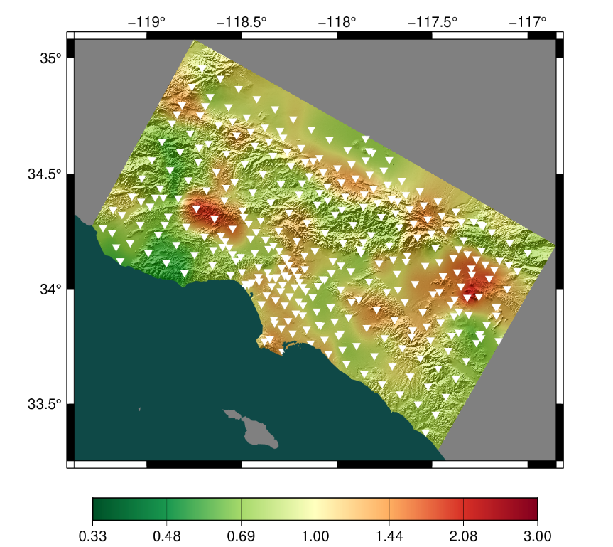
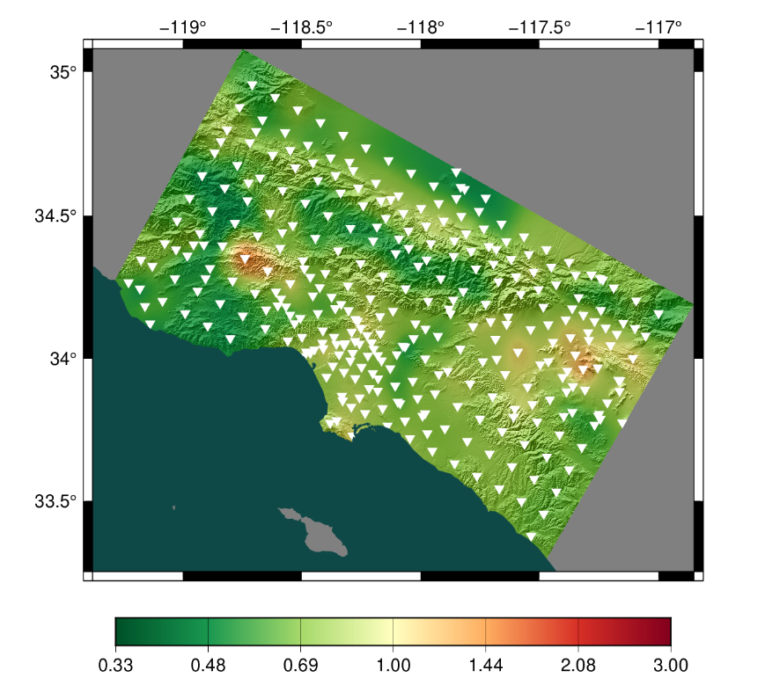
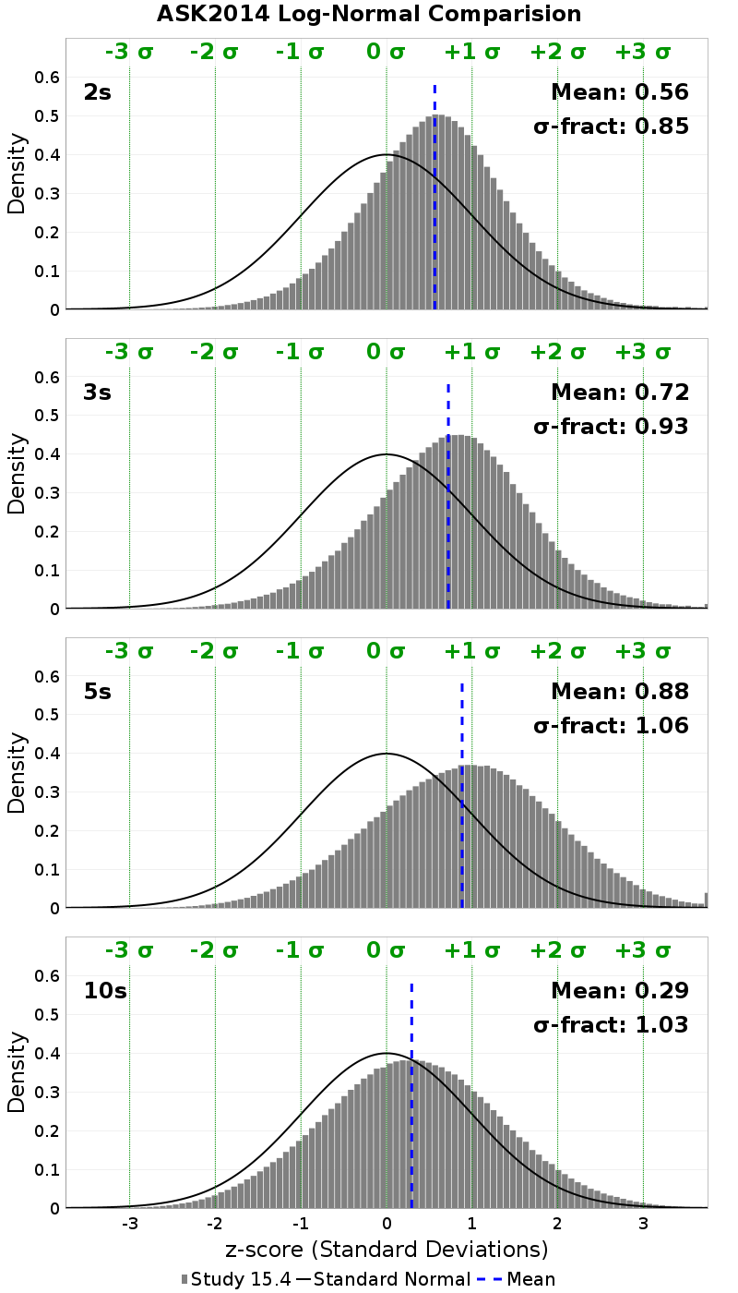
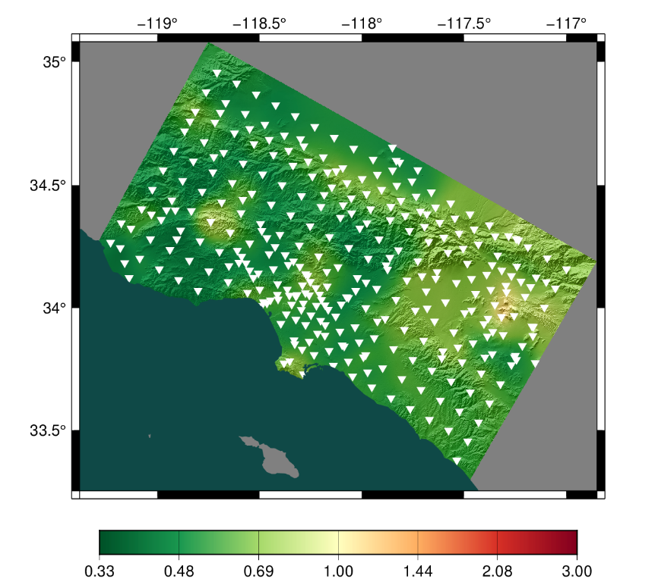
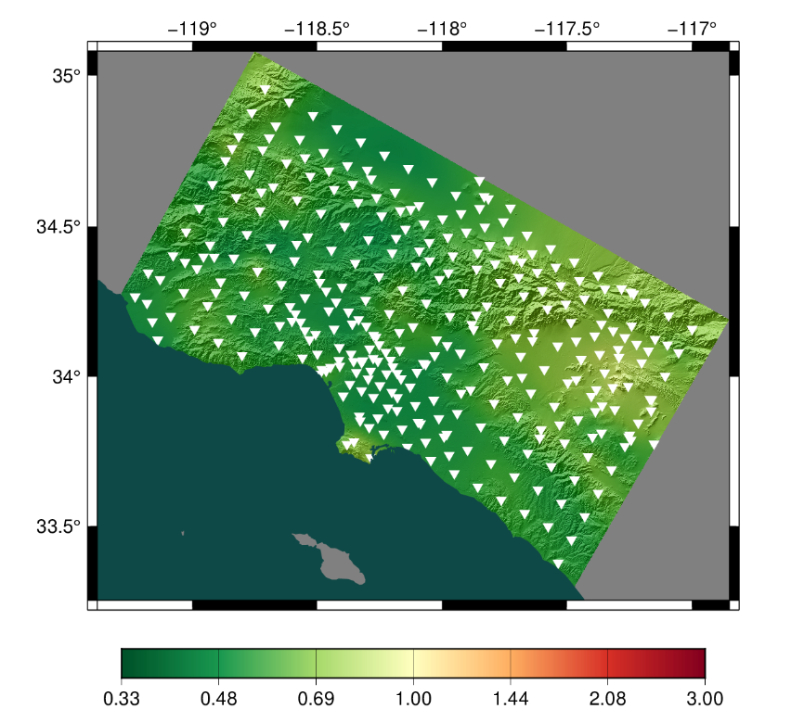
Study 21.12 comparisons to Study 15.4
Ratio, Study 21.12/Study 15.4
2 sec
3 sec
5 sec
10 sec
Study 21.12 vs ASK2014
Study 15.4 vs ASK2014

Slide 10
Study 21.12b
Interested in impact of RSQSim rupture modifications
Adjusted RSQSim frictional parameters
  Reduced b above 3 km to mimic velocity strengthening layer and reduce near-surface stress drops
Generated new catalog, 240 kyr (64,291 selected events)
Reran CyberShake seismogram synthesis with new catalog
  Since same rupture geometry, no need to rerun wave propagation

Slide 11
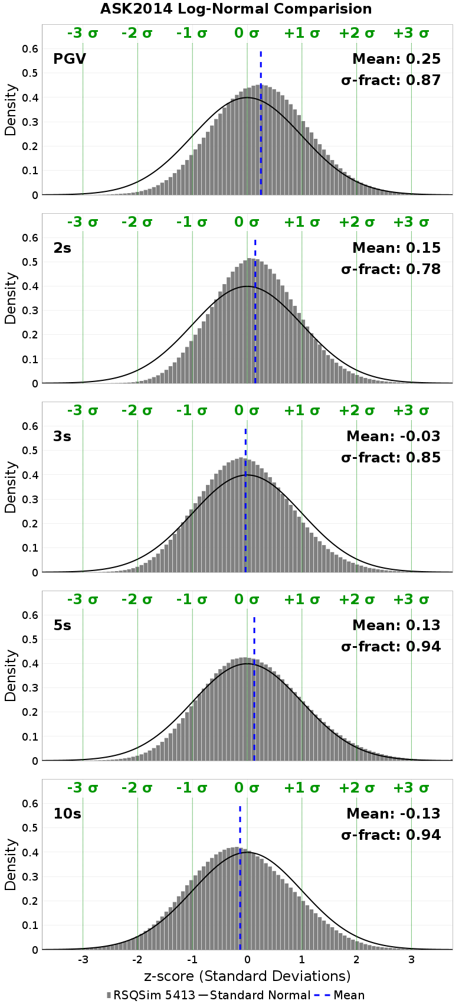
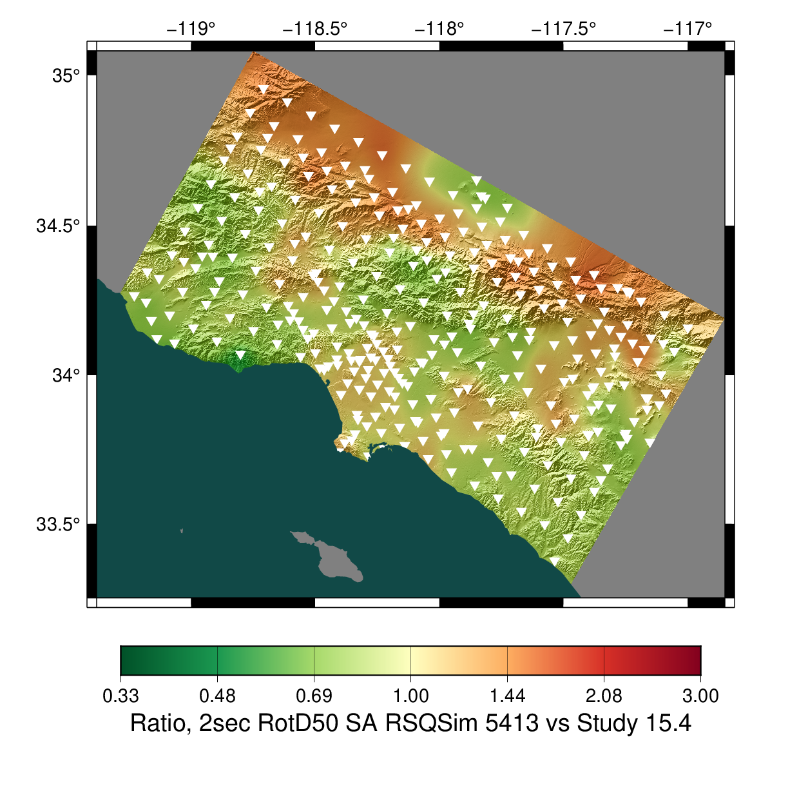
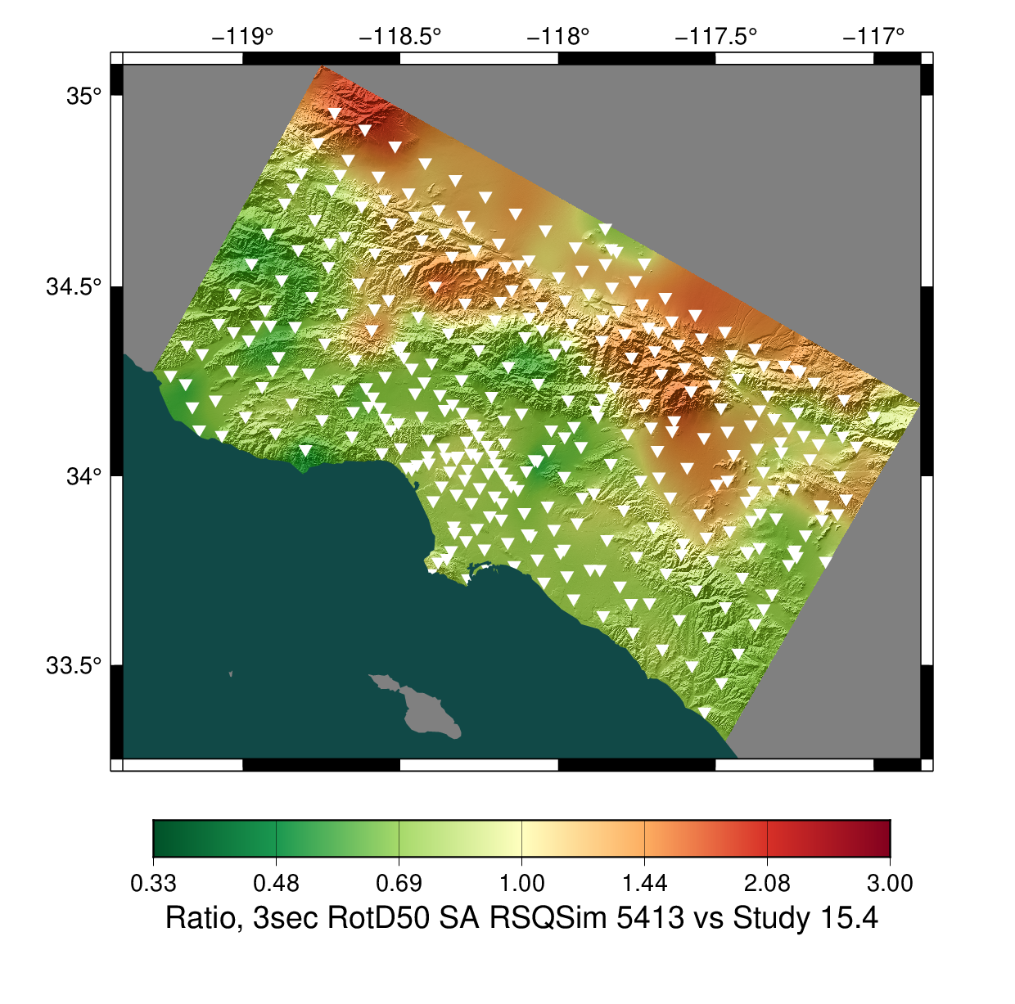
Study 21.12b Results
Ratio, Study 21.12/Study 15.4

Slide 12
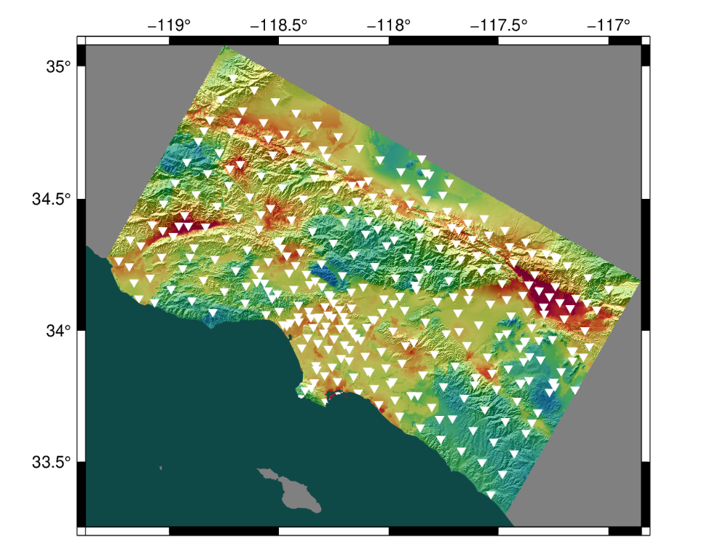
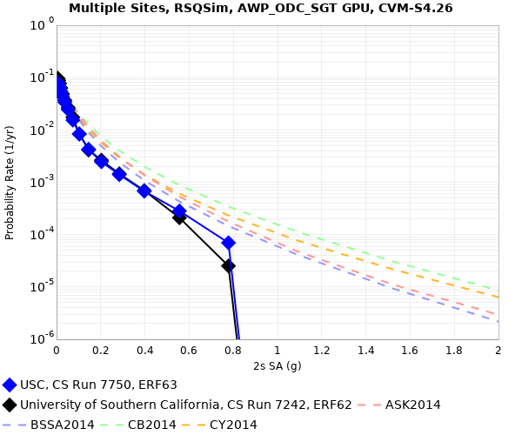
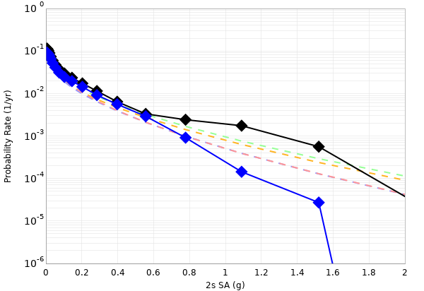
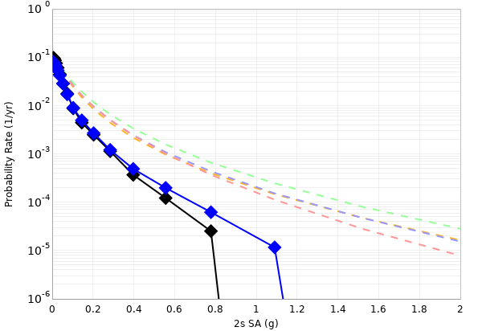
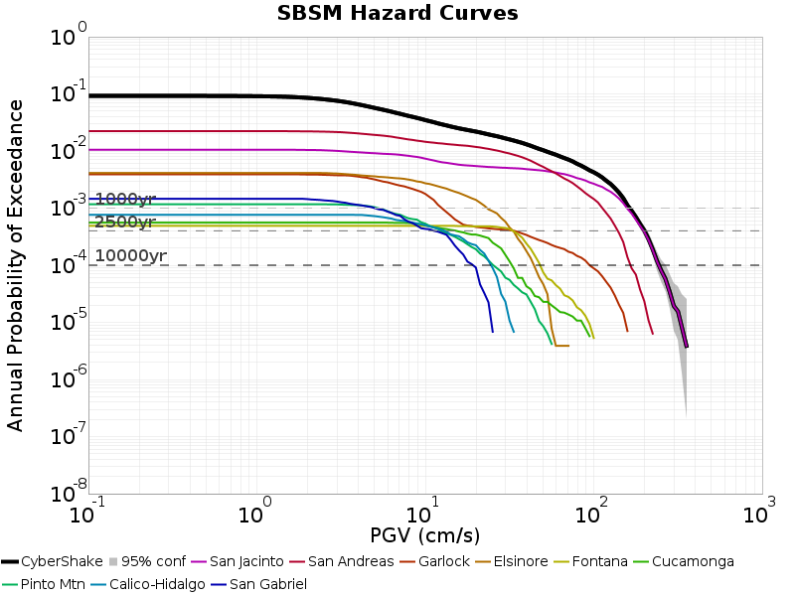
Study 21.12b Hazard Curves
USC
SBSM
STNI
Study 21.12 (black)
Study 21.12b (blue)

Slide 13
Summary
RSQSim-generated ERFs coupled with CyberShake provide an approach for fully physics-based PSHA
Ground motion distribution of RSQSim CyberShake closely resembles GMPEs
Inclusion of velocity strengthening layer reduces large ground motions at 2 sec
Future plans:
  Look at ground motion radiation patterns and compare to kinematic models
  Increase rupture surface resolution

Slide 14









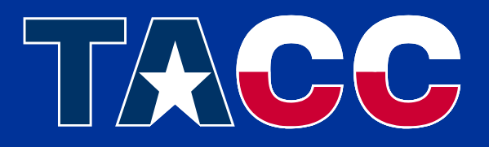

Thanks!

