Slide 1








Simplify Your Science with Workflow Tools
Scott Callaghan (SCEC)
July 17, 2026
2026 IHPCSS
scottcal@usc.edu

Slide 2
I’ve got a problem.
300,000 earthquakes
127 million simulated seismograms
5 million computational tasks
Statewide California Earthquake Center | www.scec.org

Slide 3
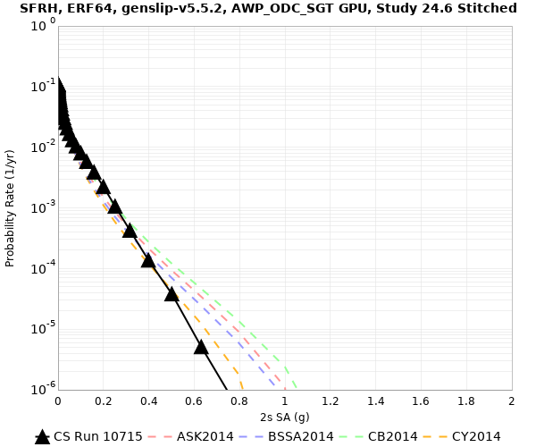
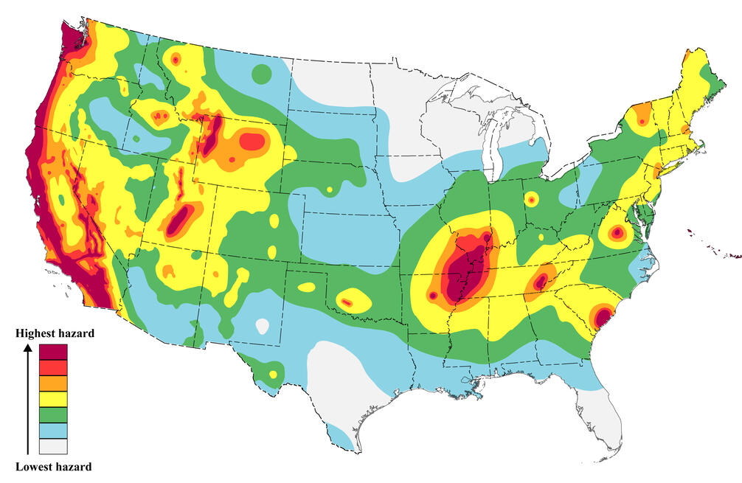
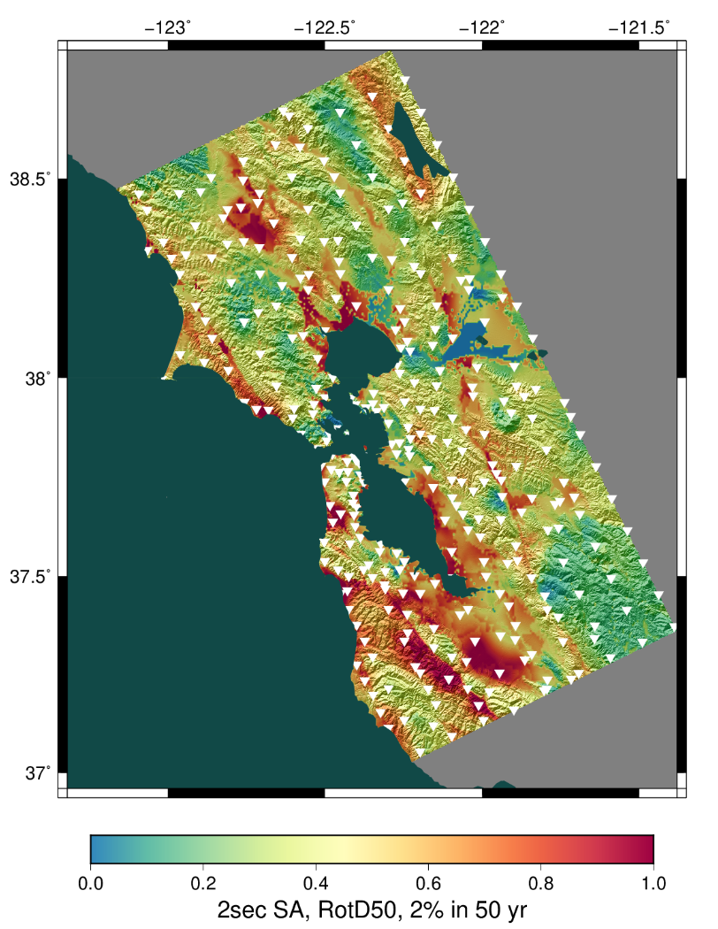
Why am I doing this?
Want to know expected earthquake shaking over the next 50 years
  Building codes
  Insurance rates
  Disaster planning
Interested in Northern California,
near San Francisco (9M residents)
Want to use best available science
  Run wave propagation simulations
  of many possible earthquakes
  Use shaking information
  for hazard estimates
Statewide California Earthquake Center | www.scec.org

Slide 4
What are my challenges?
Automation
  Too many jobs to run by hand
Data management
  Millions of input and output files to track
Job execution
  Heterogenous job types (serial, parallel, CPU, GPU)
  Millions of executions
Error recovery
  Many jobs and files will lead to problems
Statewide California Earthquake Center | www.scec.org

Slide 5
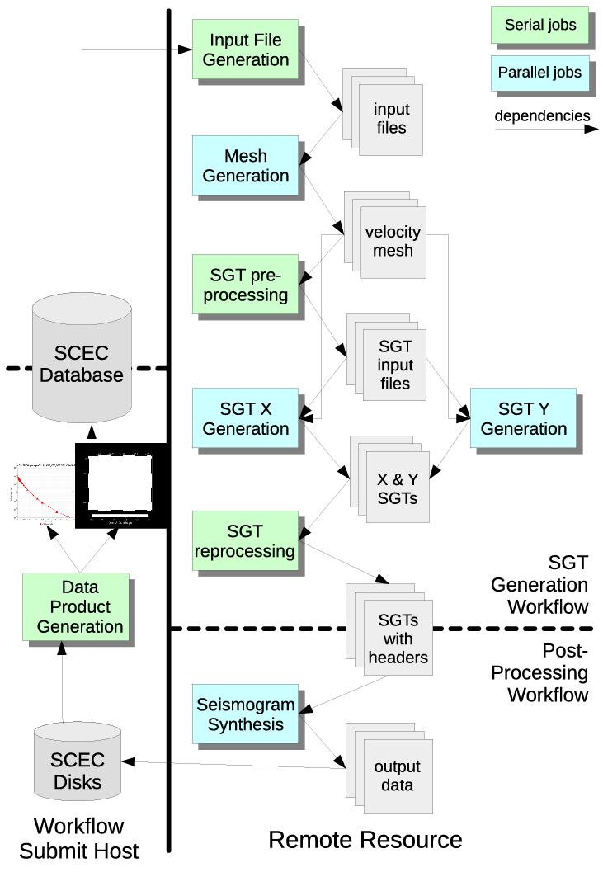
Solution: Scientific Workflows
We at SCEC decided to use scientific workflows to manage challenges
Work is described as a directed graph of tasks with dependencies
Separation of process from data
  Can run the same workflow with different data
  Can run the same workflow on different systems
Jobs are queued and executed
We use two open-source tools in user space:
  Pegasus-WMS
  HTCondor
Statewide California Earthquake Center | www.scec.org

Slide 6
How did workflow tools help me?
Automation
  Jobs are automatically submitted when ready to run
  Workflow tools able to automate jobs with 2FA
Data management
  Input and output files are copied automatically
Job execution
  Support remote, distributed execution of heterogeneous jobs
  My seismic workflow has run on 14 systems since 2007
Error recovery
  Failed jobs retried
  Workflow checkpointed if jobs keep failing
No changes made to application codes
CPU
GPU
HTC
Scientific codes
task graph
data management
execution
Workflow middleware
cloud
cluster
Compute resources
Statewide California Earthquake Center | www.scec.org

Slide 7

NAS report
US National Academy of Sciences commissioned a report on automated research workflows (ARWs) in 2020
“The common goal of researchers implementing ARWs is to accelerate scientific knowledge generation, potentially by orders of magnitude, while achieving greater control and reproducibility in the scientific process.”
“The common goal of researchers implementing ARWs is to accelerate scientific knowledge generation, potentially by orders of magnitude, while achieving greater control and reproducibility in the scientific process.”
“The tools and techniques being developed under the large umbrella of ARWs promise to transform the centuries-old serial method of research investigation... Simultaneously, ARWs provide a way to satisfy pressing demands across fields to increase interoperability, reproducibility, replicability, and trustworthiness by better tracking results, recording data, establishing provenance, and creating more consistent metadata than even the most dedicated researchers can provide themselves.”
“The tools and techniques being developed under the large umbrella of ARWs promise to transform the centuries-old serial method of research investigation... Simultaneously, ARWs provide a way to satisfy pressing demands across fields to increase interoperability, reproducibility, replicability, and trustworthiness by better tracking results, recording data, establishing provenance, and creating more consistent metadata than even the most dedicated researchers can provide themselves.”
Statewide California Earthquake Center | www.scec.org

Slide 8
Your turn!
What bottlenecks are you experiencing in your work that workflow tools might be able to help with?
Take a minute to reflect and come up with a few items.
Now, turn to a neighbor and talk about your bottlenecks together.
Who would like to share something smart their partner said?
Statewide California Earthquake Center | www.scec.org

Slide 9
Basic tool concepts
Many workflow tools actively supported, but shared concepts between them
Way to represent workflow tasks and their data
  Can be specified through API, annotations, GUI
  Explicit or implicit data roles
Tools prepare workflow to run on certain hardware
Schedule and run the workflow, honoring dependencies
  May include remote job submission and data transfer
  Some tools support interactivity and notebooks
  Capture of metadata and provenance
User monitors workflow execution
  May include error handling and retry provisions
Statewide California Earthquake Center | www.scec.org

Slide 10
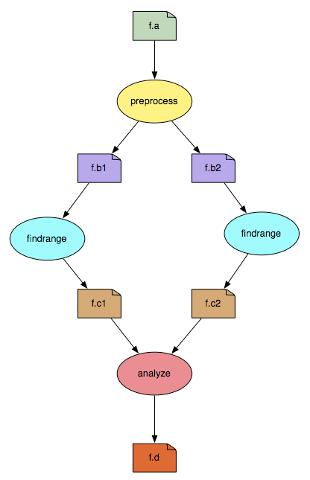
Popular Workflow Tools
Pegasus-WMS (what I use)
  Developed at USC’s Information Sciences Institute
Used in many science domains, including LIGO project
You use API to write code describing workflow
  Python, R, or Java
  Define tasks with parent / child relationships
  Describe files and their roles
Pegasus creates YAML file describing workflow
Workflow represented by directed acyclic graph
Workflows are executed from local machine
  Jobs can run on local machine or on distributed resources
Tools for AI-generated workflows
Statewide California Earthquake Center | www.scec.org

Slide 11


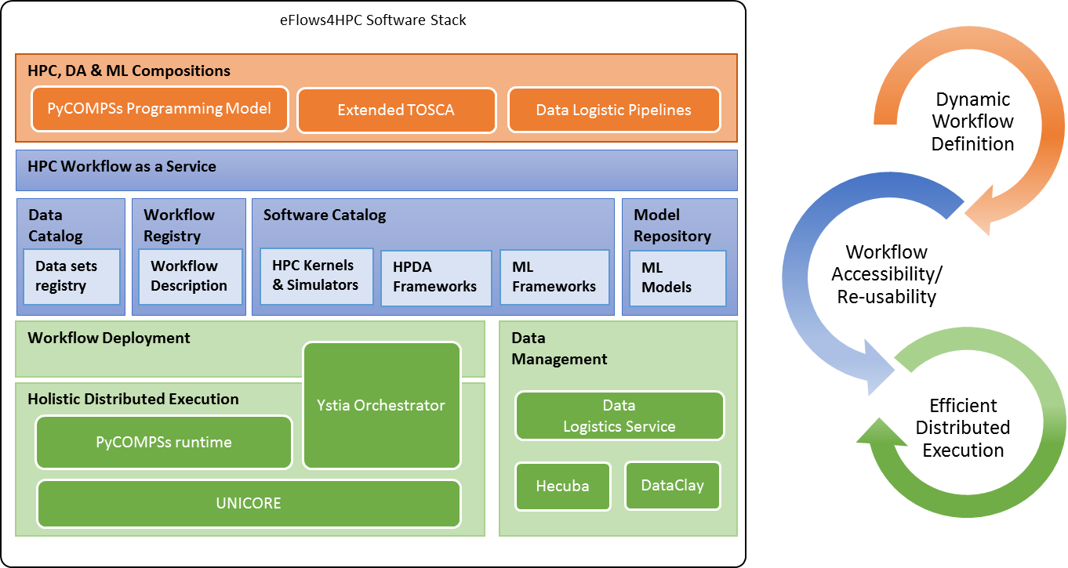
Popular Workflow Tools
(U of Chicago/Argonne NL)
  Parallelize Python by annotating functions or external apps
  Integrated with Jupyter notebooks
  Link outputs and inputs of annotations to describe workflow
  Focus on large data, many tasks
eFlows4HPC (BSC)
  Workflow platform integrating different workflow software elements
  PyCOMPS responsible for runtime
  Workflows-as-a-service paradigm
@bash_app
def mysim(stdout=("output/p1.out", "w"),
stderr=("output/p1.err", "w")):
#Call a bash command-line app ‘simulate’
return "app/simulate"
# call the mysim app and wait for the result
mysim().result()
# open the output file and read the result
with open('output/p1.out', 'r') as f:
print(f.read())
Statewide California Earthquake Center | www.scec.org

Slide 12

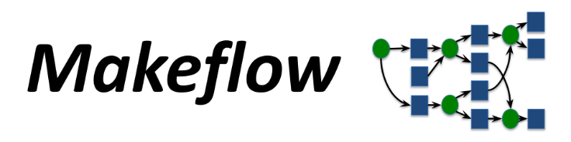

Popular Workflow Tools
Snakemake (international; most maintainers in Europe)
  Create “rules” in Pythonish language describing how to create outputs from inputs
  Good integration with Conda and containers
  Support for dynamic workflows
Makeflow (Notre Dame)
  Makefile-type syntax to specify workflow
    Targets are output files, dependent on input files, with execution string to run
  Can work with Work Queue for management of compute resources (workers)
    Multiple clusters, pilot jobs, dynamic worker pool
Nextflow (Seqera Labs in Barcelona, but open source)
  Uses dataflow paradigm: tasks write/read from channels (not always a file), can be piped
  Custom scripting language for defining workflows
  Integrates well with containers
Many more! Ask me about specific use cases
Statewide California Earthquake Center | www.scec.org

Slide 13
Challenge: Data Management
Millions of data files produced and consumed
  Pegasus provides staging
    Symlinks files if possible, transfers files if needed
    Transfers output back to local archival disk
    Supports running parts of workflows on separate systems
  Cleans up temporary files when no longer needed
  Directory hierarchy to reduce files per directory
We added automated checks for file correctness
  Number of files, NaNs, zero-value checks, correct size
  Included as new jobs in workflow
Statewide California Earthquake Center | www.scec.org

Slide 14
Challenge: Job Execution
For large parallel jobs, workflow tools submit to remote scheduler
  SSH (or other tool) puts jobs in remote queue
  Runs like a normal batch job
  Can specify either CPU or GPU nodes
Workflow tools support job bundling
For small serial jobs, need high throughput
  Putting lots of jobs in the batch queue is ill-advised
    Scheduler isn’t designed for heavy job load
    Scheduler cycle is ~5 minutes
    Policy limits number of job submissions
Workflow management system
Task 1
Task 2
Task 3
. . .
Workflow submission host
Remote compute resource
. . .
Task 1
. . .
. . .
Remote queue
Statewide California Earthquake Center | www.scec.org

Slide 15
Pegasus-mpi-cluster (PMC)
MPI wrapper around workflows of serial or thread-parallel jobs
  Manager-worker paradigm
  Preserves dependencies
  Job is submitted to multiple nodes, starts PMC
  Specify jobs as usual, Pegasus does wrapping
Uses intelligent scheduling
  Core counts
  Memory requirements
Developed for our application
PMC
workflow
manager
workers
Statewide California Earthquake Center | www.scec.org

Slide 16

Recent Science Results
Completed regional hazard calculation for Northern California
45 days of around-the-clock execution
Used two systems:
  55,000 node-hrs (mostly GPU) on Frontier, peak 44%
  125,000 node-hrs (all CPU) on Frontera, peak 12%
Workflow tools:
  Ran 27,720 jobs
  Managed 1.0 PB of data
  Staged 350 TB from Frontier to Frontera
  Staged 36 TB / 9 M files to long-term storage
  Inserted 2.3 billion shaking metrics into local database
Statewide California Earthquake Center | www.scec.org

Slide 17
But what about Python scripts?
You can reproduce some features with custom scripts
Cluster scheduler supports basic features
  Can enforce job dependencies
  Email notifications when complete
Can check exit status and retry on failure
Copy files in and out when required
Statewide California Earthquake Center | www.scec.org

Slide 18
What approach should you use?
What are some pros and cons of using an established tool or custom scripts?
Statewide California Earthquake Center | www.scec.org

Slide 19
What did we learn?
Workflow tools exist!
  Designed to resolve bottlenecks, improve your efficiency, and aid in reproducibility
Work with any computational tasks
  No changes required to application codes
Help manage jobs, files, and metadata
Separate process from data
  Distributed execution
  Migrate workflow to new systems
  Easy to explain your process to new users
Statewide California Earthquake Center | www.scec.org

Slide 20
Closing thoughts
Automation is vital, even without workflow tools
  Eliminate human polling
  Get everything to run automatically if successful
  Be able to recover from common errors
Put ALL processing steps in the workflow
  Include validation, visualization, publishing, notifications
Avoid premature optimization
Consider new, larger, compute environments (dream big!)
  Larger clusters, clouds
Tool developers want to help you!
Statewide California Earthquake Center | www.scec.org

Slide 21
Links
SCEC: http://www.scec.org
Pegasus: http://pegasus.isi.edu
Pegasus-mpi-cluster: http://pegasus.isi.edu/wms/docs/latest/cli-pegasus-mpi-cluster.php
HTCondor: http://www.cs.wisc.edu/htcondor/
Parsl: https://parsl-project.org/
eFlows4HPC: https://eflows4hpc.eu/
pyComps: https://eflows4hpc.readthedocs.io/en/latest/Sections/01_Software_Stack/02_Runtime_Components/COMPSs.html
Snakemake: https://snakemake.github.io/
Makeflow: http://ccl.cse.nd.edu/software/makeflow/
Work Queue: http://ccl.cse.nd.edu/software/workqueue/
Nextflow: https://www.nextflow.io/
CyberShake (my project): https://www.scec.org/software/cybershake
Statewide California Earthquake Center | www.scec.org

Slide 22

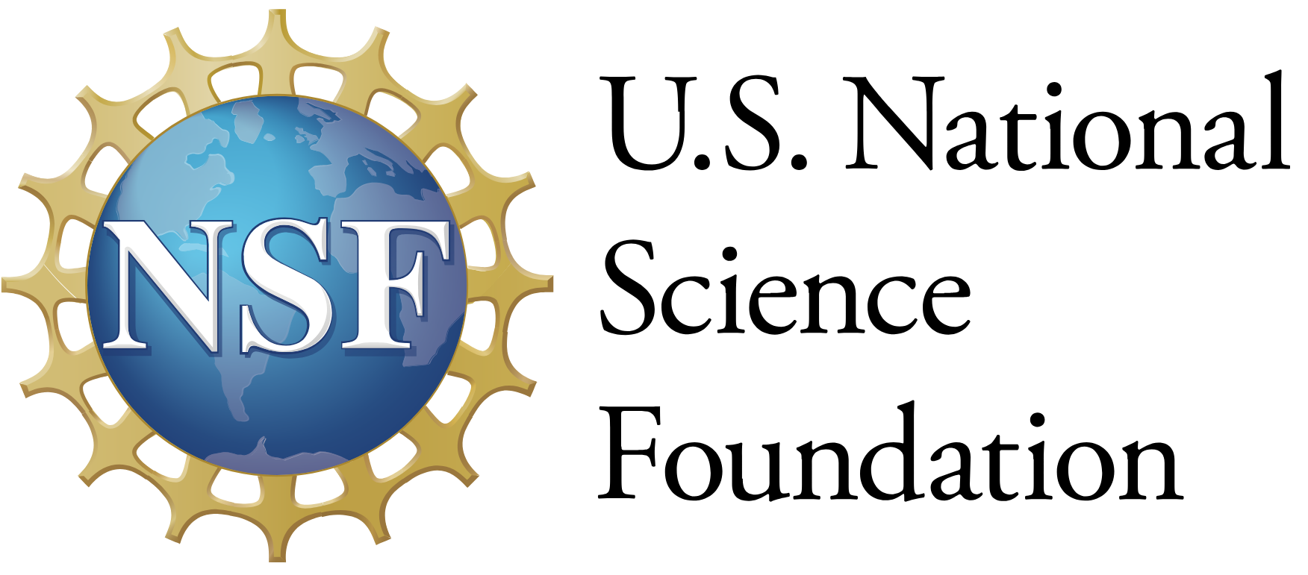




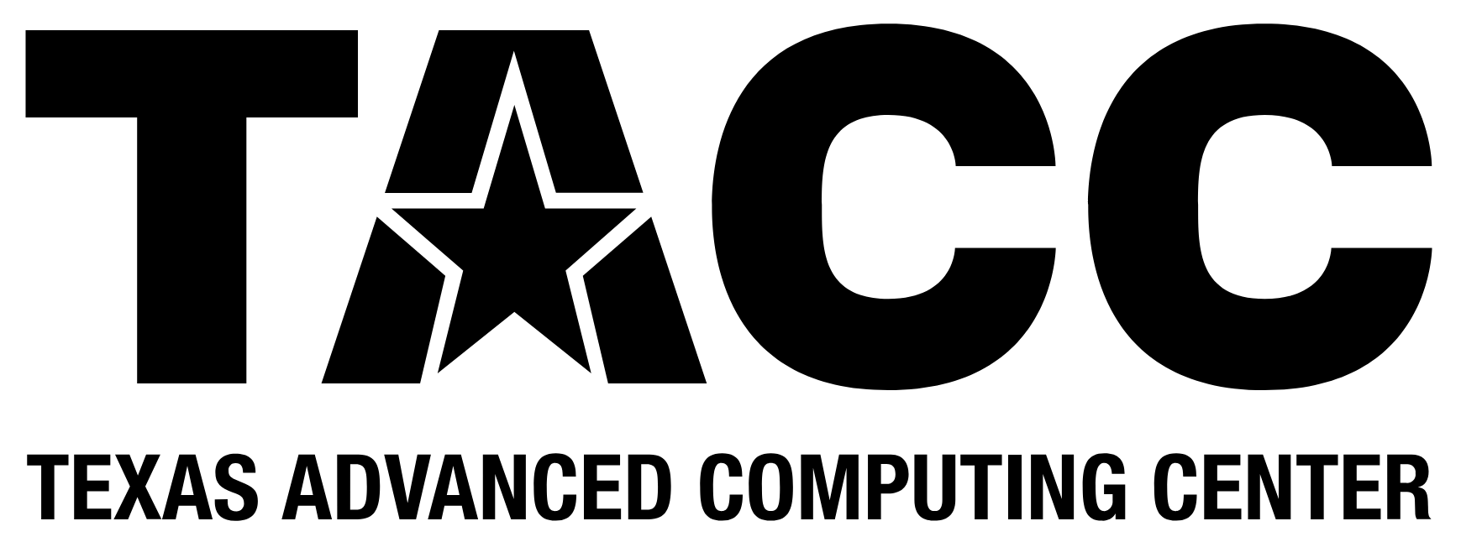



Thanks!
Statewide California Earthquake Center | www.scec.org

Slide 23
Solution: Scientific Workflows
We at SCEC decided to use scientific workflows to manage challenges
Describe your workflow as a directed graph of tasks with dependencies
  No changes to application codes
Separation of process from data
  Can run the same workflow with different data
  Can run the same workflow on different systems
Jobs are queued and executed
We use two open-source tools in user space:
  Pegasus-WMS
  HTCondor
Statewide California Earthquake Center | www.scec.org

Slide 24
Solution: Scientific Workflows
We at SCEC decided to use scientific workflows to manage challenges
Describe your workflow as a directed graph of tasks with dependencies
  No changes to application codes
Separation of process from data
  Can run the same workflow with different data
  Can run the same workflow on different systems
Jobs are queued and executed
We use two open-source tools in user space:
  Pegasus-WMS
  HTCondor
Statewide California Earthquake Center | www.scec.org

