Slide 1








Managing Simulated Data Products from the CyberShake PSHA Platform
Scott Callaghan (SCEC) & the CyberShake Collaboration
September 2, 2024
Geo-INQUIRE Workshop on Data Lakes
scottcal@usc.edu

Slide 2
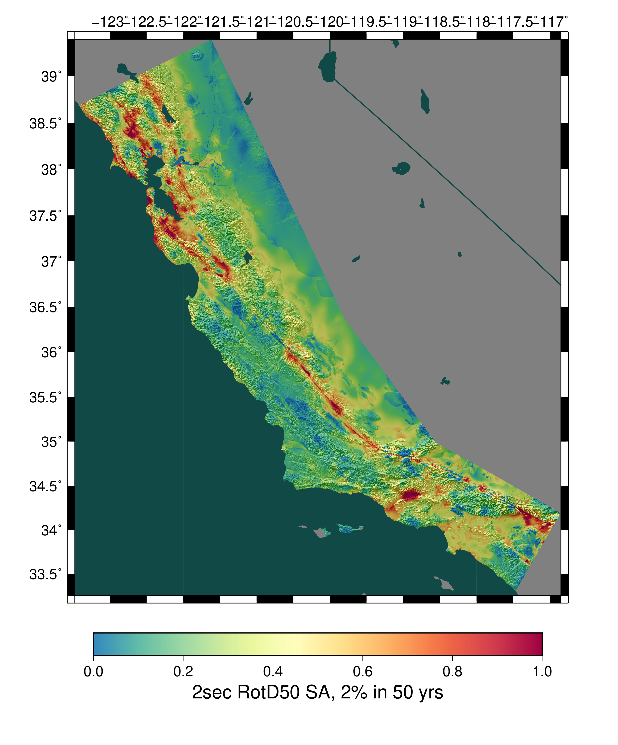
CyberShake Overview
Data and Metadata
Current CyberShake milestones
Data challenges (and solutions)
What’s next?
Opportunities for collaboration
Statewide California Earthquake Center | www.scec.org

Slide 3
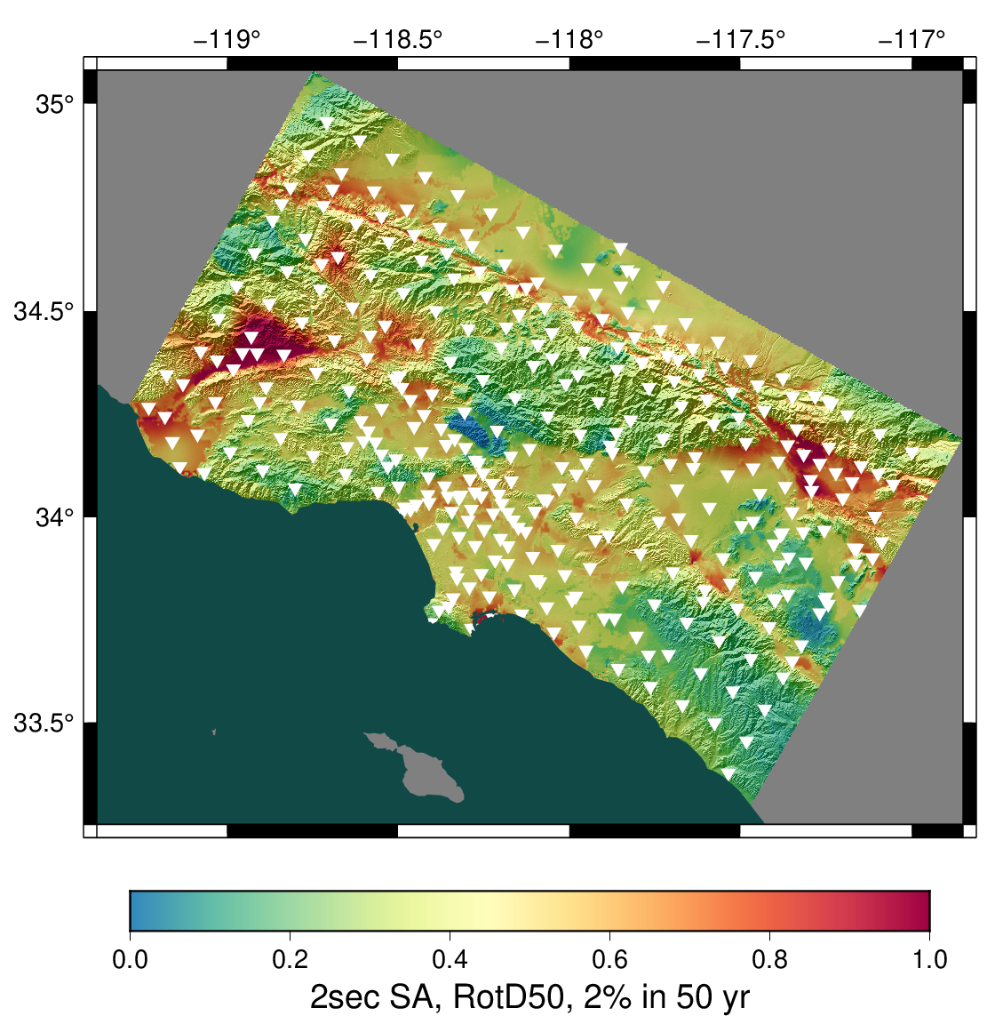
CyberShake overview
SCEC-developed 3D physics-based probabilistic seismic hazard analysis (PSHA) platform
Earthquake rupture forecast (ERF) provides list of relevant events + probabilities
Reciprocity-based approach to simulate low-frequency seismograms for sites of interest
Intensity measures derived from seismograms
Hazard results from sites interpolated for map
Optional stochastic high-frequency simulations to produce broadband models
Hazard map from most recent Southern California CyberShake Study, 22.12. Each triangle is a site location.
Statewide California Earthquake Center | www.scec.org

Slide 4

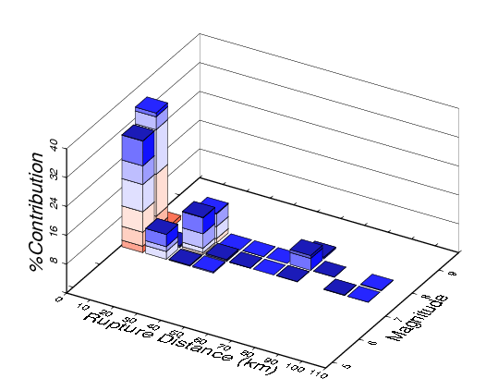
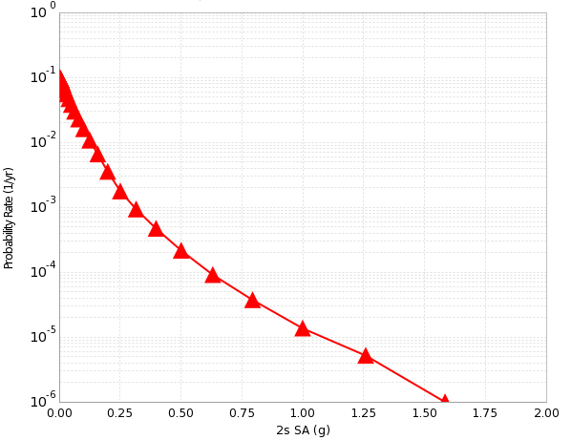
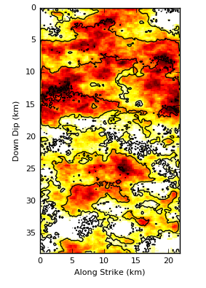
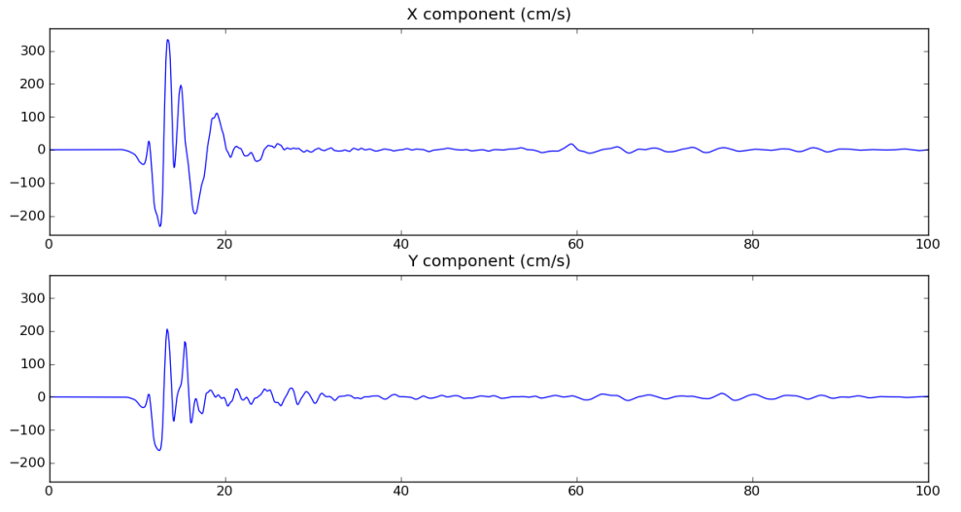
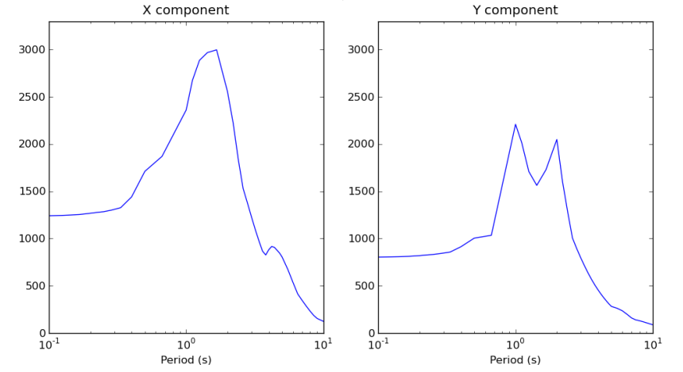
CyberShake Data Layers
Hazard Map
Hazard Curve
Disaggregation
Intensity Measures
Seismograms
Rupture Realization
4
Statewide California Earthquake Center | www.scec.org

Slide 5
Data Products
Seismograms (historically 2-component) for each event for each site
  Base raw data product
Peak shaking measures
  Used to be geometric mean; now RotD50 and RotD100
  Subset (~25%) stored in relational database for quick access
Durations
  5-75%, 5-95%, others
  ~25% stored in relational database
Disaggregations, hazard curves, hazard maps
  Aggregate data products
Statewide California Earthquake Center | www.scec.org

Slide 6
Metadata
Seismic
  Maximum frequency
  Site info
  Event information (magnitude, hypocenter, fault name)
  Velocity model
  Rupture generator
  Tracked in database
Simulation-based
  Mesh dimensions
  Timestep size, number of timesteps
  Tracked in database, on wiki
Runtime-based (provenance)
  Execution system
  Code version
  Command-line arguments
  Runtime
  Tracked by workflow system (Pegasus-WMS, HTCondor)
Statewide California Earthquake Center | www.scec.org

Slide 7
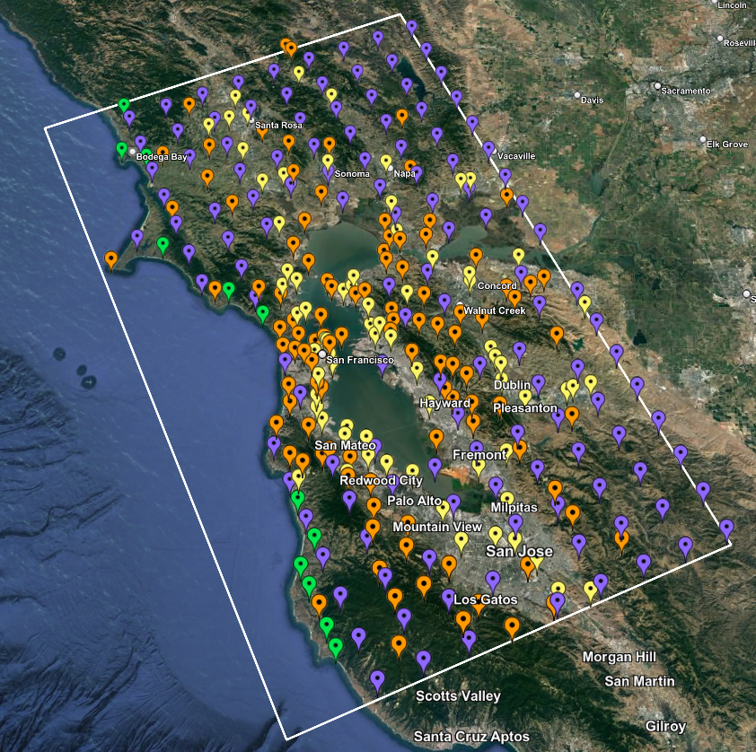
Study 24.8
Began latest CyberShake study last Tuesday
Updated broadband simulations for the San Francisco Bay Area
Improved velocity model
Similar configuration to Study 22.12
New data products:
  3-component seismograms
  Vertical response spectra
  Period-dependent durations
Statewide California Earthquake Center | www.scec.org

Slide 8
Challenge: Large Data Lake Size
From Study 22.12
Data Product | Records per study | Number of files per study | Data size per study
Low-frequency seismograms | 200 million | 2 million | 15 TB
Low-frequency IMs | 10 billion | 6 million | <1 TB
Broadband seismograms | 200 million | 2 million | 60 TB
Broadband IMs | 30 billion | 6 million | <1 TB
Aggregate products | 3,000 | 3,000 | <1 TB
Total | 40 billion | 16 million | 75 TB
Data currently stored at Center for Advanced Research Computing at USC
Plan to migrate to DesignSafe at Texas Advanced Computing Center
Statewide California Earthquake Center | www.scec.org

Slide 9
Challenge: Support Community Access
Key contribution of CyberShake is the creation of the dataset for later use
Dozens of researchers interested in working with CyberShake data
  Internal: members of the CyberShake collaboration
  External: members of the broader SCEC, engineering, and preparedness communities
Describe what data products are available
Different users desire different levels of access:
  Nicely packaged data
  Interactive interface
  API for scripting
Statewide California Earthquake Center | www.scec.org

Slide 10
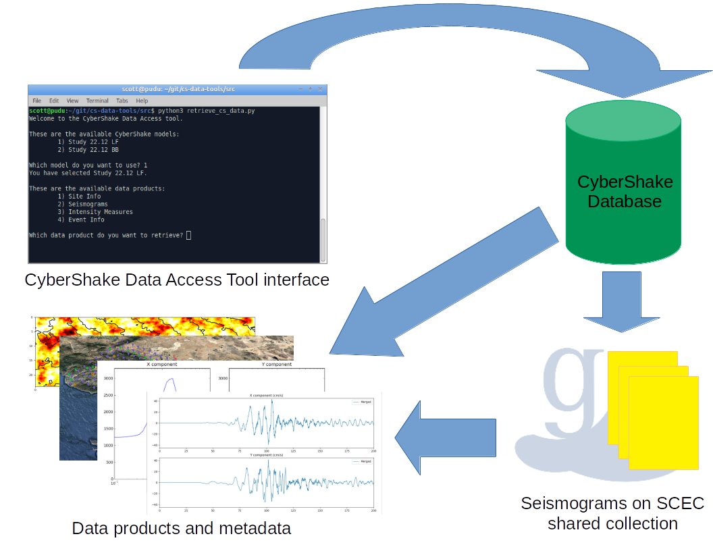
Challenge: Identify and Deliver Data Subsets
Size of the dataset makes full download difficult
  Most users don’t need it all anyway
  Query interface needed to help users select subsets
Metadata must be delivered with data products
  Documentation necessary
Developed CyberShake Data Access Tool
  Python-based, open source
  Prompts users with questions to create filters
  Users can bypass interactive components for
  use with scripting
  Delivers database products, seismograms,
  and seismic metadata
  https://github.com/SCECcode/cs-data-tools/
Statewide California Earthquake Center | www.scec.org

Slide 11
Challenge: On-Demand Data Products
Not all possible data products are created at study time
Rupture slip time histories
Synthetic ShakeMaps
Disaggregations at additional return periods
Intensity measures on disk, but not in database
How to support user generation of data products? Gateway? Quakeworx? No implemented solution to this challenge yet
Statewide California Earthquake Center | www.scec.org

Slide 12
Challenge: Human Resources
Difficult to obtain funding for scientific software development in the US
Limited resources for facilitating delivery of data products to users
  Minimize CyberShake developer involvement
  Easy-to-use interfaces
  Documentation, tutorials
  Extensible
Balance between targeting new scientific milestones and improving usefulness of existing data
Statewide California Earthquake Center | www.scec.org

Slide 13
Looking Ahead
Study 24.8 to finish in about 2 months
CyberShake data lakes will continue to grow
  2 Hz deterministic runs targeted for 2025
  Integrate non-linear forward simulations
  Quantify uncertainty of velocity model and high-frequency codes through additional simulations
Looking for ways to remove barriers to usage
  Improved documentation
  Migration to DesignSafe (DOI, access to DesignSafe tools)
  Increase awareness in potential users

Slide 14
Collaboration and Standardization Opportunities
File formats + converters
  CyberShake uses custom binary data formats
  Move to more common format? (HDF5, ASDF, …)?
  Regardless of format, standard converters will be needed
Capture and distribution of simulation parameters
  Identify standard simulation parameters that are:
    Of interest to users
    Needed for reproducibility
  Distribute along with other metadata when data is delivered
What level of reproducibility do we seek?
If formats and metadata are similar, opportunities for common tools
  Single point-of-entry for users to access multiple data lakes

Slide 15
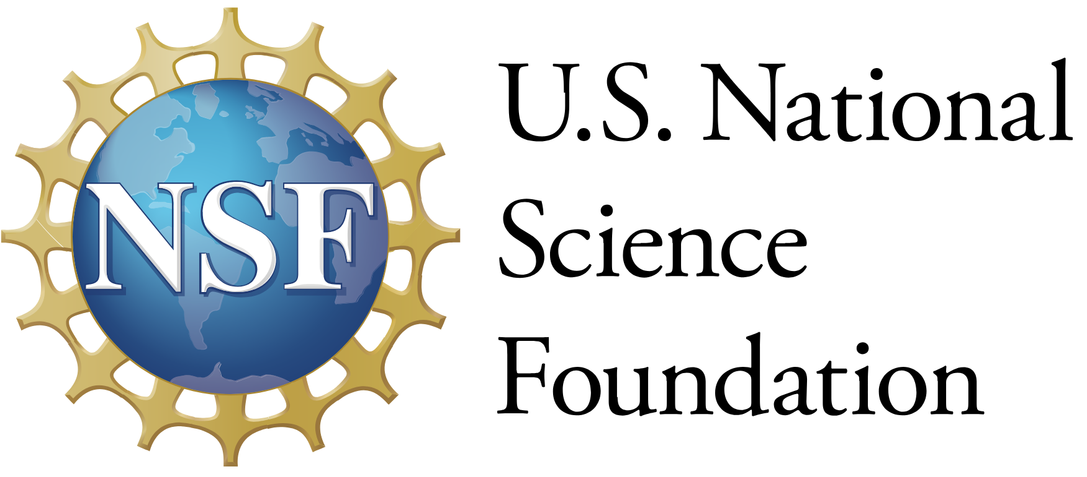



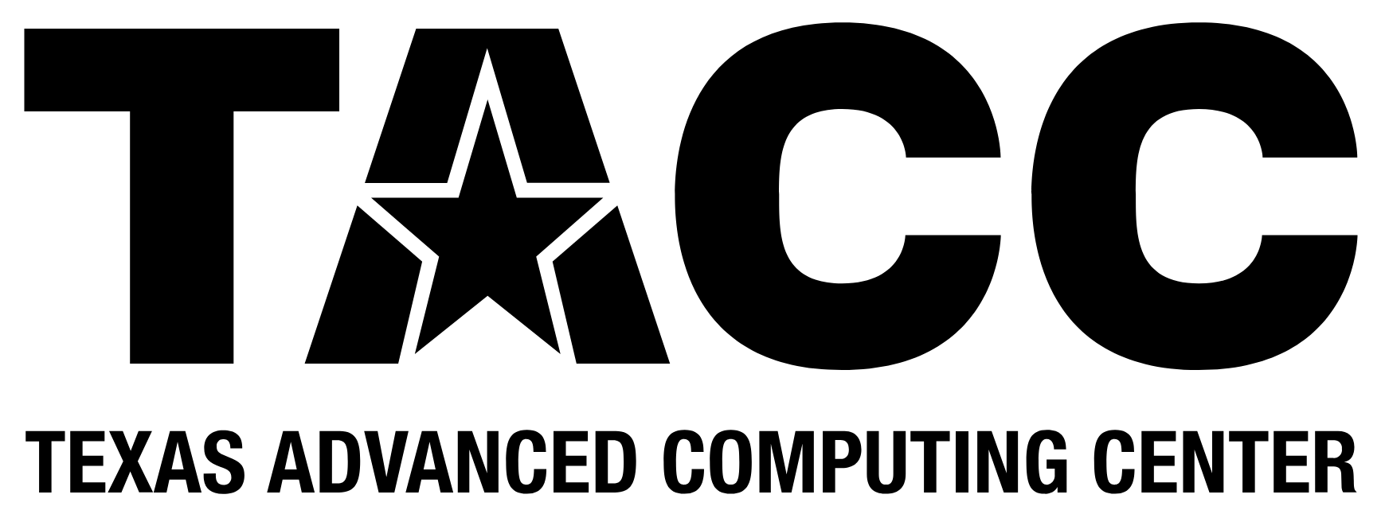

Thanks!

