Slide 1
Effects of near-surface velocity profile, nonlinear model and input parameters in site response predictions
Carson Site s429 Case study
D. Asimaki
Mechanical and Civil Engineering
Caltech
SCEC UGMS Committee, USC, May 2016
Notes:
Lets now examine the role of geology in shaping the ground motion at Kathmandu and elsewhere

Slide 2
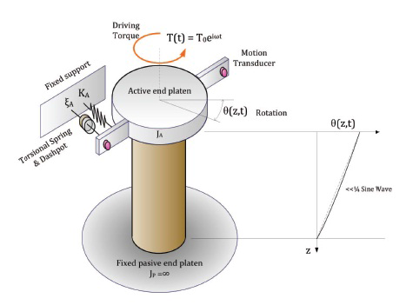
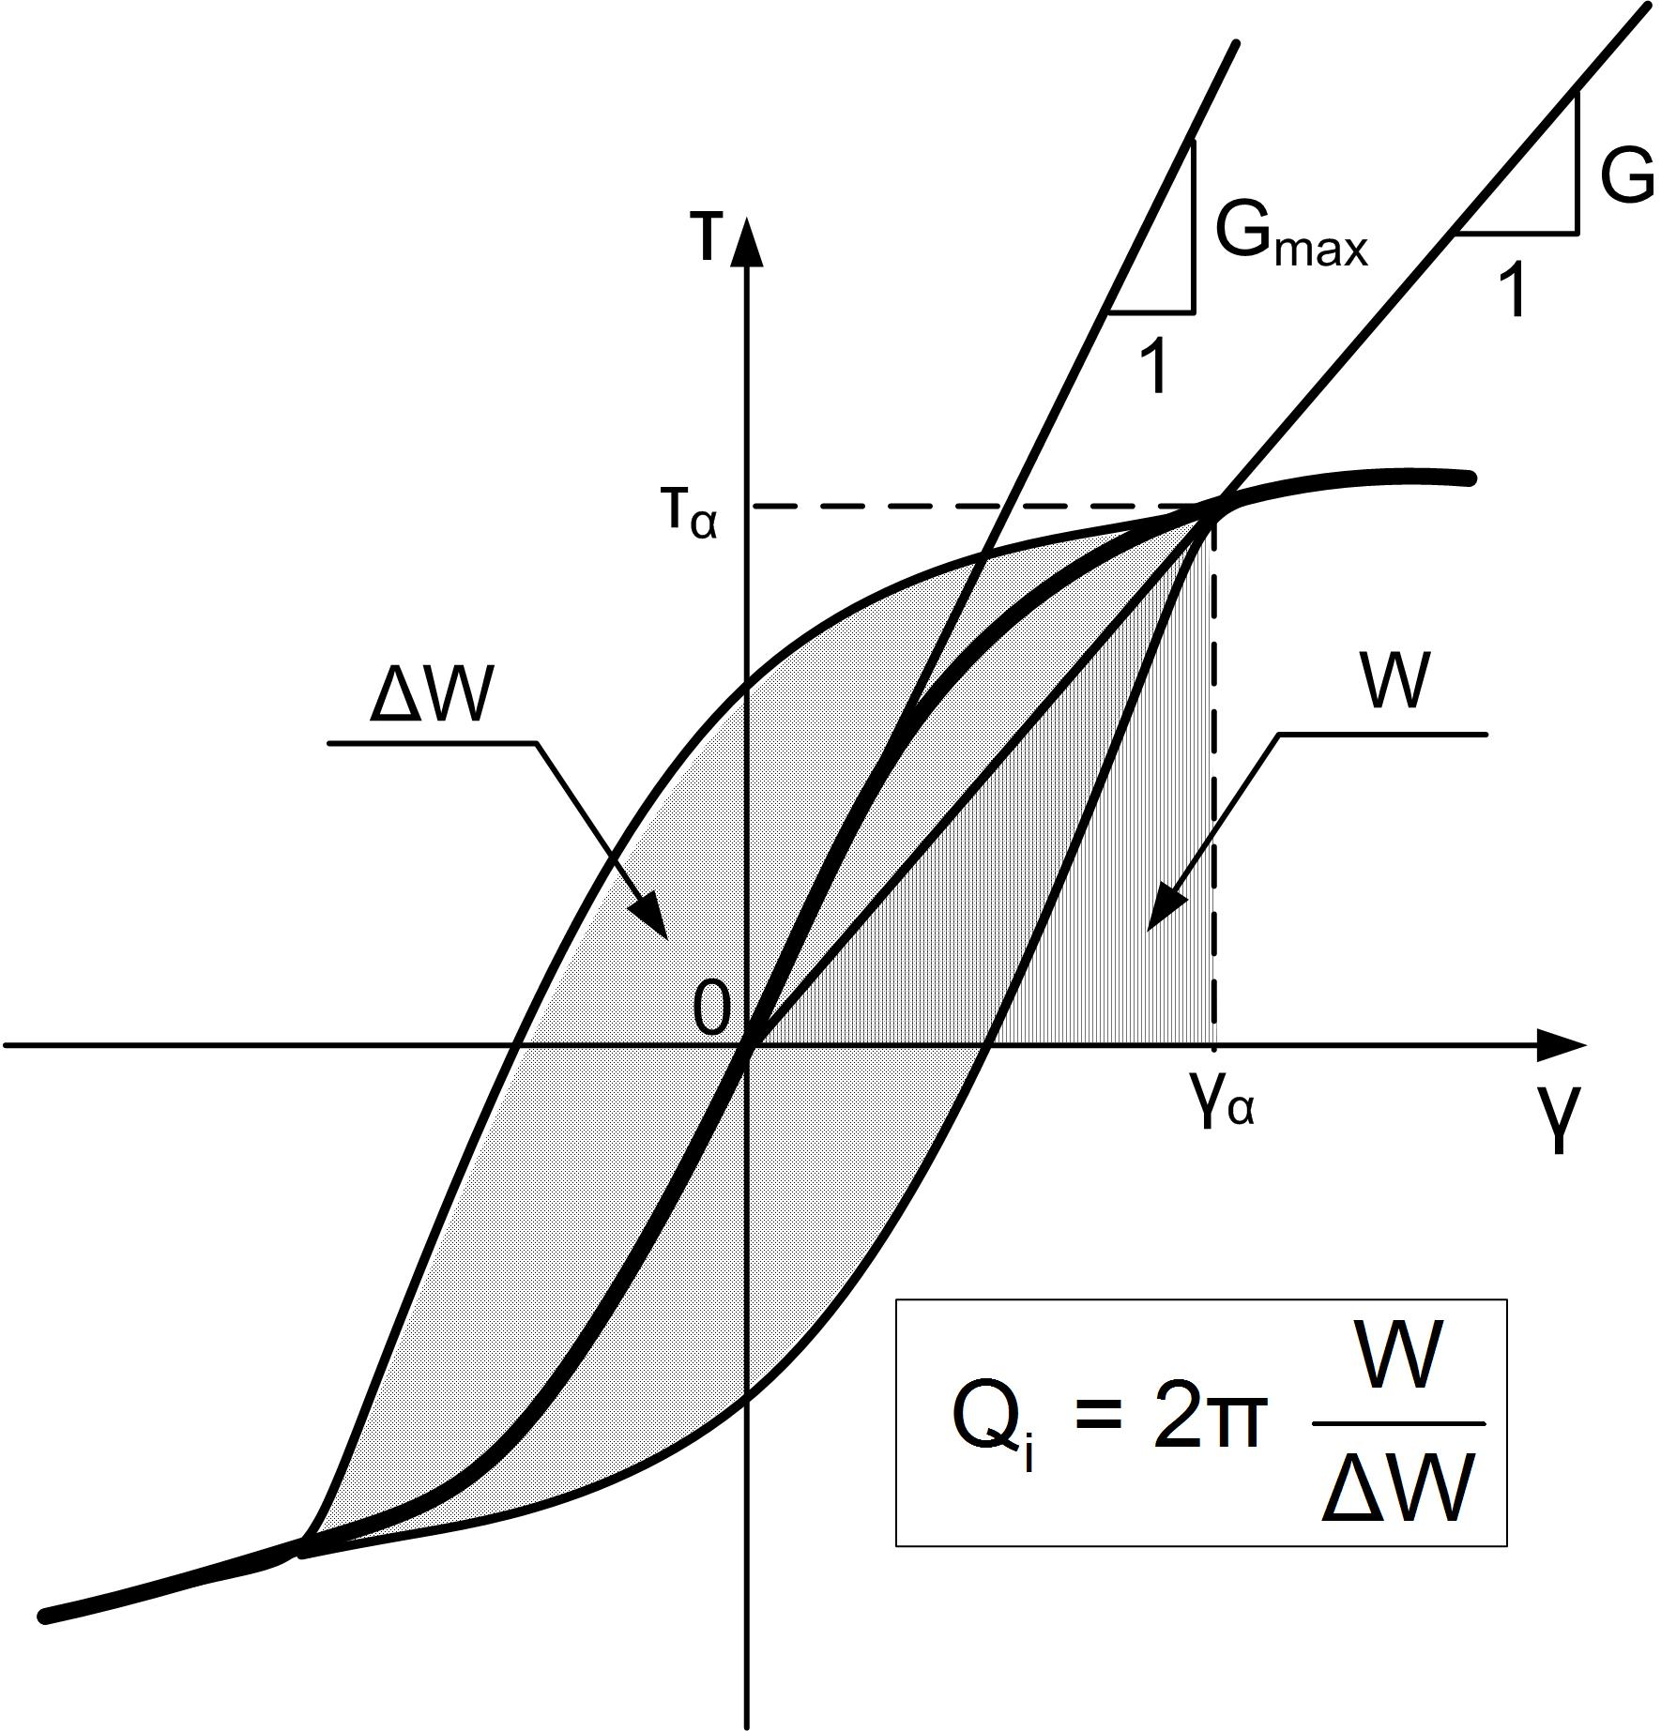

Slide 3
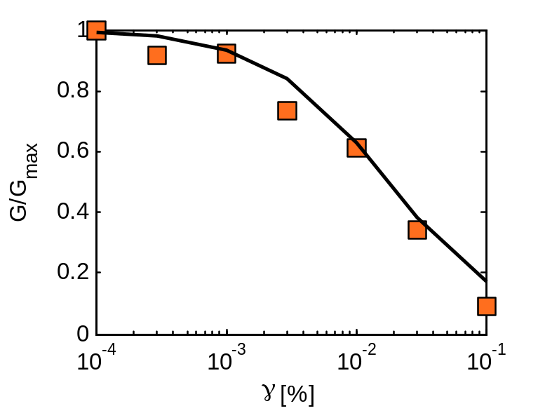
Nonlinear soil behavior in cyclic loading
Resonance column test
Notes:
Typically, nonlinear soil response is measured in the laboratory through the so-called resonant column test, and is reported as the reduction in stiffness and increase in damping as a function of strain

Slide 4
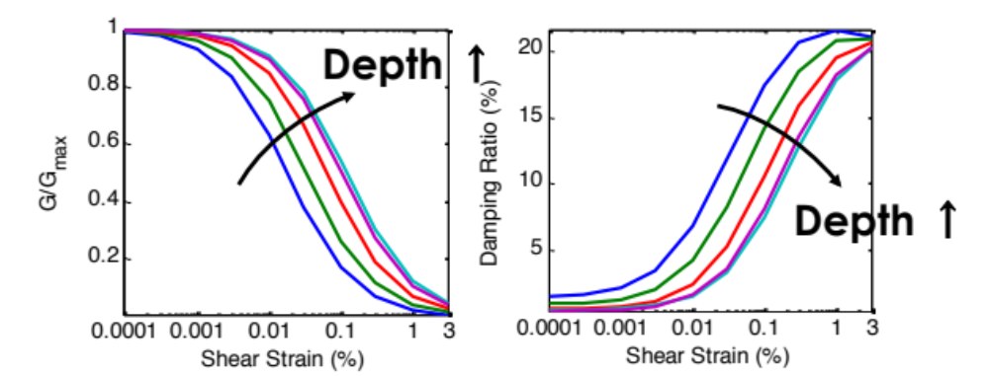
Nonlinear soil behavior in cyclic loading
Resonance column test
Notes:
Typically, nonlinear soil response is measured in the laboratory through the so-called resonant column test, and is reported as the reduction in stiffness and increase in damping as a function of strain

Slide 5
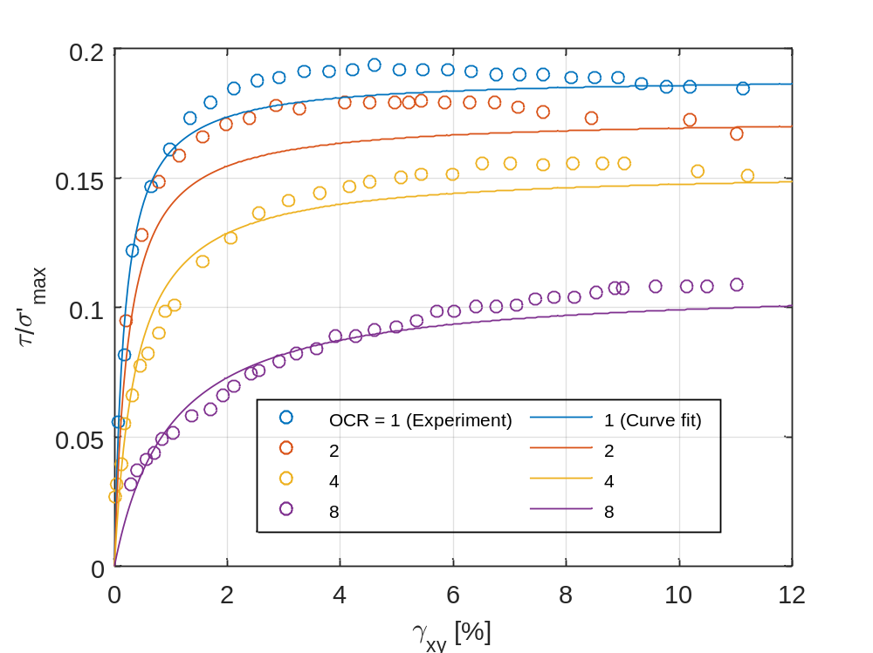
Hybrid stress-strain model: Strength
Direct simple shear test (from Ladd & Edgers, 1972)
Notes:
Quasi-static vs cyclic…
The model is versatile enough to capture, with very few parameters, the shape of typical monotonic and cyclic loading soil tests…

Slide 6
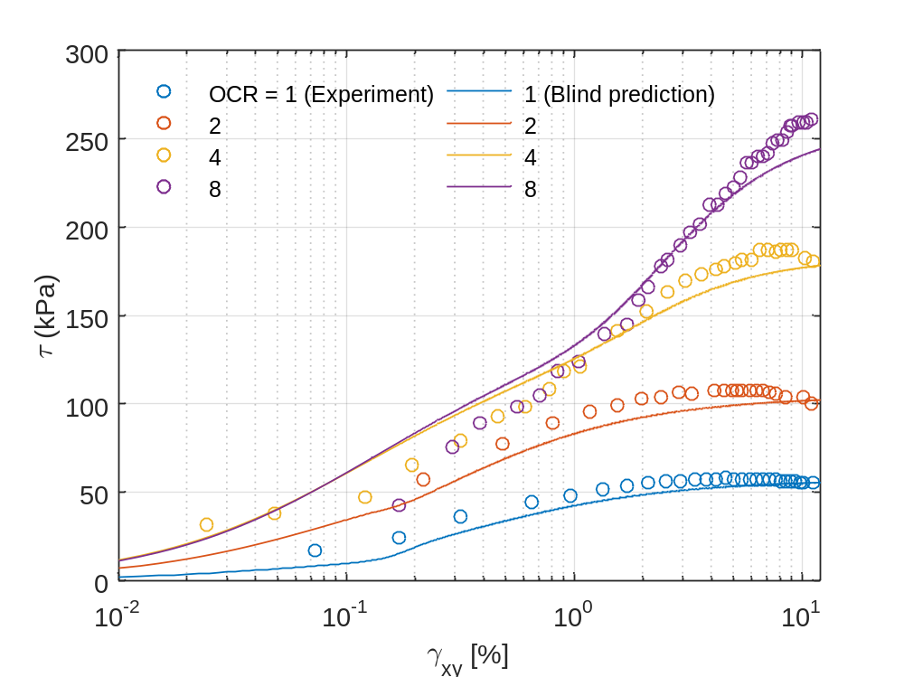
Nonlinear site-specific response = function of V_{s}
Nonlinear optimization to achieve smoothness
Darendeli (2001)
Ladd (1991), Mayne et al (1996, 1998)
Vardanega & Bolton (2011)
V_{S} profile
Ladd & Edgers, 1972
Notes:
Last, when fed with Vs and depth – and combined with well-known empirical correlations of these properties to other soil parameters like OCR, modulus degradation and strength, the model performed exceptionally well when compared to laboratory data in a blind prediction.

Slide 7
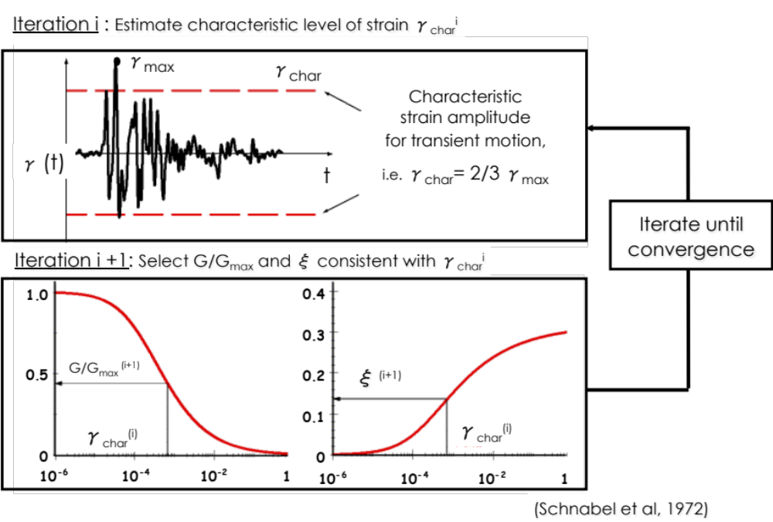
Equivalent Linear Site Response (SoP)

Slide 8
Velocity, damping and density profiles

Slide 9
1978 Tabas, Iran, Free Field Accelerations (SF=1)
Acceleration [g]
T [sec]

Slide 10
LN Cybershake / NL Site-Specific
Notes:
Lets now examine the role of geology in shaping the ground motion at Kathmandu and elsewhere

Slide 11
SF=1
SF=0.75
T [sec]
SF=0.5
SF=0.25
T [sec]

Slide 12
Summary figure for CB NL / HH nonlinear model
T [sec]

Slide 13
LN Cybershake / EQ Site-Specific
Notes:
Lets now examine the role of geology in shaping the ground motion at Kathmandu and elsewhere

Slide 14
SF=1
SF=0.75
T [sec]
SF=0.5
SF=0.25
T [sec]

Slide 15
Summary figure for CB NL / EQ linear model
T [sec]

Slide 16
LN CBS / NL vs. EQ site-specific
Notes:
Lets now examine the role of geology in shaping the ground motion at Kathmandu and elsewhere

Slide 17
SF=1
SF=0.75
T [sec]
SF=0.5
SF=0.25
T [sec]

