Slide 1

Preparing Seismic Applications for Exascale using Scientific Workflows
Scott Callaghan, Philip J. Maechling, Karan Vahi, Ewa Deelman, Fabio Silva, Kevin R. Milner, Kim B. Olsen, Robert W. Graves, Thomas H. Jordan, and Yehuda Ben-Zion
Wednesday, May 24, 2023
GC11 – Solid Earth

Slide 2
Outline
What is a workflow?
What are key workflow concepts?
How do workflows benefit real-world seismic applications?
What are the community challenges as we look ahead to exascale?
Before we get started –
  Who here uses a released workflow tool?
  Who here has written their own workflow tool?

Slide 3
What is a workflow?
Series of computational tasks with dependencies between them
  Short, long, serial, parallel, …
Capture executables, parameters, input, output
Workflow process and data are usually independent
  Can rerun same workflow on different data
  System-independent: can run same workflow on different systems
Workflow logic independent from scientific codes
CPU
GPU
HTC
Scientific codes
task graph
data management
execution
Workflow middleware
cloud
cluster
Compute resources
Notes:
Finish layers

Slide 4
Workflow Shared Concepts
Many workflow tools, but common concepts between them
Representation of workflow tasks and their data
  Can be specified through API, annotations, GUI
  Explicit or implicit data roles
Workflow prepared to run on certain hardware
Schedule and run the workflow, honoring dependencies
  May include remote job submission and data transfer
  Some support interactivity and notebooks
User monitors workflow execution
  May include error handling and retry provisions
Notes:
Convert to a flow chart

Slide 5
Why Use Scientific Workflows?
Automated management of task execution
Support for distributed execution
Data management
Metadata management
Error recovery
Portable description of pipeline

Slide 6
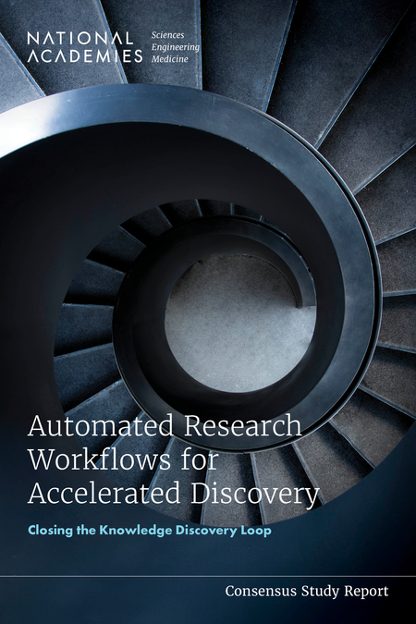
NAS report
US National Academy of Sciences commissioned a report on automated research workflows (ARWs) in 2020
“The common goal of researchers implementing ARWs is to accelerate scientific knowledge generation, potentially by orders of magnitude, while achieving greater control and reproducibility in the scientific process.”
“The common goal of researchers implementing ARWs is to accelerate scientific knowledge generation, potentially by orders of magnitude, while achieving greater control and reproducibility in the scientific process.”
“The tools and techniques being developed under the large umbrella of ARWs promise to transform the centuries-old serial method of research investigation... Simultaneously, ARWs provide a way to satisfy pressing demands across fields to increase interoperability, reproducibility, replicability, and trustworthiness by better tracking results, recording data, establishing provenance, and creating more consistent metadata than even the most dedicated researchers can provide themselves.”
“The tools and techniques being developed under the large umbrella of ARWs promise to transform the centuries-old serial method of research investigation... Simultaneously, ARWs provide a way to satisfy pressing demands across fields to increase interoperability, reproducibility, replicability, and trustworthiness by better tracking results, recording data, establishing provenance, and creating more consistent metadata than even the most dedicated researchers can provide themselves.”

Slide 7
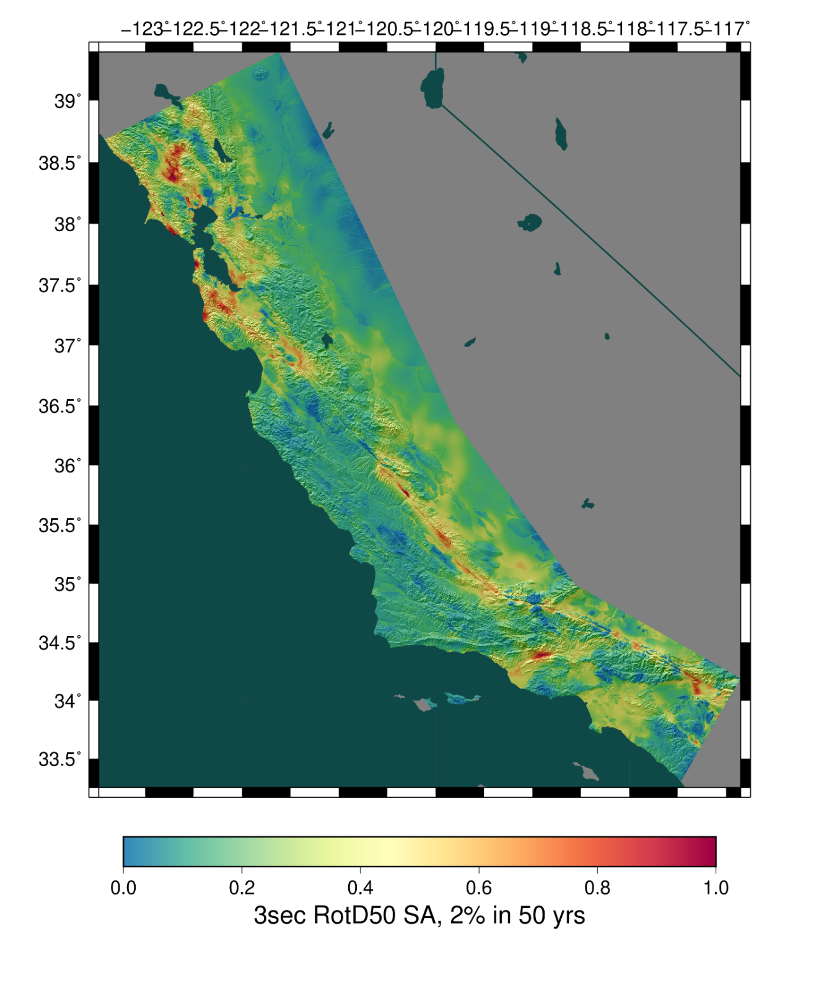
Real-World Scientific Workflows
Southern California Earthquake Center’s CyberShake platform as example of scientific workflows in action
3D physics-based probabilistic seismic hazard analysis platform
Simulation-based alternative to empirical ground motion models (GMMs)
Reciprocity used to reduce computational cost
  670 instead of 720,000 regional wave propagation sims
Approach used in California and SW Iceland
Continue to improve models and codes

Slide 8
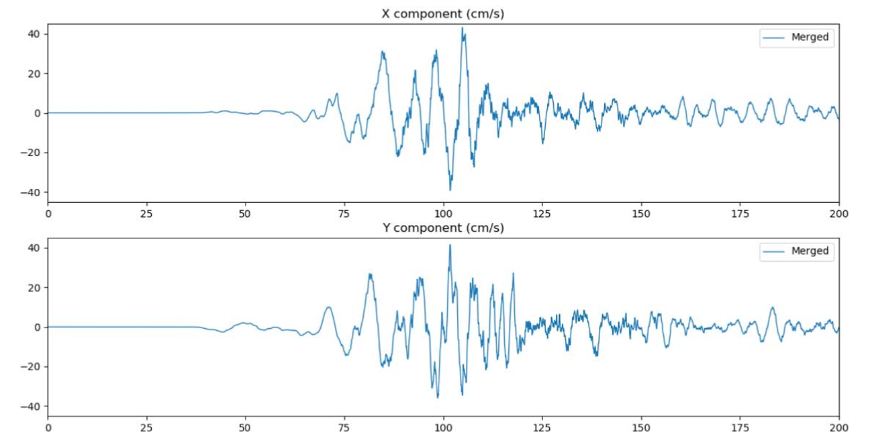
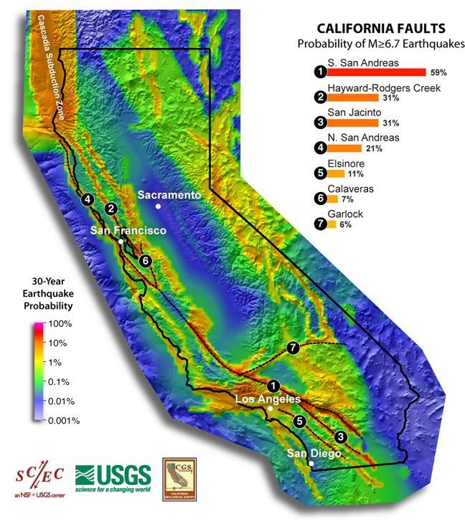
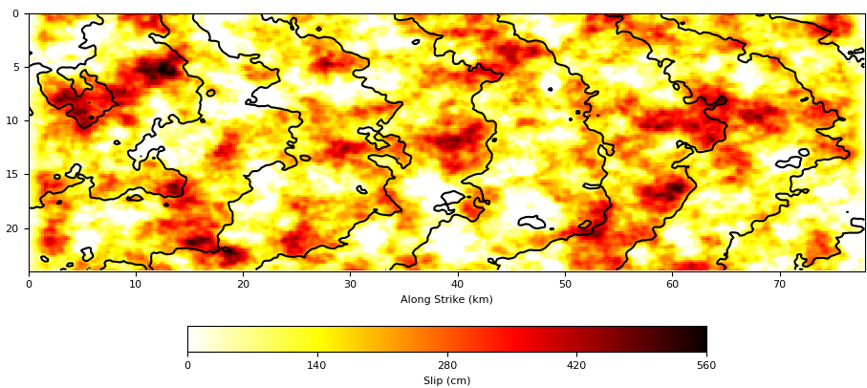
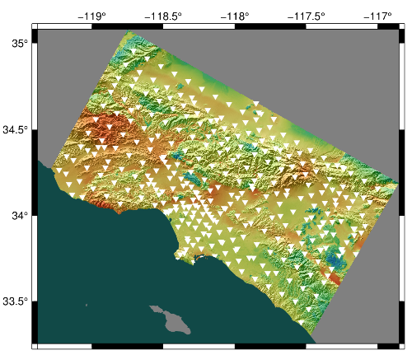
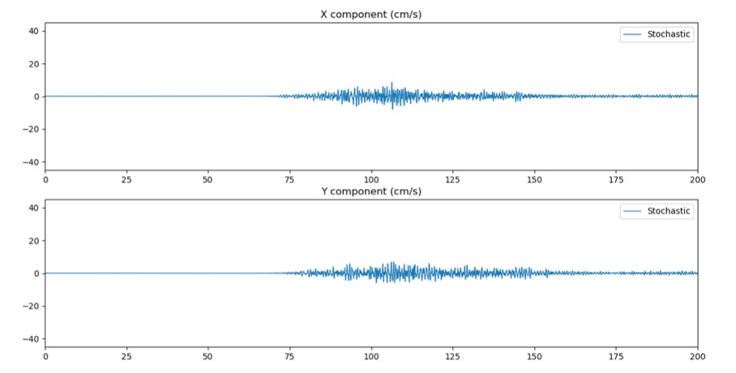
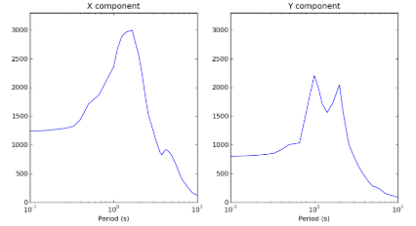
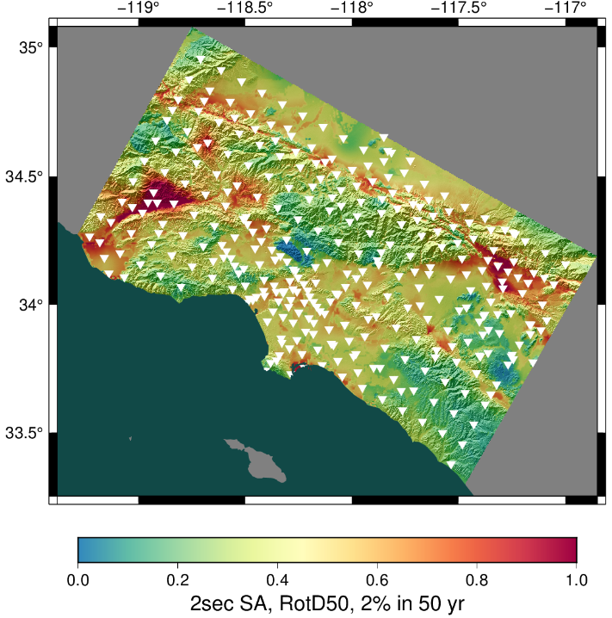
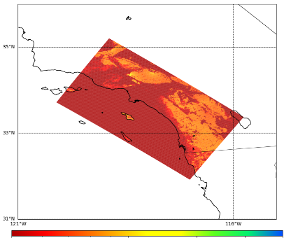
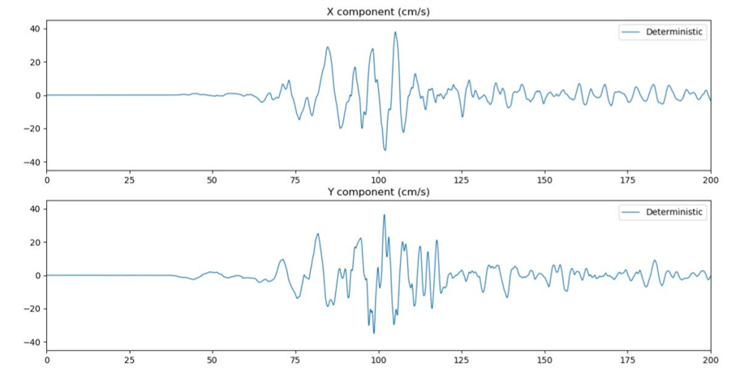
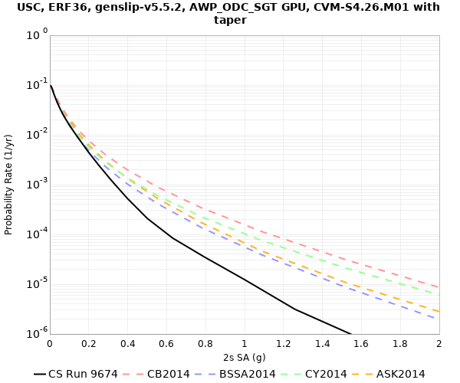
Broadband CyberShake workflow
Low-frequency CyberShake workflow
Graves & Pitarka kinematic rupture generator
High-frequency seismogram synthesis (BBP)
Merge and combine
0-50 Hz broadband data products
600,000+ events
Uniform California Earthquake Rupture Forecast
1-50 Hz seismograms
RotD50, PGA, PGV
AWP-ODC-SGT
wave propagation
Low-frequency seismogram synthesis
Intensity measures
Aggregate
data products
UCVM
0-1 Hz low-frequency seismograms
RotD50, PGA, PGV
Velocity Mesh
Hazard Curve
Hazard Map

Slide 9
CyberShake Computational Requirements
CyberShake Stage | Number of Tasks | Node-Hours | Output Data
Velocity mesh creation (parallel) | 1 | 10 CPU | 300 GB
Wave propagation (parallel) | 2 | 80 GPU | 1500 GB
Low-frequency seismogram synthesis (parallel) | 1 | 1000 CPU | 38 GB
High-frequency seismogram synthesis (serial) | 77,000 | 1000 CPU | 187 GB
Total, 1 site (including small jobs) | 77,020 | 2090 | 2025 GB
Total, full region | 25.8 million | 700,000 | 680 TB
Large computational and data requirements
Mix of large parallel CPU and GPU jobs with HTC
High degree of automation required to support continuous execution

Slide 10
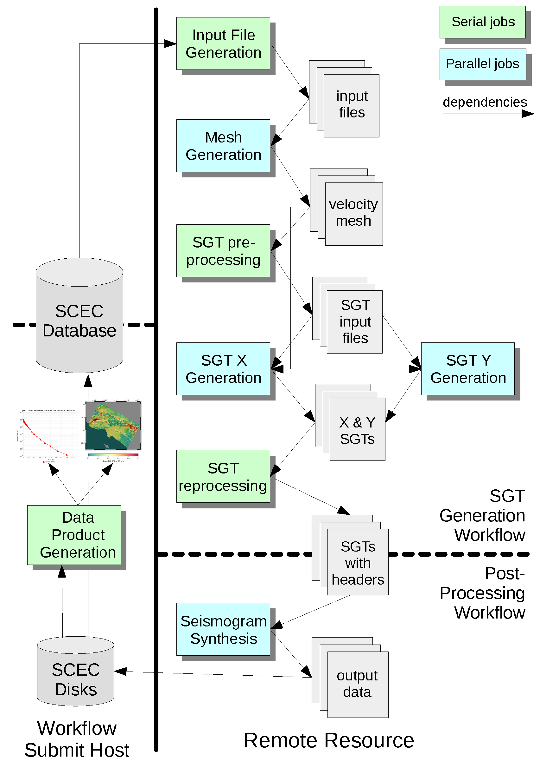
CyberShake Workflow Framework
Pegasus-WMS
  Use API to create description of workflow
    Tasks with dependencies
    Input/output files
  Plans workflow for execution on specified systems
  Adds jobs to manage data
  Wraps executables to track runtime metadata
HTCondor
  Manages real-time execution of jobs
  Submits jobs to remote systems, checks on success
  Monitors dependencies
  Checkpoints workflow
Globus used to transfer data
Schematic of CyberShake low-frequency workflow

Slide 11
CyberShake Challenges: Automated Job Submission
CyberShake studies take months to run
  Automated job submission is a must!
Many HPC systems require two-factor authentication
  Manual token entry conflicts with automated job submission
Could orchestrate workflows from cluster
  Limited support for distributed execution
  Restricted to center-supported workflow systems
We preferred solutions with independent
workflow submission host
Compute Resource
Workflow Engine
Workflow Engine
. . .
Workflow Server
job queue
. . .
. . .
wf task
. . .
wf task
filesystem
Compute node

Slide 12
Job Submission Solutions
Pull-based: get resources first, then ‘pull’ work onto them
Push-based: jobs sent when ready
  Daemon required to set up connection
Workflow management system
Workflow management system
task 1
task 1
task 2
task 2
task 3
task 3
. . .
. . .
Workflow submission host
Workflow submission host
Remote compute resource
Remote compute resource
. . .
pilot job
. . .
. . .
task 1
. . .
task 1
pilot job
task 1
. . .
Long-running daemon
. . .
Remote queue
Compute node(s)
Remote queue
Compute node(s)

Slide 13
CyberShake Challenges: Job Execution
Workflows include heterogeneous jobs
  Serial, parallel, CPU, GPU
Targeted OLCF Summit (#5)
  Summit prioritizes large jobs
  Want to run in bins 1 or 2
  Largest tasks in the workflow
  are ~1.5% of the system
Use pull-based approach
  Create large (~1000 node) pilot jobs, then fill with tasks
  Created process to monitor task queue on workflow submission host and submit pilot jobs when enough tasks were ready
Summit Scheduling Policy
Bin | Min Nodes | Max Nodes | Aging Boost
1 | 2765 (50%) | 4608 | 15 days
2 | 922 (20%) | 2764 | 10 days
3 | 92 (2%) | 921 | 0
4 | 46 (1%) | 91 | 0
5 | 1 | 45 | 0

Slide 14
CyberShake Challenges: Job Execution
High throughput needed for small serial tasks
  77,000 tasks per site for broadband calculations
Can’t place jobs directly in the Summit queue
  Schedulers aren’t designed for this kind of load
  Scheduler cycle is ~5 minutes
  Policy limits number of jobs in queue
Bundle high throughput jobs using Pegasus-mpi-cluster (PMC)
  MPI wrapper around tasks
  Uses manager-worker paradigm to execute tasks
  Preserves dependencies
Push-based approach for PMC jobs
PMC
workflow
manager
workers

Slide 15
CyberShake Challenges: Data Management
Millions of data files
  Workflows stage files needed for executables
    Supports running distributed workflows
  Output data staged back to archival storage
Data integrity
  Automated checks to detect file errors early
    Correct number of files, correct size, NaNs present, zero-value checks, MD5 sums
  Included as new jobs in workflow
Preparing output data for easy access later
  Work in progress

Slide 16
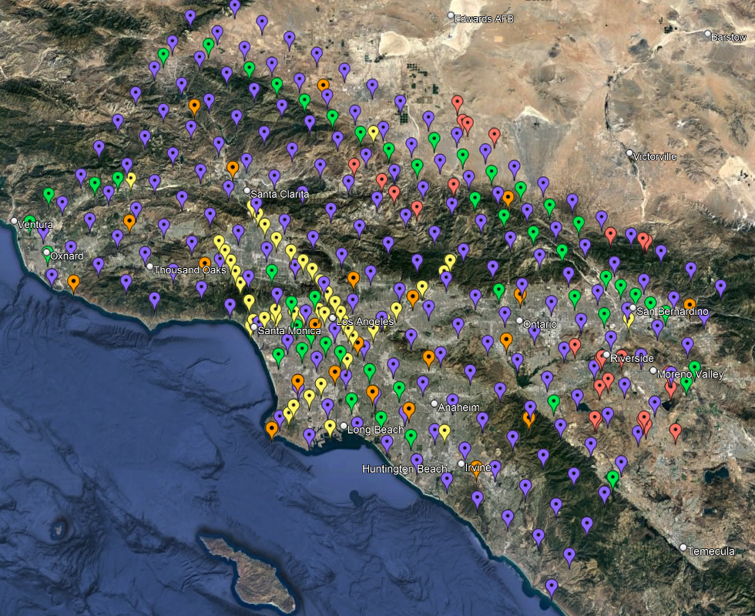
Study 22.12
CyberShake study for 335 sites in
Southern California
Both low-frequency (0-1 Hz) and
broadband (0-50 Hz) hazard models
  Broadband approach validated against
  historic earthquakes
Updated rupture generation process
  Reduced slip/risetime correlation
  Reduced shallow rupture speeds
  Increased hypocentral density from 4.5 → 4 km
Improved near-surface 3D velocity model
  Added Vs30-derived merged taper to create more realistic velocity profiles
180 km
100 km
Study 22.12 site map

Slide 17
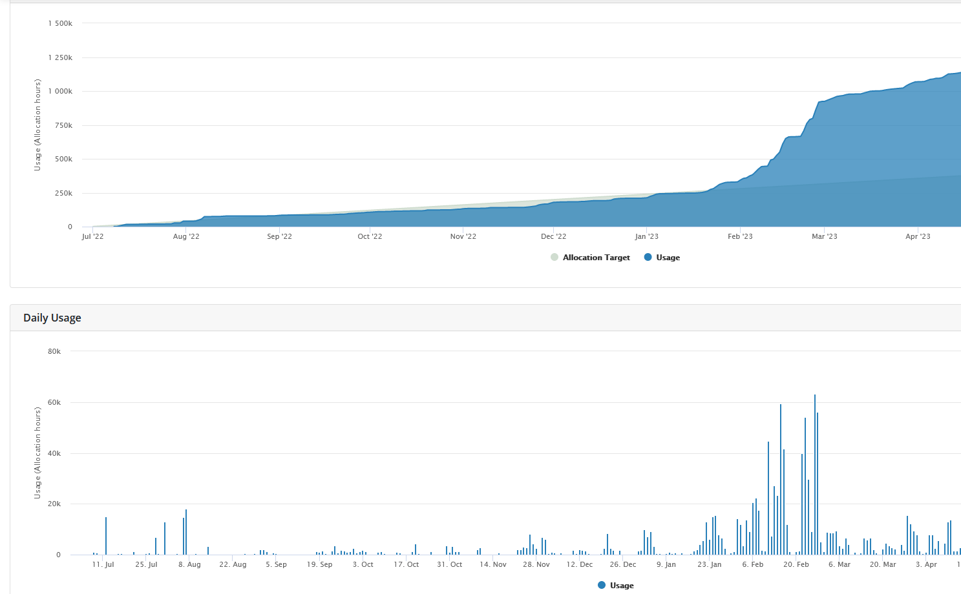
Study 22.12 Statistics
Makespan of 108 days
Used 772,000 node-hours on OLCF Summit
  Averaged 442 nodes
  Max of 3382 (73% of Summit,
  ~17x MareNostrum 4,
  ~50% MareNostrum V)
Workflow tools managed:
  28,120 tasks (11,431 remote)
  ~2.5 PB total data
  74 TB / 19M files transferred
  and archived
Overall Usage
BB
LF
SGTs
Analysis
Daily Usage
Stress
Test

Slide 18
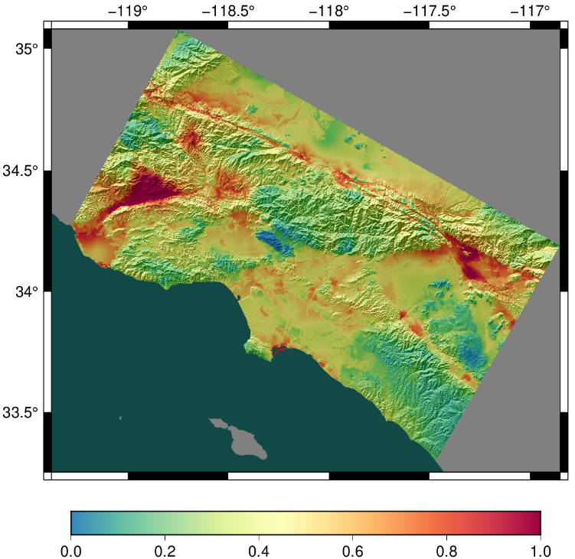
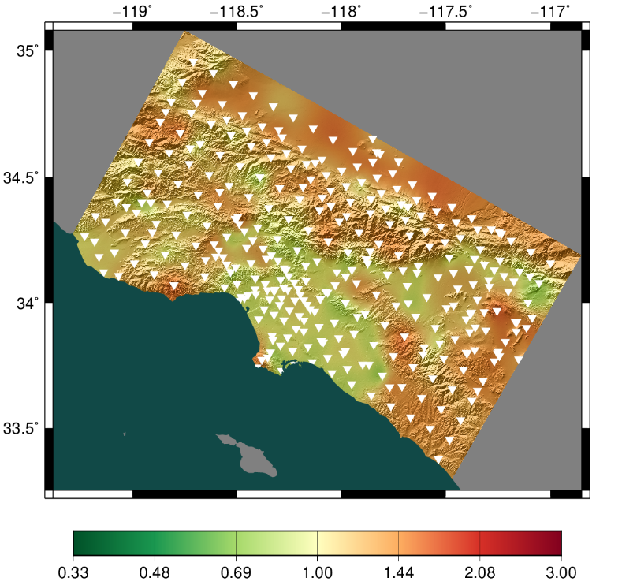
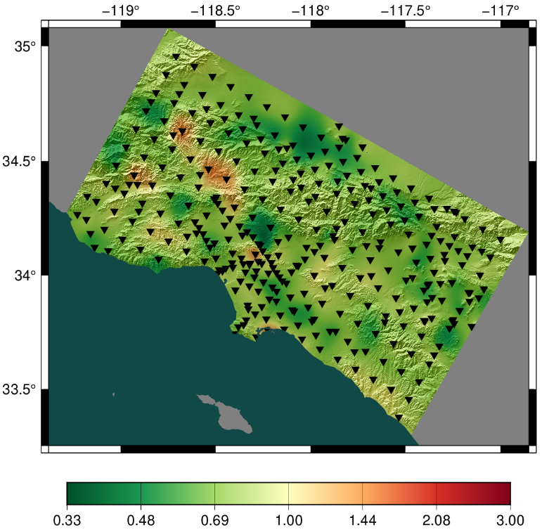
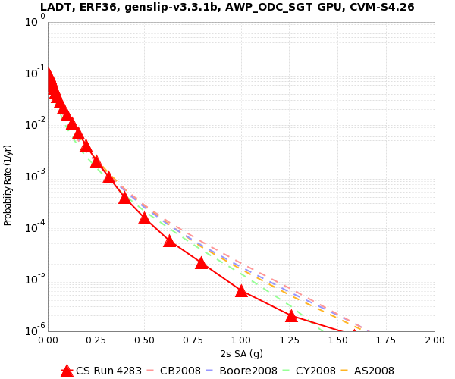
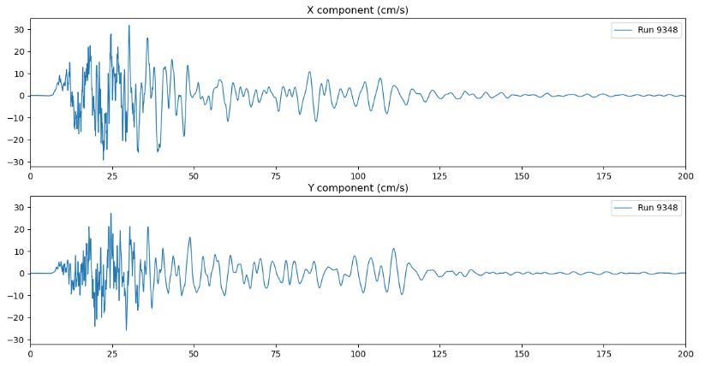
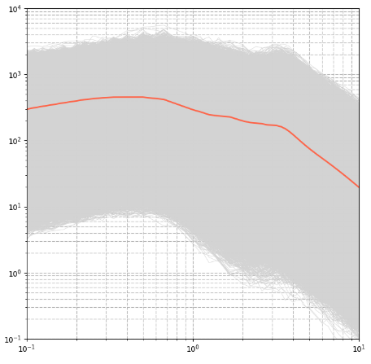
Study 22.12 Results
Study 22.12
Ratio, new/old CyberShake
Ratio, 22.12/GMMs
These hazard maps were generated using:
10,720 hazard curves
420 million
2-component
seismograms
83 billion
intensity
measures

Slide 19
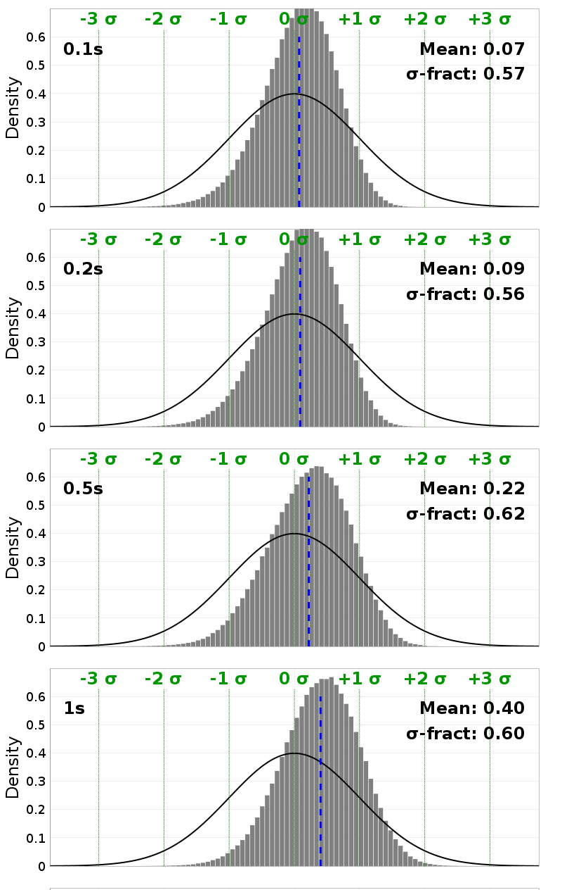
Future Science Directions
Increase deterministic frequency to 2 Hz
  Frequency-dependent attenuation
  Small-scale velocity heterogeneities
Include nonlinear simulations
  Reciprocity is by definition linear
  Identify subset of events for full nonlinear simulations
  Apply pseudo-nonlinearity to reciprocity results
Streamline process of integrating new codes
  Goal is to support multiple codes for each stage
  Supports improved quantification of uncertainty
Study 22.12 Broadband vs. GMM ASK2014 z-scores

Slide 20
Future Computational Challenges
Workflows to support hybrid linear/nonlinear approach
  Must bookkeep and combine site-based and event-based seismograms
Largest systems are becoming more specialized
  For example, not feasible to run GPU and CPU jobs on OLCF Frontier
  Will require distributed workflows
Improved data management and delivery
  DOIs for data products
  Continue to develop data access tool for direct data product access
Support execution by other researchers
  Containers?

Slide 21
Looking Ahead
Questions for us to consider as scientific workflow simulations move to exascale systems
How do we take best advantage of upcoming opportunities?
Hope to encourage discussion!

Slide 22
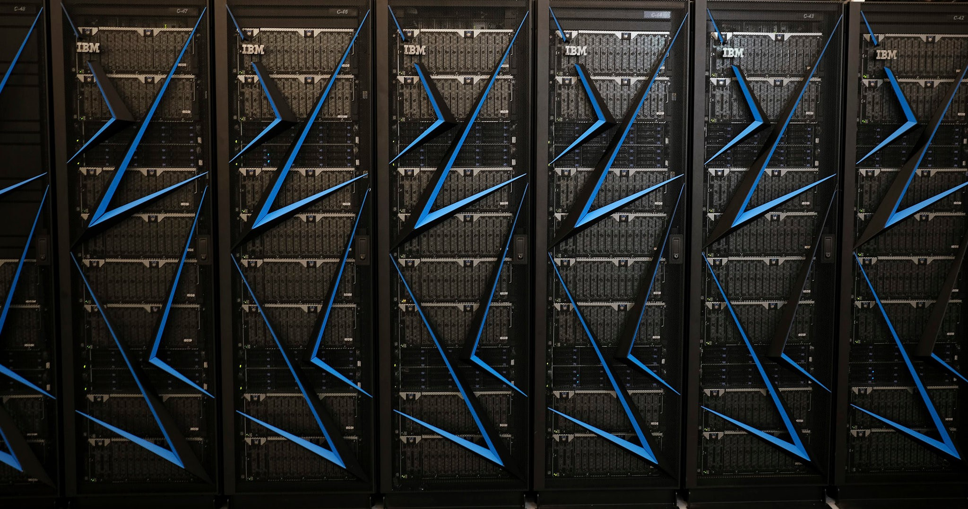
Utilizing Exascale Systems
How can applications best utilize exascale machines to perform cutting-edge science?
Full-system hero runs?
Ensembles?
Combination?
Notes:
Hero runs: hard to do – millions of compute elements – but makes it possible to run unprecedented problems
Ensembles: easier to do, supports investigating uncertainties. Used with CyberShake.

Slide 23
Application Resiliency
How should applications and workflows manage component failures?
Things will break more frequently on exascale systems
Can we/should we do better than ‘turn it off and turn it back on again’?
Notes:
OLCF Frontier: 1.2M compute threads, 75K GPUs, 48K spinning disks
In CyberShake, saw issues in ~1/100k files
Current model is that errors are caught at the driver or OS level
Some efforts to use ML to better identify anomalies and recover

Slide 24
Exascale Data
How do we automate data and metadata management to ensure our simulation results are useful to the community?
During simulations?
Support for FAIR principles through workflows?
  Archiving, indexing, DOIs, …
Notes:
Staging during simulations
Workflows reduce time and cost to FAIR
Archive, indexing, DOIs, derived data products, make publicly available

Slide 25
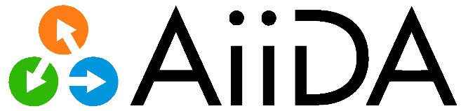

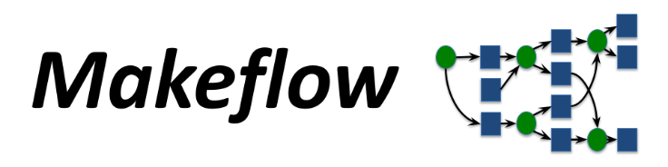






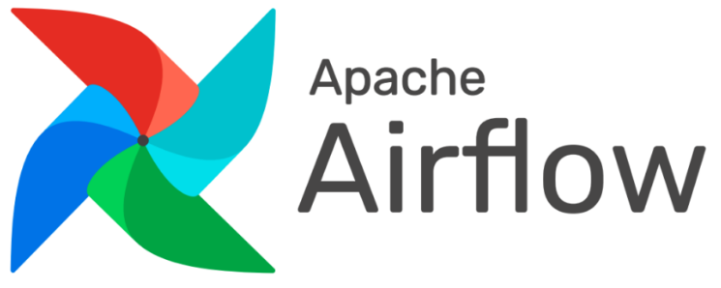





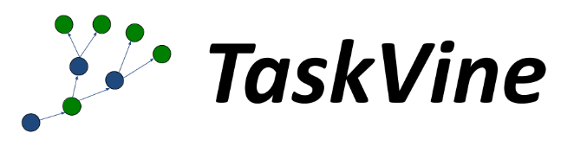
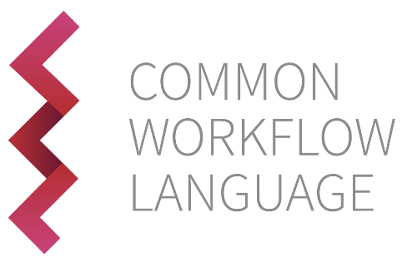




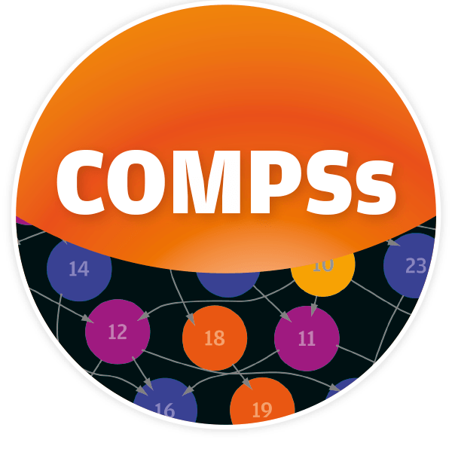






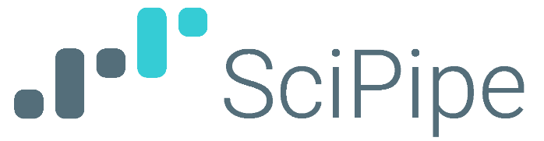

Which workflow tool do you use?
RADICAL Cybertools
Geoweaver
Cromwell
WATTS
CWL project lists 334 “existing workflow systems”

Slide 26
Workflow Community
How should the workflow community work towards common goals, given the number of available tools and approaches?
Umbrella and standards groups?
  ExaWorks
  eFlows4HPC
  Common Workflow Language
How to reach out to new users with existing tools?
Notes:
Don’t write your own tool!

Slide 27
Urgent Computing
Can we use workflow tools to fully automate urgent computing simulations?
Use sensors to trigger simulations?
Operational aftershock forecasting
Simulation-informed ShakeMaps

Slide 28
Upcoming HPC Trends
How can upcoming HPC trends help move our simulations forward?
Composible computing?
ML/AI?
Notes:
FASTER at Texas A&M – 5 different kinds of GPUs
ML/AI (1) integrated into simulations, (2) inform new simulations, (3) improve workflow tools

Slide 29
Reproducibility Crisis
Are current tools sufficient, or are we still missing key elements to achieve simulation reproducibility?
How do we improve on the 40% of earth/environmental scientists who can’t reproduce their own results? (Nature)
How do we get to meta-FAIR?

Slide 30
Software Sustainability
How do we support the software development needed for exascale computing?
Science codes?
Workflow tools?
Data management tools?
Notes:
Difficult to get US funding for software development

Slide 31

Final Thoughts
We live in exciting computational times!
Excellent opportunity to consider what’s next
Workflow tools can help us navigate exascale challenges
NAS report: “Realizing the potential of ARWs could accelerate the pace of scientific discovery by orders of magnitude and thereby expand the research enterprise’s contribution to society.”

Slide 32








Thanks!

