Slide 1
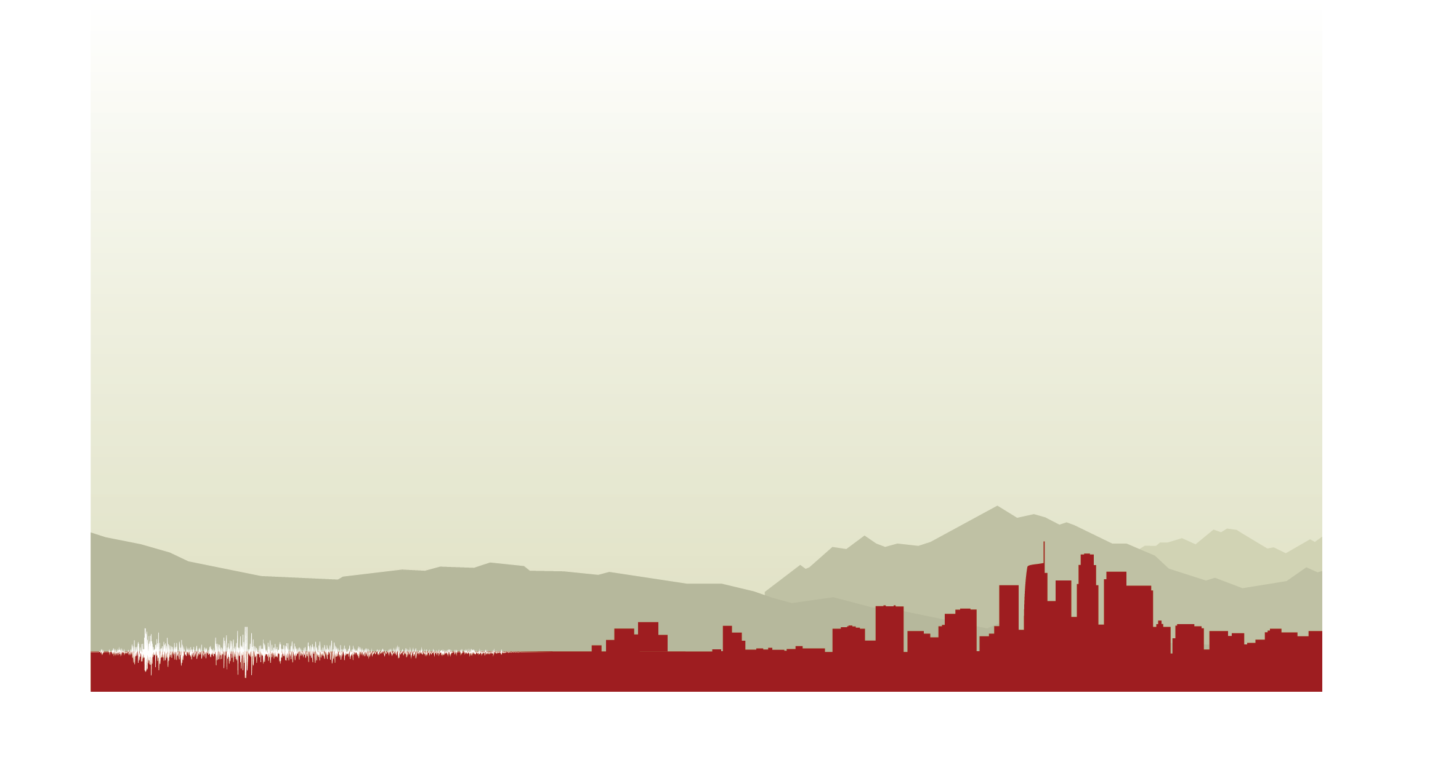
Verification and Validation of the Broadband CyberShake Platform Using Observations
Scott Callaghan, Christine A. Goulet, Fabio Silva, Philip J. Maechling, Robert W. Graves, Kim B. Olsen, Te-Yang Yeh, Albert Kottke, and Yehuda Ben-Zion
2022 SSA Annual Meeting
Wednesday, April 20, 2022

Slide 2
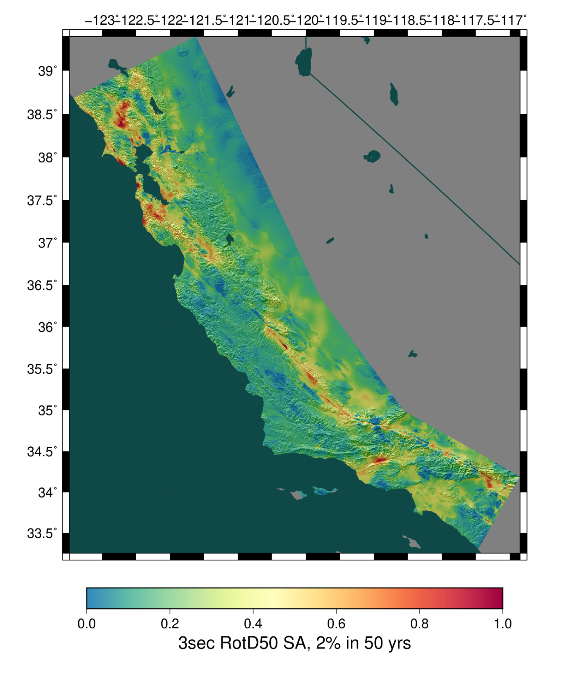
CyberShake Platform
Southern California Earthquake Center’s 3D physics-based probabilistic seismic hazard analysis (PSHA) platform
UCERF2 or RSQSim earthquake simulator ERF
  75,000-500,000 events per site
Reciprocity-based approach to simulate seismograms
Intensity measures derived from seismograms
Hazard results from individual sites interpolated with GMPE basemap

Slide 3
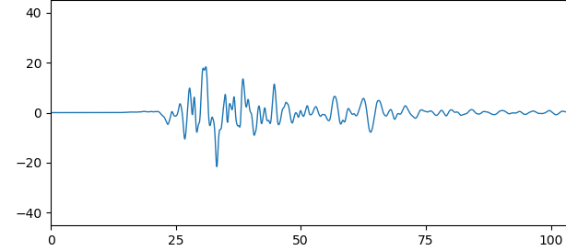
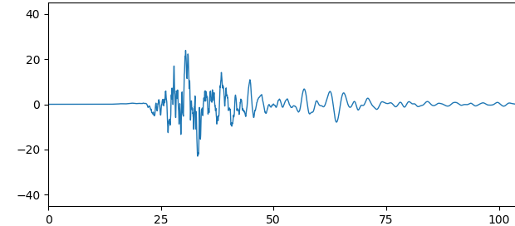
Broadband CyberShake
Deterministic CyberShake currently limited to 1 Hz
Computational cost scales as (frequency)⁴
Additional physics required
Higher frequencies desirable for many applications
Alternatively, combine SCEC Broadband Platform (BBP) high-frequency stochastic modules with CyberShake low-frequency deterministic

Slide 4
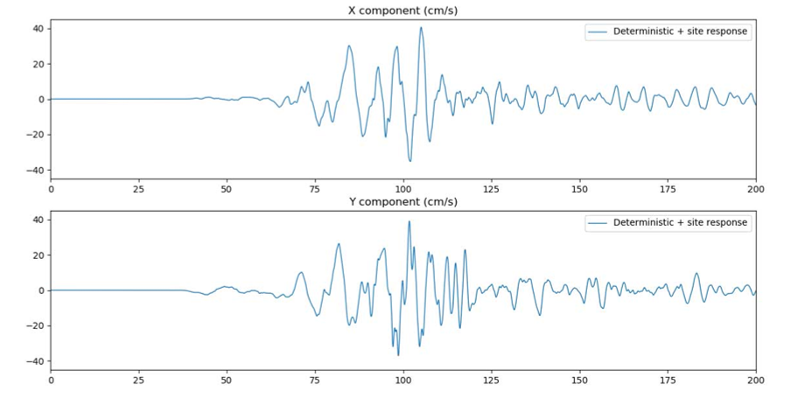
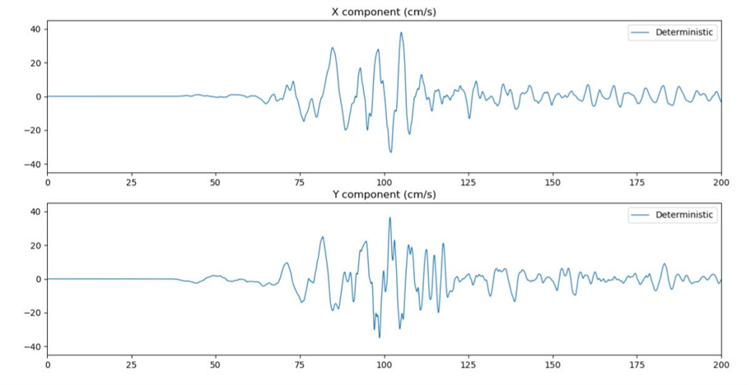
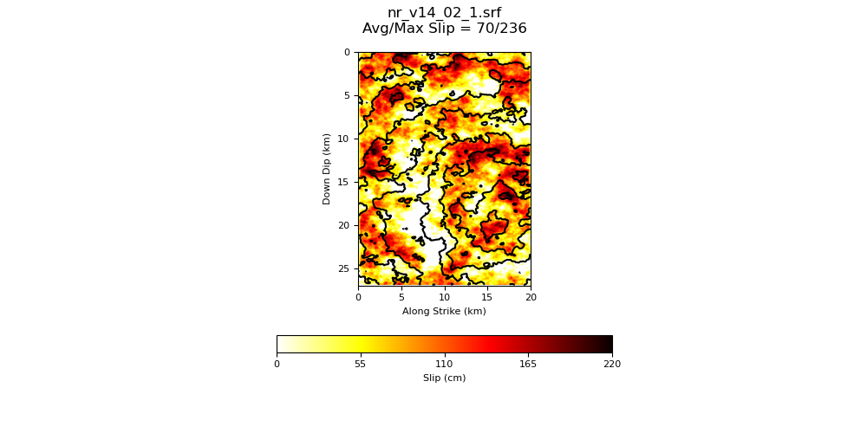
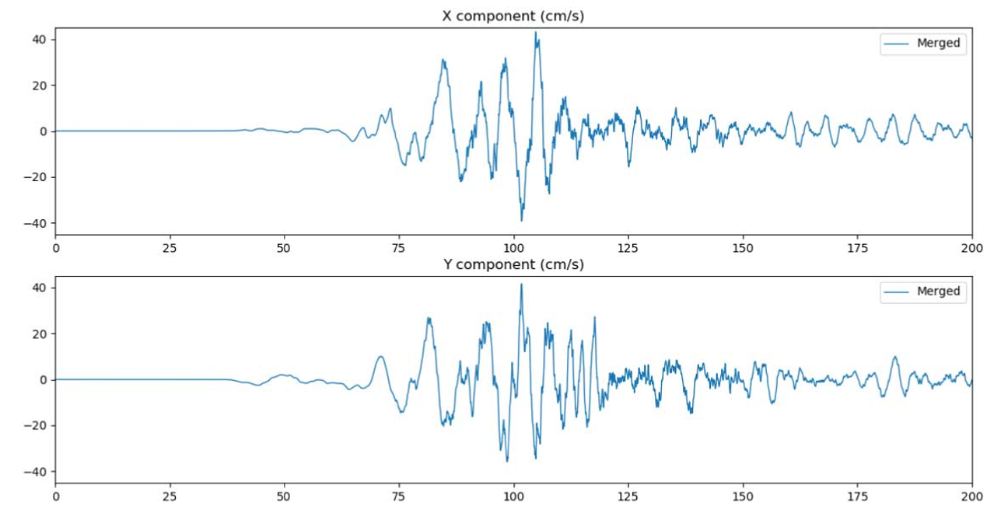
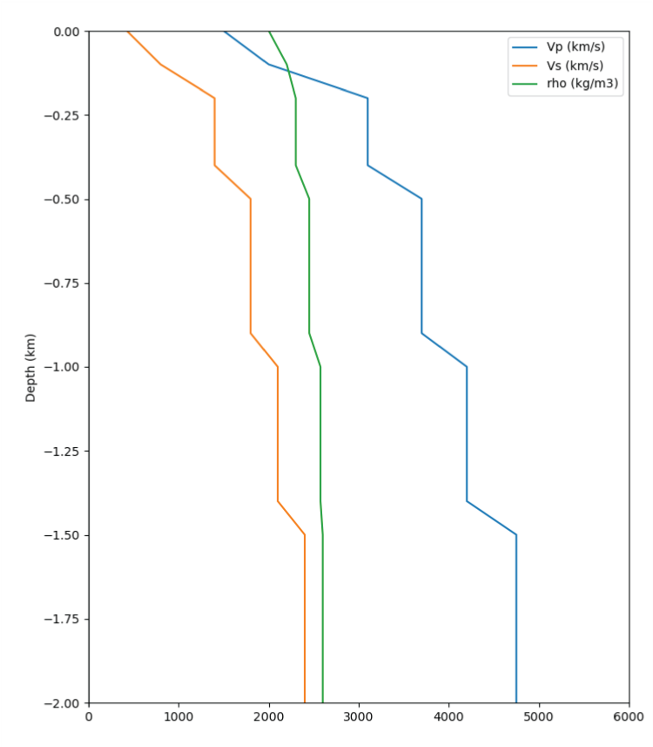
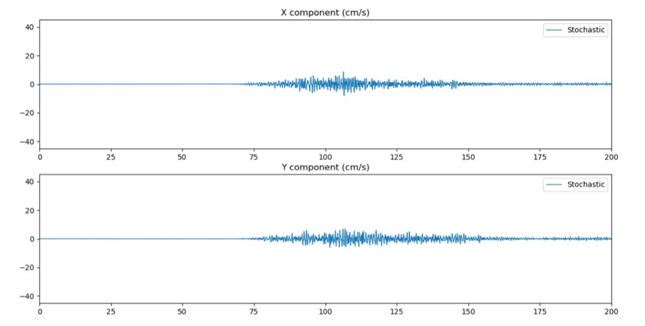
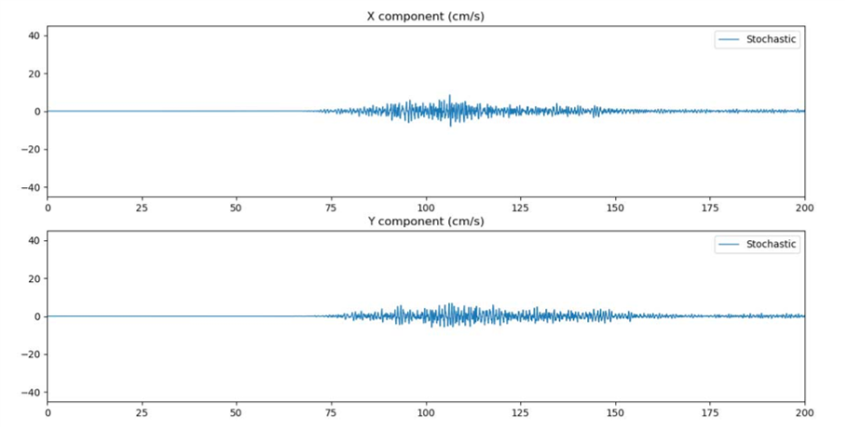
Broadband CyberShake Processing Stages
Low-Frequency Deterministic CyberShake
LF Site Response
LF with site response
LF Seismogram
Resample, Filter, Combine
Rupture Description
High-Frequency
Stochastic Synthesis
HF Site Response
Broadband
1D Velocity Model
CyberShake Module
BBP Module
HF Seismogram
HF with site response

Slide 5
Verification and Validation Motivation
Develop simulation platform for use in engineering applications
Show that the method works
  Produce reasonable ground motions for both historic and hypothetical events
Historic events
  Can get very good low-frequency agreement with tuning
  Here, want to validate entire method on known and unknown events
  Goal is to get reasonable results on realization sweeps

Slide 6
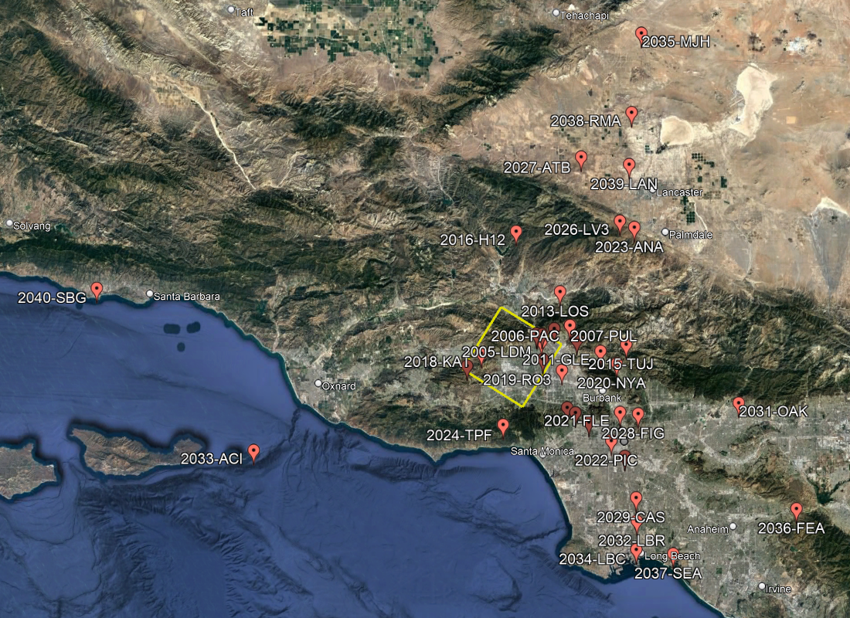
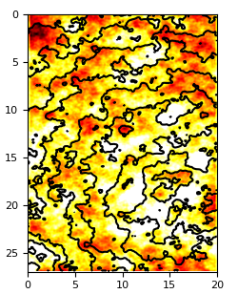
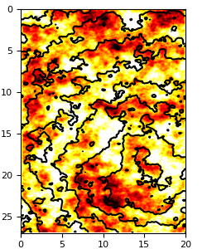
Verification and Validation Events
1994 Northridge event
38 stations in Southern California
Multiple realizations
  Hypocenter and magnitude preserved
  Variations in slip

Slide 7
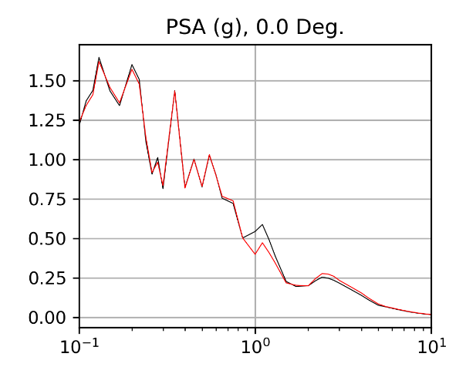
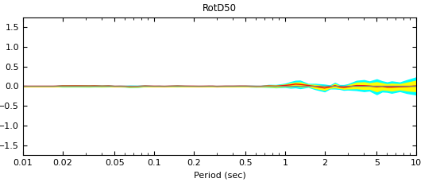
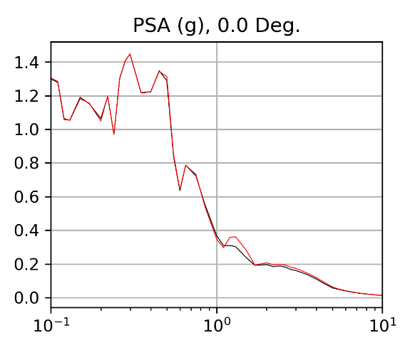
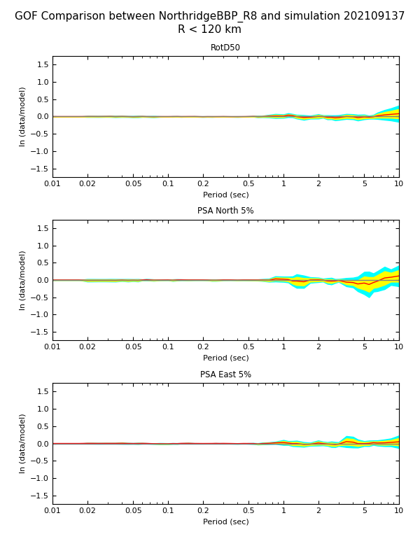
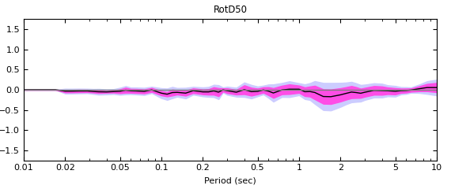
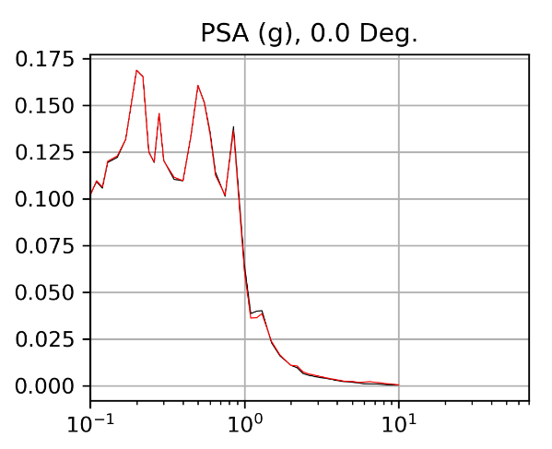
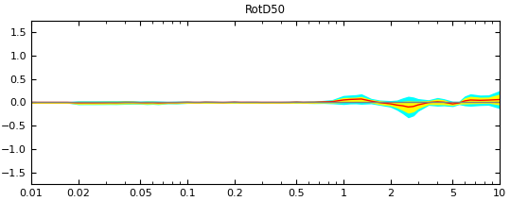
Comparison Data Products
RotD50 PSA comparisons, 1 station, 1 realization
Goodness-of-fit, 1 realization, aggregated across stations
Goodness-of-fit, across all stations and realizations

Slide 8
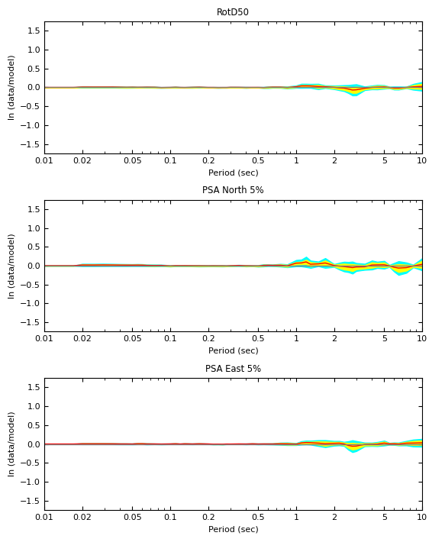
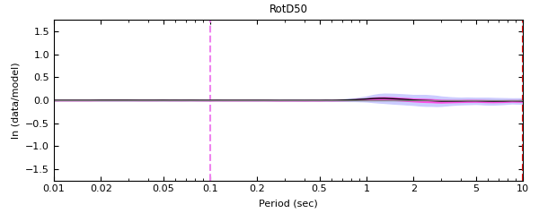
1D Broadband CyberShake vs 1D BBP
38 stations, 10 realizations
High degree of agreement
Combined goodness-of-fit
Realization 4
Realization 8

Slide 9
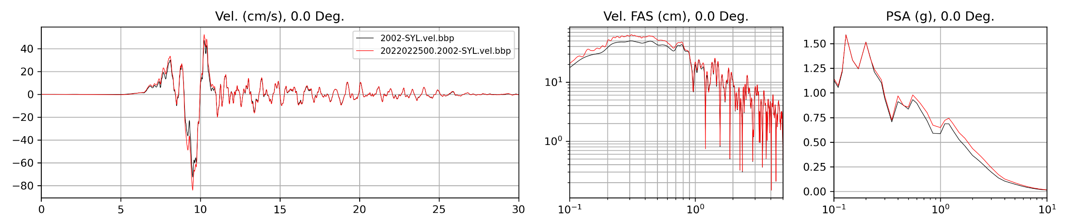
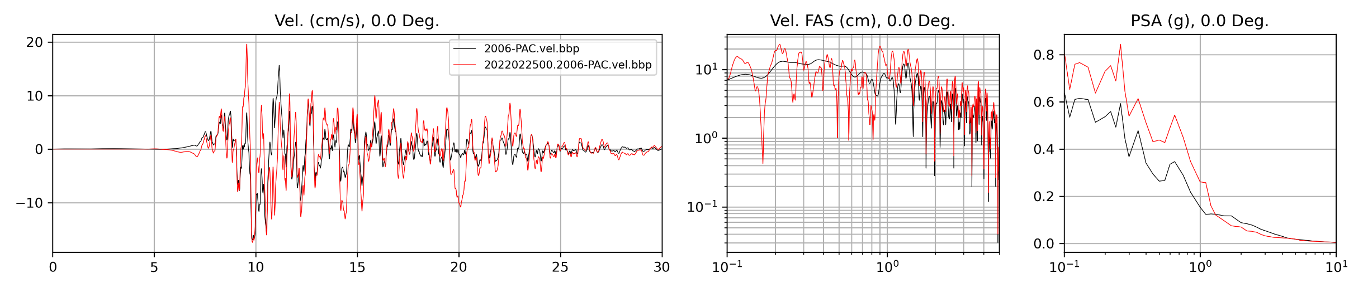
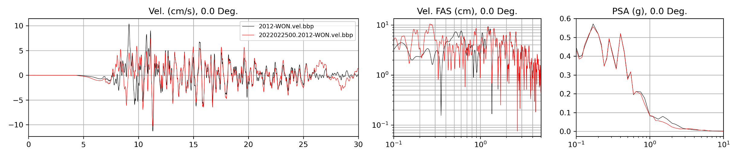
3D Broadband CyberShake vs 1D BBP
Station SYL
Station PAC
Station WON
Freq (Hz)
Period (sec)
— 3D CyberShake — 1D BBP

Slide 10
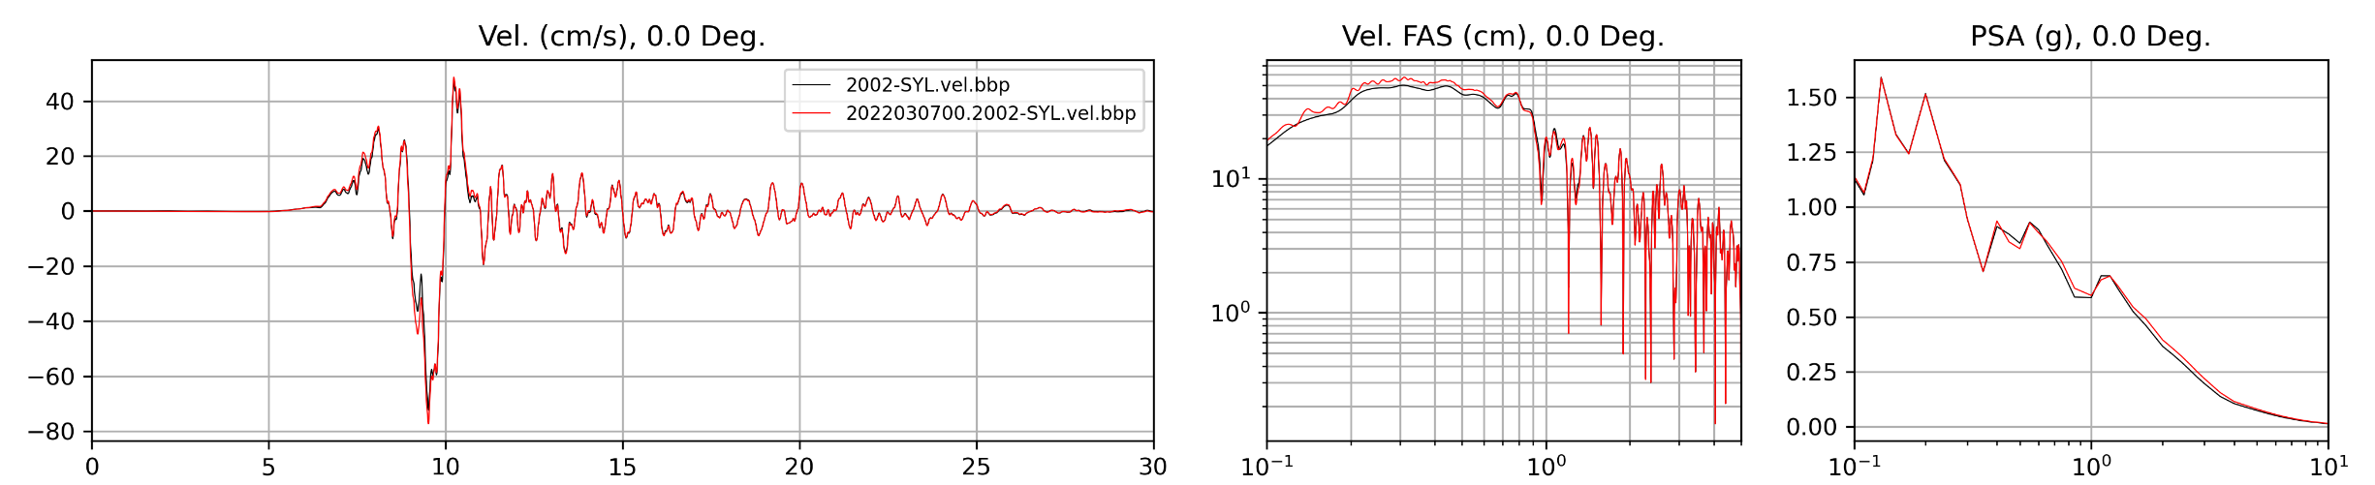
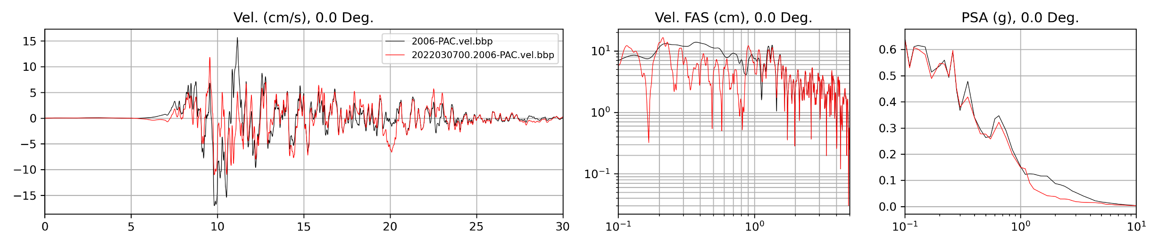

3D BB CS vs 1D BBP, same Vs30
Station SYL
Station PAC
Station WON
Freq (Hz)
Period (sec)
— 3D CyberShake — 1D BBP

Slide 11
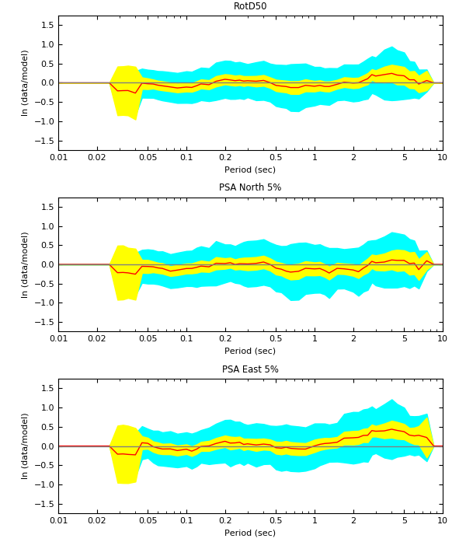
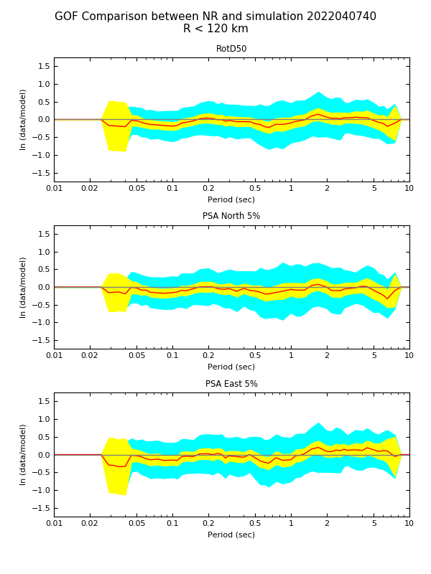
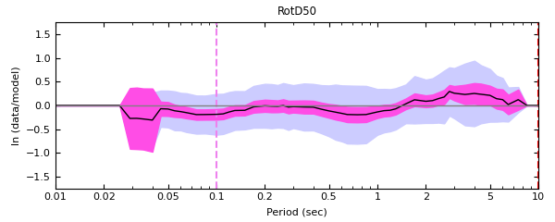
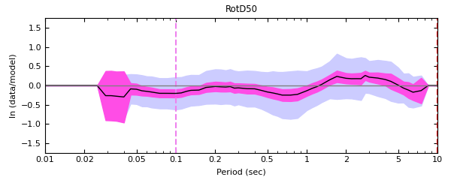
Northridge GoF Comparisons
38 stations, 64 realizations
BBP combined goodness-of-fit
CyberShake combined goodness-of-fit
Smallest bias, BBP
Smallest bias, CyberShake

Slide 12
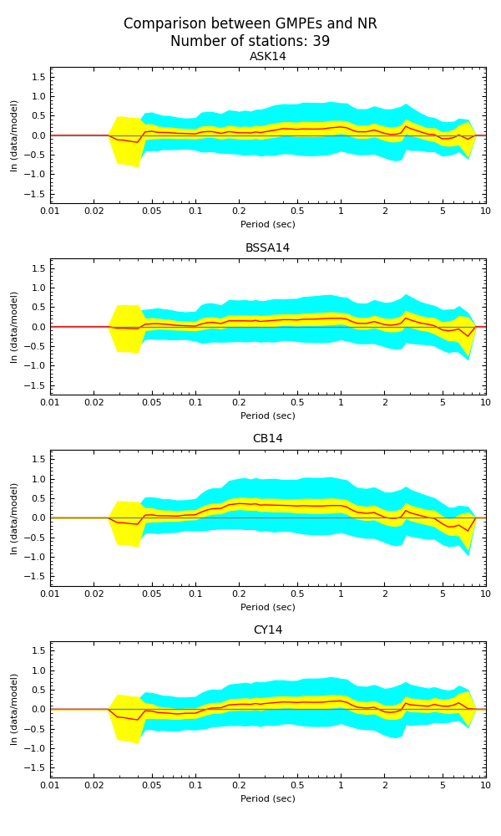
Northridge GoF Comparisons
Smallest bias, BBP
Smallest bias, CyberShake
4 NGA West2 GMMs

Slide 13
Future Plans
Continue investigating Northridge results
Broadband CyberShake validation with other historic events
  Landers
  North Palm Springs
  Whittier
  Chino Hills
Broadband CyberShake hazard map for Southern California

Slide 14










Thanks!

