Slide 1
Producing GMPE-Based maps
UCVM query needs

Slide 2
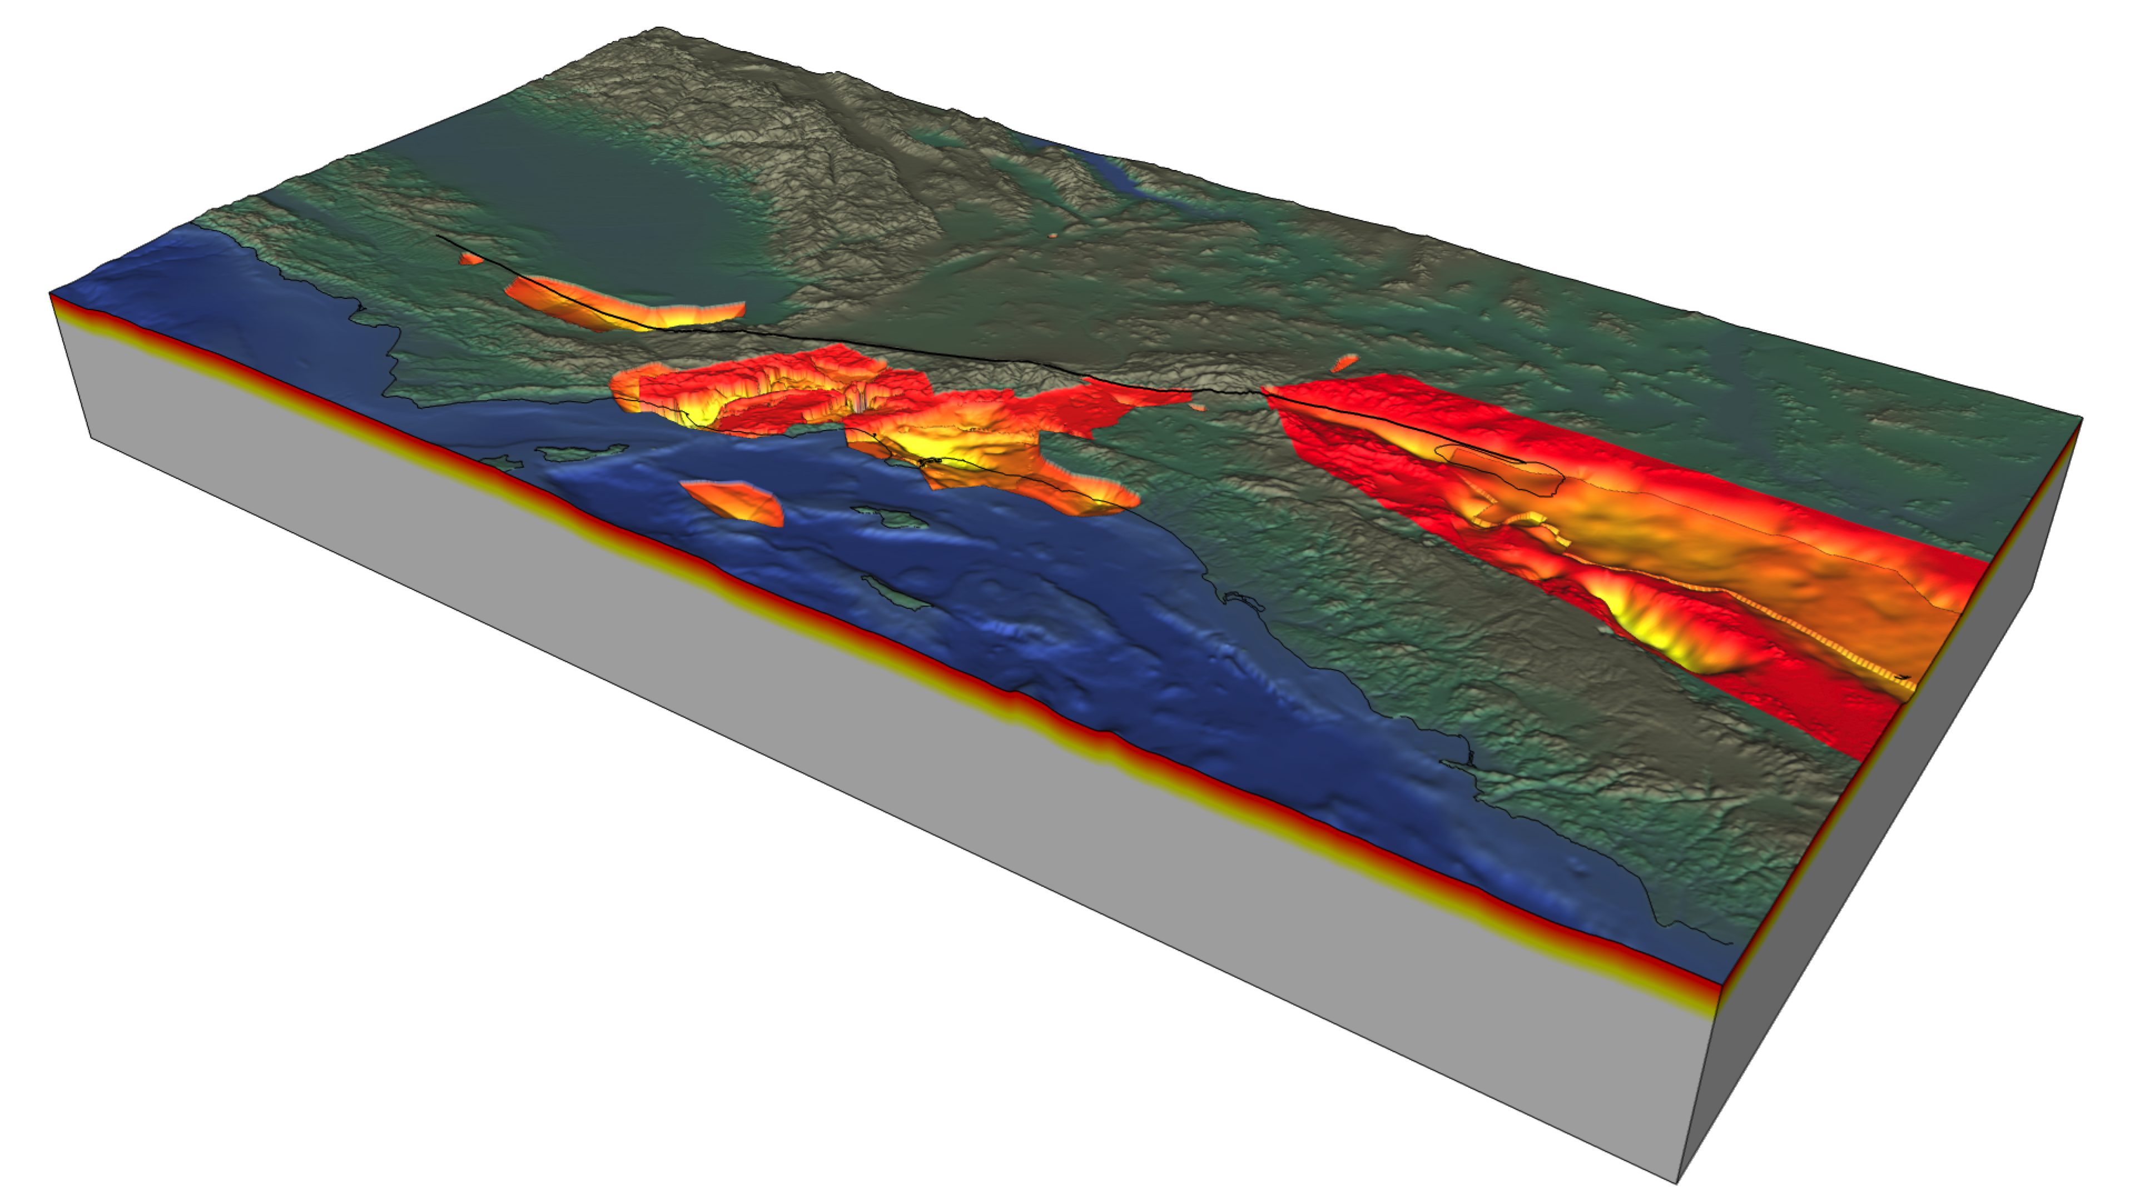
Basin effects – wave reflections in soft sediments

Slide 3
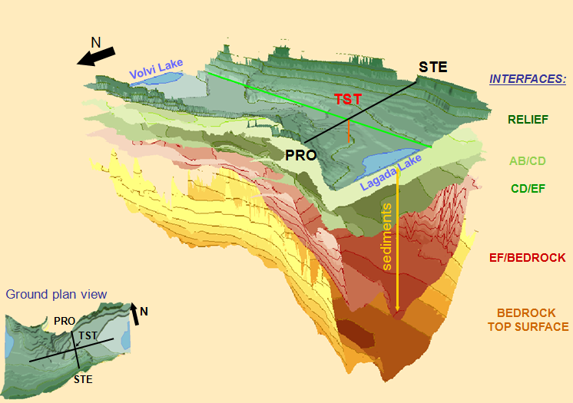
Basin effects – wave reflections in soft sediments

Slide 4
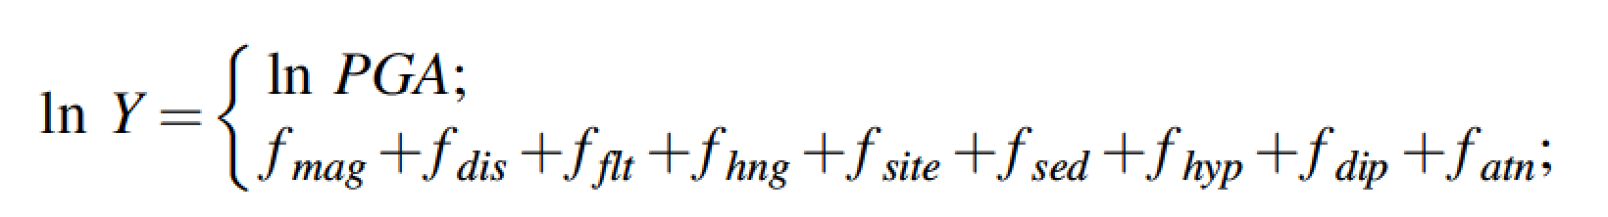
GMPE/GMM
Ground Motion prediction Equation/Ground Motion Models
  Developed using recorded ground motions
  Contain multiple “terms” to quantify ground
  motions:
  Use a proxy for basin effects...

Slide 5
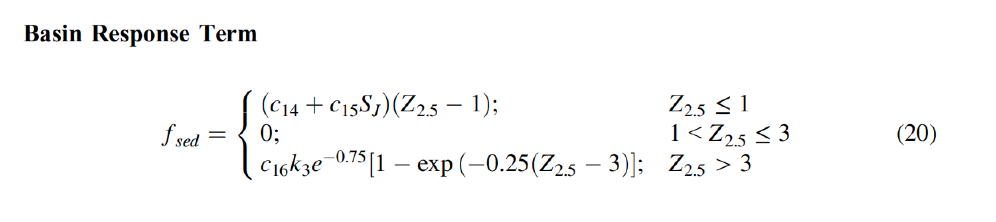
Basin effects in GMPEs
Example of Campbell and Bozorgnia 2014:
Depth to “rock” used as a proxy to model basin effects
Z2.5: depth to shear wave velocity (Vs) of 2.5 km/s
Z1.0 is also used: depth to shear wave velocity (Vs) of 1 km/s

Slide 6
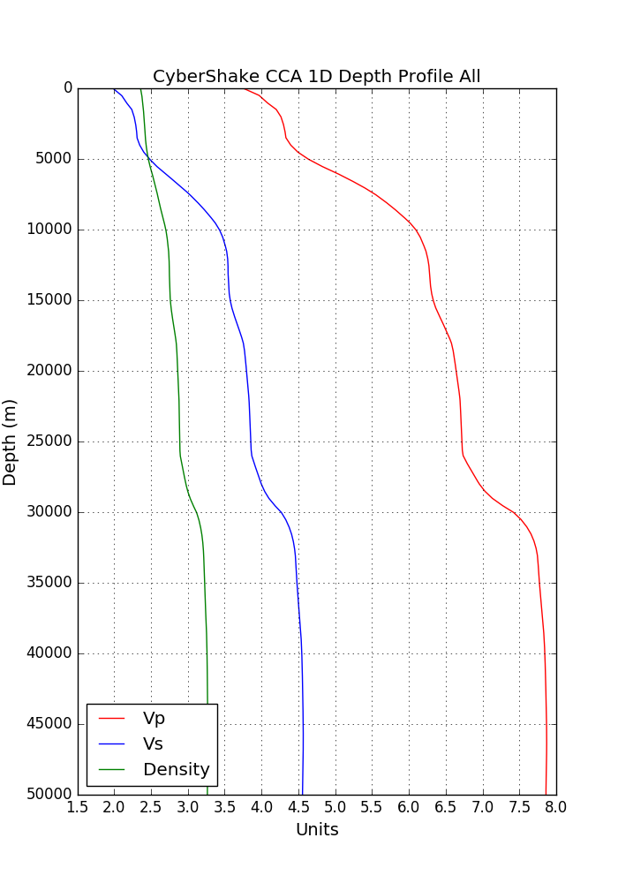

Slide 7
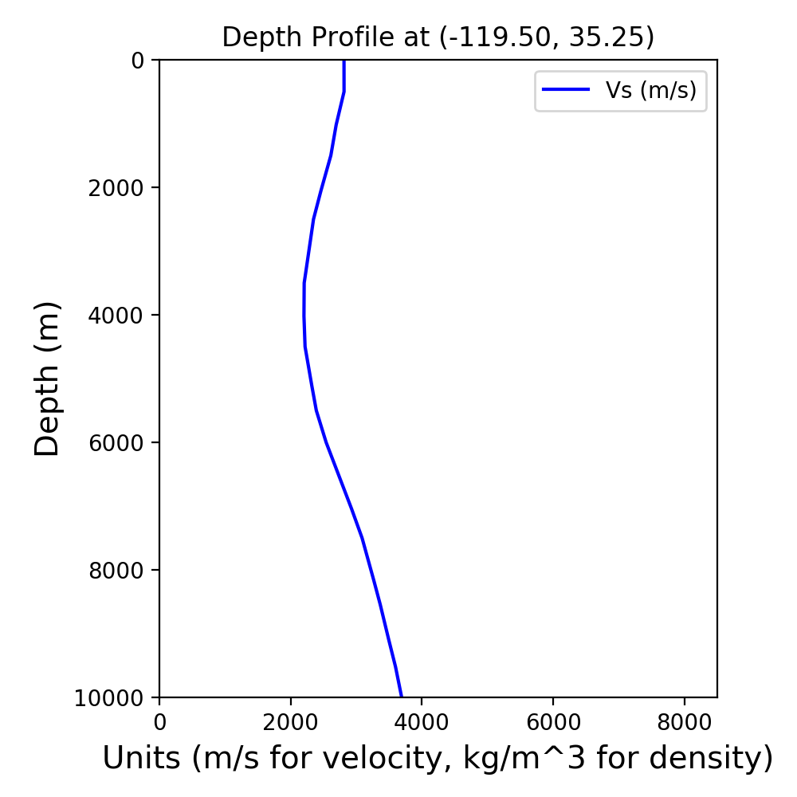
Issues in our CVMs – due to tomography process

Slide 8
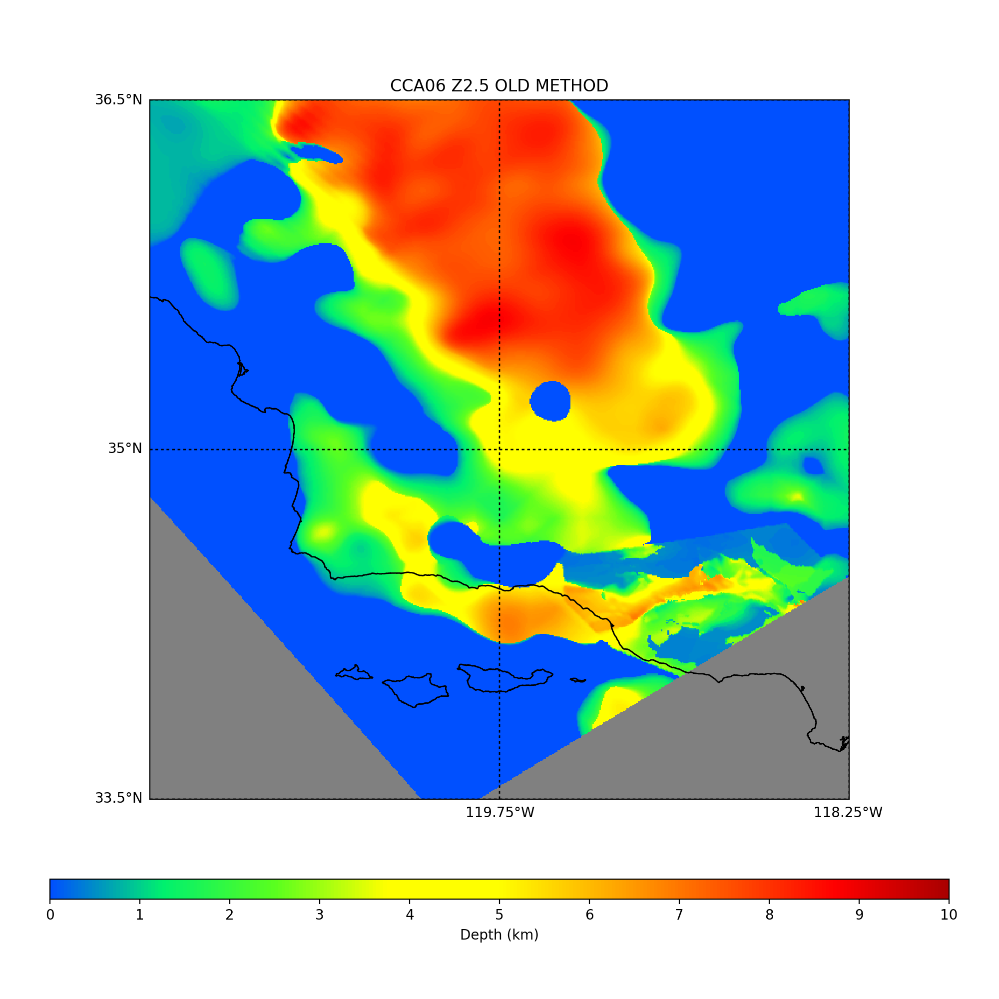

Z2.5: first crossing
Z2.5: second crossing

Slide 9
How should we get Z1.0 and Z2.5?
Depends on the cause of artifacts in the tomography-derived models
  Definitely not the first Z2.5 crossing if it’s at the surface
  Definitely not the first Z1.0 crossing if it’s at the surface and there is another one below
  Po and En-Jui preferred the “last crossing”, which in most cases is the second one

Slide 10
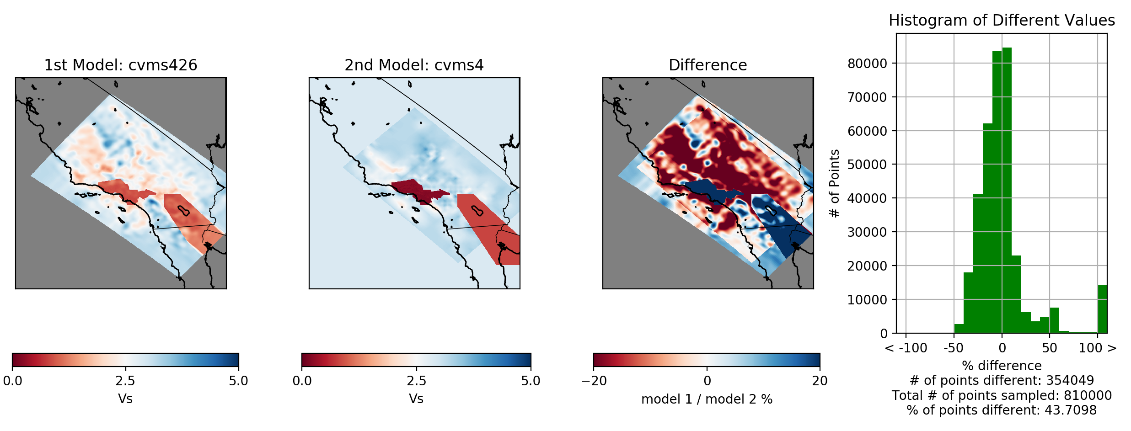
Toward GMPE maps
Decide on Z definition (first, second or last crossing): create maps for each, evaluate
Compare mapped Z values directly
Then compare ground motion results using GMPEs in OpenSHA

