Slide 1
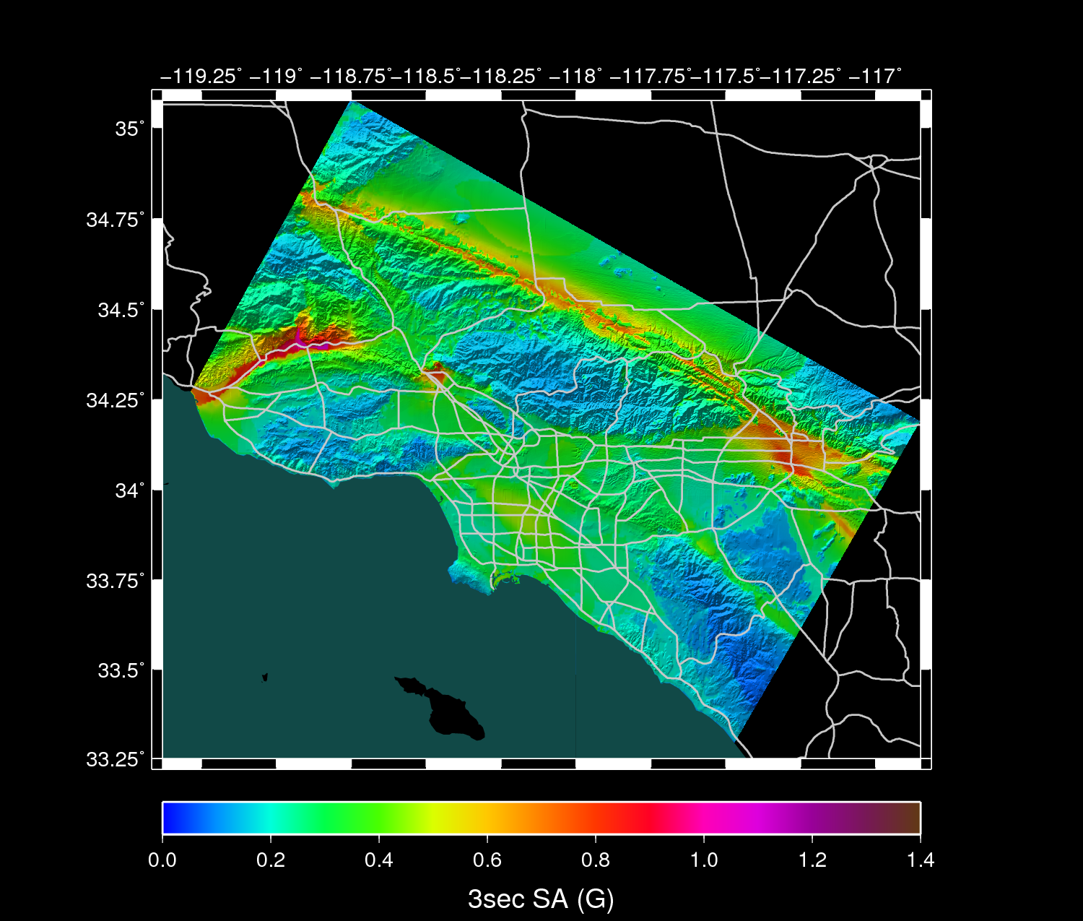
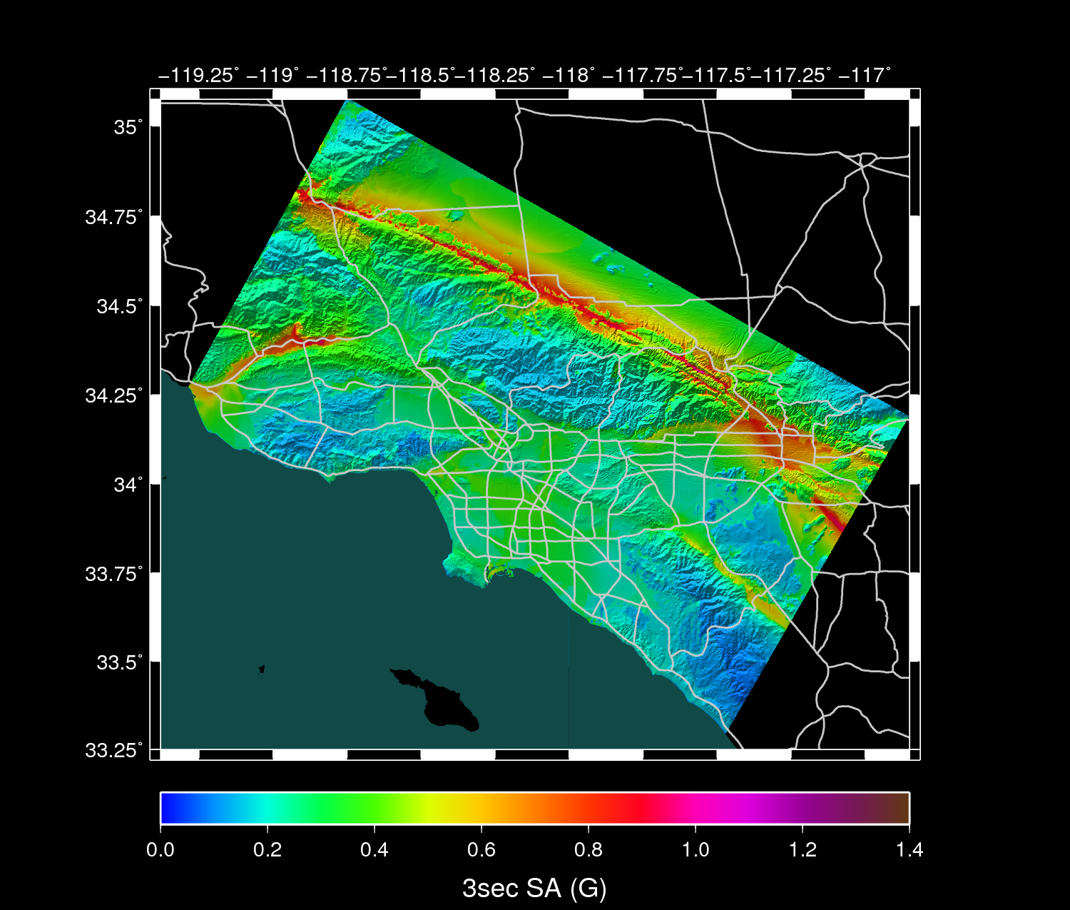
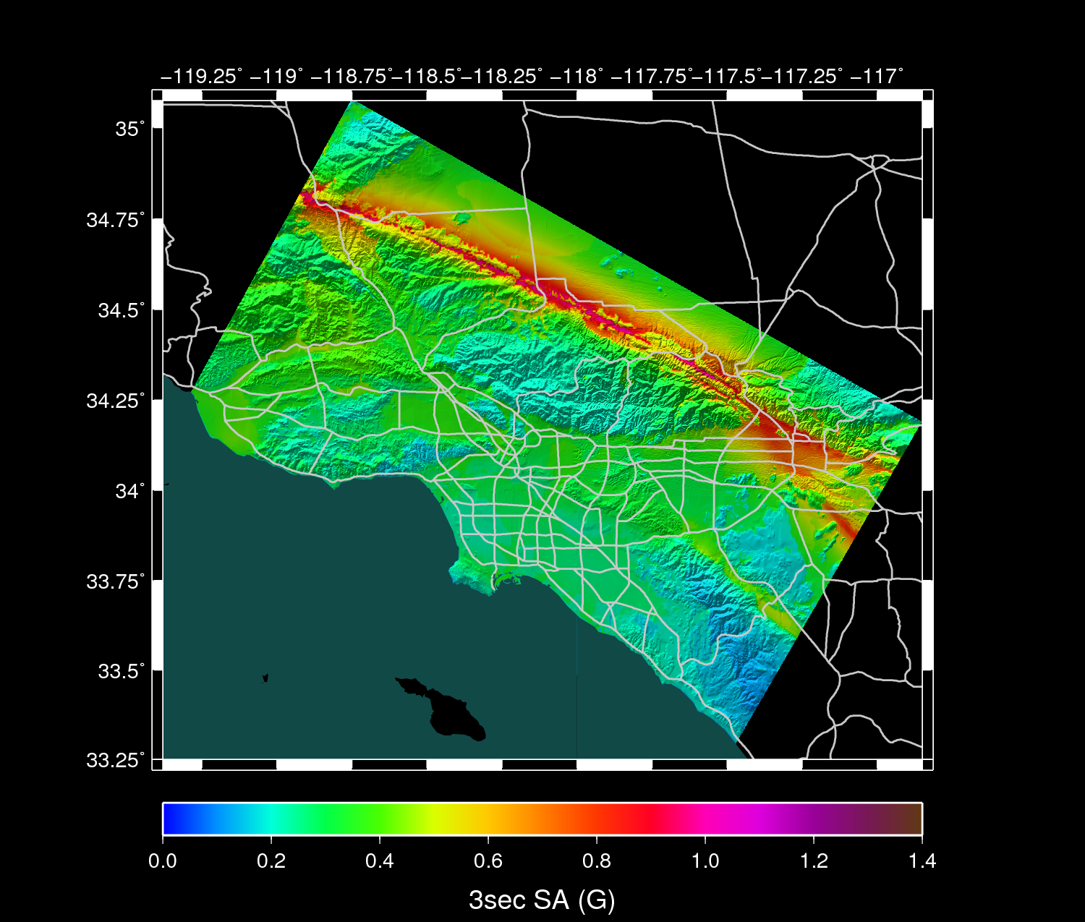
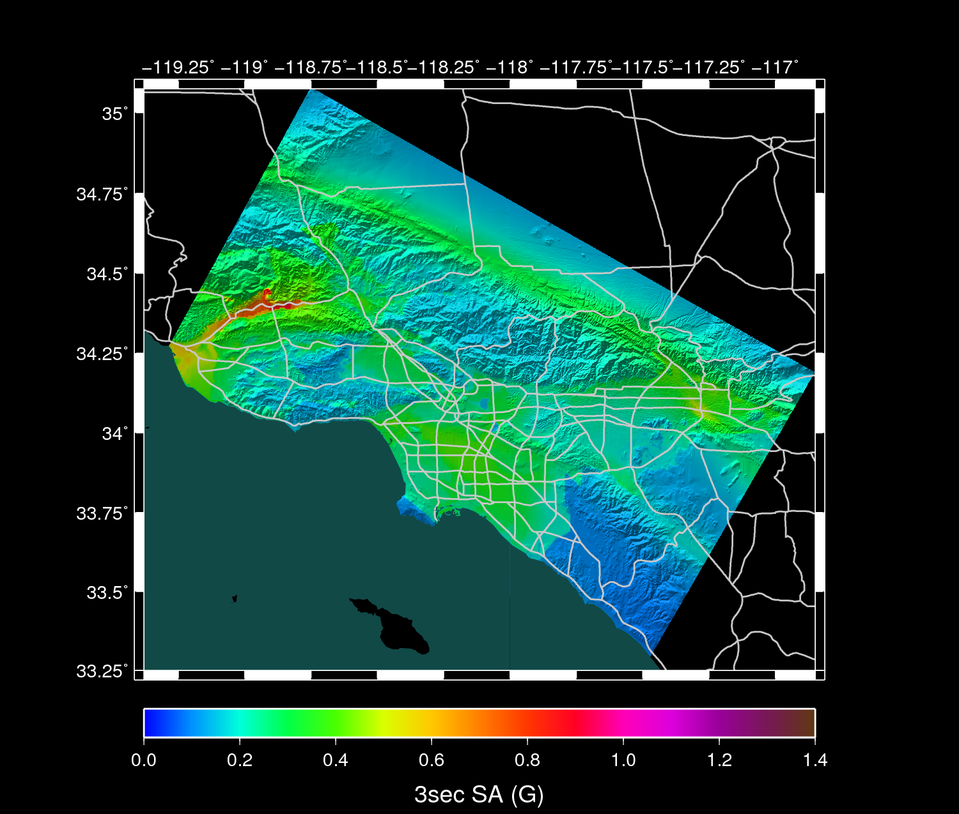
Epistemic Differences
NGA (2008) Attenuation Relations used in National Seismic Hazard Maps
NGA
Campbell & Bozorgnia
NGA
Chiou & Youngs
near-fault effects
basin effects
NGA
Boore & Atkinson
SA-3s
NGA
Abrahamson & Silva
PE = 2%/50 yr
UCERF2, no background seismicity

Slide 2

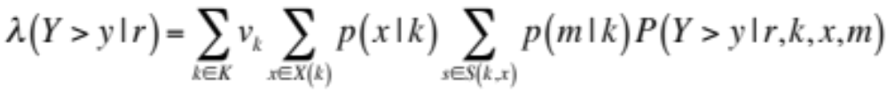
Ground Motion Prediction Equations
Formulation of time-independent PSHA for empirical GMPEs:
conditional hypocenter distribution (CHD)
conditional magnitude distribution (CMD)
F₁ site effect
F₂ path effect
F₃ directivity effect
F₄ source-size effect
Earthquake Rupture
Forecast
Ground Motion
Prediction Eqn
Intensity
Measures

Slide 3

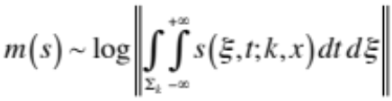
CyberShake Hazard Model
Formulation of time-independent PSHA for CyberShake simulations:
conditional hypocenter distribution (CHD)
conditional slip distribution (CSD)
CSD magnitude functional:
Extended EFR
KFR
AWP
NSR
Ground
Motion
Physics-based
simulations
Earthquake Rupture
Forecast
Ground Motion
Prediction Eqn
Intensity
Measures
Empirical PSHA
model
KFR = kinematic fault rupture model
AWP = anelastic wave propagation model
NSR = nonlinear site response

Slide 4
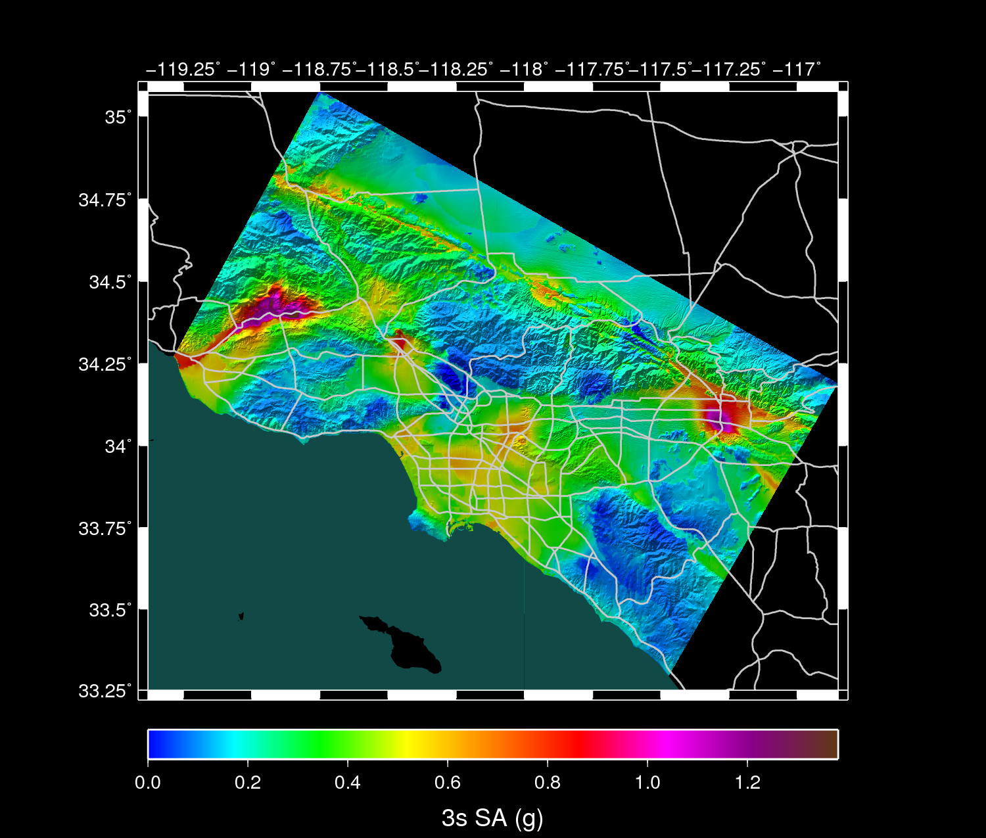
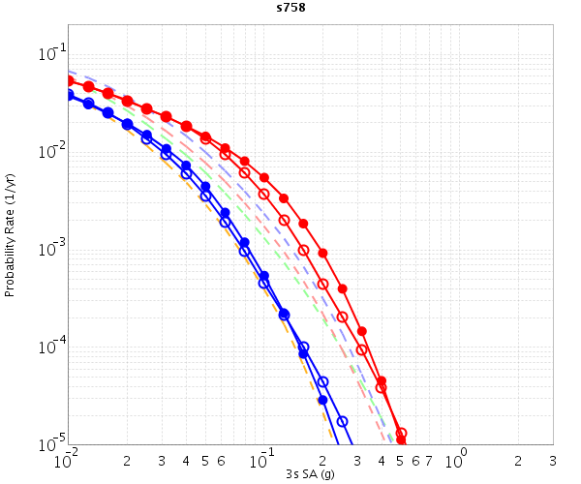
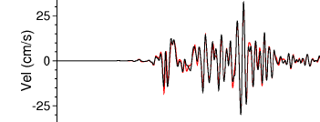
CyberShake Hazard Model
hazard maps
hazard curves
seismograms
Extended EFR
KFR
AWP
NSR
Ground
Motion
Physics-based
simulations
Earthquake Rupture
Forecast
Ground Motion
Prediction Eqn
Intensity
Measures
Empirical PSHA
model
KFR = kinematic fault rupture model
AWP = anelastic wave propagation model
NSR = nonlinear site response

Slide 5
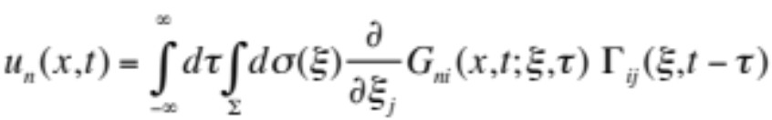

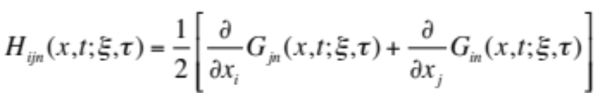
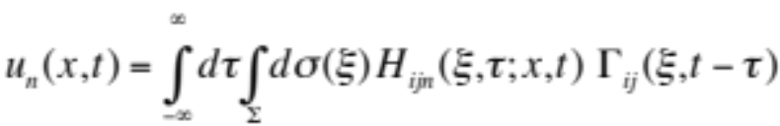
Computational Efficiency of Seismic Reciprocity
To account for source variability requires very large sets of simulations
  7,000 ruptures from UCERF2; 415,000 rupture variations
Ground motions can be calculated at much smaller number of surface sites to produce hazard map
  283 in LA region, interpolated using empirical attenuation relations
Elastodynamic representation theorem
Reciprocity
Strain Green tensor (SGT)
Site-oriented simulation
Use of reciprocity reduces CPU time by a factor of ~1,000
Receiver
Source 1
Source 2
Source 3
M sources to N receivers requires M simulations
M sources to N receivers requires 2N or 3N simulations

Slide 6
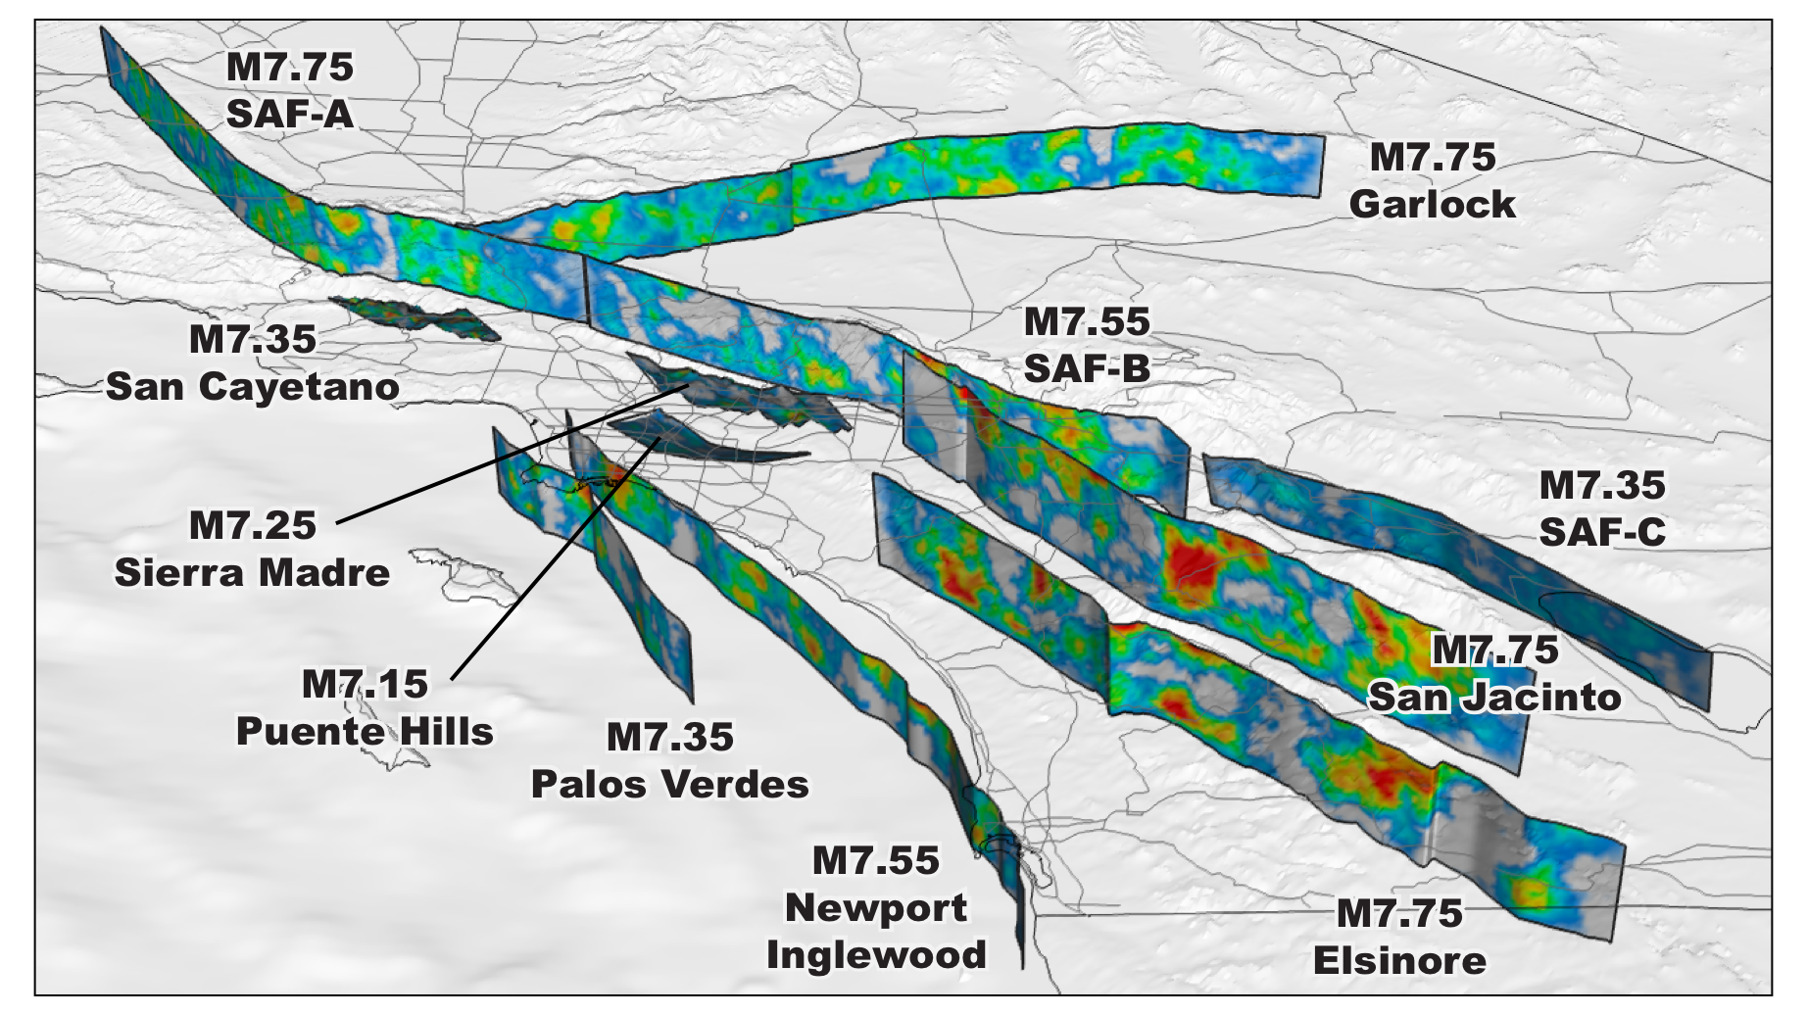
CyberShake Rupture Models

Slide 7
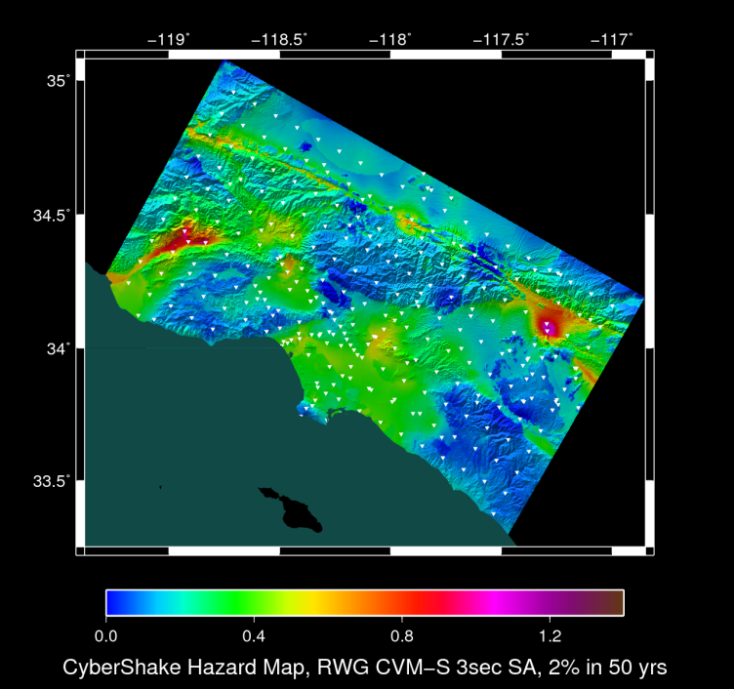
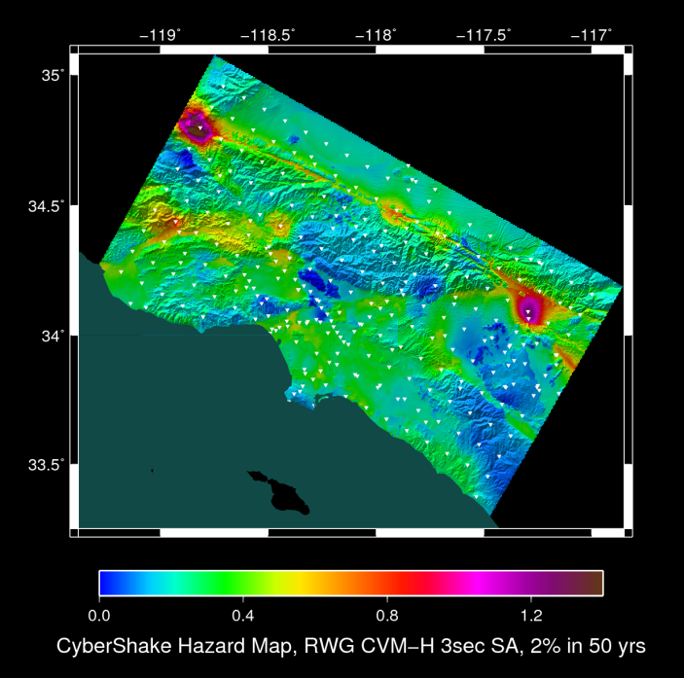

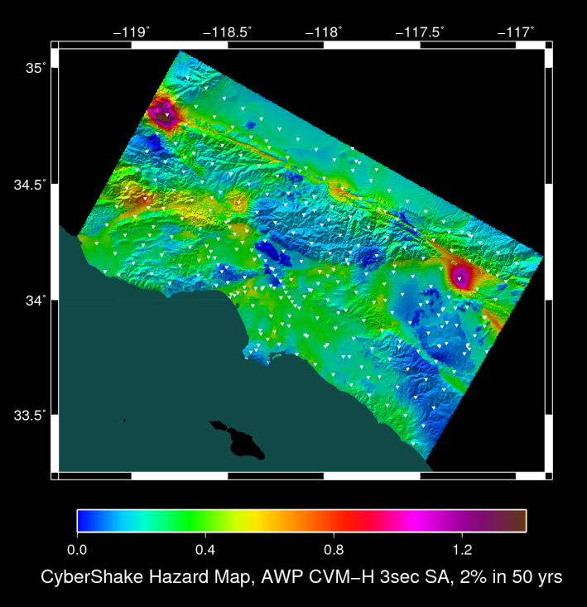
CyberShake Hazard Maps from CS13 Study
CS13a
CS13b
Graves SGTs
CS13c
CS13d
AWP-ODC SGTs
CVM-S4
CVM-H11

Slide 8
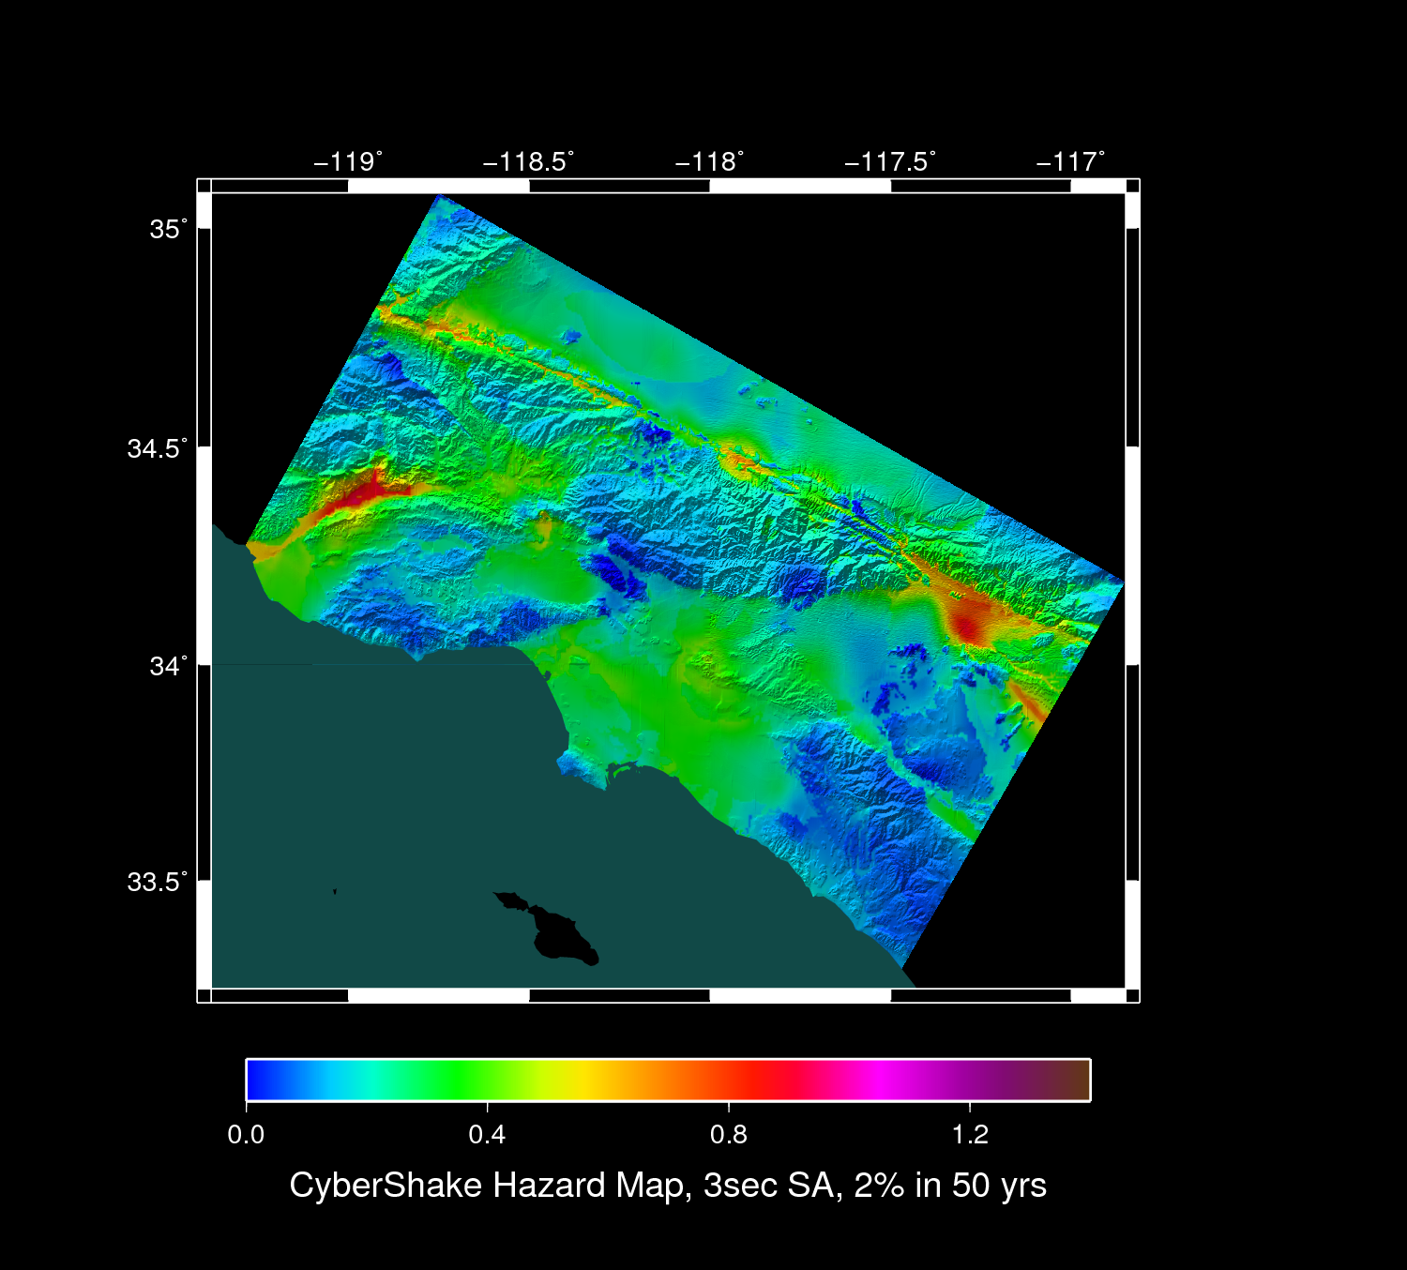
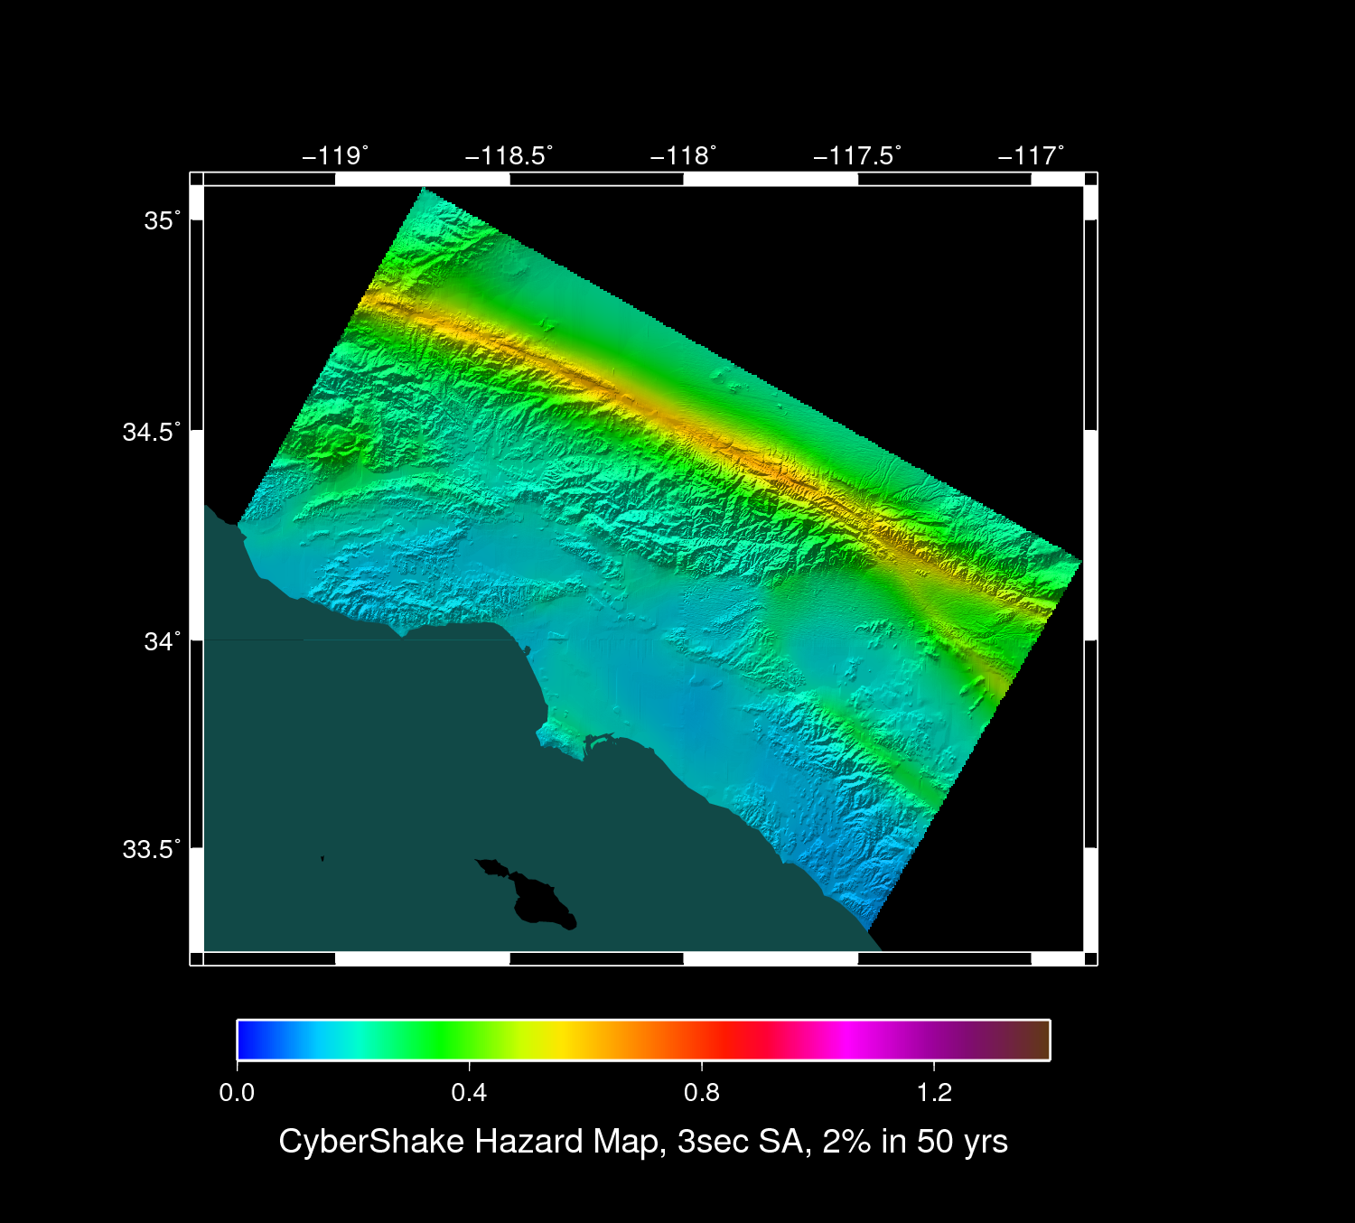
CS11 : CVM-S4
CS13 : CVM-H11
CS14 : CVM-S4.26
CS14 : BBP-1D

Slide 9
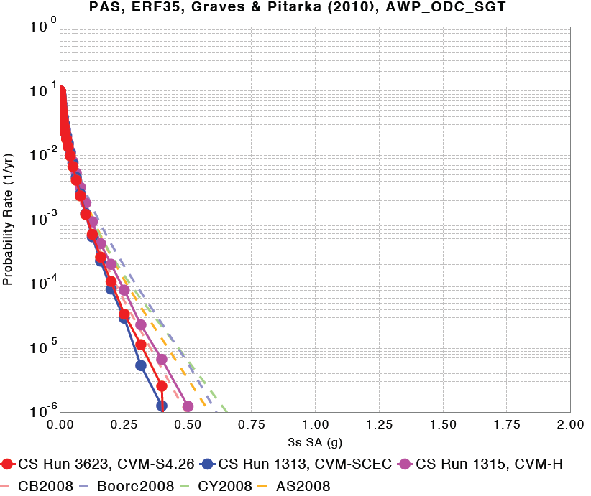
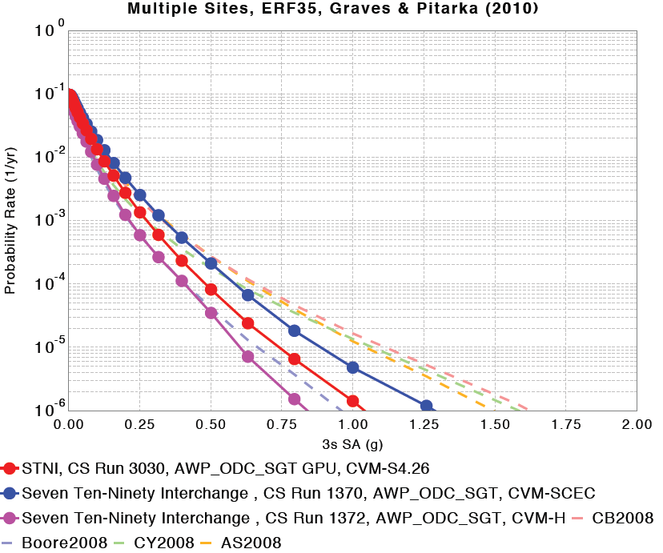
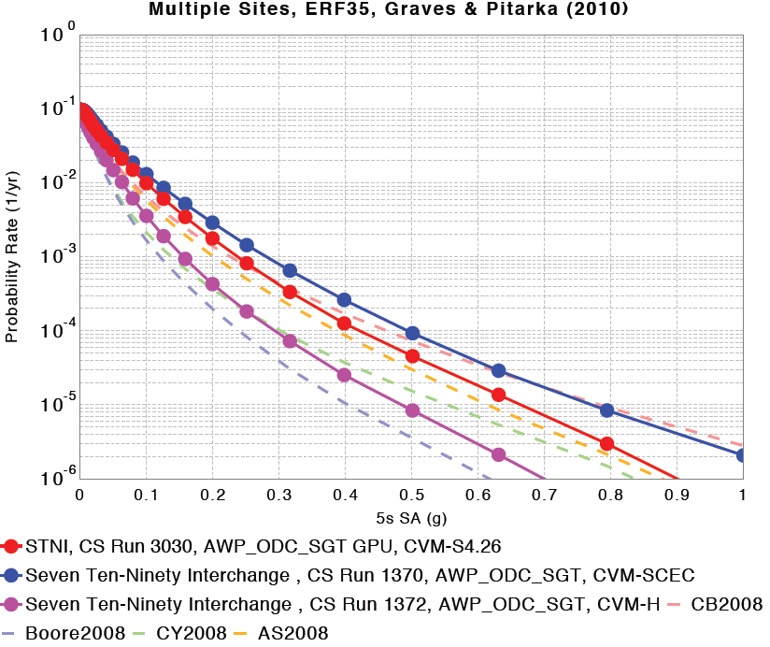
NGA08-CyberShake Comparisons
Site STNI

Slide 10
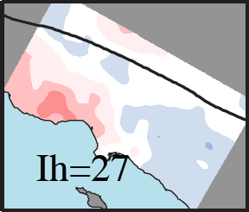
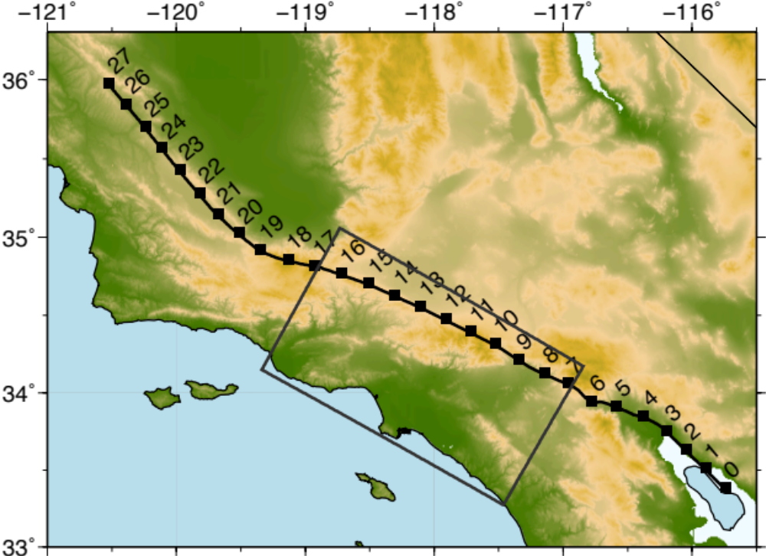
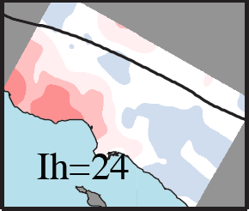
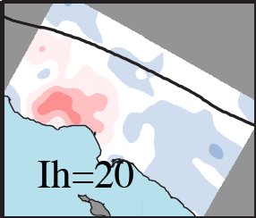
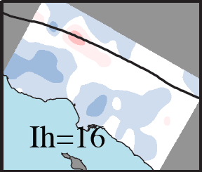
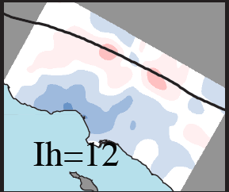
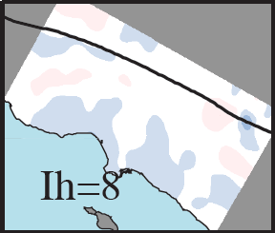
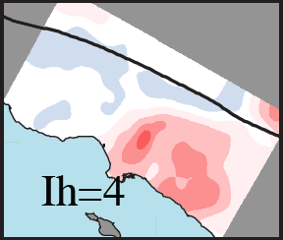
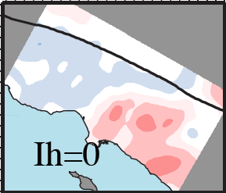

ABF Directivity-Basin Coupling Maps
(M8 source; variable hypicenter; SA-3s corrected for SC08 directivity)
Wang & Jordan (2013)
coupling point
coupling point
ln d(r)

Slide 11

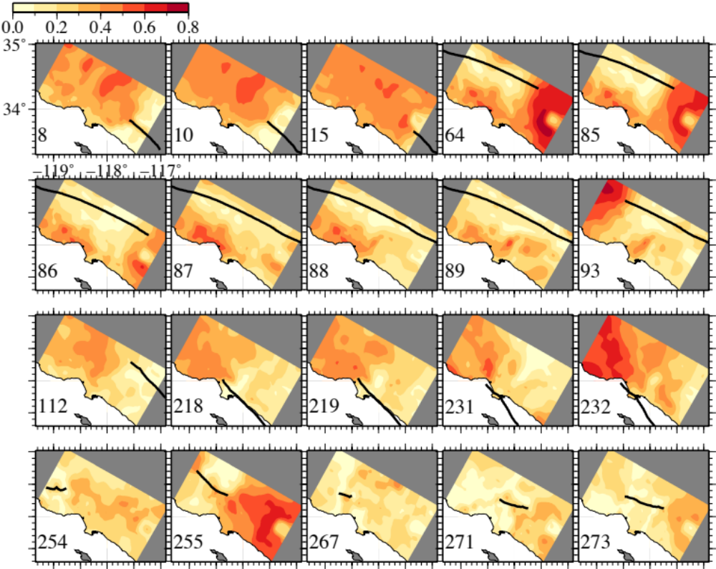
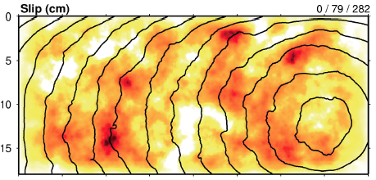
Dependence of Directivity Effects on Rupture Complexity
σ_{d} maps (SA-3s)
CS11 – SC08
GP07
used in CS11
Model σ_{d}
GP07 raw 0.41
GP07-SC08 0.31
Notes:
All sources sigma_d (cybershake1 – BA)

Slide 12
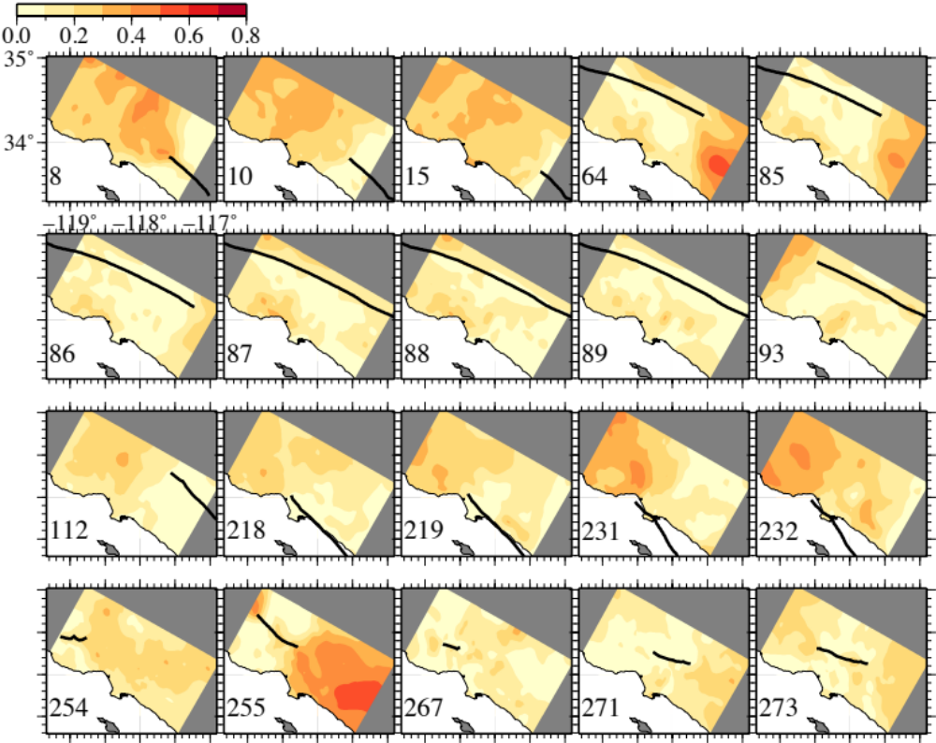
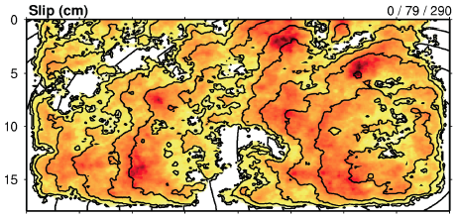
Dependence of Directivity Effects on Rupture Complexity
σ_{d} maps (SA-3s)
CS13a – SC08
GP10
used in CS13a
Model σ_{d}
GP07 raw 0.41
GP07-SC08 0.31
GP10 raw 0.26
GP10-SC08 0.17
Notes:
All sources sigma_d (CyberShake2 – BA)

Slide 13
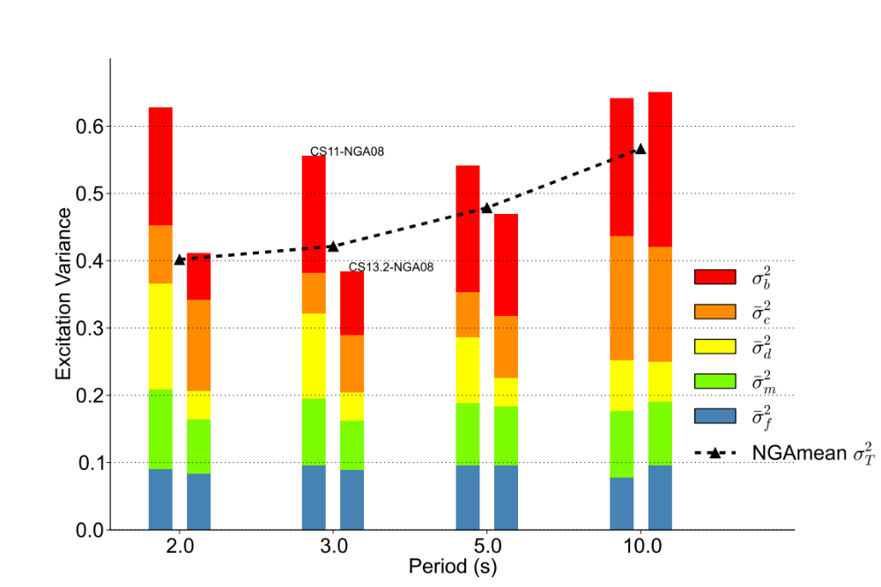
ABF Variance Analysis
Reduction in site-effect & directivity-effect variance
CS11-
NGA08
CS13.b-
NGA08
NGA08
σ_{T}²
Residual Variance
site
path
directivity
magnitude
source complexity

Slide 14
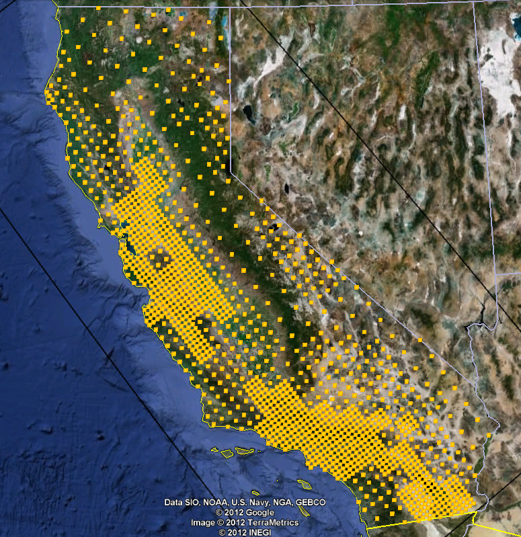
CyberShake: Initiative to Compute a Statewide Physics-Based Hazard Model
Extend CyberShake models to 1400 sites across California
  Develop statewide Unified Community Velocity Model (UCVM)
  Compute site response to 1 Hz deterministic, 10 Hz stochastic
Couple time-dependent UCERF3 to CyberShake
  Provide frequently updated time-dependent seismic hazard maps
Extend CSEP to prospectively test ground motion forecasts against observations throughout California
Statewide CyberShake
Computational requirements for 1 Hz deterministic, 10 Hz stochastic:
  Number of jobs: 23.2 billion
  Storage: 2800 TB seismograms
  Computer hours: 392 million

