Slide 1
10 years of CyberShake:
Where are we now and where are we going with physics-based PSHA?
Scott Callaghan, Robert W. Graves, Kim B. Olsen, Yifeng Cui, Kevin R. Milner,
Christine A. Goulet, Philip J. Maechling, Thomas H. Jordan
2017 SCEC Annual Meeting September 11, 2017

Slide 2
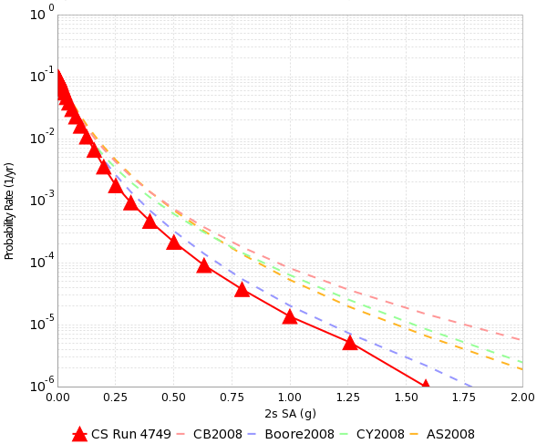
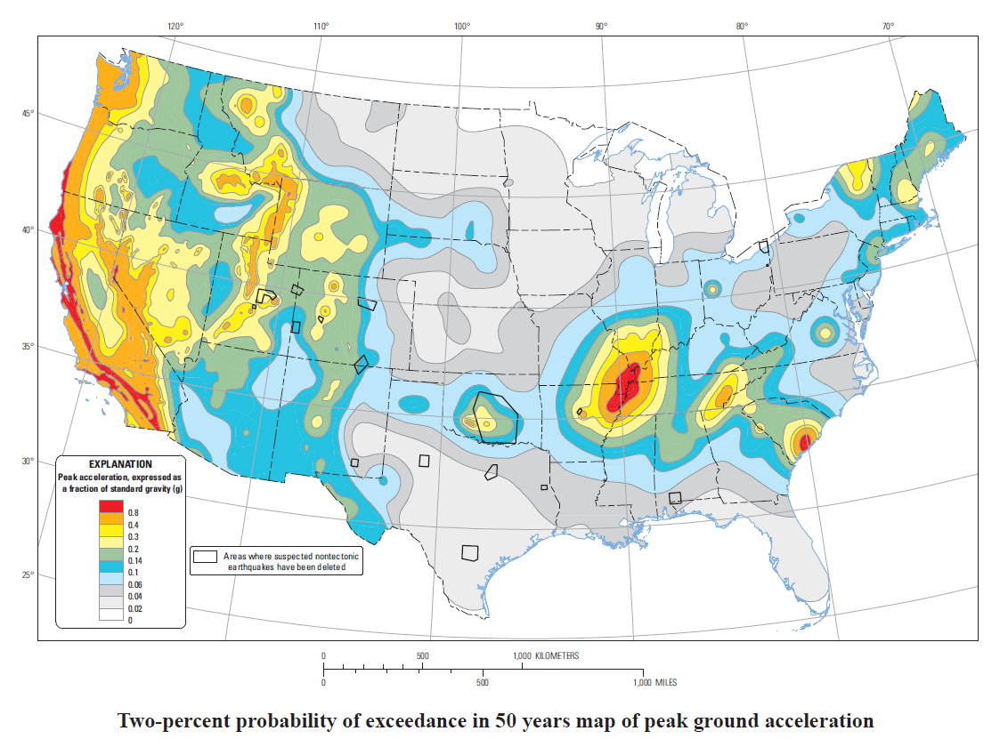
Probabilistic Seismic Hazard Analysis (PSHA)
Method for probabilistically quantifying expected shaking over a given time frame
Useful for:
  Building engineers
  Disaster planning
  Insurance rates
PSHA is performed by
  Assembling a list of earthquakes
  Determining intensity measures from each event
  Combining the intensity measures with probability of occurrence
2% in 50 yrs
0.4 g

Slide 3
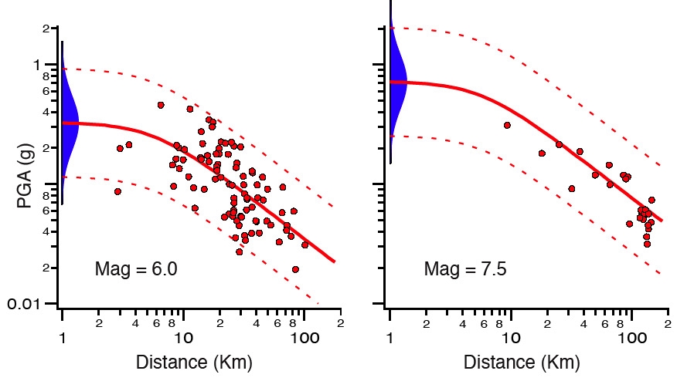
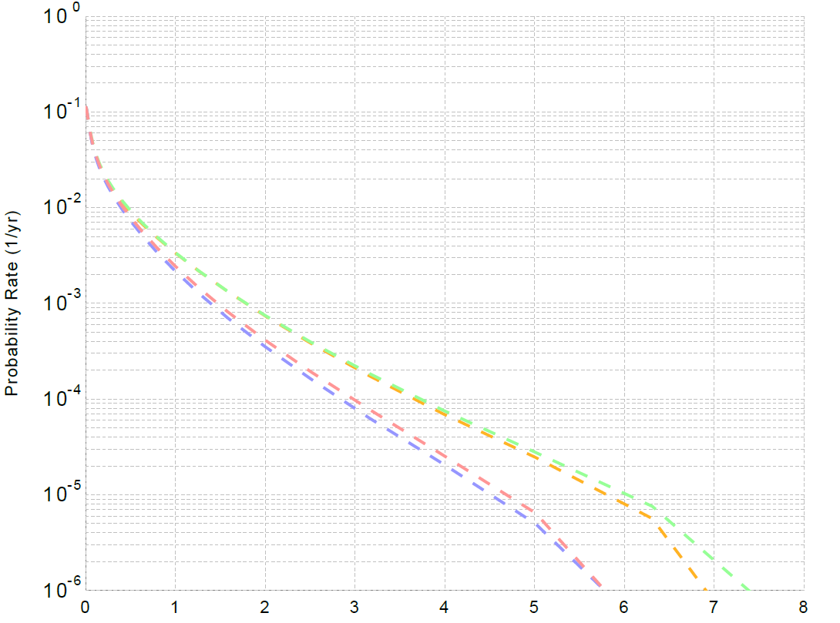
PSHA Approaches
Empirical – Ground Motion Prediction Equations (GMPEs)
Simulation – reduce uncertainty by capturing
variability in source description, velocity model
Limited large magnitude data
Limited near-fault data
Large variability
Long tails
6-7g
San Bernardino, 1 sec SA (g)

Slide 4

What is CyberShake?
SCEC’s 3D physics-based PSHA platform
7,000 ERF ruptures -> 500,000 events
  Slips and hypocenter locations varied
Simulating all variations is very expensive
Instead, use seismic reciprocity
  2 simulations per site
  200-500 sites needed for map
  Reduces computation by ~500x
Interpolate using GMPEs to produce map
Earthquake forecast: UCERF2
Structural model: CVM-S4.26

Slide 5
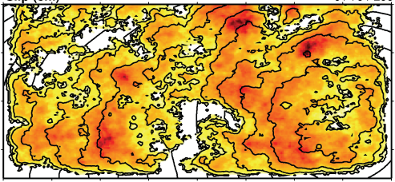
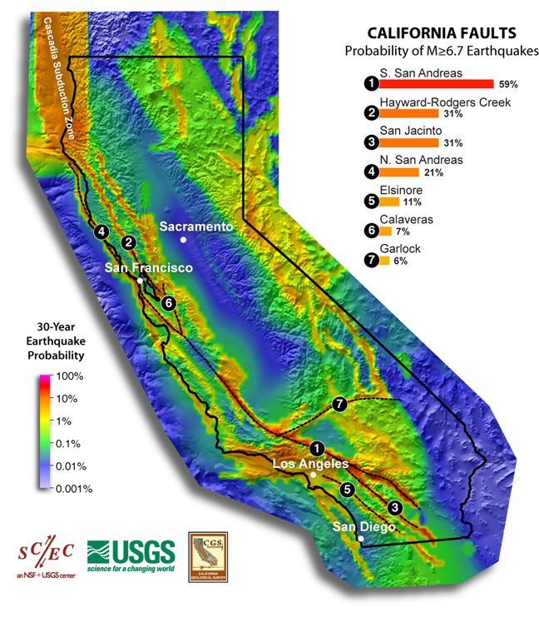

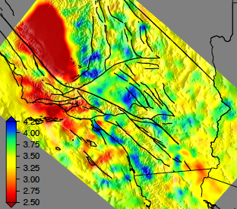
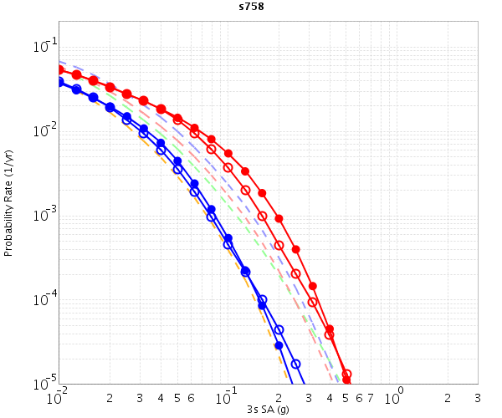
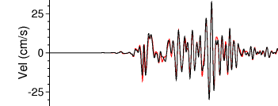
CyberShake Data Flow
Graves-Pitarka kinematic rupture generator
CyberShake Hazard Map
UCVM
(poster 302)
AWP-ODC
(poster 279)
Seismogram Synthesis
Data
Product Generation
12 TB
data transfer
Mesh generation
1 job per site
MPI, 1500-4000 cores
SGT computation
2 jobs per site
MPI, 200-800 GPUs
Post-processing
500,000 jobs per site
MPI master/worker, 3712 cores
Populate DB, construct images
6 jobs per site
Uniform California Earthquake Rupture Forecast
CVM-S4.26
z = 6 km
hazard curves
Most recent CyberShake study took 4 weeks of real time and used 21 million core-hours
500,000 Seismograms
75M intensity measures
Community Velocity Model

Slide 6

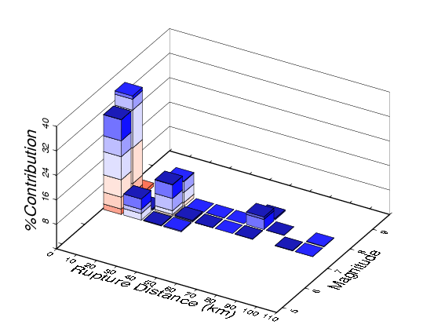
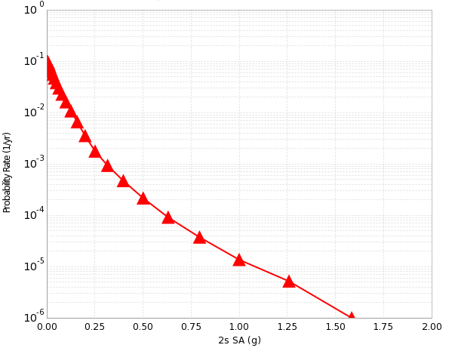
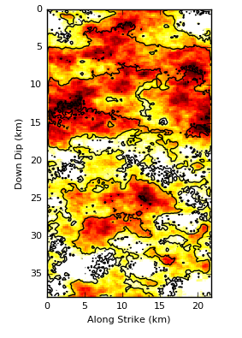
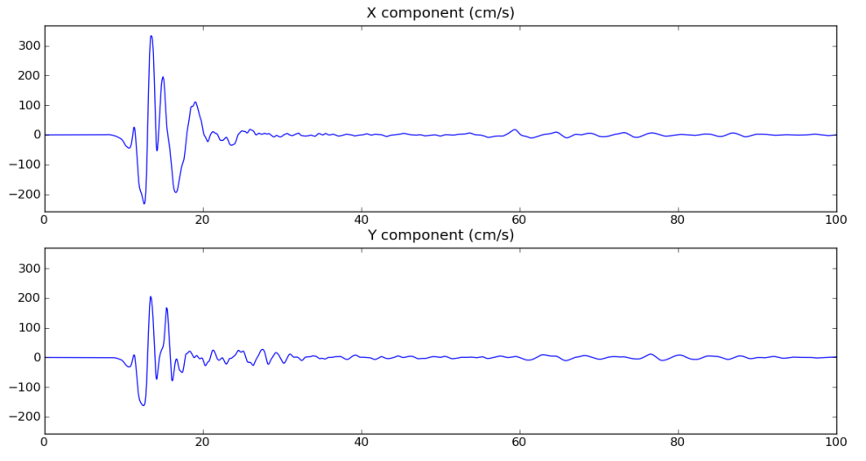
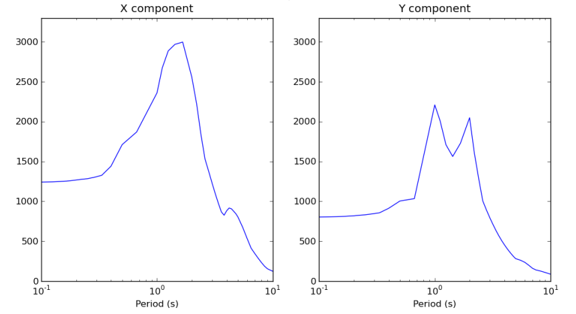
CyberShake Data Layers
Hazard Map
Hazard Curve
Disaggregation
Intensity Measures
Seismograms
Rupture Realization

Slide 7
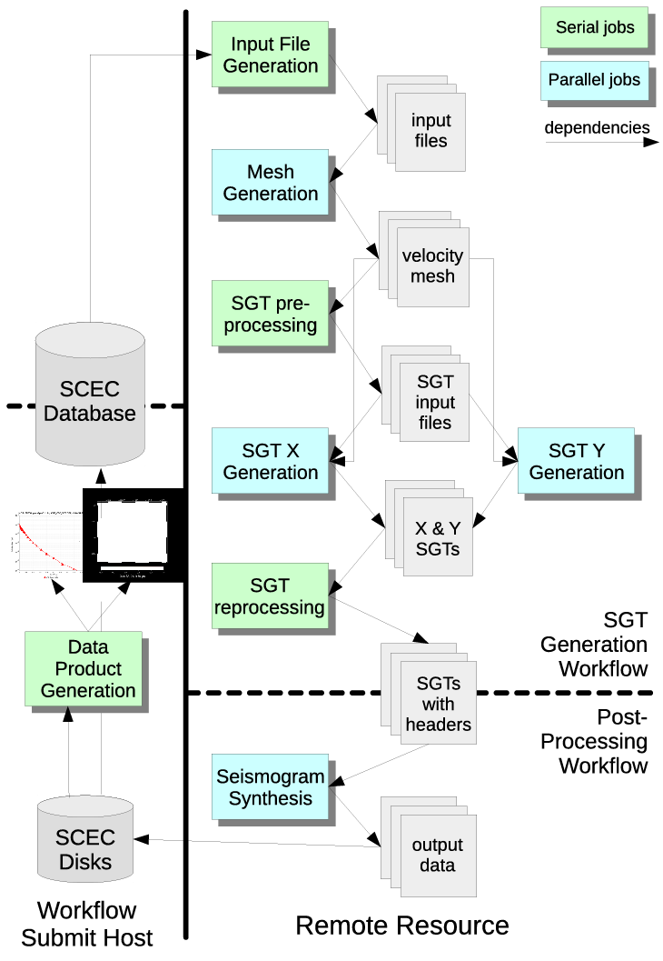
CyberShake Workflows
Scientific workflow tools orchestrate CyberShake simulations
  Pegasus-WMS, HTCondor, Globus
  Create description of workflow with files and dependencies
  Tools then manage real-time execution of workflow
Automation: supports running millions of jobs over weeks
Data management: files are automatically staged in and out
Resource provisioning: jobs submitted to multiple clusters
Enabled SCEC to scale CyberShake since 2007
  100 million core-hours
  2 billion two-component seismograms
  210 billion intensity measures

Slide 8
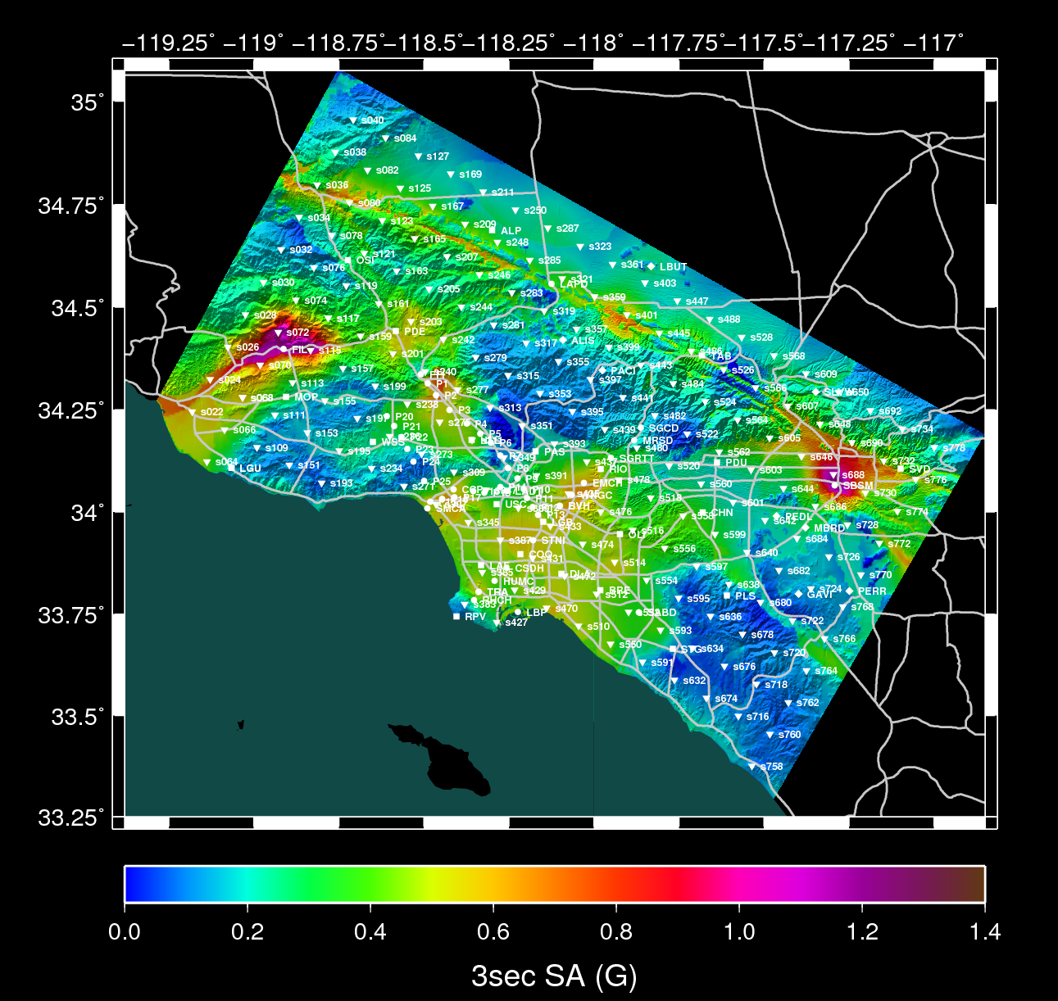
CyberShake Study 1.0
April-June 2009
223 sites in Southern California
0.5 Hz
UCERF 2
Graves & Pitarka 2007 rupture generator
Velocity models:
  CVM-S4

Slide 9
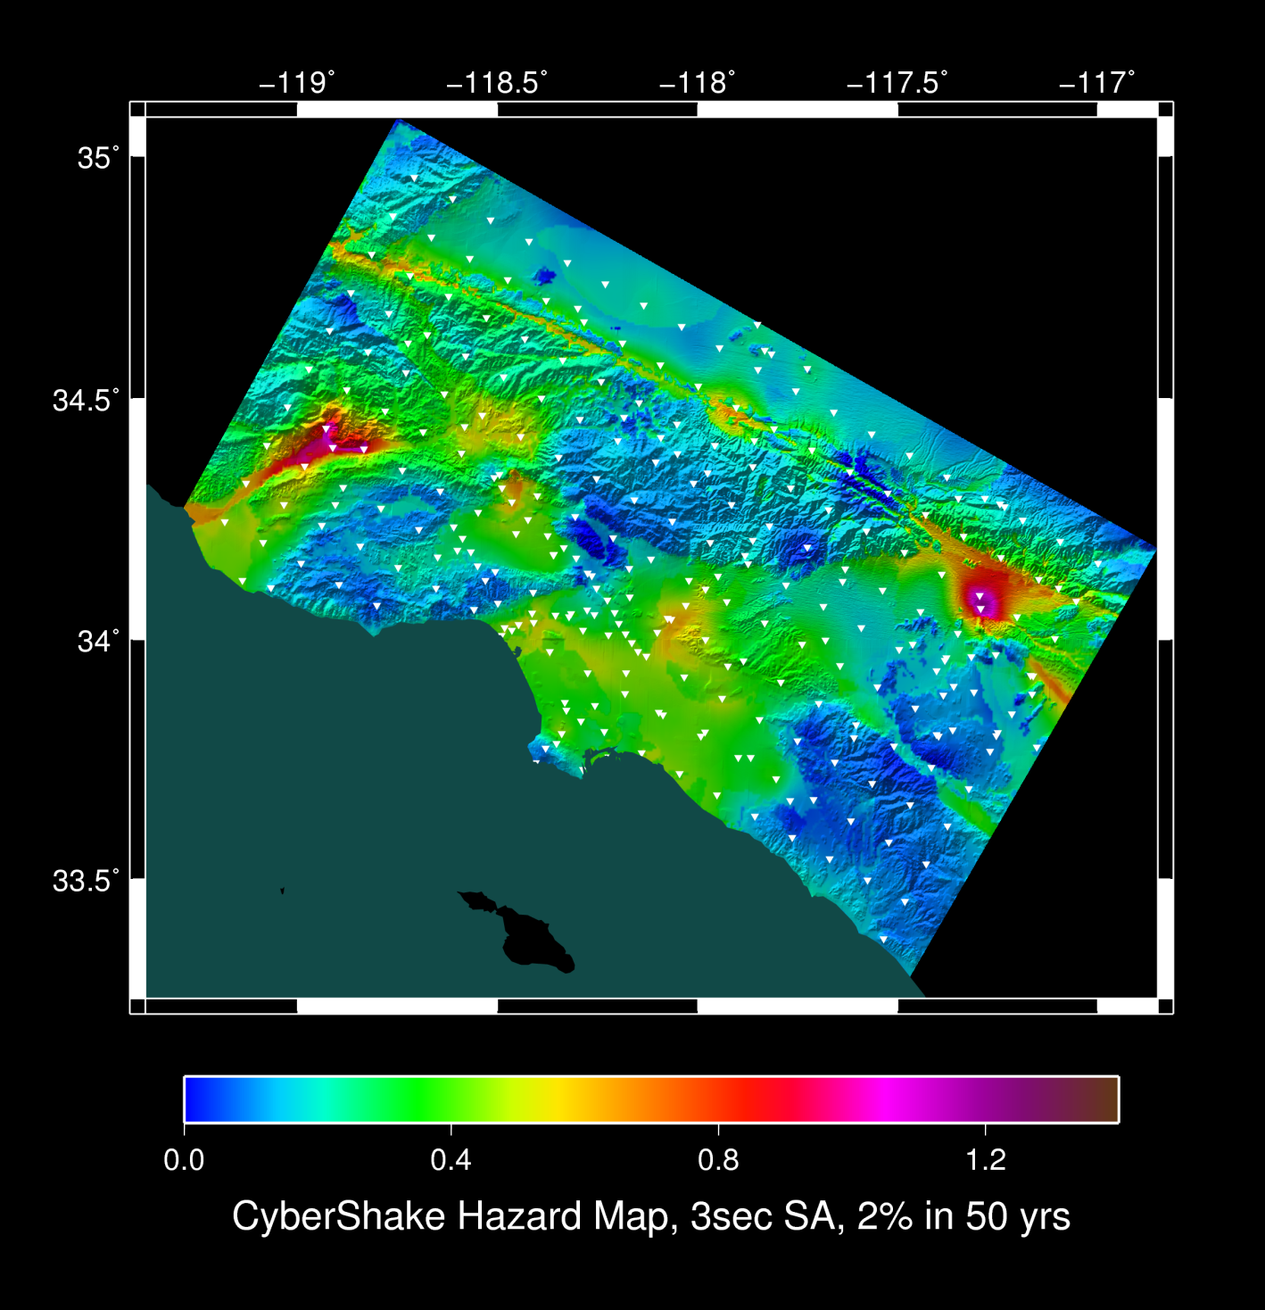
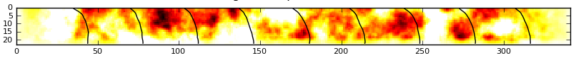
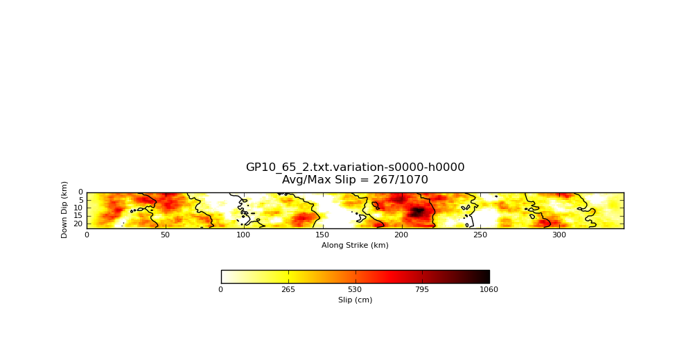
CyberShake Study 2.2
October 2012 – March 2013
223 sites in Southern California
0.5 Hz
UCERF 2
Graves & Pitarka 2010 rupture generator
Velocity models:
  CVM-S4

Slide 10
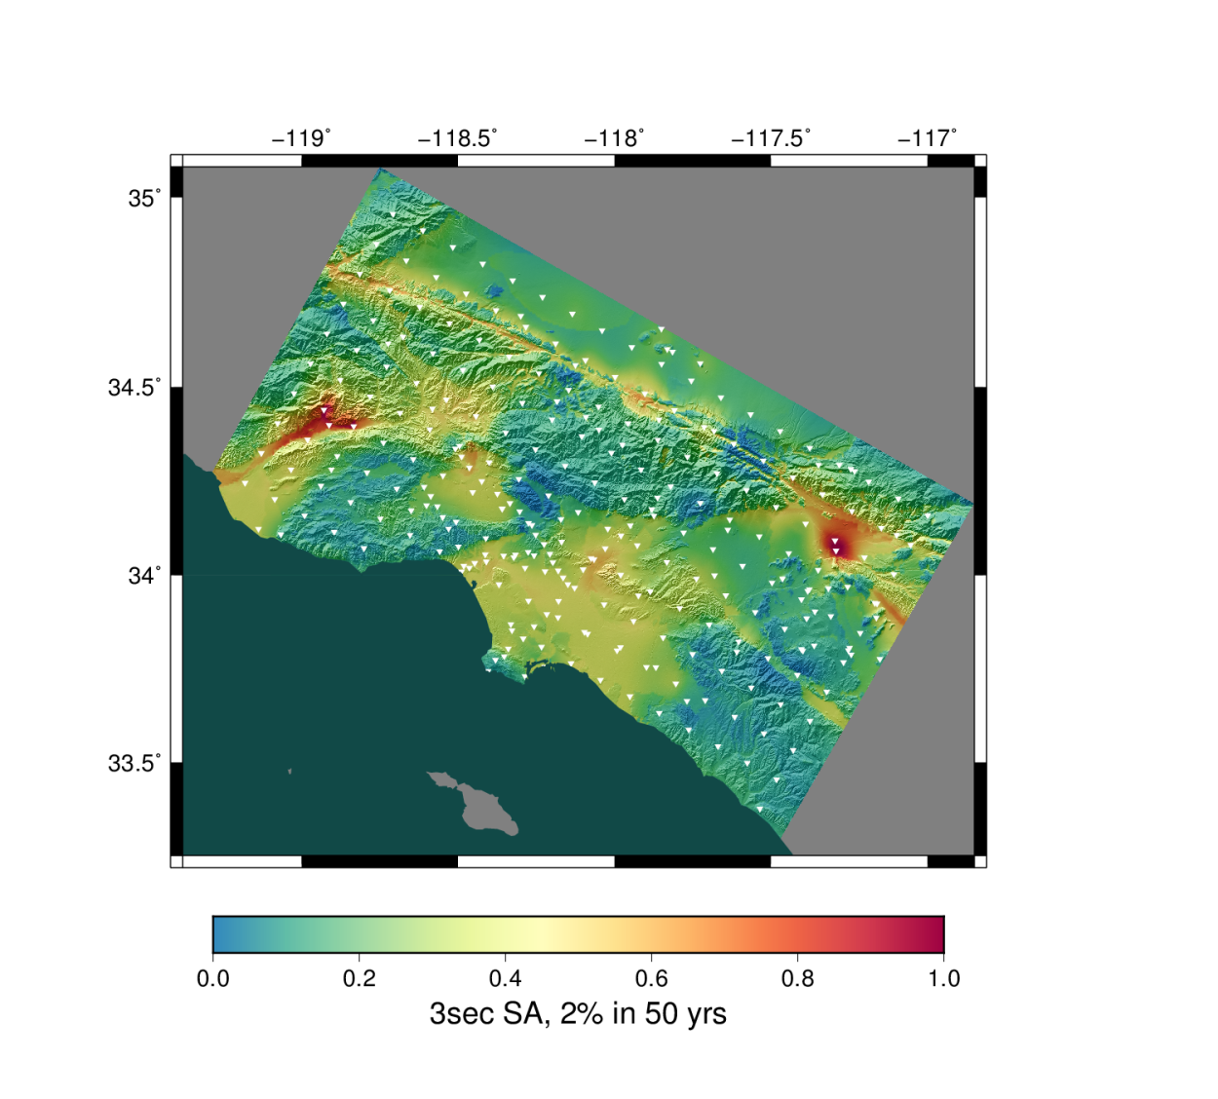
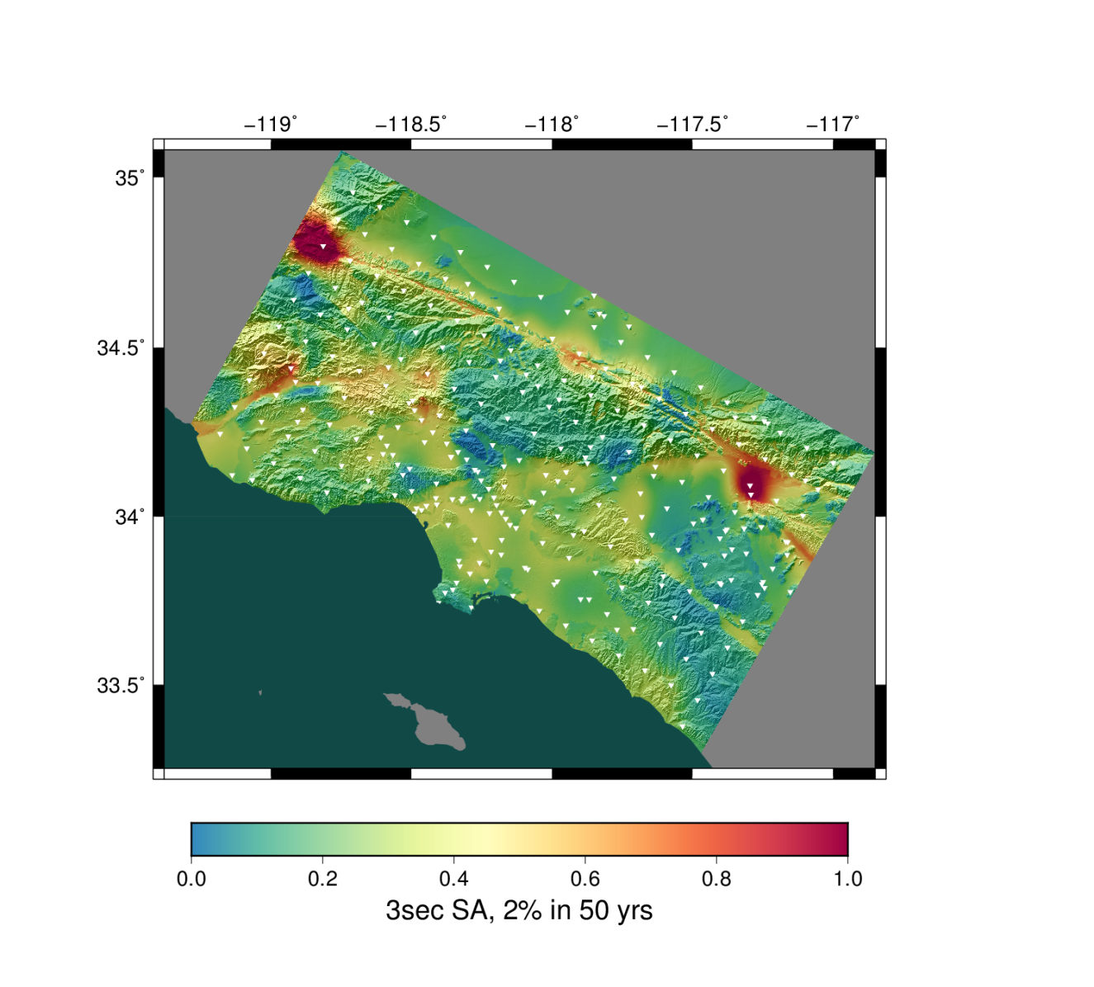
CyberShake Study 13.4
April – June 2013
283 sites in Southern California
0.5 Hz
UCERF 2
Graves & Pitarka 2010 rupture generator
Velocity models:
  CVM-S4
  CVM-H
CVM-S4
CVM-H

Slide 11
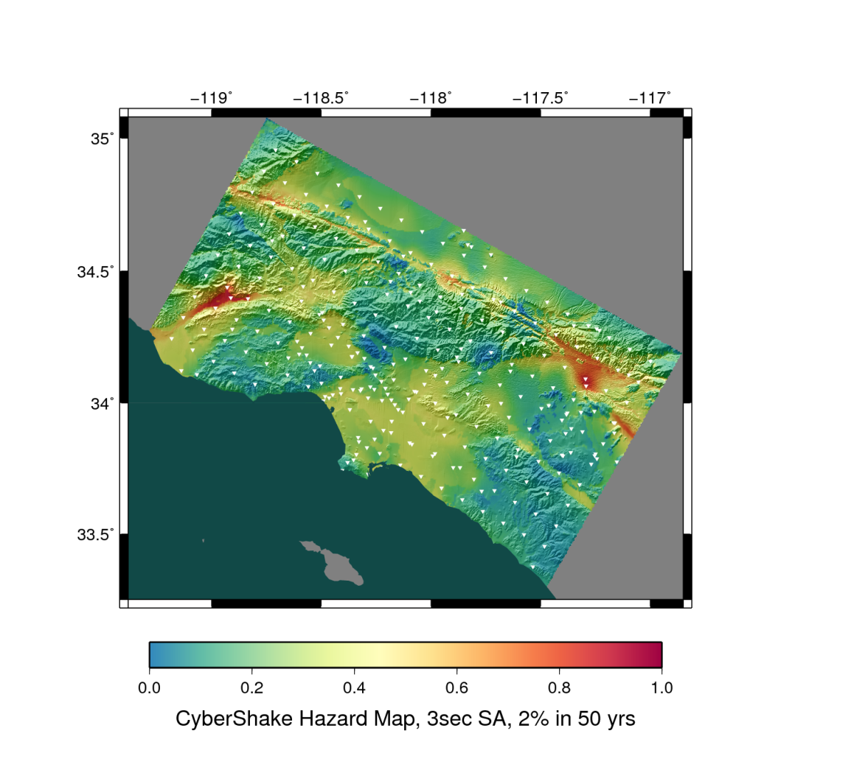
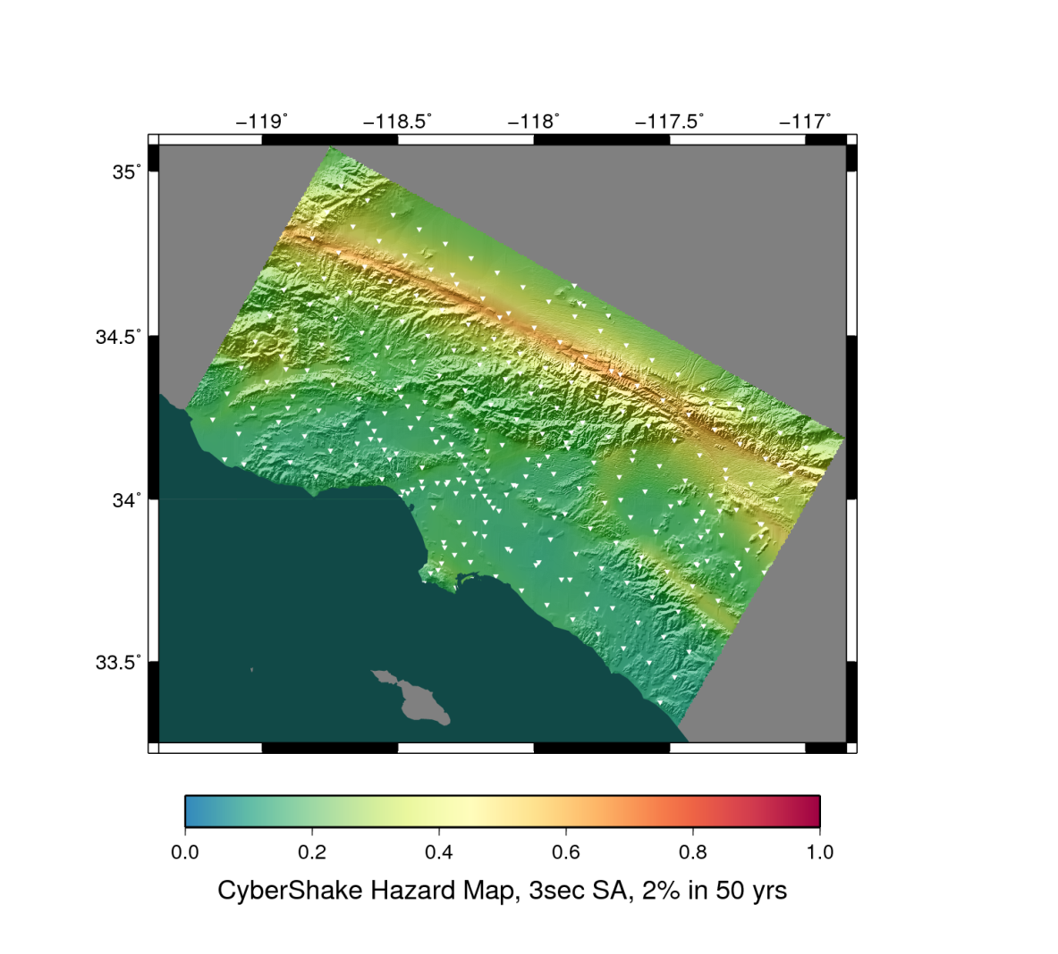
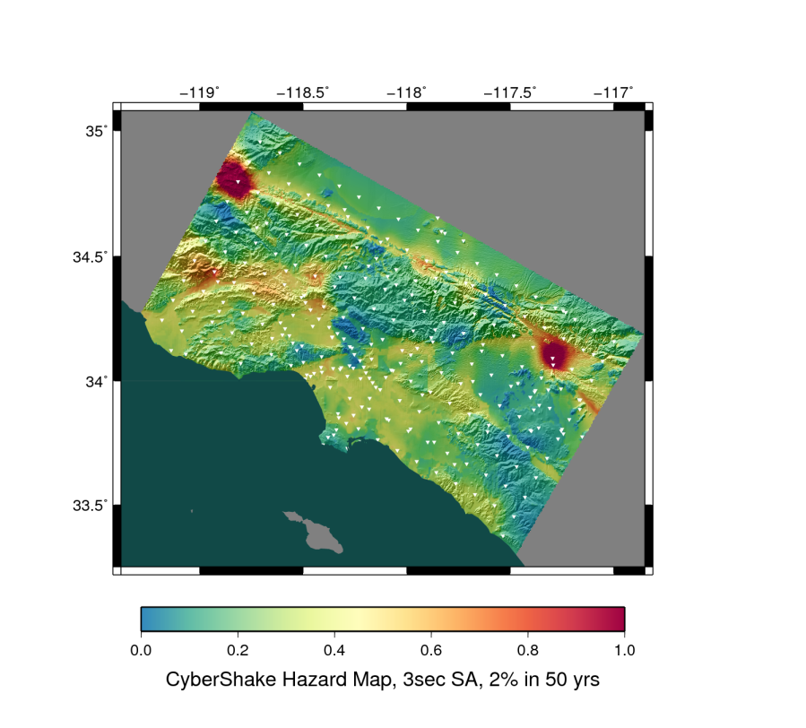
CyberShake Study 14.2
February – March 2014
286 sites in Southern California
0.5 Hz
UCERF 2
Graves & Pitarka 2010 rupture generator
Velocity models:
  CVM-S4.26 (tomographic)
  CVM-H, no GTL
  Broadband Platform 1D
CVM-S4.26
BBP 1D
CVM-H, no GTL

Slide 12
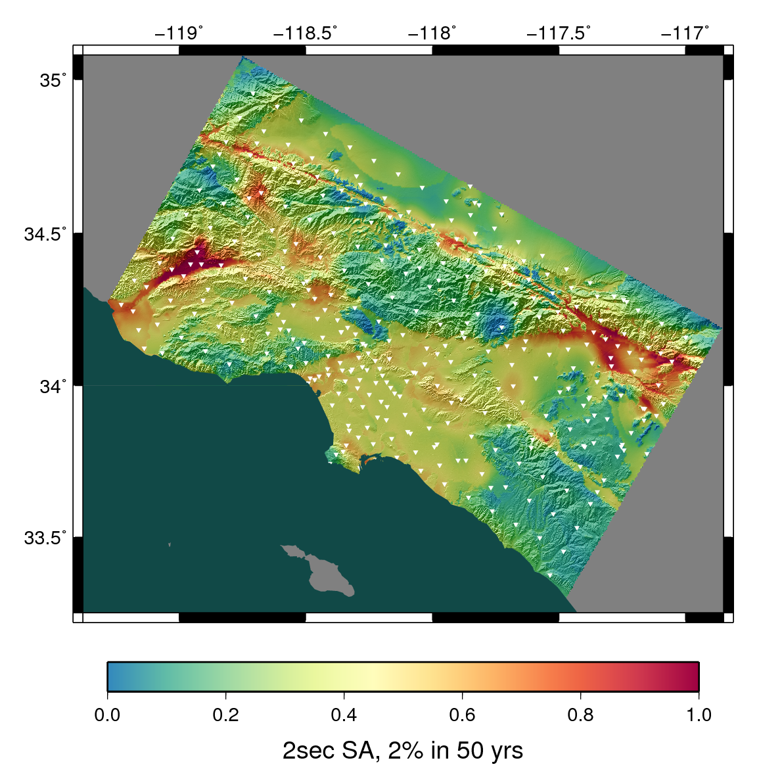
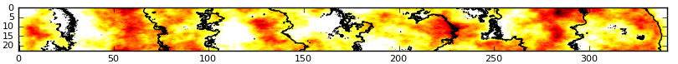
CyberShake Study 15.4
April – May 2015
336 sites in Southern California
1.0 Hz
UCERF 2
Graves & Pitarka 2014 rupture generator
Velocity models:
  CVM-S4.26 (tomographic)

Slide 13
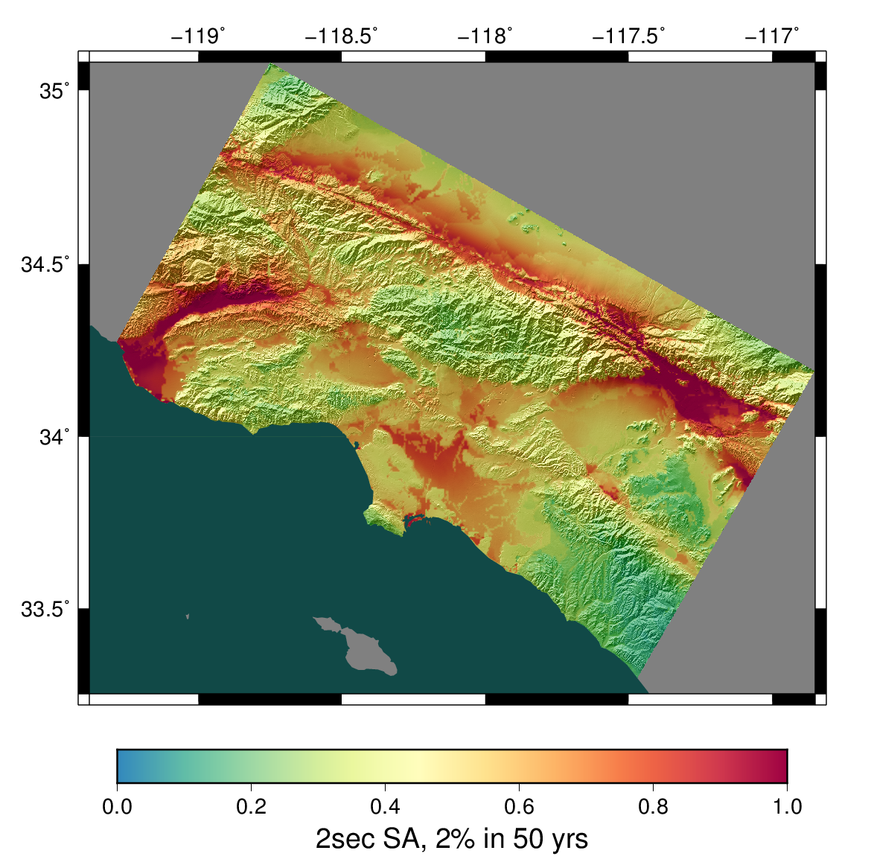
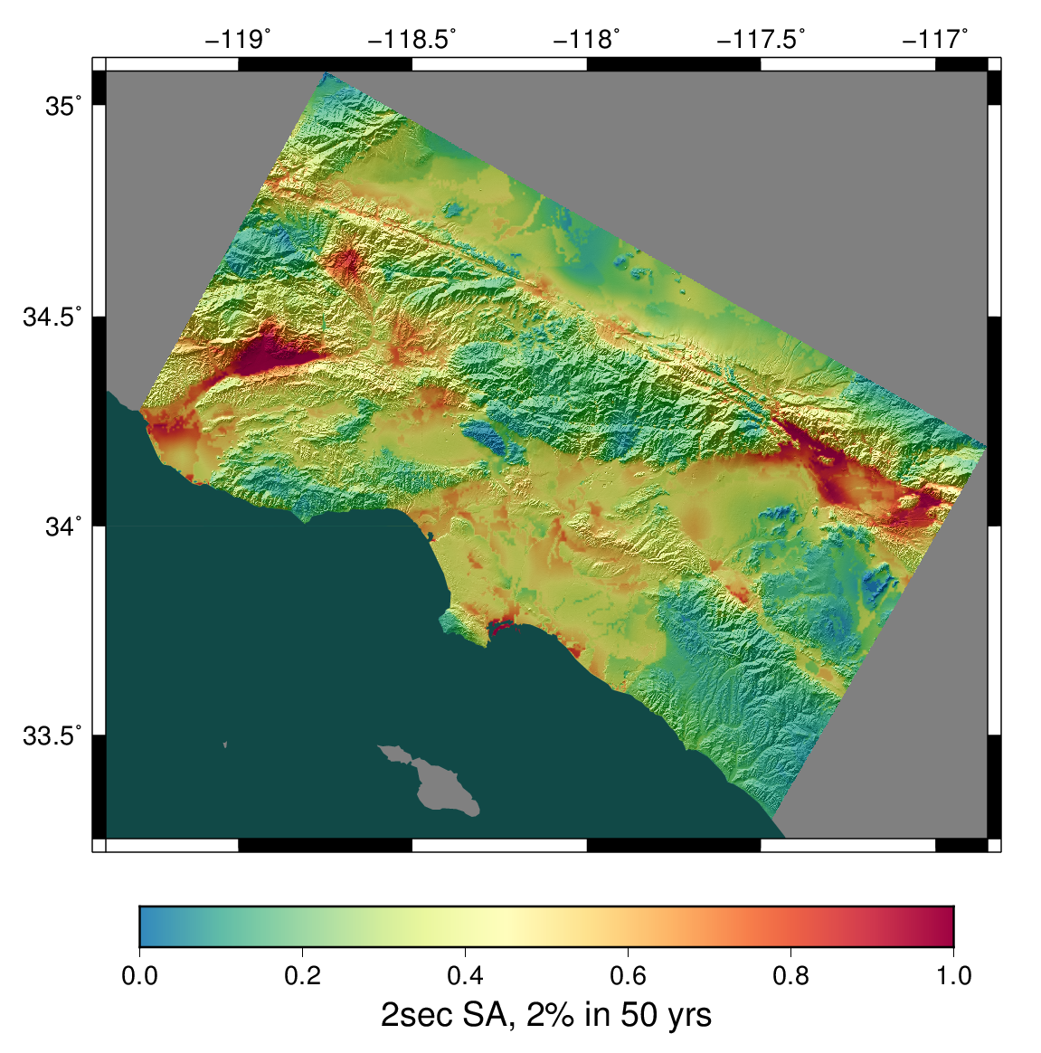
CyberShake Study 15.4 comparison with GMPEs
NGA2s
CyberShake Study 15.4

Slide 14



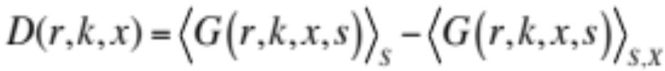

Averaging-Based Factorization (Wang & Jordan, BSSA, 2014)
GMPEs are easily decomposed into attenuation, site effects, directivity
To perform similar decomposition for CyberShake, we use ABF
  Expected shaking intensities are constructed from a hierarchy of
  sites (r), sources (k), hypocenters (x), and slip variations (s)
  Average over each component and subtract mean to isolate effects
    Overall level:
    Site effect:
    Path effect:
    Directivity effect:
    Slip complexity effect:
ln(y)
Level
Site effect
Path effect
Directivity effect
Slip complexity effect

Slide 15
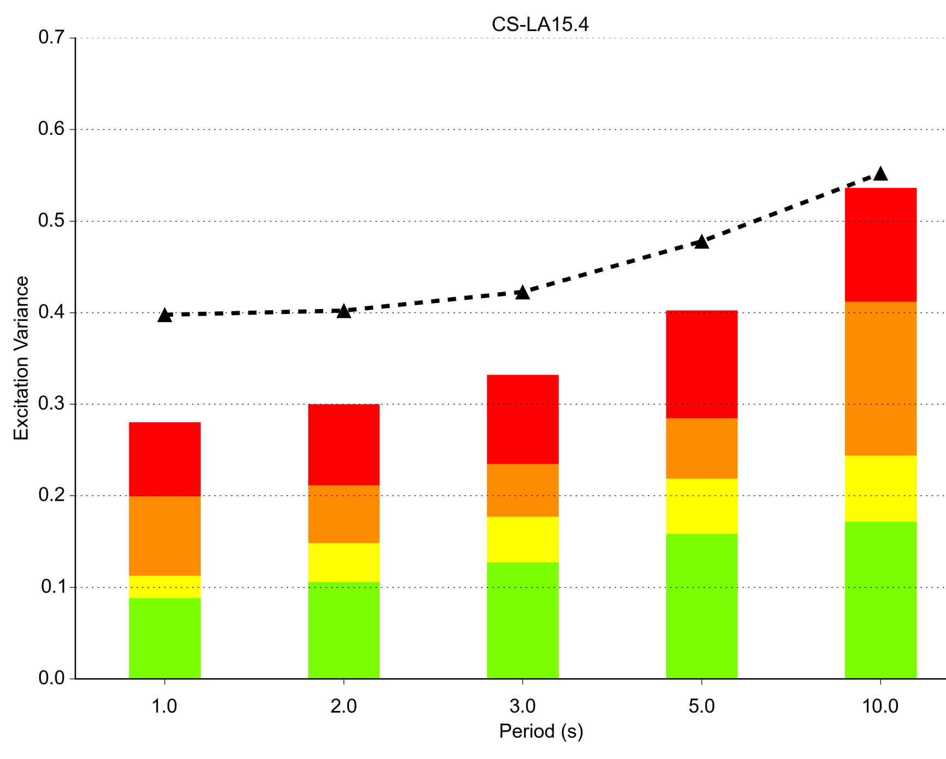
ABF comparisons
ABF terms are uncorrelated, enabling breakdown of variance
Physics-based PSHA has the potential to reduce site and path variance
Could reduce long tails
site
NGA14
path
directivity
source complexity

Slide 16
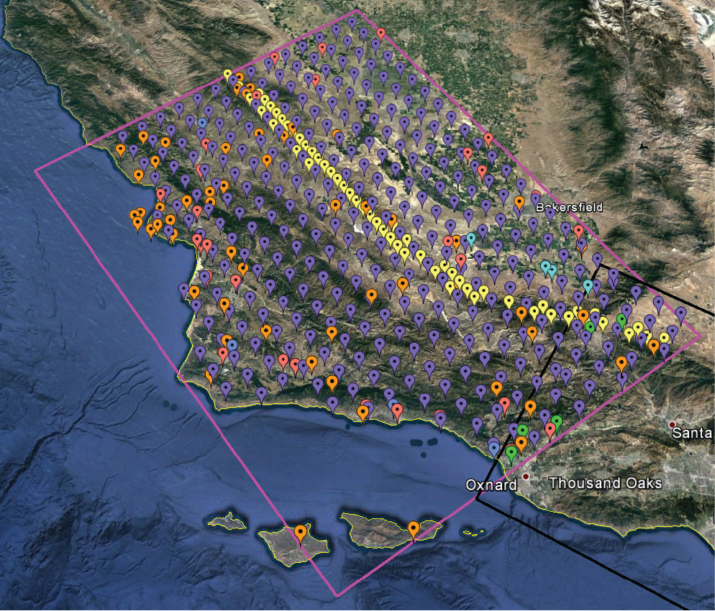
Study 17.3 overview
March – April 2017
438 sites in Central California
1.0 Hz
UCERF 2
Graves & Pitarka 2014 rupture generator
Velocity models:
  CCA-06 (3D tomographic)
  CCA 1D
  Tiled models with smoothing

Slide 17
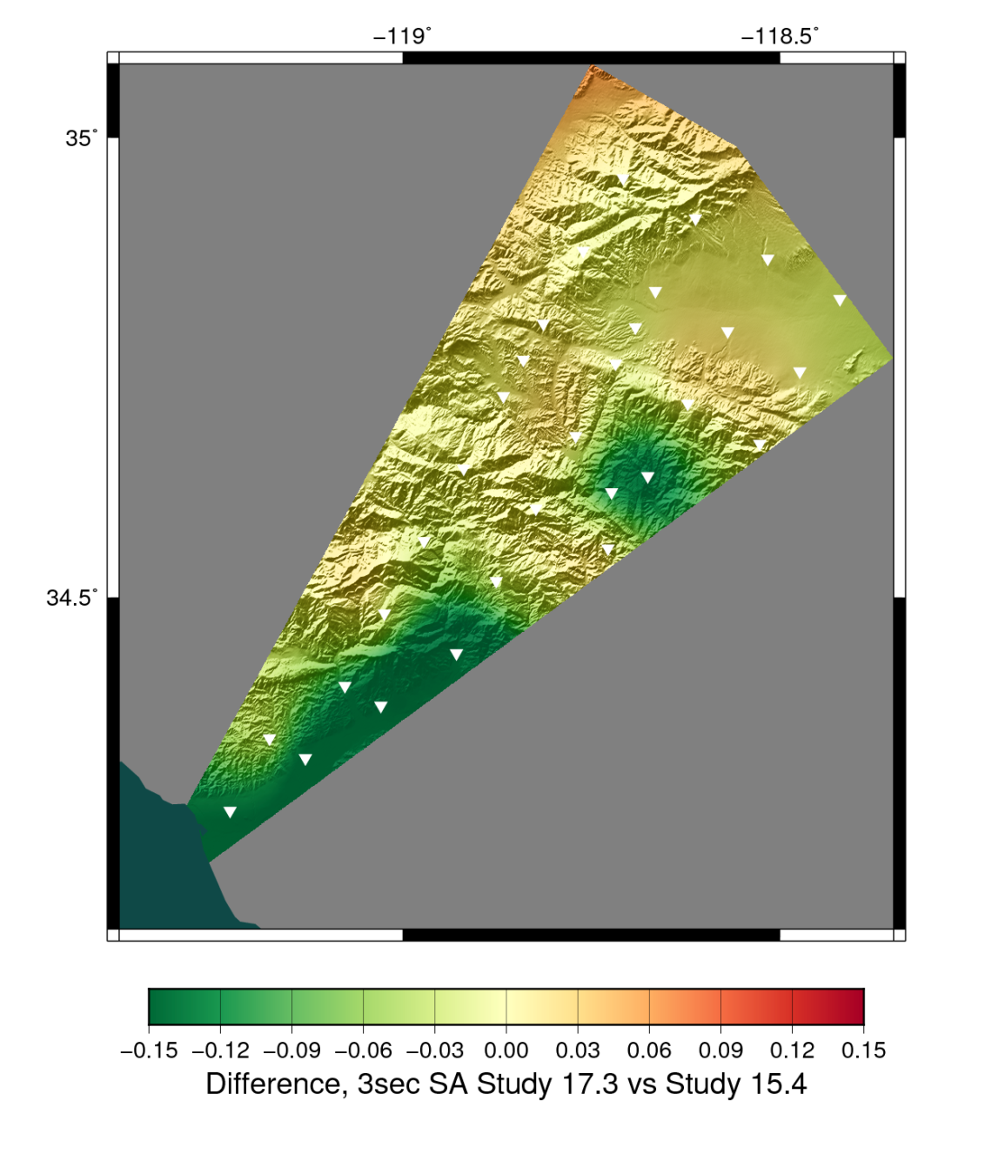
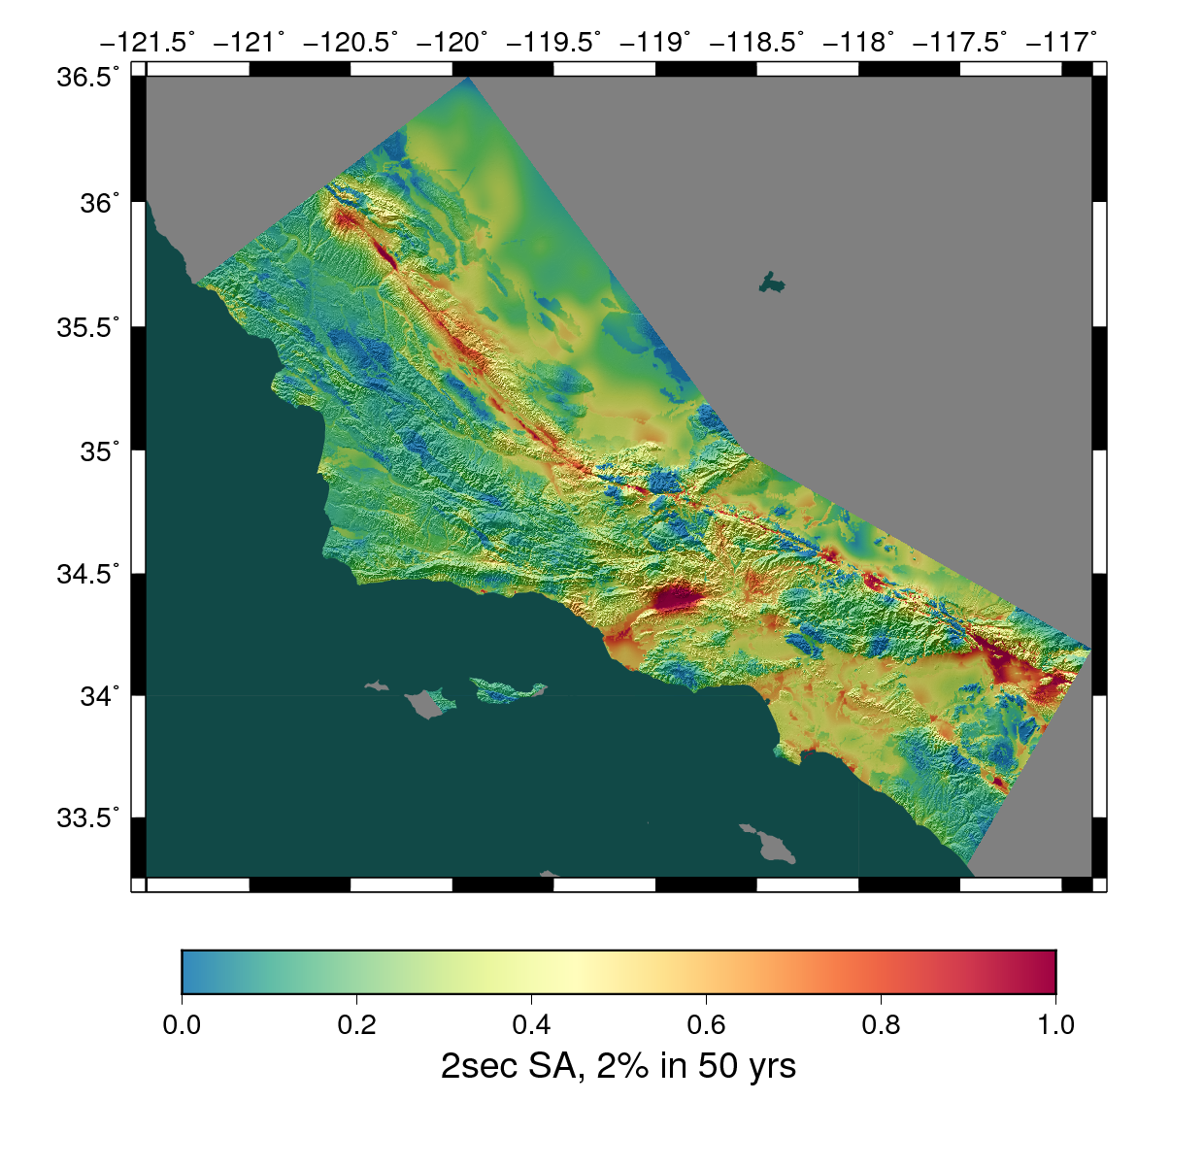
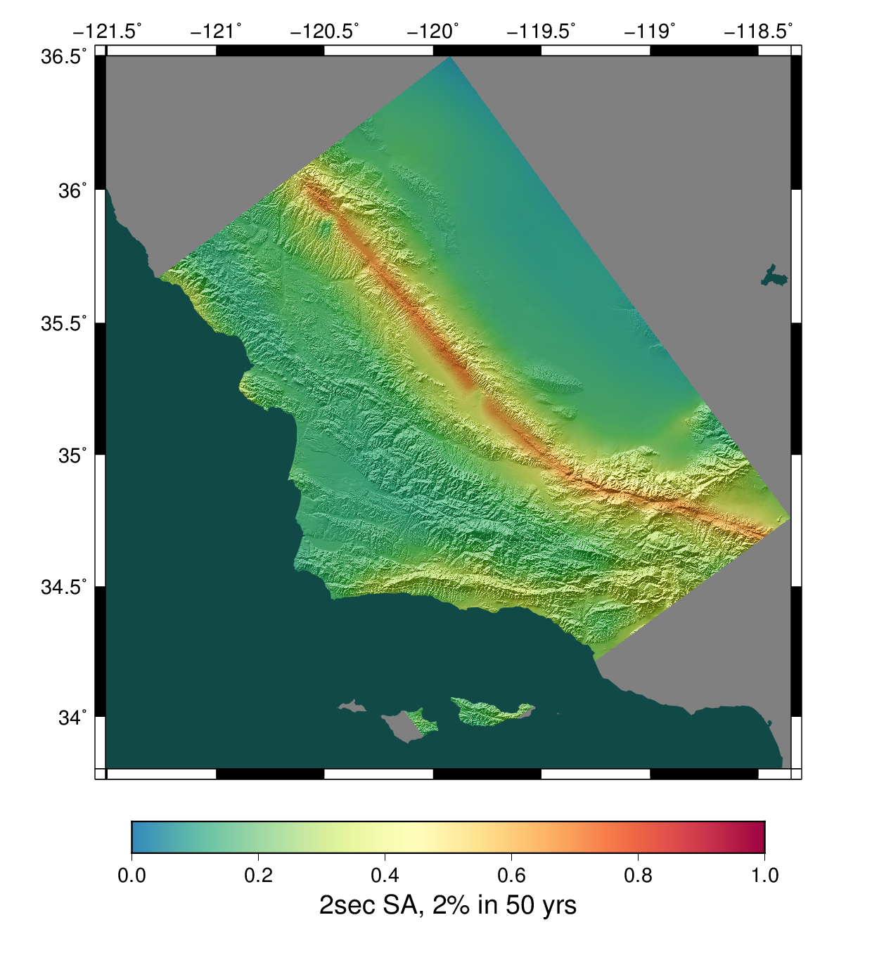
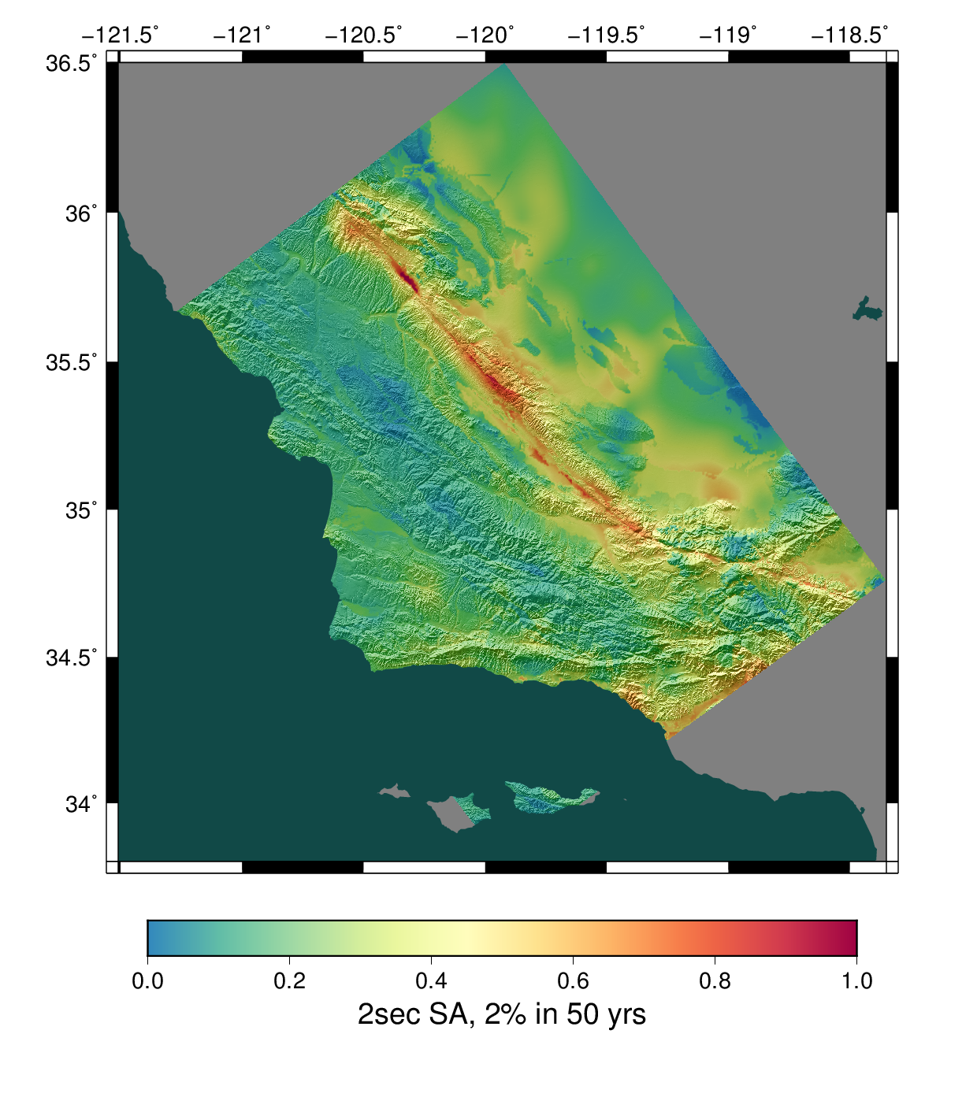
Study 17.3 results (poster 303)
Difference, Study 17.3 – Study 15.4
CCA 1D
CCA-06 (3D)
Combined 3D

Slide 18
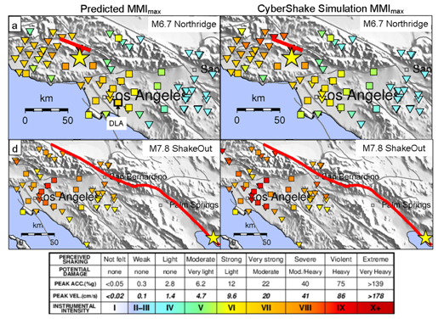
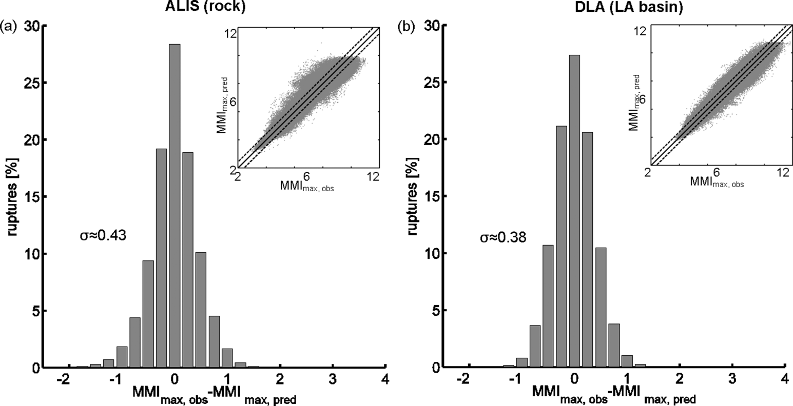
CyberShake and Earthquake Early Warning
CyberShake provides large dataset of simulated M6.5+ events
Used to train model to predict MMI_{max} (Böse et al., Geophys. J. Int., 2014)
CyberShake was augmented with stochastic high-frequency data, using the Graves & Pitarka method

Slide 19
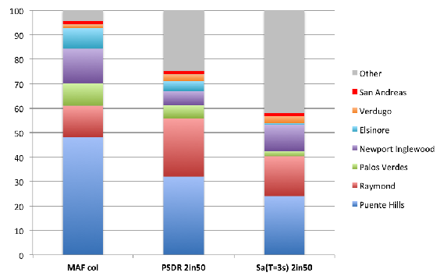
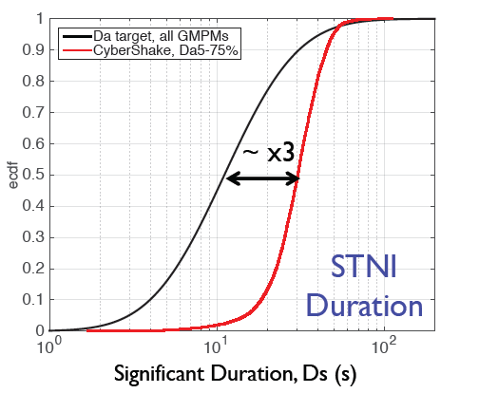
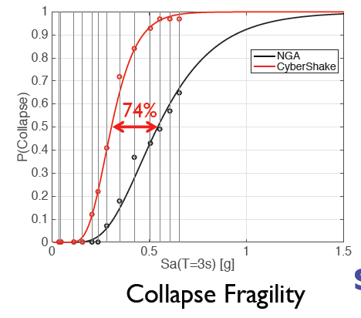
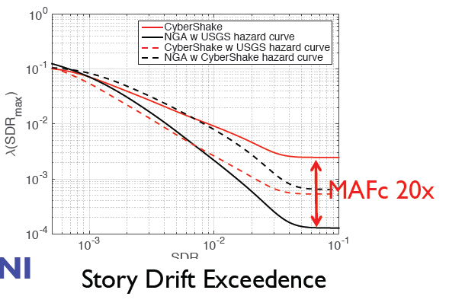
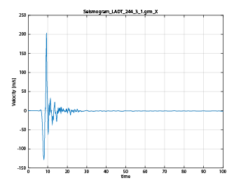
CyberShake for Building Engineering Applications
Deierlein et al., 2016 SCEC Meeting
CyberShake (+ stochastic) intensity measures and durations used to examine building response at high intensities
Can disaggregate to examine seismograms

Slide 20
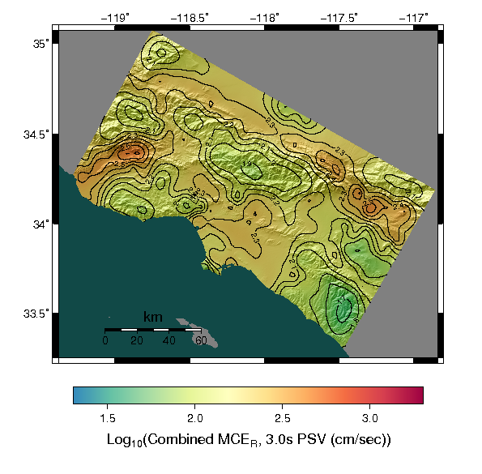
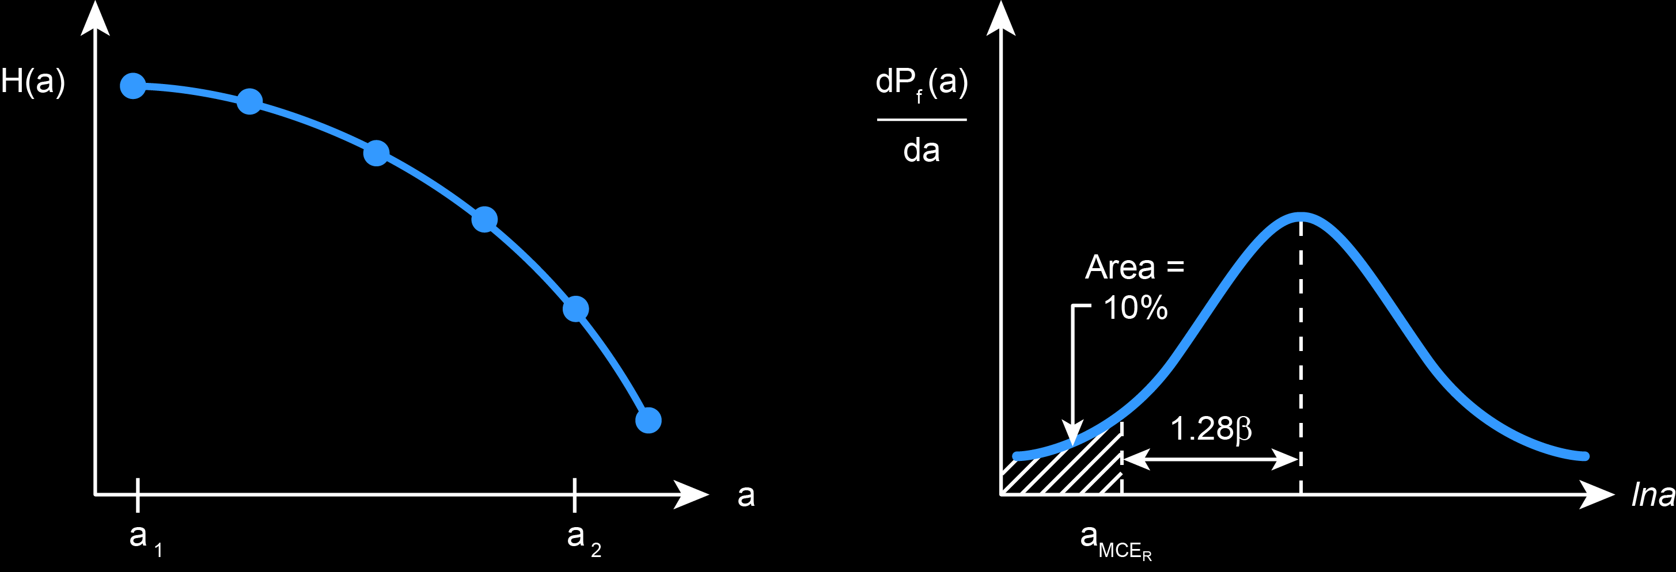
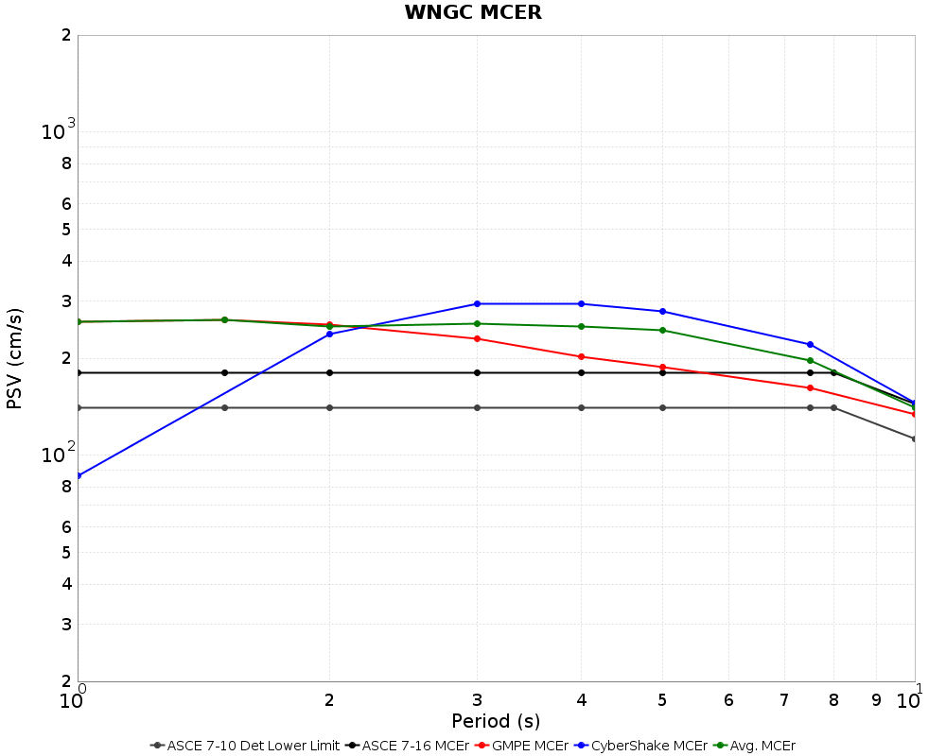
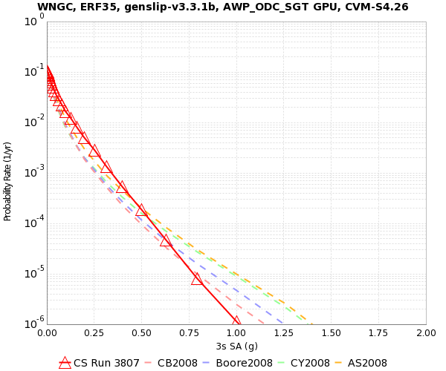
SCEC Utilization of Ground Motion Simulation Committee
CyberShake results are being considered as inputs to seismic codes under Project 17
Hazard curves convolved with fragility function to produce MCE_{R}
CyberShake MCE_{R} results are combined with GMPEs in a period-dependent way to produce overall results
+
CyberShake Hazard Curve
Fragility Function
MCE_{R} for 1 site
MCE_{R} for region

Slide 21
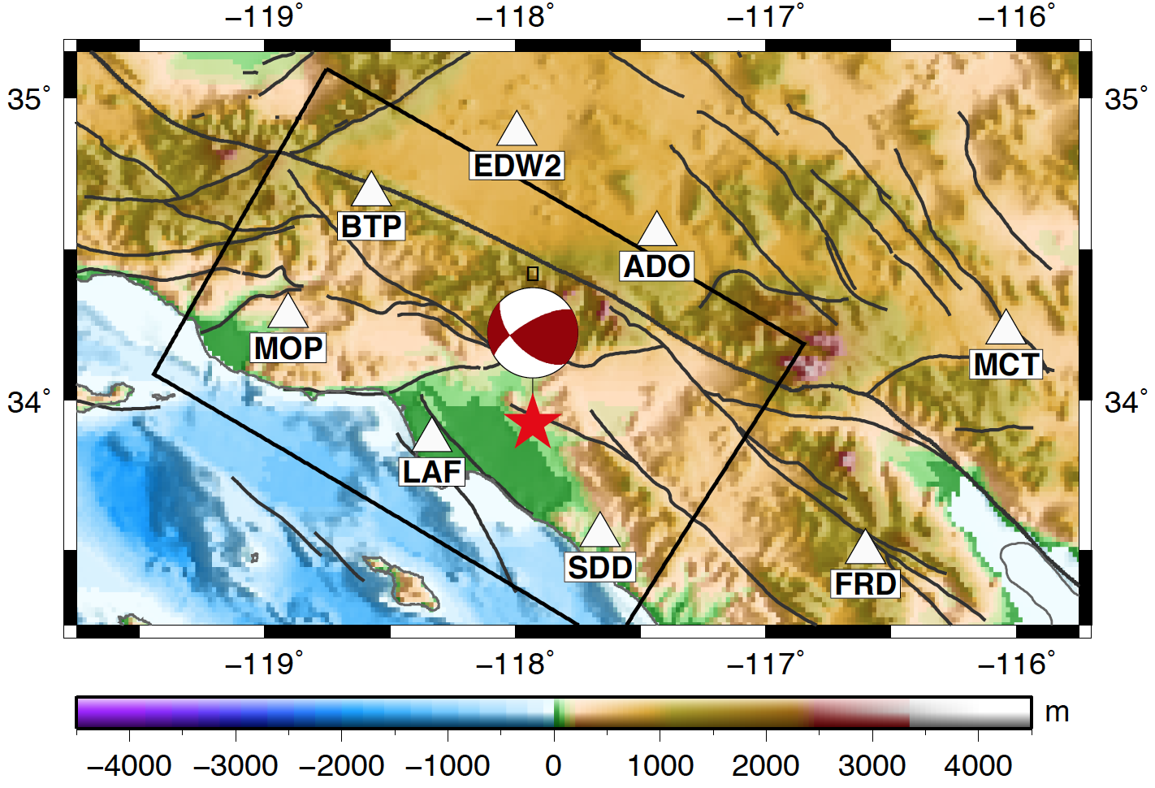
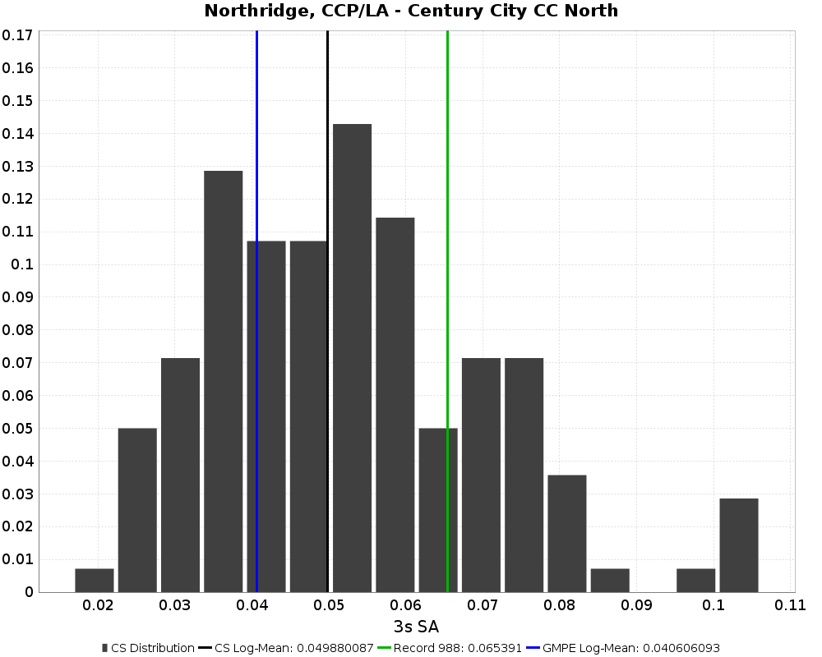
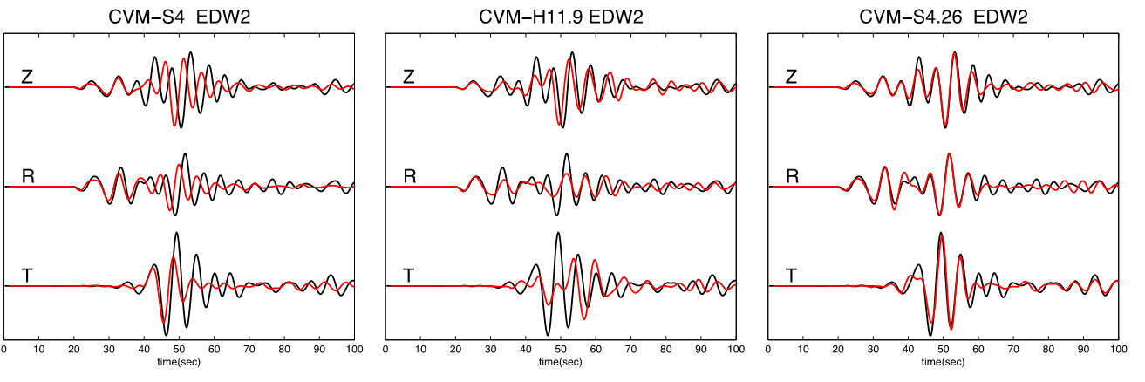
CyberShake Validation
03/28/14 La Habra
Earthquake (M5.1)
Station EDW2
Observed in black
Synthetic in red
Lee, Chen & Jordan (2014)
Study 1.0: CVM-S4 Study 13.4: CVM-H 11.9 Study 14.2: CVM-S4.26
Histogram of CyberShake amplitudes
Green: Northridge recording
Blue: GMPE log-mean
Black: CyberShake log-mean

Slide 22
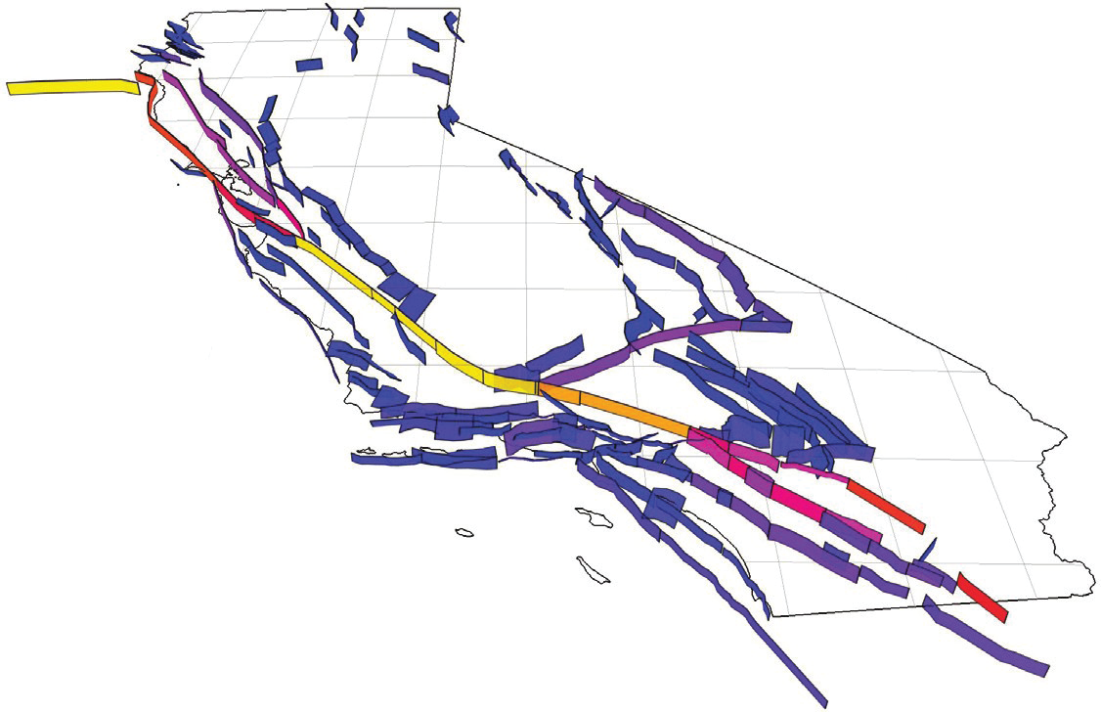

Future directions
UCERF2
14,000 ruptures
UCERF3
350,000 ruptures
Move to new ERF
  UCERF 3
    Must reduce size of rupture
    set to be tractable
  RSQSim
    Feed events directly into CyberShake
Increase maximum frequency
Add new physics: Q(f), velocity model heterogeneities, non-linear effects
Continue to run CyberShake in new regions
  San Diego? Bay Area?

Slide 23


Conclusion
CyberShake provides an alternative approach for calculating PSHA
Integrates current models and software from other SCEC efforts
Provides promise of reducing hazard uncertainties
Rich suite of CyberShake data products is useful for many applications
?
2007
2017
2027

Slide 24














Thanks!

