Slide 1

Using CyberShake 3D Ground Motion Simulation Workflows to Advance Central California PSHA
2017 SSA Annual Meeting
April 18, 2017
Scott Callaghan
Southern California Earthquake Center
2017 SSA Annual Meeting
April 18, 2017

Slide 2

CyberShake Overview
3D physics-based probabilistic seismic hazard analysis
Uses reciprocity-based approach to simulate seismograms from UCERF earthquake rupture forecast (<200 km)
Intensity measures extracted from seismograms
Hazard curves created for individual locations in region of interest, interpolated for map
Engineers using CyberShake results to inform ground motion predictions
  UGMS Committee: “Use of 3-D Physics-Based Numerical Simulations in the Development of Long Period Ground-Motion Maps for Los Angeles”, Thursday at 4:15
Earthquake forecast: UCERF2
Structural model: CVM-S4.26

Slide 3
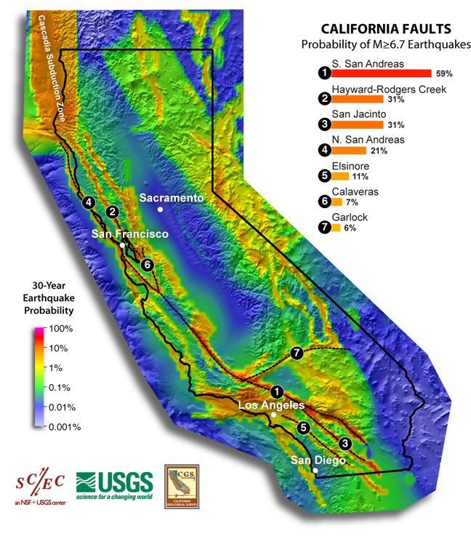
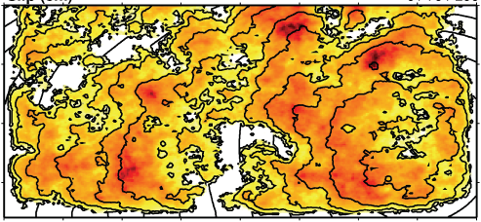

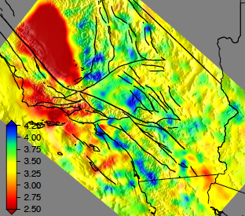
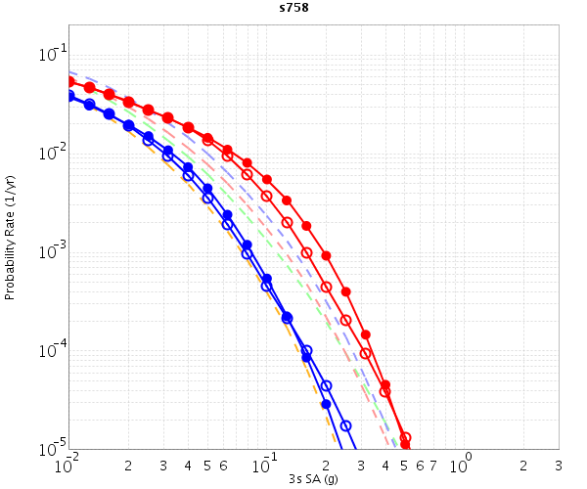
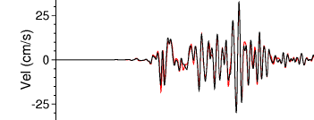
CyberShake Data Flow
Graves-Pitarka kinematic rupture generator
CyberShake Hazard Map
UCVM
(poster 84)
AWP-ODC
Seismogram Synthesis
Data
Product Generation
12 TB
data transfer
Mesh generation
1 job per site
MPI, 1500-4000 cores
SGT computation
2 jobs per site
MPI, 200-800 GPUs
Post-processing
~500,000 jobs per site
MPI master/worker, 3712 cores
Populate DB, construct queries
6 jobs per site
Uniform California Earthquake Rupture Forecast
CVM-S4.26
z = 6 km
hazard curves
500,000 Seismograms
75M intensity measures
Community Velocity Model

Slide 4
CyberShake Workflows
Use scientific workflow tools to orchestrate CyberShake calculations
  Pegasus, HTCondor, Globus
  Use tools to write description of workflow with files and dependencies
  Tools then manage real-time execution of workflow
Automation
  Supports running thousands of jobs over days or weeks
Data management
  Files are automatically staged in and out as needed
Resource provisioning
  From workflow host, can submit jobs to multiple remote resources
Enabled SCEC to scale CyberShake since 2007

Slide 5
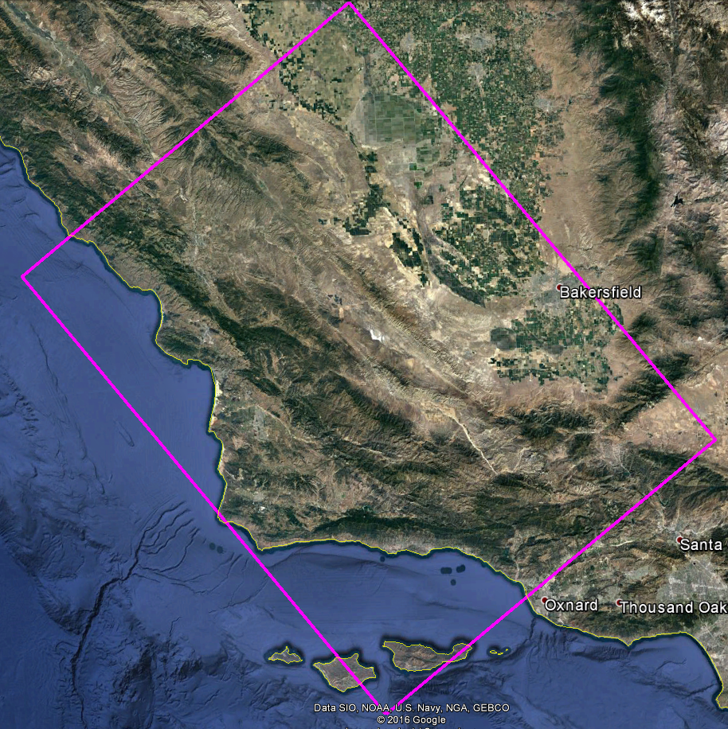
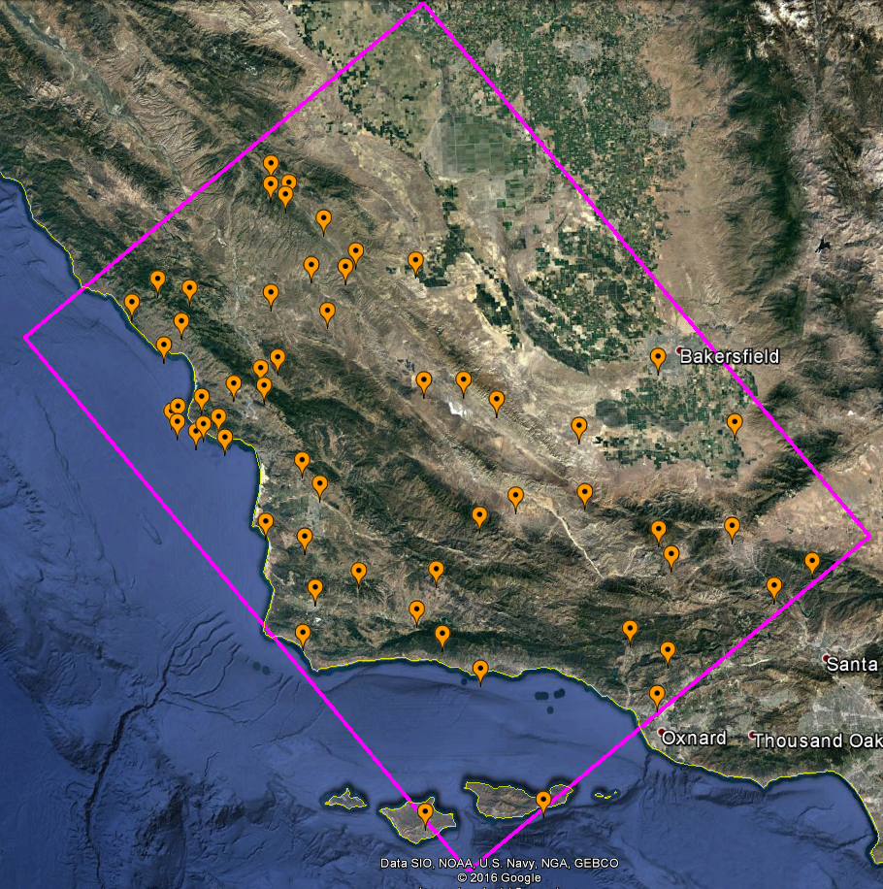



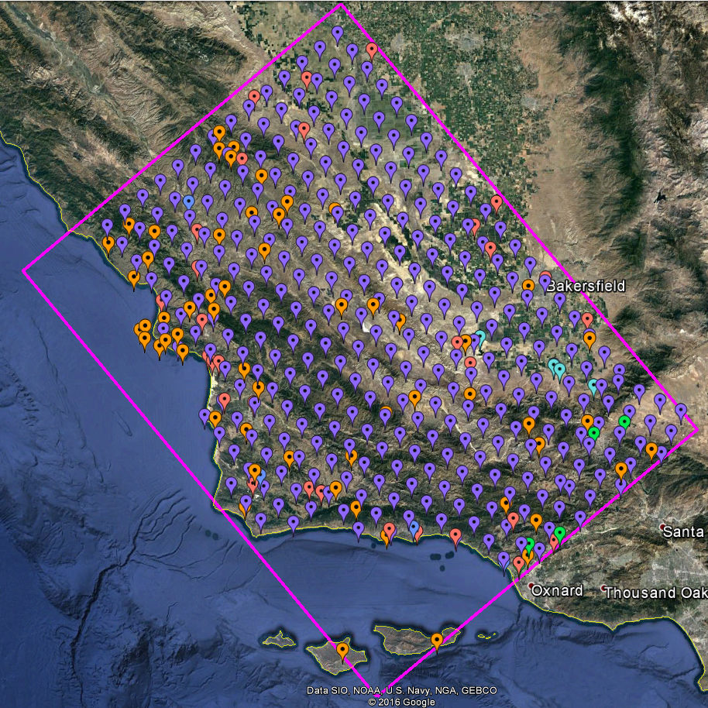
CyberShake Central California
Proof-of-concept for expanding CyberShake to new regions
Maximum frequency of 1 Hz
Twice the size of CyberShake Southern California
438 locations
  CISN stations
  PG&E pumping sites
  Cities from USGS Gazetteer
  Historic missions
  Regular grid for interpolation

Slide 6
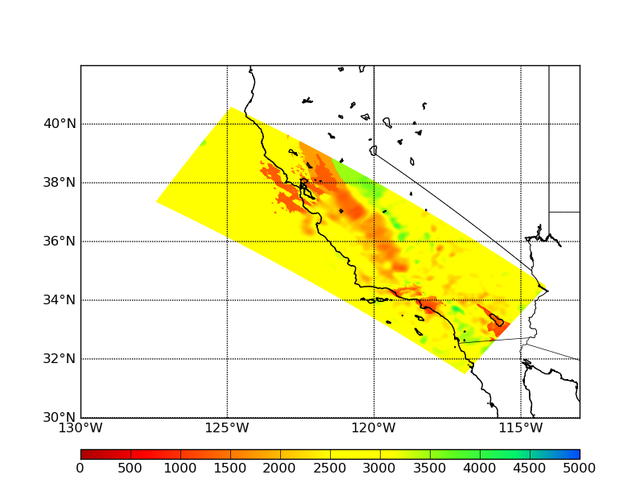
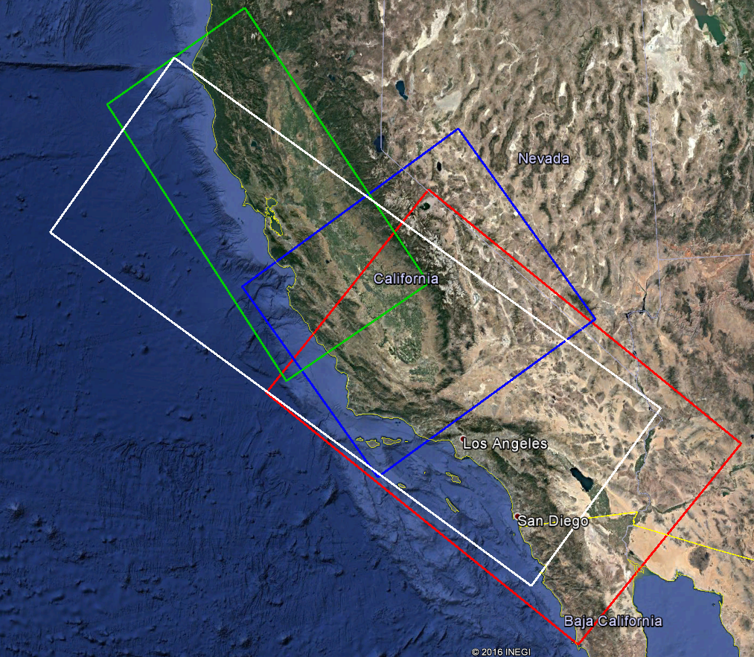
Central California Velocity Models
3D model
  Simulation volumes too large for single velocity model (white)
    CCA-06 (Central CA, tomographic inversion, blue)
    CVM-S4.26 (Southern CA, tomographic inversion, red)
    USGS Bay Area (green)
  Smoothing applied along model interfaces
1D model
  Averaged CCA-06 over land
Horizontal plot of Vs from 3D model at depth=1.05 km

Slide 7
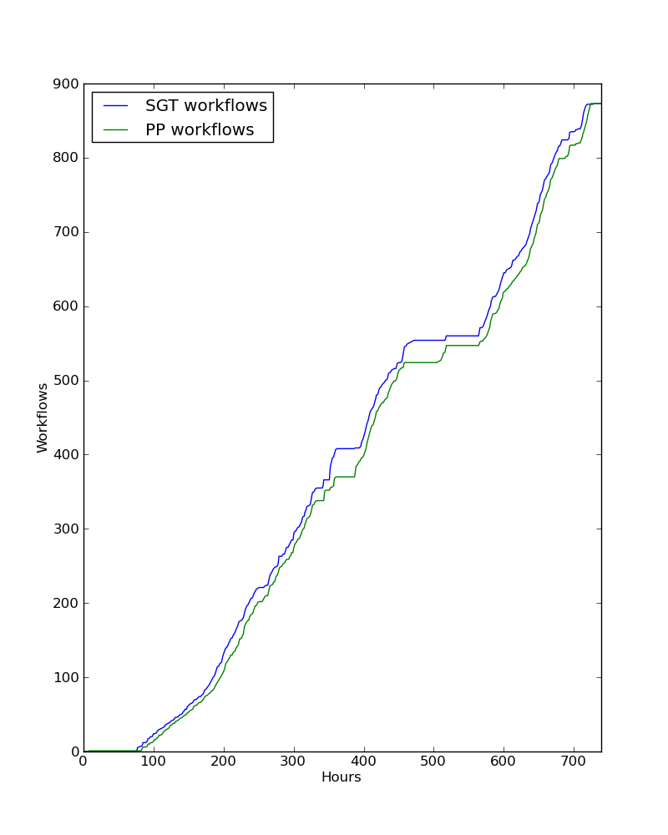
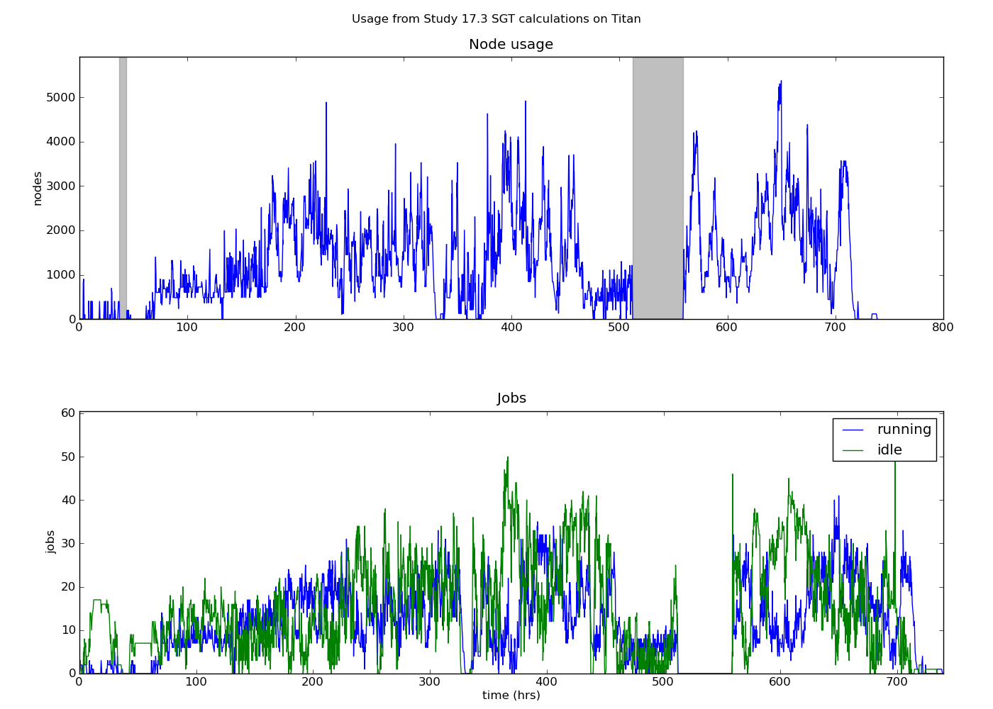
CyberShake Study 17.3
Calculations for 2 velocity models for each of 438 sites
Averaged 1295 nodes (CPU + GPU) for 31 days, maximum of 5374
  900,000 node-hours consumed (21.6M core-hours)
Used OLCF Titan and NCSA Blue Waters
  Workflow tools scheduled 15,581 jobs to both systems
  Transferred 308 TB of intermediate data between the two systems
Generated 285 million two-component seismograms
  43 billion intensity measures
Workflow tools managed 777 TB of data
  10.7 TB of output data automatically staged back for archival storage

Slide 8
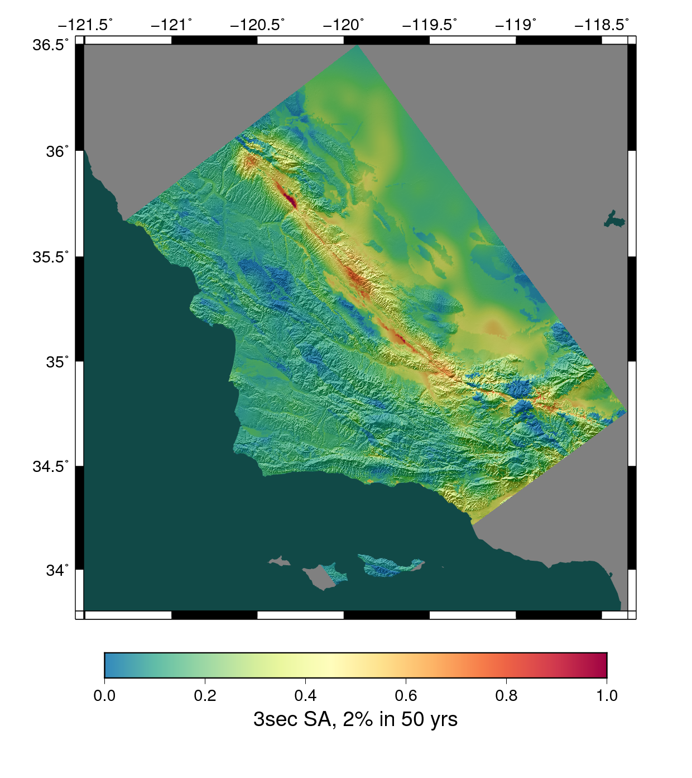
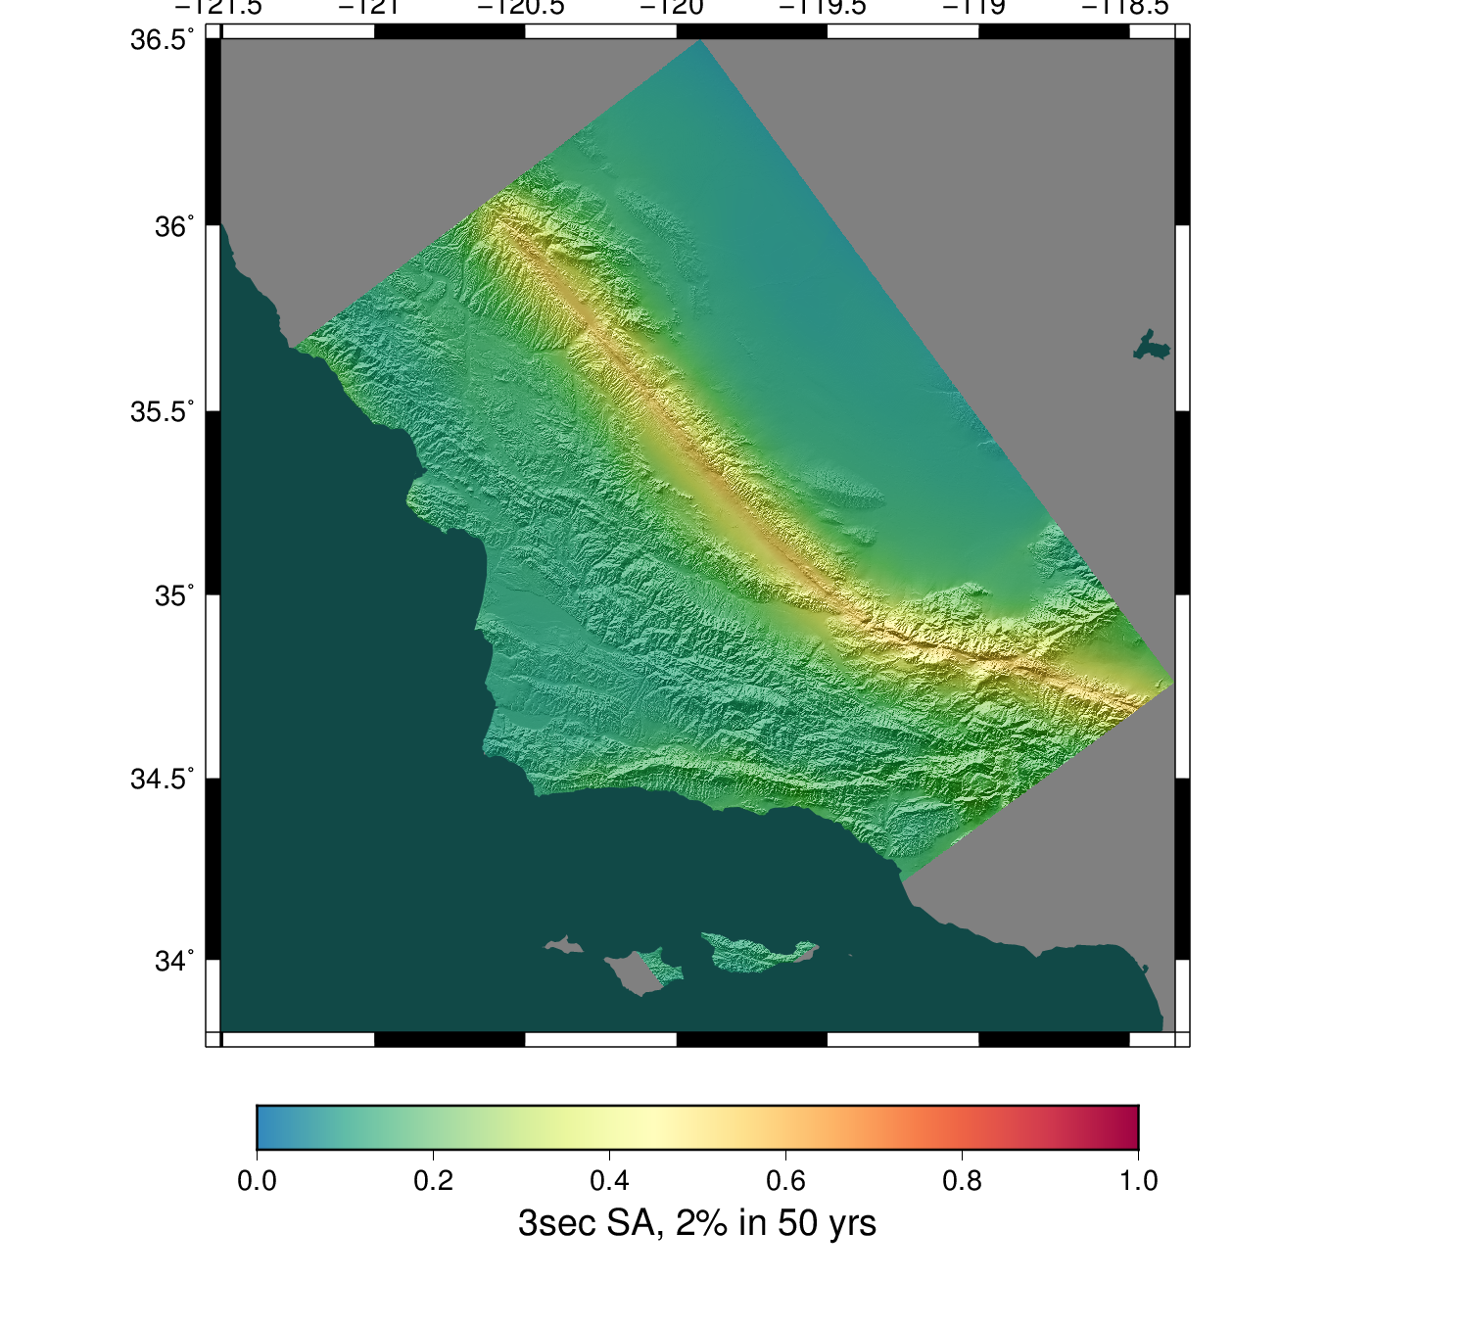
CyberShake Study 17.3 Results: Velocity Model Comparison
3D model
1D model

Slide 9
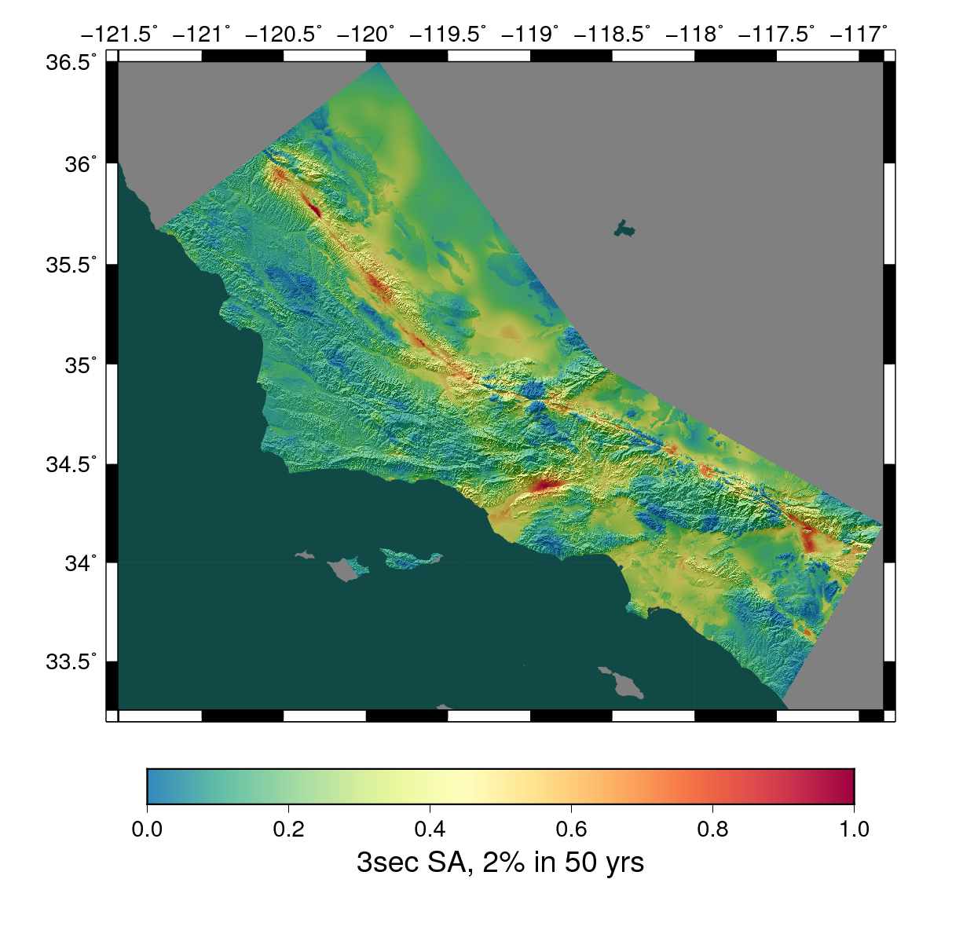
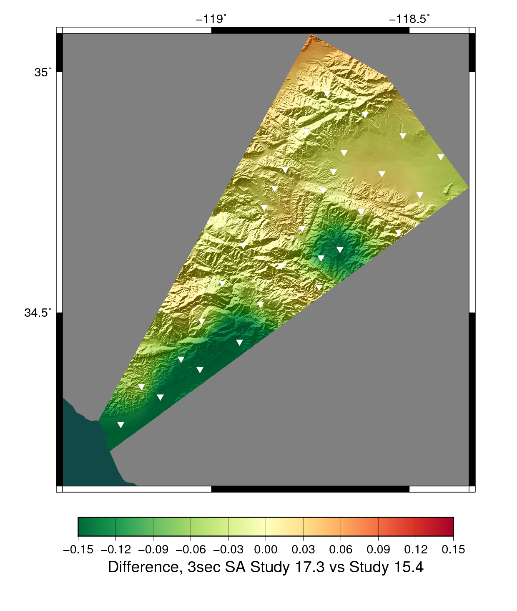
CyberShake Study 17.3 Results: CCA and LA
Central CA results typically lower than LA results
Likely due to lack of GTL and higher Vs min (500 m/s for LA, 900 m/s for CCA)
Combined CyberShake map

Slide 10
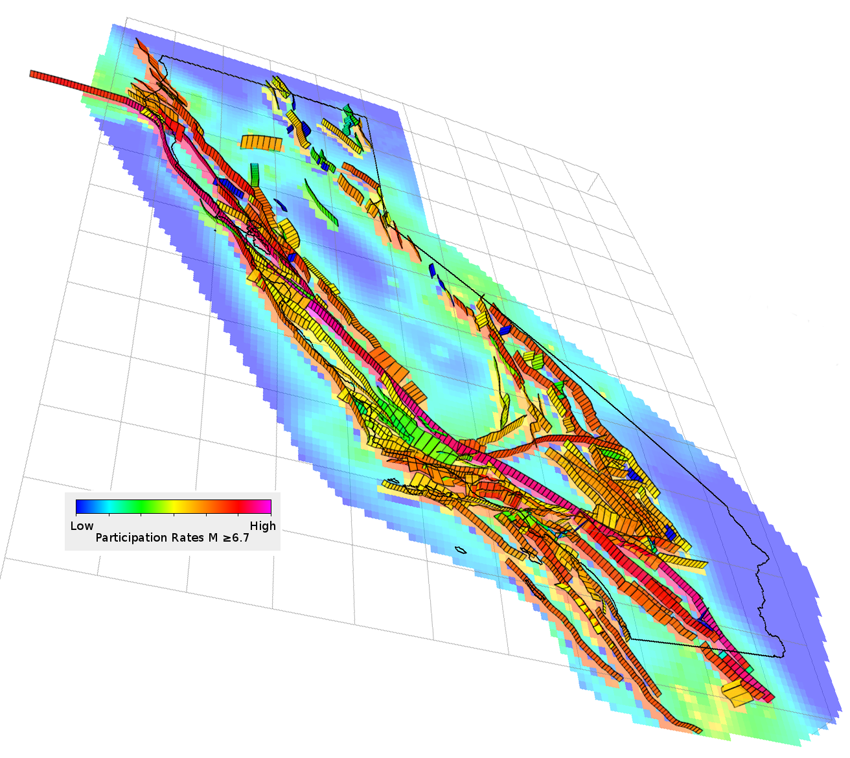
CyberShake Future Directions
Continue to run CyberShake in new regions
  Bay Area?
Integrate UCERF 3 ruptures
  Must reduce rupture set for 3D simulations
Increase maximum frequency
  Must include additional physics
    Frequency-dependent Q
    Velocity model heterogeneities
    Non-linear effects?

Slide 11










Questions?

