Slide 1

Integrating Physics-based Earthquake Cycle Simulator Models and High-Resolution Ground Motion Simulations into a Physics-based Probabilistic Seismic Hazard Model
PI: J. Vidale; Former PI: T. H. Jordan
Co-authors: J. Bielak, S. Callaghan, Y. Cui, A. R. Escandon, J. Gilchrist, C. A. Goulet, R. W. Graves, Z. Hu, A. Juarez, N. Khoshnevis, P. J. Maechling, D. Mu, K. R. Milner, K. B. Olsen, D. Pekurovsky, D. Restrepo, D. Roten, W. H. Savran, B. Shaw, R. Taborda, Q. Yao
2018 Blue Waters Symposium
June 5, 2018

Slide 2

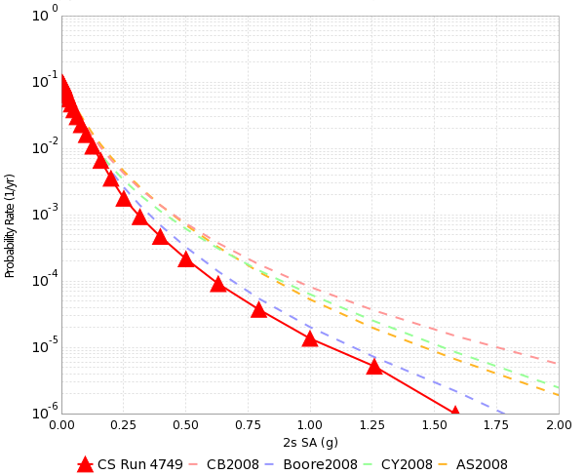
Probabilistic Seismic Hazard Analysis (PSHA)
What will peak earthquake shaking be over the next 50 years?
Useful information for:
  Building engineers
  Disaster planners
  Insurance agencies
PSHA performed by
  Assembling a list of earthquakes
  Determining how much shaking each event causes
  Combining the shaking levels with probabilities
SCEC CyberShake simulates ~500k events
Improving the estimates relies on improving the individual steps
2% in 50 yrs
0.4 g

Slide 3
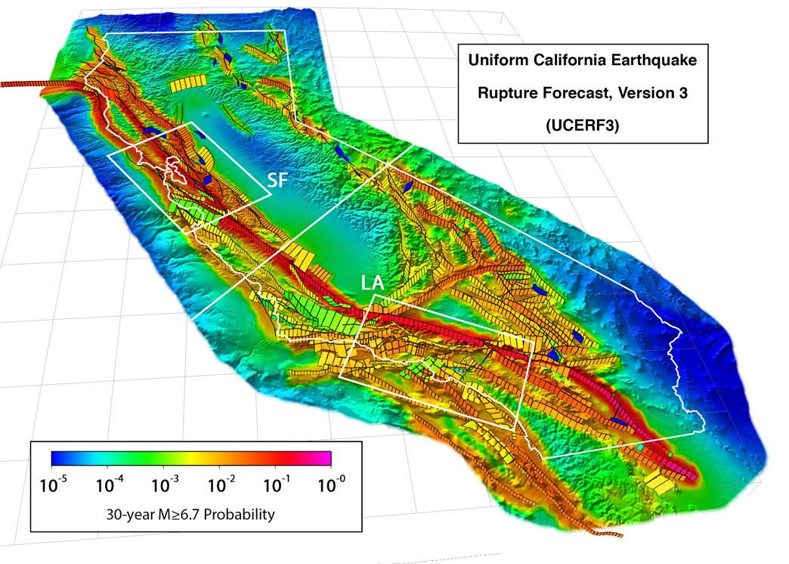
Earthquake Rupture Forecasts
Lists of future potential earthquakes come from earthquake rupture forecasts (ERFs)
  How big are potential earthquakes?
  What faults do they occur on?
  How often should we expect them?
Typically produced by
aggregating data
  Recurrence intervals
  Slip and stress rates
Generates logic tree
Can be difficult to capture sufficient variability for simulation

Slide 4
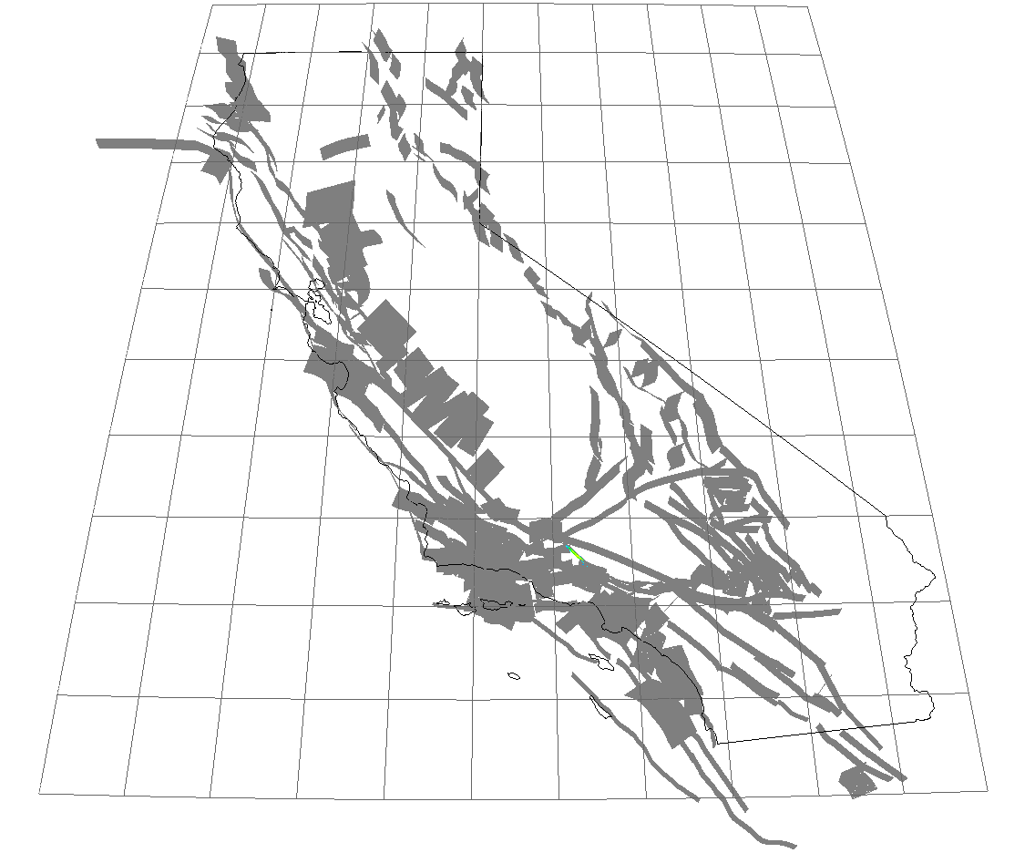
RSQSim
Alternative is to use physics-based approach to simulate ERF
Rate State earthQuake Simulator (Richards-Dinger & Dieterich, 2012)
Physics-based multi-cycle simulator
  Evolves fault system over time by loading
  slip and releasing through earthquakes
  No prescribed ruptures
  Generates catalogs of >1 million years
CPU code with global communication
  ~7000 node-hours on Blue Waters for 1Myrs
3000 years of simulated earthquakes (100 years per second)

Slide 5
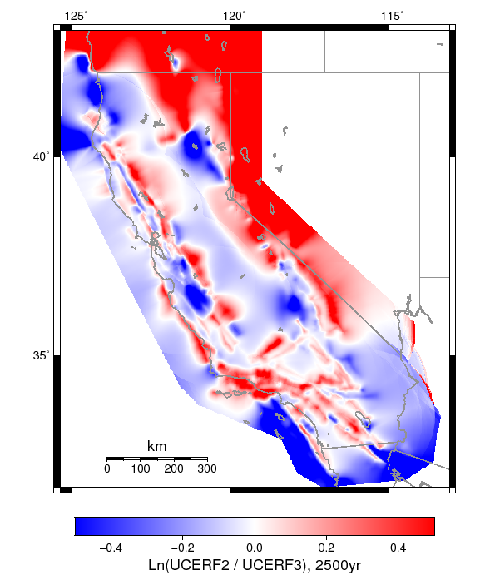
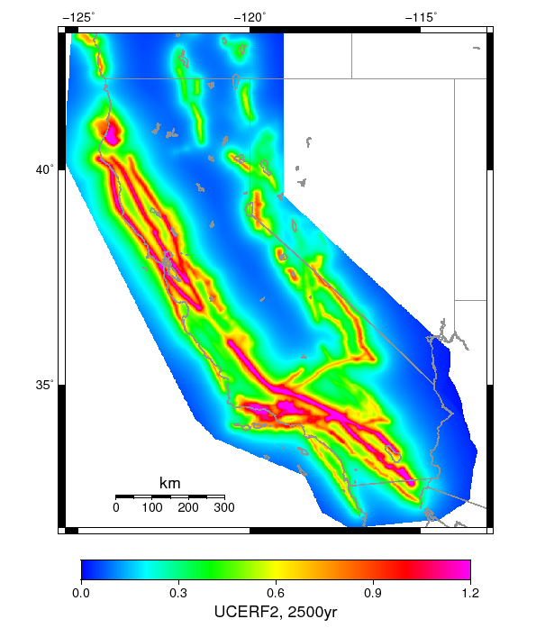
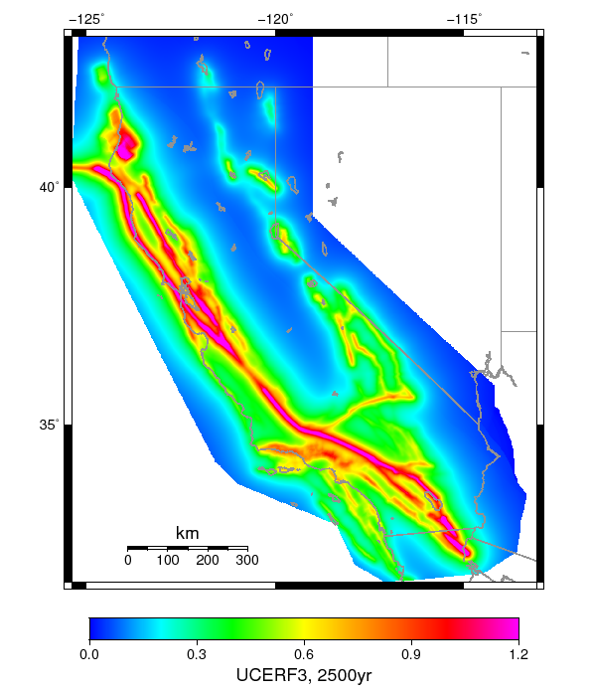
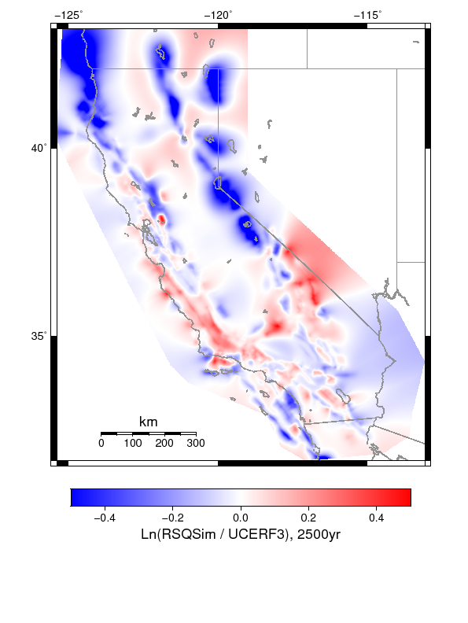
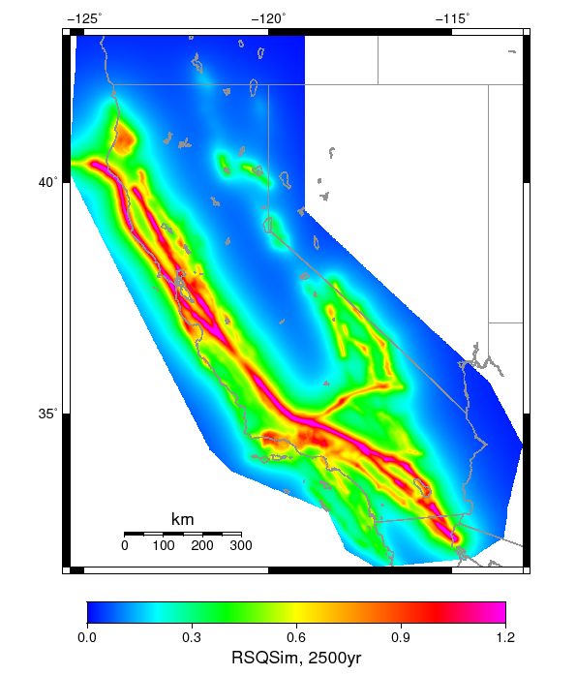
RSQSim Results
~275,000 node-hrs used in 2017
  Parameter sweeps
  Long catalogs needed to identify cycles and low-probability events
RSQSim results agree closely with empirical approach
UCERF2
UCERF3
RSQSim
Peak acceleration (g), 2% in 50 yrs

Slide 6
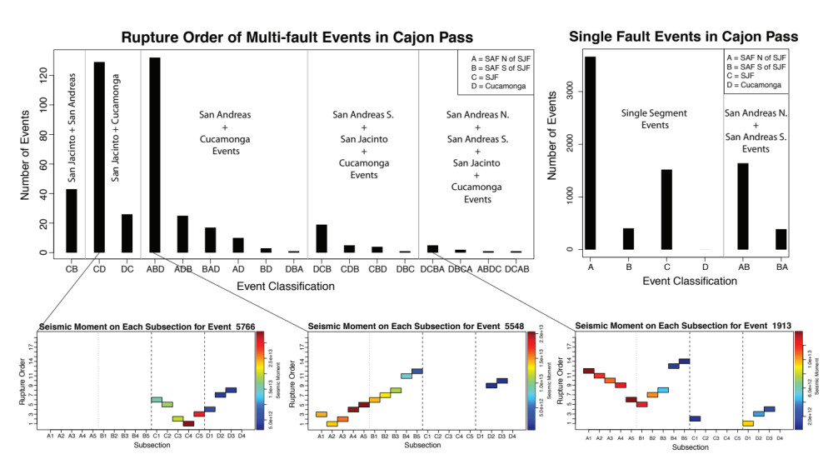
RSQSim Multi-Fault Events
Multi-fault ruptures are difficult to investigate historically: not much data
Certain combinations of faults are much more likely to rupture together

Slide 7
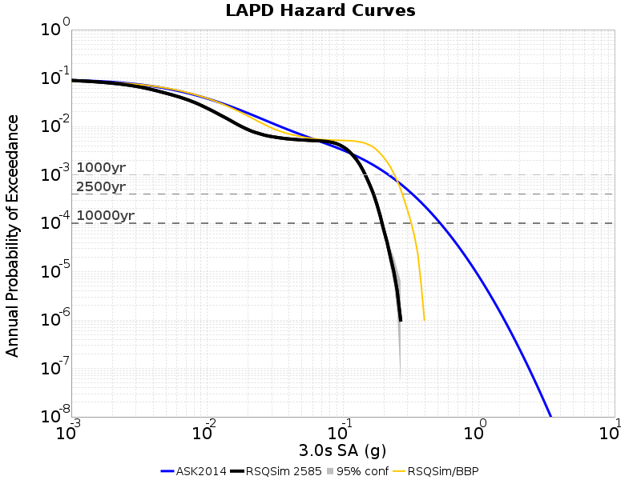
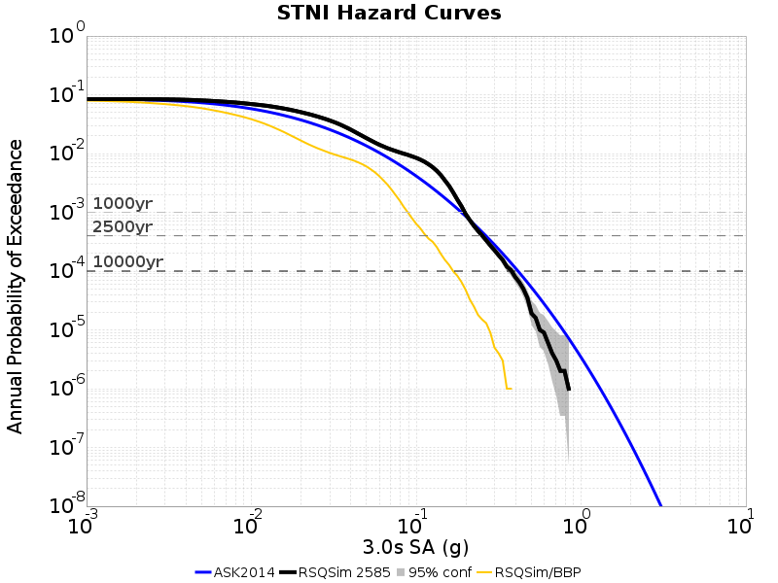
RSQSim and CyberShake
Coupled RSQSim ERF with CyberShake
Used Blue Waters to produce world’s first end-to-end fully physics-based PSHA results for 6 locations
Performing verification
and validation on
ruptures
Planning a regional
study later in 2018
RSQSim + 3D CyberShake
RSQSim + empirical relationship
RSQSim + 1D model

Slide 8
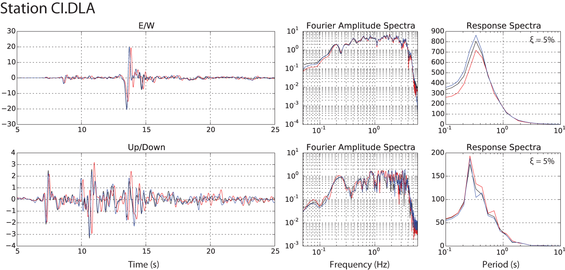

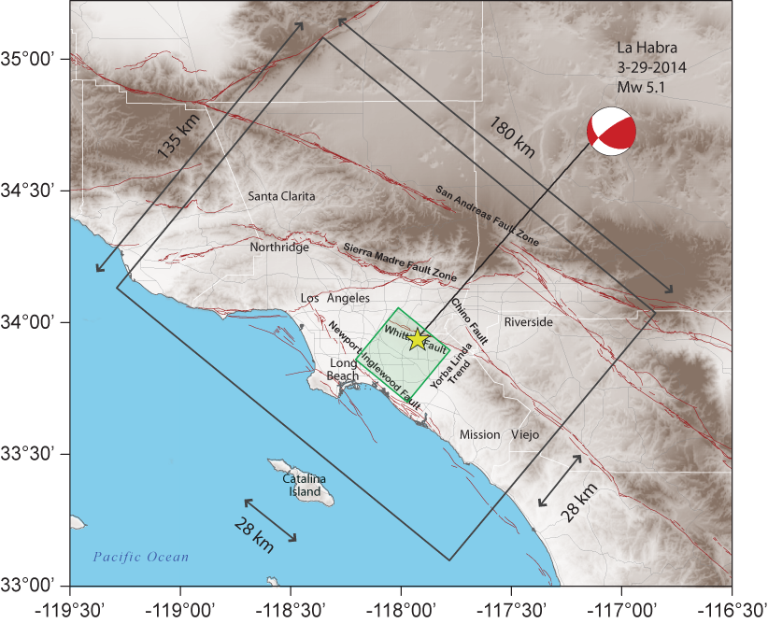
High-F
Additional improvements to PSHA come from added physics
Developed as part of SCEC High-F project
Verification and validation with 3 wave propagation codes
  2 finite difference, 1 finite element
M5.1 La Habra event
selected for comparison

Slide 9
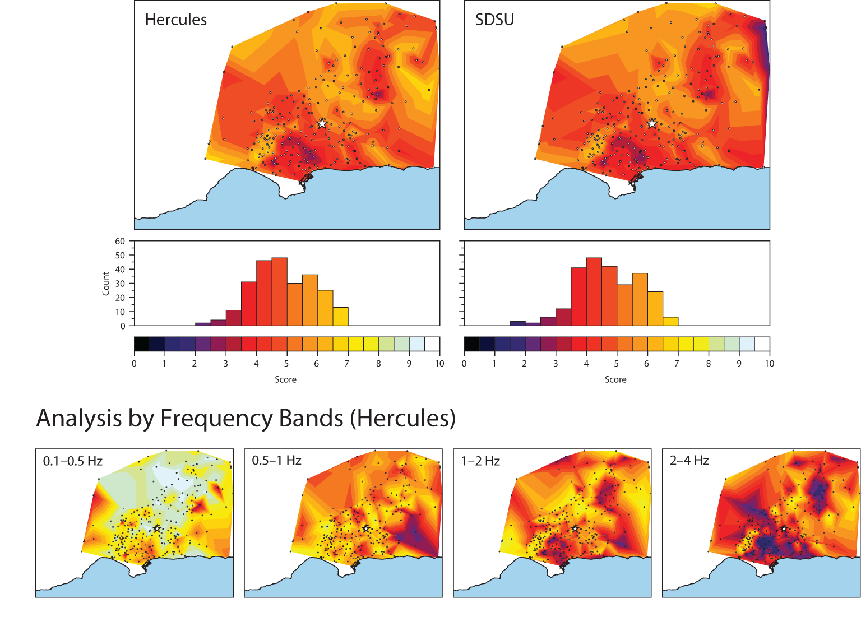
High-F validation
Simulation results compared
against observed seismograms
Identified areas of improvement
at higher frequencies
Advances integrated back
into CyberShake for
improved PSHA
Goodness-of-fit maps.
Higher numbers (yellows and whites) represent better fit.

Slide 10
SCEC UseIT
SCEC conducts an NSF-funded REU, Undergraduate Studies in Earthquake Information Technology (UseIT) since 2002
20-25 students from across the country for 8-week summer program
  44% female
  42% underrepresented minorities
  53% first-generation college students
Students accomplish a ‘grand challenge’ which includes earth science and computer science elements
Since 2016, has included an HPC component on Blue Waters
  Goal is to make students aware of HPC as a field

Slide 11
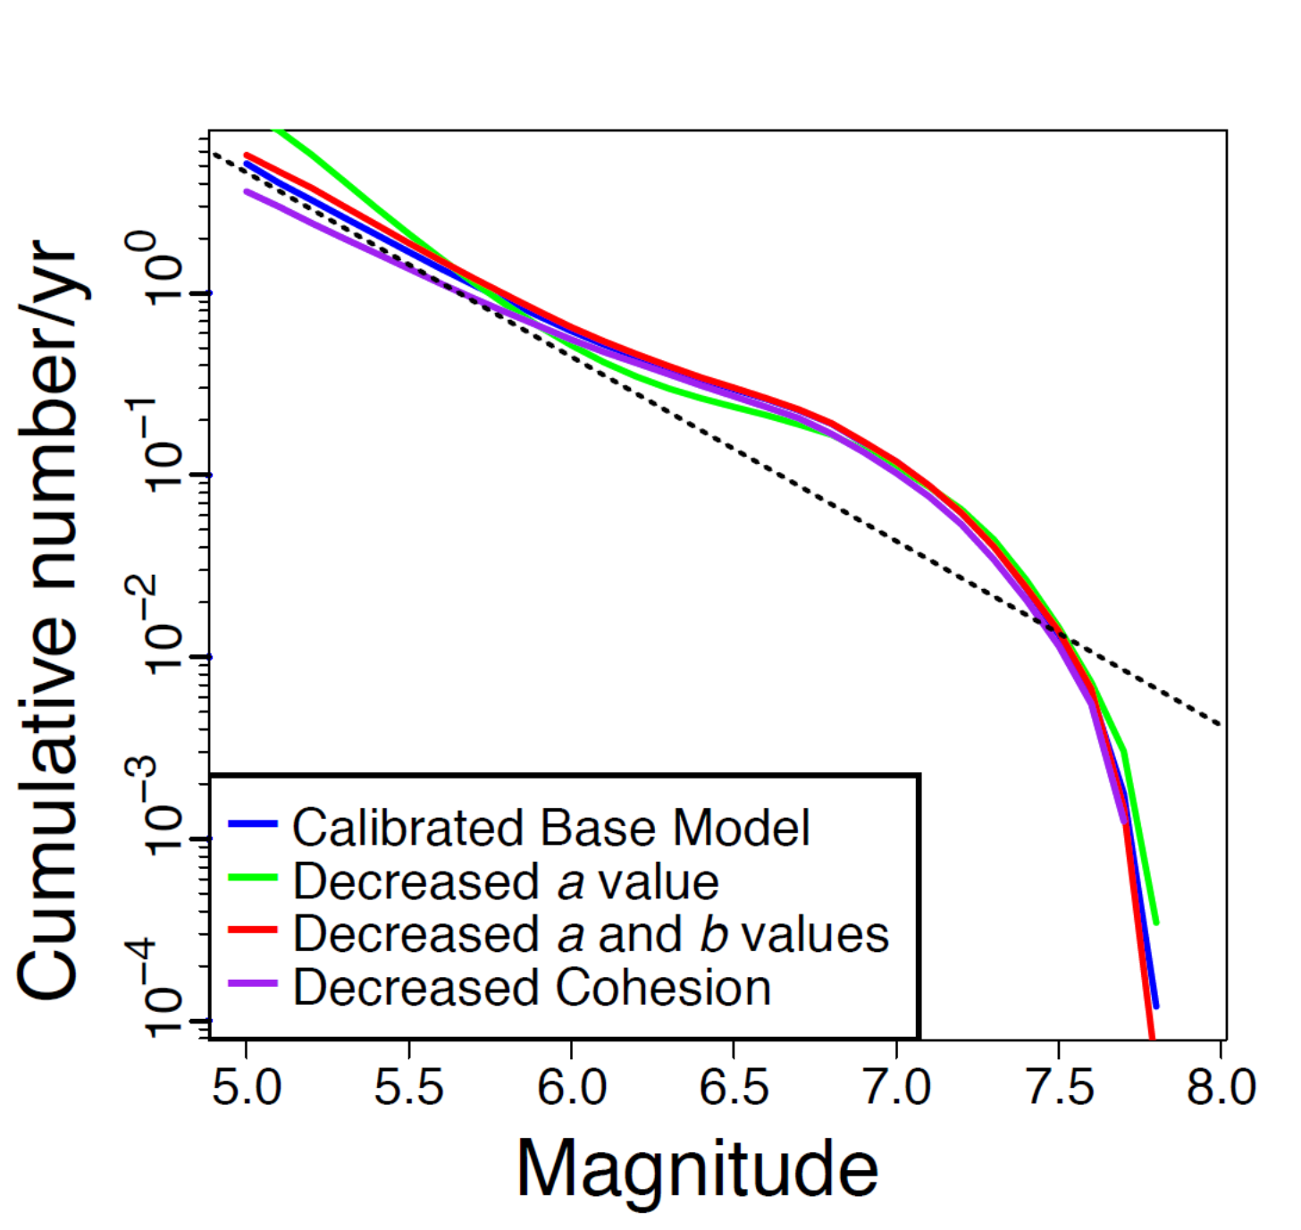
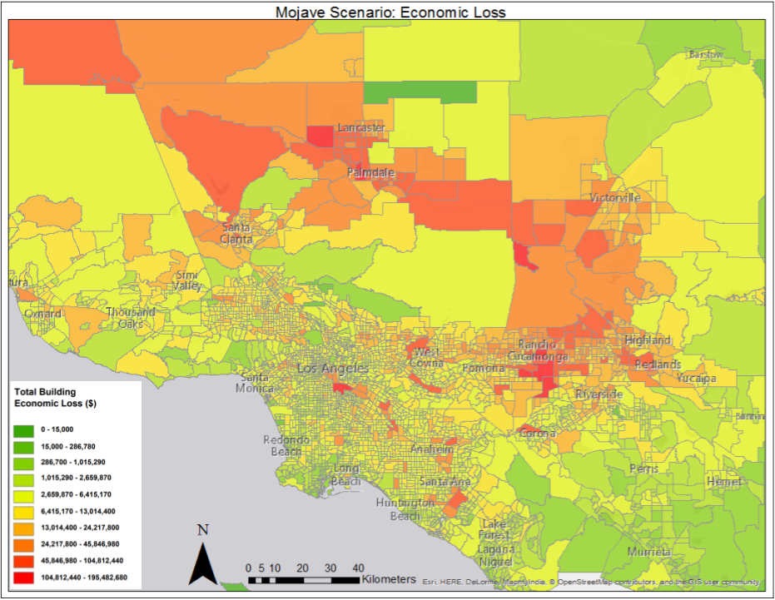
UseIT on Blue Waters
In 2017, interns used Blue Waters to generate RSQSim catalogs
  30,000 node-hours
  Performed parameter sweeps
  Catalogs used to predict likelihood of large aftershock sequences and losses
Many students now have an interest in HPC careers
Magnitude frequency distribution of 4 RSQSim catalogs with varying frictional parameters
Projected economic loss due to a M7.7 on the Mojave fault

Slide 12
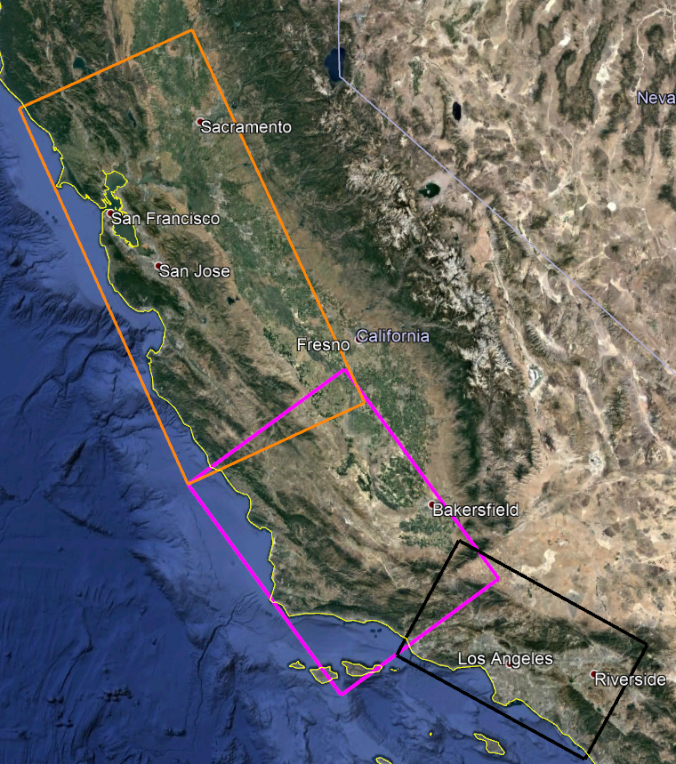
Blue Waters Plans for 2018
Building on 2017 Blue Waters accomplishments
Full regional PSHA study using RSQSim
  500,000 node hours
Physics-based PSHA study in Bay Area
  1.5 million node-hours
Integration of additional physics into High-F
  Nonlinearity
  Topography
  Attenuation
UseIT intern class starts next week

Slide 13





Questions?

