Slide 1

S068-05: Enhancing CyberShake Simulations for Engineering Applications
Scott Callaghan, Philip J. Maechling, Christine A. Goulet, Kevin R. Milner,
Robert W. Graves, Kim B. Olsen, Fabio Silva, and Yehuda Ben-Zion
2020 AGU Fall Meeting

Slide 2
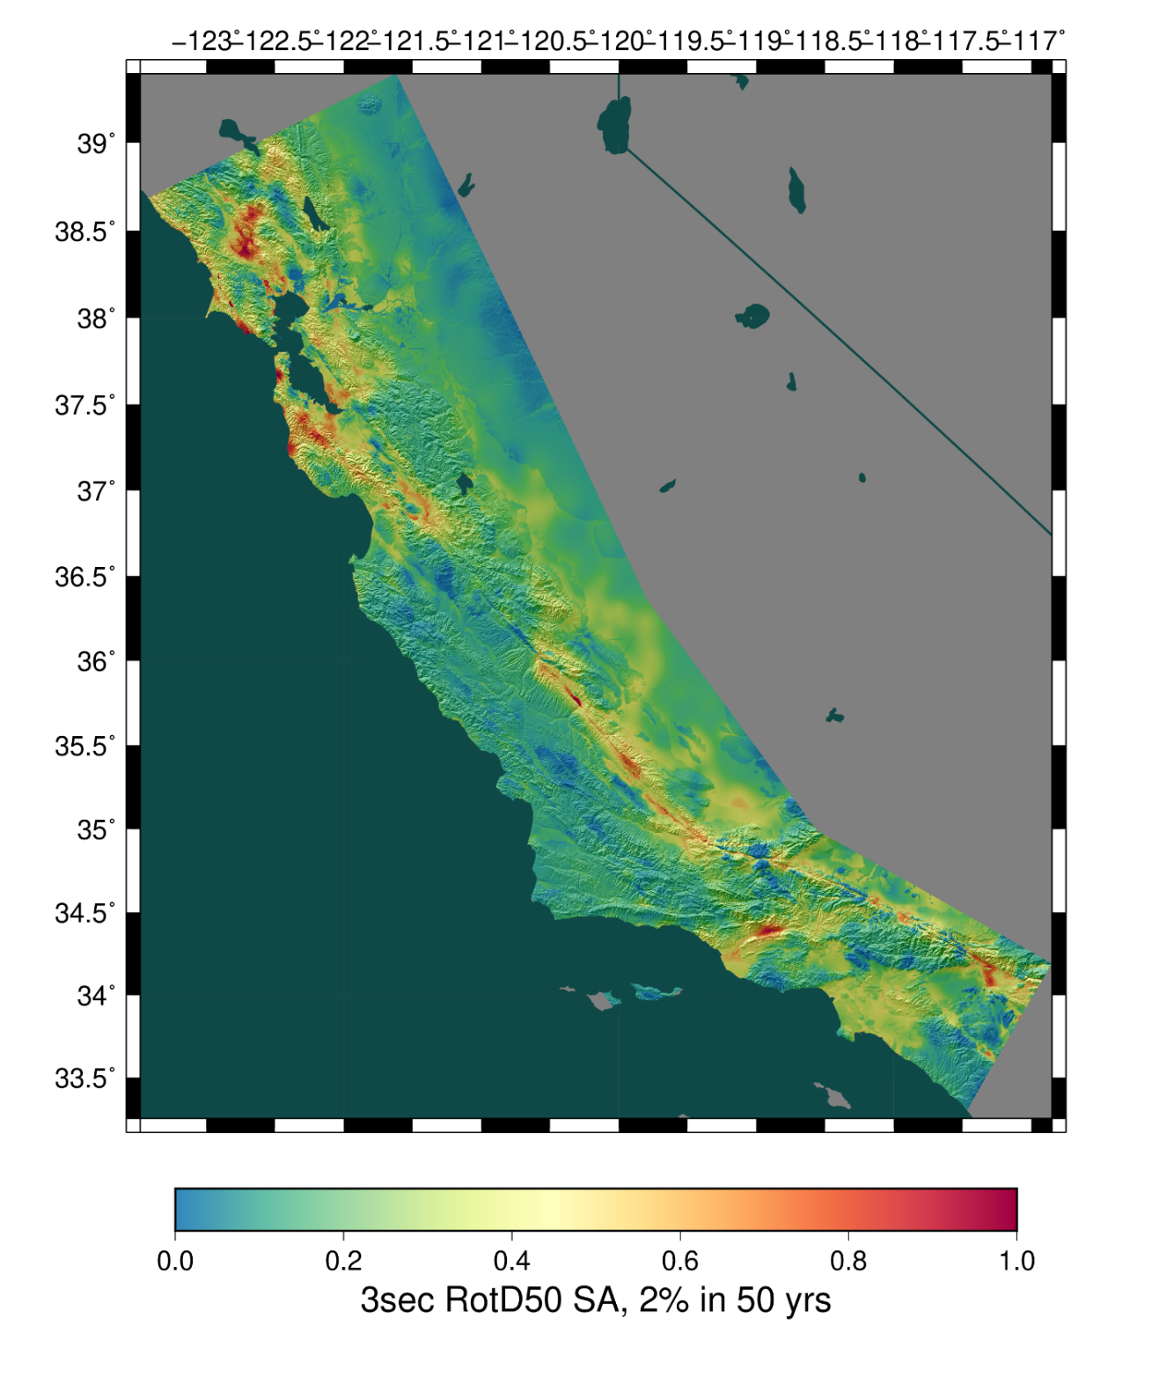
CyberShake Overview
Southern California Earthquake Center’s 3D physics-based probabilistic seismic hazard analysis (PSHA) platform
UCERF2 ERF (M≥6.5, ≤200 km) with Graves & Pitarka rupture generator
  ~500,000 events per site
Reciprocity-based approach to simulate seismograms
Intensity measures derived from seismograms
Hazard results from individual sites interpolated with GMPE basemap
Deterministic simulations to 1 Hz

Slide 3
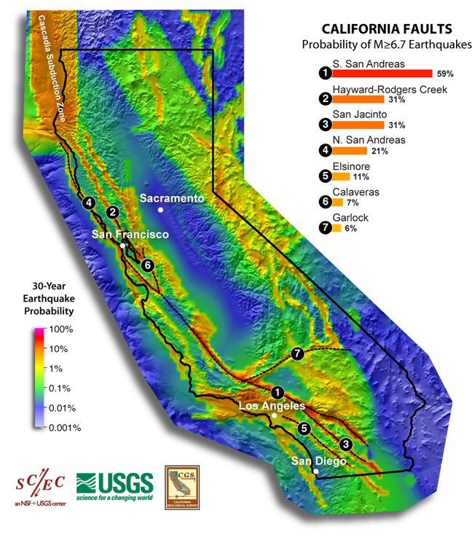
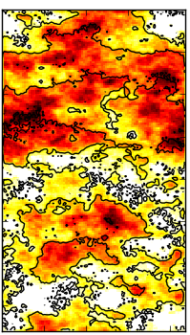
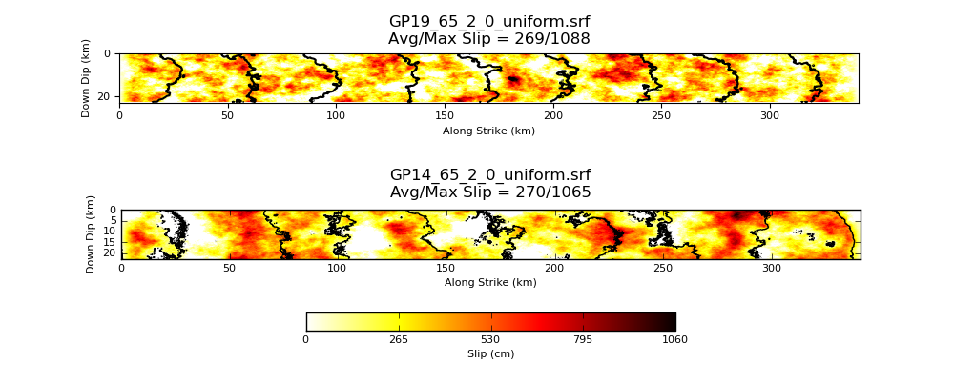
Updated Rupture Generator
Since 2015, CyberShake has used Graves & Pitarka (2014)
Update to 2019 version
  Same version used in SCEC Broadband Platform v19.4.0
Rupture Generator
Uniform California Earthquake Rupture Forecast
9 – 822 variations per rupture
Southern San Andreas, M7.85
GP 2019 updated implementation of slip, rupture speed, rise time
  Reduces coherence
GP 2019
GP 2014

Slide 4
Impact of Rupture Generator
Site USC: Black = GP 2019, Blue = GP 2014
Reduced hypocentral spacing from 4.5 to 4 km
  30% increase in number of rupture variations
  Sampling effects lead to higher hazard at 2 sec
Reduced coherency results in lower hazard at 10 sec

Slide 5
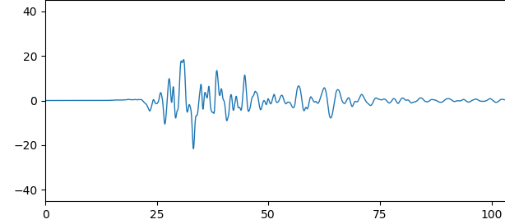
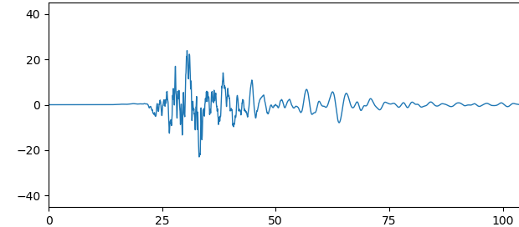
Broadband CyberShake
Current CyberShake deterministic simulations to 1 Hz
Higher frequencies are desirable for engineering applications
Computational cost scales as (frequency)⁴
Alternatively, perform stochastic high-frequency simulations and combine with deterministic low-frequency

Slide 6
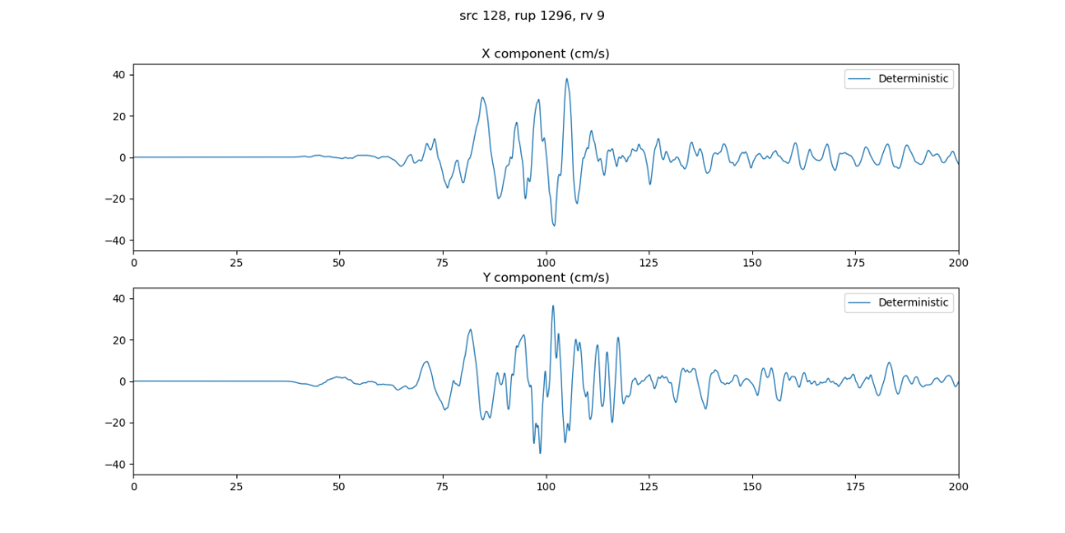
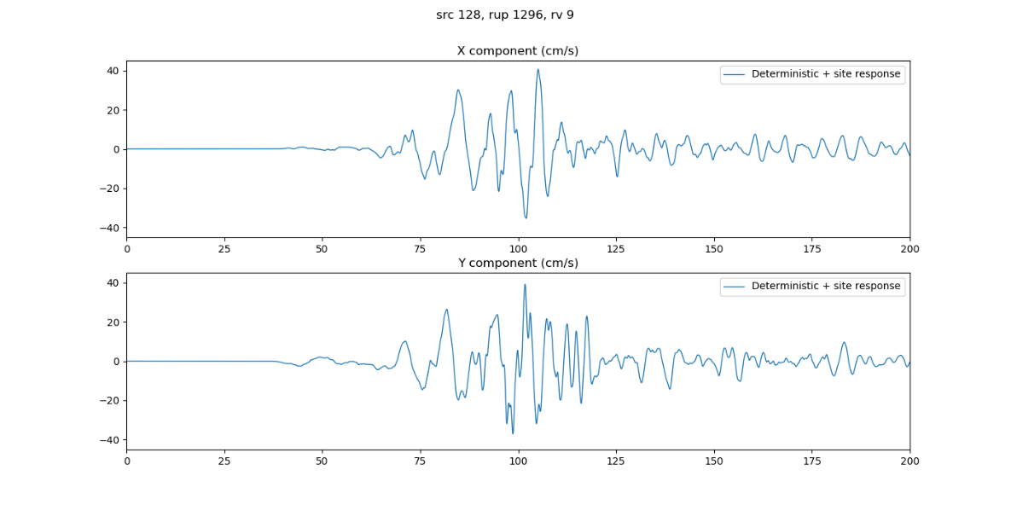
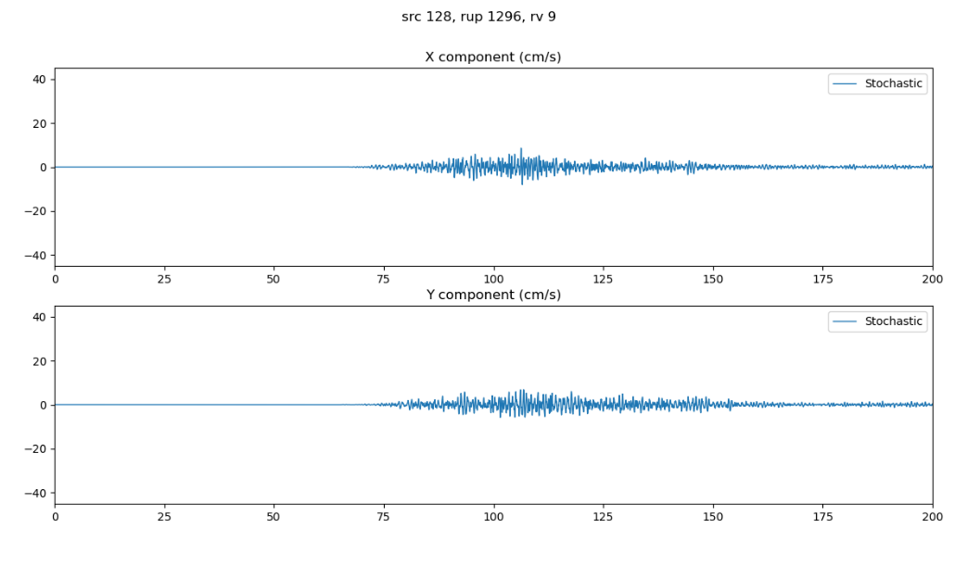
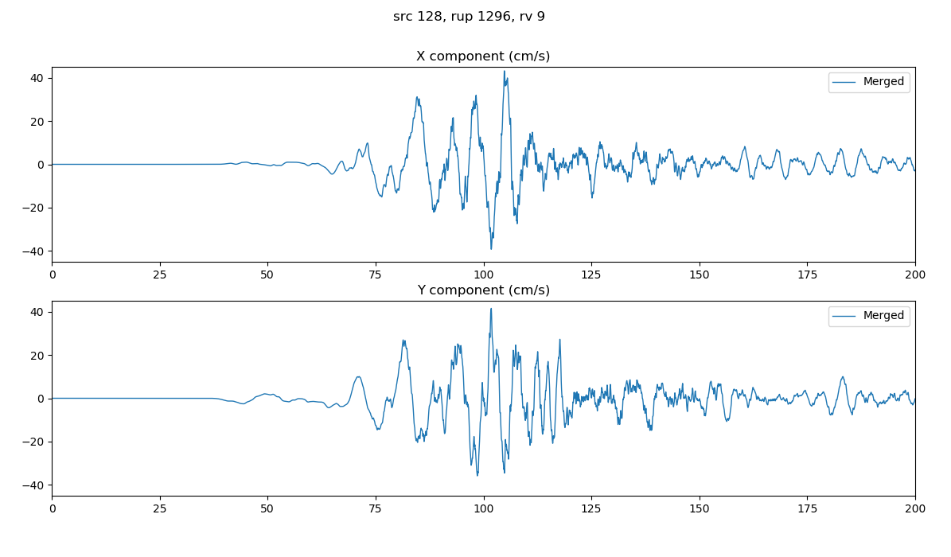
Broadband CyberShake Stages
Deterministic CyberShake
Site Response
Deterministic (≤1 Hz)
Deterministic + site response
Resample and merge
Stochastic Synthesis
Stochastic (1-50 Hz)
Broadband (0-50 Hz)

Slide 7
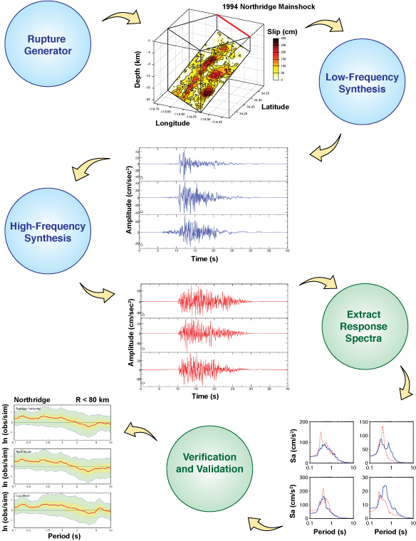
Integration with BBP
Stochastic codes already developed for SCEC Broadband Platform (BBP)
  High-frequency stochastic synthesis
  Site response
  Resampling and merging
Refactored BBP codebase so CyberShake can call directly
  Separated BBP codes into I/O and science kernel
Changes to BBP codebase will be picked up automatically by CyberShake
  Enhancement over previous CyberShake broadband efforts

Slide 8
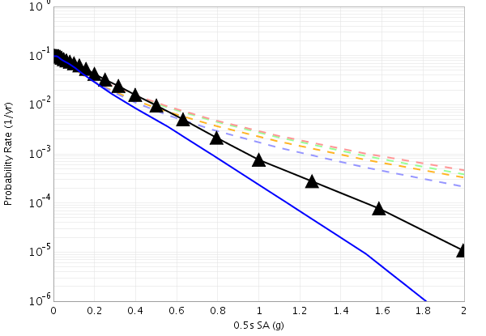
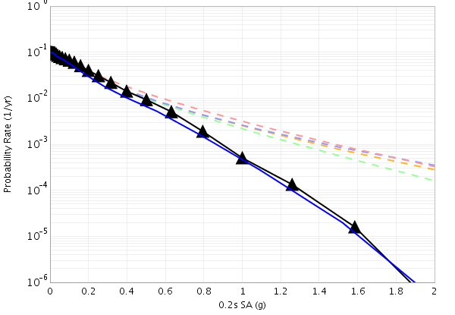
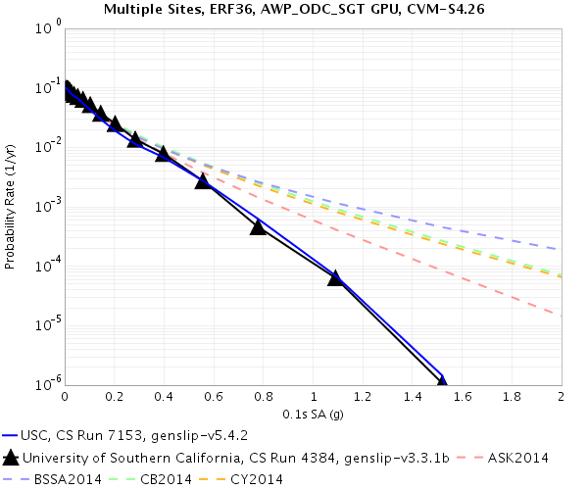
Broadband CyberShake Results
Site USC
0.5 s RotD50
0.2 s RotD50
0.1 s RotD50
2020 results
Study 15.12

Slide 9
Future Work
Validation exercise
  Run 5 BBP validation events through CyberShake
    Chino Hills, Northridge, Landers, Whittier, North Palm Springs
  First time historical events will be run in CyberShake
New Southern California hazard map
  Update Study 15.4 and 15.12 results
Workflow and technical updates to include broadband by default

Slide 10










Thanks!

