Slide 1
ECP Career Paths: Life as a Pretend Seismologist
Scott Callaghan
Statewide California Earthquake Center
scottcal@usc.edu

Slide 2
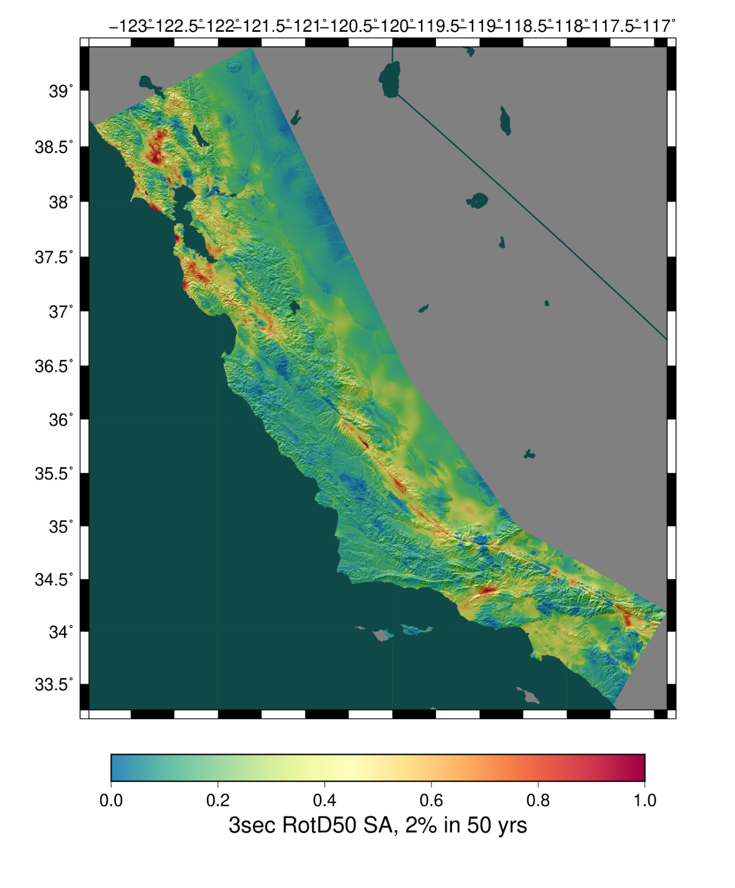
Computer Scientist at the Statewide California Earthquake Center
I’m an application developer
My work includes:
Large-scale scientific workflows
Seismic hazard analysis through simulating hundreds of thousands of earthquakes
Optimization of codes
Mentoring, HPC outreach, interns

Slide 3
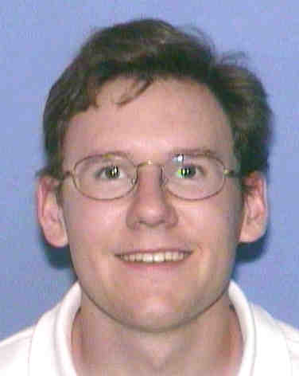
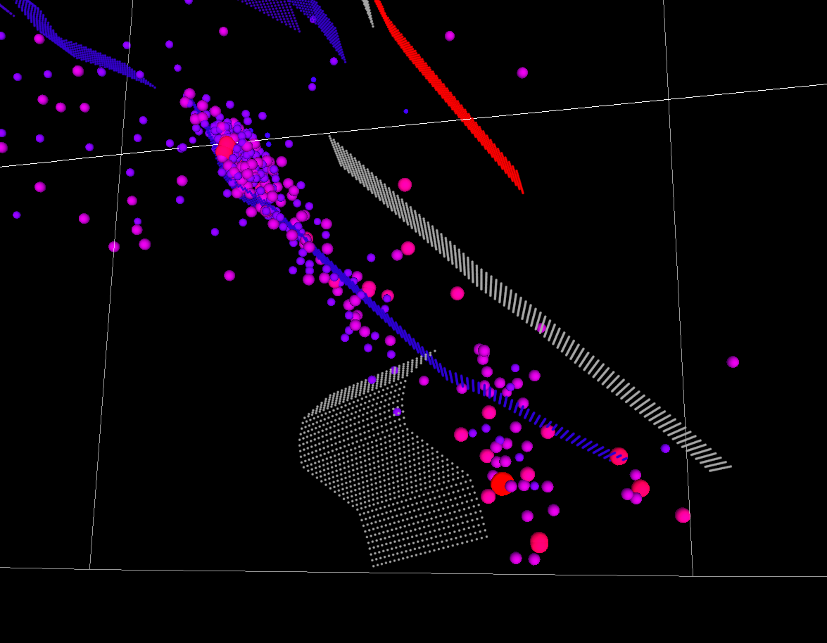
Computer Science undergrad at USC (2000-2004)
Not sure what to do after graduation
Summer of 2004, got internship with the Southern California Earthquake Center (at USC)
Worked on 3D visualization tool for earthquakes and related datasets with team of 20 interns
Discovered the world of software for science!
Original student ID picture.

Slide 4
After graduation, started working for SCEC
Got involved in HPC through large simulations
First SC was SC05
Temp employee, 2005
M.S. in Computer Science (High Performance Computing and Simulations), 2006-7
Thesis on automated testing for workflows
Full-time research programmer, 2008

Slide 5
In 2008, my wife got a post-doc in London, Ontario, Canada
Started working remotely

Slide 6
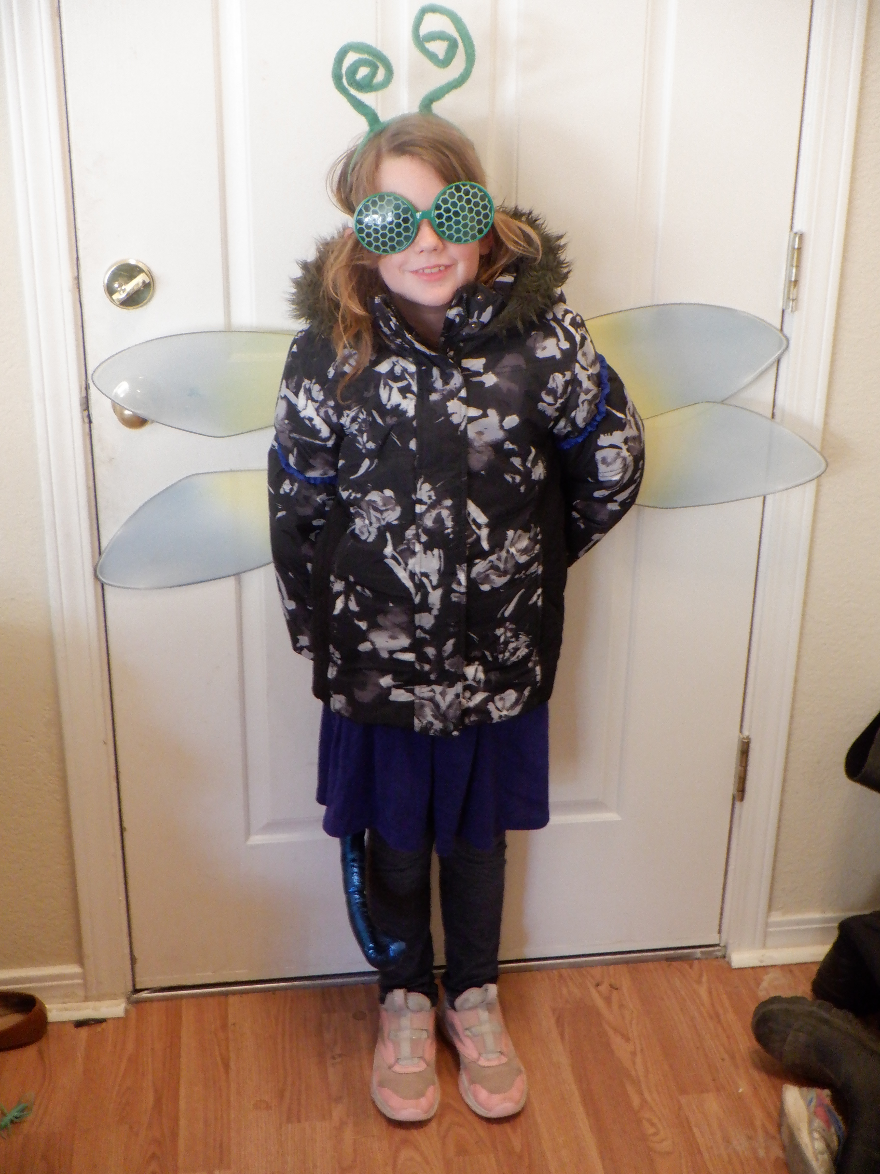
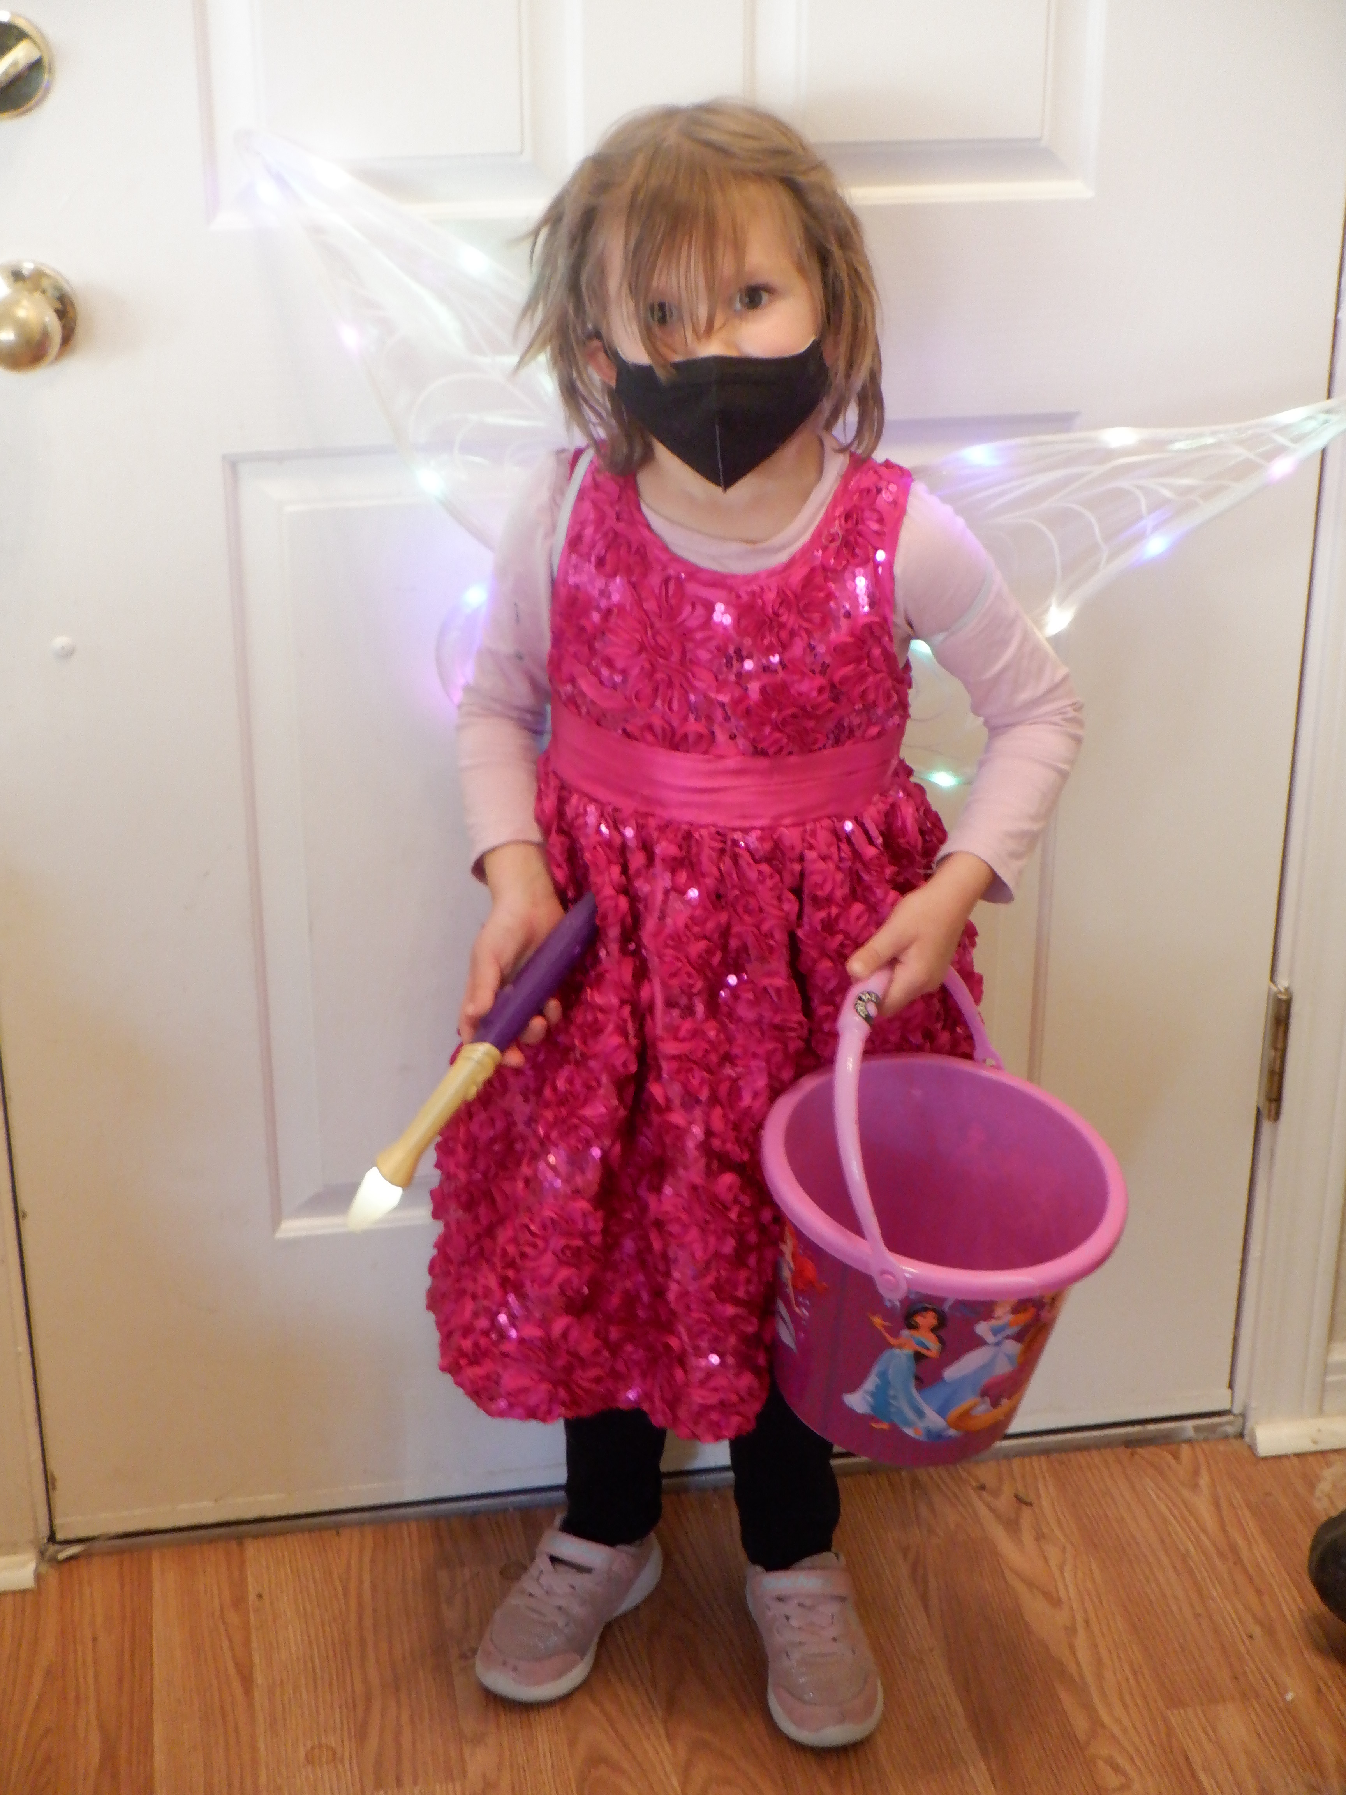
In 2012, my wife got a faculty position at UMSL (University of Missouri – St. Louis)
Max, born in 2015
Alex, born in 2018
In 2018, I was promoted to Computer Scientist

Slide 7
In 2020, my wife got a faculty position at University of Nevada Reno
No change to my employment
SCEC is going through a transition
In the middle of the promotion process

Slide 8
Look at the examples set by leadership when considering a position
Work/life balance?
Steady work or putting out fires?
Ask for what you want and need, from your workplace and your family
Don’t be afraid to stay put if it’s working for you
Plan, but remain open to opportunities

