Slide 1
CyberShake Physics-Based PSHA in Central California
Scott Callaghan, Philip J. Maechling, Christine A. Goulet, Kevin R. Milner, Robert W. Graves, Kim B. Olsen, Thomas H. Jordan, and the CyberShake Collaboration
2017 AGU Fall Meeting
December 12, 2017

Slide 2
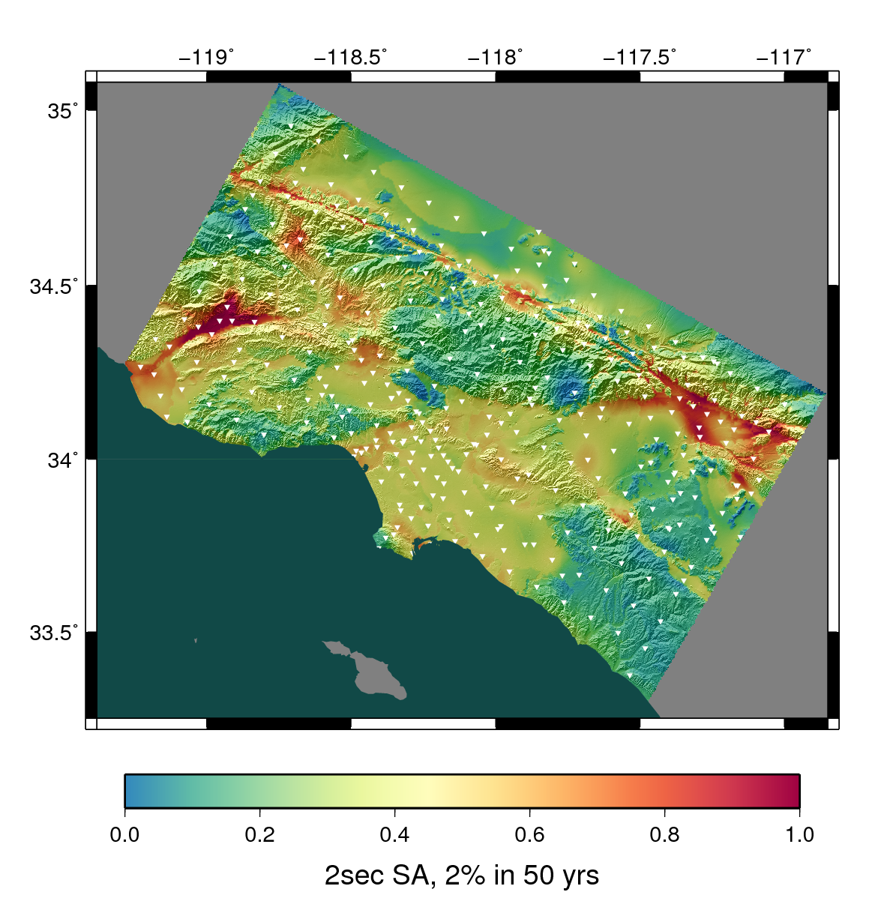
CyberShake Overview
Southern California Earthquake Center’s 3D physics-based probabilistic seismic hazard analysis (PSHA) platform
UCERF2 used as earthquake rupture forecast (M≥6.5, <200 km)
Reciprocity-based approach to simulate seismograms (~500,000 per site)
Intensity measures derived from seismograms
Hazard results from individual sites interpolated with GMPEs to make map
Earthquake forecast: UCERF2
Structural model: CVM-S4.26

Slide 3
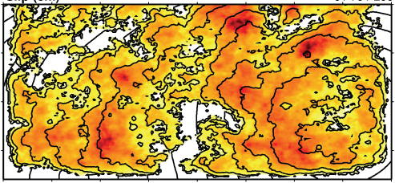
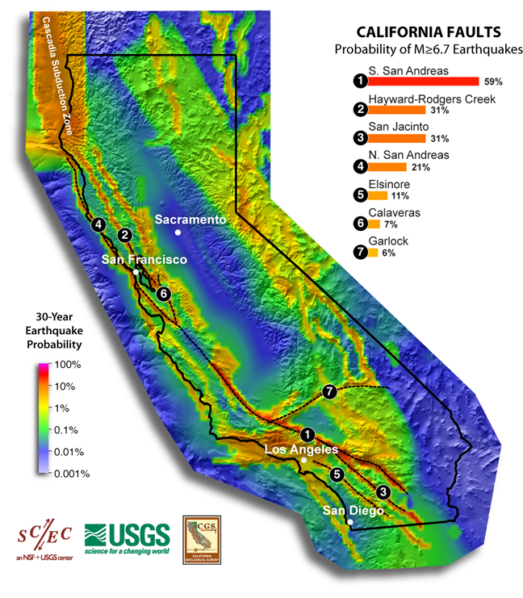
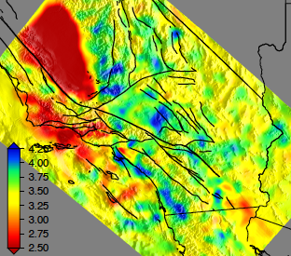
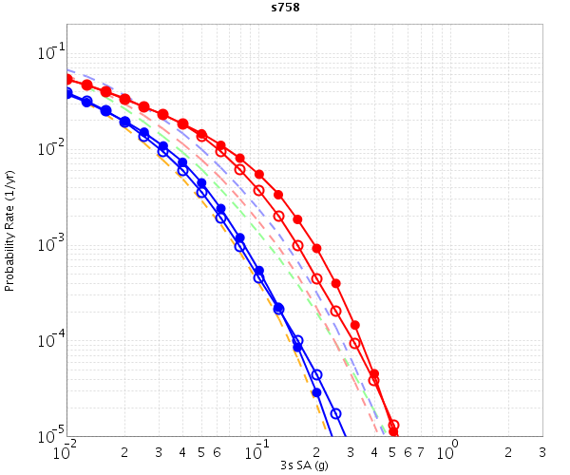
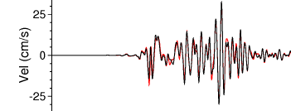
CyberShake Components
Graves-Pitarka (2014) kinematic rupture generator
CyberShake Hazard Map
UCVM
(NH21A-0164)
AWP-ODC
Seismogram Synthesis
Data
Product Generation
12 TB
data transfer
Mesh generation
1 job per site
MPI, 1500-4000 cores
SGT computation
2 jobs per site
MPI, 200-800 GPUs
Post-processing
500,000 jobs per site
MPI master/worker, 3712 cores
Populate DB, construct images
6 jobs per site
Uniform California Earthquake Rupture Forecast
CVM-S4.26
z = 6 km
hazard curves
Most recent CyberShake study took 4 weeks of real time and used 21 million core-hours
500,000 Seismograms
75M intensity measures
Community Velocity Model

Slide 4
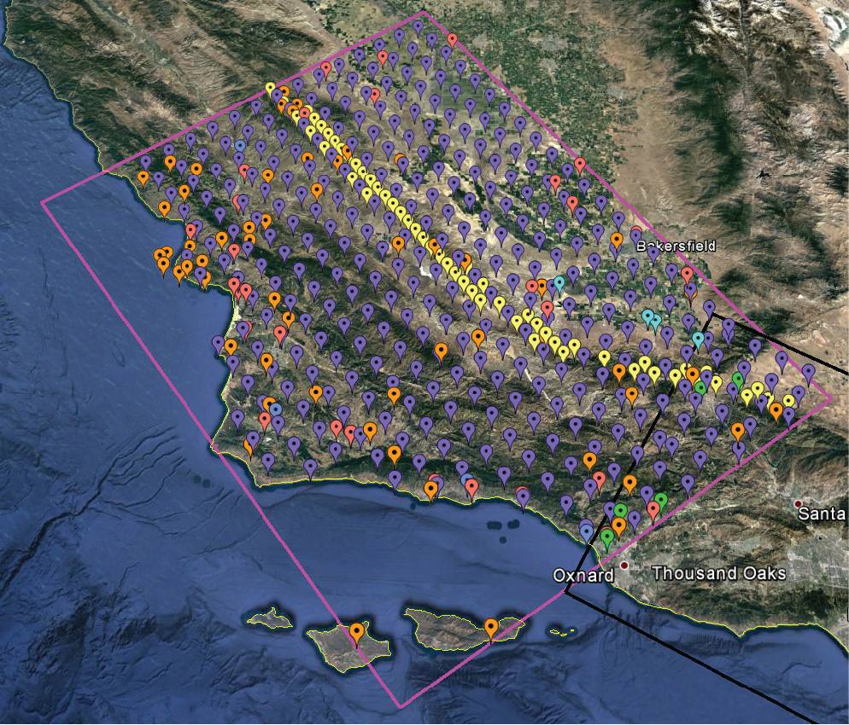
CyberShake in Central California
To date, CyberShake only used for Southern California
Proof-of-concept for CyberShake in new regions
438 new locations
58 sites added for better SAF coverage
1 Hz
Two velocity models
CCA-06: 3D, from tomography
CCA 1D: averaged version of 3D

Slide 5
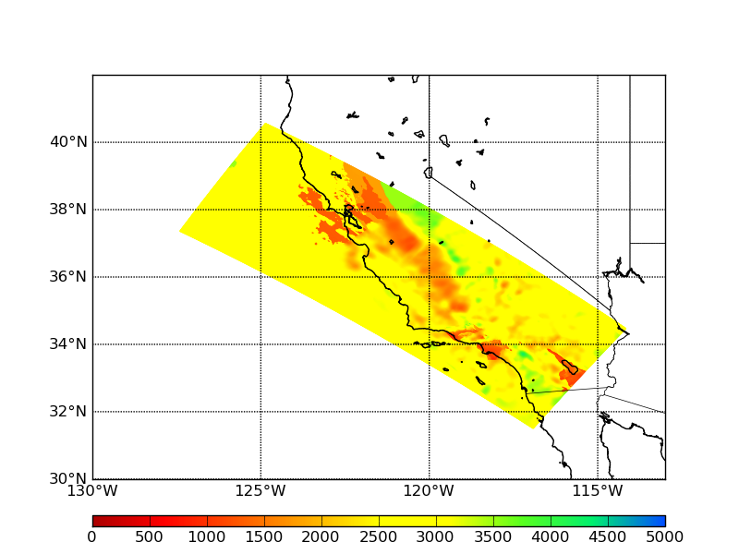
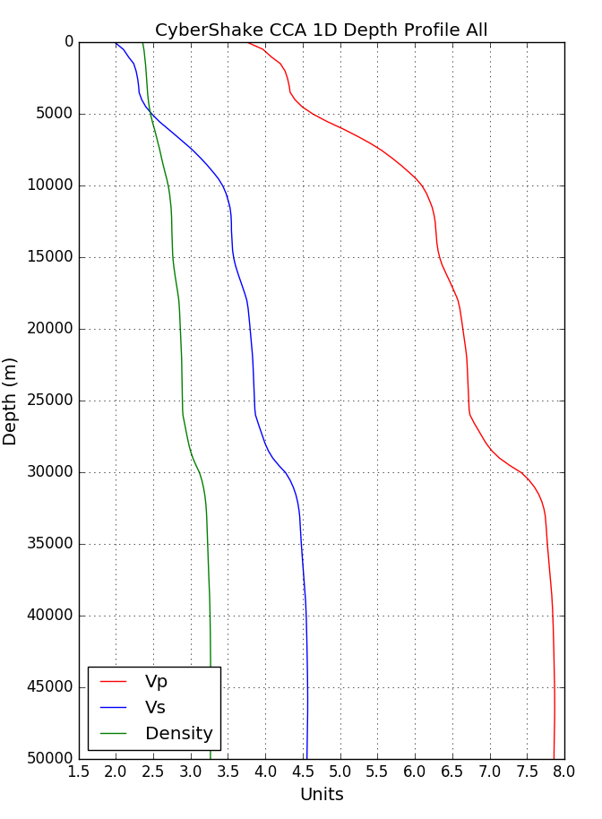
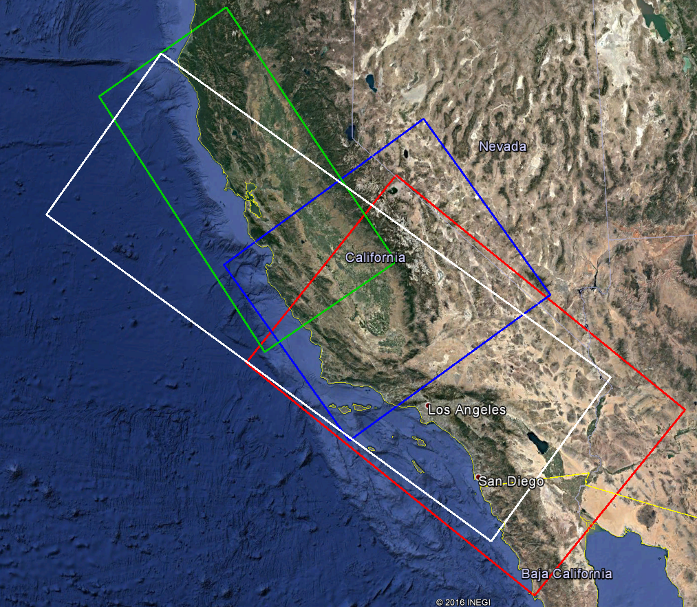
Central California Velocity Models
Horizontal plot of Vs from 3D model at depth=1.05 km
Combined 3D models and smoothed: CCA-06, CVM-S4.26, USGS Bay Area, 1D background
CCA 1D model profile

Slide 6
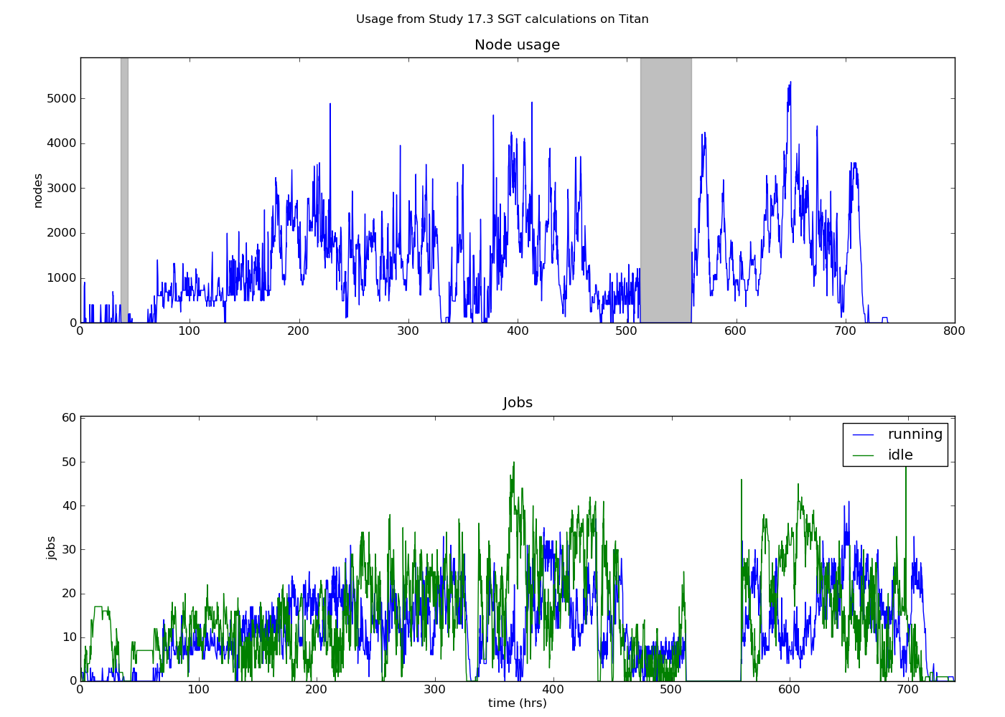
CyberShake Study 17.3
2 velocity models x 438 sites
Study conducted over 31 days on NCSA Blue Waters and OLCF Titan
Averaged 1295 nodes, max of 5374
Burned 900k node-hrs (21.6M core-hrs)
777 TB of data generated
10.7 TB staged to SCEC disks for storage
Synthesized 285 million two-component seismograms
43 billion intensity measures

Slide 7
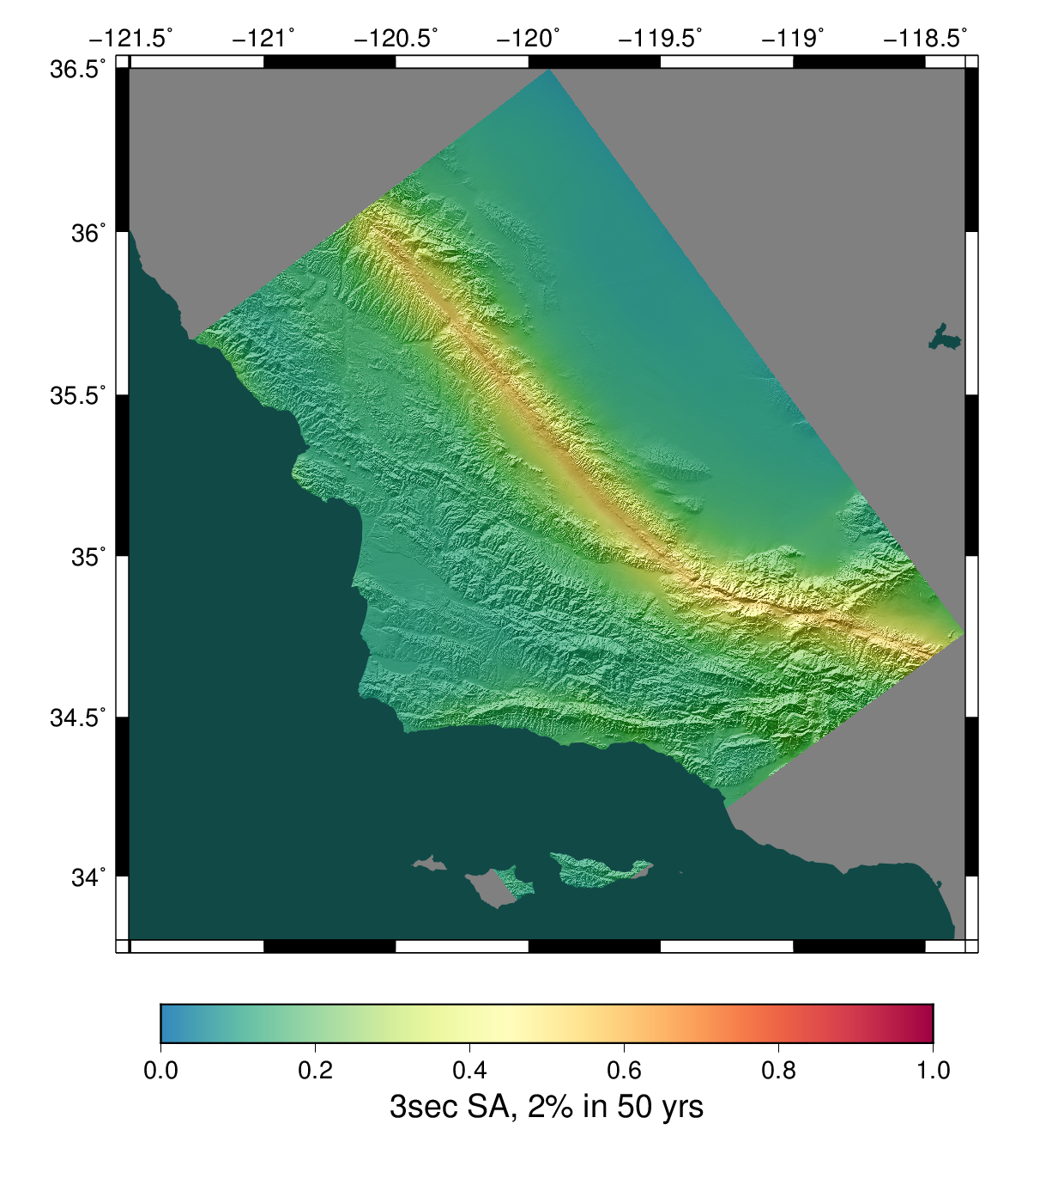
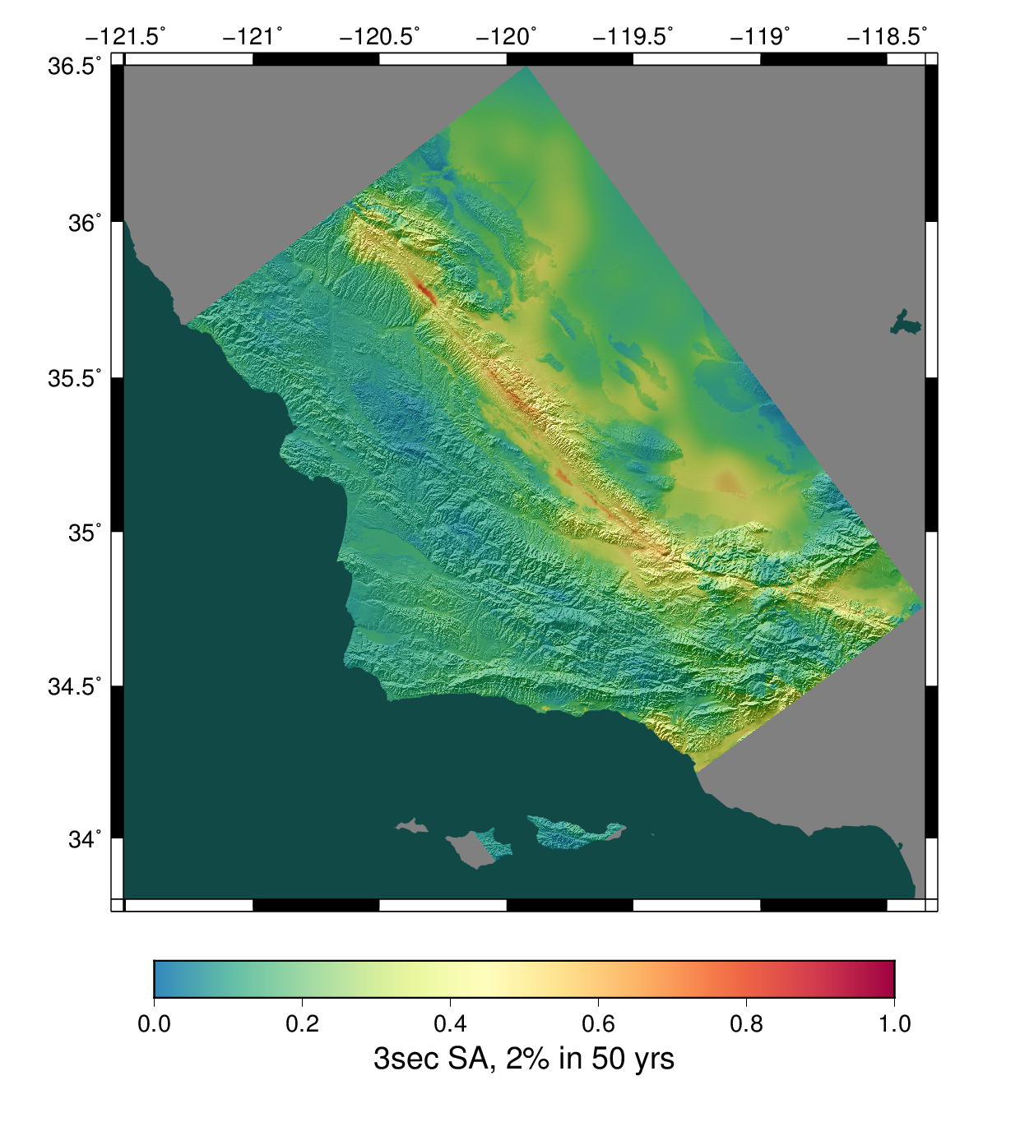
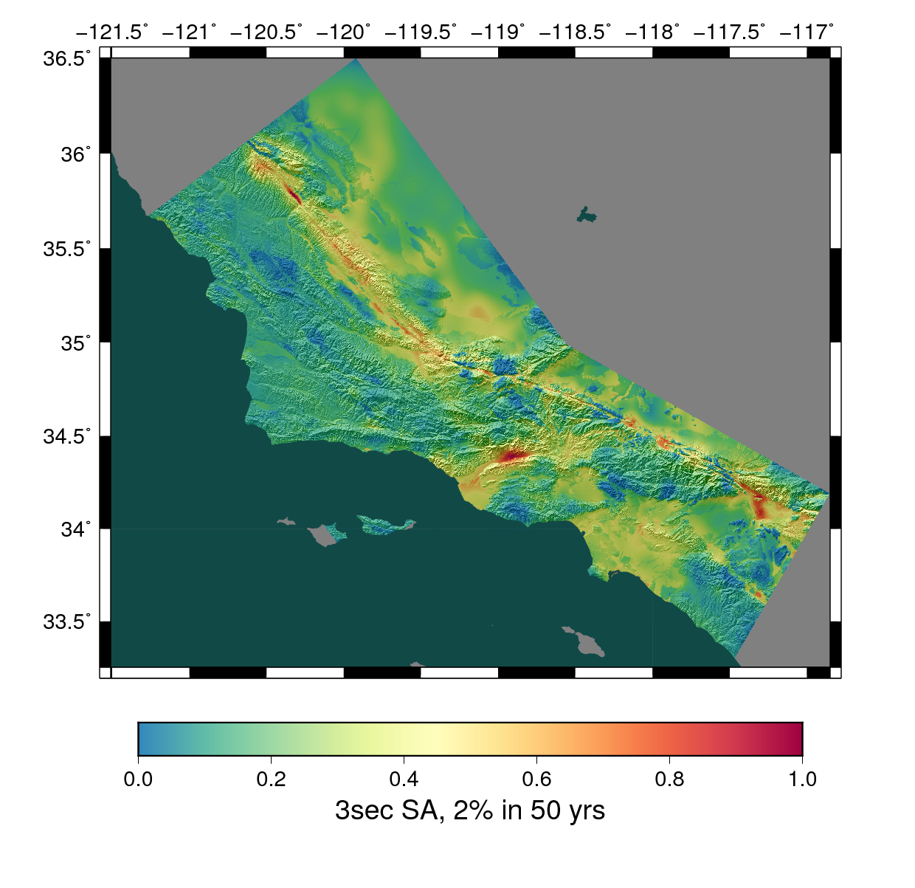
Study 17.3 Results
1D model
3D model
Combined 3D model

Slide 8
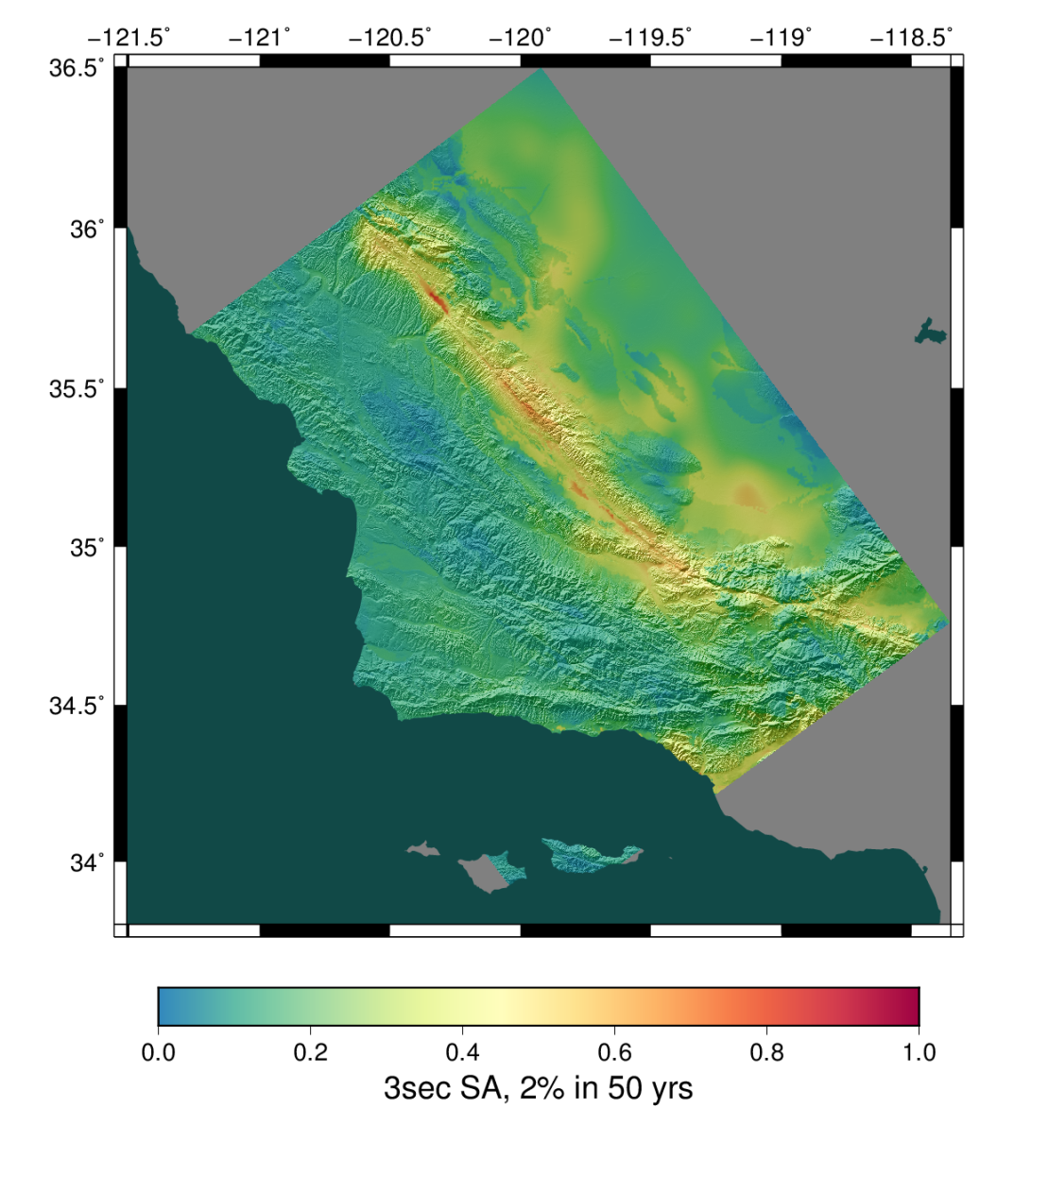
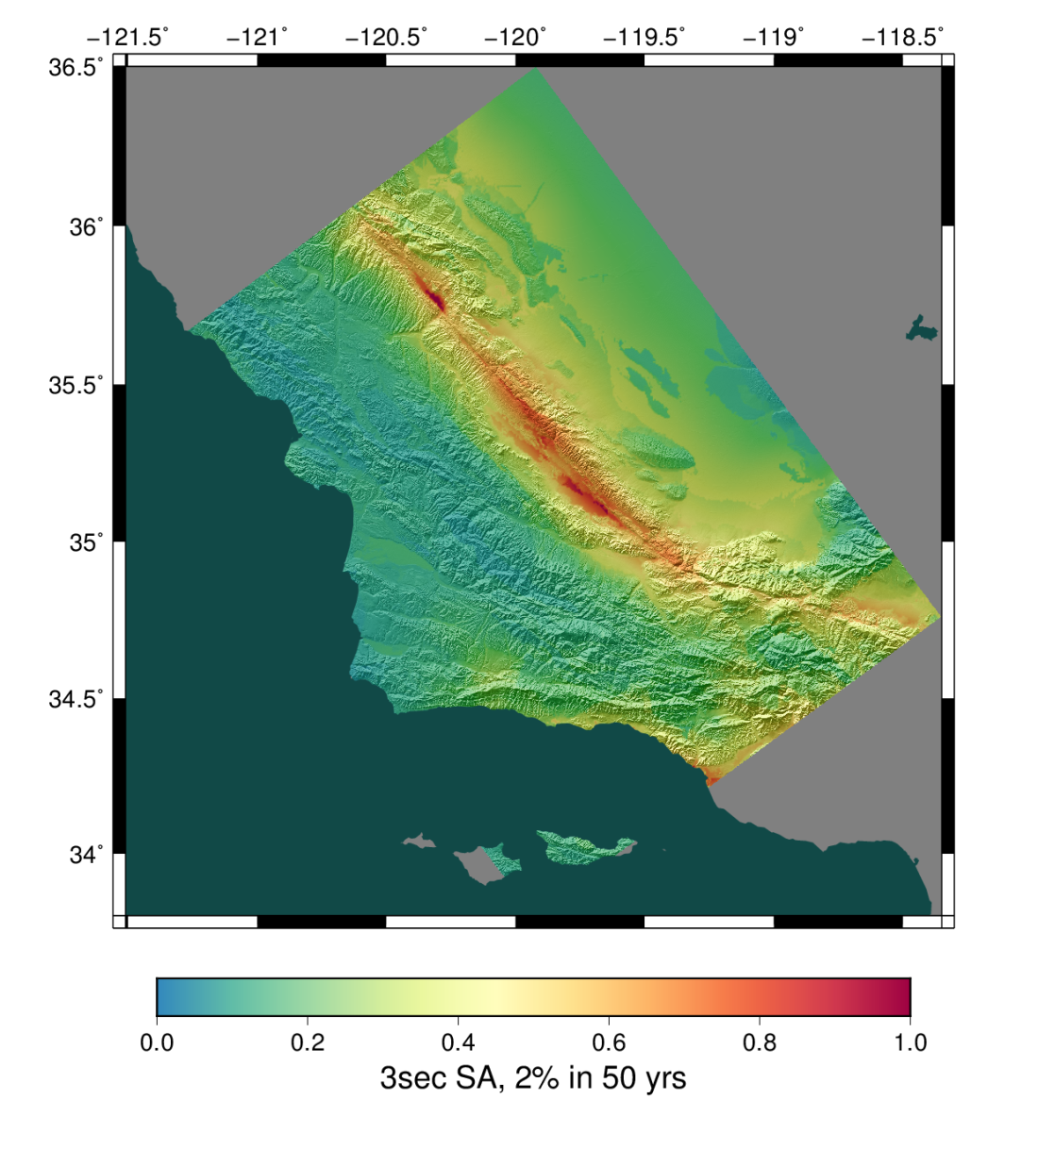
Study 17.3 Results
CyberShake 3D
NGA-2 GMPEs

Slide 9
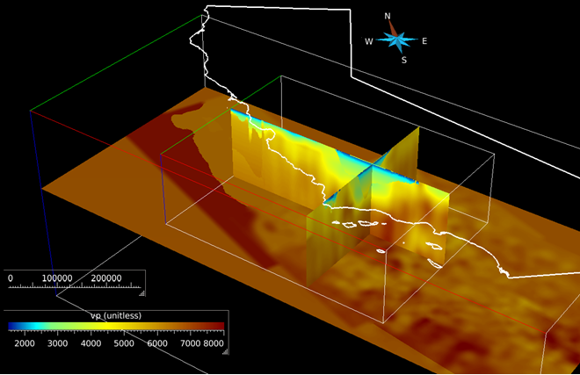
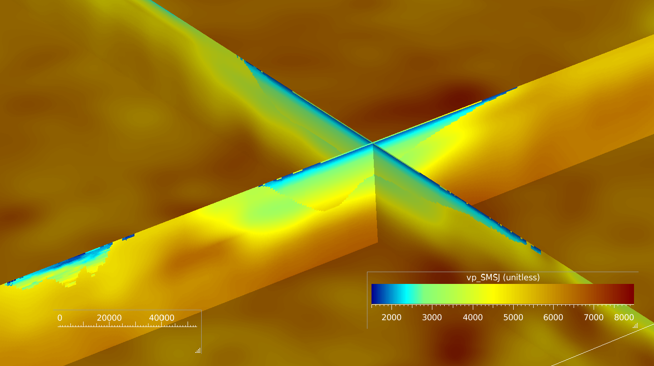
New CCA Basins
Working with Shaw and Plesch to integrate enhanced basin information into CCA-06 3D model and back into UCVM
Rerun CyberShake with improved model

Slide 10
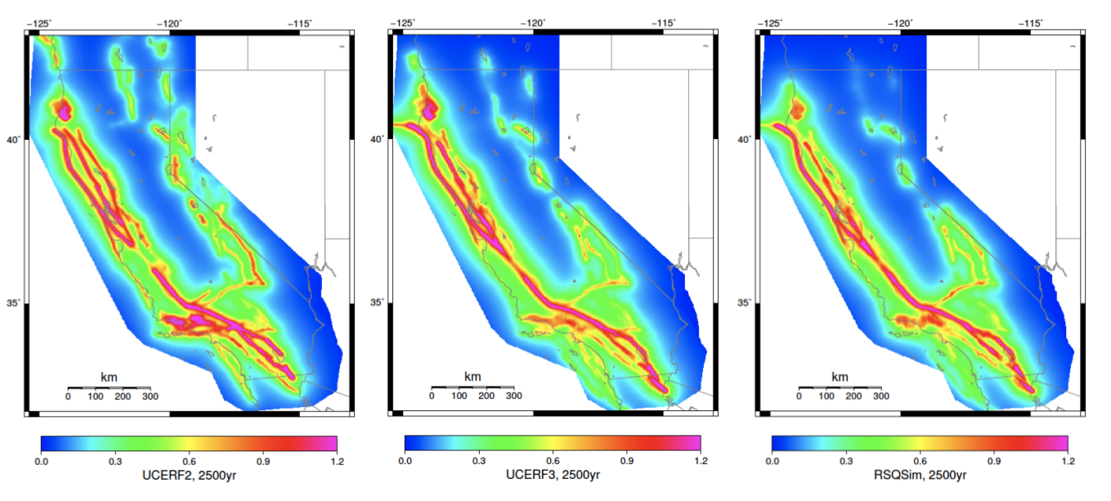
Earthquake Simulator Integration
Would like to update ERF from UCERF2
UCERF3 includes 25x more ruptures
Alternative: RSQSim (Dieterich & Richards-Dinger, 2010) earthquake simulator
UCERF2
UCERF3
RSQSim
Simulate 1+Myr catalog in RSQSim
Use events directly in CyberShake as extended ERF
Enables full end-to-end physics-based PSHA
Using SCEC Broadband Platform to test RSQSim events as sources

Slide 11
Questions?
10

