Slide 1
Simplify Your Science with Workflow Tools
International HPC Summer School
June 4, 2014
Scott Callaghan
Southern California Earthquake Center
University of Southern California
scottcal@usc.edu

Slide 2
Overview
What are scientific workflows?
What problems do workflow tools solve?
Overview of available workflow tools
CyberShake (seismic hazard application)
Computational overview
Challenges and solutions
Ways to simplify your work
Goal: Help you figure out if this would be useful

Slide 3
Scientific Workflows
Formal way to express a scientific calculation
Multiple tasks with dependencies between them
No limitations on tasks
Short or long
Loosely or tightly coupled
Independence of workflow process and data
Often, run same workflow with different data
You use workflows all the time…

Slide 4
Sample Workflow
#!/bin/bash
1) Stage-in input data to compute environment
scp myself@datastore.com:/data/input.txt /scratch/input.txt
2) Run a serial job with an input and output
bin/pre-processing in=input.txt out=tmp.txt
3) Run a parallel job with the resulting data
mpiexec bin/parallel-job in=tmp.txt out_prefix=output
4) Run a set of independent serial jobs in parallel – scheduling by hand
for i in `seq 0 $np`; do
bin/integrity-check output.$i &
done
5) While those are running, get metadata and run another serial job
ts=`date +%s`
bin/merge prefix=output out=output.$ts
6) Finally, stage results back to permanent storage
scp /scratch/output.$ts myself@datastore.com:/data/output.$ts

Slide 5
Could think of shell script as a workflow
input.txt
output.$ts
integrity-check
input.txt
tmp.txt
output.*
pre-processing
parallel-job
stage-in
merge
stage-out
date
output.$ts

Slide 6
Workflow Components
Task executions
Specify a series of tasks to run
Data and control dependencies between tasks
Outputs from one task may be inputs for another
Task scheduling
Some tasks may be able to run in parallel with other tasks
File and metadata management
Track when a task was run, key parameters
Resource provisioning (getting cores)
Computational resources are needed to run jobs on

Slide 7
What do we need help with?
Task executions
What if something fails in the middle?
Data and control dependencies
Make sure inputs are available for tasks
May have complicated dependencies
Task scheduling
Minimize execution time while preserving dependencies
Metadata
Automatically capture and track
Getting cores

Slide 8
Workflow Tools
Define workflow via programming
Can support all kinds of workflows
Provide many kinds of fancy features and capabilities
Flexible but can be complex
Will focus on Pegasus, but concepts are shared

Slide 9
Pegasus-WMS
Developed at USC’s Information Sciences Institute
Designed to address our earlier problems:
Task execution
Data and control dependencies
Data and metadata management
Error recovery
Uses HTCondor DAGMan for
Task scheduling
Resource provisioning

Slide 10
Pegasus Concepts
Separation of “submit host” and “execution site”
Create workflow using code on your local machine
Can run on local machine or on distributed resources
Workflow represented with directed acyclic graphs
You use API to write code describing workflow
Python, Java, Perl
Tasks with parent / child relationships
Files and their roles
Can have nested workflows
Pegasus creates XML file of workflow called a DAX

Slide 11
Sample Workflow
first_job
input.txt
tmp.txt
simul_job
simul_job
simul_job
simul_job
simul_job
output.0.dat
output.1.dat
output.2.dat
output.3.dat
output.4.dat

Slide 12
Sample DAX Generator
//Create DAX object
dax = ADAG("test_dax")
//Define first job
firstJob = Job(name="first_job")
//Input and output files to first job
firstInputFile = File("input.txt")
firstOutputFile = File("tmp.txt")
//Arguments to first_job (first_job input=input.txt output=tmp.txt)
firstJob.addArgument("input=input.txt", "output=tmp.txt")
//Role of the files for the job
firstJob.uses(firstInputFile, link=Link.INPUT)
firstJob.uses(firstOutputFile, link=Link.OUTPUT)
//Add the job to the workflow
dax.addJob(firstJob)

Slide 13
for i in range(0, 5):
//Create simulation job
simulJob = Job(id="%s" % (i+1), name="simul_job")
//Define files
simulInputFile = File("tmp.txt")
simulOutputFile = File("output.%d.dat" % i)
//Arguments to job
//simulJob parameter=<i> input=tmp.txt output=output<i>.dat
simulJob.addArgument("parameter=%d" % i, "input=tmp.txt",
"output=%s" % simulOutputFile.getName())
//Role of files
simulJob.uses(simulInputFile, link=Link.INPUT)
simulJob.uses(simulOutputFile, line=Link.OUTPUT)
//Add job to dax
dax.addJob(simulJob)
//Dependency on firstJob
dax.depends(parent=firstJob, child=simulJob)
//Write to file
fp = open("test.dax", "w")
dax.writeXML(fp)
fp.close()

Slide 14
Planning
DAX is “abstract workflow”
Logical filenames and executables
Algorithm description
Prepare workflow to execute on a certain system
Use Pegasus to “plan” workflow
Uses catalogs to resolve logical names, compute info
Pegasus automatically augments workflow
Stages jobs (if needed) with GridFTP or Globus Online
Registers output files in a catalog to find later
Wraps jobs in pegasus-kickstart for detailed statistics
Generates a DAG
Top-level workflow description (tasks and dependencies)
Submission file for each job (HTCondor format)

Slide 15
Pegasus Workflow Path
Create workflow description (you write this)
Planning
Running
Jobs Execute
DAX API
Scheduler
(HTCondor)
Abstract workflow (DAX)
Logical names, algorithm
Concrete workflow (DAG)
Physical paths, job scripts

Slide 16
Running with HTCondor
Developed by HTCondor group at U of Wisconsin
Pegasus “submits” workflow to HTCondor DAGMan
Contains local queue of jobs
Monitors dependencies
Schedules jobs to resources
Automatically retries failed jobs
Writes rescue DAG to restart if job keeps failing
Updates status (jobs ready, complete, failed, etc.)
Can run jobs locally or remotely (cluster, cloud)
HTCondor-G uses GRAM to submit jobs to remote scheduler

Slide 17
GRAM
Part of the Globus Toolkit
Uses certificate-based authentication
Like gsissh, GridFTP, Globus Online
Requires X509 certificate and account on remote machine
Enables submission of jobs into a remote queue
Supported by many HPC resources
Stampede, Blue Waters, SuperMUC

Slide 18
Pegasus/HTCondor/GRAM stack
Local machine
Remote machine
What you do:
Create workflow description
Remote scheduler
What the tools do:
HTCondor
Pegasus
GRAM
local queue
remote queue
DAG

Slide 19
Other Workflow Tools
Regardless of the tool, trying to solve same problems
Describe your workflow (Pegasus “Create”)
Prepare your workflow for the execution environment (Pegasus “Plan”)
Send jobs to resources (HTCondor, GRAM)
Monitor the execution of the jobs (HTCondor DAGMan)
Brief overview of other available tools

Slide 20
Other Workflow Tools: Swift
Similar, but workflow defined via scripting language
Developed at the University of Chicago
//Create new type
type messagefile;
//Create app definition, returns messagefile
app (messagefile t) greeting() {
//Print and pipe stdout to t
echo “Hello, world!” stdout=@filename(t);
}
//Create a new messagefile, linked to hello.txt
messagefile outfile <“hello.txt”>
//Run greeting() and store results
outfile = greeting();
Catalogs used to resolve executables and resources
Workflow compiled internally and executed

Slide 21
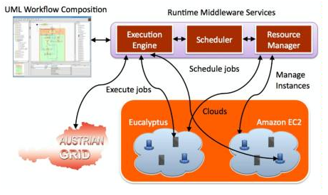
Other Workflow Tools: Askalon
Developed at University of Innsbruck
Similar approach to Pegasus/HTCondor
Create workflow description
Either program in workflow language
Or use UML editor to graphically create
Conversion: like planning, to bind to specific execution
Submit jobs to Enactment Engine, which distributes jobs for execution at remote grid or cloud sites
Provides monitoring tools

Slide 22
Other Workflow Tools
WS-PGRADE/gUSE
Developed at the Hungarian Academy of Sciences
WS-PGRADE is GUI interface to gUSE services
Supports “templates”, like OOP inheritance
Describe workflow, then configure it for execution
UNICORE
Maintained by Jülich Supercomputing Center
GUI interface to describe workflow
Submit workflow to Gateway which manages execution
Gateway interfaces with schedulers over the Grid

Slide 23
Other Remote Job Tools: SAGA
These tools only submit remote jobs
You must check jobs for success and manage dependencies
Developed at Rutgers University
Python API for job submission and data transfer
Interfaces with many scheduler types
ctx = saga.Context("ssh“) # Use SSH for authentication
ctx.user_id = "your_username“ # Your identity
session = saga.Session() # Create new session
session.add_context(ctx) # Link session with authentication
# Use a PBS adaptor
js = saga.job.Service("pbs+ssh://%s“ % REMOTE_HOST,session=session)
jd = saga.job.Description() # Create description
jd.executable = '/bin/ls‘ # Could include environment, input, output
myjob = js.create_job(jd) # Create job with description and service
myjob.run() # Submit job
myjob.wait() # Wait for completion or error

Slide 24
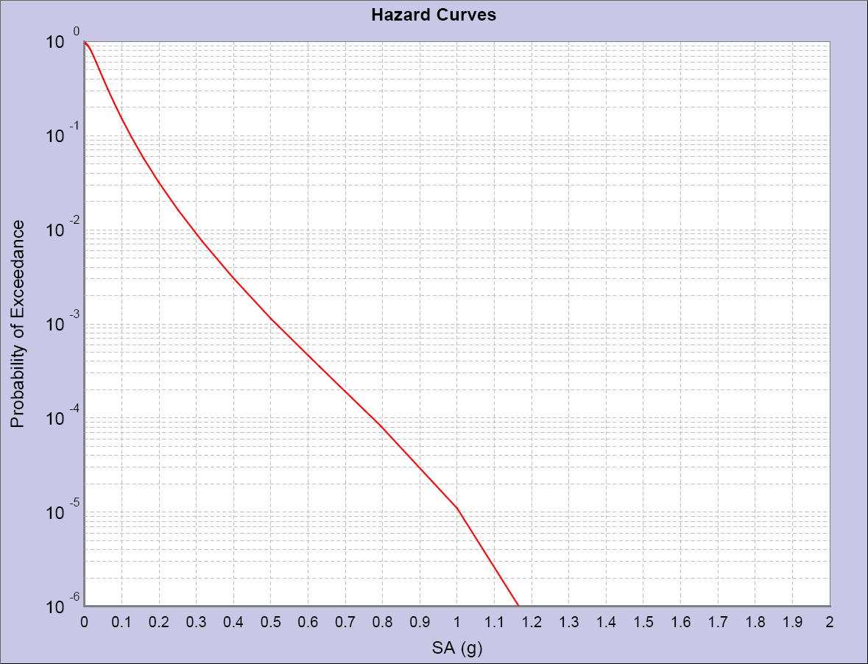
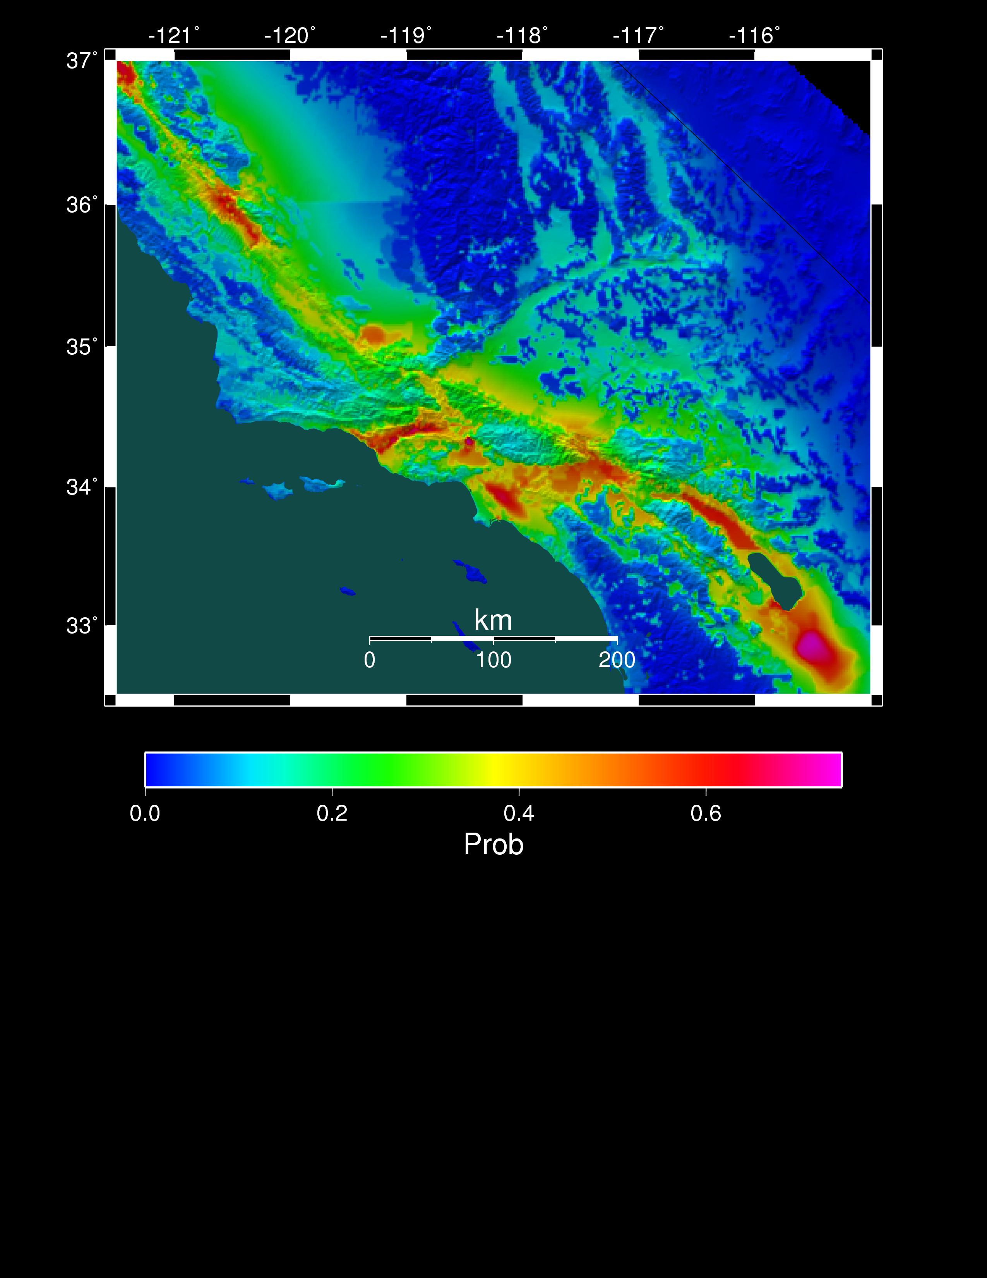
Workflow Application: CyberShake
What will peak ground motion be over the next 50 years?
Used in building codes, insurance, government, planning
Answered via Probabilistic Seismic Hazard Analysis (PSHA)
Communicated with hazard curves and maps
2% in 50 years
0.6 g
Hazard curve for downtown LA
Probability of exceeding 0.1g in 50 yrs

Slide 25
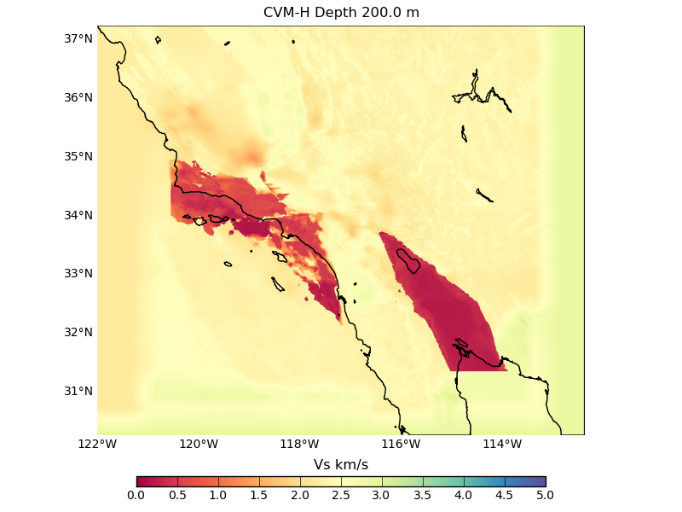
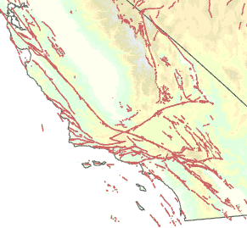
Seismic Hazard Analysis Calculation
Tensor simulation
Create 1.5 billion point mesh with material properties
Generate tensors across volume
Parallel, ~8,000 CPU-hrs

Slide 26
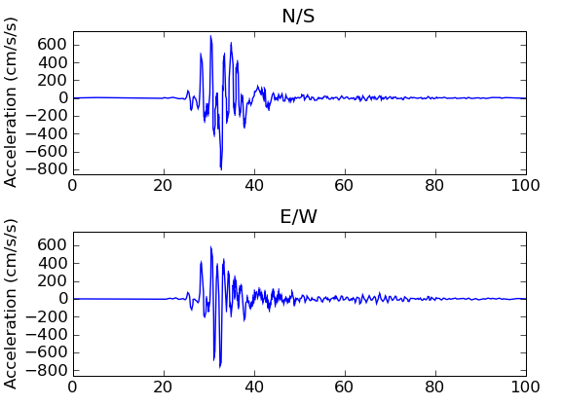
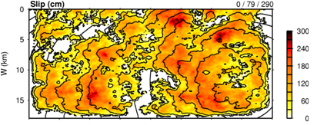
Post-Processing
Individual earthquake contributions
Get list of earthquakes of interest (~415,000)
Simulate seismograms for each earthquake
Loosely-coupled, short-running serial jobs
Combine the levels of shaking with probabilities to produce a hazard curve.

Slide 27
Computational Requirements
Component | Data | Executions | Cores/exec | Core hours
Mesh generation | 15 GB | 1 | 320 | 50
Tensor simulation | 40 GB | 2 | 10,000 CPU 100 GPU | 16,000 CPU 1,200 GPU
Tensor extraction | 690 GB | 6 | 256 | 275
Seismogram synthesis | 12 GB | 415,000 | 1 | 2,300
Curve generation | 1 MB | 1 | 1 | < 1
Total | 757 GB | 415,000 |  | 18,625
Tensor Creation
Post Processing
This is for one location of interest; we wanted to run ~1000

Slide 28
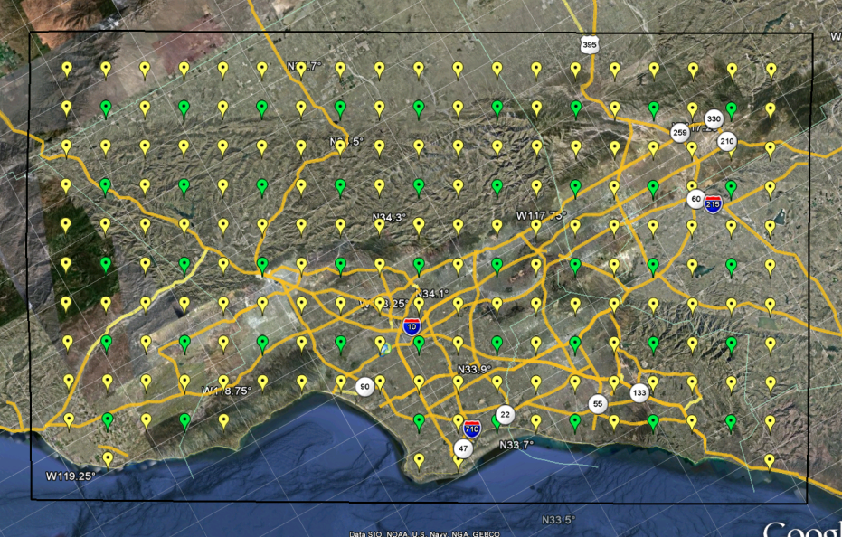
Why Scientific Workflows?
Large-scale, heterogeneous, high throughput
Parallel and many (~415,000) serial tasks
Task duration 100 ms – 2 hours
Automation
Data management
Error recovery
Resource provisioning
Scalable
System-independent description

Slide 29
CyberShake workflows
Tensor Workflow
Post-Processing Workflow
Seismogram synthesis
Tensor extraction
Seismogram synthesis
Hazard Curve
Mesh generation
Tensor simulation
.
.
.
.
.
.
Tensor extraction
Seismogram synthesis
x1
x2
x6
x415,000
x1

Slide 30
Challenge: Resource Provisioning
In tensor workflow, submit job to remote scheduler
GRAM puts jobs in remote queue
Runs like a normal batch job
Can specify either CPU or GPU nodes
For post-processing workflow, need high throughput
Putting lots of jobs in the batch queue is ill-advised
Scheduler isn’t designed for heavy job load
Scheduler cycle is ~5 minutes
Policy limits too
Solution: Pegasus-mpi-cluster (PMC)

Slide 31
Pegasus-mpi-cluster
MPI wrapper around serial or thread-parallel jobs
Master-worker paradigm
Preserves dependencies
HTCondor submits job to multiple nodes, starts PMC
Specify jobs as usual, Pegasus does wrapping
Uses intelligent scheduling
Core counts, memory requirements, priorities
Locality preferences under development

Slide 32
Challenge: Data Management
Millions of data files
Pegasus provides staging
Symlinks files if possible, transfers files if needed
Supports running parts of workflows on separate machines
Transfers output back to local archival disk
Pegasus registers data products in catalog
Cleans up temporary files when no longer needed
Directory hierarchy to reduce files per directory
Added automated checks to check integrity
Correct number of files, NaN, zero-value checks
Included as new jobs in workflow

Slide 33
Challenge: File System Load
Seismogram tasks cause heavy I/O load
Reads an earthquake description
Writes a seismogram file
Reduce reads
Generate earthquake description on the fly, from geometry
Added memcached to cache rupture geometry
Local memory cache on compute node
Pegasus-mpi-cluster hook for custom startup script
Reduce writes
Pegasus-mpi-cluster supports “pipe forwarding”
Workers write to pipes, master aggregates to fewer files

Slide 34
CyberShake Study 14.2
Hazard curves for 1144 sites
46,720 CPUs + 225 GPUs for 14 days (Blue Waters)
Peak of 295,040 CPUs, 1100 GPUs
99.8 million tasks executed
81 tasks/sec
Only 31,463 jobs in Blue Waters queue
On average, 26.2 workflows running concurrently
Managed 830 TB of data
57 TB output files
12.3 TB staged back to local disk (~16M files)
Workflow tools scale!

Slide 35
Should you use workflow tools?
Probably using a workflow already
Replaces manual hand-offs and polling to monitor
Provides framework to assemble community codes
Scales from local computer to large clusters
Provide portable algorithm description independent of data
Does add additional software layers and complexity
Some development time is required

Slide 36
Problems Workflows Solve
Task executions
Workflow tools will retry and checkpoint if needed
Data management
Stage-in and stage-out data
Ensure data is available for jobs automatically
Task scheduling
Optimal execution on available resources
Metadata
Automatically track runtime, environment, arguments, inputs
Getting cores
Whether large parallel jobs or high throughput

Slide 37
Final Thoughts
Automation is vital
Eliminate human polling
Get everything to run automatically if successful
Be able to recover from common errors
Put ALL processing steps in the workflow
Include validation, visualization, publishing, notifications
Avoid premature optimization
Consider new compute environments (dream big!)
Larger clusters, XSEDE / PRACE, Amazon EC2
Tool developers want to help you!

Slide 38
Links
SCEC: http://www.scec.org
Pegasus: http://pegasus.isi.edu
Pegasus-mpi-cluster: http://pegasus.isi.edu/wms/docs/latest/cli-pegasus-mpi-cluster.php
HTCondor: http://www.cs.wisc.edu/htcondor/
Globus: http://www.globus.org/
Swift: http://swift-lang.org
Askalon: http://www.dps.uibk.ac.at/projects/askalon/
WS-PGRADE: https://guse.sztaki.hu/liferay-portal-6.0.5/
UNICORE: http://www.unicore.eu/
SAGA: http://saga-project.github.io/saga-python/
CyberShake: http://scec.usc.edu/scecpedia/CyberShake
Notes:
Update links

Slide 39
Questions?

Slide 40
Types of Tools
Workflow management systems take care of these concerns
GUI-based (generally targeted at medium-scale)
Kepler
Taverna, Triana, VisTrails
Scripting (generally more scalable, more complexity)
Pegasus (and Condor)
Swift
Most tools are free and open source
Not a complete list!

Slide 41
Kepler
Developed by NSF-funded Kepler/CORE team (UCs)
Actor and Director model
Actors = tasks
Director = controls execution of tasks
Serial, parallel, discrete time modeling
Many built-in math and statistics modules
Generally, execution on local machine
Extensive documentation

Slide 42
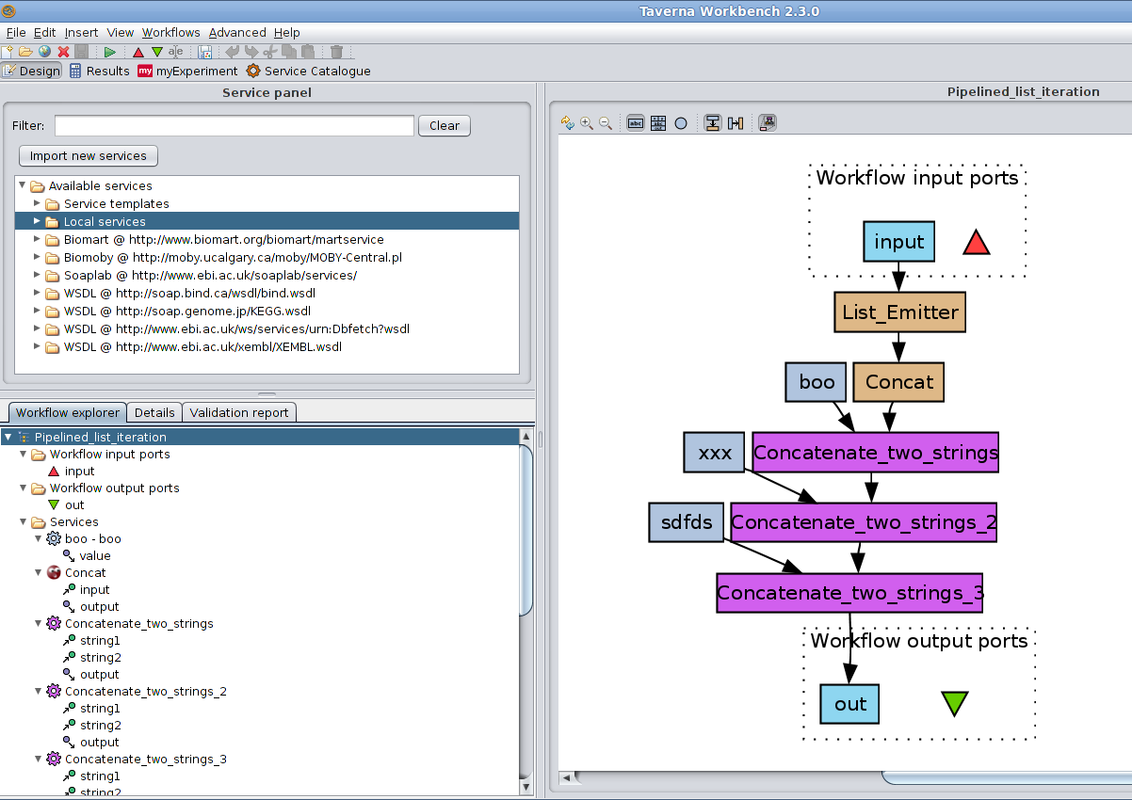
Other Graphical Tools
Taverna
Developed by myGrid (UK)
Runs workflow to minimize completion time
Commonly used in life science community
Triana
Signal analysis, image manipulation
VisTrails
Visualization

Slide 43
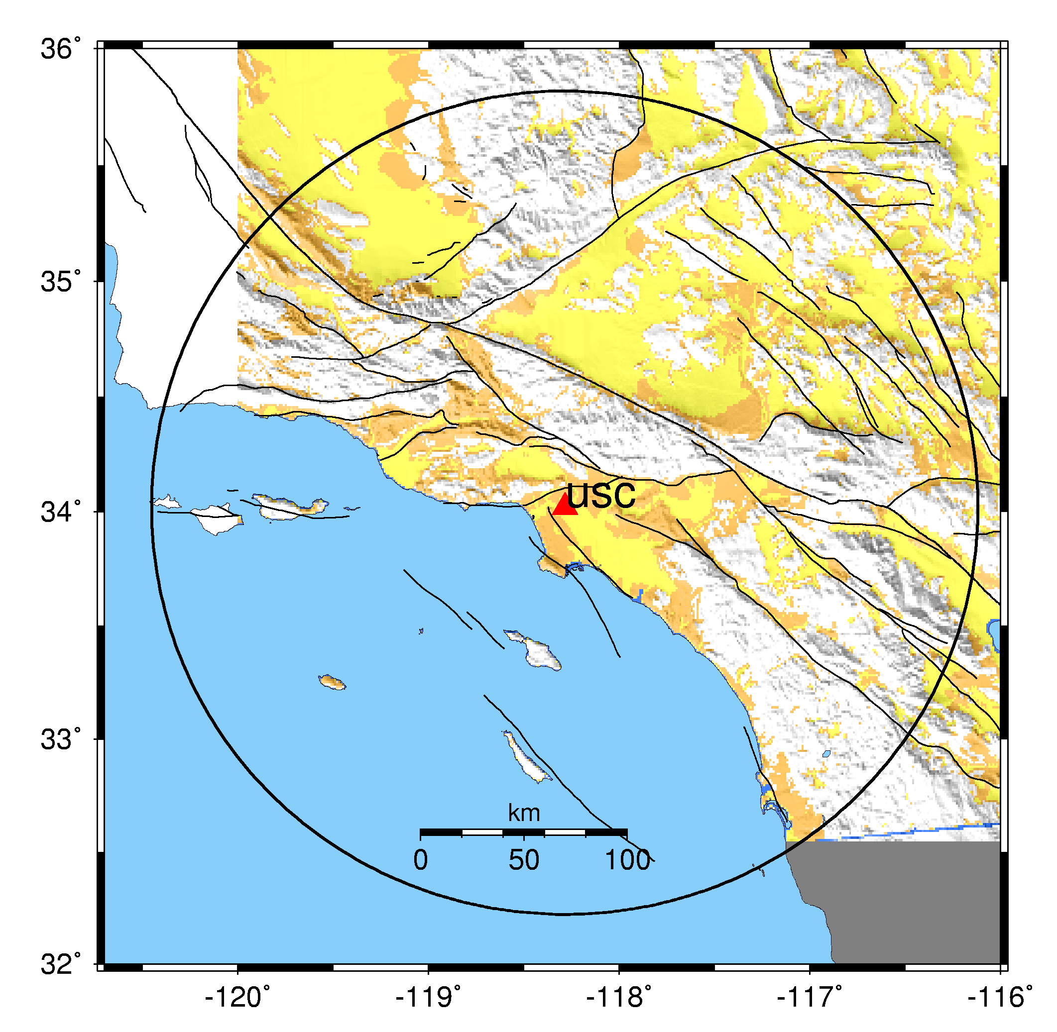
How do you do PSHA?
Pick a location of interest.
Determine what future earthquakes might happen which could affect that location.
Estimate the magnitude and probability for each earthquake.

Slide 44
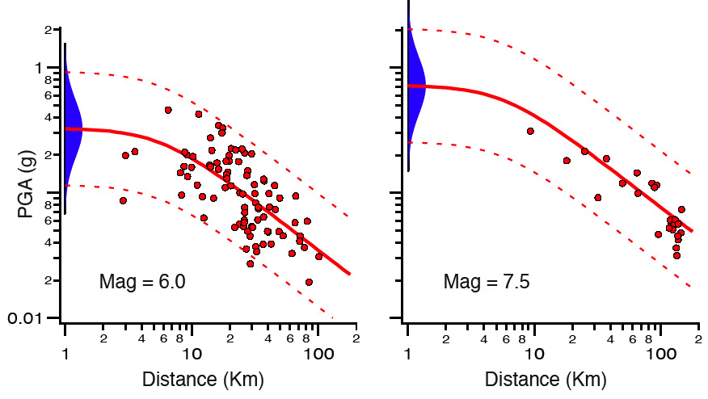
The computationally intensive part...
4. Determine the shaking caused by each earthquake at the site of interest.
Can calculate with ‘attenuation relationships’ – extrapolate from historical data. Very quick, but simple.
Alternatively, can use 3D physics- based simulation.
Captures more complex phenomena.

Slide 45
Southern California Earthquake Center
Collaboration of 600+ scientists at 60+ institutions
Focus on Southern California
Earthquake system science
Computational models of earthquake processes
Shaking from one earthquake (MPI codes)
Hazard at one location (high throughput)

Slide 46
Example scenario earthquake
W2W (S-N)

Slide 47
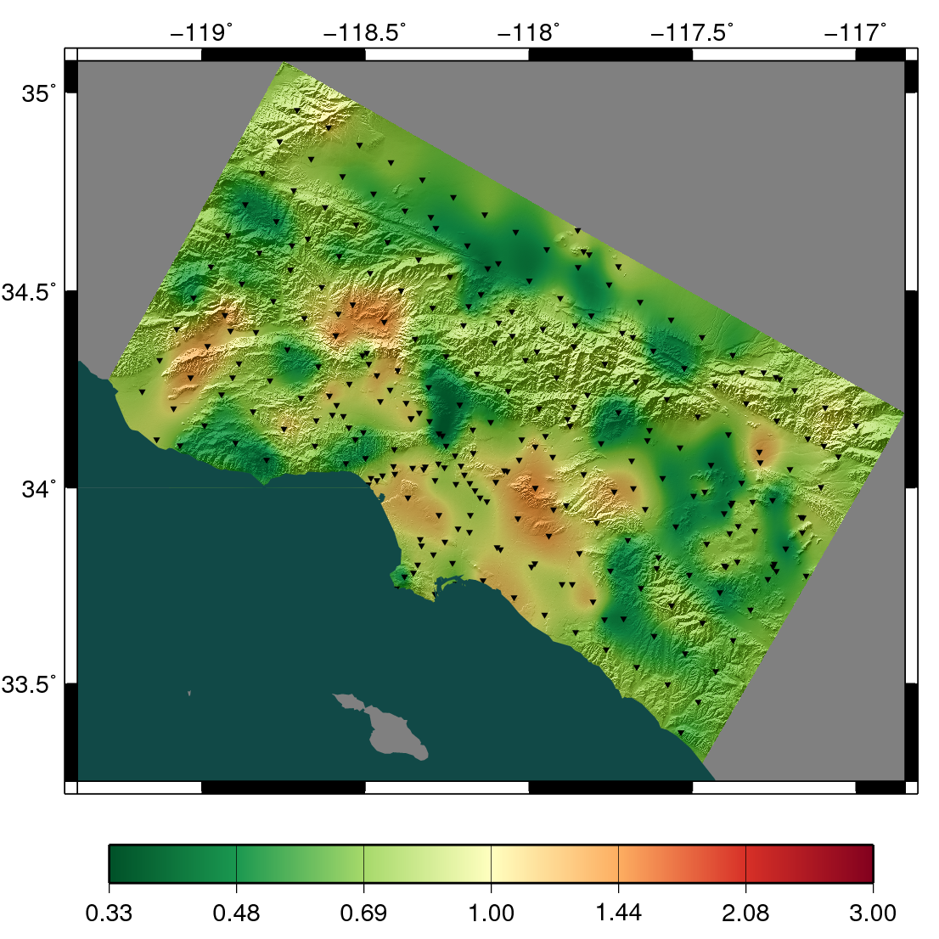
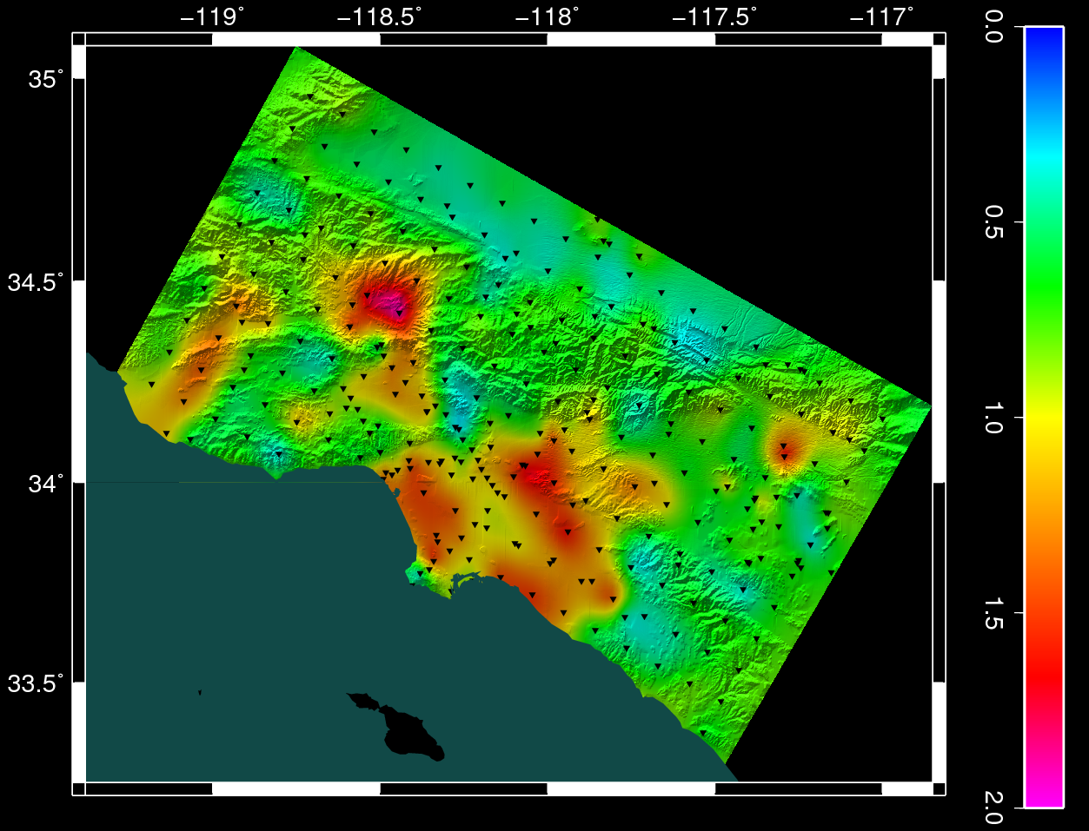
Results (ratio)
0.0
Southern California
15 million people
0.5
1.0
1.5
Los Angeles
2.0
Lower Attenuation
Higher CyberShake
CyberShake map compared to attenuation map – red is higher risk, green lower

Slide 48
Challenge: Sustained Automation
CyberShake studies can run for weeks
Need to automate as much as possible
Workflow tools handle
Automated job submission, retries
Data transfer
But we still have to
Monitor certificates
Check that job submission and file transfer servers are up
Monitor and management at the study level
Pegasus team working on “Ensemble Manager”

Slide 49
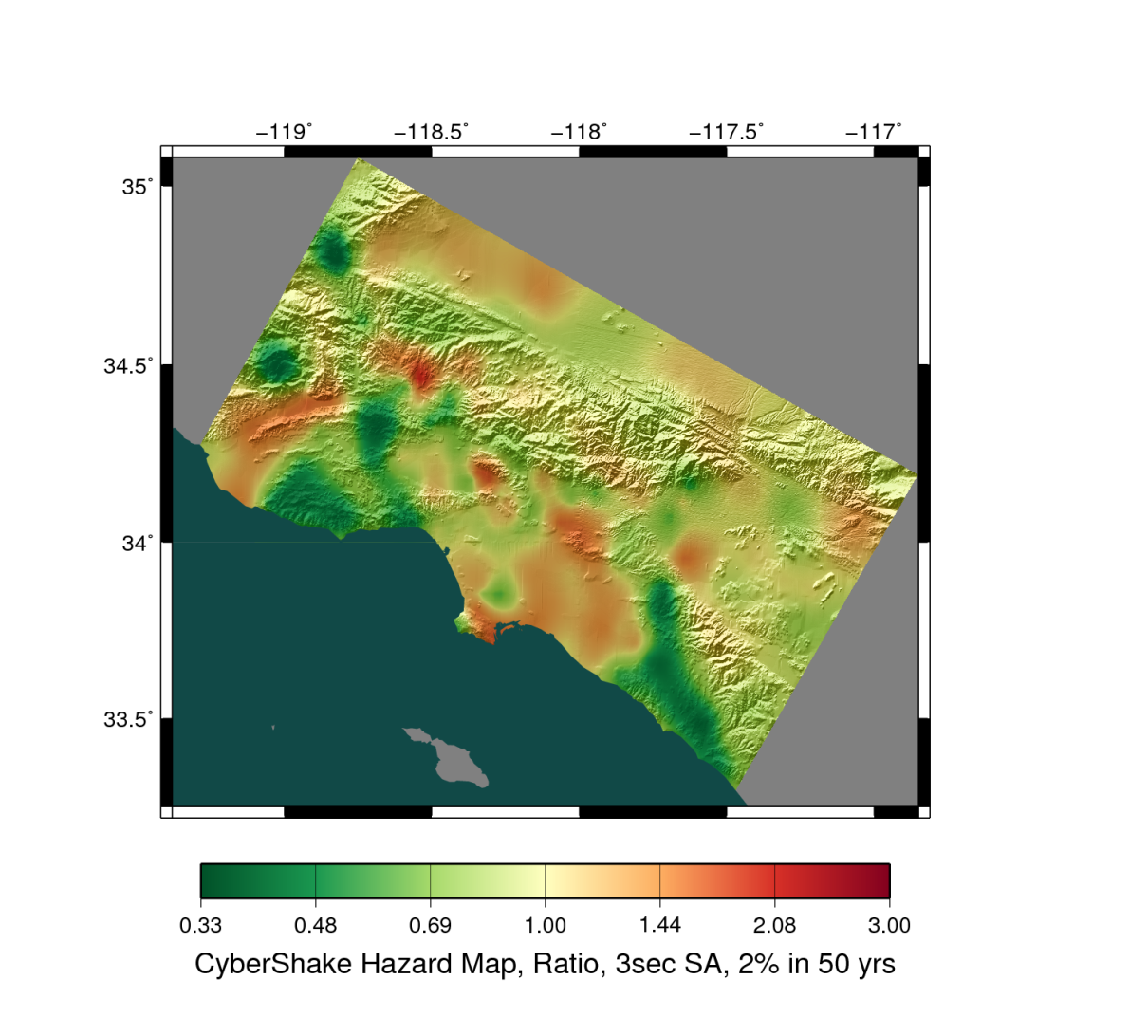
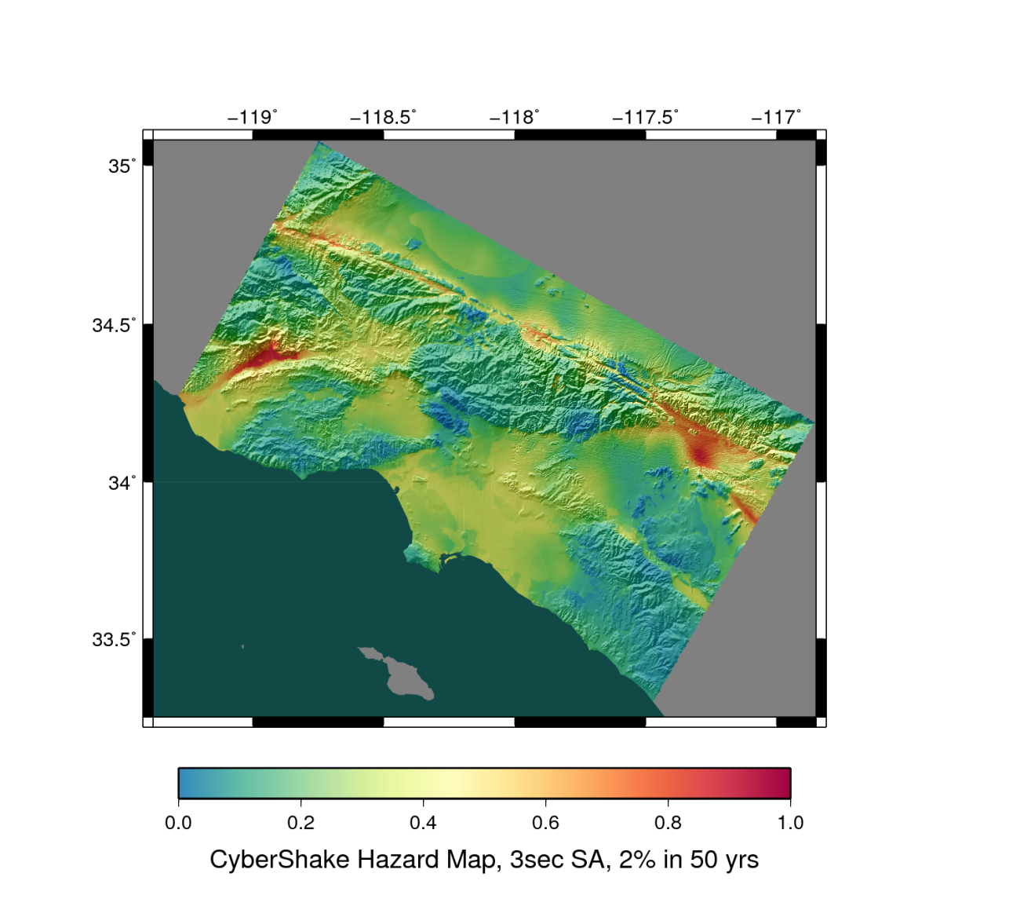
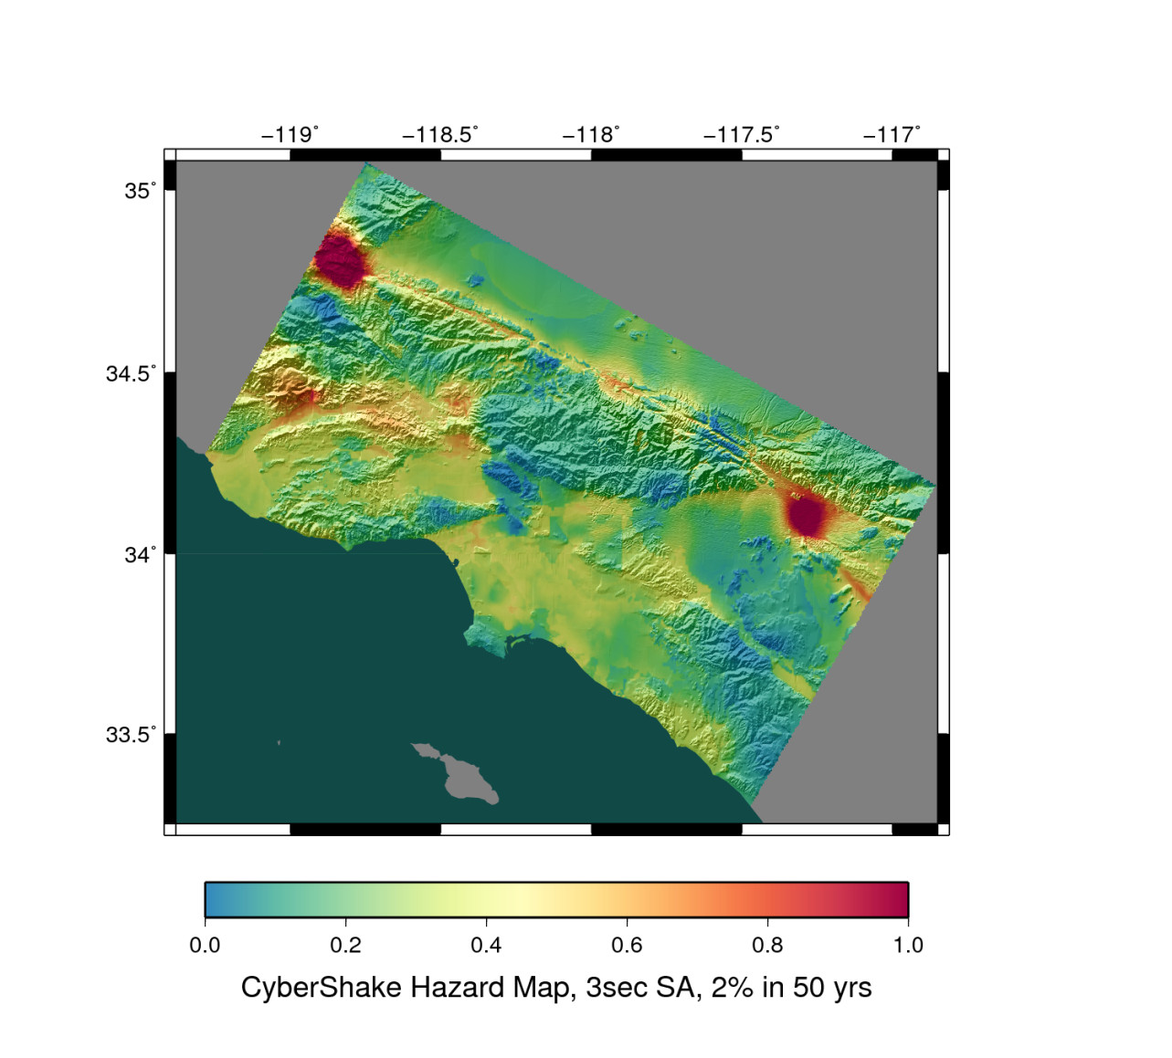
CyberShake Results
Southern California
15 million people
Los Angeles
Notes:
Fix graphic

Slide 50
Sample DAX Generator
public static void main(String[] args) {
//Create DAX object
ADAG dax = new ADAG("test_dax");
//Define first job
Job firstJob = new Job("0", "my_namespace", "first_job", "v1.0");
//Input and output files to first job
File firstInputFile = new File("input.txt");
File firstOutputFile = new File("tmp.txt");
//Arguments to first_job (first_job input=input.txt output=tmp.txt)
firstJob.addArgument("input=input.txt");
firstJob.addArgument("output=tmp.txt");
//Role of the files for the job
firstJob.uses(firstInputFile, File.LINK.INPUT);
firstJob.uses(firstOutputFile, File.LINK.OUTPUT);
//Add the job to the workflow
dax.addJob(firstJob);

Slide 51
for (int i=0; i<5; i++) {
//Create simulation job
Job simulJob = new Job(i+1, "my_namespace", "simul_job", "v2.1");
//Define files
File simulInputFile = new File("tmp.txt");
File simulOutputFile = new File("output." + i + ".dat");
//Arguments to job
//simulJob parameter=<i> input=tmp.txt output=output<i>.dat
simulJob.addArgument("parameter=" + i);
simulJob.addArgument("input=tmp.txt");
simulJob.addArgument("output=" + simulOutputFile.getName());
//Role of files
simulJob.uses(simulInputFile, File.LINK.INPUT);
simulJob.uses(simulOutputFile, File.LINK.OUTPUT);
//Add job to dax
dax.addJob(simulJob);
//Dependency on firstJob
dax.addDependency(firstJob, simulJob);
}
//Write to file
dax.writeToFile("test.dax");
}

