Slide 1
rvGAHP – Push-Based Job Submission Using Reverse SSH Connections
Scott Callaghan, Gideon Juve, Karan Vahi, Philip J. Maechling, Thomas H. Jordan and Ewa Deelman
WORKS ‘17
November 13, 2017

Slide 2
Motivation
Scientific workflows continue to scale up
Require automated resource provisioning on largest available clusters
Two main approaches:
Push-based: requests initiate from workflow queue
Pull-based: requests initiate from remote resource
Both have limitations
Push-based: not viable on systems with two-factor authentication
Pull-based: risk of high overhead with heterogeneous workloads
rvGAHP: alternative approach

Slide 3
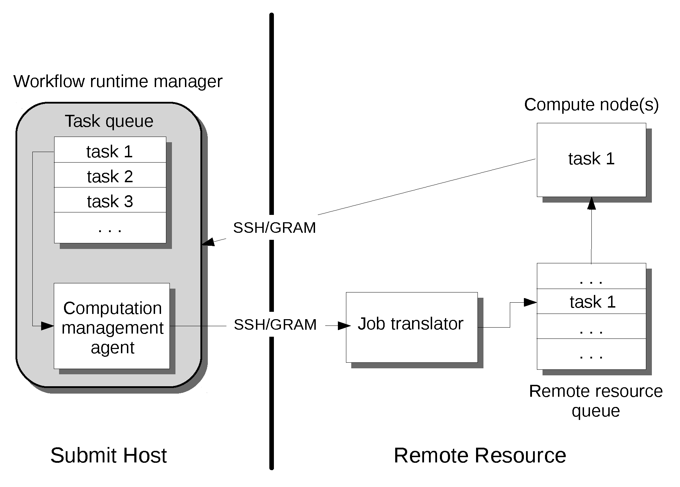
Push-Based Approach
Resource requests are on-demand, initiating from runtime manager
Request waits in remote queue, starts up, runs workflow task
Efficient use of remote resources: nodes only used when workflow tasks are being run
Requires automated authentication to remote system

Slide 4
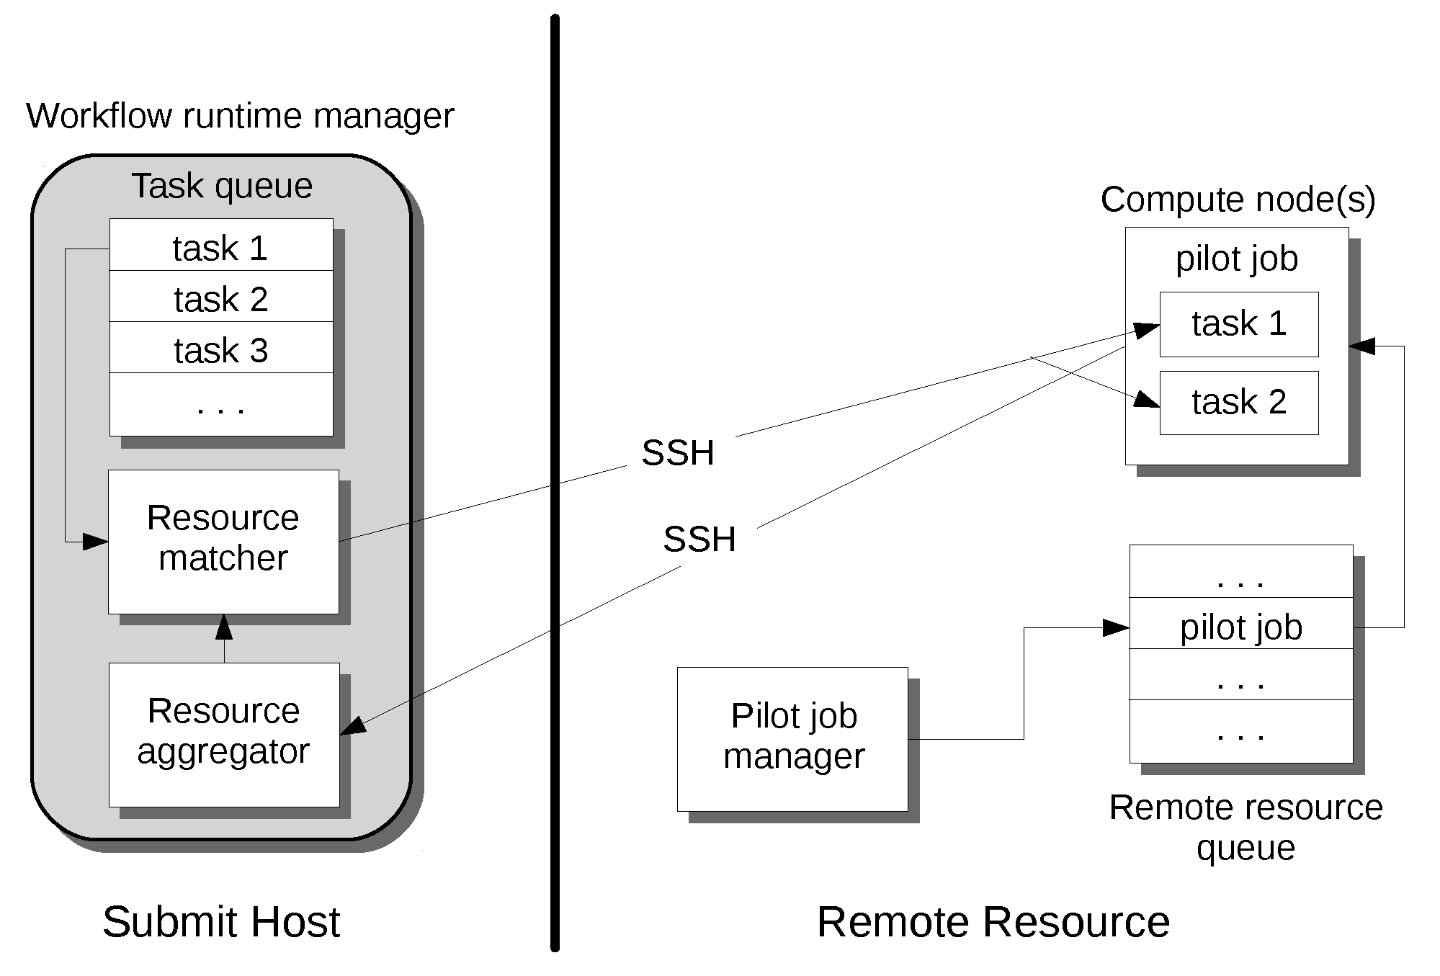
Pull-Based Approach
Resource requests initiate from remote resource (‘pilot job’)
Resources advertised to workflow submission host for task scheduling
Requires authentication from remote system to workflow host
Can incur overhead
Waiting for workflow task
Mismatch of pilot job to task size and length

Slide 5
Summary of Approaches
Push-based
Potential issues with automated authentication
Little overhead: node-hours burned are used for workflow work
Pull-based
Authentication performed from remote system to workflow host
Risk of high overhead, especially for heterogeneous workloads
Would like solution with overhead characteristics of push-based, but with authentication flexibility of pull-based

Slide 6
rvGAHP Overview
Developed new solution, reverse GAHP (rvGAHP)
Implementation of text-based GAHP protocol
Push-based approach
Does not require automated authentication to remote resource, just to workflow submission host
Does require daemon running on remote resource
Integrates cleanly with HTCondor

Slide 7
rvGAHP Details
rvgahp_server is started on remote resource
rvgahp_server establishes ssh connection to workflow submission host and starts rvgahp_proxy
When remote GAHP job is submitted, GridManager launches rvgahp_client
rvgahp_client, via rvgahp_proxy, starts appropriate GAHP process on remote resource
A socketpair is set up between remote GAHP process and ssh process, establishing communication between GridManager and remote GAHP process
Another ssh process and rvgahp_proxy are started by the rvgahp_server (not shown)
GridManager
File transfer
condor_ft-gahp
fork()
fork()
rvgahp_client
rvgahp_server
socketpair
PBS/LSF/SGE
UNIX socket
fork()
qsub/qstat/qdel
fork()
rvgahp_proxy
ssh
ssh
socketpair
batch_gahp
GAHP
Workflow Submission Host
Remote Resource

Slide 8
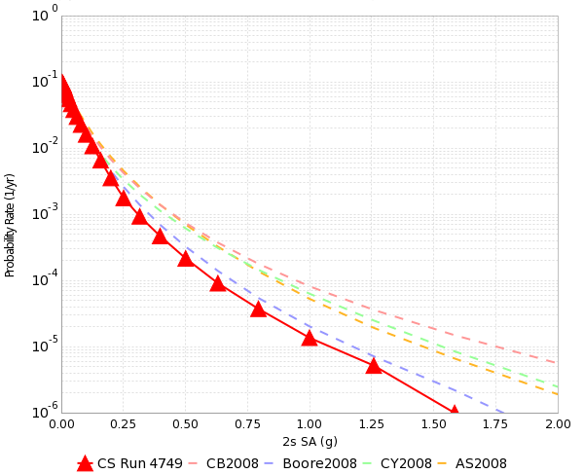
Application Overview
Probabilistic Seismic Hazard Analysis (PSHA)
What will ground motion be in the next 50 years?
Building engineers
Insurance companies
Disaster planners
PSHA is performed by
Assembling a list of earthquakes
Calculating the shaking of each
Combining shaking with probability
SCEC CyberShake project – simulation-based approach to step 2

Slide 9
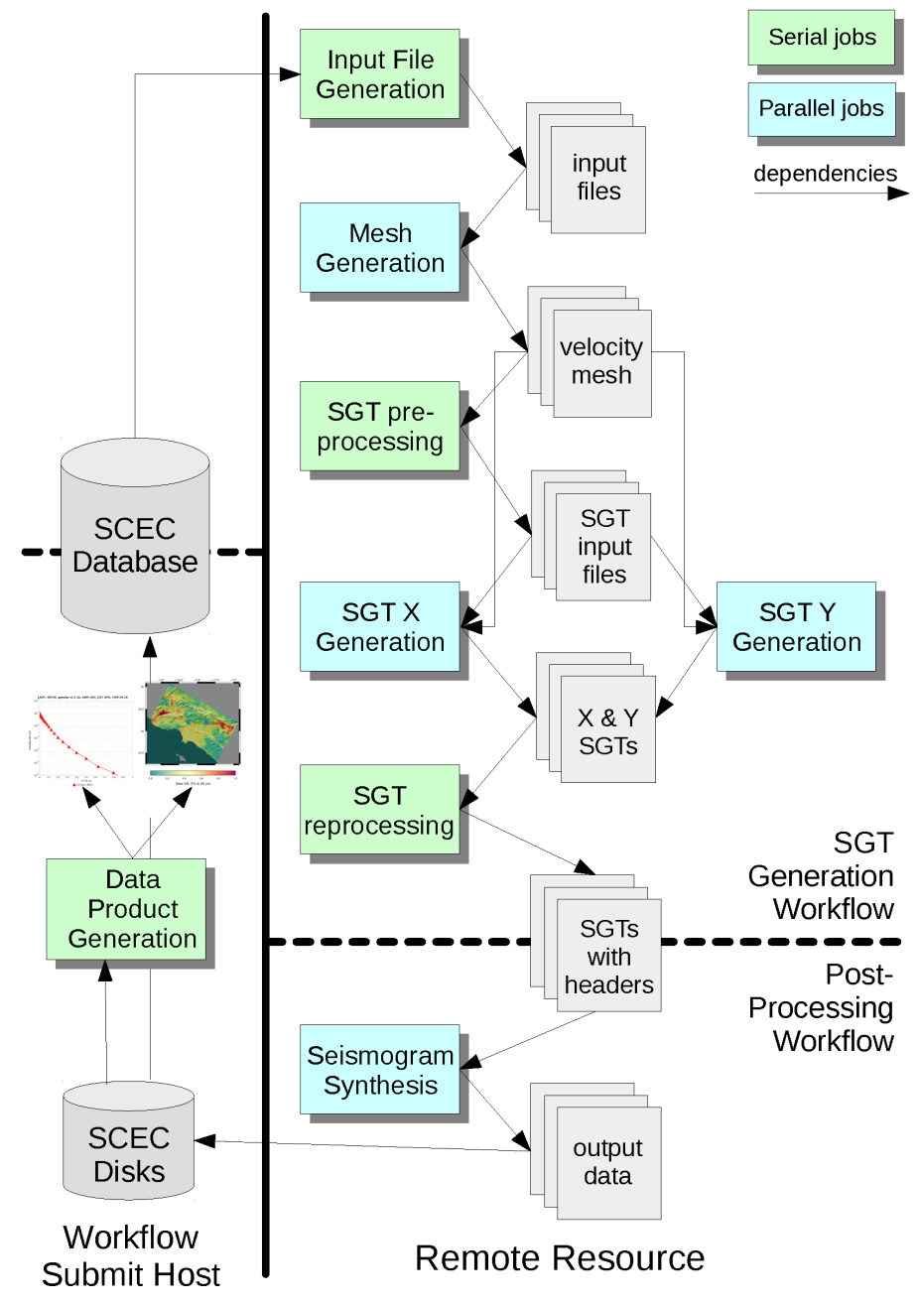
Resource Requirements
Computational requirements per site
Stage | Code Type | Nodes | Walltime
Mesh Creation | MPI CPU | 240 | 0.4 hrs
SGT Generation | MPI GPU | 800 | 1.0
Seismogram Synthesis | MPI CPU | 240 | 10
Other | Sequential | 1 | 0.1 – 2
200-400 sites required to complete study
Parallelism dominated by SGT generation
2 jobs of 800 GPU nodes x ~1 hour
Cost dominated by seismogram synthesis
240 nodes for ~10 hours
CyberShake workflow schematic
Stage | Code Type | Output Data | Titan Node Hours
Mesh Creation | MPI CPU | 120 GB | 100
SGT Generation | MPI GPU | 1500 GB | 1490
Seismogram Synthesis | MPI CPU | 30 GB | 2440
Other | Sequential | <1 GB | 10
Total |  | 1650 GB | 4030

Slide 10
CyberShake Workflows
Each ‘run’ for a single site consists of a workflow
Software stack:
Pegasus-WMS to create workflow description, plan for execution
HTCondor for runtime execution
Globus GRAM for communication between workflow host and remote system
CyberShake study consists of running hundreds of sites
Site parallelism of 10-30
Able to split CyberShake studies to run on multiple resources

Slide 11
Current Solutions for CyberShake
CyberShake requires 800-node GPU jobs
6.5x faster than CPU version
Targeted NCSA Blue Waters and OLCF Titan
For Blue Waters: push solution works well
When jobs appear in HTCondor queue, GRAM submits them over the network to be translated and scheduled in Blue Waters queue
For Titan: push solution unavailable due to authentication policy
Two-factor with fob
Proxies only issued for data transfer nodes
Decided to try pull-based approach with HTCondor pilot jobs

Slide 12
CyberShake with Pull-Based Approach
In 2015, used pull solution using HTCondor pilot jobs
Pilot daemon running on login node queried HTCondor queue on workflow submission host for jobs
When idle jobs found, pilot job submitted to Titan queue
Because of variability in task sizes, 4 different sizes of pilot jobs
Introduced complexity and possibility of errors
Pull solution resulted in only 68% resource utilization
Scheduling overhead
Tradeoff between pilot jobs terminating before workflow tasks, and pilot jobs sitting idle

Slide 13
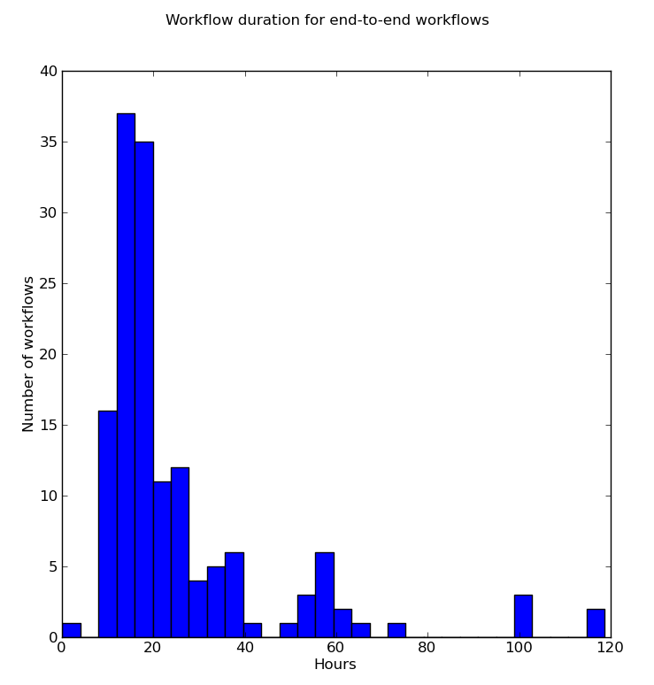
CyberShake with rvGAHP
In 2017, performed 31-day CyberShake study on Titan using rvGAHP
rvgahp_server daemon ran on Titan login node
13,334 jobs submitted through rvGAHP
10 minutes – 9 hours walltime
1 – 240 nodes wide
450,000 node-hours total
Increased resource utilization from 68% to 97%
Savings of ~130,000 node hours
Decreased delay per job from 9.2 to 0.6 hrs

Slide 14
Conclusion
rvGAHP provides new approach for remote resource provisioning
Reduced overhead of push-based approaches
Runs on systems requiring two-factor authentication
Requires little of application developers already using HTCondor
Very effective for real-world seismic hazard workflow application
Increases efficiency on current systems
Opens up new systems for scientific workflows

Slide 15
Thanks!
14

