Slide 1
S11A-05: Verification and Validation of the Broadband CyberShake Platform
Scott Callaghan, Christine A. Goulet, Fabio Silva, Philip J. Maechling, Robert W. Graves, Ossian O’Reilly, Te-Yang Yeh, Kim B. Olsen, Albert Kottke, and Yehuda Ben-Zion
2021 AGU Fall Meeting

Slide 2
Broadband CyberShake
Broadband Platform modules integrated with CyberShake
Verification and validation to assess Broadband CyberShake
Both simple and complex tests

Slide 3
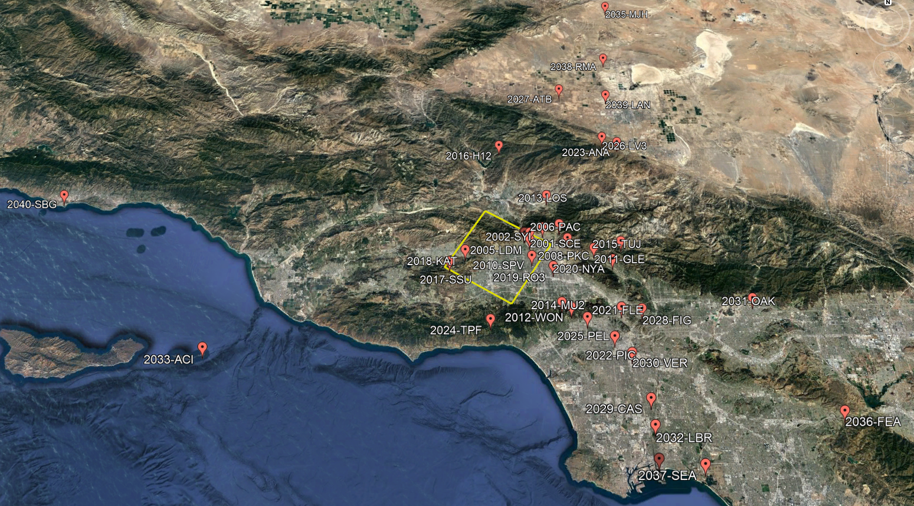
Comparisons
10 realizations of 1994 Northridge earthquake
38 stations at distances of 0 – 105 km

Slide 4
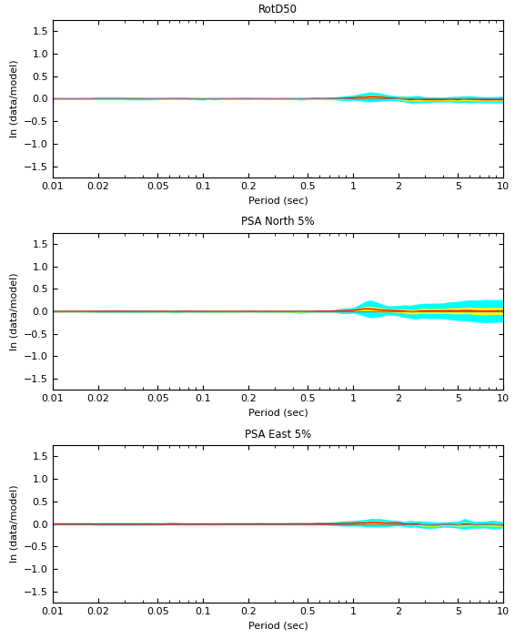
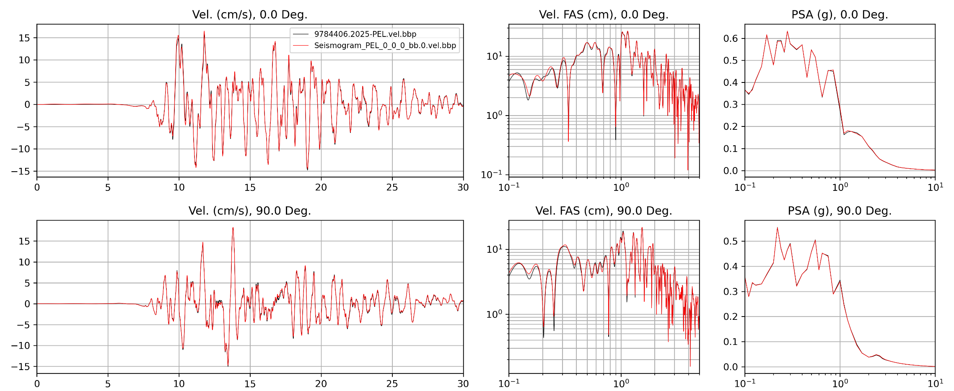
Results
Overall, BBP and CyberShake results agree closely despite using different low-frequency approaches
Site PEL (20 km SE)
Next we will compare Broadband CyberShake to Northridge observations
Goodness-of-fit for realization #3

