Slide 1
CyberShake as a CISM ground motion prediction platform
Scott Callaghan
2016 SCEC Annual Meeting CISM Workshop
September 11, 2016

Slide 2
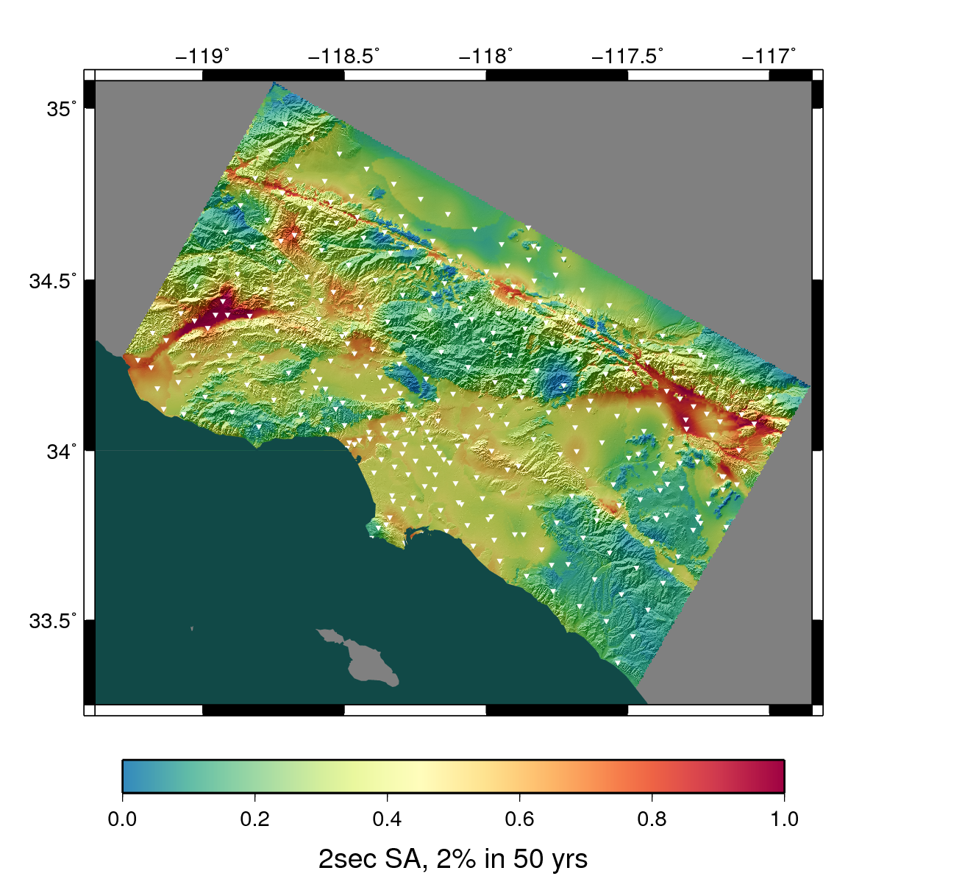
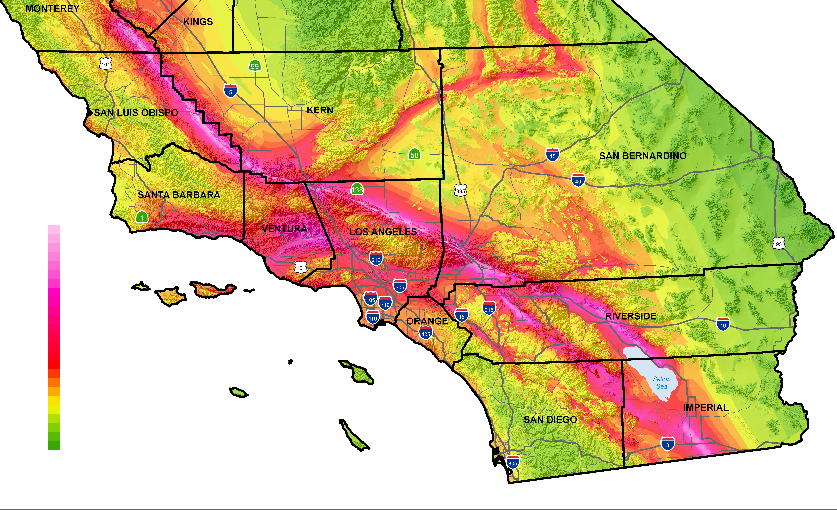
CyberShake Overview
3D physics-based probabilistic seismic hazard analysis
Uses seismic reciprocity to simulate seismograms from UCERF earthquake rupture forecast (distance<200 km)
Hazard curves are created for individual locations in region of interest, interpolated for map
Model produces 300M+ seismograms, 22B intensity measures
Earthquake forecast: UCERF2
Structural model: CVM-S4.26
LA region

Slide 3
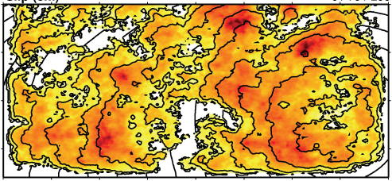
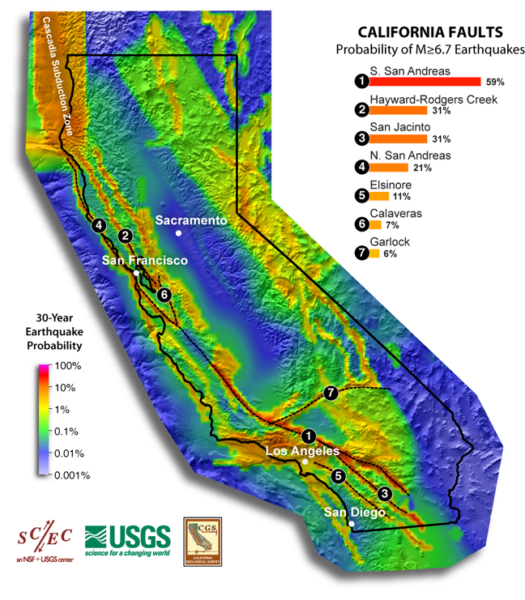
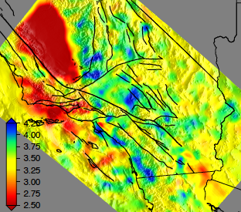
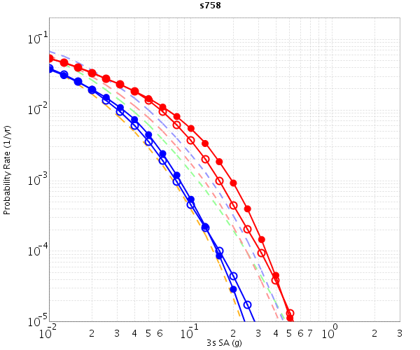
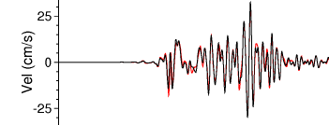
CyberShake Data Flow
Most recent CyberShake study took 5 weeks of real time and used 38 million core-hours
Graves-Pitarka kinematic rupture simulator
Data
Product Generation
UCVM
AWP-ODC
Seismogram Synthesis
12 TB
data transfer
Mesh generation
1 job per site
MPI, 3840 cores
SGT computation
2 jobs per site
MPI, 200-800 GPUs
Post-processing
~500,000 jobs per site
MPI master/worker, 3712 cores
Populate DB, construct queries
6 jobs per site
CyberShake Hazard Map
Uniform California Earthquake Rupture Forecast
NCSA Blue Waters
OLCF Titan
NCSA Blue Waters
OLCF Titan
CVM-S4.26
z = 6 km
hazard curves
Community Velocity Model
500,000 Seismograms
75M intensity measures

Slide 4
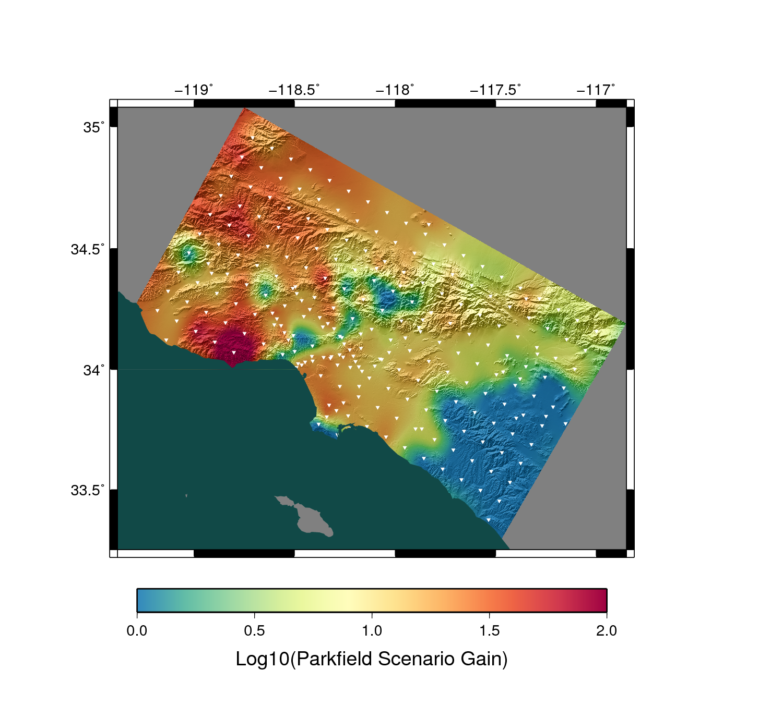
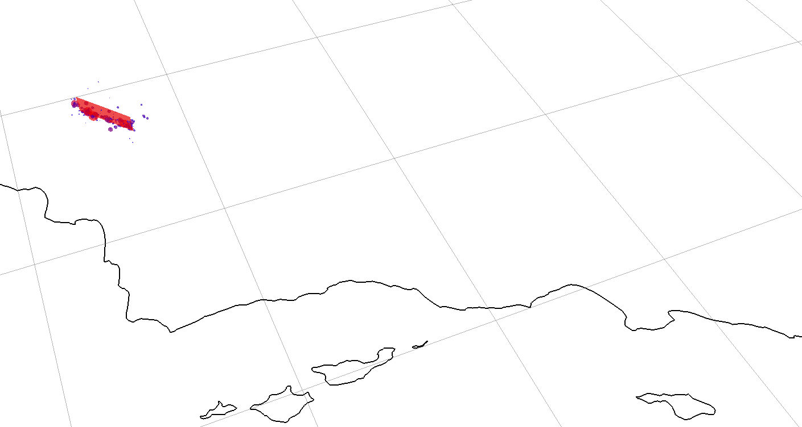
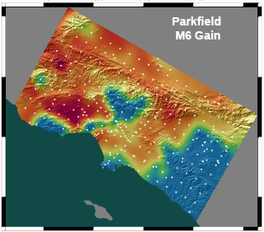
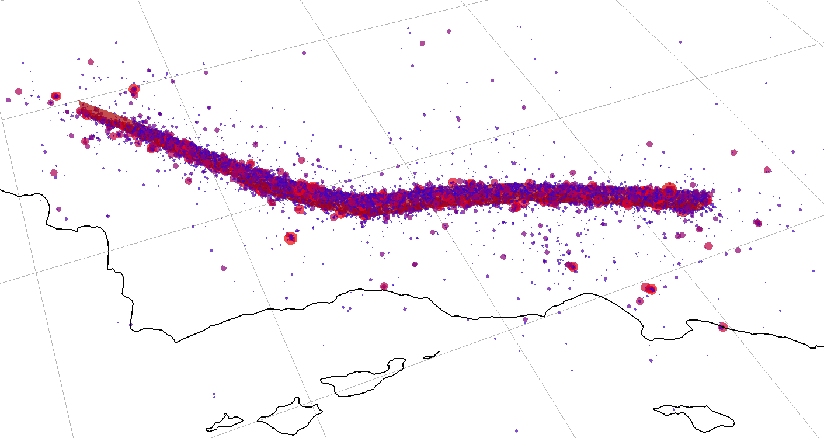
Forecasting with CyberShake
Since 1B+ intensity measures are stored for each model, can quickly recompute with modified probabilities from UCERF or RSQSim
Parkfield M6 mainshock
normal aftershock sequence
Los Angeles
Parkfield M6 mainshock
productive aftershock sequence
(including M7.8)
Los Angeles

Slide 5
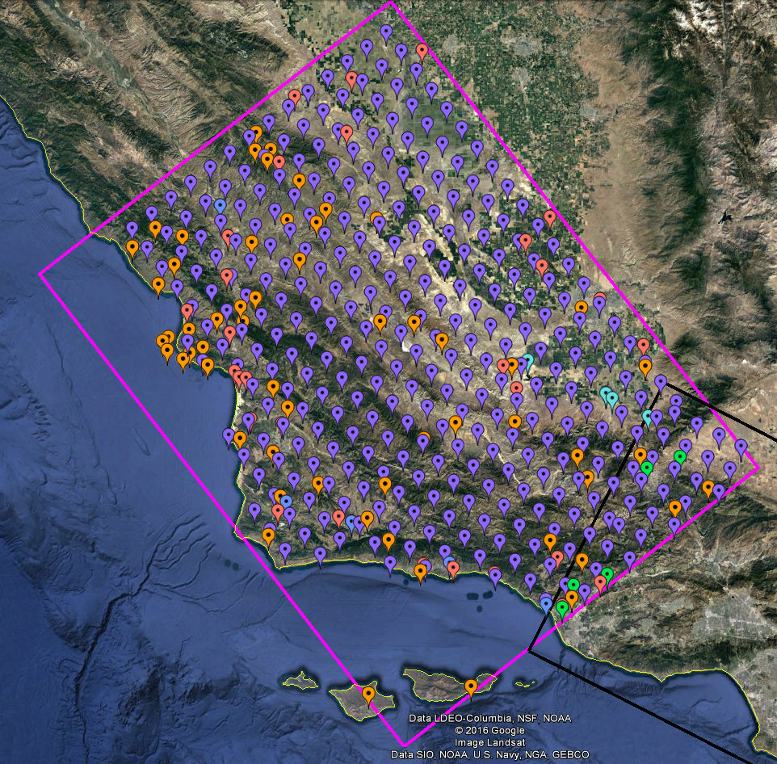
CyberShake Central California
Preparing to begin CyberShake study in Central California
408 new locations, including CISN stations, cities, missions, PG&E pumping sites
Using CCA-06 (tomographic inversion) velocity model and 1D derived model
Proof-of-concept for CyberShake expansion into new regions

Slide 6
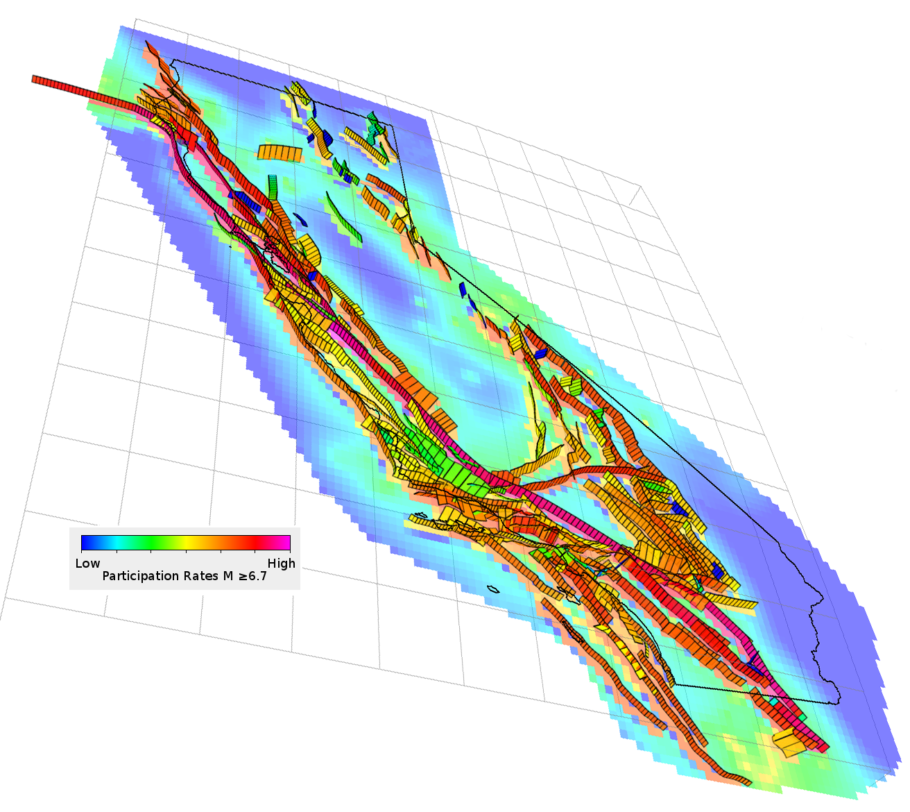
Challenges in CyberShake migration to UCERF 3
Many more ruptures
About 25x compared to UCERF 2
Statewide ruptures
Mendocino to Bombay Beach has a (low) probability
More complex ruptures
Multi-segment
Fault-to-fault jumps

Slide 7
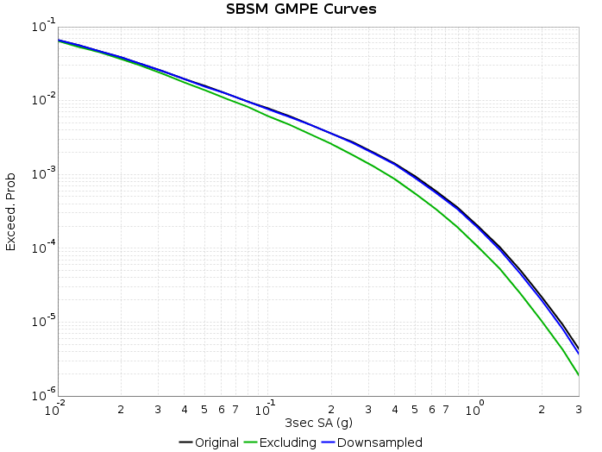
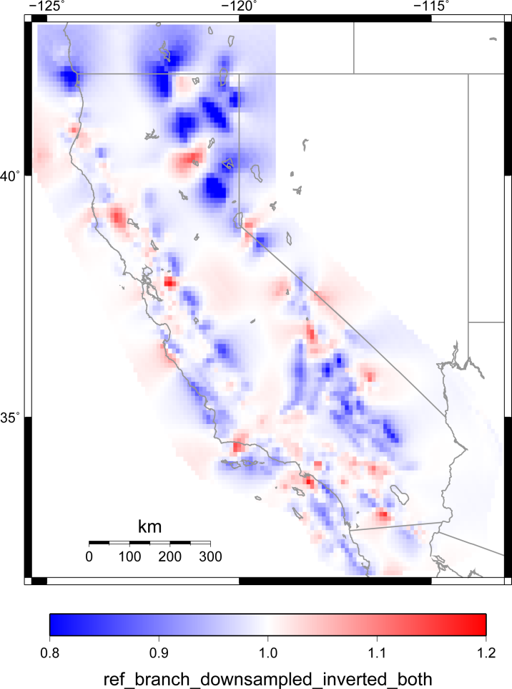
Possible UCERF 3 solutions
Avoid performing 3D simulations of all ruptures
Downsampling: map rate from distant ruptures onto closer ruptures
Reduces rupture set by 75%
Grow UCERF 3 ruptures in terms of magnitude, not fault segments
Reduces rupture set by 87%
Shows promise; more tweaking required
1D modeling
Use 1D Green’s functions for distant events
Move to rupture generator capable of handling complex ruptures
Right: Downsampling test: original (black), downsampled (blue), excluded (green)
Left: Ratio of 2% in 50 yr PGA, downsampled/original

Slide 8
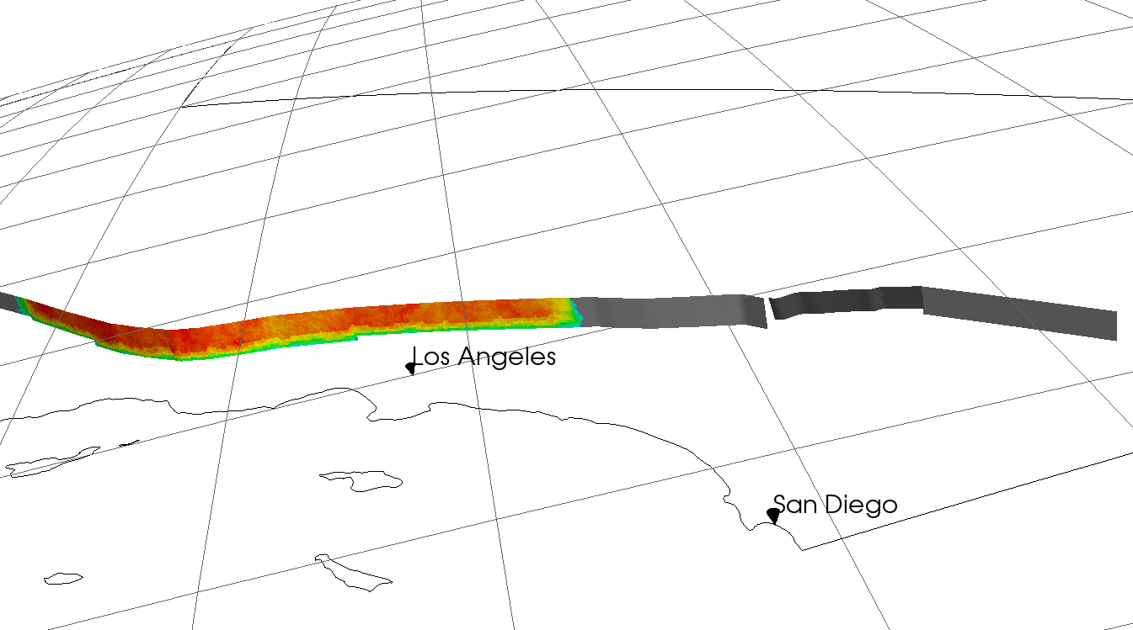
Future CyberShake Plans
Short-term:
Central California Study
Medium-term:
Migration to UCERF 3
Expansion to other regions (Bay Area?)
Increase in maximum frequency from 1 Hz
Long-term:
Migration to RSQSim as ERF
Transition from reciprocity to forward simulation

