Slide 1








CyberShake Results for Northern California
Scott Callaghan (SCEC), Phil Maechling, Fabio Silva, Christine Goulet, Kevin Milner, Mei-Hui Su, Xiaofeng Meng, Camilo Pinilla-Ramos, Kim Olsen, Rob Graves, Norm Abrahamson, Albert Kottke, Karan Vahi, Ewa Deelman, Tom Jordan, Yehuda Ben-Zion
January 28, 2025
2025 USGS Northern California Earthquake Hazards Workshop
scottcal@usc.edu

Slide 2
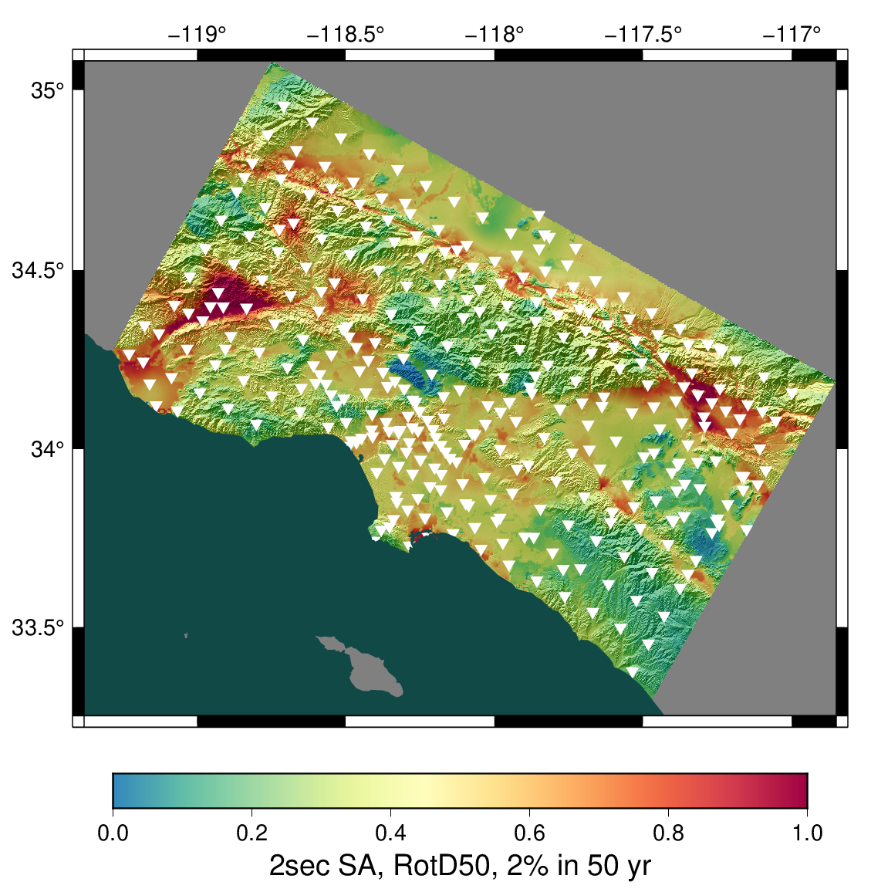
CyberShake overview
SCEC-developed 3D physics-based probabilistic seismic hazard analysis (PSHA) platform
Earthquake rupture forecast (ERF) provides list of relevant events + probabilities
Reciprocity-based approach to simulate low-frequency seismograms for sites of interest
Intensity measures derived from seismograms
Hazard results from sites interpolated for map
Stochastic high-frequency simulations added to produce broadband models
Hazard map from most recent Southern California CyberShake Study, 22.12. Each triangle is a site location.
Statewide California Earthquake Center | www.scec.org

Slide 3
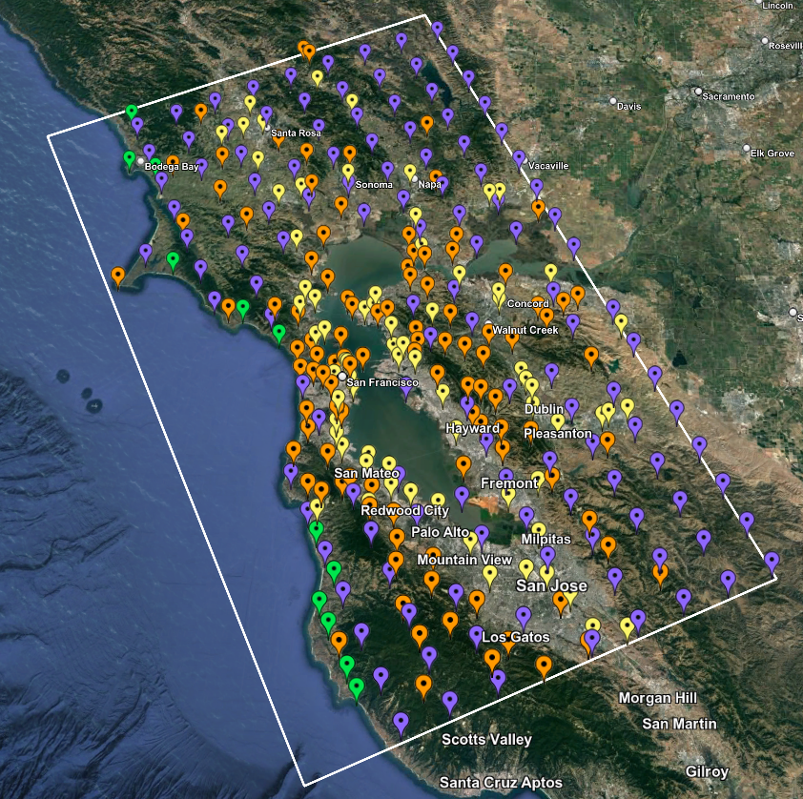
CyberShake Study 24.8: Northern California
315 sites in greater Bay Area
  Smaller region than last Bay Area study (18.8)
Most parameters consistent with Southern California Study 22.12:
  UCERF2-derived ERF
  Graves & Pitarka (2022) rupture generator
    ~200,000 events per site
  1 Hz deterministic
  50 Hz broadband using modules from the SCEC Broadband Platform
Map of Study 24.8 sites
Statewide California Earthquake Center | www.scec.org

Slide 4
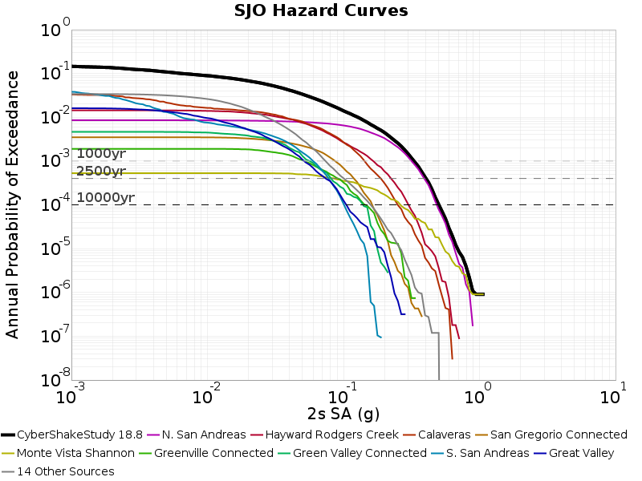
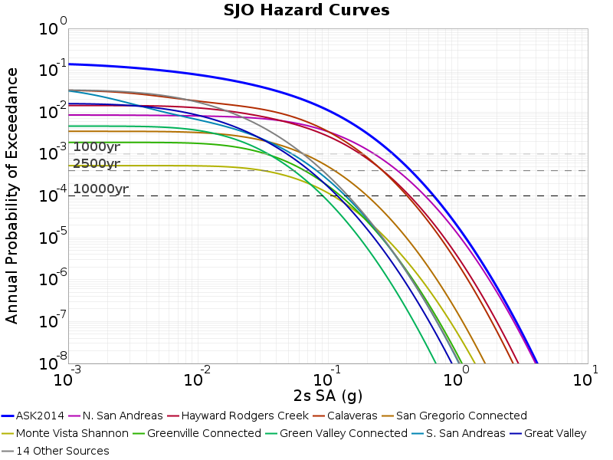
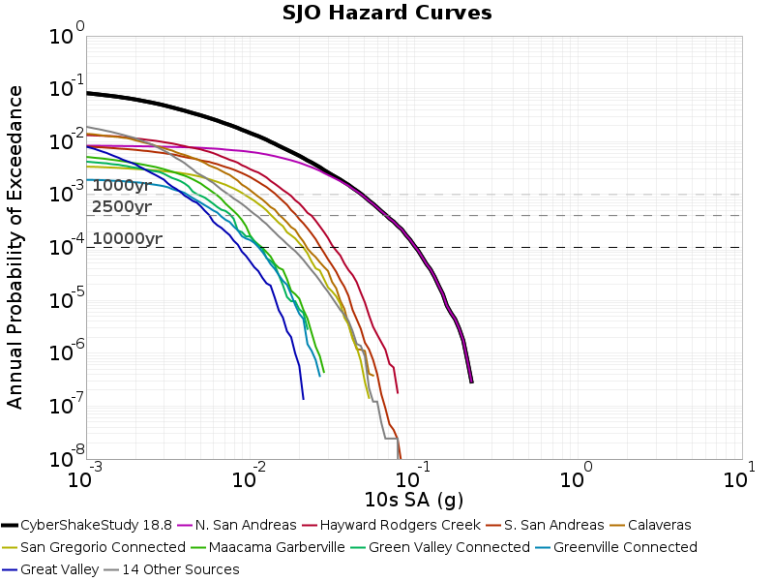
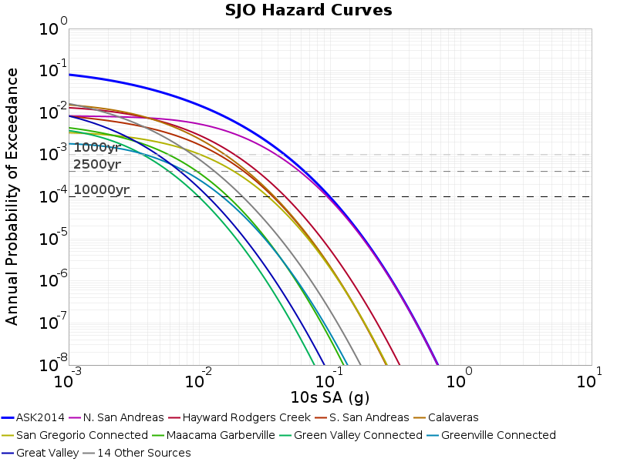
Study 24.8 Changes and Updates
Removal of southern SAF events
  For return periods > 1000 yrs, sSAF
  events have little contribution to hazard
  Reduces volume size by ~40%
Minimum Vs reduced to 400 m/s
Modifications to velocity model
New data products:
  Vertical component seismograms
  Vertical response spectra
  Period-dependent durations
CyberShake Study 18.8
ASK 2014
2 sec
10 sec
Hazard breakdown by source, site SJO
Statewide California Earthquake Center | www.scec.org

Slide 5
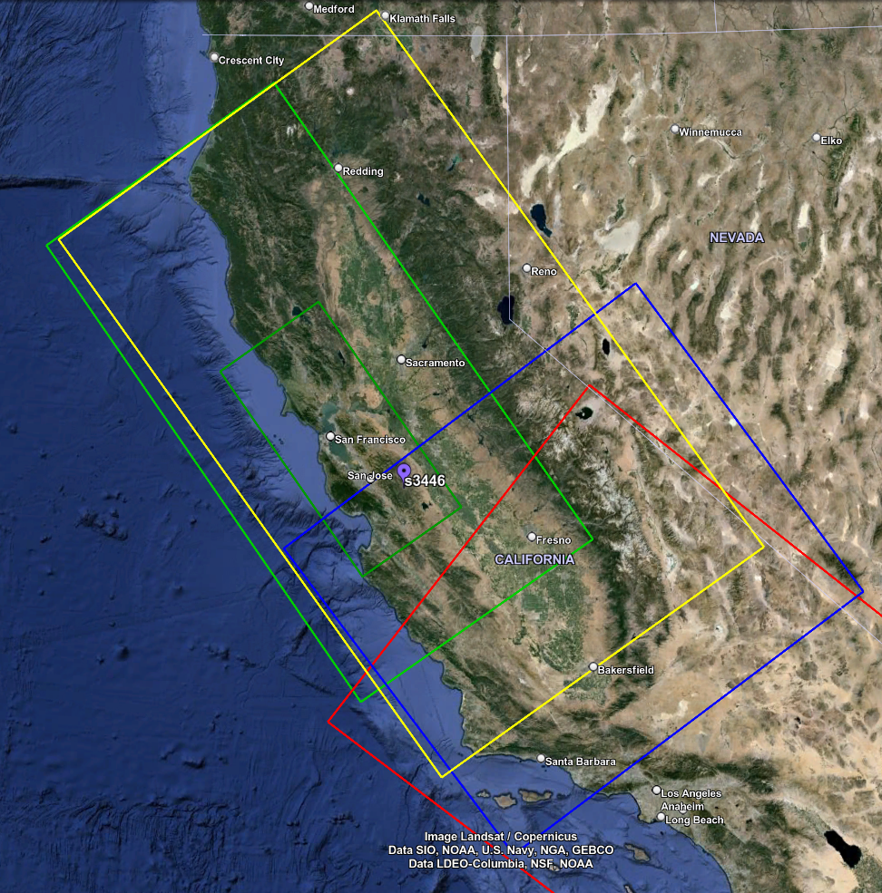
Velocity Model
Model consists of 3 tiled models
  USGS SFCVM, v21.1
  CCA-06 (tomographic model)
  1D background model, based on Sierra geologic region in SFCVM
San Leandro Gabbro modification applied to SFCVM to reduce near-surface velocities
Smoothing applied 20km from all interfaces
Surface point populated at depth of 20m (80m grid spacing)
Vp/Vs ratio capped at 4
Sample simulation volume with tiling
Statewide California Earthquake Center | www.scec.org

Slide 6
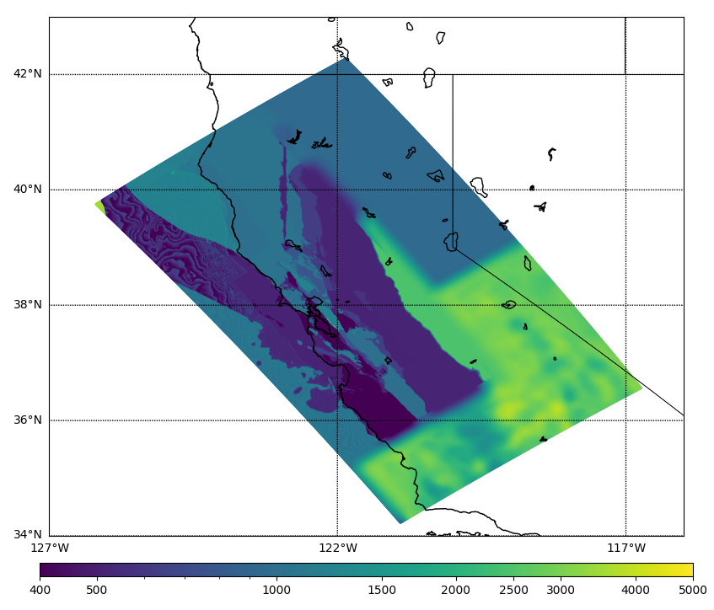
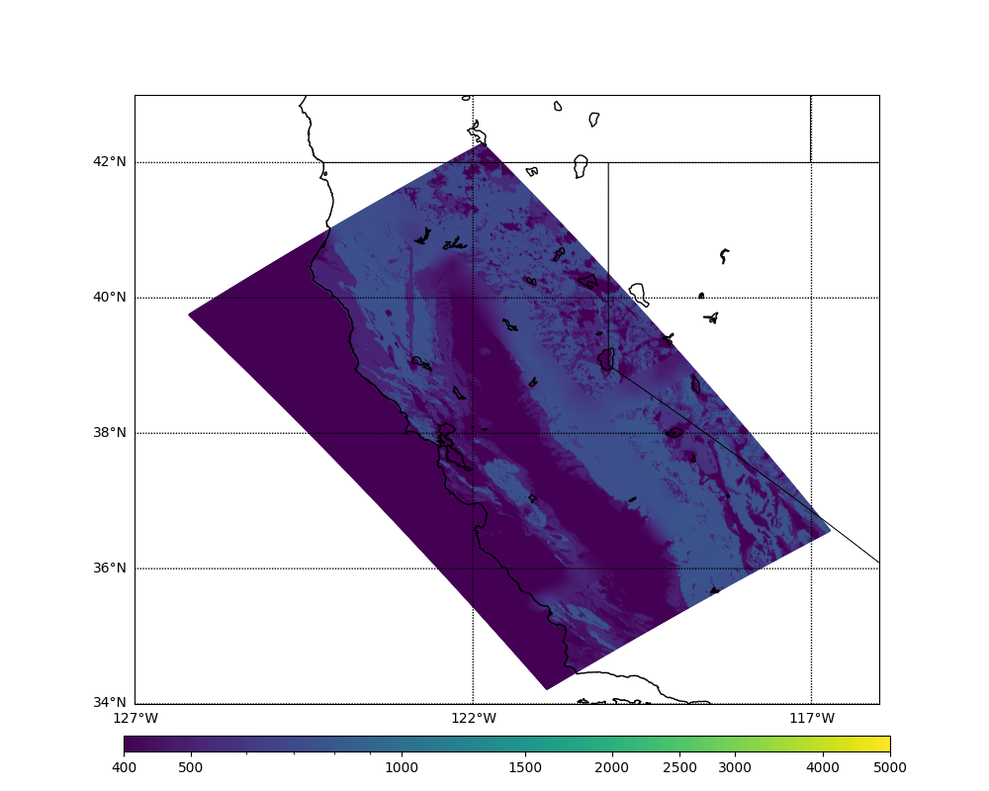
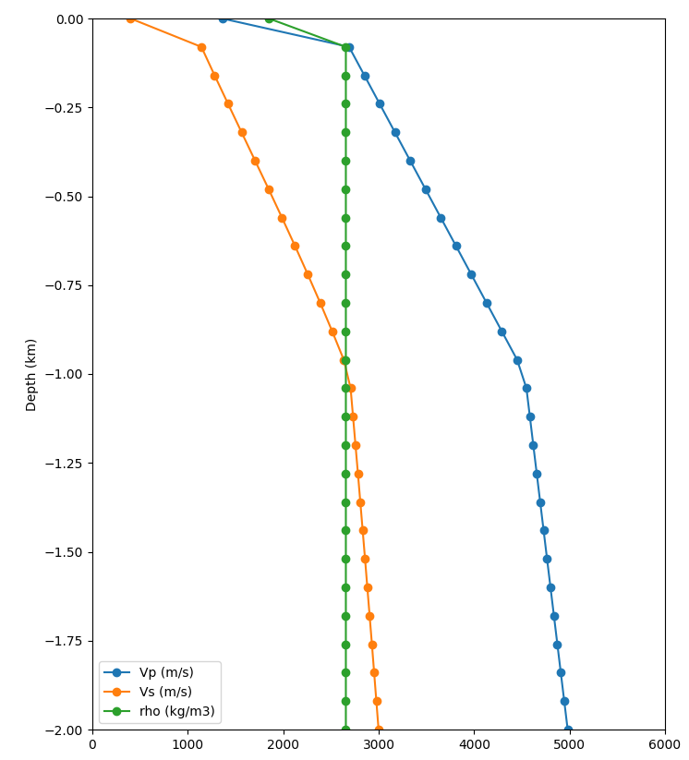
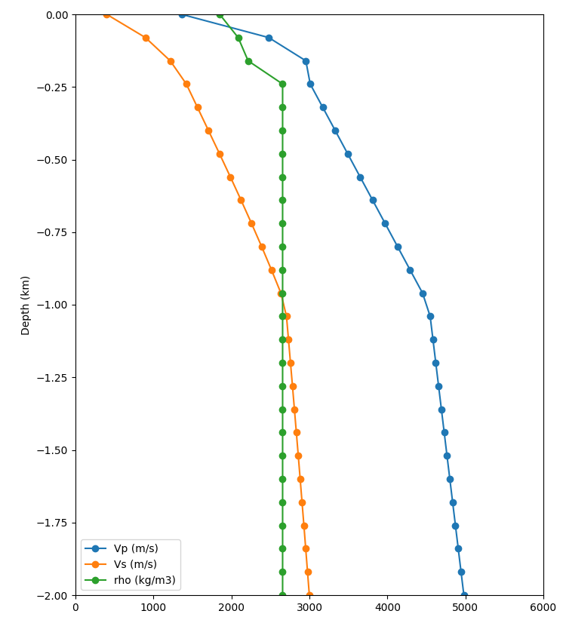
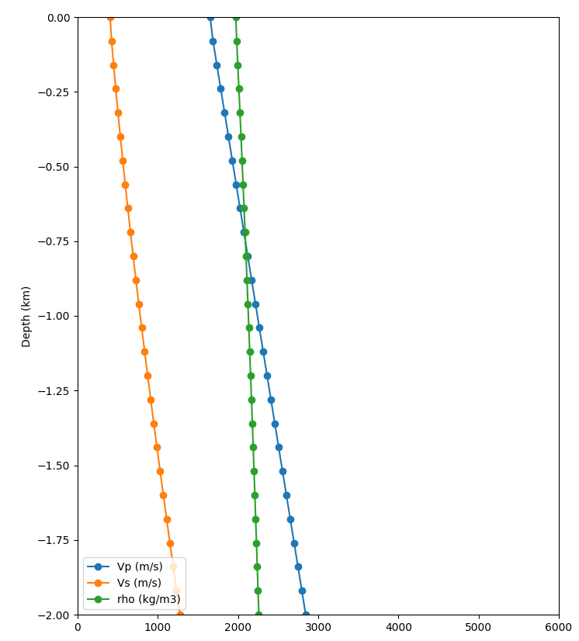

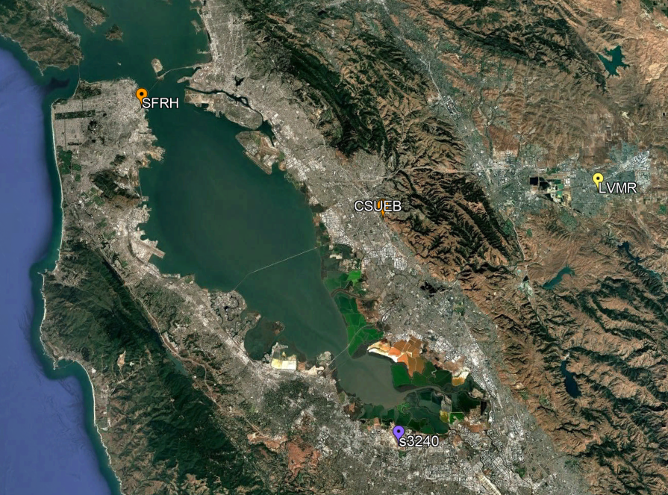
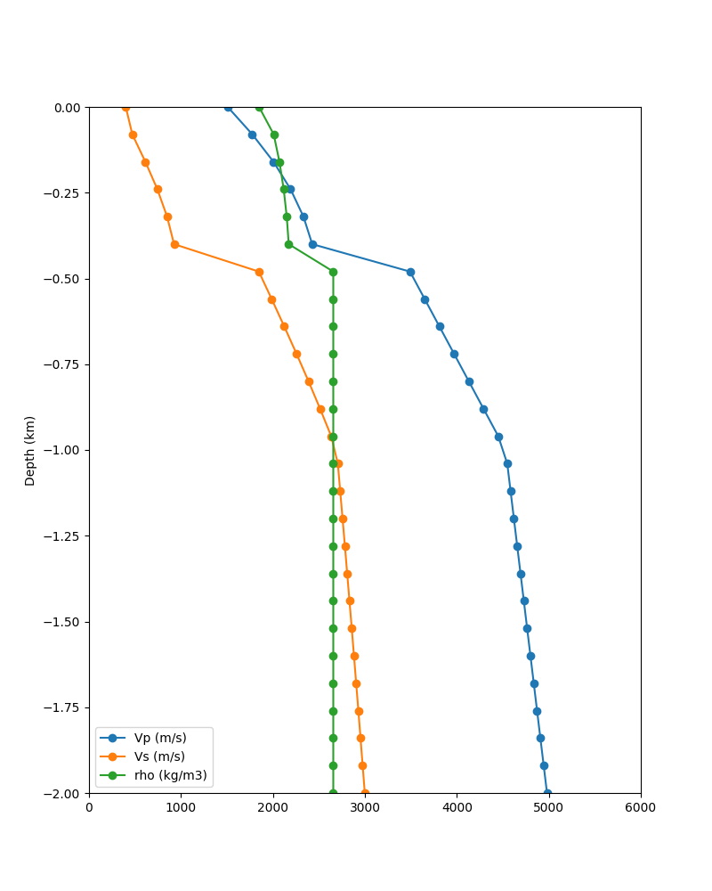
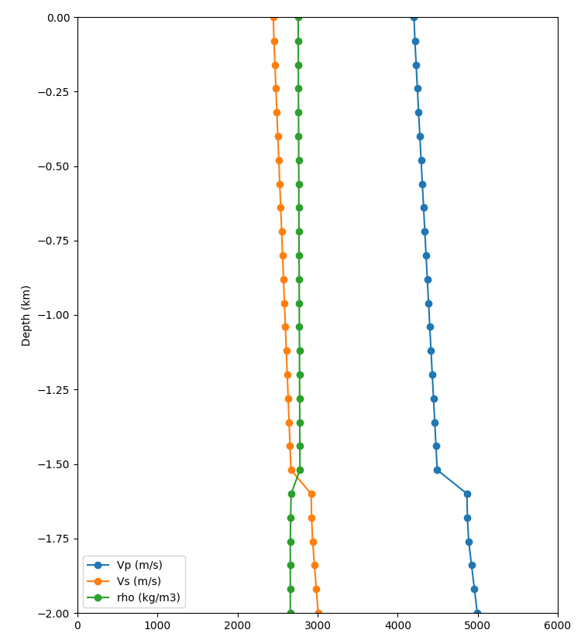
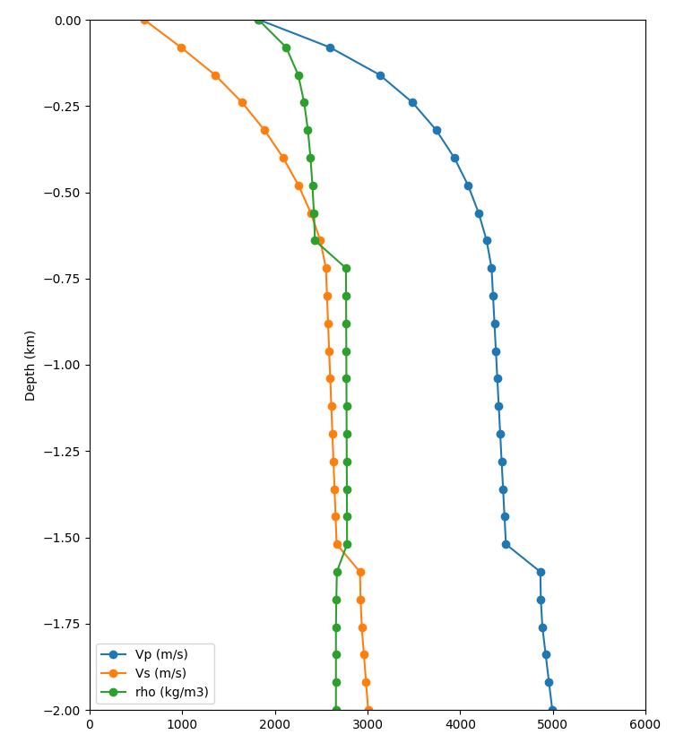
Merged Taper
Apply Thompson Vs30-based taper to grid points in top 700m if resulting Vs is lower
Before taper
After taper
Before taper
After taper
Surface slice, no taper
Surface slice, merged taper
Statewide California Earthquake Center | www.scec.org

Slide 7
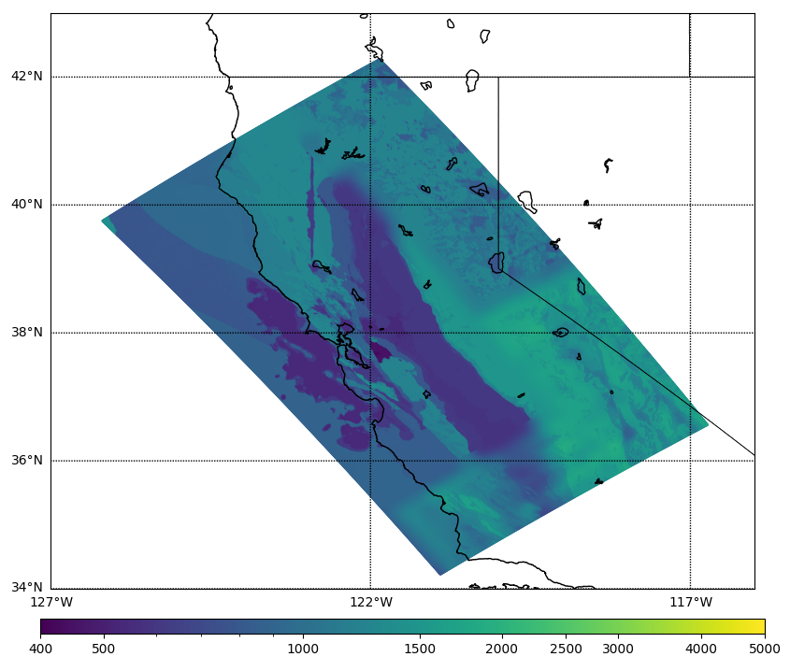
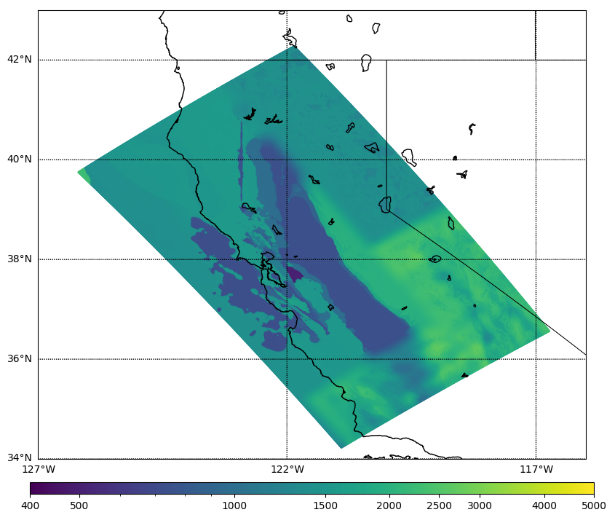
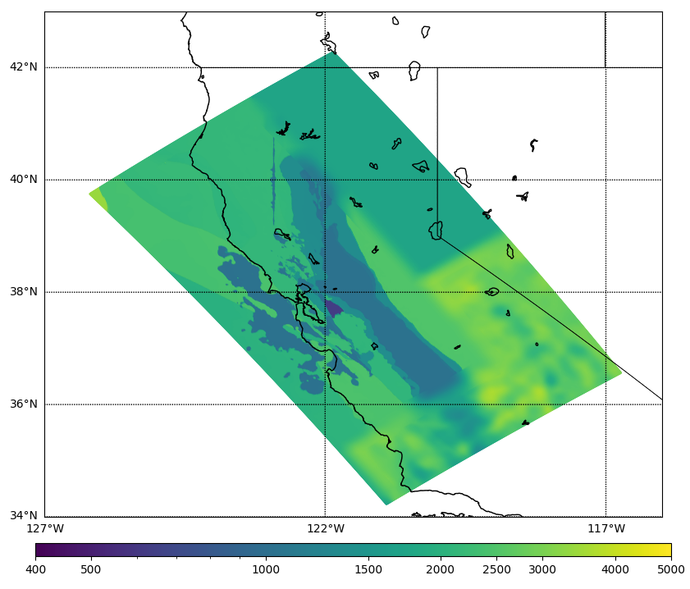
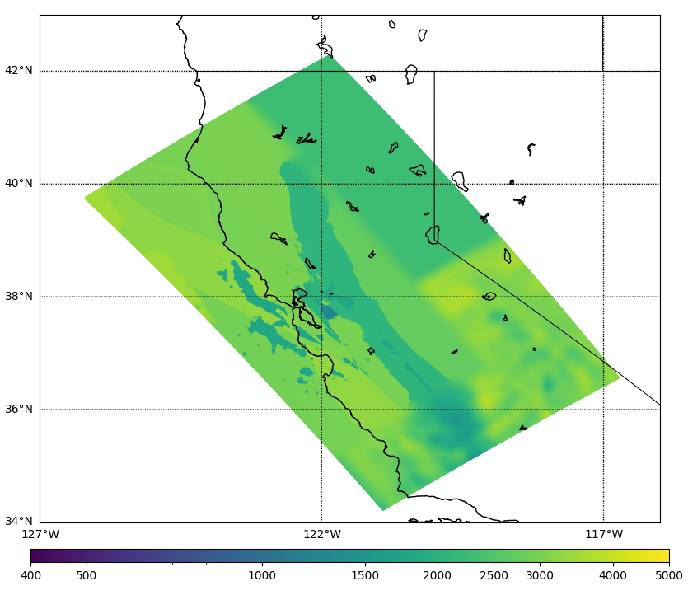
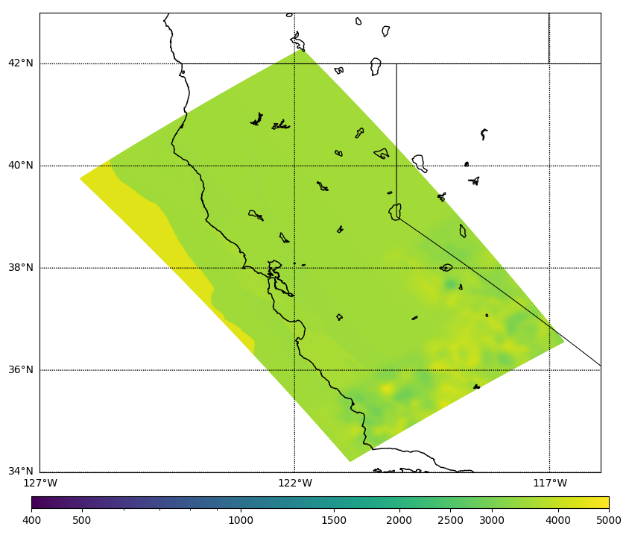
Velocity Model Slices
Surface
160 m
320 m
640 m
2000 m
10000 m
Statewide California Earthquake Center | www.scec.org

Slide 8
Study 24.8 Statistics
September 24 – November 8 (45 days)
Ran wave propagation calculations on OLCF Frontier and low-frequency synthesis and stochastic simulations on TACC Frontera
Used about 180,000 node-hours, including up to 44% of Frontier
Ran 27,800 jobs using Pegasus-WMS and HTCondor workflow tools
Managed 1 PB of data
Produced 36 TB / 9 million files of output data products
Generated 126.8 million three-component seismograms and 34.3 billion IMs
Statewide California Earthquake Center | www.scec.org

Slide 9
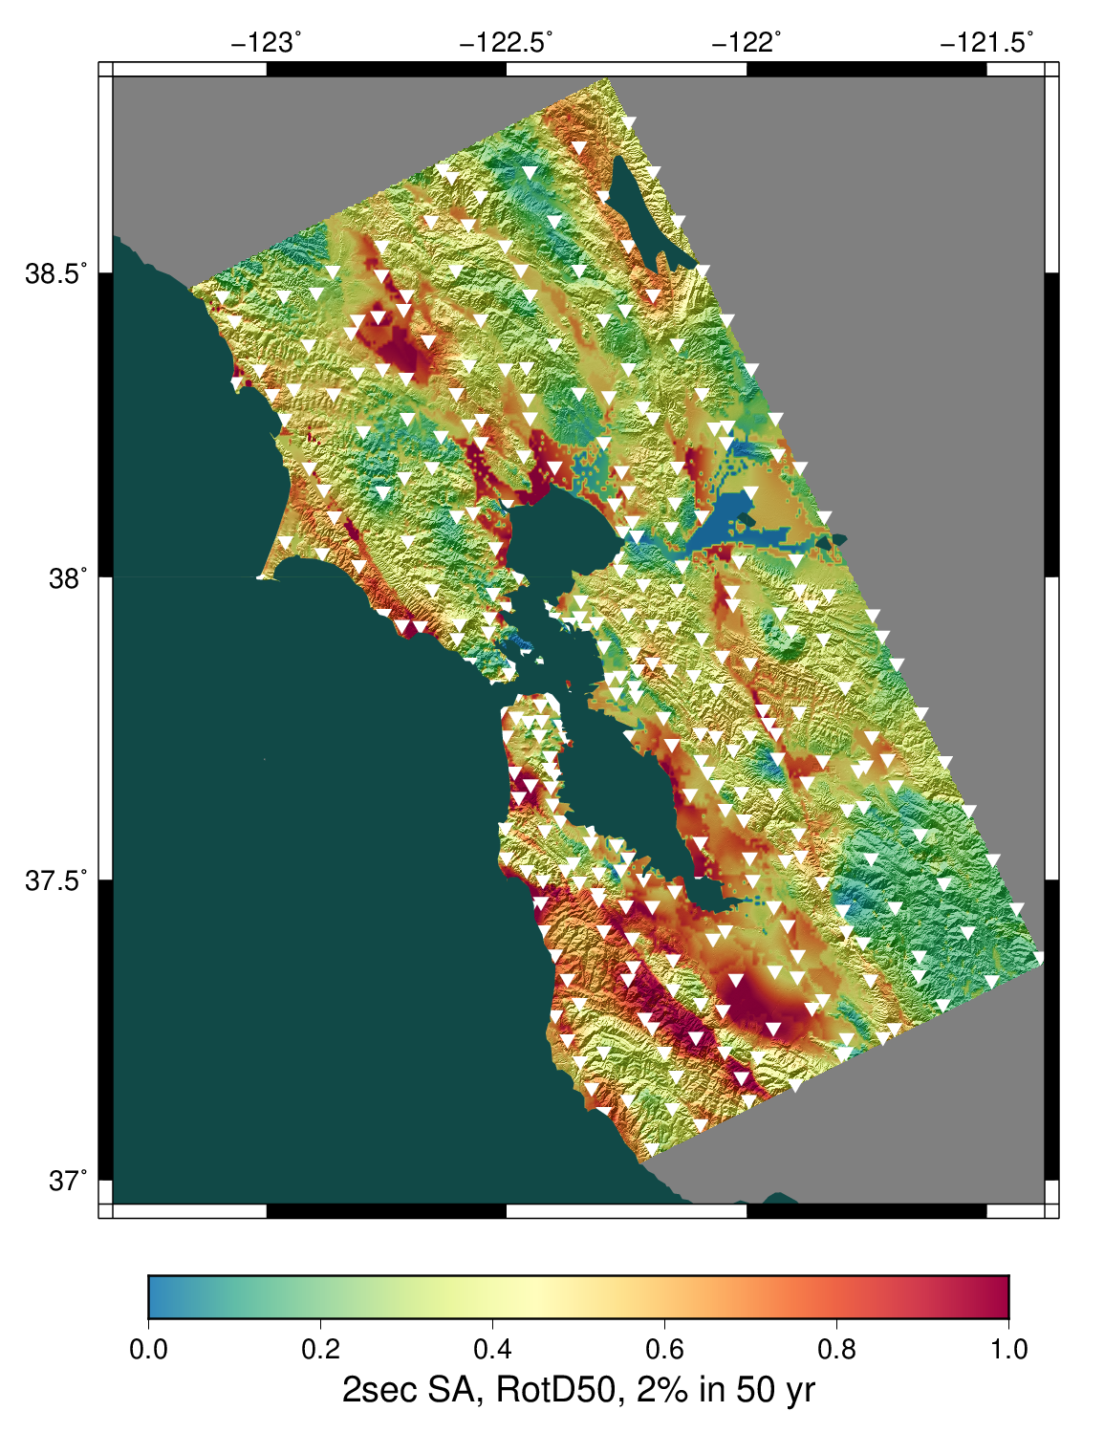
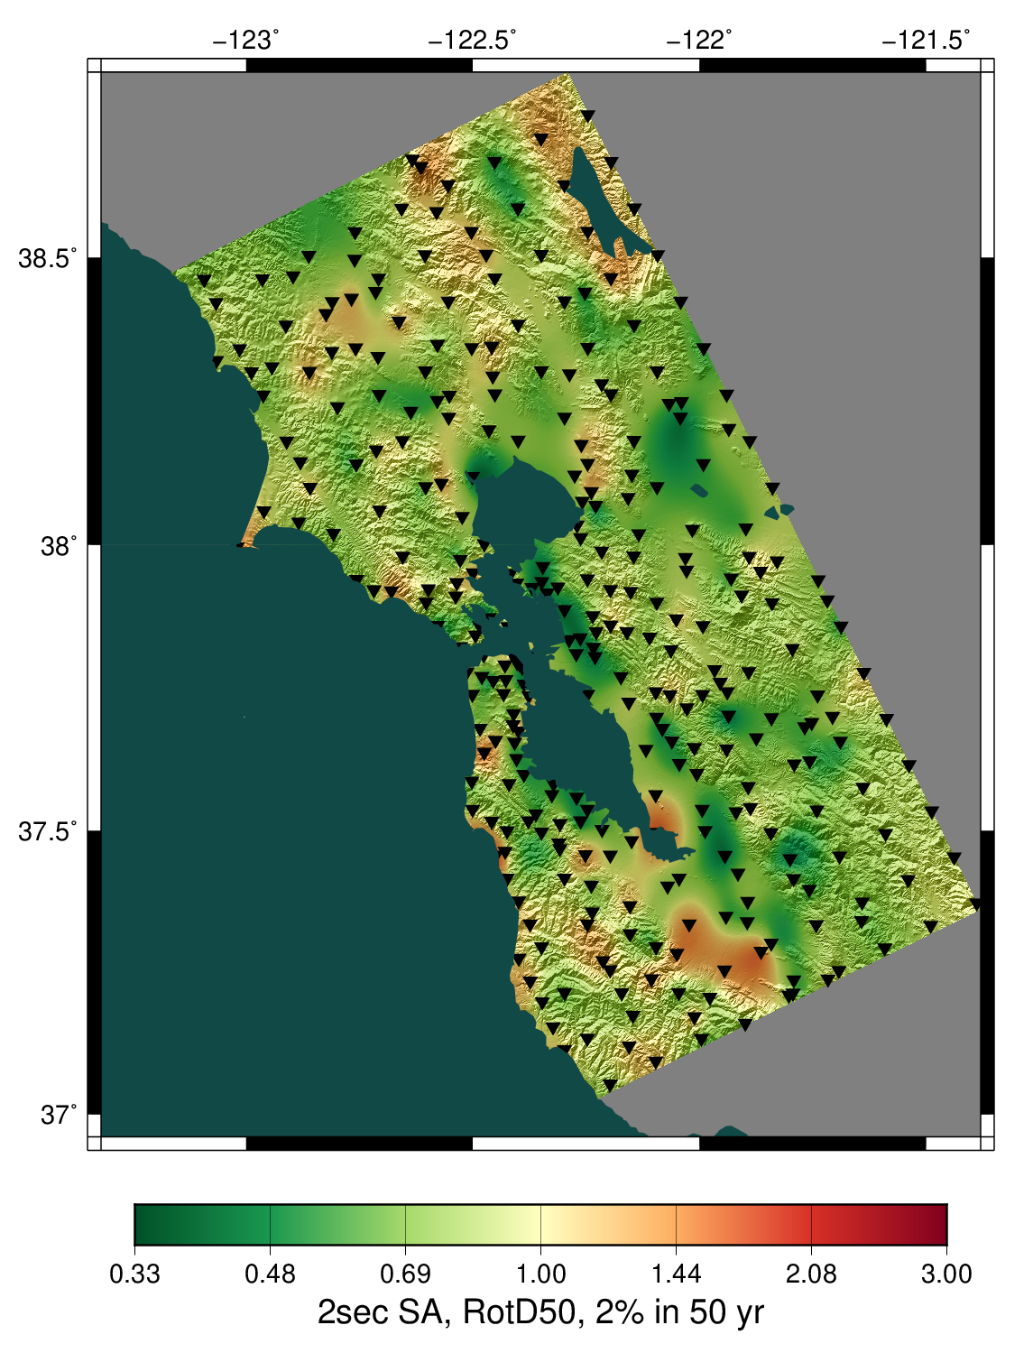
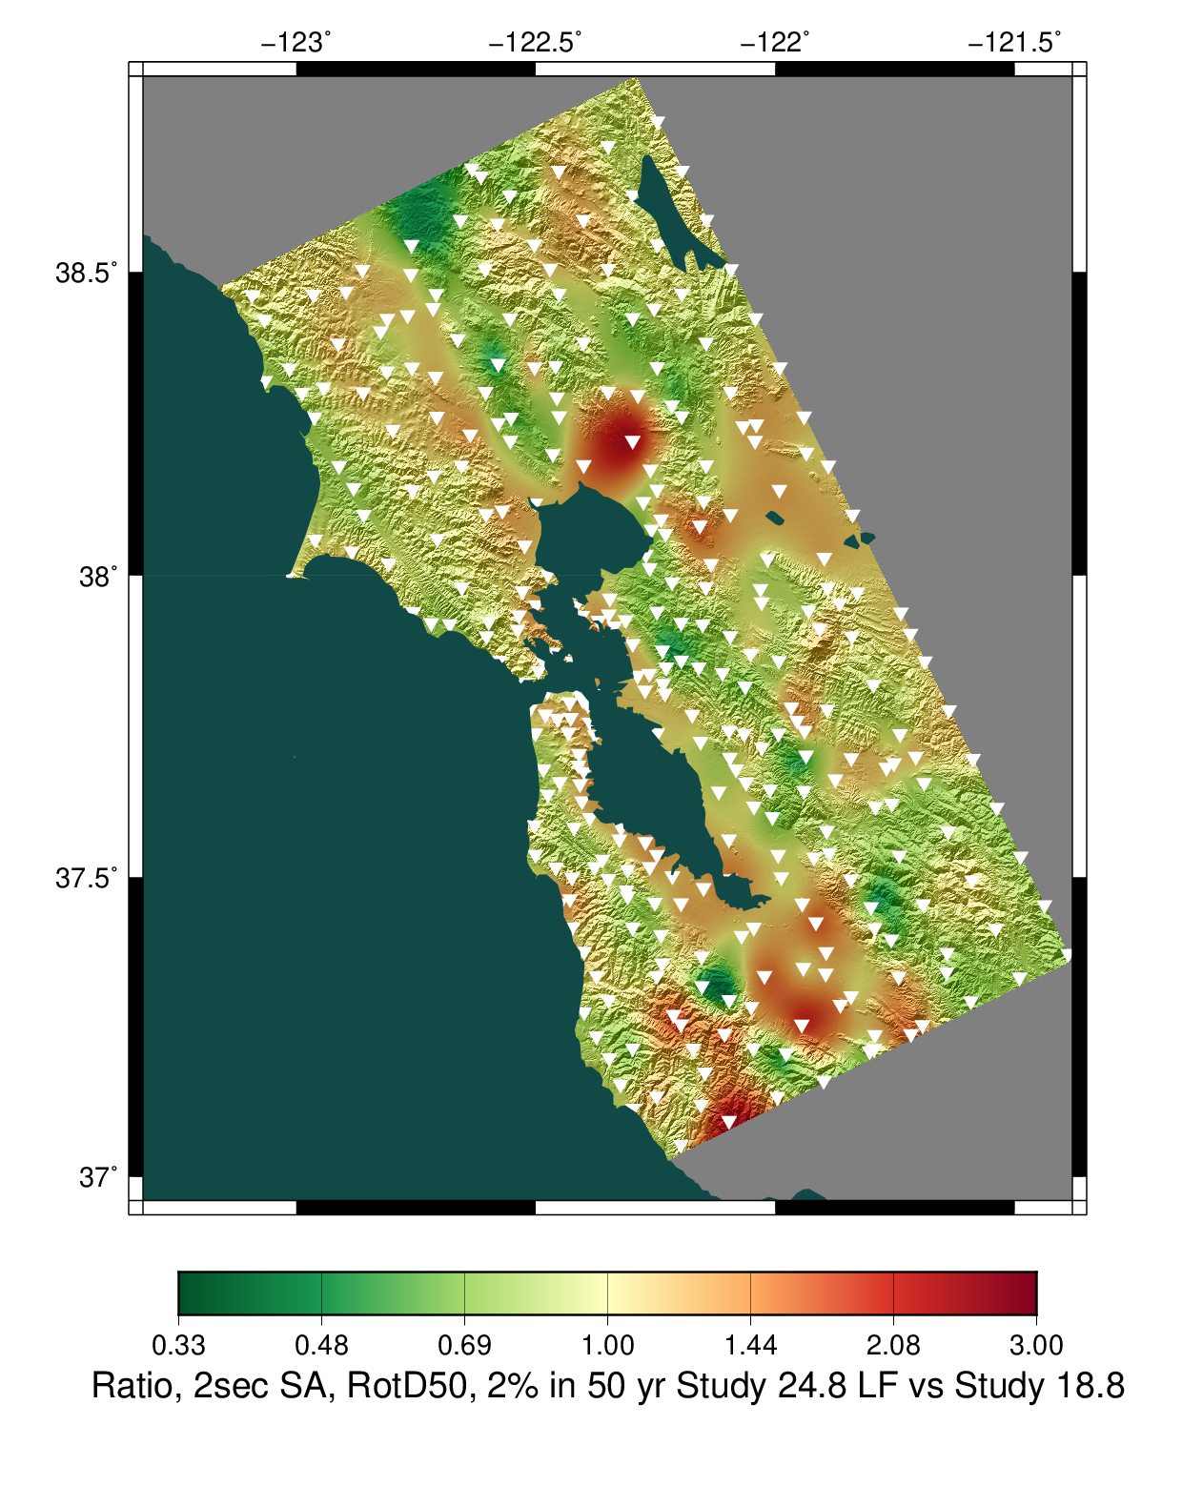
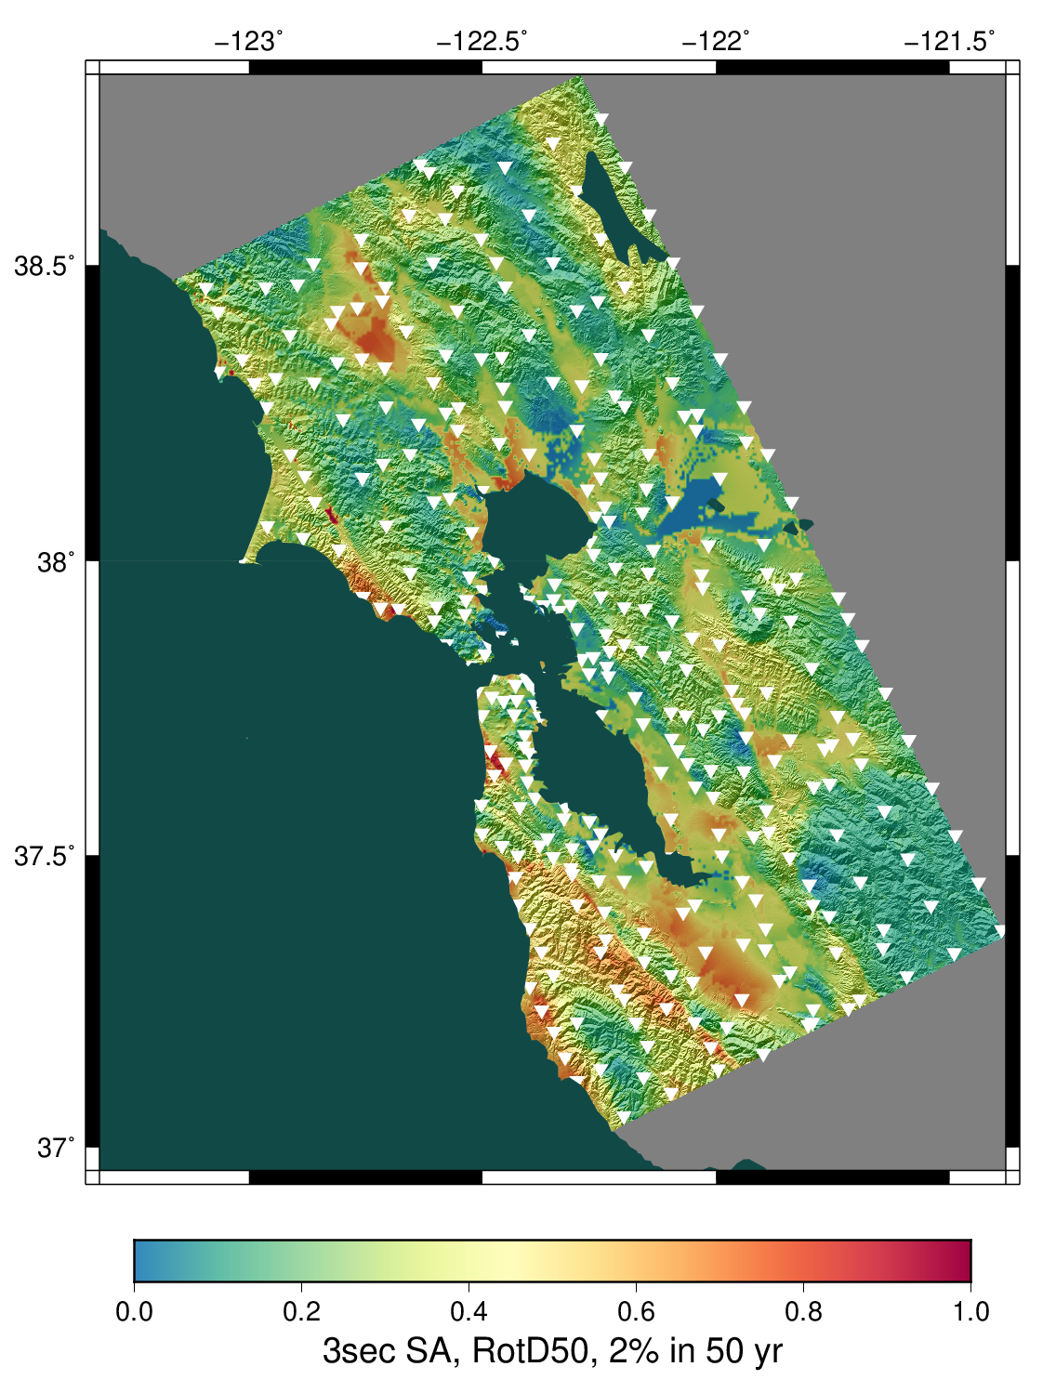
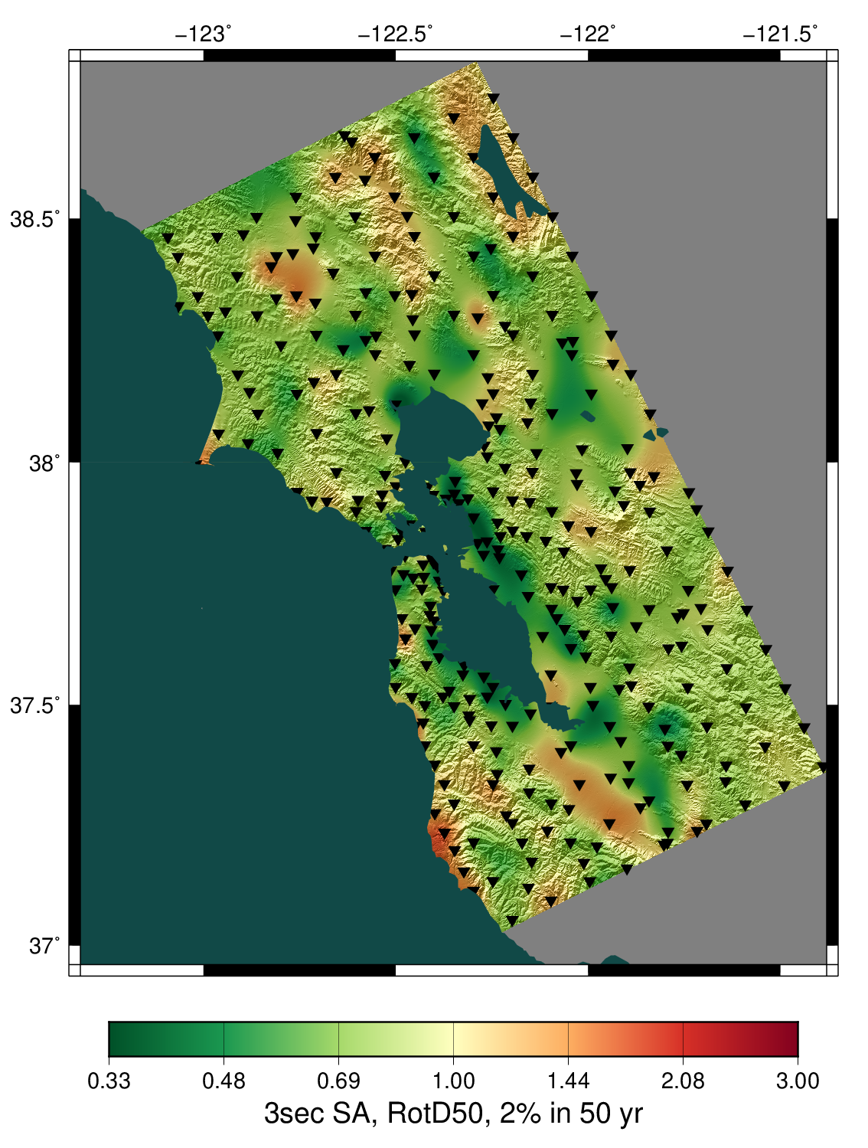
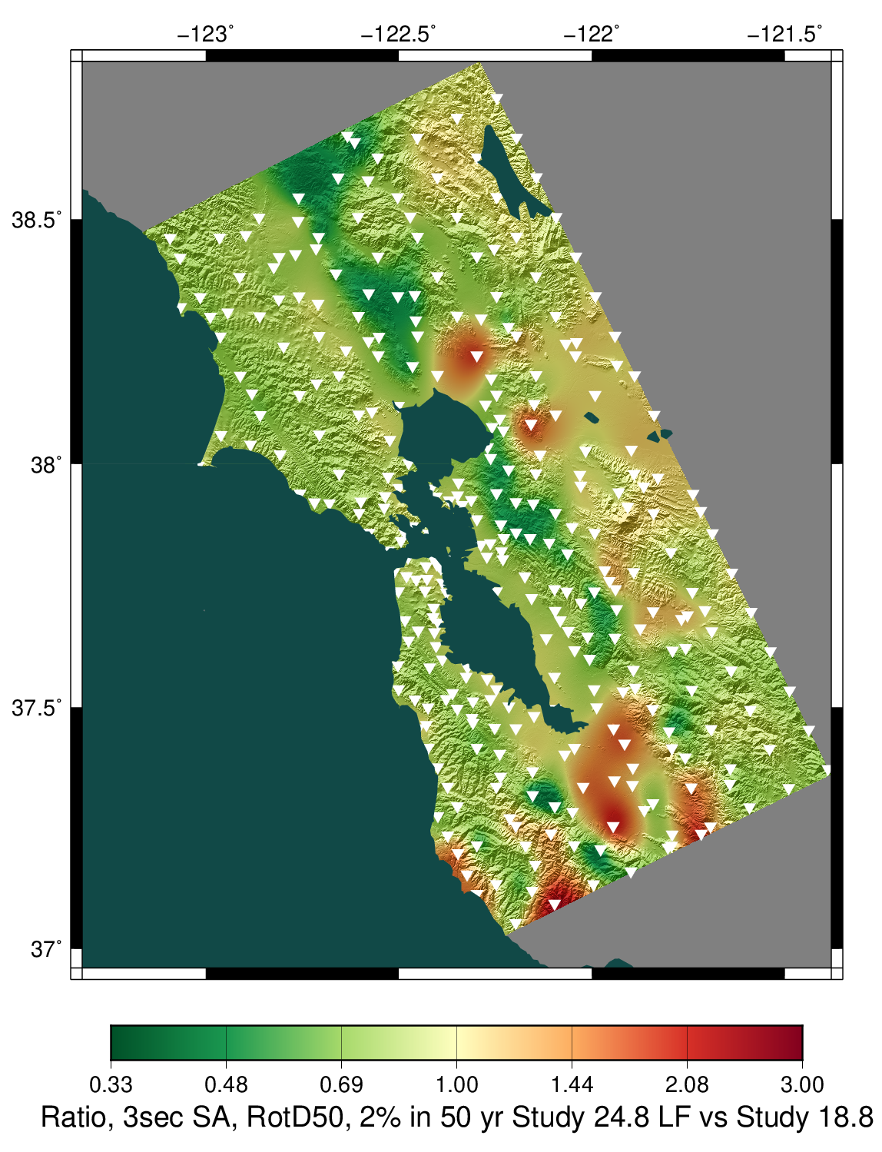
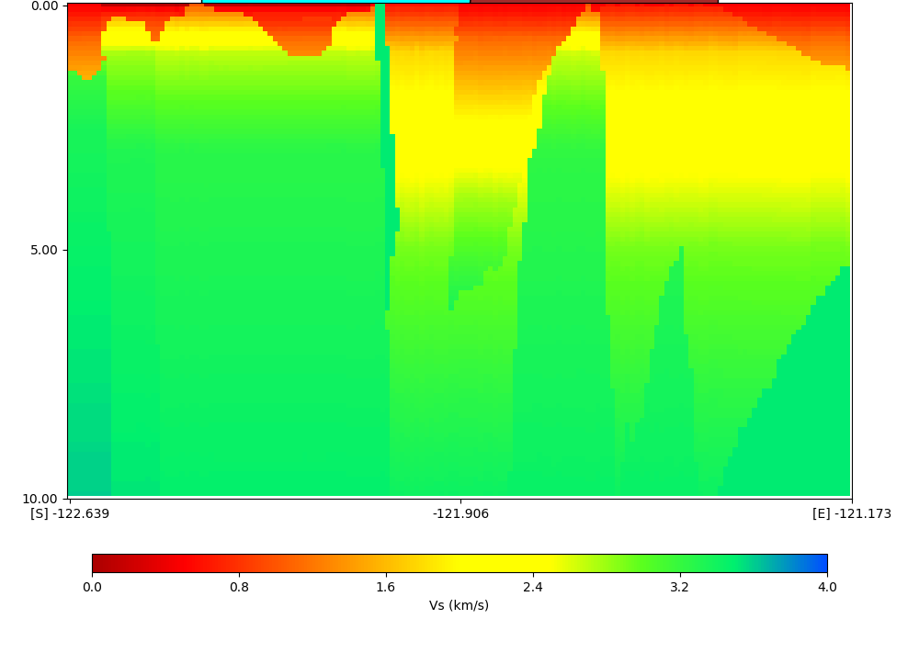
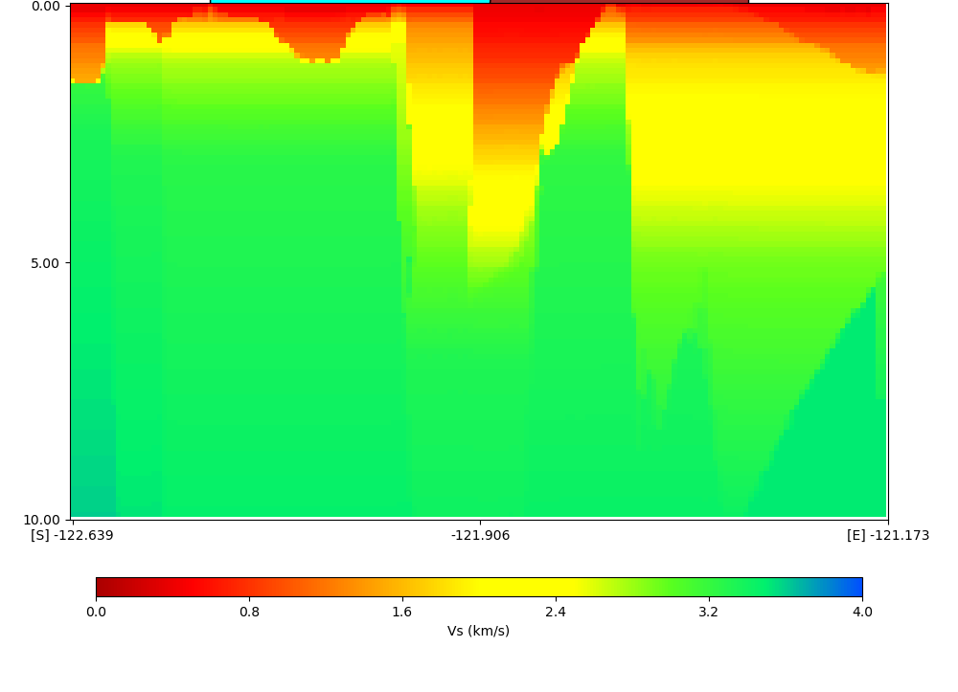
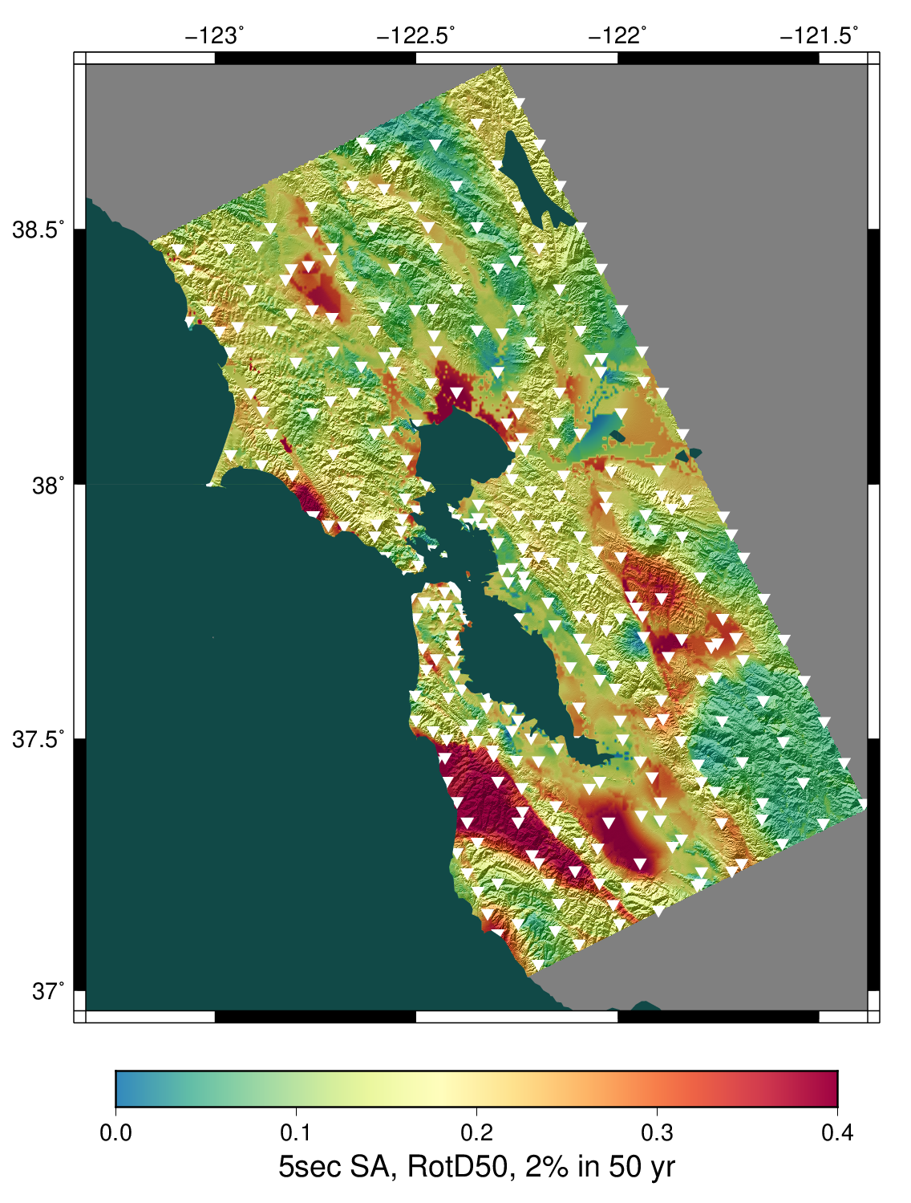
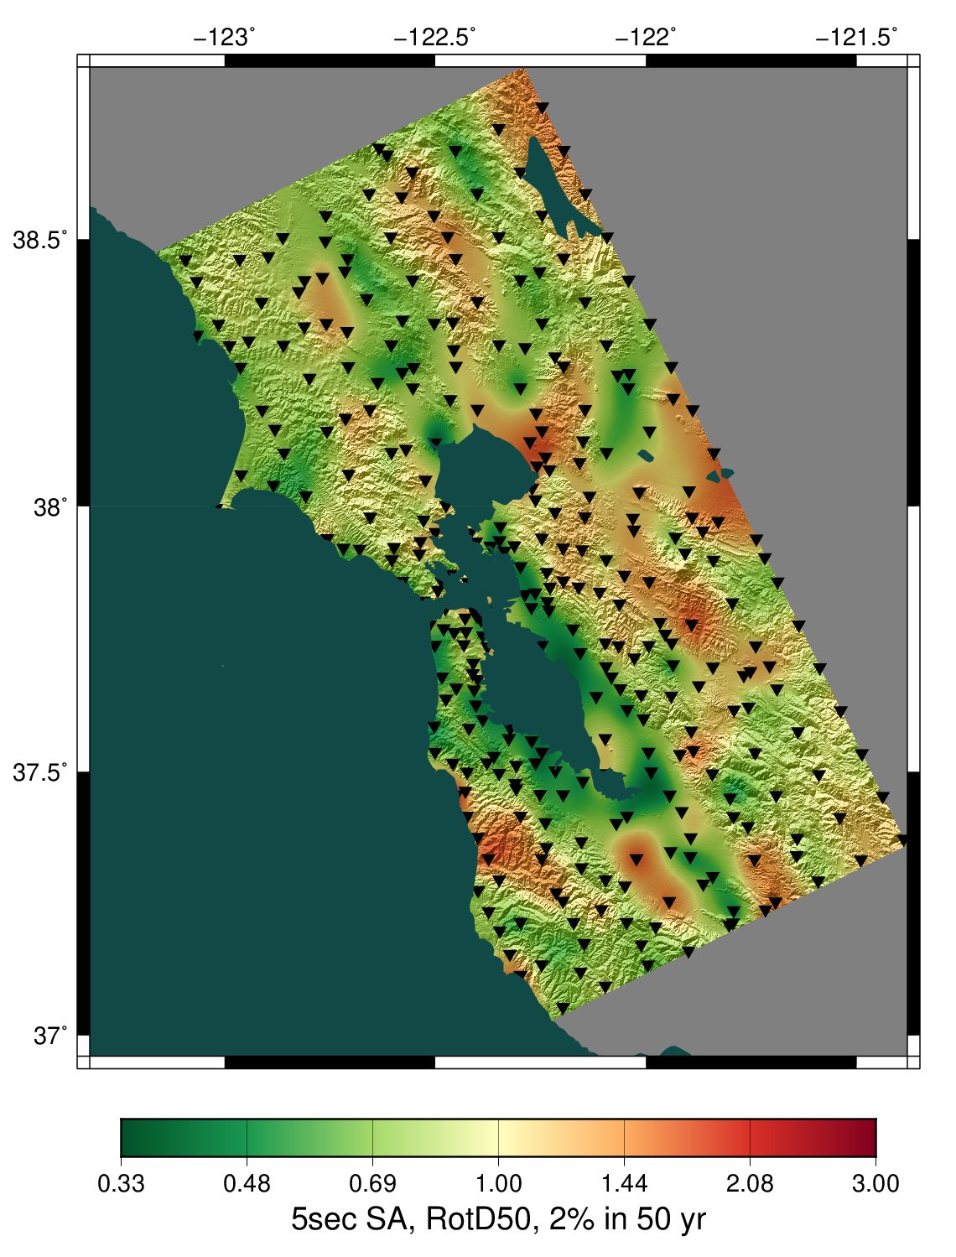
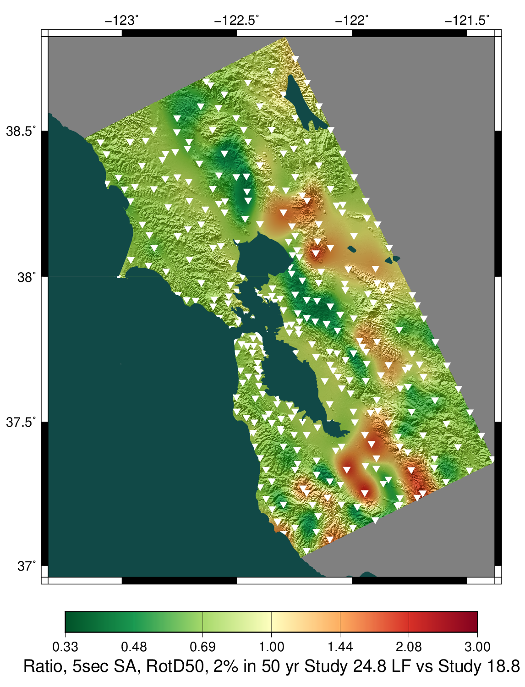
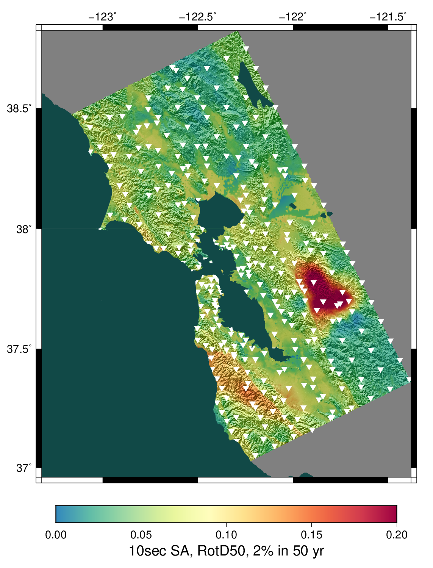
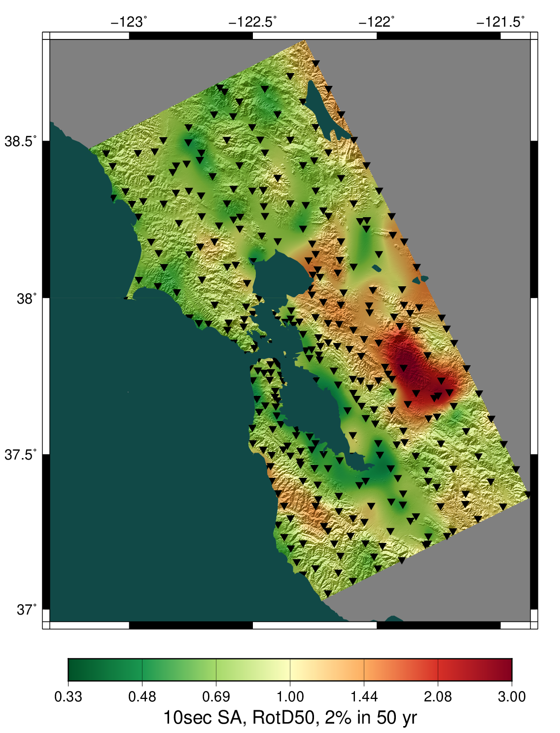
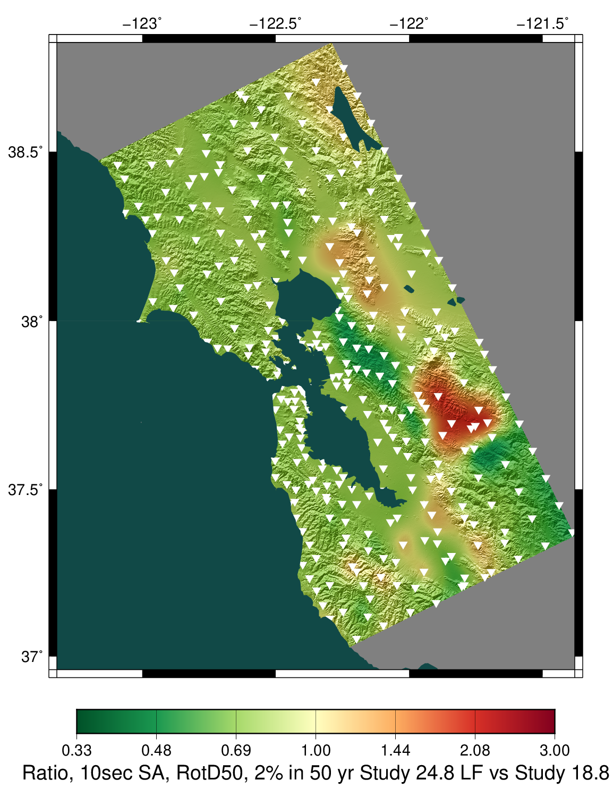
Low-frequency Hazard Maps
2s
2s
2s
CS18.8 velocity profile
CS24.8 velocity profile
3s
3s
3s
CS24.8
CS24.8
GMMs
CS24.8
CS18.8
CS24.8
CS24.8
GMMs
CS24.8
CS18.8
5s
5s
5s
10s
10s
10s
CS24.8
CS24.8
GMMs
CS24.8
CS18.8
CS24.8
GMMs
CS24.8
CS18.8
CS24.8
Statewide California Earthquake Center | www.scec.org

Slide 10
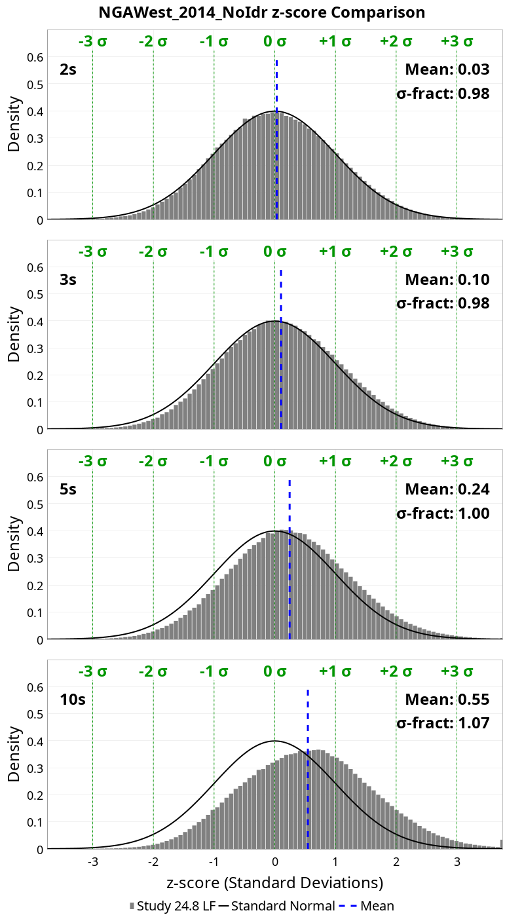
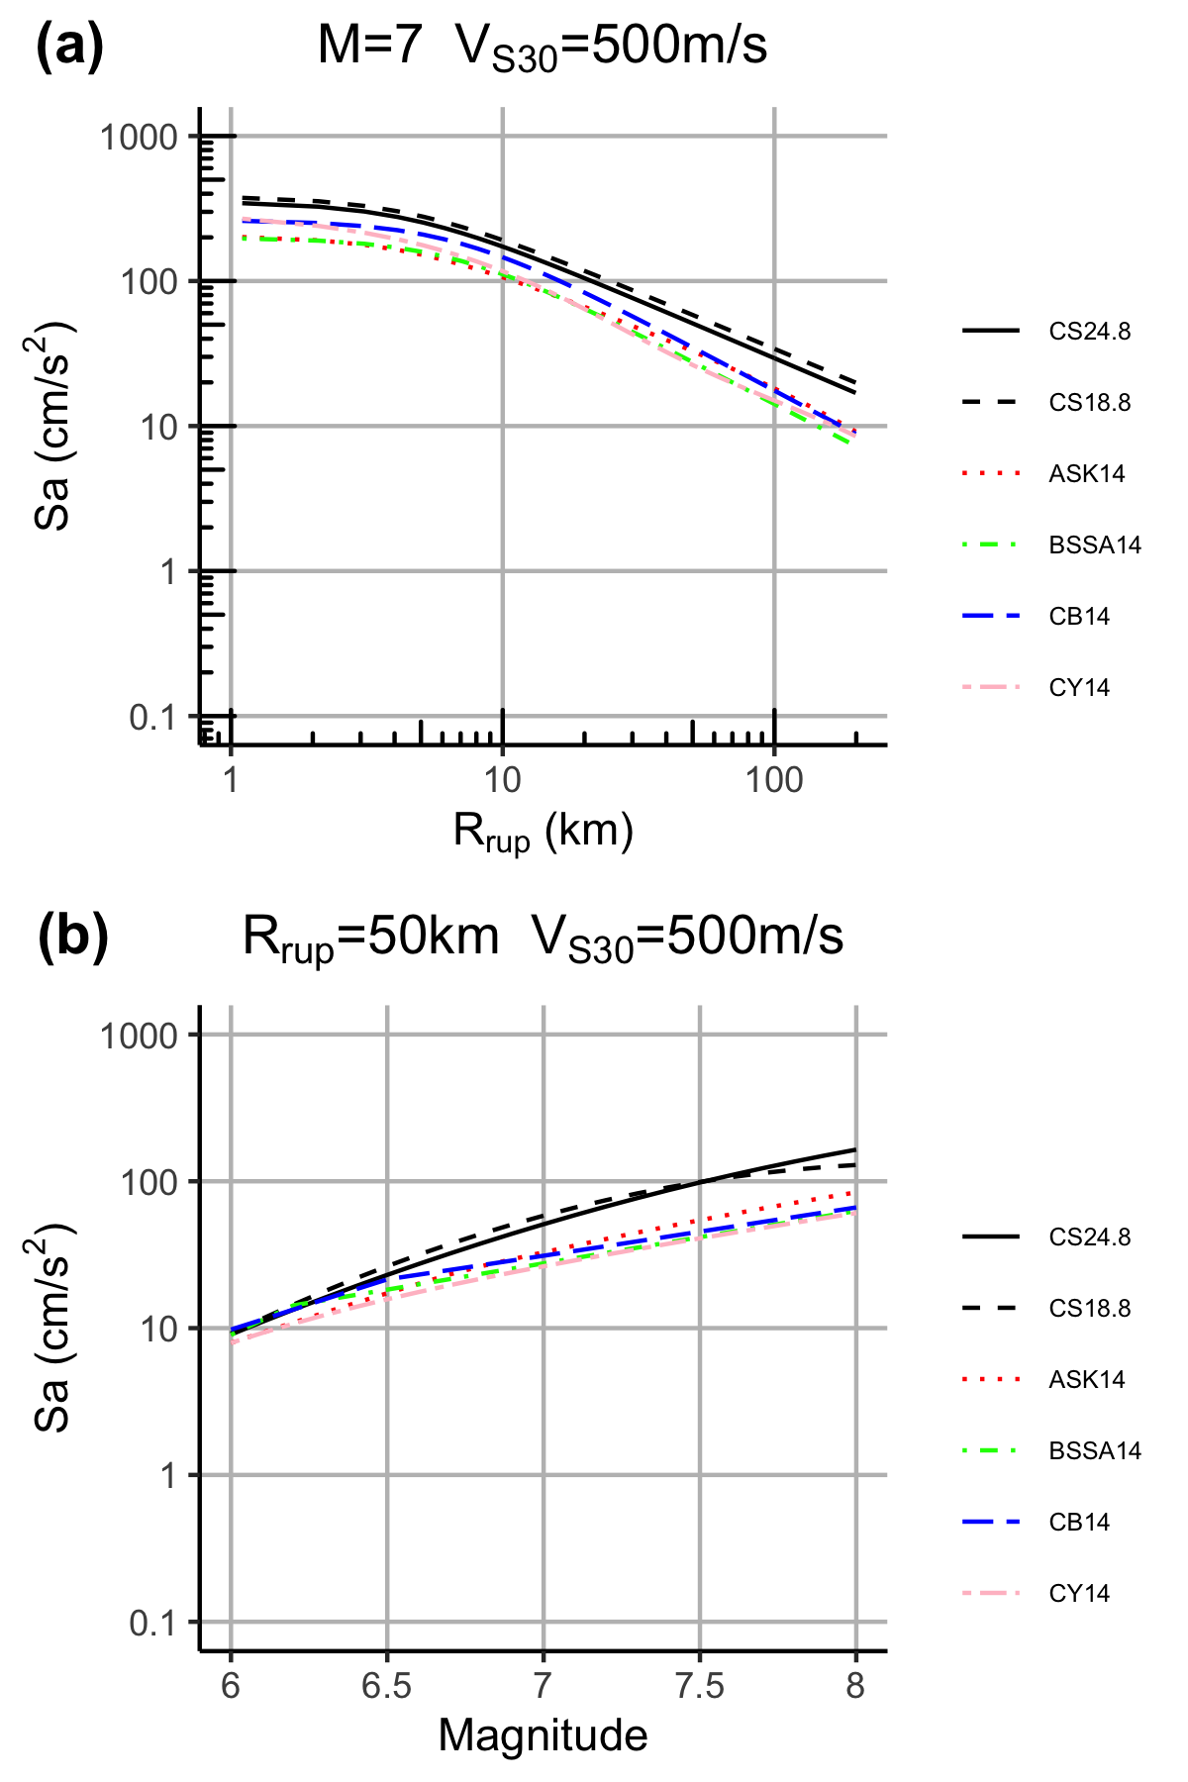
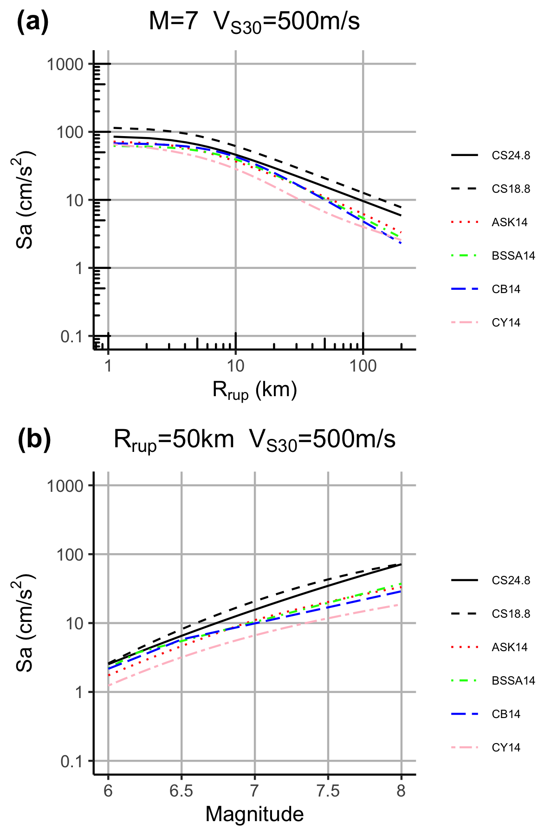
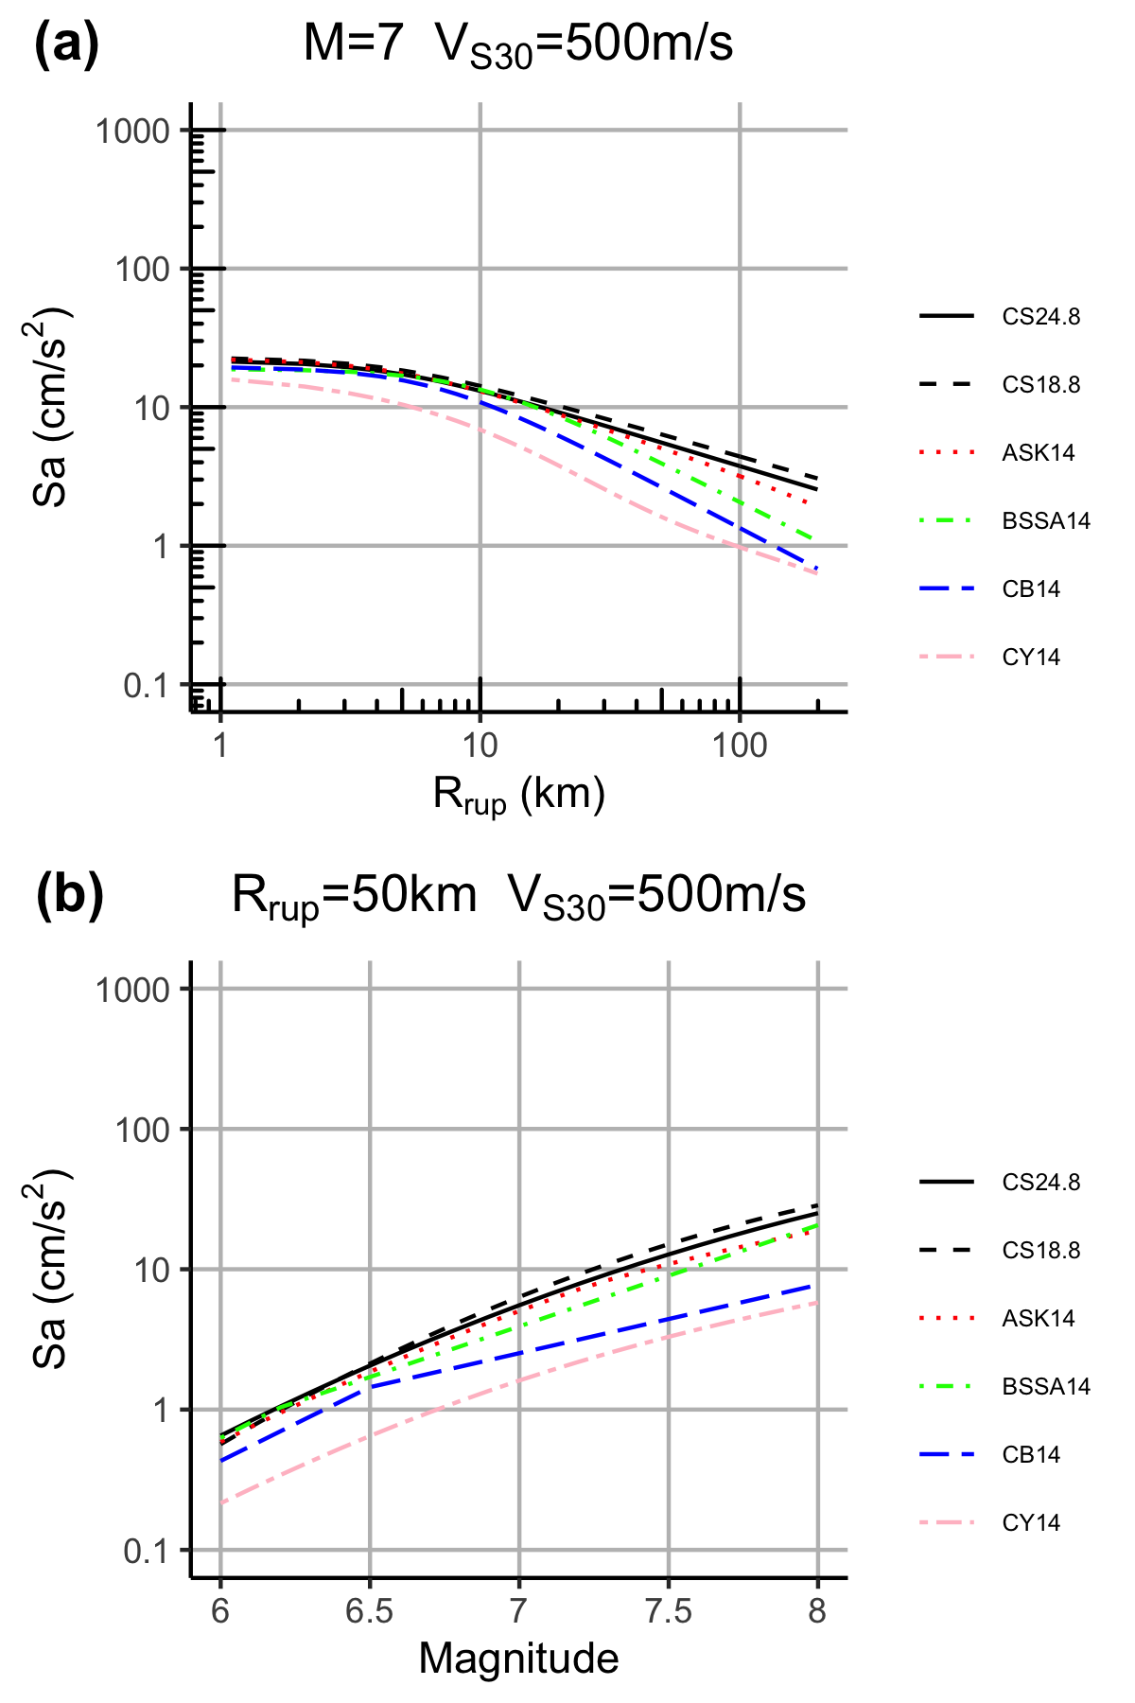
Low-frequency Aggregate Analyses
2 sec
5 sec
10 sec
Comparison of distance and magnitude scaling between CyberShake-derived GMM and other GMMs
Z-score distribution
Statewide California Earthquake Center | www.scec.org

Slide 11
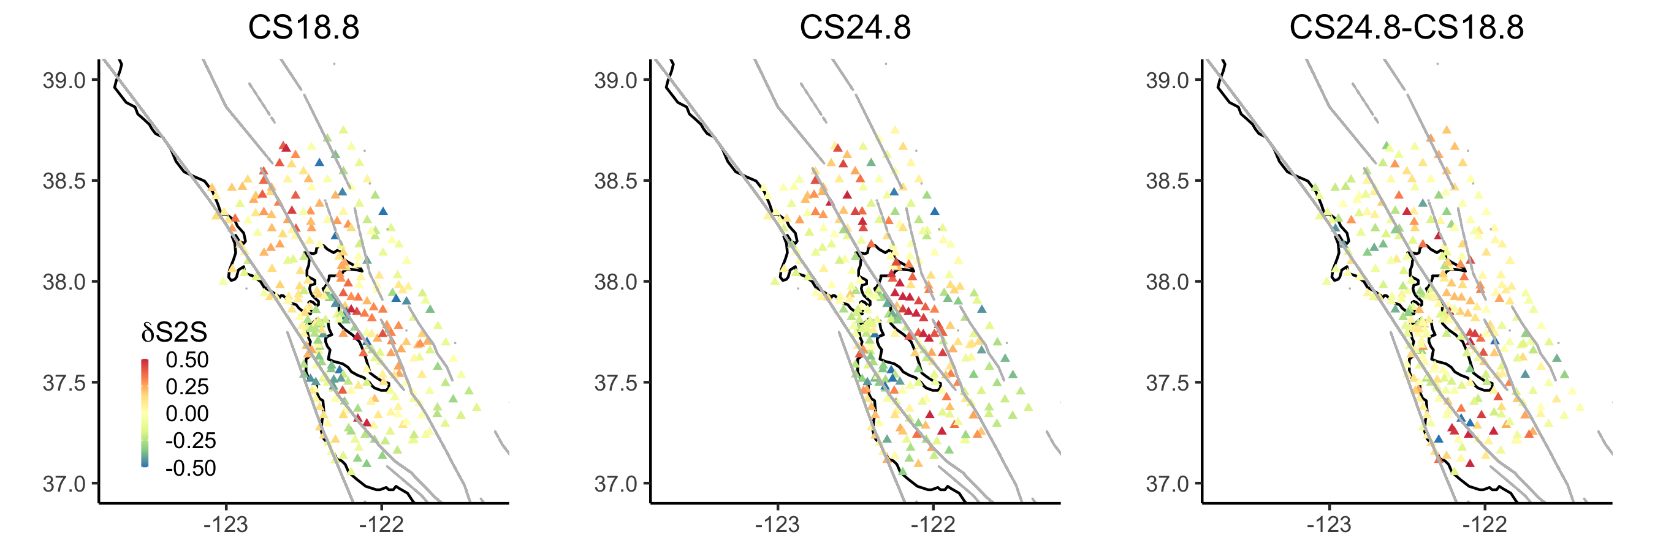
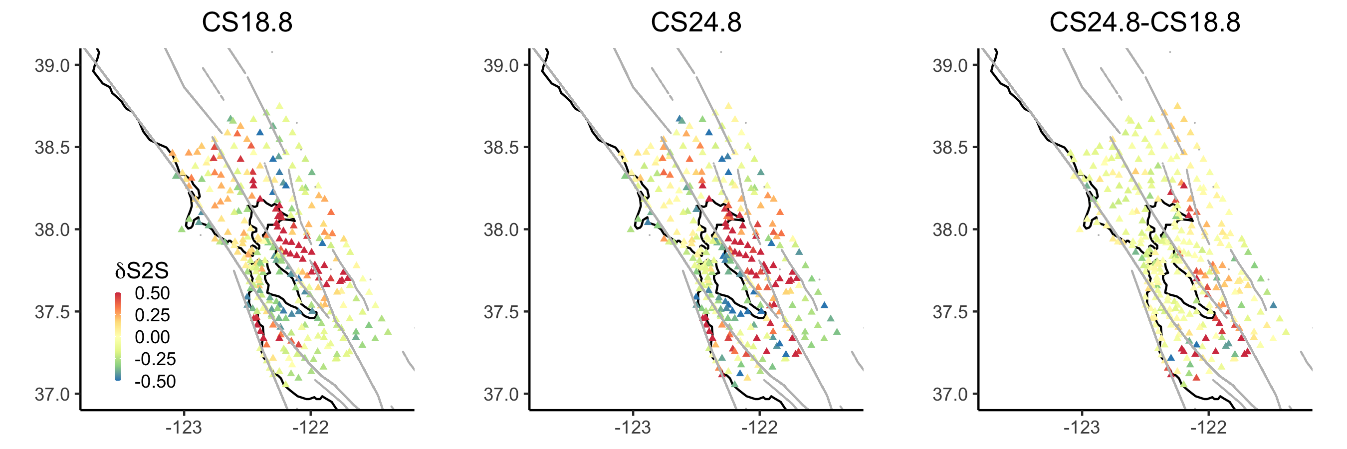
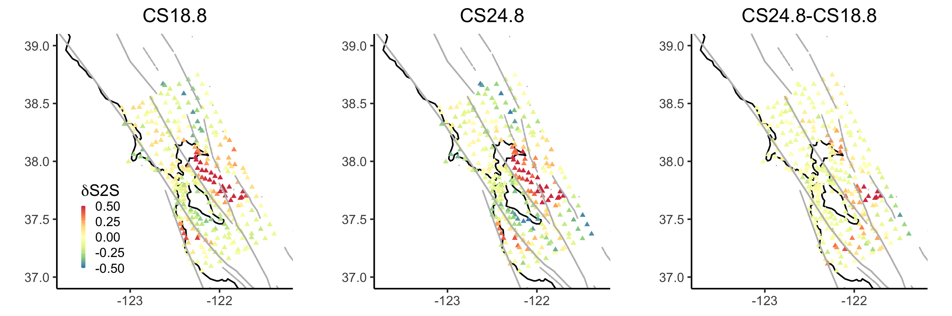
Low-Frequency Site Terms
Site terms derived from CyberShake-derived GMM
At 2 and 5 sec, slightly higher in South and East Bay
At 10 sec, higher site terms in Livermore basin
2 sec
5 sec
10 sec
Statewide California Earthquake Center | www.scec.org

Slide 12
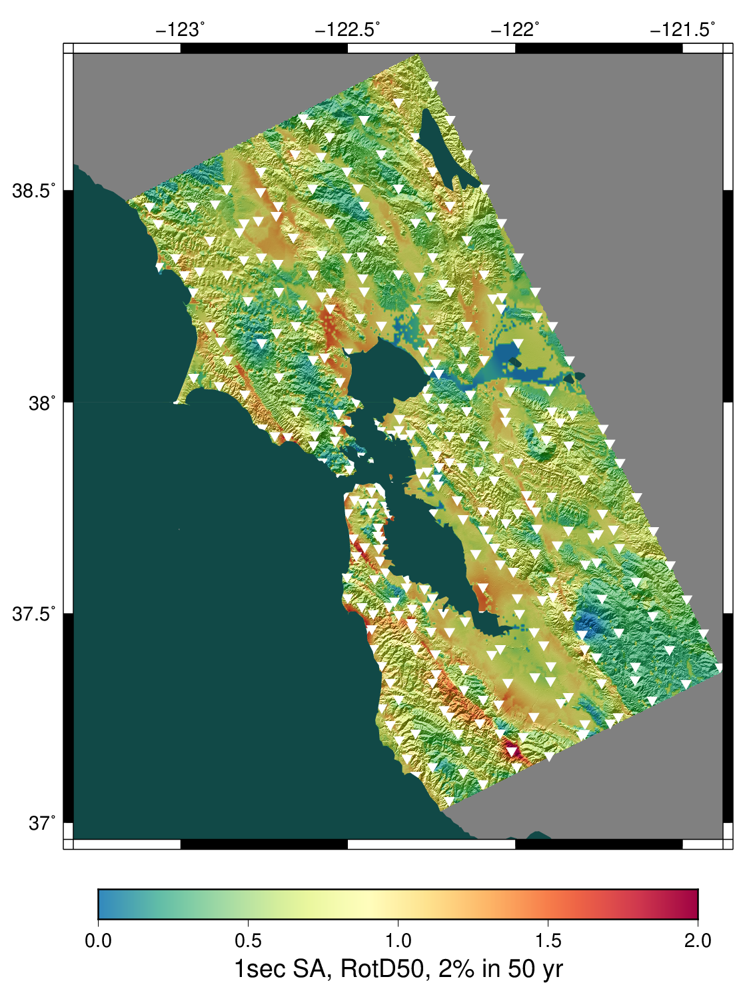
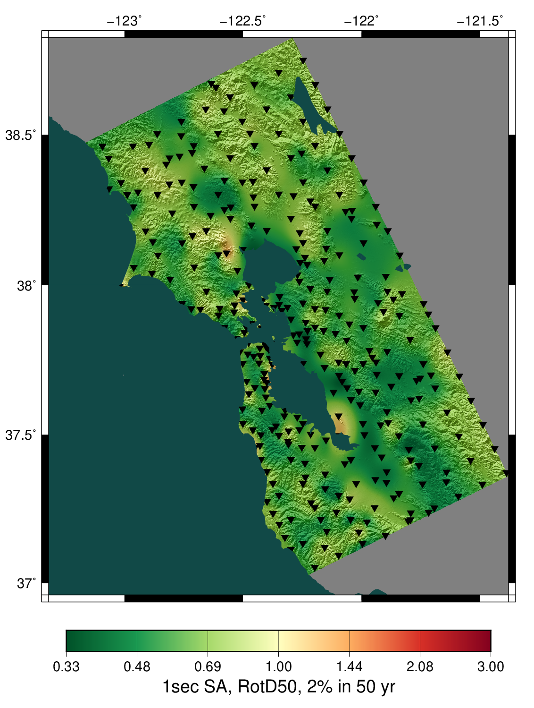
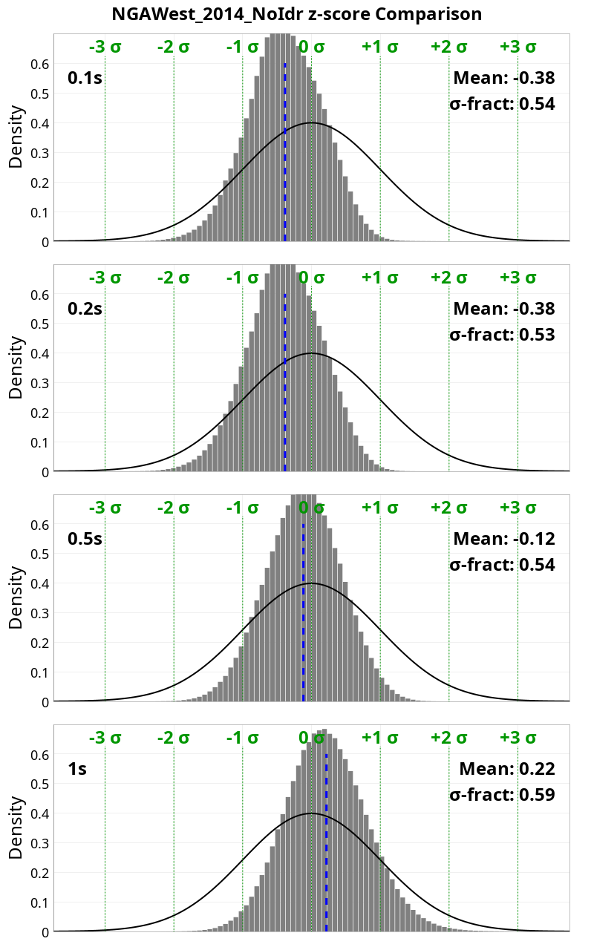
Broadband Data Products
1s
1s
CS24.8
GMMs
CS24.8
Z-score distribution
Statewide California Earthquake Center | www.scec.org

Slide 13
Next Steps
Short-term:
  Continue Study 24.8 analysis
  Improve community access to data products
  Calculate Fourier spectra for all events
Medium-term:
  Perform 2 Hz tests in small region of interest (will require code modifications)
  Look at reducing minimum Vs
Long-term:
  Ways to integrate non-linearity with reciprocity
  Include topography
Let me know if you’d like access to data!
  Velocity model is integrated into UCVM
Statewide California Earthquake Center | www.scec.org

Slide 14
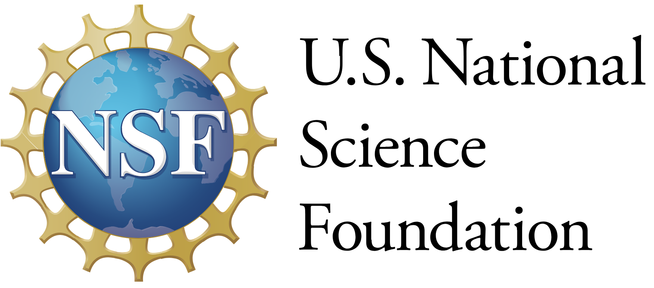



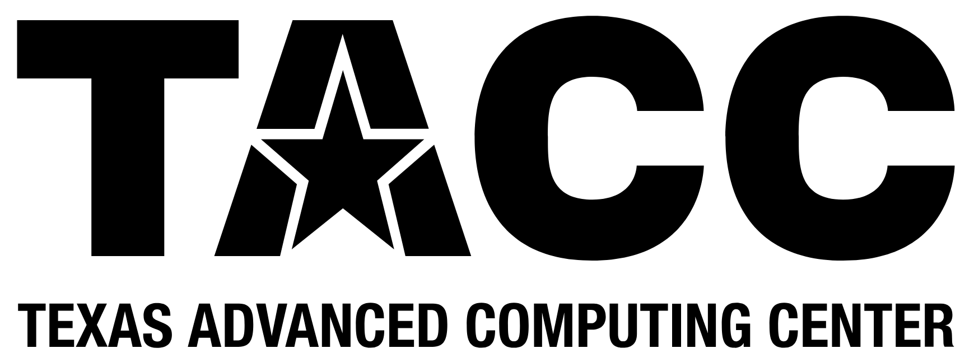


Thanks!
Statewide California Earthquake Center | www.scec.org

