Slide 1
Computational Tools to Support Large-Scale CyberShake PSHA Simulations
Scott Callaghan, Philip J. Maechling, Christine A. Goulet, Kevin R. Milner, Mei-Hui Su, Karan Vahi, Ewa Deelman, Robert W. Graves, Kim B. Olsen, Yifeng Cui, and Thomas H. Jordan
2019 SSA Annual Meeting
April 24, 2019

Slide 2
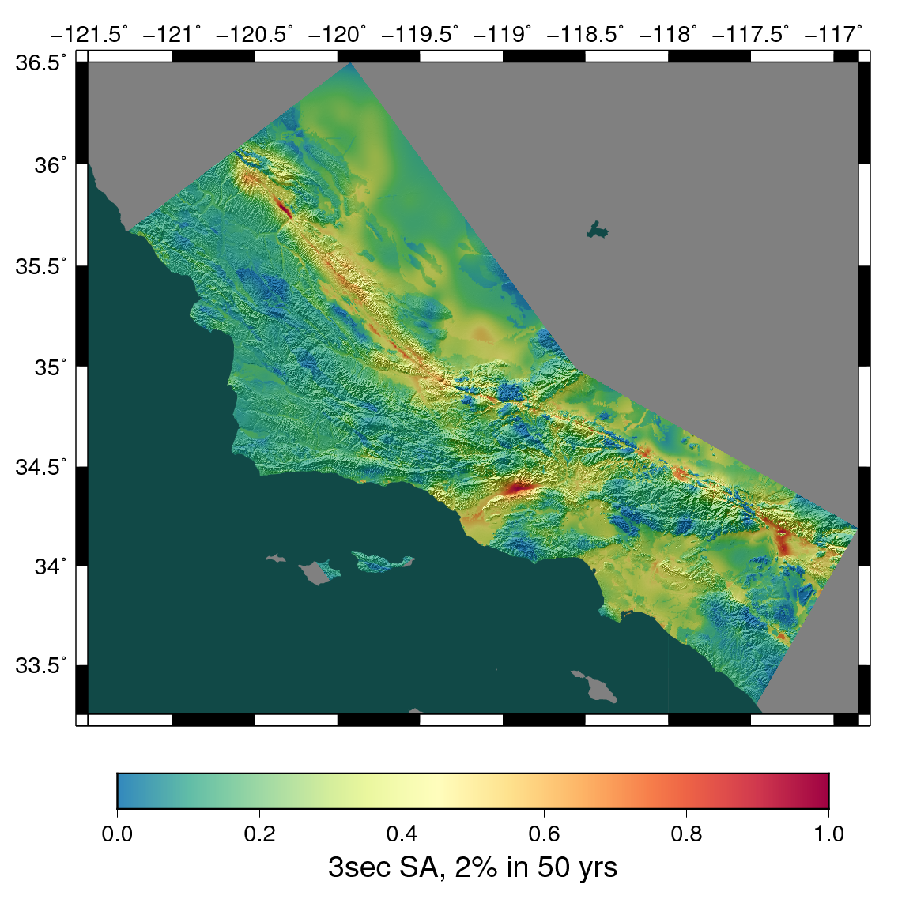
CyberShake Overview
Southern California Earthquake Center’s 3D physics-based probabilistic seismic hazard analysis (PSHA) platform
UCERF2 ERF (M≥6.5, ≤200 km) with Graves & Pitarka rupture generator (~500,000 events per site)
Reciprocity-based approach to simulate seismograms
Intensity measures derived from seismograms
Hazard results from individual sites interpolated with GMPEs to make map
Structural models: CVM-S4.26, CCA-06
Earthquake forecast: UCERF2

Slide 3
Northern California: Study 18.8
After success of Central California CyberShake, move further north
869 locations
1 Hz
Vs min = 500 m/s
Large simulation volumes (1100 x 450 km)
Tiled velocity model
CCA-06 + Ely GTL
USGS Bay Area model
CVM-S4.26.M01
Southern CA region in black
Central CA region in magenta
Bay Area region in orange
869 sites, densest near San Francisco Bay

Slide 4
CyberShake Computational Requirements
CyberShake stage | Compute-hours | Output data
Velocity mesh creation using UCVM | 3,700 CPU | 177 GB
Strain Green Tensor (SGT) simulations | 2,500 GPU | 345 GB
Seismogram Synthesis (post-processing) | 61,000 CPU | 17 GB
Total, 1 site | 64,700 CPU; 2,500 GPU | 539 GB
Total, entire study | 56 million CPU, 2.1 million GPU | 457 TB
Very large computational requirements
Targeted NCSA Blue Waters and OLCF Titan supercomputers
High degree of automation required for around-the-clock execution
SCEC uses scientific workflow technology to orchestrate these simulations

Slide 5
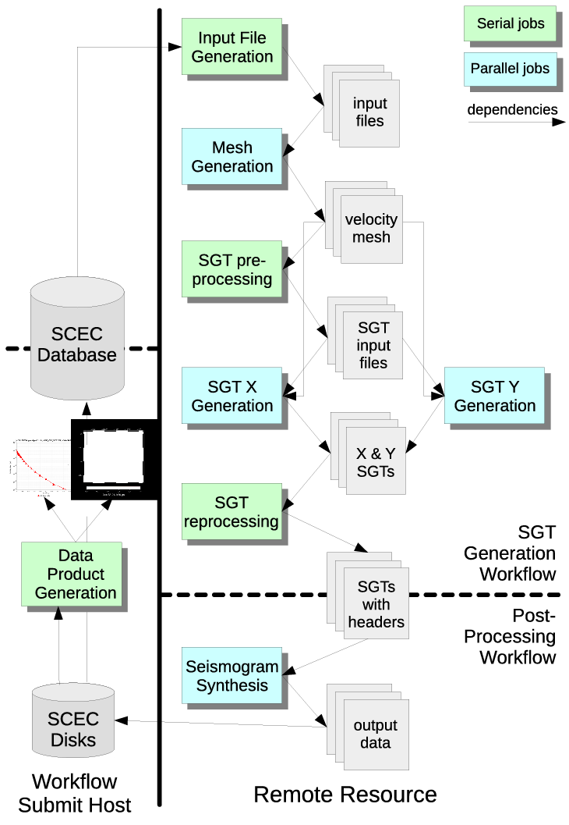
Scientific Workflow Tools
Pegasus-WMS
Use API to create description of workflow
Tasks with dependencies
Input/output files
Plans workflow for execution on specified systems
Adds jobs to manage data
Wraps executables to track metadata
HTCondor
Manages real-time execution of jobs
Submits jobs to remote systems, checks on success
Monitors dependencies
Checkpoints workflow
GridFTP used to transfer data
Schematic of CyberShake workflow

Slide 6
Automated Remote Job Submission
Push-based
When jobs are ready to run, send them over the network to wait in queue
SSH: keys must be accepted on remote system
Globus GRAM: protocol for job submission, requires support on remote system
rvGAHP: daemon on remote system connects to workflow submit host
Can be used on systems with two-factor authentication
Pull-based (“pilot jobs”)
Submit job on remote system first
After job starts up, advertises to workflow submit host
Results in additional overhead
Can take advantage of queue policies
Bin | Node Range | Aging Boost
1 | 11250+ | 15 days
2 | 3750 – 11249 | 5 days
3 | 313 – 3749 | 0
4 | 126 – 312 | 0
5 | 1 – 125 | 0
OLCF Titan Scheduling Policy

Slide 7
Dynamic Workflow Assignment
To accomplish CyberShake study efficiently, must be able to use resources when available
Job throughput on large clusters varies widely
Designed workflow metascheduler to submit workflows
Split workflows into SGT and post-processing
Ability to run each part on separate systems
Are the clusters available for workflows?
Yes
No
Are MAX_WORKFLOWS running?
No
Yes
Select new workflows from workflow queue to submit
Determine number of available workflow slots on clusters
 | BW SGTs | Titan SGTs | Total
BW PP | 444 | 290 | 734
Titan PP | 0 | 135 | 135
Total | 444 | 425 | 869
Create, plan, and run the workflows
Wait 10 minutes
Systems used for SGT and post-processing workflows

Slide 8
Study 18.8 Metrics
Study conducted over 128 days
Consumed 6.2 million node-hours (120M core-hours/13,650 core-years)
Averaged 2,018 nodes / 38,850 cores
Max of 16,219 nodes
Ran 10,308 jobs on Blue Waters (GRAM)
7613 rvGAHP jobs on Titan (20% of compute time), 144 pilot jobs (80%)
1.2 PB of data generated
157 TB of data automatically transferred
14.4 TB of final data products
Synthesized 203 million two-component seismograms
30.4 billion intensity measures

Slide 9
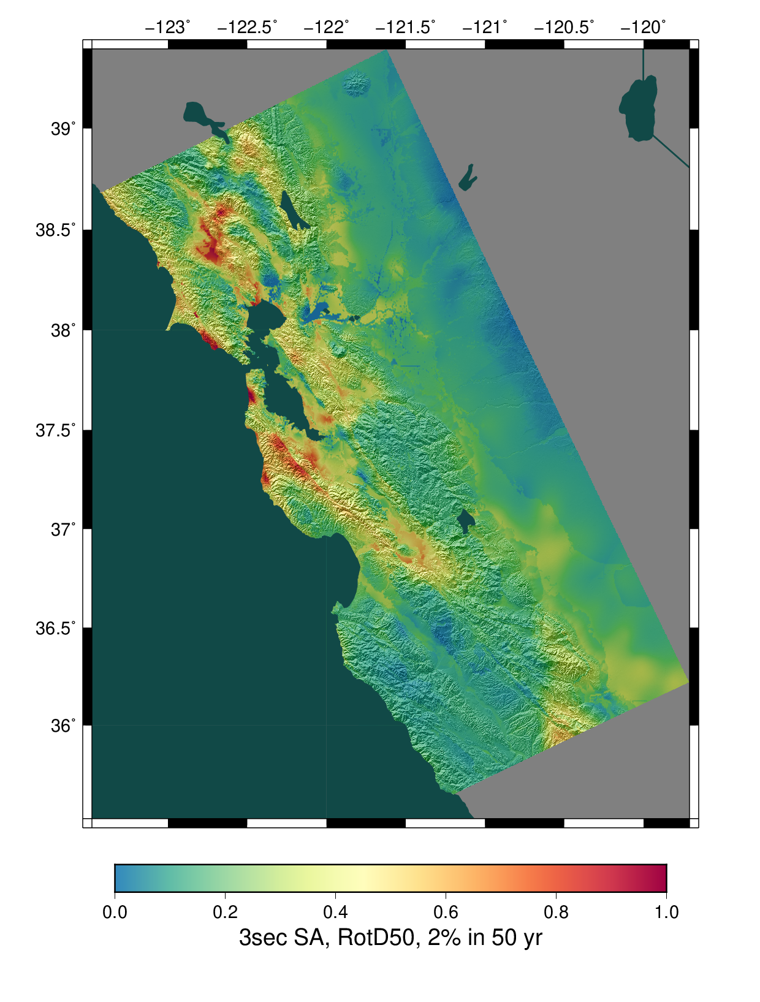
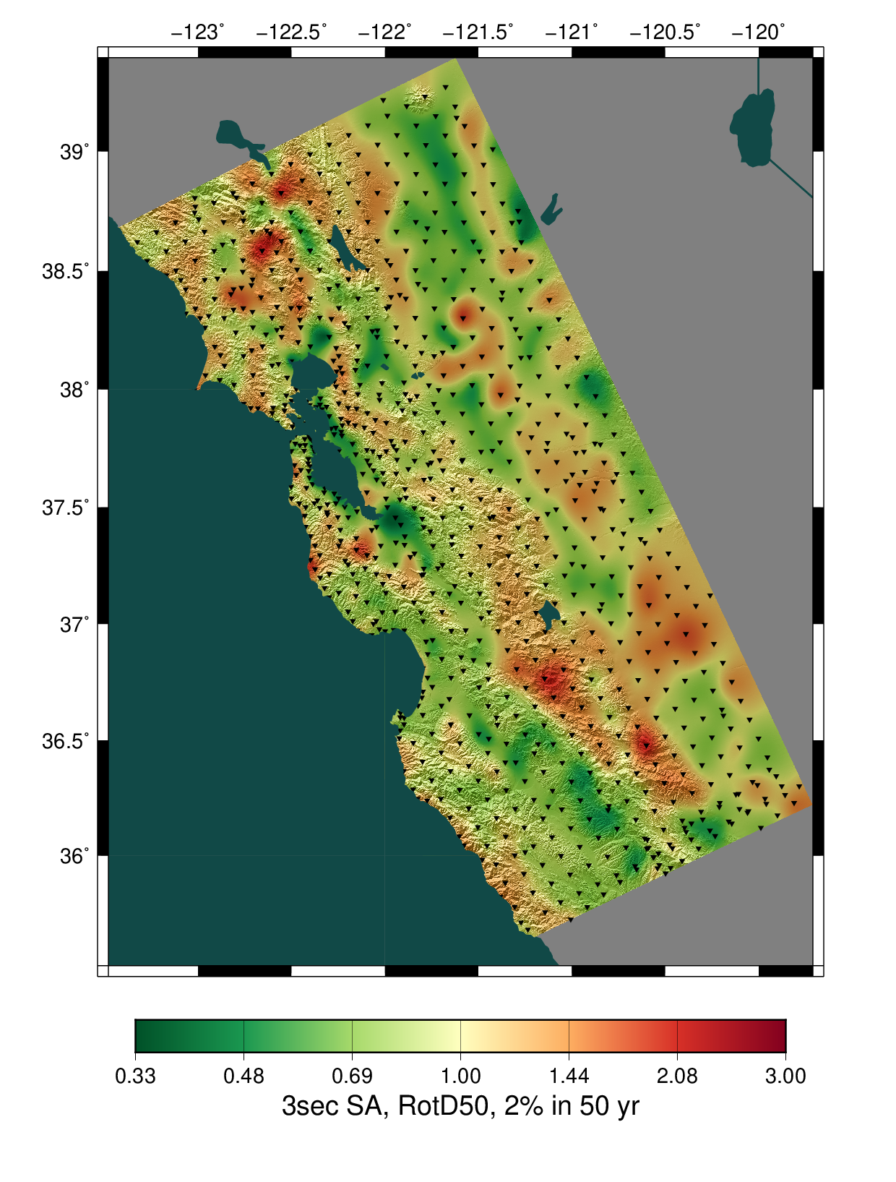
Study 18.8 Results
CyberShake
Ratio of CyberShake/GMPEs
Avg of 4 NGAWest2 GMPEs
Notes:
New systems
DM code
Containerized version

Slide 10
Questions?

