Slide 1
Seismic Hazard Analysis Using Distributed Workflows
Scott Callaghan
Southern California Earthquake Center
University of Southern California
SC15

Slide 2
Outline
Seismic Hazard Analysis
SCEC CyberShake
Overview
Technical Requirements
Scientific Workflows
Advantages of workflow tools
CyberShake Study 15.4
Challenges
Results & Performance
Future Directions

Slide 3
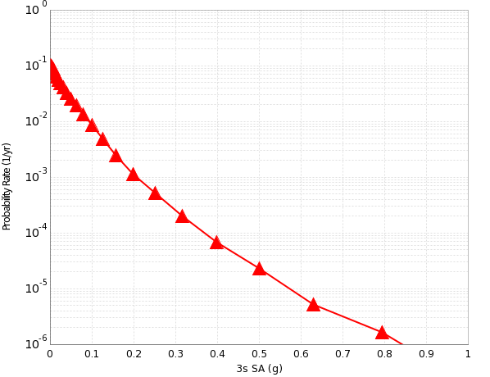
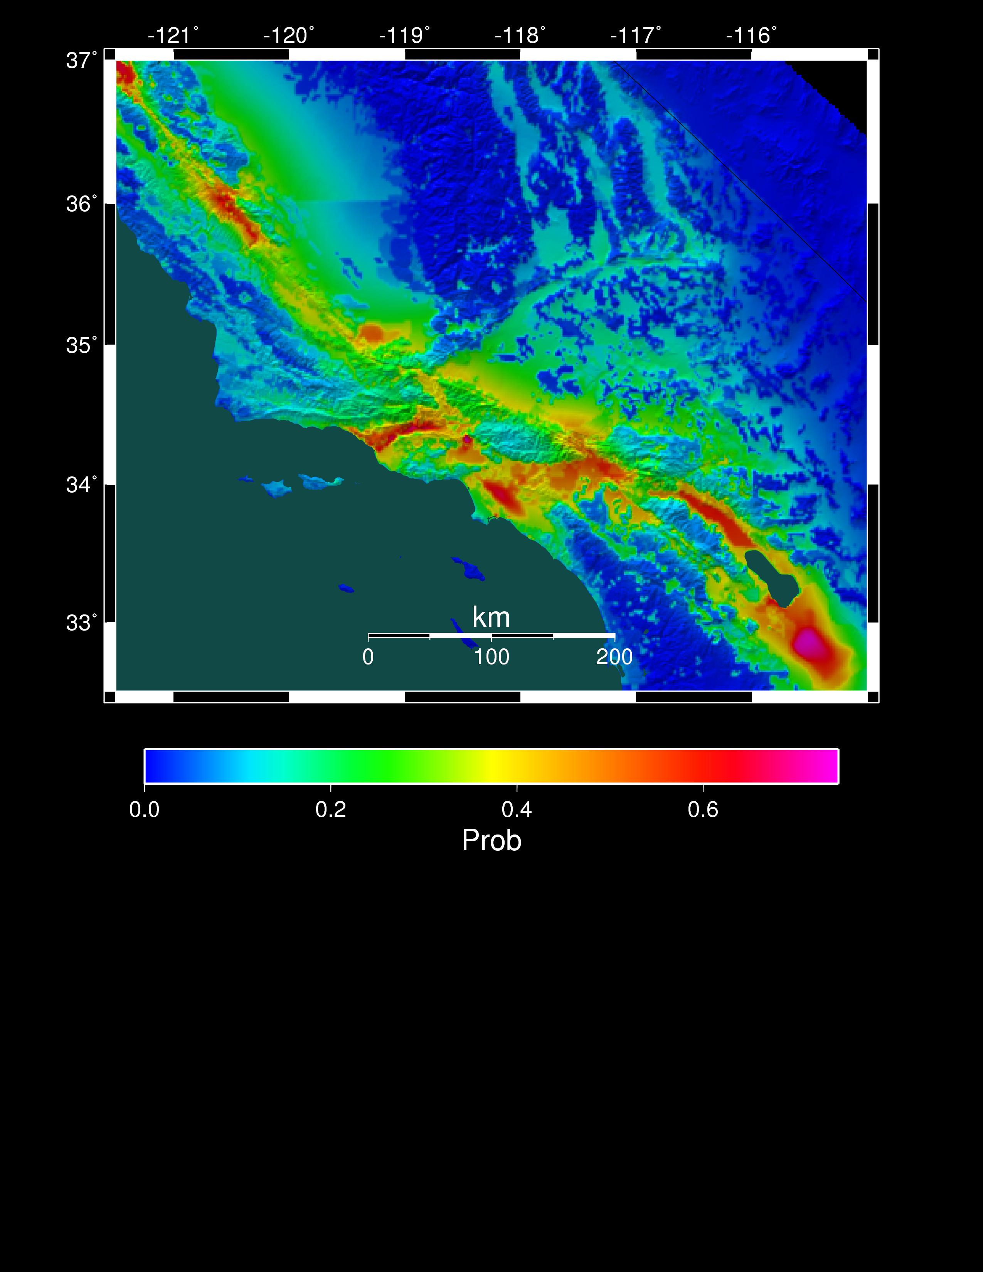
Seismic Hazard Analysis
What will peak ground motion be over the next 50 years?
Used in building codes, insurance, government, planning
Answered via Probabilistic Seismic Hazard Analysis (PSHA)
Communicated with hazard curves and maps
2% in 50 years
0.25 g
Hazard curve for downtown LA
Probability of exceeding 0.1g in 50 yrs

Slide 4
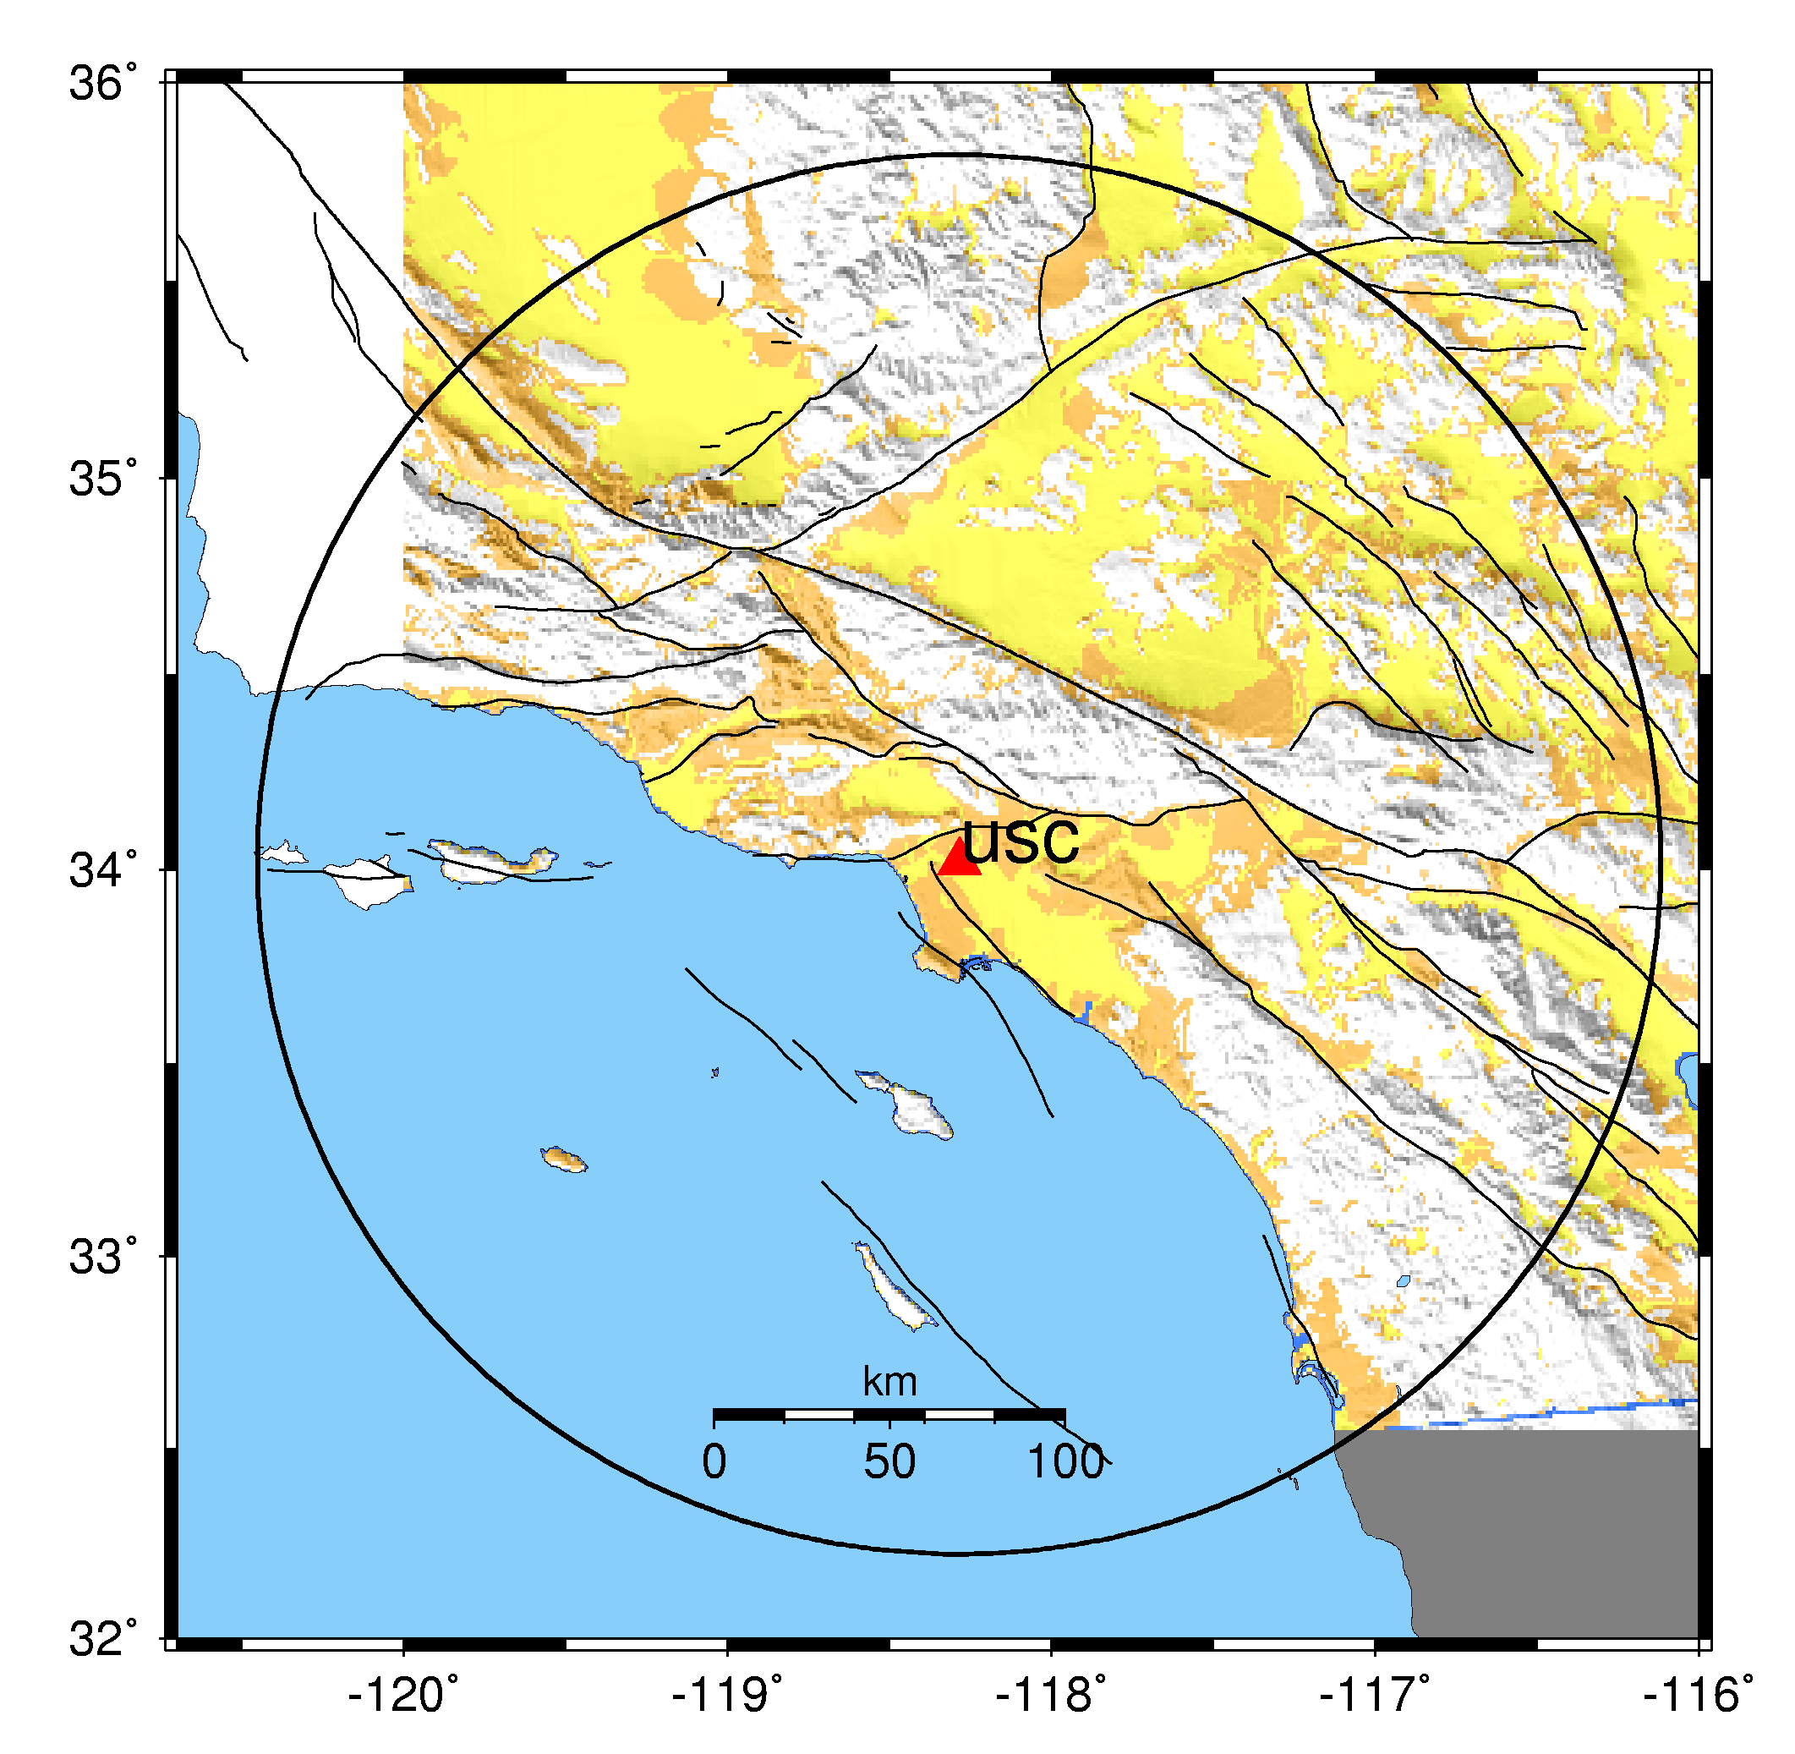
PSHA Process
Pick a location of interest.
Determine what future earthquakes might happen which could affect that location.
Estimate the magnitude and probability for each earthquake.

Slide 5
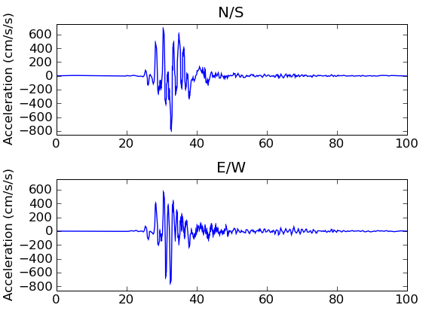
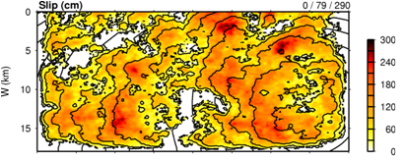
PSHA Process, cont.
4. Determine the shaking caused by each earthquake at the site of interest (we use physics-based simulation)
5. Combine the levels of shaking with the probabilities from (3) to produce a hazard curve.

Slide 6
SCEC CyberShake Project
Physics-based seismic hazard analysis
Began project in 2008
Continuous improvement in realism
Date | Study | Number of sites | Systems
6/08-7/08 | 0.5 | 9 | USC HPC, NCSA Mercury
4/09-6/09 | 1.0 | 223 | USC HPC, TACC Ranger
11/11-3/12 | 1.4 | 46 | USC HPC, TACC Ranger
10/12-3/13 | 2.2 | 268 | USC HPC, NICS Kraken
4/13-6/13 | 13.4 | 1144 | USC HPC, NCSA Blue Waters, TACC Stampede
2/14-3/14 | 14.2 | 1144 | USC HPC, NCSA Blue Waters

Slide 7
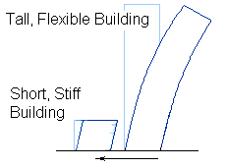
Demand for Higher Frequencies
CyberShake runs to date with f = 0.5 Hz
Buildings most affected by
Frequency = 10 / (height in floors)
Demand by building engineers for higher frequencies
CyberShake advanced to 1 Hz, ~16x computation

Slide 8
Computational Requirements
Component | Data | Executions | Cores/exec | Node-hrs
Mesh generation | 120 GB | 1 | 3840 CPUs | 45
Tensor simulation | 1.5 TB | 2 | 800 GPUs | 1485
Seismogram synthesis (master/worker) | 30 GB | 1 | 3712 CPUs | 1220
Curve generation | 1 MB | 1 | 1 | < 1
Total | 1.6 TB | 5 |  | 2750
Tensor Creation
Post Processing
This is for one location of interest;
want to run many for a hazard map

Slide 9
System Requirements
Need to be able to utilize large HPC systems
2750 node-hrs/site x 300 sites ~ 1M node-hrs
Must have GPUs for tensor calculation
Coordinate jobs across multiple systems
USC HPC
NCSA Blue Waters
OLCF Titan
Data management
Automated for around-the-clock execution
We use scientific workflows

Slide 10
Workflow Tools
We use Pegasus-WMS, HTCondor, Globus stack
Pegasus-WMS (USC/ISI)
Use API to describe workflow as tasks with dependencies
Plan workflow for execution on specific resource
Adds data transfer jobs when needed
Gideon Juve’s talk for more details
HTCondor (U of Wisconsin)
Manages runtime execution of jobs
Globus (U of Chicago/ANL)
GRAM: Protocol for remote job submission
GridFTP: Fast transfer between sites

Slide 11
Why these workflow tools?
Abstract vs. Concrete workflow
Abstract workflow: algorithmic description of tasks with dependencies
Concrete workflow: jobs and files are bound to paths on a specific system
Since abstract workflow is the same between systems, only need to change the mappings for new systems
Data management
Transfer intermediate data between systems
Transfer output data to USC HPC filesystems
Data products registered for discovery

Slide 12
Why these workflow tools? (cont.)
Remote job submission
Need to submit jobs to HPC systems automatically
Interface with HTCondor and GRAM provides that
Pilot jobs for systems which don’t support GRAM
Pegasus-MPI-cluster (PMC)
Tool provided with Pegasus
MPI wrapper around tasks
Master-worker paradigm
Converts many small jobs into 1 large efficient one
Can run entire workflow this way

Slide 13
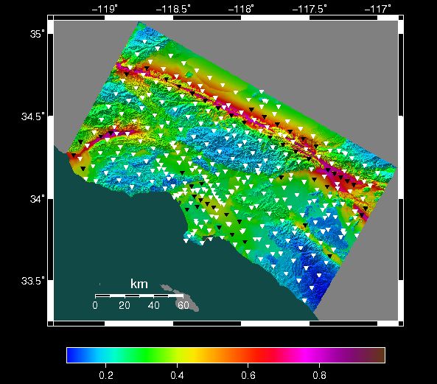
CyberShake Study 15.4
CyberShake Study at 1 Hz
Included new locations, for 336 in total
New, more complex descriptions of earthquakes
Run on
USC HPC
NCSA Blue Waters
OLCF Titan

Slide 14
Workflows on Blue Waters
Want to run both GPU and CPU jobs
22,500 CPU, 4,700 GPU nodes
Support for GRAM job submission
HTCondor on submit host at USC submits jobs to Blue Waters via GRAM
If job fails, retry
Advantages:
All the logic is in the submit host
Little overhead

Slide 15
Workflows on Titan
Want to run GPU jobs
18,700 GPU nodes
No support for GRAM
Use “pilot jobs”:
Daemon on Titan monitors HTCondor queue at USC
When tasks appear, daemon submits pilot job to Titan
When pilot job starts, calls back to HTCondor collector
Work is assigned to pilot job
Must be able to connect to collector from pilot job
Titan scheduler only knows about pilot job, not workflow jobs

Slide 16
Workflows on Titan (cont.)
Used multiple pilot jobs with different sizes, lengths
Can define job type to match with 1 kind of job
Dependencies enforced with qsub
Can vary the number of ‘slots’ (tasks per pilot job)
Balance in runtime between efficiency and failure
Pilot jobs will terminate after idle time
Will terminate at end of runtime, regardless of task
Pilot jobs have complexity and overhead
Can wrap jobs across multiple workflows
Submitted jobs of up to 8000 (43%) nodes

Slide 17
Execution Schematic
USC
Blue Waters
Pegaus workflow description
GRAM
GRAM to PBS
Blue Waters queue
HTCondor queue
Workflow task
HTCondor
Titan
Pilot daemon
Data products task
Titan queue
Pilot job
Transfer
job
Workflow task

Slide 18
Study 15.4 Performance Metrics
Makespan: 914.2 hrs (38.1 days)
1.4 million node-hours
4372 jobs submitted
3933 to Blue Waters via GRAM
439 pilot jobs on Titan
Average of 1,962 nodes, with a max of 17,986 used
20% of Blue Waters, 80% of Titan
On average, 53 workflows running concurrently
Managed 550 TB of data
197 TB transferred from Titan to Blue Waters
9.8 TB staged back to USC HPC disk (~7M files)
36.5% more efficient than 0.5 Hz runs

Slide 19
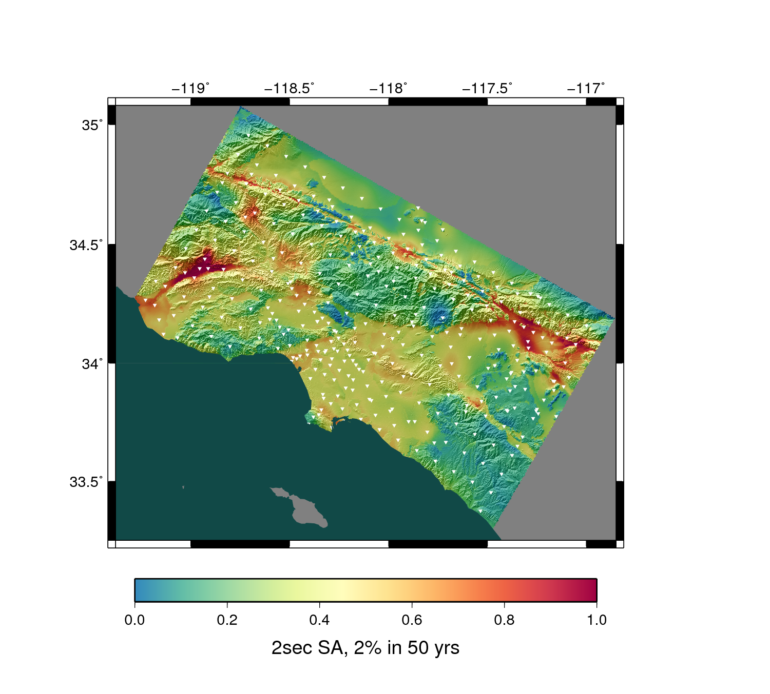
Results
Hazard curves for 336 sites
For each site:
500,000 seismograms
Maximum shaking measures for each seismogram
List of which ruptures contribute the most
Useful dataset for wide-ranging applications

Slide 20
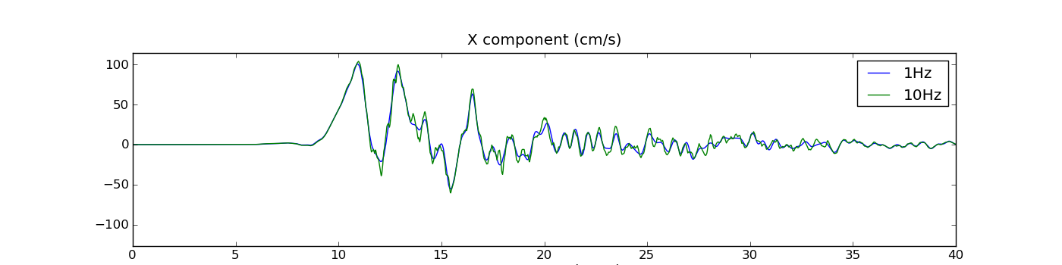
Future Directions: Broadband CyberShake
Building engineers looking for higher frequencies
Prohibitive to simulate to 10 Hz
Use stochastic technique to calculate 1-10 Hz seismograms
Combine with Study 15.4 results
Requires 21,000 additional tasks per site
Runtimes of <1 sec to 30 min
Using Pegasus-mpi-cluster to manage execution

Slide 21
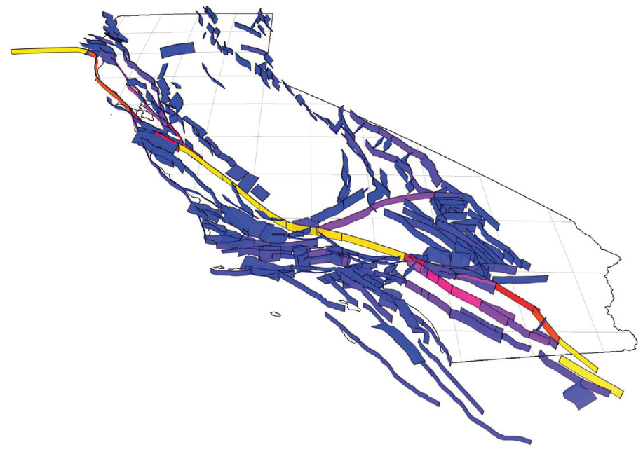
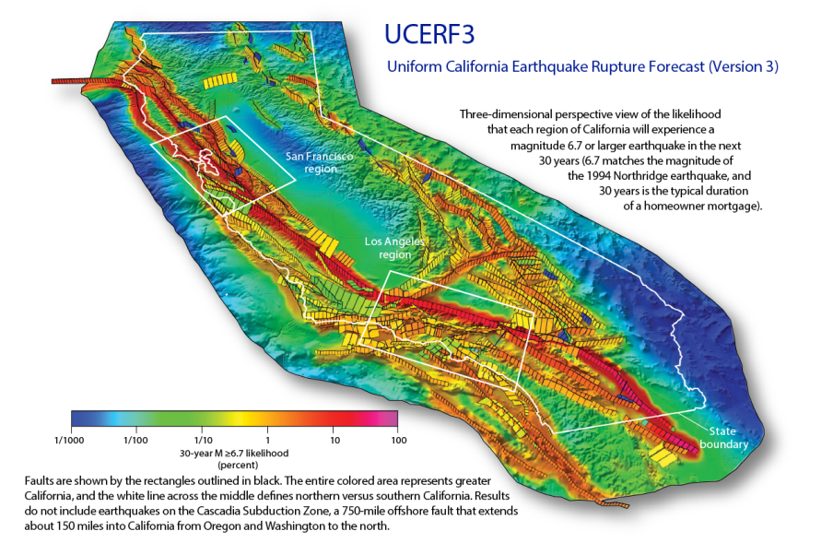
Future Directions
Larger geographic region
Good models exist for the Bay Area
Working to improve models for Central California
New rupture forecast
25x as many earthquakes to consider
Some are very large; may need to approximate
Earthquake forecasting
Use CyberShake ground motions and long-term simulators to make forecasts
Test forecasts in SCEC CSEP testing center

Slide 22
Questions?

