Slide 1
Overview of Scientific Workflows: Why Use Them?
Blue Waters Webinar Series
March 8, 2017
Scott Callaghan
Southern California Earthquake Center
University of Southern California
scottcal@usc.edu

Slide 2
Overview
What are “workflows”?
What elements make up a workflow?
What problems do workflow tools solve?
What should you consider in selecting a tool for your work?
How have workflow tools helped me in my work?
Why should you use workflow tools?

Slide 3
Workflow Definition
Formal way to express a calculation
Multiple tasks with dependencies between them
No limitations on tasks
Short or long
Loosely or tightly coupled
Capture task parameters, input, output
Independence of workflow process and data
Often, run same workflow with different data
You use workflows all the time…

Slide 4
Sample Workflow
#!/bin/bash
1) Stage-in input data to compute environment
scp myself@datastore.com:/data/input.txt /scratch/input.txt
2) Run a serial job with an input and output
bin/pre-processing in=input.txt out=tmp.txt
3) Run a parallel job with the resulting data
mpiexec bin/parallel-job in=tmp.txt out_prefix=output
4) Run a set of independent serial jobs in parallel – scheduling by hand
for i in `seq 0 $np`; do
bin/integrity-check output.$i &
done
5) While those are running, get metadata and run another serial job
ts=`date +%s`
bin/merge prefix=output out=output.$ts
6) Finally, stage results back to permanent storage
scp /scratch/output.$ts myself@datastore.com:/data/output.$ts

Slide 5
Workflow schematic of shell script
input.txt
output.$ts
integrity-check
input.txt
tmp.txt
output.*
pre-processing
parallel-job
stage-in
merge
stage-out
date
output.$ts

Slide 6
Workflow Elements
Task executions with dependencies
Specify a series of tasks to run
Outputs from one task may be inputs for another
Task scheduling
Some tasks may be able to run in parallel with other tasks
Resource provisioning (getting processors)
Computational resources are needed to run jobs on

Slide 7
Workflow Elements (cont.)
Metadata and provenance
When was a task run?
Key parameters and inputs
File management
Input files must be present for task to run
Output files may need to be archived elsewhere

Slide 8
What do we need help with?
Task executions with dependencies
What if something fails in the middle?
Dependencies may be complex
Task scheduling
Minimize execution time while preserving dependencies
May have many tasks to run
Resource provisioning
May want to run across multiple systems
How to match processors to work?

Slide 9
Metadata and provenance
Automatically capture and track
Where did my task run? How long did it take?
What were the inputs and parameters?
What versions of code were used?
File management
Make sure inputs are available for tasks
Archive output data
Automation
You have a workflow already – are there manual steps?

Slide 10
Workflow Tools
Software products designed to help users with workflows
Component to create your workflow
Component to run your workflow
Can support all kinds of workflows
Can run on local machines or large clusters
Use existing code (no changes)
Automate your pipeline
Provide many features and capabilities for flexibility

Slide 11
Problems Workflow Tools Solve
Task execution
Workflow tools will retry and checkpoint if needed
Data management
Stage-in and stage-out data
Ensure data is available for jobs automatically
Task scheduling
Optimal execution on available resources
Metadata
Automatically track runtime, environment, arguments, inputs
Resource provisioning
Whether large parallel jobs or high throughput

Slide 12
Workflow Webinar Schedule
Overview of different workflow tools to help you pick the one best for you
Date | Workflow Tool
March 8 | Overview of Scientific Workflows
March 22 | Makeflow and WorkQueue
April 12 | Computational Data Workflow Mapping
April 26 | Kepler Scientific Workflow System
May 10 | RADICAL-Cybertools
May 24 | Pegasus Workflow Management System
June 14 | Data-flow networks and using the Copernicus workflow system
June 28 | VIKING

Slide 13
How to select a workflow tool
Tools are solving same general problems, but differ in specific approach
A few categories to think about for your work:
Interface: how are workflows constructed?
Workload: what does your workflow look like?
Community: what domains does the tool focus on?
Push vs. Pull: how are resources matched to jobs?
Other points of comparison will emerge

Slide 14
Interface
How does a user construct workflows?
Graphical: like assembling a flow chart
Scripting: use a workflow tool-specific scripting language to describe workflow
API: use a common programming language with a tool-provided API to describe workflow
Which is best depends on your application
Graphical can be unwieldy with many tasks
Scripting and API can require more initial investment
Some tools support multiple approaches

Slide 15
Workload
What kind of workflow are you running?
Many vs. few tasks
Short vs. long
Dynamic vs. static
Loops vs. directed acyclic graph
Different tools are targeted at different workloads

Slide 16
Community
What kinds of applications is the tool designed for?
Some tools focus on certain science fields
Have specific paradigms or task types built-in
Workflow community will share science field
Less useful if not in the field or users of the provided tasks
Some tools are more general
Open-ended, flexible
Less domain-specific community

Slide 17
Push vs. Pull
Challenge: tasks need to run on processors somewhere
Want the approach to be automated
How to get the tasks to run on the processors?
Two primary approaches:
Push: When work is ready, send it to a resource, waiting if necessary
Pull: Gather resources, then find work to put on them
Which is best for you depends on your target system and workload

Slide 18
Push
Remote queue
Workflow scheduler
Task 1
Workflow queue
(1)
. . .
Task is submitted to remote job queue
Remote job starts up on node, runs
Task status is communicated back to workflow scheduler
Task 1
Task 2
Task 3
(2)
. . .
(3)
Task 1
Low overhead: nodes are only running when there is work
Must wait in remote queue for indeterminate time
Requires ability to submit remote jobs

Slide 19
Pull
Workflow scheduler
Pilot job manager
Remote queue
Workflow queue
Pilot job
Pilot job manager submits job to remote queue
Pilot job starts up on node
Pilot job requests work from workflow scheduler
Task runs on pilot job
Task 1
(1)
Task 2
. . .
Task 3
. . .
(3)
(2)
(4)
Pilot job
Task 1
Overhead: pilot jobs may not map well to tasks
Can tailor pilot job size to remote system
More flexible: pilot job manager can run on either system

Slide 20
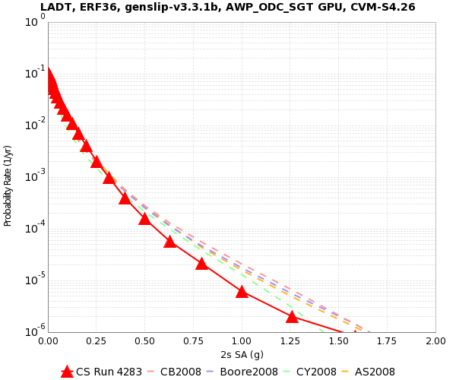
How do workflows help real applications?
Let’s examine a real scientific application
What will the peak seismic ground motion be in the next 50 years?
Building codes, insurance rates, emergency response
Use Probabilistic Seismic Hazard Analysis (PSHA)
Consider 500,000 M6.5+ earthquakes per site
Simulate each earthquake
Combine shaking with probability to create curve
“CyberShake” platform
2% in 50 years
0.4 g

Slide 21
CyberShake Computational Requirements
Large parallel jobs
2 GPU wave propagation jobs, 800 nodes x 1 hour
Total of 1.5 TB output
Small serial jobs
500,000 seismogram calculation jobs
1 core x 4.7 minutes
Total of 30 GB output
Few small pre- and post-processing jobs
Need ~300 sites for hazard map

Slide 22
CyberShake Challenges
Automation
Too much work to run by hand
Data management
Input files need to be moved to the cluster
Output files transferred back for archiving
Resource provisioning
How to move 500,000 small jobs through the cluster efficiently?
Error handling
Detect and recover from basic errors without a human

Slide 23
CyberShake workflow solution
Decided to use Pegasus-WMS
Programmatic workflow description (API)
Supports many types of tasks, no loops
General community running on large clusters
Supports push and pull approaches
Based at USC ISI; excellent support
Use Pegasus API to write workflow description
Plan workflow to run on specific system
Workflow is executed using HTCondor
No modifications to scientific codes

Slide 24
CyberShake solutions
Automation
Workflows enable automated submission of all jobs
Includes generation of all data products
Data management
Pegasus automatically adds jobs to stage files in and out
Could split up our workflows to run on separate machines
Cleans up intermediate data products when not needed

Slide 25
CyberShake solutions, cont.
Resource provisioning
Pegasus uses other tools for remote job submission
Supports both push and pull
Large jobs work well with this approach
How to move small jobs through queue?
Cluster tasks (done by Pegasus)
Tasks are grouped into clusters
Clusters are submitted to remote system to reduce job count
MPI wrapper
Use Pegasus-provided option to wrap tasks in MPI job
Master-worker paradigm

Slide 26
CyberShake solutions, cont.
Error Handling
If errors occur, jobs are automatically retried
If errors continue, workflow runs as much as possible, then writes workflow checkpoint file
Can provide alternate execution systems
Workflow framework makes it easy to add new verification jobs
Check for NaNs, zeros, values out of range
Correct number of files

Slide 27
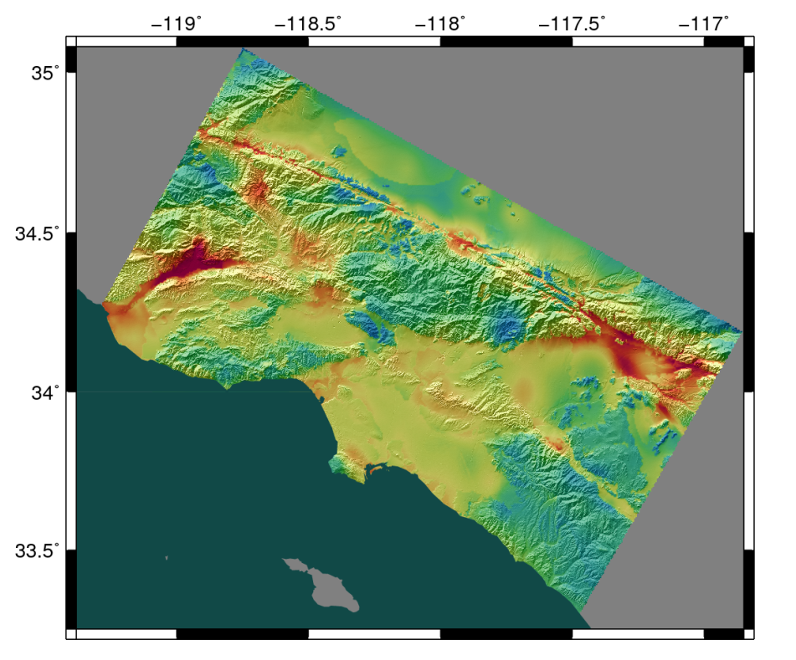
CyberShake scalability
CyberShake run on 9 systems since 2007
First run on 200 cores
Now, running on Blue Waters and OLCF Titan
Average of 55,000 cores for 35 days
Max of 238,000 cores (80% of Titan)
Generated 340 million seismograms
Only ran 4372 jobs
Managed 1.1 PB of data
408 TB transferred
8 TB archived
Workflow tools scale!

Slide 28
Why should you use workflow tools?
Probably using a workflow already
Replace manual steps and polling to monitor
Scales from local system to large clusters
Provides a portable algorithm description independent of data
Workflow tool developers have thought of and resolved problems you haven’t even considered

Slide 29
Thoughts from my workflow experience
Automation is vital
Put everything in the workflow: validation, visualization, publishing, notifications…
It’s worth the initial investment
Having a workflow provides other benefits
Easy to explain process
Simplifies training new people
Move to new machines easily
Workflow tool developers want to help you!

Slide 30
Resources
Blue Waters 2016 workflow workshop: https://sites.google.com/a/illinois.edu/workflows-workshop/home
Makeflow: http://ccl.cse.nd.edu/software/makeflow/
Kepler: https://kepler-project.org/
RADICAL-Cybertools: http://radical-cybertools.github.io/
Pegasus: https://pegasus.isi.edu/
Copernicus: http://copernicus-computing.org/
VIKING: http://viking.sdu.dk/

Slide 31
Questions?

