Slide 1








Simplify Your Science with Workflow Tools
Scott Callaghan (SCEC)
July 12, 2025
2025 IHPCSS
scottcal@usc.edu

Slide 2
I’ve got a problem.
300,000 earthquakes
127 million seismograms
5 million computational tasks
Statewide California Earthquake Center | www.scec.org

Slide 3
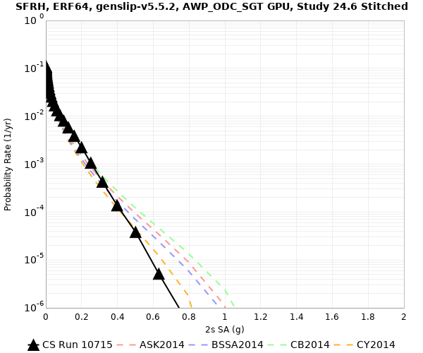
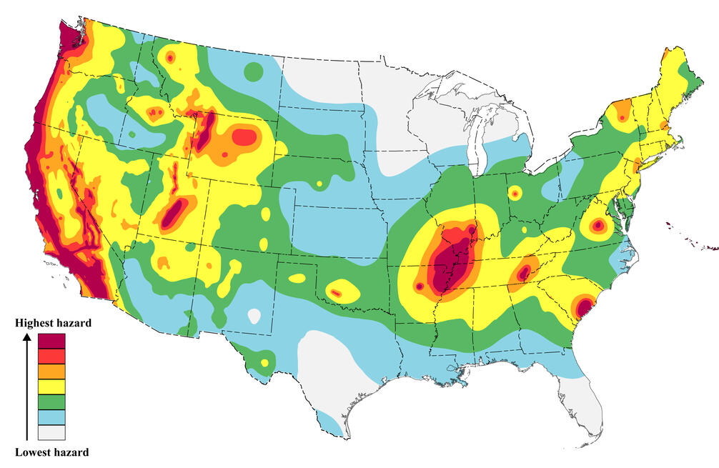
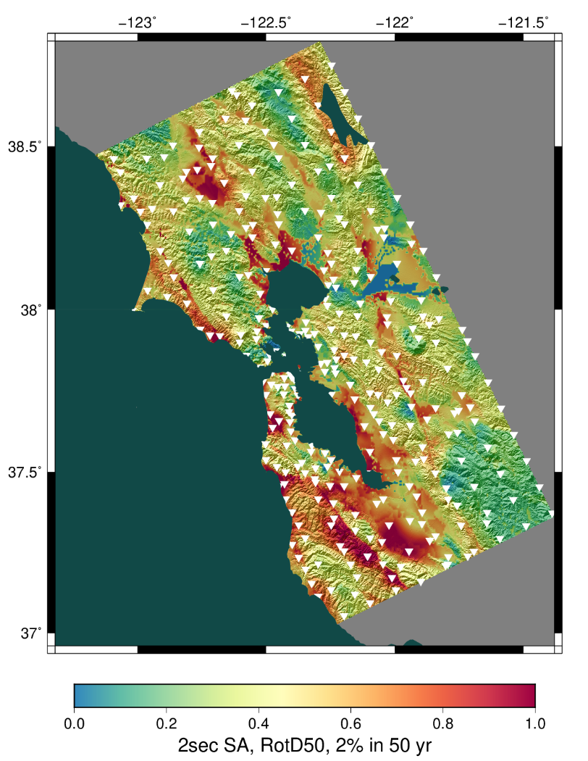
Why am I doing this?
Want to know expected earthquake shaking over the next 50 years
Building codes
Insurance rates
Disaster planning
Interested in Northern California, near San Francisco
Want to use best available science
Run wave propagation simulations of many possible earthquakes
Use shaking information for hazard estimates
Statewide California Earthquake Center | www.scec.org

Slide 4
What are my challenges?
Automation
Too many jobs to run by hand
Data management
Millions of input and output files to track
Job execution
Heterogenous job types (serial, parallel, CPU, GPU)
Millions of tasks
Error recovery
Resiliency to common problems
Statewide California Earthquake Center | www.scec.org

Slide 5
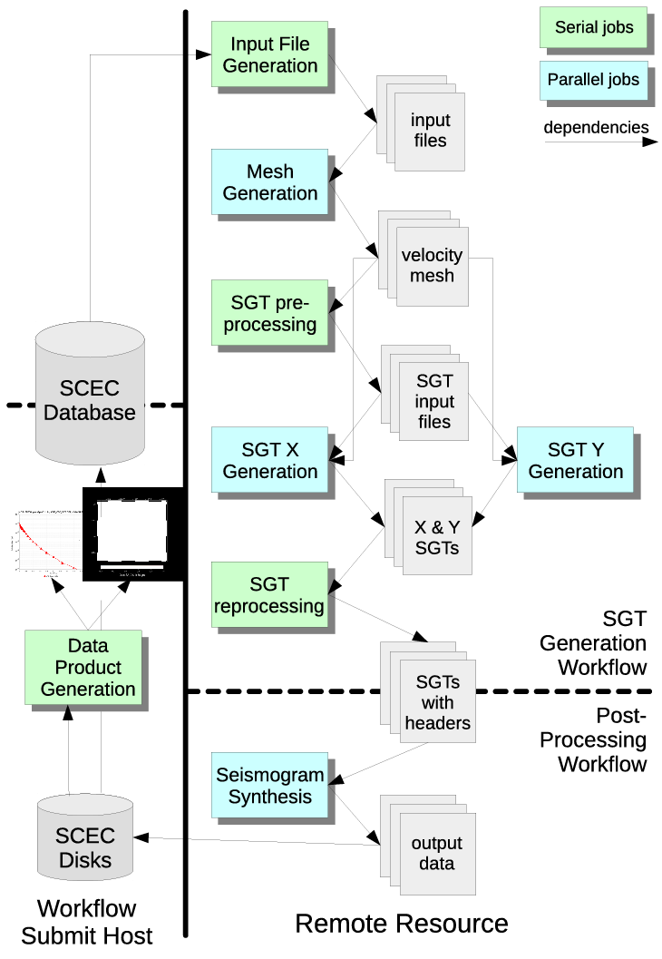
Solution: Scientific Workflows
Decided to use scientific workflows to manage challenges
Selected a pair of open-source tools which work together
Pegasus-WMS
HTCondor
Express tasks as a directed graph of jobs with dependencies
No changes to application codes
Jobs are queued and executed
Statewide California Earthquake Center | www.scec.org

Slide 6
How did workflow tools help?
Automation
Jobs are automatically submitted when ready to run
Workflow tools able to automate jobs with 2FA
Data management
Input and output files are copied automatically
Job execution
Support remote, distributed execution of heterogeneous jobs
Workflow has run on 14 systems since 2007
Error recovery
Failed jobs retried
Workflow checkpointed if jobs keep failing
CPU
GPU
HTC
Scientific codes
task graph
data management
execution
Workflow middleware
cloud
cluster
Compute resources
Statewide California Earthquake Center | www.scec.org

Slide 7
Challenge: Data Management
Millions of data files produced and consumed
Pegasus provides staging
Symlinks files if possible, transfers files if needed
Transfers output back to local archival disk
Supports running parts of workflows on separate systems
Cleans up temporary files when no longer needed
Directory hierarchy to reduce files per directory
We added automated checks for file correctness
Right number of files, NaNs, zero-value checks, correct size
Included as new jobs in workflow
Statewide California Earthquake Center | www.scec.org

Slide 8
Challenge: Job Execution
For large parallel jobs, workflow tools submit to remote scheduler
SSH (or other tool) puts jobs in remote queue
Runs like a normal batch job
Can specify either CPU or GPU nodes
Workflow tools support job bundling
For small serial jobs, need high throughput
Putting lots of jobs in the batch queue is ill-advised
Scheduler isn’t designed for heavy job load
Scheduler cycle is ~5 minutes
Policy limits number of job submissions
Workflow management system
Task 1
Task 2
Task 3
. . .
Workflow submission host
Remote compute resource
. . .
Task 1
. . .
. . .
Remote queue
Statewide California Earthquake Center | www.scec.org

Slide 9
Pegasus-mpi-cluster (PMC)
MPI wrapper around serial or thread-parallel jobs
Manager-worker paradigm
Preserves dependencies
Job is submitted to multiple nodes, starts PMC
Specify jobs as usual, Pegasus does wrapping
Uses intelligent scheduling
Core counts
Memory requirements
Developed for our application
PMC
workflow
manager
workers
Statewide California Earthquake Center | www.scec.org

Slide 10

Recent Results
Completed regional hazard calculation for Northern California
45 days of around-the-clock execution
Used two systems:
55,000 node-hrs (mostly GPU) on Frontier, peak 44%
125,000 node-hrs (all CPU) on Frontera, peak 12%
Workflow tools:
Ran 27,720 jobs
Managed 1.0 PB of data
Staged 350 TB from Frontier to Frontera
Staged 36 TB / 9 M files to long-term storage
Inserted 2.3 billion shaking metrics into local database
Statewide California Earthquake Center | www.scec.org

Slide 11
Your turn!
What bottlenecks are you experiencing in your work that workflow tools might be able to help with?
Take a minute to reflect and come up with a few items.
Now, turn to a neighbor and talk about your bottlenecks with each other.
Who would like to share something smart their partner said?
Statewide California Earthquake Center | www.scec.org

Slide 12
Scientific workflow tools can help!
Mature community of tool developers to improve your efficiency
Describe your workflow as tasks with dependencies between them
“Tasks” are anything you can run on a computer
Separation of process from data
Can run the same workflow with different data
Can run the same workflow on different systems
Provide a variety of features to help address bottlenecks
Statewide California Earthquake Center | www.scec.org

Slide 13
Basic tool concepts
Many workflow tools, but shared concepts between them
Way to represent workflow tasks and their data
Can be specified through API, annotations, GUI
Explicit or implicit data roles
Workflow prepared to run on certain hardware
Schedule and run the workflow, honoring dependencies
May include remote job submission and data transfer
Some tools support interactivity and notebooks
Capture of metadata
User monitors workflow execution
May include error handling and retry provisions
Statewide California Earthquake Center | www.scec.org

Slide 14

NAS report
US National Academy of Sciences commissioned a report on automated research workflows (ARWs) in 2020
“The common goal of researchers implementing ARWs is to accelerate scientific knowledge generation, potentially by orders of magnitude, while achieving greater control and reproducibility in the scientific process.”
“The common goal of researchers implementing ARWs is to accelerate scientific knowledge generation, potentially by orders of magnitude, while achieving greater control and reproducibility in the scientific process.”
“The tools and techniques being developed under the large umbrella of ARWs promise to transform the centuries-old serial method of research investigation... Simultaneously, ARWs provide a way to satisfy pressing demands across fields to increase interoperability, reproducibility, replicability, and trustworthiness by better tracking results, recording data, establishing provenance, and creating more consistent metadata than even the most dedicated researchers can provide themselves.”
“The tools and techniques being developed under the large umbrella of ARWs promise to transform the centuries-old serial method of research investigation... Simultaneously, ARWs provide a way to satisfy pressing demands across fields to increase interoperability, reproducibility, replicability, and trustworthiness by better tracking results, recording data, establishing provenance, and creating more consistent metadata than even the most dedicated researchers can provide themselves.”
Statewide California Earthquake Center | www.scec.org

Slide 15
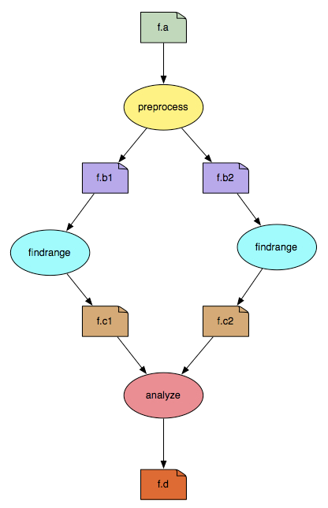
Popular Workflow Tools
Pegasus-WMS (what I use)
Developed at USC’s Information Sciences Institute
Used in many science domains, including LIGO project
Workflows are executed from local machine
Jobs can run on local machine or on distributed resources
You use API to write code describing workflow
Python (recommended), R, or Java
Define tasks with parent / child relationships
Describe files and their roles
Pegasus creates YAML file describing workflow
Workflow represented by directed acyclic graph
Statewide California Earthquake Center | www.scec.org

Slide 16


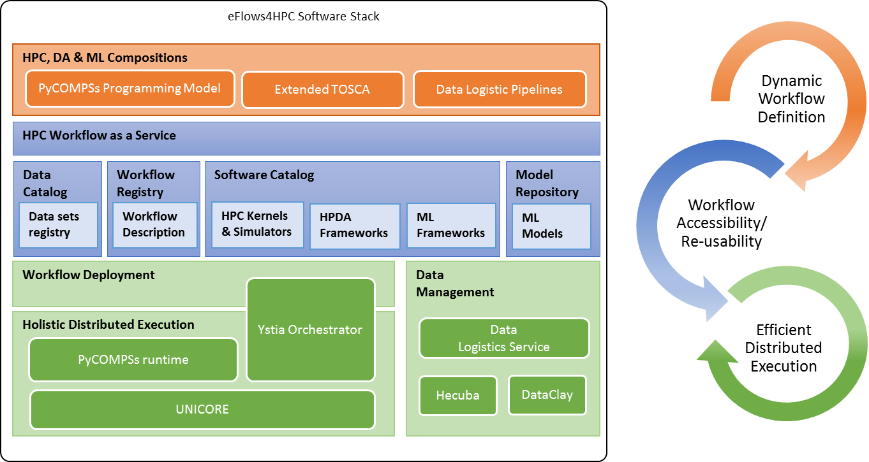
Popular Workflow Tools
(U of Chicago/Argonne NL)
Parallelize Python by annotating functions or external apps
Integrated with Jupyter notebooks
Link outputs and inputs of annotations to describe workflow
Focus on large data, many tasks
eFlows4HPC (BSC)
Workflow platform integrating different workflow software elements
PyCOMPS responsible for runtime
Workflows-as-a-service paradigm
@bash_app
def mysim(stdout=("output/p1.out", "w"), stderr=("output/p1.err", "w")):
#Call a bash command-line app ‘simulate’
return "app/simulate"
# call the mysim app and wait for the result
mysim().result()
# open the output file and read the result
with open('output/p1.out', 'r') as f:
print(f.read())
Statewide California Earthquake Center | www.scec.org

Slide 17

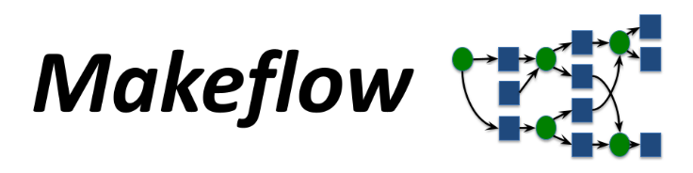

Popular Workflow Tools
Snakemake (international; most maintainers in Europe)
Create “rules” in Pythonish language describing how to create outputs from inputs
Good integration with Conda and containers
Support for dynamic workflows
Makeflow (Notre Dame)
Makefile-type syntax to specify workflow
Targets are output files, dependent on input files, with execution string to run
Can work with Work Queue for management of compute resources (workers)
Multiple clusters, pilot jobs, dynamic worker pool
Nextflow (Seqera Labs in Barcelona, but open source)
Uses dataflow paradigm: tasks write/read from channels (not always a file), can be piped
Custom scripting language for defining workflows
Integrates well with containers
Many more! Ask me about specific use cases
Statewide California Earthquake Center | www.scec.org

Slide 18
But what about Python scripts?
You can reproduce some features with custom scripts
Cluster scheduler supports basic features
Can enforce job dependencies
Email notifications when complete
Can check exit status and retry on failure
Copy files in and out when required
Statewide California Earthquake Center | www.scec.org

Slide 19
What approach should you use?
What are some pros and cons of using an established tool or custom scripts?
Statewide California Earthquake Center | www.scec.org

Slide 20
What did we learn?
Workflow tools exist!
Designed to resolve bottlenecks and improve your efficiency
Work with any computational tasks
No changes required to application codes
Help manage jobs, files, and metadata
Separate process from data
Distributed execution
Migrate workflow to new systems
Easy to explain your process to new users
Statewide California Earthquake Center | www.scec.org

Slide 21
Closing Thoughts
Automation is vital, even without workflow tools
Eliminate human polling
Get everything to run automatically if successful
Be able to recover from common errors
Put ALL processing steps in the workflow
Include validation, visualization, publishing, notifications
Avoid premature optimization
Consider new, larger, compute environments (dream big!)
Larger clusters, clouds
Tool developers want to help you!
Statewide California Earthquake Center | www.scec.org

Slide 22
Links
SCEC: http://www.scec.org
Pegasus: http://pegasus.isi.edu
Pegasus-mpi-cluster: http://pegasus.isi.edu/wms/docs/latest/cli-pegasus-mpi-cluster.php
HTCondor: http://www.cs.wisc.edu/htcondor/
Parsl: https://parsl-project.org/
eFlows4HPC: https://eflows4hpc.eu/
pyComps: https://eflows4hpc.readthedocs.io/en/latest/Sections/01_Software_Stack/02_Runtime_Components/COMPSs.html
Snakemake: https://snakemake.github.io/
Makeflow: http://ccl.cse.nd.edu/software/makeflow/
Work Queue: http://ccl.cse.nd.edu/software/workqueue/
Nextflow: https://www.nextflow.io/
CyberShake (my project): https://www.scec.org/software/cybershake
Statewide California Earthquake Center | www.scec.org

Slide 23

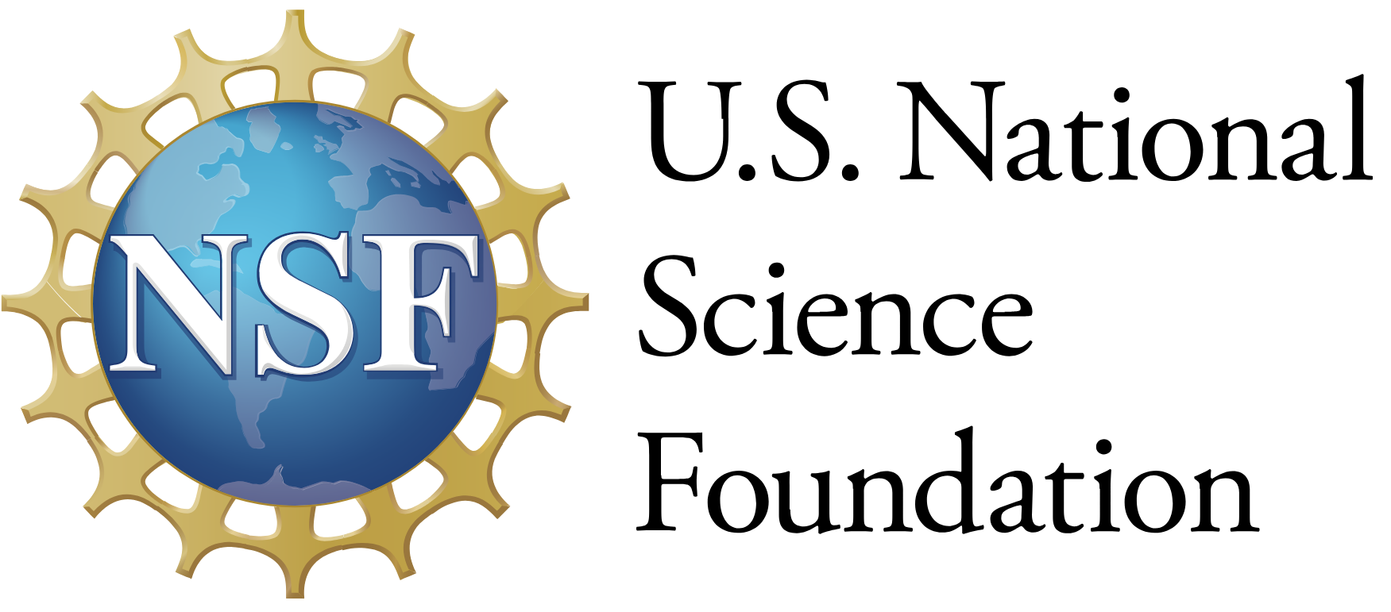




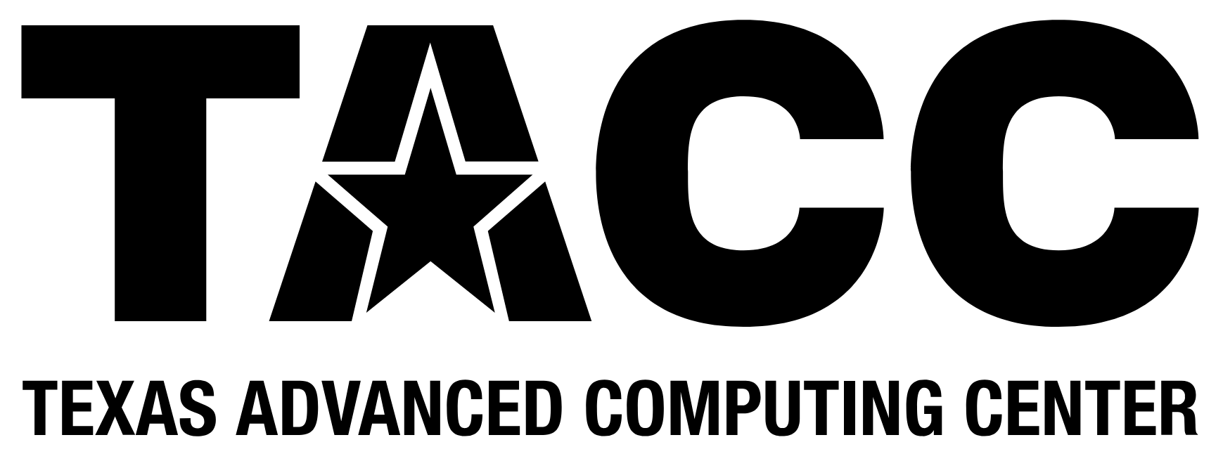



Thanks!
Statewide California Earthquake Center | www.scec.org

