Slide 1
SCEC CyberShake Data Access Training
Scott Callaghan & the CyberShake Collaboration
scottcal@usc.edu
CyberTraining for Seismology 2023
Thursday, May 11, 2023

Slide 2
Outline for today’s training
Overview of the CyberShake platform
Available CyberShake data products
Overview of data access tool
Hands-on training with CyberShake data access tool
Requires Docker
Docker setup instructions
If you have questions, please ask!
HPS Slack
scottcal@usc.edu

Slide 3
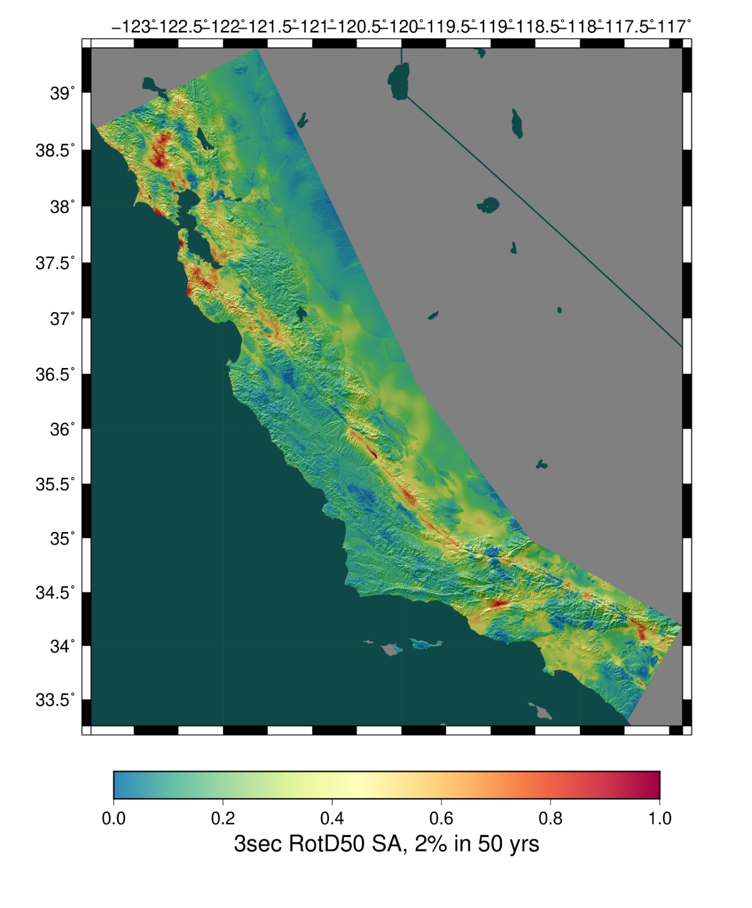
CyberShake Overview
SCEC’s 3D physics-based probabilistic seismic hazard analysis (PSHA) platform
Alternative to using ground motion models (GMMs) to perform PSHA
Simulates large suites of events to determine ground motions at a site
~625,000 events per site
Calculations performed at hundreds of sites for regional hazard
Today, discussing newest CyberShake results for Southern California

Slide 4
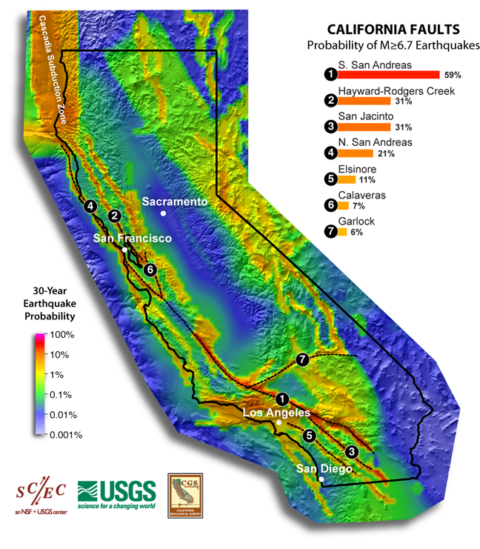
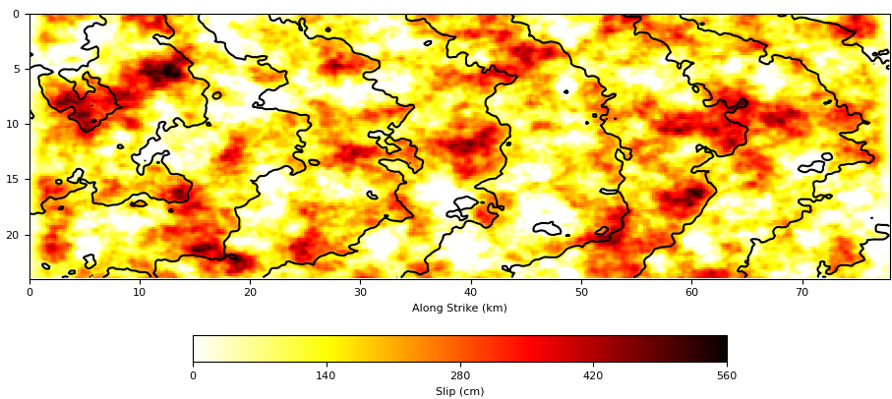
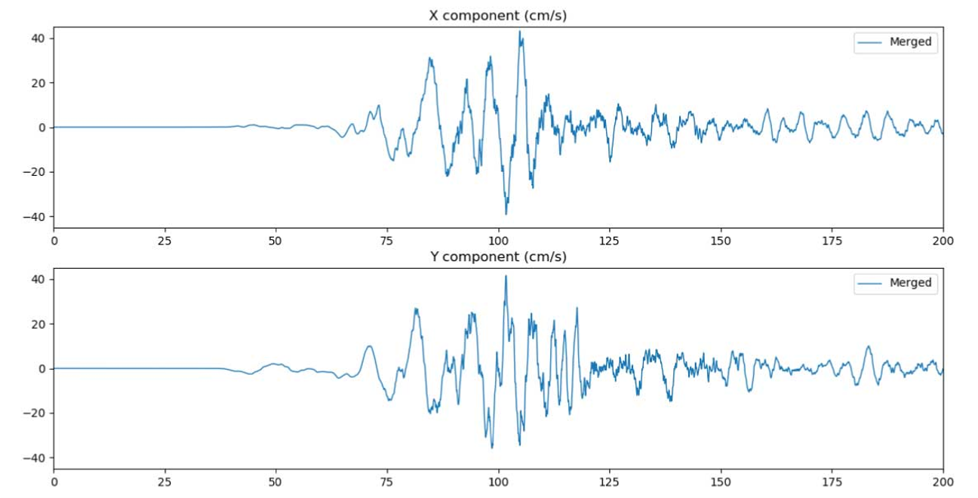
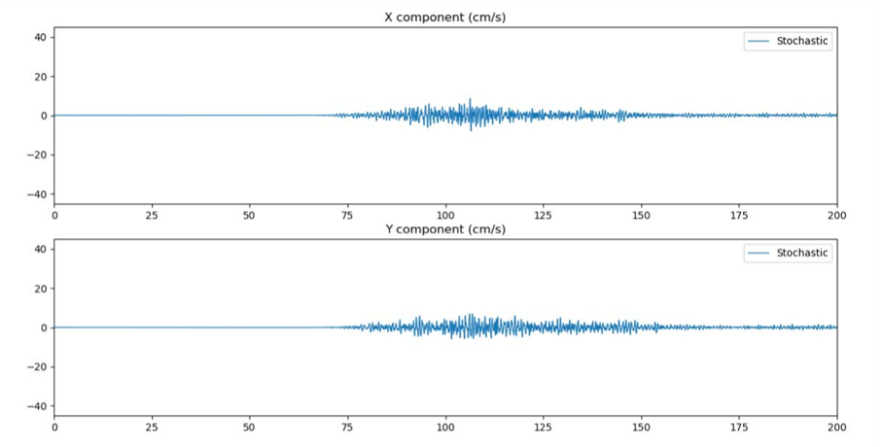
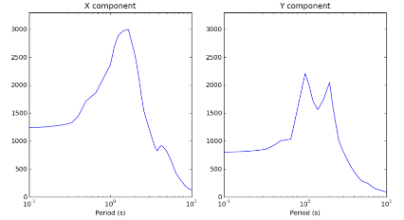
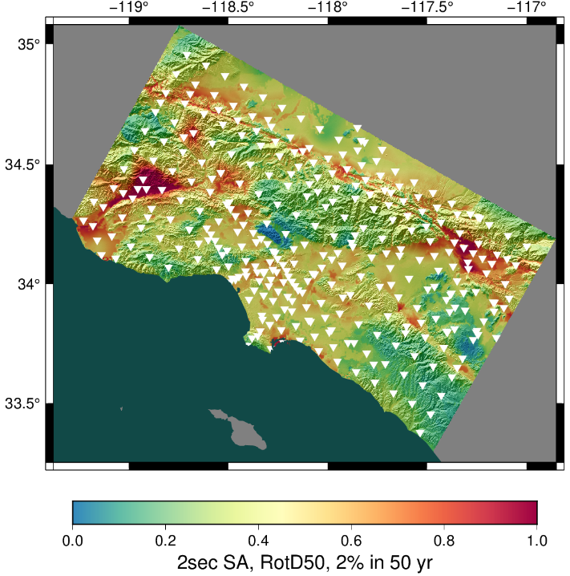
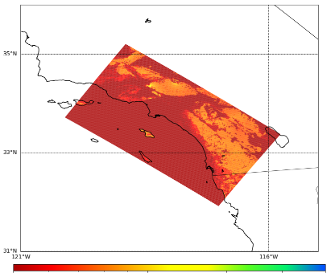
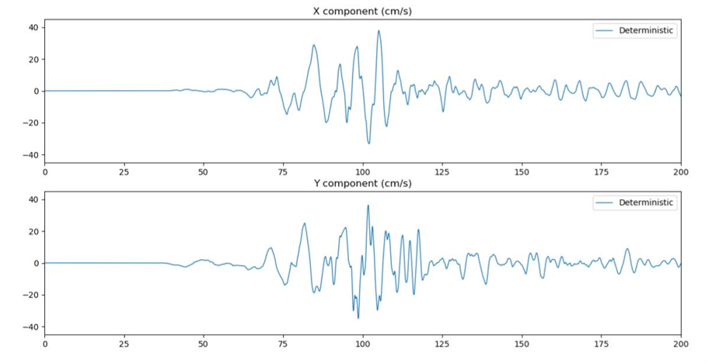
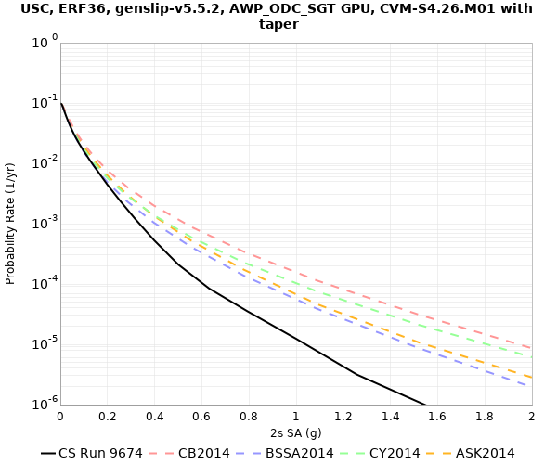
Broadband CyberShake
Low-frequency CyberShake
Graves & Pitarka kinematic rupture generator
High-frequency seismogram synthesis (BBP)
Merge and combine
Events
0-50 Hz broadband seismograms
Uniform California Earthquake Rupture Forecast
1-50 Hz seismograms
RotD50, PGA, PGV
AWP-ODC-SGT wave propagation
Low-frequency seismogram synthesis
Intensity measures
Aggregate data products
UCVM
0-1 Hz low-frequency seismograms
RotD50, PGA, PGV
Velocity Mesh
Hazard Curve
Hazard Map

Slide 5
Key CyberShake terms
“Model”: Set of CyberShake data products produced using the same set of parameters (3D velocity model, ERF, rupture generator, etc.)
Today, accessing data from most recent models, produced with Study 22.12
“Site”: location for which CyberShake results are calculated
335 sites in Southern California
“Seismogram”: velocity (cm/s), two-component
Study 22.12 produced about 420 million seismograms
“Event”: single earthquake derived from UCERF2 ERF with unique hypocenter and slip distribution
Identified through the combination of (source ID, rupture ID, rupture variation ID)
Approximately 719,000 total events in this study
Assigned a 'source name' from UCERF2

Slide 6
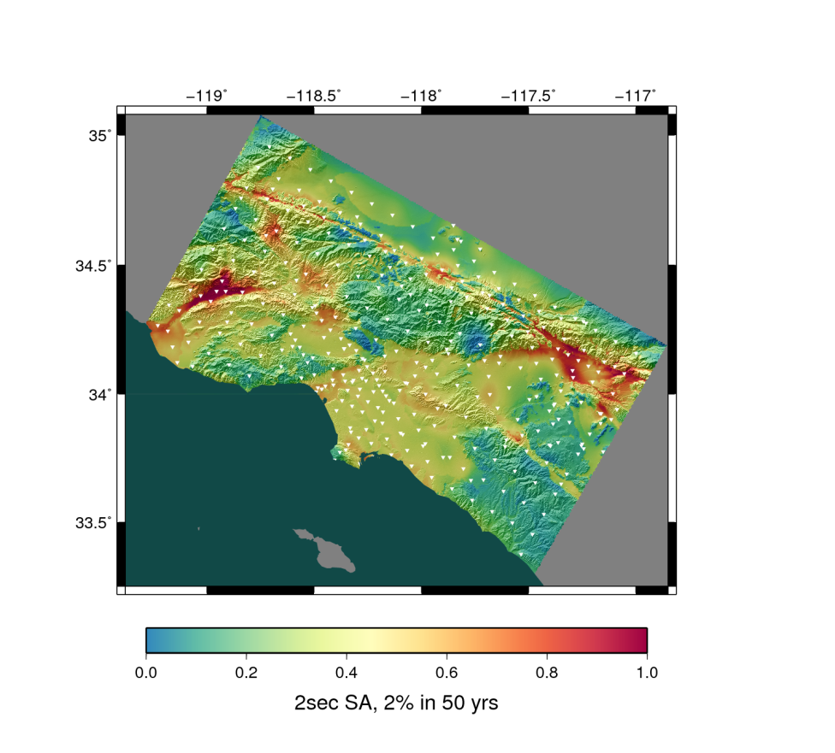
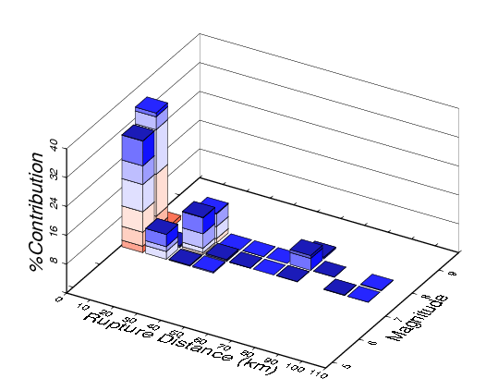
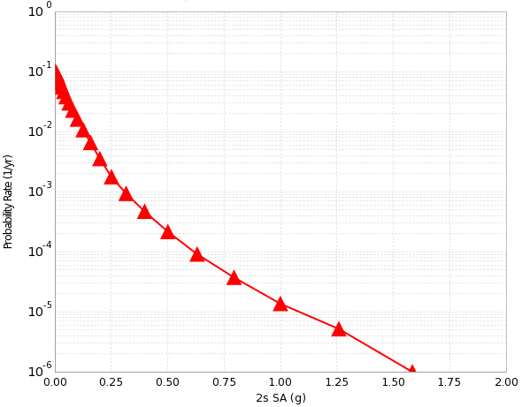
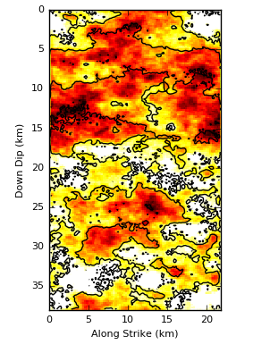
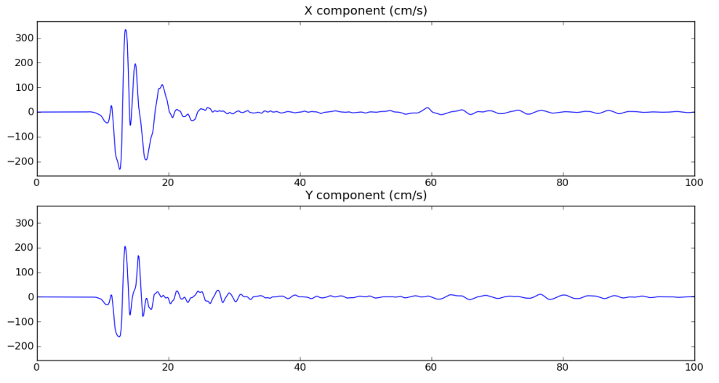
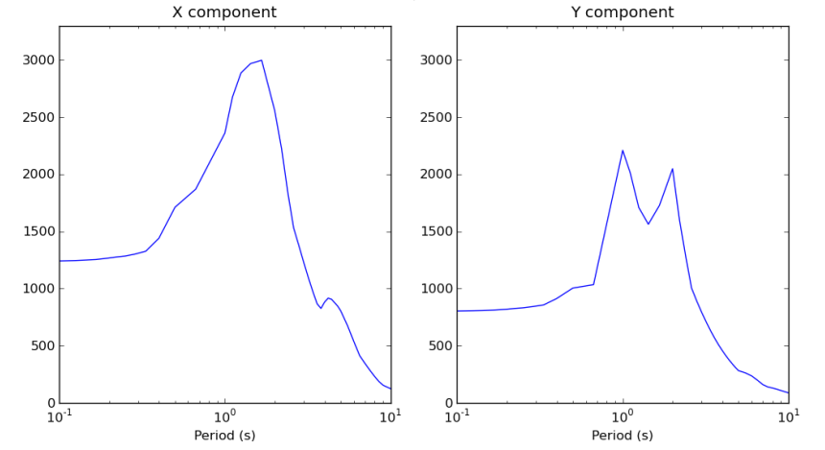
CyberShake Data Layers
Hazard Map
Hazard Curve
Disaggregation
Intensity Measures
Seismograms
Events

Slide 7
CyberShake Data Products
Hazard Maps
Available through SCECpedia page for the study (https://strike.scec.org/scecpedia/CyberShake_Study_22.12#Data_Products)
Seismograms
Available through CS Data Access tool (files retrieved from Globus share at USC)
Intensity Measures
Available through CS Data Access tool (data retrieved from CyberShake database)
Metadata
Site locations
Event magnitudes, probabilities, fault names
Available through CS Data Access tool (data retrieved from CyberShake database)

Slide 8
CyberShake data access tool
Pure Python interactive command-line tool
Enables user to specify what data they want
User is expected to interactively provide the following information:
Model – which CyberShake hazard model should the data be retrieved from?
Study 22.12 LF (Low-Frequency)
Study 22.12 BB (BroadBand)
Data Product – what data product should be retrieved?
Site information
Intensity measures
Seismograms
Event information
Filters – what filter(s) should be applied so that only the data of interest is retrieved?
Site, intensity measure period, intensity measure amplitude, source-site distance, event parameters
These filters are inclusive – you specify what data you want and everything else is excluded

Slide 9
How the tool works
CS Data Access performs the following steps:
Asks the user what model, data product, and filters they want, with optional sort
Performs the required database queries to retrieve data and metadata
Metadata is retrieved to a file on local storage
If seismograms are requested, seismograms are downloaded to local storage
Tool will notify the user of how much data will be downloaded
Entire Study 22.12 LF + BB results are ~70 TB
Editable parameter limiting amount of data to download
Bulk seismograms downloaded to temp storage, then extracted and cleaned up
In addition to data products, tool produces files describing the request
Helpful for remembering what you looked for!

Slide 10
Metadata format
Metadata retrieved from a relational database
Like a spreadsheet – columns with headers, rows with information
Metadata delivered in the following formats (user option):
CSV file – can read with spreadsheet application or write your own script
SQLite database – can read with SQLite application or through Python
Since metadata comes from a database, queries with many filters which return lots of data can take a long time (15+ minutes)
Tool doesn't currently predict how long a query will take
Can Ctrl-C to end a long-running query

Slide 11
Seismogram format
Seismograms are in CyberShake seismogram format
Documentation is available here: https://strike.scec.org/scecpedia/Accessing_CyberShake_Seismograms#Seismogram_Format
Seismograms are binary format and consist of a header followed by data
Header:
Information about site, event id, dt, nt
Sample C and Python code to read the header is here: https://strike.scec.org/scecpedia/CyberShake_output_data_headers#Seismogram_header
Data
X component followed by Y
NT 4-byte floats
Sample code to read the data is available here: https://strike.scec.org/scecpedia/Accessing_CyberShake_Seismograms#Seismogram_Format

Slide 12
Hands-on Tutorial
Before we start – any questions so far?

