Slide 1
SCEC CyberShake Study 22.12 Methods, Results, and Plans
Scott Callaghan
SCEC Staff Meeting
Thursday, December 7, 2023

Slide 2
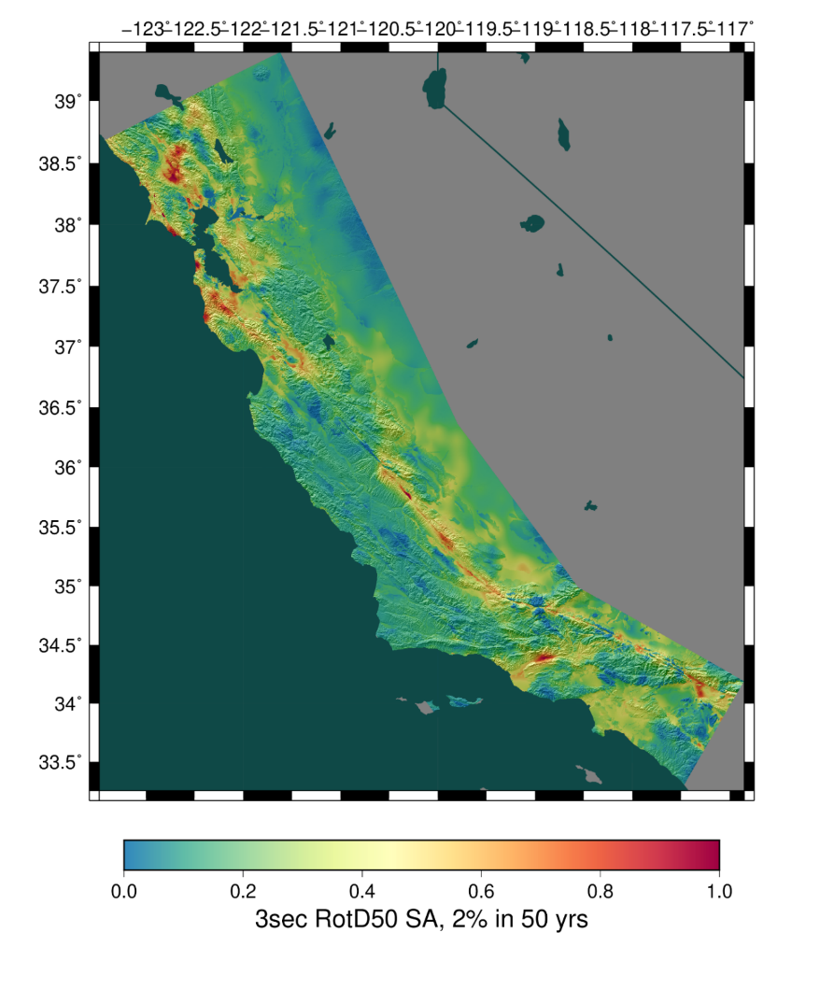
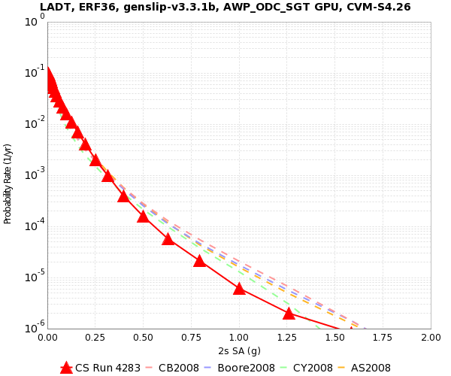
What is CyberShake, again?
SCEC’s 3D physics-based probabilistic seismic hazard analysis (PSHA) platform
Pick a location of interest.
Get a list of all possible earthquakes from an earthquake rupture forecast that might affect the site, along with their probabilities.
Calculate the amount of shaking each earthquake would cause at the location, by running simulations.
Combine the shaking values with probabilities to produce a hazard curve.
2% in 50 yrs
0.4g

Slide 3
What is a CyberShake Study?
CyberShake goes through cycles, usually lasting 1-2 years
A study produces a new hazard model for hundreds of sites
Identify new science goals
Analyze results
Add new codes and models
Perform regional hazard study
Verify and validate changes

Slide 4
New Features in CyberShake Study 22.12
Update to previous Southern California Studies (15.4 and 15.12)
Broadband simulations (up to 25 Hz)
Wave propagation simulations for 0-1 Hz
Code from Broadband Platform for 1-25 Hz
Validated against historic events
Modifications to 3D velocity model
To resolve issues with high velocities at the surface
Updates to rupture generation for individual events
Migration to more recent rupture code
Sampling of additional variability

Slide 5
Broadband Validation
Selected validation events from the SCEC Broadband Platform
Northridge, Whittier, Chino Hills, Landers
64 realizations created for each event
Hypocenter and magnitude preserved
Different slip realizations
CyberShake workflows run for sites with recordings in BBP
Usually ~40 stations per event
Calculate goodness-of-fit metrics using the BBP
3 slip realizations for 1994 Northridge

Slide 6
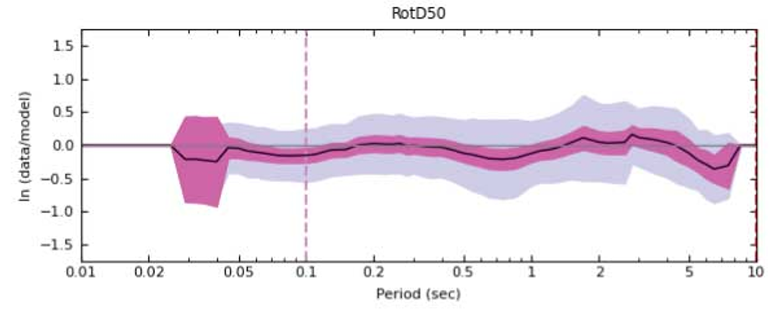
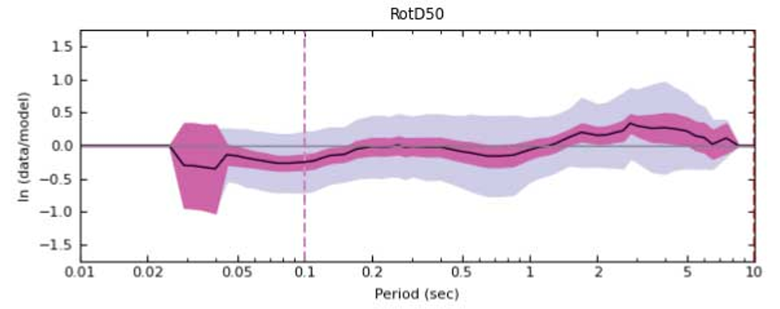
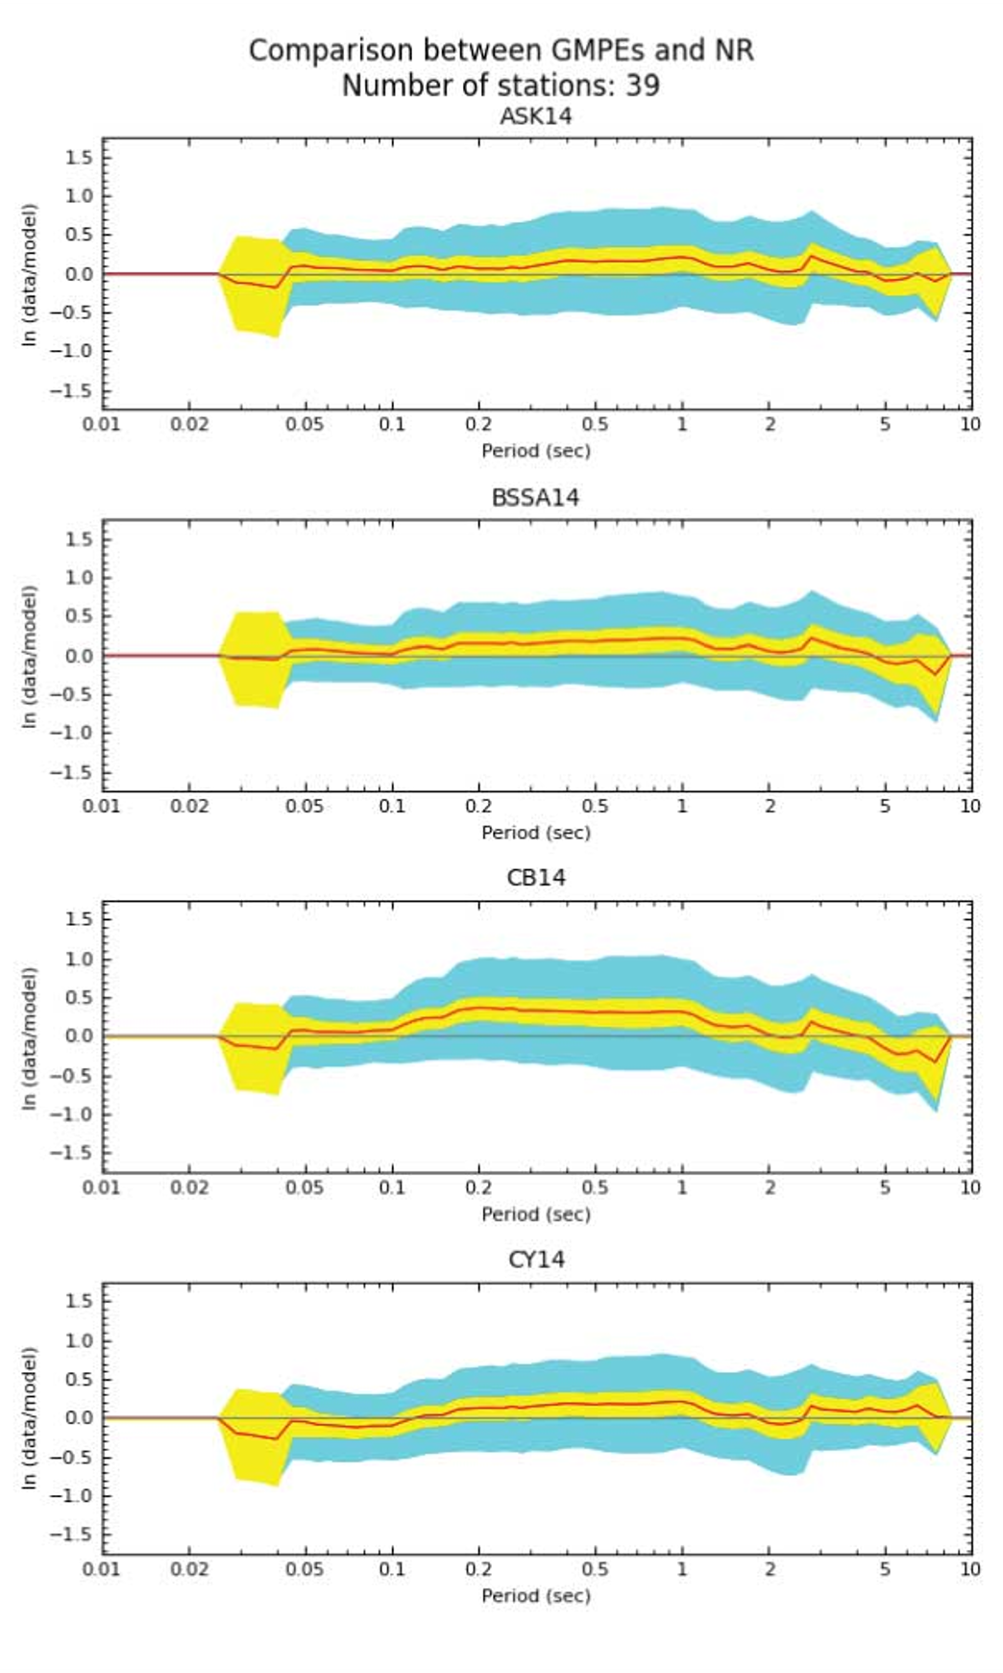
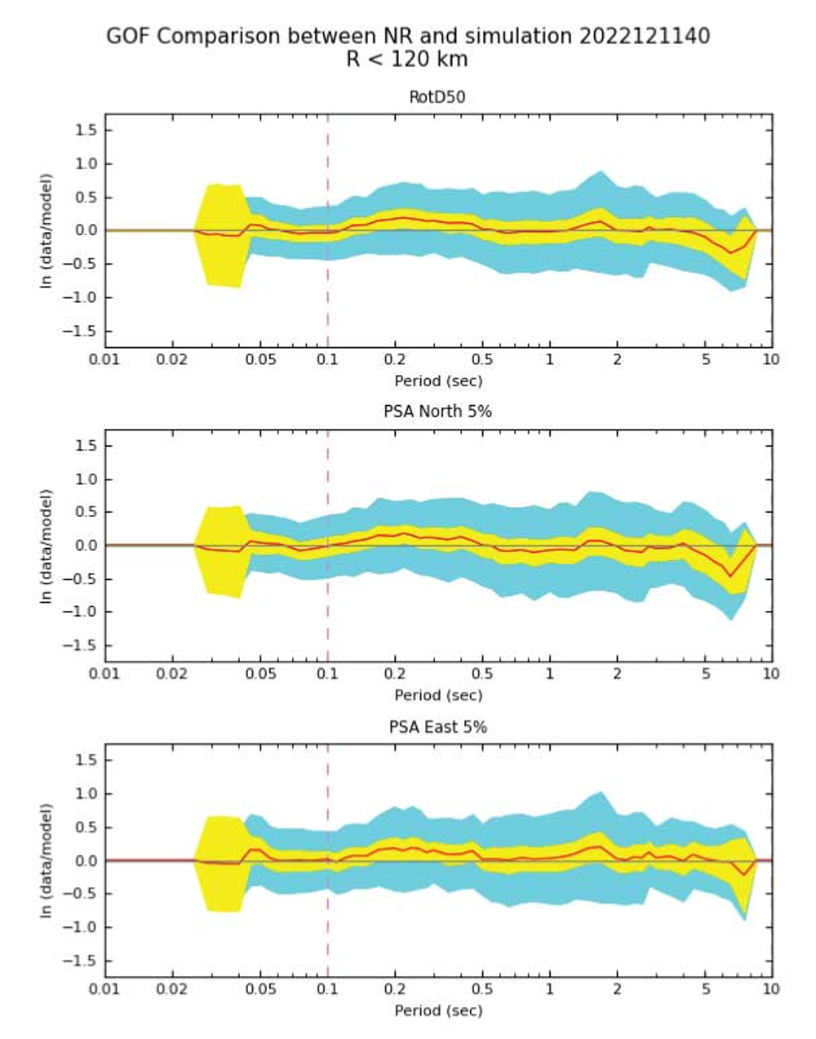
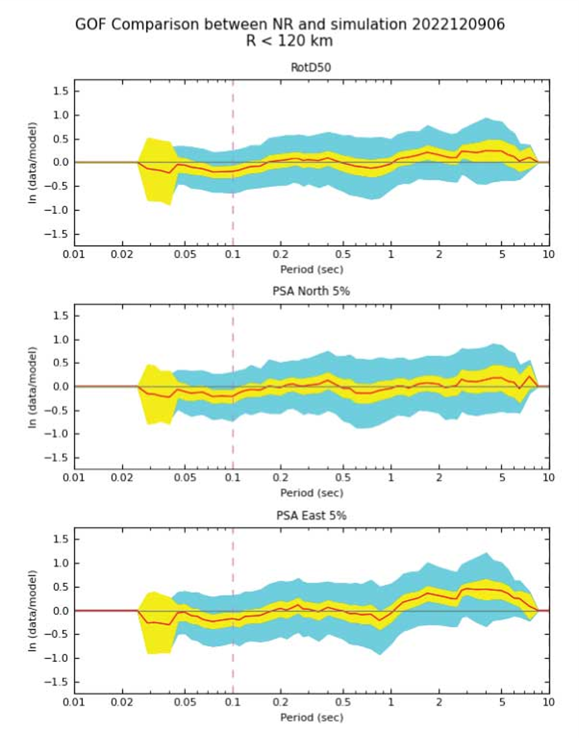
Northridge
3D CyberShake
1D BBP
GMMs
Overall GoF
Best Realization

Slide 7
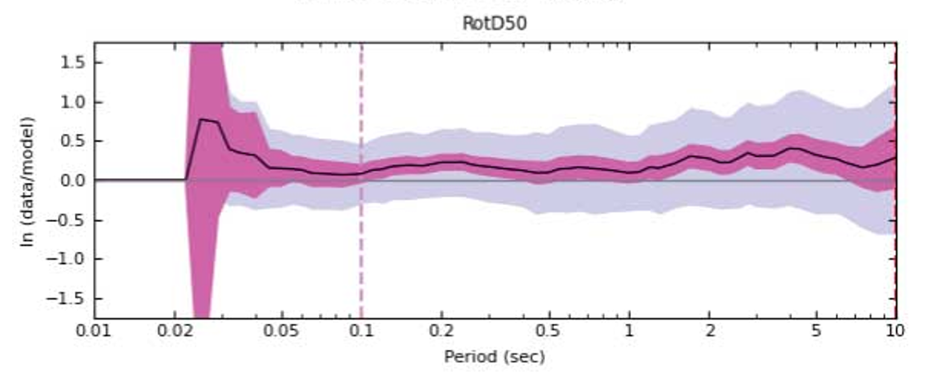
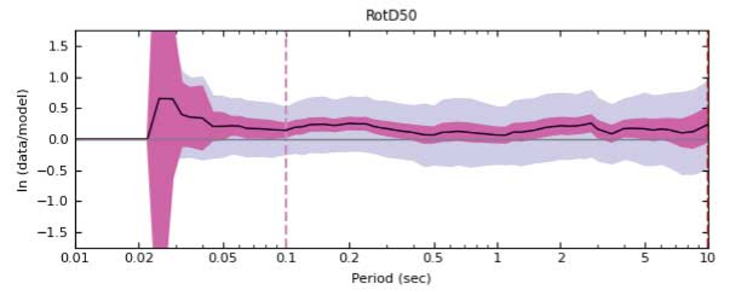
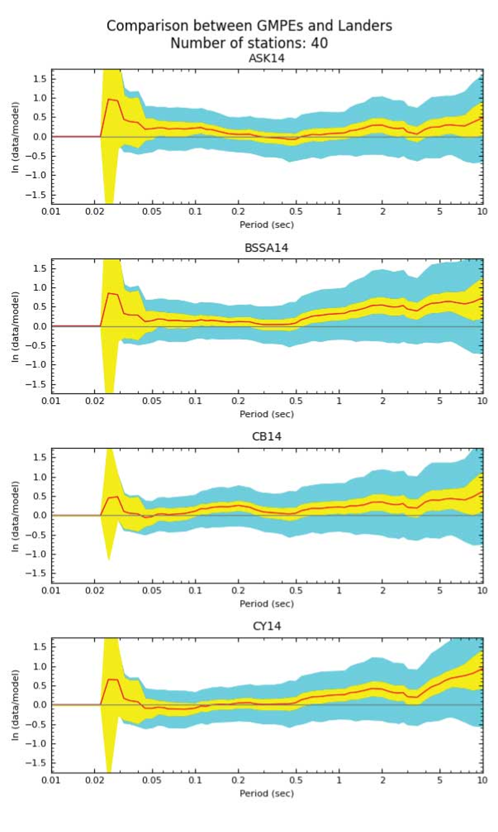
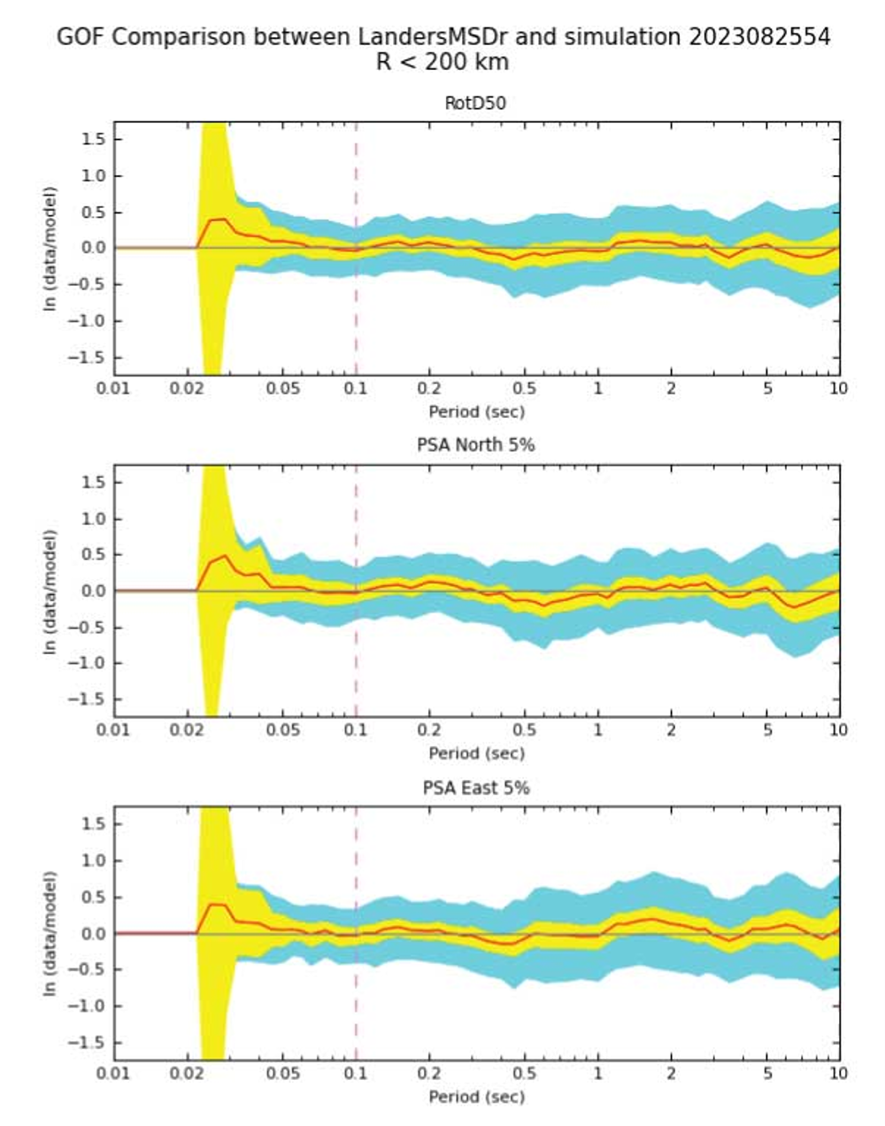
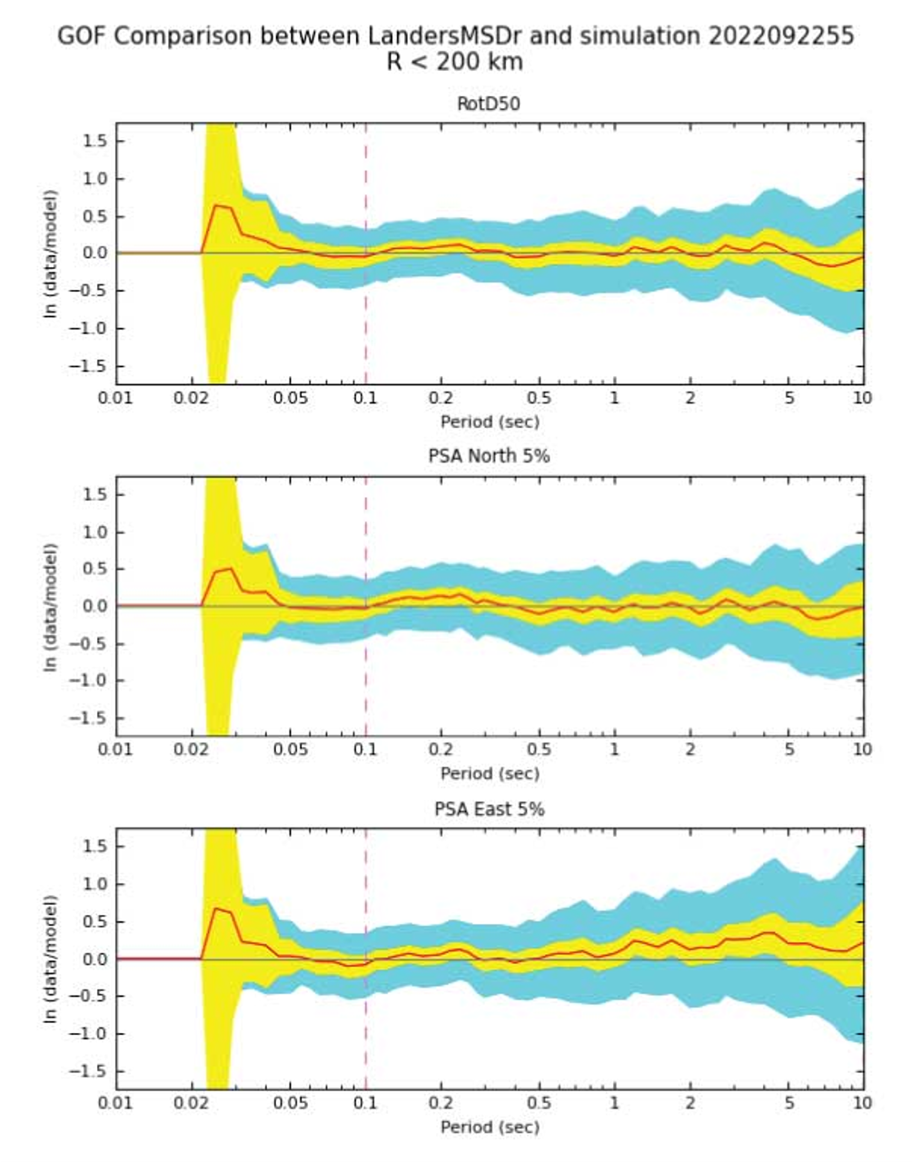
Landers (multi-segment)
3D CyberShake
1D BBP
GMMs
Overall GoF
Best Realization

Slide 8
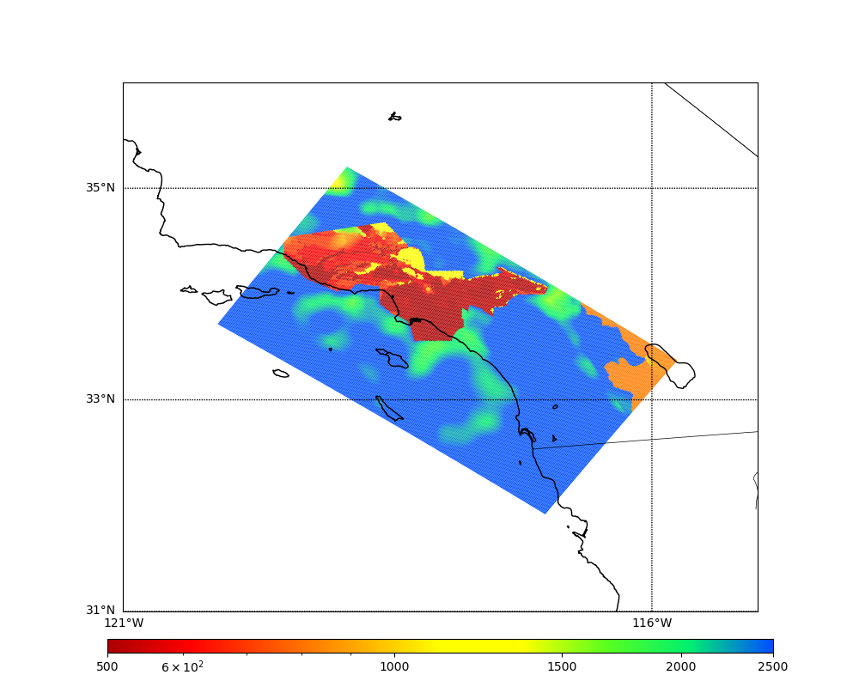
Velocity Model Updates
Previous studies used CVM-S4.26.M01 velocity model
High Vs values outside of basins
Used Vs30-based taper approach to reduce Vs values outside of basins
Calculate properties with and without taper
Select smaller properties
Only affects top 700m
CVM-S4.26.M01, surface Vs
LAPD
USC
500
1000
2500

Slide 9
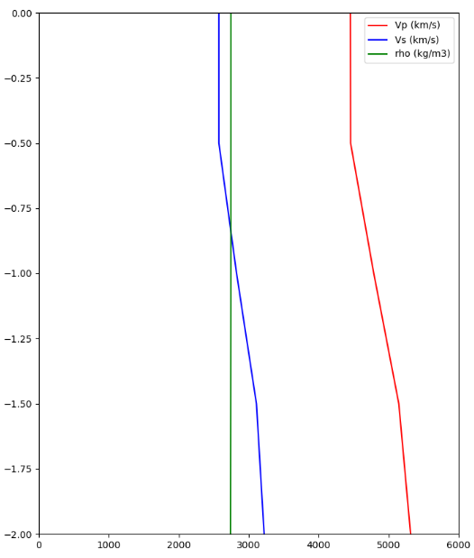
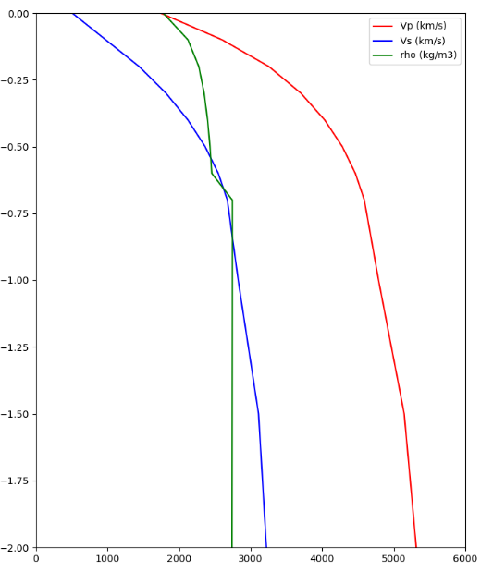
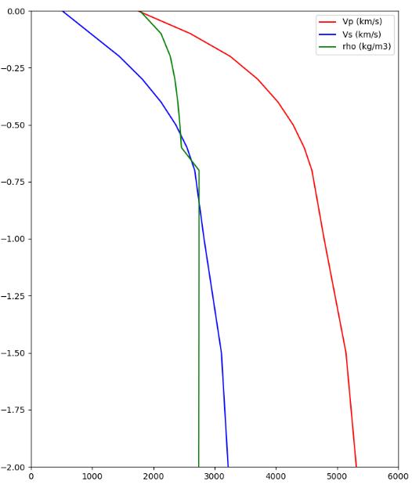
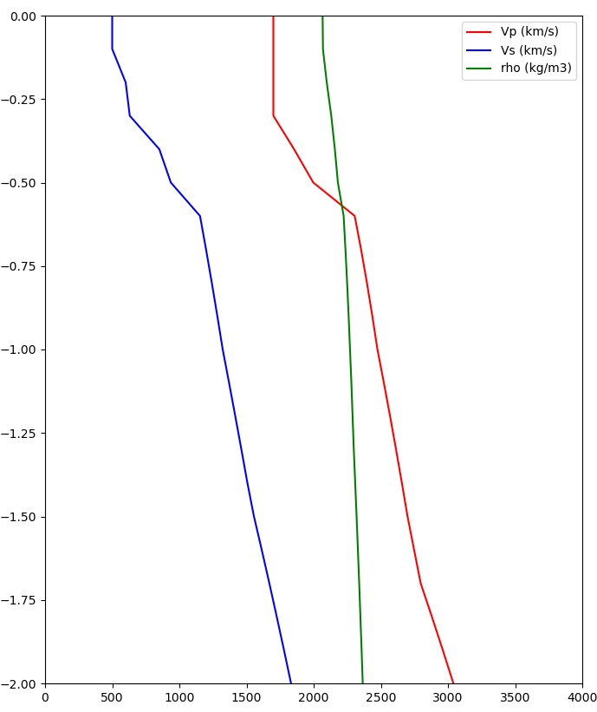
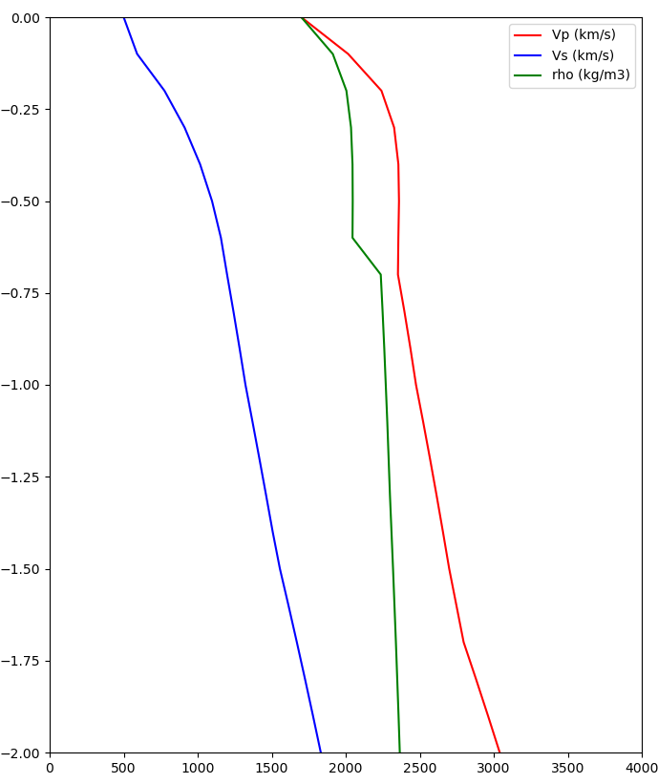
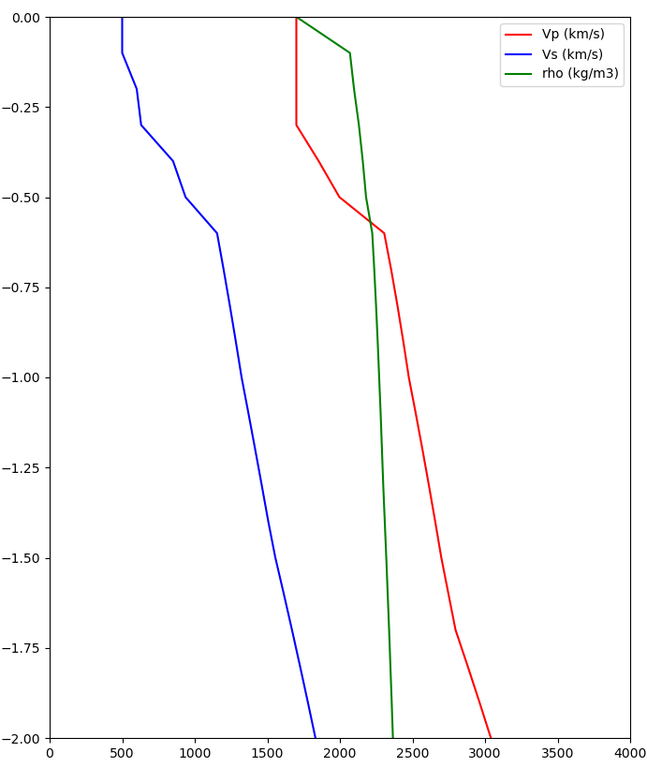
Site Velocity Profiles
Original model
700m taper
Final model
Taper is selected at all depths to 700m
Surface Vs: 2500->400 m/s
LAPD (outside basin)
~2500 m/s
~400 m/s
Taper is only selected at surface point
Surface Vs: 500->490 m/s
USC (in basin)
500 m/s
490 m/s

Slide 10
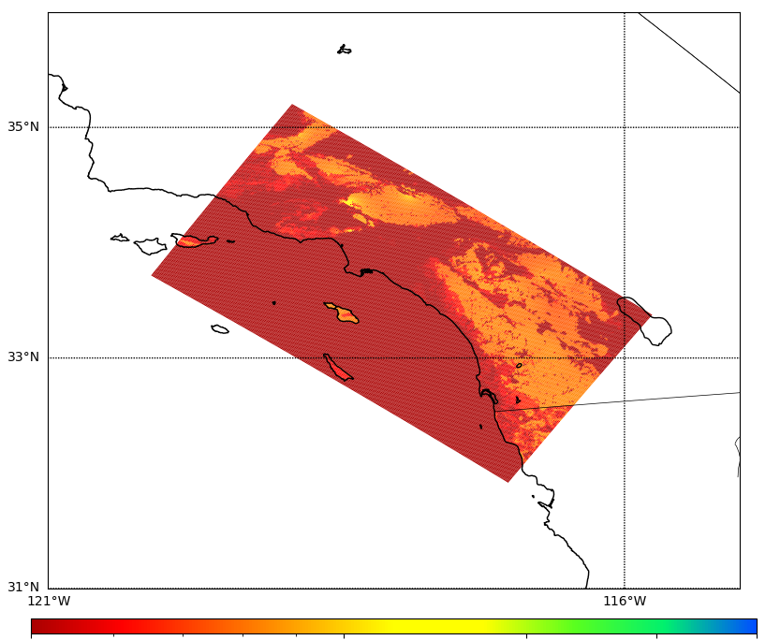
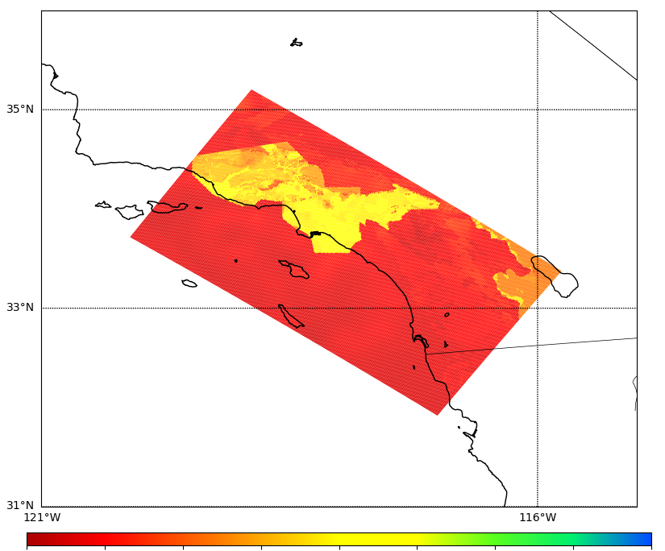
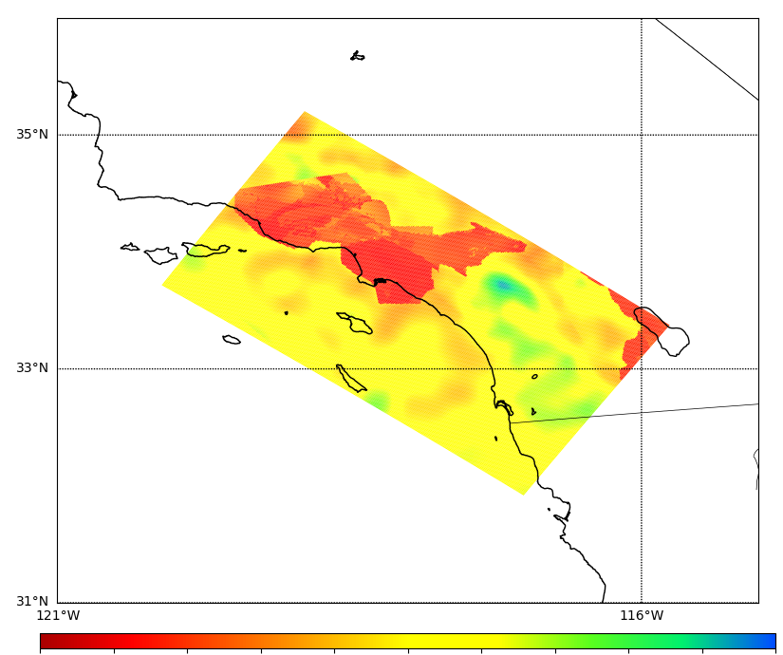
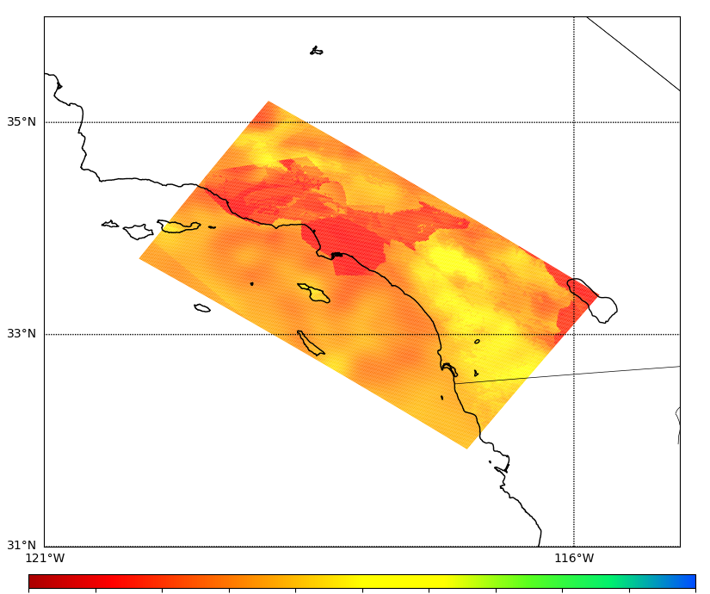
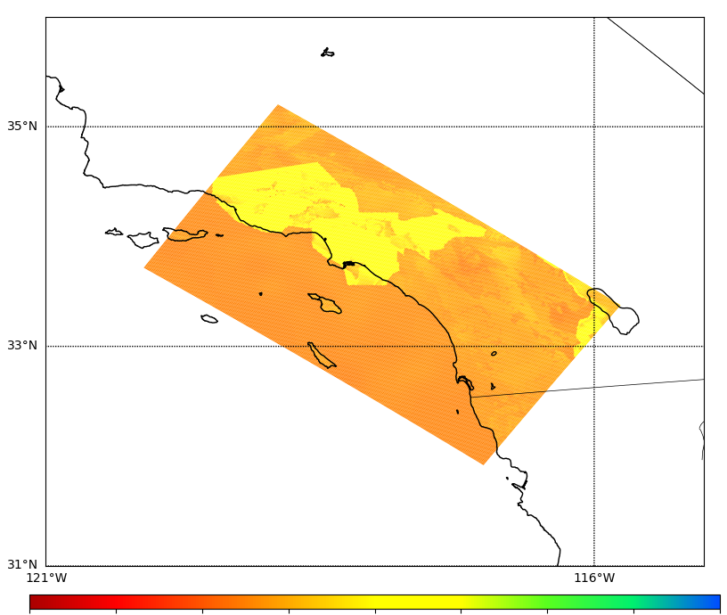
Merged Taper Cross-sections
Original model
Final model
% difference
Surface
500
1000
2500
500
1000
2500
-100%
0%
100%
300m depth
500
1000
2500
500
1000
2500
-100%
0%
100%

Slide 11
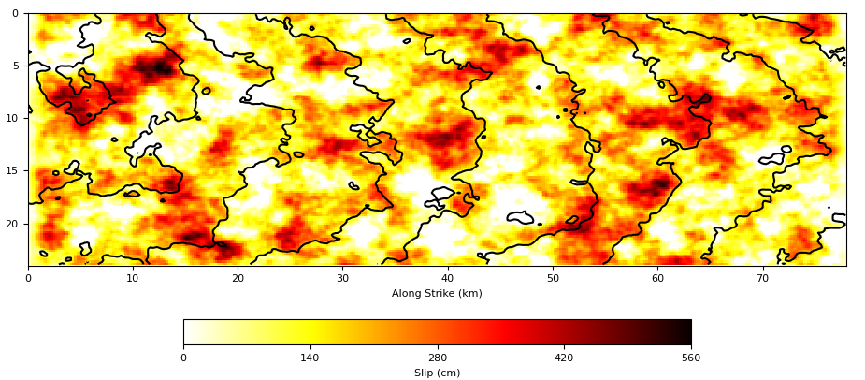
Updates to Rupture Generation
New version of rupture generator, same as in latest BBP release
Reduced correlation between slip and risetime
Reduced shallow fault rupture speed
Slightly weaker directivity
Increased fault roughness
Rupture velocity permitted to vary
Denser hypocentral spacing
~31% increase in number of events
Slip plot, old version from Study 15.4 (top); new version from Study 22.12 (bottom)

Slide 12
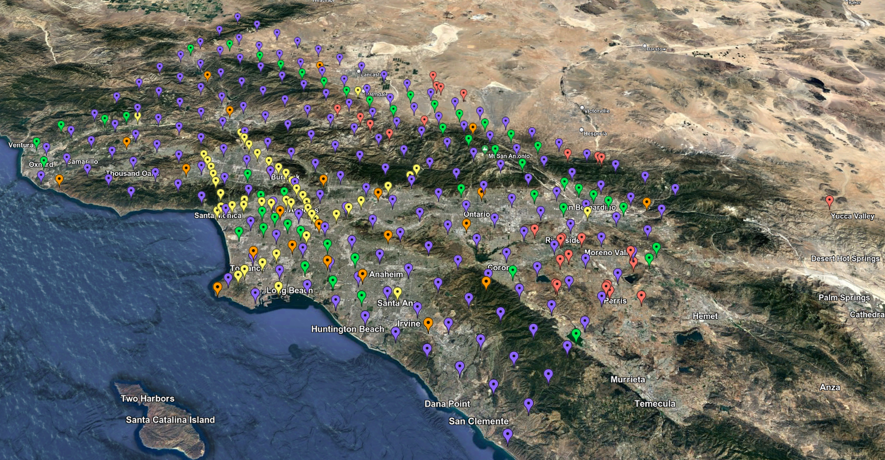
Study 22.12 Statistics
Study ran from Dec 2022-Apr 2023
335 sites around SoCal
772,000 node-hrs on OLCF Summit
Equivalent to entire system for 1 week
Max of 73% of Summit
Managed ~2.5 PB of data
74 TB of data copied back to USC storage
420 million two-component low-frequency and broadband seismograms
83 billion intensity measures and durations
Study 22.12 site map

Slide 13
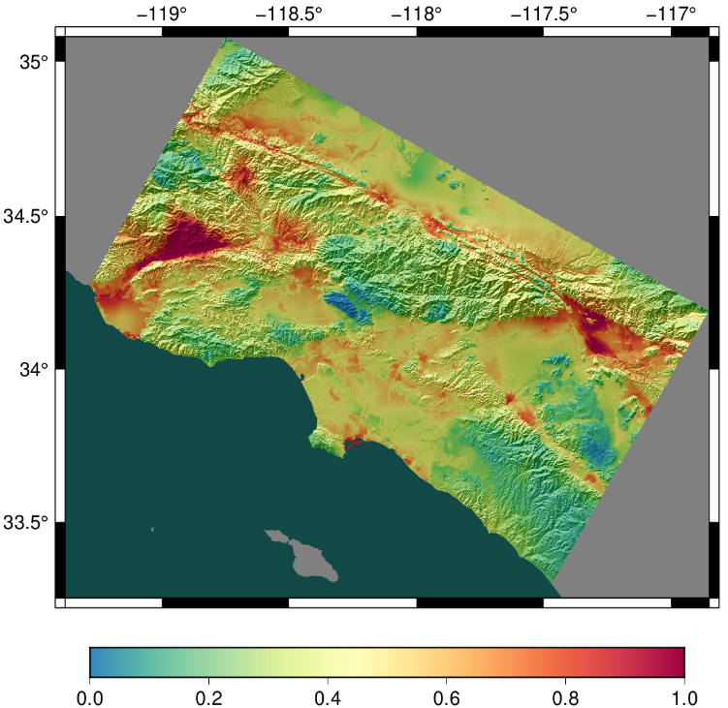
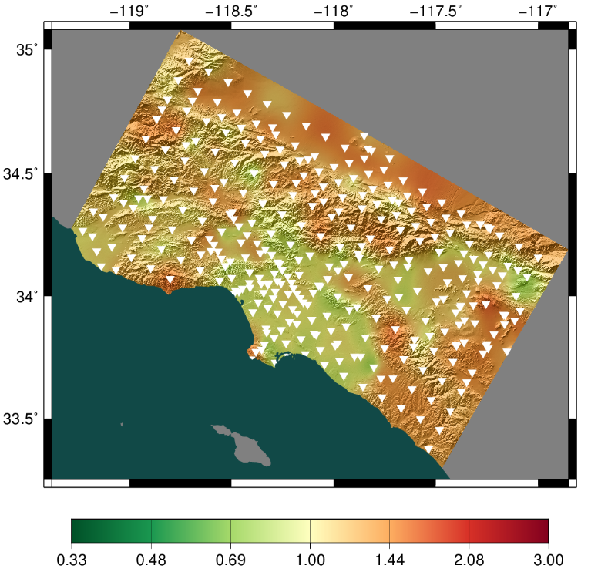
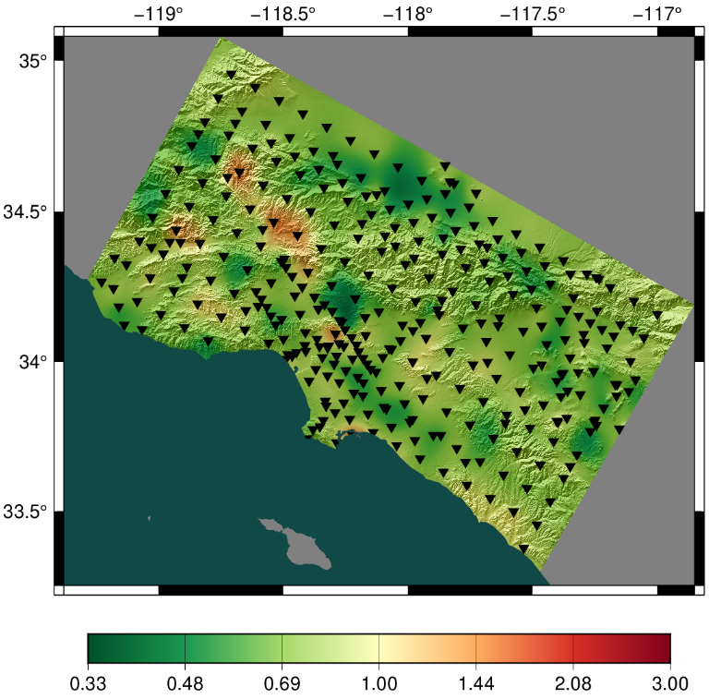
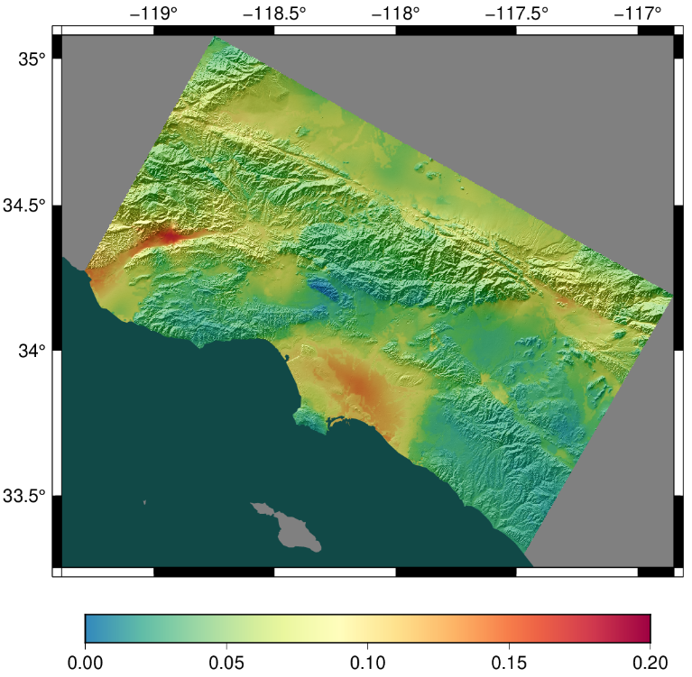
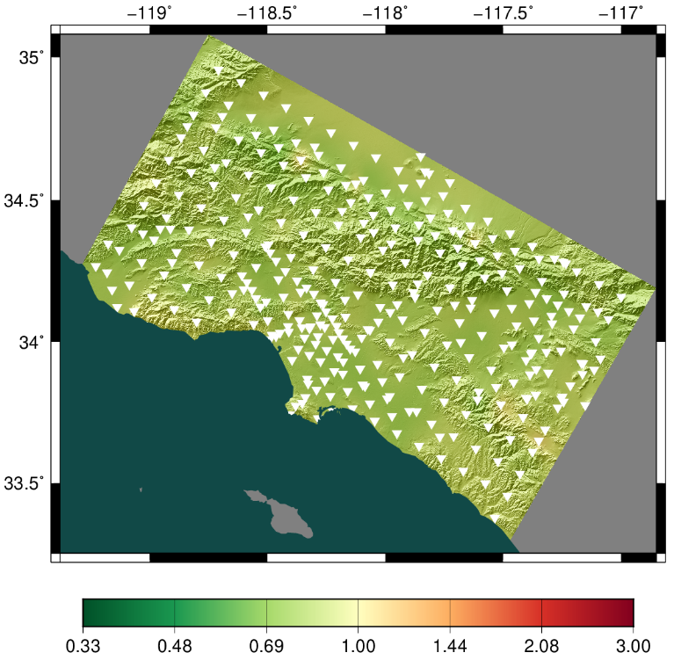
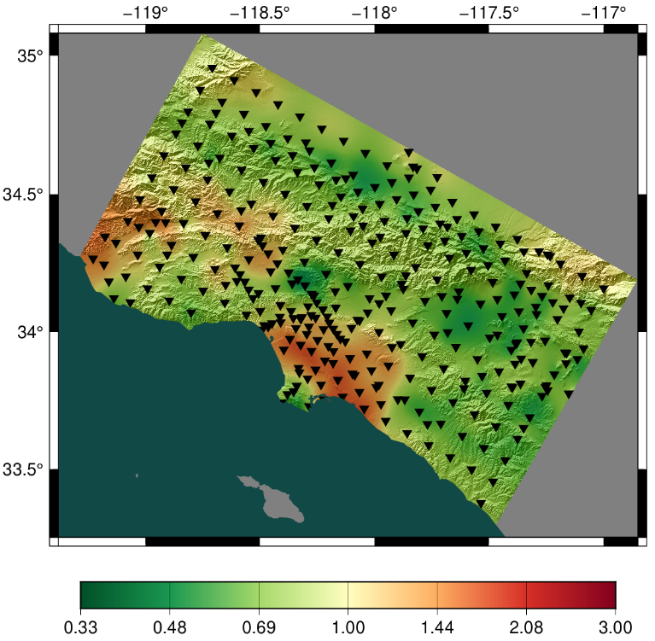
Study 22.12 Low-Frequency Results
Study 22.12
Ratio, 22.12/15.4
Ratio, 22.12/GMMs
2 sec, RotD50
10 sec, RotD50

Slide 14
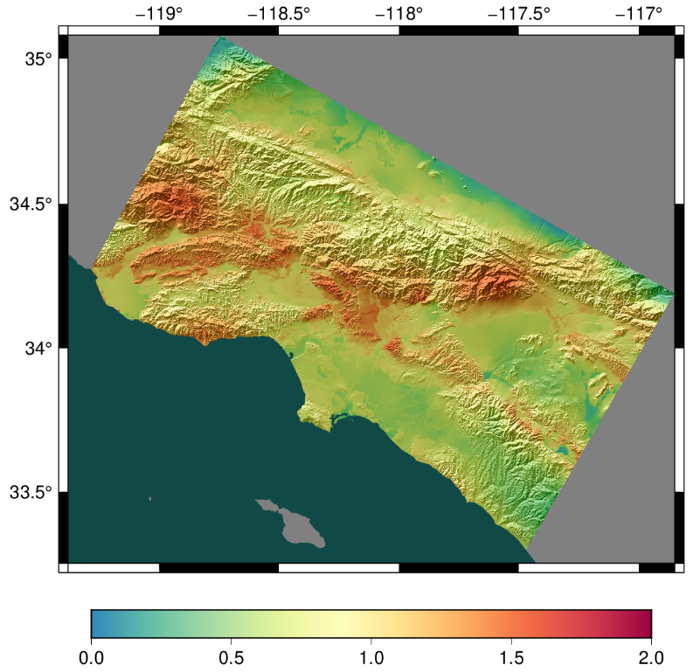
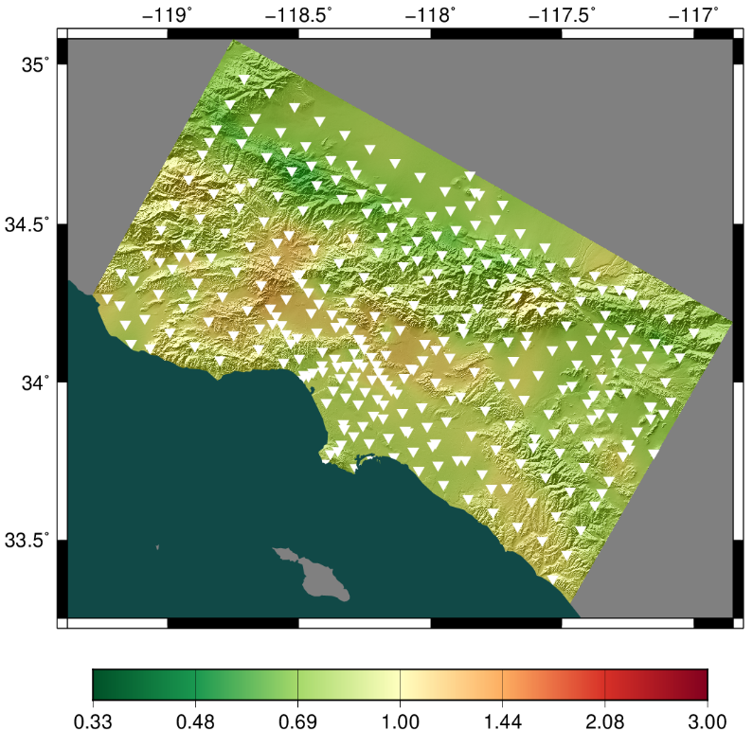
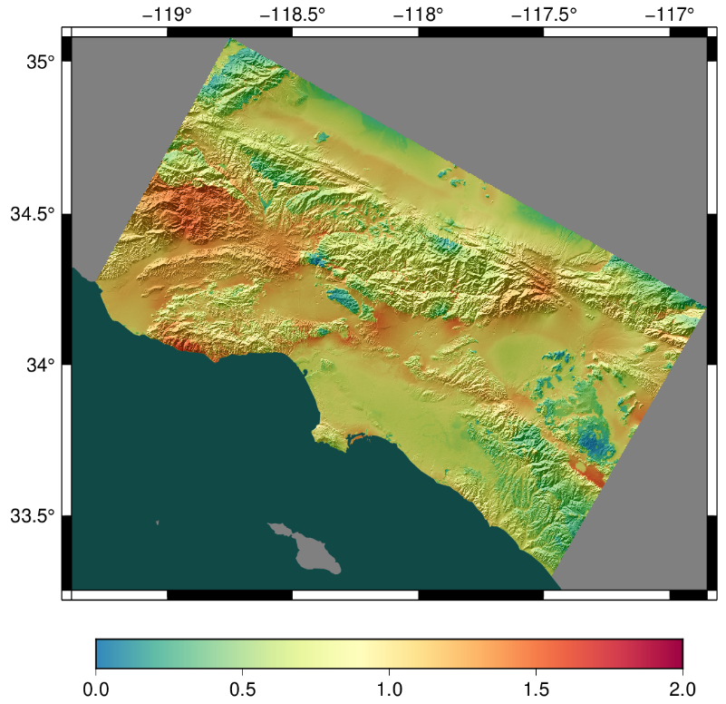
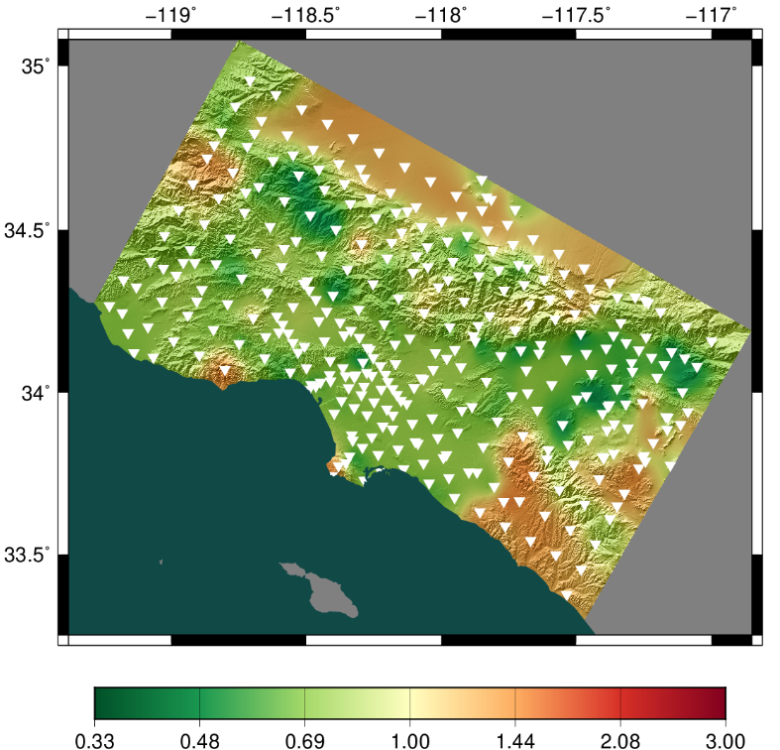
Study 22.12 Broadband Results
Study 22.12
Ratio, 22.12/15.12
0.1 sec, RotD50
0.5 sec, RotD50
Distribution of z-scores between 22.12 BB and GMM

Slide 15
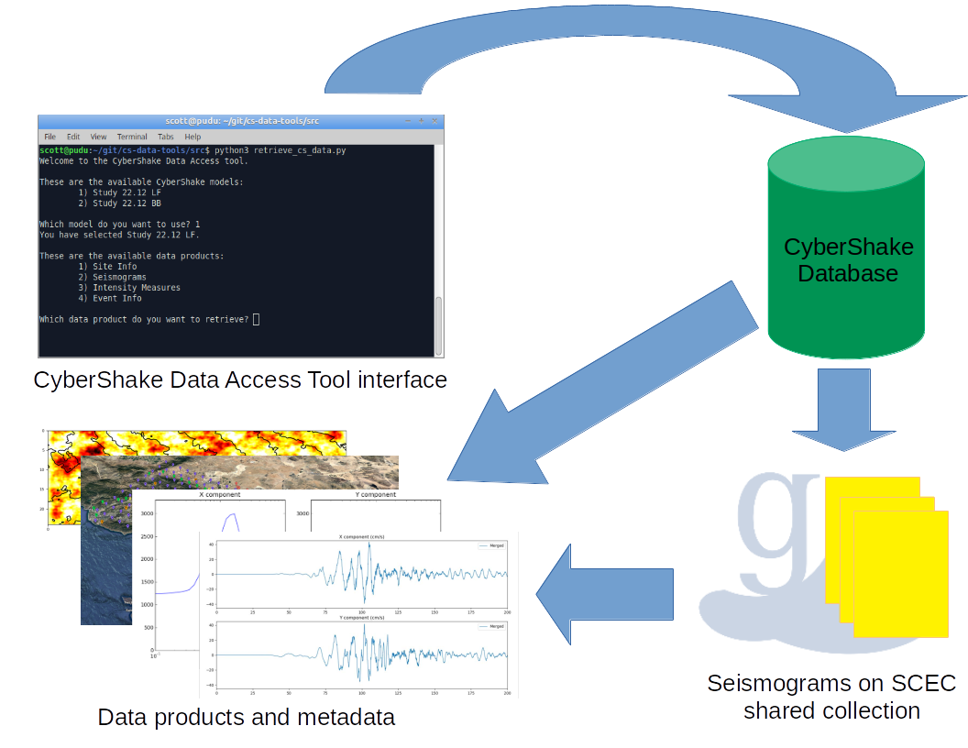
Study 22.12: Data Access
Developed CyberShake data access tool
Python-based
Asks user series of questions
Applies filters to select subset
Simplifies access to variety of CyberShake data products
Site metadata
Earthquake metadata
Intensity measures
Seismograms
Available on github: https://github.com/SCECcode/cs-data-tools/

Slide 16
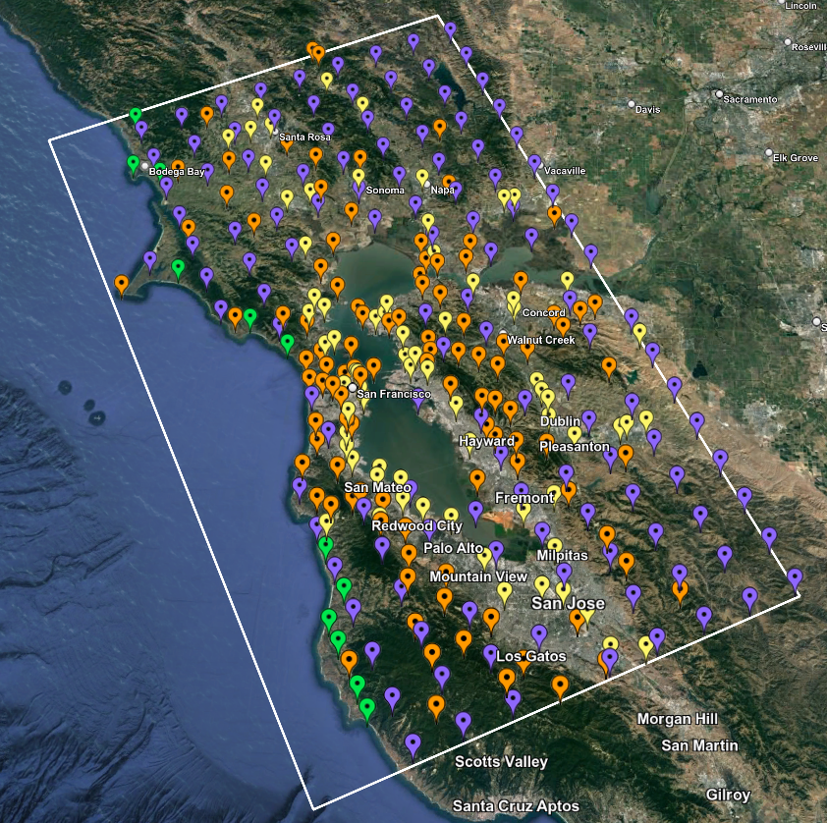
Next Study
Preparing for next study
Greater Bay Area
Similar to Study 22.12
Will use world’s first exascale computer, OLCF Frontier
Currently evaluating 3D velocity models in this region
Will validate with Central and Northern CA BBP validation events
Northern California site map

Slide 17
Future Plans
Increase deterministic frequency to 2 Hz
Requires additional physics
These codes exist, but must be added to CyberShake and verified
Include nonlinear simulations
Can have a big impact on ground motions, but is computationally expensive
Current CyberShake approach is linear
Identify subset of events for full nonlinear simulations
Streamline process of integrating new codes and models
Goal is to support multiple codes for each stage
Supports improved quantification of uncertainty

Slide 18
Thanks!

