Slide 1
CyberShake Study 18.8 Planning
Scott Callaghan

Slide 2
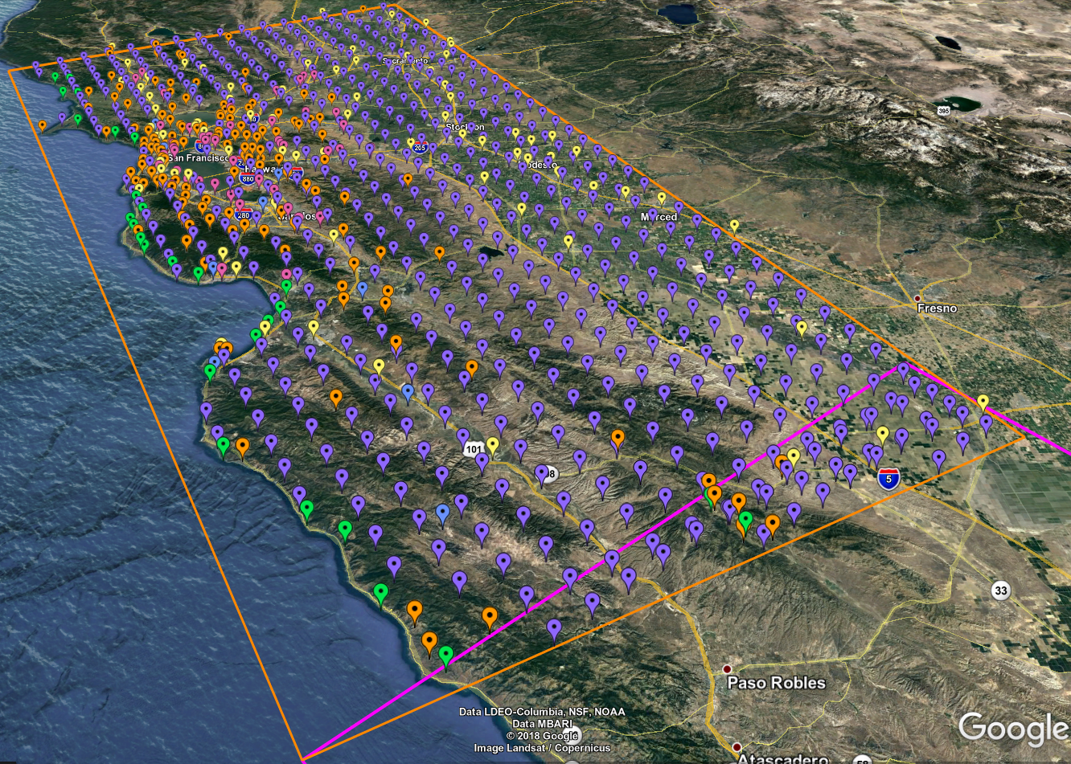
Study 18.8 Goals
Perform physics-based seismic hazard analysis in the extended San Francisco Bay Area
Will perform CyberShake calculations for 869 locations
New combination of velocity models
Area of overlap with previous studies to examine model impact
We anticipate this will be the largest CyberShake study to date

Slide 3
Execution Plan
CyberShake consists of two parts:
Strain Green Tensor (SGT) workflow
Dominated by 2 MPI GPU jobs, 40-80 minutes on 800 nodes
48K SUs total
Post-processing workflow
Dominated by master/worker MPI CPU job, 2-14 hours on 240 nodes
More heterogeneity than in previous studies due to volume sizes
In 2017, ran both workflows on both Blue Waters and Titan
Plan to use similar plan for 2018
Goals are to minimize makespan and human involvement

Slide 4
Execution Plan, cont.
Blue Waters allocation expiring on 8/31: plan to run 75% on Blue Waters and 25% on Titan
25.1M SUs on Titan, 51% of remaining 2018 allocation
Will modify depending on throughput
To support automated remote execution, will use rvgahp approach, same method as 2017
Daemon runs on Titan login node
Makes SSH connection back to SCEC workflow submission host
Listens for job submissions, translates them, and inserts them into batch queue
Estimated duration of 4 weeks
Data transfer
54 TB Titan SGTs archived on Blue Waters
3 TB output data transferred to SCEC storage

Slide 5
Staff
SCEC Staff
Scott Callaghan
Phil Maechling
Christine Goulet
Mei-Hui Su
Kevin Milner
John Yu
Pegasus Staff
Karan Vahi
Mats Rynge
OLCF Staff
Judy Hill

Slide 6
Requests
Longer runtimes for 240-node jobs
Post-processing jobs may take up to 14 hours
Since max queue time for 240-node jobs is 6 hours, must restart from checkpoint
1-2 hours runtime lost due to restart
Disk usage OK
Cumulative disk usage of 200 TB; will clean up as we go
Changes from 2017 study for increased throughput
5-day priority boost
5 jobs running in bin 5
8 jobs eligible to run
Scheduled downtime?

