Slide 1
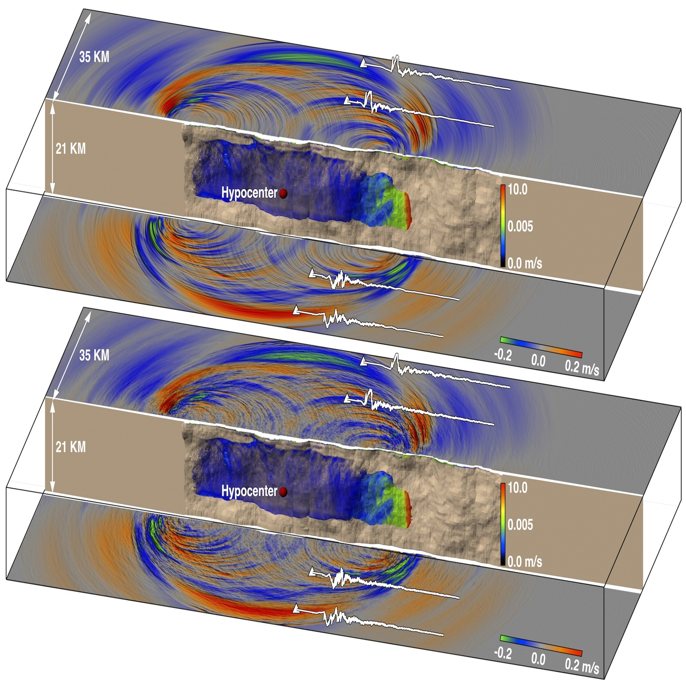
SCEC Application Performance and Software Development
Yifeng Cui¹, Thomas Jordan², Philip Maechling², Scott Callaghan², Kim Olsen³, Jacobo Bielak⁴, Steven Day³, Ricardo Taborda⁵, Po Chen⁶, Patrick Small², Daniel Roten¹, Efecan Poyraz¹ and SCEC CME Collaboration
¹University of California at San Diego, ²Southern California Earthquake Center, ³San Diego State University, ⁴Carnegie Mellon University
⁵University of Memphis, ⁶University of Wyoming
OLCF Users Meeting, July 22-24, 2014

Slide 2
SCEC Computational Pathways
AWP-ODC
1
Standard seismic hazard analysis (RWG, AWP-ODC)
Hybrid MPI/CUDA
AWP-ODC, Hercules
2
Ground motion simulation (AWP-ODC, Hercules)
3
Dynamic rupture modeling (SORD, AWP-ODC)
4
Ground-motion inverse problem (AWP-ODC, SPECFEM3D)
Other Data
Geology
Geodesy
AWP-ODC – Yifeng Cui and Kim Olsen
Hercules – Jacobo Bielak and Ricardo Tarbora
SORD – Steven Day
CyberShake - Scott Callaghan
OpenSHA/UCERF3 - Kevin Milner
UCVM, CVM-H - David Gill
Broadband - Fabio Silva
Structural Representation
Invert
4
Improvement of models
DFR
AWP
KFR
AWP
NSR
Ground
Motions
Physics-based
simulations
3
2
“Extended” Earthquake Rupture Forecast
Empirical
models
Earthquake Rupture
Forecast
Attenuation
Relationship
Intensity
Measures
1
KFR = Kinematic Fault Rupture
DFR = Dynamic Fault Rupture
AWP = Anelastic Wave Propagation
NSR = Nonlinear Site Response

Slide 3
AWP-ODC
Started as personal research code (Olsen 1994)
3D velocity-stress wave equations
solved by explicit staggered-grid 4th-order FD
Memory variable formulation of inelastic relaxation
using coarse-grained representation (Day 1998)
Dynamic rupture by the staggered-grid split-node (SGSN) method (Dalguer and Day 2007)
Absorbing boundary conditions by perfectly matched layers (PML) (Marcinkovich and Olsen 2003) and Cerjan et al. (1985)
Inelastic relaxation variables for memory-variable ODEs in AWP-ODC

Slide 4
AWP-ODC Weak Scaling
93% efficiency
2.3 Pflop/s
100% efficiency
94% efficiency
(Cui et al., 2013)

Slide 5
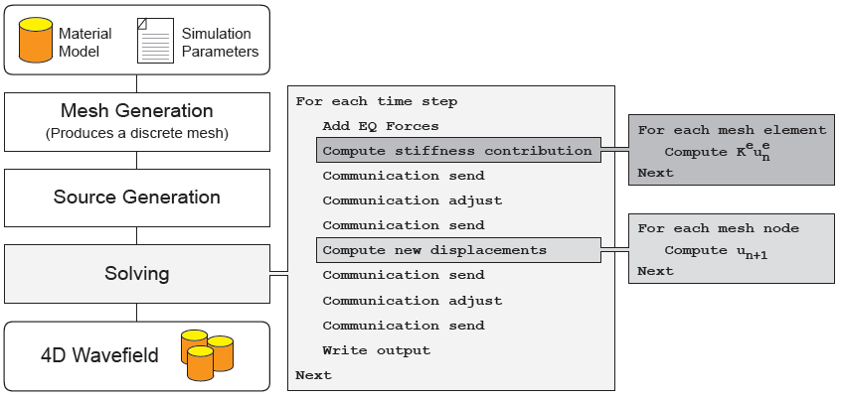
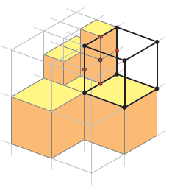
Hercules – General Architecture
» Finite-Element Method
» Integrated Meshing
(unstructured hexahedral)
» Uses and octree-based library
for meshing and to order
elements and nodes in memory
» Explicit FE solver
» Plane wave approximation to
absorbing boundary conditions
» Natural free surface condition
» Frequency Independent Q
Hercules was developed by the Quake Group at Carnegie Mellon University with support from SCEC/CME projects. Its current developers team include collaborators at the National University of Mexico, the University of Memphis, and the SCEC/IT team among others.
End-to-End
Simulation Process
Main Solving
Loop
Most Demanding
Operations
Octree-Based
FE Mesh
Jacobo Bielak (CMU) and Ricardo Taborda (UM)
See Refs. Taborda et al. (2010) and Tu et al. (2006)

Slide 6
Hercules on Titan – GPU Module Implementation
Modifications to Solver Loop
Chino Hills 2.8 Hz, BKT damping, 1.5 B elements, 2000 time steps (512 compute nodes)
Original Solver Loop
I/O
Source Forces
Stiffness,
Attenuation
Nonlinear
and Buildings
Comm
Forces
Disp Update
Comm
Disp
CPU
Reset
GPU Solver Loop
I/O
Source Forces
Nonlinear and Buildings
Comm
Forces
Comm
Disp
CPU
Sync point
Disp
Forces
Forces
Disp
Stiffness,
Attenuation
Disp Update
GPU
Reset
(Patrick Small of USC and Ricardo Taborda of UM, 2014)

Slide 7
Hercules on Titan – GPU Performance
Initial Strong Scaling Tests on Titan (in green) compared to other systems
Recent Hercules developments include GPU capabilities using CUDA
Performance tests for a benchmark 2.8 Hz Chino Hills simulation show near perfect strong and weak scalability on multiple HPC systems including TITAN using GPU
The acceleration ratio of the GPU code with respect to the CPU is of a factor of 2.5x overall. Larger factors are obtained in the specific modules where GPU was implemented
(Jacobo Bielak of CMU, Patrick Small of USC and Ricardo Taborda of UM, 2014)

Slide 8
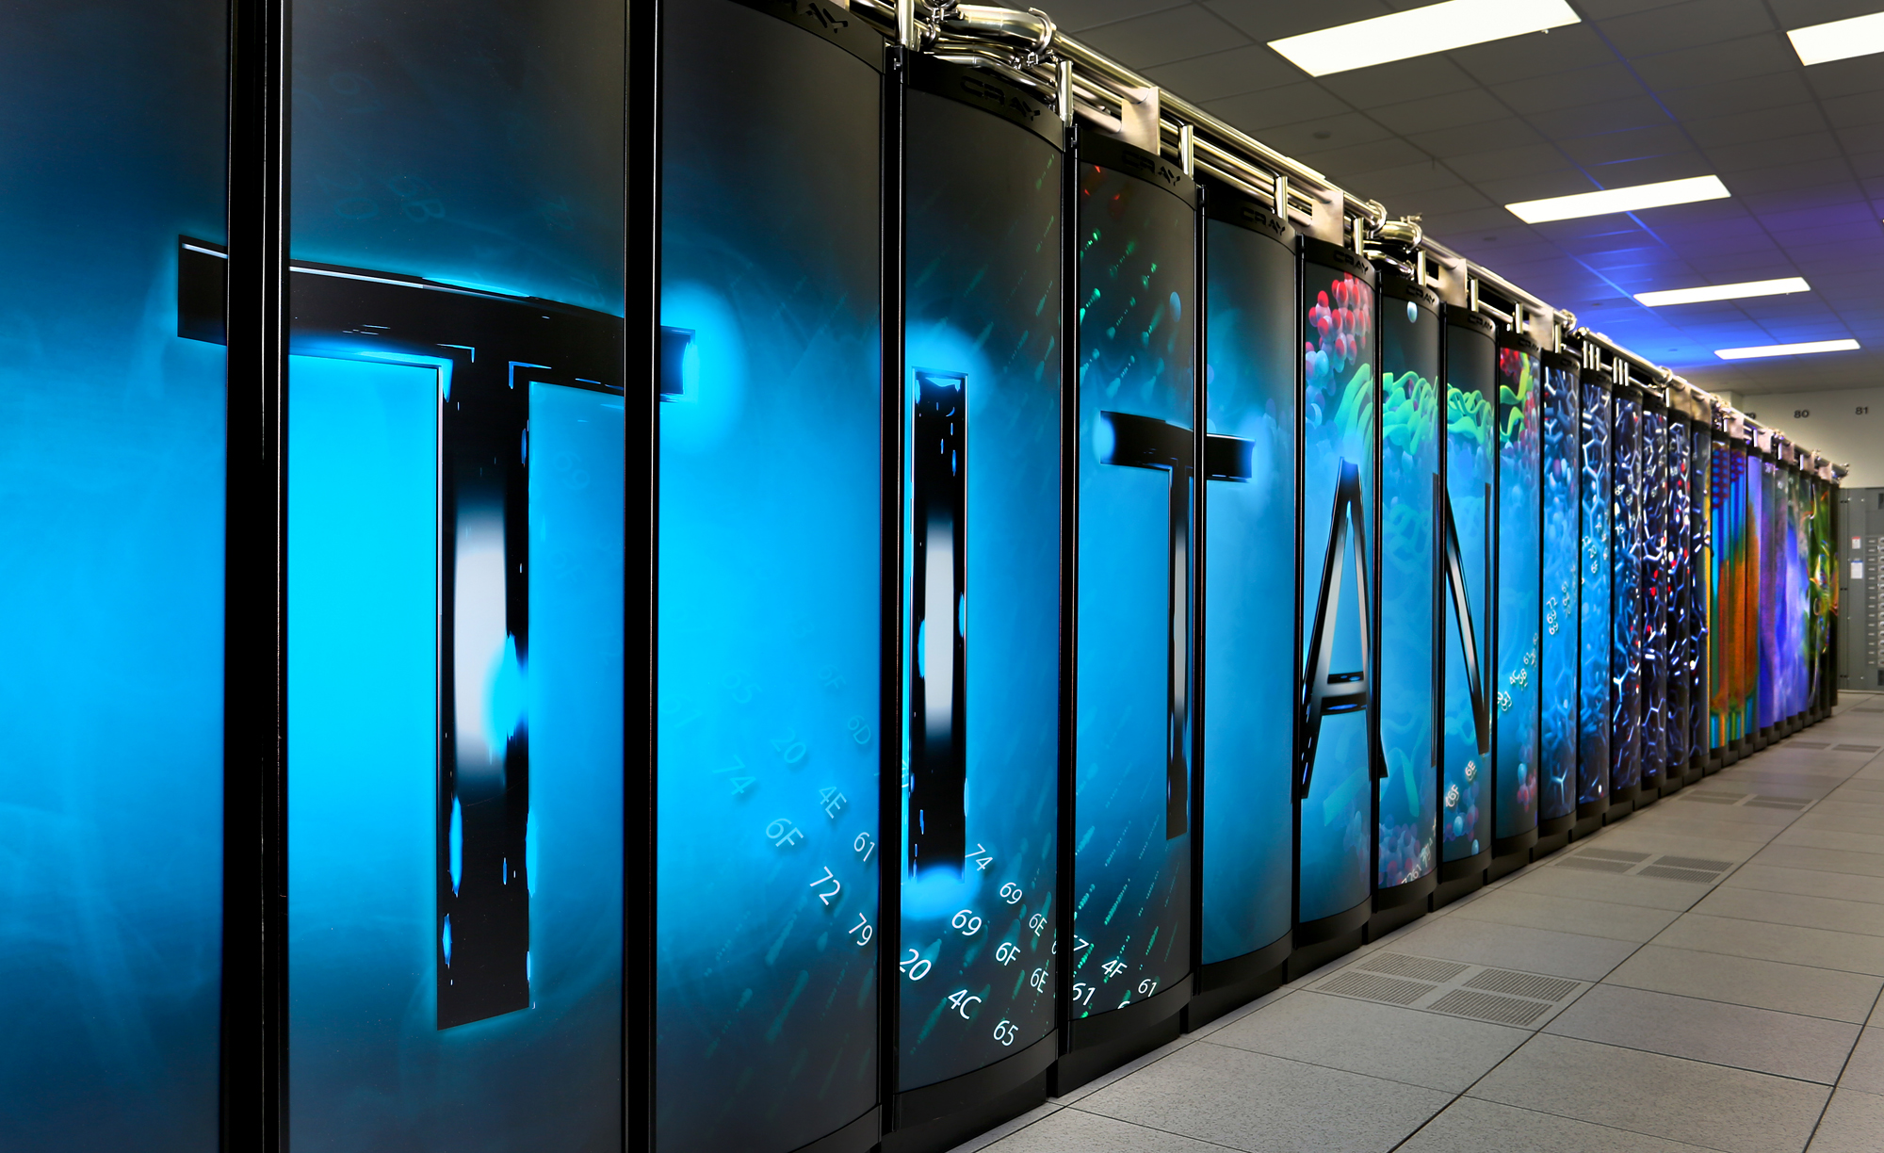
Hercules on Titan – Validation of La Habra
Resource Utilization
6
Simulations
1024
CPU cores
5713
Titan Core-Hours
64
Compute Nodes
64
Nvidia GPUs
ORNL

Slide 9
Hercules on Titan – Validation of La Habra
Modeling, Simulation and Validation Process
SCEC Data Center
Recorded
Seismograms
Combination of 3 SCEC Software Platforms (BBP, UCVM, High-F) across multiple HPC systems including TITAN at OLCF and other DOE (Mira) and NSF (Blue Waters) systems
USC HPC
MIRA
BBP Extended
Source Generation
Source Inversion
Standard Rupture Format
TITAN
Centroid Moment Tensor
Desktop Computer
Hercules
(GPU Module)
Synthetic
Seismograms
Post-processing
CVM-S4
Extended and
Point Source
Models
SCEC Data Center
Recorded
Seismograms
Validation
(GOF Scores)
MIRA
Blue Waters
3D Tomographic
Inversion
UCVM Platform
Plotting
(Matlab + GMT)
CVM-S4.26
Perturbations
3D Grid
CVM-S4
CVM-S4.26
Etrees
(Patrick Small of USC and Ricardo Taborda of UM, 2014)

Slide 10
Algorithms and Hardware Attributes
SCEC Apps
Massive I/O requirements
Stencil computations
Nearest neighbor comm.
I/O
Throughput
Regular
Comp. pattern
Memory
intensive
Comm.
latency
Contiguous
I/O access
Effective
Buffering
ADIOS
Array
Optimization
Memory Reduction
Cache
Utilization
Node
Mapping
Latency
hiding
Limited
OSTs
Vector
Capable
Shared
Memories
Machine
Topology
Lustre File System
Node Architecture
3-D Torus Interconnect
HW Systems

Slide 11
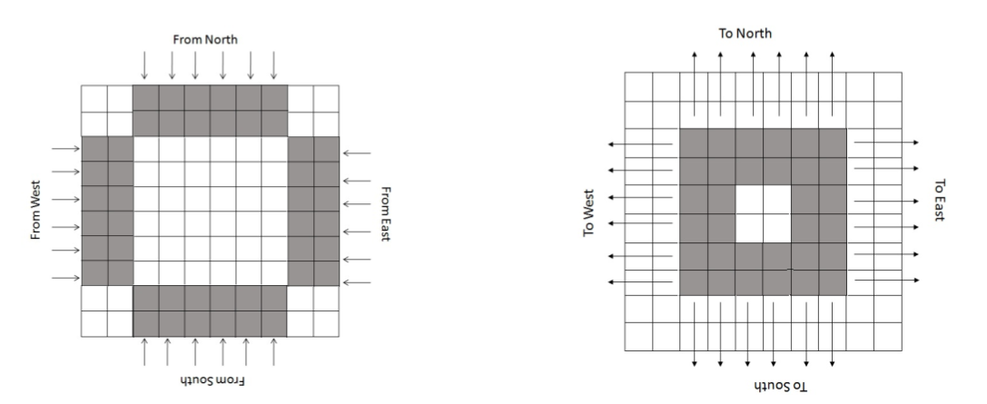
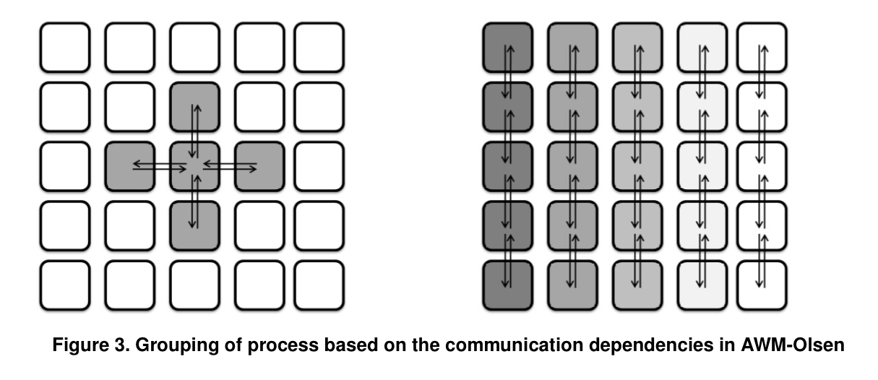
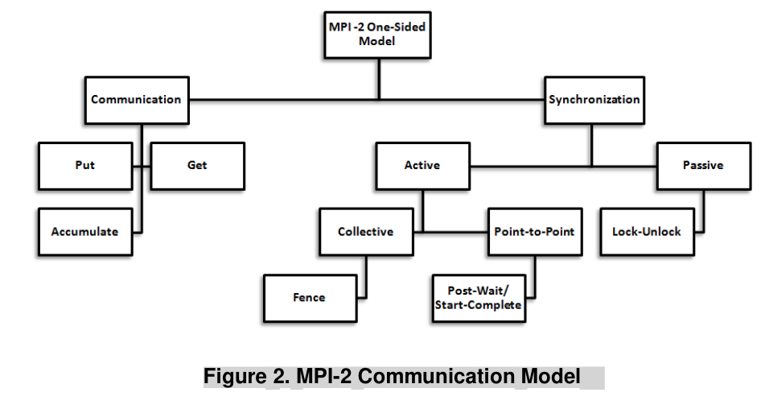
AWP-ODC Communication Approach on Jaguar
Rank placement technique
  Node filling with X-Y-Z orders
  Maximizing intra-node and minimizing inter-node communication
Asynchronous communication
  Significantly reduced latency through local communication
  Reduced system buffer requirement through pre-post receives
Computation/communication overlap
  Effectively hide computation times
  Effective when Tcompute_hide>Tcompute_overhead
  One-sided Communications (on Ranger)
(Joint work with DK Panda Team of OSU)
(Potluri, S., et al., ICS’10)

Slide 12
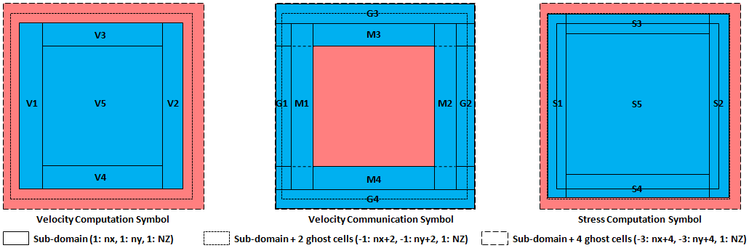
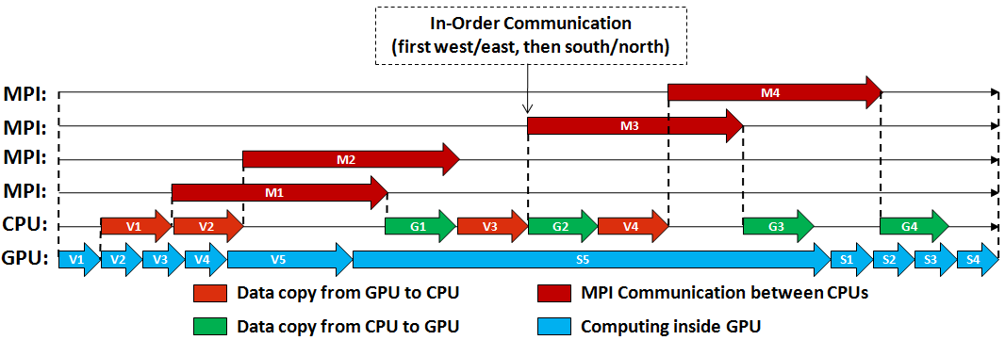
AWP-ODC Communication Approach on Titan
(Cui et al., SC’13)

Slide 13
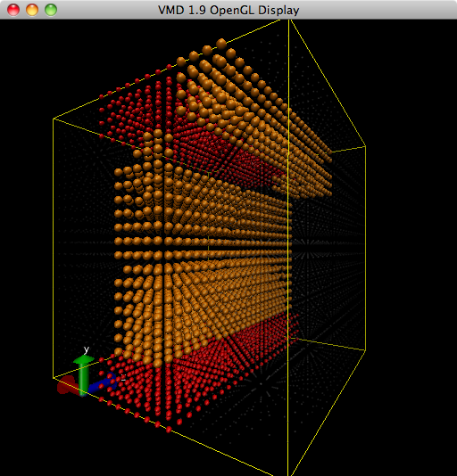
Topology Tuning on XE6/XK7
Matching the virtual 3D Cartesian to an elongated physical subnet prism shape
Maximizing faster connected BW XZ plane allocation
Obtaining a tighter, more compact and cuboidal shaped BW subnet allocation
Reducing inter-node hops along the slowest BW torus Y direction
Joint work with G. Bauer, O. Padron (NCSA), R. Fiedler (Cray) and L. Shih (UH)

Slide 14
Topology Tuning on Blue Waters
Topology Tuning
on XE6/XK7
Matching the virtual 3D Cartesian to an elongated physical subnet prism shape
Maximizing faster connected BW XZ plane allocation
Obtaining a tighter, more compact and cuboidal shaped BW subnet allocation
Reducing inter-node hops along the slowest BW torus Y direction
Joint work with G. Bauer, O. Padron (NCSA), R. Fiedler (Cray) and L. Shih (UH)

Slide 15
Topology Tuning on Blue Waters
Topology Tuning
on XE6/XK7
# nodes | Default | Topaware | Speedup | Efficiency
64 | 4.006 | 3.991 | 0.37% | 100%
512 | 0.572 | 0.554 | 3.15% | 87.5%->90%
4096 | 0.119 | 0.077 | 35.29% | 52.6%->81%
Matching the virtual 3D Cartesian to an elongated physical subnet prism shape
Maximizing faster connected BW XZ plane allocation
Obtaining a tighter, more compact and cuboidal shaped BW subnet allocation
Reducing inter-node hops along the slowest BW torus Y direction

Slide 16
Two-layer I/O Model
Parallel I/O
  Read and redistribute multiple terabytes inputs (19 GB/s)
    Contiguous block read by reduced number of readers
    High bandwidth asynchronous point-to-point communication redistribution
cores
Shared file

Slide 17

Two-layer I/O Model
Parallel I/O
  Read and redistribute multiple terabytes inputs (19 GB/s)
    Contiguous block read by reduced number of readers
    High bandwidth asynchronous point-to-point communication redistribution
  Aggregate and write
OSTs

Slide 18
Two-layer I/O Model
Parallel I/O
  Read and redistribute multiple terabytes inputs (19 GB/s)
    Contiguous block read by reduced number of readers
    High bandwidth asynchronous point-to-point communication redistribution
MPI-IO
time step 1
time step 2
… …
time step N
Temporal aggregator
Stripe
size
Stripe
size
Stripe
size
  Aggregate and write (10GB/s)
    Temporal aggregation buffers
    Contiguous writes
    Throughput
…
OSTs

Slide 19
Fast X or Fast T
(Poyraz et al., ICCS’’14)

Slide 20

ADIOS Checkpointing
Problems at M8: system instabilities, 50 TB simulation data
Chino Hills 5Hz simulation is used to validate:
Mesh size: 7000x5000x2500
#cores: 87,500 on Jaguar
WCT: 3 hr
Total timesteps: 40K
3.3 TB simulation data
ADIOS saved checkpoints at 20K^{th} timestep and validated the outputs at 40K^{th} timestep
Avg. I/O performance: 22.5 GB/s (compared to 20 GB/s with MPI-IO)
AWP-ODC
ADIOS
(Supported by Norbert Podhorszki, Scott Klasky, Qing Liu, ORNL)
Lustre

Slide 21
SEISM-IO: IO Library for Integrated Seismic Modeling

Slide 22
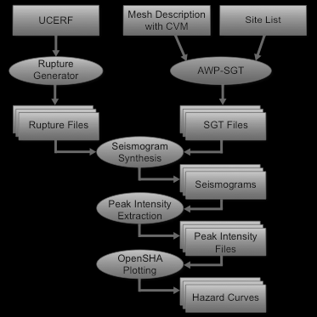
CPUs/GPUs Co-scheduling
  CPUs run reciprocity-based seismogram and intensity computations
  Run multiple MPI jobs on compute nodes using Node Managers (MOM)
aprun -n 50 <GPU executable> <arguments> &
get the PID of the GPU job
cybershake_coscheduling.py:
build all the cybershake input files
divide up the nodes and work among a customizable number of jobs
for each job:
fork extract_sgt.py cores --> performs pre-processing and launches
"aprun -n <cores per job> -N 15 -r 1 <cpu executable A>&"
get PID of the CPU job
while executable A jobs are running:
check PIDs to see if job has completed
if completed: launch
“aprun -n <cores per job> -N 15 -r 1 <cpu executable B>&”
while executable B jobs are running:
check for completion
check for GPU job completion

Slide 23
Post-processing on CPUs: API for Pthreads
AWP-API lets individual pthreads make use of CPUs: post-processing
  Vmag, SGT, seismograms
  Statistics (real-time performance measuring)
  Adaptive/interactive control tools
  In-situ visualization
  Output writing is introduced as a pthread that uses the API

Slide 24
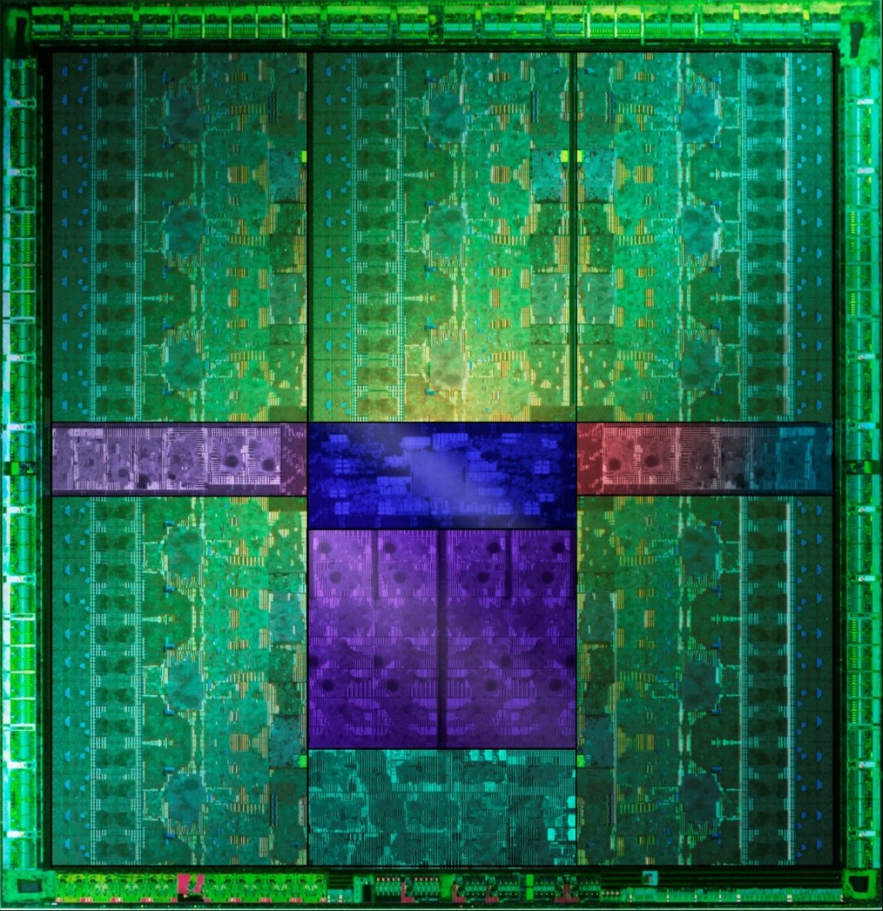
Main thread
Initialize simulation
Modules on other CPUs on XK7
Initialize modules
Initialize
Initialize
GPU
Start computation on GPU
Is the signal received?
Specified time step?
no
yes
Calculate SGT
yes
Copy velocity data and signal modules
Is it time to write out?
no
More time steps?
yes
yes
no
Write out - MPI-IO
Finalize

Slide 25
Probabilistic Seismic Hazard Model
Physics-based seismic hazard model requires more than a few earthquake simulations
  Standard “forward” simulation computing 3-component seismograms from M sources at N sites requires M simulations (M > 10⁵, N ~ 10³)
  Strain Green tensor based “reciprocal” simulation computing 3-component seismograms for M sources at N sites requires only 3N simulations
  Use of reciprocity reduces CPU time by a factor of ~2,000
Receiver
Source 1
Source 2
Source 3
M sources to N receivers requires 3N simulations
M sources to N receivers requires M simulations
U_{n}(r,r_{s})=H(r_{s},r)M_{ji}
H(r_{s},r)=[G_{jn,i}(r_{s},r) + G_{in,j}(r_{s} ,r)]/2
U_{n}(r,r_{s})=G_{nj,i}(r,r_{s})M_{ji}
Earthquake Rupture
Forecast
Attenuation
Relationship
Intensity
Measures
P(S_{n})
P(IM_{k} | S_{n})
P(IM_{k})
Probabilistic Seismic Hazard Analysis

Slide 26
CyberShake Calculations
CyberShake contains two phases
Strain Green Tensor (SGT) calculation
  Large MPI jobs
  AWP-ODC-SGT GPU
  85% of CyberShake compute time
Post-processing (reciprocal calculation)
  Many (~400k) serial, high throughput, loosely coupled jobs
  Workflow tools used to manage jobs
Both phases are required to determine seismic hazard at one site
For a hazard map, must calculate ~200 sites

Slide 27
CyberShake workflows
Tensor Workflow
Post-Processing Workflow
Data Products Workflow
PMC
SeisPSA
.
.
.
Tensor extraction
SeisPSA
DB
Insert
.
.
.
Mesh generation
Tensor simulation
PMC
SeisPSA
Tensor extraction
.
.
.
Hazard
Curve
SeisPSA
1 job
6 jobs
85,000 jobs
6 PMC jobs
2 jobs
Notes:
Green are MPI jobs
Yellow are serial jobs
Tensor workflow runs on Titan, post-processing on Blue Waters or Stampede, data products on SCEC servers

Slide 28
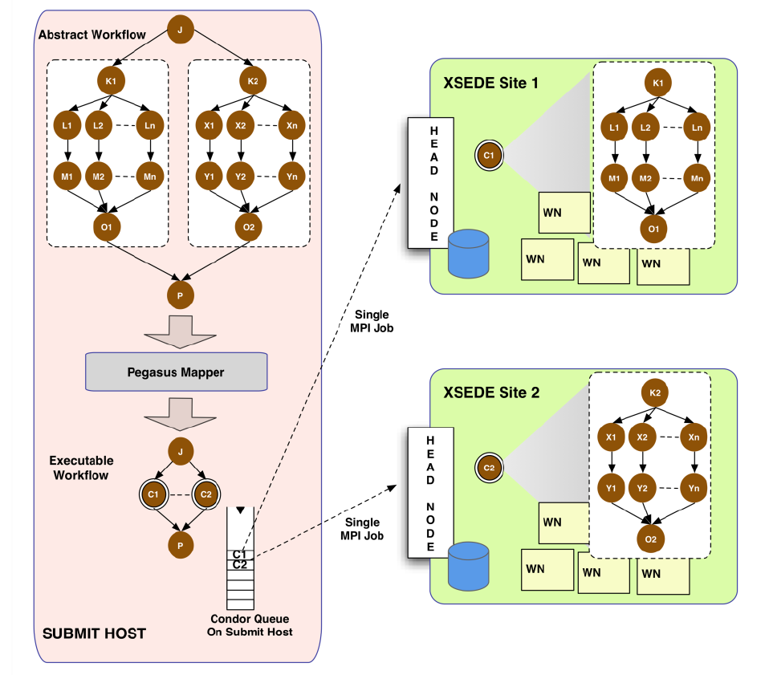
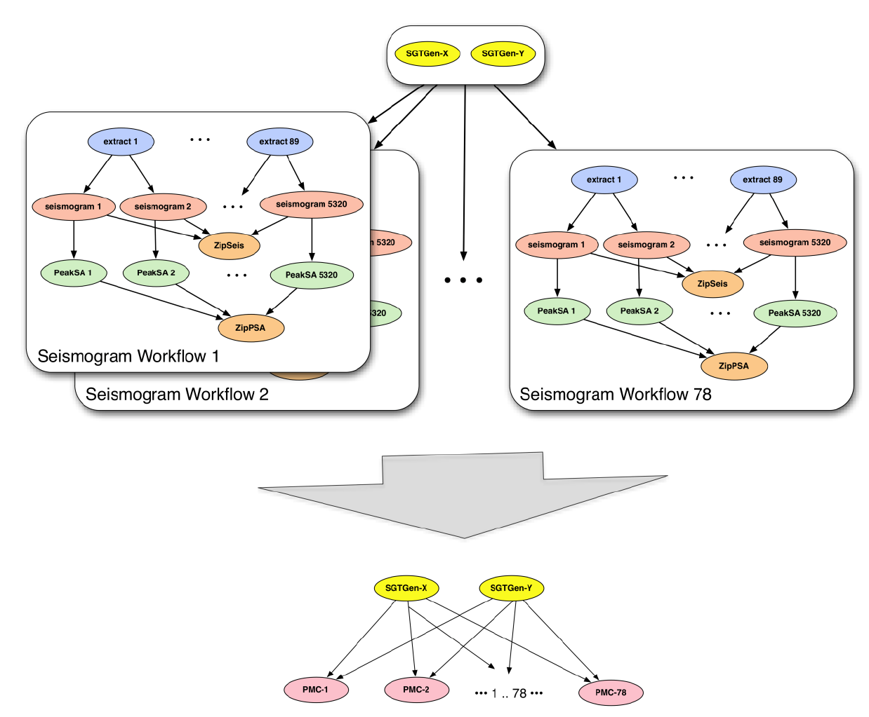
CyberShake Workflows mapped to Pegasus-MPI-Cluster Jobs
High throughput jobs wrapped in MPI master-worker job

Slide 29
CyberShake Study 14.2 Metrics
1,144 hazard curves (4 maps) on NCSA Blue Waters
342 hours wallclock time (14.25 days)
46,720 CPUs + 225 GPUs used on average
  Peak of 295,040 CPUs, 1100 GPUs
GPU SGT code 6.5x more efficient than CPU
99.8 million jobs executed (81 jobs/second)
  31,463 jobs automatically run in the Blue Waters queue
On average, 26.2 workflows (curves) concurrently
Notes:
Job failure rate: 1.3%

Slide 30
1-Hz CyberShake Hazard Curve on Titan
Software: AWP-ODC-GPU
Number of Nodes: 800 XK7 nodes for SGTs, 40 XK7 nodes for velocity mesh
Input data description: 128 GB velocity mesh per site
Simulation wallclock time: 50 minutes for each component
Output data description: 440 GB x 2 components = 880 GB per site
Production setting tested for USC, PAS, SB and WNGC sites
Notes:
Job failure rate: 1.3%

Slide 31
CyberShake SGT Simulations on XK7 vs XE6
CyberShake 1.0 Hz | XE6 | XK7 | XK7 (CPU-GPU co-scheduling)
Nodes | 400 | 400 | 400
SGT hrs per site | 10.36 | 2.80 | 2.80
Post-processing hours per site** | 0.94 | 1.88 | 2.00
Total Hrs per site | 11.30 | 4.68 | 2.80
Total SUs(Millions)* | 723 M | 299 M | 179 M
SUs saving (Millions) |  | 424 M | 543 M
3.7x
speedup
* Scale to 5000 sites based on two strain Green tensor runs per site
** based on CyberShake 13.4 map

Slide 32
CyberShake SGT Simulations on XK7 vs XE6
CyberShake 1.0 Hz | XE6 | XK7 | XK7 (CPU-GPU co-scheduling)
Nodes | 400 | 400 | 400
SGT hrs per site | 10.36 | 2.80 | 2.80
Post-processing hours per site** | 0.94 | 1.88 | 2.00
Total Hrs per site | 11.30 | 4.68 | 2.80
Total SUs(Millions)* | 723 M | 299 M | 179 M
SUs saving (Millions) |  | 424 M | 543 M
3.7x
speedup
* Scale to 5000 sites based on two strain Green tensor runs per site
** based on CyberShake 13.4 map

Slide 33
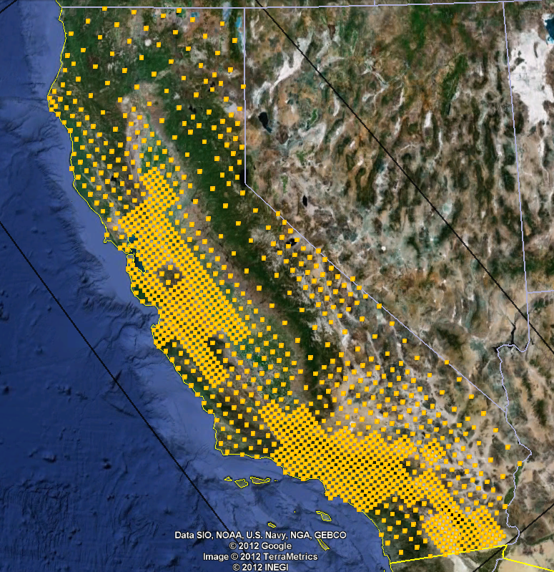
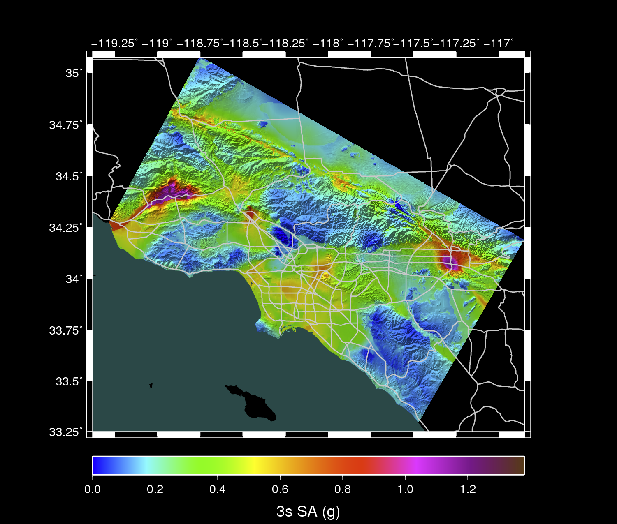
Create a broadband CyberShake hazard model for all of California
Computational requirements for 1400 sites across California
Seismicity-weighted CyberShake grid
SCEC CS14.2 study launched on Blue Waters on 18 Feb 2014, 0.5 Hz deterministic, 2 components
  Turnaround: 342 hours
  XE6/XK7 nodes used: 1620, or 49,280 cores
  Jobs submitted: 31,463
  Number of tasks: 470 million
  Storage used: 57 TB
  Allocation hours: 16 M (CPUs + GPUs)
The CS study proposed on Titan for 2014-2015, 1.0 Hz deterministic, 3 components
  Turnaround: 2 days
  XK7 nodes to use: 13,500
  Sustained PFLOP/s: 2.07
  Jobs to submit: 34,263
  Number of tasks: 575 M
  Storage used: 2 PB
  Allocation hours: 20 M (GPUs) + 220 M (CPUs)
The CS study proposed for
2015, 1.5 Hz deterministic
+ stochastic, 3 components
  Turnaround: 16 days
  XK7 nodes used: 17,400
  Sustained PFLOP: 2.67
  Jobs to submit: 51,000
  Number of tasks: 1.73 billion
  Storage used: 8 PB
  Allocation hours: 160 million (GPUs) + free CPUs
The statewide CyberShake hazard model will comprise 1.8 billion seismograms
Go Green

Slide 34
UCVM Code development bbp 1D mesh
Science Objective:
Creation of 1D mesh BBP etree and mesh on Titan using UCVM.
Computational Information:
(1) Systems Used: Titan
(2) Software Used: UCVM
(3) Number of Nodes/GPU/Cores: 512 cores on 32 nodes (16 cores/node)
(4) Input Data Description: 1M Configuration, 1G
(5) Simulation Runtime: 40 minutes
(6) Output Data Description: etree containing 180km x 110km x 50 km (110GB file)

Slide 35
Chino Hills 1Hz (Hercules) BBP with Extended Sources
Science Objective:
Compare impact of 1D ground motion simulations to 3D ground motion simulations when used in Broadband validation tests.
Computational Information
Systems Used: Titan
Software Used: Hercules GPU
(3) Number of Nodes/GPU/Cores: 800 GPUs (SGTs), 640 CPUs (velocity mesh)
(4) Input Data Description: 120 GB velocity mesh per Site
(5) Simulation Runtime: 50 minutes for each component
(6) Output Data Description: 440 GB x 2 components = 880 GB per Site

Slide 36
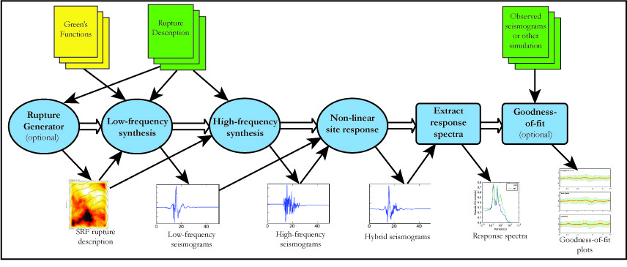
Broadband Platform Overview
Broadband Platform Software Distributions:
  Source Codes and Input Config Files : 2G (increases as platform runs)
  Data Files (Greens Functions) : 11G (static input files)

Slide 37
ObsFormat.acc
Obs.rd50
Obs_corrected.rd50
AriasDur
RotD50
SiteCorrect
GP GOF
Observed Data Processing
Simulation Data Processing
GP RupGen
GP LowFreq
GP HiFreq
RotD50
BiasPlot
Common
Post-Processing
Utilities
LOMAP.srf
SynthHiFreq.acc.bbp
Synth.rd50
LOMAP.src
SynthLoFreq.bbp

Slide 38
ObsFormat.acc
Obs.rd50
Obs_corrected.rd50
AriasDur
RotD50
SiteCorrect
GP GOF
Observed Data Processing
Simulation Data Processing
GP RupGen
Hercules 3D
GP HiFreq
RotD50
BiasPlot
Common
Post-Processing
Utilities
LOMAP.srf
SynthHiFreq.acc.bbp
Synth.rd50
LOMAP.src
SynthLoFreq.bbp

Slide 39
Looking ahead: Extreme Scale Earthquake Problems
Dynamic rupture simulations
  Current 1D outer/inner scale: 6x10⁵
  Target: 1D 600000m/0.001m (6x10⁸)
Wave propagation simulations
  Current 4D scale ratio: 1x10¹⁷
  Target 4D scale ratio: 3x10²³
Data-intensive simulations
  Current tomography simulations: ~ 0.5 PB
    SCEC 2015-2016 INCITE plan to carry out 5 iterations, 1.9 TB for each seismic source, total 441 TB for the duration of the inversion alone
  Target tomography simulations:~ 32 XBs

Slide 40
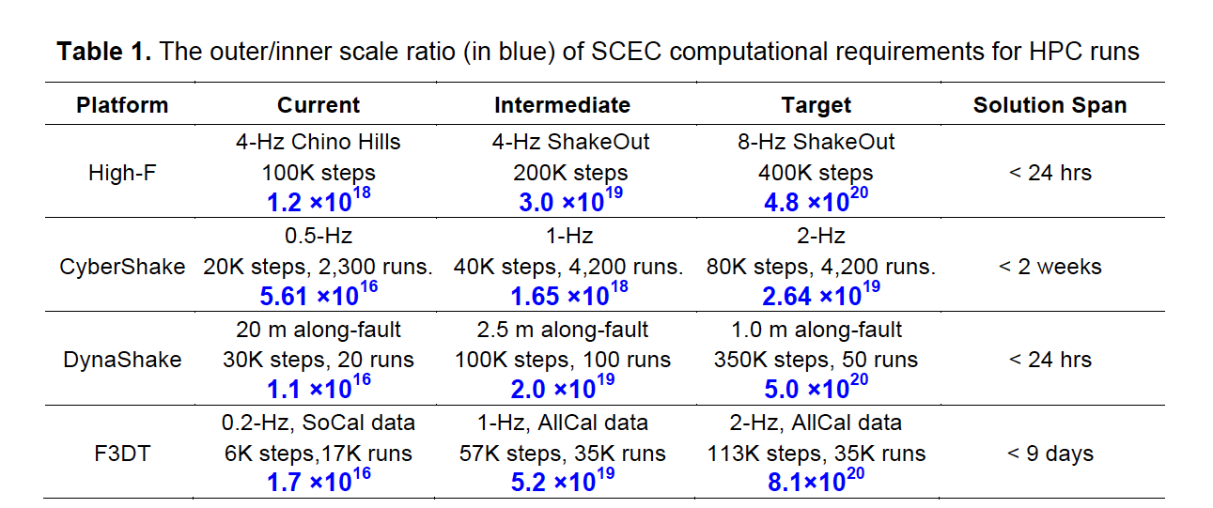
Outer/inner Scale Ratio of
SCEC Computational Requirements

Slide 41
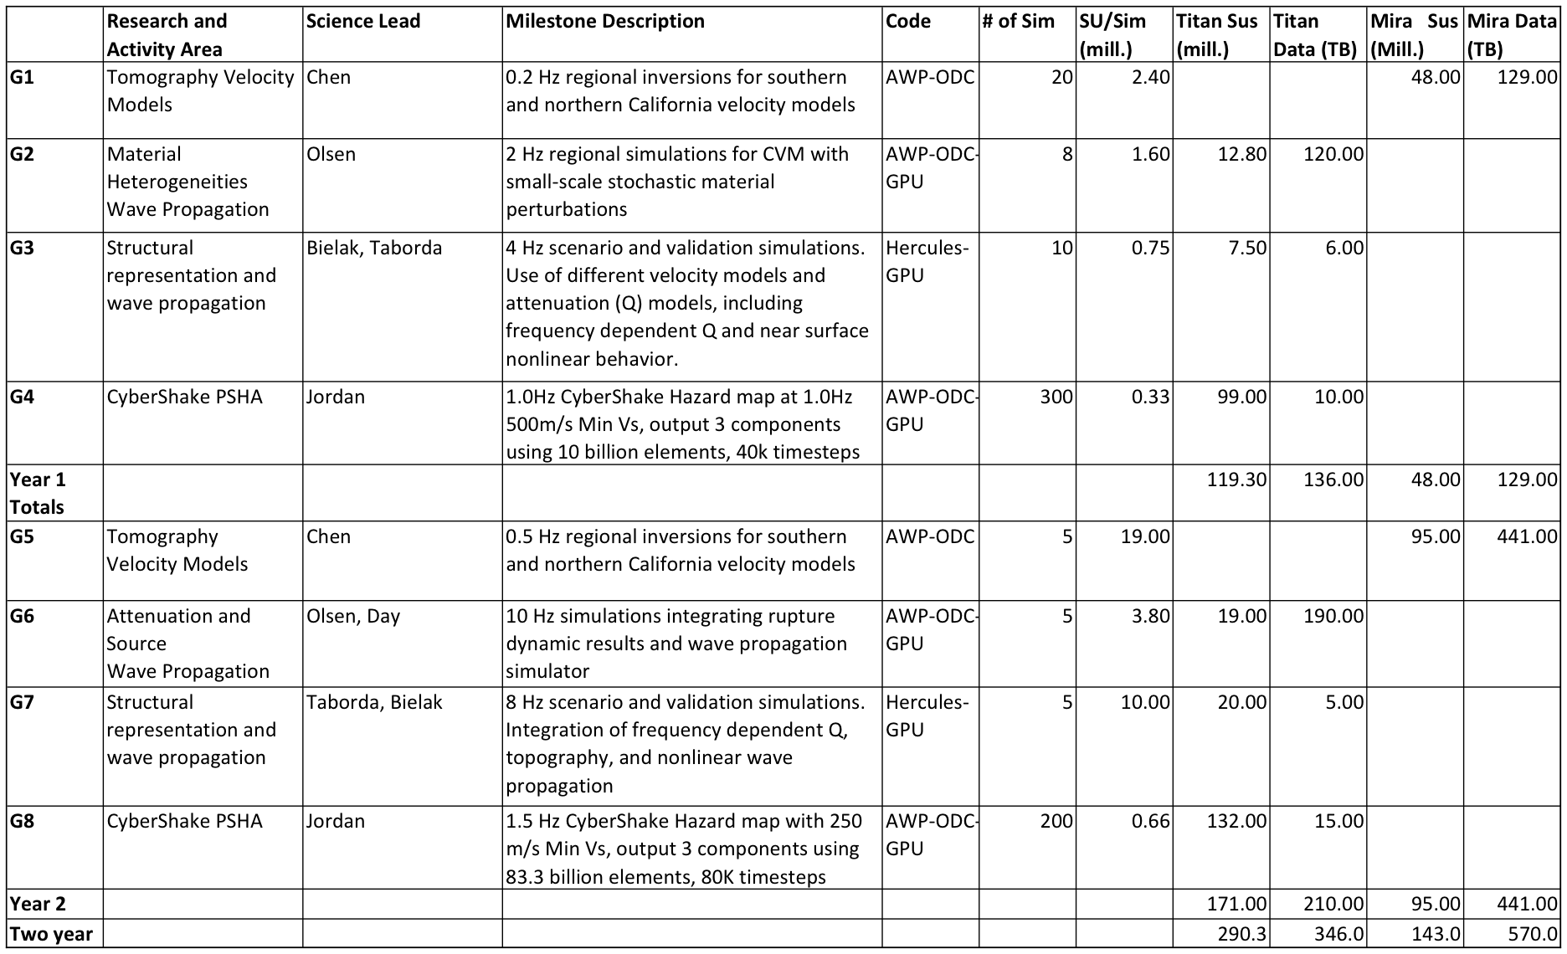
SCEC Computational Plan 2015-2016

Slide 42
SCEC Software Development
Advanced algorithms
  Development of Discontinuous Mesh AWP
  Fractal distribution and strike-slip acceleration
  Small-sale heterogeneities
  Frequency-dependent attenuation
  Include near-surface low-velocity material up to higher frequencies than previously possible
  High-F simulation of ShakeOut scenario 0-4Hz
Prepare SCEC HPC codes for next-generation systems
  Programming model
    Three levels of parallelism to address accelerating technology
    Portability
    Avoid communication and power dominating design
    Data locality
  Automation: Enable workflows on advanced systems
  I/O and fault tolerance
    Data scaling to perform more work per unit data movement
    Deal with heterogeneous architectures and tiered storage
    Data reduction methods and caching algorithms to move in/out data from dynamic storage
    Fault tolerance
  Performance: topology mapping on Titan, parallel threads implementation, and load balancing
  Scaling: dealing with million-way concurrency, strong + weak scaling
  New architectures: prepare mini-application to support new processors and interconnects

Slide 43
Computing at Extreme Scale
Top 500 No. 1 Peak Capability
Peak DOE Capability
Sustained NSF
Sustained DOE
Peak NSF
Year

Slide 44
Computing at Extreme Scale
Top 500 No. 1 Peak Capability
Peak DOE Capability
Sustained NSF
Sustained DOE
Peak NSF
Sustained SCEC measured performance for a single milestone capability simulation
Year

Slide 45
Computing at Extreme Scale
High-F + topo
Top 500 No. 1 Peak Capability
High-F + plasticity
High-F + small-scale heterogeneities
High-F + lower Vsmin
Peak DOE Capability
High-F + Q (f)
Sustained NSF
Sustained DOE
Sustained SCEC High-F
Peak NSF
Sustained SCEC measured performance for a single milestone capability simulation
Year

Slide 46
Computing at Extreme Scale
High-F + topo
Top 500 No. 1 Peak Capability
High-F + plasticity
High-F + small-scale heterogeneities
High-F + lower Vsmin
Peak DOE Capability
High-F + Q (f)
Sustained NSF
Sustained DOE
Sustained SCEC High-F
Peak NSF
Sustained SCEC measured performance for a single milestone capability simulation
CyberShake (CS) Disiderata predicted sustained performance for 4,000 sites required to generate 1.0-Hz, 1.5-Hz and 2.0-Hz state-wide seismic hazard map normalized to 24-hr completion
Year
Notes:
Timeline of the SCEC milestone runs, comparing performance requirements with DOE INCITE and NSF XSEDE/TeraGrid top high-end system. Previous TeraShake (TS1, TS2), ShakeOut (SO-K, SD-D), M8, Chino Hills 5-Hz (CH-5Hz), Rough Fault 10-Hz (RH-10Hz), and single CyberShake SGT CS-0.5Hz, future CS-1.0Hz, CS-1.5Hz, CS-2.0Hz runs are shown for comparison. Yellow circles are required sustained performance to enable completion of 4,000 sites simulations normalized to 24-hr run

Slide 47
Computing at Extreme Scale
High-F + topo
CyberShake Disiderata
Top 500 No. 1 Peak Capability
High-F + plasticity
High-F + small-scale heterogeneities
High-F + lower Vsmin
Peak DOE Capability
High-F + Q (f)
Sustained NSF
Sustained DOE
Sustained SCEC High-F
Peak NSF
Sustained SCEC measured performance for a single milestone capability simulation
CyberShake (CS) Disiderata predicted sustained performance for 4,000 sites required to generate 1.0-Hz, 1.5-Hz and 2.0-Hz state-wide seismic hazard map normalized to 24-hr completion
Year

Slide 48
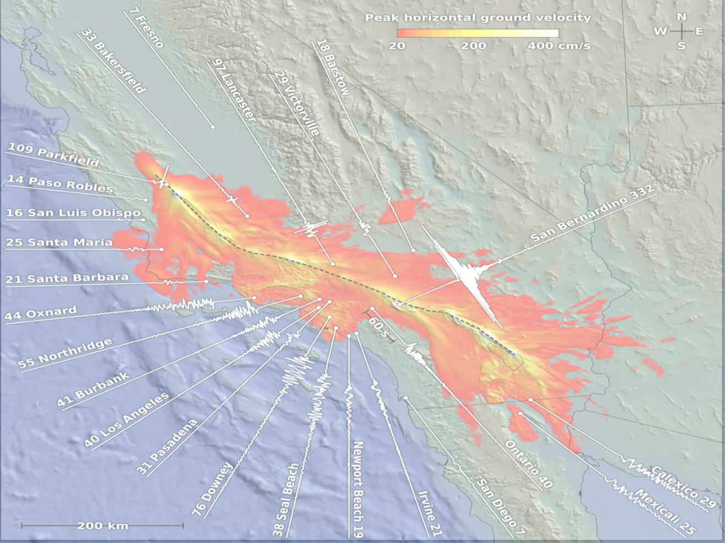
Acknowledgements
Collaborators
Matthew Norman, Jack Wells, Judith Hill (ORNL), Carl Ponder, Cyril Zeller, Stanley Posey and Roy Kim (NVIDIA), Jeffrey Vetter, Mitch Horton, Graham Lopez, Richard Glassbrook (NICS), DK. Panda and Sreeram Potluri (OSU), Gregory Bauer, Jay Alameda, Omar Padron (NCSA); Robert Fiedler (Cray), Liwen Shih (UH)
Computing Resources
NCSA Blue Waters, OLCF Titan, XSEDE Keeneland,
NVIDIA GPUs donation to HPGeoC/SDSC
NSF Grants
NCSA NEIS-P2/PRAC OCI-0832698, XSEDE ECCS, PRAC, SI2-SSI (OCI-1148493 ), Geoinformatics (EAR-1226343), NSF/USGS SCEC4 Core (EAR-0529922 and 07HQAG0008)

Slide 49
End

