Slide 1










Accelerating AWP-ODC Seismic Simulations through MPI Optimizations
Scott Callaghan (Statewide California Earthquake Center)
Yifeng Cui (San Diego Supercomputing Center)
November 19, 2025
scottcal@usc.edu
yfcui@sdsc.edu

Slide 2
Earthquake Simulations
Earthquakes cause major human impacts
  Türkiye doublet (2023)
  Myanmar (2025)
  13 M7+ earthquakes worldwide in the past year
  Annualized loss in the US is $14.7 billion/year
Large earthquakes in well-instrumented
areas are rare
  Difficult to collect useful data
Experiments only possible on small scales
Simulation and modeling critical to test
hypotheses and improve preparedness
US annualized earthquake loss by region (source: FEMA)

Slide 3
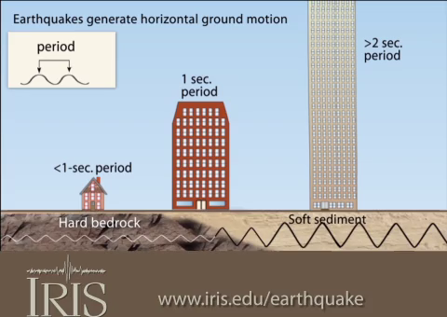
Need for HPC
Wave propagation simulations model ground motion from earthquakes
Different kinds of buildings are affected by different frequency motion
  Resonance is approximately 10/(building height in floors) Hz
Computational cost scales as the 4th power of frequency
Other components increase cost too
  Nonlinear response
  Topography
Higher-performing codes
can include more physics
  Leads to more accurate,
  broadly useful results
Simulated peak velocity for 2019 M7.1 Ridgecrest earthquake

Slide 4
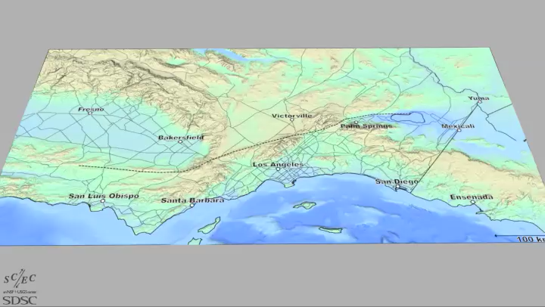

Slide 5

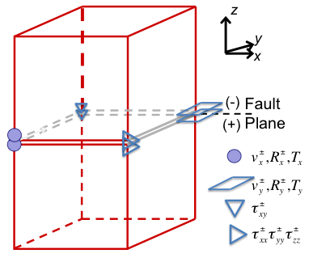
AWP-ODC
Anelastic Wave Propagation – Olsen, Day, and Cui
Started as personal research code
3D velocity-stress wave equations
solved by explicit staggered-grid
4th order finite difference
Displacement nodes split at fault
surface: explicitly discontinuous
displacement & velocity
Absorbing boundary conditions by perfectly matched layers
Supports dynamic rupture simulations as well
Variables:
V_{i}± split-node particle velocities
τ_{ij} stresses
T_{i}± split-node traction (no jump)
R_{i}± stress divergence terms

Slide 6
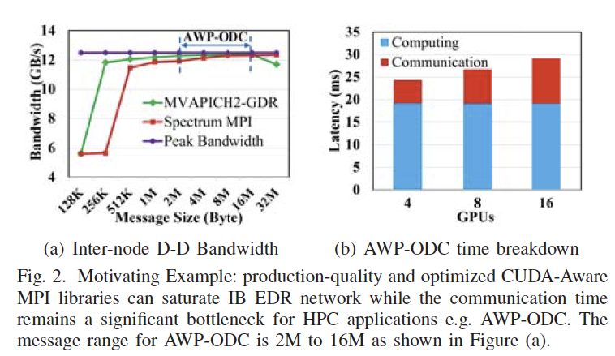
Motivation for MPI Compression
Collaboration with DK Panda team at OSU
Each AWP-ODC process communicates
with (up to) 6 neighbors
Significant communication times
at large scale
Inter-node bandwidth is often saturated
Disparity between intra-node and
inter-node GPU communication
bandwidth impedes efficient scalability
(Q. Zhou et al. IPDPS’21)

Slide 7
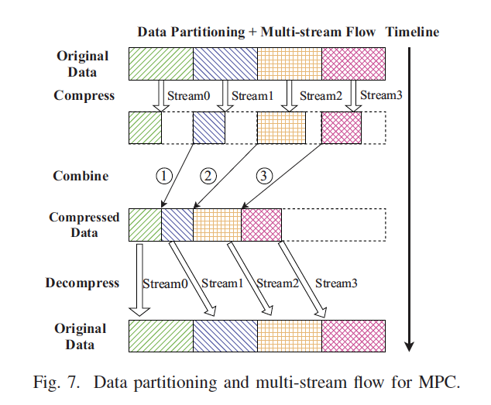
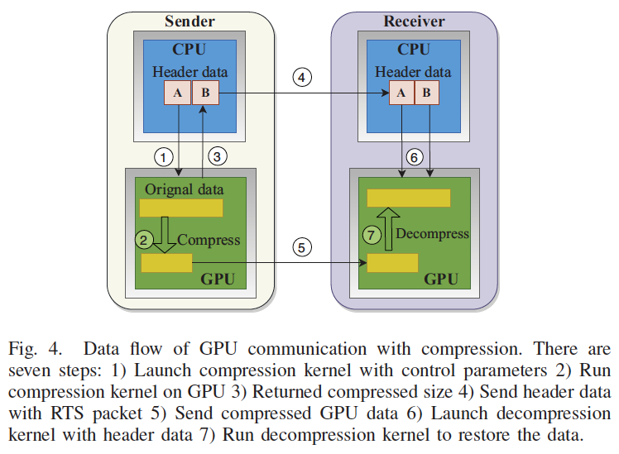
On-the-fly Compression on GPUs
Designed on-the-fly message compression schemes in MVAPICH2-GDR
Messages are compressed and combined, then sent and decompressed
Two GPU compression algorithms integrated into MVAPICH-GDR:
  MPC: lossless
  ZFP: lossy
Overlap compression/
decompression kernels
(Q. Zhou et al. IPDPS’21)

Slide 8
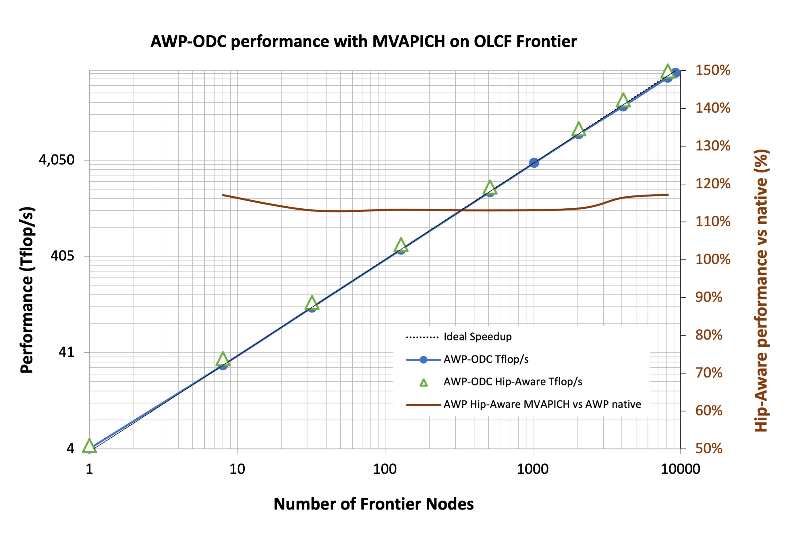
AWP-ODC Performance on OLCF Frontier
MVAPICH used for full system scale on Frontier
95% efficiency
17.2% improvement in time-to-solution with MVAPICH2-GDR (GPU-aware MPI), better than Cray MPICH (14%)
Working on compression implementation

Slide 9
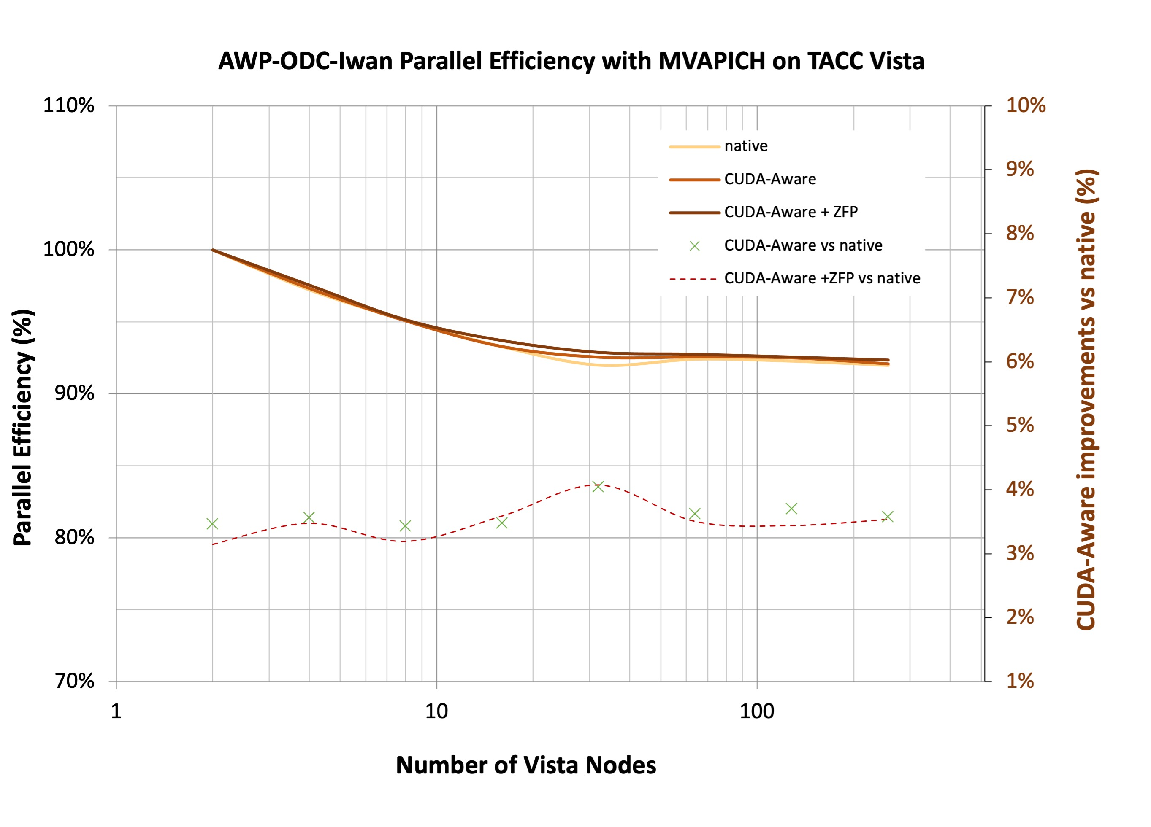
AWP-ODC Performance on TACC Vista
3.5% improvement with on-the-fly ZFP compression for 256 nodes
Smaller improvement due to fast CPU/GPU data transfer

Slide 10
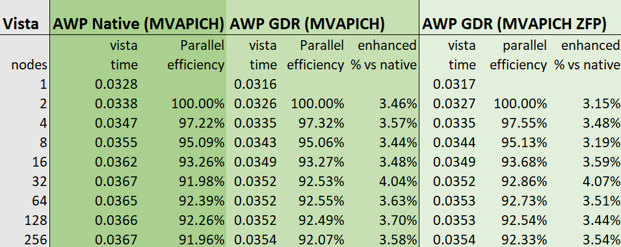
Vista performance summary

Slide 11
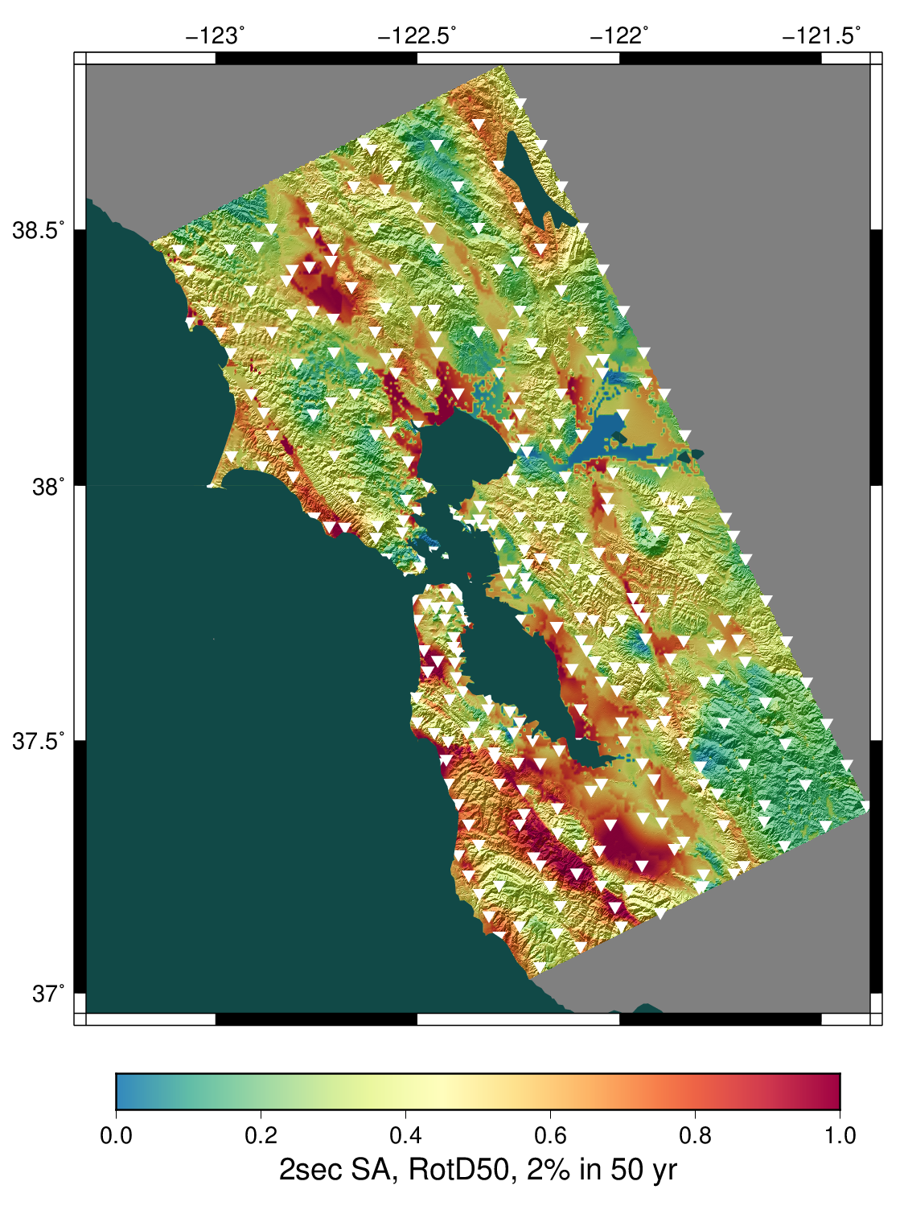
Applications of AWP-ODC
SCEC CyberShake project uses simulations to
improve seismic hazard models in California
  AWP-ODC used to run wave propagations
  Ran code 945 times on Frontier to create hazard map
  Represents best available science
In 2026, code will be used to improve input velocity
models and run high-resolution nonlinear scenarios
AWP is a Characteristic Science Application for TACC
Horizon
  Will use Vista experience for Horizon
Physics-based seismic hazard map for Northern California

Slide 12
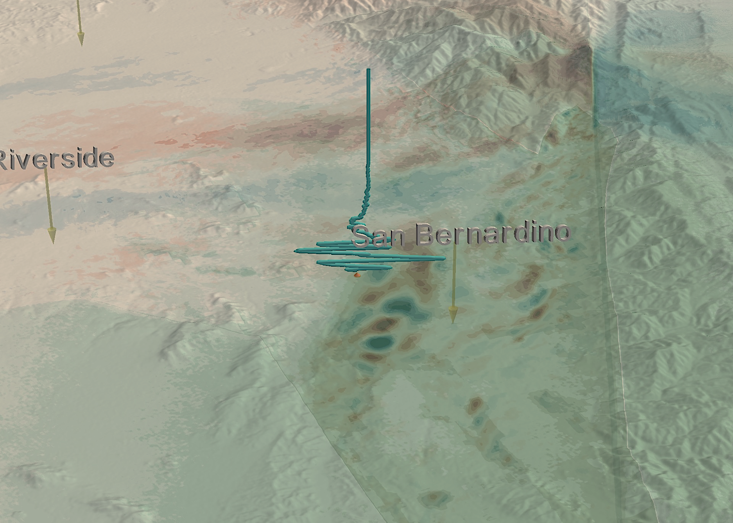



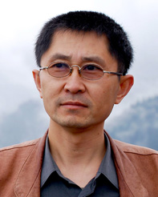
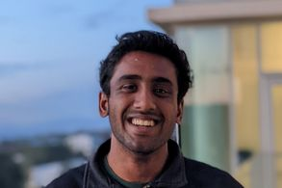
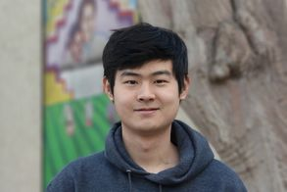
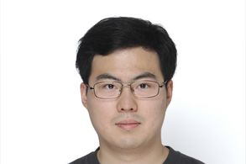
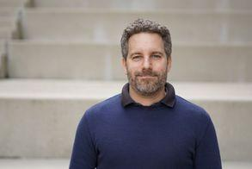



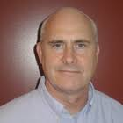

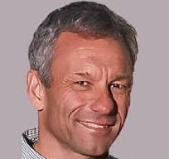
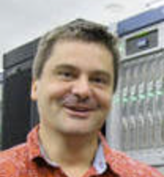



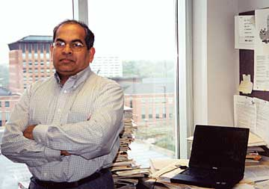
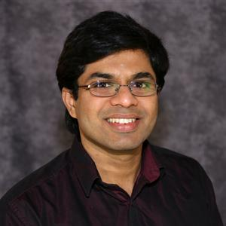
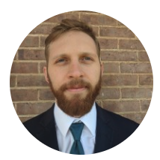








Acknowledgments
HPGeoC Team
Yifeng Cui
Akash Palla Tom Zhang Shijie Wang Daniel Roten
Collaborators
Philip Maechling Scott Callaghan Kim Olsen Lars Koesterke
NOWLAB Team
DK Panda Hari Subramoni Nick Contini Chen-Chun Chen Lang Xu
Computing Allocation OLCF DD, TACC LSCP and CSA, SDSC Expanse, DOE INCITE
Funding NSF LCCF/CSA, NSF CSSI, NSF/USGS SCEC Core, SDSC Core

