Slide 1
CyberShake Seismic Hazard Models for Central California
Scott Callaghan
SC17

Slide 2
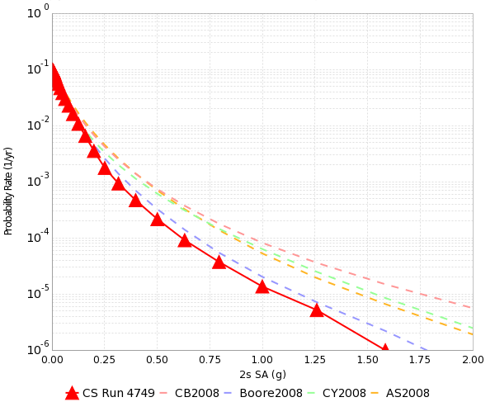
Probabilistic Seismic Hazard Analysis (PSHA)
What will peak earthquake shaking be over the next 50 years?
Useful information for:
Building engineers
Disaster planners
Insurance agencies
PSHA performed by
Assembling a list of earthquakes
Determining how much shaking each event causes
Combining the shaking levels with probabilities
2% in 50 yrs
0.4 g

Slide 3
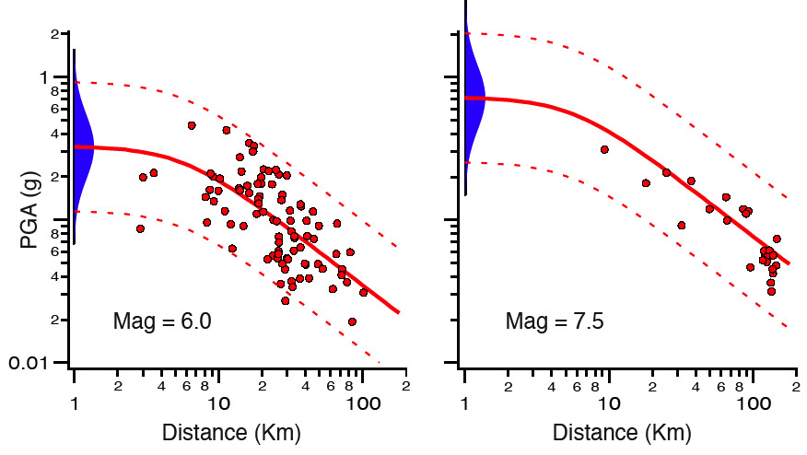
PSHA Approaches
Ground Motion Prediction Equations (GMPEs)
Equations derived from historical data
Limited large magnitude data
Limited near-fault data
Large variability
Long tails
Simulation-based approach
Reduce uncertainty by capturing complex physics
Computationally expensive
6-7g

Slide 4
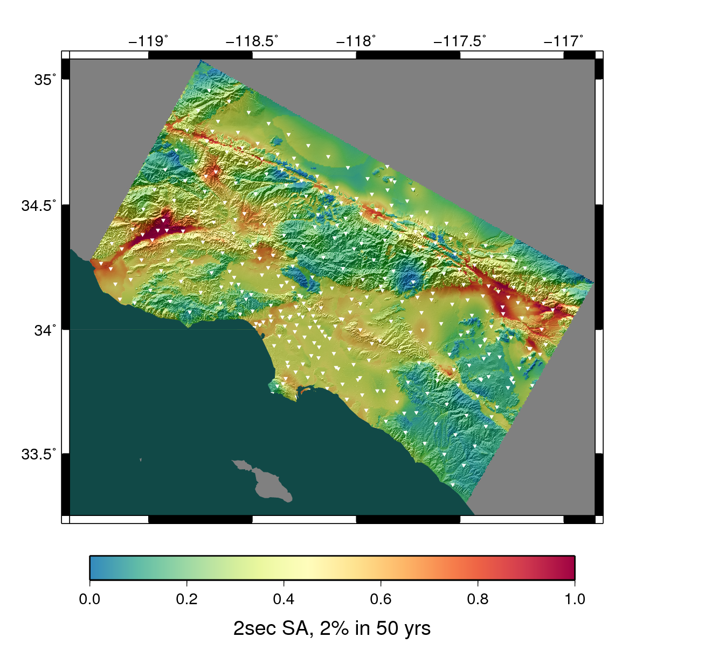
SCEC CyberShake Project
3D physics-based platform for PSHA
For each site of interest:
Determine nearby (<200 km) earthquakes
Add variability to earthquakes
Simulate each of 500,000 earthquakes
Determine maximum shaking from each
Combine with probabilities
Project began in 2007
Continual improvement

Slide 5
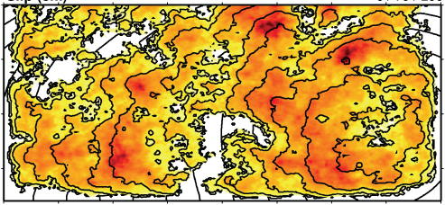
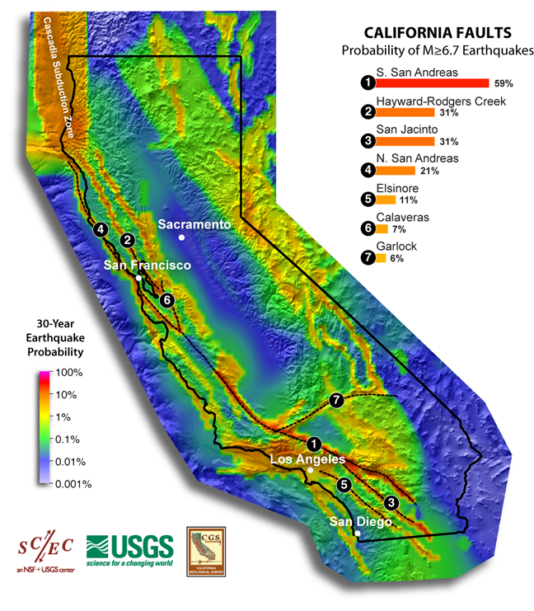
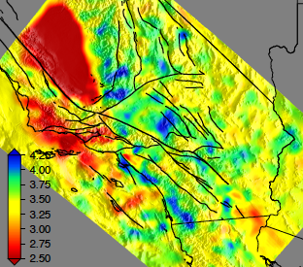
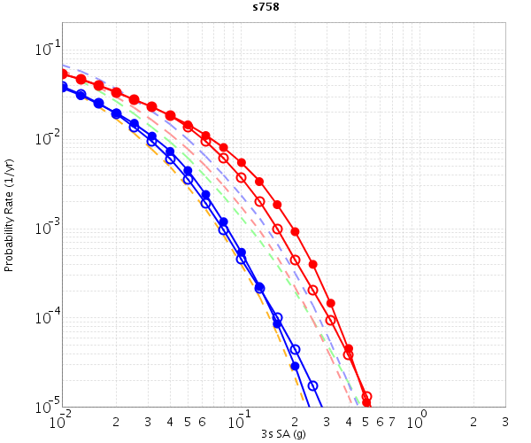
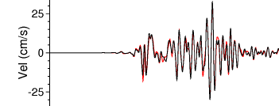
CyberShake Data Flow
Rupture Generator
CyberShake Hazard Map
UCVM
AWP-ODC
Seismogram Synthesis
Data
Product Generation
3 TB
data transfer
Mesh generation
1 job per site
MPI, 1500-4000 cores
SGT computation
2 jobs per site
MPI, 200-800 GPUs
Post-processing
500,000 jobs per site
MPI master/worker, 3712 cores
Populate DB, construct images
6 jobs per site
Uniform California Earthquake Rupture Forecast
CVM-S4.26
z = 6 km
hazard curves
Most recent CyberShake study took 4 weeks of real time and used 21 million core-hours
500,000 Seismograms
75M intensity measures
Community Velocity Model

Slide 6
CyberShake Requirements
200-400 sites needed for a hazard map
Execute jobs across multiple systems
USC HPC, NCSA Blue Waters, OLCF Titan
Automated execution of jobs
Data management
28,000 files and 30 GB output per site
Migration of input and output files when needed
Error recovery
Decided to use scientific workflows

Slide 7
CyberShake Workflow Tools
Pegasus-WMS (USC ISI)
Use API to describe workflow as tasks with dependency
Plan workflow for execution on specific resource(s)
Adds data transfer jobs and metrics wrappers
Intro to Pegasus Wed at 2; office hours Tues at 3 and Wed at 3
HTCondor (U of Wisconsin)
Manages runtime execution of jobs
Resolves dependencies
Checkpoints workflows
Globus (booth #373)
GRAM for communication between workflow host and remote system
GridFTP for file transfer

Slide 8
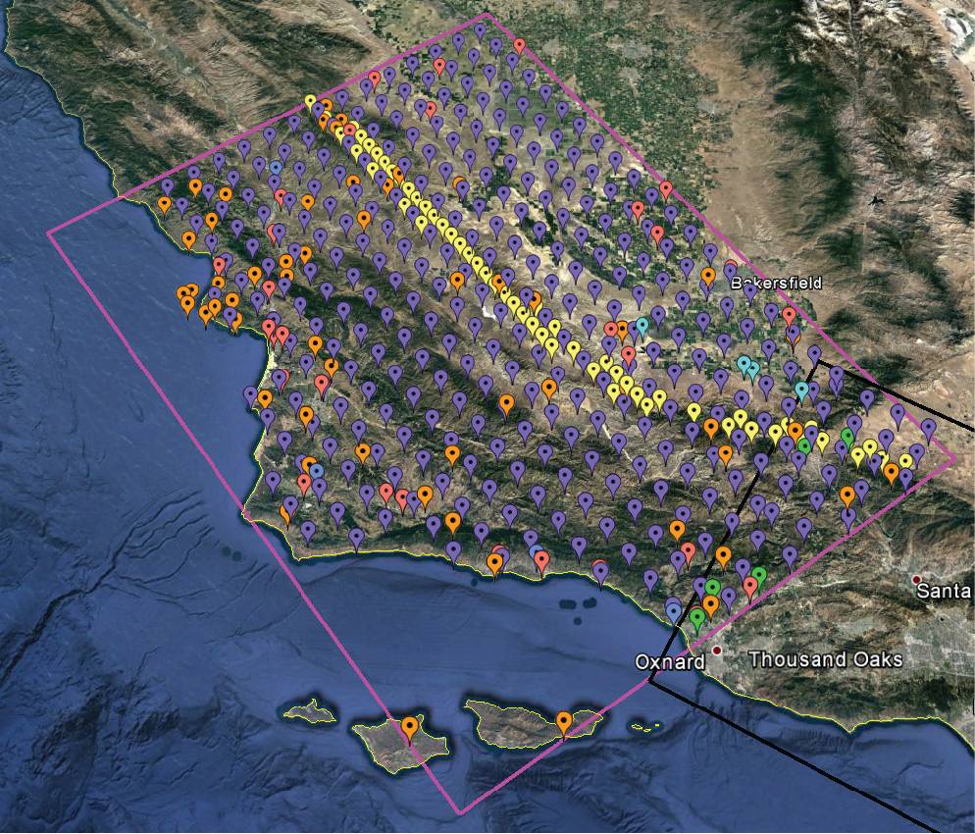
CyberShake in Central California
2017 science goal
Proof-of-concept that CyberShake can be moved outside of Southern California
New sites
New velocity model of earth’s crust
New workflow approach

Slide 9
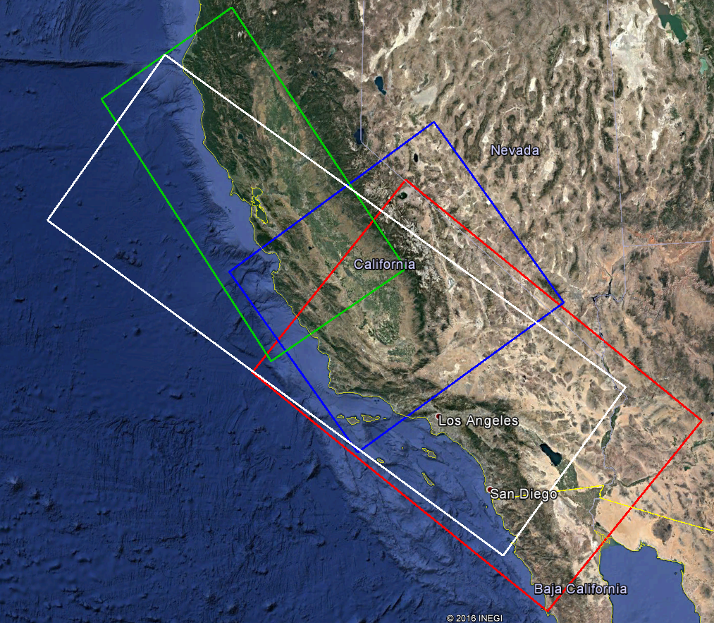
Central California Challenges
Simulation volume
Had to combine multiple velocity models
Smooth across interfaces
Targeted OLCF Titan for 200-node GPU jobs
Requires two-factor authentication
Difficult to automate job submission
Tried pilot job approach in 2015; successful but with 32% overhead
Looking for more efficient solution

Slide 10
rvGAHP Workflow Approach
“reverse GAHP” – approach using HTCondor protocol
Enables remote job submission without authentication to remote system
Daemon runs on remote system
Initiates connection to workflow submission host
Workflow can then use connection to submit jobs to remote queue
Opens up Titan to low-overhead workflows

Slide 11
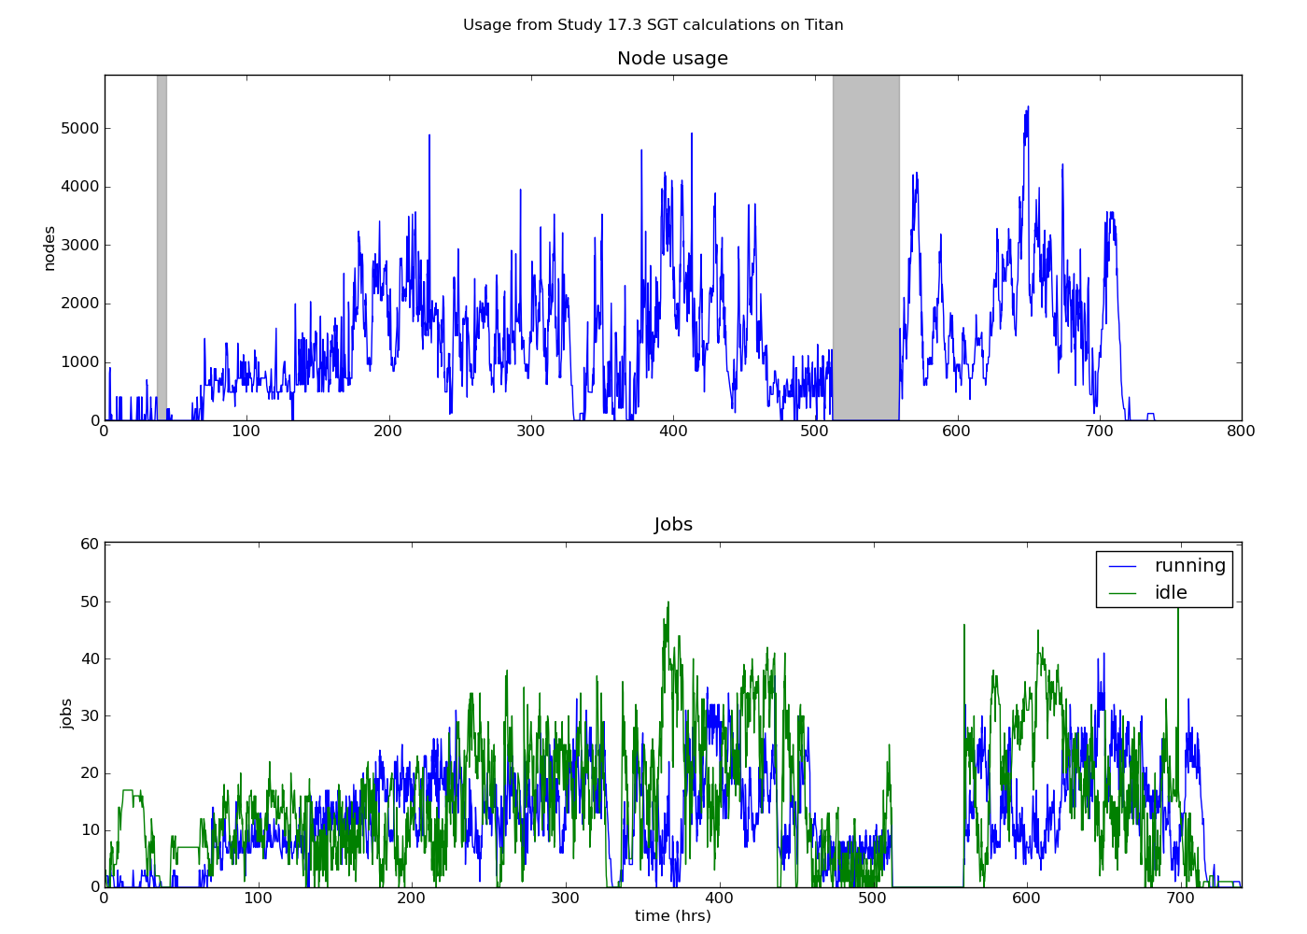
CyberShake Study 17.3
Conducted over 31 days in March-April 2017 on NCSA Blue Waters, OLCF Titan, USC HPC
2 models at 438 sites
Averaged 1295 nodes, max of 5374
900,000 node-hrs (21.6M core-hrs)
Workflow tools scheduled 15,581 jobs
777 TB of data managed
308 TB transferred
10.7 TB archived on USC disks
Generated 285 million seismograms

Slide 12
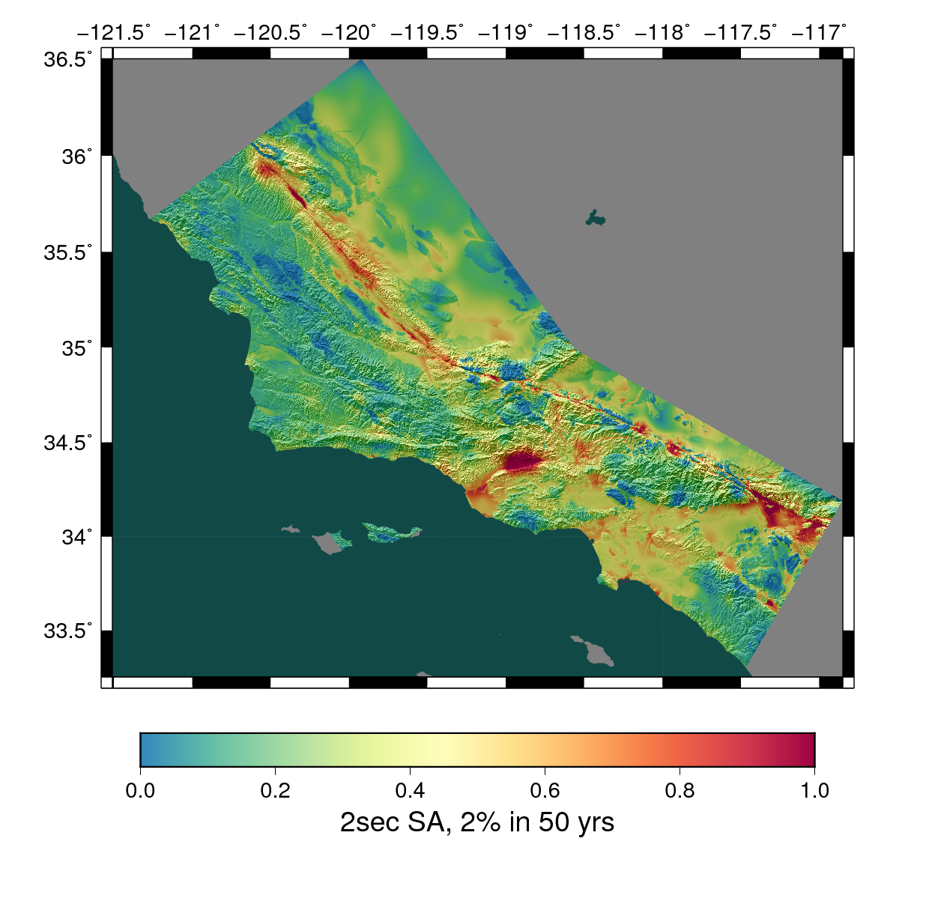
CyberShake Study 17.3 Results
Study 17.3
Combined map

Slide 13
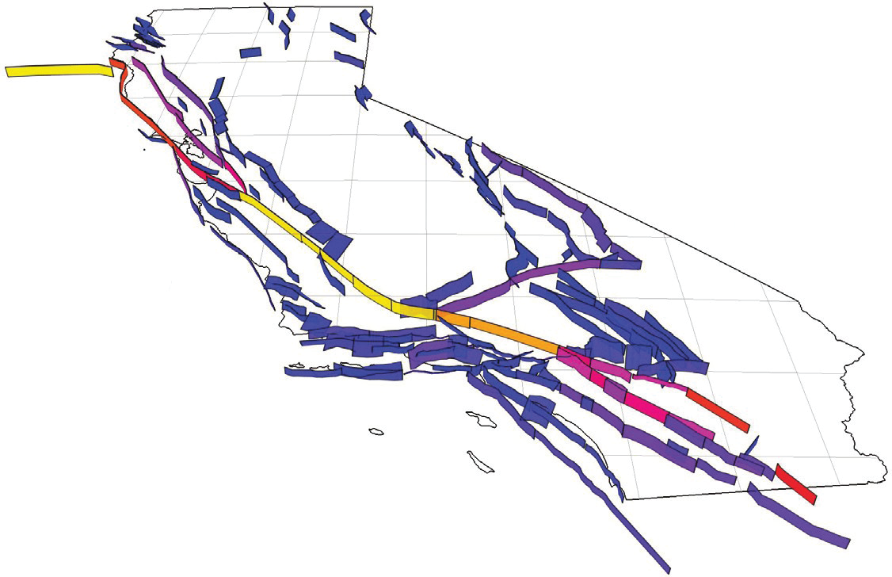
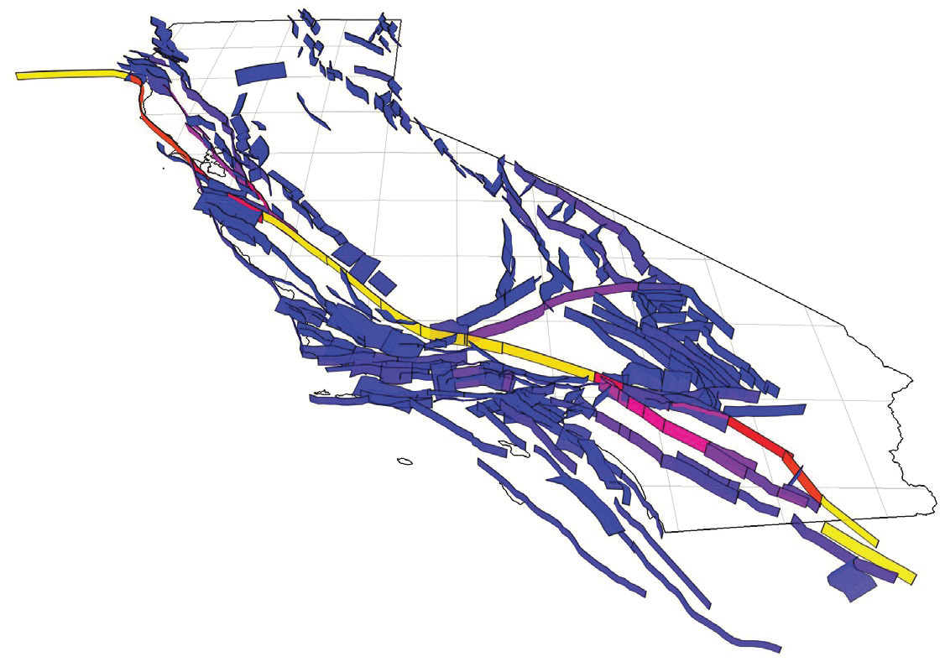
Future Directions
UCERF2
14,000 ruptures
UCERF3
350,000 ruptures
Move to new forecast
UCERF 3
RSQSim earthquake simulator
Run CyberShake in new regions – San Diego? Bay Area?
Add new physics
Increase maximum frequency – applicable to more buildings
Velocity model heterogeneities, fault roughness, topography
Optimize
Seismogram synthesis – compress data? Large shared-memory nodes?
Use machine learning to eliminate some earthquakes

Slide 14
Thanks!

