Slide 1










MPI-based Optimizations for
AWP-ODC Seismic Simulation Code
Scott Callaghan (Statewide California Earthquake Center)
Yifeng Cui (San Diego Supercomputing Center)
November 19, 2024
scottcal@usc.edu
yfcui@sdsc.edu

Slide 2
Earthquake Simulations
Earthquakes cause major human impacts
  Haiti (2021)
  Türkiye doublet (2023)
  10 M7+ earthquakes worldwide in the past year
  Annualized loss in the US is $14.7 billion/year
Large earthquakes in well-instrumented
areas are rare
  Difficult to collect useful data
Experiments only possible on small scales
Simulation and modeling critical to test
hypotheses and improve preparedness
US annualized earthquake loss by region (source: FEMA)

Slide 3
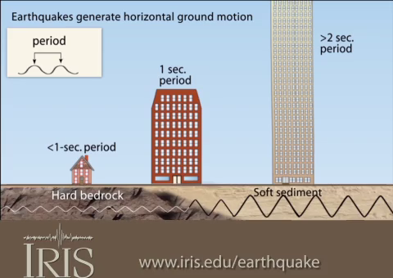
Need for HPC
Wave propagation simulations capture ground motion from earthquakes
Different kinds of buildings are affected by different frequency motion
  Resonance is approximately 10/(building height in floors) Hz
Computational cost scales as the 4th power of frequency
Other components increase cost too
  Nonlinear response
  Topography
Higher-performing codes
can yield more accurate,
broadly useful results
Simulated peak velocity for 2019 M7.1 Ridgecrest earthquake

Slide 4

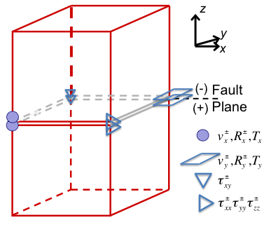
AWP-ODC
Anelastic Wave Propagation – Olsen, Day, and Cui
Started as personal research code
3D velocity-stress wave equations
solved by explicit staggered-grid
4th order finite difference
Displacement nodes split at fault
surface: explicitly discontinuous
displacement & velocity
Absorbing boundary conditions by perfectly matched layers
Supports dynamic rupture simulations as well
Variables:
V_{i}± split-node particle velocities
τ_{ij} stresses
T_{i}± split-node traction (no jump)
R_{i}± stress divergence terms

Slide 5
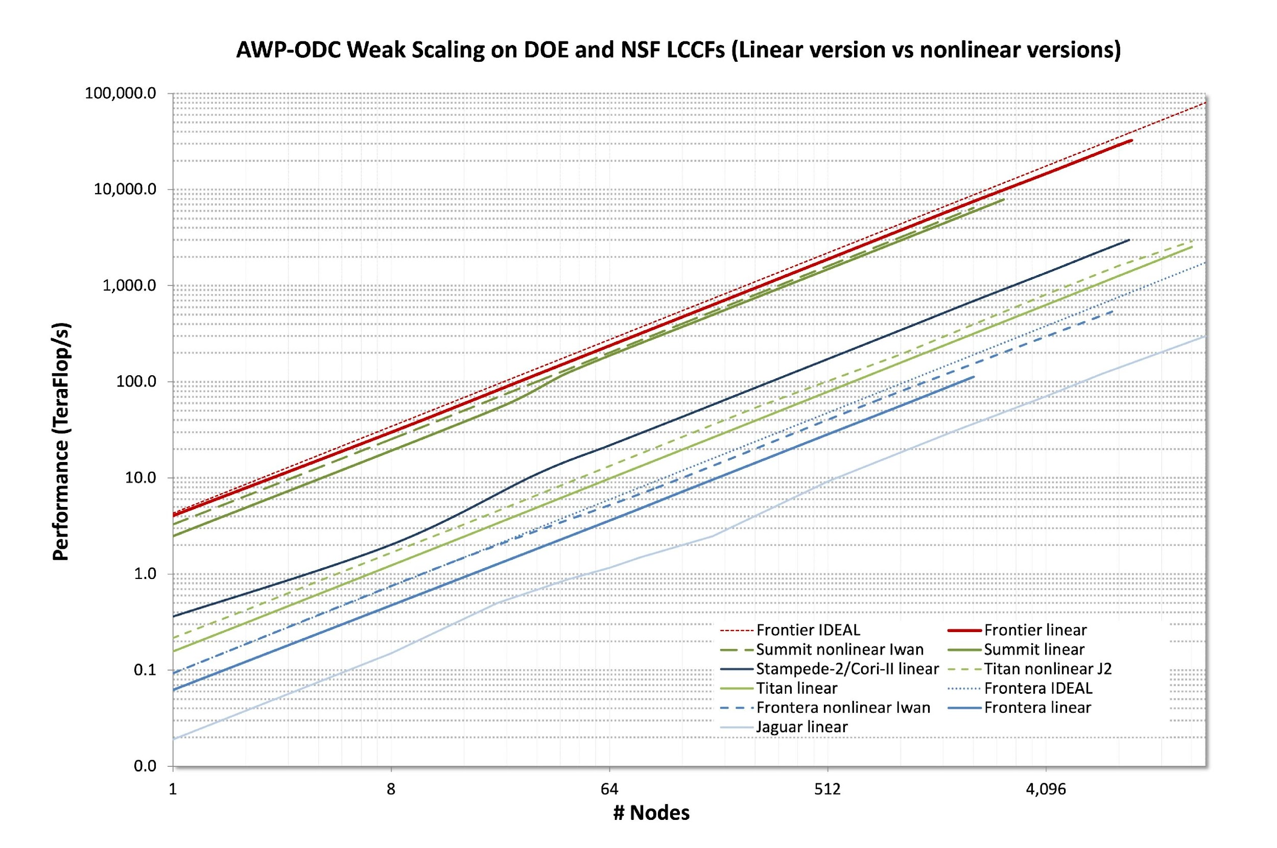
Scalability
AWP-ODC scales well on leadership-class systems

Slide 6
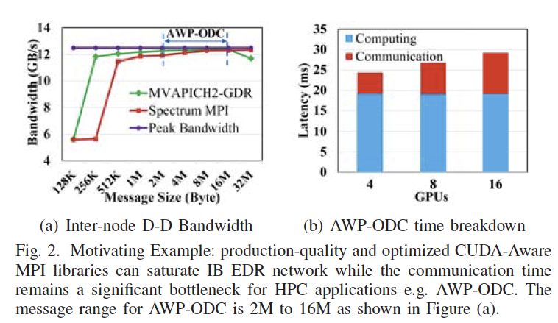
Motivation for MPI Compression
Collaboration with DK Panda team at OSU (IPDPS’21 Best Paper Finalist)
Each AWP-ODC process communicates
with (up to) 6 neighbors
Significant communication times
at large scale
Inter-node bandwidth is often saturated
Disparity between intra-node and inter-node
GPU communication bandwidth impedes
efficient scalability
(Q. Zhou et al. IPDPS’21)

Slide 7
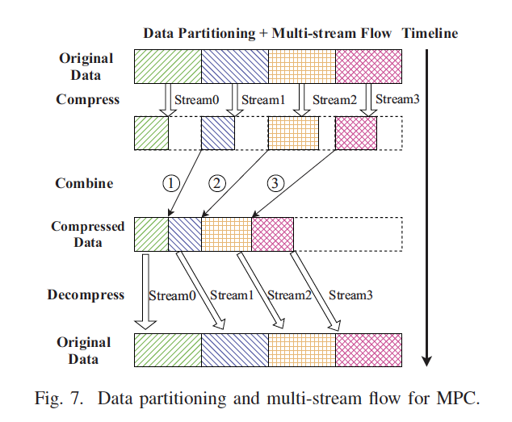
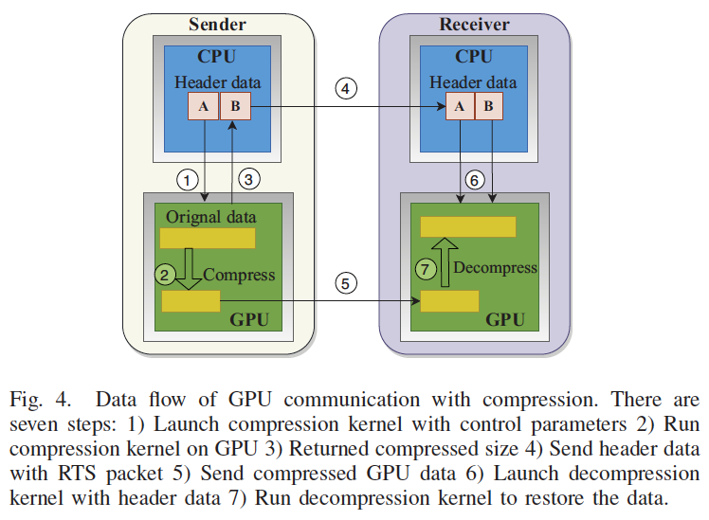
On-the-fly Compression on GPUs
Designed on-the-fly message compression schemes in MVAPICH2-GDR
Messages are compressed and combined, then sent and decompressed
Two GPU compression algorithms integrated into MVAPICH-GDR:
  MPC: lossless
  ZFP: lossy
Overlap compression/
decompression kernels
(Q. Zhou et al. IPDPS’21)

Slide 8
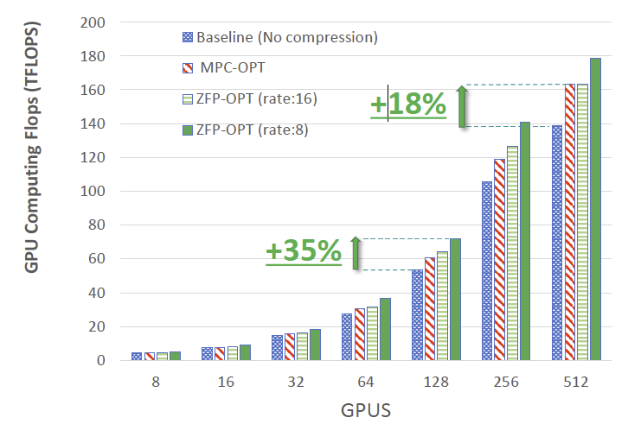
MPI Compression Performance Results
MPC (lossless)
  18% increase in flops
  15% reduction in runtime
ZFP (lossy)
  35% increase in flops
  26% reduction in runtime
Latency reduced up to 85%
(Q. Zhou et al. IPDPS’21)

Slide 9
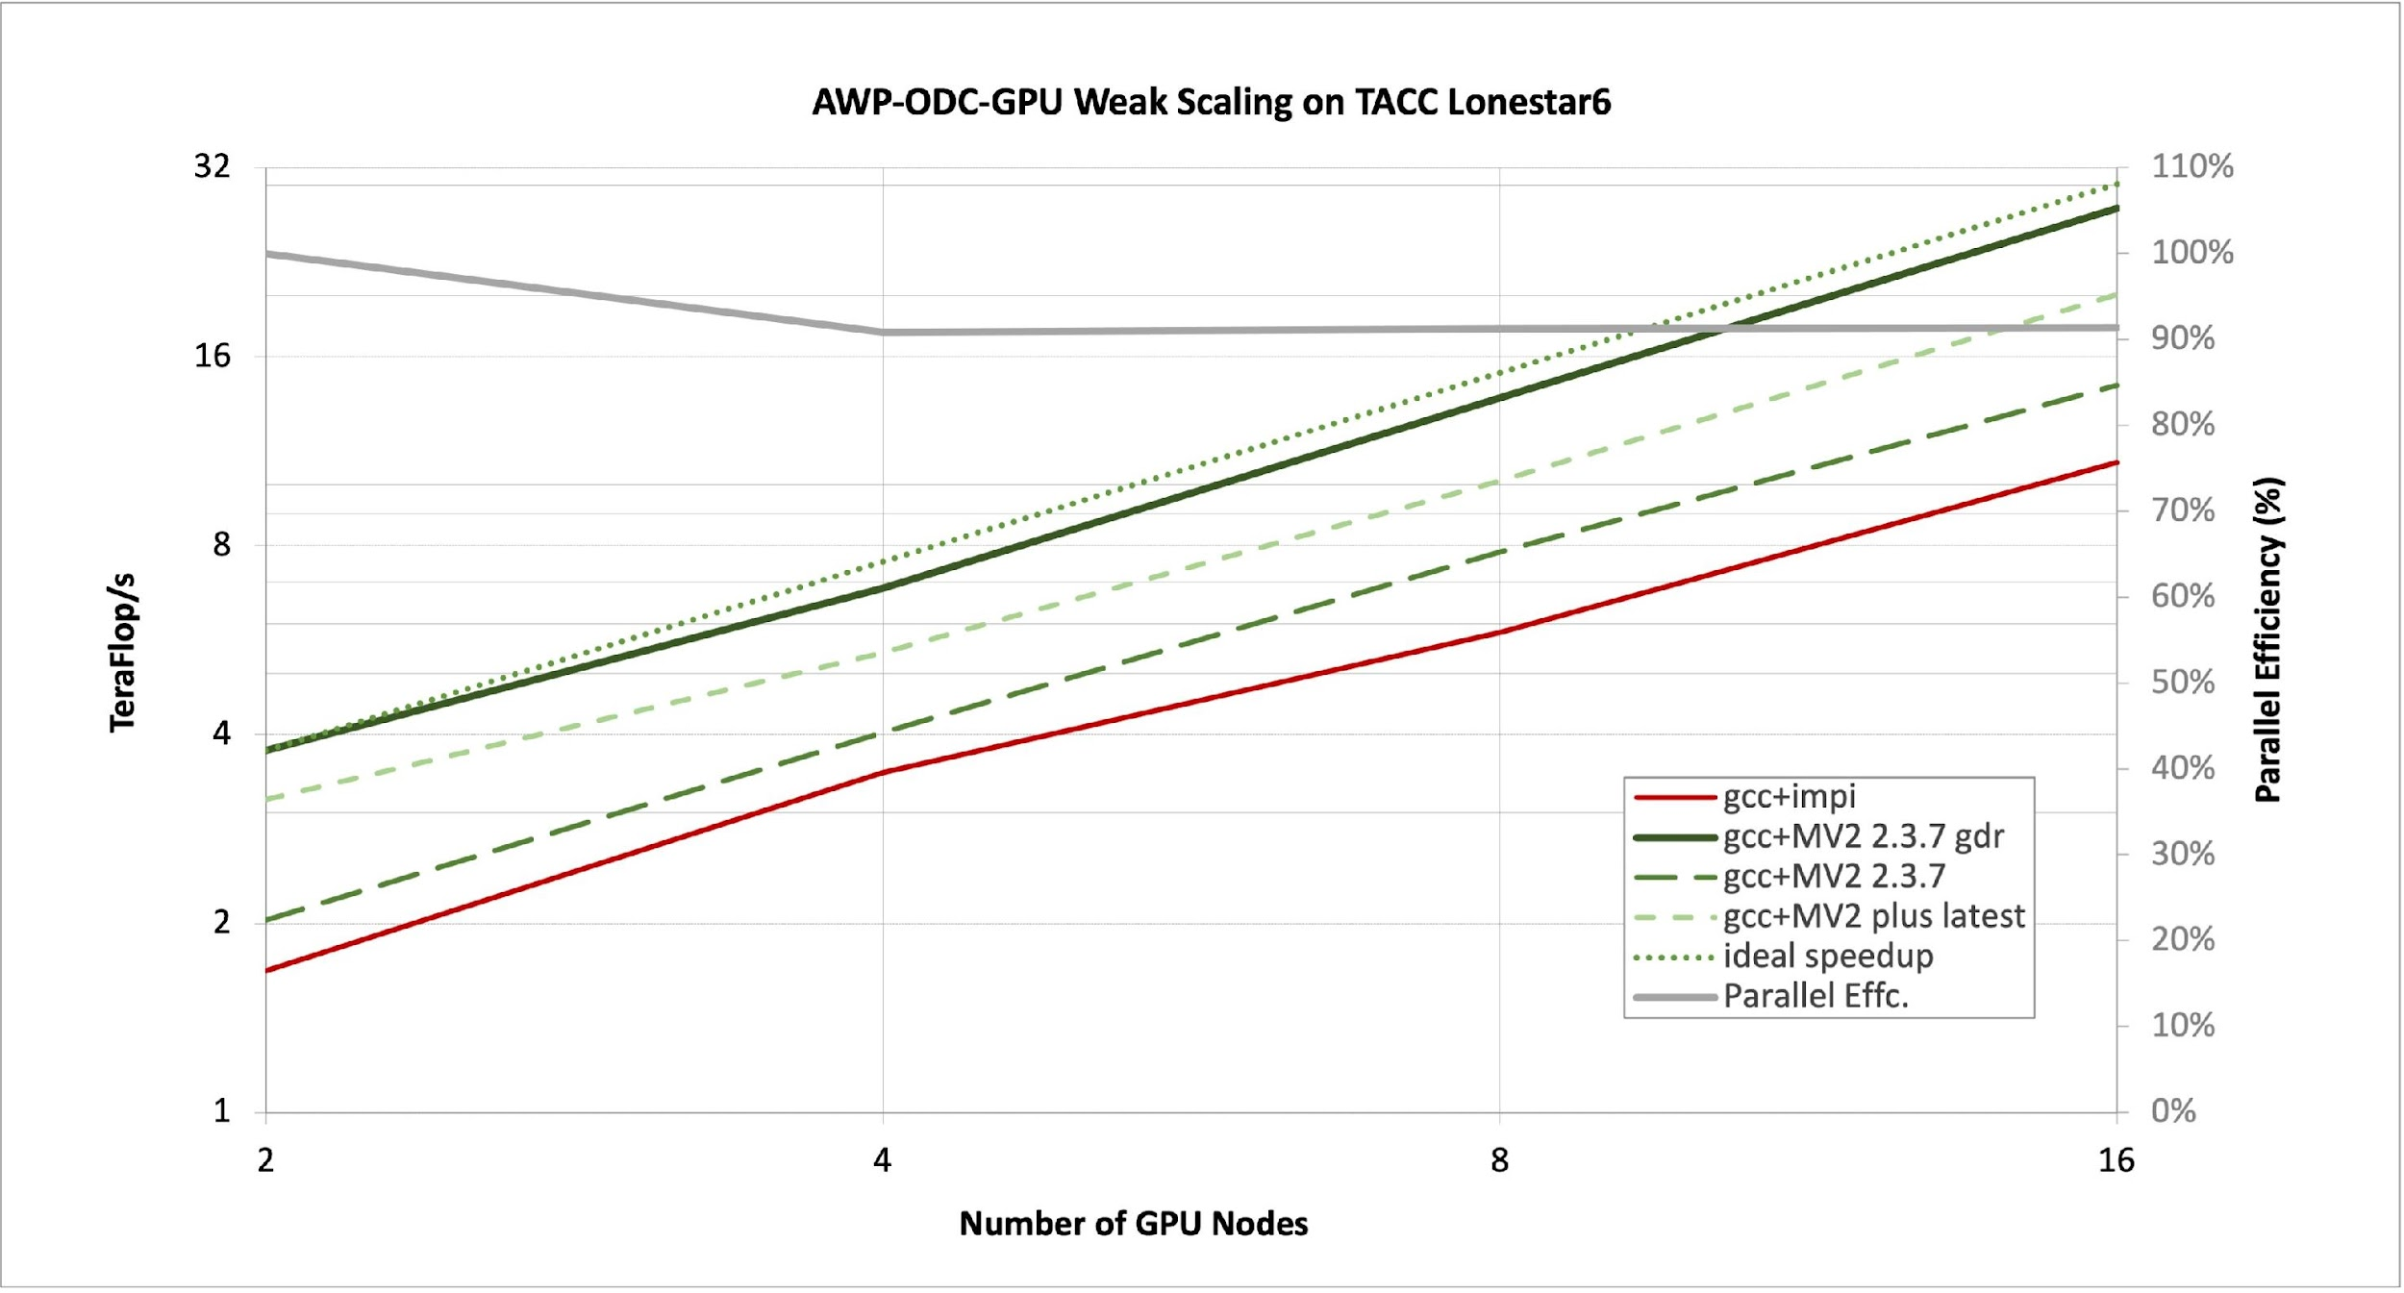
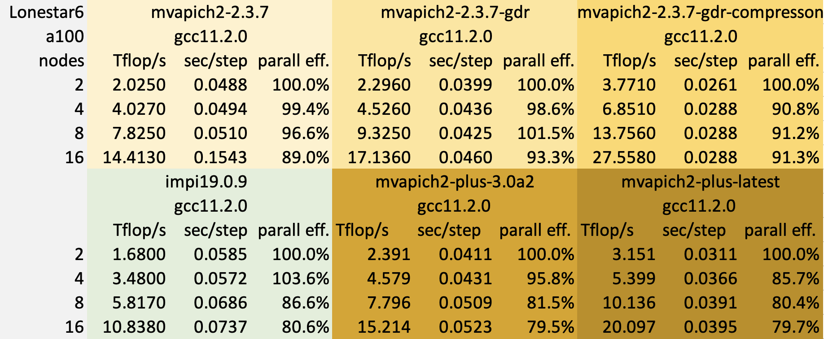
Performance Comparisons
Best performance with MVAPICH2 + GDR + compression (at right)
~2x speedup with CUDA-aware MPI + compression (below)
Promising results with Grace Hopper on TACC Vista
AWP-ODC | K20X | KNL7250 | V100 (NVLink) | A100 (NVLink) | A100 (PCIe) | A100 (PCIe+Opt) | H100 (PCIe) | H100 (PCIe+Opt) | MI250X (Slingshot) | GH200
MLUPS** | 552 | 1092 | 1598 | 1937 | 896 | 2009 | 3713 | 5145 | 1711 | 8480
Speedup | 1x* | 1.98x | 2.89x | 3.51x | 1.62x | 3.64x | 6.72x | 9.32x | 3.10x | 15.36x
* 160x160x2048 per GPU configuration ** Millions of lattice point update completed per second
48%-64% improvement using on-the-fly MPC compression over GDR

Slide 10
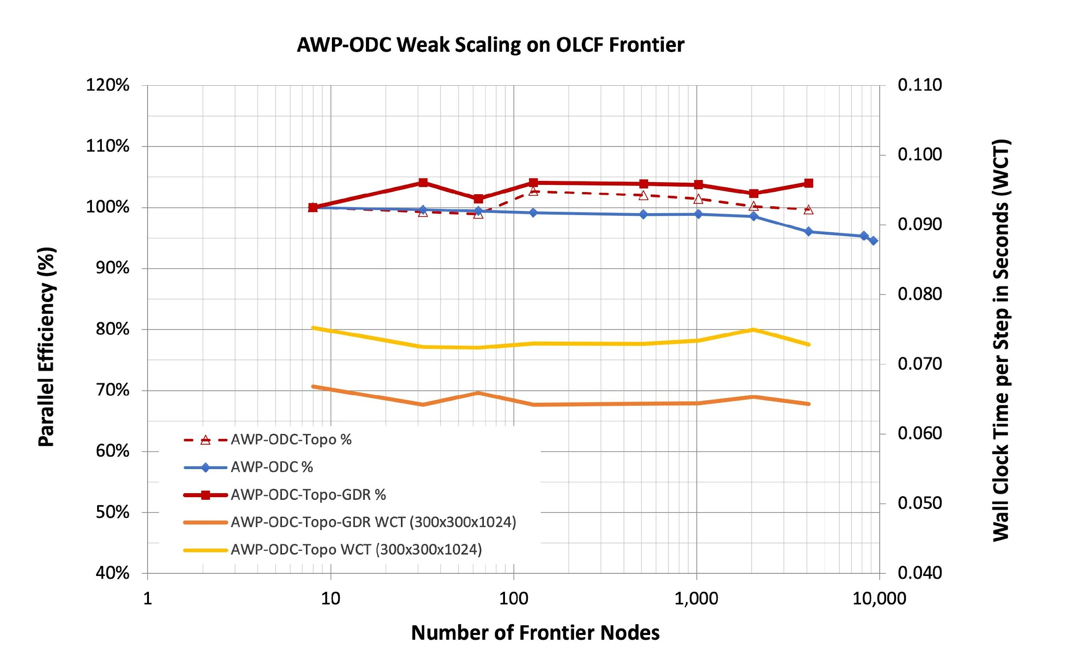
AWP-ODC-Topo w/ and w/o ROCm-Aware on Frontier
14% improvement
Notes:
We recently implemented ROCm-Aware into Topo code. While this development still needs to be verified, the initial results show that the GDR enabled results in additional 14% gain up to 4096 tested node, this might go higher when running on full machine scale.

Slide 11
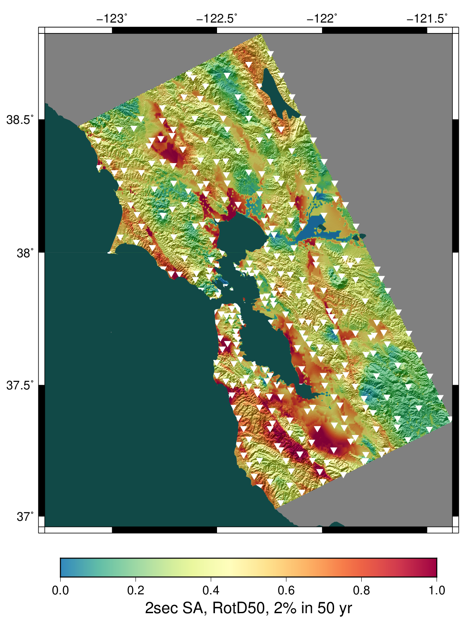
Applications of AWP-ODC
SCEC CyberShake project uses simulations to
improve seismic hazard models in California
  AWP-ODC used to run wave propagations
  Ran code 945 times on Frontier to create hazard map
  Represents best available science
In 2025, code will be used to improve input velocity
models and run high-resolution nonlinear scenarios
Planning to use optimized code for capability runs
on LLNL El Capitan
Physics-based seismic hazard map for Northern California

Slide 12
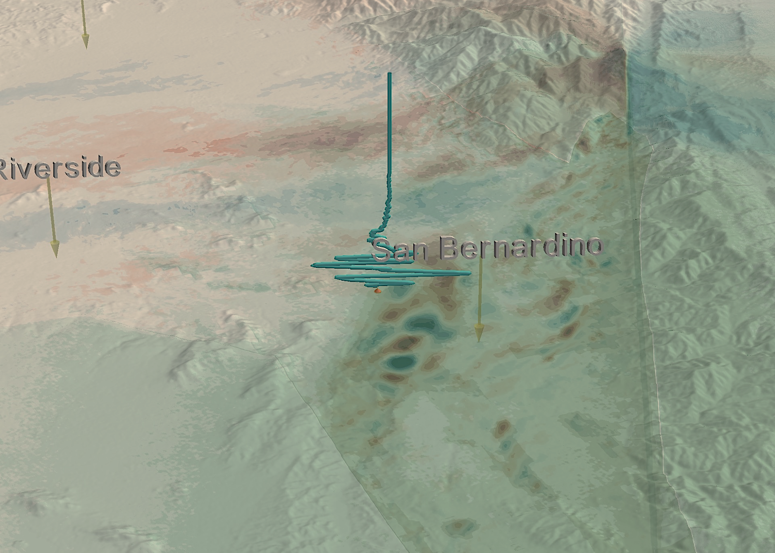



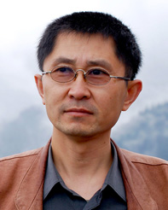
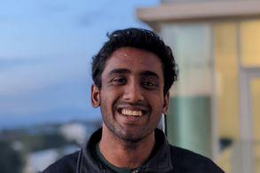
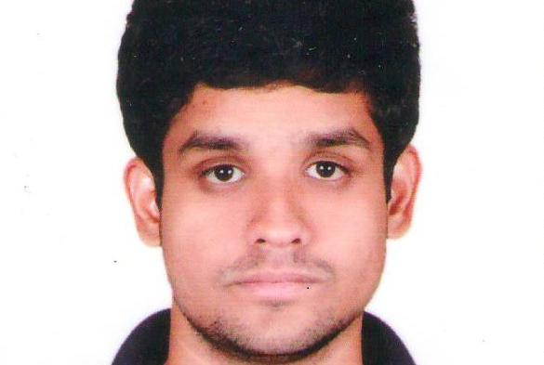
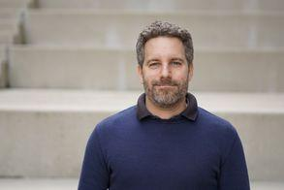



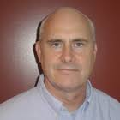
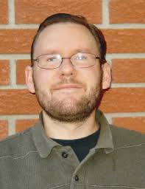
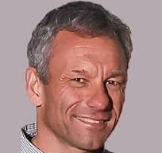
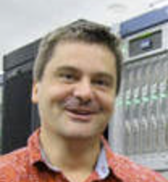



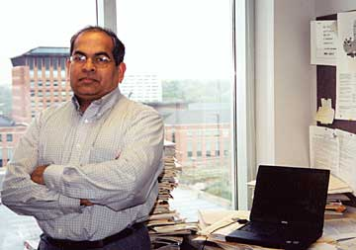
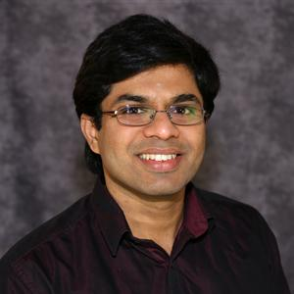
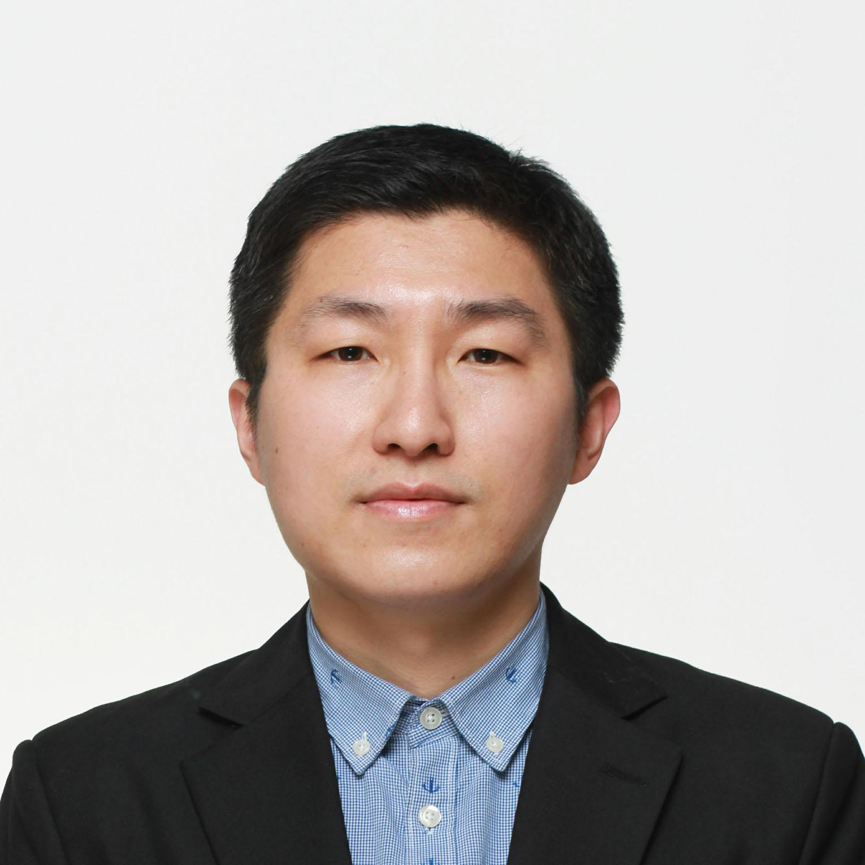







Acknowledgments
HPGeoC Team
Yifeng Cui
Akash Palla Arnav Talreja Daniel Roten
Collaborators
Philip Maechling Scott Callaghan Kim Olsen Lars Koesterke
NOWLAB Team
DK Panda Hari Subramoni Qinghua Zhou Lang Xu
Computing Allocation OLCF DD, TACC LSCP and CSA, ACCESS Delta, SDSC Expanse, AMD AAC,
DOE INCITE & ALCC
Funding NSF CSSI, LCCF/CSA, NSF/USGS SCEC Core, SDSC

