Slide 1
Managing Simulated Data Products from the CyberShake PSHA Platform
Scott Callaghan (SCEC) & the CyberShake Collaboration
September 2, 2024
Geo-INQUIRE Workshop on Data Lakes
scottcal@usc.edu

Slide 2
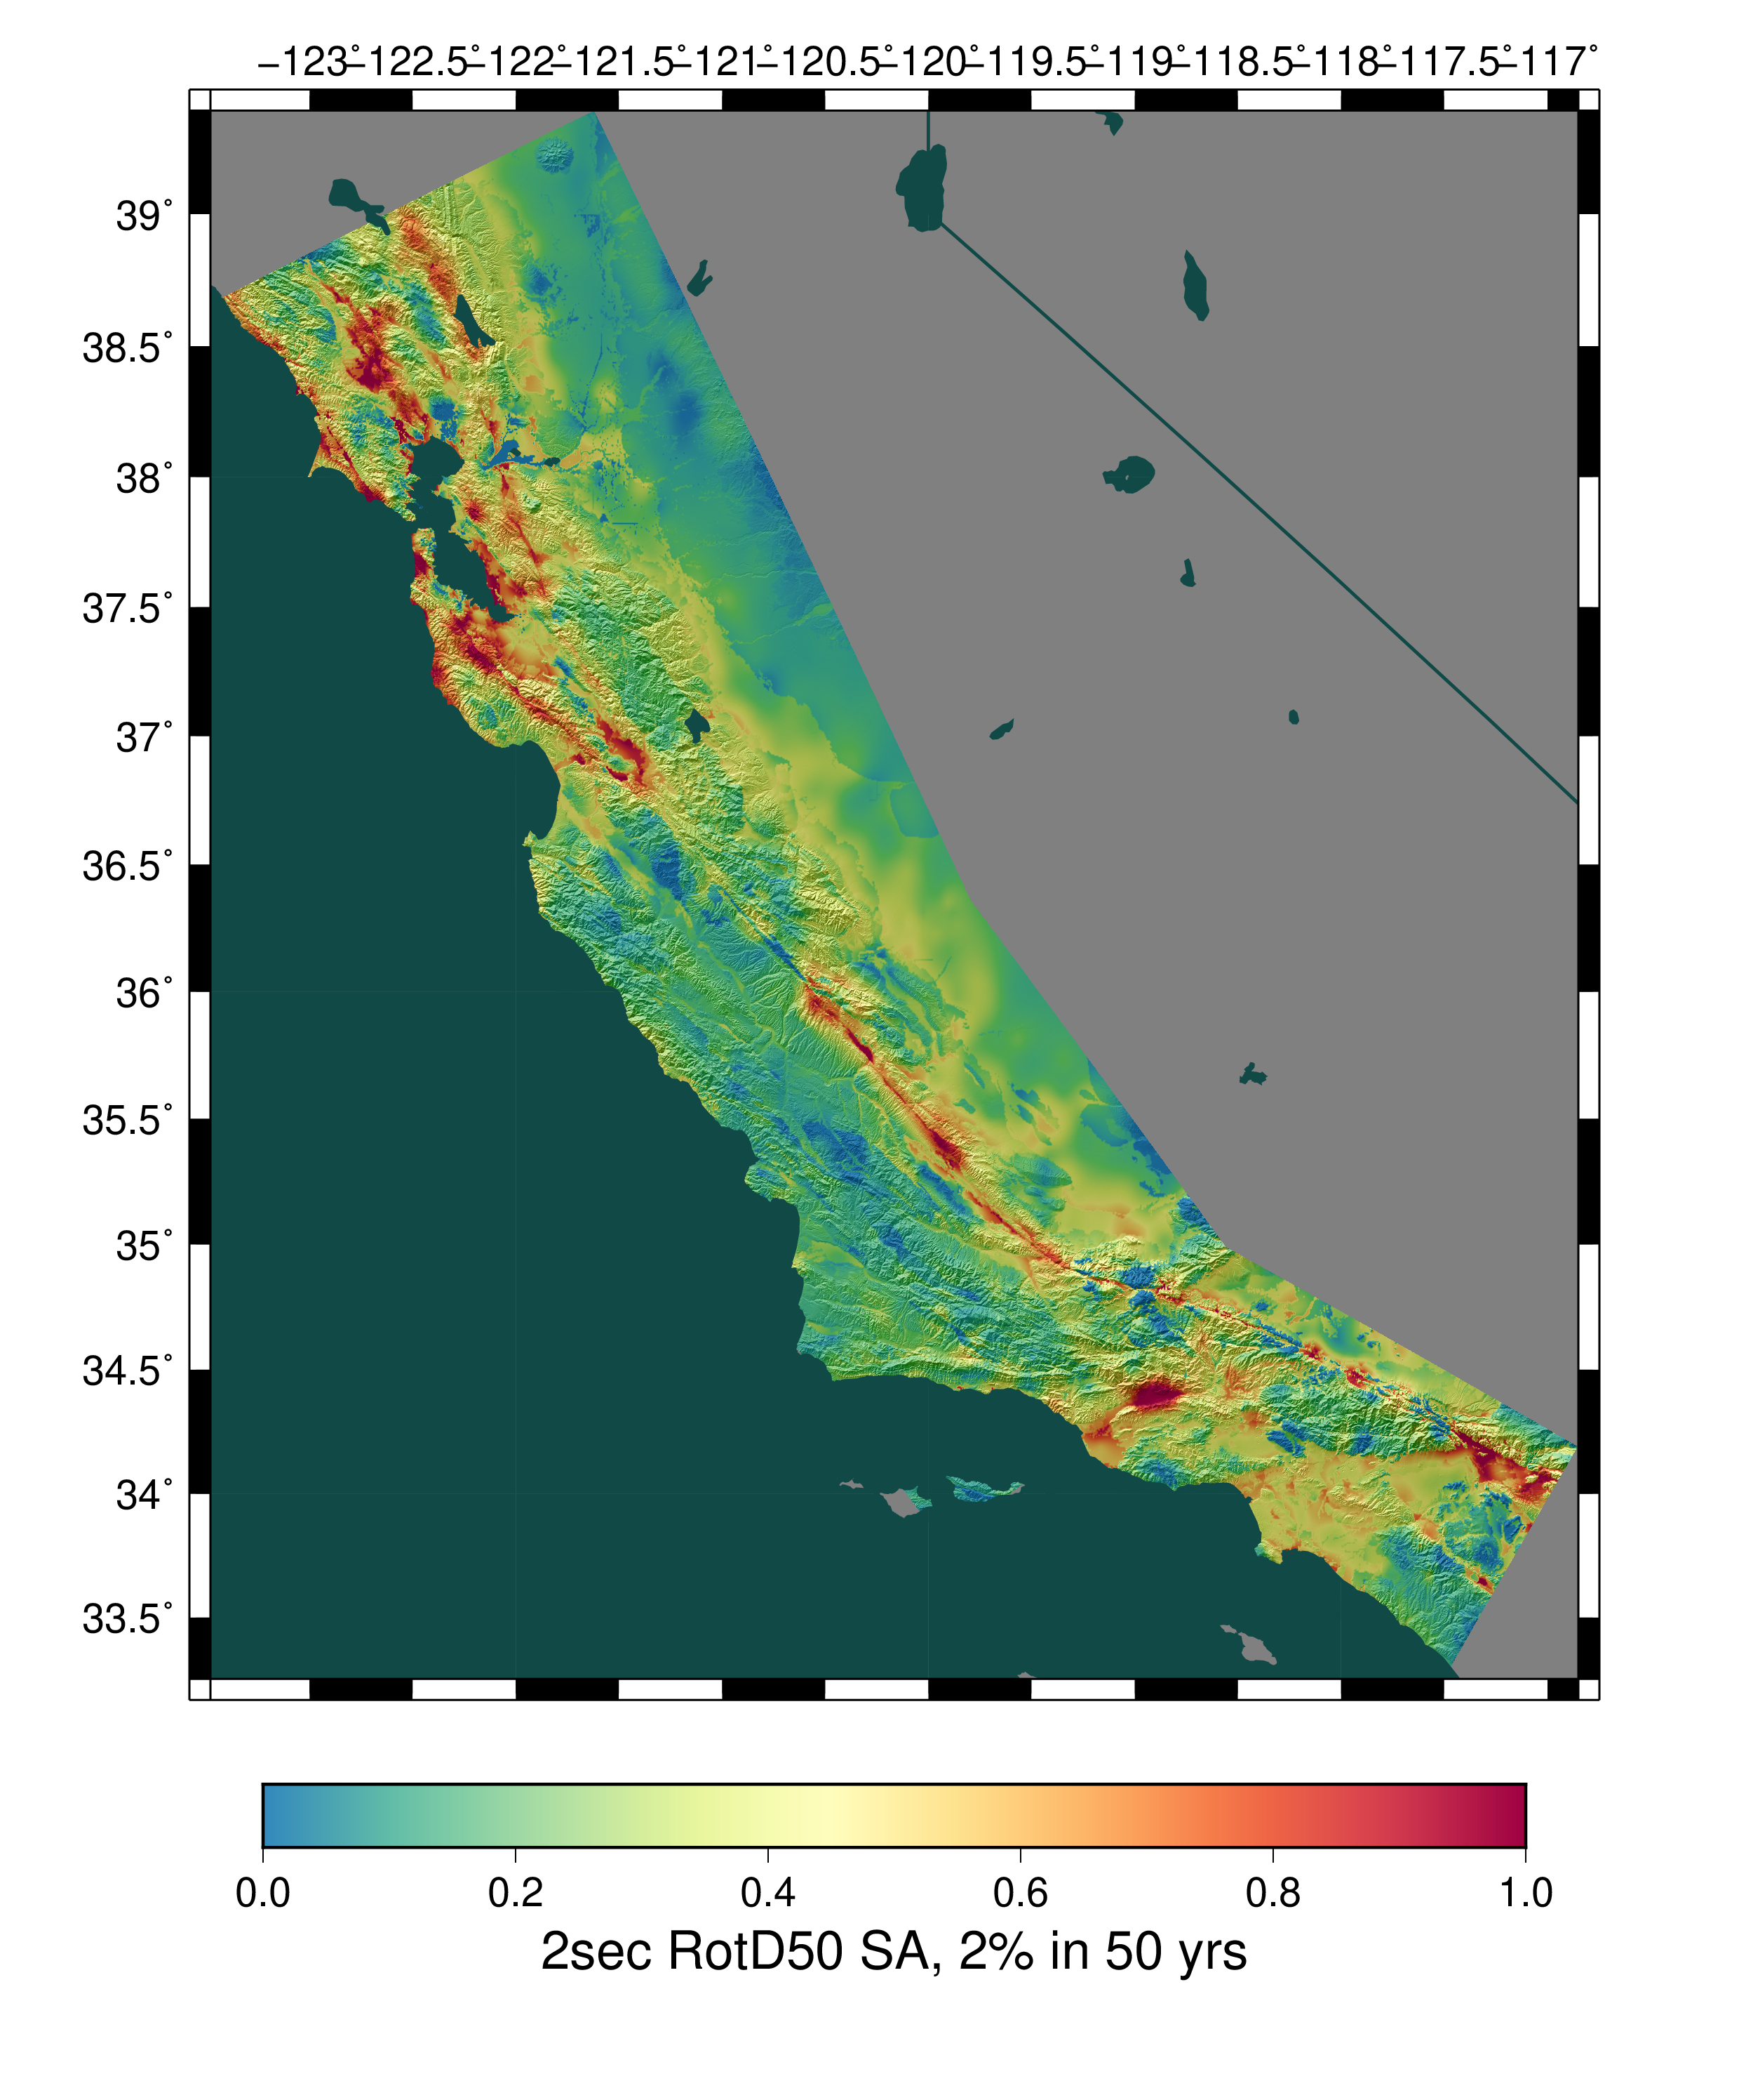
CyberShake Overview
Data and Metadata
Current CyberShake milestones
Data challenges (and solutions)
What’s next?
Opportunities for collaboration
Statewide California Earthquake Center | www.scec.org

Slide 3
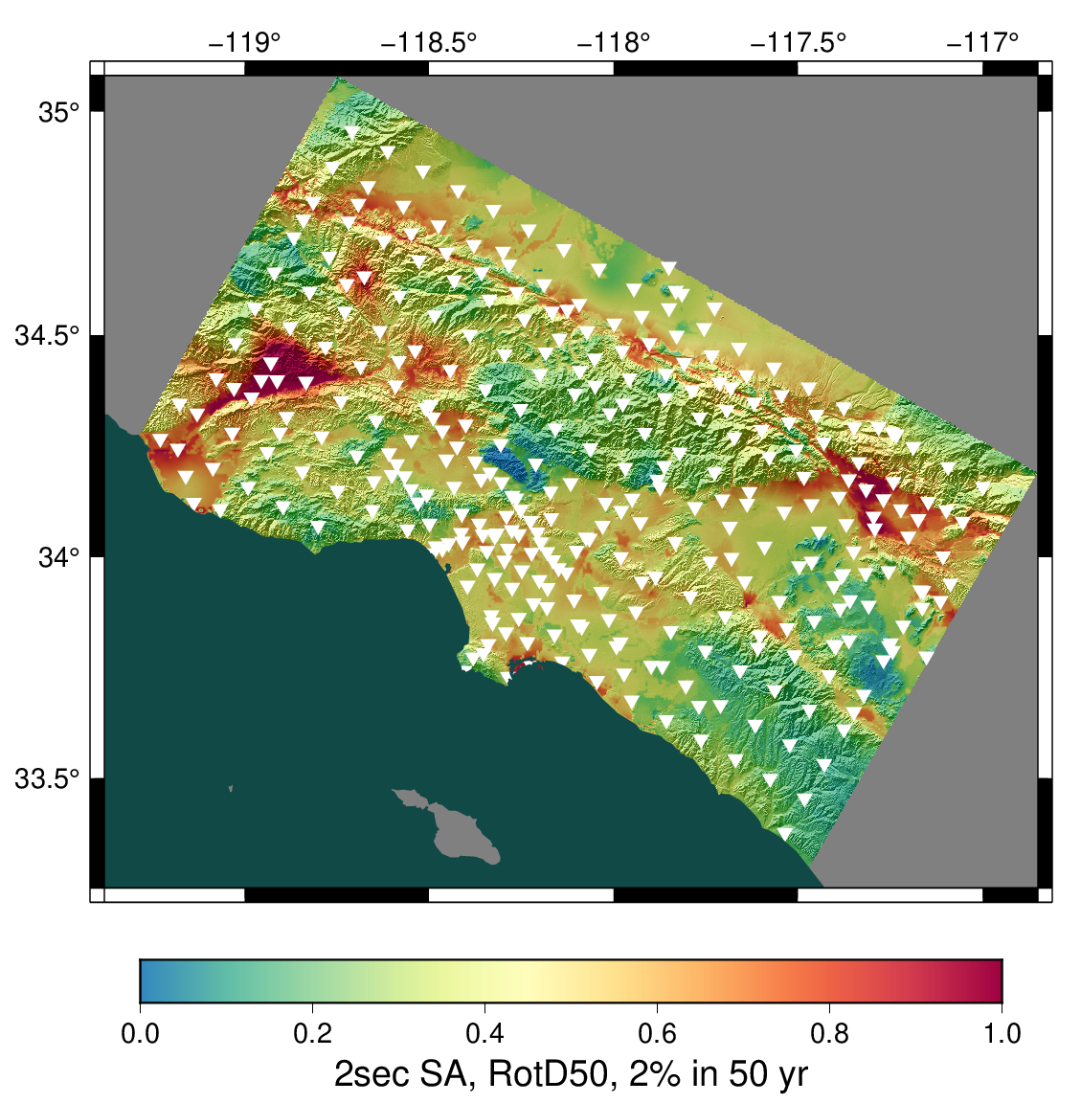
CyberShake overview
SCEC-developed 3D physics-based probabilistic seismic hazard analysis (PSHA) platform
Earthquake rupture forecast (ERF) provides list of relevant events + probabilities
Reciprocity-based approach to simulate low-frequency seismograms for sites of interest
Intensity measures derived from seismograms
Hazard results from sites interpolated for map
Optional stochastic high-frequency simulations to produce broadband models
Hazard map from most recent Southern California CyberShake Study, 22.12. Each triangle is a site location.
Statewide California Earthquake Center | www.scec.org

Slide 4
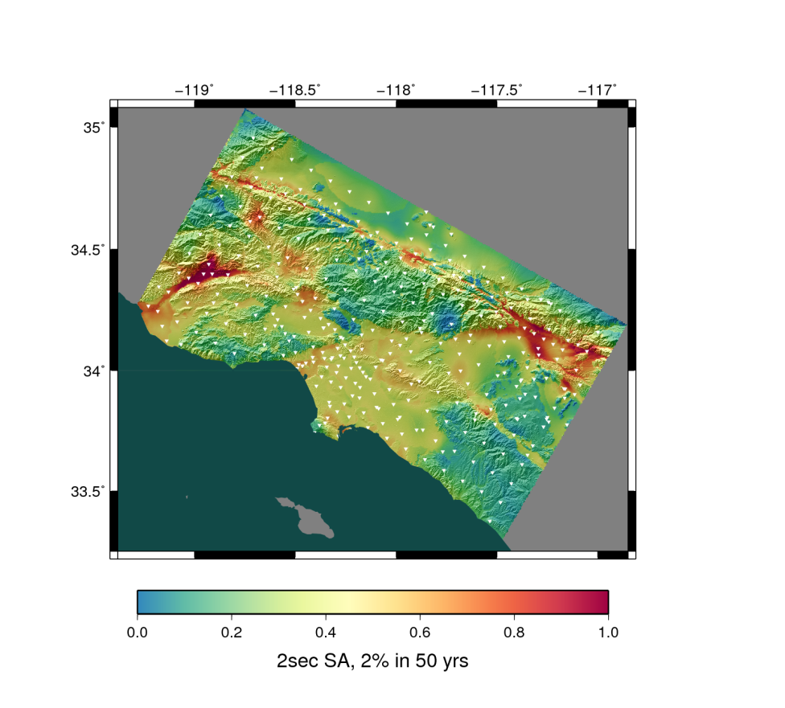
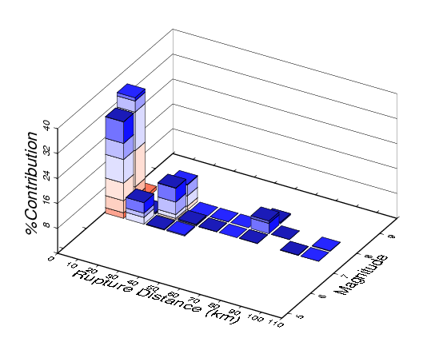
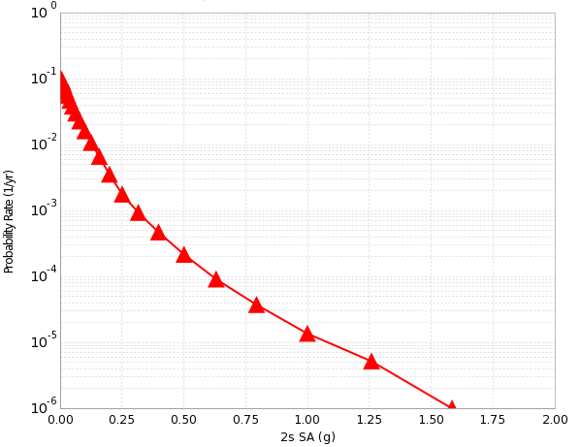
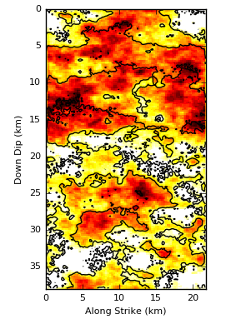
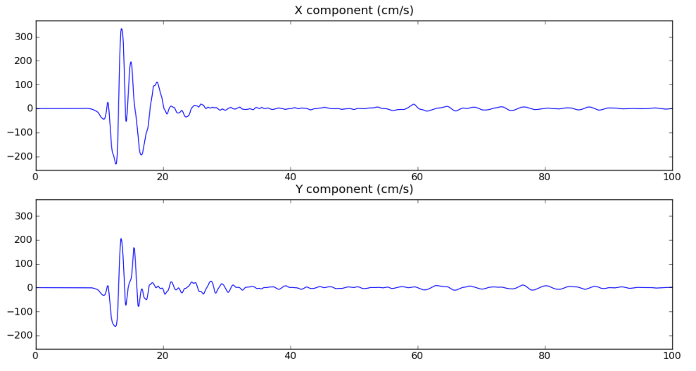
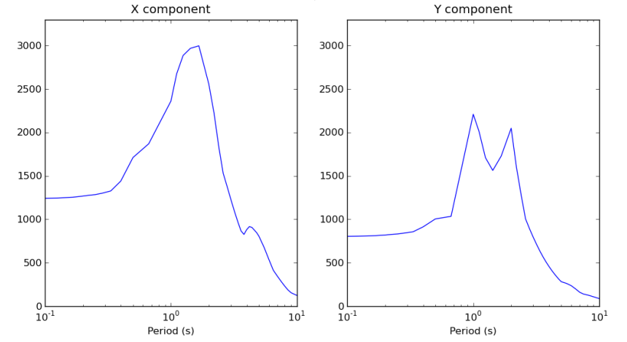
CyberShake Data Layers
Hazard Map
Hazard Curve
Disaggregation
Intensity Measures
Seismograms
Rupture Realization
4
Statewide California Earthquake Center | www.scec.org

Slide 5
Data Products
Seismograms (historically 2-component) for each event for each site
Base raw data product
Peak shaking measures
Used to be geometric mean; now RotD50 and RotD100
Subset (~25%) stored in relational database for quick access
Durations
5-75%, 5-95%, others
~25% stored in relational database
Disaggregations, hazard curves, hazard maps
Aggregate data products
Statewide California Earthquake Center | www.scec.org

Slide 6
Metadata
Seismic
Maximum frequency
Site info
Event information (magnitude, hypocenter, fault name)
Velocity model
Rupture generator
Tracked in database
Simulation-based
Mesh dimensions
Timestep size, number of timesteps
Tracked in database, on wiki
Runtime-based (provenance)
Execution system
Code version
Command-line arguments
Runtime
Tracked by workflow system (Pegasus-WMS, HTCondor)
Statewide California Earthquake Center | www.scec.org

Slide 7
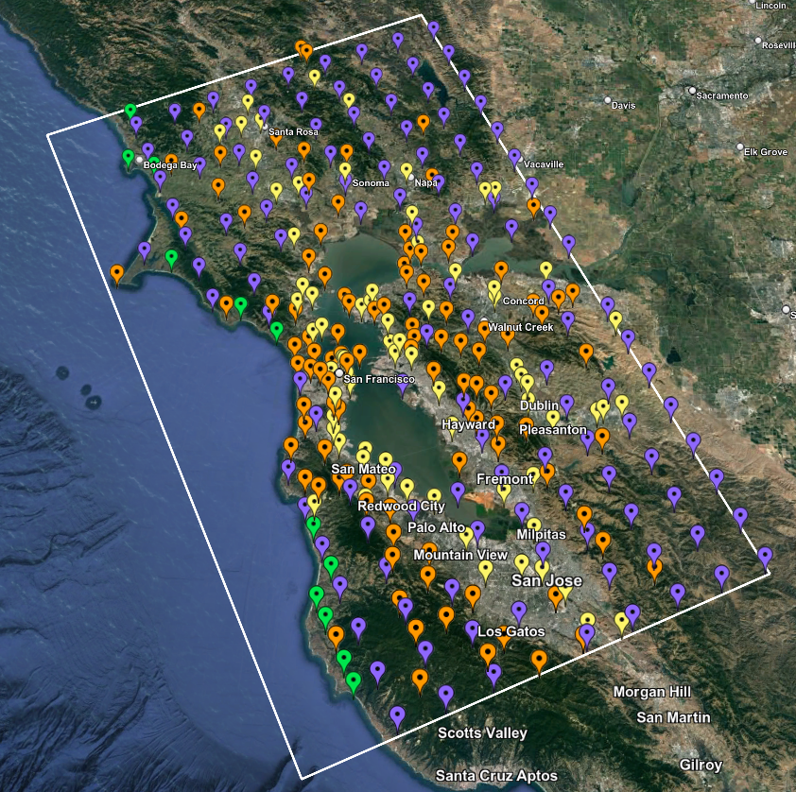
Study 24.8
Began latest CyberShake study last Tuesday
Updated broadband simulations for the San Francisco Bay Area
Improved velocity model
Similar configuration to Study 22.12
New data products:
3-component seismograms
Vertical response spectra
Period-dependent durations
Statewide California Earthquake Center | www.scec.org

Slide 8
Challenge: Large Data Lake Size
From Study 22.12
Data Product | Records per study | Number of files per study | Data size per study
Low-frequency seismograms | 200 million | 2 million | 15 TB
Low-frequency IMs | 10 billion | 6 million | <1 TB
Broadband seismograms | 200 million | 2 million | 60 TB
Broadband IMs | 30 billion | 6 million | <1 TB
Aggregate products | 3,000 | 3,000 | <1 TB
Total | 40 billion | 16 million | 75 TB
Data currently stored at Center for Advanced Research Computing at USC
Plan to migrate to DesignSafe at Texas Advanced Computing Center
Statewide California Earthquake Center | www.scec.org

Slide 9
Challenge: Support Community Access
Key contribution of CyberShake is the creation of the dataset for later use
Dozens of researchers interested in working with CyberShake data
Internal: members of the CyberShake collaboration
External: members of the broader SCEC, engineering, and preparedness communities
Describe what data products are available
Different users desire different levels of access:
Nicely packaged data
Interactive interface
API for scripting
Statewide California Earthquake Center | www.scec.org

Slide 10
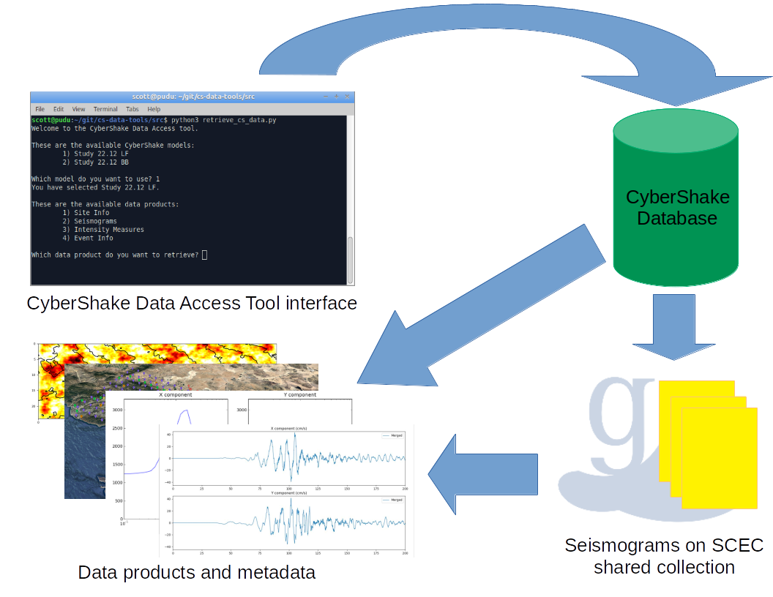
Challenge: Identify and Deliver Data Subsets
Size of the dataset makes full download difficult
Most users don’t need it all anyway
Query interface needed to help users select subsets
Metadata must be delivered with data products
Documentation necessary
Developed CyberShake Data Access Tool
Python-based, open source
Prompts users with questions to create filters
Users can bypass interactive components for use with scripting
Delivers database products, seismograms, and seismic metadata
https://github.com/SCECcode/cs-data-tools/
Statewide California Earthquake Center | www.scec.org

Slide 11
Challenge: On-Demand Data Products
Not all possible data products are created at study time
Rupture slip time histories
Synthetic ShakeMaps
Disaggregations at additional return periods
Intensity measures on disk, but not in database
How to support user generation of data products? Gateway? Quakeworx? No implemented solution to this challenge yet
Statewide California Earthquake Center | www.scec.org

Slide 12
Challenge: Human Resources
Difficult to obtain funding for scientific software development in the US
Limited resources for facilitating delivery of data products to users
Minimize CyberShake developer involvement
Easy-to-use interfaces
Documentation, tutorials
Extensible
Balance between targeting new scientific milestones and improving usefulness of existing data
Statewide California Earthquake Center | www.scec.org

Slide 13
Looking Ahead
Study 24.8 to finish in about 2 months
CyberShake data lakes will continue to grow
2 Hz deterministic runs targeted for 2025
Integrate non-linear forward simulations
Quantify uncertainty of velocity model and high-frequency codes through additional simulations
Looking for ways to remove barriers to usage
Improved documentation
Migration to DesignSafe (DOI, access to DesignSafe tools)
Increase awareness in potential users

Slide 14
Collaboration and Standardization Opportunities
File formats + converters
CyberShake uses custom binary data formats
Move to more common format? (HDF5, ASDF, …)?
Regardless of format, standard converters will be needed
Capture and distribution of simulation parameters
Identify standard simulation parameters that are:
Of interest to users
Needed for reproducibility
Distribute along with other metadata when data is delivered
What level of reproducibility do we seek?
If formats and metadata are similar, opportunities for common tools
Single point-of-entry for users to access multiple data lakes

Slide 15
Thanks!

