Slide 1
SCEC Drupal Website Development Overview and Status
http://scec.usc.edu/scecpedia/SCEC_Web_Development_Home_Page
24 March 2015

Slide 2
Drupal Website Development Plan
Custom Drupal Theme
Development Approach
Deployment Strategy
User Roles and Associated Capabilities
Use Cases Implemented
Article Contribution Workflow Sequence
Demonstrations
Assignments
Next Steps

Slide 3
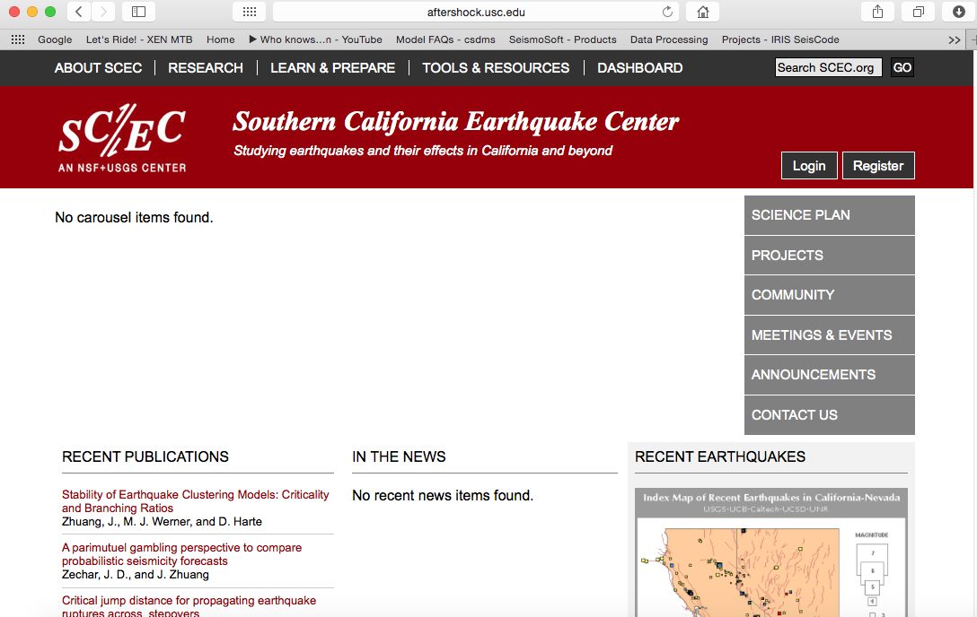

Slide 4
Drupal Website Development Plan
Custom Drupal Theme
Development Approach
Deployment Strategy
User Roles and Associated Capabilities
Use Cases Implemented
Article Contribution Workflow Sequence
Demonstrations
Assignments
Next Steps

Slide 5
Drupal Development Approach
Moved Development to Recent Version of Drupal
Upgrade to recent Drupal Version (7.x)
Use existing (core and contributed) Drupal modules where possible
Write custom web capabilities as Drupal Modules

Slide 6
Drupal Website Development Plan
Custom Drupal Theme
Development Approach
Deployment Strategy
User Roles and Associated Capabilities
Use Cases Implemented
Article Contribution Workflow Sequence
Demonstrations
Assignments
Next Steps

Slide 7
Drupal Website Deployment Approach
Develop, Stage, Live
Public (Live) Website to be based on KVM image running on server
Staging Website established with its local LDAP server (aftershock.usc.edu)
Development Websites (for software development) moved to Laptops (David, Phil etc), using MAMP, and local LDAP server
Deployment Instructions Posted:
https://scec.usc.edu/it/SCEC_Drupal_Website_Deployment

Slide 8
Content Modifications
Deployment Approach Permits Content to be migrated between Websites
We expect content to be added to Live Site
We expect content to be added to Staging Site
We expect software modifications and content to be made to Development Site

Slide 9
Drupal Website Development Plan
Custom Drupal Theme
Development Approach
Deployment Strategy
User Roles and Associated Capabilities
Use Cases Implemented
Article Contribution Workflow Sequence
Demonstrations
Assignments
Next Steps

Slide 10
Website User Roles and Permissions
Website functions change based on the “role” assigned to the user that is logged in. Currently defined roles are:
Anonymous User: non-registered user to the SCEC website
Member: User with a username and password to log into the SCEC website and other limited functionality (e.g. search for other members, register for the annual meeting)
Contributor: User recognized as an active SCEC participant that can contribute content to the SCEC website.
Editor: User that can review, edit, and publish content on the SCEC website.
Staff: User that can assign user roles, and all other functionalities on the SCEC website, except modify the software
Developer: User that can modify the Drupal software and edit the LDAP DB

Slide 11
Drupal Website Development Plan
Custom Drupal Theme
Development Approach
Deployment Strategy
User Roles and Associated Capabilities
Use Cases Implemented
Article Contribution Workflow Sequence
Demonstrations
Assignments
Next Steps

Slide 12
Website User Roles and Permissions
We are using Use Cases to define the site requirements. Use cases should express web site functionality without defining how that functionality is implemented:
We try to express our Use Cases in a three part format:
As a <user role>,
I <do something> using the website,
for <a reason>.
Our initial set of use cases are defined below:
https://scec.usc.edu/it/SCEC_Prototype_Use_Cases

Slide 13
Drupal Website Development Plan
Custom Drupal Theme
Development Approach
Deployment Strategy
User Roles and Associated Capabilities
Use Cases Implemented
Article Contribution Workflow Sequence
Demonstrations
Assignments
Next Steps

Slide 14
SCEC Website Use Cases
As a contributor I want to add an article so that I can highlight my research
As an editor, I want to review submitted articles to see which ones should approved and added to the SCEC site
As an editor, I want to ask the contributor to make revisions to their article
As a contributor, I want to make the revisions asked by the editor so that my article can be featured on the SCEC site
As an editor, I want to publish an article and promote it to the home page
As an editor, I want to edit an existing web page on the SCEC site to add and/or update publicly viewable SCEC content

Slide 15
Drupal Website Development Plan
Custom Drupal Theme
Development Approach
Deployment Strategy
User Roles and Associated Capabilities
Use Cases Implemented
Article Contribution Workflow Sequence
Demonstrations
Assignments
Next Steps

Slide 16
Working With the Prototype
To evaluate this prototype, would like stakeholder (future users and contributors) to try entering content on the website:
We ask users to enter content on the “Staging” Website. All entered content will be preserved http://aftershock.usc.edu
Report Problems, Comments, Suggestions, Questions via IM or email to David
David will preserve the comments into the Trouble Ticket System (Trac)

Slide 17
Working With the Prototype
Content Assignments:
Mark, as a editor, add content to the “"Earthquake & Tsunami Preparedness” Page, so the public can easily find accurate and helpful preparedness information.
Jason, as a contributor, add content from recent SCEC highlights as articles, to communicate recent SCEC accomplishments to the Public.
Mark, as an editor, approve these articles and promote them to the carousel.
John Marquis, as contributor, enter one or more new publications from recent progress reports in as publications, so SCEC has a current publication list for our next progress report.
Tran, as editor, review the new publications and approve them when ready.
Phil, as developer, deploy the prototype on development computer using deployment instructions.

Slide 18
Drupal Website Development Plan
Custom Drupal Theme
Development Approach
Deployment Strategy
User Roles and Associated Capabilities
Use Cases Implemented
Article Contribution Workflow Sequence
Demonstrations
Assignments
Next Steps

Slide 19
Next Steps
Anticipated Next Steps in Website Development:
Collect and document feedback from prototype.
Practice deployment process.
Establish nightly backups.
Develop detail users profile display pages
Review fields in publications for completeness
Establish linking mechanism between files (including images) and articles
Develop group email list capabilities
Develop Basic calendar functionality

Slide 20
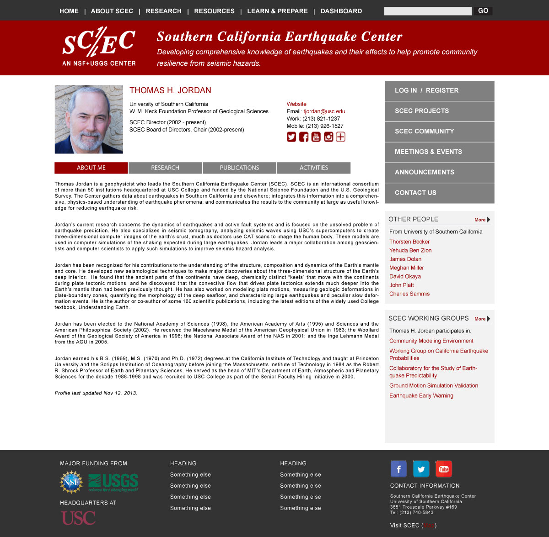

Slide 21
End

