Slide 1
Updates on CyberShake Ground Motion Simulations for Southern California
Scott Callaghan, Philip J. Maechling, Fabio Silva, Kevin R. Milner, Mei-Hui Su, Christine A. Goulet, Kim B. Olsen, Te-Yang Yeh, Robert W. Graves, Karan Vahi, Ewa Deelman, Albert Kottke, Thomas H. Jordan, and Yehuda Ben-Zion
NGA-W3 meeting
Thursday, November 9, 2023

Slide 2
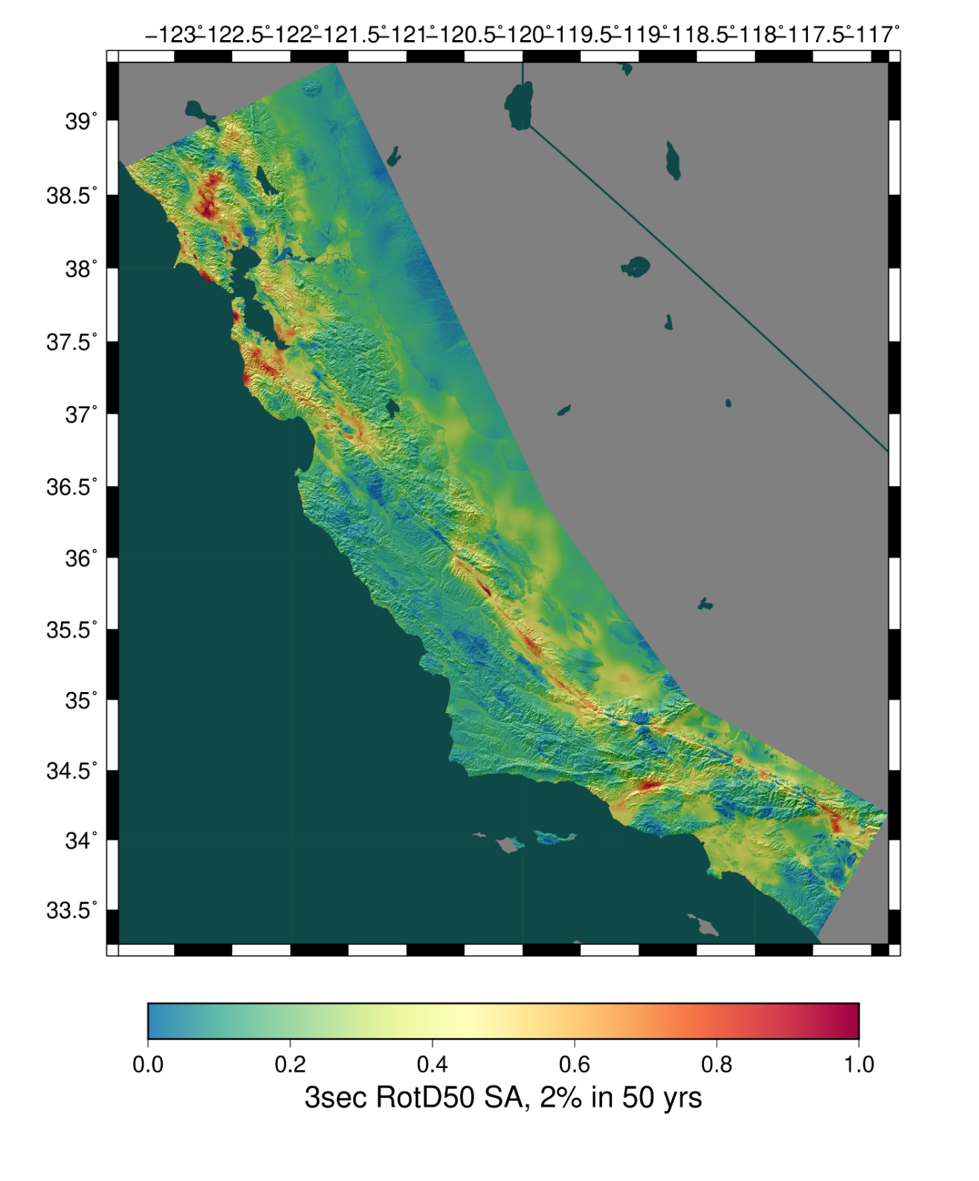
CyberShake Overview
SCEC’s 3D physics-based probabilistic seismic hazard analysis (PSHA) platform
Earthquake Rupture Forecast (ERF) provides list of relevant events with probabilities
625,000 events per site
Reciprocity-based approach to simulate low-frequency seismograms
Intensity measures derived from seismograms
Hazard results from individual sites interpolated with GMM basemap

Slide 3
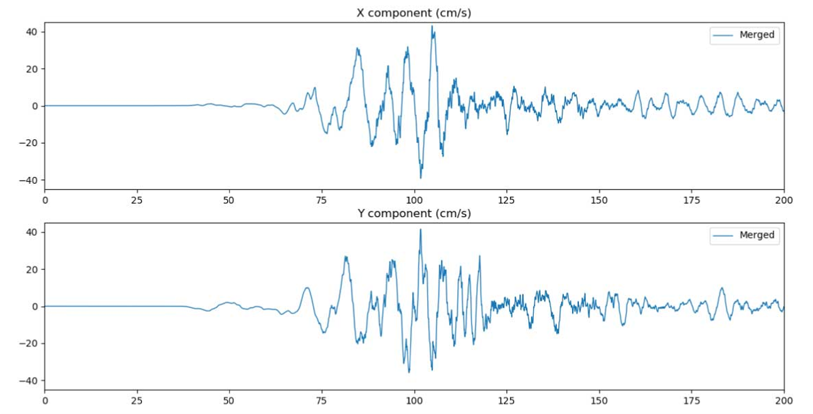
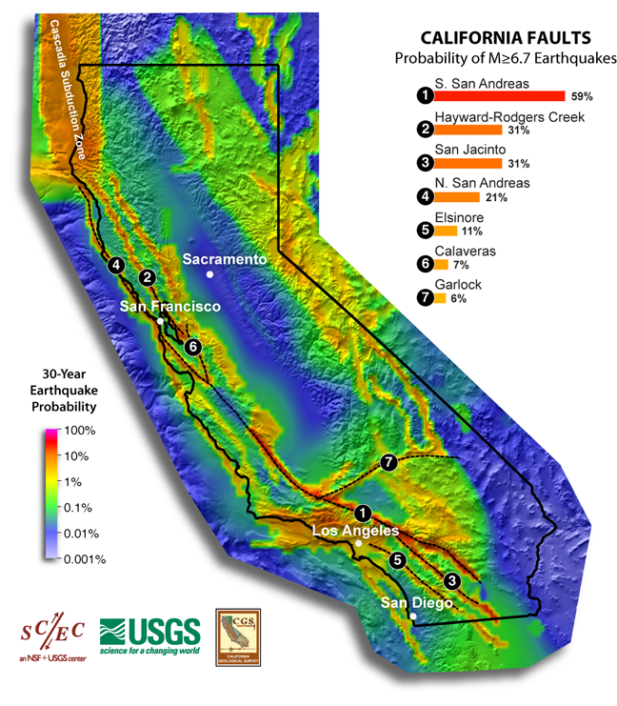
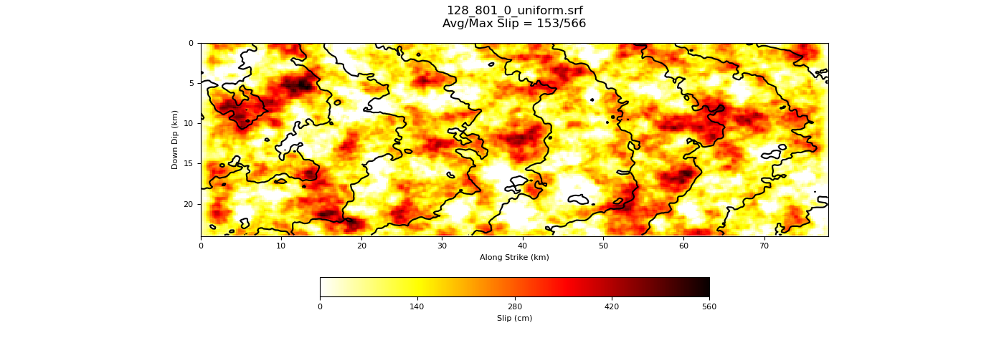
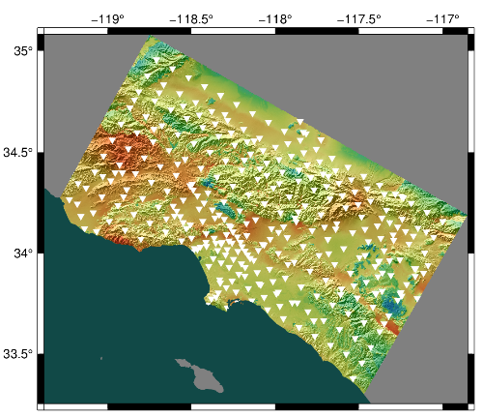
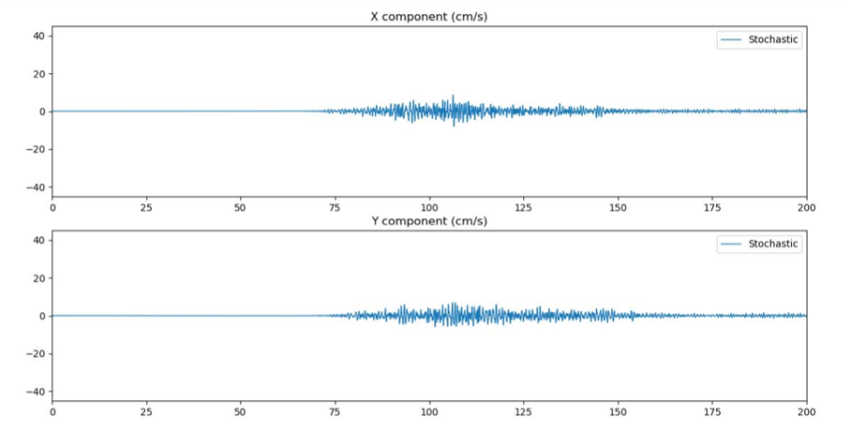
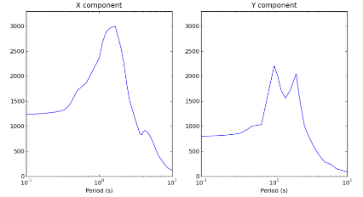
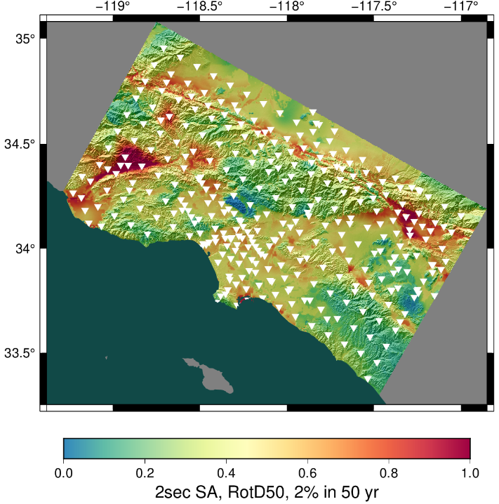
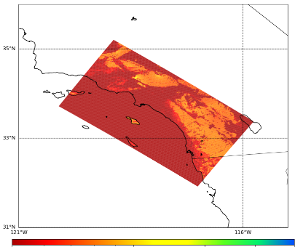
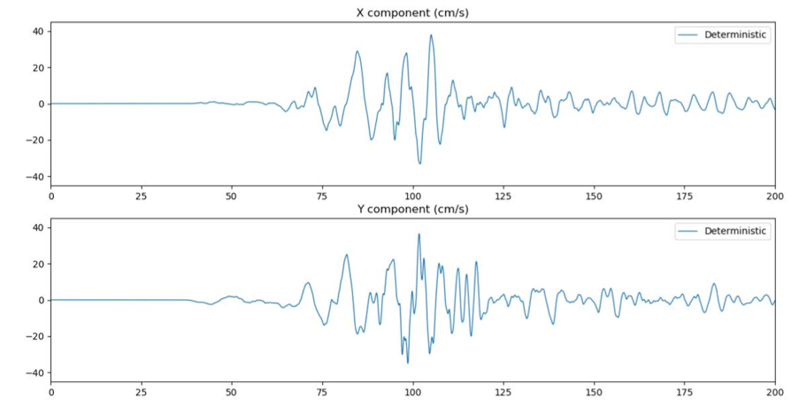
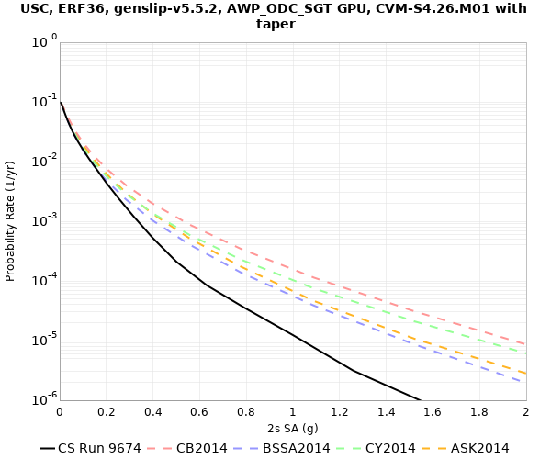
Broadband CyberShake workflow
Low-frequency CyberShake workflow
Graves & Pitarka kinematic rupture generator
High-frequency seismogram synthesis (BBP)
Merge and combine
0-50 Hz broadband data products
600,000+ events
Uniform California Earthquake Rupture Forecast
1-50 Hz seismograms
RotD50, PGA, PGV
AWP-ODC-SGT wave propagation
Low-frequency seismogram synthesis
Intensity measures
Aggregate data products
UCVM
0-1 Hz low-frequency seismograms
RotD50, PGA, PGV
Velocity Mesh
Hazard Curve
Hazard Map

Slide 4
New Features in CyberShake Study 22.12
Update to Study 15.4 and 15.12
Broadband simulations
Validated against historic events
Modifications to 3D velocity model
Goal is to resolve issues with high velocities at the surface
Updates to rupture generation for individual events
Migration to more recent kinematic rupture code
Sampling of additional variability

Slide 5
Broadband Validation
Selected validation events from the SCEC Broadband Platform
Northridge, Whittier, Chino Hills, Landers
64 realizations created for each event
Hypocenter and magnitude preserved
Different slip realizations
GP rupture generator used
CyberShake pipeline run for sites with recordings in BBP
Usually ~40 stations per event
Calculate metrics
3 slip realizations for 1994 Northridge

Slide 6
Validation Metrics
Looking at BBP goodness-of-fit metric
Both overall GoF (all sites, all realizations) and best realization
Compare 3D CyberShake, 1D BBP, and GMMs to observations
Show that CyberShake works
Reasonable ground motions for both historic and hypothetical events
Wiggle-to-wiggle agreement not the goal
Can get very good low-frequency agreement with tuning
Here, want to validate entire method on known and unknown events
Goal is to get reasonable results on realization sweeps

Slide 7
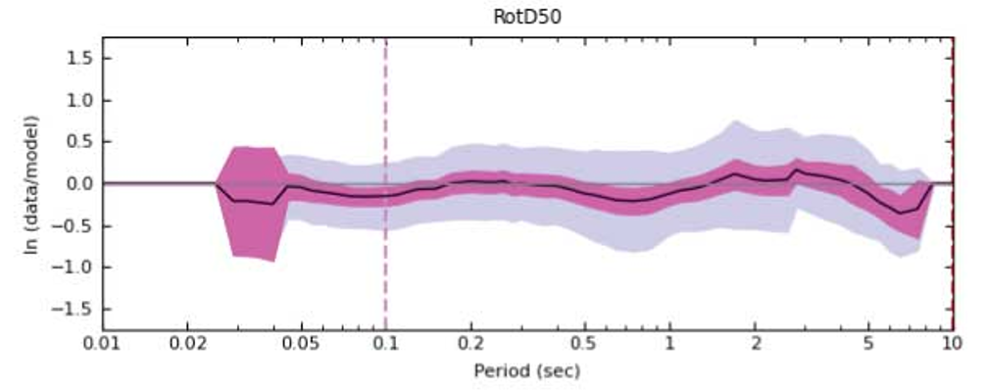
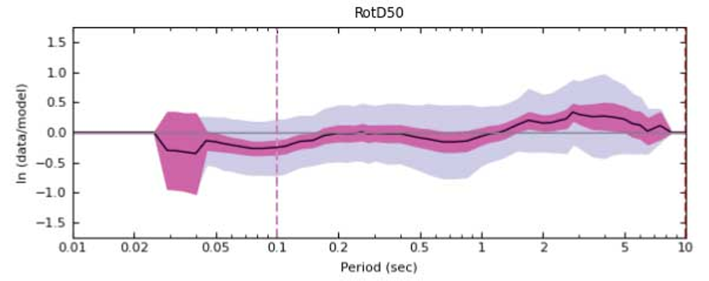
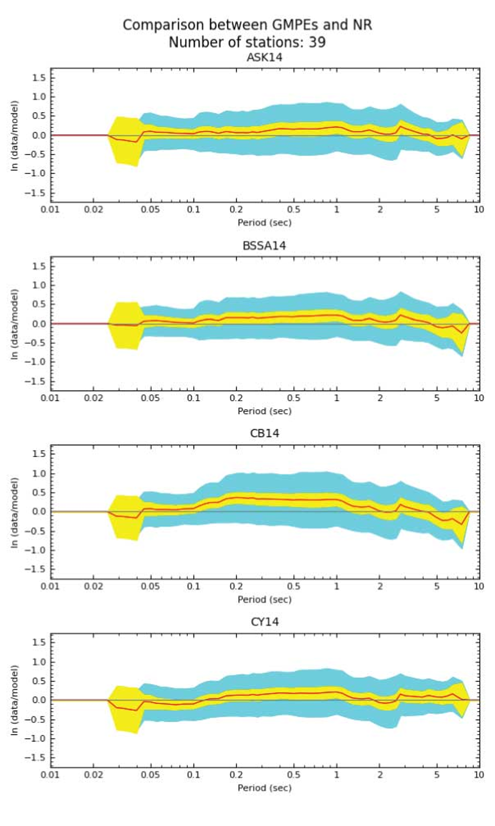
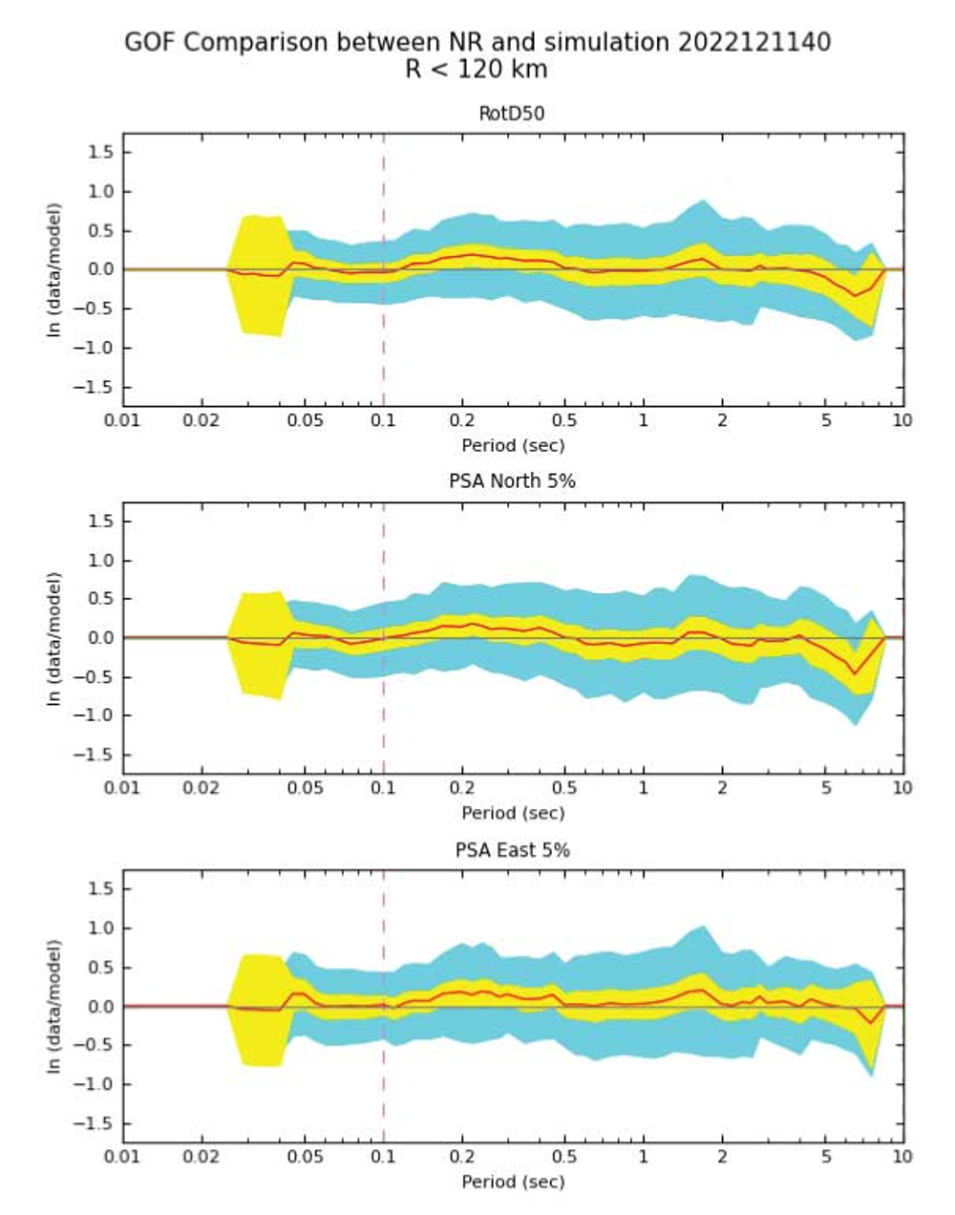
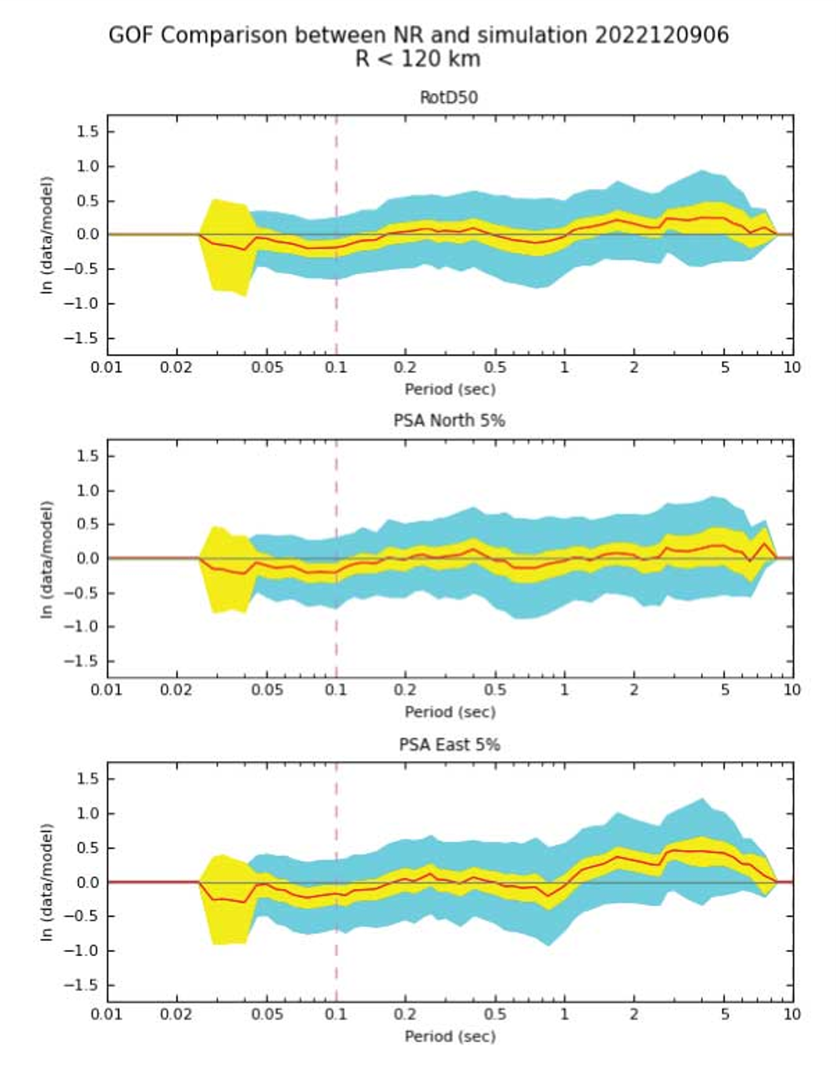
Northridge
3D CyberShake
1D BBP
GMMs
Overall GoF
Best Realization

Slide 8
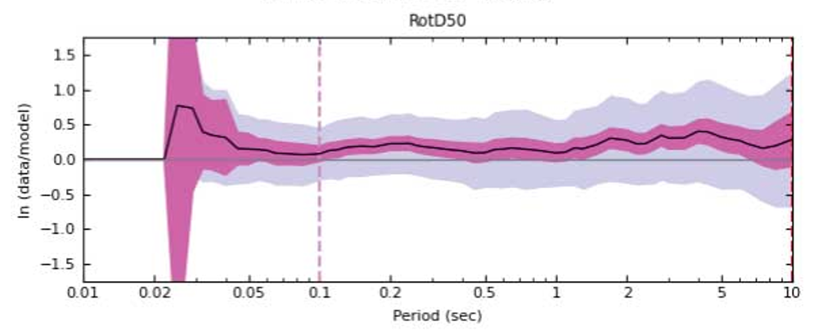
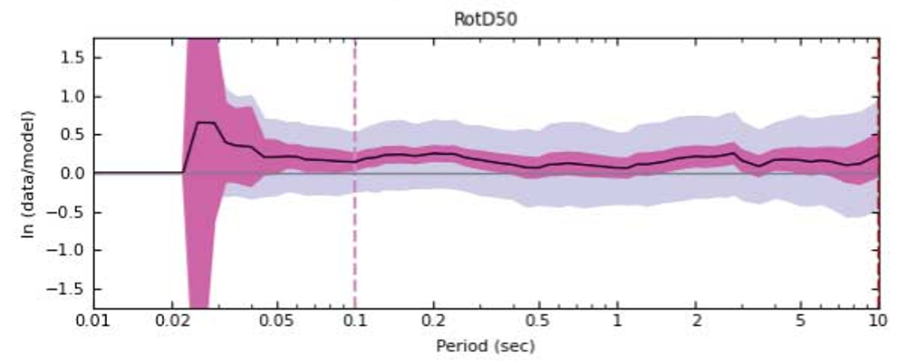
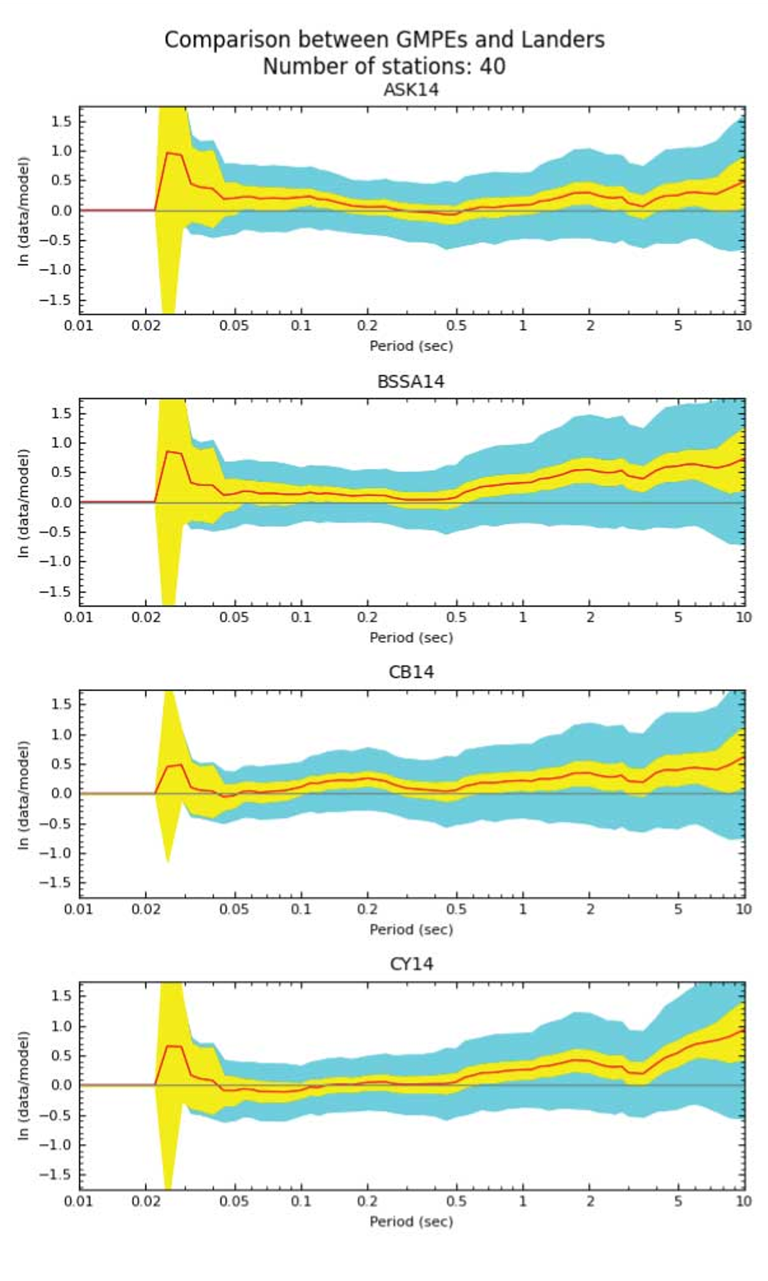
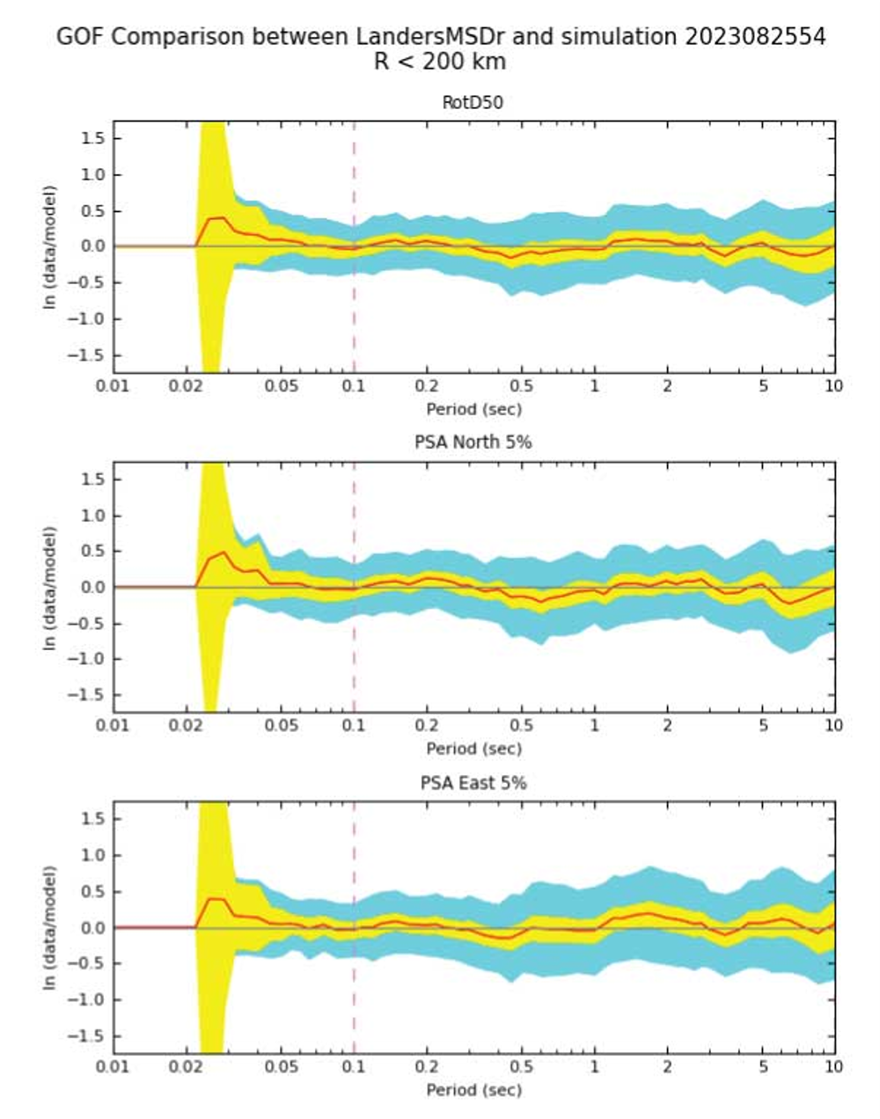
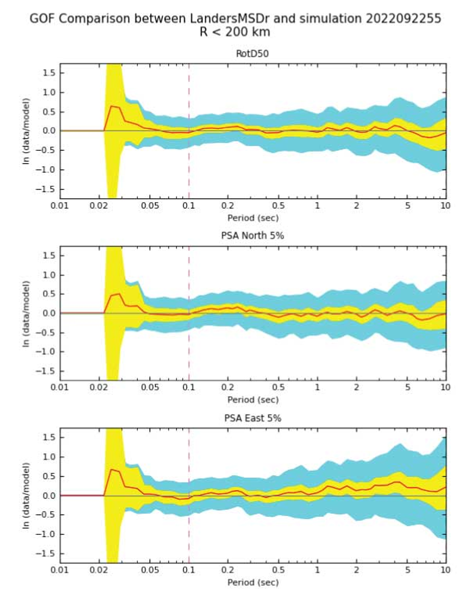
Landers (multi-segment)
3D CyberShake
1D BBP
GMMs
Overall GoF
Best Realization

Slide 9
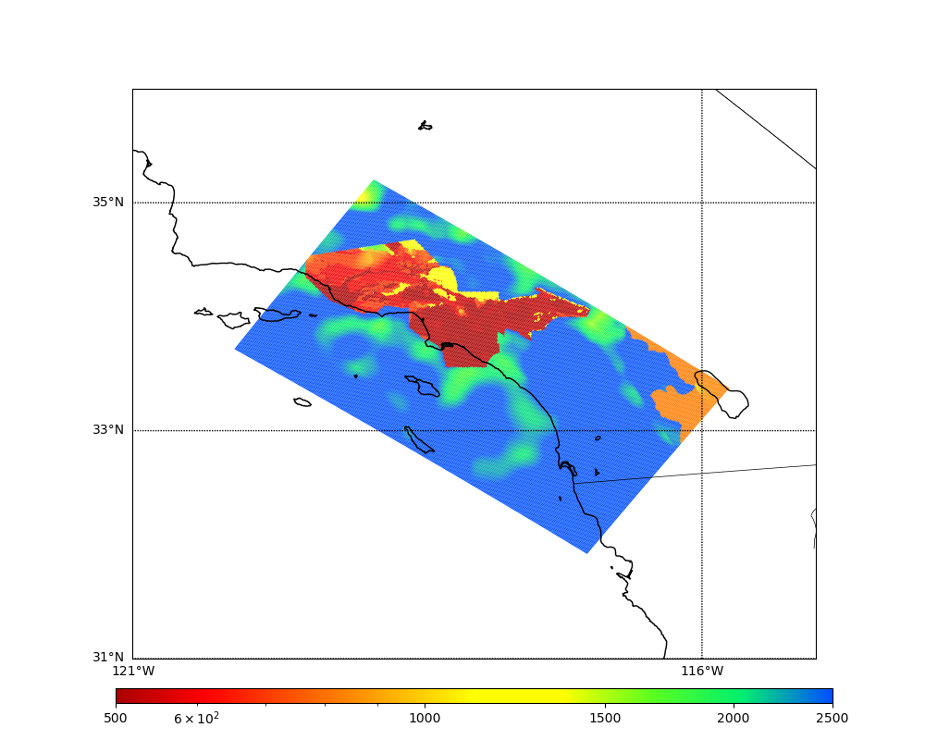
Velocity Model Merged Taper
Previous studies used CVM-S4.26.M01
Tomography model + near-surface layer
High Vs values outside of basins
Used Ely-Jordan approach to apply Vs30- based taper down to 700m (Hu et al. 2022)
Using taper, determine Vp, Vs, rho values at each grid point in the mesh
Compare taper and non-taper Vs value
Select smaller Vs value (and corresponding Vp and rho) to preserve basins
CVM-S4.26.M01, surface Vs
LAPD
USC
500
1000
2500

Slide 10
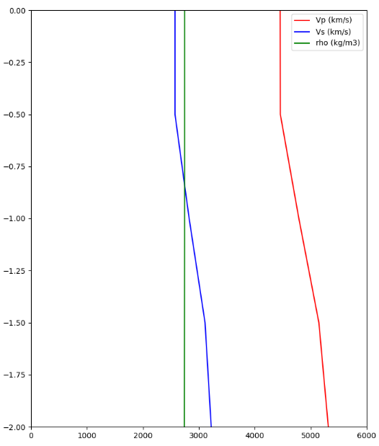
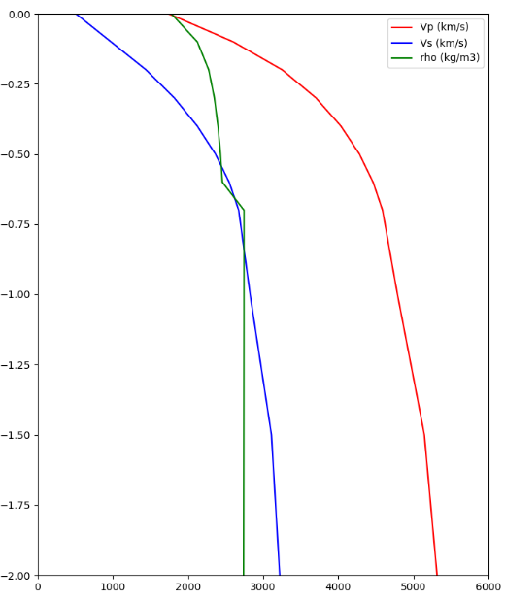
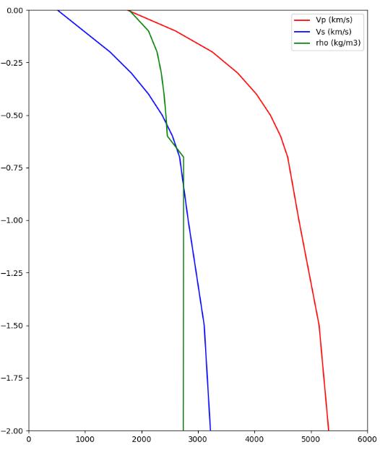
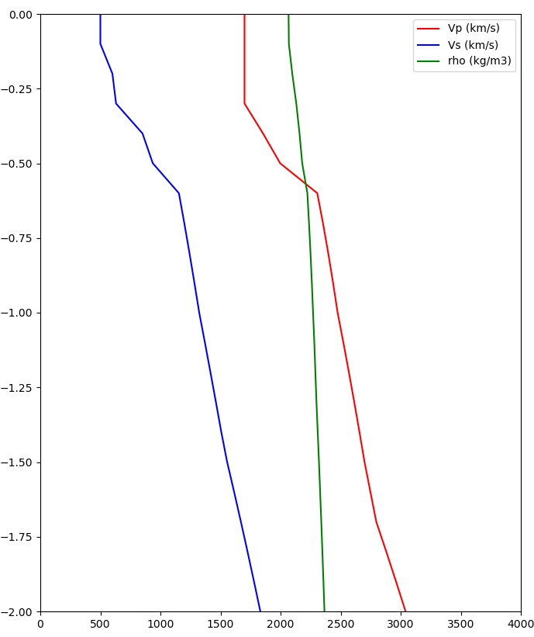
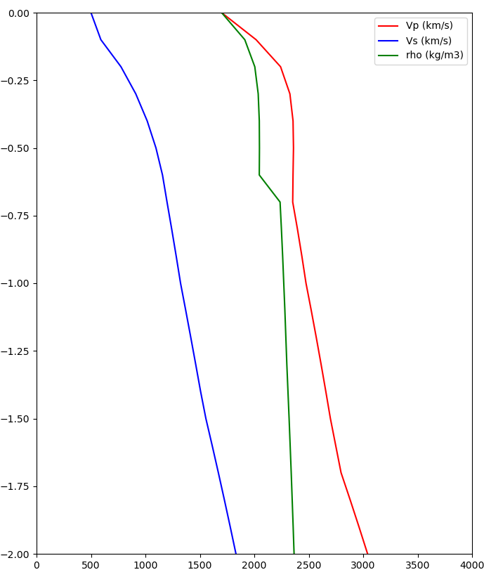
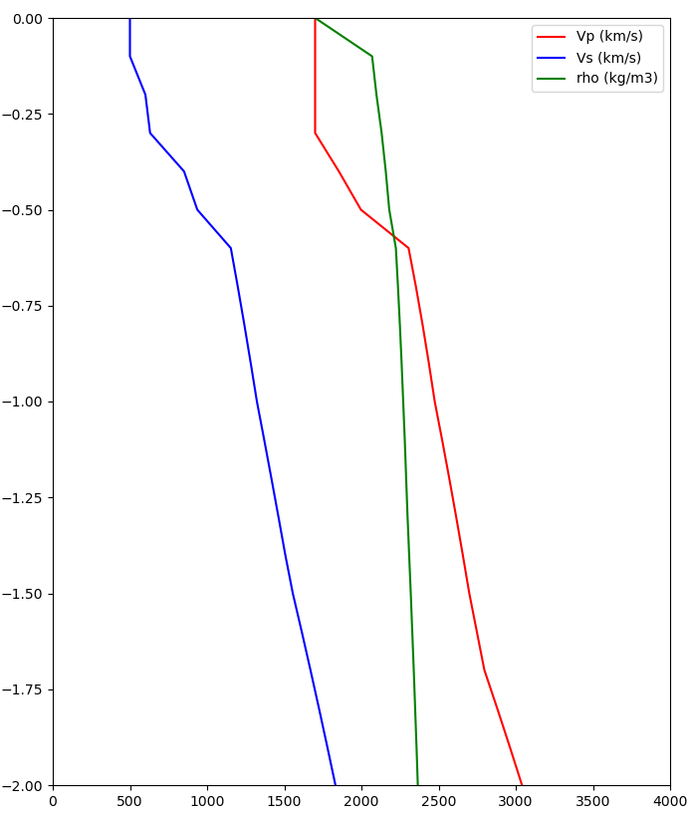
Site Velocity Profiles
CVM-S4.26.M01
700m taper
Merged taper
Taper is selected at all depths to 700m
Vs30: 2573 m/s -> 400 m/s
Z1.0: 0m -> 110m
LAPD (outside basin)
~2500 m/s
~400 m/s
Taper is only selected at surface point
Vs30: 500 m/s -> 500 m/s
Z1.0: 580m -> 580m
USC (in basin)
500 m/s
<500 m/s

Slide 11
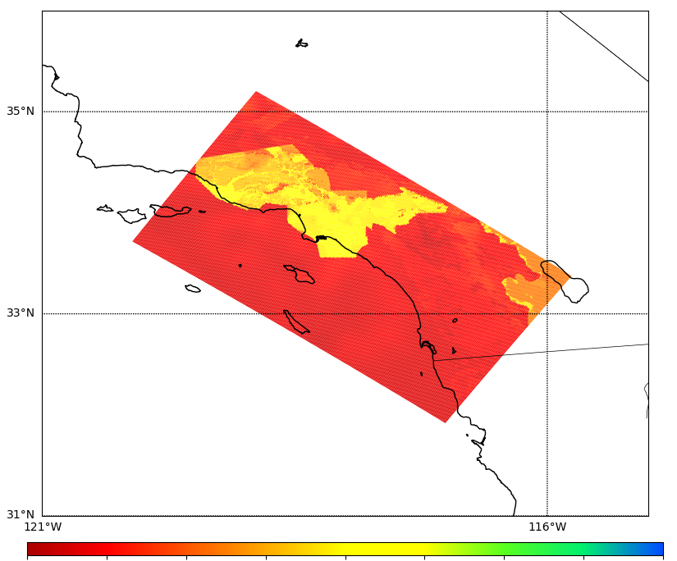
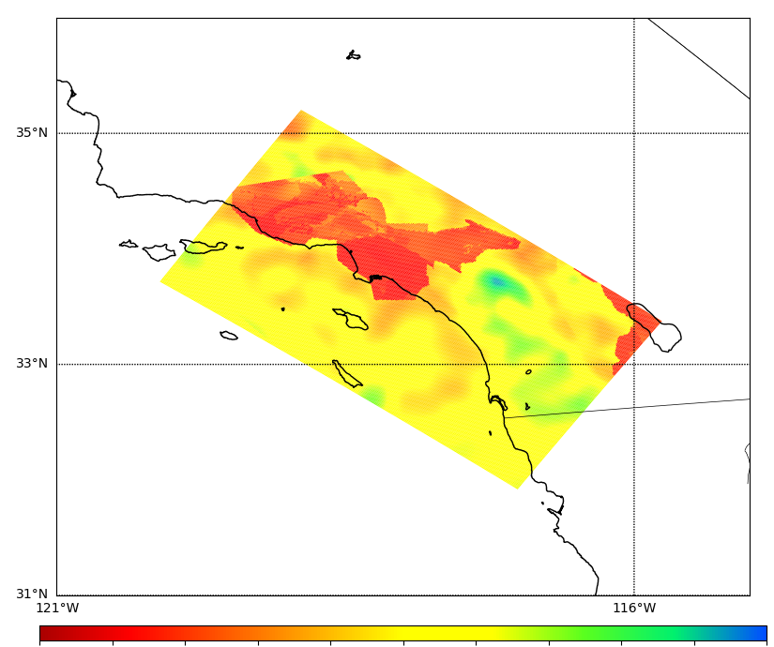
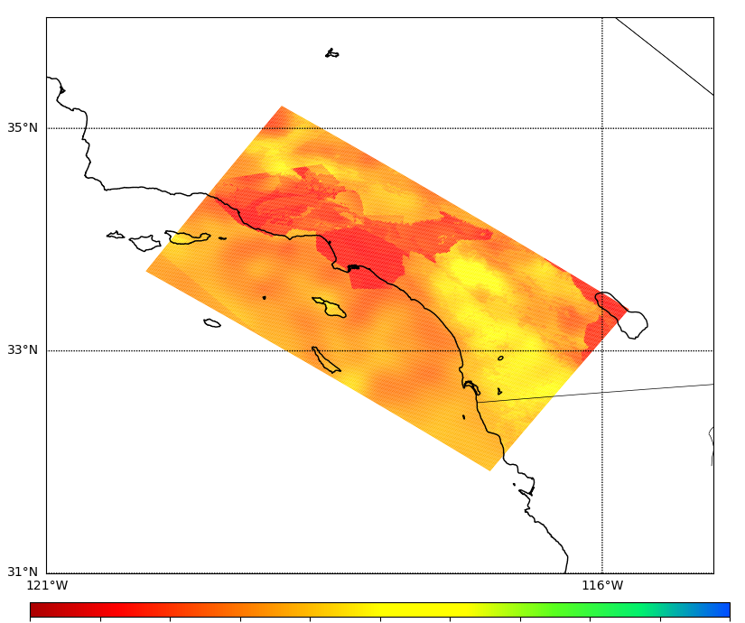
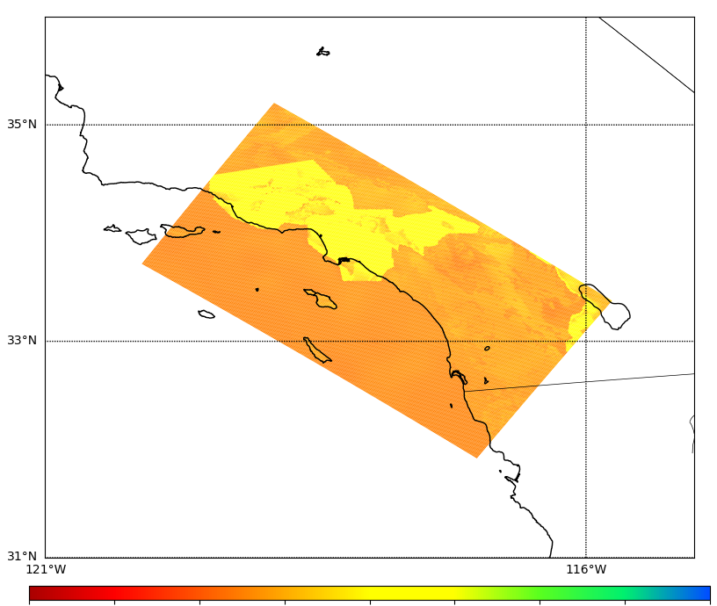
Merged Taper Cross-sections
CVM-S4.26.M01
Merged Taper
% difference
Surface
500
1000
2500
500
1000
2500
-100%
0%
100%
300m depth
500
1000
2500
500
1000
2500
-100%
0%
100%

Slide 12
Updates to Rupture Generation
New version of GP generator (v5.5.2, same as in latest BBP release)
Reduced correlation between slip and risetime
Reduced shallow fault rupture speed
Slightly weaker directivity
Variable strike & dip
Increased energy at 2-3 sec
Rupture velocity is no longer fixed
67.5%-87.5% of shear wave velocity
Denser hypocentral spacing
4.5 km -> 4 km
~31% increase in rupture variations
Slip plot, v3.3.1 from Study 15.4 (top); v5.5.2 from Study 22.12 (bottom)

Slide 13
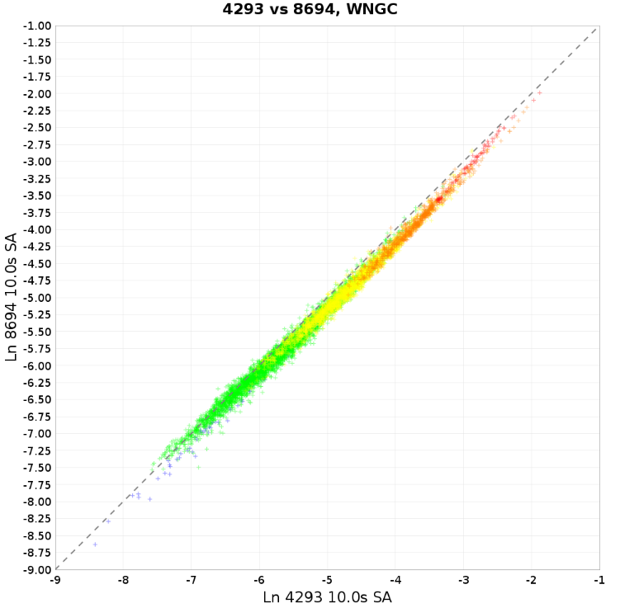
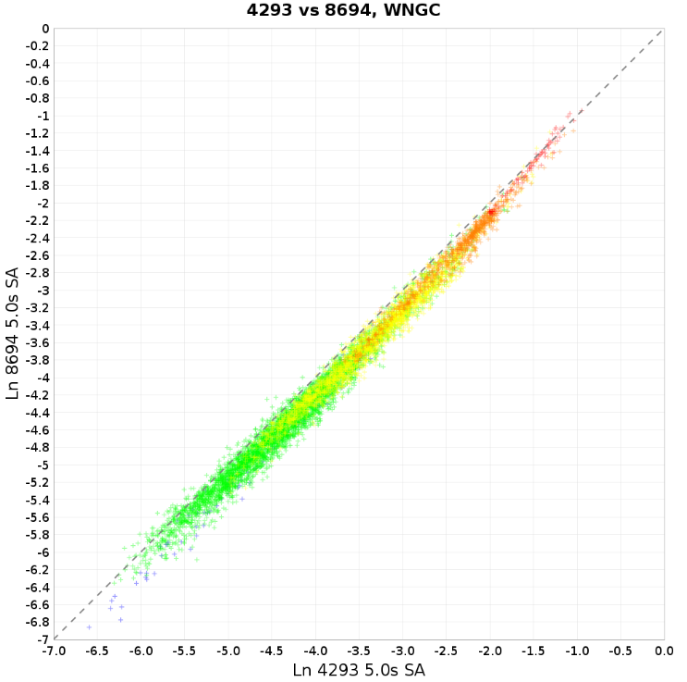
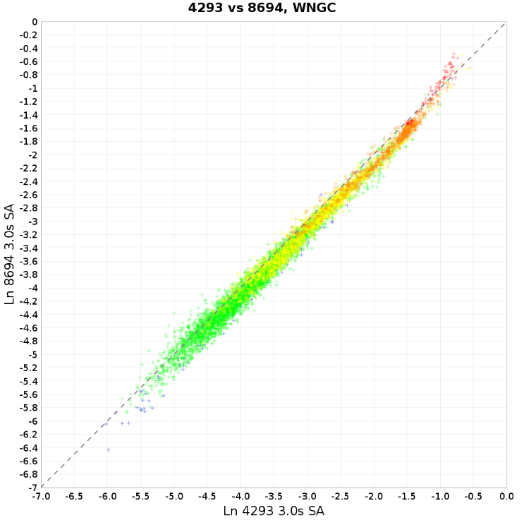
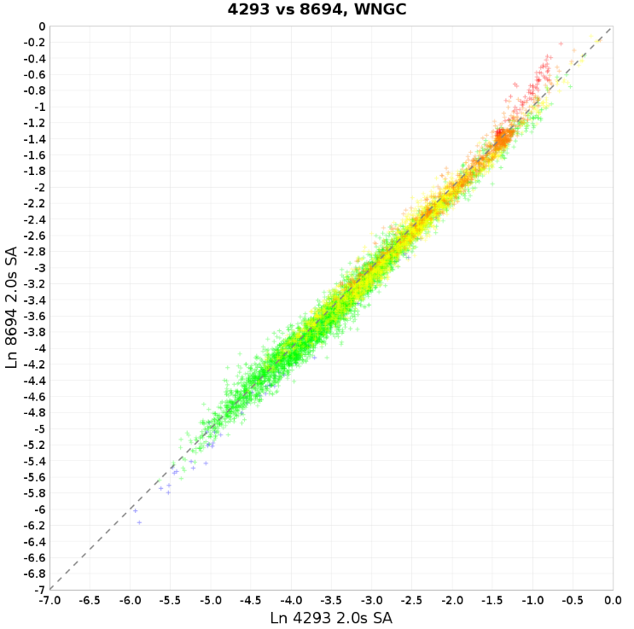
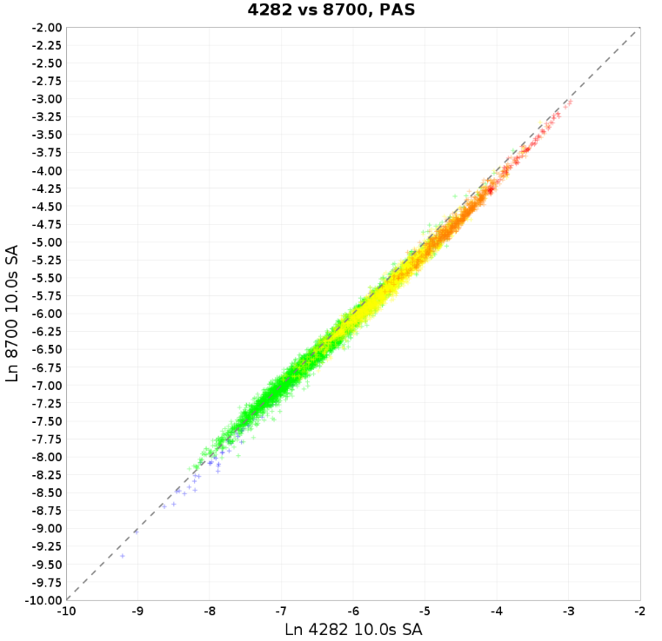
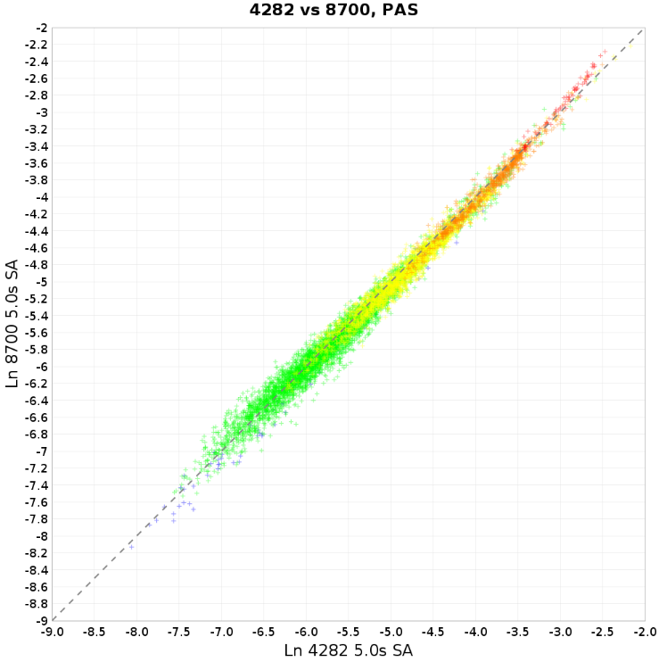
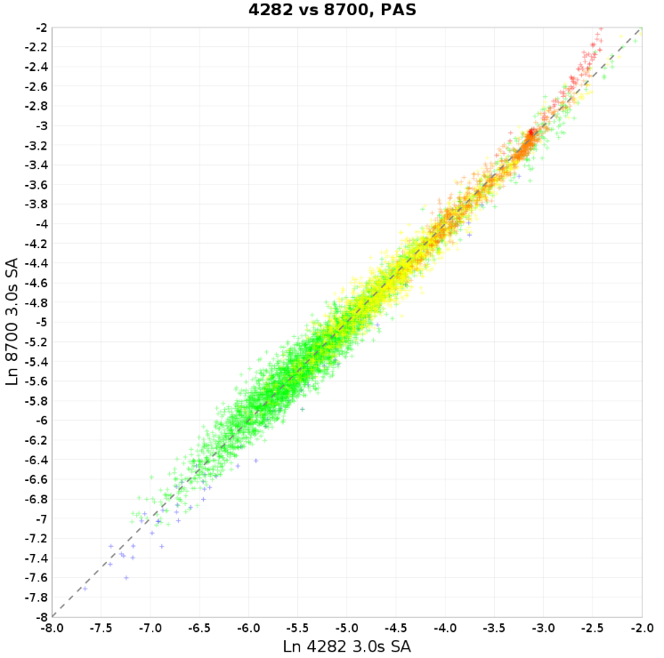
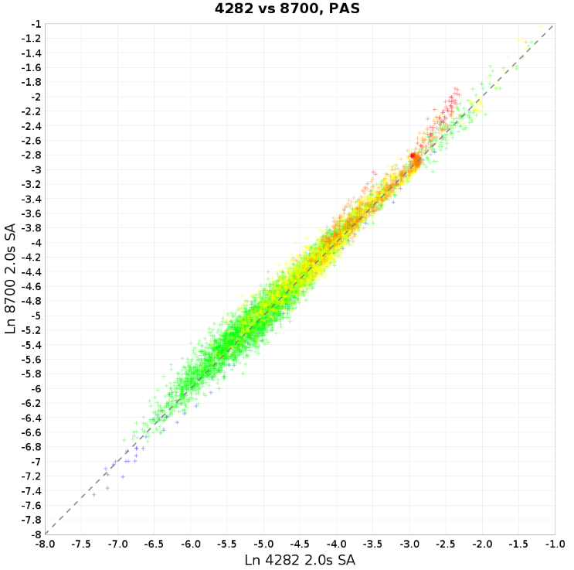
Rupture Generator Impact on Ground Motions
10 sec
5 sec
3 sec
2 sec
WNGC
PAS

Slide 14
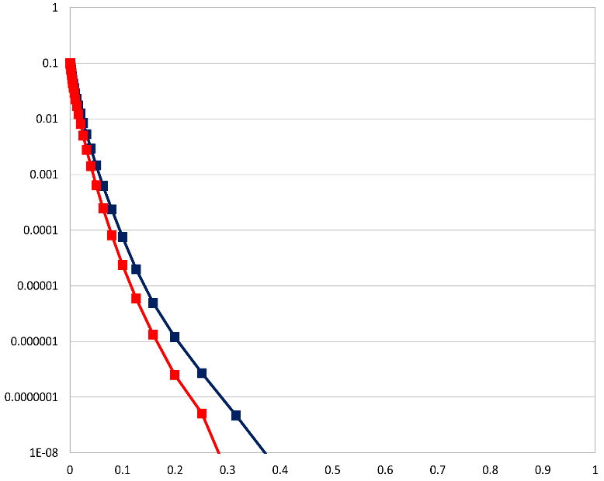
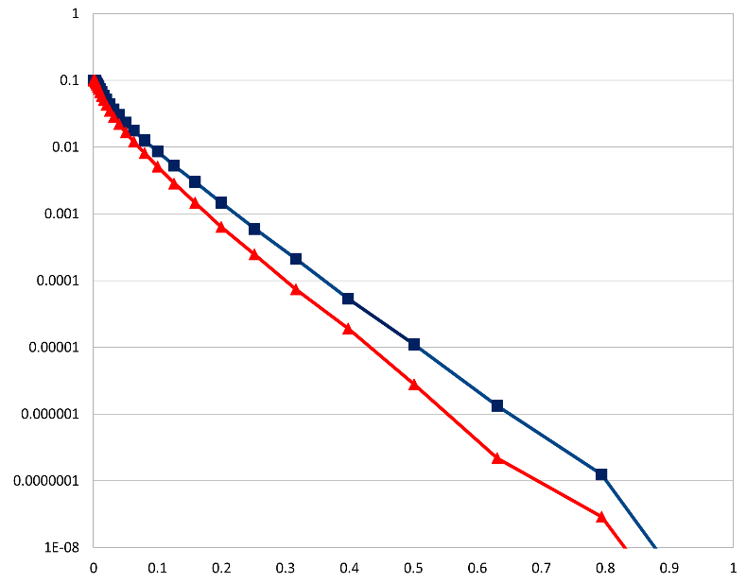
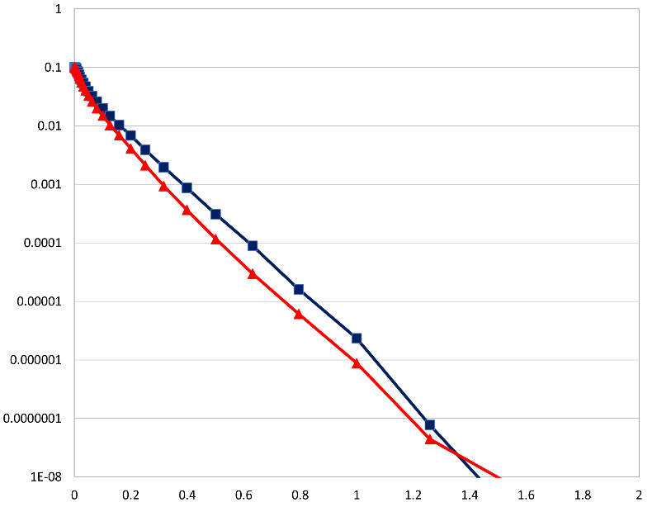
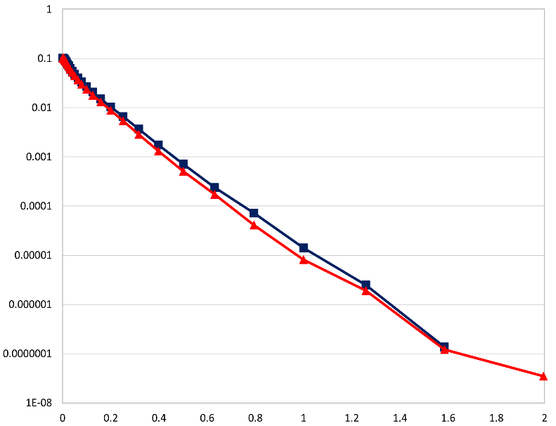
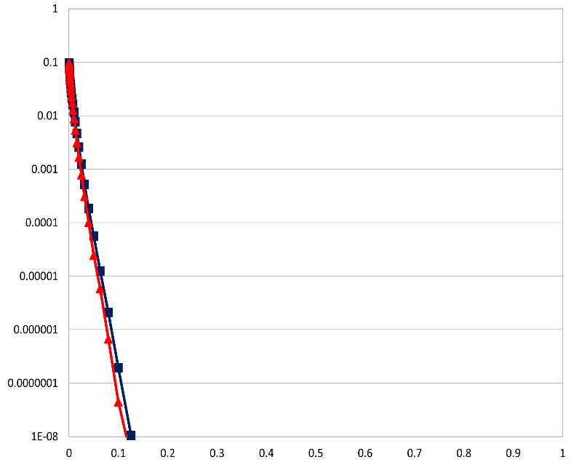
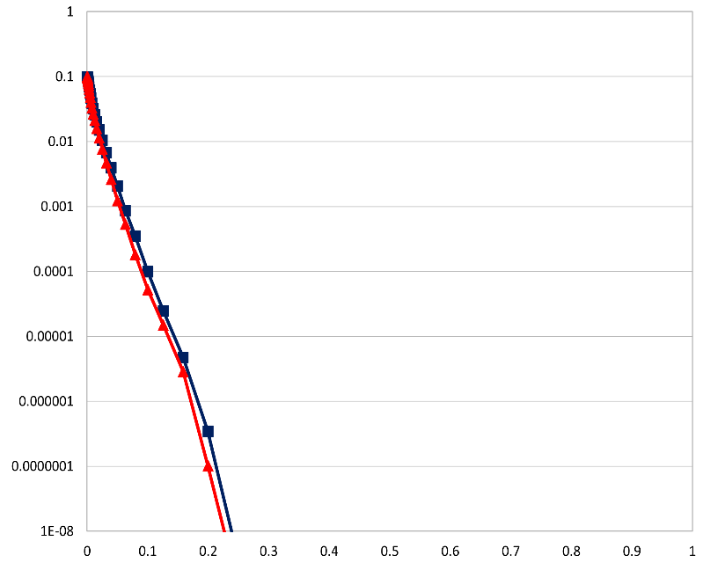
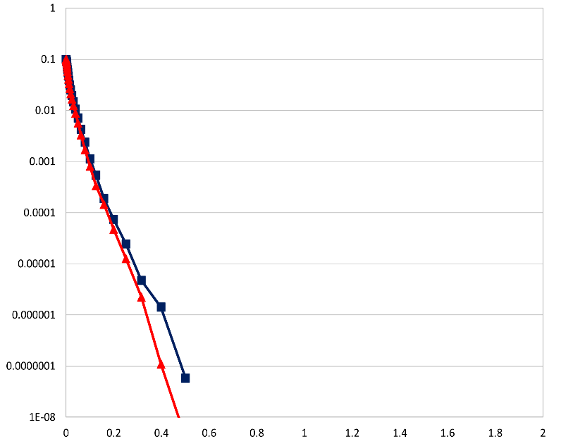
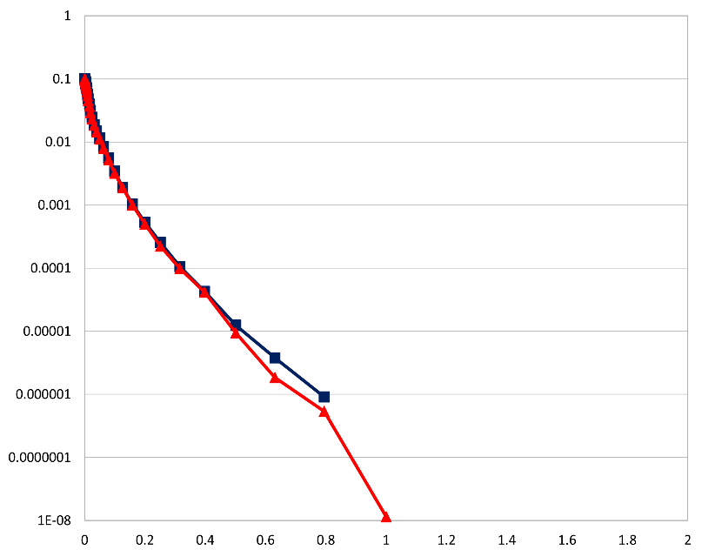
Rupture Generator Impact on Hazard
10 sec
5 sec
3 sec
2 sec
WNGC
Study 15.4 rupture generator (v3.3.1)
Study 22.12 rupture generator (v5.5.2)
PAS

Slide 15
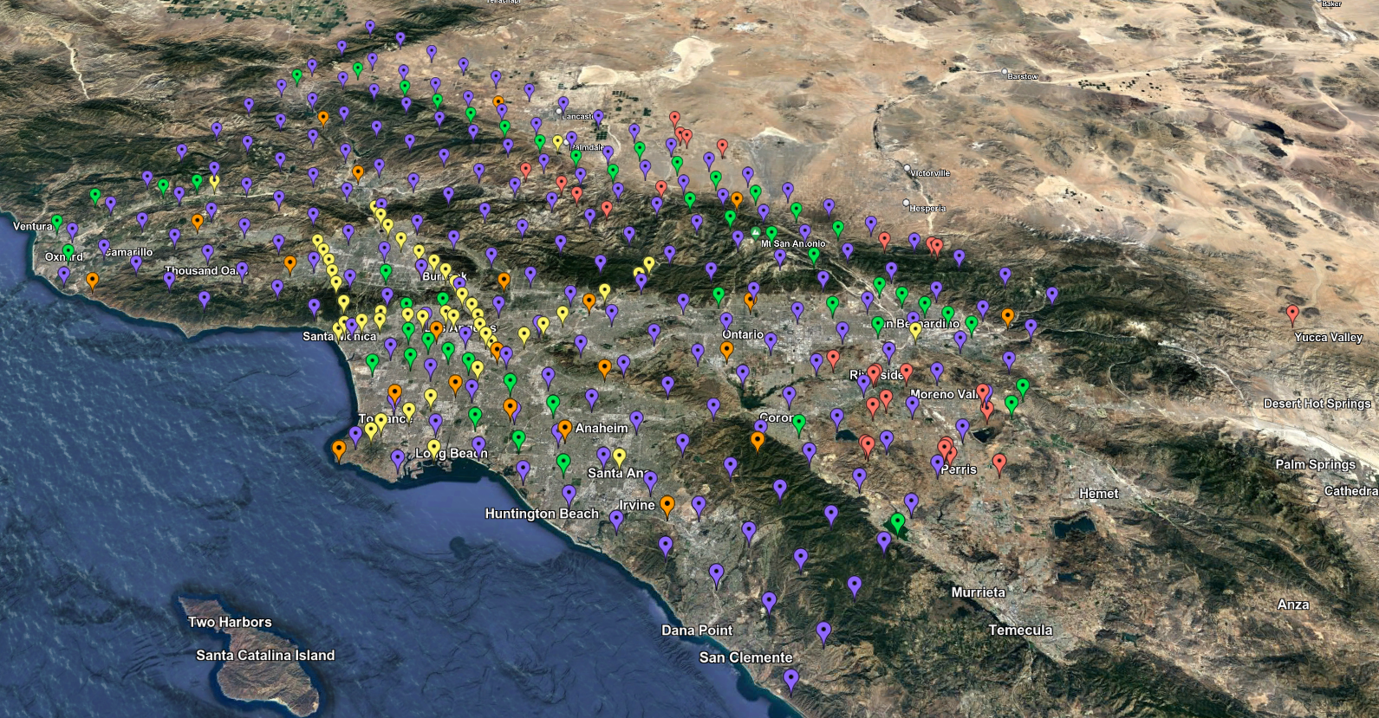
Study 22.12 Statistics
335 sites around SoCal
Study performed over 76 days
772,000 node-hrs on OLCF Summit
Averaged 422 nodes
Max of 3382 (73% of Summit)
Managed ~2.5 PB of data
74 TB of data staged back to archival storage
420 million two-component low-frequency and broadband seismograms
83 billion intensity measures and durations
Study 22.12 site map

Slide 16
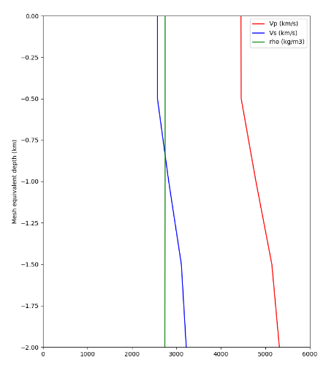
Change in Hazard, non-basin sites
LAPD
3 sec curves
Study 15.4
Study 22.12
s211
s035
s764

Slide 17
Change in Hazard, basin sites
s117
3 sec curves
Study 15.4
Study 22.12
SBSM
WNGC
USC

Slide 18
Study 22.12: Low-Frequency Curves
2 sec RotD50
3 sec RotD50
5 sec RotD50
10 sec RotD50
LBUT (outside basin)
USC (inside basin)
Red: Study 15.4
Black: Study 22.12

Slide 19
Low-Frequency Results
Study 22.12
Ratio, 22.12/15.4
Ratio, 22.12/GMMs
2 sec, RotD50
10 sec, RotD50

Slide 20
Study 22.12: Broadband Results
Study 22.12
Ratio, 22.12/15.12
0.1 sec, RotD50
0.5 sec, RotD50
Distribution of z-scores between 22.12 BB and ASK2014

Slide 21
Study 22.12: Data Access
Developed CyberShake data access tool
Python-based
Asks user series of questions
Applies filters to select subset
Simplifies access to variety of CyberShake data products
Site metadata
Event metadata
Intensity measures
Seismograms
Available on github: https://github.com/SCECcode/cs-data-tools/

Slide 22
Next Study
Preparing for Study 24.1
Greater Bay Area
Similar to Study 22.12
Just got the compute time this week!
Currently evaluating 3D velocity models
Will validate with Central and Northern CA BBP validation events
Study 24.1 site map

Slide 23
Future Plans
Increase deterministic frequency to 2 Hz
Frequency-dependent attenuation
Small-scale velocity heterogeneities
Include nonlinear simulations
Reciprocity is by definition linear
Identify subset of events for full nonlinear simulations
Apply pseudo-nonlinearity to reciprocity results
Streamline process of integrating new codes and models
Goal is to support multiple codes for each stage
Supports improved quantification of uncertainty

Slide 24
Thanks!

