Slide 1
CyberShake Study 18.8 Planning
Scott Callaghan

Slide 2
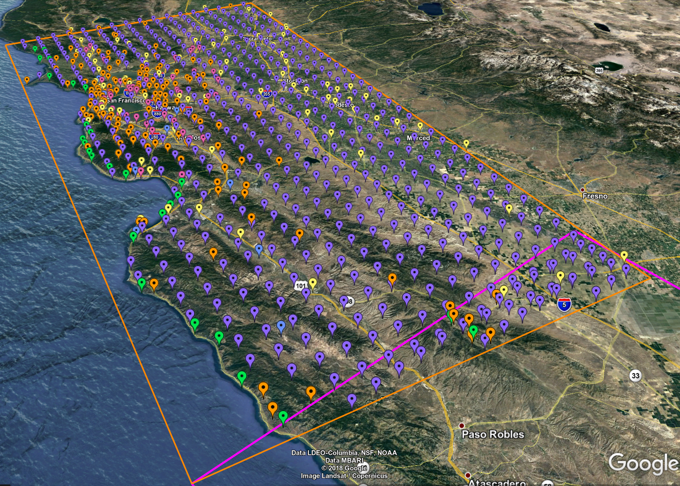
Study 18.8 Goals
Perform physics-based seismic hazard analysis in the extended San Francisco Bay Area
Will perform CyberShake calculations for 869 locations
New combination of velocity models
Area of overlap with previous studies to examine model impact
We anticipate this will be the largest CyberShake study to date

Slide 3
Execution Plan
CyberShake consists of two parts:
Strain Green Tensor (SGT) workflow
Dominated by 2 MPI GPU jobs, 40-80 minutes on 800 nodes
1600 node-hrs total
Post-processing workflow
Dominated by master/worker MPI CPU job, 2-13 hours on 120 nodes
More heterogeneity than in previous studies due to volume sizes
In 2017, ran both workflows on both Blue Waters and Titan
Plan to use similar plan for 2018

Slide 4
Execution Plan, cont.
Goals are to minimize makespan and human involvement
Recognize Blue Waters allocation is expiring on 8/31
75% on Blue Waters, 25% on Titan: 1.8M node-hours
Plan to use standard workflow software stack
Pegasus, HTCondor, GRAM job submission
Estimated duration of 4 weeks
Data transfer
54 TB Titan SGTs archived on Blue Waters
9 TB output data transferred to SCEC storage

Slide 5
Staff
SCEC Staff
Scott Callaghan
Phil Maechling
Christine Goulet
Mei-Hui Su
Kevin Milner
John Yu
Pegasus Staff
Karan Vahi
Mats Rynge
NCSA Staff
Tim Bouvet
Greg Bauer

Slide 6
Requests
Reservation on XK nodes
2400 nodes, to run 3 SGT jobs concurrently
Reservation on XE nodes
1000 nodes, to process SGTs at the rate the XK nodes are producing them
Disk usage OK
Cumulative disk usage of 600 TB, will clean up as we go
Scheduled downtime?

