Slide 1
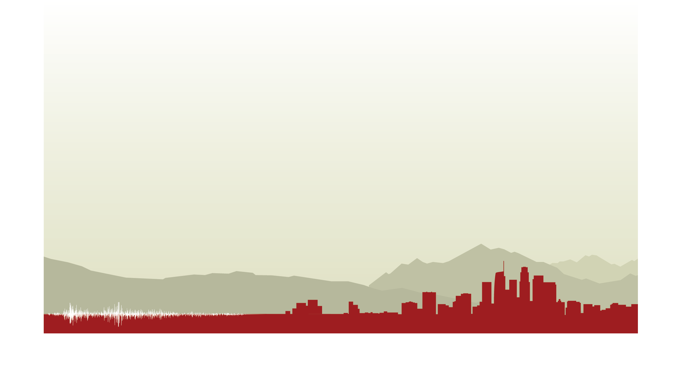
New Advances in
CyberShake PSHA Models
Scott Callaghan, Philip J. Maechling, Christine A. Goulet, Kevin R. Milner,
Mei-Hui Su, Robert W. Graves, Kim B. Olsen, Yifeng Cui, Brad Aagaard, Kathryn E. Wooddell, Albert R. Kottke, Bruce E. Shaw, and Thomas H. Jordan
2019 AGU Fall Meeting
December 10, 2019

Slide 2
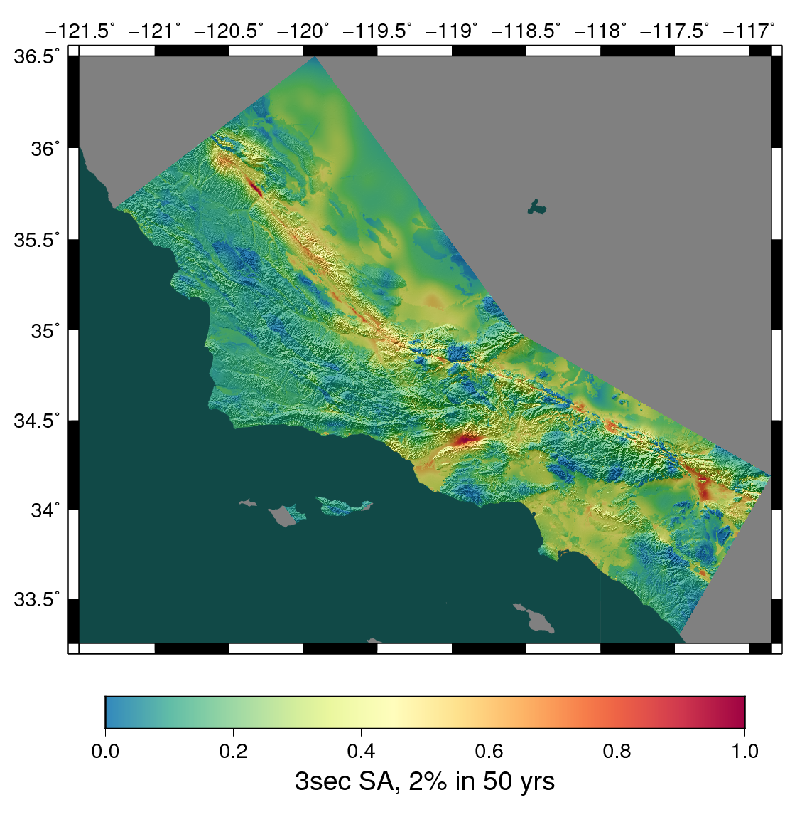
CyberShake Overview
Southern California Earthquake Center’s 3D physics-based probabilistic seismic hazard analysis (PSHA) platform
UCERF2 ERF (M≥6.5, ≤200 km) with Graves & Pitarka rupture generator (~500,000 events per site)
Reciprocity-based approach to simulate seismograms
Intensity measures derived from seismograms
Hazard results from individual sites interpolated with GMPE basemap
Structural models: CVM-S4.26, CCA-06
Earthquake forecast: UCERF2

Slide 3
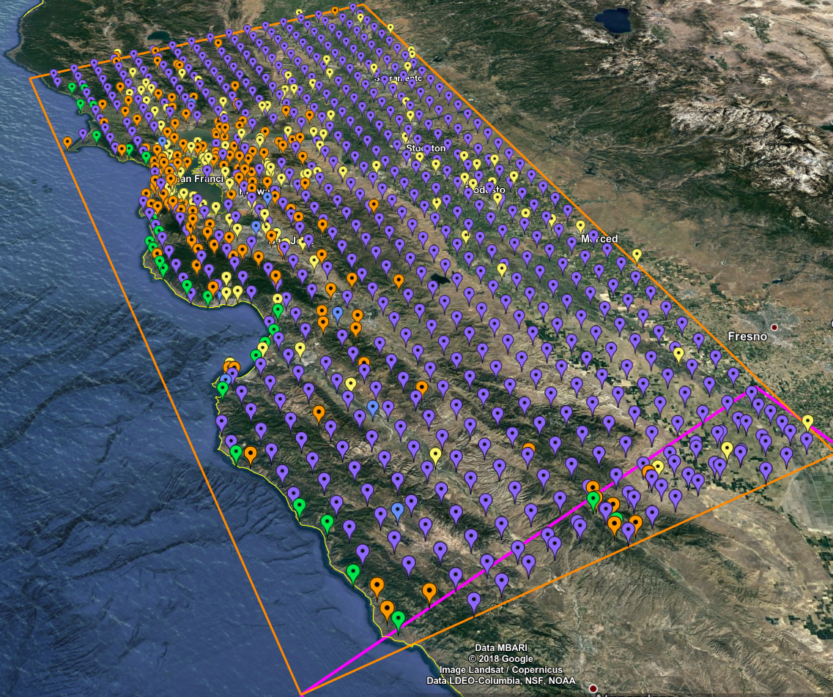
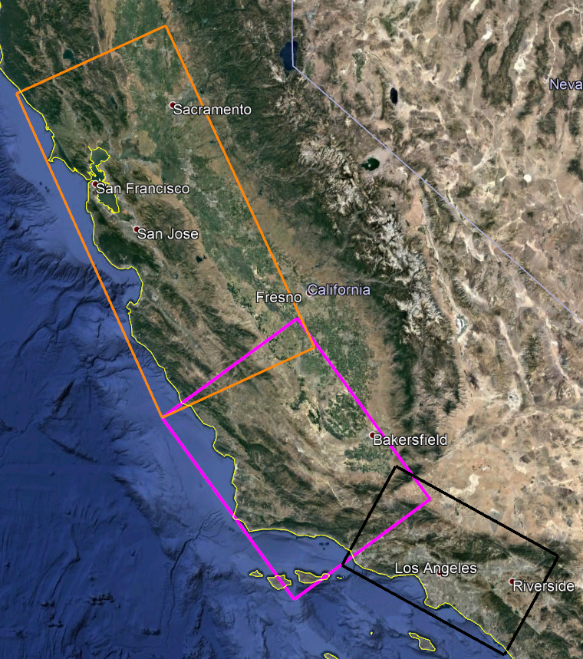
Northern California: Study 18.8
Contiguous with previous CyberShake studies
869 locations
1 Hz deterministic
Vs min = 500 m/s
Study performed over 128 days
  120 million core-hours
  1.2 PB data
  40,000 jobs run
  203 million 2-component seismograms
Southern CA (Study 15.4) region in black
Central CA (Study 17.3) region in magenta
Bay Area (Study 18.8) region in orange
869 sites, densest near San Francisco Bay

Slide 4
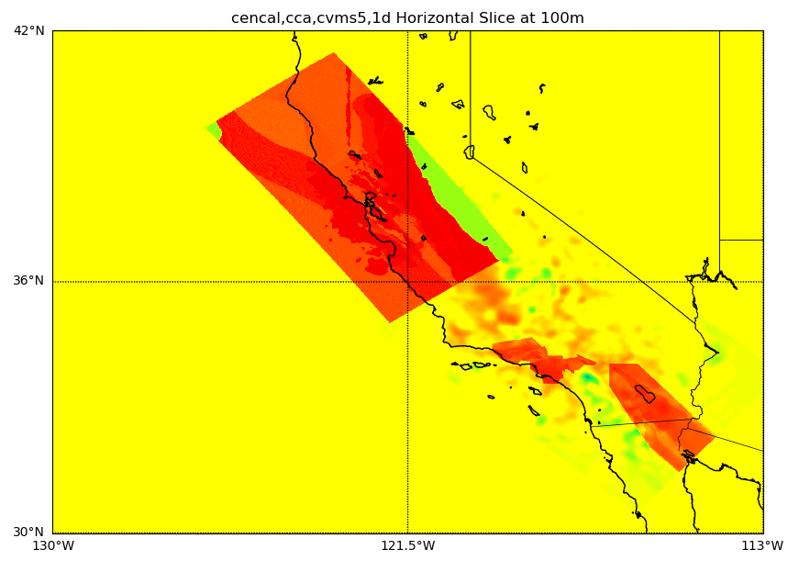
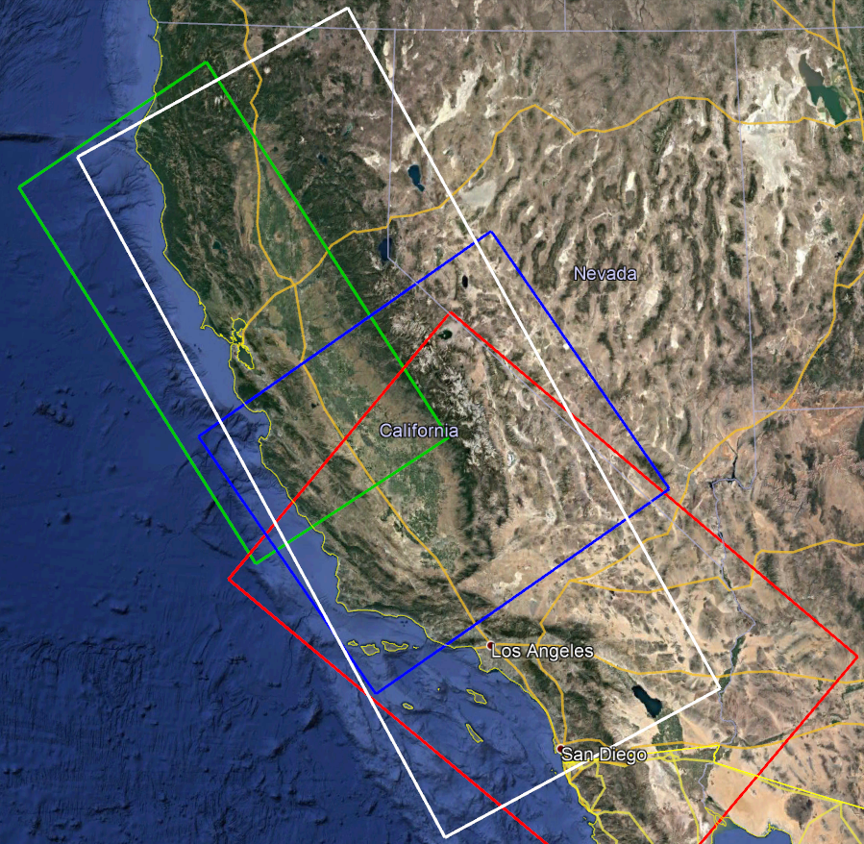
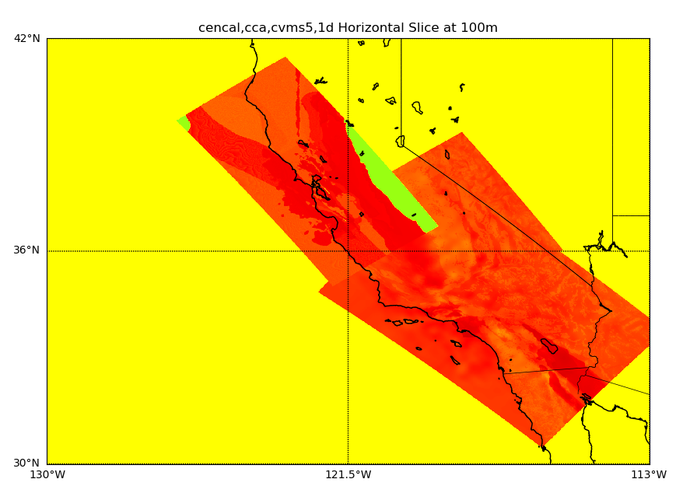
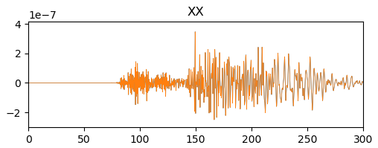
Modifications for Study 18.8
Statewide simulation volumes
New tiled velocity model
  20 km smoothing along interfaces
Added geotechnical layer for
CCA-06, following Ely (2010)
Extended SGT and seismogram durations
1D
no GTL
USGS
Bay Area
CCA-06 + Ely GTL
GTL
CVM-S4.26.M01
1D
200s
300s

Slide 5
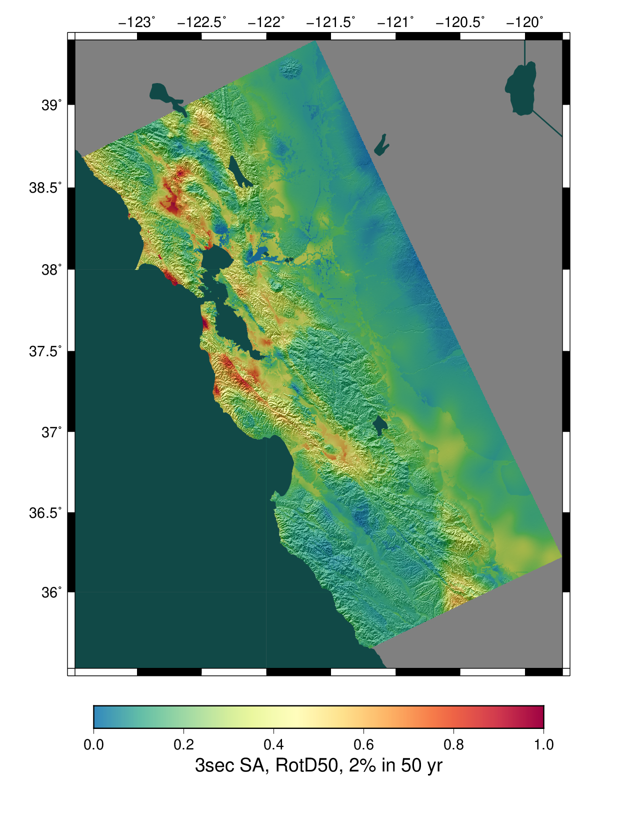
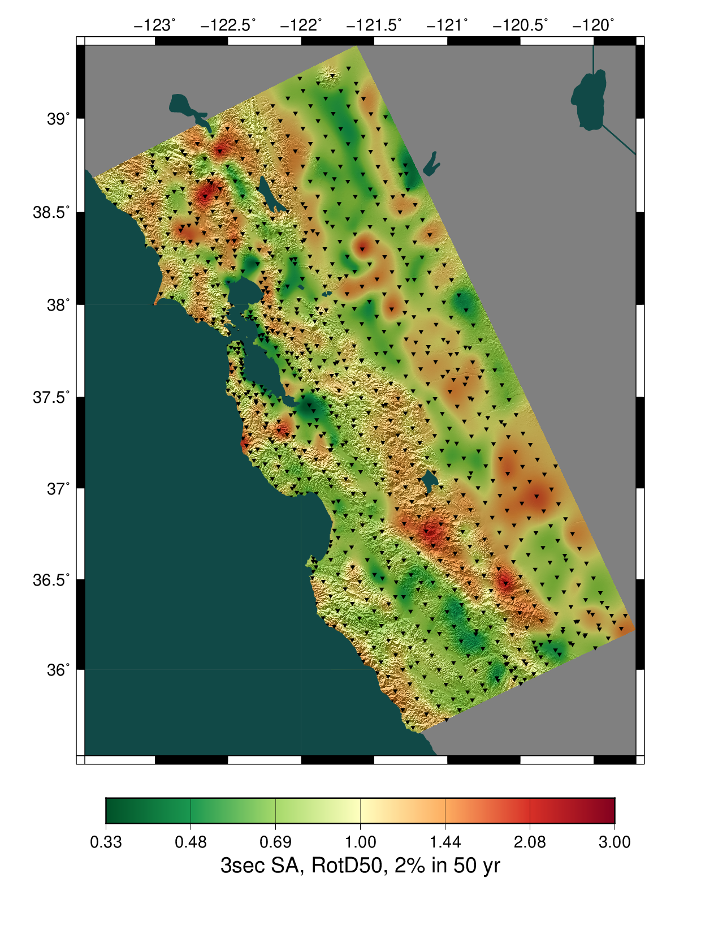
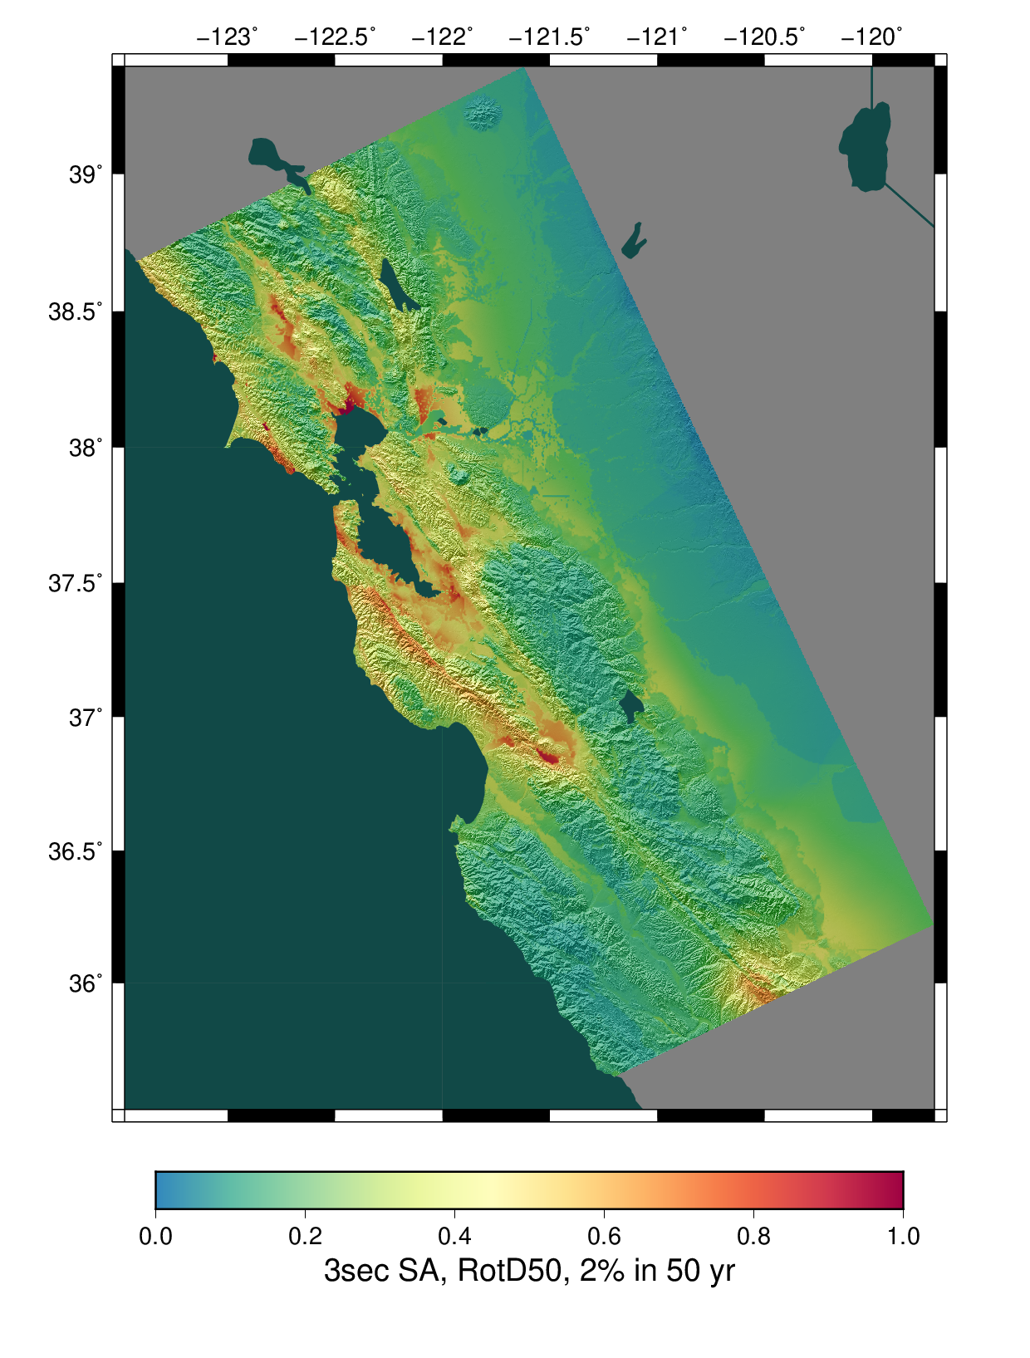
Study 18.8 Hazard Maps
CyberShake
Ratio of CyberShake/GMPEs
Avg of 4 NGAWest2 GMPEs

Slide 6
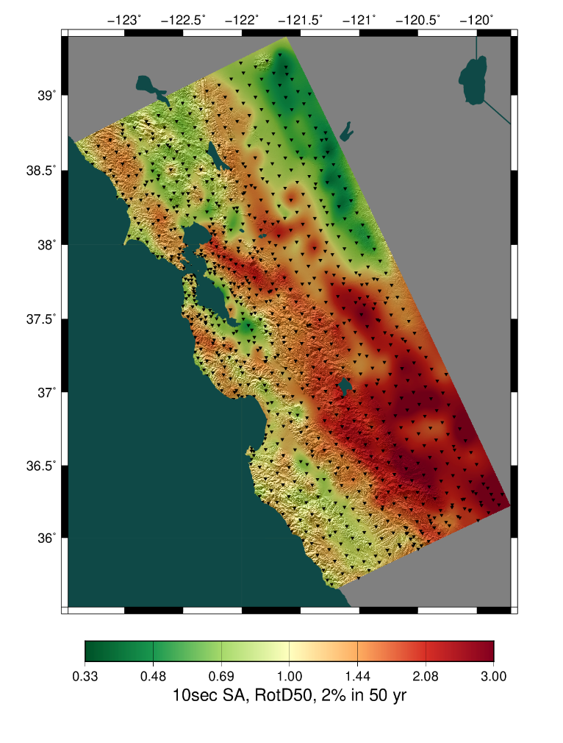
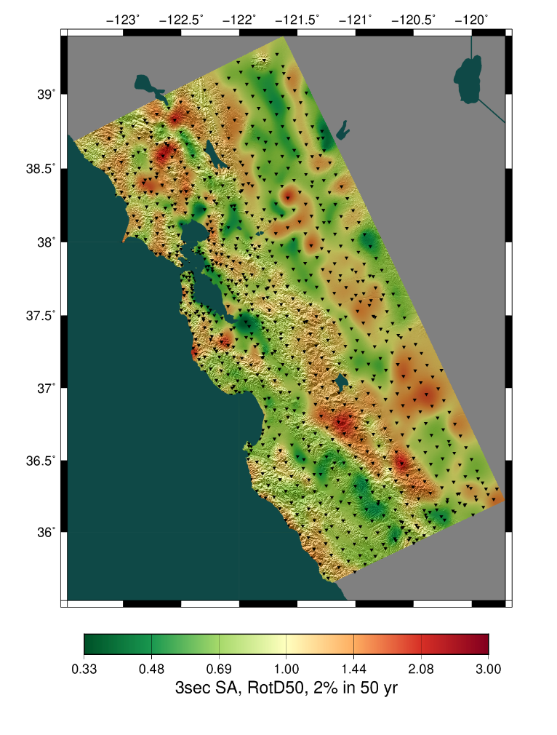
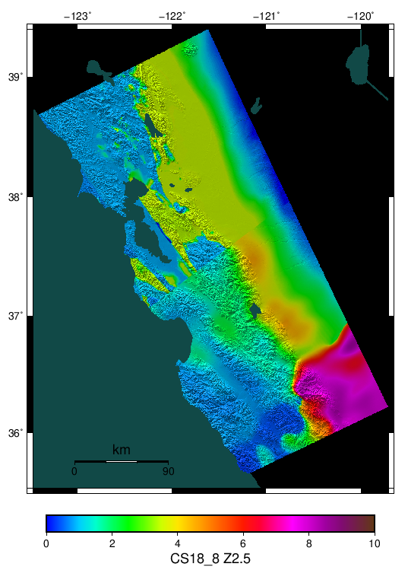
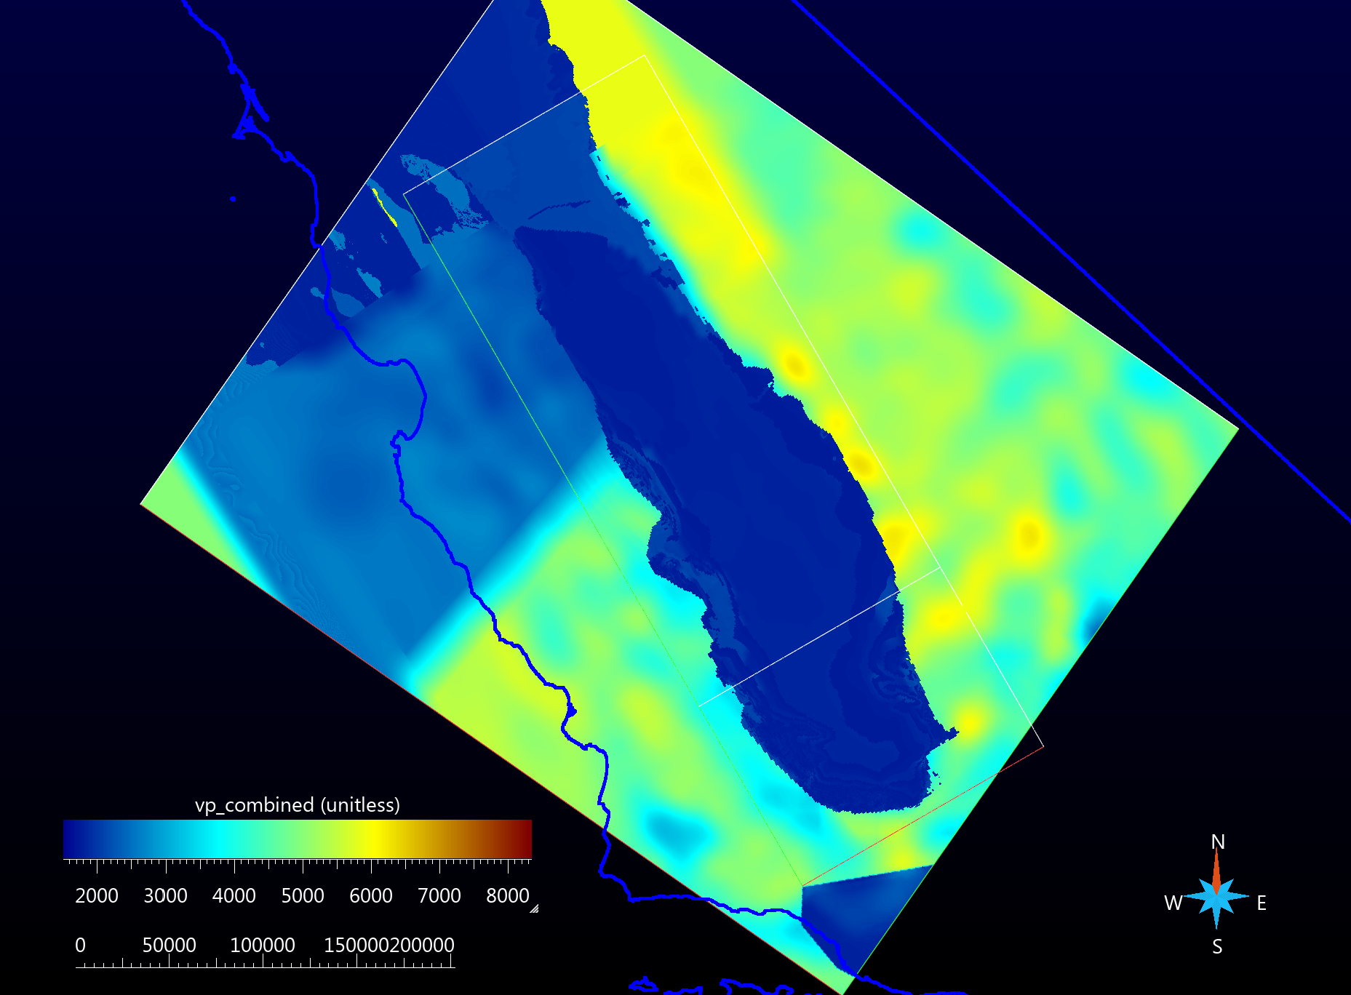
Study 18.8 Results: San Jacinto Valley
CyberShake shows increased hazard in San Joaquin Valley, especially at longer periods
Likely due to basins in tomographic CCA-06 model
CS173-H includes improved basin model
3 sec
10 sec
Z2.5

Slide 7
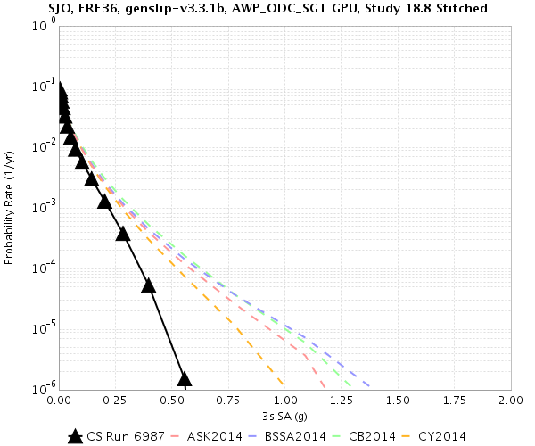
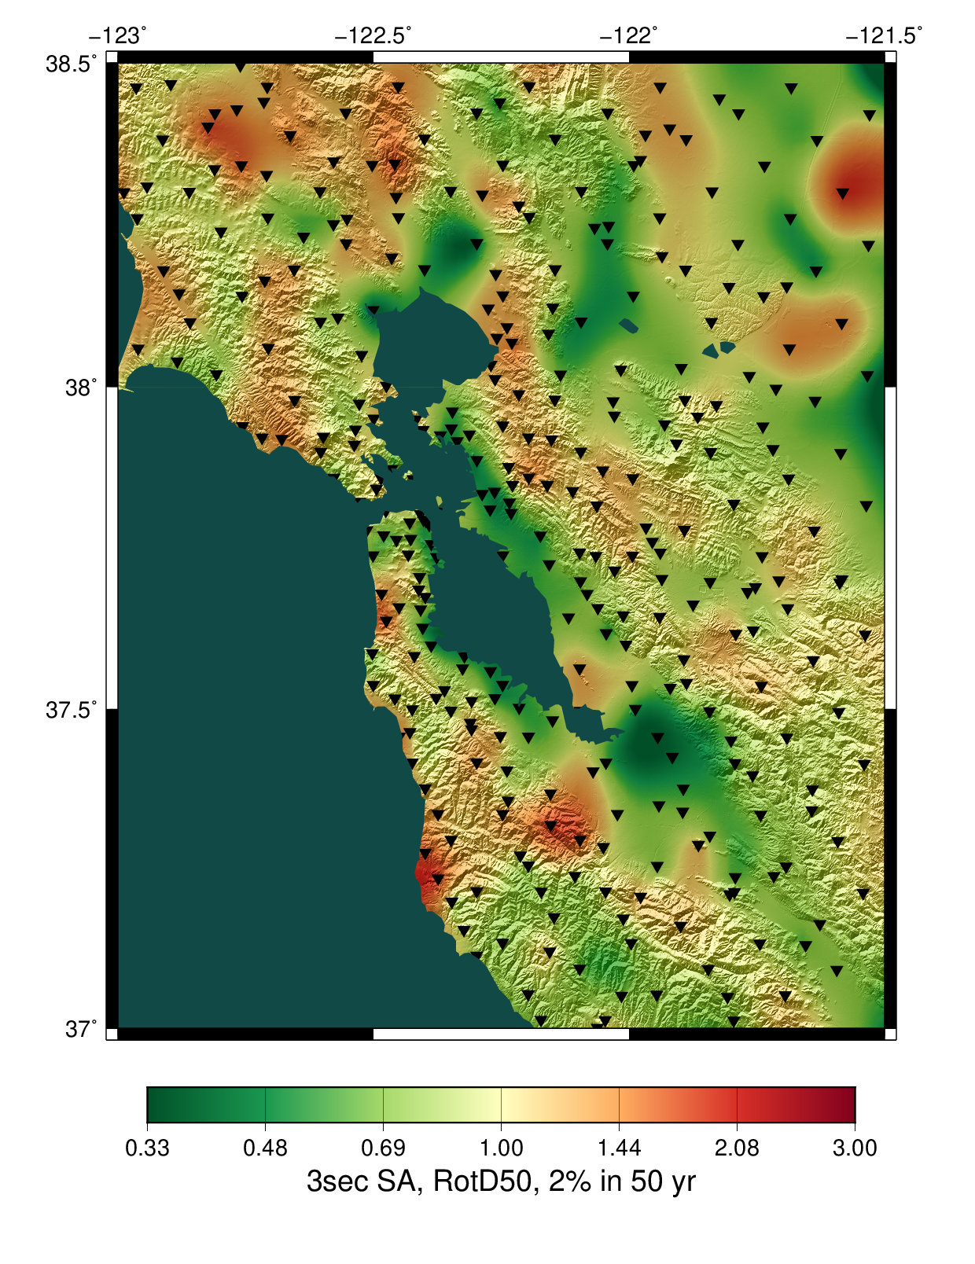
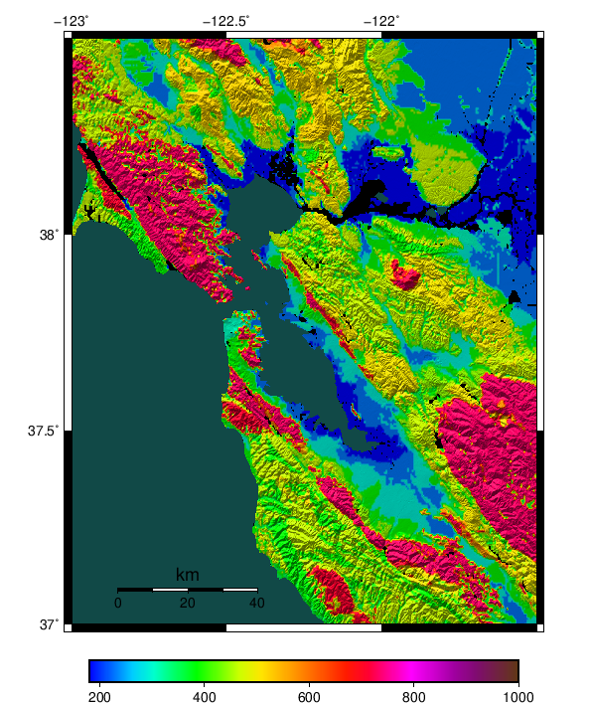
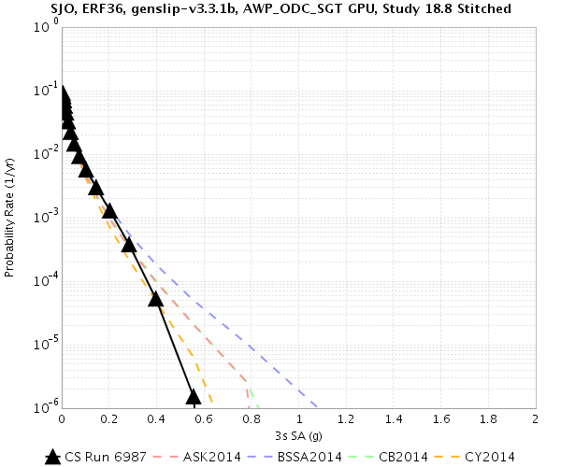
Study 18.8 Results: Bay Area
Ratio of CyberShake/GMPEs
Wills (2015) Vs30
CyberShake shows lower hazard immediately around San Francisco Bay
Differences reflect Vs30 values (used in GMPE comparisons)
Perform subset of runs using lower minimum Vs
GMPE Vs30=293.5
GMPE Vs30=500
500 m/s

Slide 8
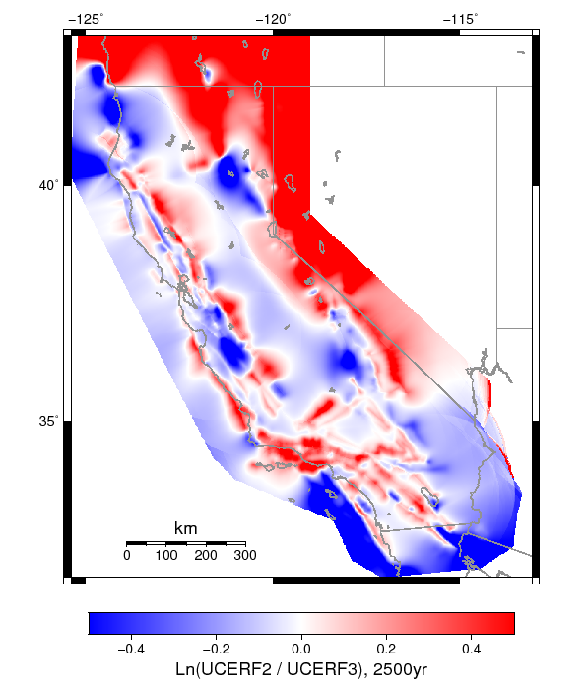
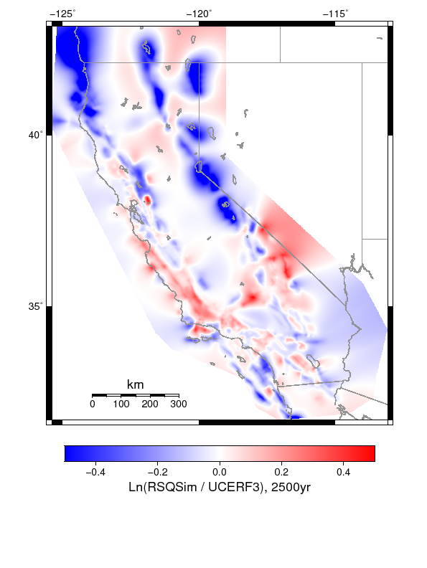
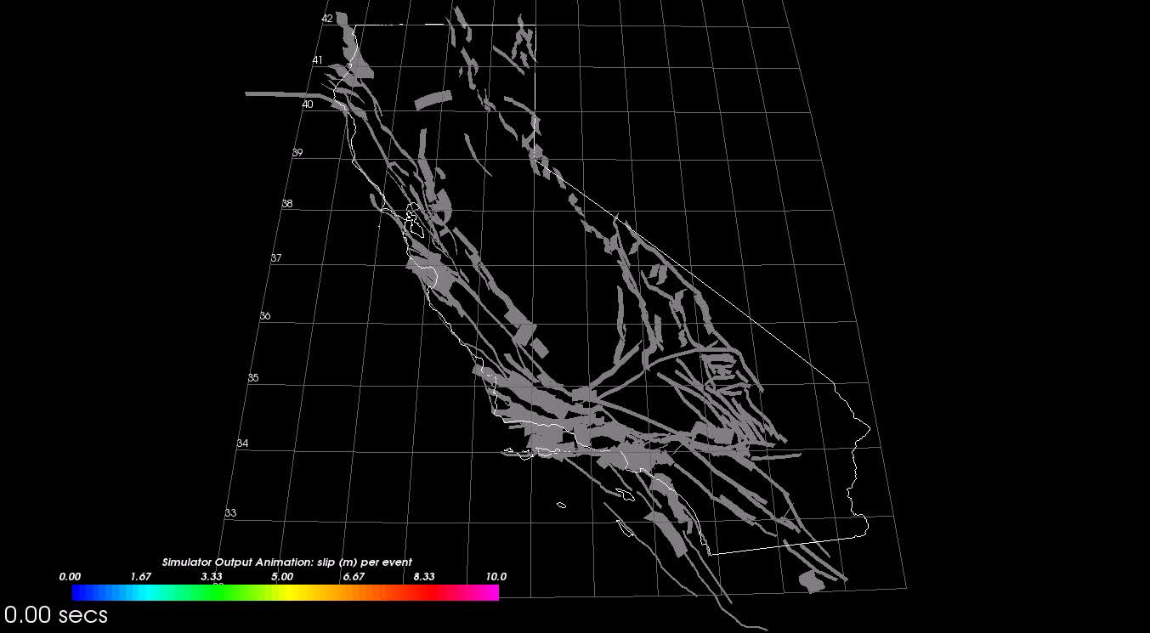
RSQSim
Rate and State Earthquake Simulator
  Richards-Dinger & Dieterich, 2012
Based on rate-and-state friction
Produces similar ERF to UCERF 3
UCERF2 vs UCERF3
RSQSim vs UCERF3
RSQSim produces full slip time histories
Can take events from long-running catalog and use to construct ERF
ERF passed to CyberShake and used for hazard calculations

Slide 9
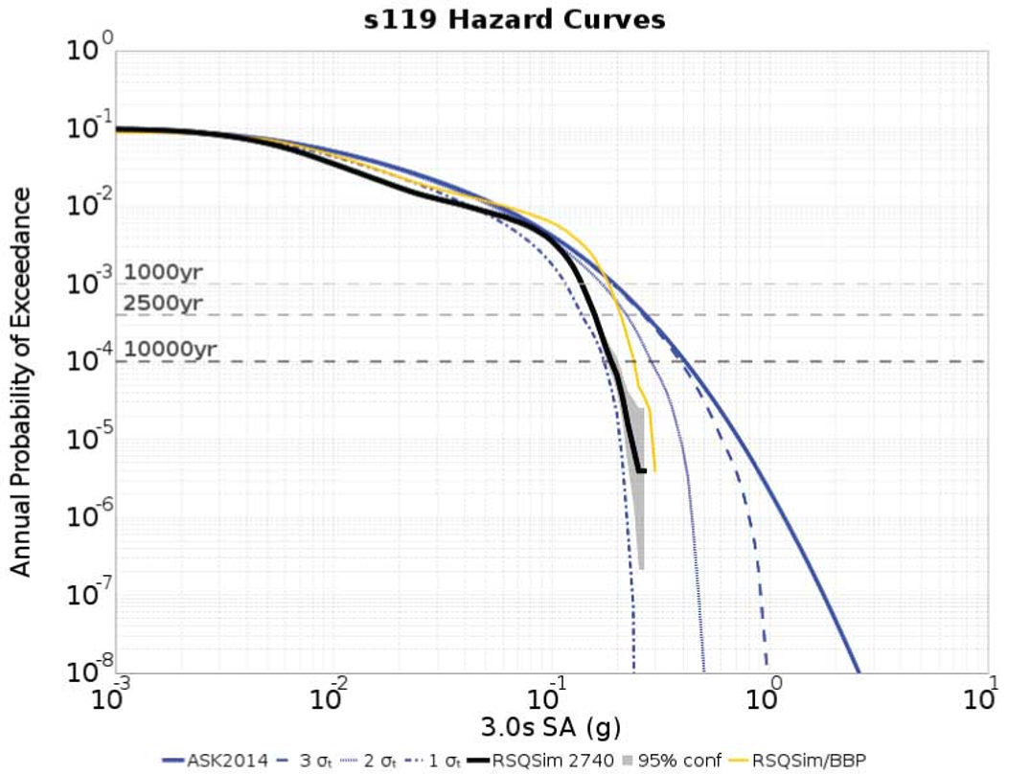
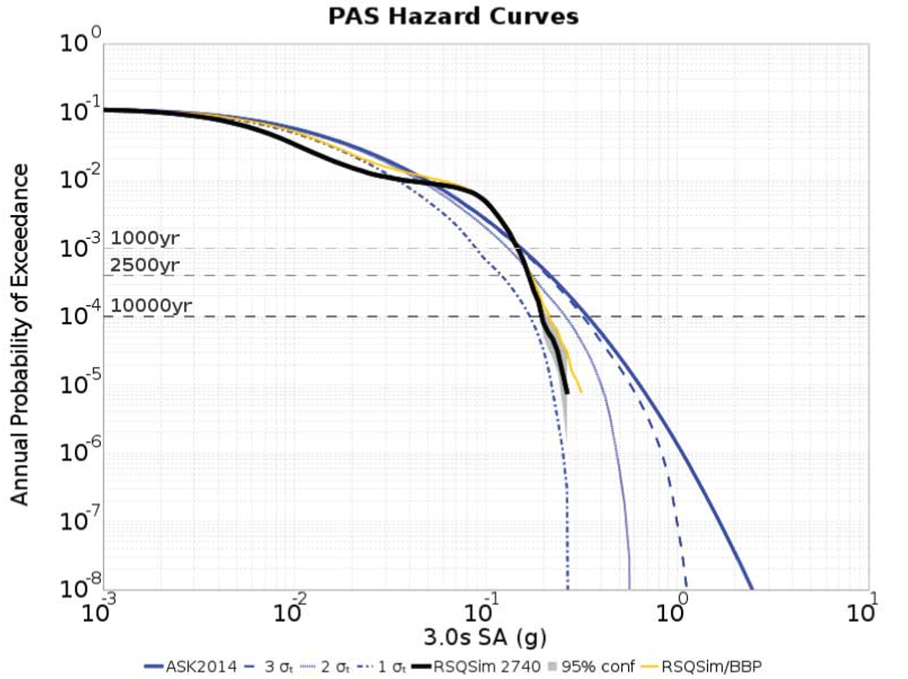
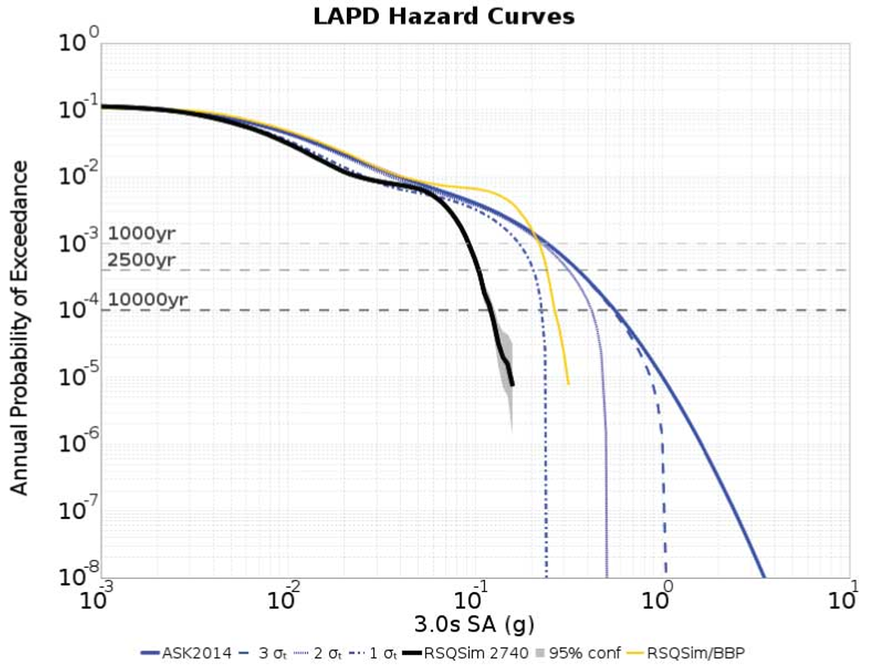
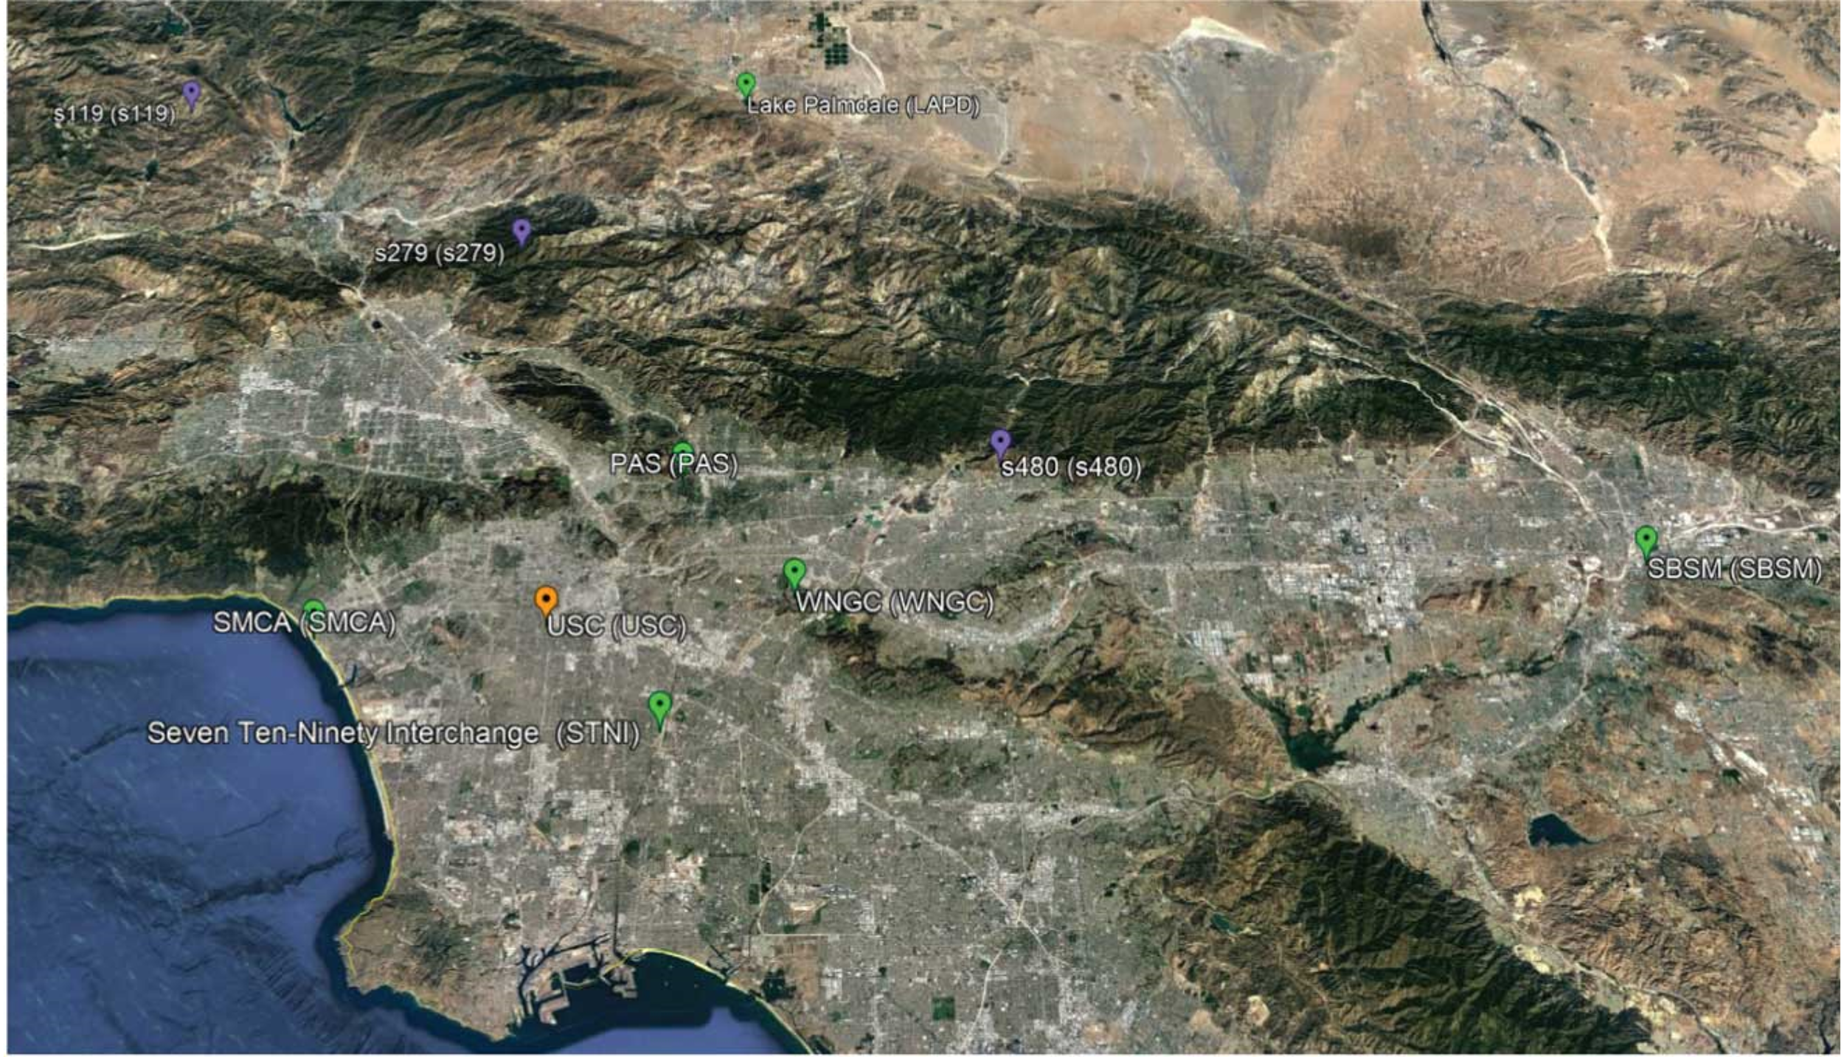
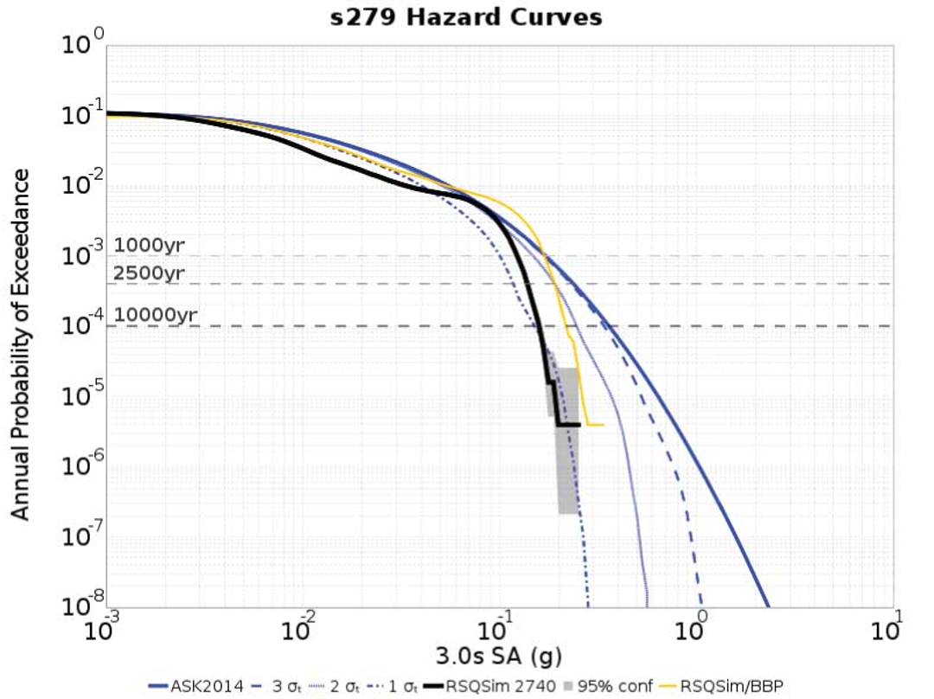
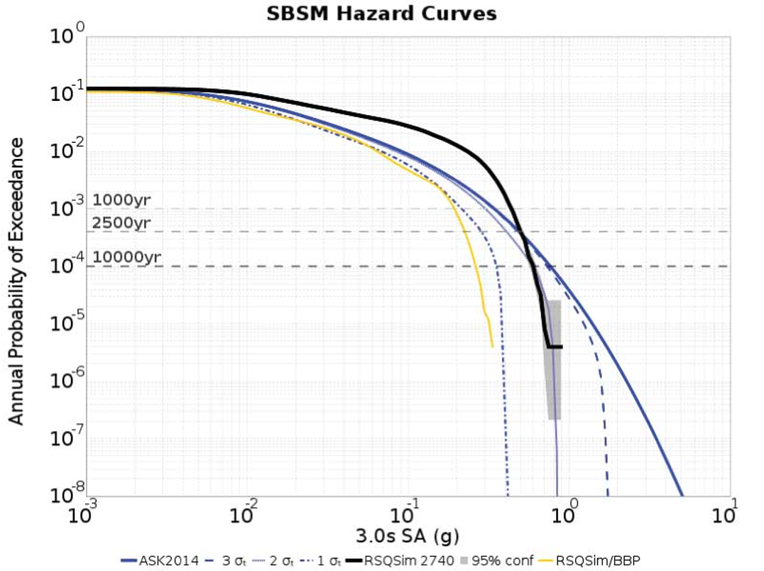
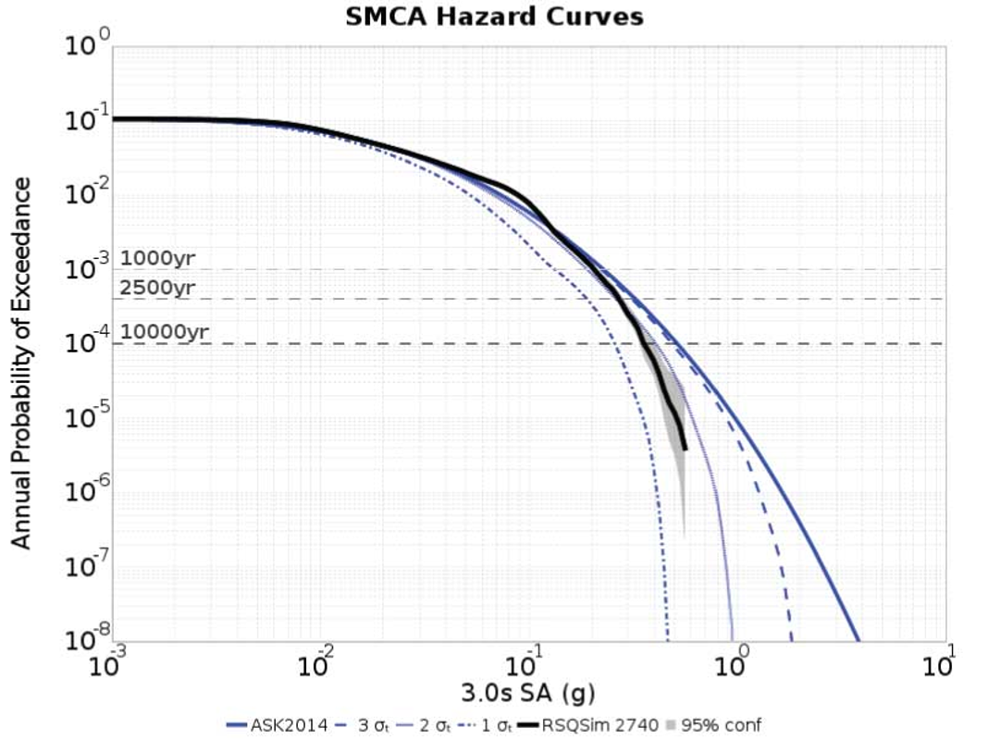
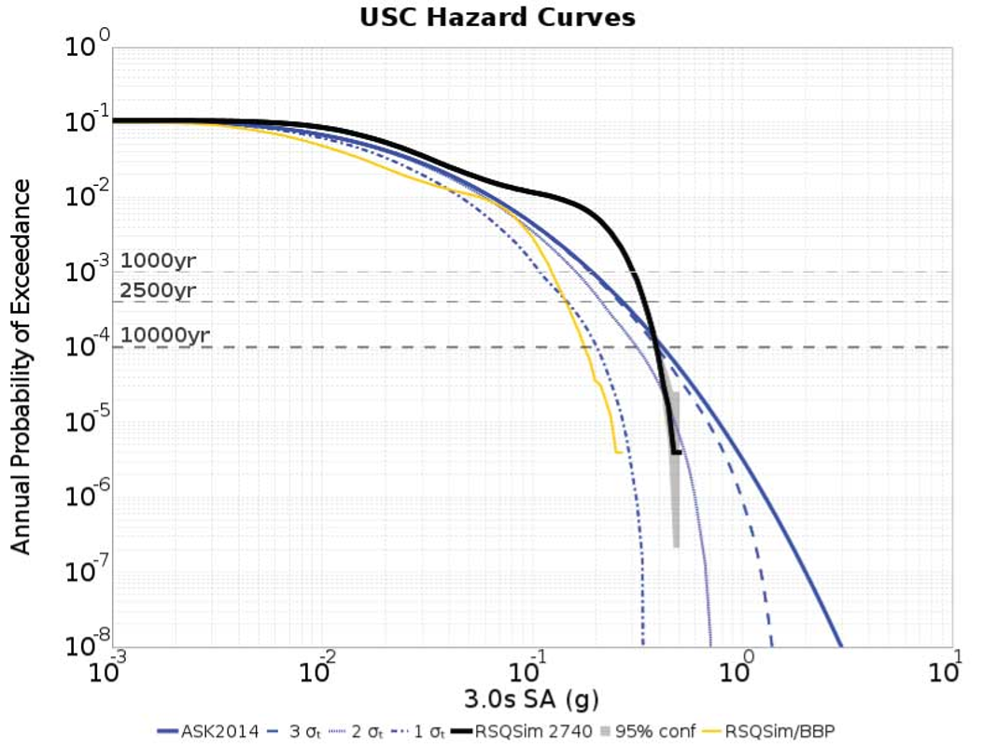
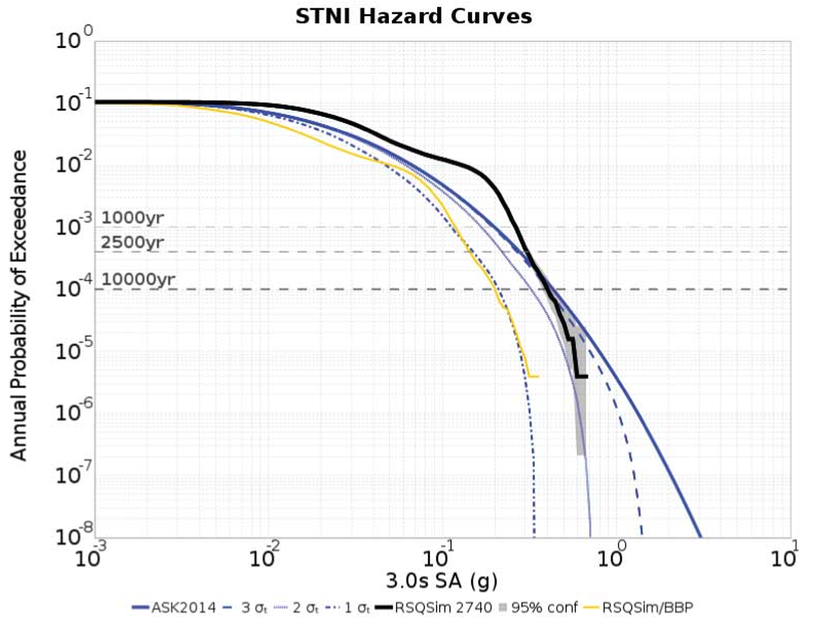
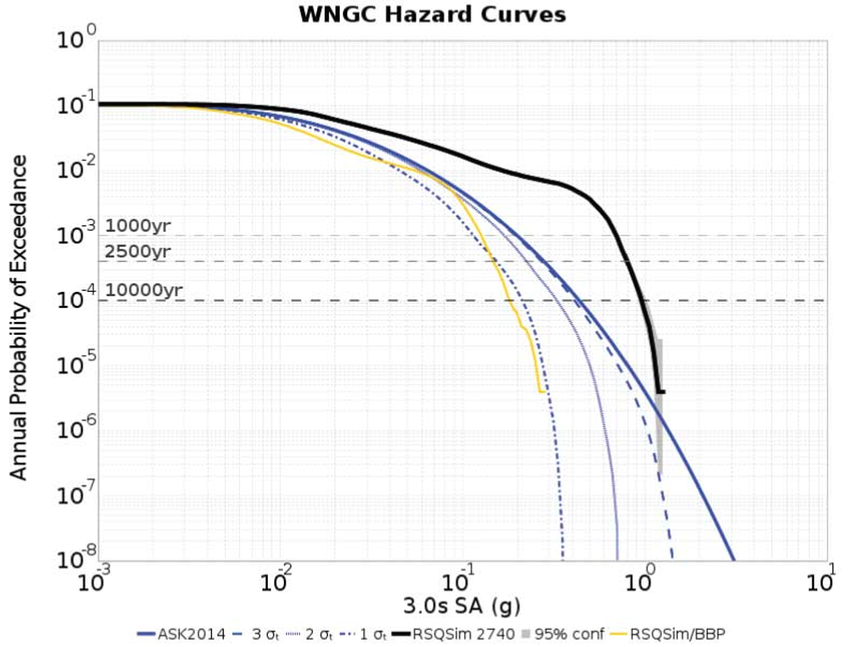
RSQSim CyberShake results
RSQSim/ASK 2014
3 σ
2 σ
1 σ
RSQSim/CyberShake
95% confidence
RSQSim/BBP

Slide 10
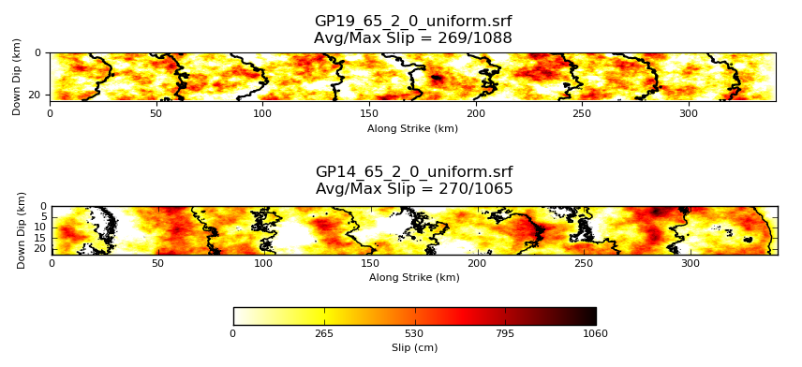
Graves & Pitarka (2019) Rupture Generator
Updated CyberShake to latest version of Graves & Pitarka generator
  Same version as Broadband Platform v19.4.0
Increased roughness and parameter variability

Slide 11
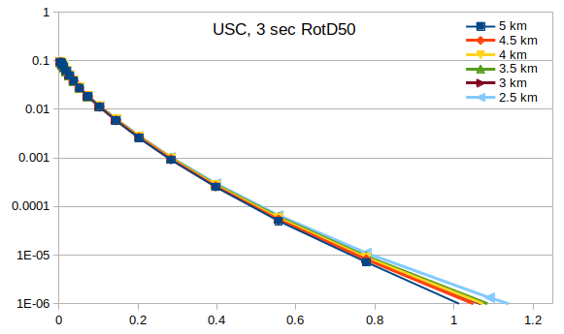
Hypocentral Spacing
Investigated impact of varying hypocentral spacing in GP 2019
  Average difference (in X and Y) between hypocenters across fault surface
  4.5 km used in previous GP rupture generators with CyberShake
Tradeoff of increased variability vs computational cost
Selected 6 hypocentral spacing
values (2.5, 3, 3.5, 4, 4.5, 5 km)
Calculated hazard curves for USC
Curve tends to increase with density

Slide 12
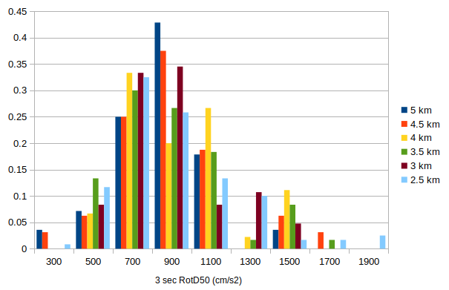
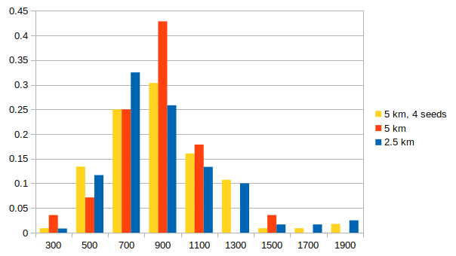
Hypocentral Spacing
Hypothesis: differences due to sampling effects
  Hazard curves affected by the high end of the distribution
  More rupture variations mean more samples from high end
4 km is sparsest value with distribution similar to denser samplings
Histogram from largest contributing rupture
Histogram, including 4 realizations at 5 km

Slide 13












Questions?

