Slide 1
Current SCEC CyberShake Activities
Scott Callaghan
QuakeCoRE GMS&V meeting
May 24, 2018

Slide 2
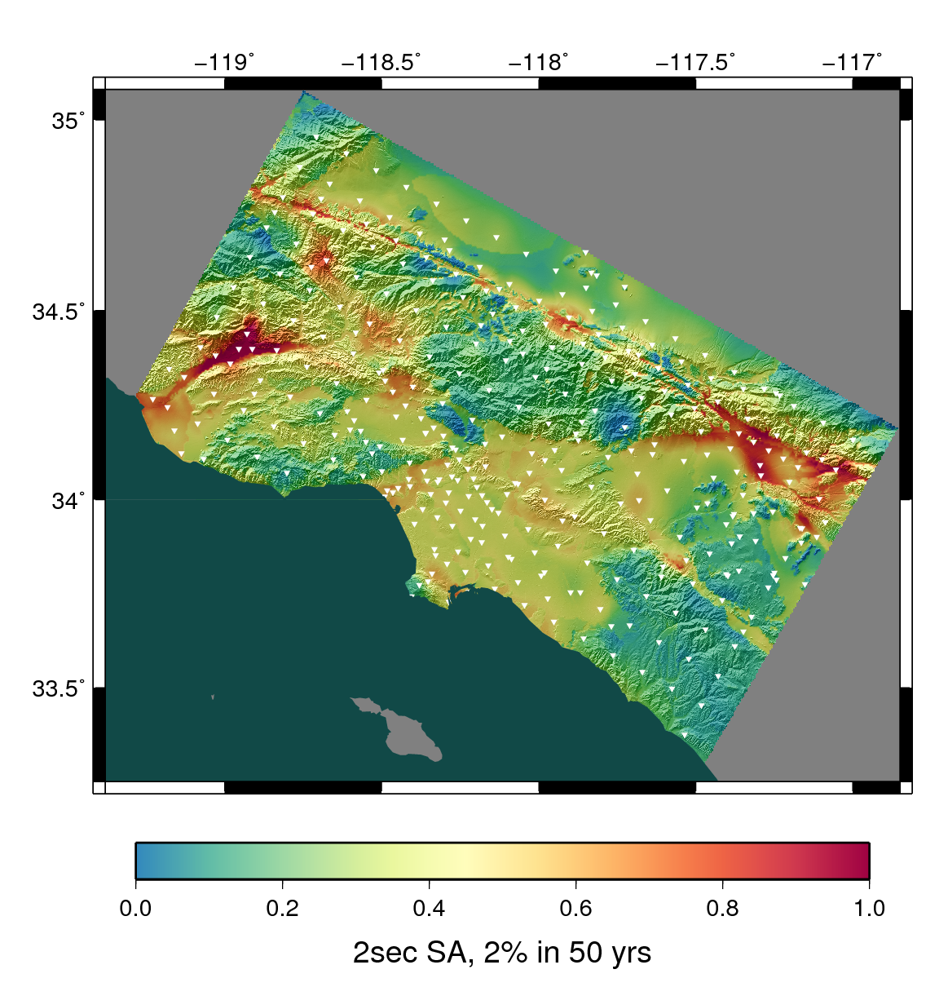
CyberShake Overview
Southern California Earthquake Center’s 3D physics-based probabilistic seismic hazard analysis (PSHA) platform
UCERF2 used as earthquake rupture forecast (M≥6.5, <200 km)
Reciprocity-based approach to simulate seismograms (~500,000 per site)
Intensity measures (geometric mean, RotD50, RotD100) & duration calculated
Hazard results from individual sites interpolated with GMPEs to make map
Earthquake forecast: UCERF2
Structural model: CVM-S4.26

Slide 3
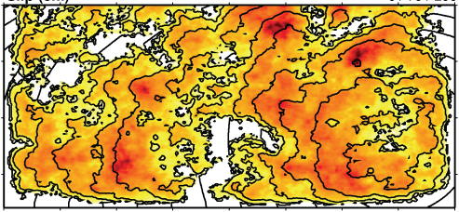
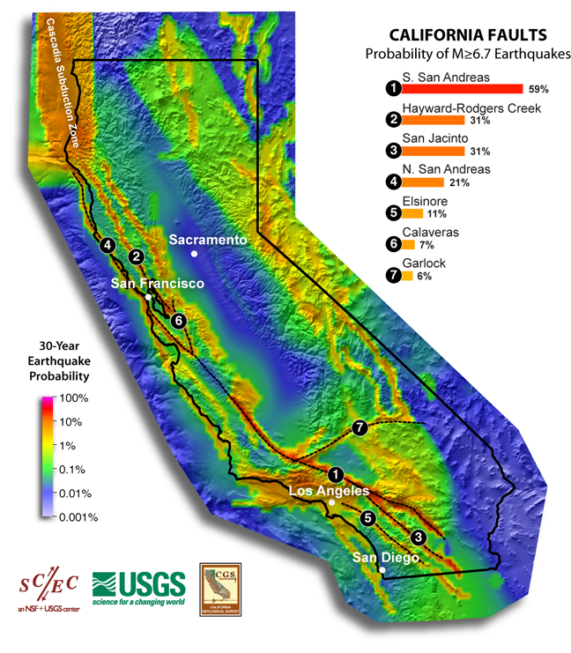
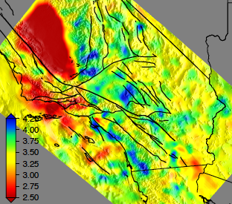
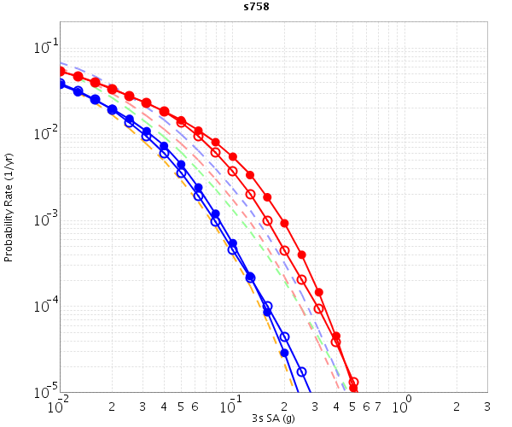
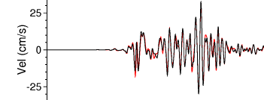
CyberShake Components
Graves-Pitarka (2014) kinematic rupture generator
CyberShake Hazard Map
UCVM
AWP-ODC
Seismogram Synthesis
Data
Product Generation
11 GB
data transfer
Mesh generation
1 job per site
MPI, 1500-4000 cores
SGT computation
2 jobs per site
MPI, 200-800 GPUs
Post-processing
500,000 events per site
MPI master/worker, ~4000 cores
Populate DB, construct images
6 jobs per site
Uniform California Earthquake Rupture Forecast
CVM-S4.26
z = 6 km
hazard curves
Most recent CyberShake study took 4 weeks of real time and used 21 million core-hours
500,000 Seismograms
75M intensity measures
Community Velocity Model

Slide 4
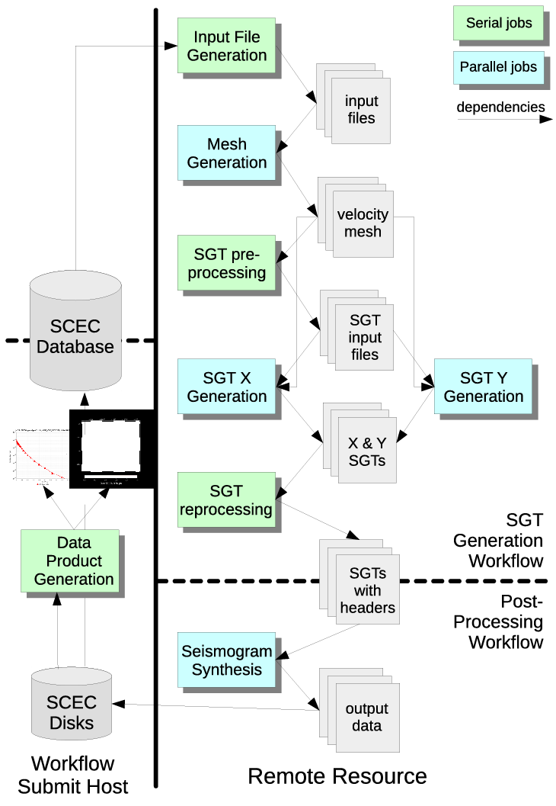
CyberShake Workflows
Scientific workflow tools orchestrate CyberShake simulations
Pegasus-WMS, HTCondor, Globus Toolkit
Create description of workflow with files and dependencies
Tools then manage real-time execution of workflow
Provide key benefits
Automation: supports running millions of jobs over weeks
Data management: files are automatically staged in and out
Resource provisioning: jobs submitted to multiple clusters
Enabled SCEC to scale CyberShake since 2007
9 different supercomputers
100 million core-hours

Slide 5
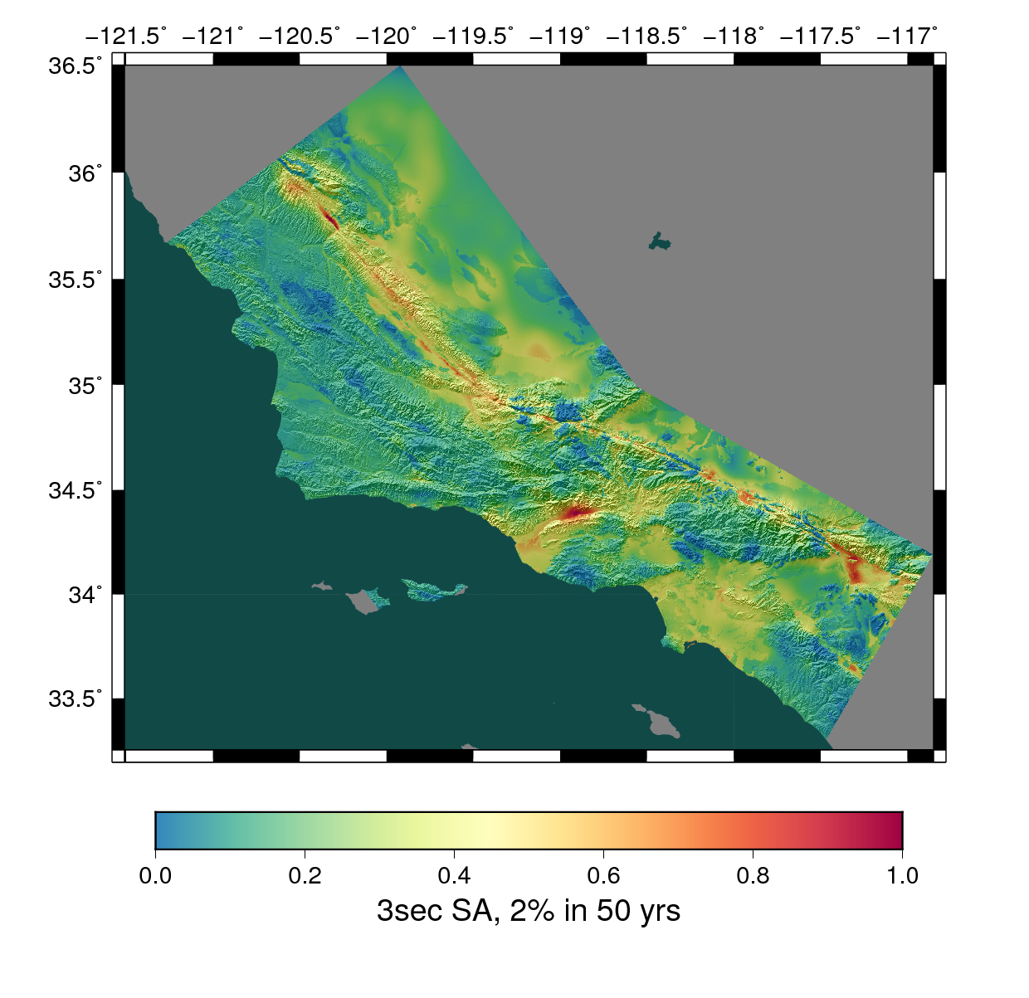
2017 Results
Study 17.3: Central California
438 sites (+57) x 2 velocity models
Tomographically-derived 3D (CCA-06)
1D average of 3D model
Burned 21.6M core-hours on NCSA Blue Waters and OLCF Titan
Ran 15,581 jobs using workflows
Managed 777 TB data
308 TB transferred between systems
10.7 TB archived (285M seismograms)
Combined 3D model
Study 15.4
Study 17.3

Slide 6
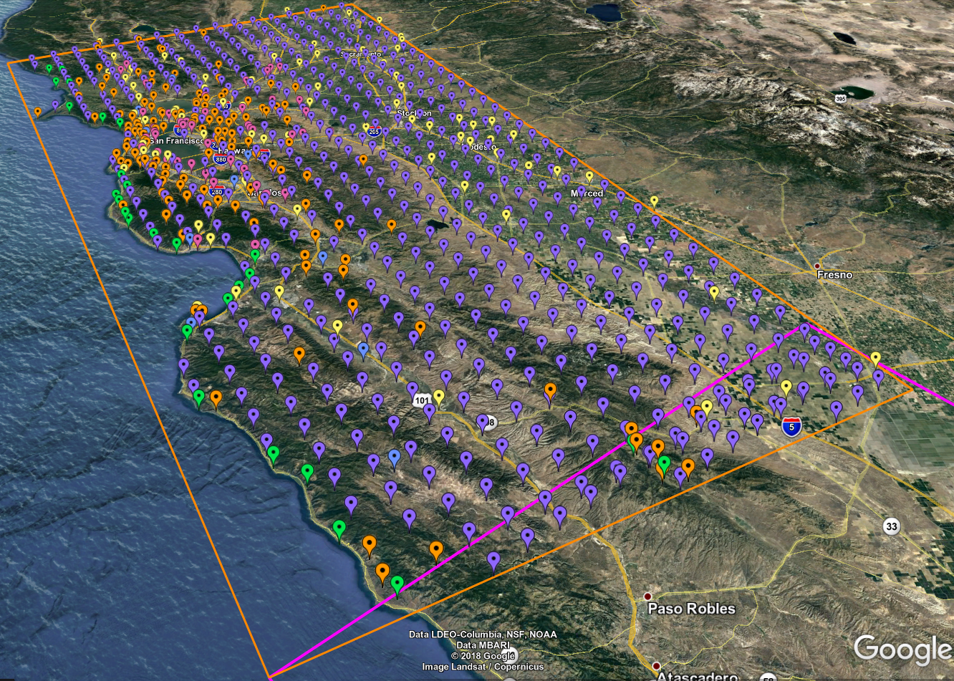
CyberShake Study 18.5
Migrate CyberShake farther north, to greater San Francisco (“Bay Area”)
837 new sites + 32 for verification
New combination of velocity models
First physics-based PSHA results for this region
Largest study computationally
Southern CA region in black
Central CA region in magenta
Bay Area region in orange
869 sites, densest near San Francisco

Slide 7
Velocity Model
No single model large enough for statewide volume
Must stitch together models
USGS Bay Area (green)
CCA-06 (blue)
CVM-S4.26 (red)
1D background model (white)
Apply smoothing along model interfaces

Slide 8
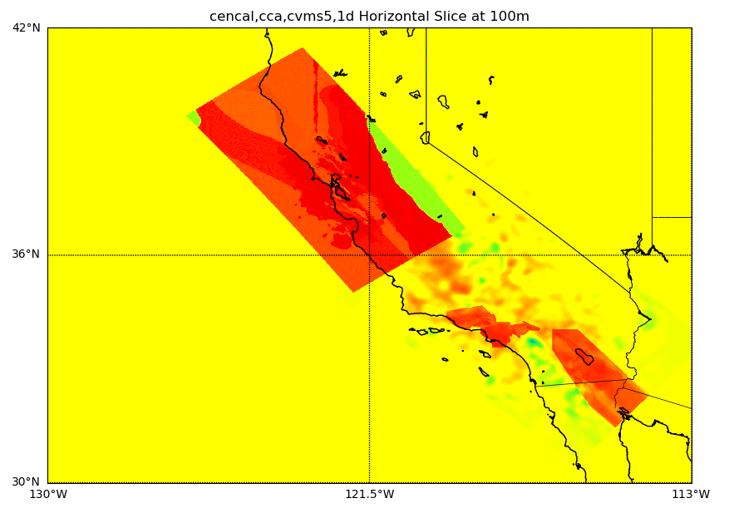
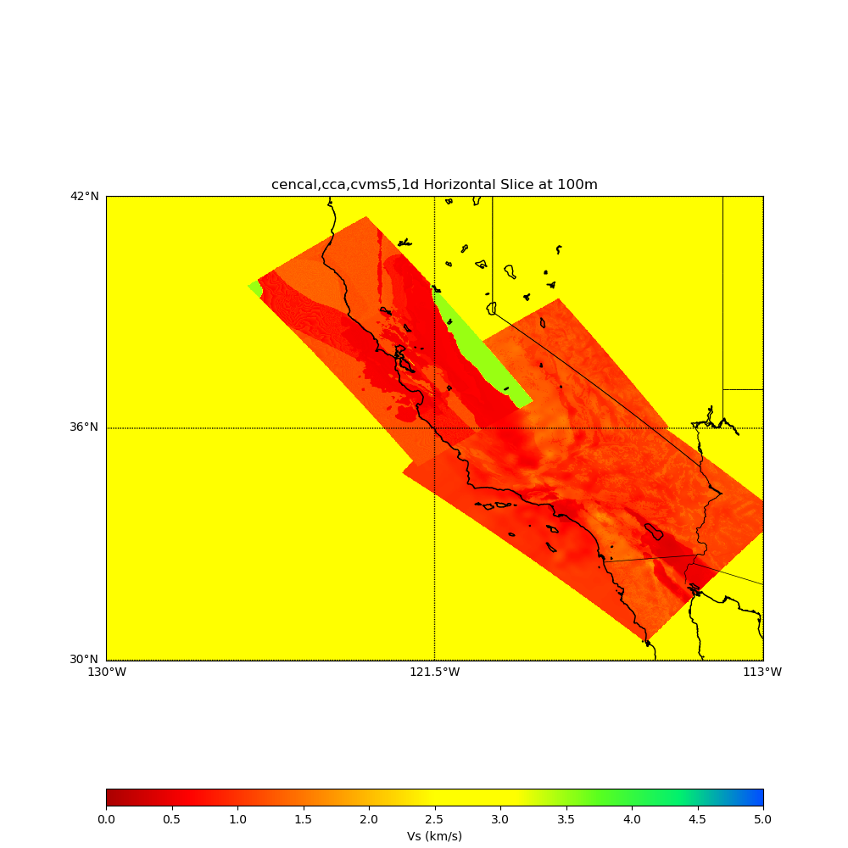
Geotechnical Layer
Study 17.3 used Vs min=900 m/s due to tomography with CCA-06
Plan to perform Study 18.5 at Vs min=500 m/s
Added Vs30-derived GTL (from Wills (2015))
No GTL applied
Ely GTL applied

Slide 9
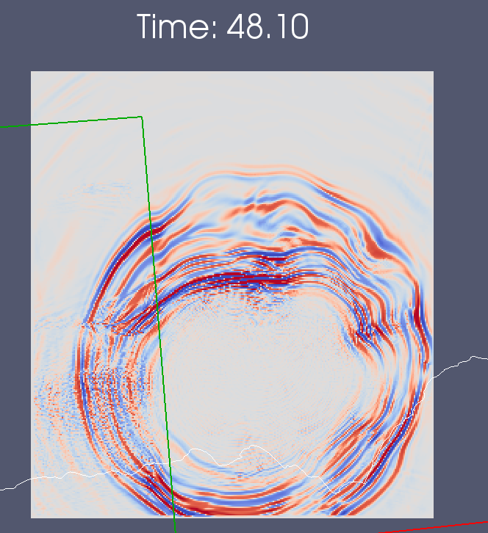
Velocity Model Verification
Performed forward simulations near model interface to test smoothing
Wavefront encounters smoothed region
10 km smoothing
20 km smoothing
20 km smoothing shows reduced refraction effects

Slide 10
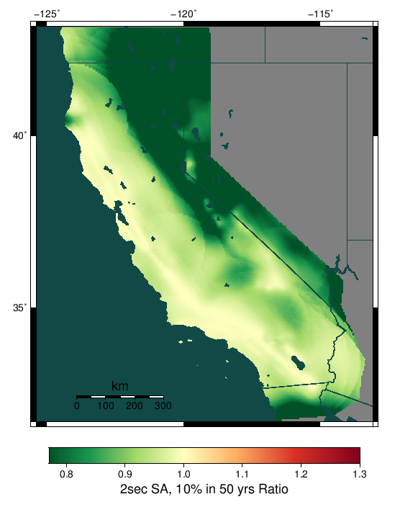
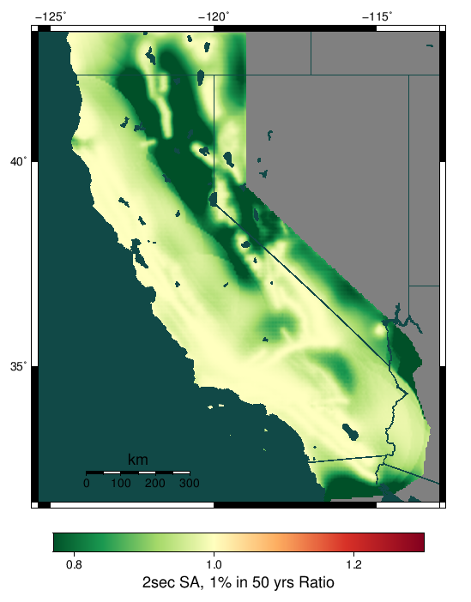
Background Seismicity
UCERF models include off-fault background seismicity
In previous CyberShake regions can be ignored
UCERF2 GMPEs show impact of up to 10% on eastern edge of region
Planning to add background seismicity to Study 18.5
2 sec SA, 10% in 50 years exclude/include
2 sec SA, 1% in 50 years exclude/include

Slide 11
Study 18.5 Requirements
869 sites
1 Hz, Vs min=500 m/s, UCERF 2 ERF
~80M core-hours, divided between Titan and Blue Waters
GPUs for SGT generation
CPUs for mesh generation, reciprocity calculations
750 TB intermediate data
12.6 TB output data products
Planning to start in 2 weeks

Slide 12
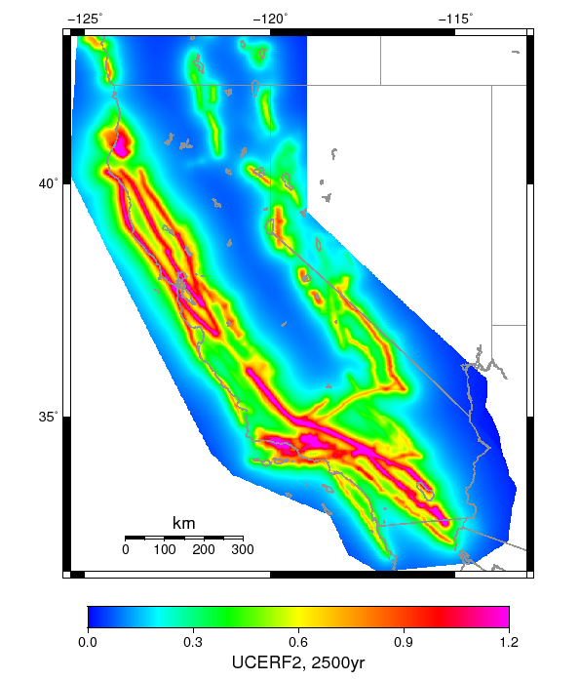
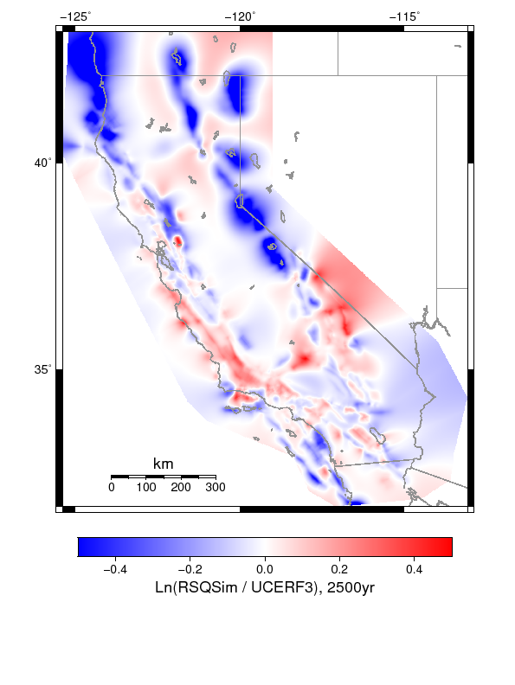
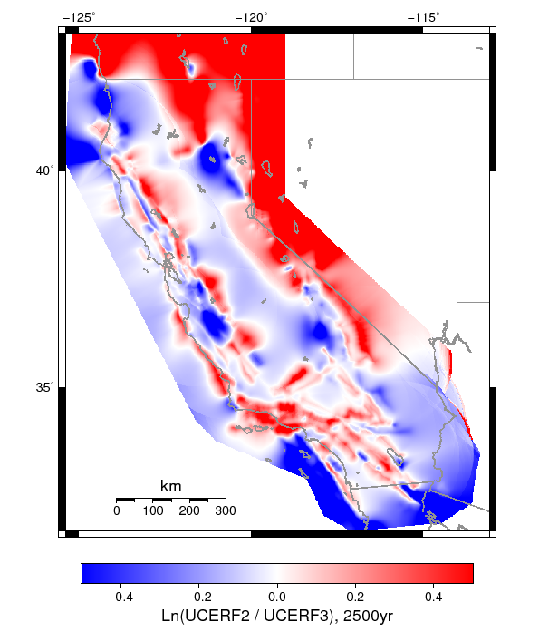
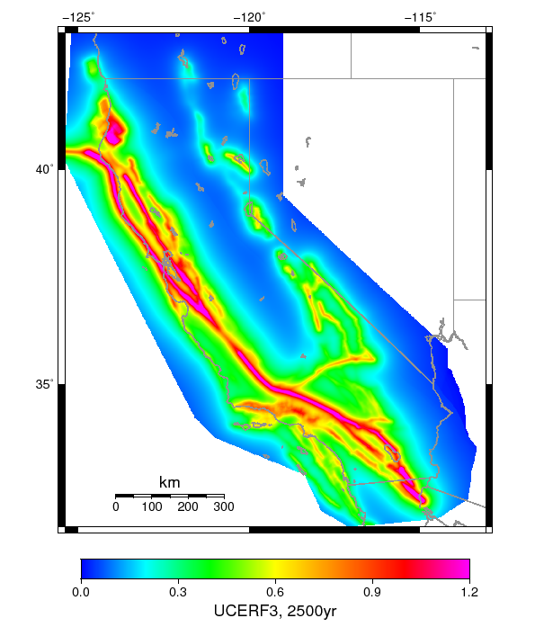
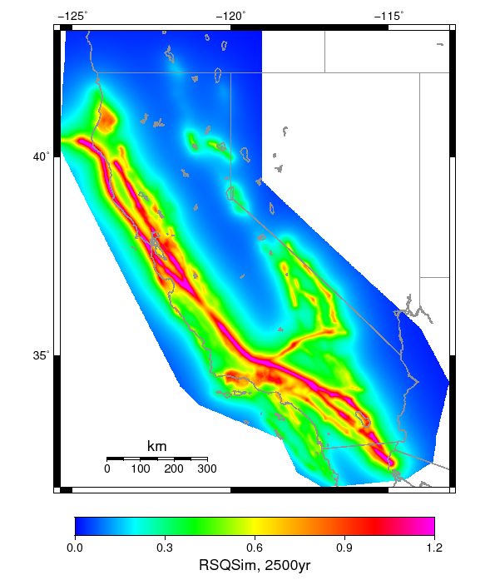
RSQSim
Updating ERF from UCERF2
UCERF3 difficult for CyberShake
Alternative: use RSQSim to generate long seismicity catalogs
Based on rate-and-state friction
Similar ERF to UCERF3
UCERF2
UCERF3
RSQSim
PGA (g), 2% in 50 yrs
RSQSim events fed directly into CyberShake
Slip time functions produced, no need for generator
Fully physics-based PSHA
Undergoing extensive validation

Slide 13
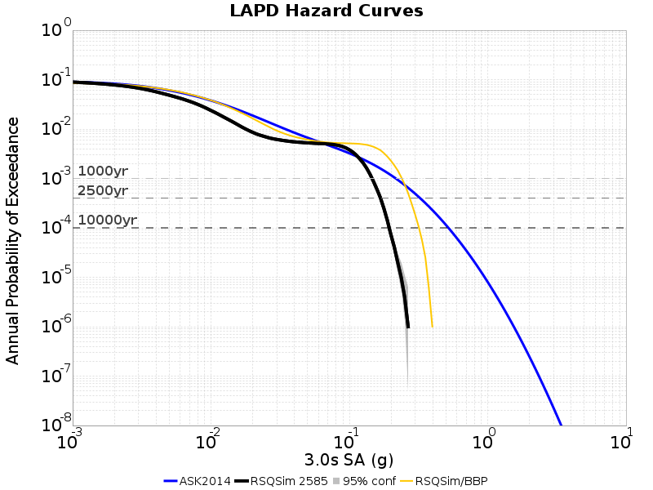
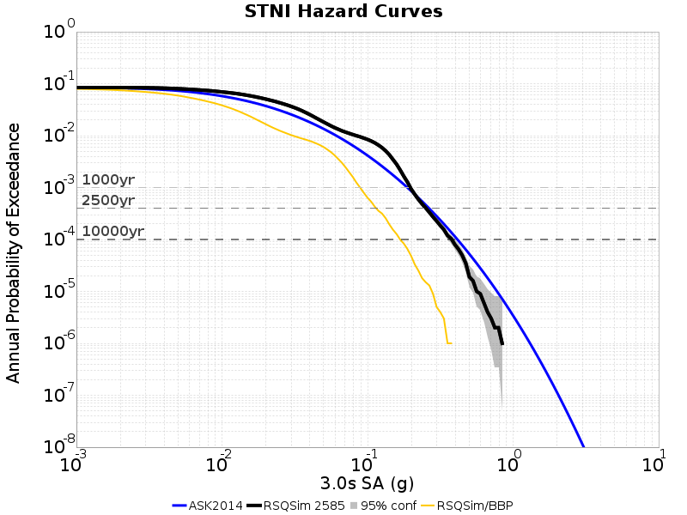
RSQSim Results
Hard rock site
Hazard curves
RSQSim/CyberShake (3D)
RSQSim/GMPE (ASK 2014)
RSQSim/SCEC Broadband Platform (1D)
Curves less smooth due to less variability for individual sources
About 20% as many events
Simulation curves are truncated
1 million year catalog: minimum probability of 10⁻⁶
Working to improve match with observed rupture velocities using SCEC BBP
Deep basin site

Slide 14
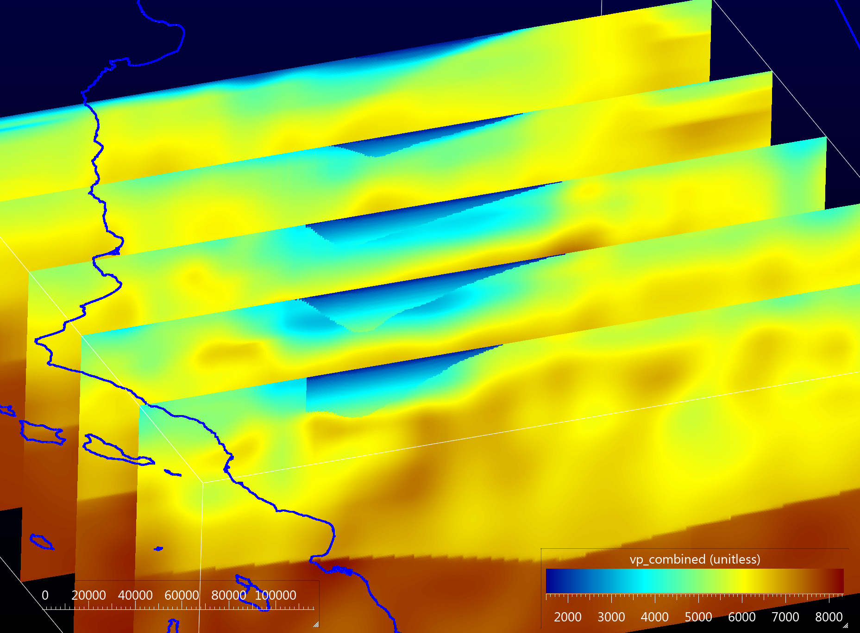
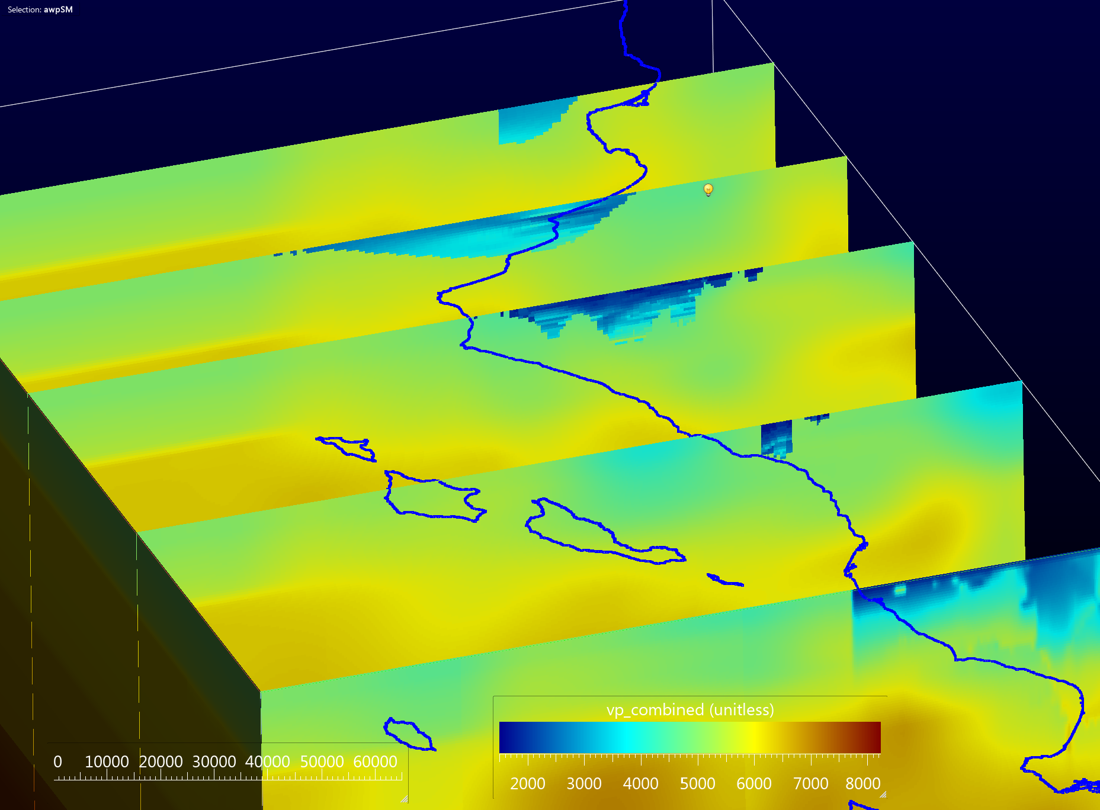
Improved Central California Basins
Integrating improved basins from Shaw and Plesch into CCA-06
Will rerun Study 17.3 with improved model
San Joaquin basin
Santa Maria basin

Slide 15
On the horizon
Discontinuous mesh implementation of SGT code
Current version uses regular mesh
Performance improvement
Includes frequency-dependent Q, plasticity
Nonlinearity
Breaks reciprocity: will require changes to CyberShake
Exploring multiple paths forward
Use nonlinear approximations in reciprocity
Perform forward simulation of small subset of events, use reciprocity for others
Use machine learning to identify which events should be forward-simulated
Create ‘equivalent kinematic sources’, which reproduce nonlinear effects

Slide 16
Questions?

