Slide 1








Validation for CyberShake in Northern California
Scott Callaghan (SCEC), Xiaofeng Meng, Rob Graves, Kim Olsen, Mei-Hui Su, Morgan Moschetti, Albert Kottke, Camilo Pinilla-Ramos, Kevin Milner, Fabio Silva, Phil Maechling, Norm Abrahamson, Tom Jordan, Yehuda Ben-Zion, Ahmed Elbanna
April 17, 2026
SSA 2026 Annual Meeting
scottcal@usc.edu

Slide 2
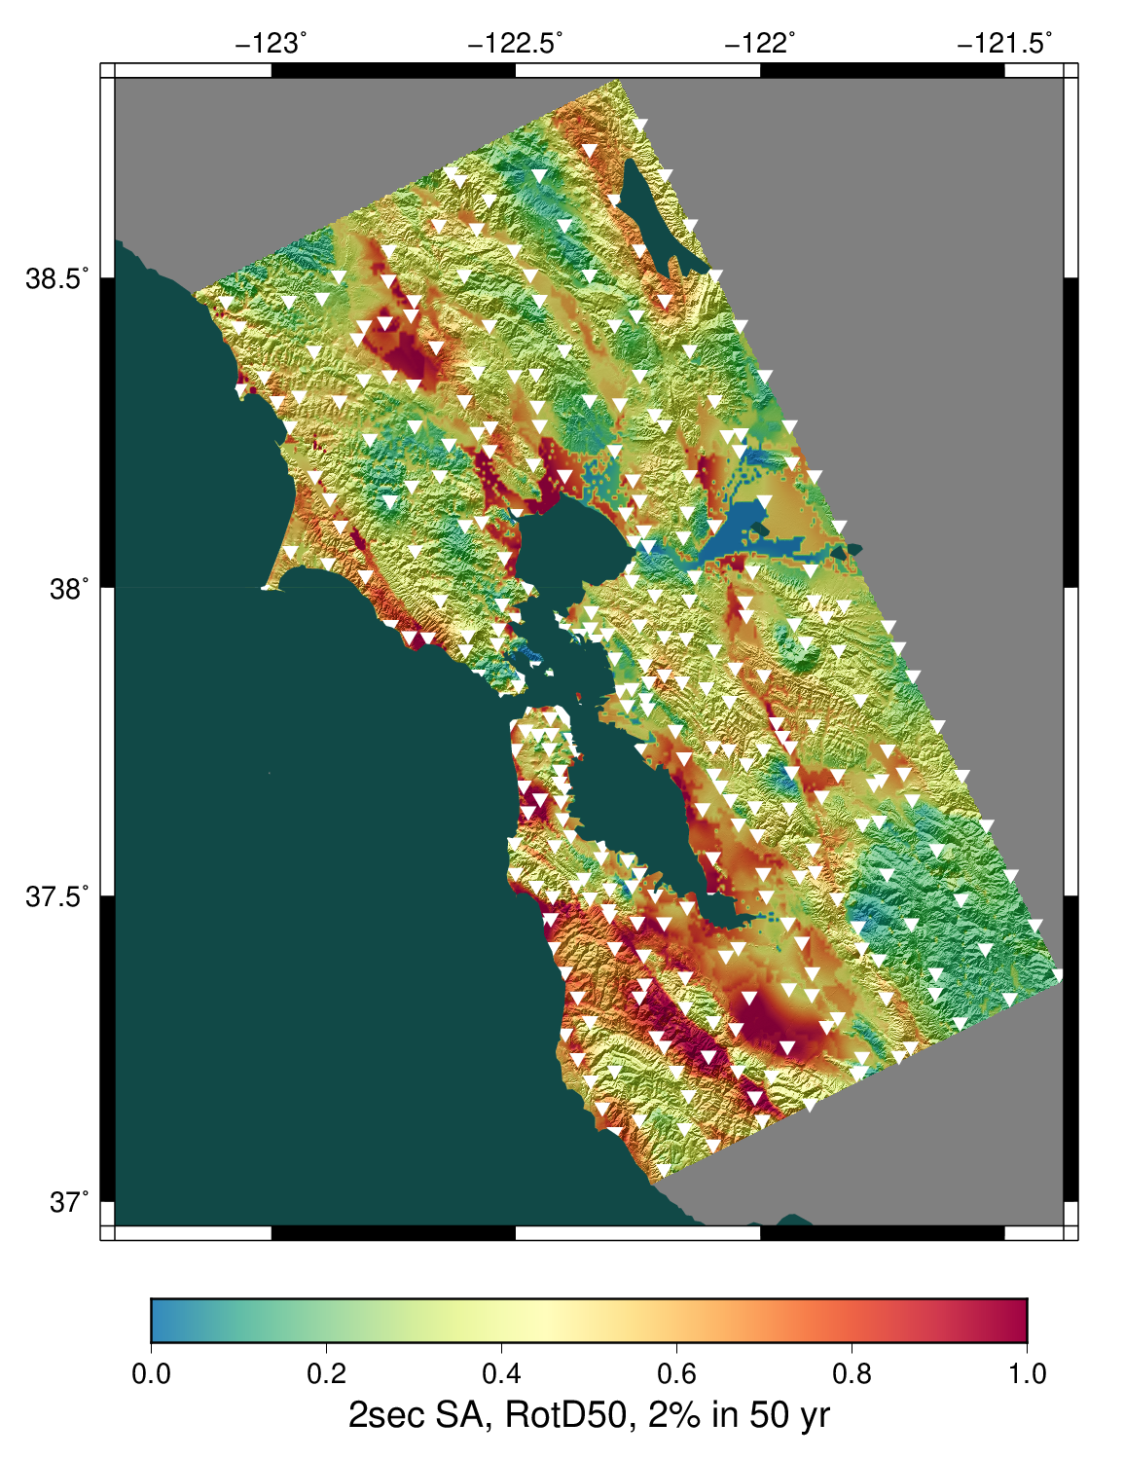
CyberShake overview
Study 24.8 hazard map
SCEC-developed 3D physics-based PSHA platform
Reciprocity-based approach simulates low-frequency seismograms from ERF
Intensity measures derived from seismograms
Hazard products calculated at sites
Stochastic high-frequency simulations up to 25 Hz added to produce broadband hazard models
Today, discussing validation work:
  Focus on Northern California study (24.8),
  with context of Southern California study (22.12).
Statewide California Earthquake Center | www.scec.org

Slide 3
Historical earthquake validation
Create 64 realizations of a historical event
  Same fault area, hypocenter, and magnitude
  Different slip distributions
Simulate ground motions for all realizations for ~40 stations with recordings
Compare simulated ground motions to recordings
Intent is not to reproduce historical event exactly; instead, confirm that the ground motions of the event are captured in the distribution
Statewide California Earthquake Center | www.scec.org

Slide 4
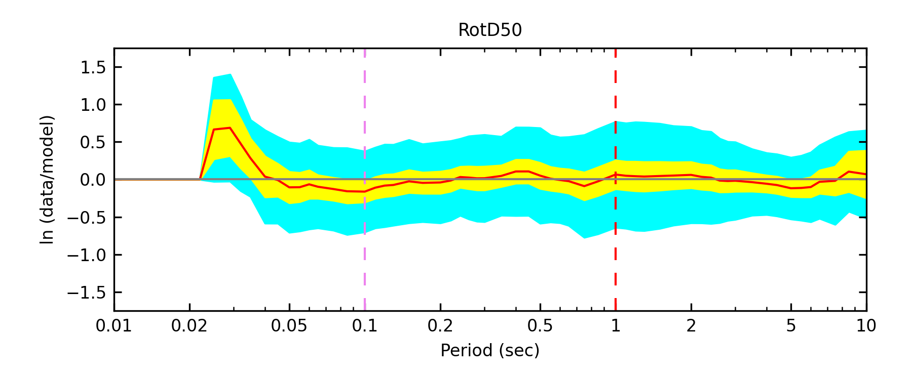
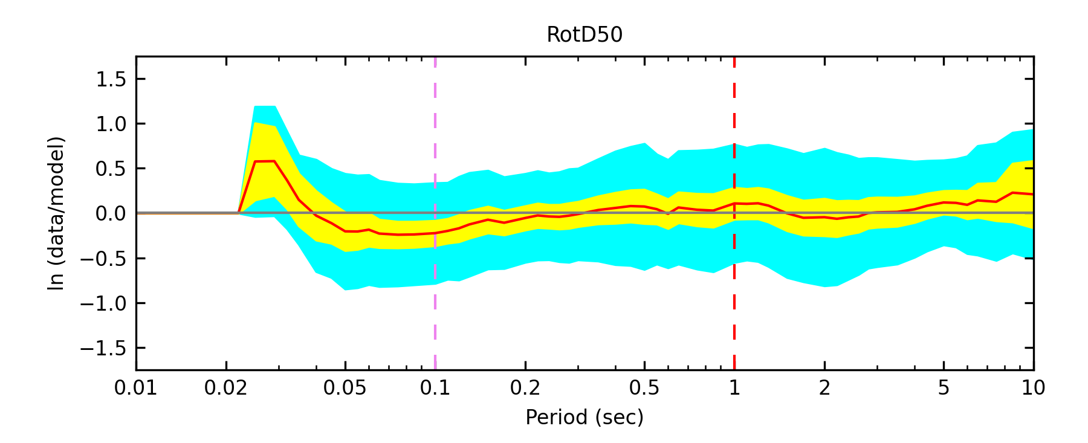
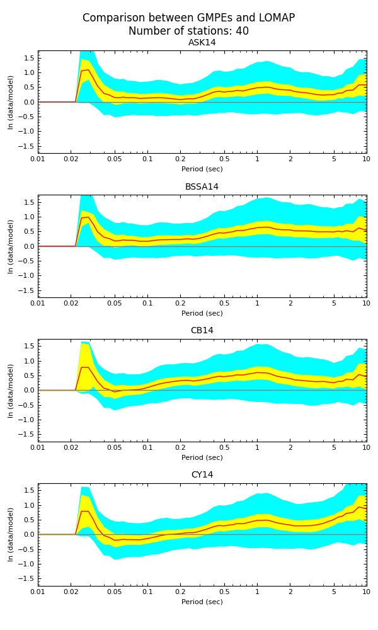
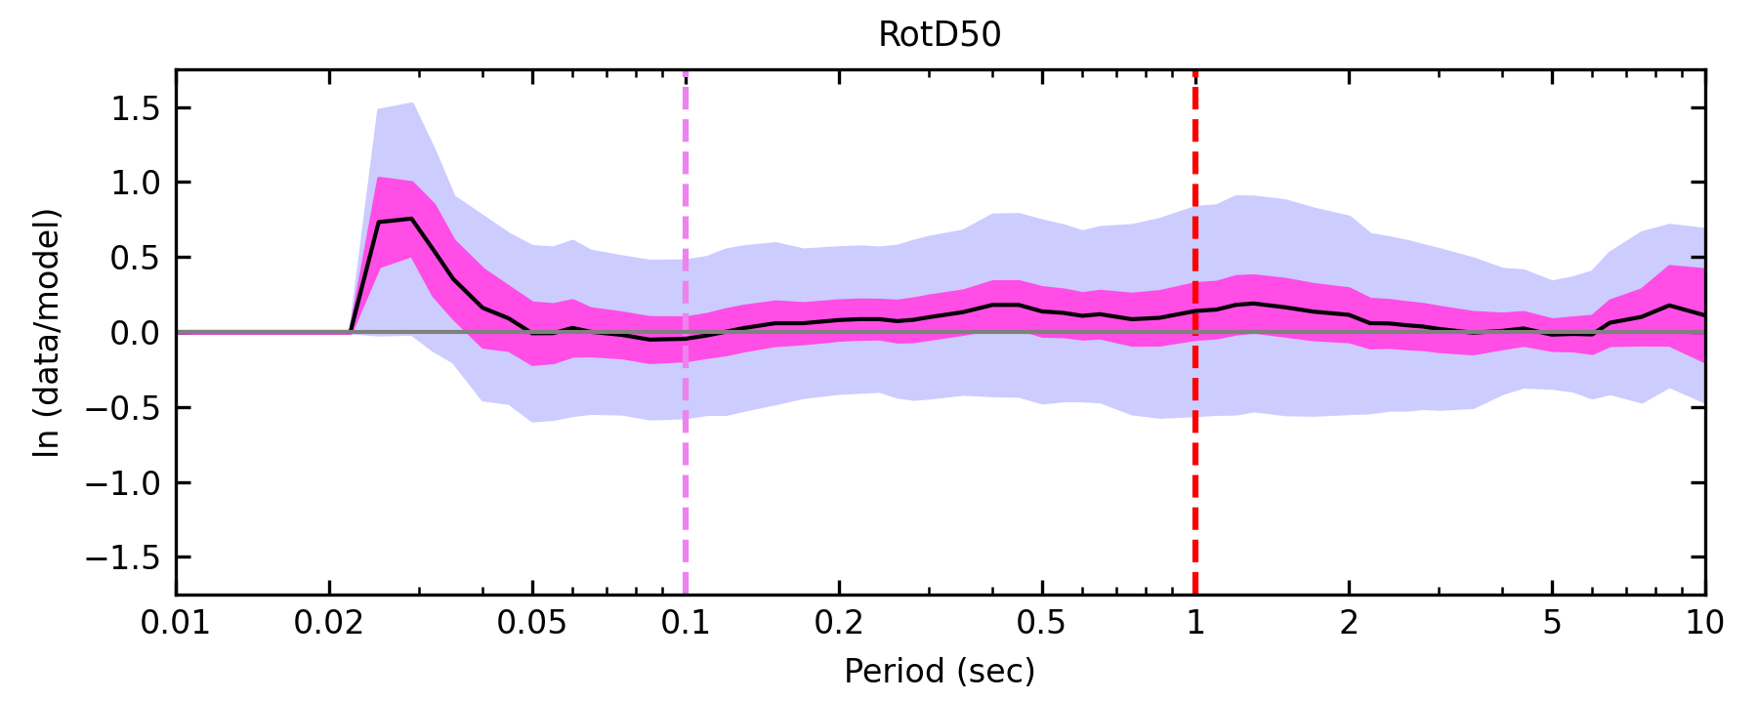
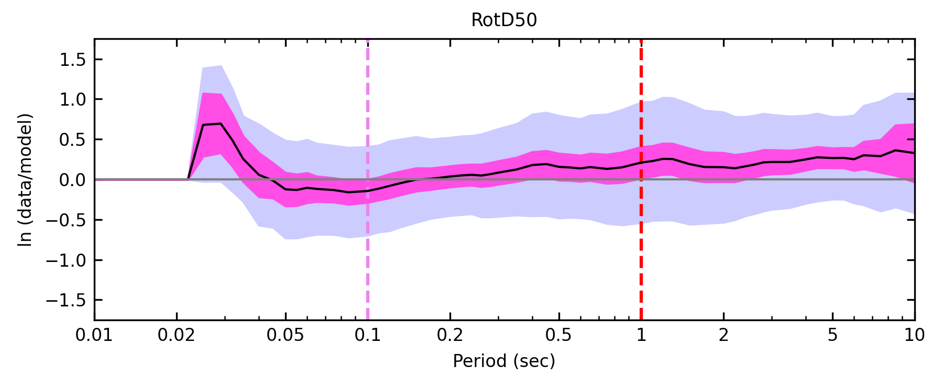
Loma Prieta results
3D CyberShake
1D Broadband Platform
NGA-West2 GMMs
Best fit realization, all sites
Best fit realization, all sites
All realizations, all sites
All realizations, all sites
Statewide California Earthquake Center | www.scec.org

Slide 5
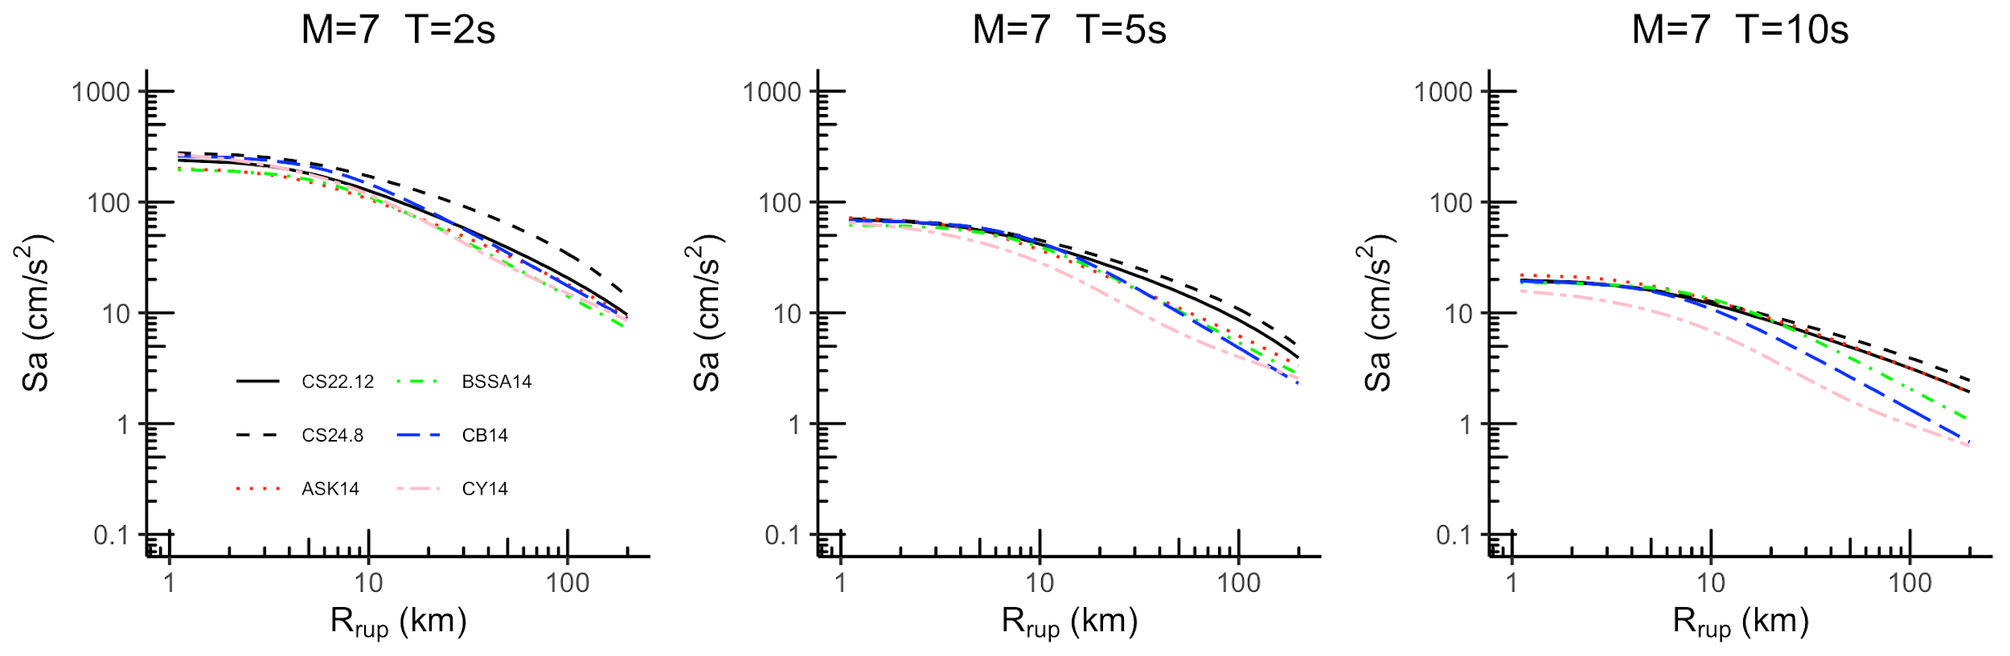
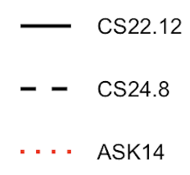
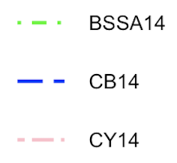
CyberShake-derived GMM
To facilitate comparisons, we create a partially non-ergodic GMM based on CyberShake
Larger ground motions with Study 24.8 (dashed line), especially at short periods
Statewide California Earthquake Center | www.scec.org

Slide 6
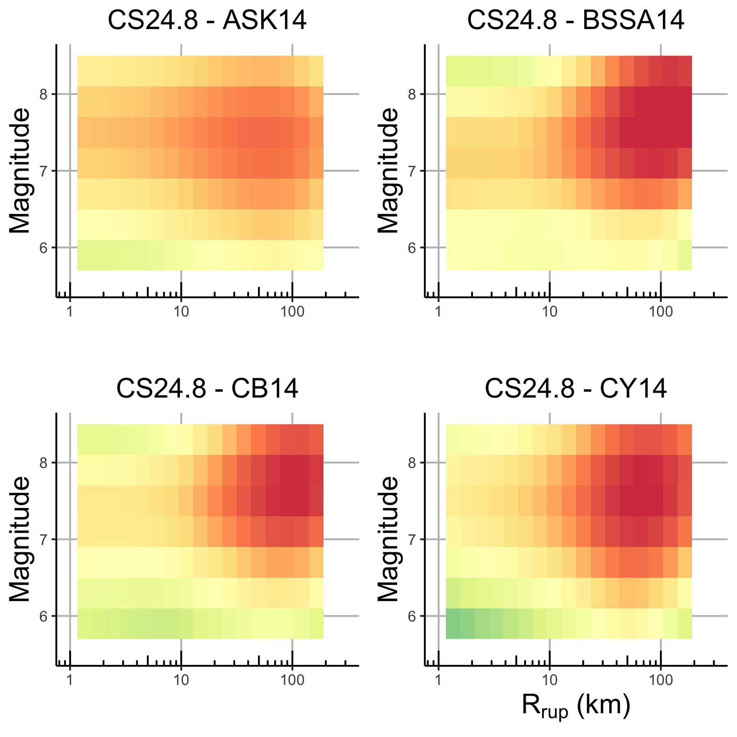
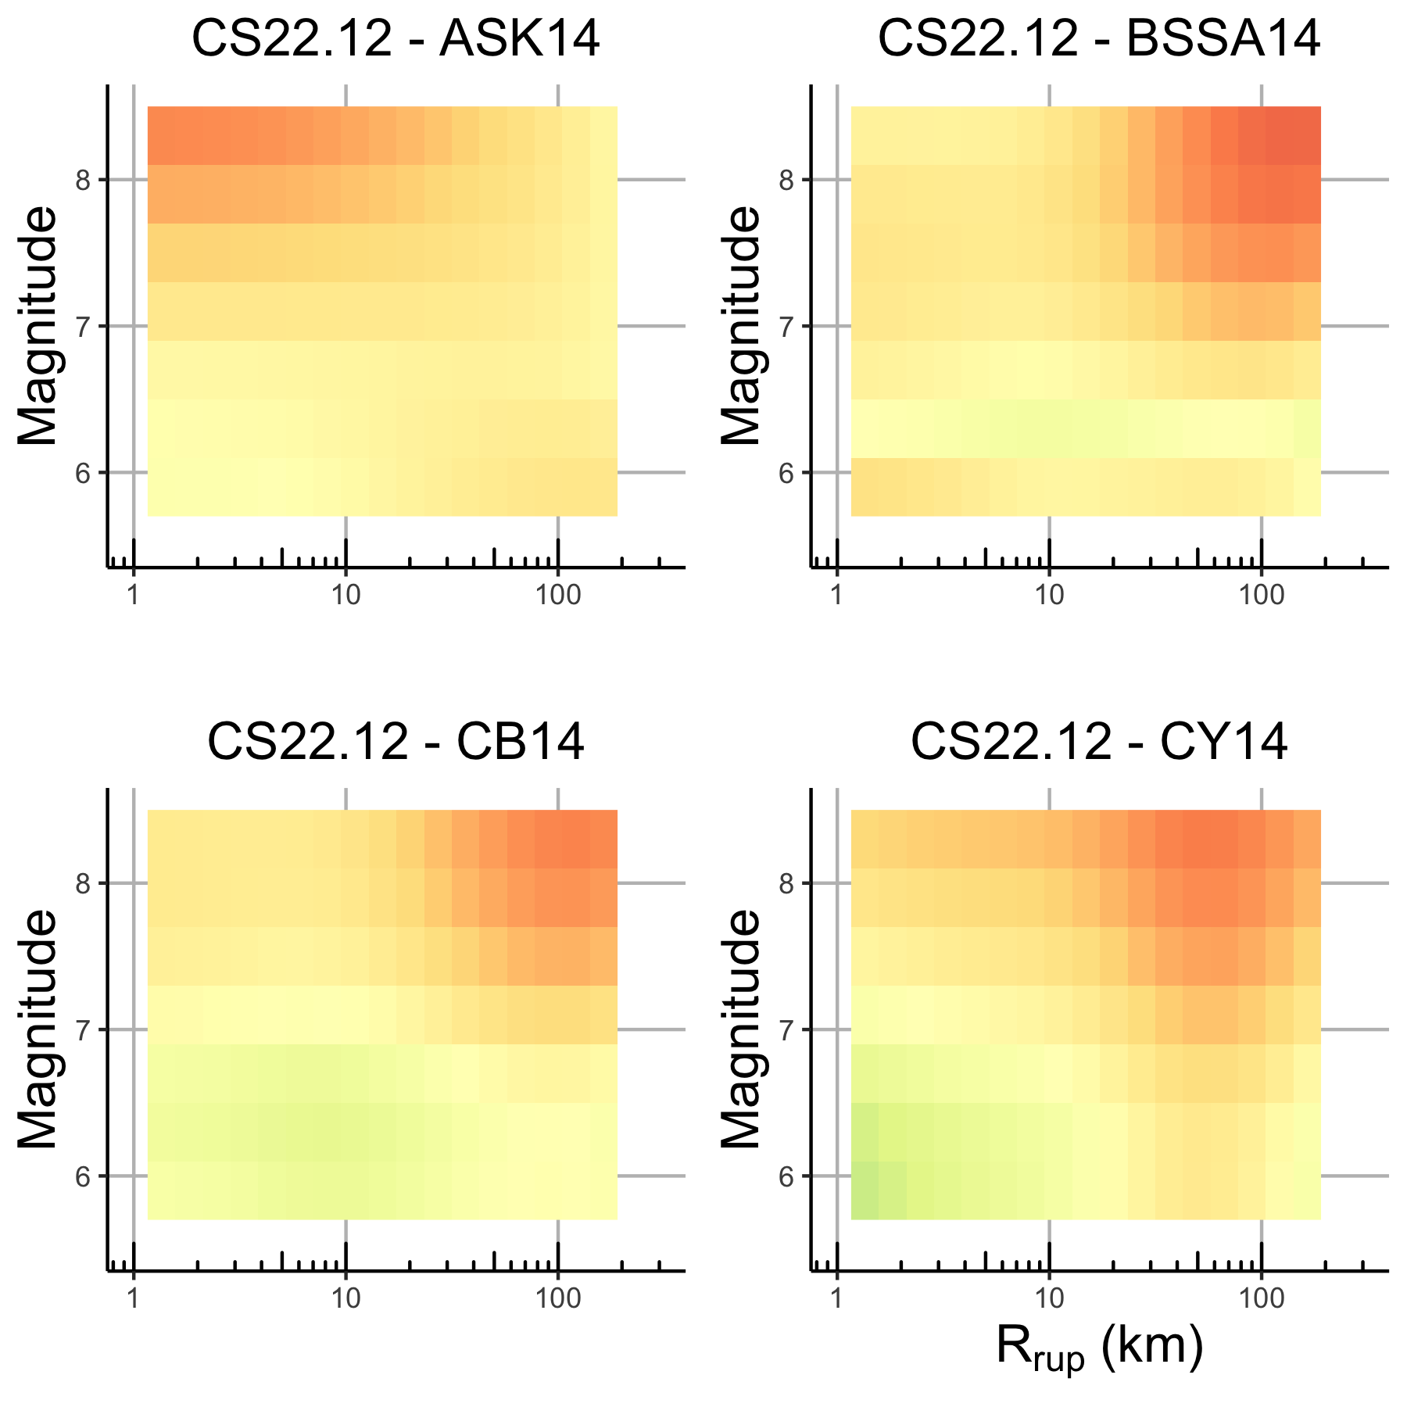
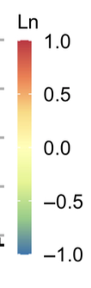
CyberShake comparisons with NGA-W2
Diff. in
Ln unit
Statewide California Earthquake Center | www.scec.org

Slide 7
Study 24.8 differences
We believe higher Northern California CyberShake ground motions are the result of a more coherent velocity model and increased directivity
Increased directivity in Study 24.8 attributable to:
  Fault / site geometry
  Velocity model
  Fault smoothness

Slide 8
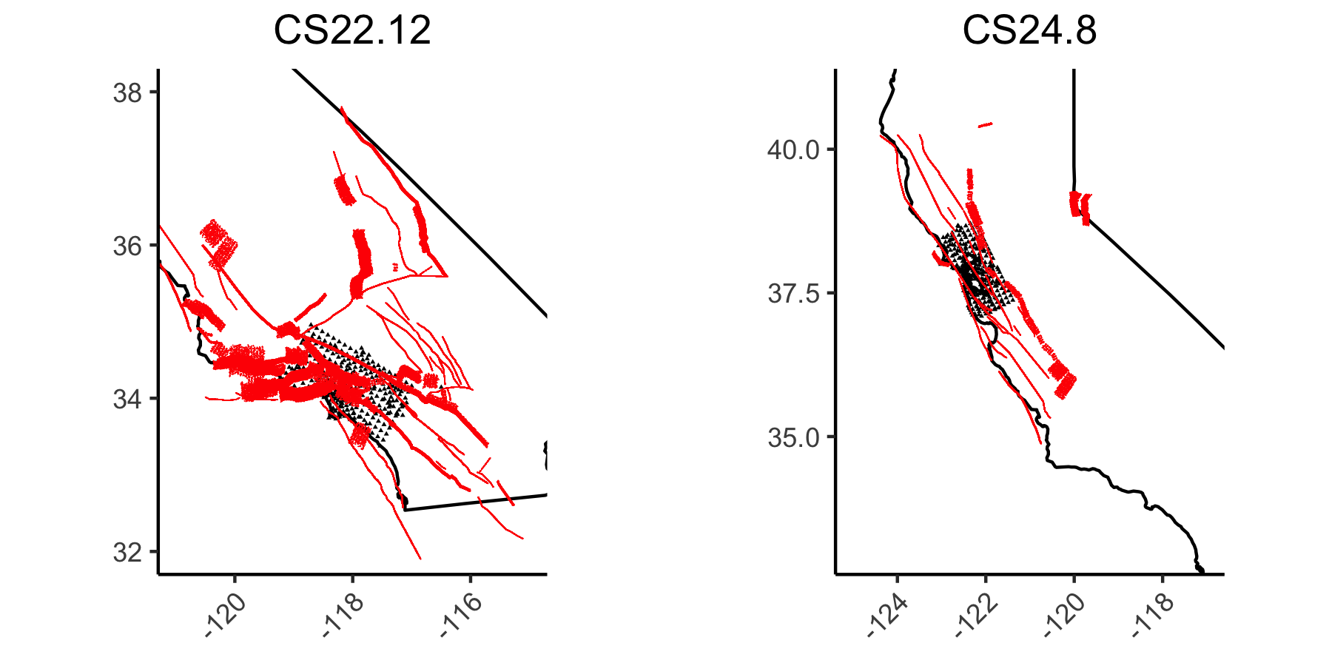
Geometry of faults and sites
Statewide California Earthquake Center | www.scec.org

Slide 9
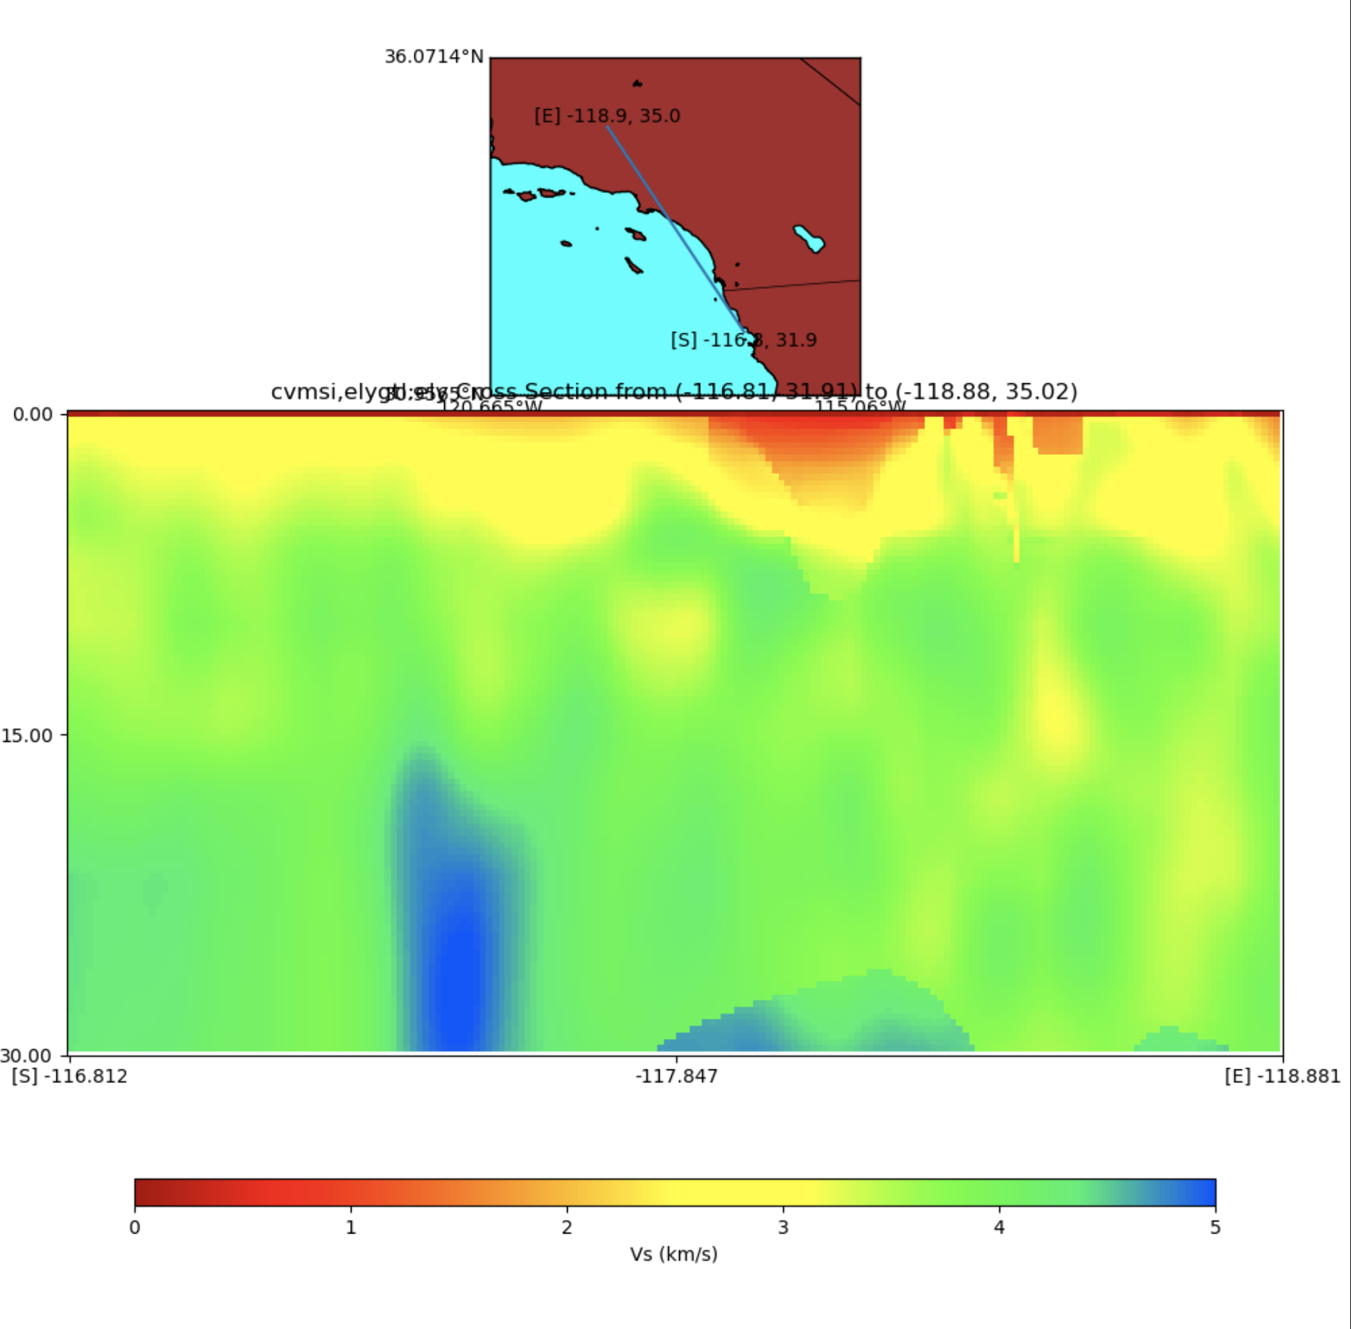
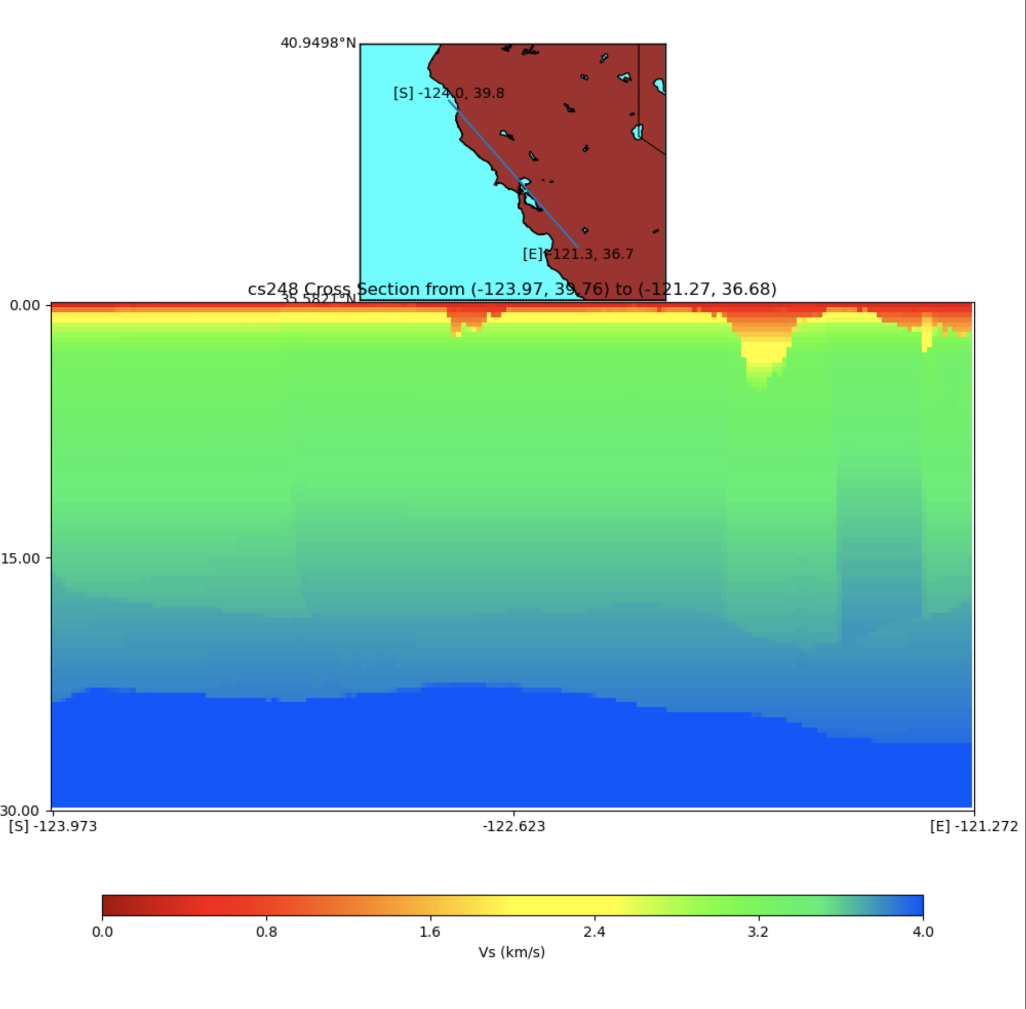
Velocity Model Comparisons
Study 22.12: CVM-S4.26.M01 (tomographic) + near-surface taper
Study 24.8: USGS SFCVM (geologic) + near-surface taper

Slide 10
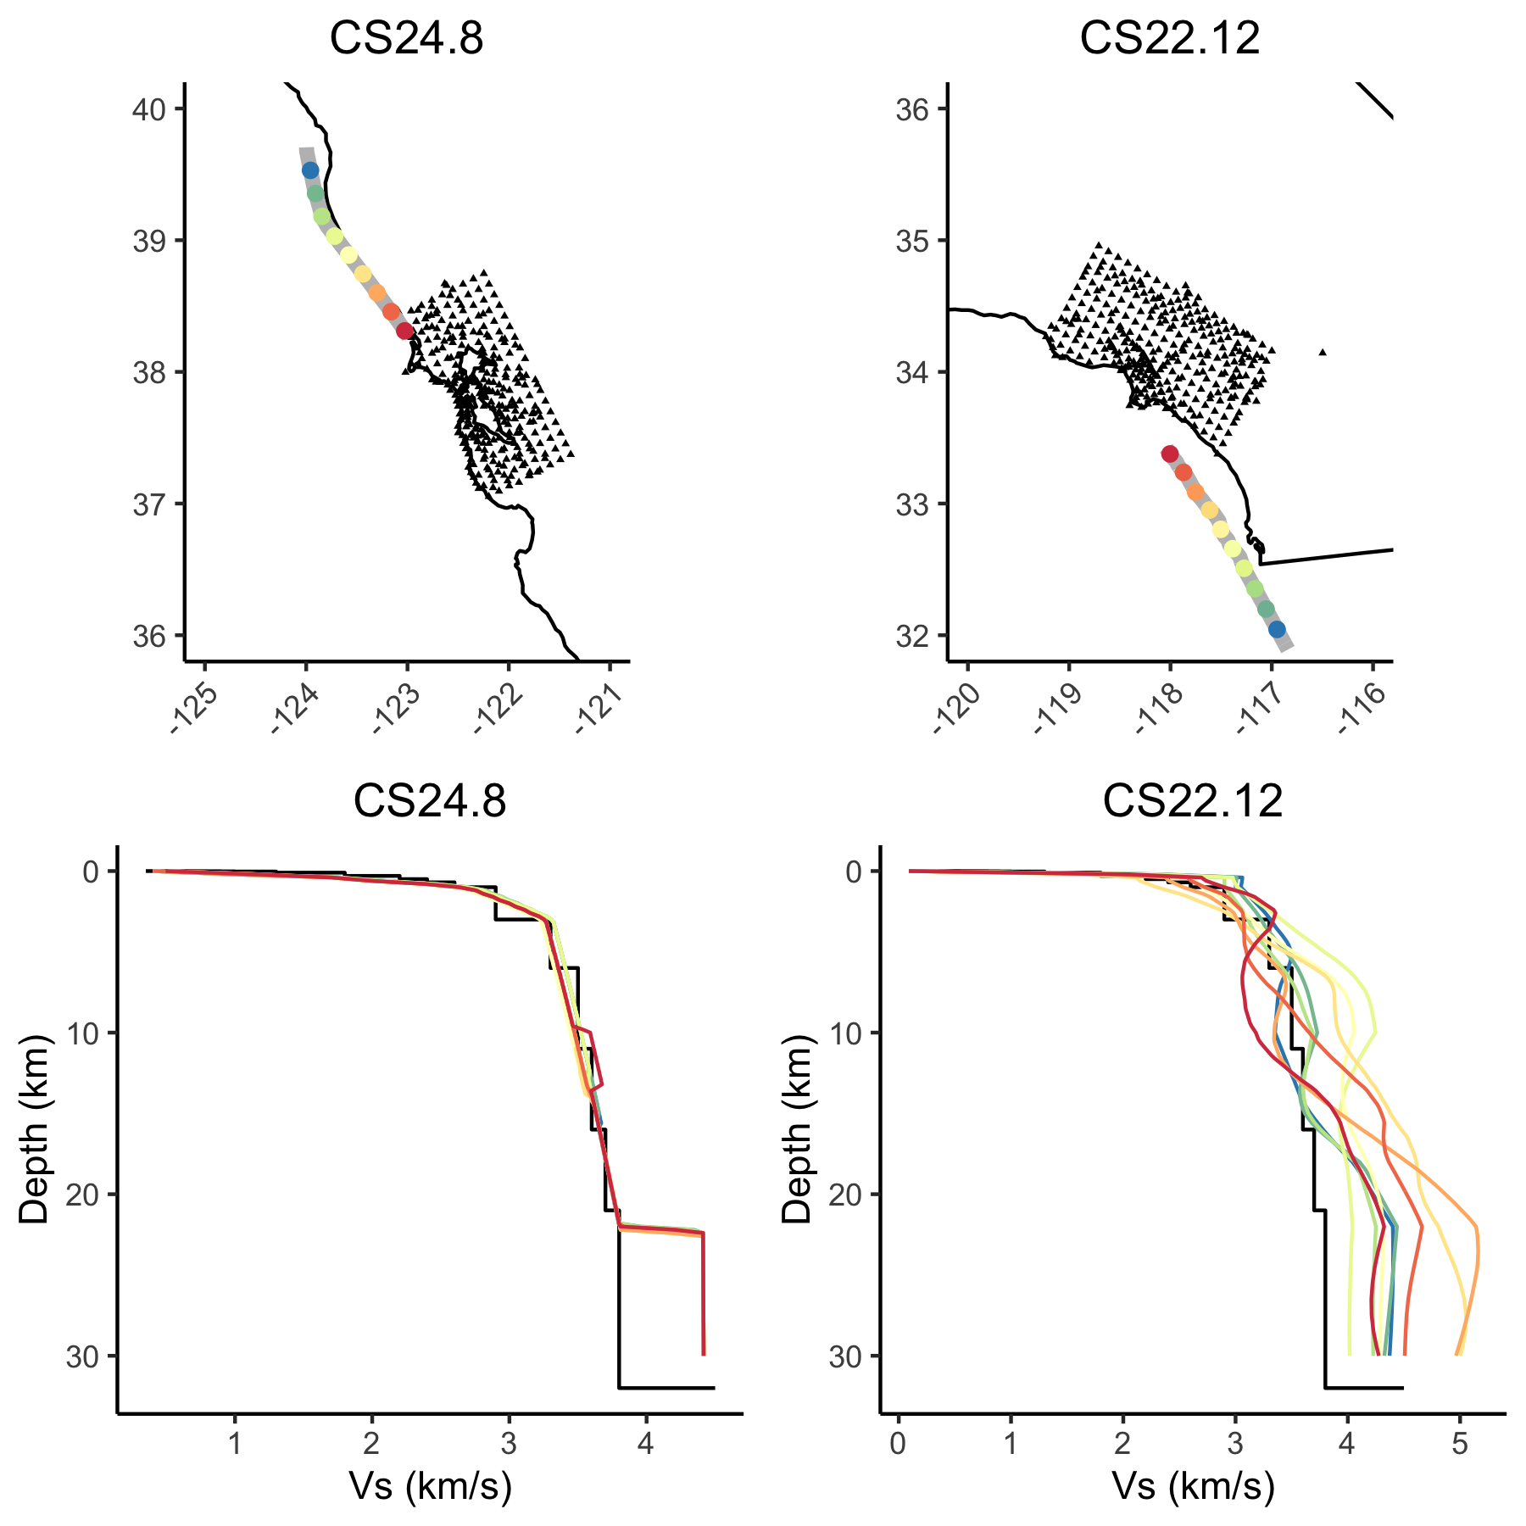
Velocity Model Comparisons
Sampled velocity model profiles at 12 locations along the N. San Andreas and the Palos Verdes
Profiles from 24.8 model are more similar than from 22.12 model
Higher homogeneity in 24.8 leads to larger directivity effects

Slide 11
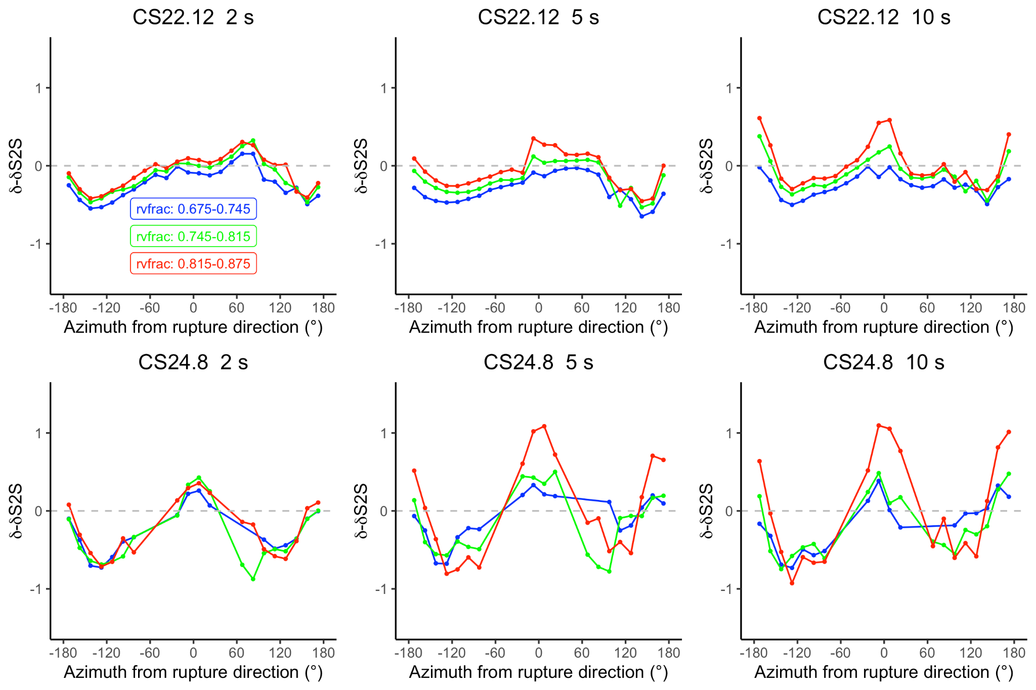
CyberShake rupture velocity
CyberShake rupture velocities are determined by V_{rup} = V_{s,1D} x rvfrac,
where
  V_{s,1D} is the velocity from a 1D reference model
  rvfrac is a parameter uniformly sampled from [0.675, 0.875]
V_{s,1D} is the same for all events for both studies
rvfrac is unique for each event

Slide 12
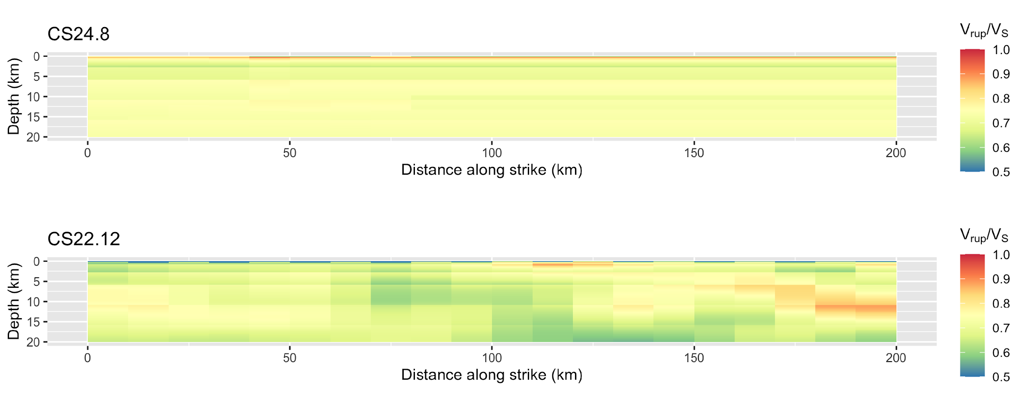
Fault Smoothness
V_{rup}=V_{S} from 1D reference model * rvfrac (0.75)
Background V_{S} is measured from the 3D model
Northern SAF
Palos Verdes fault
The average V_{rup}/V_{S} ratios for CS24.8 and CS22.12 are 0.75 and 0.71, respectively.
Statewide California Earthquake Center | www.scec.org

Slide 13
Next Steps
Calculate V_{rup} using 3D model instead of reference 1D
New SCEC initiative: CyberShake NOVA
  New velocity model: multi-scale statewide California velocity model, MUSCAL (Yeh et al., 2026)
    More heterogeneity in northern California velocity model may reduce directivity
    Potential quantification of velocity model uncertainty
    Impacts on historical event validations
  New validation efforts: explore validation beyond spectral acceleration
  New earthquake rupture forecast based on NSHM23
Statewide California Earthquake Center | www.scec.org

Slide 14
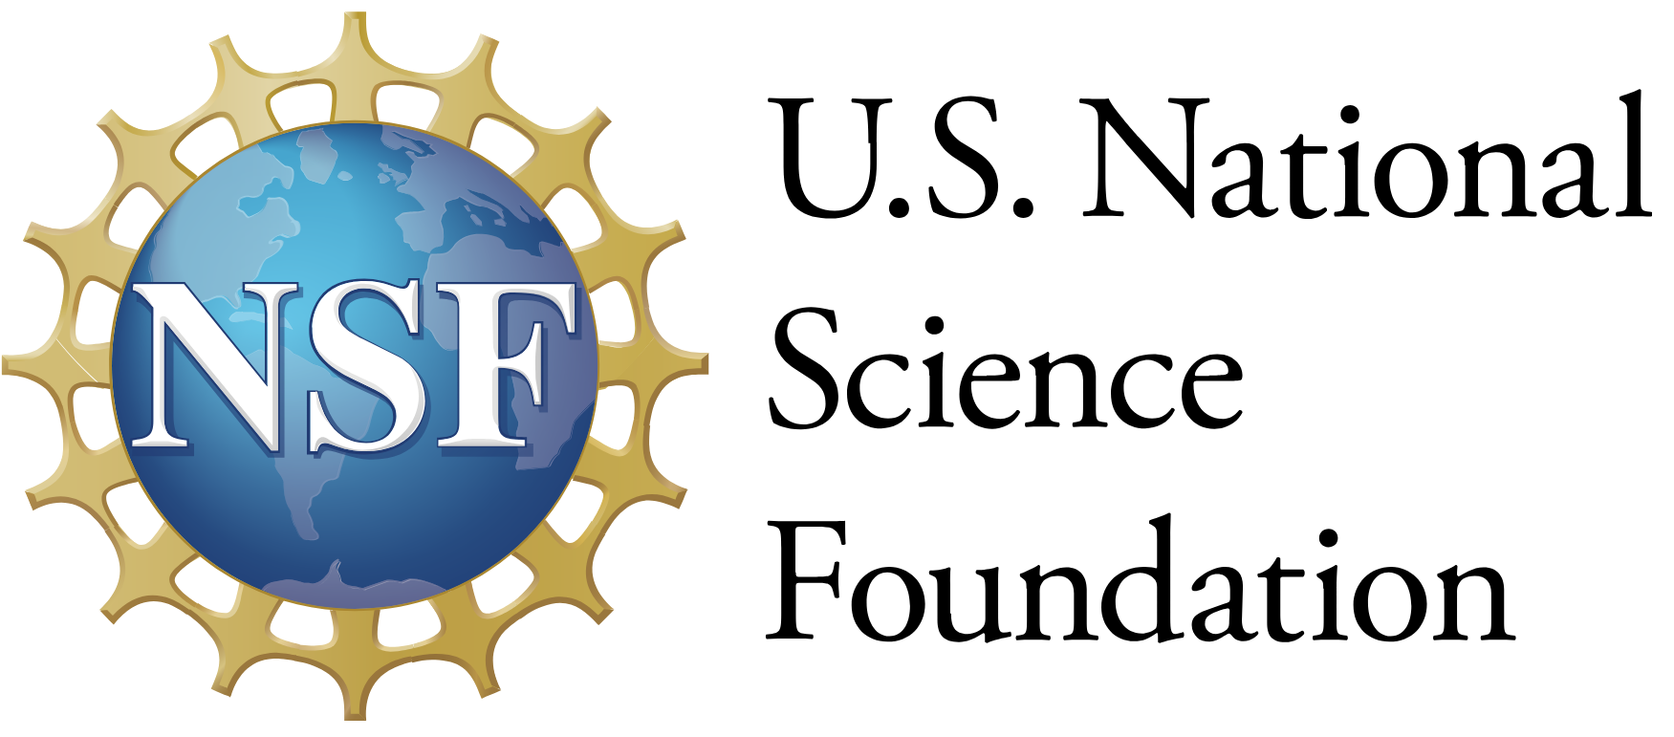



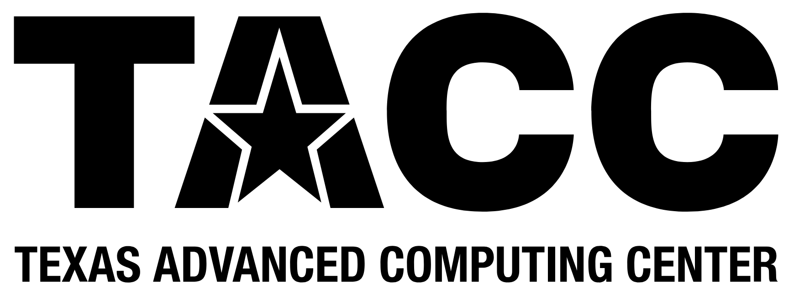


Thanks!
Statewide California Earthquake Center | www.scec.org

