Slide 1
CyberShake Study 18.8 Technical Readiness Review
Scott Callaghan

Slide 2
Study 18.8 Scientific Goals
Expand CyberShake to the extended Bay Area.
1 Hz
UCERF 2
Graves & Pitarka (2014) rupture generator
Calculate CyberShake results with a new combination of velocity models.
USGS Bay Area, CCA-06 + Ely-Jordan GTL, CVM-S4.26.M01
Compare Central and Bay Area results at overlapping sites.
Include background seismicity contributions in final hazard estimates

Slide 3
Study 18.8 Technical Goals
Perform computationally largest CyberShake study to date
Increase throughput over previous studies to finish study by end of August
Improve Blue Waters reservation utilization

Slide 4
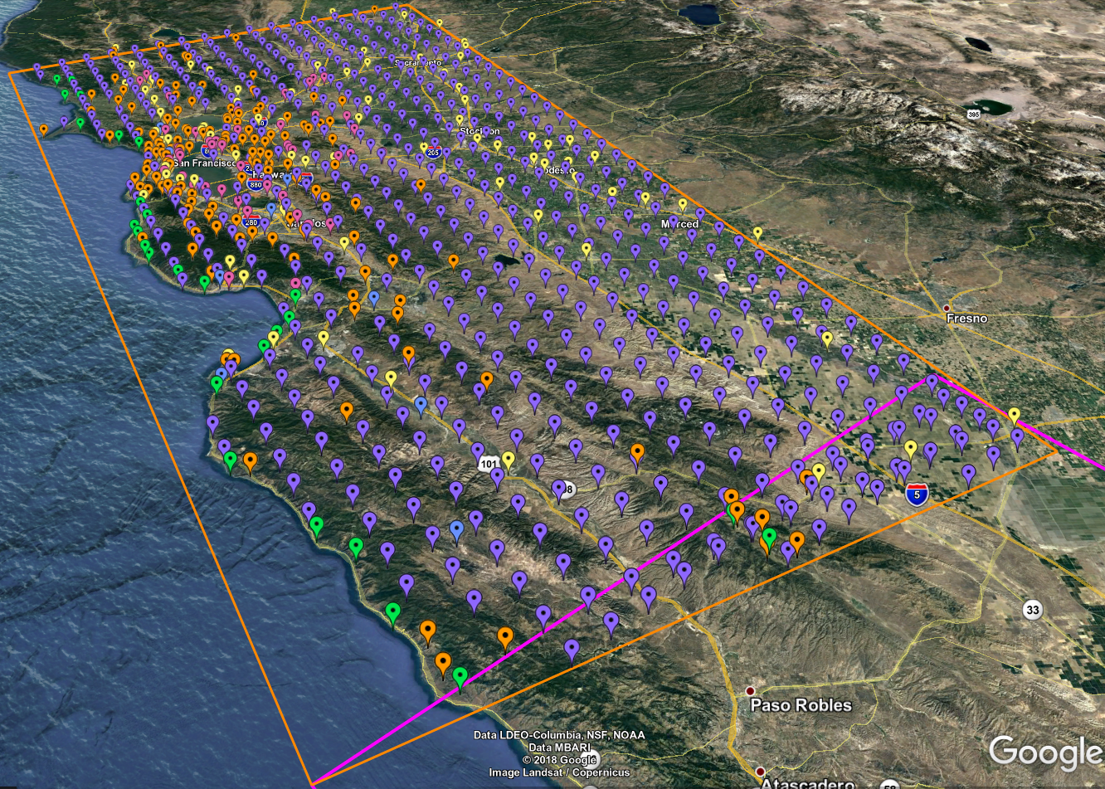
869 Proposed Study sites
10 km spacing (purple)
5 km spacing for greater shore density (green)
CISN stations (orange)
PG&E sites (pink)
Cities (yellow)
Decimation was applied to reduce overall number
32 sites overlap with Study 17.3 region
44% have sSAF events

Slide 5
Study 18.8 Data Products
Two-component seismograms (~195 million)
Intensity measures
Geometric mean at 44 periods (0.1 – 10 sec): 2, 3, 5, 10 sec stored in DB
RotD50 and RotD100 at 22 periods (1 – 10 sec): 2, 3, 4, 5, 7.5, 10 sec stored in DB
Duration metrics
Energy integral, Arias intensity, cumulative absolute velocity
Significant durations (5-75%, 5-95%, 20-80%) for velocity and acceleration
Hazard curves for 869 sites
RotD100 at 2, 3, 4, 5, 7.5, 10 sec
RotD50 at 2, 3, 4, 5, 7.5, 10 sec
Geometric mean at 2, 3, 5, 10 sec
RotD50 hazard maps at 2, 3, 5, and 10 sec

Slide 6
Study 18.8 Notables
First Bay Area CyberShake calculation
First study with Ely-Jordan GTL applied
Largest study to date

Slide 7
Study 18.8 Parameters
1.0 Hz deterministic
100 m grid spacing
dt = 0.005 sec
SGT nt = 40000 timesteps (200 sec)
Seismogram nt = 8000 timesteps (400 sec)
Source filtered at 2.0 Hz
UCERF 2 ERF
200 m rupture grid point spacing
Graves and Pitarka (2014) rupture variations

Slide 8
Changes to SGT Workflow Software Stack
UCVMC 18.5.0
Wills 2015 Vs30 for use in Ely-Jordan GTL
NanCheck
Added check for correct SGT file size to address issue in Study 17.3 where an SGT file was truncated

Slide 9
Changes to Workflows
Monitord events generated in real-time due to reduced number of jobs
Will plan only full workflows (on either Titan or Blue Waters) to avoid extra file transfers
Workflows running under Scott’s certificates, not tera3d

Slide 10
Distributed Processing
Pegasus 4.9.0
HTCondor 8.6.10
Globus 5.2.5
Cron job on shock.usc.edu creates/plans/runs workflows
Submitted to Blue Waters via GRAM
Submitted to Titan via rvGAHP
Results staged back to SCEC disks, DB populated, curves generated

Slide 11
Computational Requirements
Variable requirements depending on if site includes southern SAF events
SGT workflow (50-68%)
Changed volume angle to reduce size by ~15%
Titan: 17K – 76K SUs (weighted average of 48K)
Blue Waters: 560 – 2440 node-hours (weighted average of 1540)
PP workflow (32-50%)
Titan: 15K – 100K SUs (weighted average of 49K)
Blue Waters: 220 – 1500 node-hours (weighted average of 730)
Smaller proportion of runtime because fewer variations/site (225K)

Slide 12
Computational Plan
Goals are to minimize makespan and human involvement
SGTs: 75% Blue Waters, 25% Titan
1.2M node-hrs on Blue Waters
12.5M SUs on Titan
Post-processing: 75% Blue Waters, 25% Titan
600K node-hrs on Blue Waters
12.6M SUs on Titan
Total of 1.8M node-hrs on BW, 25.1M SUs on Titan
BW has 6.98M node-hrs
Titan has 48.5M Sus
May adjust percentages depending on throughput

Slide 13
Storage Requirements
Titan
Purged: 148 TB temp files + 3 TB output files = 151 TB
Blue Waters
Purged: 589 TB temp files + 9 TB output files = 598 TB
SCEC
12 TB archived (29 TB free on shared SCEC disks)
1 TB workflow logs
360 GB database entries (2.0 TB free on moment.usc.edu)

Slide 14
Metrics Gathering
Monitord for workflow metrics
Python scripts to calculate standard metrics
Cron jobs on Titan and Blue Waters to track
Node usage
Running jobs
Idle jobs

Slide 15
Monitoring Tools
Study Manager on northridge.usc.edu
Overall progress
Estimates completion time
Condor queue on shock
Real-time status of jobs
Queues on Titan and Blue Waters
Individual workflow logs, if errors

Slide 16
Estimated Duration
Dependent on BW GPU throughput
To complete in 4 weeks before BW allocation expires, must achieve 80% higher usage than during Study 15.4
Planning to request XE and XK
Planning to request queue changes on Titan for higher throughput

Slide 17
Risks
GPU throughput on Blue Waters
Blue Waters allocation expiration
Can request extension of the smaller of 5% or 300K node hours
SCEC disks filling
Planning to use 40% of available space

Slide 18
Action Items
Complete synching code across Blue Waters and Titan
Make changes to DB to support tracking Z1.0, Z2.5
Calculate comparison curves on Blue Waters for verification
Have calls with OLCF and NCSA

Slide 19
Thanks for your time!

